Slide 1
Addressing Research Cyber Security on Campus
June 24, 2019
Scott Maize
Research Cyber Security Program Manager
Office of Information Security (OIS)
Office of Integrity, Safety, and Compliance
scott.maize@colorado.edu

Slide 2
Today’s Roadmap
Reason for Topic Change
Cyber Security Concepts
Threats to Research Data on Campus
The Alphabet Soup of Cyber Security Compliance
Research Data Cyber Security Compliance
Contact Info and Questions
Notes:
Why Kate isn’t here.
Give understanding of today’s presentation and where we hope to end up.

Slide 3
Helpful Cyber Security Concepts
What is Cyber Security?
CIA Triad
Data Classifications & Impact
Notes:
Need to know the concepts to understand why compliance standards apply.

Slide 4
Cyber Security Concepts
What is Cyber Security?
“Cybersecurity 101” YouTube, uploaded by NOVA PBS Official, 15 September 2015, https://www.pbs.org/video/nova-cybersecurity-101/

Slide 5
CIA Triad – No, not the spies
“What is the C.I.A. Triad?” YouTube, uploaded by Circadence, 19 September 2018, https://youtu.be/rwigKjEsdTc

Slide 6
Data Classifications and Impact
Why?
We classify data and its impact in order to apply the appropriate protective controls
Who?
Data and process owners classify their data
When?
Preferably prior to data acquisition or generation, but certainly prior to sharing that data
And……….

Slide 7
Data Classifications and Impact cont.
How?
Data is classified based on its sensitivity (how confidential it is and its criticality to business processes) and the impact to the owner if it was available to unauthorized parties
Classification guidance can come from different sources
Statutory requirements
FERPA, HIPAA, CUI, etc
Contractual obligations
Included in research awards and contracts
Data owner guidance
Ultimately, a data owner determines the sensitivity and classification of data

Slide 8
Threats to Research Data on Campus
Threats
Actors and their motivations
Entropy – everything breaks at some point
Methods

Slide 9
Research Data Threat Actors
Insiders
Disgruntled employees, “curious” students, or any person with access to internal systems at the University who want the data
Motivated by
Financial gain, activism, patriotism (nation state), curiosity, and any other human motivation

Slide 10
Research Data Threat Actors, cont.
Outsiders
Any person or organization external to the University attempting unauthorized access to controlled data
Motivated by financial gain, patriotism (nation state), activism, curiosity, etc.
Methods
Phishing, social engineering, identity theft, DDoS, hacking, taking advantage of administrative good practice failures, etc.

Slide 11
Research Data Threat Actors, cont.
Entropy – everything fails at some point
Fire, Flood, Electrical Failure, etc.
Method – Entropy is the method, and the method is entropy

Slide 12
The Alphabet Soup of Cyber Security Compliance
Where do compliance requirements come from?
Common Compliance Standards Required on Campus
FERPA, HIPPA, & CUI
Where do Export Controls fit?

Slide 13
Compliance Requirement Sources
Federal
FERPA, HIPAA, Controlled Unclassified Information (CUI)
State
Colorado Student Data Transparency and Security Act
Local
CU Data Classifications (https://www.cu.edu/ois/data-classifications-impact)
Contractual
Private and public award contract clauses

Slide 14
Federal Research Data Compliance
FERPA
Federal Educational Rights & Privacy Act
Protects privacy of student educational records
Reference: https://www.colorado.edu/registrar/students/records/ferpa
HIPAA
Health Insurance Portability & Accountability Act
Protects the privacy and security of individually identifiable health information.
CUI
Controlled Unclassified Information
Standardizes the way the Executive branch handles unclassified information requiring safeguarding or dissemination controls

Slide 15
What is CUI?
Controlled Unclassified Information (CUI)
“Established by Executive Order 13556, the Controlled Unclassified Information (CUI) program standardizes the way the Executive branch handles unclassified information that requires safeguarding or dissemination controls pursuant to and consistent with law, regulations, and Government-wide policies.” – National Archive CUI website
Covered Defense Information (CDI) – Dept. of Defense version
Program managed by National Archive - https://www.archives.gov/cui
Examples of CUI include: Defense, Critical Infrastructure, Export Control, Financial, Intelligence, Law Enforcement, Legal, Patent, Privacy, Proprietary Info, Tax, Transportation (https://www.archives.gov/cui/registry/category-list)
CU Research touches many of these – should be identified by agency
All restricted research is CUI, not all CUI is restricted research
Data protection (IT) controls prescribed by National Institute of Standards and Technology (NIST) Special Publication 800-171r1
CUI program requirements are called out in contract language
Sometimes when not applicable – mandatory flow down
FAR, DFAR, NIST, Cybersecurity, IT Security, etc.

Slide 16
What about Export Controls?
Export Controls fall under the CUI program. “Export Controls” refers to US federal regulations that restrict the release of certain technology, hardware, software, and services to foreign nationals and foreign entities
Purpose:
US national security
US foreign policy enforcement
Trade sanctions, embargoes, export debarment
Prevention of Weapons of Mass Destruction (WMD)
Biological, Chemical, and Nuclear proliferation
Economic and Intellectual Property (IP) protection
Billions of dollars lost every year to foreign economic espionage and copyright infringement

Slide 17
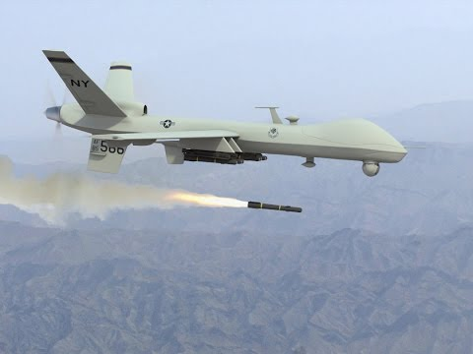
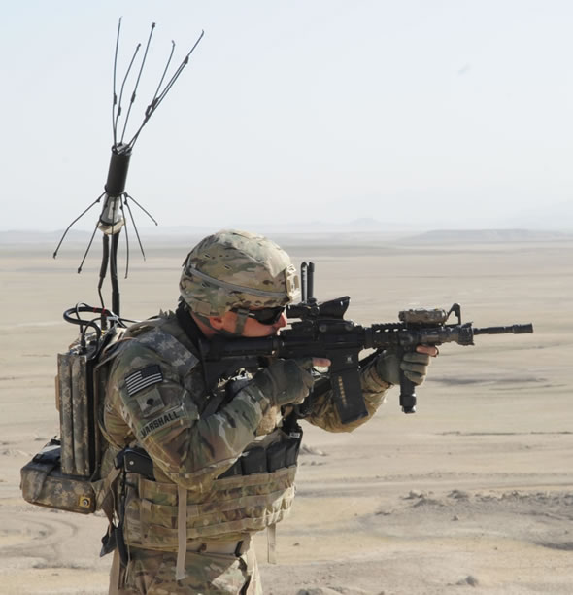
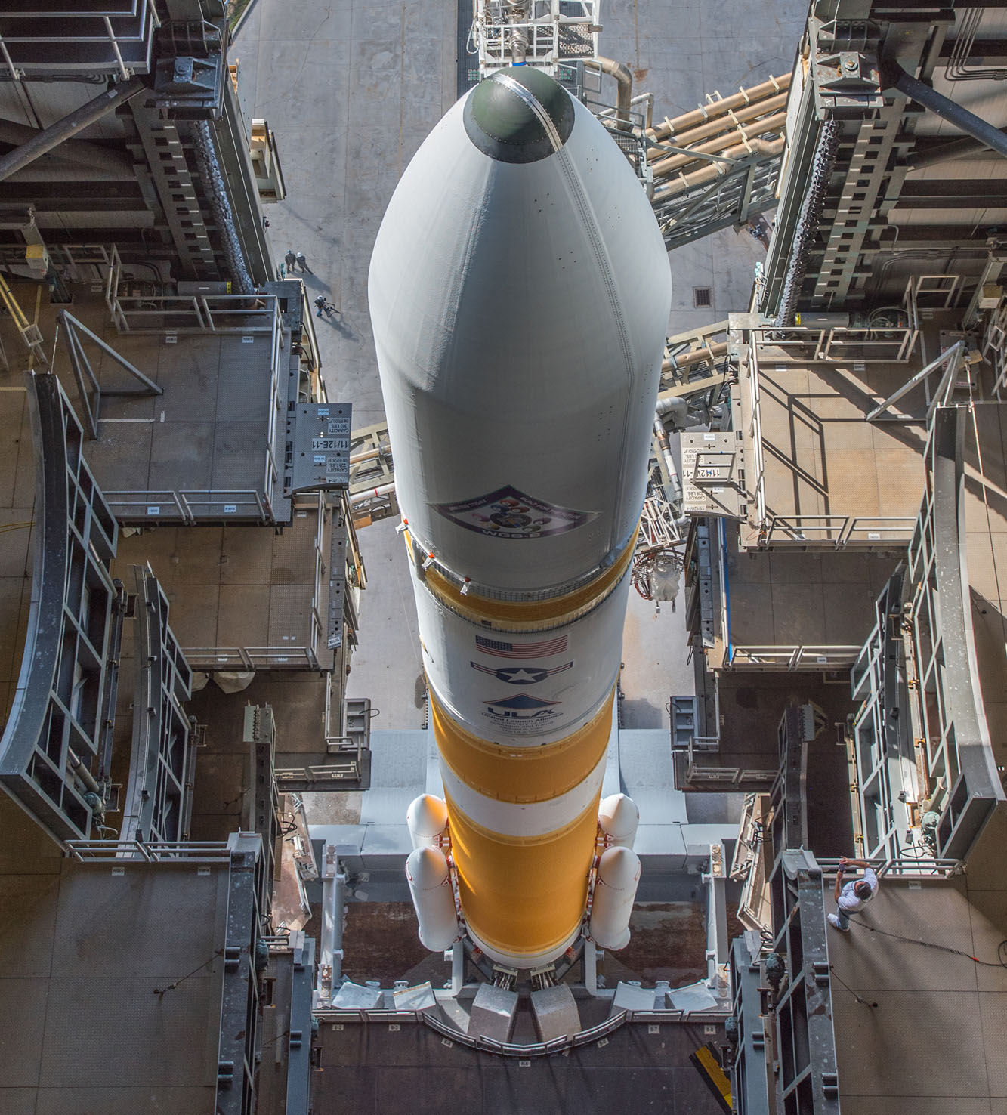
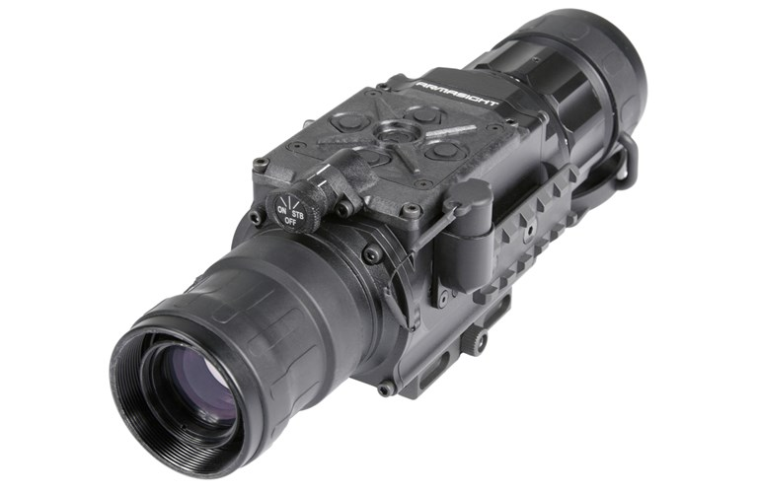
What about Export Controls cont.
Hardware, software, technology, and services specifically designed and intended primarily for military end-use are governed by the US Department of State
These items are controlled under the International Traffic in Arms Regulations (ITAR)
These items are enumerated on the United States Munitions List (USML)

Slide 18
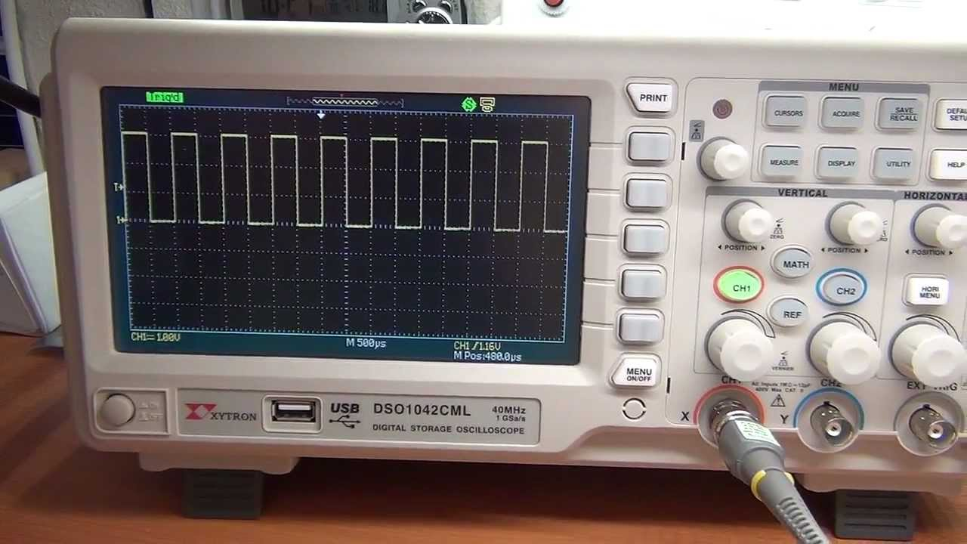
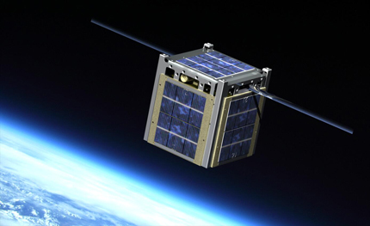
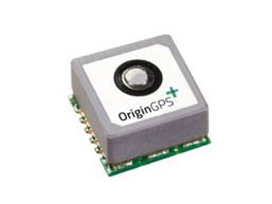
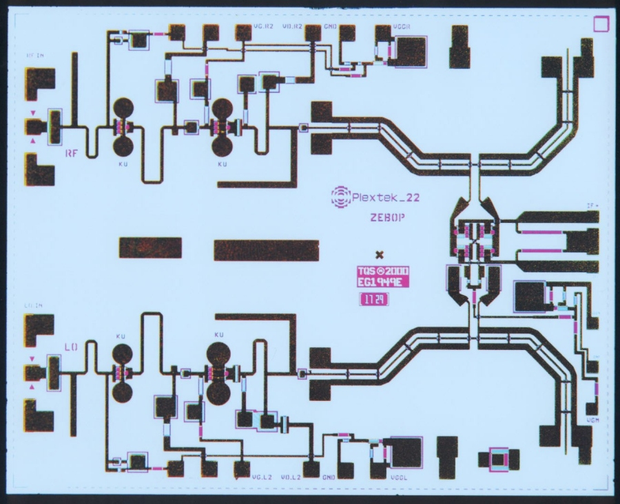
What about Export Controls cont.
Specific hardware, software, technology, and services with primarily commercial but potential military end-use are governed by the US Department of Commerce (also known and “dual use”)
These items are controlled under the Export Administration Regulations (EAR)
These items are enumerated on the Commerce Control List (CCL)

Slide 19
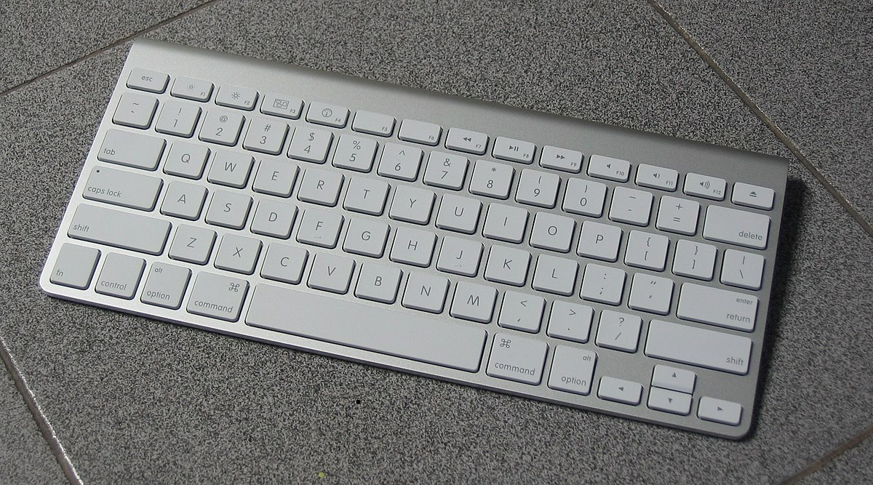
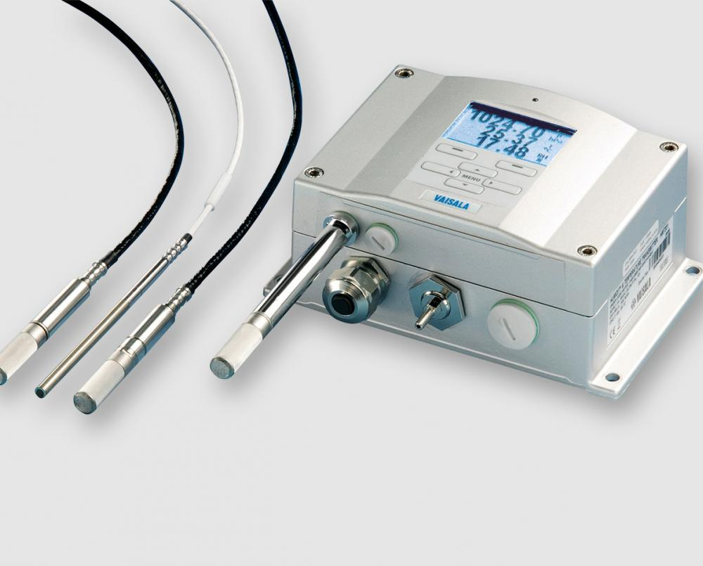
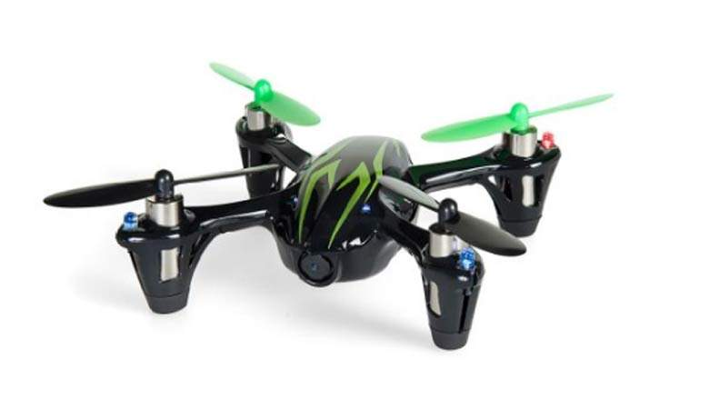
What about Export Controls cont.
Exports of EAR99 items to an embargoed country, an end-user of concern, or in support of a prohibited end-use may require a license

Slide 20
Research Data Cyber Security Compliance
Research Cyber Security Program
Business Processes Supporting Compliance
CUI
IRB

Slide 21
Research Cyber Security Program
CFO, RIO and the Office of Information Security (OIS) sponsor the Research Cyber Security program
Includes OCG and Office of Research Integrity
Program Deliverables
Established Research Cybersecurity Office
Streamline business processes
Develop CUI compliance resources
Provide cyber security compliance consulting

Slide 22
Impacts to Proposal, Award and Contract Process
Awards and Contracts
OCG contract officers aware of clauses requiring CUI
When discovered triggers a security review by OIS
Verification of CUI in the SOW
Business Processes between OCG, OIS, and Research Integrity office streamlined to complete them quickly
Proposals
Watch for Keywords
OCG Proposals Team aware and watching as well
If not applicable, ensure SOW addresses
Resources being developed to assist in planning for CUI compliance

Slide 23
Award and Contract Reviews
Contract officer identifies CUI controls in contract or award
Notifies OIS of need for security review
OIS contacts PI or assigned representative and initiates cyber security review
OIS and PI work to identify and plan to implement necessary security controls
OIS notifies OCG that PI’s computing environment is or will be compliant or not
OCG completes award based on security review findings

Slide 24
Award and Contract Reviews
CUI controls identified in award/contract
OCG requests OIS cyber security review
OIS contacts PI and initiates cyber security review
OIS and PI identify necessary security controls and develop plan
OIS notifies OCG of compliance/non-compliance
OCG proceeds with contract/award process

Slide 25
Proposal Reviews
Not as in-depth as contract and award reviews
Two avenues to address it
OCG proposal team aware of requirements and keywords
Self-service/self-awareness resources being developed for PIs and support staff
Research Cybersecurity website (in development)
Keywords to watch for in proposals
Example IT architectures compliant with CUI to use for planning
CUI guidance resources
OIS consulting services to assist with planning
Security reviews when necessary are less in-depth with a planning focus – if awarded can we accept….

Slide 26
Proposal Reviews
No OIS Review
PI identifies CUI controls in proposal
PI utilizes self-service resources to address CUI needs in proposal
Proposal submitted to OCG
OIS Review Requested
OIS and PI identify necessary security controls and develop plan
Proposal submitted to OCG
OCG recognizes need to address CUI and contacts OIS
OIS notifies OCG security review complete
PI incorporates plan into proposal and resubmits to OCG

Slide 27
IRB Cyber Security Review Process
Data is Level 3? (Highly Confidential)
PI initiates IRB review submission form
PI completes Data Classification section of form
No
Yes
PI contacts OIS and works to identify necessary security controls and develop plan
OIS notifies IRB Admin and PI of security control plan
PI Continues IRB review submission process

Slide 28
Contact Information and Questions

Slide 29
Who to contact?
Contract, Award, and Proposal questions?
Contact OCG
Your assigned Contract Officer, Grant Officer or Proposal Analyst will be able to assist
www.colorado.edu/ocg/directory
IRB process questions?
Contact the IRB (irbadmin@Colorado.edu), or visit https://www.colorado.edu/researchinnovation/irb
CUI, security review of IRB submissions, or any other research data compliance or cyber security questions?
Contact OIS
Scott Maize, Research Cyber Security Program Manager Scott.Maize@Colorado.edu, x5-6190
Export Control Questions?
Contact Export Control Office
Joe Rosse, Joseph.Rosse@Colorado.EDU or Linda Morris, Linda.S.Morris@Colorado.EDU

Slide 30
Questions

