Slide 1
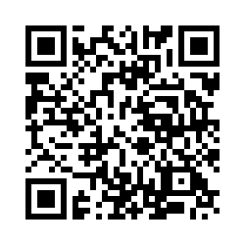
Please sign in!
Only in-person participants need to sign in,
and you only need to sign in once for the entire conference. Thanks!
https://tinyurl.com/FallConference2025
(Link is case sensitive)
Notes:
https://cuboulder.qualtrics.com/jfe/form/SV_9Le4SBIK4ayfLme

Slide 2

Peer Instruction in your classroom:
Writing Great questions, and Facilitating DISCUSSION
Prof. Steven Pollock
CU Physics Department
With great thanks to Stephanie Chasteen
colorado.edu/sei or colorado.edu/per/

Slide 3

Who are you?
Show of hands
Natural sciences & Engineering
Social sciences
Arts & Humanities
Other

Slide 4
Have you used response systems (clickers) in your teaching?
Not at all, and I haven’t seen them used
Not at all, but I’ve observed their use somewhat
I’ve used them a little
I’ve used them a lot
I could be (should be?) giving this workshop
Take a clicker & turn it on
Enter our room code
If the green light flashes, your
vote has been counted

Slide 5
What are you most interested in learning about?
Colored cards
MOSTLY writing good questions
MOSTLY how to effectively use the technique (facilitation tips)
I’m torn between the two, they’re both great
I’m not sure/ Don’t know enough to decide
Something else

Slide 6

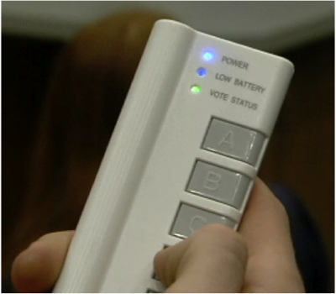
Discussion and Voting
(colored cards, raising hands, clickers or phones…) is a tool for engagement
But not a magic bullet!
(Don't equate pedagogy with technology)
Notes:
We know that interactive engagement works. But how can we achieve it?
One method is through question-driven teaching.
This is an entirely new way of teaching, consisting of asking students a question, they discuss it, you discuss it as a class, and then repeat the cycle a few times per class.
Clickers are just a tool to achieve these ends. They aren’t a magic bullet. They are a way to achieve a certain pedagogical and learning goal. They can be used poorly and not achieve these goals!

Slide 7
Learning goals for this session
You will be able to:
Describe Peer Instruction, and explain why it is an effective method of teaching and engaging students
Evaluate the potential effectiveness of various types of questions for use in Peer Instruction
Write effective clicker questions for use at the beginning, middle, or end of instruction
Describe and use best-practices in clicker facilitation

Slide 8

Agenda
The purpose of questioning
What is peer instruction?
Writing clicker questions
Facilitating clicker questions

Slide 9
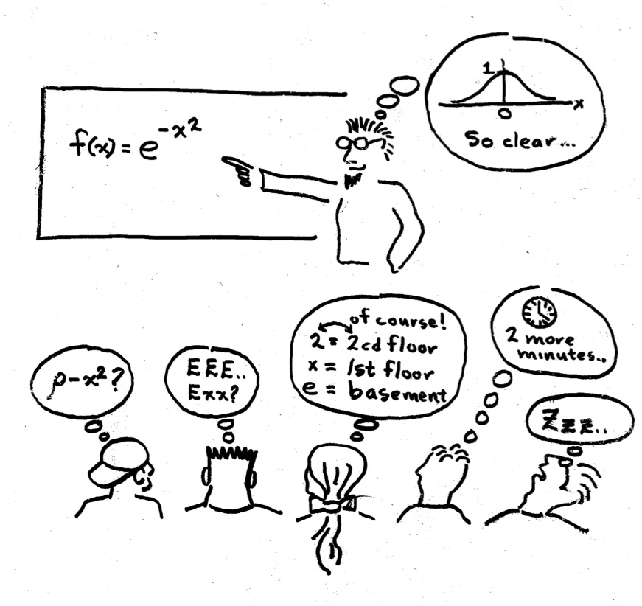
Discuss: Why question?
Why do we ask students questions in class?
Why might we use clicker questions in class?
Small groups

Slide 10
Clickers are a tool for FORMATIVE assessment
In contrast with summative assessments:
provide information about mastery
  Exams, papers, presentations
  Typically occur at the end of teaching
  Usually part of grade for the class
  Formative assessments:
  provide feedback to both the instructor and students during the learning process
  In-class, homework, pre-class online assignments,…
  Can be for a grade, or EC, can just be “participation”

Slide 11
Agenda
The purpose of questioning
What is peer instruction?
Writing clicker questions
Facilitating clicker questions

Slide 12
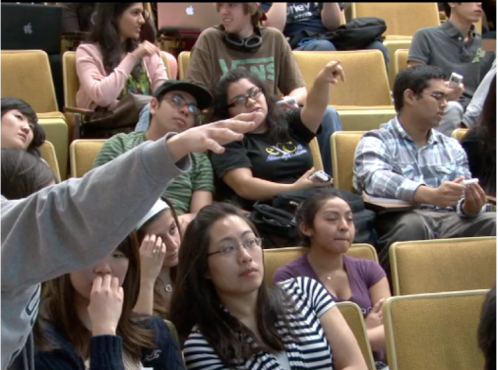

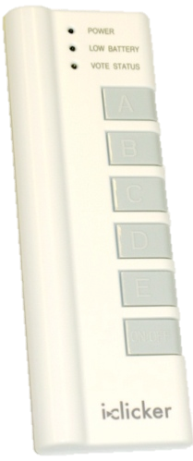
Peer Instruction is the recommended pedagogy used with clickers
  3-5 questions per class (?)
  Students discuss & vote
  Improved learning (multiple studies)
  Used by ~30% of physics faculty nationally *
  Used in ~100% of large lecture STEM courses at CU
* Dancy & Henderson, AJP, 2010
Apkarian et al 2021
Notes:
12

Slide 13
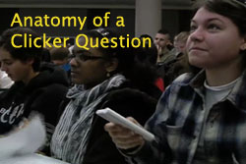
Anatomy of Peer Instruction
Ask Question
…Lecture…
Individual vote
Whole-class debrief
Peer Discussion
Vote
* See also: Peer Instruction, A User’s Manual. E. Mazur.
Notes:
We recap the cycle of peer instruction from the video to make sure the process is clear.

Slide 14
Why/does Peer Instruction help students learn?
Give students feedback (before exams)
Create “benchmarks” for learning
Students can better answer a similar question after talking to their peers (especially difficult questions!)
Courses using peer instruction outperform traditional lecture courses on a common test
Creates a more democratic, engaging classroom culture – lifting the “ban” on speaking
http://STEMclickers.colorado.edu for references

Slide 15
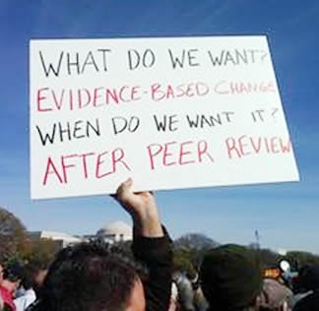
Notes:
We aren’t just trying to sell you on peer instruction because it seems like a good idea. There is lots of research on this. We’ll show a little later, but realize that lots of evidence points towards this being a more effective mode of instruction than lecture only.

Slide 16
Some example questions

Slide 17
Example question: Physics
Which superpower would you rather have?
The ability to…
Change the mass of things
Change the charge of things
Change the magnetization of things
Change the boiling point of things
Question: Ian Beatty, UNC Greensboro

Slide 18
Example question: Literature
If Homer wrote the Iliad today, Stanley Fish and Harold Bloom would argue, respectively, whether the work should be categorized as:
Existential vs. Romantic
Postmodern vs Classical
Modern vs Romantic
Postcolonial vs Modern
Preliterate vs Postliterate
Origin unknown
Notes:
Students have to unpack the assumptions behind the alternatives, and disagreement is productive rather than evidence that the question failed.
From the chatbot:
That is essentially the humanities analogue of a good conceptual physics clicker question: not “calculate $F$,” but something like “two students give these different predictions—which reasoning is correct?” The distractors represent plausible conceptual positions, so the distribution of answers becomes the beginning of the instruction rather than merely an assessment at the end.

Slide 19
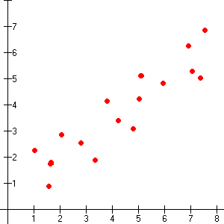
Example question: Stats
This is an example of:
Heteroskedasticity
A positive correlation
A negative correlation
Multicollinearity
An inverse relationship
Stefanie Mollborn
Notes:
Stefanie is a Sociologist

Slide 20
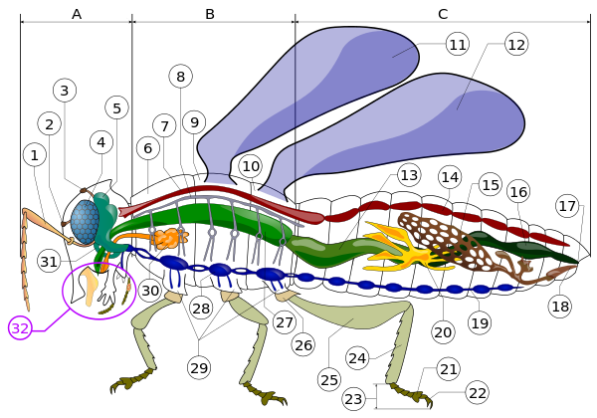
Lecture: https://en.wikipedia.org/wiki/Insect
Head
Thorax
Abdomen
Notes:
Pretty sure the answer is that exactly THREE of the drawings have the "basic distinguishing characteristics" (namely, 6 legs and 3 body segments: head, thorax, abdomen), top left, middle right, bottom left.
Of those, TWO would NOT be classified as insects because the top left one has the legs on the abdomen (wrong) and the middle right one has the legs spread out (wrong)
So the legs are in the wrong place on TWO of THREE. I choose B.
Some might want to answer "5 of 6 are wrong" (i.e. E can generate some *nearly correct* votes, I think they have correctly understood the insect question being asked, but are misreading the complicated directions)
Some might totally misread the question and answer A, 1 of the 6 is CORRECT

Slide 21
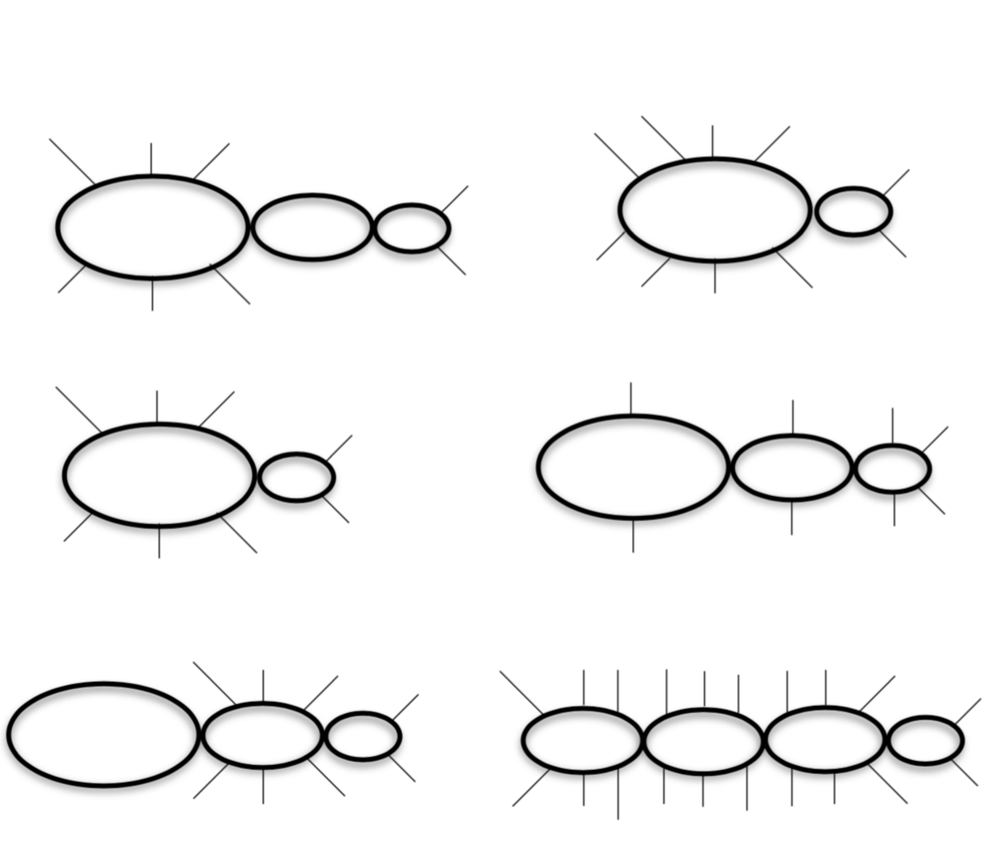
How many of the illustrations have the basic distinguishing characteristics of insects, but would NOT be classified as insects because those characteristics are not in the right place?
A) 1
B) 2
C) 3
D) 4
E) More than 4!
Notes:
Pretty sure the answer is that exactly THREE of the drawings have the "basic distinguishing characteristics" (namely, 6 legs and 3 body segments: head, thorax, abdomen), top left, middle right, bottom left.
Of those, TWO would NOT be classified as insects because the top left one has the legs on the abdomen (wrong) and the middle right one has the legs spread out (wrong)
So the legs are in the wrong place on TWO of THREE. I choose B.
Some might want to answer "5 of 6 are wrong" (i.e. E can generate some *nearly correct* votes, I think they have correctly understood the insect question being asked, but are misreading the complicated directions)
Some might totally misread the question and answer A, 1 of the 6 is CORRECT

Slide 22
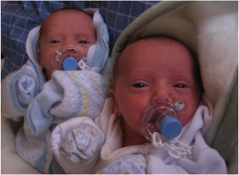
Your sister in law calls to say that she’s having fraternal twins.
Which of the following is the most likely?
Twin boys
Twin girls
One girl and one boy
All are equally likely
Derek Bruff, Vanderbilt

Slide 23

Example question: Psychology
One of you will be randomly selected to be a winner! Pick one:
You can receive $10 (cash) right now
You can receive $11 (cash) during the next meeting of this class
This is a question recreating a classic psychology experiment about delayed rewards.
Notes:
Results: 66% of class took $1 now (but 33% if $1 on next to last day of class instead of last day of class)
From Dr JamesIII at http://www.youtube.com/watch?v=CnnP0uCqD4k

Slide 24
I think the toughest thing about using clickers and peer instruction in class is / will be:
Writing good questions
Getting students to really think about the questions
Getting students to share their reasoning with the whole class
The same students always respond in whole class discussion
It takes too long / I have a lot of content to cover

Slide 25
Agenda
The purpose of questioning
What is peer instruction?
Writing clicker questions
Facilitating clicker questions

Slide 26

Question break
Notes:
This part is actually quite important – to provide opportunity for questions early in the workshop. This ensures you’re not seen just as a salesman of the technique but are rather open to the common concerns about using Peer Instruction. However, if this Q&A goes on too long, it can make the workshop go long, and participants can get restless.

Slide 27
the learning cycle
BEFORE
DURING
AFTER
setting up
instruction
developing
knowledge
assessing
learning
Provoke thinking
Motivate
Probe preconception
Exercise skill
Apply and analyze
Demonstrate success
Review and recap
Students
What do they know?
What do they care about?
Are they getting it?
What are they thinking?
What should I do next?
Can I move on?
Did that activity work?
Teachers
Adapted from Rosie Piller, Ian Beatty, Stephanie Chasteen
Notes:
An alternate presentation of the Question Cycle by Peter Newbury

Slide 28
Question-writing tips
Ask throughout lecture: Before, during, and after
Where do students struggle?
What are your core goals?
Look through lecture notes: Where can you ask students, instead of telling?
Mix up your difficulty levels
Find questions that emphasize reasoning,
not the right answer
Notes:
The handout has a more complete list of question-writing tips. Can do this as a group brainstorm first, and then add your own.
4 used to say “(and consider two-tiered questions)” What is that?

Slide 29
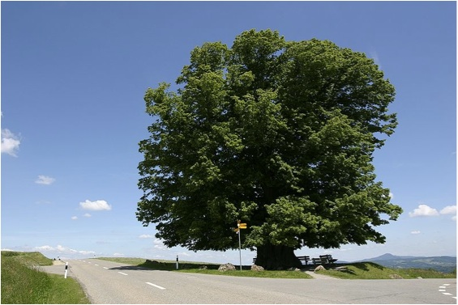
Use questions requiring conceptual reasoning & discussion
A small acorn over time can grow into a huge oak tree. The tree can weigh many tons. Where does most of the mass come from as the tree grows?
Minerals in the soil
Organic matter in the soil
Gases in the air
Sunlight
A Private Universe; Annenberg Media

Slide 30
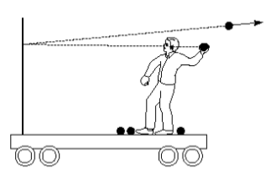
Use questions requiring prediction and experiments
You’re on a cart, initially at rest, throwing balls at a partition that is rigidly mounted on the front of the cart. If the balls bounce straight back, as in the figure, then is the cart put in motion?
Yes, left
Yes, right
No
Don’t know
Eric Mazur, “Peer Instruction”

Slide 31
You can "help" students along…
You’re on a cart, initially at rest, throwing balls at a partition that is rigidly mounted on the front of the cart. If the balls bounce straight back, as in the figure, then is the cart put in motion?
Yes, left
Yes, right
No
Don’t know

Slide 32
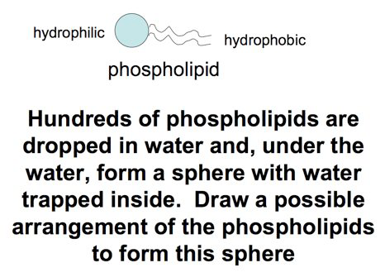
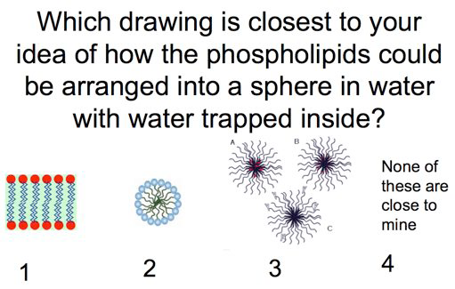
Ask open-ended questions
Kate Dollard, Northampton High School

Slide 33
Is this effective for peer discussion?
Which of the following statements are correct?
ATP serves as the main energy carrier inside cells
In the cell, ATP drives reactions that require energy by the transfer of a phosphate group to specific reactants
The regeneration of ATP from ADP and phosphate is a reaction that requires energy
A and B only
A, B and C
No need to talk to your neighbor; you know it or you don’t! Does not encourage reasoning.
So, should you ask such a question?

Slide 34
Traditional lecture on seasons:
First let’s put a myth to bed: Summer occurs when the Earth is closest to the Sun. Not true. The Earth orbits the sun in an ellipse, kind of like an oval.
While Earth’s orbit around the Sun does play a role in the changing of the seasons, it’s not because the Earth receives more solar energy when it’s closer to the Sun or less energy when it’s further away.
The main reason we have the seasons is due to the Earth’s tilt.
https://weather.com/news/why-are-there-seasons-20130930

Slide 35
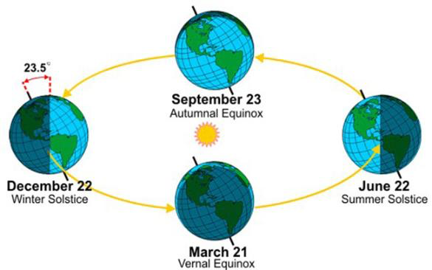
Traditional lecture - continued
The earth's "tilt" points in the same direction as it orbits the sun
Orbit (just slightly elliptical)
Less solar flux in
northern hemisphere
= winter in Boulder!
More solar flux in
northern hemisphere
= summer in Boulder!

Slide 36
What kind of question might we craft
to assess student understanding of this topic?

Slide 37
This question could be improved. Why?
Do you understand what causes the seasons?
Yes
No
I'm still not really sure
- Do your students interpret "understand" the same as you do?
- Are you learning anything useful about their thinking or
reasoning?

Slide 38
This question could also be improved. Why?
What causes the seasons?
The change in the earth’s distance from the sun during the year
The tilt of the earth’s axis
Changes in the sun’s brightness
Changes in weather
None of the above, or MORE than one!
You can MEMORIZE or "pattern-match" to find the answer.
Doesn’t give much information about reasoning
Doesn't help me decide what the student understands

Slide 39
What would happen to the seasons if the earth’s orbit around the sun was made a perfect circle (but nothing else changed) ?
Is this a better version than the previous?
If so, how/why? If not, why not?
There would be no seasonal changes any more!
The seasons would remain pretty much as they are today (Winter/Spring/Summer/Fall)
Winter to spring would differ from each other much less than now
Winter to spring would differ from each other much more than now

Slide 40
What would happen to the seasons if the earth’s orbit around the sun was made a perfect circle (but nothing else changed) ?
Is this a better version than the previous?
If so, how/why? If not, why not?
There would be no seasonal changes any more!
The seasons would remain pretty much as they are today (Winter/Spring/Summer/Fall)
Winter to spring would differ from each other much less than now
Winter to spring would differ from each other much more than now
Requires reasoning
Note that asking for a prediction often results in better questions.

Slide 41
Do I know if my students understand the reason for seasons now?

Slide 42
How about this…
How many of the Earth locations marked with an "X"
Would be experiencing Winter right now?
Only one
Two
Three
Four
All Five
Sunlight
X
X
X
X
X

Slide 43

Write higher-level questions: Bloom’s Taxonomy
Are you asking the student to…
create
Produce new or original work?
Design, assemble, construct, conjecture, develop, formulate, author, investigate
See handouts with Bloom’s verbs
evaluate
Justify a stand or decision?
appraise, argue, defend, judge, select, support, value, critique, weigh
Do the questions you use intellectually challenge your students or simply assess their factual knowledge?
Draw connections among ideas?
differentiate, organize, relate, compare, contrast, distinguish, examine, experiment, question, test
analyze
Use information in new situations?
execute, implement, solve, use, demonstrate, interpret, operate, schedule, sketch
apply
understand
Explain ideas or concepts?
classify, describe, discuss, explain, identify, locate, recognize, report, select, translate
remember
Recall facts and basic concepts?
define, duplicate, list, memorize, repeat, state

Slide 44

Find believable “distractors” by….
Talking with other instructors that have taught the course in the past.
Talking with your students one-on-one before class, after class, during office hours.
Using student responses to open-ended questions that you include in HW and exams.
Asking your students to come up with answers that will be used as the choices.
Use researched and documented student misconceptions.
44
D. Duncan, Univ. of Colorado

Slide 45
Burning questions?
Ask Question
…Lecture…
(Maybe vote)
Class Discussion
Peer Discussion
Vote
* See also: Peer Instruction, A User’s Manual. E. Mazur.
Notes:
What comes first? Learning goals.

Slide 46
Agenda
The purpose of questioning
What is peer instruction?
Writing clicker questions
Facilitating clicker questions

Slide 47
FACILITATING CLICKERS EFFECTIVELY
Notes:
To do: Make signs based on registrants, organize handouts, add table to handouts, make outline
To bring: Clickers,
Jenny: Direct people to groups and questions in start, help with long winded discussions, circulate during activities and

Slide 48
What do you think the biggest implementation challenges will be?

Slide 49
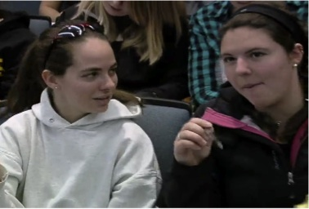
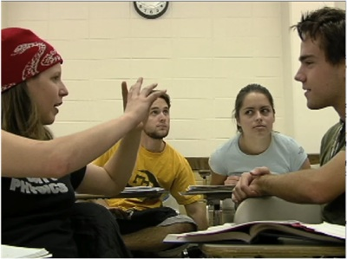
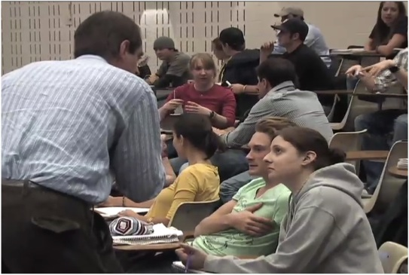
Getting students to talk to each other?
Philosophies:
Students learn through discussion
Students need to know you value their ideas & that it’s safe to share
Solutions:
Make it clear why you’re doing this
Circulate and ask questions / model
Use questions they want to discuss
Allow enough time (2-5 mins)
Focus on reasoning in wrap-up
Notes:
Instructor circulates, may need to show that you’re serious

Slide 50
Facilitation Tips for Success
#1 Use a cue that encourages students to do what you feel is most important
For example: “As you answer this question….
-”make sure to consider why each answer is correct or incorrect” OR
-”construct an argument with reasons and evidence for your choice” OR
-”be ready to share the reasons for your answers with your neighbors and the rest of the class”

Slide 51
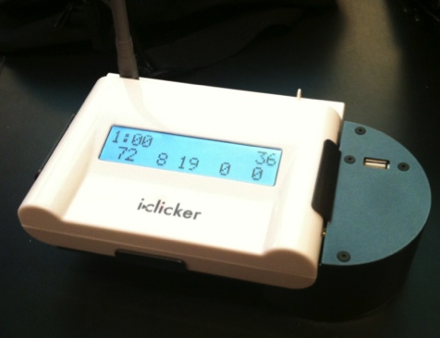
Facilitation Tips for Success
#2. Don’t show the histogram to the class after the first vote, unless it is an equal split.
Popular choices may sway second vote.
a student who picked an unpopular choice may be reluctant to discuss
Everyone thinks the popular vote is correct

Slide 52
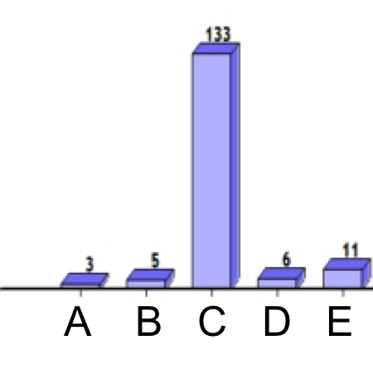
What do you think you should do with this first-vote distribution?
(C is the correct answer)
“Turn to your neighbours and discuss the reasons for your answer”
Move on after a brief confirmation of correct answer
“Can someone share with us the reason for their answer?”
other
Notes:
Courtesy Cynthia Heiner and Peter Newbury, CW-SEI
Answer is B

Slide 53
Facilitation Tips for Success
#3: Don’t spend time going over things that students already know
Emphasize the reasoning behind the answers
(why the wrong answer is wrong and why the right answer is right)

Slide 54
Research tidbit
Should you have students discuss easy questions? No!
Studies confirm: students don't learn as much from talking to their neighbors on easy questions. Above ~70% correct in initial vote – maybe skip the peer discussion.

Slide 55
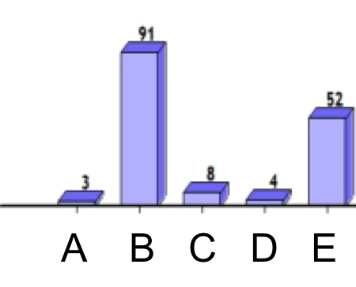
What do you think you should do with this first-vote distribution?
“You’re split! Turn to your neighbors and discuss the reasons for your answer”
Move on after a brief confirmation of correct answer
“Can someone who answered either B or E explain the reasons for their answer?
other
Notes:
Courtesy Cynthia Heiner and Peter Newbury, CW-SEI
Answer is A

Slide 56
Facilitation Tips for Success
#4: Give students opportunity to discuss their reasons whenever two or more votes (or an incorrect answer) are popular

Slide 57
Research Tidbit
Should you have students discuss when most of them get the answer wrong?
Yes!
Students learn from talking with each other, even if none knew the answer before.
(learning gains are highest when students talk)
Students learn the most when many students got the question initially wrong (individual vote).
Even when the majority get it wrong (e.g. < 35%),
students still benefit from talking

Slide 58
What do you think you should do when the second vote is the same as the first vote?
Notes:
Courtesy Cynthia Heiner and Peter Newbury, CW-SEI
Answer is D??

Slide 59
Facilitation Tips for Success
#5: Encourage them to explain their reasons
During wrap-up, focus on hearing students' ideas, rather than only your own explanation.
But make sure that the correct answer is clear by the end of discussion.
Giving the answer stops student thinking!

Slide 60
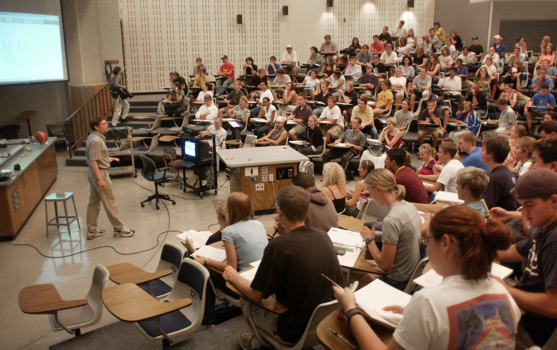
Student buy-in is key!

Slide 61
Facilitation Tips for Success
#6: Encourage participation, likely with grading credit… but not too much credit!
Credit for participation communicates the value you place on peer instruction.
But too much credit, & students stress about getting the answer. Consider the “whiff of credit.”

Slide 62
Research Tidbit
Should you give credit for correct answers? Probably not…
Several studies show that this changes the dynamics of the conversation, so that conversation is dominated by one student, and there is less rich peer discussion.

Slide 63
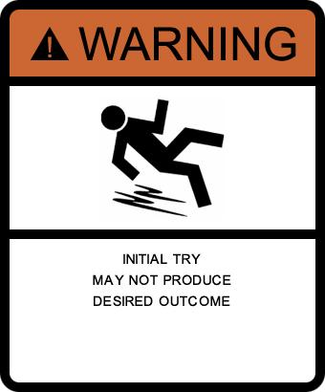
Remember….
Becoming a master “peer instructor” is a process!
Talk to colleagues, watch other users, read research
Start small and don’t aim for perfection yet
Try questions in class and take notes on how it goes
The perfect question doesn’t solve all problems!
Notes:
Facilitation matters too. You don’t want to stress too much over making perfect questions and not pay attention to facilitation.
Can add in the middle Use Bloom’s Taxonomy to push questions higher

Slide 64

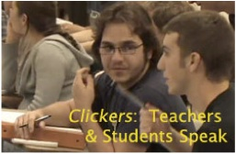


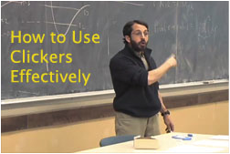
U. Colorado clicker resources…
THANKS! Email me (steven.pollock@colorado.edu)
https://tinyurl.com/CUclickers26
Clicker resource page
Instructor’s Guide
Question banks
Workshops
Literature / Articles
Short videos of effective use of clickers https://tinyurl.com/CUclickers26b
Notes:
These are available for anyone to use and access.

Slide 65
The Message:
The answer is NOT important.
The strategy for getting the answer is the goal.

Slide 66
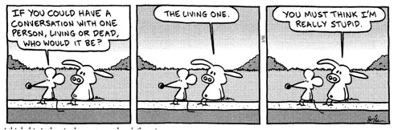
Two way conversations with students are vital...
From Pearls before Swine, Stephen Pastis
...because students can misunderstand what we say

Slide 67
Some core philosophies of mine
Students learn by teaching each other
Students learn by articulating their ideas
It’s important for me to hear student ideas
I need to know what my students understand during the course of instruction, before the test
I value and respect student ideas
I want students to know that I value student ideas
I want students to feel safe sharing their ideas
Clicker questions are an integral part of my lecture

