Slide 1
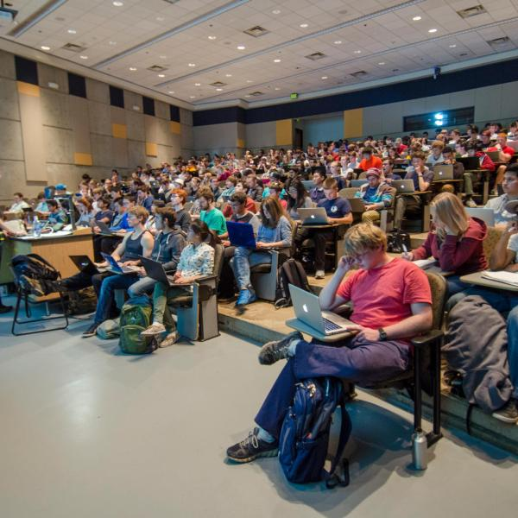
Big Class,
Bigger Impact
A trifecta of academic technologies to enhance engagement in large lecture courses
Alexandra Jones
Rob Leary
Nick Steinkamp
Notes:
“Good morning. Our session today is really about a challenge that becomes more noticeable as our classes get larger: how do we create more opportunities for students to engage with course material when we can’t necessarily interact individually with every student?”
“We’re going to look at three technologies that support students at different points in the learning process — before class, while they’re in the room, and after class when they may need to revisit something.”

Slide 2
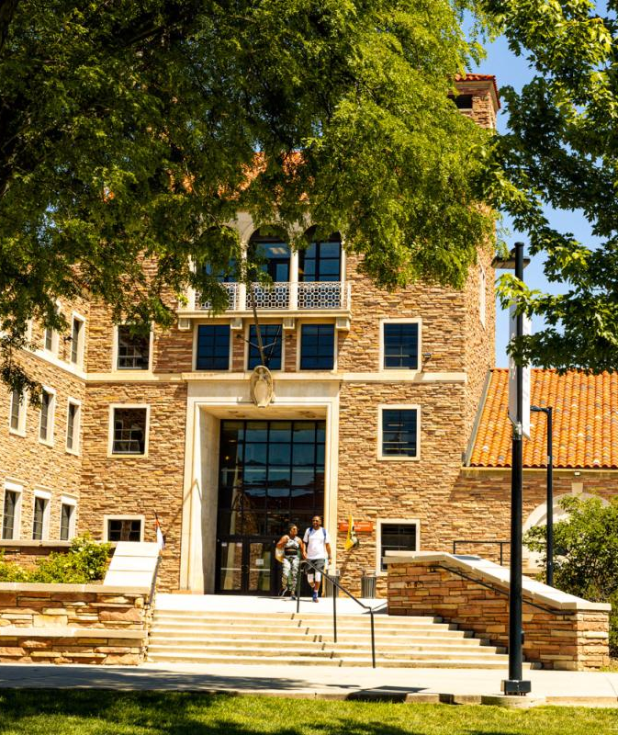
Agenda
Introductions
WeVideo Interactive
iClicker
Classroom Capture
Questions
Notes:
For each tool, we want to show you what it is, and why you might use it.
And one thing you'll notice throughout the session is that all three tools connect back to Canvas, so students can access these resources within an environment they’re already using.

Slide 3

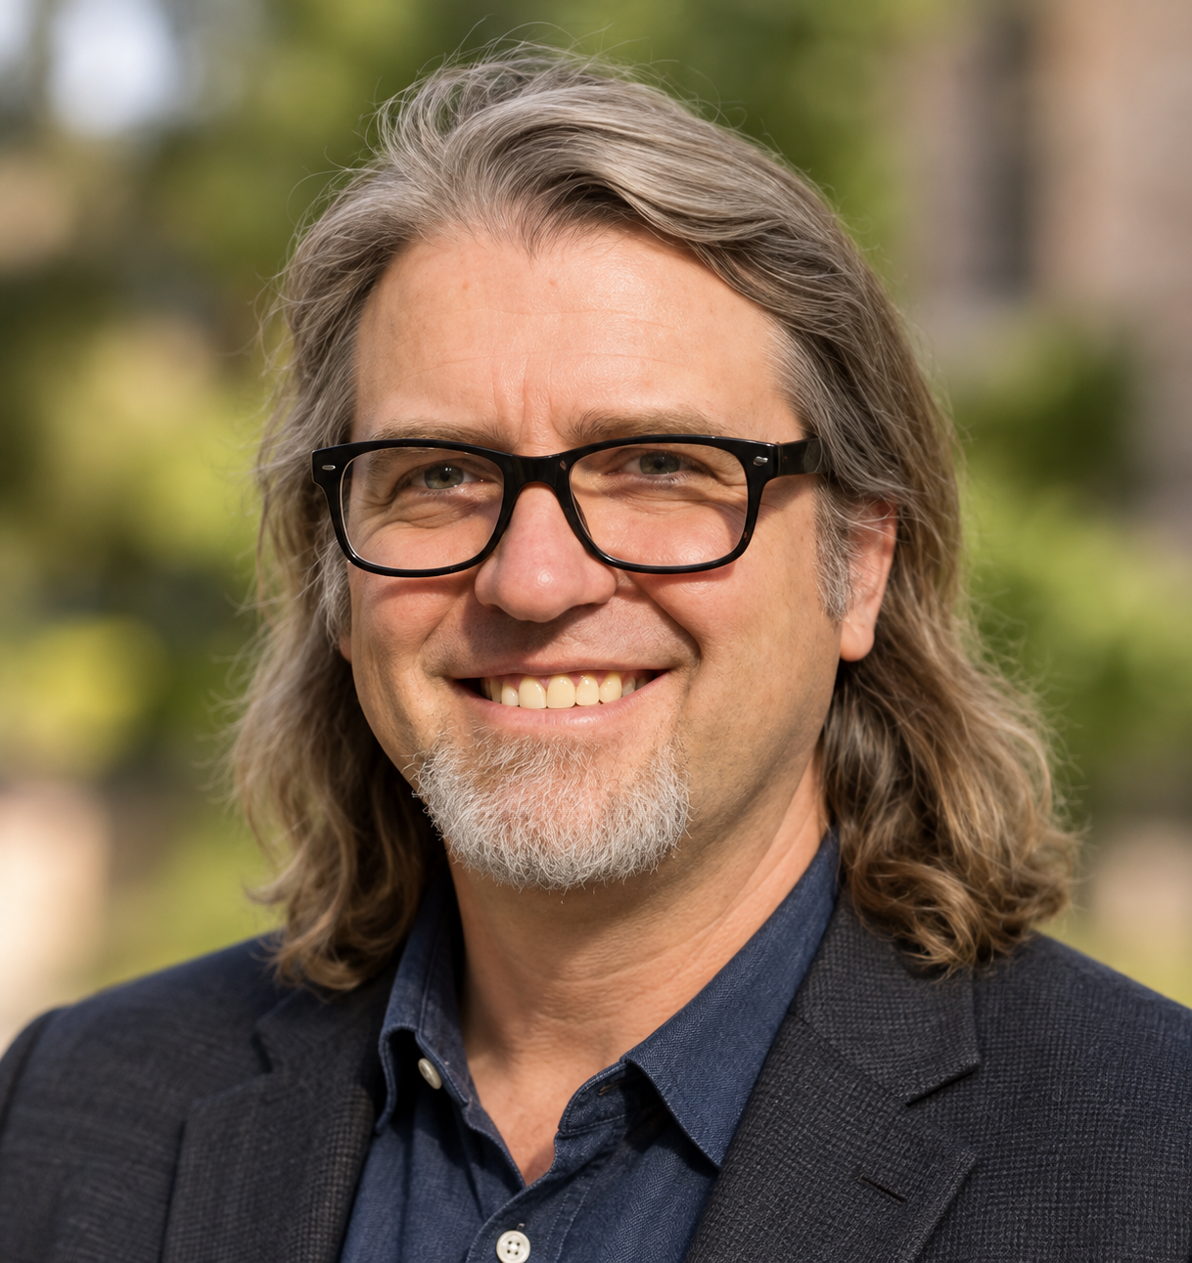

Biographies
Alexandra Jones
Academic Technology Documentation & Training
OIT, UCB
Certified Technology Specialist (CTS)
Rob Leary
Academic Technology Consultant
OIT, UCB
EdM Risk & Prevention
Nick Steinkamp
Academic Technology Applications Program Manager
OIT, UCB

Slide 4
What is WeVideo?
WeVideo Interactive (FKA PlayPosit)

Slide 5
What is WeVideo?
Pre-Learning Engagement
Your pre-lecture videos
Assessment tools
  Questions
  Activities
  External Links
  Feedback

Slide 6
Why should I use WeVideo?
Self paced learning
Better retention
Incentive to prepare
Feedback on class preparation
Tailor activities based on results

Slide 7
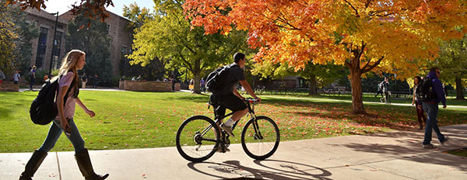
How does it work?
Find or record your content
Build interactive questions
Assign pre-class viewing

Slide 8
How do I access WeVideo?
Built into Canvas
Linked to your Canvas Studio Library
  Screencast-O-Matic!
YouTube, Vimeo, or your own content

Slide 9
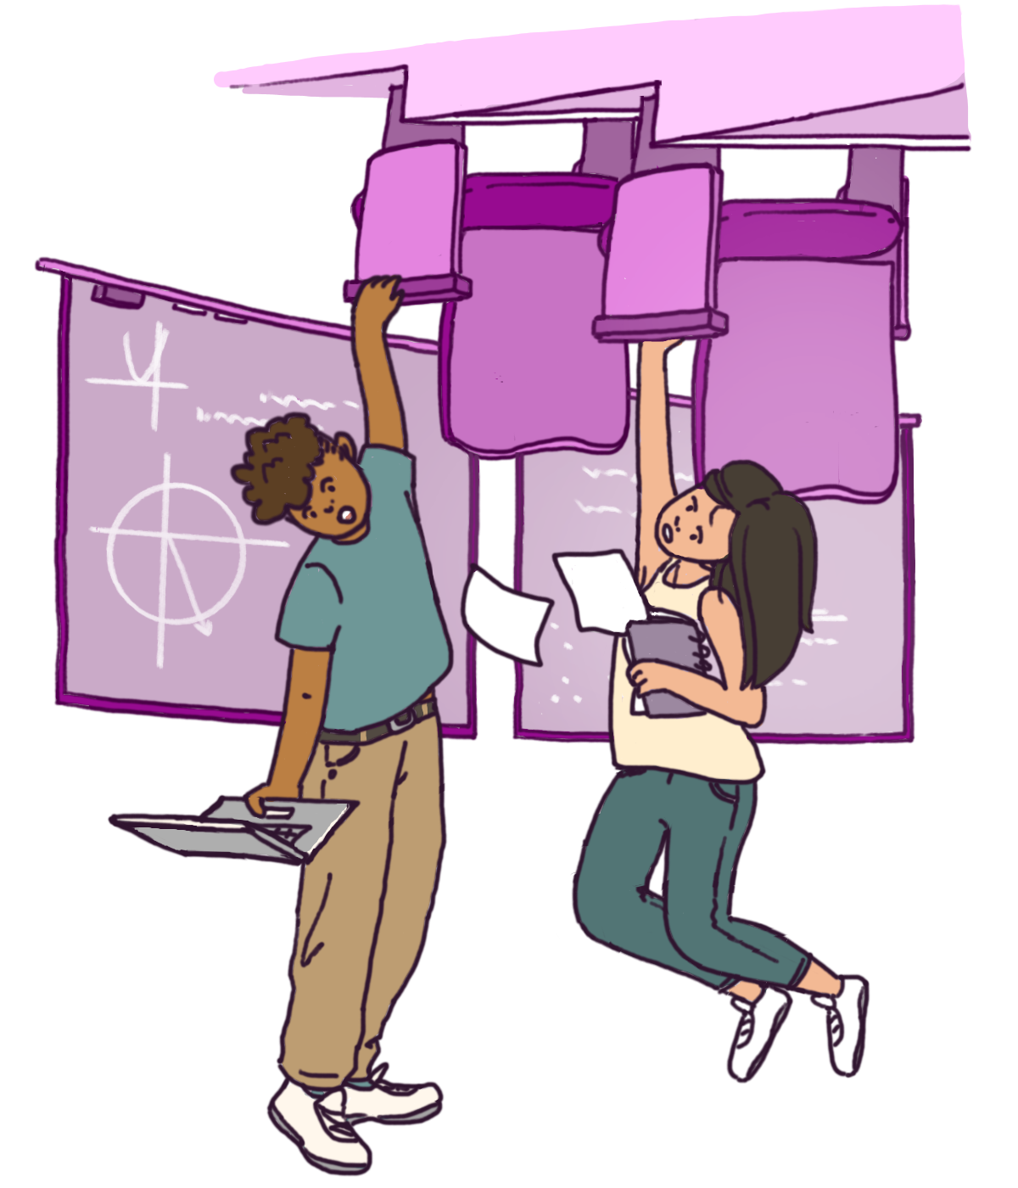
So, what is a flipped classroom?

Slide 10
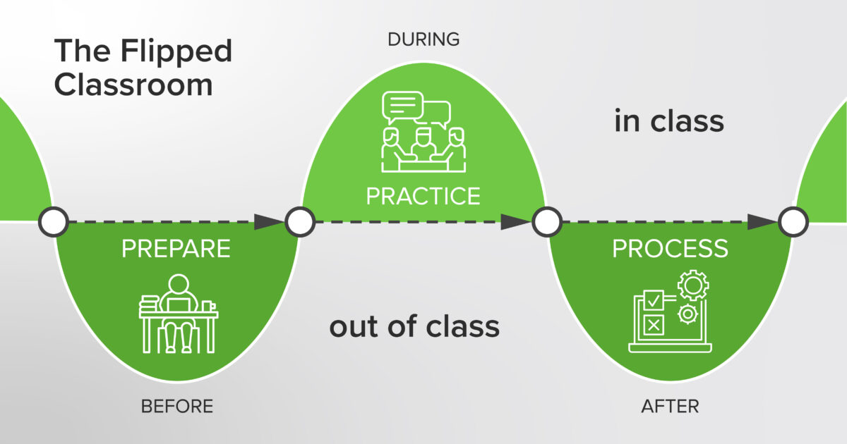
The flipped classroom:
Pre-learning Activity
Blended Learning
Engage Students: Practice
Post-class process

Slide 11
Example Interactive Video
Pre-learning iClicker Activity

Slide 12
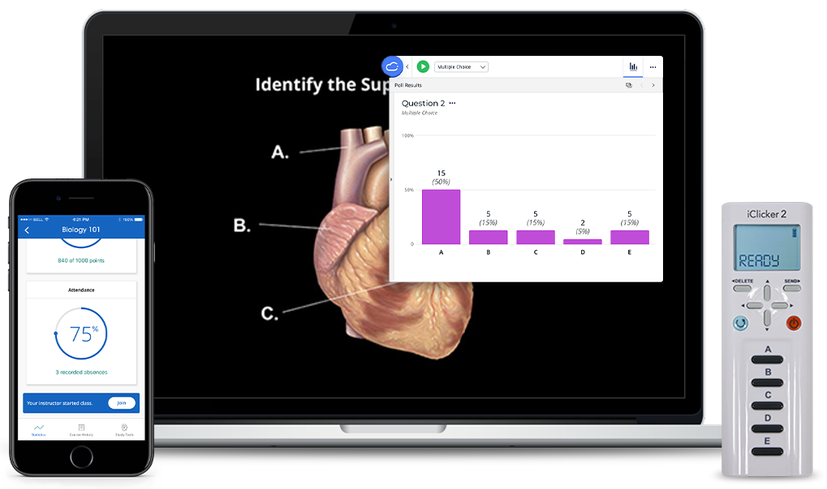
What is CUClickers?
Audience response system
Common-good license
Mobile devices
Physical clickers also available
Canvas roster and grade sync

Slide 13

Why use CUClickers?
Create engagement opportunities
Group work
Immediate feedback
Promote attendance
Measure understanding

Slide 14
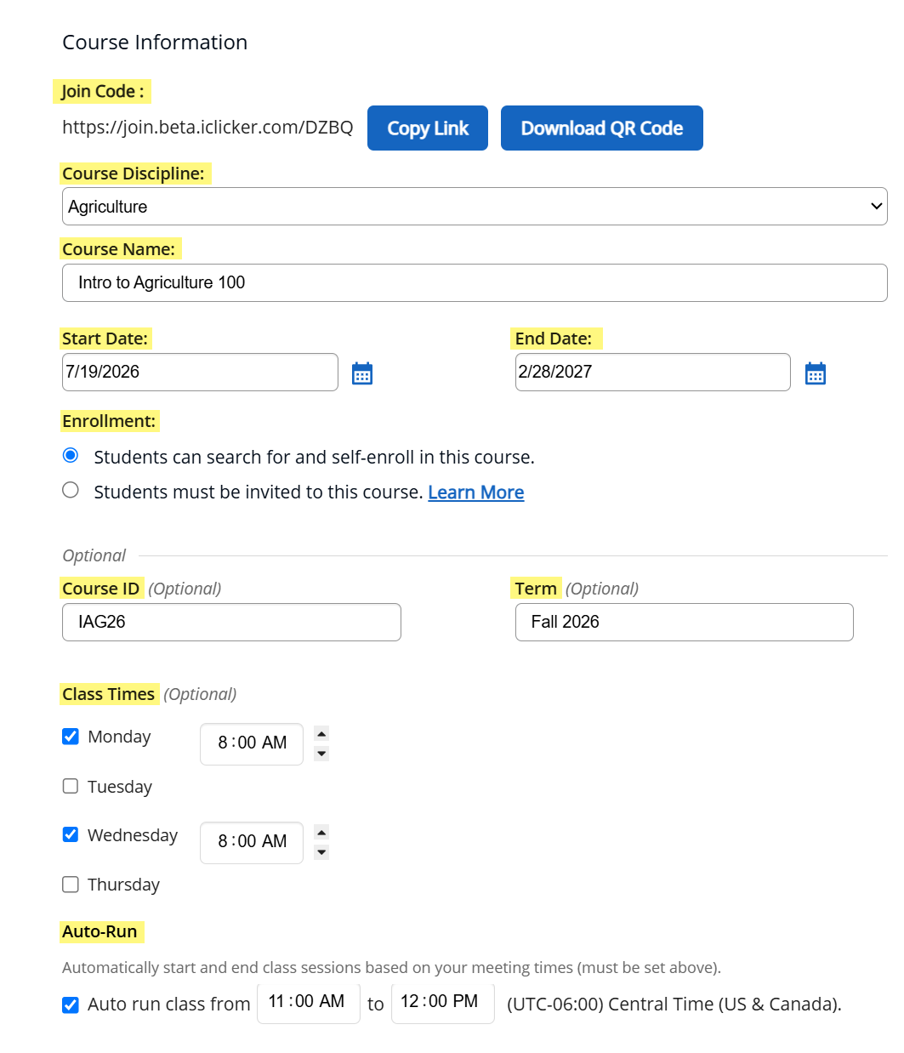
How to Implement iClicker
Decide how you want to use it
Set up class
Set up Canvas integration
The first steps are the hardest!

Slide 15
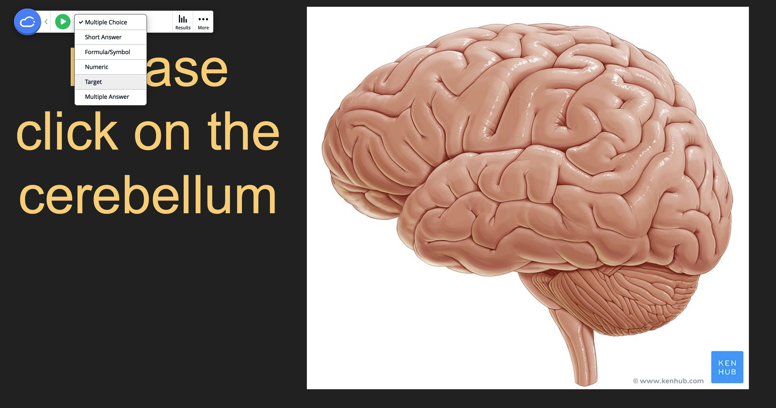
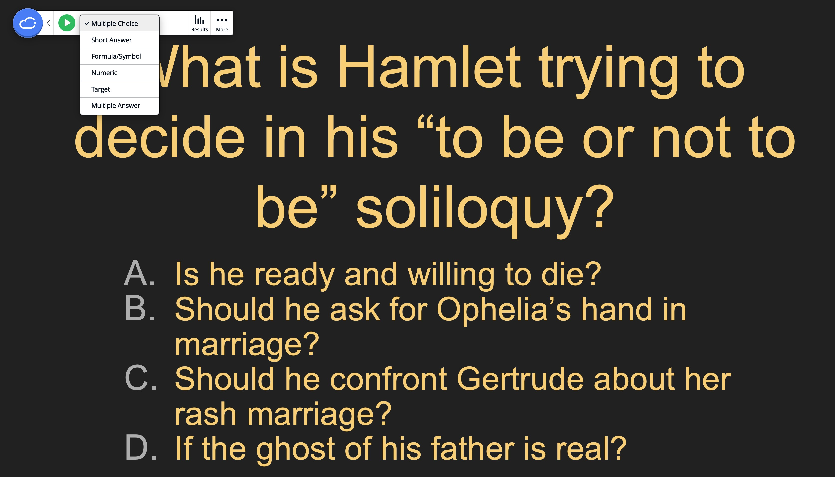
Build clicker activities into your presentation​
  MCQ's​​
  Short Answer​​
  Target Questions​​

Slide 16

Why does it work?
Group/collaborative learning
Active participation stimulates critical thinking
Making a choice reinforces retention
Anonymity
Immediate feedback

Slide 17
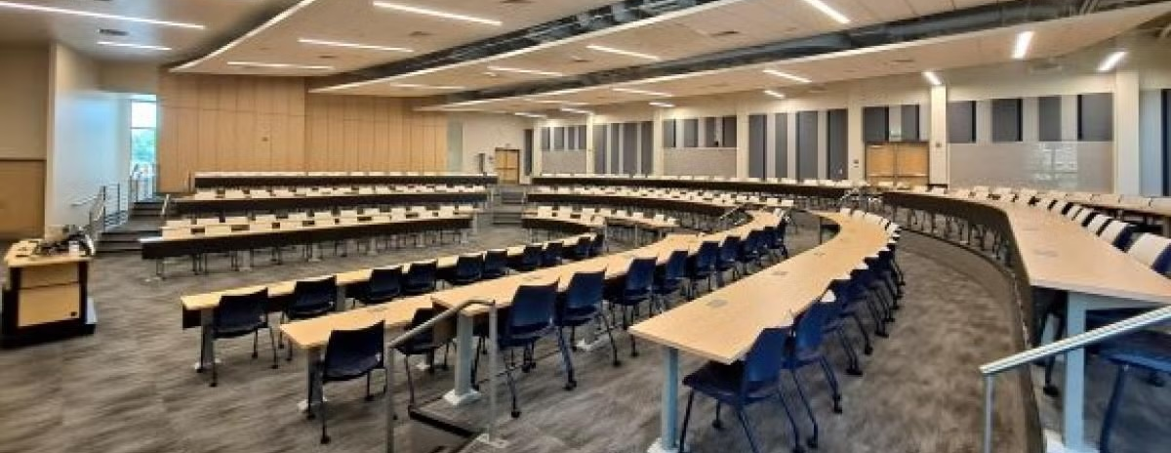
What is Classroom Capture?
Notes:
So far we've talked about what happens before class and what happens during class.
Classroom Capture gives students another learning opportunity after that class session has ended.
It isn’t just a tool for students who missed class, it is a rich digital resource that can be returned to for many reasons.

Slide 18
Video Demo!

Slide 19
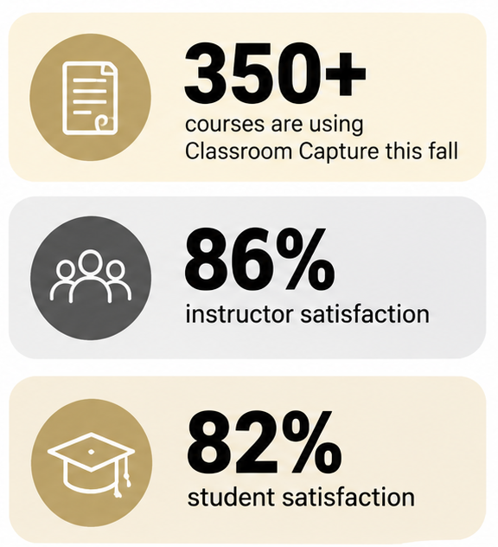

Why use it?
Supports student learning. Simple for you.
For students:
Review difficult material
Catch up after an absence
Revisit content at their own pace
For faculty:
Control access
Support diverse learning needs with greater flexibility
Reduce administrative workload in managing make-up requests
Notes:
“Think about a student who was in class but didn't fully understand one concept. They don't necessarily need the entire lecture retaught to them. They may just need the opportunity to hear that explanation one more time.”
“Or think about the student who misses class because they're sick, traveling with an athletic team, or dealing with something unavoidable. Classroom Capture gives them a way to stay current without the instructor recreating that material individually.”
There's a benefit on the faculty side too. Instead of managing multiple requests for missed content, you're providing one consistent resource
This is not a niche service anymore – More than 350 courses are using it this fall.
86% instructor satisfaction
82% student satisfaction
350+ courses are using it this fall

Slide 20
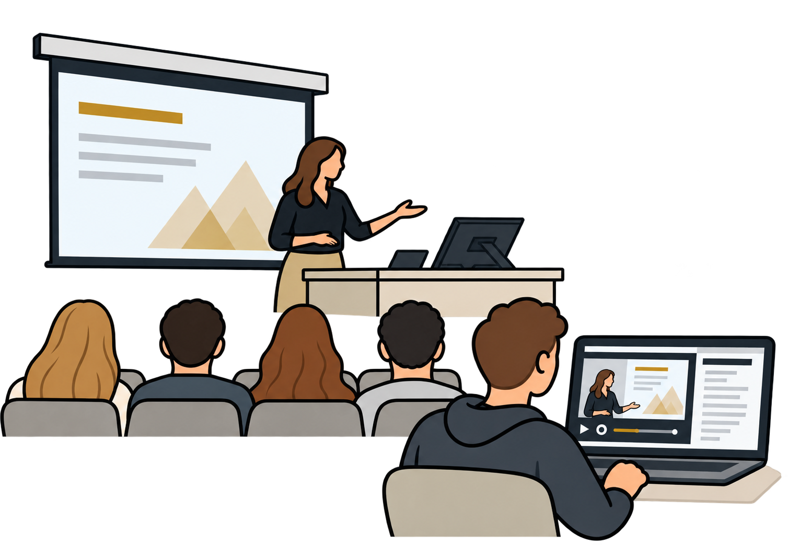
Automated lecture recording service
Available in 72 centrally scheduled classrooms
Optional integration with Canvas
Instructors have full control to share, edit, download, or remove content at any time
Recordings include captions, searchable transcripts, and viewing analytics
Notes:
Classroom Capture is our automated lecture-recording service. Once you've signed up, there is nothing extra you need to do during class, you teach the way you normally would.
It is in over 70 classrooms and we have intentionally expanded into rooms that serve large classes.
The recordings also have features beyond just playback — captions, searchable transcripts and analytics can make the recording much more useful as a learning resource. But what I want to emphasize the most is instructor control. Recording something doesn't mean you're giving up ownership or control of it. Faculty can manage their content, and Canvas access is optional.
Classroom Capture is CU Boulder's automated lecture recording service that allows instructors to record class sessions and optionally share them with students through Canvas. Instructors maintain full control over their recordings and can choose whether to share, edit, download, or remove content at any time. Recordings include captions, searchable transcripts, viewing analytics, and content management tools that help instructors support teaching, review course content, and provide students with flexible access to recorded materials when desired. Request Classroom Capture & Video Demo

Slide 21
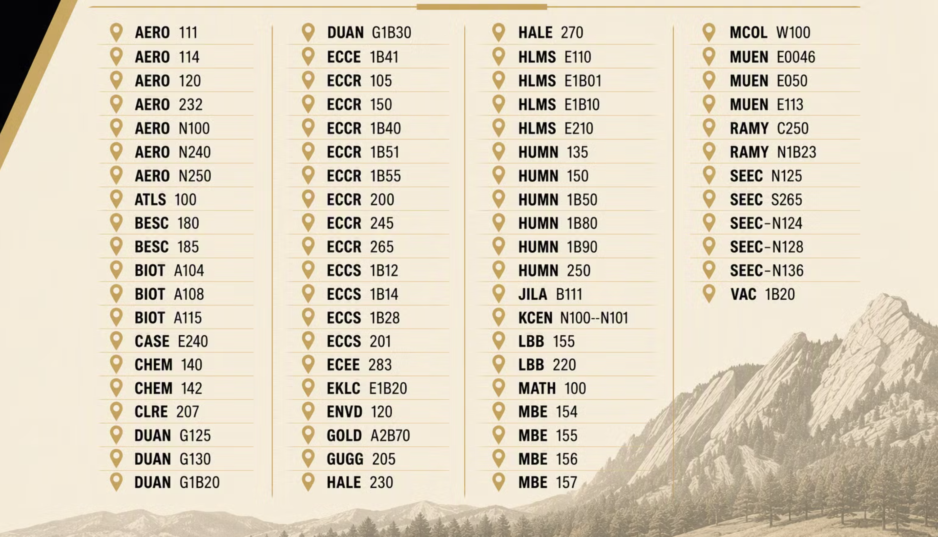
Notes:
So what rooms have Classcap? Here is the list. No need to memorize this list,
the important point is its available in many rooms, and this list is growing. You can find this on our website, or contact OIT.

Slide 22
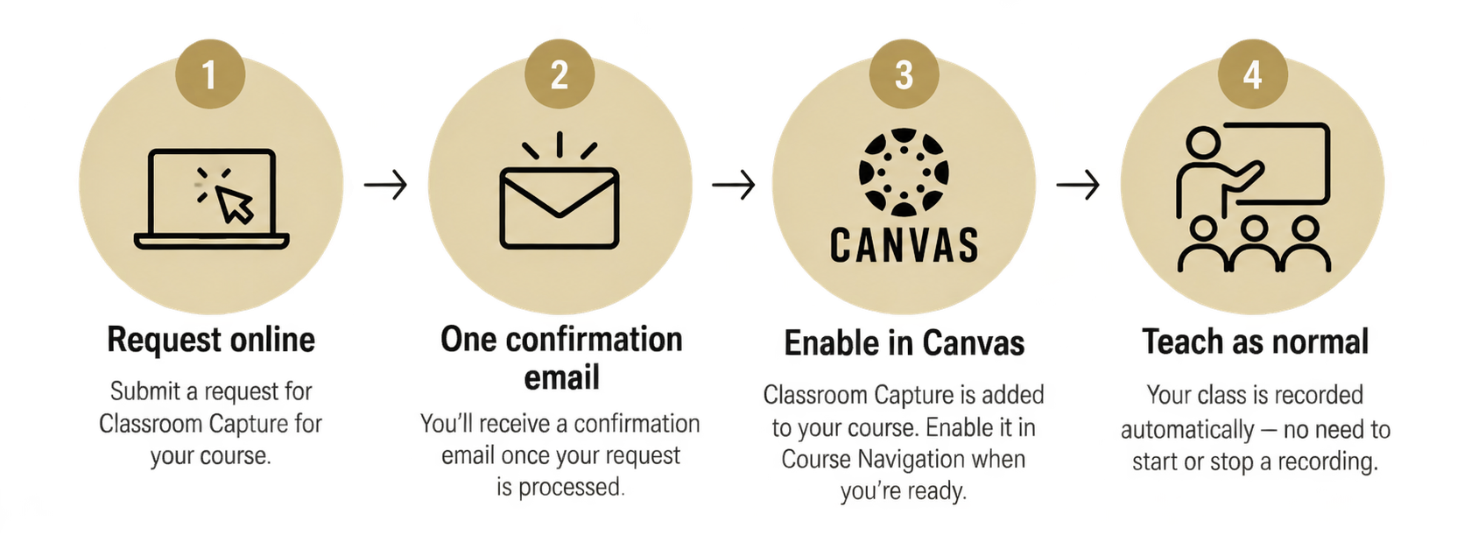
How does it work?
Notes:
Submit request – confirm email – if you want student access, share on canvas – Teach as you normally would
You can even request class cap even if you are unsure if you’ll use it. Keep the recordings as a just-in-case.

Slide 23
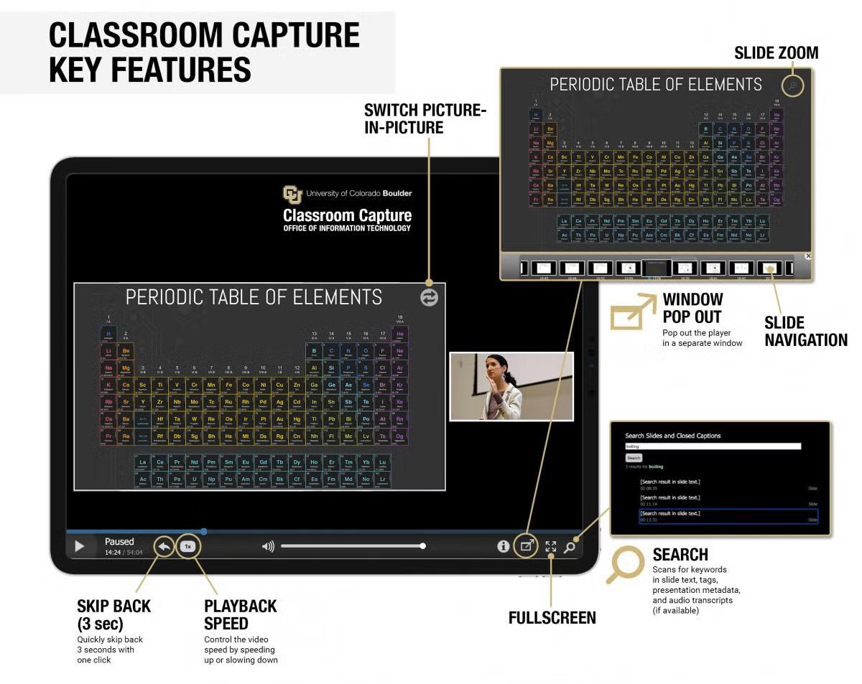
How do the videos look?
Notes:
Students can use picture in picture, change playback speed, navigate through slides, and search transcripts for specific terms creating a richer digital version of what happened in the classroom.
This can bring up some security concerns, especially with AI. You control access, you can edit, remove videos, and disable downloads. Including just temporarily during exam days.

Slide 24
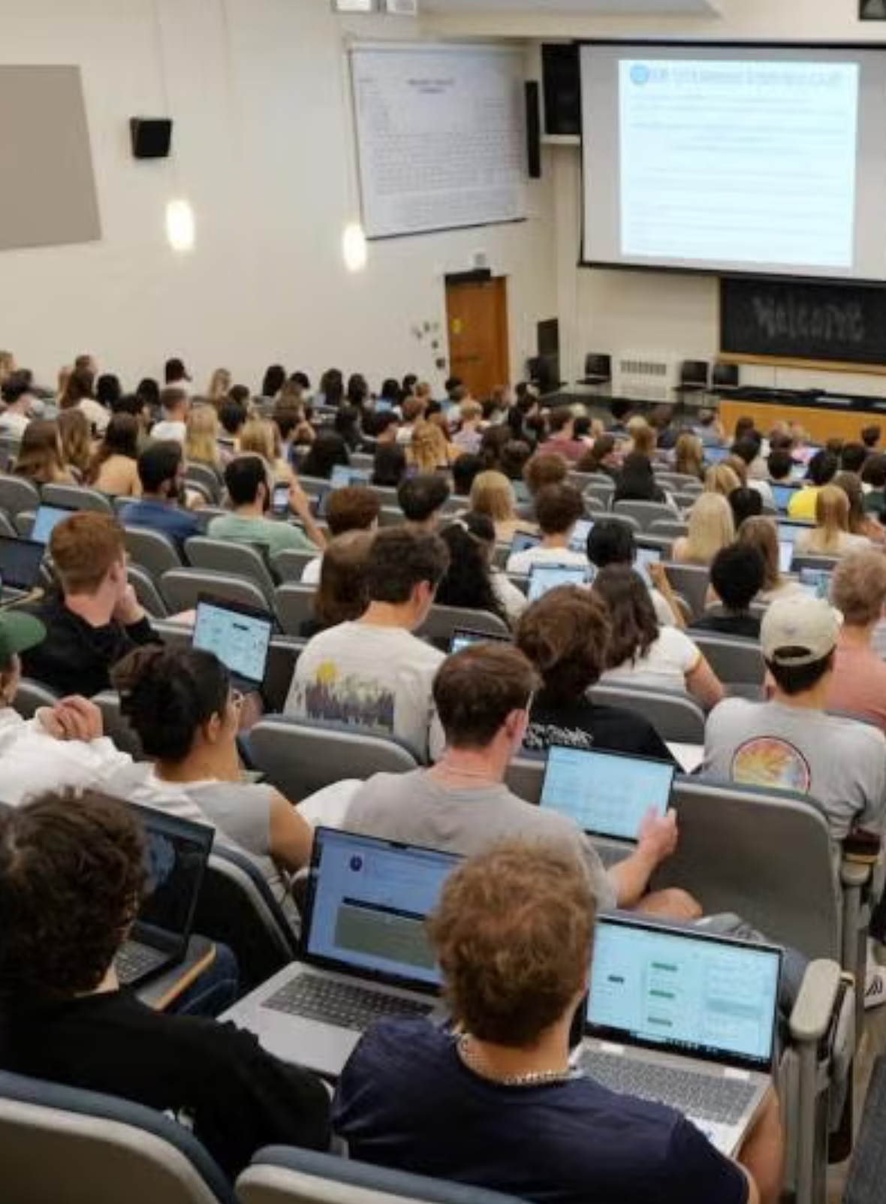
Attendance Concerns
“I’ve been using classroom capture for many years and have found that my overall attendance has stayed steady. Students still come to class for the benefits of being there in person.”​
“Does it affect attendance? Probably a little, some students tell themselves they can just watch the recording. But that’s not enough to outweigh the benefits. In my view, the increase in student learning far exceeds any small drop in attendance.”​
“Students not coming to class was a concern, but its value in the larger classes—there are a variety of reasons for students missing class—is enabling students to stay current with material without any inconvenience to myself.”
Notes:
Use recordings to support the in-person experience, not replace it.
In a recent AT survey attendance is described as only minimally affected.
CC gives access to the content, but the other technologies we discussed today build up the in-person experience - discussion, interaction, practice, feedback and participation

Slide 25
Questions?

Slide 26
Contact info: rob.leary@colorado.edu apjones@colorado.edu
CUClickers
Classroom Capture
WeVideo

