Slide 1
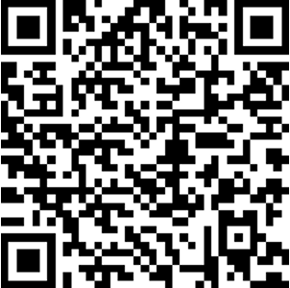
Please take a moment to sign in!
You only need to sign in once for the entire conference. Only in-person participants need to sign in.
https://tinyurl.com/FallConference2026 (link is case sensitive)

Slide 2
Making a Large Class Feel Like a Small Class: Strategies for Building Community
Dr. Emily Schell
Psychology and Neuroscience
CTL Fall Conference 2026

Slide 3
Today’s Agenda
02
01
03
04
Why Does Community Matter?
Strategies for Community Building
Before, During, and After Class
Small Group Workshops
Q&A
Leave with ideas you can use!

Slide 4
Let’s break the ice!
Turn and talk to someone you don’t know.
Share:
Your name
Your pronouns
Your role/department
What color is your mood today?

Slide 5
Turn and Talk:
Now, with another new person, introduce yourself and discuss:
Why should we care about building community in large classes?

Slide 6

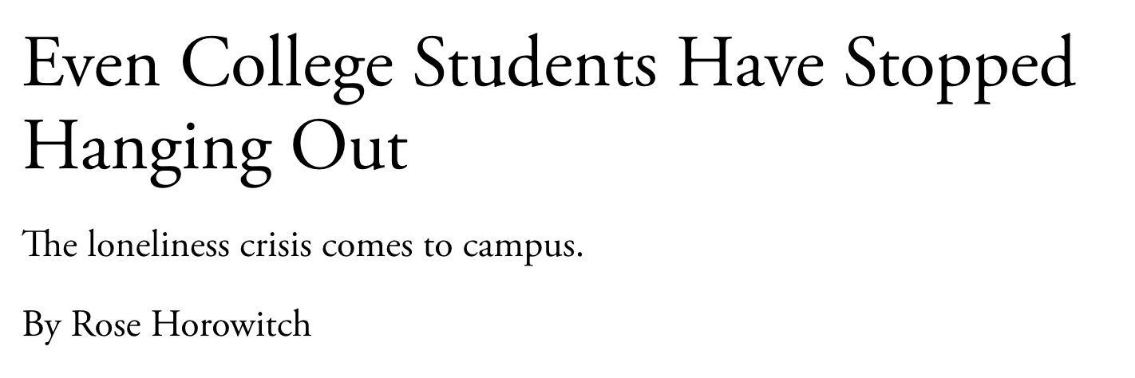
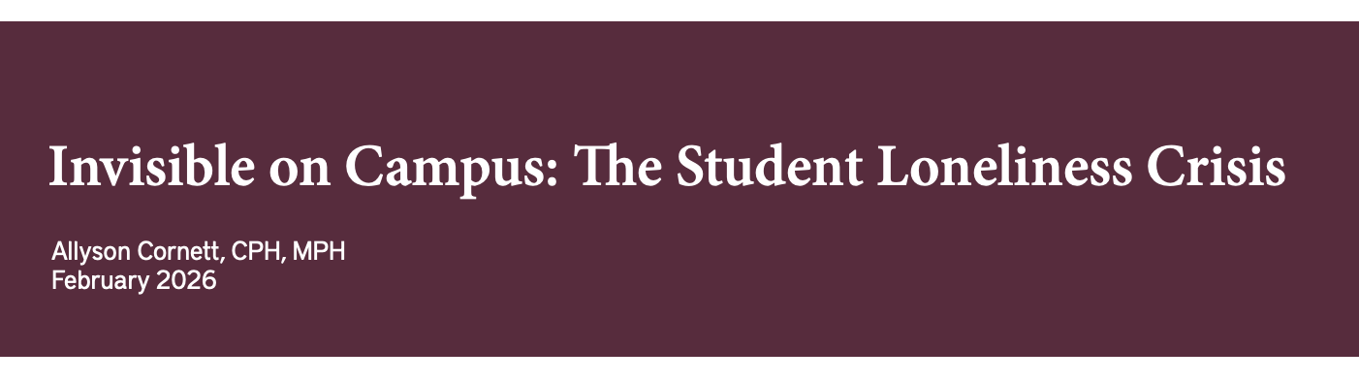
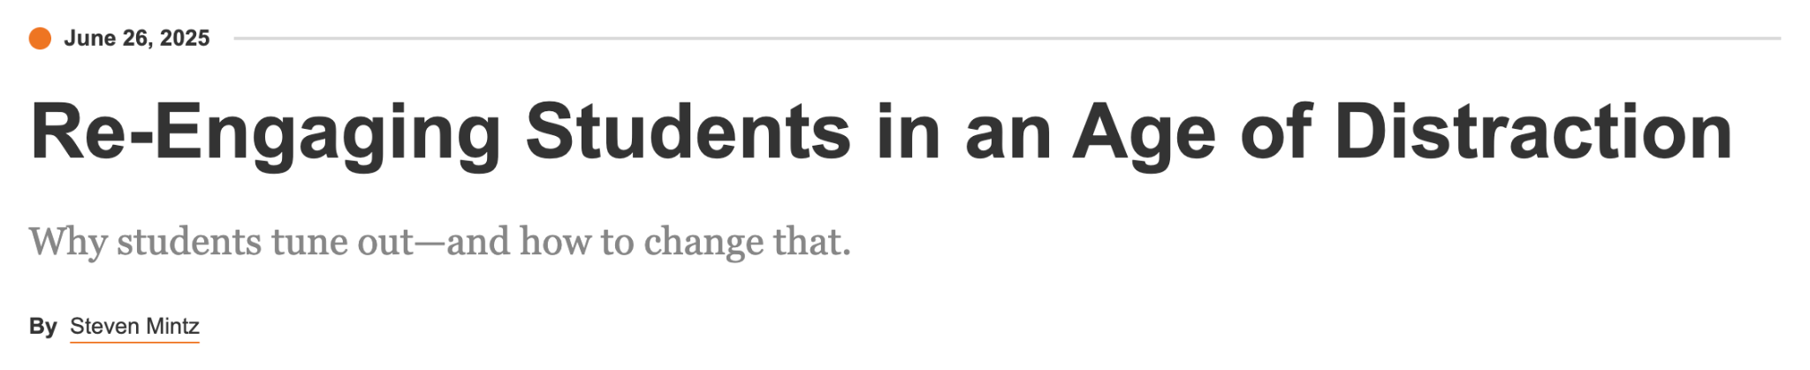
Don’t Just Take It From Me…

Slide 7

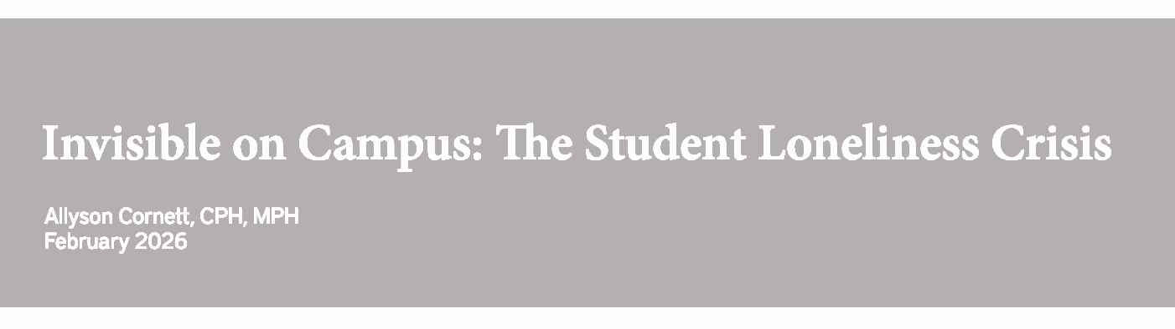
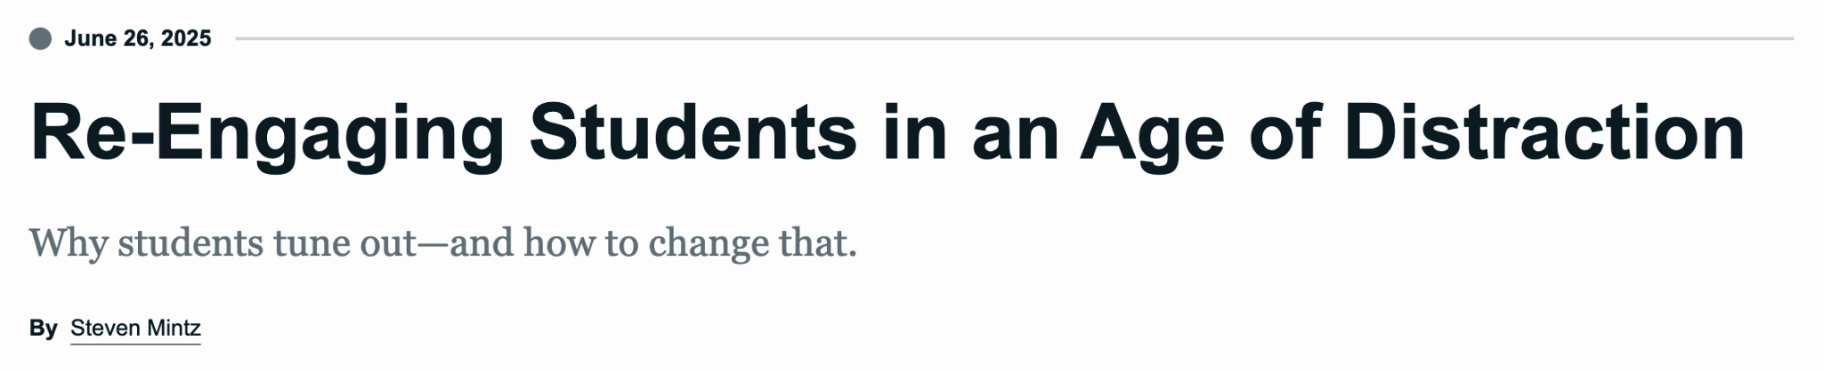
Don’t Just Take It From Me…
Community building is not a panacea.
But it may (and empirically does) help address these concerns.

Slide 8

What do I even mean by community
building?
Intentional actions that:
Foster students’ social integration into the classroom
Help students cultivate relationships with their peers, professors, and university
(Astin, 1984; Tinto, 1997)

Slide 9
Community Building Contributes to…
Persistence
Belonging
(Hansen et al., 2024; Kuh et al., 2008; Tinto, 1997)
(Hurtado & Carter, 1997; Museus, 2014)
Self-Efficacy
Engagement
(Inside & Outside of Class)
(Murphy et al., 2020; Walton & Cohen, 2011)
(Anistranski & Brown, 2023; Stanton-Salazar, 2011)

Slide 10
Community Building Contributes to…
Community building is a powerful engagement tool, especially in large classes where students are rarely expecting community.
When students don’t feel like a number in a seat, they are motivated to return and care.
Persistence
Belonging
Hansen et al., 2024; Kuh et al., 2008; Tinto, 1997
(Hurtado & Carter, 1997; Museus, 2014)
Self-Efficacy
Engagement
(Inside & Outside of Class)
Murphy et al., 2020; Walton & Cohen, 2011
(Anistranski & Brown, 2023; Stanton-Salazar, 2011)
Notes:
Because they know you do! This also connects to motivation contagion…

Slide 11
Strategies for Community Building
These are a few of the tools I implement in my large (N=110) classes.
Like any good toolkit, you might not use them all (and you won’t need them all at once).

Slide 12
Strategies to Use Before Class
Learn Students’ Names
Have a Collaborative Playlist
Use Pre-Class Time to Meet Students
MyCUInfo’s Photo Roster + paper name cards the first few weeks are your friends.
I memorize 250+ students’ names each semester. It is worth the time investment.
Music helps students:
Share in a low-stakes way
See themselves represented in the class
Many of our students are in class (shockingly) early.
Walk around, say hi, and make personal connections.

Slide 13
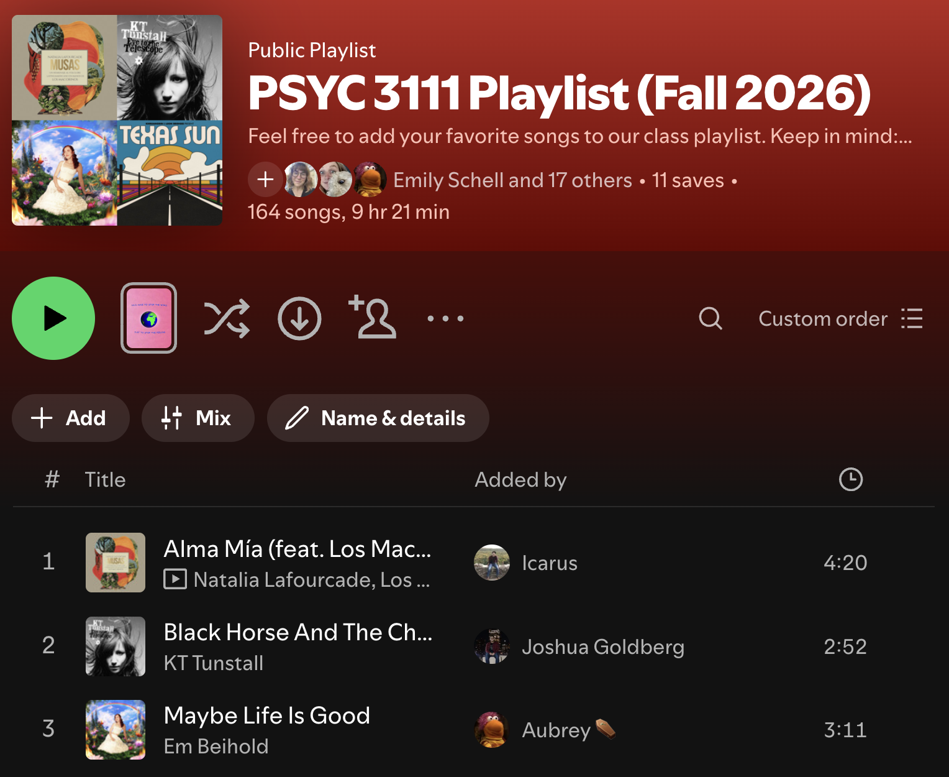
Creating a Collaborative Playlist
Most students use Spotify.
Once you have Spotify, create a “Public Playlist.”
Add the collaboration link to your course Canvas.

Slide 14
Strategies to Use During Class (Pt. 1)
Use iClickers
Think-Pair-Share (TPS), With a Twist
Jigsaw Activity
Especially the short answer functionality!
Students who feel too shy to speak out may engage through iClicker.
Rather than having students speak to the same peers, encourage them to:
Talk to people in other directions
Move to find people
Provide students with a structure to engage deeply with new peers (beyond TPS).
More on the next slide…

Slide 15
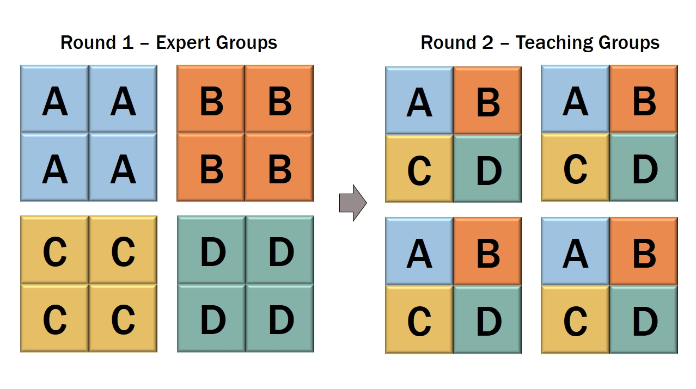
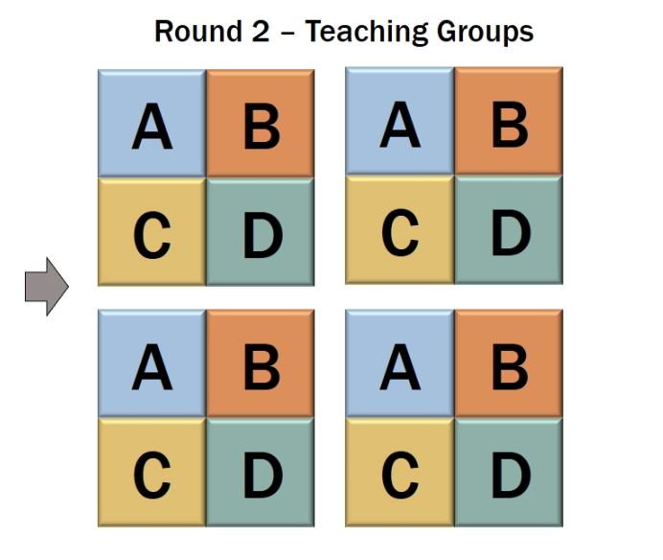
Facilitating a Jigsaw
Example from my Educational Psych. Class (N=50*):
Each expert group will learn more about one intelligence theory.
They then will teach one another about their intelligence theory in “jigsaw” groups.

Slide 16
Strategies to Use During Class (Pt. 2)
Norm-Setting
Icebreakers
Students have ownership over how the class functions
Small, but important, ways to humanize yourself and peers
Show Warmth and Accessibility
Incorporate Students’ Lives
I incorporate their pet photos, but use what is most authentic to you!
More on the next slides…

Slide 17
How Do I Norm Set?
I often will use a Google doc to collaborate with students on norms + post that to our “Course Resources” Canvas module
There is not a “right” or “wrong” way here! However, norm-setting has consistently been shown to support students’ community and feelings of ownership in the classroom (Johnson & Johnson, 2009; Ostrom, 2000).
The most important thing is that students leave a norm-setting exercise with a clear understanding of:
  Their expectations for themselves (e.g., attendance, communication)
  Their expectations for their peers (e.g., managing class conflict, treating one another)
  Their expectations for their instructor (e.g., communicating expectations and feedback to students)

Slide 18
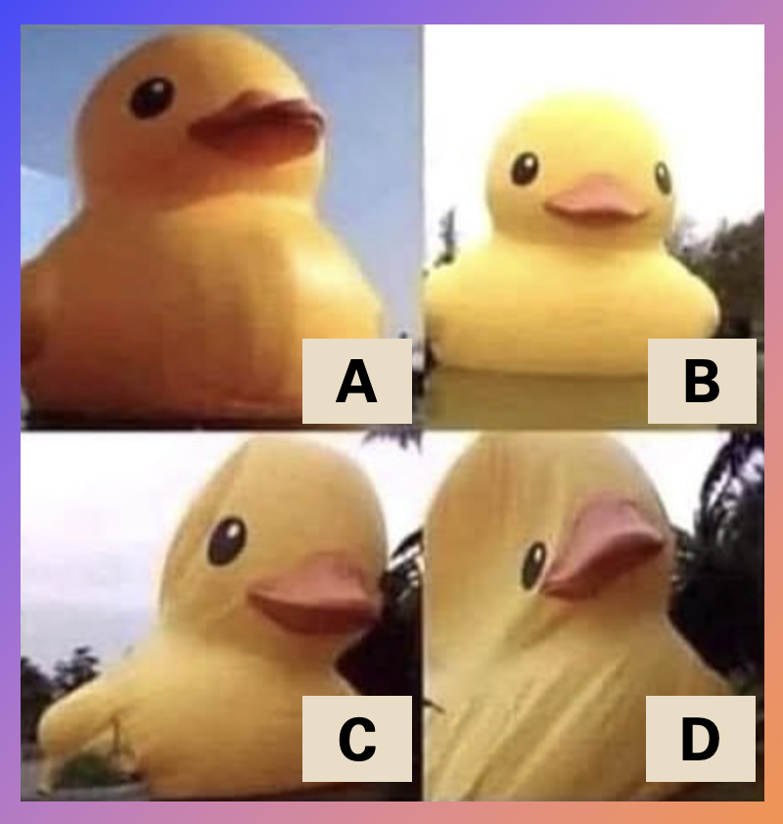
What About Icebreakers?
Again, there is not a “right” or “wrong” way here! However, icebreakers also have been shown to foster familiarity, connection, and participation norms (in a low stakes environment) (Johnson & Johnson, 2009).
Here are some fun ones I’ve used:
  The one we had today (“What color is your mood?”)
  “What’s your favorite song right now?”
  “What’s your favorite season?”
  “If you could be any kitchen appliance, what would you be?”
  Pictorial icebreakers →
With the iClicker question: “Which duck depicts how you’re feeling this week?”

Slide 19
How Do I Incorporate Students’ Lives?
When students see themselves represented in the course content (e.g., their culture, family, things they love) → increased inclusion and belonging (Hurtado & Carter, 1997)
I do this through culturally responsive pedagogy (Museus, 2014).
  Examples: Incorporating readings and media from diverse perspectives, allowing students to choose topics for assignments
But you also can incorporate their lives in “sillier” ways, such as…

Slide 20
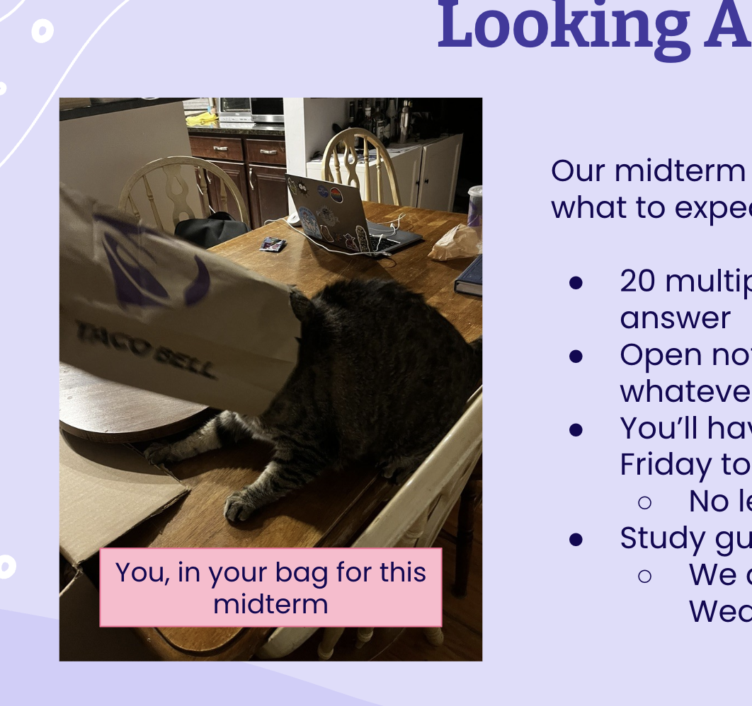
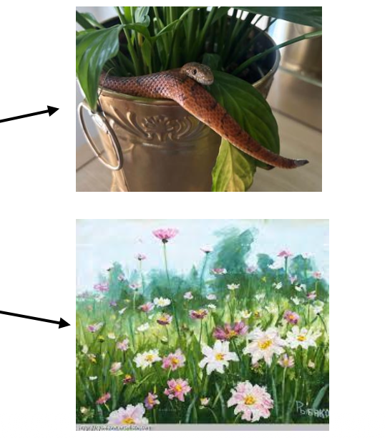
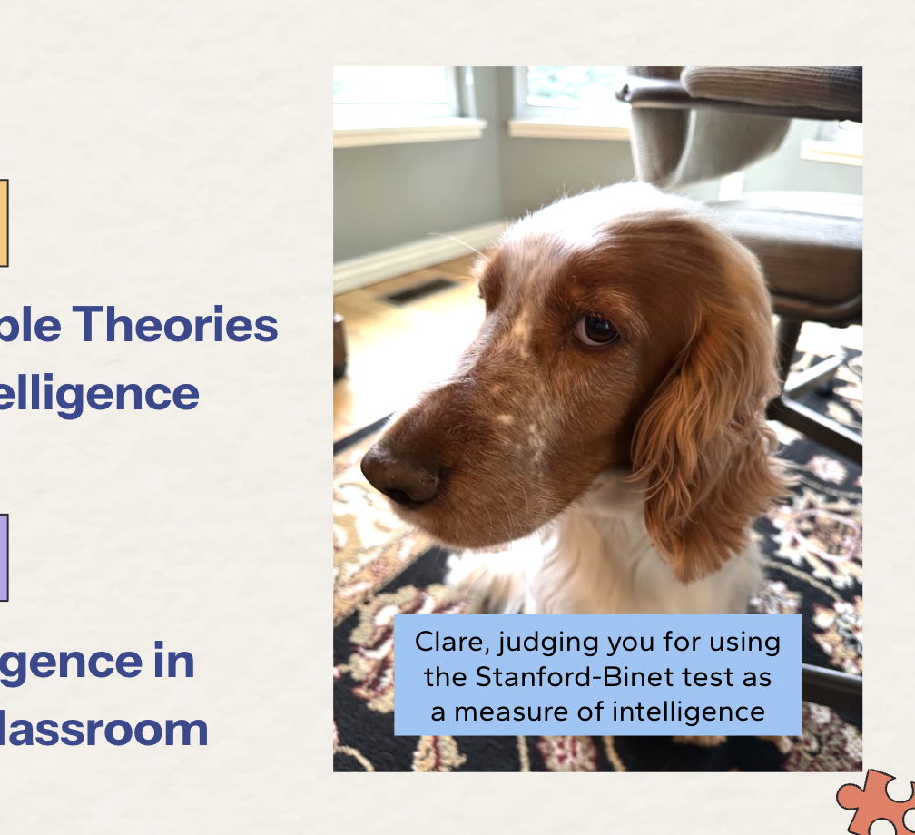
What started as a joke with one class two years ago has transformed into a tradition. I get emails from students with their pets daily!

Slide 21
And Finally, Show Warmth!?
What do you mean by that?!

Slide 22
How I Show Warmth
The literature calls this “creating a welcoming environment.” I conceptualize it as:
How can I humanize myself and make myself/my content more approachable?
  Through memes (even if they don’t land, students appreciate the effort!)
  Through engaging, approachable slide design (i.e., SlidesGo)
  By making it clear how to reach me
    I use Calendly for student hours so students can reserve a time and know that it is their time. It has the added benefit of adding an event to their calendar automatically.
  Through sharing student announcements and resources
    I post events students share with me to my slides.
    I also have Canvas discussion threads where students can post resources.

Slide 23

Workshop Time
In groups of 3-4, discuss:
What are 1-2 community building strategies you want to try in your class?
How, if at all, do you think you will need to adjust them for your class?
What challenges might arise in implementation?

Slide 24
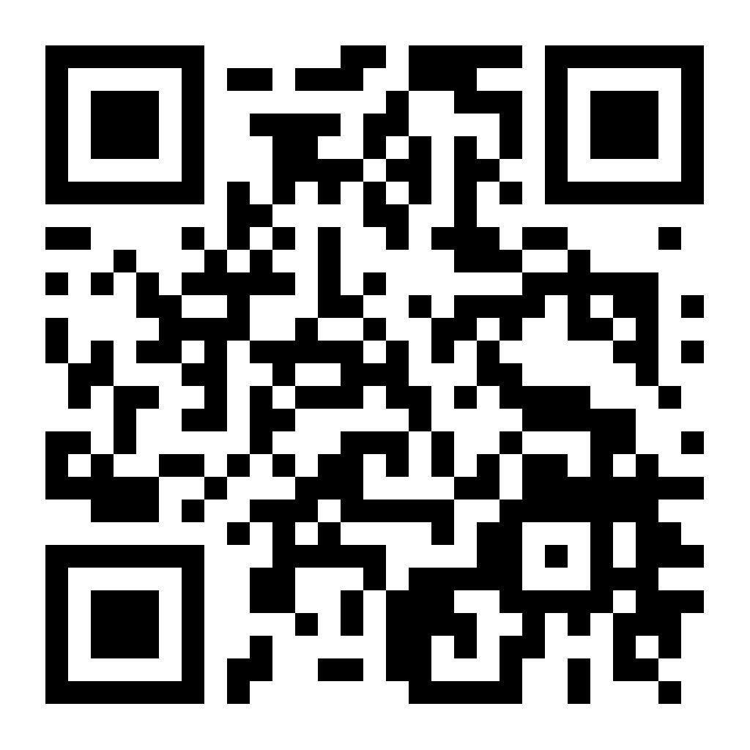
You can access my slides here:

Slide 25
Questions?
Thank you for being here!
Please contact me at emily.schell@
colorado.edu

