Slide 1


Two-Stage Exams in a Large Lecture Course
Daniel Bolton | CTL Conference | October 15, 2026

Slide 2
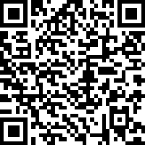
Please sign in!
Please take a moment to sign in! Thanks!
You only need to sign in once for the entire conference. Only in-person participants need to sign in.
https://tinyurl.com/FallConference2026
(Link is case sensitive)
Notes:
https://cuboulder.qualtrics.com/jfe/form/SV_bHKUHpaIVJPpQEu

Slide 3
Outline
Discussion
Large Physics Courses
Two-Stage Exams: Structure
Discussion
Two-Stage Exams: Outcomes

Slide 4
Discussion Questions
Goals of exams in large-enrollment intro courses?
Barriers to achieving these goals?

Slide 5
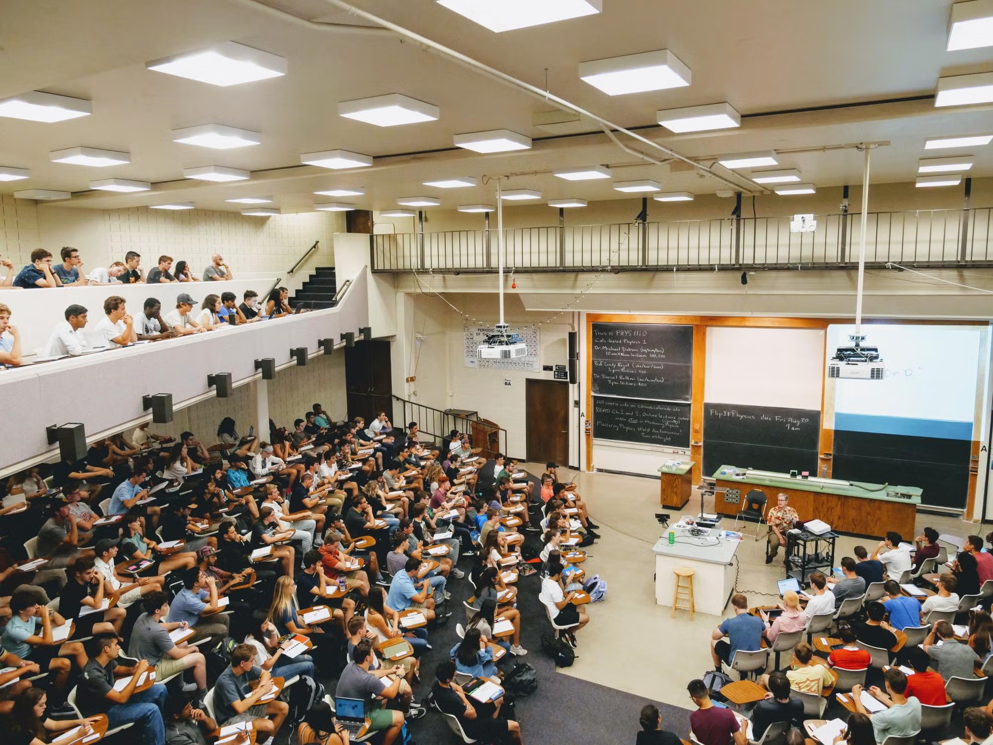
Large Physics Courses
Course Structure
  Up to 1,300 students
  MWF lectures + recitation
  Peer instruction
  Exams = 75% course grade

Slide 6
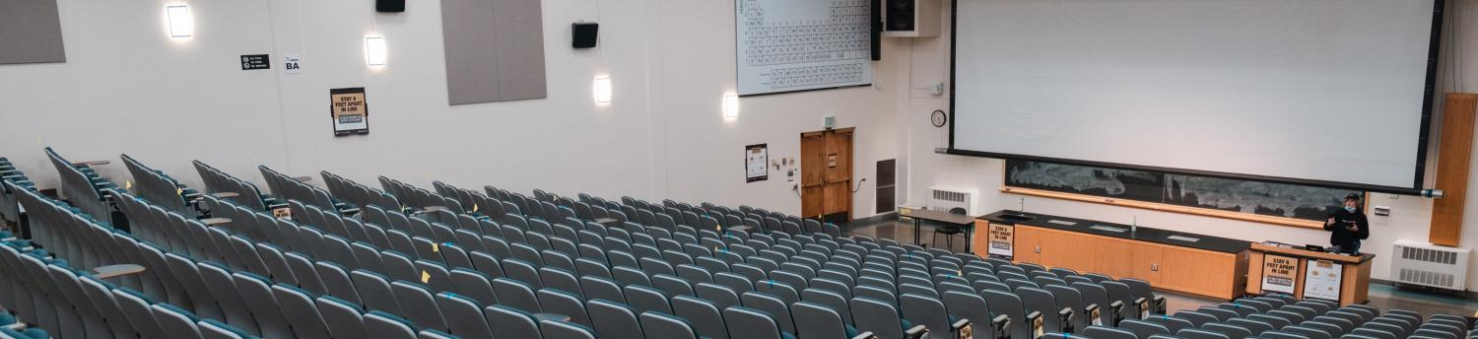
Large Physics Courses
Exam Structure
  Multiple choice, paper and pencil
  Mix of concepts and calculations
  7:30-9:30 pm
  Lecture halls across campus

Slide 7
Two-Stage Exams: Structure
History
  C. E. Wieman, G. W. Rieger, and C. E. Heiner, Physics exams that promote collaborative learning, The physics teacher 52, 51 (2014).
  A. P. Martin, A quantitative framework for the analysis of two stage exams., International Journal of Higher Education 7, 33 (2018).
  W. Block and C. West, , presented at the Physics Education Research Conference 2025, Washington, DC, 2025

Slide 8

Two-Stage Exams: Structure
Timing
  80 minutes individual
  40 minutes group
Grading
  85% individual + 15% group
  Group score cannot lower grade

Slide 9
Discussion Questions
What outcomes one might expect?
What might one expect for the nature of the group discussions?

Slide 10
Two-Stage Exams: Observations
Typical Statistics (from PHYS 1110 Fa26 Exam 1)
  Individual Exam
    Average 77% (Std. Dev. 19%)
  Group Exam
    Average 96% (Std. Dev. 6%)
  Total Score
    Average 80%

Slide 11

Two-Stage Exams: Observations
Block and West – types of group interaction
  Productive Collaboration
  Consensus-Building
  Misunderstanding
  Counterproductive Collaboration

Slide 12
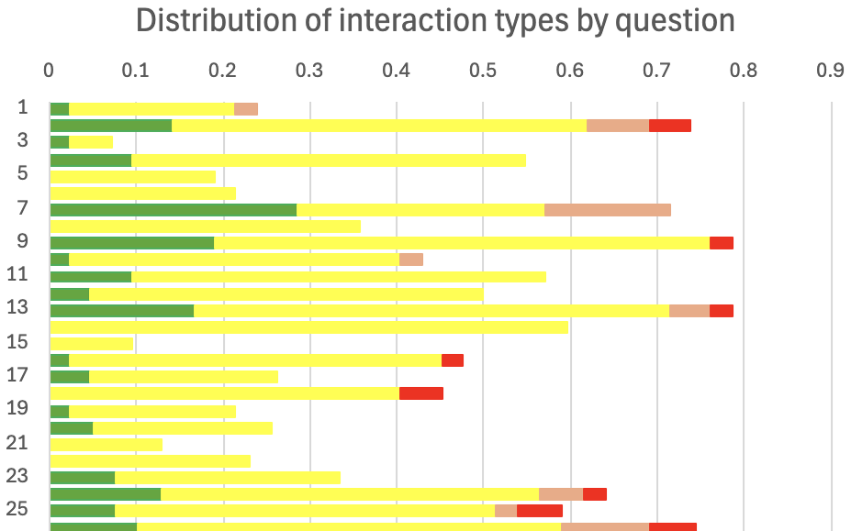
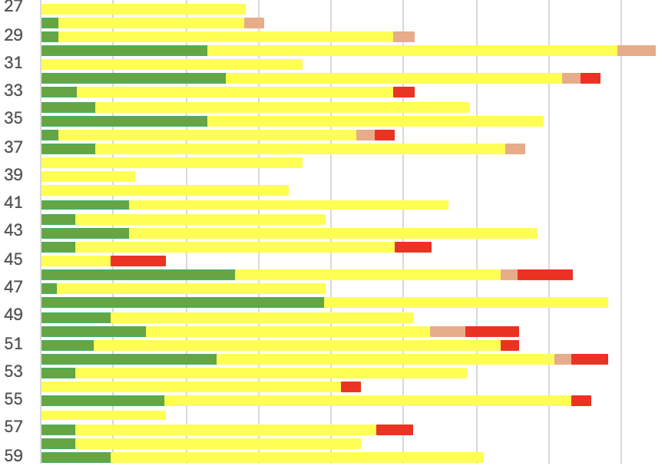
Two-Stage Exams: Observations

Slide 13
Two-Stage Exams: Observations
If ALL the students in a group had the wrong answers individually, they nevertheless arrive at the correct answer on the group exam 17% of the time.
If one student in a group has the right answer, but there is a majority in the group that had the wrong answer, they get the question right 46% of the time.

Slide 14
Two-Stage Exams: Observations
If one student in the group has the right answer and there is NO majority among the other wrong answers, the group ends up getting the question right 86% of the time.

Slide 15
Two-Stage Exams: Observations
Why two-stage exams?
  Turn the exam into a learning experience
  Build community
  Reduce complaints

