Slide 1
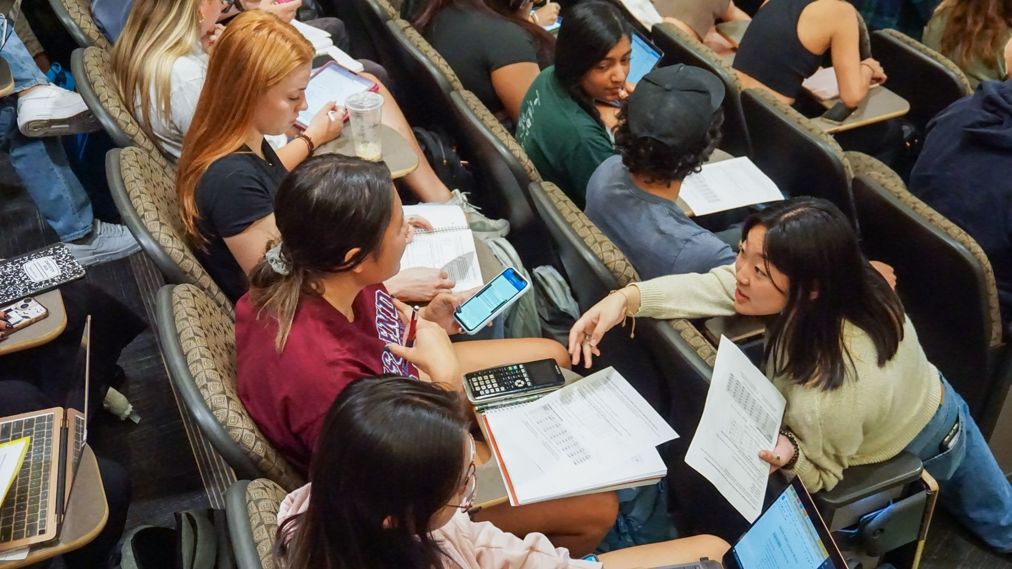

Small Group Activities for Engagement in Large Courses
Christy Fillman
Notes:
Photo from the Learning Assistant Program MCDB 2150

Slide 2
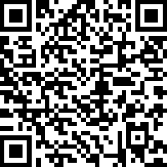
Please sign in!
Please take a moment to sign in! Thanks!
You only need to sign in once for the entire conference. Only in-person participants need to sign in.
https://tinyurl.com/FallConference2026
(Link is case sensitive)
Notes:
https://cuboulder.qualtrics.com/jfe/form/SV_bHKUHpaIVJPpQEu

Slide 3
How do you get students to practice the kind of thinking that you want them to learn?
Students should regularly practice
Applying new concepts
Interpreting data
Solving complex problems
Explaining their reasoning
Traditional methods:
Weekly problem sets
Clicker questions
Practice quizzes
Assigned readings
Pitfalls of traditional methods:
Delayed feedback
Limited support while struggling
Limited peer reasoning
Limited instructor insight
Limited complexity or requirement to explain reasoning

Slide 4
Small Group Work in a Lecture Class
Instructor led introduction or review of a topic
TAs and LAs circulate and support learning
Discuss the reasoning as a class – immediate feedback
Students immediately apply the concept
Students struggle with their peers
Students write something down commit to an answer
Students submit their work
Accountability

Slide 5
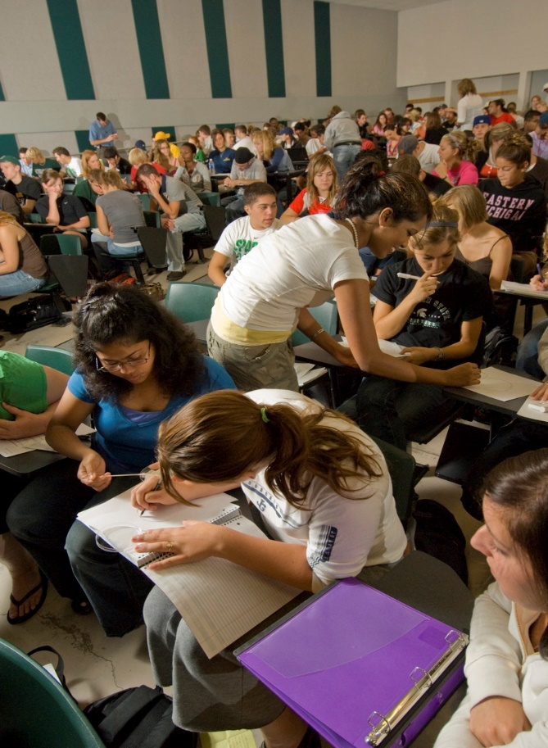
It takes a Village – Excellent TAs and LAs are required
For a 200-person class, I have 4 .25FTE Teaching Assistants (undergrad and grad) and 2 Learning Assistants (all paid)
Meet weekly to go over in class activities
Circulate during clicker questions and activities
Learning Assistant Program
https://www.colorado.edu/program/learningassistant/

Slide 6
How I Design Activities
Start with a challenging learning objective
Use backwards design – what do I want students to be able to do on an assessment?
Create a problem that requires discussion
Integrate the activity into the class
Allow productive struggle – with lots of classroom support
Time can vary 10-15 minutes is typical

Slide 7
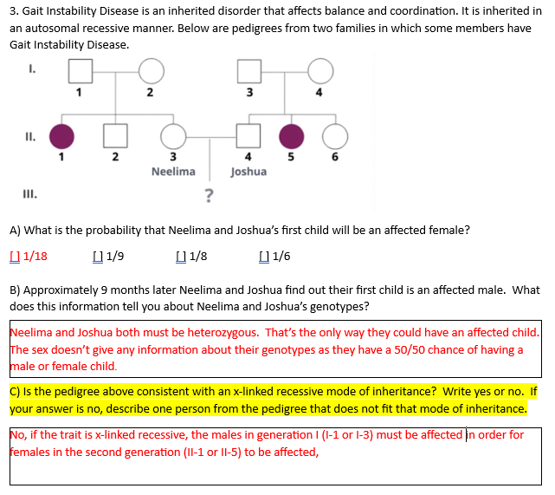
Activity Example – Genetics Pedigrees
Challenging learning objective
Distinguish between dominant, recessive, autosomal, and X-linked modes of inheritance when displayed in a pedigree
Assessment Question
Use backwards design – what do I want students to be able to do on an assessment?
Answer two questions where students determine if a pedigree is consistent with a mode of inheritance.

Slide 8
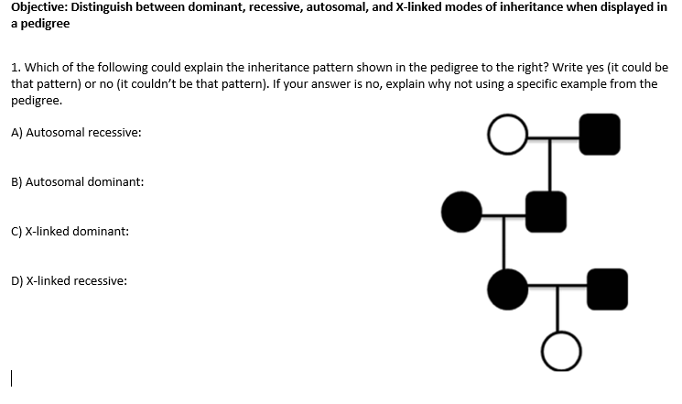
Activity Example – Genetics Pedigrees
Create a problem that requires discussion
This question is more difficult than the example I give in lecture and similar or more difficult than the assessment questions.

Slide 9
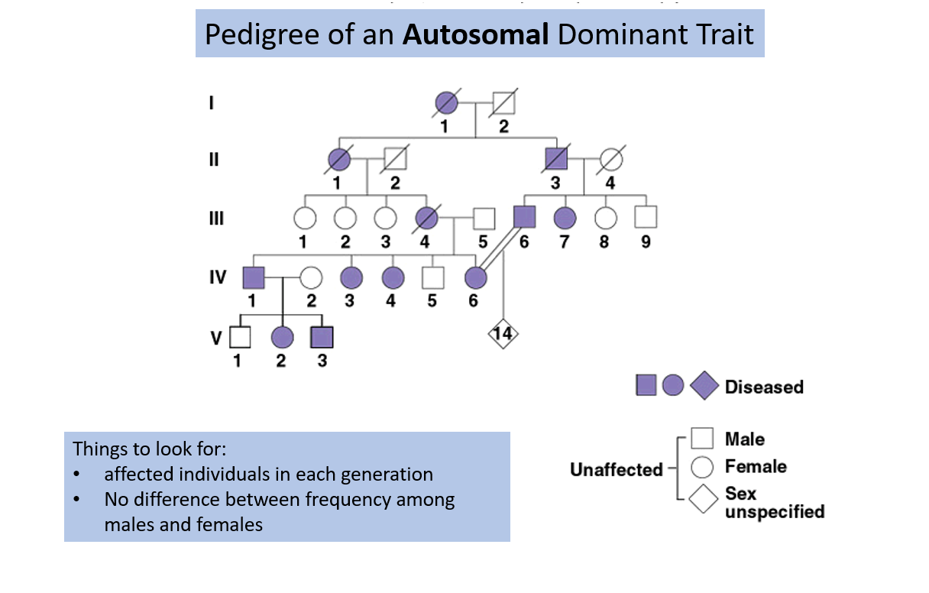
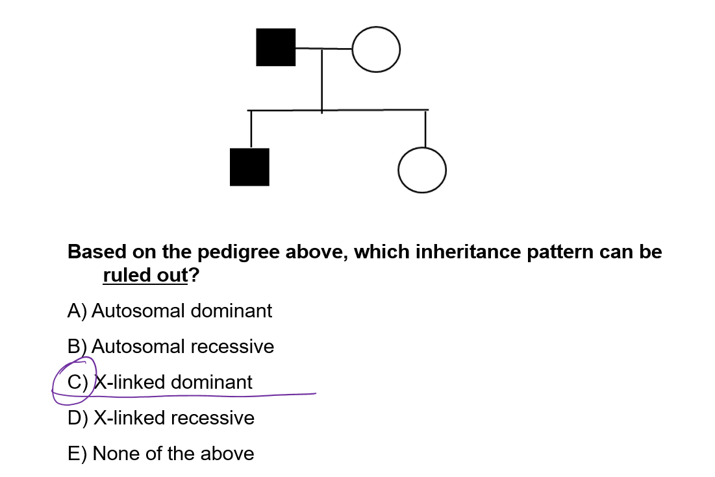
Activity Example – Genetics Pedigrees
Integrate the activity into the class
Pre class assignment – reading and questions in Codon
In class introduction
Review each mode of inheritance with an example pedigree
Provide a simpler example as a clicker question

Slide 10
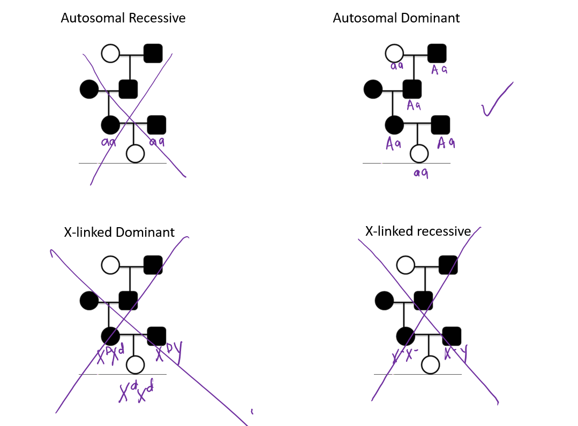
Activity Example – Genetics Pedigrees
Allow productive struggle – with lots of classroom support
This activity takes 10-15 minutes; TAs, LAs, and instructor circulate during this time

Slide 11
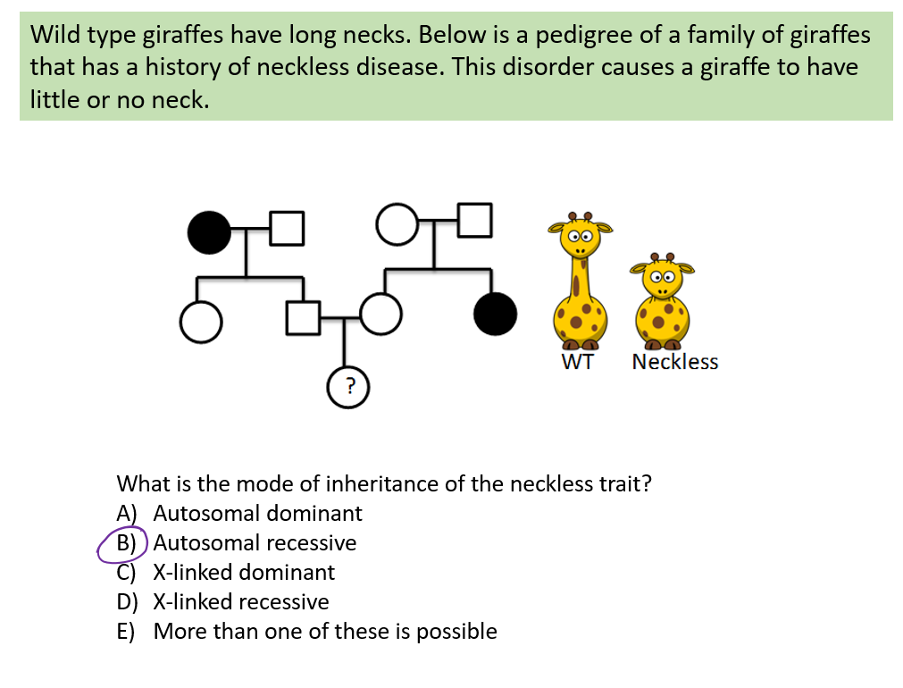
Activity Example – Genetics Pedigrees
Integrate the activity into the class
This question is more difficult than the example I give in lecture and similar or more difficult than the assessment questions.
Pre class assignment – reading and questions in Codon
In class introduction
Follow up with a similar but different clicker question (sometimes it’s the same question).
Clicker questions help bring the class back together

Slide 12
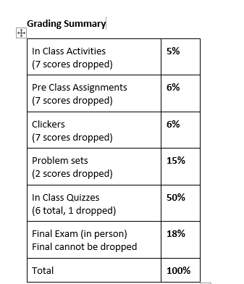
Logistics - How Does Small Group Work in a Lecture Class?
Students form informal groups – based on where they choose to sit. Students can change groups whenever they want (they usually don’t)
Students submit their work individually to Canvas (photo or digital file)
TAs grade activities for completion 1pt per class – 20 min per activity
Due by 11:59PM class day (encourage in class submission)
Activity available digitally or hard copy – published workbook (~$7 per student)
I used mixam printing (https://mixam.com)
7 “free” missed activities, no make ups until after 7 misses

