Slide 1
Preparing your Professional Teaching Statement
University of Colorado Boulder, Center for Teaching and Learning
Notes:
Hello! This brief video will be an overview of the CU Boulder Center for Teaching & Learning’s guide to preparing your professional teaching statement. I will go over the resource found on this page and talk you through the suggestions from the CTL.

Slide 2
There is no single correct way to write a teaching statement.
The goal is to write a teaching statement that best reflects who you are as an instructor/educator and that addresses issues of interest and relevance to the teaching profession.
Notes:
Firstly, there is no single correct way to go about crafting your statement. Your statement’s goal is to reflect your unique approach to educating and to articulate your specific areas of interest within teaching and learning.
The CTL recommends addressing six dimensions relevant to teaching and to crafting your teaching statement. These dimensions can help to develop an existing statement, or could guide your process in creating an entirely new statement!
A generally effective practice is to remember to be succinct, detailed, and professional in writing. This statement could be used during your annual reviews or as a teaching philosophy you might share with a prospective employer in the future.

Slide 3
Dimension 1: Motivation
Questions you can ask yourself:
What is it about your discipline that excites or interests you?
What do you see as the relationship between the learner and the instructor and their respective responsibilities?
Why do you teach or want to teach?
Notes:
To help articulate your motivations for teaching, think about addressing these three prompts in some form or fashion in your statement

Slide 4
Dimension 2: Inclusive Teaching
In what ways do you support diverse approaches to learning?
How does your classroom teaching reflect sensitivity to and support of diversity of learners from across the range of social, economic, and demographic factors?
How does your mentorship of learners support their efforts to achieve their professional and personal goals?
Notes:
Another dimension worth considering is your approaches to inclusive teaching, these prompts can be used to encourage you to reflect on your inclusivity in the classroom ! (Read questions)

Slide 5
Dimension 3: Goal-Oriented Teaching
What kinds of learning goals do you have for learners in your courses?
How do these learning goals relate to the priorities of your discipline?
How do these learning goals connect to learners’ personal, academic, and/or professional growth?
Notes:
A third dimension to consider is goal oriented teaching, which helps you to consider how you formulate learning goals and encourage students to achieve learning goals. Some prompts to begin articulating this could be (Read questions)

Slide 6
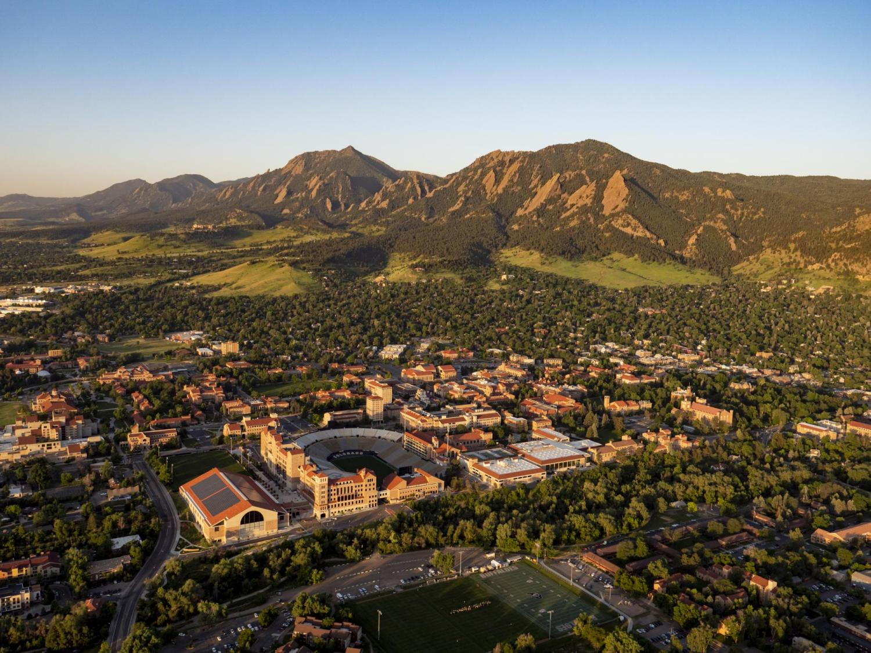
Dimension 4: Scholarly Teaching
What kinds of research-based teaching methods do you use to facilitate learners’ achievement of the learning goals?
Why are these teaching methods appropriate for the discipline and/or your preferred approach to teaching?
How will you balance supporting learners’ development of disciplinary knowledge, skills, and attitudes?
Notes:
Reflecting on your approach to scholarly teaching is another helpful angle to consider. These questions could be additional prompts for you to articulate things you may intuitively know about your own teaching into more precise words and terms, like explaining why you may use certain teaching methods for your specific discipline (Read questions)

Slide 7
Dimension 5: Assessment
Prompts for articulating assessment methods:
How do you use the results of these assessments to reflect on and guide your instructional methods?
Why are these assessments appropriate for the discipline and/or your preferred approach to teaching?
How will you determine the extent to which learners achieved the learning goals (e.g., tests, papers, projects)?
Notes:
A fifth dimension to consider is your approach to assessments! Your approach to assessments is the complement to your approach to educating, this is where students’ grasp of learning goals can really shine. You likely have your preferred methods, these questions can help to organize the specifics of your methodology and how it is most beneficial. (Read questions)

Slide 8
Dimension 6: Experience and Professional Development
What previous experiences have you had that have prepared you to teach?
What aspects of your teaching are you working on now (if any)?
In what ways do you intend to further grow and develop as an instructor in your discipline?
Notes:
Finally, you may want to consider gathering together your previous experience and areas of development you may be cultivating or wish to cultivate in the future. (Read questions)

Slide 9
Thank you!
CTL@colorado.EDU | Center for Academic Success & Engagement (CASE), E-390 (Third Floor)
Credits to Dr. Leilani Arthurs and the CU ASSETT team
Notes:
Thank you for watching this brief overview of how to approach crafting your professional teaching statement! Please do not hesitate to reach out to the CTL team with any questions or clarifications or if you would like additional resources on this topic.

