Slide 1
What is Online Teaching?
CU Boulder Center for Teaching and Learning

Slide 2
What is Online Learning?
A form of distance education using internet technology
Originated from correspondence courses (1700s), first online in 1960s
Offers flexibility and accessibility for diverse learners
Supports students with:
Health concerns
Caregiving duties
Work/school balance
Notes:
Original distance education included correspondence courses that involved communication through traditional mail; online education involves a technological component, such as the internet for communication to occur during the learning process.
Online learning allows learners that are unable to participate in traditional learning due to multiple reasons including access, health concerns, juggling responsibilities (CITE Elearn article). Online learning allows for flexibility in that learners do not have to travel to attend class, and various forms of online education offer varied degrees of flexibility in learning.

Slide 3
Challenges of Online Learning
Lack of non-verbal cues can cause isolation
Requires careful course design
Misconceptions from emergency remote teaching (2020–21):
Not all online learning is the same
Good online teaching ≠ simply moving in-person content online
Notes:
online learning can bring with it challenges for both the instructors and learners. Due to the lack of inherent non-verbal cues and in-person interactions, learners can feel isolated, and for some, more marginalized. For instructors, this means taking diligent care in designing, organizing, and facilitating online courses.

Slide 4
Today’s Learners
Many college students = emerging adults
Share traits with non-traditional learners:
Work obligations
Caregiving roles
Time constraints
Notes:
Although distance education and online learning were historically offered for adults as a means to acquire lifelong learning or formal education, it is imperative that we remember traditional-college age learners are emerging adults. Today’s learners resemble non-traditional age learners due to many of the responsibilities they bring with them, such as care-giving, working while going to school, and managing their time and engagement with decreased capacities due to a myriad of other reasons (Lumina Foundation, 2022).

Slide 5
Formats of Online Learning
Notes:
Online learning exists on a spectrum of flexibility and structure.
We’ll look at 5 formats

Slide 6
Asynchronous
No scheduled meetings
High flexibility
Requires:
Self-direction
Time management
Instructor role: clear structure + consistent communication
Notes:
Asynchronous-Learners are not required to meet simultaneously. This format offers the most flexibility in terms of learner scheduling conflicts, requires developing self-directed and self-efficacy skills, and among other things, instructor organization and time management skills.

Slide 7
Synchronous
Scheduled live sessions via Zoom, etc.
Mimics in-person structure
Still includes asynchronous elements (LMS, prep work)
Requires:
Digital presence
Tech setup
Notes:
Synchronous-Learners meet at designated times through platforms such as Zoom. Although replicating an in-person course more than the asynchronous format, in-person teaching does not translate 1:1 in designing and facilitating synchronously. Often, there is still asynchronous elements involved through the learning management system (LMS).

Slide 8
Hybrid
Combines in-person and online components
Meetings are pre-scheduled
Ex: Flipped classroom (asynchronous prep + active in-person time)
Notes:
Hybrid-These courses have required in-person and online components. Meeting days and times are specified before the course begins. Flipped classrooms are an example of a hybrid format, in which, learners are required to do asynchronous work to prepare for the more active in-person meeting.

Slide 9
Blended Learning
Umbrella term for any combo of online + in-person
Examples:
Hybrid
Flipped
HyFlex
Uses technology to enhance learning
Notes:
Blended learning-This format uses online technology and pedagogy to enhance in-person learning. Blended learning is an umbrella term to capture learning with in-person and online components. Hybrid, Hy-flex, and flipped classrooms are just a few examples that fall within this umbrella term.

Slide 10
HyFlex
Learners choose:
In-person
Live online
Switch day-to-day
Requires:
Strong planning + tech support
Clear expectations
Notes:
Hy-flex-This format allows learners to choose attending class in-person or synchronously via a video-conferencing method, such as Zoom. Learners can choose on a day-to-day basis on which way they will attend.

Slide 11
Choosing the Right Format
Often determined by program/department
As an instructor, consider:
Learner needs
Content type
Level of interaction
Tech tools and support
Resource: “Blended Learning: Balancing the Best of Both Worlds for Adult Learners”
Notes:
The formats mentioned above are often determined by the program or department. As instructors, it is important to understand the nuances that affect teaching and learning within each format. The following article, Blended Learning: Balancing the Best of Both Worlds for Adult Learners provides a matrix to help make decisions on the type of activities that are best suited for in-person and online.

Slide 12
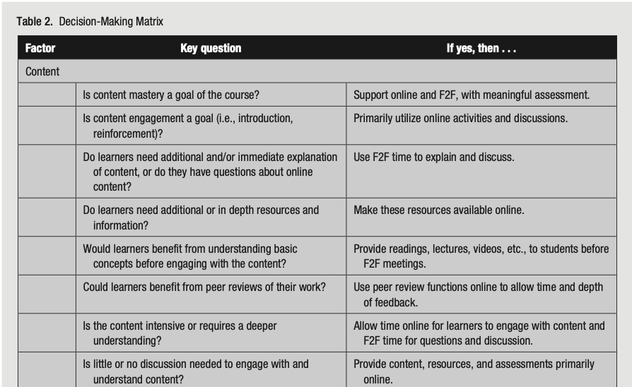
Notes:
Blended Learning
Balancing the Best of Both Worlds for Adult Learner

Slide 13
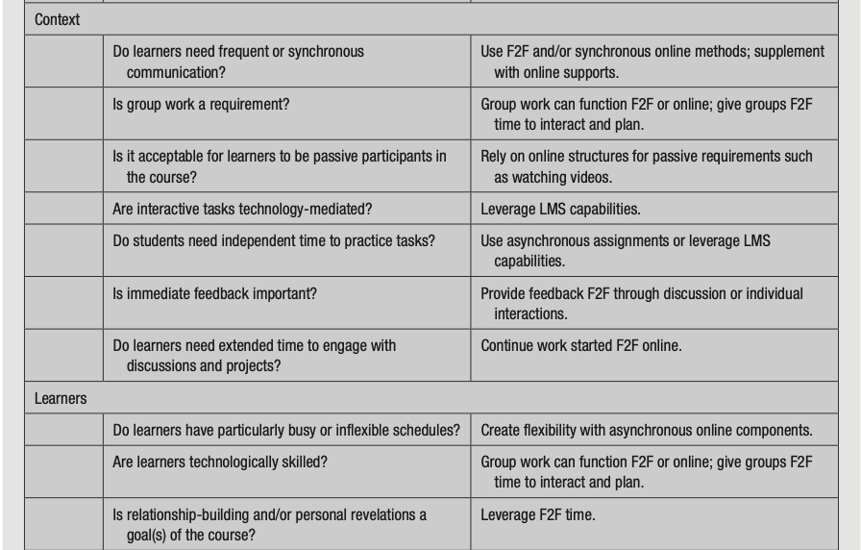
Notes:
Blended Learning
Balancing the Best of Both Worlds for Adult Learner

Slide 14
Getting Started
Explore our Pages on:
Course Design Tips for Online Teaching
Time Management Tips
Learner Resources
To schedule a one-on-one consultation, please visit the Center for Teaching & Learning website.
Notes:
To schedule a one-on-one consultation, please visit the Center for Teaching & Learning website.

Slide 15
Thanks!
CTL@colorado.EDU | Center for Academic Success & Engagement (CASE), E-390 (Third Floor)

