Slide 1
Understanding Your Learners:
Cognitive Load and Learning Transfer
CU Boulder Center for Teaching and Learning
Notes:
Today, we’re diving into the fascinating concept of learning transfer and how it helps us apply knowledge and skills in new contexts

Slide 2
Notes:
"Effective learning transfer starts with understanding cognitive load.
Cognitive load refers to the amount of information our working memory can hold at once.
This graphic in the bottom corner illustrates how our memories process information.
Information enters through our sensory memory, which filters and passes key details to working memory. Working memory can handle about 5-9 chunks of information at a time. With practice and use, this information gets stored in long-term memory as schemas — mental frameworks that help us understand more complex concepts.

Slide 3
Scaffolding Instruction
Notes:
To best support learning transfer, we can scaffold instruction. This means teaching prerequisite skills, like at the base of a pyramid, before introducing more complex topics, like the top of a pyramid, helping learners build upon their own schemas for deeper and lasting understanding.

Slide 4
Power
Load
McClusky’s Theory of Margin
Notes:
"McClusky's Theory of Margin reminds us that a learner's success improves when learners and instructors are focused on balancing their power — the resources they can access — with their load, like the demands placed on them. When power meets or exceeds load, learners are more likely to persevere and succeed."

Slide 5
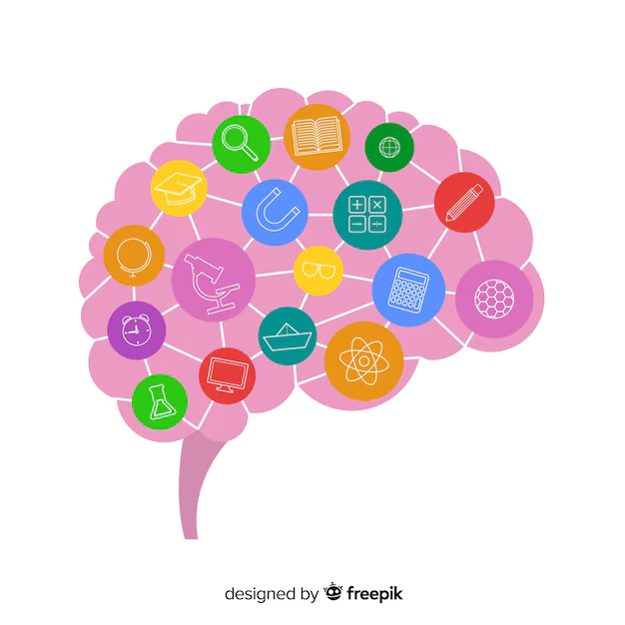
Learning Transfer
Learning transfer is the ability to apply previous knowledge, skills, and strategies to new contexts or situations.
Baldwin and Ford
Notes:
Baldwin and Ford's foundational research highlights three factors influencing learning transfer: 1. learner characteristics like motivation and ability, 2, training design including content and sequencing, and 3. the learning environment, such as support systems and opportunities for practice."

Slide 6
Factors Influencing Learning Transfer
Baldwin and Ford
Learner characteristics, like motivation and ability
Training design including content and sequencing of information
Learning environment, such as support systems and opportunities for practicing skills
Broad and Newstrom
Expanded this model to emphasize additional factors, such as program design, content, and cultural context
Notes:
Broad and Newstrom’s expansions call particular attention to the importance of Culture, which plays a critical role since learning is both social and contextual

Slide 7
Leimbach's Three Learning Transfer Activities (2010)
Learner Readiness: Build motivation and align learning with career goals.
Learning Transfer Design: Use practice, modeling, and goal-setting.
Organizational Alignment: Provide coaching, peer review, and real-world relevance
Notes:
Alongside these thinkers, Leimbach (2010) identified three key activities for learning transfer:
First, learner readiness activities help prepare learners for learning by addressing motivation, practicing skills and integrating knowledge, and aligning their knowledge and skills to their future career goals.
Second, learning transfer design activities include practice and modeling, setting learning goals, and frequent review of applications.
Although Leimbach uses slightly different terminology for the third category, organizational alignment, these activities include coaching/guiding as the instructor’s role, peer review (learner to learner interactions), providing relevancy (to real-world context and jobs), and encouraging a growth mindset.

Slide 8
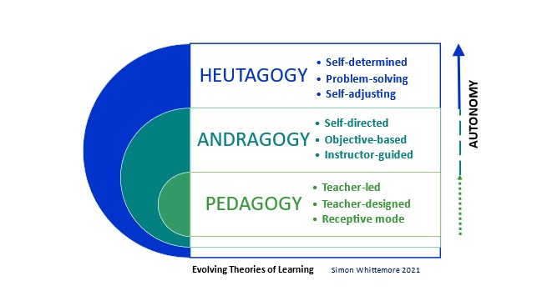
Pedagogy, Andragogy, and Heutagogy Spectrum
Figure 1. Pedagogy to Heutagogy spectrum. Adapted from “The Difference Among Pedagogy, Andragogy and Heutagogy,” by David Edward Marcinko, 2022, Medical Executive Post. https://medicalexecutivepost.com/2022/02/25/the-difference-between-pedagogy-andragogy-and-heutagogy/.
Notes:
Teaching today’s learners requires different approaches depending on their developmental level.
Pedagogy (define) focuses on younger learners, emphasizing developmental stages like Piaget's Cognitive Development and psychological theories such as Behaviorism and Cognitivism.
Andragogy, the science of teaching adults, emphasizes relevancy, self-direction, and practical application, as noted by Malcolm Knowles (1980).
Finally, heutagogy centers on self-managed learning where learners determine their own questions and problems to explore.

Slide 9
Leimbach's Suggested Questions for Course Design
Are learners ready for the content?
How will goal-setting and practice be incorporated?
Will learners have support after the course ends?
Is the learning environment culturally supportive?
Notes:
The key to successful learning transfer is to begin with these ideas in mind during the instructional design process. Leimbach provides the following questions to consider:
How do we know that learners are ready for the learning event, and what is the best way to prepare them to learn and use the skills?
How is goal setting included within the learning process?
What forms of practice and modeling are best for this course content and learners?
What kinds of learning review and application support are needed to encourage the skills that will be used after the learning in the course is completed?
What is the best way to align the course to support the use of the skills learned?
Are instructors prepared to coach and support the application of learning?
Will the course culture support the use of learning, or will it be a barrier? If the latter, how can the culture be altered?

Slide 10
Thank you!
Email: CTL@Colorado.EDU
Center for Academic Success & Engagement (CASE), E-390 (Third Floor)
Notes:
By keeping these strategies in mind, we can create effective learning experiences where knowledge truly transfers into real-world success.
Thank you so much for watching. This brief overview is only scratching the surface of available resources and suggestions for engaging with cognitive load and learning transfer across pedagogy, andragogy, and heutagogy. Please reach out to the CTL team with any questions, comments, or concerns. The CTL has tons of accessible resources, including one on one teaching consultations, frequent workshops, and recommendations for further reading/learning. We would love to hear from you!

