Slide 1
Understanding Your Learners
CU Boulder Center for Teaching & Learning

Slide 2
Millennials range from ages 28 to 42, while Gen Z includes ages 11-27
Notes:
You may be asking yourself why does this matter to me as an instructor. We can learn quite a bit about the learners that we work with and how best to prepare and design our instruction based on what we know about learners within generations while also being cautious as to not to overgeneralize or stereotype our learners

Slide 3
Generational Impacts on Learners
Trends displayed by Millennial and Gen Z learners:
Often raised with some degree of reliance on technology
Can often feel disconnected, unsupported, and directionless due to socio-political and environmental factors, alongside the Covid-19 pandemic
Can be entering the learning environment with significant mental health concerns, financial concerns, and accessibility-related concerns
How can these characteristics inform course preparation, course design, and ensuring we are meeting student needs?
Notes:
while society has generalized that they tend to seek immediate gratification, often feel entitled, rely on social media, have a consumerism outlook, and have short-term goals, they can be extremely creative and resourceful problem-solvers. They are actively engaged in movements and political events.

Slide 4
Cultivating Belonging
We need to nurture not only the cognitive and physical dimensions, but also tend to their emotional, social, and ethical growth to develop their whole person while on their educational journey
By acknowledging these trends in characteristics, we can better approach educating holistically
Notes:
Our responsibility in higher education includes cultivating a sense of belonging to the campus community, faculty, other learners, and the field/discipline they are studying.

Slide 5
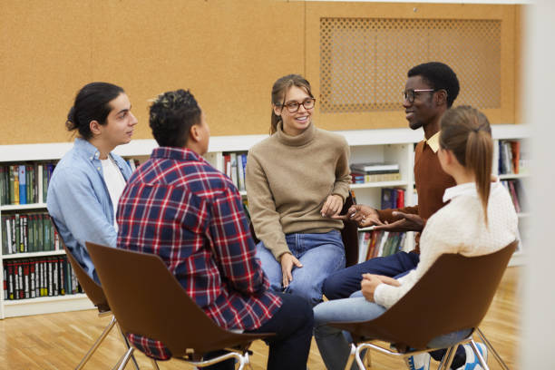
Communication
Both Millennial and Gen Z students represent diverse populations, though all students can benefit from developing cross-cultural communication skills through interacting with other students who are different than themselves
Notes:
Millennials (often represented as non-traditional college-aged, or adult learners) and Gen Z (often traditional college-aged undergraduates, and possible graduate students) represent extremely diverse populations on campus. Although they bring in diversity, they need help developing cross-cultural communication skills; that is, interacting with people that have different values, beliefs, cultural backgrounds, identities, priorities, and expectations. Bridging the divide between students and fostering communication skills is crucial.

Slide 6
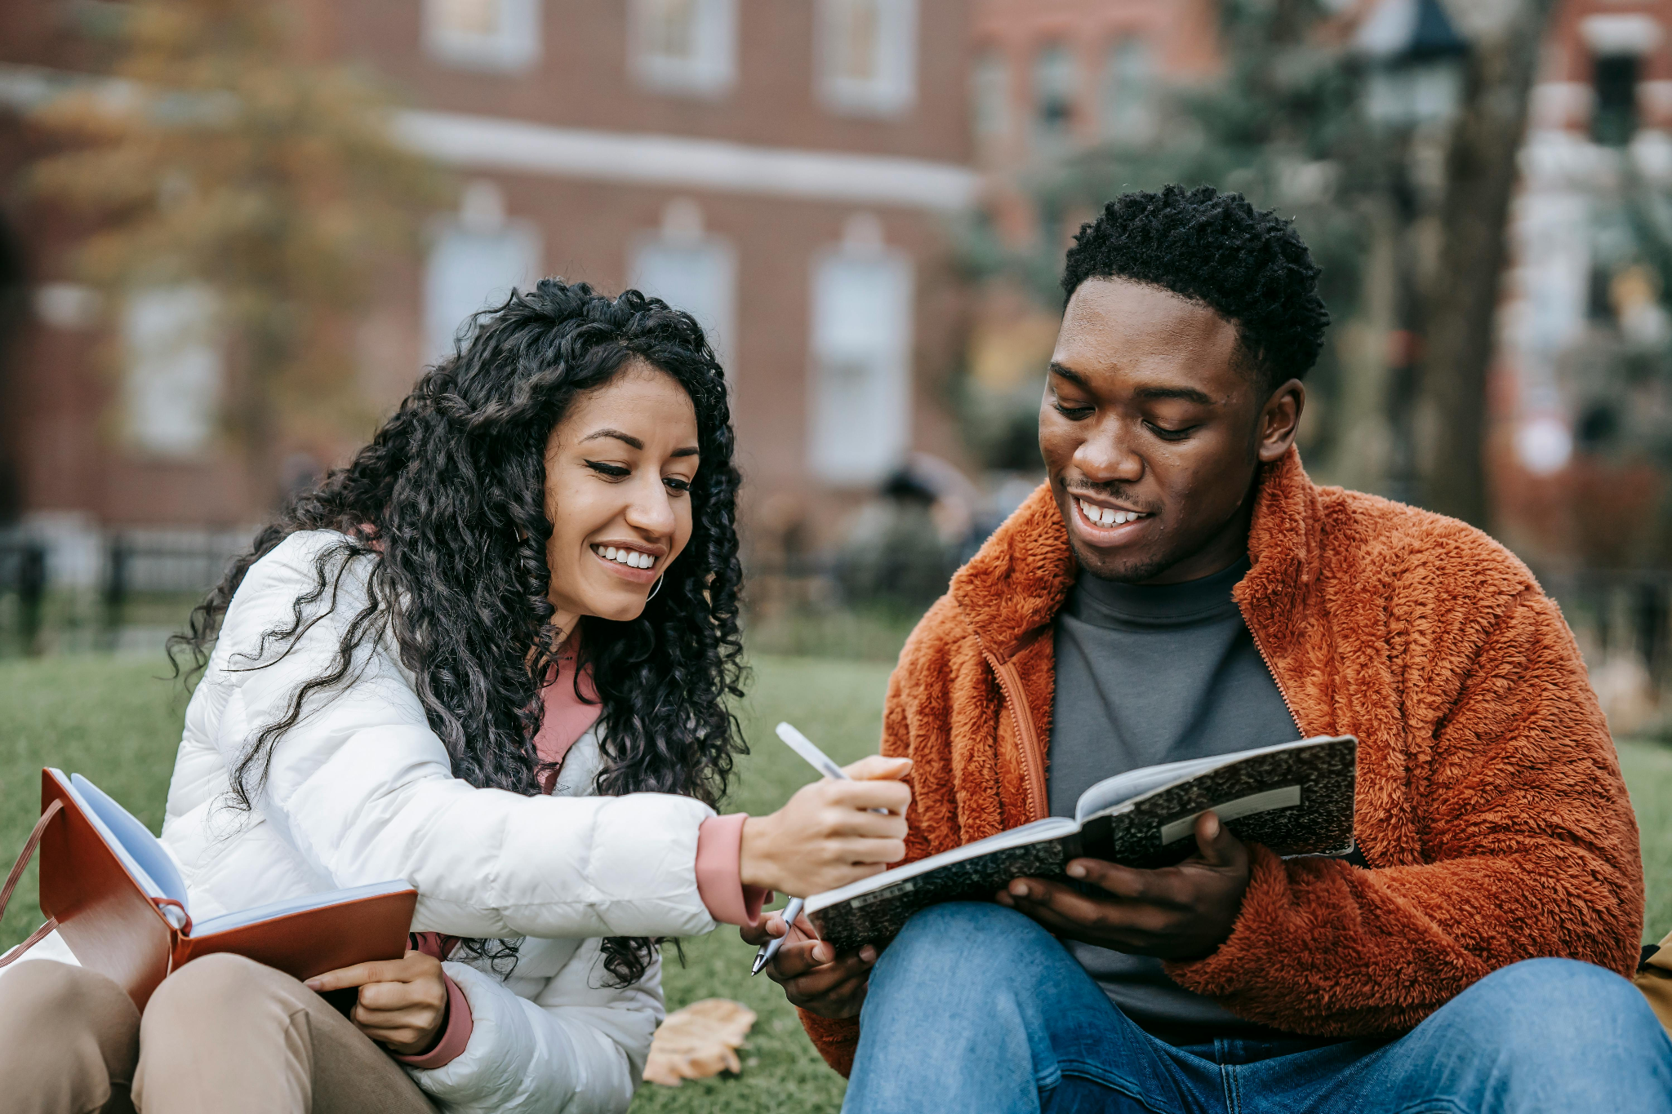
What do today’s learners want?
Relevancy of application
Guidance with options
Opportunities to learn with technology
Active learning techniques
Notes:
Today’s learners want relevancy of application, guidance with options and choice, opportunities to learn with technology that is appropriate and meaningful to the task and build digital skills, along with active learning techniques to learn the material that is being explored.
They also want to connect with others and need opportunities in multiple ways to do so that offsets any social anxiety challenges that learners may be experiencing.
They need clear expectations and instructions on how to get to desired goals.
They want acknowledgement of their identities and voices.

Slide 7
Community Building
Holistic, inclusive, and community-based learning experiences can help guide today’s learners through the learning process.
Notes:
Encouraging learner’s unique voices and experiences will help them to feel seen and heard.
Overall, _________________________-closing thoughts-______________________

Slide 8
Thank you!
Please contact the Center for Teaching & Learning with any questions at CTL@Colorado.edu

