Slide 1
Welcome!

Slide 2


EONS Challenge
COSGC’s Newest Design Challenge!
Kickoff meeting Fall 2025

Slide 3
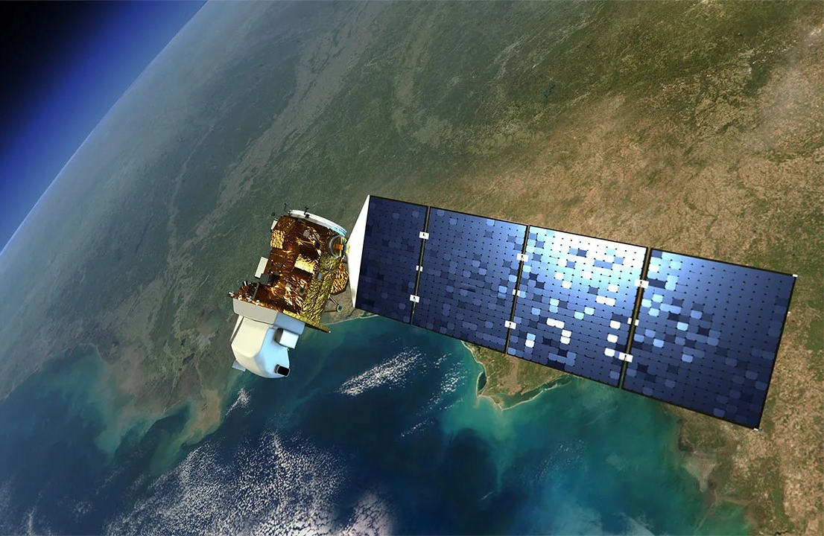
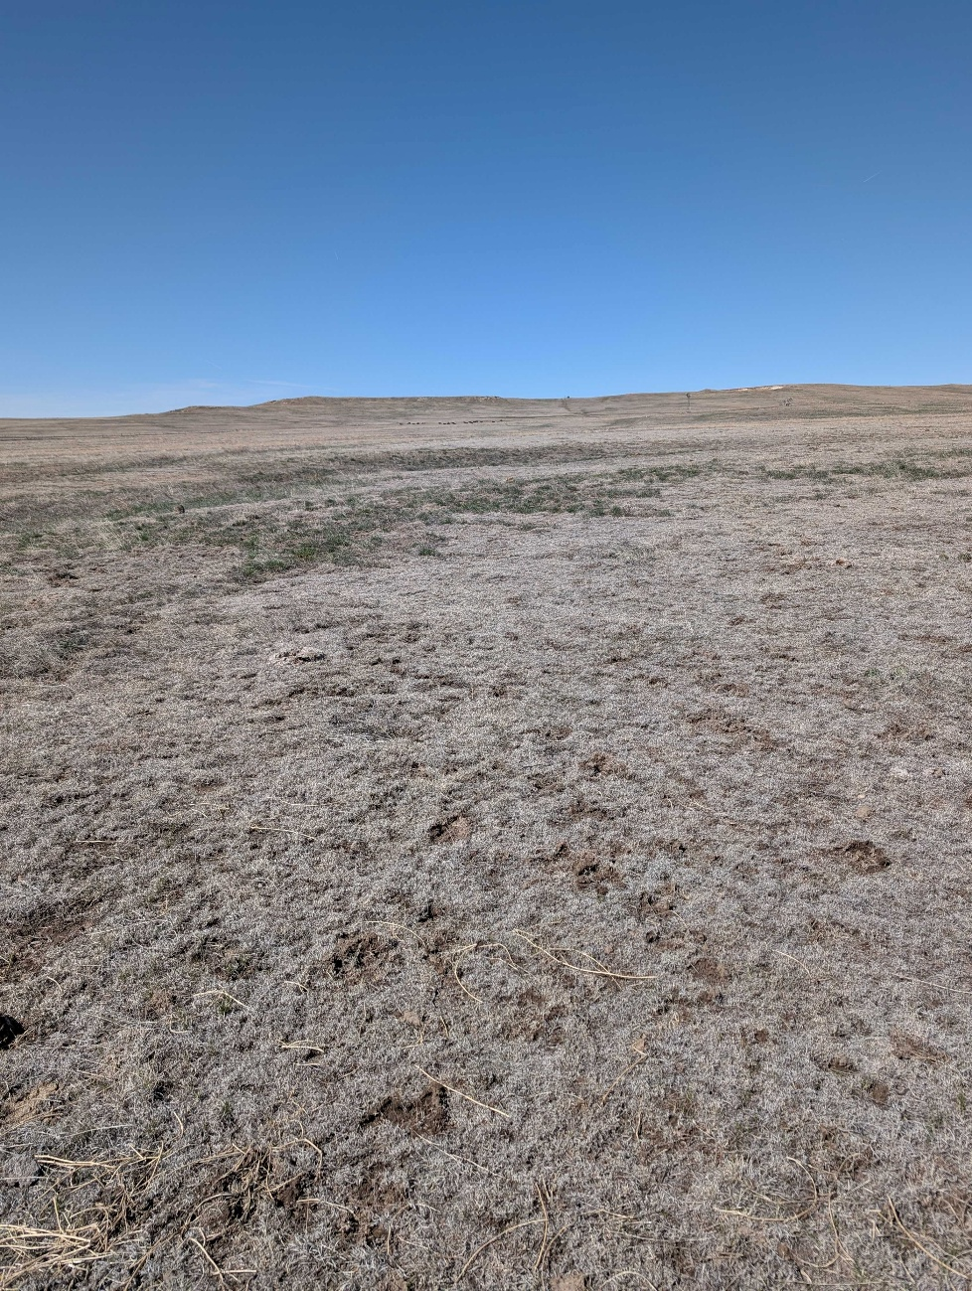
EONS Challenge
Earth Observation Network Science Challenge

Slide 4
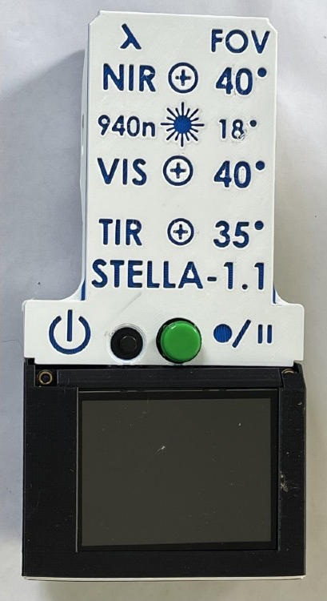
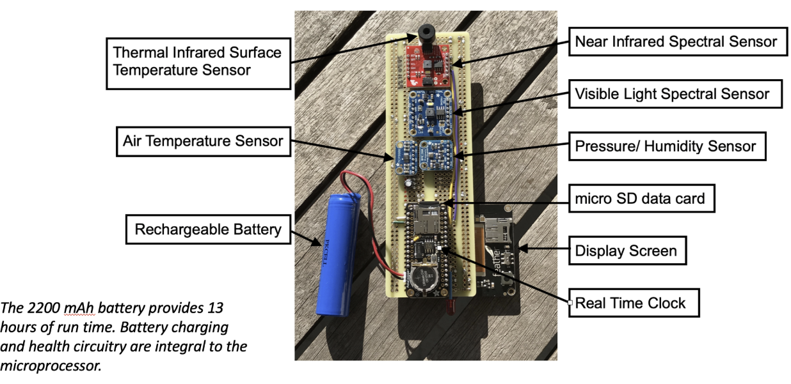
STELLA 1.1
What does it do?

Slide 5


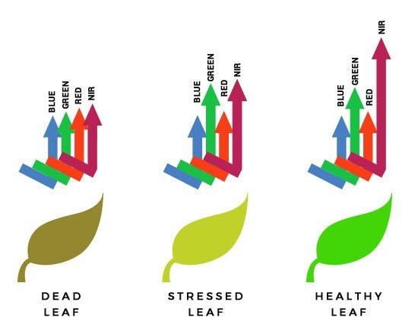
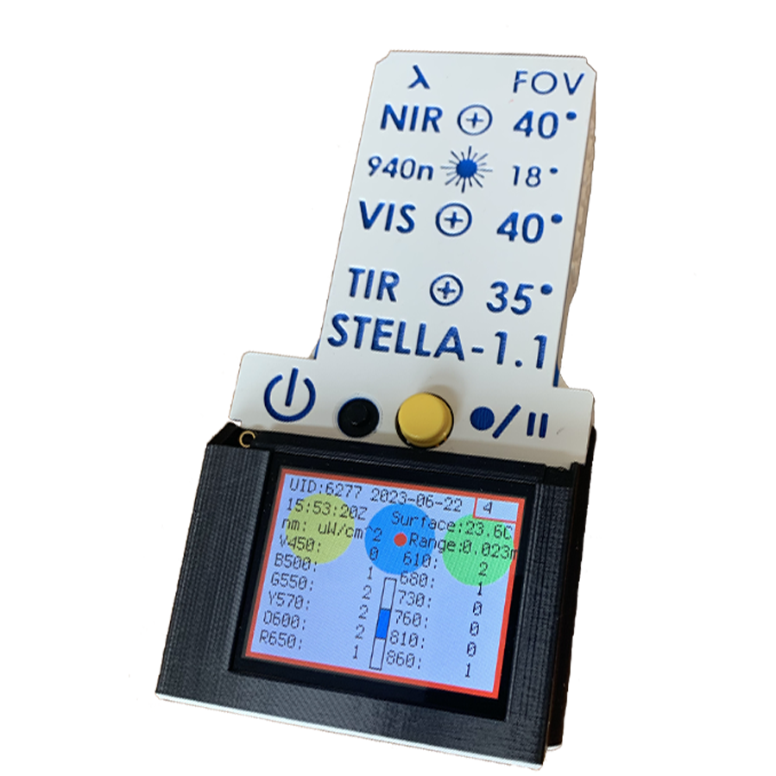
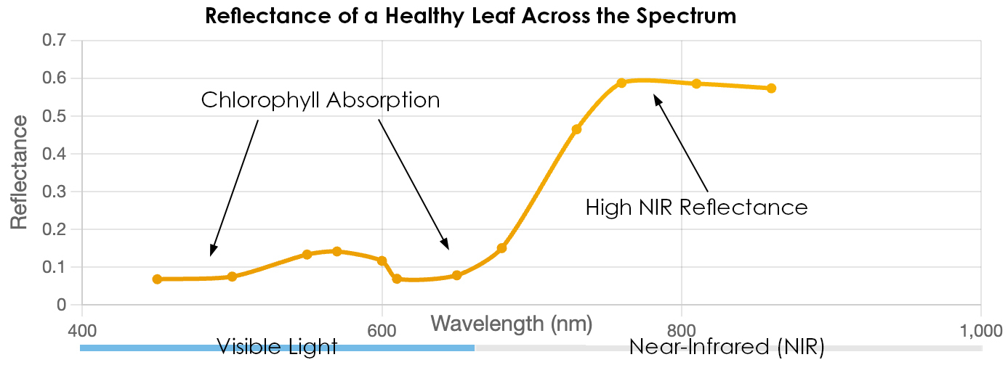
STELLA 1.1
Features:
  Near Infrared Light Sensor
  Visible Light Sensor
  Ambient Air Temperature Sensor
  Surface Temperature Sensor
  Pressure Sensor
Measures wavelengths of light in the visible and near infrared (NIR) spectrum
A healthy plant will reflect more light across the Near-Infrared Light Spectrum

Slide 6
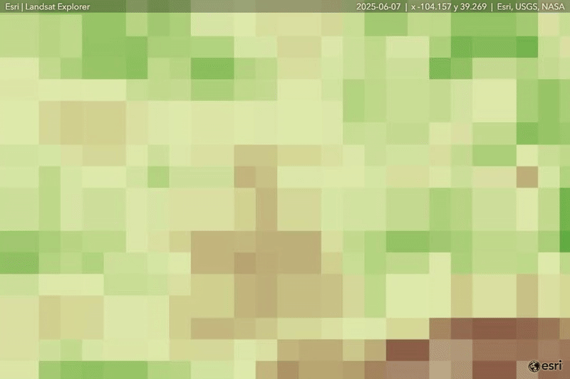
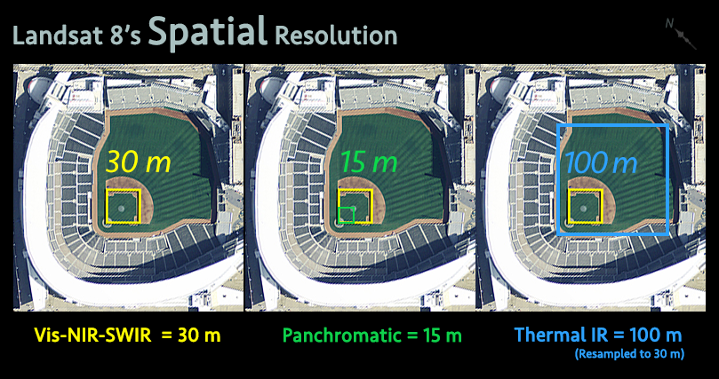
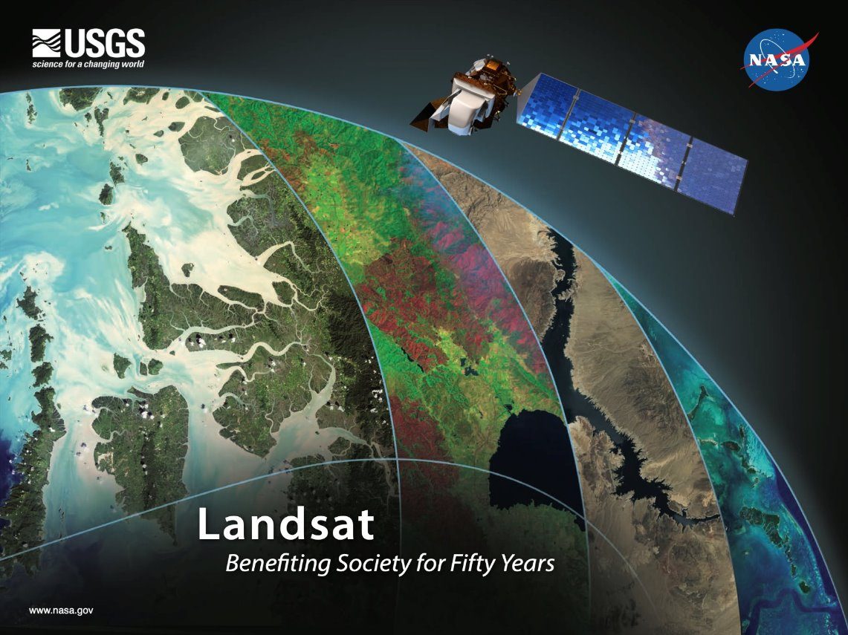
Landsat Imagery and STELLA
Comparing microscale readings to macroscale spectroscopy
STELLA – point measurements
Notes:
Sparrow

Slide 7
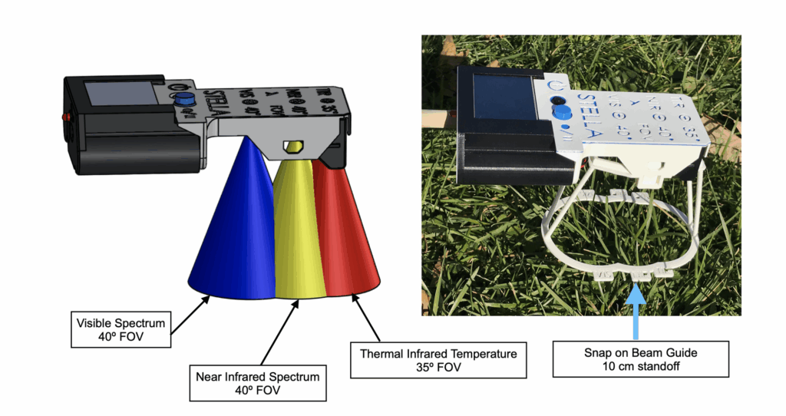
STELLA field of view

Slide 8
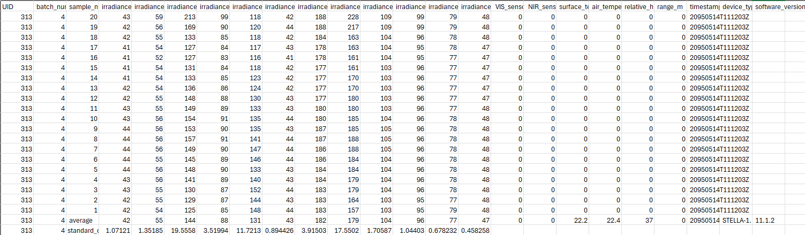
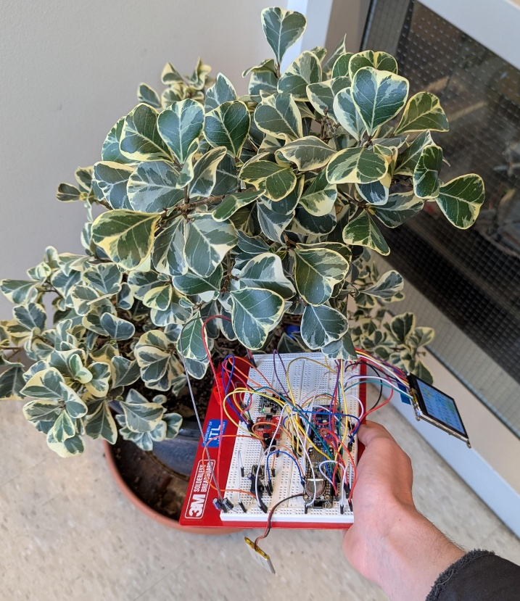
DATA EXAMPLES
Higher green and Orange (compared to nearby columns) indicate healthy vegetation.
Data being taken on potted plant
Blue | Cyan | Green | Yellow | Orange | Red | Orange | 680 | 730 | 760 | 810 | 860
UID: 312
Batch Number: 4
Timestamp: 2025/04/23
Device Type (temp): 22.2
Device Type (light): 37
Notes:
Here is an example of our device being used. Even without being tuned we can see data being organized on an exel sheet. Relevant wavelengths have been highlighted, and it can already be seen that relevant wavelengths are higher than other wavelengths

Slide 9
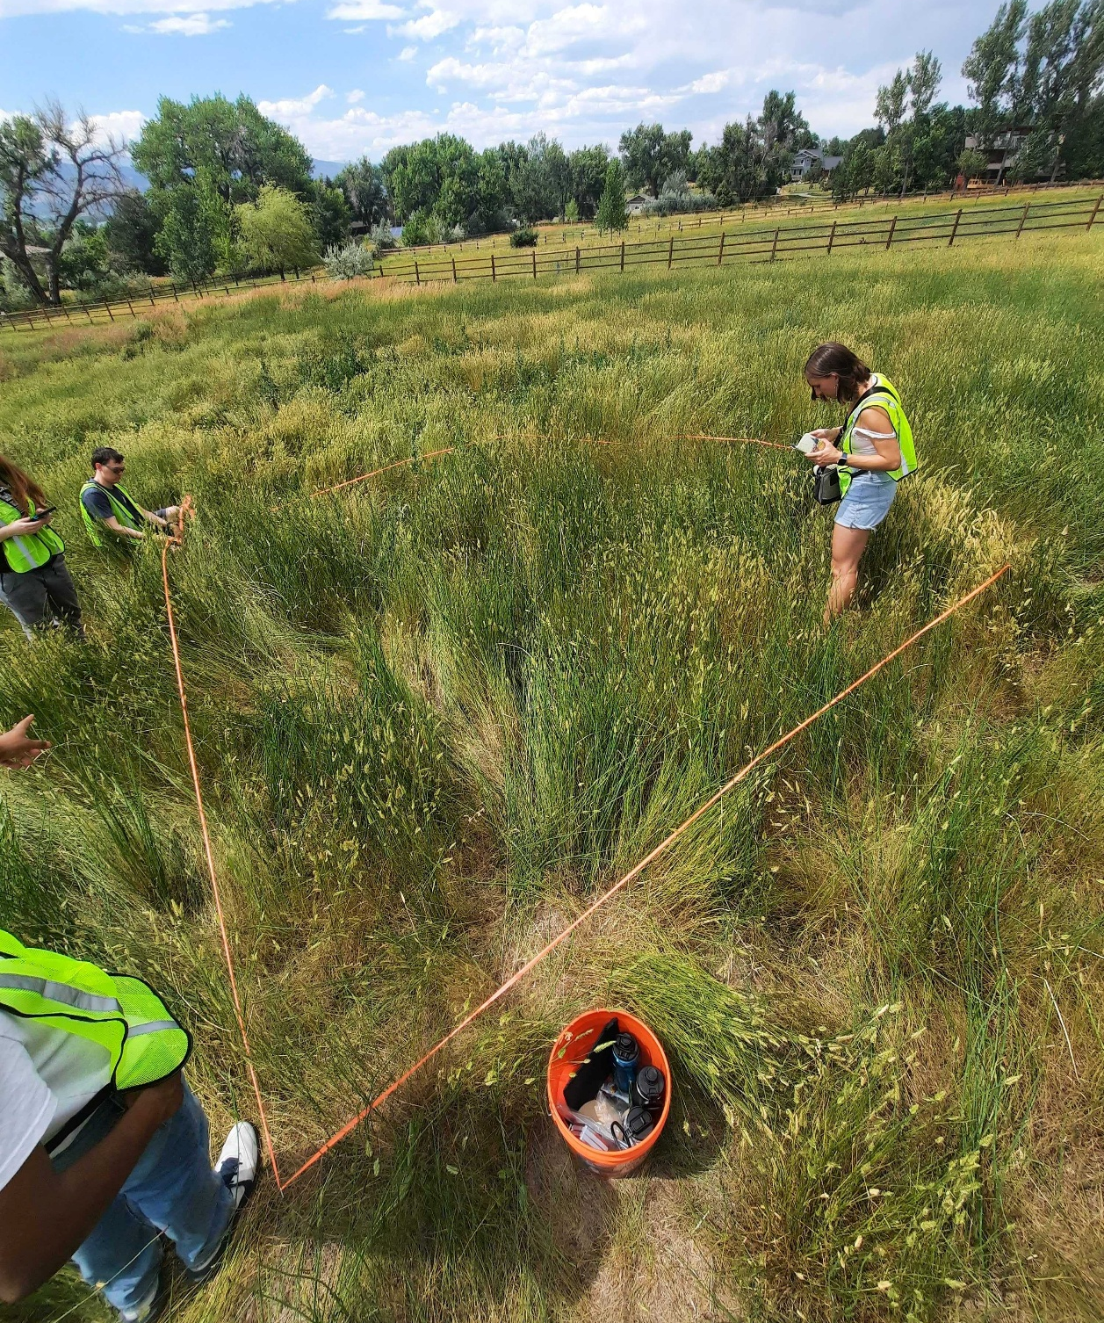
EONS Challenge
Step 1: Build a STELLA 1.1
Step 2: Practice calibrating and using the STELLA
Step 3: Develop a research question
Step 4: Develop a data acquisition plan
Step 5: Collect data and analyze
Step 6: Write up results and create video
Step 7: Present work at COSGC Symposium

Slide 10
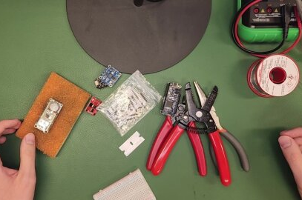
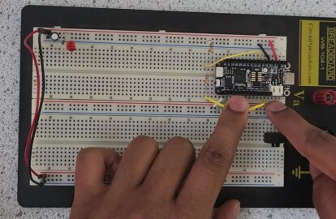
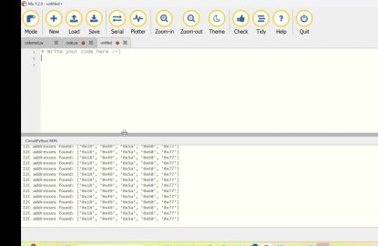
Tutorial Videos
5 Videos totaling ~70 min in length have been created that go through the process of building a STELLA 1.1
Hosted on the Colorado Space Grant Website
Augment the pdf instructions available from NASA

Slide 11
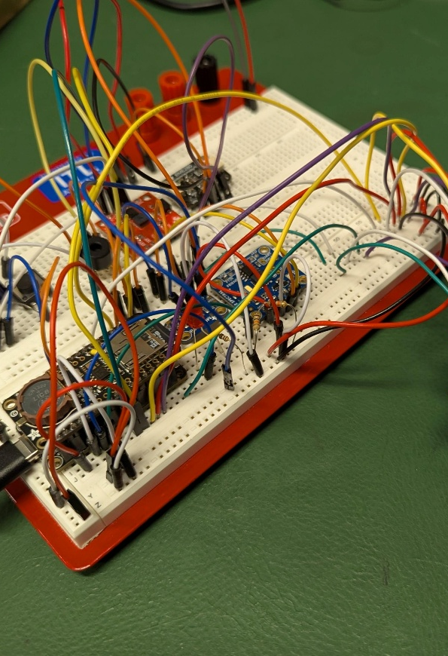
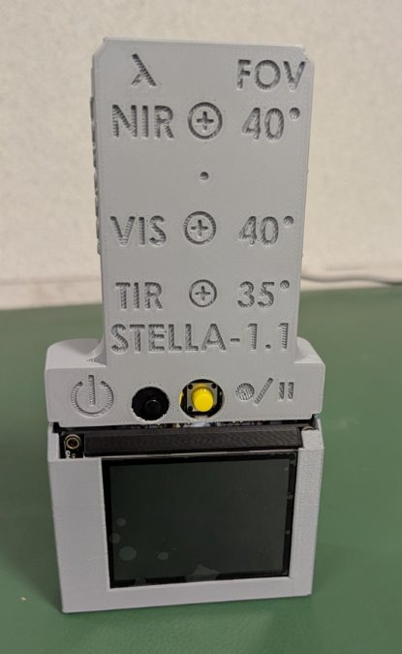
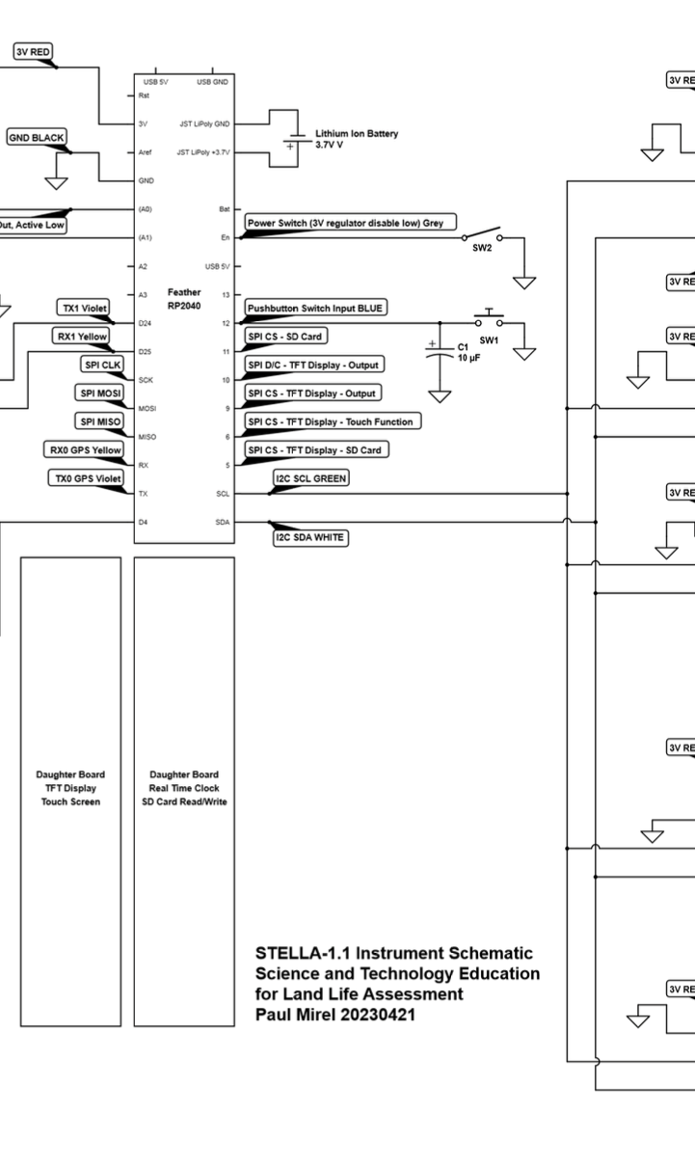
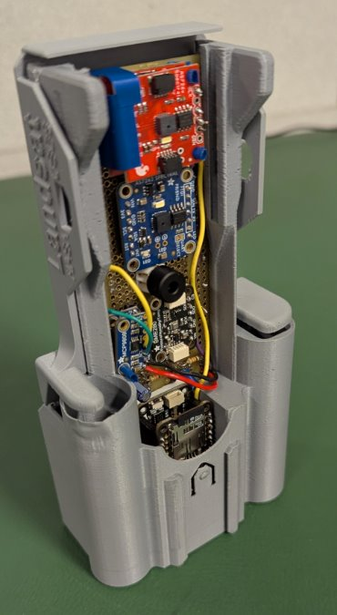
Design Progression

Slide 12
COSGC Support
Team sign up
Design review schedule
  More focus on project and research design
  Technical support
Symposium presentation in April
Videos highlighted on Social Media

Slide 13
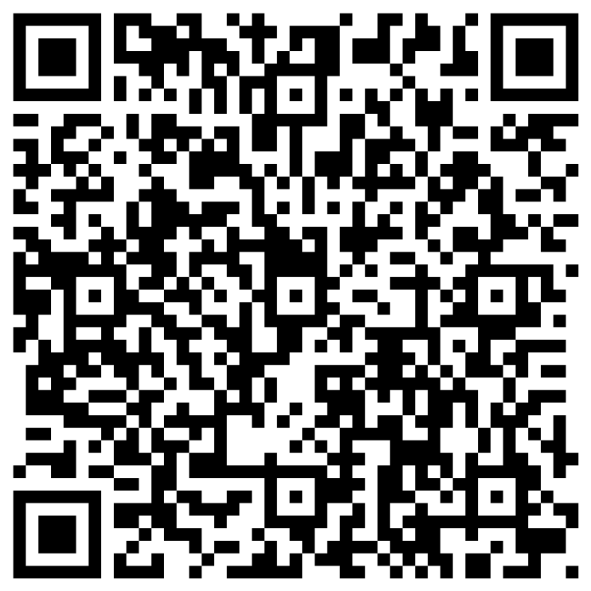
Connect with Us!
Register a Team
NASA STELLA resources
https://science.gsfc.nasa.gov/stella/instruments/spectral/stella-1-1/

Slide 14
Questions?

