Slide 1
Welcome!

Slide 2
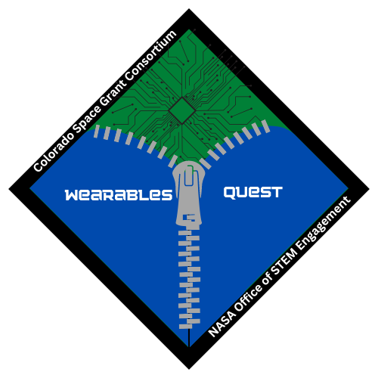


Wearables Quest
Kickoff Meeting Fall 2025

Slide 3
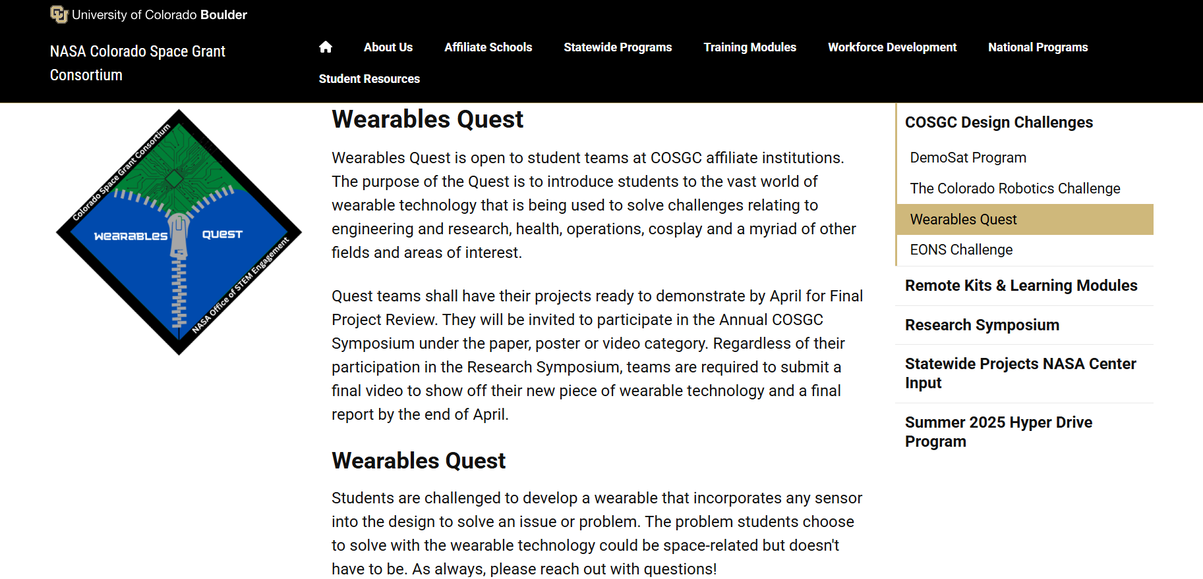
COSGC Website Resources
LINK

Slide 4
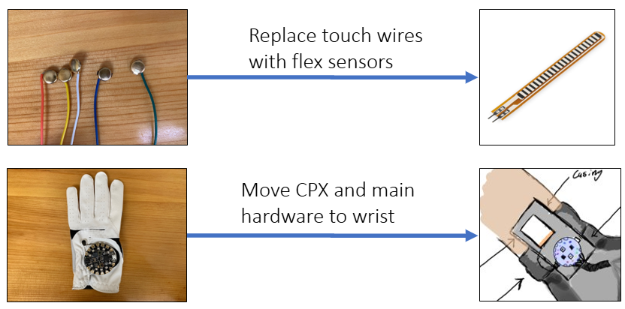
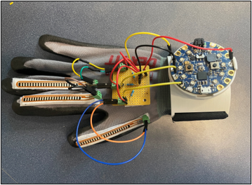
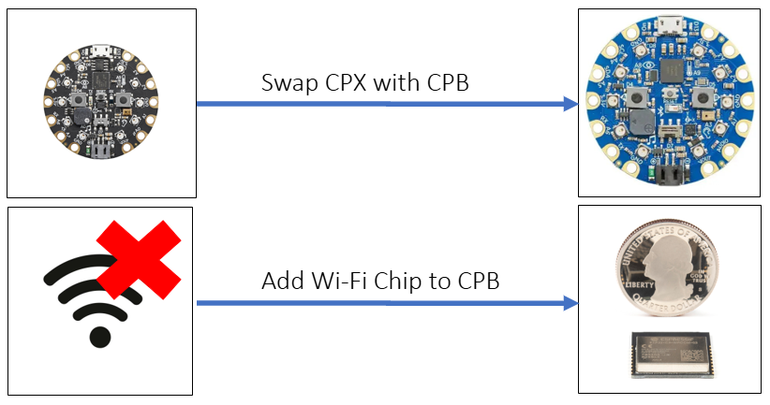
Wearables Workshop
Upgraded design
Updated modules
Videos with captions
Kit Components
From COSGC
OR
Order using Bill of Materials

Slide 5
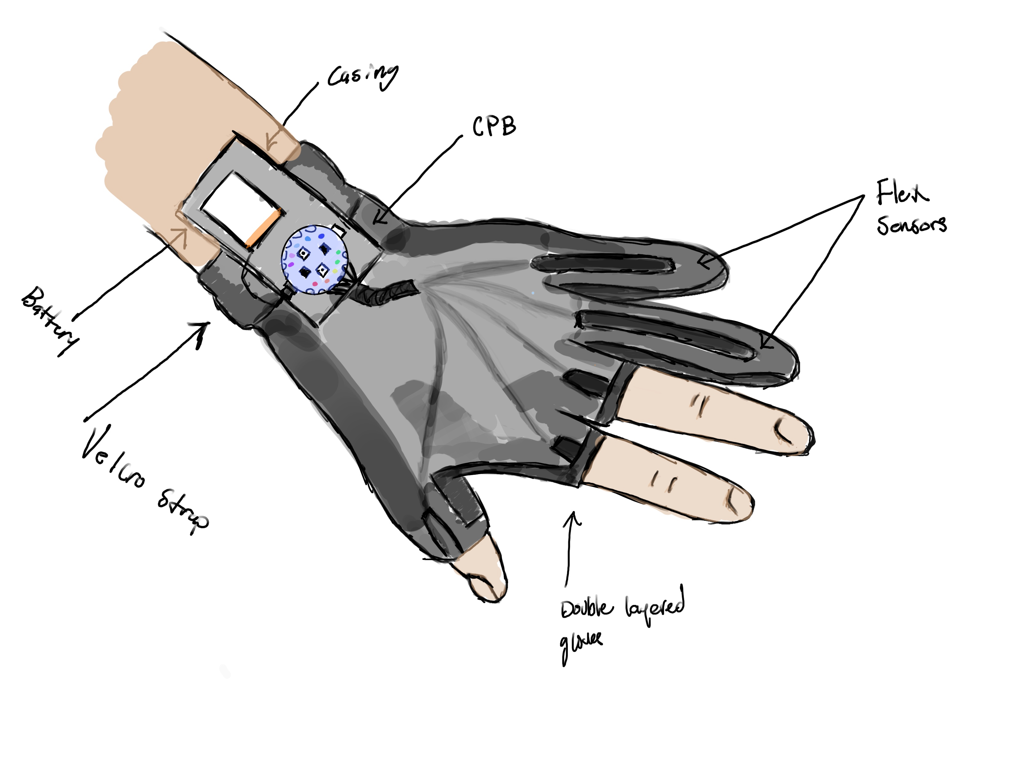
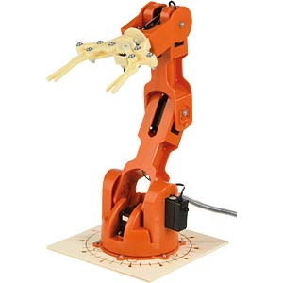
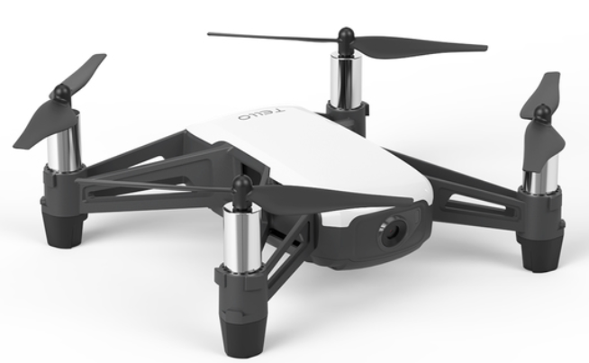
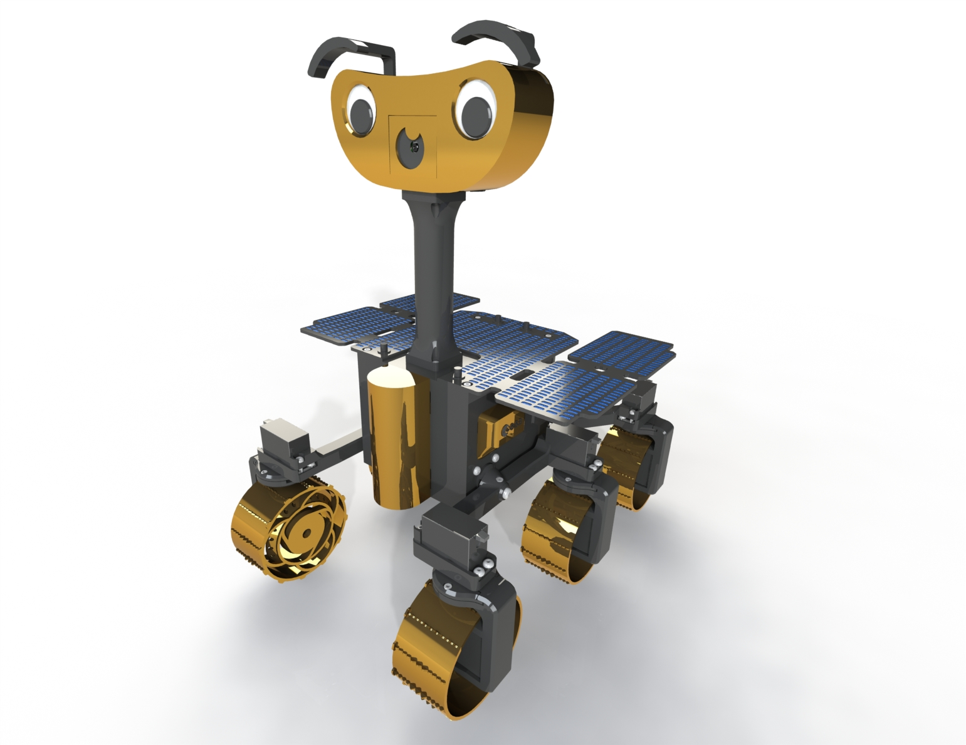
Wearable Capabilities
Cross planform wireless communication
Wi-Fi/Bluetooth Rover
Bluetooth Arm
Wi-Fi Drone

Slide 6
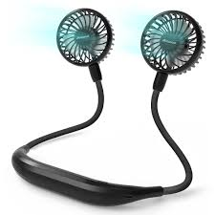
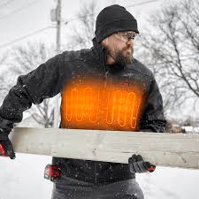
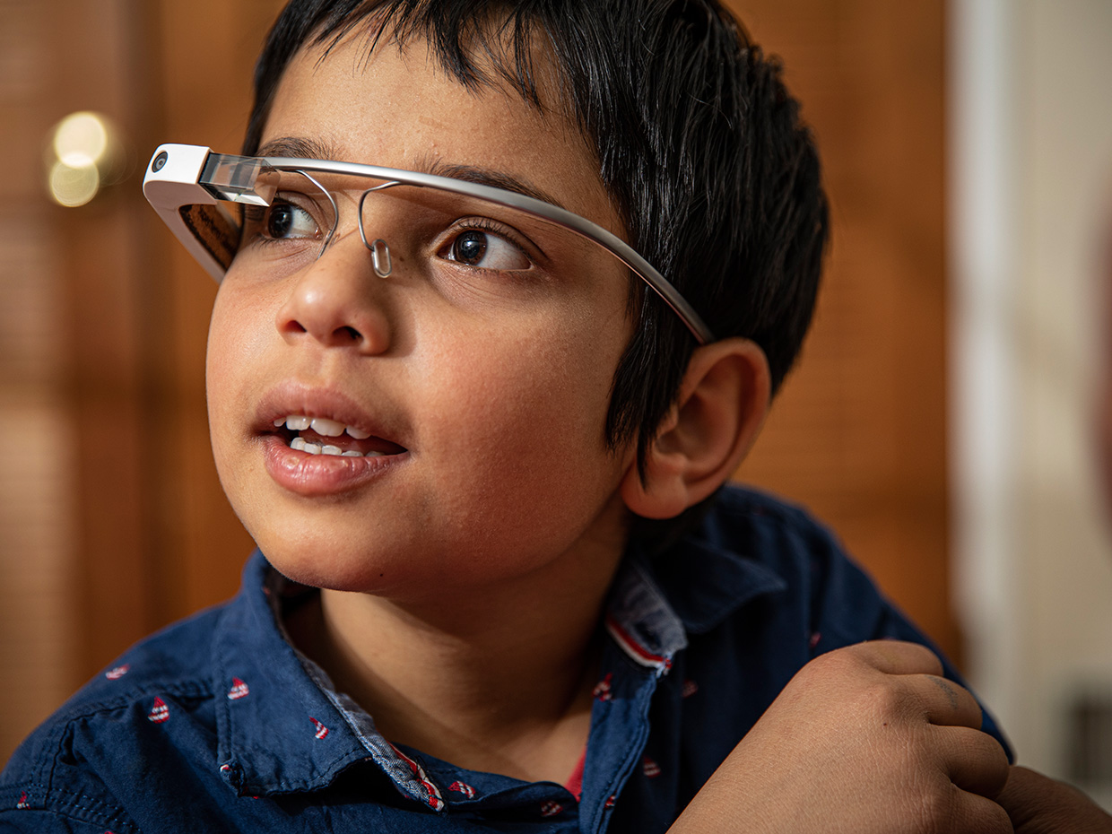
Options:
Specific research question to answer
Specific problem to solve
Does not have to be space related
Deliverables:
Design Reviews: CoDR, PDR, CDR, FPR
5-minute video
What it is it?
What research question does it answer or problem does it solve?
How does it work?
Symposium Participation
Wearable
Technology
Projects

Slide 7
Tentative Schedule
Due: Early April
CoDR
Oct 20-23
Jan 19-22
PDR: Early February
CDR: Early March
FPR: Early April
Symposium Abstract

Slide 8
Symposium
Date: April 25th
Must submit abstract for video
Encouraged to also submit Poster or a Paper to present
*Any level of success is valuable

Slide 9
Project Ideas?
Questions?

