Slide 1
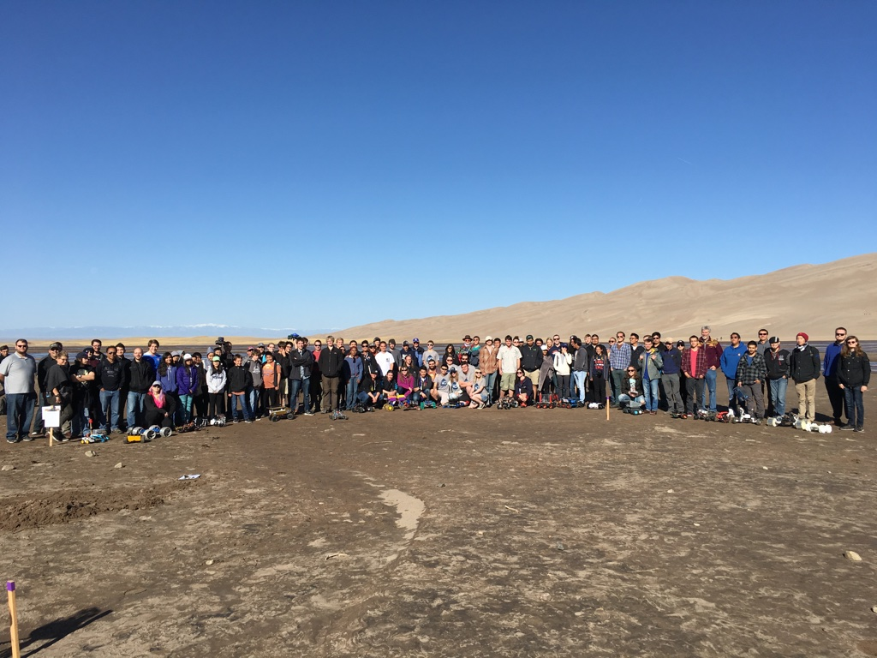
COSGC Robotics Challenge 25-26

Slide 2


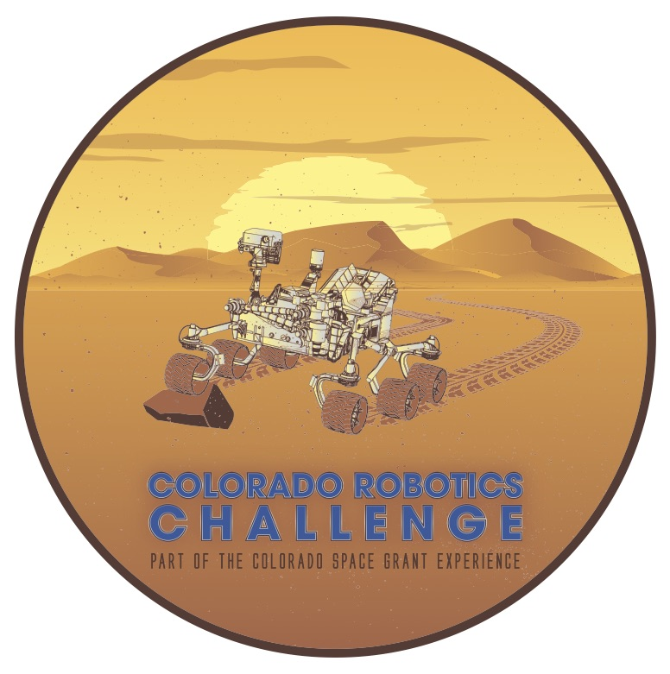
Part of the Colorado Space Grant Consortium Experience
A statewide design challenge to provide students with hands-on experiences to develop engineering and science skills using the excitement of NASA. Great way to share and connect with other students from affiliate and partner institutions around Colorado.

Slide 3
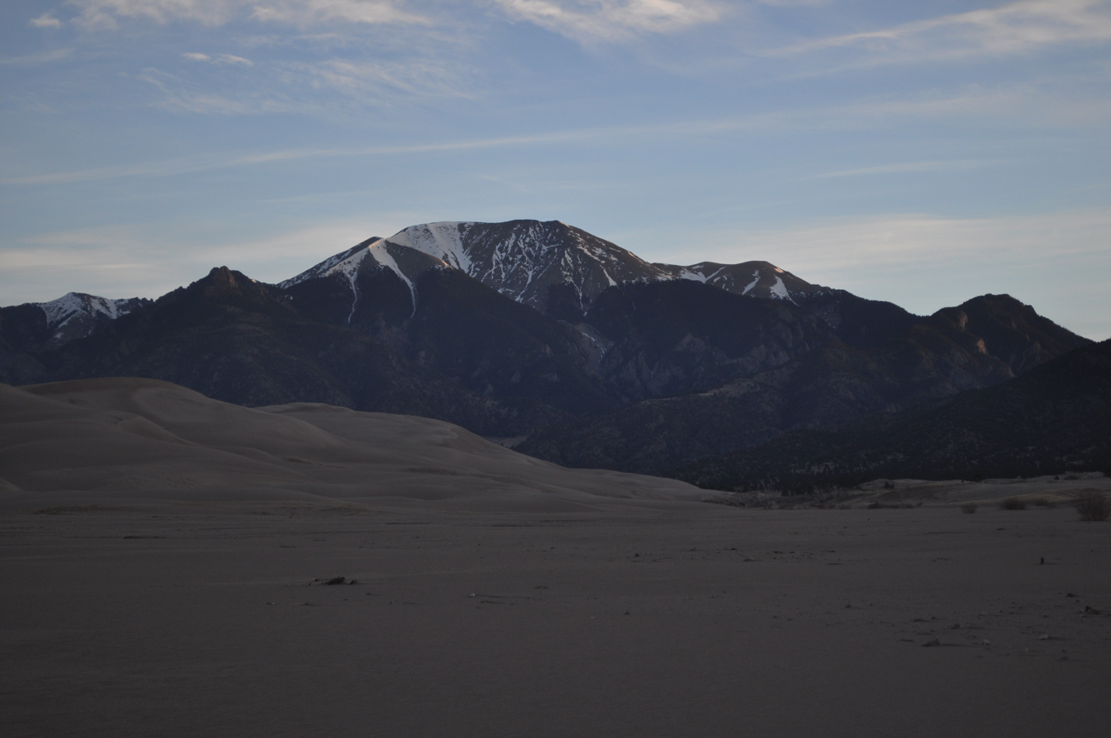
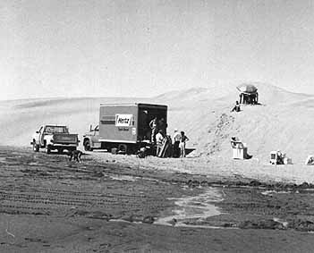
Location: Great Sand Dunes National Park
Inspired by the Viking Mars Lander missions of the 1970’s. Hardware for Mars was tested on the Dunes. Rental vans carried the hardware there from near Denver.

Slide 4
Robotics Challenge
Student Teams design a rover to navigate a series of increasingly difficult courses at the Dunes.
Challenge Design Categories
Team Recognitions

Slide 5
Resources
Online workshop tutorials
New videos
Practice robotics kits
Parts list
Kit ordering available soon
Live design reviews with staff

Slide 6
Challenge Basic Rules
Mass: Between 1 - 5 kg
Inexpensive: About $500 for final unit
Not harmful to the environment
No flying entries for safety
No GPS navigation to simulate the Mars environment.
The “is it about a cat” rule for size and mass.
Fun Team Recognition for unique and creative functioning designs.

Slide 7
Challenge Basic Rules
Several levels of success to engage all levels of students and inform build cycle
LEVEL 1: BASIC MOTION
Forward movement-direct line from start to finish
Navigation: Basic capability
LEVEL 2: GETTING SMARTER
Obstacle avoidance: recognize obstacles and get around them (things on top of the sand, or holes in the ground).
Navigation: Obstacle avoidance
LEVEL 3: CREATIVITY
Navigation: Advanced Autonomy
Choose your own challenge! See recognition categories

Slide 8
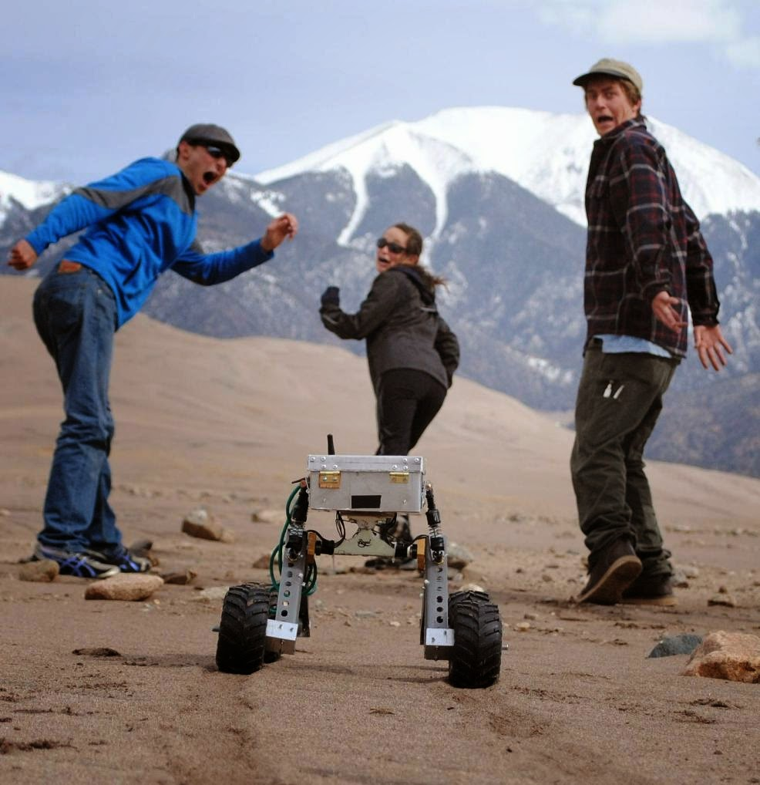
Robotics Challenge Overview
Several courses focusing on different levels of functionality.
Great way to engage new students from any experience level.
No team to team competition.

Slide 9
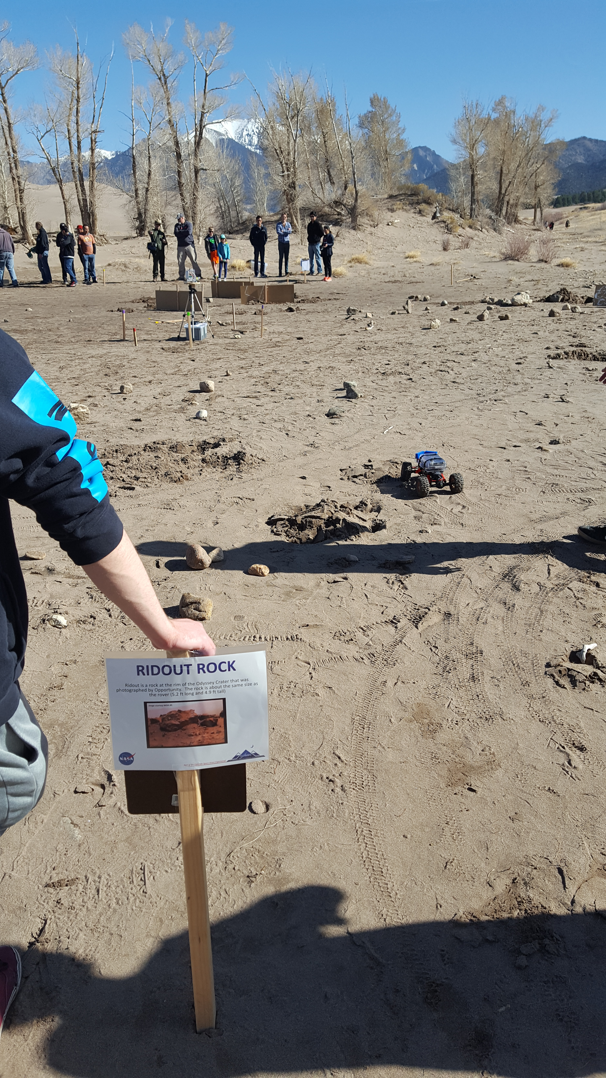
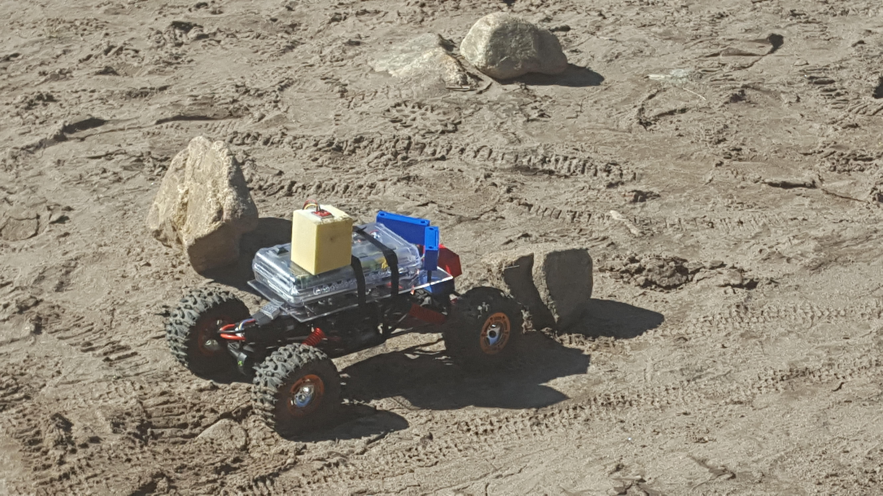
Team Design Recognition
The goals are to encourage development in these areas:
Motion
Navigation
Obstacle Avoidance
Advanced Automation/Autonomy

Slide 10
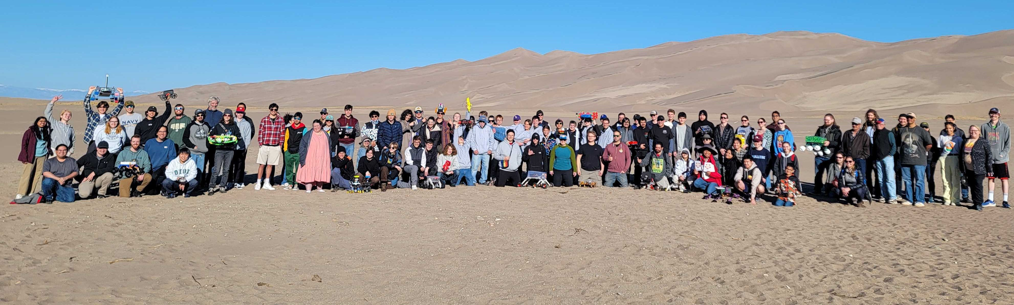
Challenge recognition categories
Best Overall < 1.5kg
Best Overall > 1.5kg
Mars Sojourner Award
Mars Spirit Award
Mars Opportunity Award
Outstanding Navigation
Creative Locomotion
Best Bioinspired Design
Best Advanced Autonomy
Attention to Detail

Slide 11
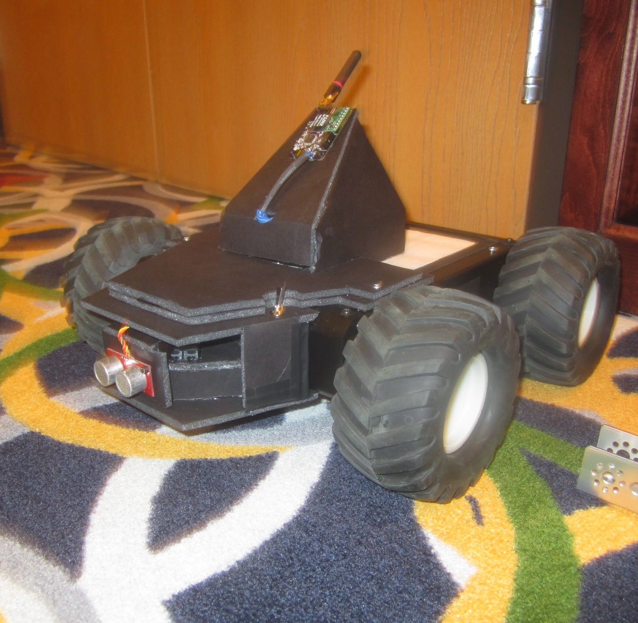
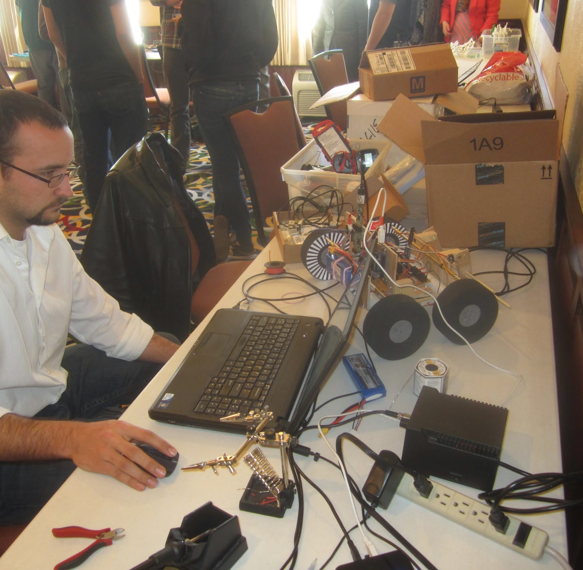
Night Before – System Checkout in Alamosa and sharing what works
Some teams use simple materials
Others have high level of complexity

Slide 12
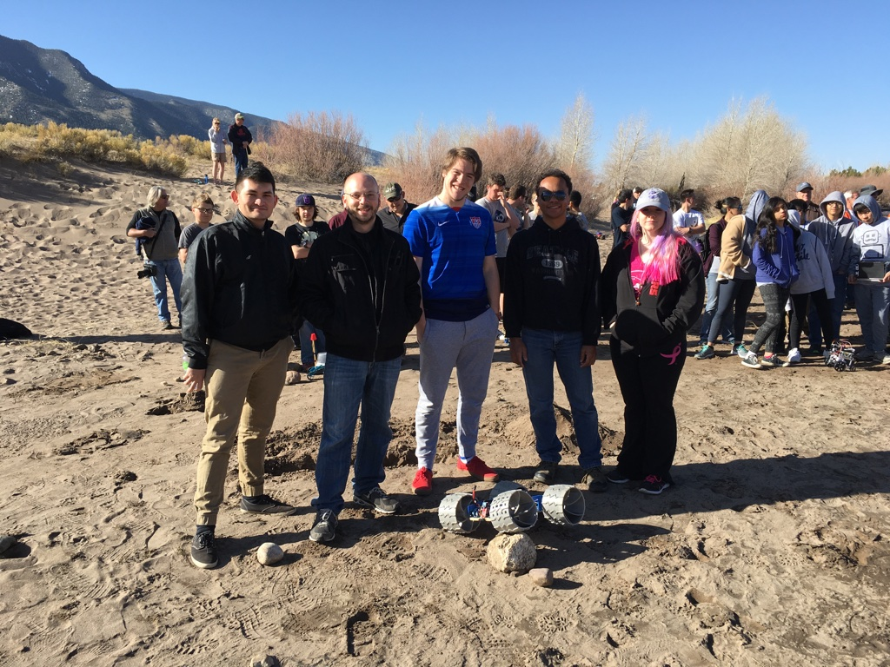
The Morning of the Event ~150 people participate in addition to the spectators

Slide 13
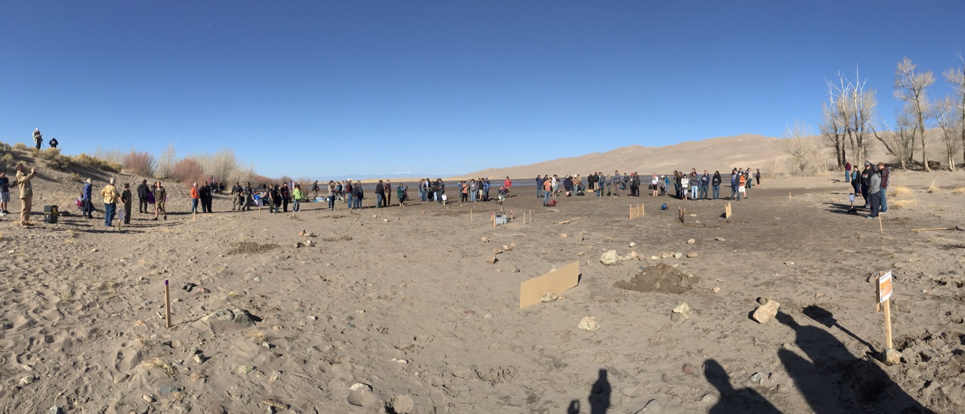
Course arena
There may be soft sand, hard pack sand, 1-2 ft deep ridges and large boulders. The course designs are not published in advance so have a good mechanical and intelligent robot system that can adapt to varying challenges. Be ready to reprogram your robot and make mechanical adjustment.

Slide 14
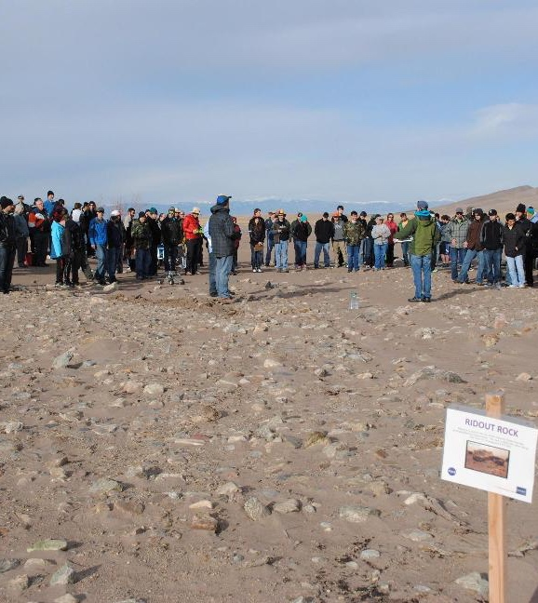
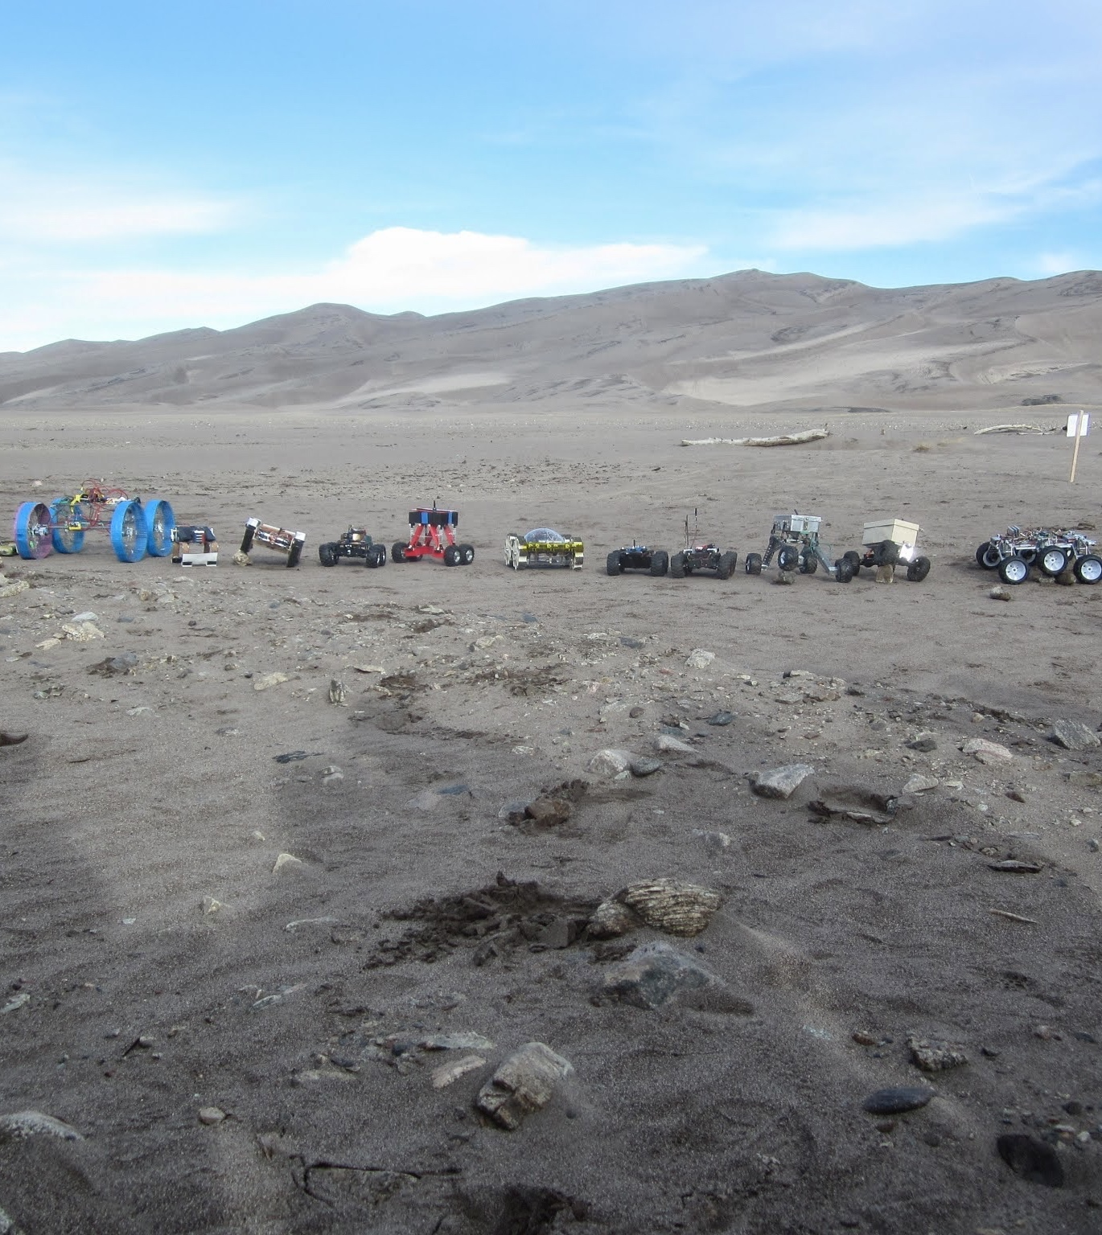
The Courses – Mars like terrain
Each robot will navigate just like NASA’s robots on Mars through the closest analog we have on Earth, the Dunes.

Slide 15
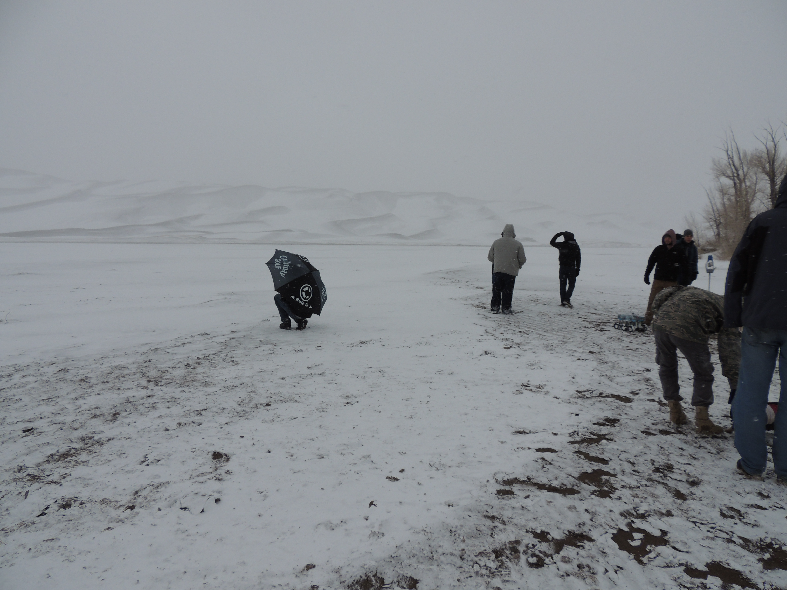
Course arena conditions
Be ready for anything!

Slide 16
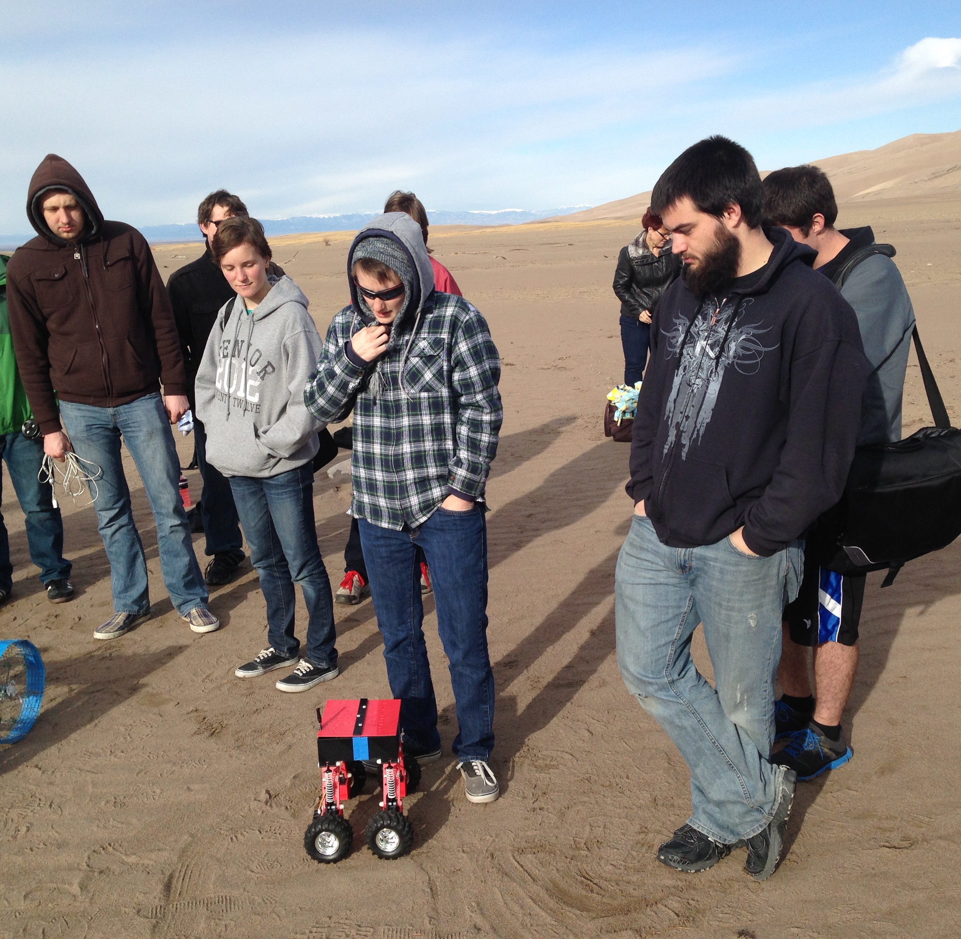
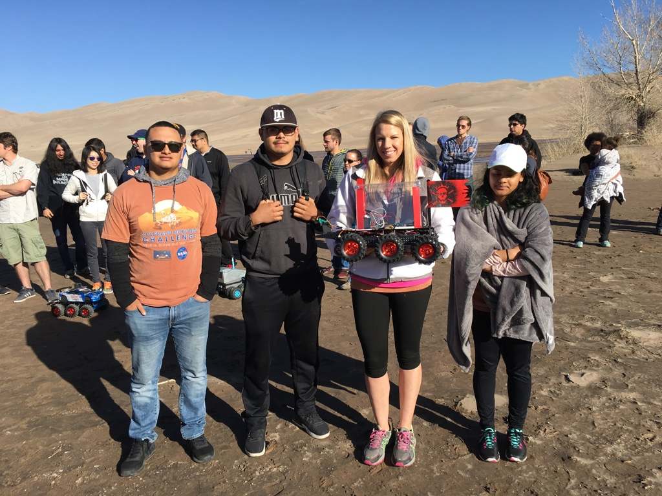
Show off your creativity
Great new manufacturing techniques
Great mechanical and software creativity
It looks cool…but does it work???!

Slide 17
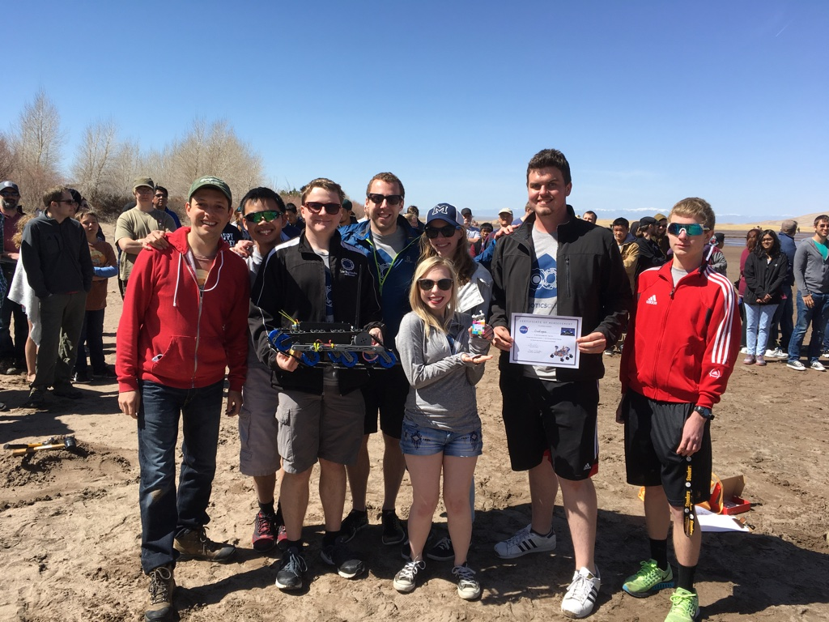
Visitors, judges and peers will talk to your teams and learn about your designs. Be prepared to share your design approaches and what you learned.

Slide 18
Timeline
September – Team Registration opens
November – CoDR Week 11/17
January – New team CoDR
February – PDR Week
March – CDR Week and Video check-ins
April 10 – Team presentations on site @ASU
April 11 – Challenge day at the Dunes

Slide 19
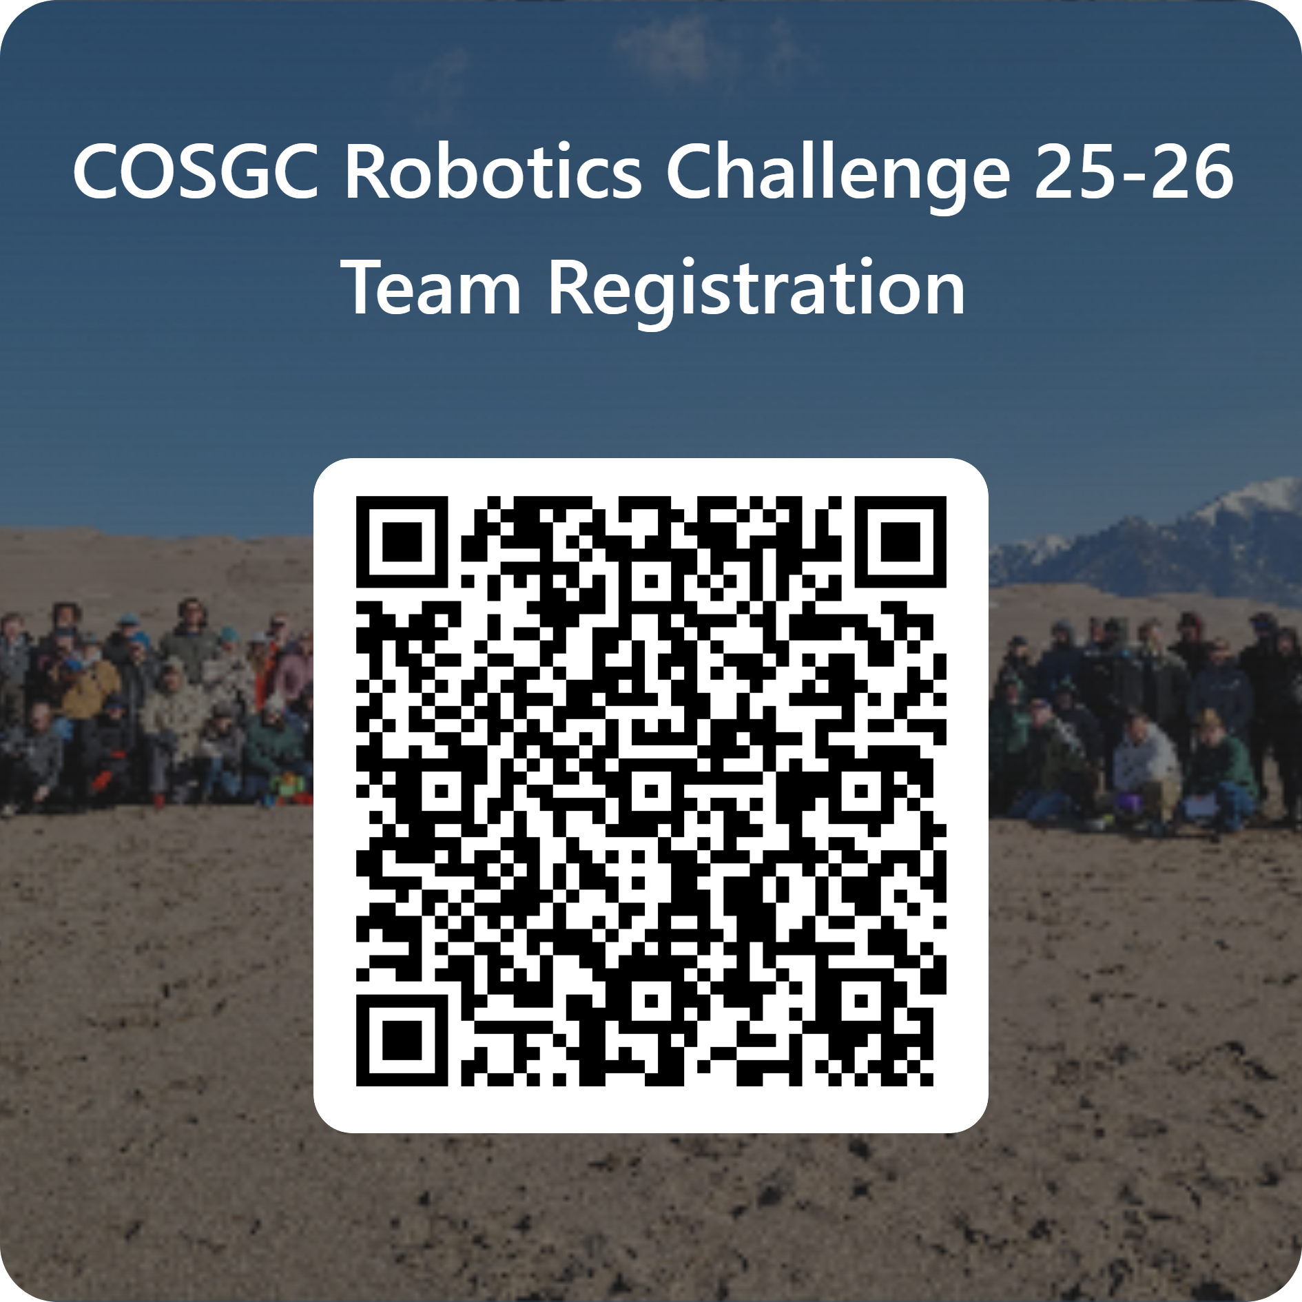

Slide 20
2025 Highlight video

Slide 21
Questions

