Slide 1
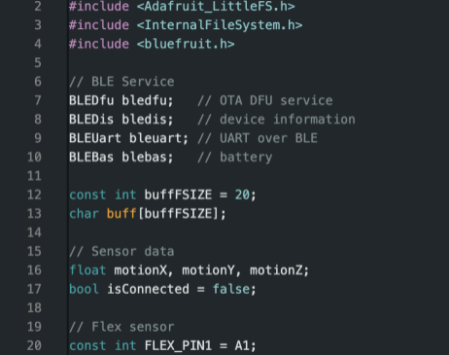
Glove Code (Module 7)

Slide 2
Overview
Congratulations—you’ve made it to the end!
By now, you should have a working glove that you can begin programming to control other devices, just like we did. You’ll find two example codes on slide 4, along with their descriptions. We’ve also included a link to a YouTube video showing the rover we controlled using our glove.
Important:
Any device you attempt to control with this glove must be Bluetooth-compatible, or it will not work with your setup.

Slide 3
Example Code
(Section 1.0)

Slide 4
Example Code
Here is the code for reading flex sensor
This code is designed to read data from three flex sensors connected to analog pins A1, A2, and A3 on a Circuit Playground board. The purpose of the code is to monitor the bending of the sensors by reading their analog values and printing these readings to the serial monitor at regular intervals.
https://github.com/codingchefsong/Wearable/tree/main/reading_flexsensor
Here is the code for glove with BLE
This code reads data from onboard sensors and send it via Bluetooth Low Energy (BLE). It sets up BLE services (UART, device info, battery, OTA updates) and transmits accelerometer readings along with button press signals ('L' or 'R') when detected. The data is sent in a formatted byte buffer, and incoming BLE messages are also relayed to the serial monitor.
https://github.com/codingchefsong/Wearable/tree/main/cpb_peripheral

