Slide 1
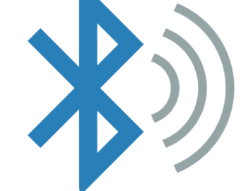
Connecting Your Devices with Low-Energy Bluetooth (Module 6)

Slide 2
Overview
This module demonstrates how to establish communication between the CPB (Circuit Playground Bluefruit) and another device using Bluetooth Low Energy (BLE).
In this example, we use an iPhone, but the process works similarly for Android devices. Simply download the Bluefruit Connect app from your device's respective app store.

Slide 3
Bluetooth Low-energy(BLE)
(Section 1.0)

Slide 4
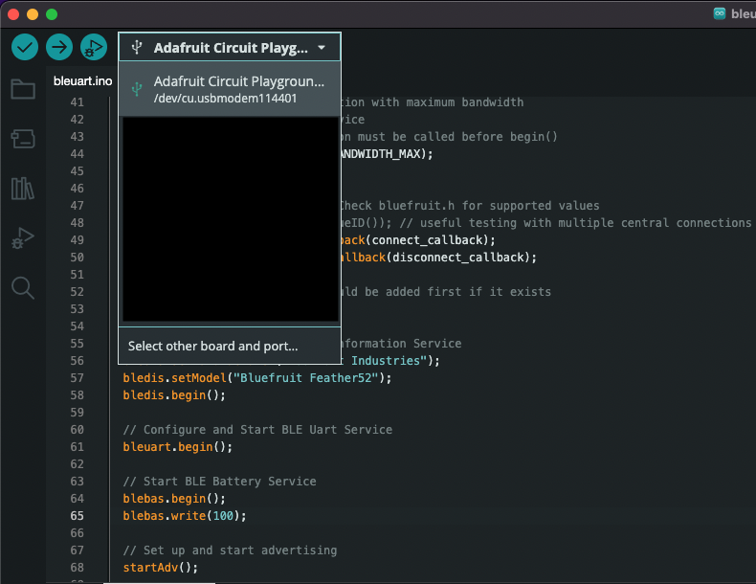
BLE UART Code (1 of 2)
You can find the example code after you finish the Module 4 Install Arduino IDE & Libraries
Connect your CPB to the computer.
Open the Arduino IDE and select the correct board and port (refer to "Demo Code and Explore CPB" in Section 4.0). Otherwise, the example code will not appear under Examples in the menu.

Slide 5
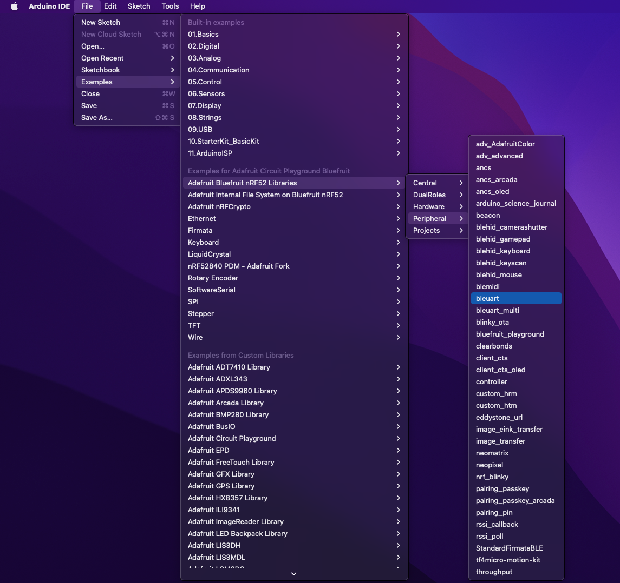
BLE UART Code (1 of 2)
Step 2: Click File -> Examples -> Adafruit Bluefruit nRF52 Libraries -> Peripheral -> bleuart.

Slide 6
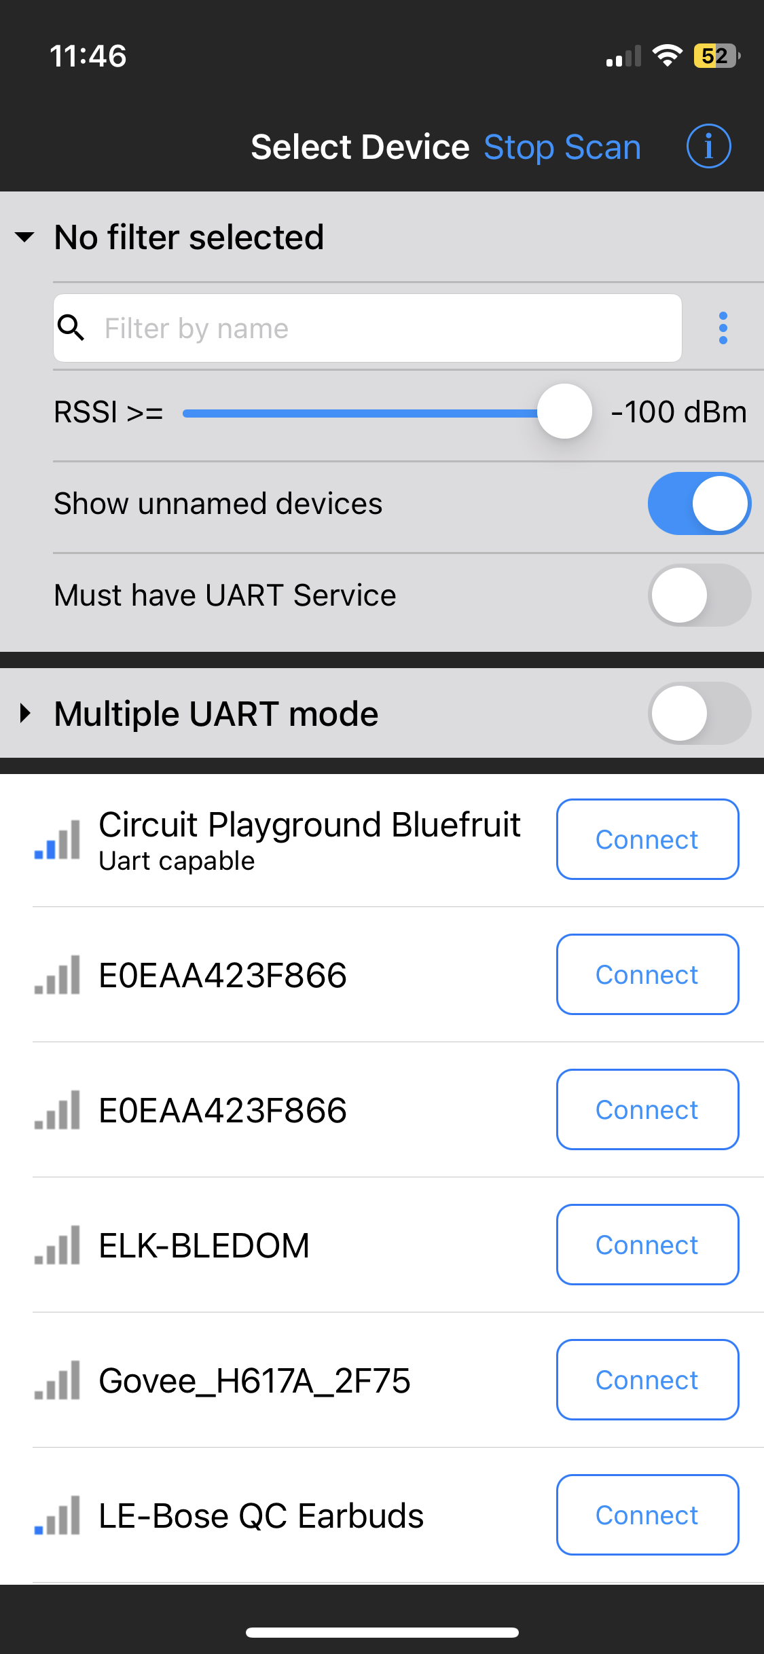
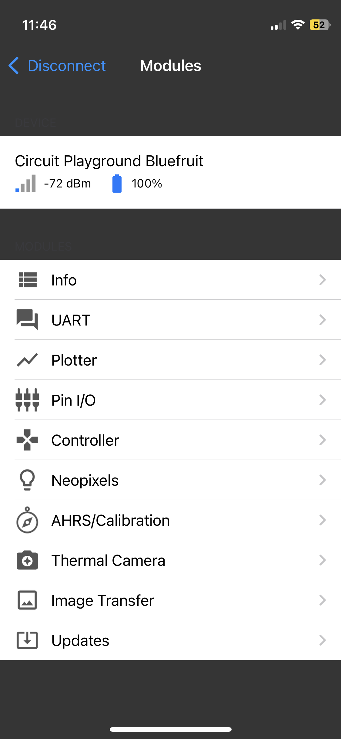
Connecting to a cellphone
Download Bluefruit Connect App
Open the App
Scroll until you find the "Circuit Playground Bluefruit"
Tap the Connect button

Slide 7
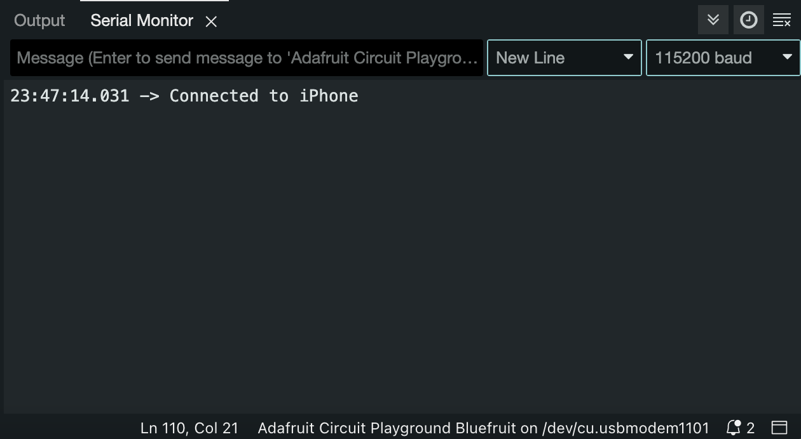
Connecting to a cellphone
Step 2: Check the message in Arduino serial monitor

Slide 8
Connecting to a cellphone
Step 3: Tap UART

Slide 9
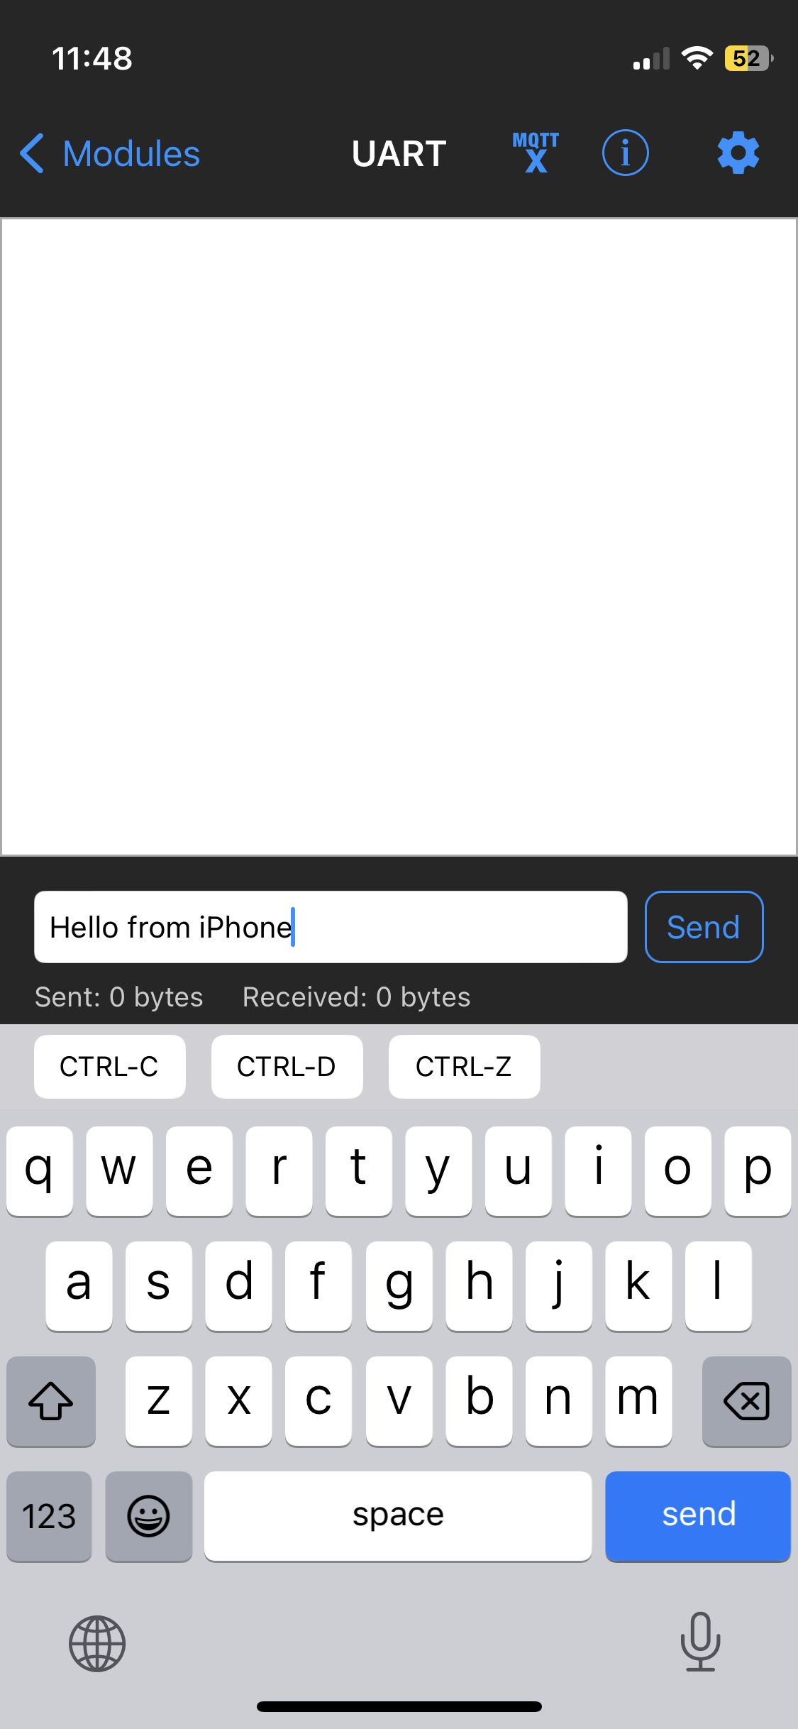
Connecting to a cellphone
Step 4: Edit the text message you would like to send →Tap the send button

Slide 10
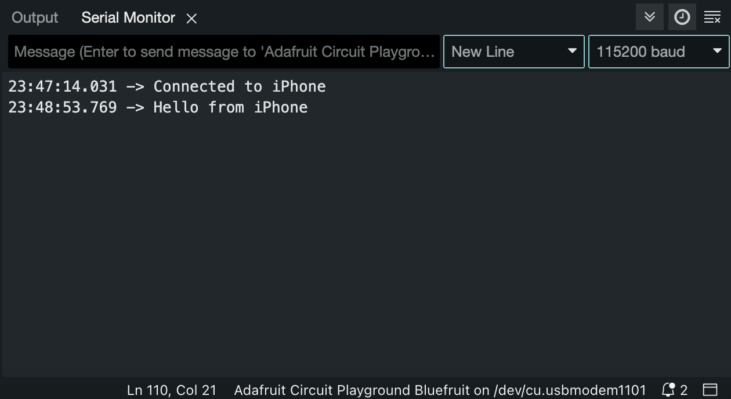
Connecting to a cellphone
Step 5: Check the message in Arduino serial monitor

Slide 11
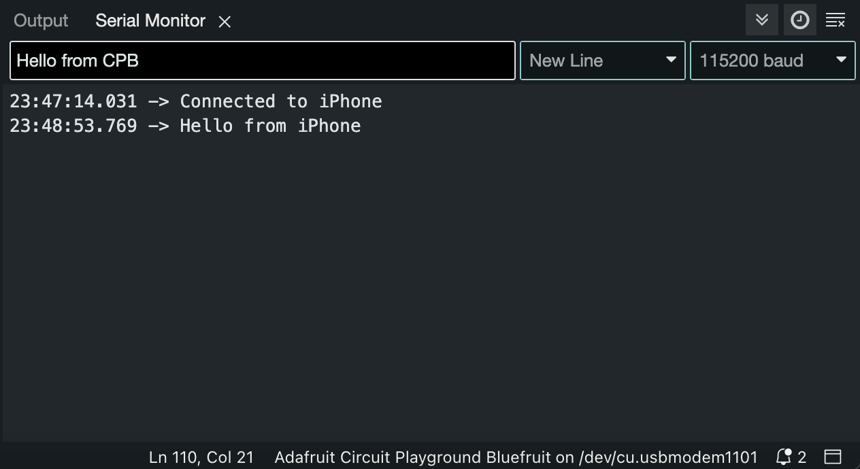
Connecting to a cellphone
Step 6: Edit message in Arduino serial monitor and hit Enter

Slide 12
Connecting to a cellphone
Step 7: Check the message in Bluefruit Connect App

