Slide 1
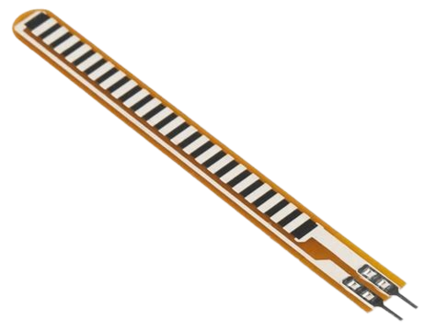
How do Flexsensors
Work (Module 5)
Notes:
Replace with a picture of the actual flex sensor

Slide 2
Overview
This module provides an example of how to use a flex sensor to light up the onboard LEDs on the CPB. The circuit is built on a breadboard, which is a great way to test your design before soldering or creating a PCB.

Slide 3
Getting Started: Flex Sensor Overview
(Section 1.0)

Slide 4
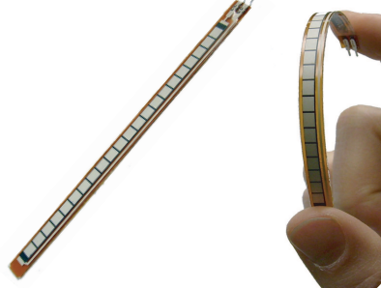
What is a Flex Sensor?
A flex sensor is basically a flexible resistor. When bent, the resistance within the flex sensor will change, causing a change in the voltage potential across the resistor.

Slide 5
Flexsensor datasheet
Link to the Spectra Flexsensor: Flexsensor datasheet
Notes:
Need to switch this for the final flex sensor

Slide 6
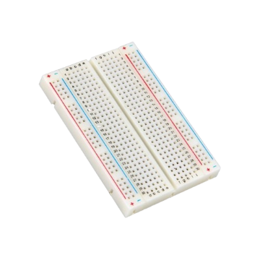
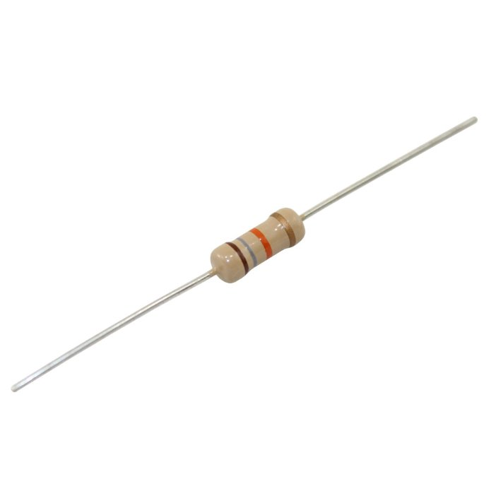
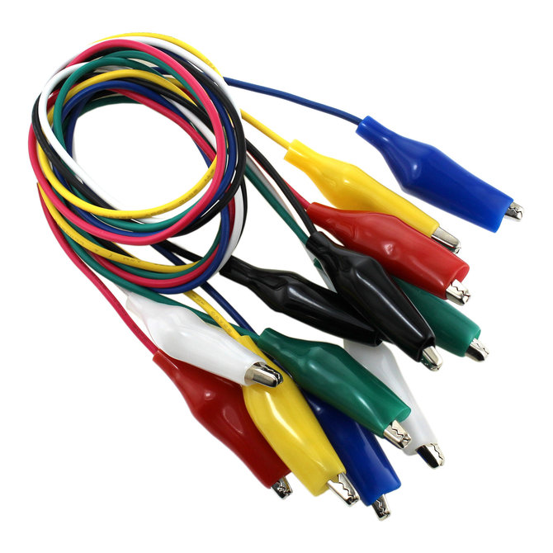
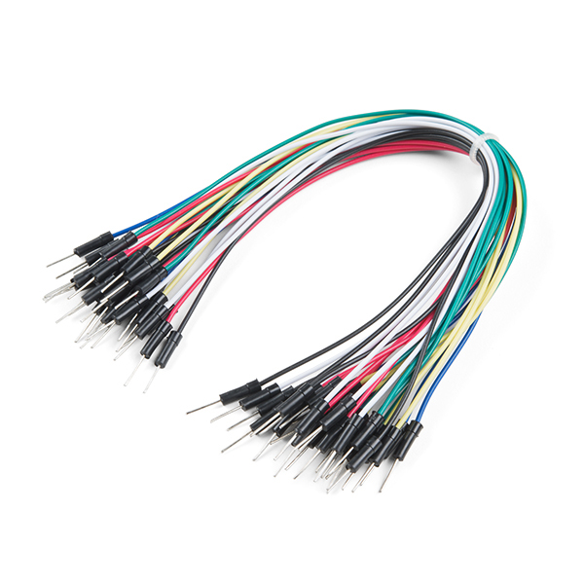
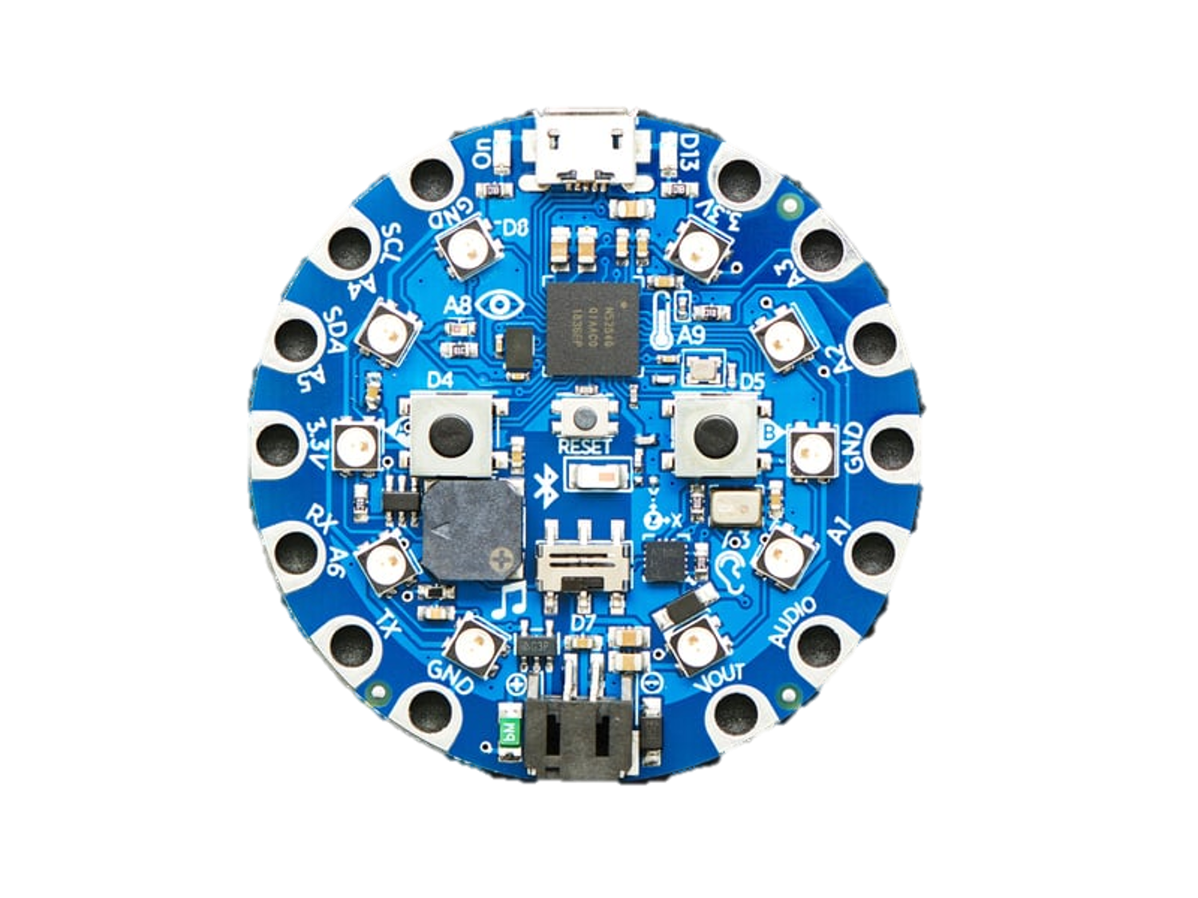
How to Use a Flex Sensor?
To test the sensitivity of a flex sensor, we will need to create a voltage divider circuit with a microcontroller, such as your CPB or an Arduino Uno.
We will need the following materials:
1x Bread Board
1x 18kOhm Resistor
Alligator clips
Wires (jumper cables preferably)
1x Flex Sensor
1x Micro Controller

Slide 7
Note to slide 6
If you don’t have an exact match for all the materials shown on slide 6, that’s okay. We chose to use alligator clips because they attach nicely to the CPB, but you can also wrap a wire around the pad if needed. You might also find that you want a different sensor reading, which can be adjusted by changing the resistor value in your circuit. We used an 18kΩ resistor because it worked well for our setup. You may remember the explanation from Module 3, Slide 5. If that wasn’t clear enough, we recommend looking up how a voltage divider circuit works. There are plenty of great resources online.

Slide 8
Building Circuits, Coding, and Testing
(Section 2.0)

Slide 9
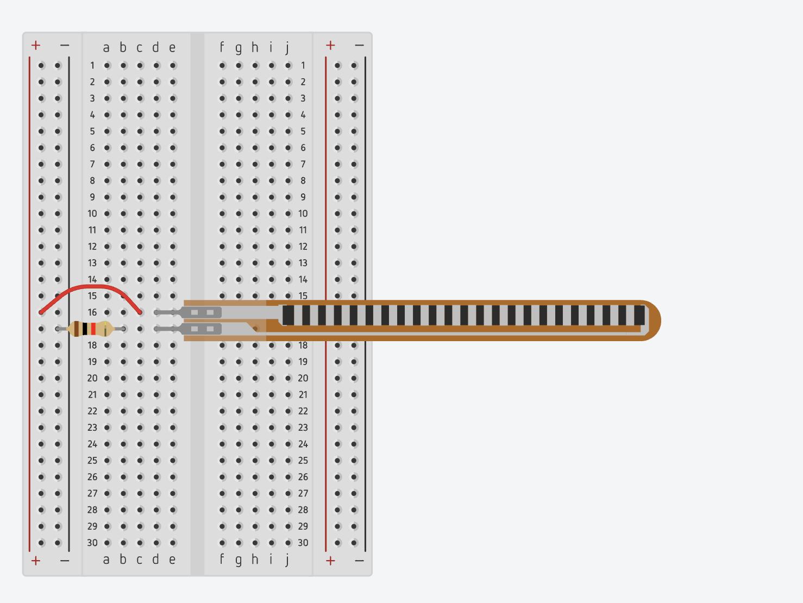
Breadboard circuit diagram

Slide 10
Using Arduino IDE
Link to GitHub for flexsensor demo: Flexsensor demo
This code will light up the onboard LEDs in proportion to how much you bend the flex sensor. The more you bend it, the more LEDs light up. When there is no bend, maybe one LED will be lit.

Slide 11
Test your results:
Justin: <<insert Video or picture of the results>>

