Slide 1
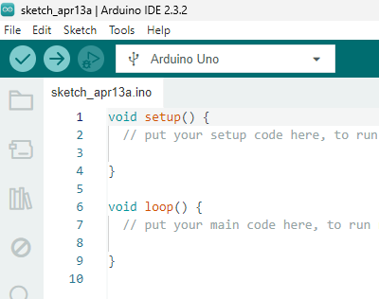
How to Install Arduino IDE & Libraries (Module 4A)

Slide 2
Overview
This module explains how to install the Arduino IDE on a Windows machine and how to add the libraries you’ll need as you program your glove and other Arduino-based projects. While there are plenty of YouTube videos and online resources available, we believe our guide is especially beginner-friendly.

Slide 3
(Windows OS) Download and Installing Arduino IDE
(Section 1.0)

Slide 4
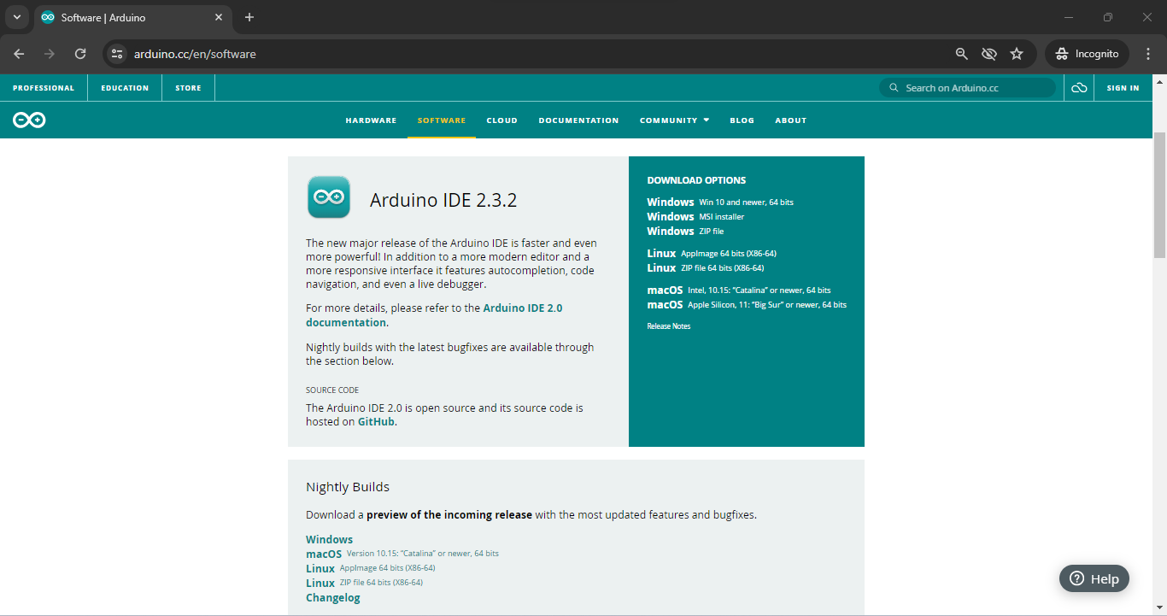
(Windows OS) Download and Installing Arduino IDE
Go to https://www.arduino.cc/en/software

Slide 5
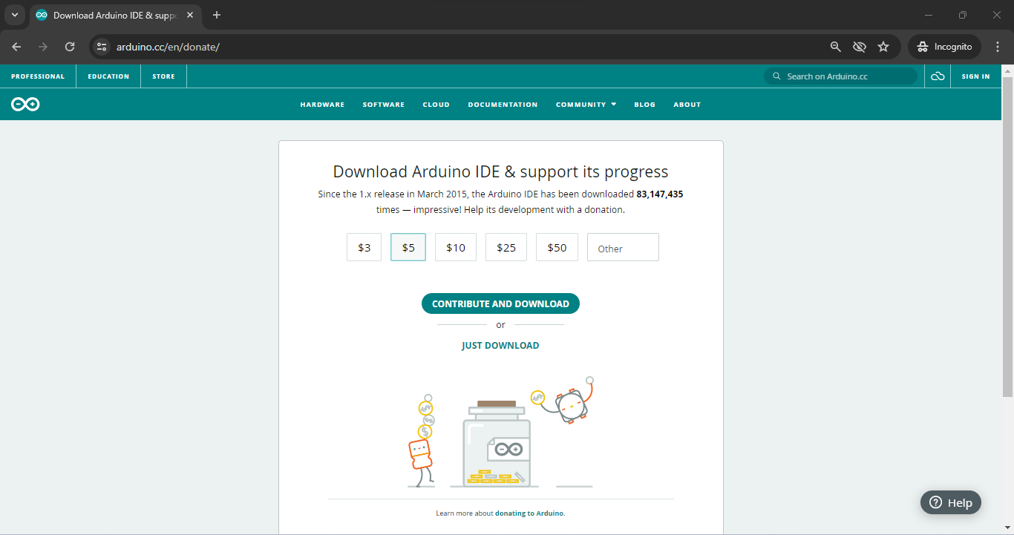
(Windows OS) Download and Installing Arduino IDE
Step 1: Click JUST DOWNLOAD

Slide 6
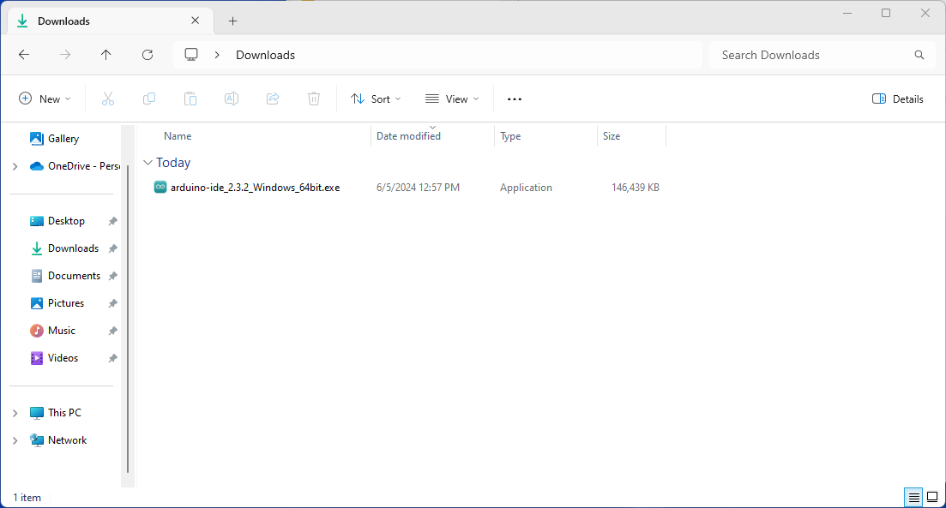
(Windows OS) Download and Installing Arduino IDE
Step 2: Open File Explorer → Go to downloads → Double click to install the file

Slide 7
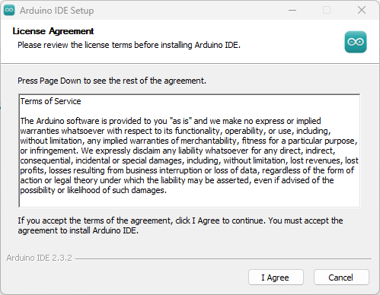
(Windows OS) Download and Installing Arduino IDE
Step 3: Click I Agree

Slide 8
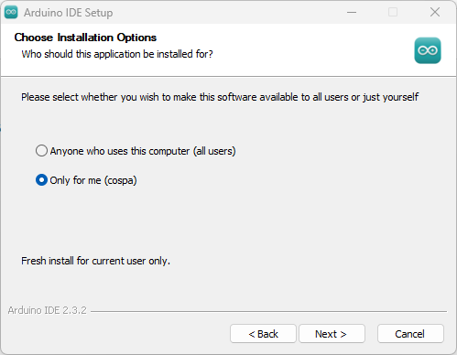
(Windows OS) Download and Installing Arduino IDE
Step 4: Select Only for me → Click next

Slide 9
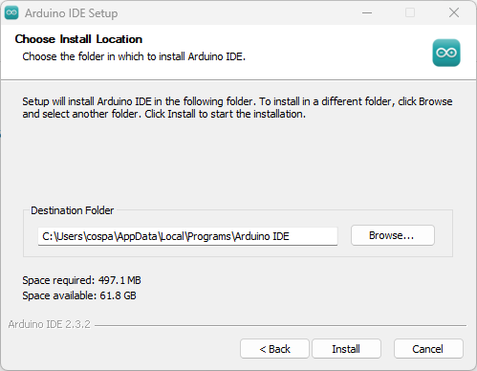
(Windows OS) Download and Installing Arduino IDE
Step 5: Click install

Slide 10
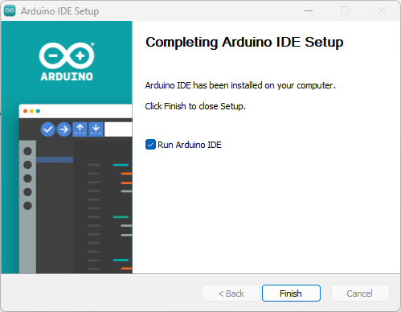
(Windows OS) Download and Installing Arduino IDE
Step 6 Click Finish

Slide 11
Arduino IDE Overview
(Section 1.0)

Slide 12
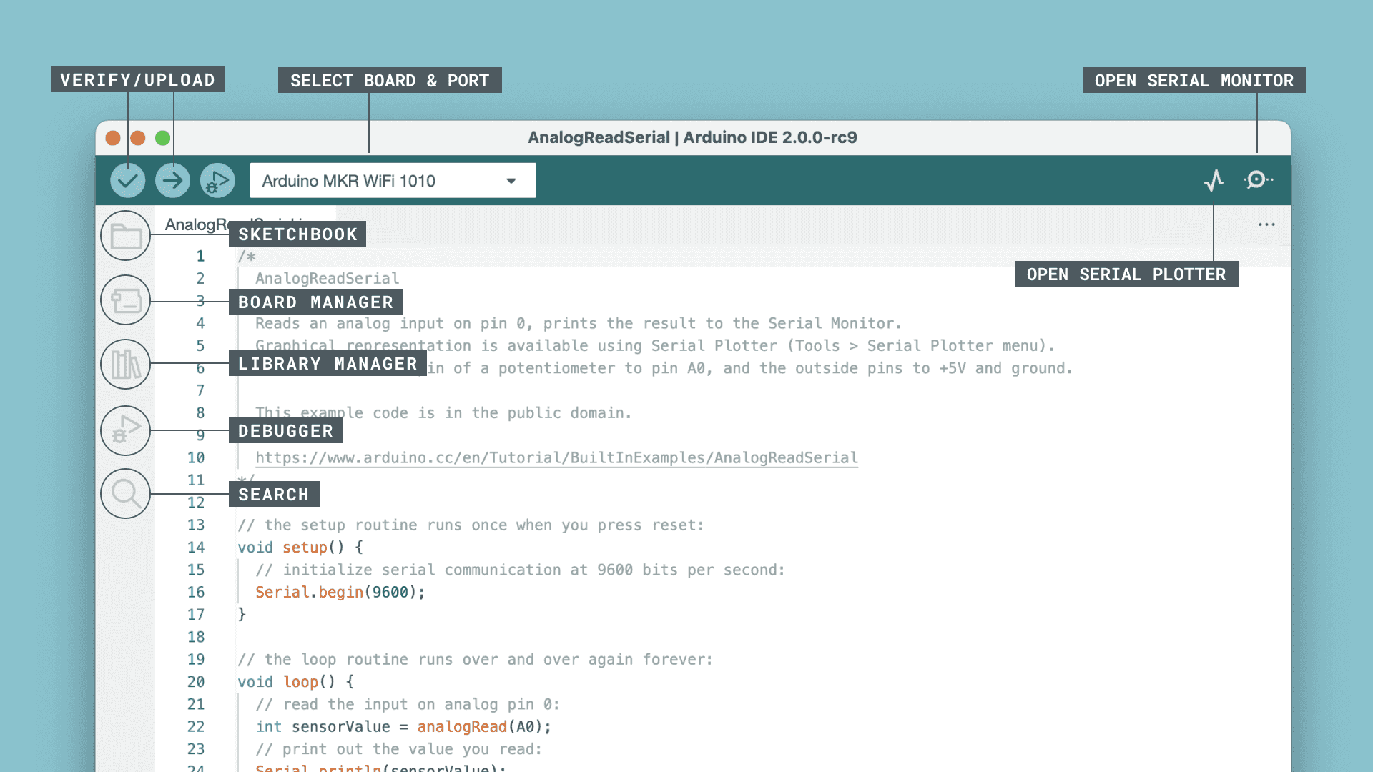
Arduino IDE interface
Verify / Upload - compile and upload your code to your Arduino Board.
Select Board & Port - detected Arduino boards automatically show up here, along with the port number.
Sketchbook - here you will find all of your sketches locally stored on your computer. Additionally, you can sync with the Arduino Cloud, and also obtain your sketches from the online environment.
Boards Manager - browse through Arduino & third party packages that can be installed. For example, using a MKR WiFi 1010 board requires the Arduino SAMD Boards package installed.
Library Manager - browse through thousands of Arduino libraries, made by Arduino & its community.
Debugger - test and debug programs in real time.
Search - search for keywords in your code.
Open Serial Monitor - opens the Serial Monitor tool, as a new tab in the console.
https://docs.arduino.cc/software/ide-v2/tutorials/getting-started-ide-v2/

Slide 13
(Windows OS) Getting Started: Adding Adafruit board index to Arduino IDE
(Section 2.0)

Slide 14
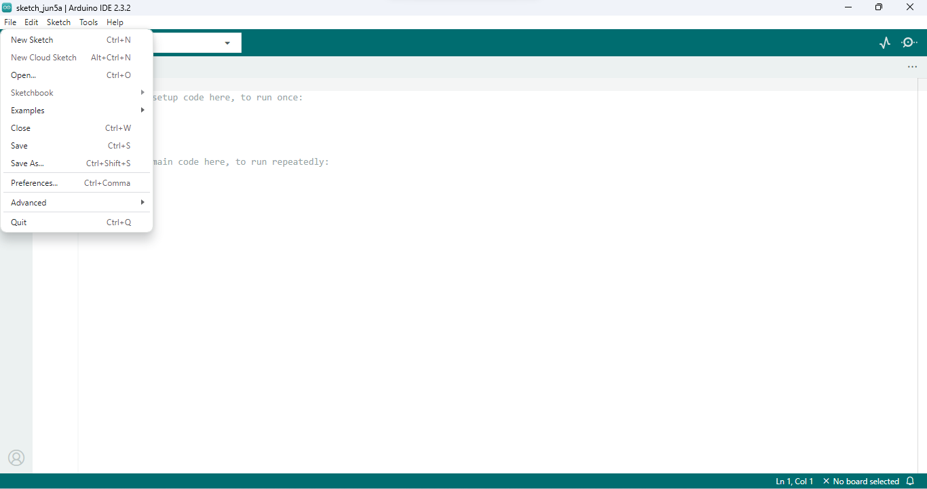
(Windows OS) Adding Adafruit Board Index
Step 1: Click File → Select Preferences

Slide 15
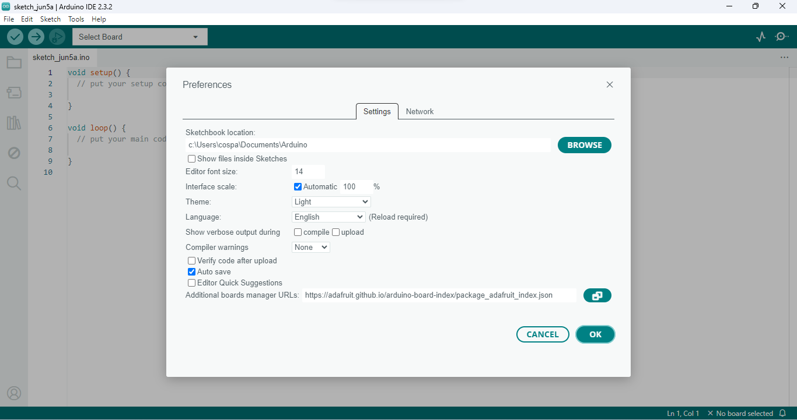
(Windows OS) Adding Adafruit Board Index
Step 2: Paste this link: https://adafruit.github.io/arduino-board-index/package_adafruit_index.json → Click OK → Restart the Arduino IDE

Slide 16
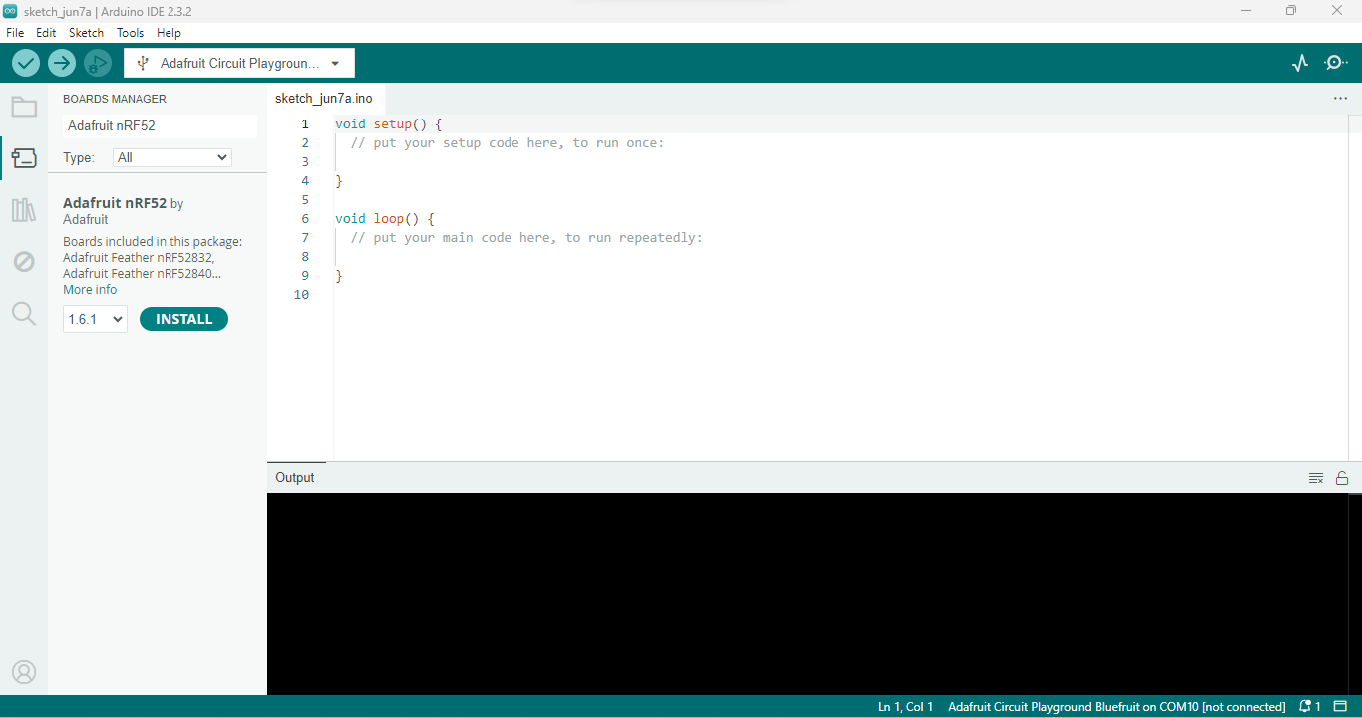
(Windows OS) Adding Adafruit Board Index
Step 3: Open the Boards Manager option from Tools → Board menu and install 'Adafruit nRF52' by Adafruit

Slide 17
(Windows OS) Installing Adafruit Circuit Playground Library
(Section 3.0)

Slide 18
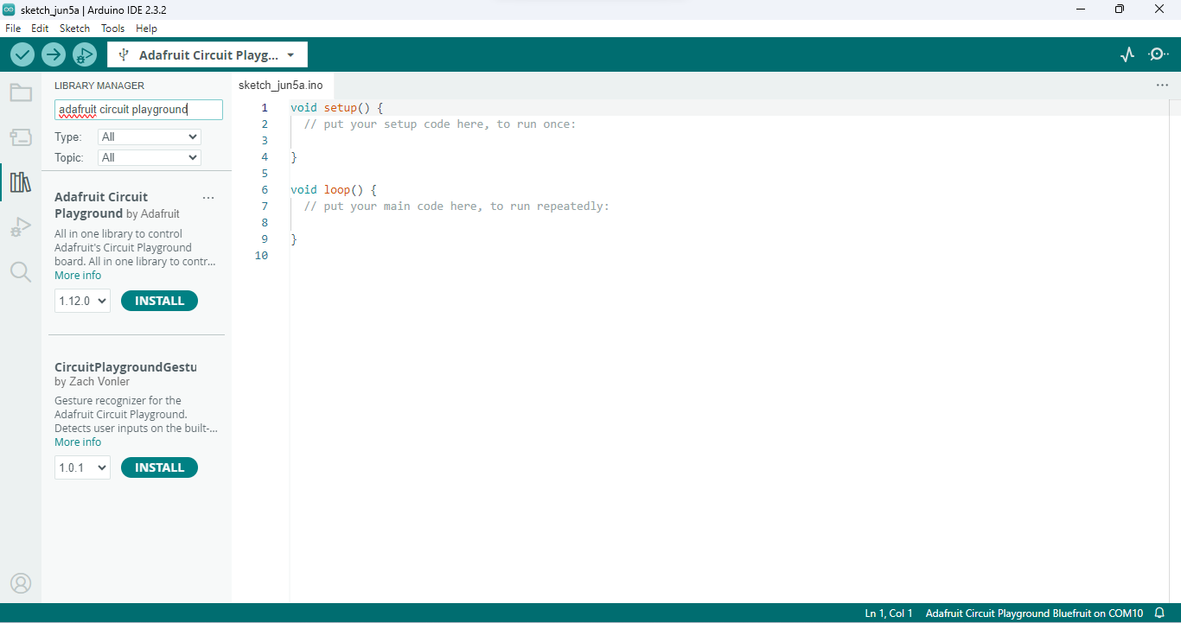
(Windows OS) Installing Adafruit Circuit Playground Library
Step 1: Open the Library Manager search for "Adafruit circuit playground“ → Select Install

Slide 19
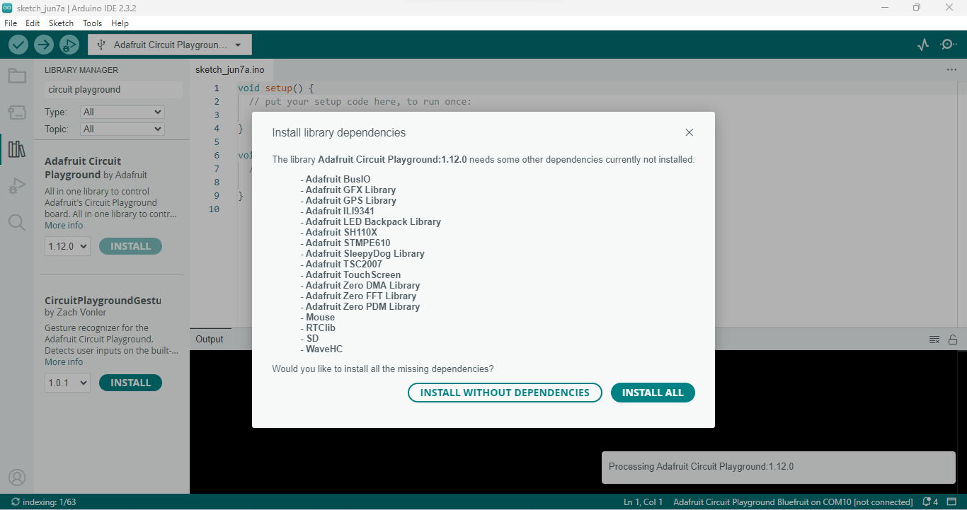
(Windows OS) Installing Adafruit Circuit Playground Library
Step 2: Click INSTALL ALL

Slide 20
(Windows OS) Demo Code and Exploring the CPB
(Section 4.0)

Slide 21
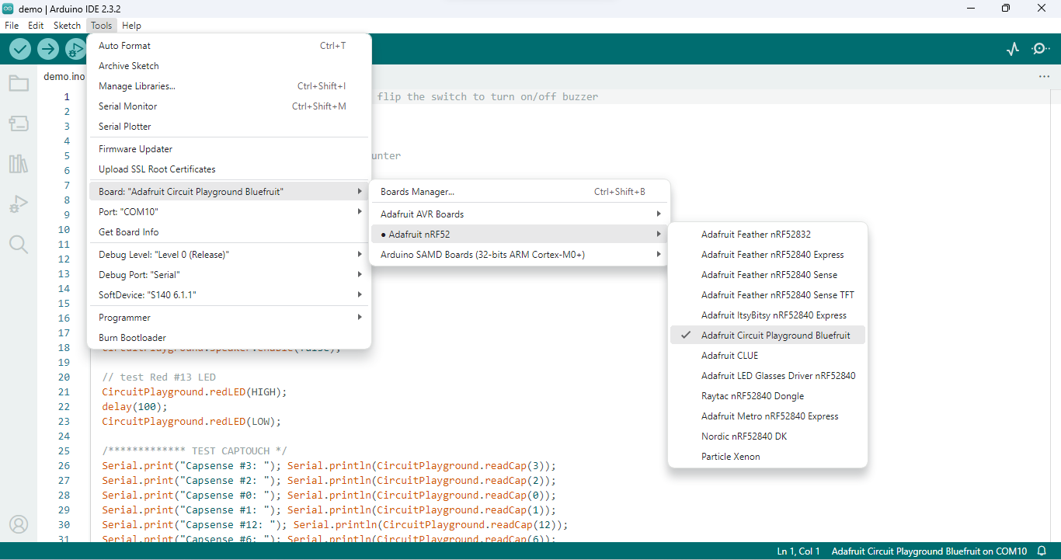
(Windows OS) Demo Code and Exploring the CPB
Step 1: Connect CPB to your computer via USB cable → Make sure the correct board is selected

Slide 22
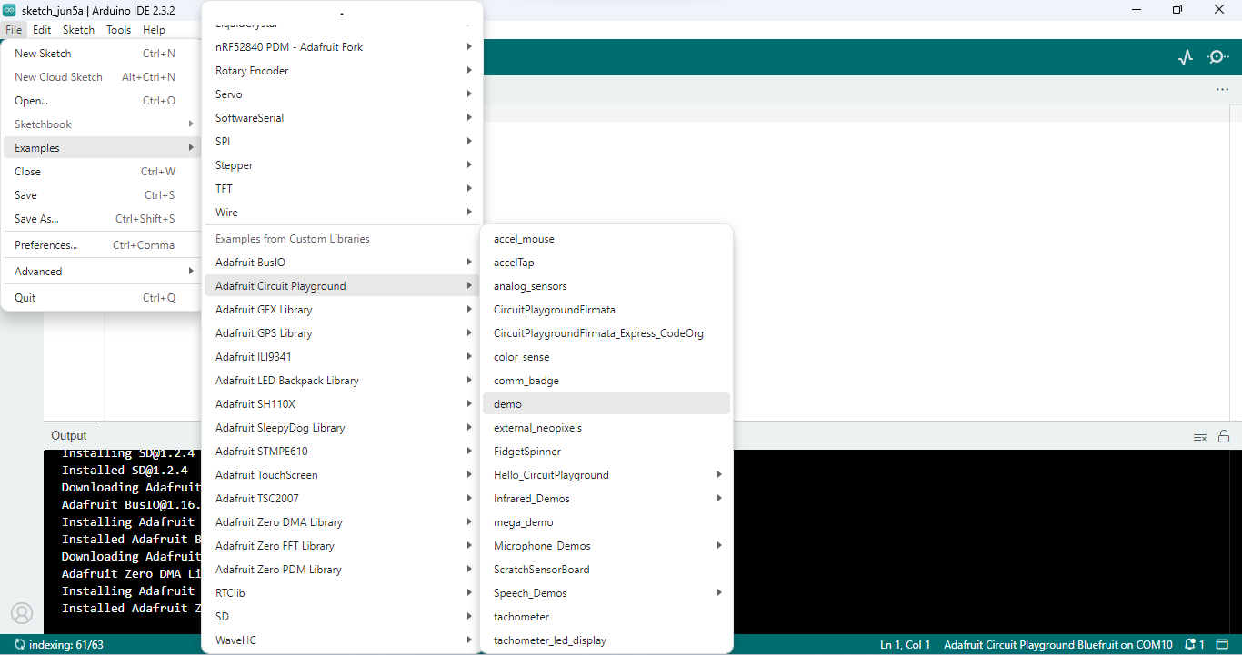
(Windows OS) Demo Code and Exploring the CPB
Step 2: Click File → Examples → Adafruit Circuit Playground → demo

Slide 23
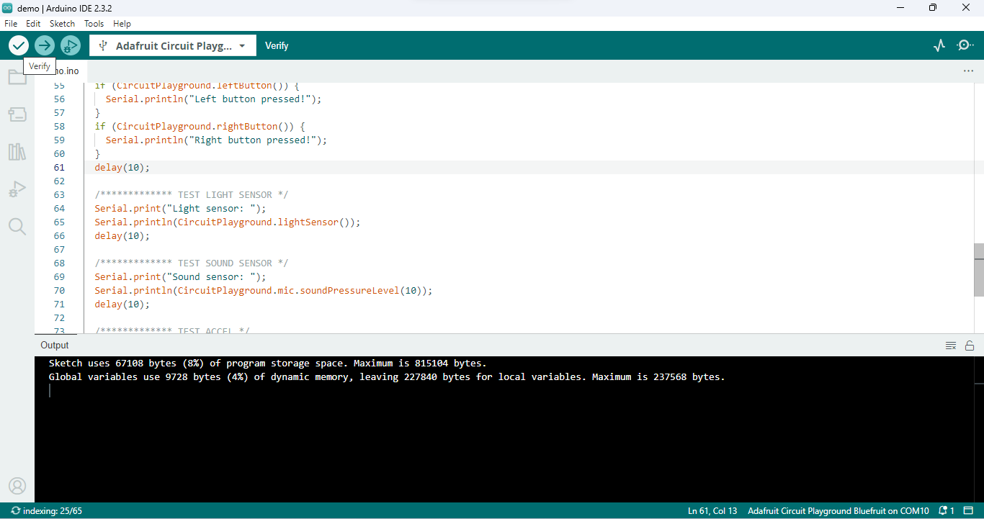
(Windows OS) Demo Code and Exploring the CPB
Step 3: Click the Verify button If everything has been set up correctly, there will be some storage information in the output window

Slide 24
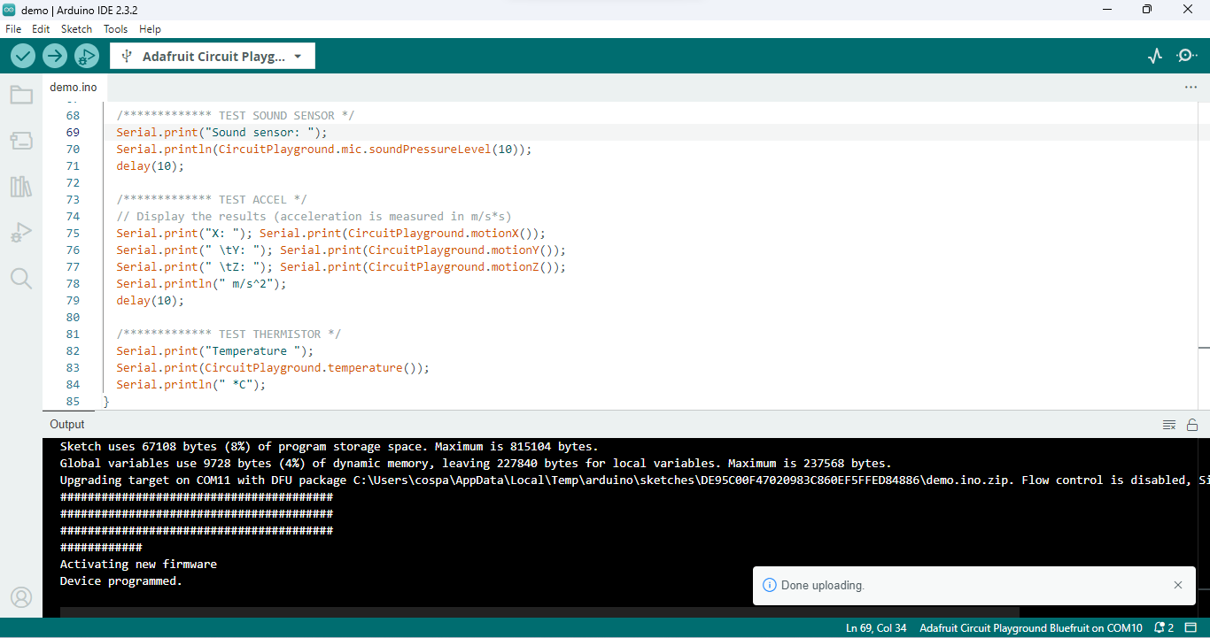
(Windows OS) Demo Code and Exploring the CPB
Step 4: Click the upload button → Wait for the upload finish

Slide 25
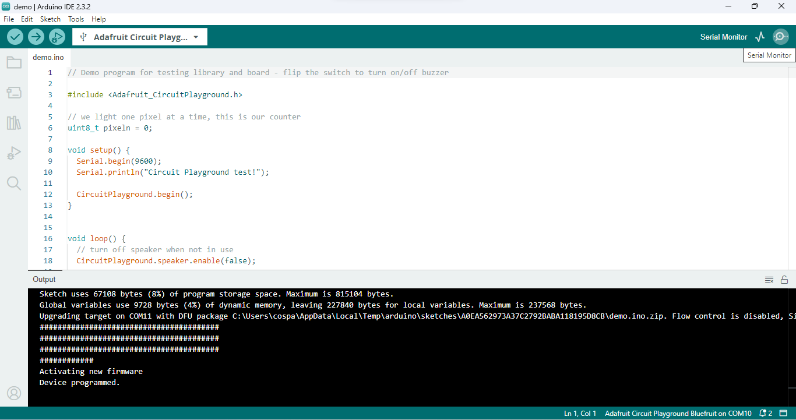
(Windows OS) Demo Code and Exploring the CPB
Step 5: Click the Serial monitor at the top right of the window

Slide 26
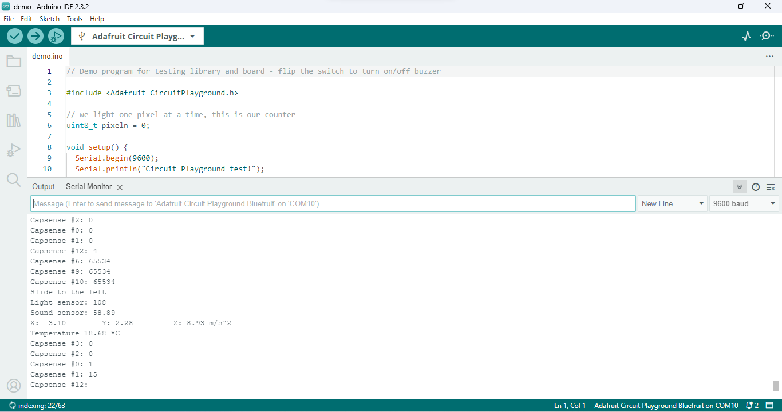
(Windows OS) Demo Code and Exploring the CPB
Step 6: Make sure your serial monitor baud rate matches with the code’s → Check output message

Slide 27
Arduino IDE Overview
(Section 1.0)

Slide 28
Arduino IDE interface
Verify / Upload - compile and upload your code to your Arduino Board.
Select Board & Port - detected Arduino boards automatically show up here, along with the port number.
Sketchbook - here you will find all of your sketches locally stored on your computer. Additionally, you can sync with the Arduino Cloud, and also obtain your sketches from the online environment.
Boards Manager - browse through Arduino & third party packages that can be installed. For example, using a MKR WiFi 1010 board requires the Arduino SAMD Boards package installed.
Library Manager - browse through thousands of Arduino libraries, made by Arduino & its community.
Debugger - test and debug programs in real time.
Search - search for keywords in your code.
Open Serial Monitor - opens the Serial Monitor tool, as a new tab in the console.
https://docs.arduino.cc/software/ide-v2/tutorials/getting-started-ide-v2/

Slide 29
Known Issues
The reading motionX, motionY have their direction flipped from demo code.
If the CPB is connected to the computer and not able to upload code, you can try double clicking the reset button on the CPB.

Slide 30
Useful links
What is library? https://learn.adafruit.com/adafruit-all-about-arduino-libraries-install-use/arduino-libraries
Instructions setup Adruino IDE and CPB: https://learn.adafruit.com/adafruit-circuit-playground-bluefxxruit/arduino-support-setup

