Slide 1
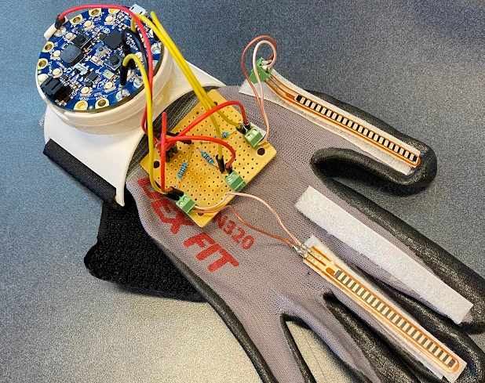
How to Assemble Your Glove (Module 3)
Notes:
Need to replace title image

Slide 2
Circuit Diagram
(Section 1.0)

Slide 3
Overview
This module explains how the circuit in your glove works and follows YouTube videos that guide you through the assembly process. You can use the video, the slides, or both to complete your glove. This module will walk you through the entire process step by step.

Slide 4
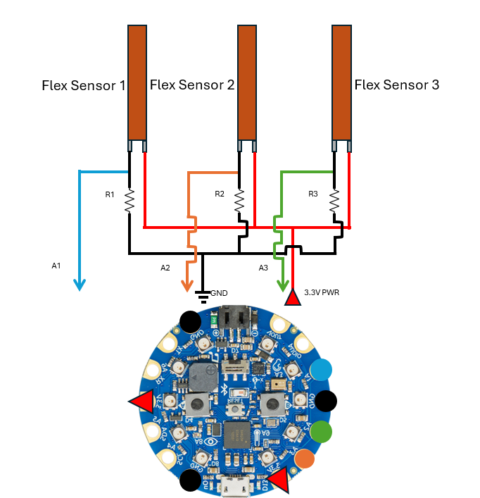
Glove final circuit schematic

Slide 5
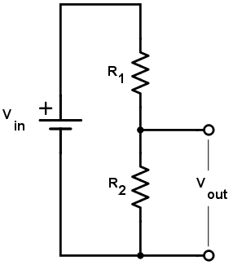
Voltage divider circuit
For reference the way we wire the flex sensors is by three voltage divider circuits in parallel. In the diagram to the left the R1 would be the flex sensor where R2 would be the 18kΩ resistor.

Slide 6
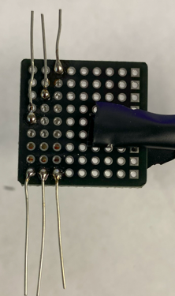
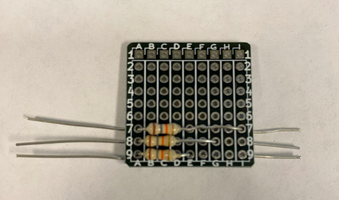
Step 1 Soldering the 18kΩ resistor to the mini breakout
Link to YouTube Video: 01 Soldering the three resistors

Slide 7
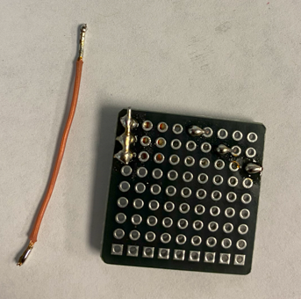
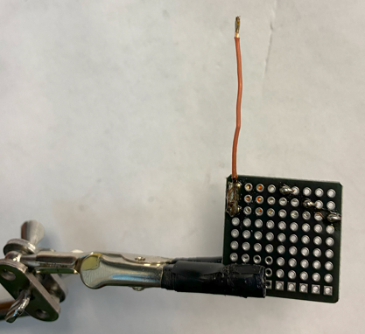
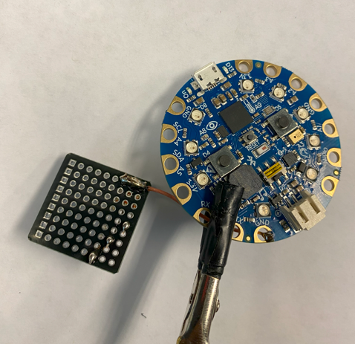
Step 2 Soldering the common ground to the mini breakout
Link to YouTube Video: 02 Soldering the common ground

Slide 8
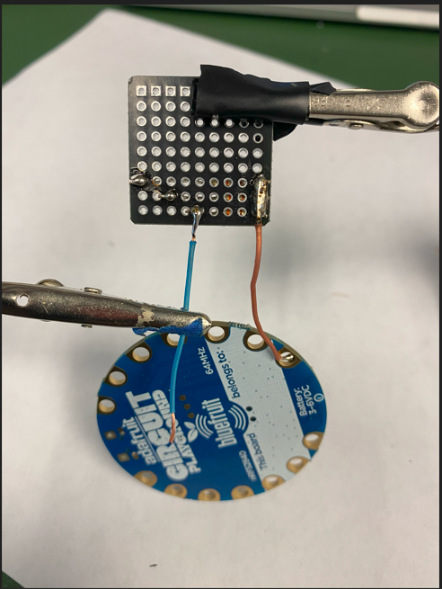
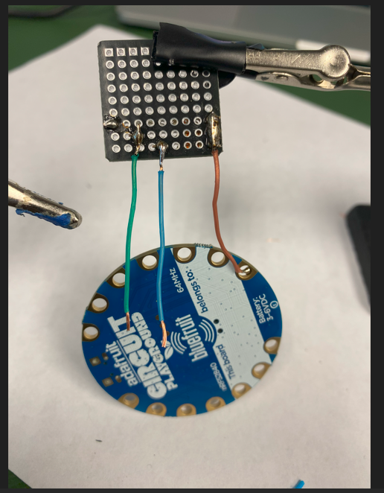
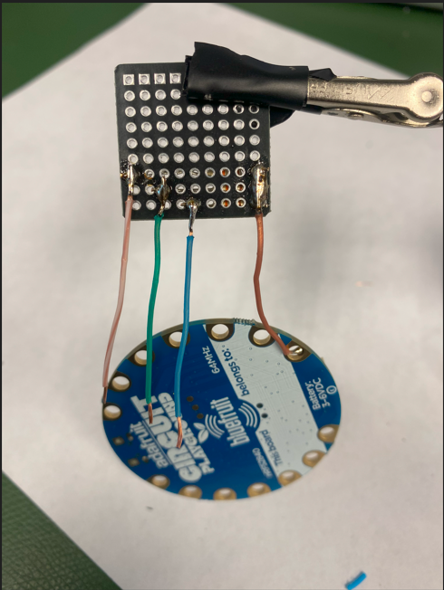
Step 3 Soldering the signal wires that goes to the CPB
Link to YouTube Video: 03 Soldering the signal wires

Slide 9
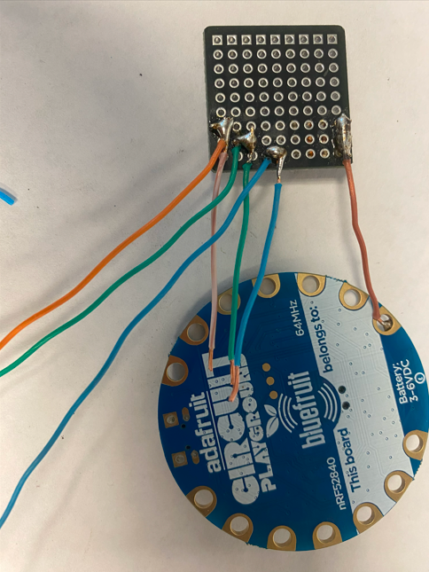
Step 3 Soldering the signal wires that goes to flex sensors
Link to YouTube Video: 03 Soldering the signal wires

Slide 10
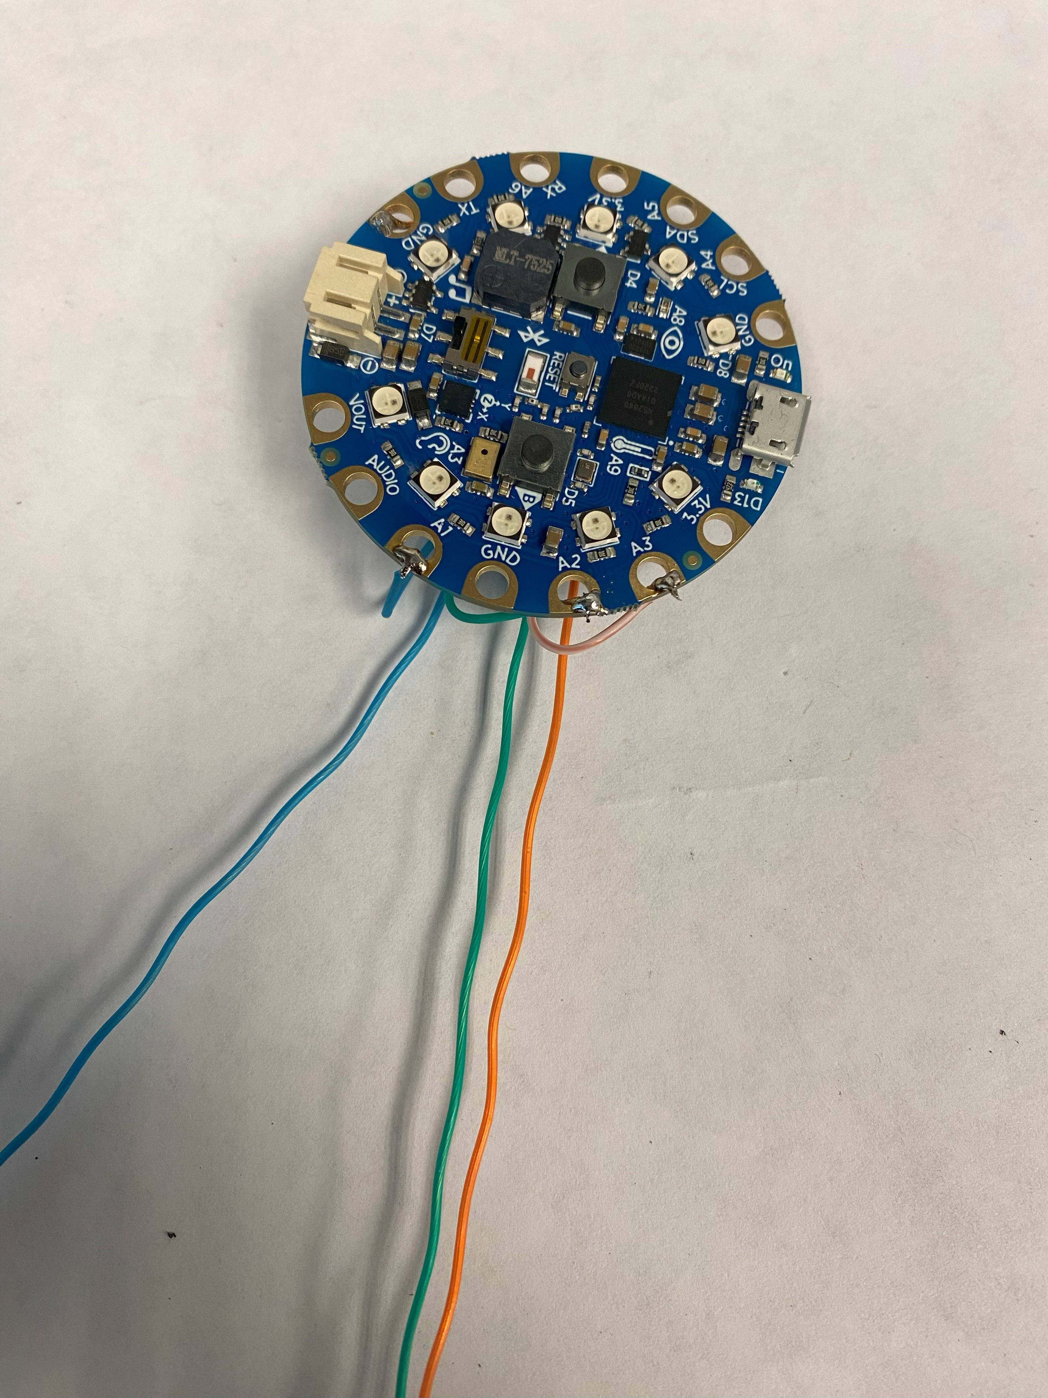
Step 3 Soldering the signal wires to the CPB
Link to YouTube Video: 03 Soldering the signal wires

Slide 11
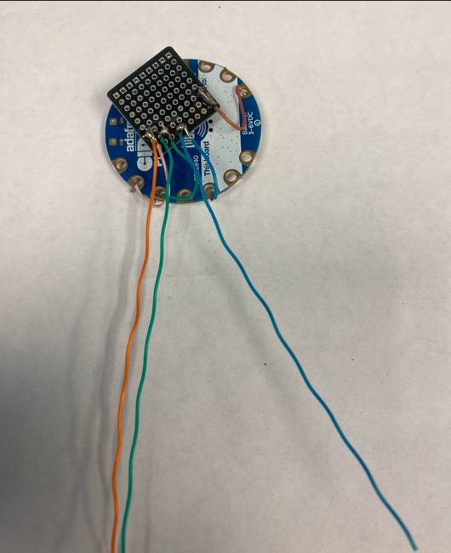
Step 3 Soldering the signal wires to the CPB
Link to YouTube Video: 03 Soldering the signal wires

Slide 12
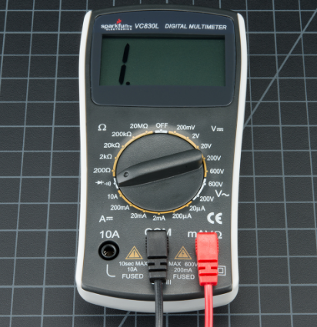
Step 4 Running a continuity test on your work so far
Link to YouTube Video: 04 Running a continuity test
This is just a way to check that your wires are connected properly. You will do this again after step 5.
After selecting the symbol shown to the right on your multimeter it should beep when an unbroken electrical path is found.
Link to how to use a multimeter: How to use a multimeter

Slide 13
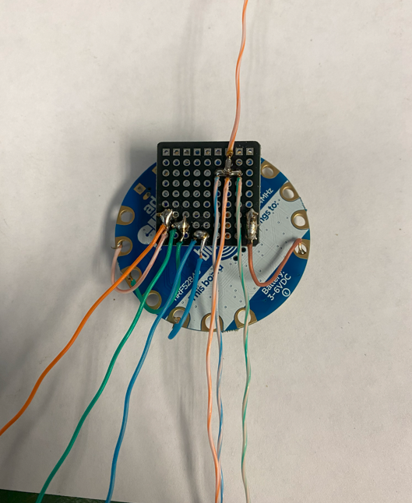
Step 5 Connecting the circuit to 3.3V power
Link to YouTube Video: 05 Connecting the circuit to 3.3V power

Slide 14
Step 6 Running a continuity test again
Link to YouTube Video: 06 Checking connections
This is just a way to check that your wires are connected properly.
After selecting the symbol shown to the right on your multimeter it should beep when an unbroken electrical path is found.
Link to how to use a multimeter: How to use a multimeter

Slide 15
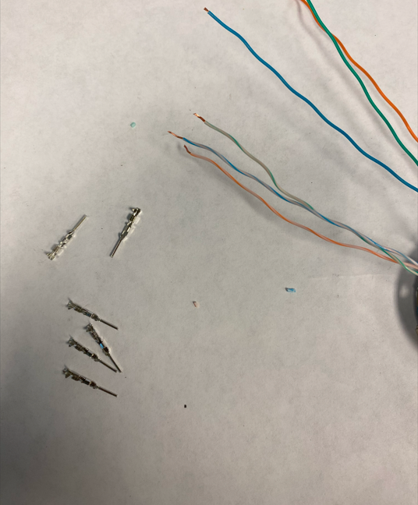
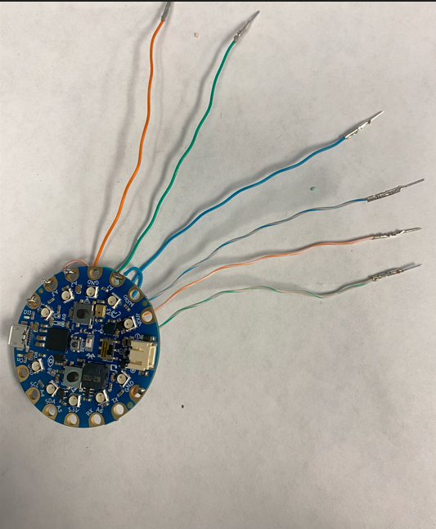
Step 7 Crimping connectors on to flex sensor wires
Link to YouTube Video: 07 Crimping connectors

Slide 16
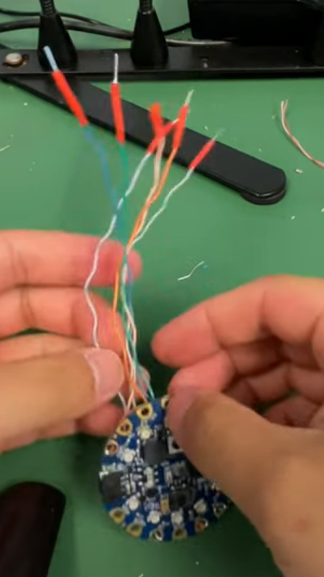
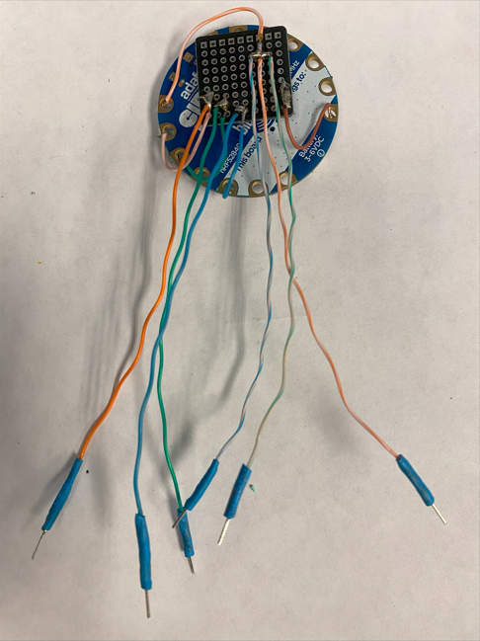
Step 8 Adding heat shrink over connectors
Link to YouTube Video: 08 Adding heat shrink over connectors

Slide 17
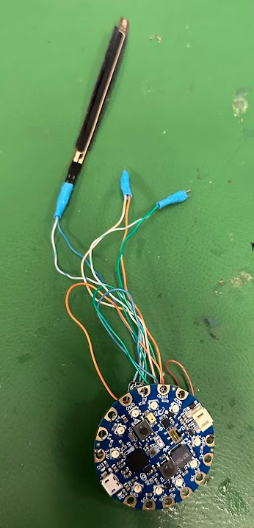
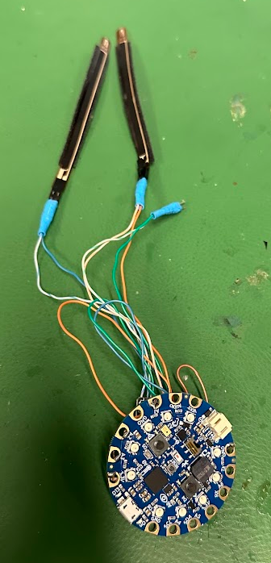
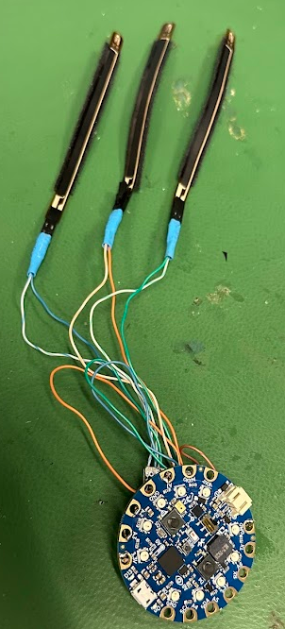
Step 9 Attaching flex sensors and reading values
Link to YouTube Video: 09 Attaching flex sensors and reading values
Notes:
Is it possible to have a screen record next to a glove bending to make the image better

Slide 18
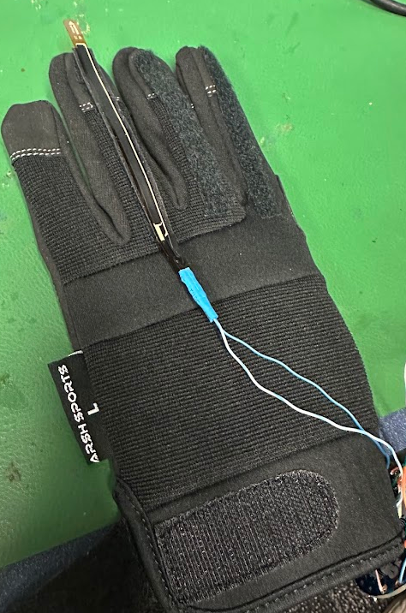
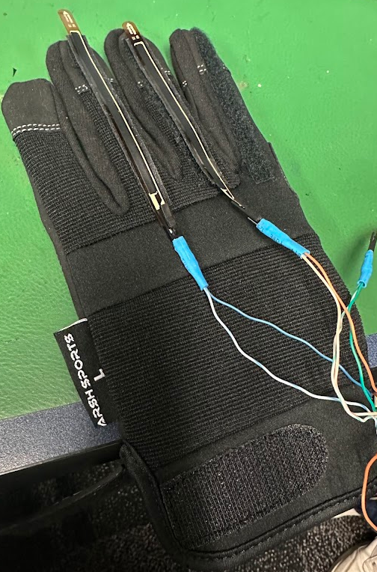
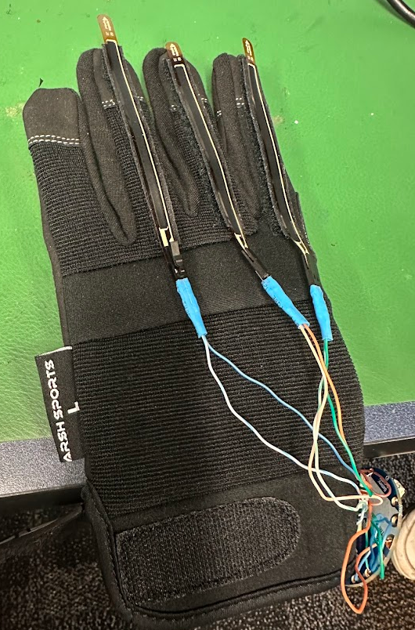
Step 10 Velcroing the flex sensors to the glove
Link to YouTube Video: 10 Velcroing the flex sensors to the glove]
Notes:
Is it possible to have a screen record next to a glove bending to make the image better

