Slide 1
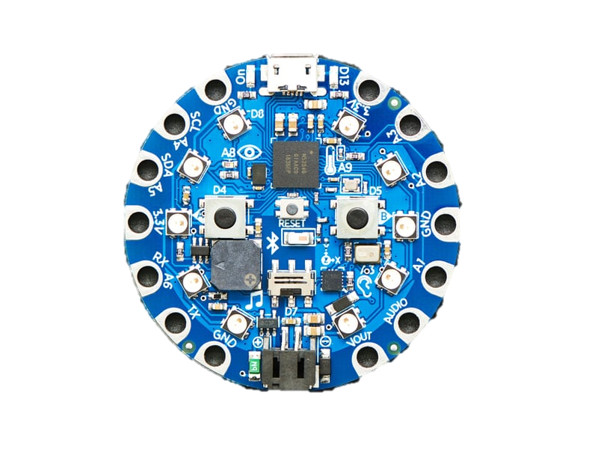
What is a Circuit Playground Bluefruit (Module 2)

Slide 2
General CPB Info (1.0)

Slide 3
Overview
This module highlights useful information from the CPB datasheet. A link to the datasheet is provided on slide 5. We recommend reviewing it as you work through your project, as it offers a more comprehensive overview and includes many examples of what you can do with a CPB.

Slide 4
What is a CPB
In the intro workshop you used the Circuit Playground Express which is a microcontroller. The CPB is the upgraded CPX which comes with a more powerful main chip and allows for Bluetooth Low Energy rather than only infrared communication.

Slide 5
Link to Datasheet
Link to Datasheet: CPB Datasheet
A datasheet is basically a comprehensive guide on what the thing you are trying to use is. In this case that is the CPB, the rest of these slides are information pulled from this document and gives you a quick summary of important things on the board.

Slide 6
Everything in the CPB
1 x nRF52840 Cortex M4 processor with Bluetooth Low Energy
10 x mini NeoPixels, each one can display any color
1 x Motion Sensor (LIS3DH triple-axis accelerometer with tap detection, free-fall detection)
1 x Temperature sensor (thermistor)
1 x Light sensor (phototransistor) also can act as color and pulse sensor
1 x Sound sensor (MEMS microphone)
1 x Mini speaker with class D amplifier (7.5mm magnetic speaker/buzzer)
2 x Push buttons labeled with A & B
1 x Slide switch
8 x input/output pins
6 x I2C, UART pins (Can do analog inputs , multiple PWM outputs)
Green “ON” LED to know its powered
Red “#13 LED” for blinking
Reset Button
2 MB of SPI flash storage
MicroUSB port for programming
MicroUSB port can act like a serial port

Slide 7
On board sensors

Slide 8
JST Battery Input
Battery connector located at the bottom of the board. Used to make CPB portable. This can take up to 6V DC power input, has reverse polarity, over current, and thermal protections. Doesn’t matter if you connect both JST Battery or computer it will default to the one with high voltage. Does not have built in charging so Alkaline or lithium batteries are safe. Works well with Lithium Polymer battery which is what we used in our project.

Slide 9
Pads
As stated on slide 3 there are 14 pads, 8 are IO, 6 are I2C & UART. Along with power and ground pins. For more details on this refer to the pinout slide.

Slide 10
Capacitive Touch Pads
Of the 14 pads 7 are capacitive touch meaning they can sense human touch without additional components. The libraries for this are supported in both CircuitPython and Arduino.

Slide 11
Microchips
Located towards the top of the CPB and boxed in RED is the nRF52840 Cortex M4 processor with Bluetooth Low Energy support. Located in the middle of the CPB and boxed in YELLOW is the Bluetooth antenna for the nRF52840 Bluetooth functionality. Keep metallic surfaces away from it to prevent interference. Located to the left of the nRF52840 and boxed in PURPLE is the SPI Flash storage drive. This is what you see when you use the CIRCUITPY drive on your computer.
Useful links for more info:
About Bluetooth antenna
About Bluetooth antenna video
About Processors
About Processors video

Slide 12
Microchips
Located towards the top of the CPB and boxed in RED is the nRF52840 Cortex M4 processor with Bluetooth Low Energy support. Located in the middle of the CPB and boxed in YELLOW is the Bluetooth antenna for the nRF52840 Bluetooth functionality. Keep metallic surfaces away from it to prevent interference. Located to the left of the nRF52840 and boxed in PURPLE is the SPI Flash storage drive. This is what you see when you use the CIRCUITPY drive on your computer.

Slide 13
LEDs
Located left of the USB connector and boxed in in GREEN is the Green ON LED. Can’t disable this light. If it is solid green, power is good. If it is dim, flickering, or off there is a power problem. Located right of the USB connector and boxed in in RED is the RED OFF LED. This LED is connected in series with the digital #13 GPIO Pin. It pulses when in boot mode and is good for an indicator that proves a program worked. Located around the board and boxed in ORANGE are the 10 full color, RGB LEDs. They also let you know when the bootloader is running (they turn solid green). If they fail to initialize USB when connected to a computer (they will turn solid red).

Slide 14
Speaker
This speaker is good for simple songs and tones. The amplifier is connected to the PWM output AUDIO pin along with the one on the connection pad located in the bottom right. You can turn off the internal speaker by using the shutdown control on pin #11.

Slide 15
Sensors (Section 2.0)

Slide 16
Light Sensor
This light sensor can be used to detect ambient light. This sensor is an analog light sensor and is connected to analog pin A8. In Arduino it will read between 0-1023 where 1023 would be the brightest. In CircuitPython, the range is 0-65535.

Slide 17
Temperature Sensor
The temperature sensor is a NTC thermistor (Murata NCP15XH103F03RC). This sensor will not give you temperature up front and will require you to calculate the temperature based on analog voltage on analog pin A9.

Slide 18
Microphone Audio Sensor
The microphone audio sensor is a MEMS microphone. It can detect audio levels and preform basic FFT functions. This mic is digital so you will have to use the CircuitPython/Arduino support libraries to read the audio volume, i.e., you can’t read it in like analog volume.

Slide 19
Motion Sensor (accelerometer)
The motion sensor in the PCB is an accelerometer, which means it uses acceleration to detect when its being moved along with gravitational pull to detect orientation. It is a LIS3DH 3-axis XYZ accelerometer and can be used for tilt, gravity, motion, along with tapping. The LIS3DH is connected to internal I2C pinset (not on the pads) and has an optional interrupt output on digital pin D24.

Slide 20
Reset Button
The reset button is in the center of the board and used to restart or reset the CPB.

Slide 21
Additional Buttons
There are two buttons A and B connected respectfully to D4 and D5. These are unconnected when not pressed and connected to 3.3V when pressed. So, by default they read HIGH values.

Slide 22
Slide Switch
There is one slide switch on the CPB. It is connected to digital D7. Unconnected when slid to the left and connected when slid to the right.

Slide 23
Pinouts (Section 3.0)

Slide 24
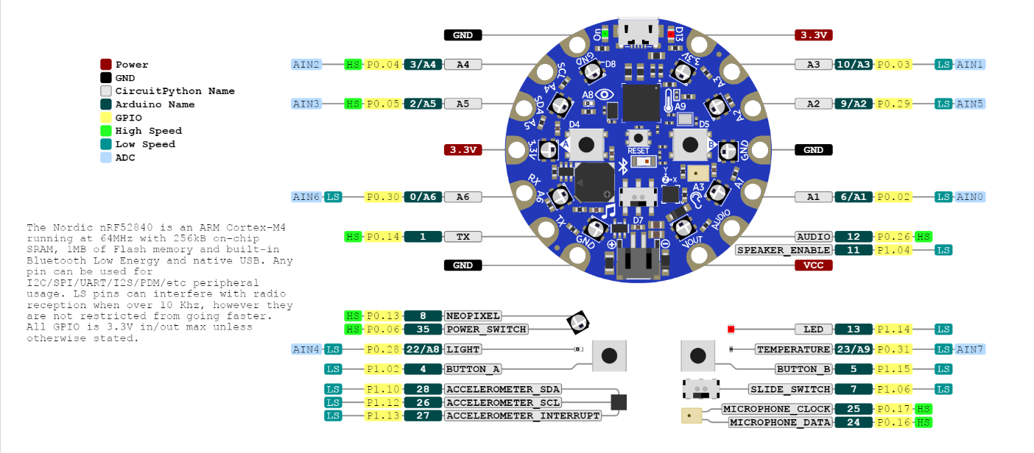
Pinouts

