Slide 1
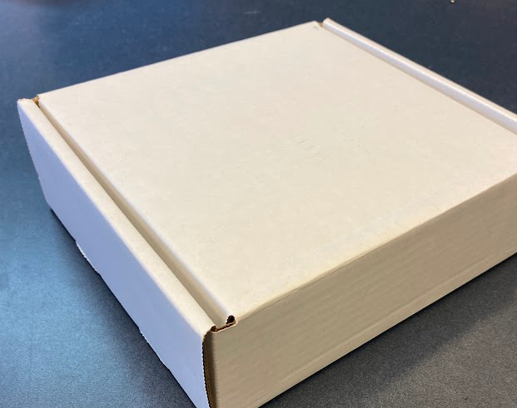
What's in your glove kit (Module 1)
Notes:
Potentially change the title image

Slide 2
Kit Contents (Section 1.0)

Slide 3
Overview
This module explains the contents of your glove kit, including pictures and quantities of all parts. The first slide also provides the Bill of Materials (BOM) for reference, in case you did not receive your kit directly from Space Grant.

Slide 4
Bill of Materials (BOM)

Slide 5
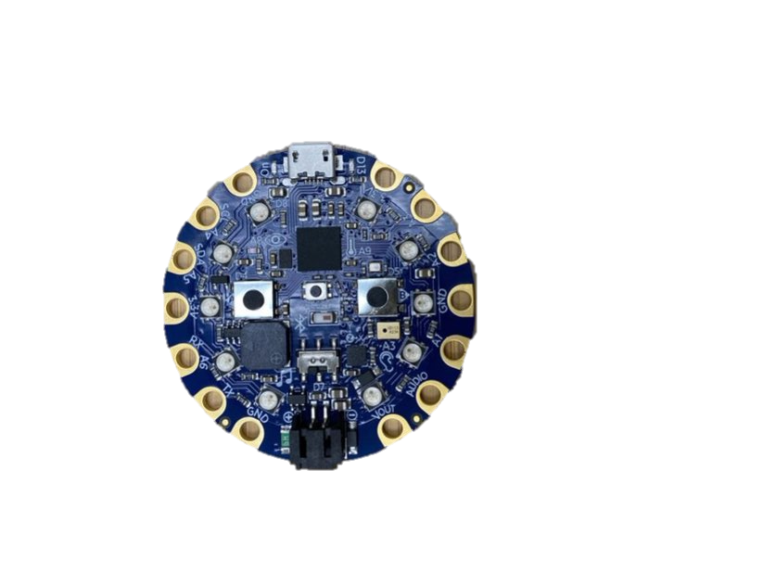
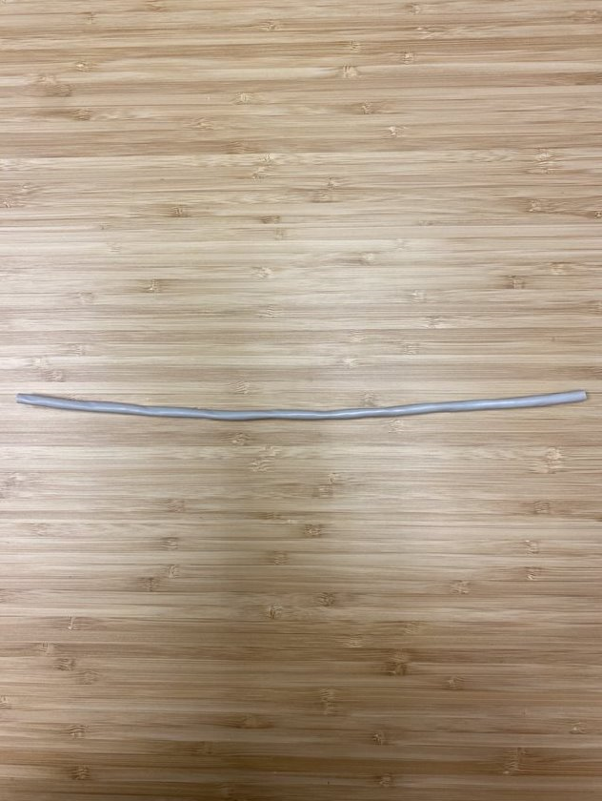
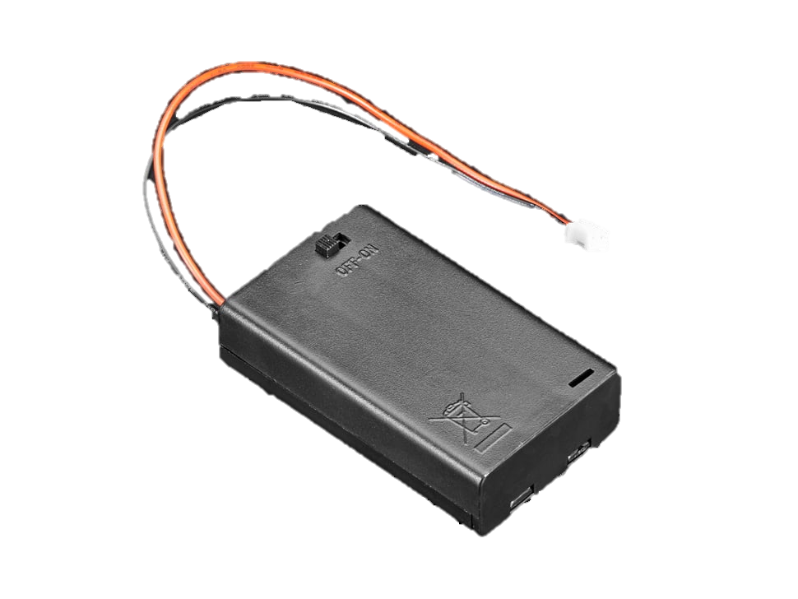
Electronics (1 of 2)
1x Circuit Playground BlueFruit (CPB)
1x 3xAAA Battery Pack
(3.3v)
1x (1x1)" Breakout Board
1x 12" Ethernet Cables
Notes:
Make a note that they could get a LiPo Battery.

Slide 6
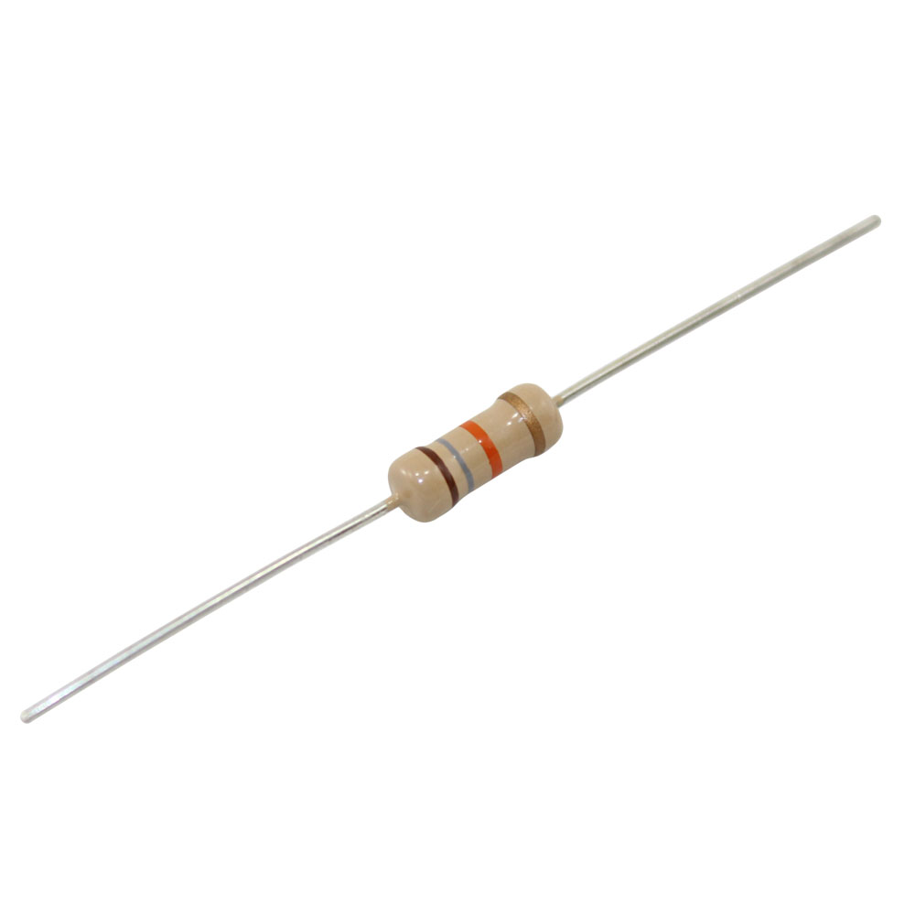
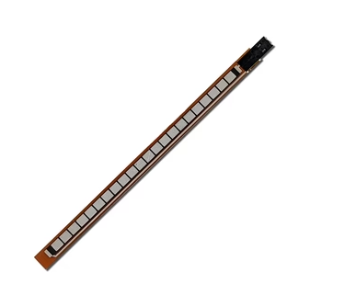
Electronics (2 of 2)
3x 55mm Spectra Flex Sensors (Female Type)
9x 18kΩ Resistors
Notes:
Change flex sensor photo

Slide 7
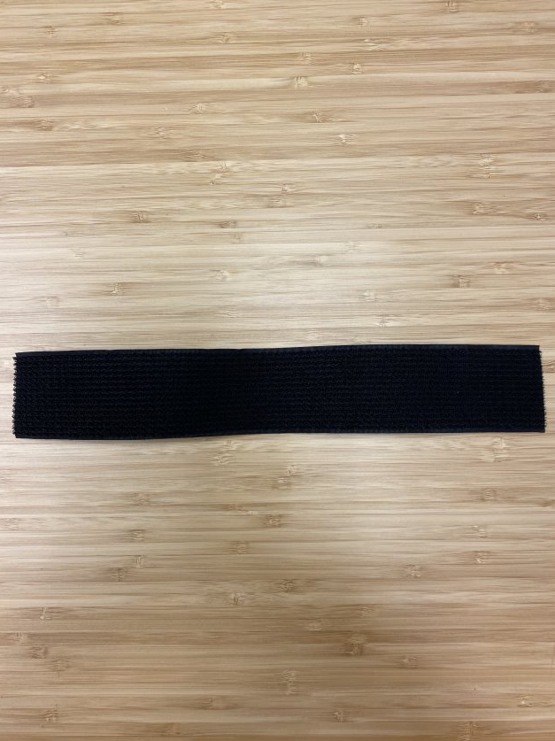
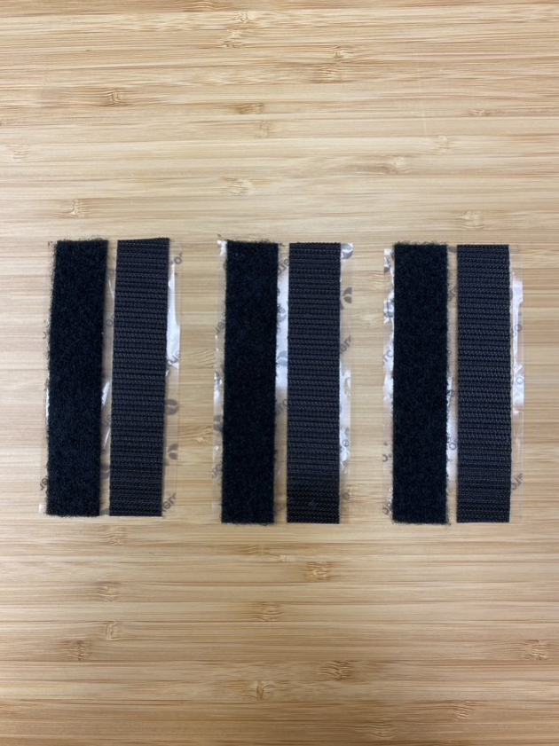
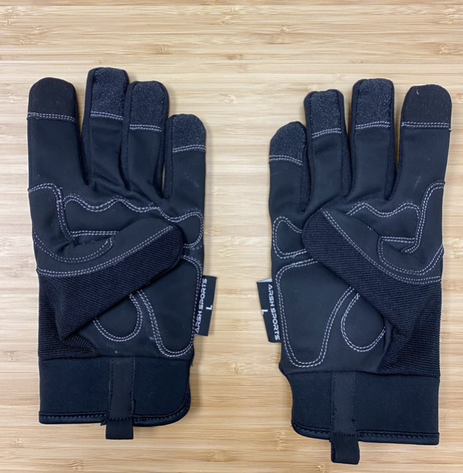
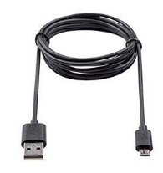
Hardware
1x 12" Black Velcro Strip (Wrist/All Purpose)
3x 4" Black Velcro Strip (Sensors)
2x Medium Black Gloves (Left & Right)
3’ USB to Micro USB Cable

