Slide 1
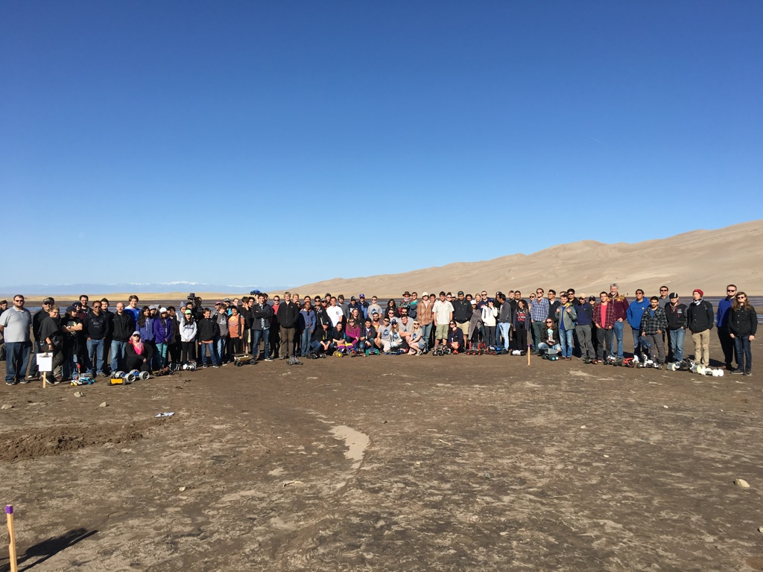
COSGC Robotics Challenge 24-25

Slide 2
Part of the Colorado Space Grant Consortium Experience
A statewide design challenge to provide students with hands-on experiences to develop engineering and science skills using the excitement of NASA. Great way to share and connect with other students from 20 institutions around Colorado.

Slide 3
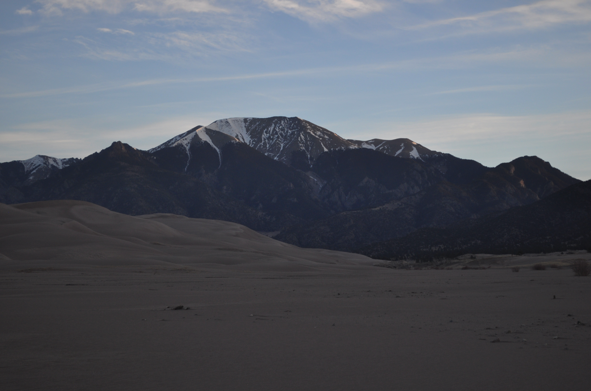
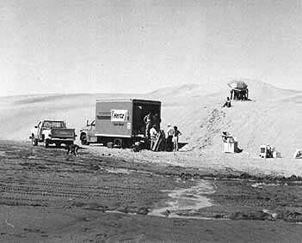
Location: Great Sand Dunes National Park
Inspired by the Viking Mars Lander missions of the 1970’s. Hardware for Mars was tested on the Dunes. Rental vans carried the hardware there from near Denver.

Slide 4
Challenge Basic Rules
Mass: Approx. 1.5 kg goal
Inexpensive: About $500 for final unit
Not harmful to the environment
No flying entries for safety
No GPS navigation to simulate the Mars environment.
The “is it about a cat” rule for size and mass.
Fun Team Recognition for unique and creative functioning designs.

Slide 5
Challenge Basic Rules
Several levels of success to engage all levels of students and inform build cycle
LEVEL 1: BASIC MOTION
Forward movement-direct line from start to finish
LEVEL 2: GETTING SMARTER
Obstacle avoidance: recognize obstacles and get around them (things on top of the sand, or holes in the ground).
Navigation: Reach goal after avoiding obstacles
LEVEL 3: CREATIVITY
Choose your own challenge! See recognition categories

Slide 6
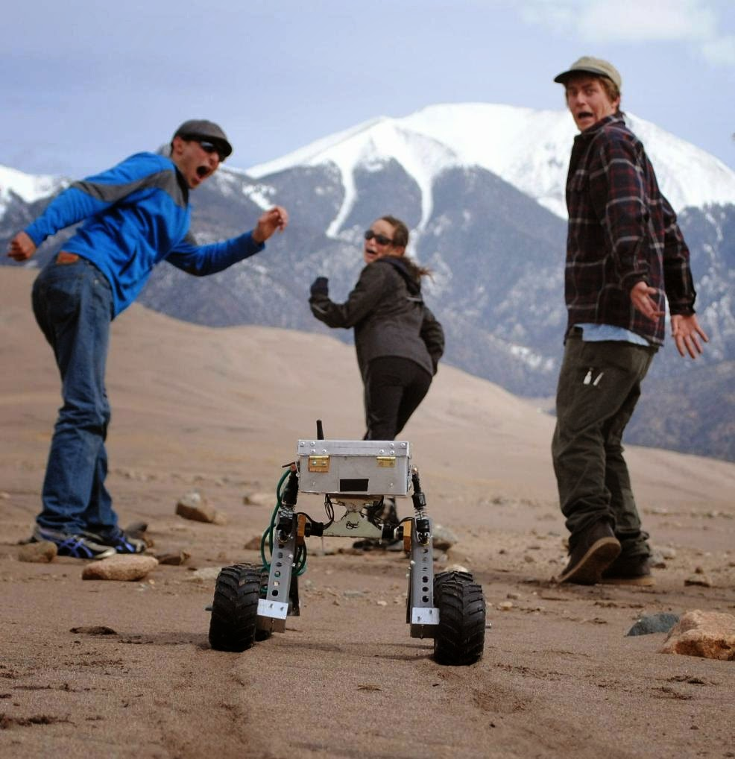
Robotics Challenge Overview
Several courses focusing on different levels of functionality.
Great way to engage new students from any experience level.
No team to team competition.

Slide 7
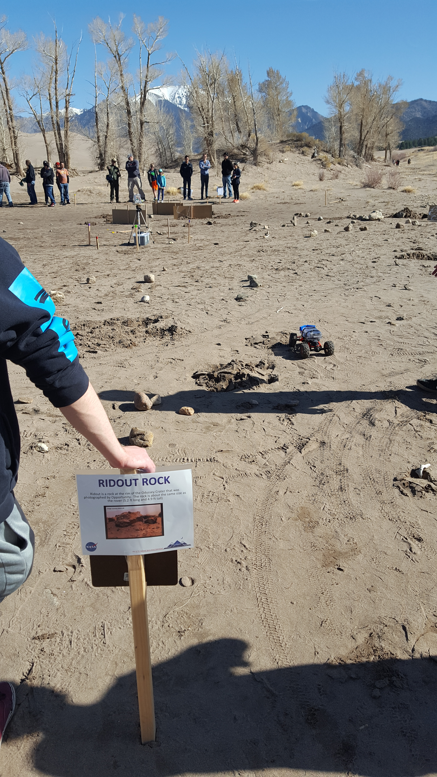
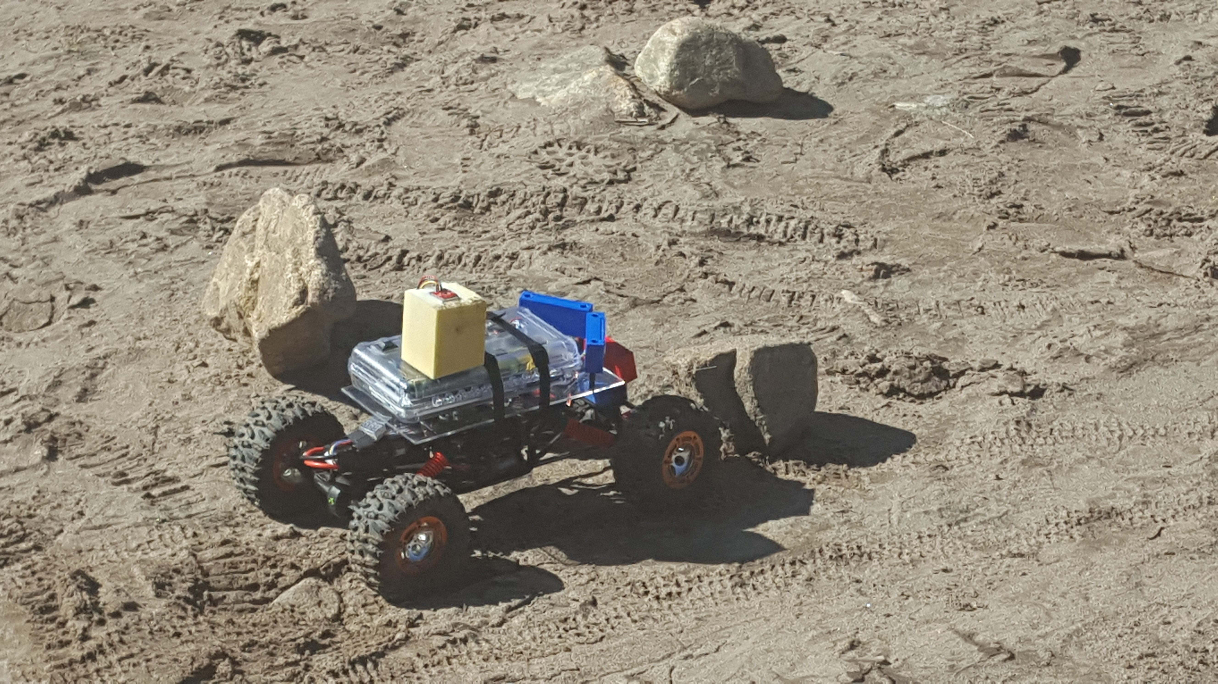
Team Design Recognition
The goals are to encourage development in these areas:
Motion
Navigation
Obstacle Avoidance
Advanced Automation/Autonomy

Slide 8
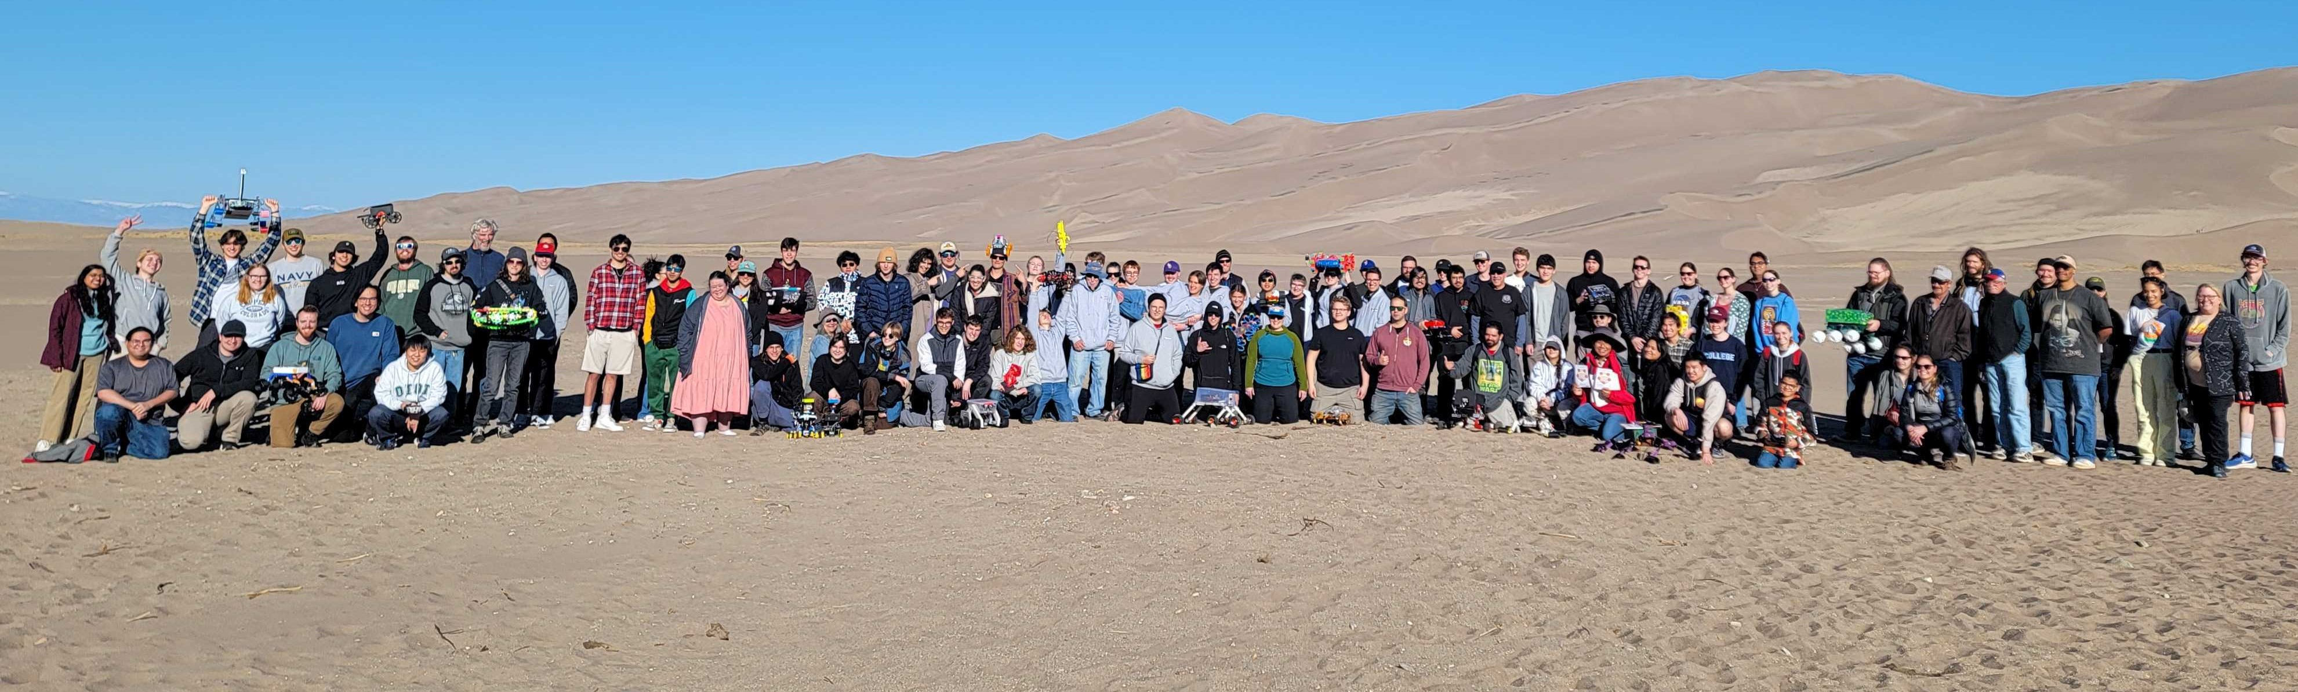
Challenge recognition categories
Best Overall < 1.5kg
Best Overall > 1.5kg
Mars Sojourner Award
Mars Spirit Award
Mars Opportunity Award
Outstanding Navigation
Creative Locomotion
Best Bioinspired Design
Best Advanced Autonomy
Attention to Detail

Slide 9
Night Before – System Checkout in Alamosa and sharing what works
Some teams use simple materials
Others have high level of complexity

Slide 10
The Morning of the Event ~150 people participate in addition to the spectators

Slide 11
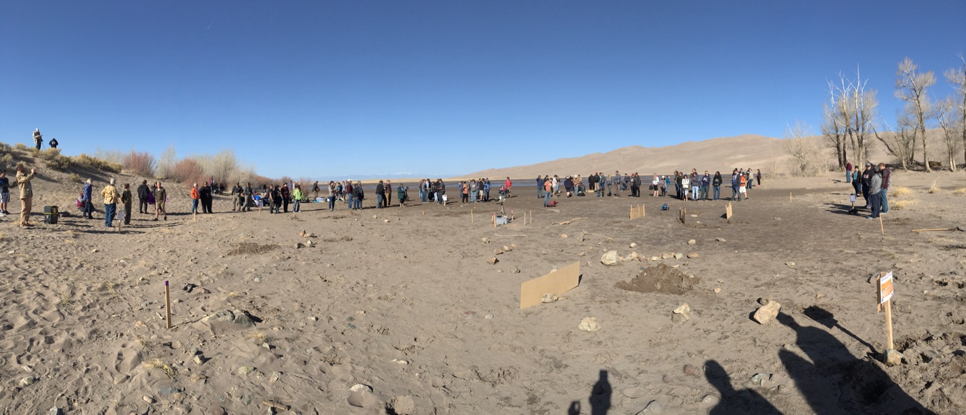
Course arena
There may be soft sand, hard pack sand, 1-2 ft deep ridges and large boulders. The course designs are not published in advance so have a good mechanical and intelligent robot system that can adapt to varying challenges. Be ready to reprogram your robot and make mechanical adjustment.

Slide 12
The Courses – Mars like terrain
Each robot will navigate just like NASA’s robots on Mars through the closest analog we have on Earth, the Dunes.

Slide 13
Course arena conditions
Be ready for anything!

Slide 14
Show off your creativity
Great new manufacturing techniques
Great mechanical and software creativity
It looks cool…but does it work???!

Slide 15
Visitors and peers will talk to your teams and learn about your designs. Be prepared to share your design approaches and what you learned.

Slide 16
Timeline
September – Team Registration opens
November – CoDR Week 11/11
January – New team CoDR
February – PDR Week
March – CDR Week and Video check-ins
April 11 – Team presentations on site @ASU
April 12 – Challenge day at the Dunes

Slide 17
Questions?

