Slide 1
Measuring Student Learning: Assessment 101
Derek Briggs
September 26, 2015

Slide 2
Measuring Student Learning: Assessment 101
Derek C. Briggs
University of Colorado
Aspen Institute Education Summit
September 26, 2015

Slide 3
Goals of this Session
To demystify
To help you fully appreciate the difference between classroom assessment and accountability testing.
Show you what’s new about recently developed tests by PARCC and Smarter-Balanced
Give you some questions to ask about “validity and reliability”
Argue for the importance of a balanced approach to student assessment.

Slide 4
The Role of (High-Stakes) Standardized Tests in the Measurement of Student Learning

Slide 5
Assessment Opportunities in Classroom Contexts
Lectures
End of Unit Tests
Projects
Quizzes
High-Stakes Standardized Tests
Teacher-developed Tests
Homework
In-class Activities
Interactive Games

Slide 6
High-Stakes Assessments (Standardized Tests) are Just One Part of this Universe
Lectures
End of Unit Tests
Projects
Quizzes
High-Stakes Standardized Tests
Teacher-developed Tests
Homework
In-class Activities
Interactive Games
Notes:
And they are used to answer a variety of different questions

Slide 7
ALIGNMENT

Slide 8
A Misaligned Educational Experience
State Standards
Standardized Testing
Curriculum & Instruction

Slide 9
An Aligned Educational Experience
Learning Objectives
Assessment
Curriculum & Instruction

Slide 10
Assessment FOR Learning: Formative Assessment
Periodic, timely and targeted FEEDBACK is the most critical ingredient
Source for Graphic: http://blogs.darienps.org/jchirles/2014/08/20/formative-assessment/
Notes:
To get and give feedback on learning.
Feedback must be timely
Feedback must be targeted and specific
Feedback should go in both directions
Not just about what students don’t understand, but about what teachers can do about it.

Slide 11
Assessment OF Learning: Summative Assessment
Source: Adapted from Pellegrino, Wilson & Koenig (2014)
Notes:
To rank and grade students
To support high-stakes decisions
Certification
Admission
Placement/Advancement
Graduation
To hold teachers and schools accountable

Slide 12
“Criterion-Referenced” Information
Source: http://nces.ed.gov/nationsreportcard/itemmaps/

Slide 13
“Norm-Referenced” Information
A student who has scored 1 standard deviation below average in grade 4 only scores higher than about 16% of other students taking the same test.
16%

Slide 14
Using Tests for Accountability
Academic achievement is the key goal of schooling
Achievement can be measured validly by standardized tests
Consequences motivate school personnel and students
Improved Instruction and higher levels of achievement will result
Unfortunate Unintended Consequences are Minimal
Source: Fuhrman (2004)

Slide 15
Not all Standardized Tests are Created Equally: Judging the Quality of a Testing Program

Slide 16
Hypothetical Development and Implementation Timeline for a New Test
Specify inferences, claims and decisions that test scores are intended to support.
Design the test within existing constraints (budget, timeline)
Develop the test questions (items, tasks)
Pilot test & field test the items, conduct statistical analyses
Administer the assessment
Set performance/achievement levels
Send out score reports
Provide documentation in support of validity, reliability and fairness of scores
Conduct ongoing evaluation studies

Slide 17
The Life-Cycle of a Test Item
Cost of creating a new multiple-choice item is about $1500.
Creating a new performance-based task (with scoring rubric) is about $4500.
Source: Scott Marion, Center for Assessment, personal communication

Slide 18
The Role of Psychometricians
Part technician, part engineer.
Ensuring the tests are built with
target levels of precision/reliability,
scores on a common scale that can be equated across different test forms,
items that are not biased against certain groups of students.

Slide 19
How are the Kinds of Tests Developed by PARCC and Smarter-Balanced Different from Tests of the Past?

Slide 20
How are New Tests Different?
Digital Interface (Computers, Tablets)
Written to measure new standards
Greater emphasis on pathway to college and career readiness
Open-ended tasks: Not just what kids know, but what they can do with what they know
MATH: Reasoning, modeling
READING/WRITING: Synthesizing ideas, supporting claims with evidence

Slide 21
2005 Colorado Model Content Standards: “Standard 1”
“Students develop number sense and use numbers and number relationships in problem-solving situations and communicate the reasoning used in solving these problems.”
Grades 5-8: use the relationships among fractions, decimals and percents in problem-solving situations

Slide 22
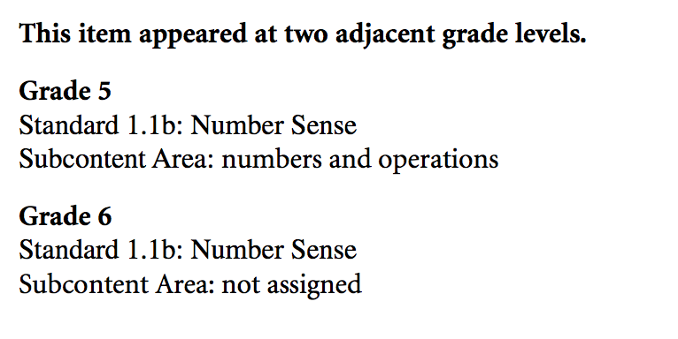
CO Grade 5 item on Fractions (from 2006 Test)

Slide 23
Common Core State Standards
Understanding of fractions has much greater emphasis in CCSS, focal area of math in grades 3-5. http://www.corestandards.org/Math/Content/NF/
By grade 5 students should be able to
Use equivalent fractions as a strategy to add and subtract fractions
Apply and extend previous understandings of multiplication and division of fractions

Slide 24
PARCC Item Design for Grade 5 Math
Major Content
in Grade 5
(B) Additional Supporting Content in Grade 5
“Type 1 Items”
(C) REASONING
(D) MODELING
“Type 2 Items”
“Type 3 Items”
Notes:
http://www.parcconline.org/assessments/test-design/mathematics/math-test-specifications-documents

Slide 25
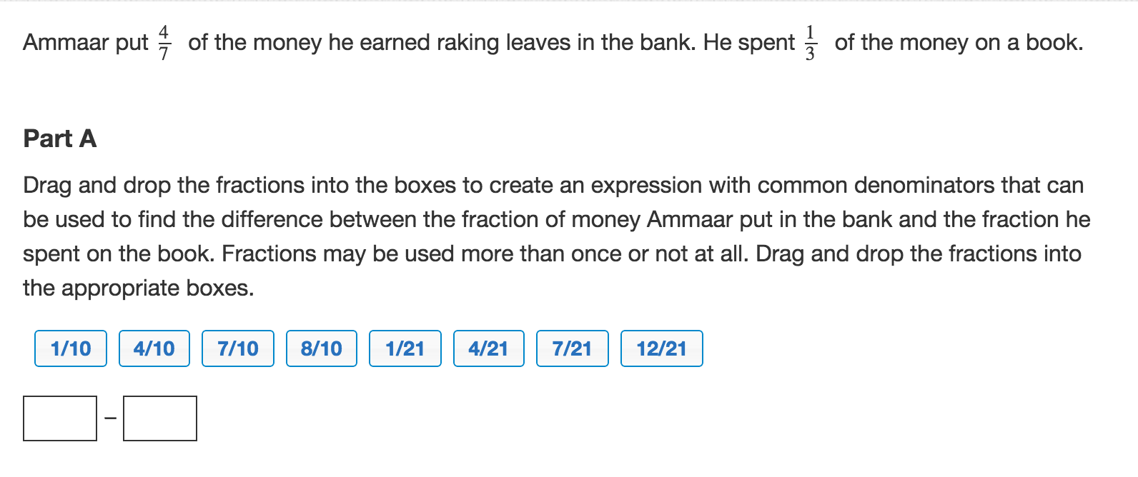
A PARCC Computer-based Type 1 Test Item

Slide 26
A PARCC Type 2 Item

Slide 27
Let’s Have a Look at Examples of “Performance-Based” (Open-Ended) Items from the Smarter-Balanced Consortium
http://www.smarterbalanced.org/practice-test/

Slide 28
Some Motivating Questions
To what extent do you think the answers to this task would reveal something valuable about what 5th grade students have or have not learned to do?
Is this the kind of task you expected to see on a large-scale standardized test?
What stands out to you about this task?

Slide 29
How do we know if a test is valid?
Depends on intended use, requires multiple sources of evidence.
Guidance on this is provided in Standards for Educational and Psychological Testing (4th Edition, 2014)
But in laymen’s terms, to paraphrase James Carville: it’s all about the items, stupid!

Slide 30
Key questions to ask
Are the intended interpretations and uses of test scores clearly stated?
How well is the test aligned to both standards and curricula?
Who developed the items, when were they developed, and according to what process?
Were all newly developed items field tested before being placed on the operational test? How were they screened?

Slide 31
How do we know if a test is reliable?
Would a student get the same score if we gave them a different set of items?
Tends to be easier to evaluate because this can be addressed by psychometricians with a single number or plot.
In general, as number of test items increase, so does reliability.
But items need to be targeted to ability level of students—this is challenging.

Slide 32
The Impact of Assessment on Student Learning

Slide 33
Does Testing for Accountability Increase Student Learning?
Little evidence in general that testing for accountability has a positive impact on student achievement or HS graduation.
Two recent studies found small improvements in math, no differences in reading attributable to NCLB
Goal of NCLB was 100% proficiency for all students by 2014, but no state met this goal
Sources: Carnoy & Loeb (2004); Dee & Jacob (2011); Wong, Cook & Steiner (2009)

Slide 34
Impact of Formative Assessment on Student Learning
Students do appear to learn more in classrooms where formative assessment is practiced.
The average impact of a curriculum invoking formative assessment is often about twice that of a teacher who is considered highly effective at increasing student achievement.
Bottom Line: More evidence that formative assessment practices have an effect on student learning than accountability testing.
Sources: Black & Wiliam (1998); Kingston & Nash (2011); Apthorp et al (2015)

Slide 35
Can We Bridge the Gap Between Formative (Classroom) and Large-Scale (Accountability) Assessment?
Yes!

Slide 36
Tradeoffs in Assessment Design
Accountability Guidance for Districts vs. Instructional Guidance for Individual Students
“Ironically, the questions that are of most use to the state officer are of the least use to the teacher.” (Pellegrino, Chudowsky, & Glaser, NRC, 2001

Slide 37
Shared Characteristics of Large-Scale and Classroom Assessments in an Ideal System
A shared model for student learning
A shared conception of disciplinary knowledge and competence
Focus on evaluating understanding and reasoning
Offer a clear vision for what constitutes “mastery”
Include complex and challenging items that are open to multiple solution strategies.

Slide 38
Learning Progressions
http://www.colorado.edu/cadre/

Slide 39
Thank You

Slide 40
References
Apthorp, H., Klute, M., Harlacher, J., & Reale, M. (2015). Formative assessment intervention effects on student academic achievement: A review of efficacy evidence in the elementary grades (REL 2015–0TK). Washington, DC: U.S. Department of Education, Institute of Education Sciences, National Center for Education Evaluation and Regional Assistance, Regional Educational Laboratory Central. Retrieved from http://ies.ed.gov/ncee/edlabs.
Black, P. & Wiliam, D. (1998). Assessment and classroom learning. Assessment in Education: Principles, Policy & Practice, 5(1), 7–74.
Carnoy, M. & Loeb, S. (2004). Does external accountability affect student outcomes? A cross-state analysis. In S. Fuhrman and R. F. Elmore (Eds.), Redesigning accountability systems for education. Teachers College. Columbia University.
Dee, T. S., & Jacob, B. (2011). The Impact of No Child Left Behind on Student Achievement. Journal of Policy Analysis and Management, Vol. 30, No. 3, 418–446
Fuhrman, S. H. (2004). Introduction. In S. Fuhrman and R. F. Elmore (Eds.), Redesigning accountability systems for education. Teachers College. Columbia University.
Kingston, N. & Nash, B. (2011). Formative assessment: A meta-analysis and a call for research. Educational Measurement: Issues and Practice, 30(4), 28–37.
Pellegrino, J., Wilson, M, & Koenig, J. (2014). Developing Assessments for the Next Generation Science Standards. Committee on Developing Assessments of Science Proficiency in K-12; Board on Testing and Assessment; Board on Science Education; Division on Behavioral and Social Sciences and Education; National Research Council.
Wong, M, Cook, T. D., & Steiner, P. (2011). No Child Left Behind: An interim evaluation of its effects on learning using two interrupted time series each with its own non-equivalent comparison series. Working Paper. Retrieved September 24, 2015 from http://www.ipr.northwestern.edu/publications/papers/2009/ipr-wp-09-11.html.

Slide 41
Extra Slides

Slide 42
Unintended Consequences? Time Spent on Standardized Testing (2013-14)
Findings from a recent study by the Center for American Progress:
Despite the perception that federally mandated state testing is the root of the issue, districts require more tests than states.
Students are tested as frequently as twice per month and an average of once per month.
Actual test administration takes up a small fraction of learning time (~2% of instructional time).
There is a culture of testing and test preparation in schools.
https://www.americanprogress.org/issues/education/report/2014/10/16/99073/testing-overload-in-americas-schools/

Slide 43
Using Tests to Measure Efficacy of Teachers and Schools
IF the results of large-scale achievement tests can be used to identify
Effective and ineffective teachers
Effective and ineffective principals/schools
and IF the case can be made that the tests themselves are valid and reliable measures of what students know and can do.
THEN this might serve as a good justification for an increase in time allocated to standardized testing.

Slide 44
The Concept of Test Score Inflation
Achievement in TX appeared to grow much faster than Achievement in MD when comparisons made relative to each state tests
When compared with respect to a common test with low stakes (NAEP), this advantage disappears

Slide 45
The Full PARCC Assessment System

Slide 46
PARCC Testing Time (Grade 5)
Test |  | Performance-based |  |  | End of Year |  | Total
 | Session | 1 | 2 | 3 | 1 | 2
ELA | Max Time | 75 | 90 | 60 | 75 |  | 300
 | Est Time | 50 | 60 | 40 | 50 |  | 200
Math | Max Time | 80 | 70 |  | 75 | 75 | 300
 | Est Time | 55 | 50 |  | 50 | 50 | 205
Max Time on Task Across Subjects = 10 hours
Estimated time on Task = about 7 hours

Slide 47
Opting Out
Questions parents should ask themselves:
What (financial) impact could this decision have on my child’s school?
Has my child been given the opportunity to learn what is being tested?
Is the specific test any good?
What is testing time being replaced with?
If we are opting out of this, to what will we be opting in?

Slide 48
Features of a Balanced Assessment System
Comprehensiveness: multiple measures to enhance validity & fairness
Coherence: shared conceptual model of student learning
Continuity: measure student progress over time

