Slide 1
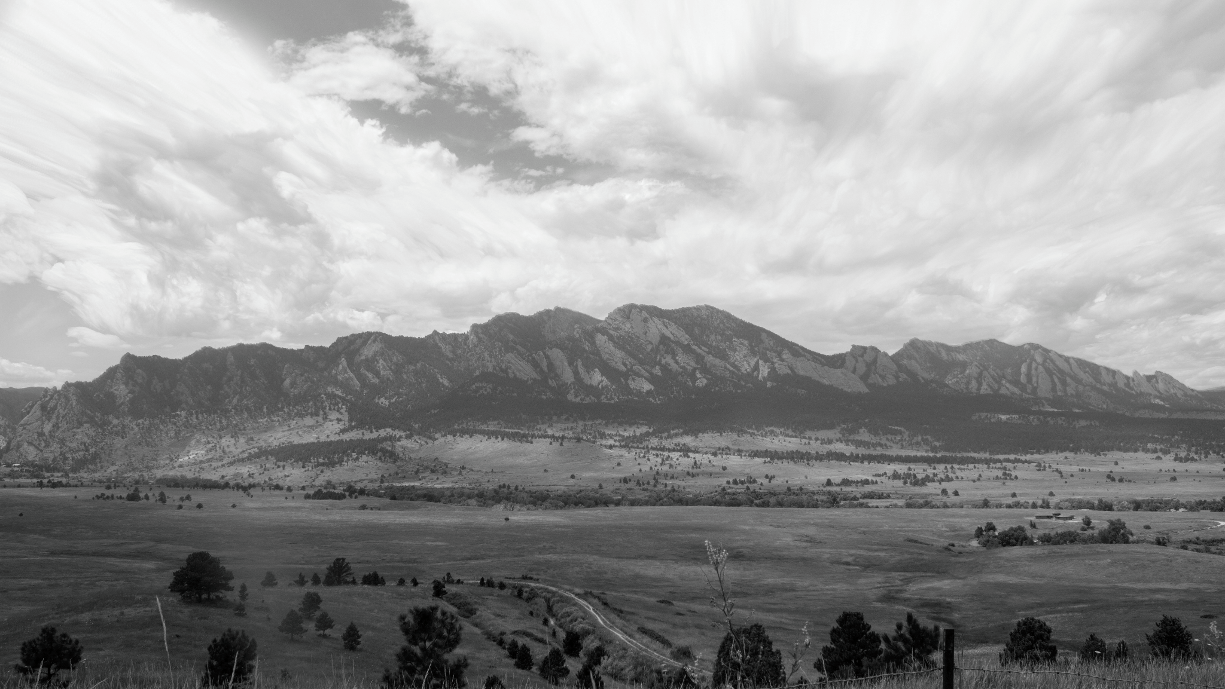
Spring Commencement
2024

Slide 2
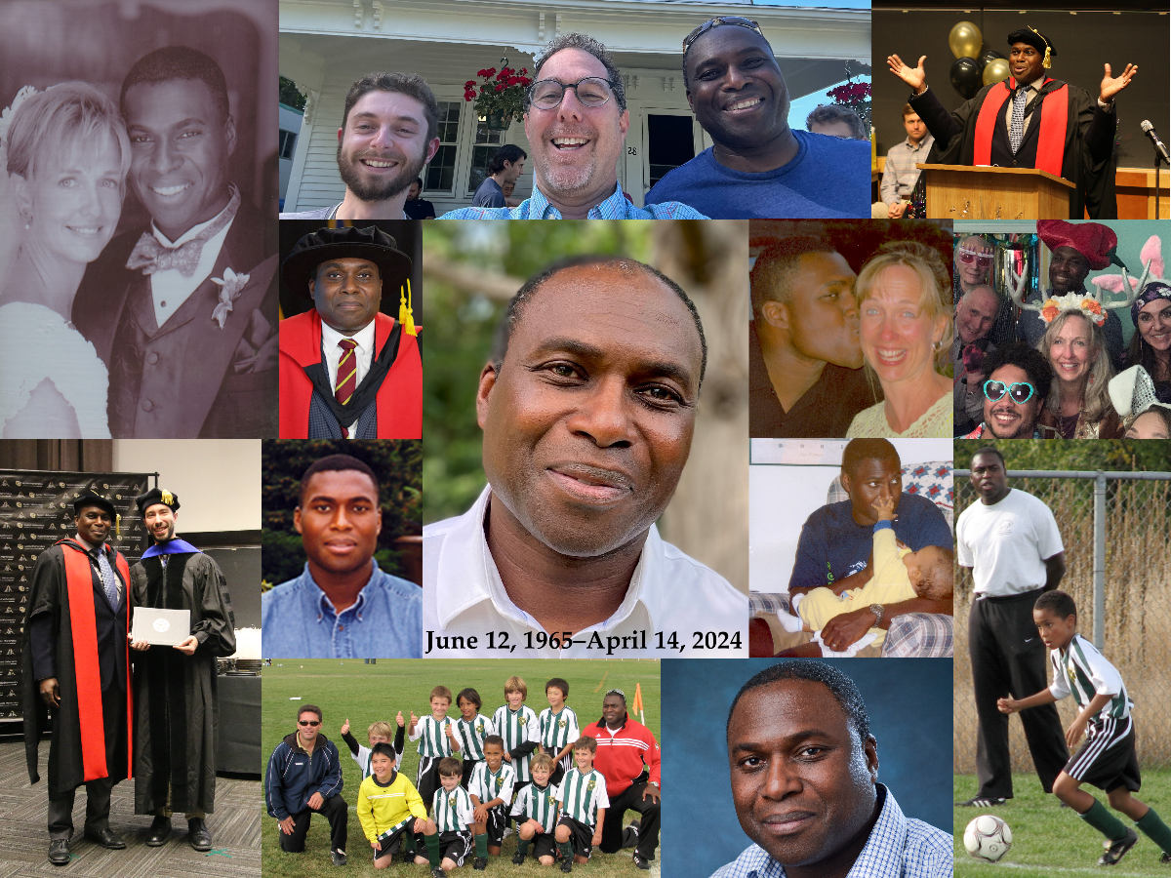
In Memoriam

Slide 3
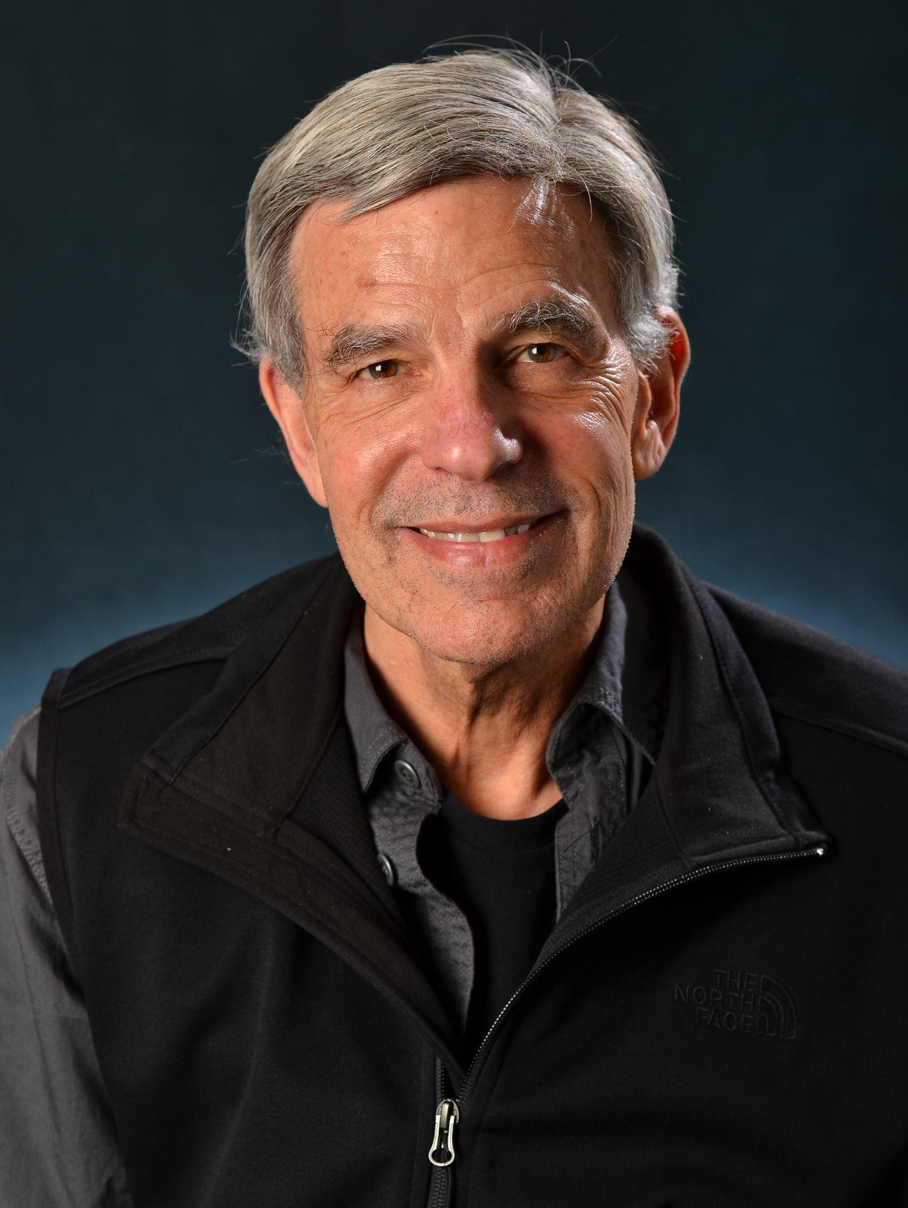
A Message From
Interim Department Chair Mark J. Ablowitz
On behalf of the faculty and staff of Applied Mathematics,
Congratulations Class of 2024! We are pleased to welcome you as new alumni and we wish you all a very fruitful journey as you embark on this new phase of your life. Please stay in touch.

Slide 4
Sabina Adhikari (Advisor: Dr. Juan G. Restrepo)
Thesis Title: Synchronization of Phase Oscillators on Hypergraphs
Caitlin Berry (Advisor: Dr. William Kleiber)
Thesis Title: Subordinated Processes and Spectral Analysis for High Frequency Time Series
Heather Lynn Cihak (Advisor: Dr. Zachary Kilpatrick)
Thesis Title: The Impact of Synaptic Dynamics on Working Memory in Neural Field Equations.
Kevin Doherty (Advisor: Dr. Stephen Becker)
Thesis Title: Numerical Methods for Non-Uniform Data in Machine Learning
Evan Gorman (Advisor: Dr. Manuel E. Lladser)
Thesis Title: Learning Sparse Representations of Hierarchically Structured Data With Applications to Comparative Metagenomics
Andrew Lawrence (Advisor: Dr. Bengt Fornberg)
Thesis Title: Advancements in Numerical Modeling: High-Order Methods for Fractional Initial Value Problems and Meshfree Solvers for Partial Differential Equations
Yifeng Mao (Advisor: Dr. Mark Hoefer)
Thesis Title: Two-Phase Wave Interactions and Periodic Wavemaker Problem in Dispersive Hydrodynamics
Sam Zhang (Advisor: Dr. Aaron Clauset)
Thesis Title: Statistical Models of Scientific Careers and Decision-Making
Applied Mathematics
Doctor of Philosophy Graduates

Slide 5
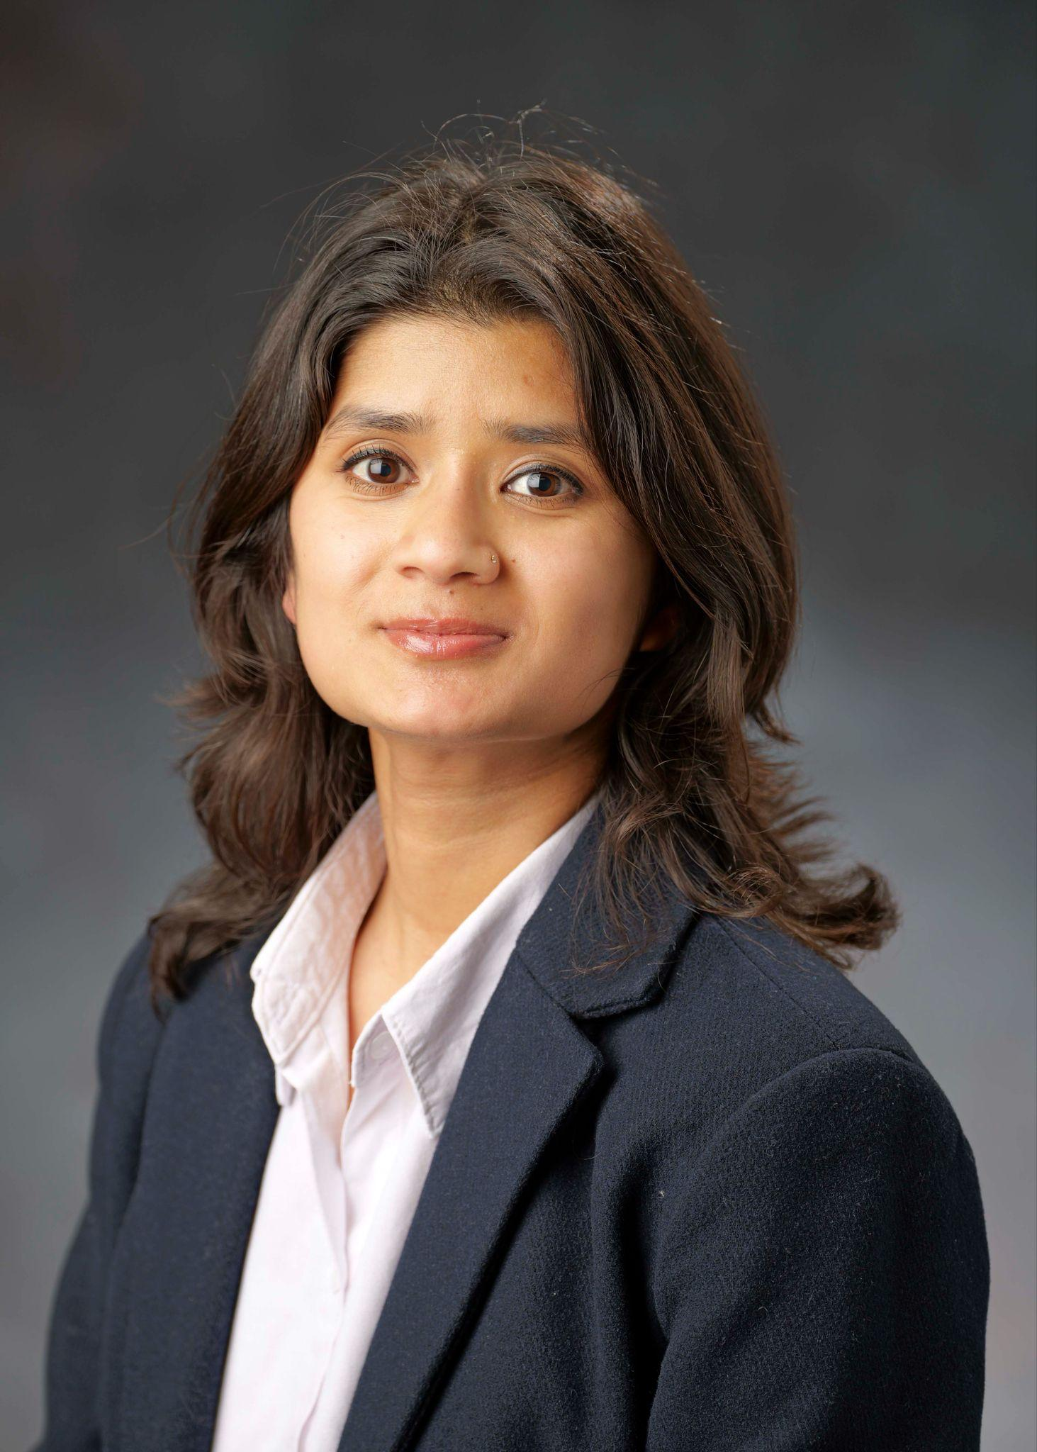
Sabina Adhikari
Doctorate of Philosophy, Applied Mathematics
I have loved insightful discussions with my professors and peers.
Also, I loved the view of flatirons from the campus.
Special thanks to my advisor Juan, my family, and other professors in APPM.
Notes:
INSTRUCTIONS
Click File -> Make a Copy -> Entire Presentation. RENAME the file in this format: “Jones_Indiana_PhD” saving it to your google drive.
Now you have your own editable file. Please make changes to the text in brackets (Click on the purple rectangle and a new action bar above the slide will populate. Please select “Replace image” and upload a portrait image with your face clearly visible, that you are comfortable being displayed publicly. Google Slides will automatically adjust the photo to fit within its size parameters. Please do not to adjust the size of your image or text boxes. (APPM staff will make formatting corrections later.)
Once your personalization is complete, please go to File -> Download -> Microsoft PowerPoint (.pptx) and save the file onto your computer.
Upload the recently downloaded .pptx file to the end of your commencement form

Slide 6
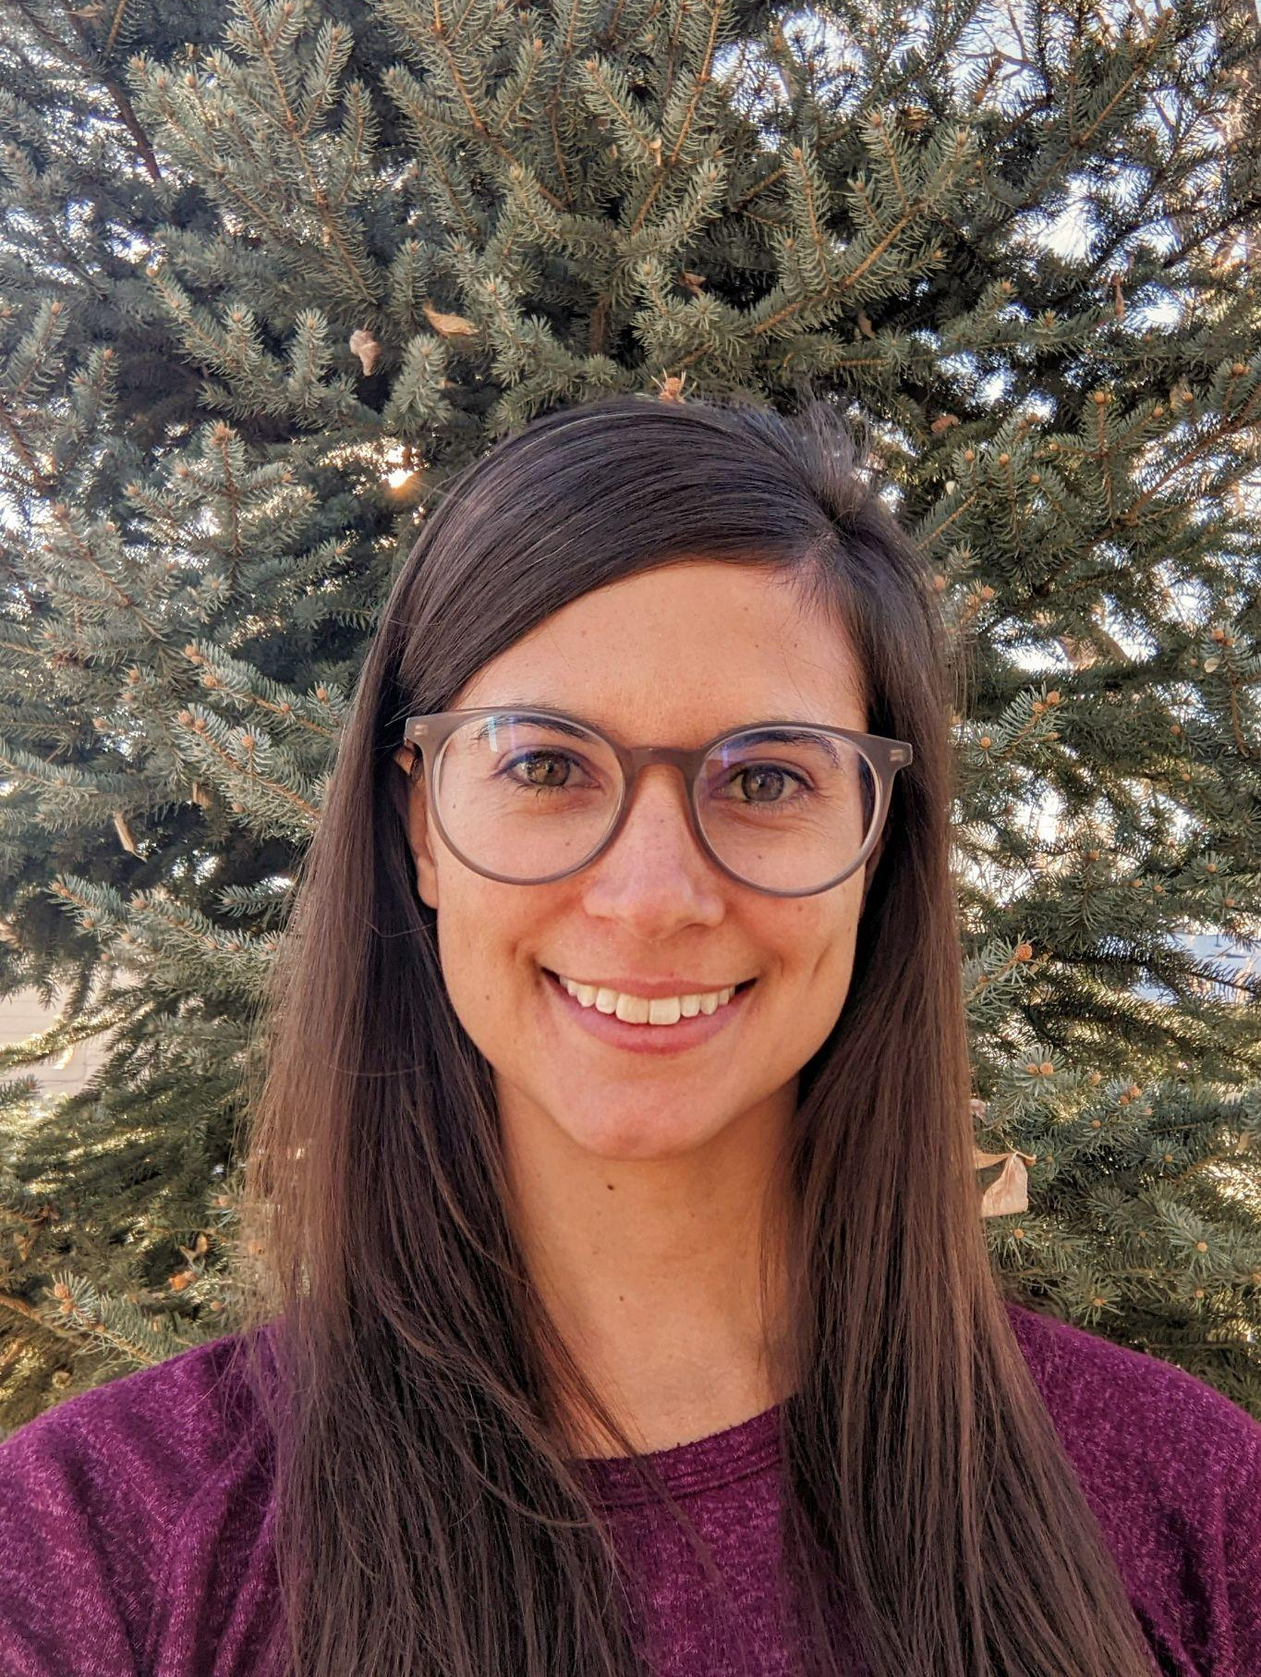
Caitlin Berry
Doctorate of Philosophy, Applied Mathematics
Caitlin’s dissertation research was in non-stationary time series modeling with various applications. During her time at CU Boulder, she was a research associate for the National Renewable Energy Lab and the National Institute for Standards and Technology and worked as a statistical collaborator for the Laboratory for Interdisciplinary Statistical Analysis for which she was awarded Outstanding Collaborator of the Year in 2020.
I have the deepest gratitude for my family and friends and my advisor Will Kleiber without whom this wouldn’t have been possible.
Notes:
INSTRUCTIONS
Click File -> Make a Copy -> Entire Presentation. RENAME the file in this format: “Jones_Indiana_PhD” saving it to your google drive.
Now you have your own editable file. Please make changes to the text in brackets (Click on the purple rectangle and a new action bar above the slide will populate. Please select “Replace image” and upload a portrait image with your face clearly visible, that you are comfortable being displayed publicly. Google Slides will automatically adjust the photo to fit within its size parameters. Please do not to adjust the size of your image or text boxes. (APPM staff will make formatting corrections later.)
Once your personalization is complete, please go to File -> Download -> Microsoft PowerPoint (.pptx) and save the file onto your computer.
Upload the recently downloaded .pptx file to the end of your commencement form

Slide 7
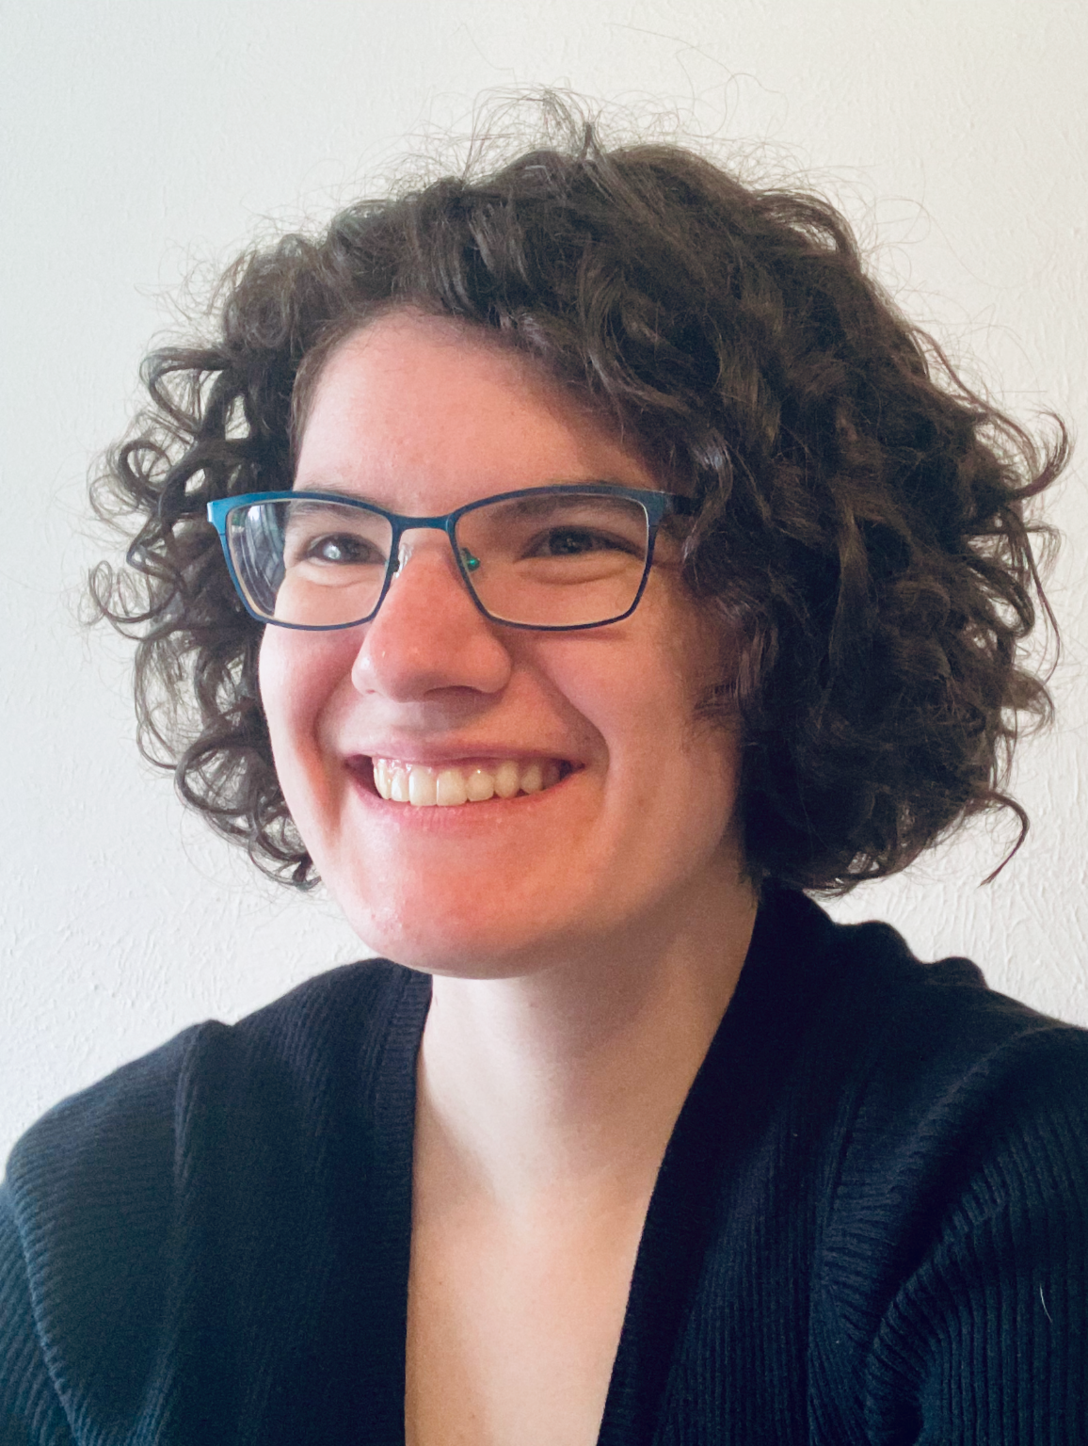
Heather Lynn Cihak
Doctorate of Philosophy, Applied Mathematics
Dissertation: The impact of synaptic dynamics on working memory in neural field equations.
Advisor: Zachary P. Kilpatrick
Heather’s work focused on developing more biologically realistic continuum neural field models of brain activity thought to underlie information maintenance in working memory. Throughout her time in the program she also pursued brief studies in literature, creative writing, and printmaking.
Heather will be starting a teaching postdoc this fall at the University of Minnesota.
Thank you to my family and friends, advisor, mentors, and committee for their advice and support throughout this adventure. I could not have done it without you and am excited for my next quest!
Notes:
INSTRUCTIONS
Click File -> Make a Copy -> Entire Presentation. RENAME the file in this format: “Jones_Indiana_PhD” saving it to your google drive.
Now you have your own editable file. Please make changes to the text in brackets (Click on the purple rectangle and a new action bar above the slide will populate. Please select “Replace image” and upload a portrait image with your face clearly visible, that you are comfortable being displayed publicly. Google Slides will automatically adjust the photo to fit within its size parameters. Please do not to adjust the size of your image or text boxes. (APPM staff will make formatting corrections later.)
Once your personalization is complete, please go to File -> Download -> Microsoft PowerPoint (.pptx) and save the file onto your computer.
Upload the recently downloaded .pptx file to the end of your commencement form

Slide 8
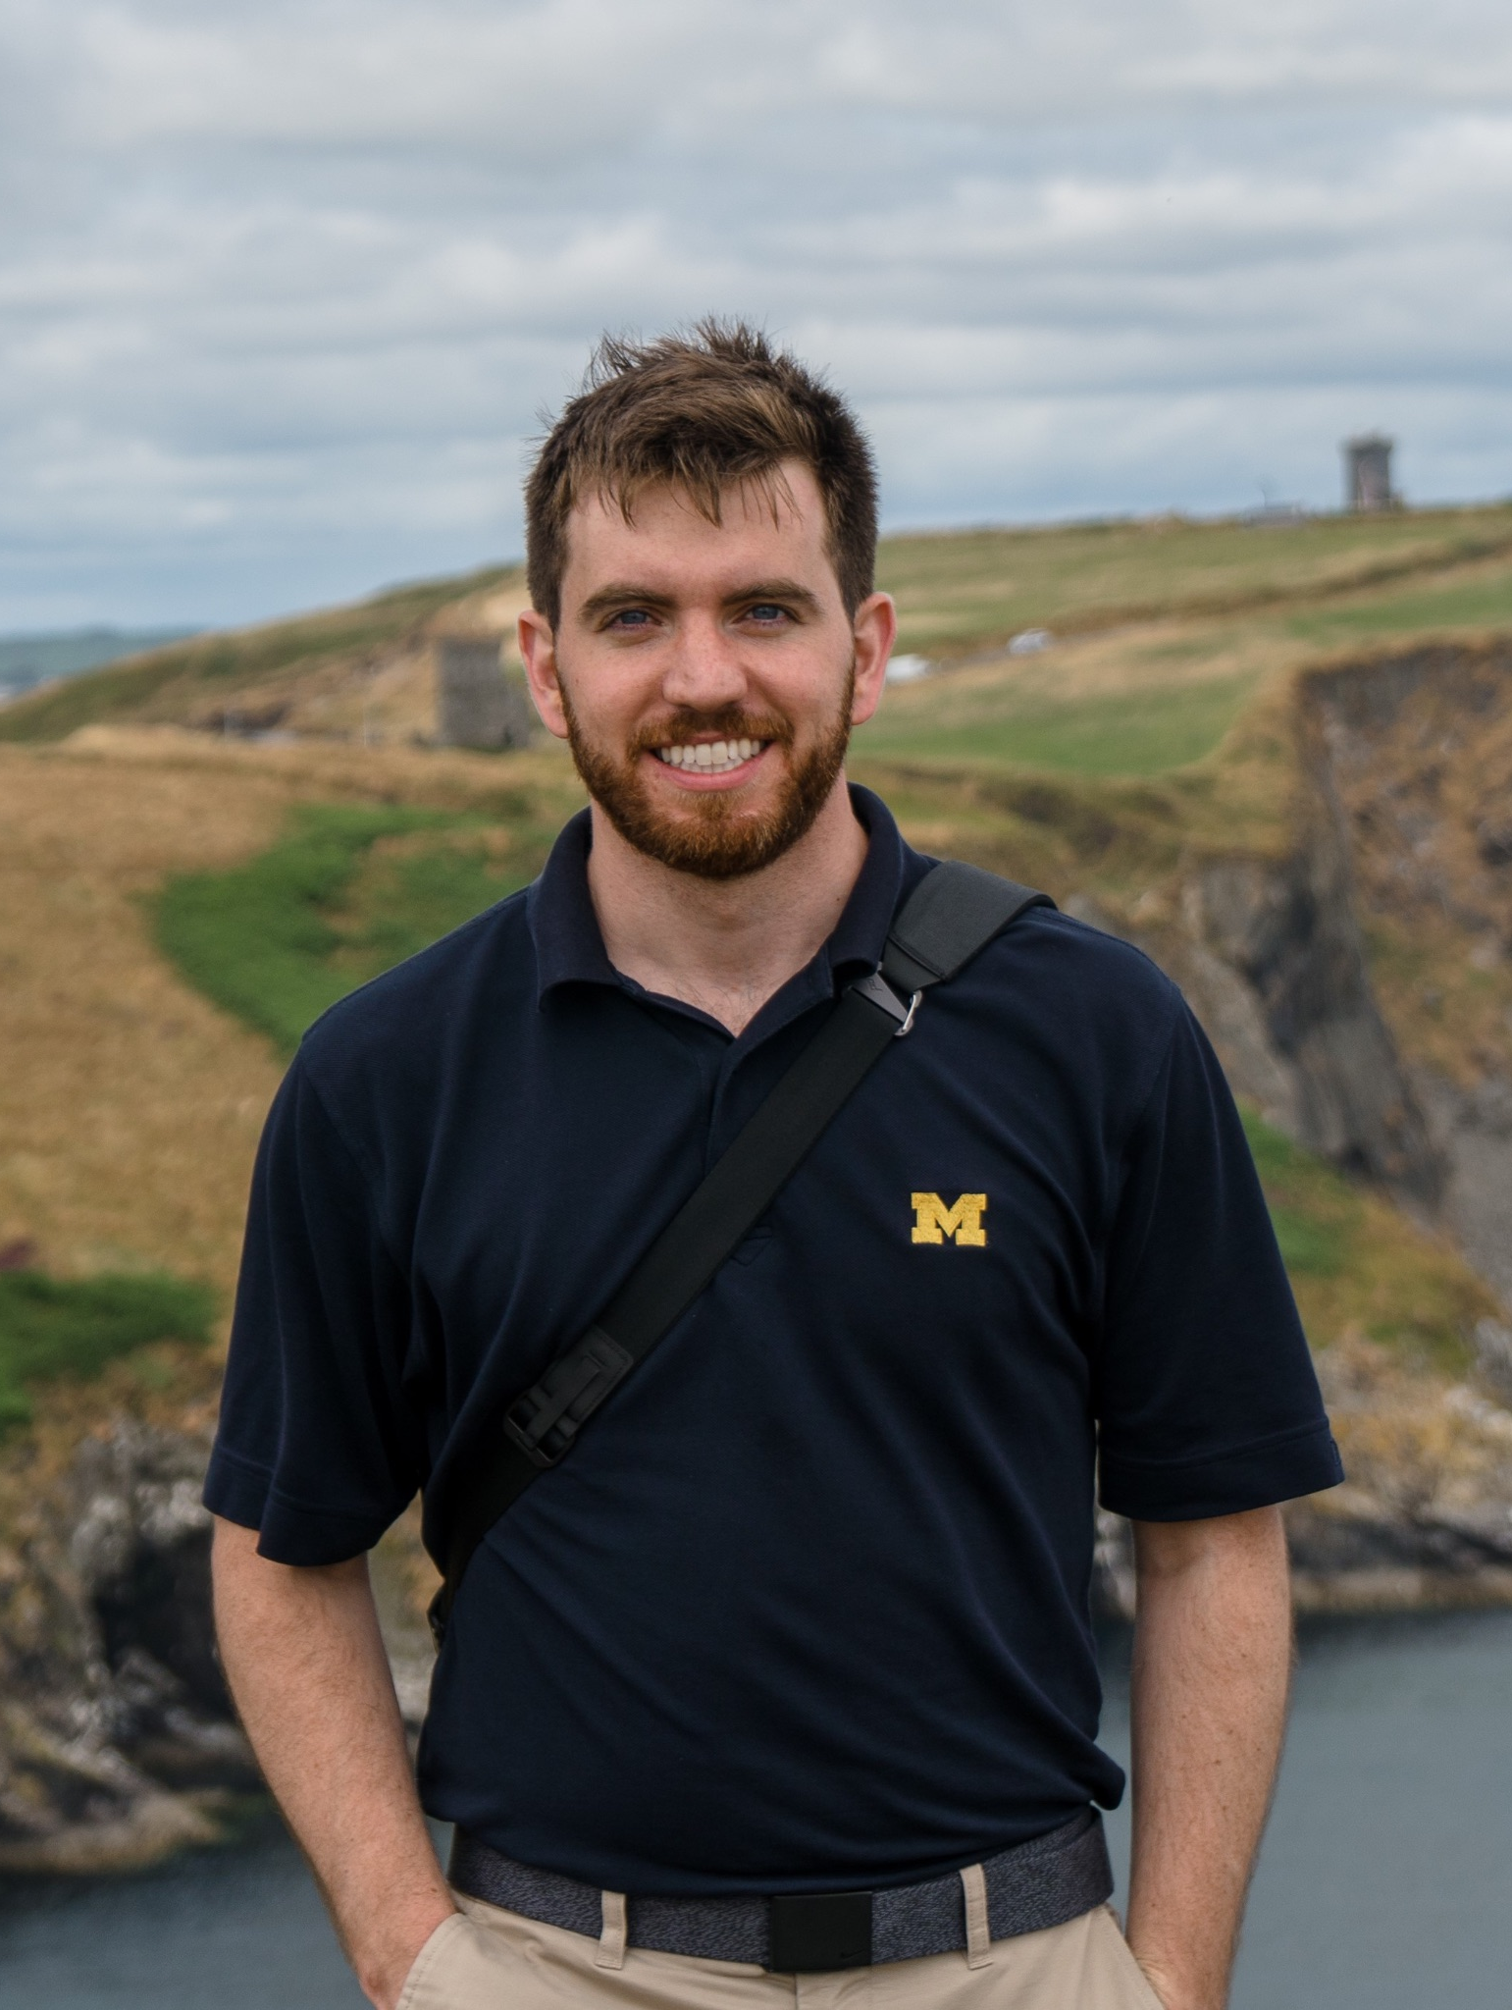
Kevin Doherty
Doctorate of Philosophy, Applied Mathematics
The CU Boulder Applied Mathematics department has been a fantastic place to spend the last 5 years. I will forever be grateful to the inspiring and brilliant individuals whom I have had the good fortune to do research with.
My advisors Stephen Becker and Alireza Doostan have been a constant source of creativity, and I hope to carry their persistence and curiosity forward in my own career.
A special thanks to my friends and family for all of their support, I could not have made it this far without you
Notes:
INSTRUCTIONS
Click File -> Make a Copy -> Entire Presentation. RENAME the file in this format: “Jones_Indiana_PhD” saving it to your google drive.
Now you have your own editable file. Please make changes to the text in brackets (Click on the purple rectangle and a new action bar above the slide will populate. Please select “Replace image” and upload a portrait image with your face clearly visible, that you are comfortable being displayed publicly. Google Slides will automatically adjust the photo to fit within its size parameters. Please do not to adjust the size of your image or text boxes. (APPM staff will make formatting corrections later.)
Once your personalization is complete, please go to File -> Download -> Microsoft PowerPoint (.pptx) and save the file onto your computer.
Upload the recently downloaded .pptx file to the end of your commencement form

Slide 9
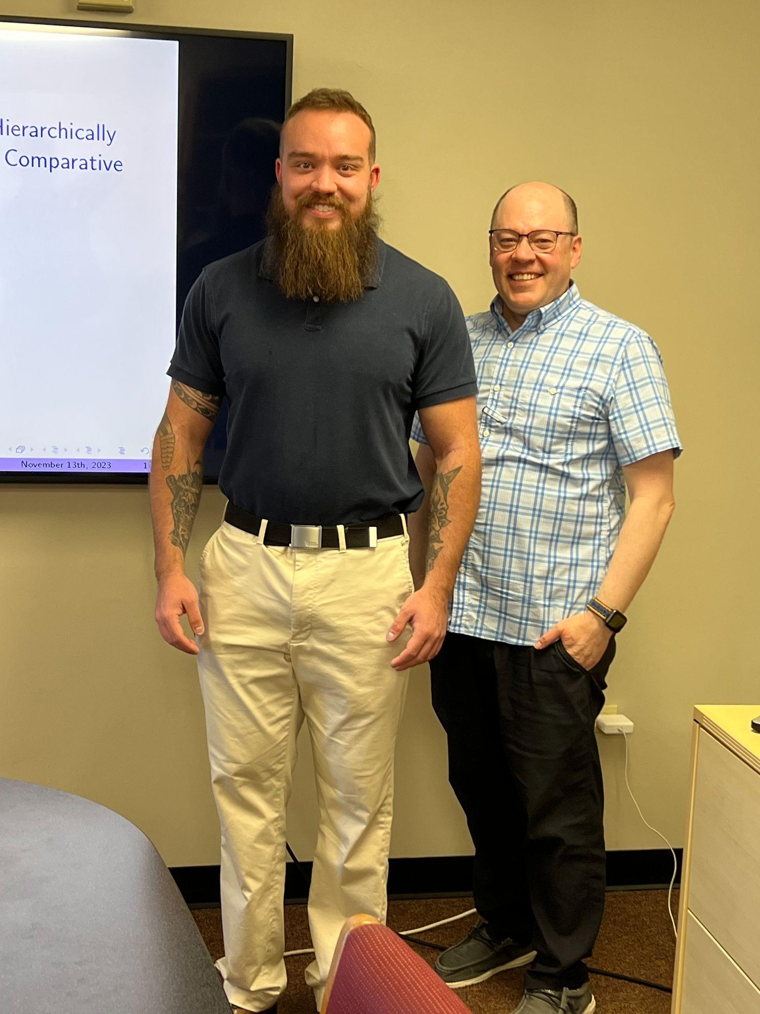
Evan Gorman
Doctorate of Philosophy, Applied Mathematics
I am grateful for the experiences and training I received from this department. I plan to pursue a career in research and at this time am interviewing at DARPA, NREL, and various postdocs.
Thank you to my advisor, fiancée, and parents for their support.
Notes:
INSTRUCTIONS
Click File -> Make a Copy -> Entire Presentation. RENAME the file in this format: “Jones_Indiana_PhD” saving it to your google drive.
Now you have your own editable file. Please make changes to the text in brackets (Click on the purple rectangle and a new action bar above the slide will populate. Please select “Replace image” and upload a portrait image with your face clearly visible, that you are comfortable being displayed publicly. Google Slides will automatically adjust the photo to fit within its size parameters. Please do not to adjust the size of your image or text boxes. (APPM staff will make formatting corrections later.)
Once your personalization is complete, please go to File -> Download -> Microsoft PowerPoint (.pptx) and save the file onto your computer.
Upload the recently downloaded .pptx file to the end of your commencement form

Slide 10
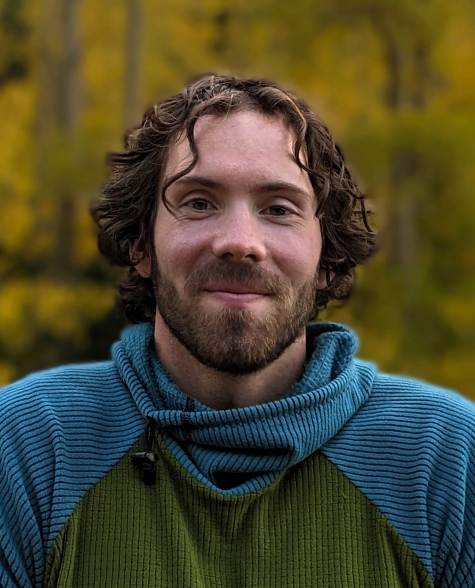
Andrew Lawrence
Doctorate of Philosophy, Applied Mathematics
Following graduation, Andrew will begin his role as an assistant professor at the Air Force Institute of Technology in Dayton, Ohio in the Department of Mathematics. Andrew was an active member of the graduate student body during his time at CU. He enjoying going to the gym with his buddy Jacob, chatting with peers during Tea Time, and playing rounds of Music Madness. He was the winner of the Winner of the 2022 APPM Holiday Bake-off. During his research, Andrew developed two new tools to model the real world. The first is a stepping stone to more efficiently and accurately model real-world scenarios in which a surface interface changes in time, such as water. The second is a state-of-the-art solver of a general class of fractional differential equations with a variety of applications from groundwater flow to financial market trends.
A special thanks to my parents, my community at Cornerstone, and Renee.
Notes:
INSTRUCTIONS
Click File -> Make a Copy -> Entire Presentation. RENAME the file in this format: “Jones_Indiana_PhD” saving it to your google drive.
Now you have your own editable file. Please make changes to the text in brackets (Click on the purple rectangle and a new action bar above the slide will populate. Please select “Replace image” and upload a portrait image with your face clearly visible, that you are comfortable being displayed publicly. Google Slides will automatically adjust the photo to fit within its size parameters. Please do not to adjust the size of your image or text boxes. (APPM staff will make formatting corrections later.)
Once your personalization is complete, please go to File -> Download -> Microsoft PowerPoint (.pptx) and save the file onto your computer.
Upload the recently downloaded .pptx file to the end of your commencement form

Slide 11
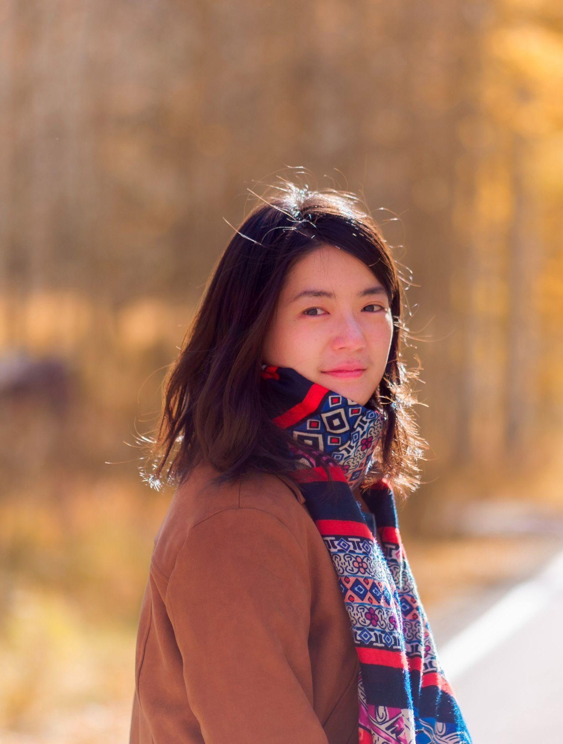
Yifeng Mao
Doctorate of Philosophy, Applied Mathematics
Yifeng Mao’s research focused on nonlinear waves and their interactions in dispersive hydrodynamics. She brings together theoretical, numerical and experimental approaches to study wave phenomena in geophysical flows. Yifeng has been a member of the Dispersive Hydrodynamics Lab, where her research roots and grows.
Yifeng will be joining the Scripps Institution of Oceanography as a postdoc fellow this summer.
I want to thank my family and friends for their love, my advisor Prof. Mark Hoefer for his support and inspiration, and everyone in APPM.
Notes:
INSTRUCTIONS
Click File -> Make a Copy -> Entire Presentation. RENAME the file in this format: “Jones_Indiana_PhD” saving it to your google drive.
Now you have your own editable file. Please make changes to the text in brackets (Click on the purple rectangle and a new action bar above the slide will populate. Please select “Replace image” and upload a portrait image with your face clearly visible, that you are comfortable being displayed publicly. Google Slides will automatically adjust the photo to fit within its size parameters. Please do not to adjust the size of your image or text boxes. (APPM staff will make formatting corrections later.)
Once your personalization is complete, please go to File -> Download -> Microsoft PowerPoint (.pptx) and save the file onto your computer.
Upload the recently downloaded .pptx file to the end of your commencement form

Slide 12
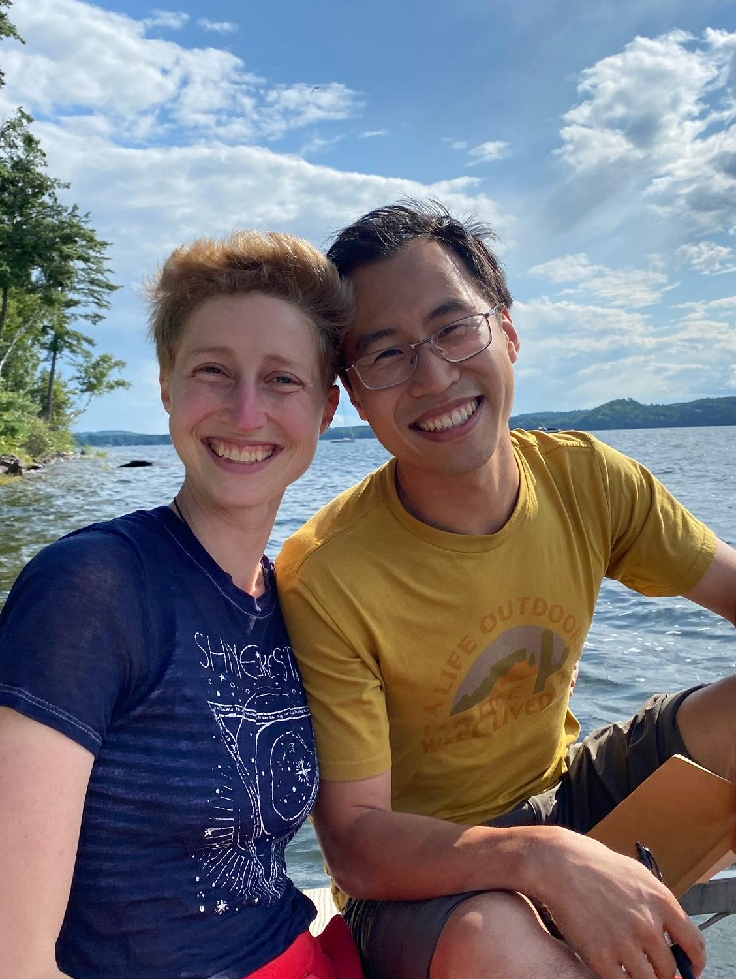
Sam Zhang
Doctorate of Philosophy, Applied Mathematics
Sam will be joining the University of Vermont Department of Statistics as an Assistant Professor in Fall 2025.
Come visit him in Burlington!
Thank you to Nora and Tulia.
I love you.
Notes:
INSTRUCTIONS
Click File -> Make a Copy -> Entire Presentation. RENAME the file in this format: “Jones_Indiana_PhD” saving it to your google drive.
Now you have your own editable file. Please make changes to the text in brackets (Click on the purple rectangle and a new action bar above the slide will populate. Please select “Replace image” and upload a portrait image with your face clearly visible, that you are comfortable being displayed publicly. Google Slides will automatically adjust the photo to fit within its size parameters. Please do not to adjust the size of your image or text boxes. (APPM staff will make formatting corrections later.)
Once your personalization is complete, please go to File -> Download -> Microsoft PowerPoint (.pptx) and save the file onto your computer.
Upload the recently downloaded .pptx file to the end of your commencement form

Slide 13
Master of Science Graduates
Anna Granquist
Tyler Jensen
Kaloyan Parvanov
John Quinn
Sean Svihla
Professional
Master of Science Graduates
Isabel Beaulieu
Ian Bircak
Claudia Chen
Connor Doyle Flaherty
Eric Flaska
Samuel Kwon
Bisman Singh
Gregory Tomy
Sam Touvannas
Rodger Zhang

Slide 14
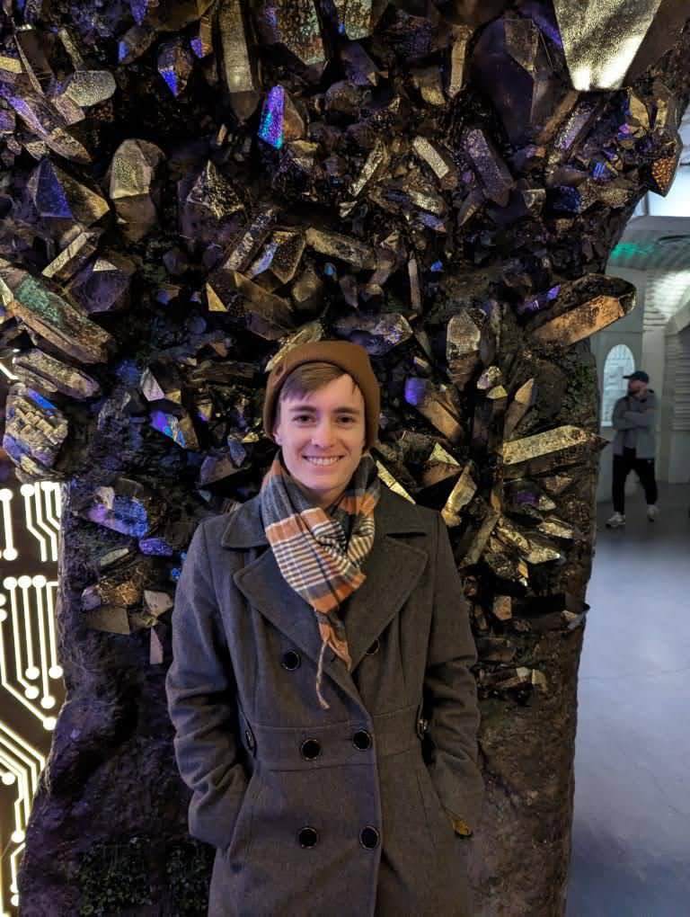
Anna Granquist
Master of Science, Applied Mathematics
I made some good friends through the applied math graduate program, and I value the personal and professional relationships that I built in my time here. One of my favorite parts about the program was working as a TA - I loved teaching with applied math and always looked forward to hosting office hours and interacting with students.
Thanks to my friends and family for coming :) It means a lot to have my people with me.
Notes:
INSTRUCTIONS
Click File -> Make a Copy -> Entire Presentation. RENAME the file in this format: “Jones_Indiana_MS” saving it to your google drive.
Now you have your own editable file. Please make changes to the text in brackets (Click on the purple rectangle and a new action bar above the slide will populate. Please select “Replace image” and upload a portrait image with your face clearly visible, that you are comfortable being displayed publicly. Google Slides will automatically adjust the photo to fit within its size parameters. Please do not to adjust the size of your image or text boxes. (APPM staff will make formatting corrections later.)
Once your personalization is complete, please go to File -> Download -> Microsoft PowerPoint (.pptx) and save the file onto your computer.
Upload the recently downloaded .pptx file to the end of your commencement form

Slide 15
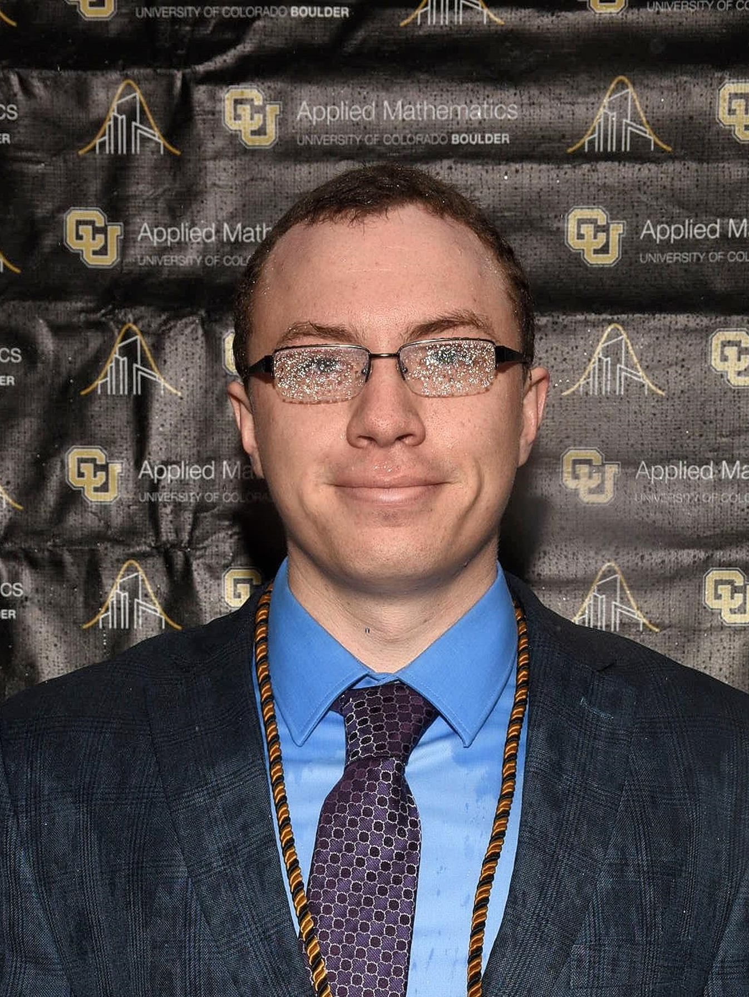
Tyler Jensen
Master of Science, Applied Mathematics
I have greatly enjoyed my experience in the Applied Math Department and I am very grateful that I will be able to continue on into the PhD program. Sko Buffs.
Thanks to my parents for always supporting me.
Notes:
INSTRUCTIONS
Click File -> Make a Copy -> Entire Presentation. RENAME the file in this format: “Jones_Indiana_MS” saving it to your google drive.
Now you have your own editable file. Please make changes to the text in brackets (Click on the purple rectangle and a new action bar above the slide will populate. Please select “Replace image” and upload a portrait image with your face clearly visible, that you are comfortable being displayed publicly. Google Slides will automatically adjust the photo to fit within its size parameters. Please do not to adjust the size of your image or text boxes. (APPM staff will make formatting corrections later.)
Once your personalization is complete, please go to File -> Download -> Microsoft PowerPoint (.pptx) and save the file onto your computer.
Upload the recently downloaded .pptx file to the end of your commencement form

Slide 16
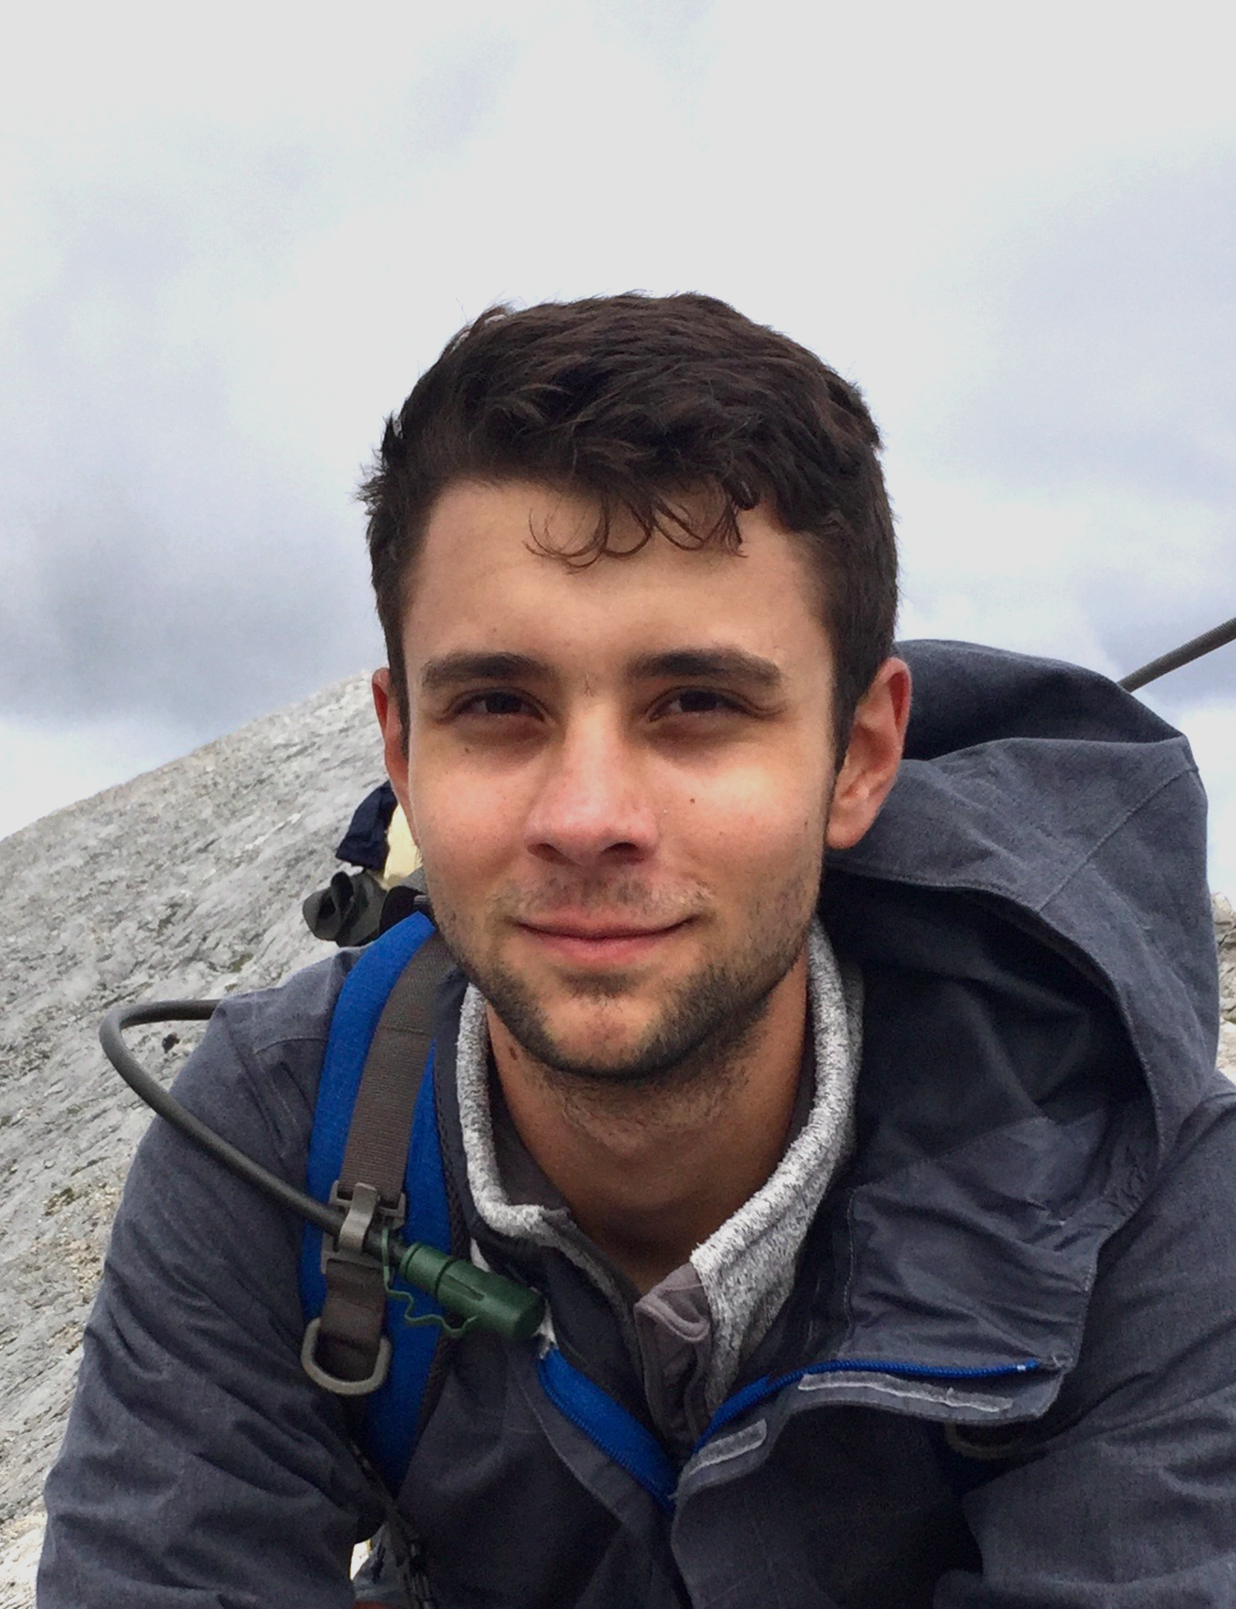
Kal Parvanov
Master of Science, Applied Mathematics
Throughout my graduate journey at CU Boulder, I've navigated the complexities of applied mathematics, delving into machine learning, numerical analysis and statistics with a spirit of curiosity and collaboration. I've embraced challenges, from theoretical research to practical applications, and learned the value of community in pushing the boundaries of knowledge. My adventures outside the classroom—scaling 14ers, skiing, and hiking—have mirrored this journey, teaching me resilience and the beauty of shared goals. I'm grateful for every lesson learned, every summit reached, and excited for the next chapter where I can apply these insights to make meaningful contributions to technology and society.
Heartfelt thanks to my parents and professors for their enduring support and wisdom on my journey. Their guidance has been my cornerstone.
Notes:
Click File -> Make a Copy -> Entire Presentation. RENAME the file in this format: “Jones_Indiana_MS” saving it to your google drive.
Now you have your own editable file. Please make changes to the text in brackets (Click on the purple rectangle and a new action bar above the slide will populate. Please select “Replace image” and upload a portrait image that you are comfortable being displayed publicly. Google Slides will automatically adjust the photo to fit within its size parameters. Please do not try to adjust the size of your image too much. (APPM staff will make formatting corrections later.)
Once your personalization is complete, please go to File -> Download -> Microsoft PowerPoint (.pptx) and save the file onto your computer.
Upload the recently downloaded .pptx file to the end of your commencement form

Slide 17
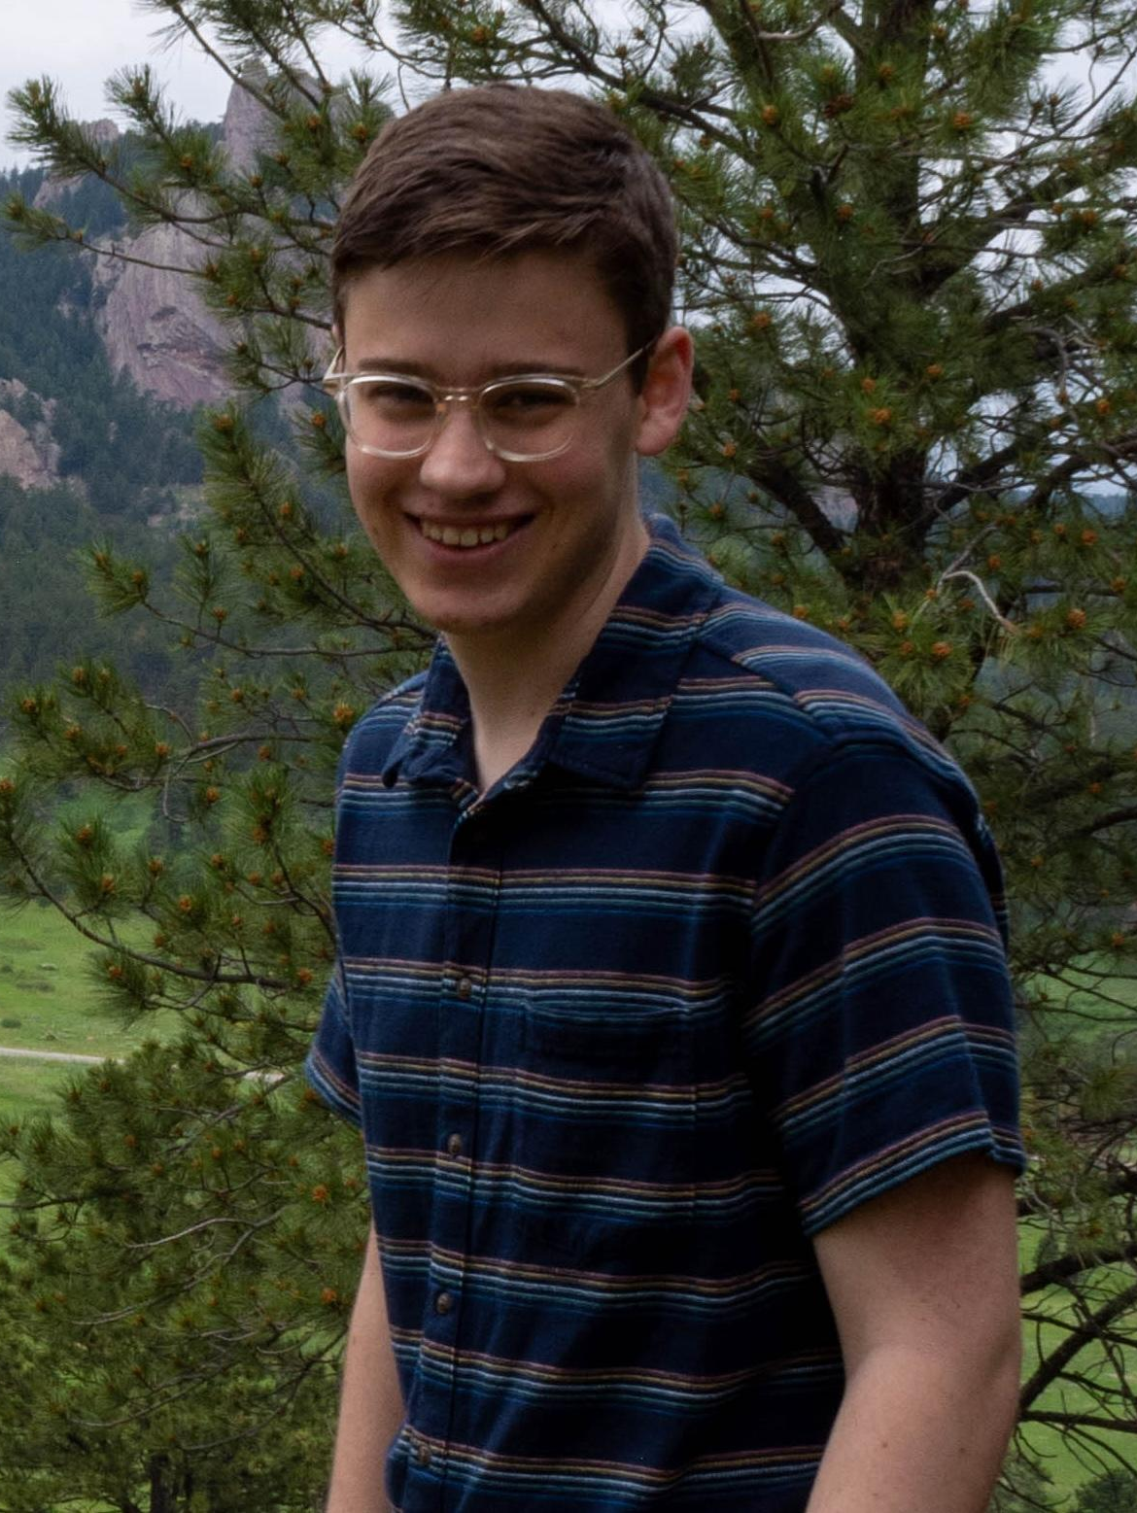
John Quinn
Master of Science, Applied Mathematics
I have really enjoyed my time here at CU. I have deeply enjoyed learning applied mathematics and am very grateful to the department of applied math and its faculty for teaching me so much. I am excited to continue my learning working toward a PhD in computational applied mathematics at the University of Texas at Austin.
I would like to thank my family for all of there support throughout my time at CU. I would also like to thank all the friends I made at CU and in applied math.
Notes:
INSTRUCTIONS
Click File -> Make a Copy -> Entire Presentation. RENAME the file in this format: “Jones_Indiana_MS” saving it to your google drive.
Now you have your own editable file. Please make changes to the text in brackets (Click on the purple rectangle and a new action bar above the slide will populate. Please select “Replace image” and upload a portrait image with your face clearly visible, that you are comfortable being displayed publicly. Google Slides will automatically adjust the photo to fit within its size parameters. Please do not to adjust the size of your image or text boxes. (APPM staff will make formatting corrections later.)
Once your personalization is complete, please go to File -> Download -> Microsoft PowerPoint (.pptx) and save the file onto your computer.
Upload the recently downloaded .pptx file to the end of your commencement form

Slide 18
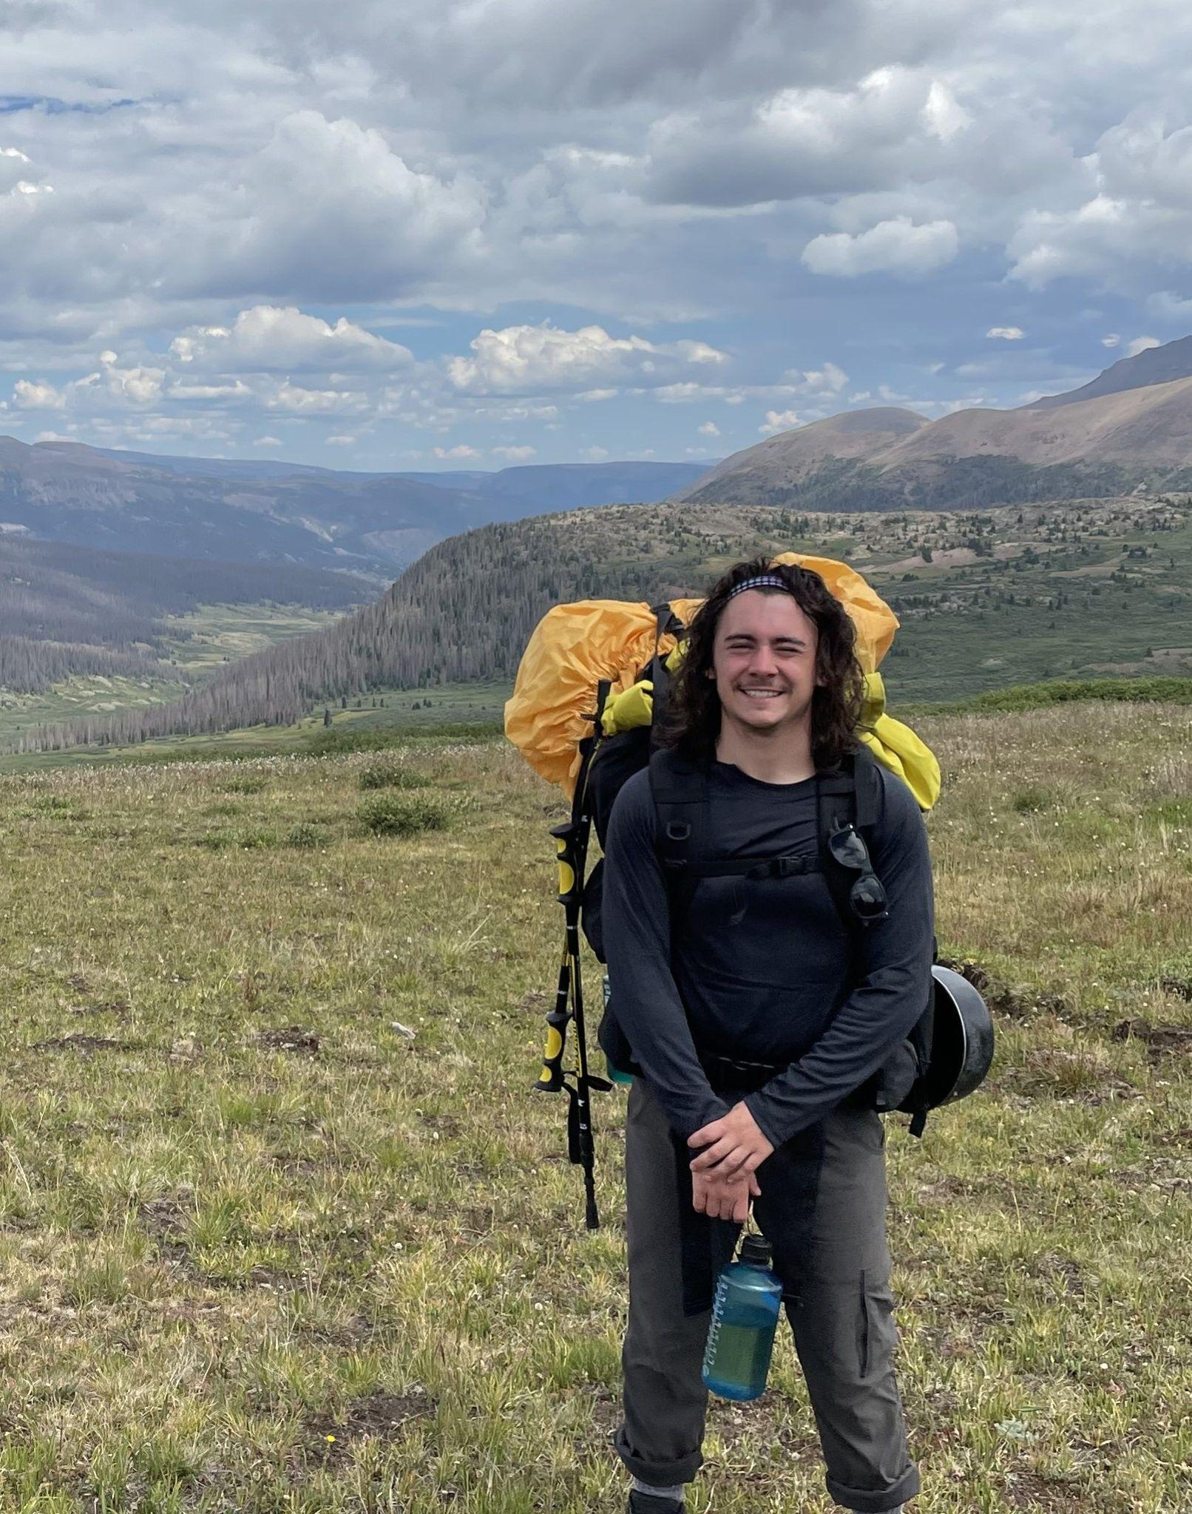
Sean Svihla
Master of Science, Applied Mathematics
Sean’s thesis focused on sparsifying covariance matrices of phylogenetic trees. He will be returning to CU in the Fall to begin work on his PhD.
To my friends, family, and mentors, thank you for your constant support!
Notes:
INSTRUCTIONS
Click File -> Make a Copy -> Entire Presentation. RENAME the file in this format: “Jones_Indiana_MS” saving it to your google drive.
Now you have your own editable file. Please make changes to the text in brackets (Click on the purple rectangle and a new action bar above the slide will populate. Please select “Replace image” and upload a portrait image with your face clearly visible, that you are comfortable being displayed publicly. Google Slides will automatically adjust the photo to fit within its size parameters. Please do not to adjust the size of your image or text boxes. (APPM staff will make formatting corrections later.)
Once your personalization is complete, please go to File -> Download -> Microsoft PowerPoint (.pptx) and save the file onto your computer.
Upload the recently downloaded .pptx file to the end of your commencement form

Slide 19
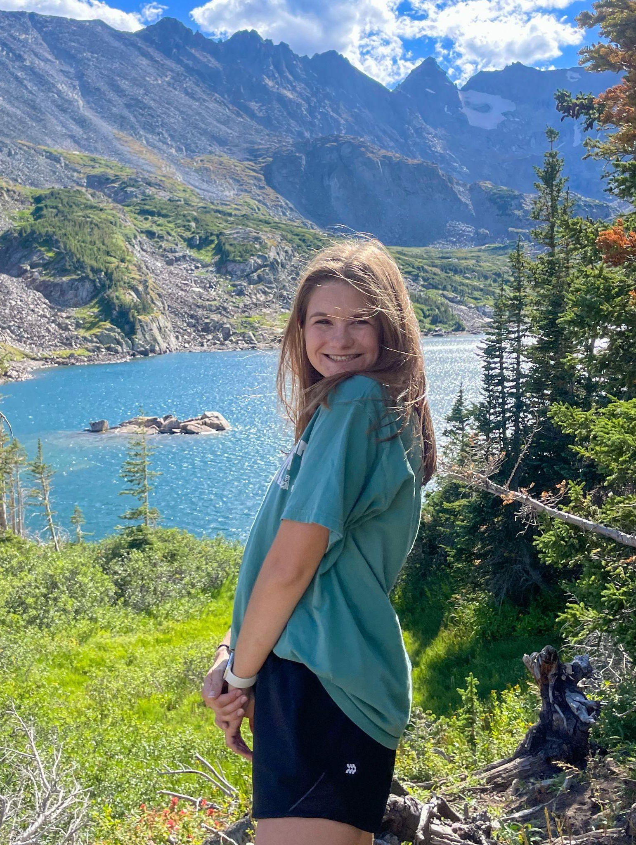
Isabel Beaulieu
Professional Masters of Science, Applied Mathematics
Shortly after Isabel joined the program, she partnered with Boeing to research taxi time and deicing events occurring at Denver Intl Airport. After graduation she will be working for CVS Health as a Data Scientist. Before that, Isabel will be taking a few months off to enjoy the summer and spend time with family and friends.
Thank you to my parents, sister, partner, friends, and my advisor Brain for always supporting me and pushing me to be my best.
Notes:
INSTRUCTIONS
Click File -> Make a Copy -> Entire Presentation. RENAME the file in this format: “Jones_Indiana_PMD” saving it to your google drive.
Now you have your own editable file. Please make changes to the text in brackets (Click on the purple rectangle and a new action bar above the slide will populate. Please select “Replace image” and upload a portrait image with your face clearly visible, that you are comfortable being displayed publicly. Google Slides will automatically adjust the photo to fit within its size parameters. Please do not to adjust the size of your image or text boxes. (APPM staff will make formatting corrections later.)
Once your personalization is complete, please go to File -> Download -> Microsoft PowerPoint (.pptx) and save the file onto your computer.
Upload the recently downloaded .pptx file to the end of your commencement form

Slide 20
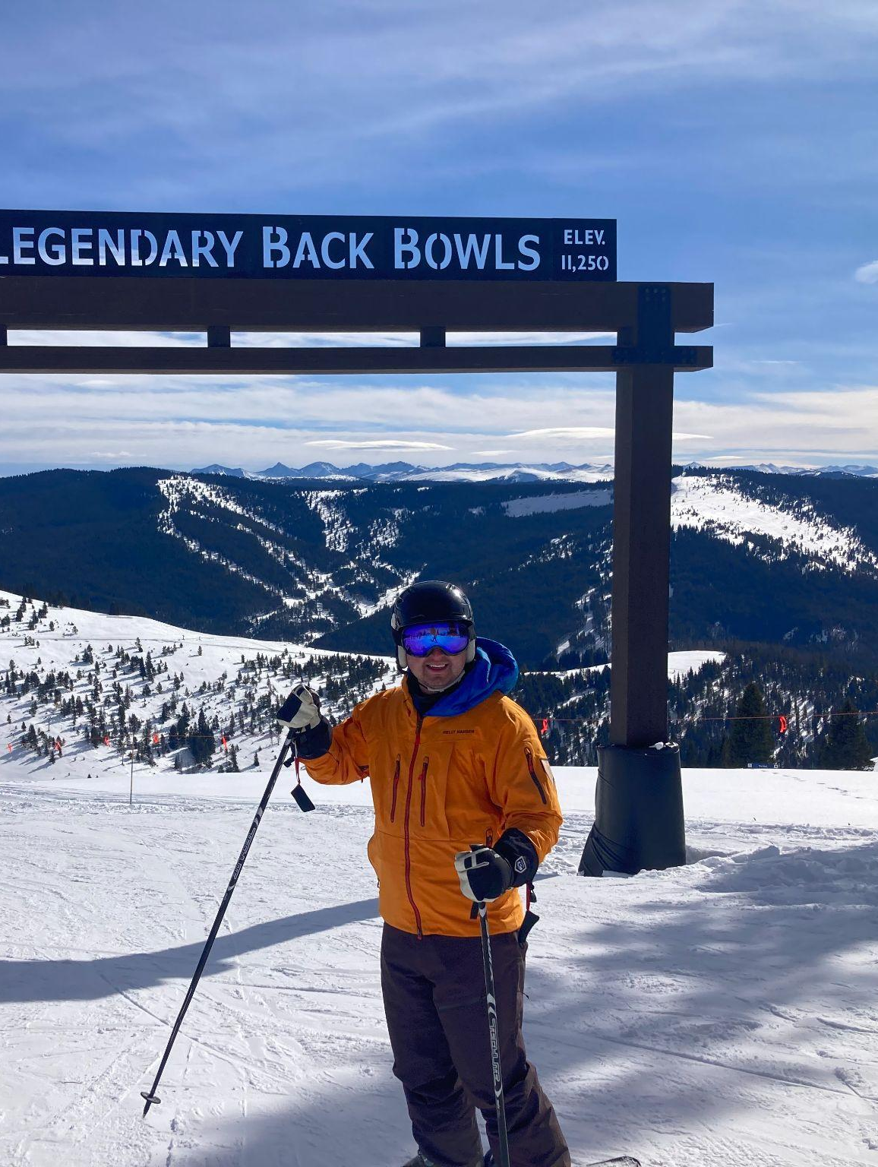
Ian Bircak
Professional Masters of Science, Applied Mathematics
Ian joined the professional MS in fall 2022, where he worked on model building with machine and deep learning techniques. He also worked part-time as a data analyst, where he will stay until he finds a full time job as a data scientist machine learning engineer. Congratulations Ian!
Super thankful for these last two years and all the people that made this experience a memorable one!
Notes:
INSTRUCTIONS
Click File -> Make a Copy -> Entire Presentation. RENAME the file in this format: “Jones_Indiana_PMD” saving it to your google drive.
Now you have your own editable file. Please make changes to the text in brackets (Click on the purple rectangle and a new action bar above the slide will populate. Please select “Replace image” and upload a portrait image with your face clearly visible, that you are comfortable being displayed publicly. Google Slides will automatically adjust the photo to fit within its size parameters. Please do not to adjust the size of your image or text boxes. (APPM staff will make formatting corrections later.)
Once your personalization is complete, please go to File -> Download -> Microsoft PowerPoint (.pptx) and save the file onto your computer.
Upload the recently downloaded .pptx file to the end of your commencement form

Slide 21
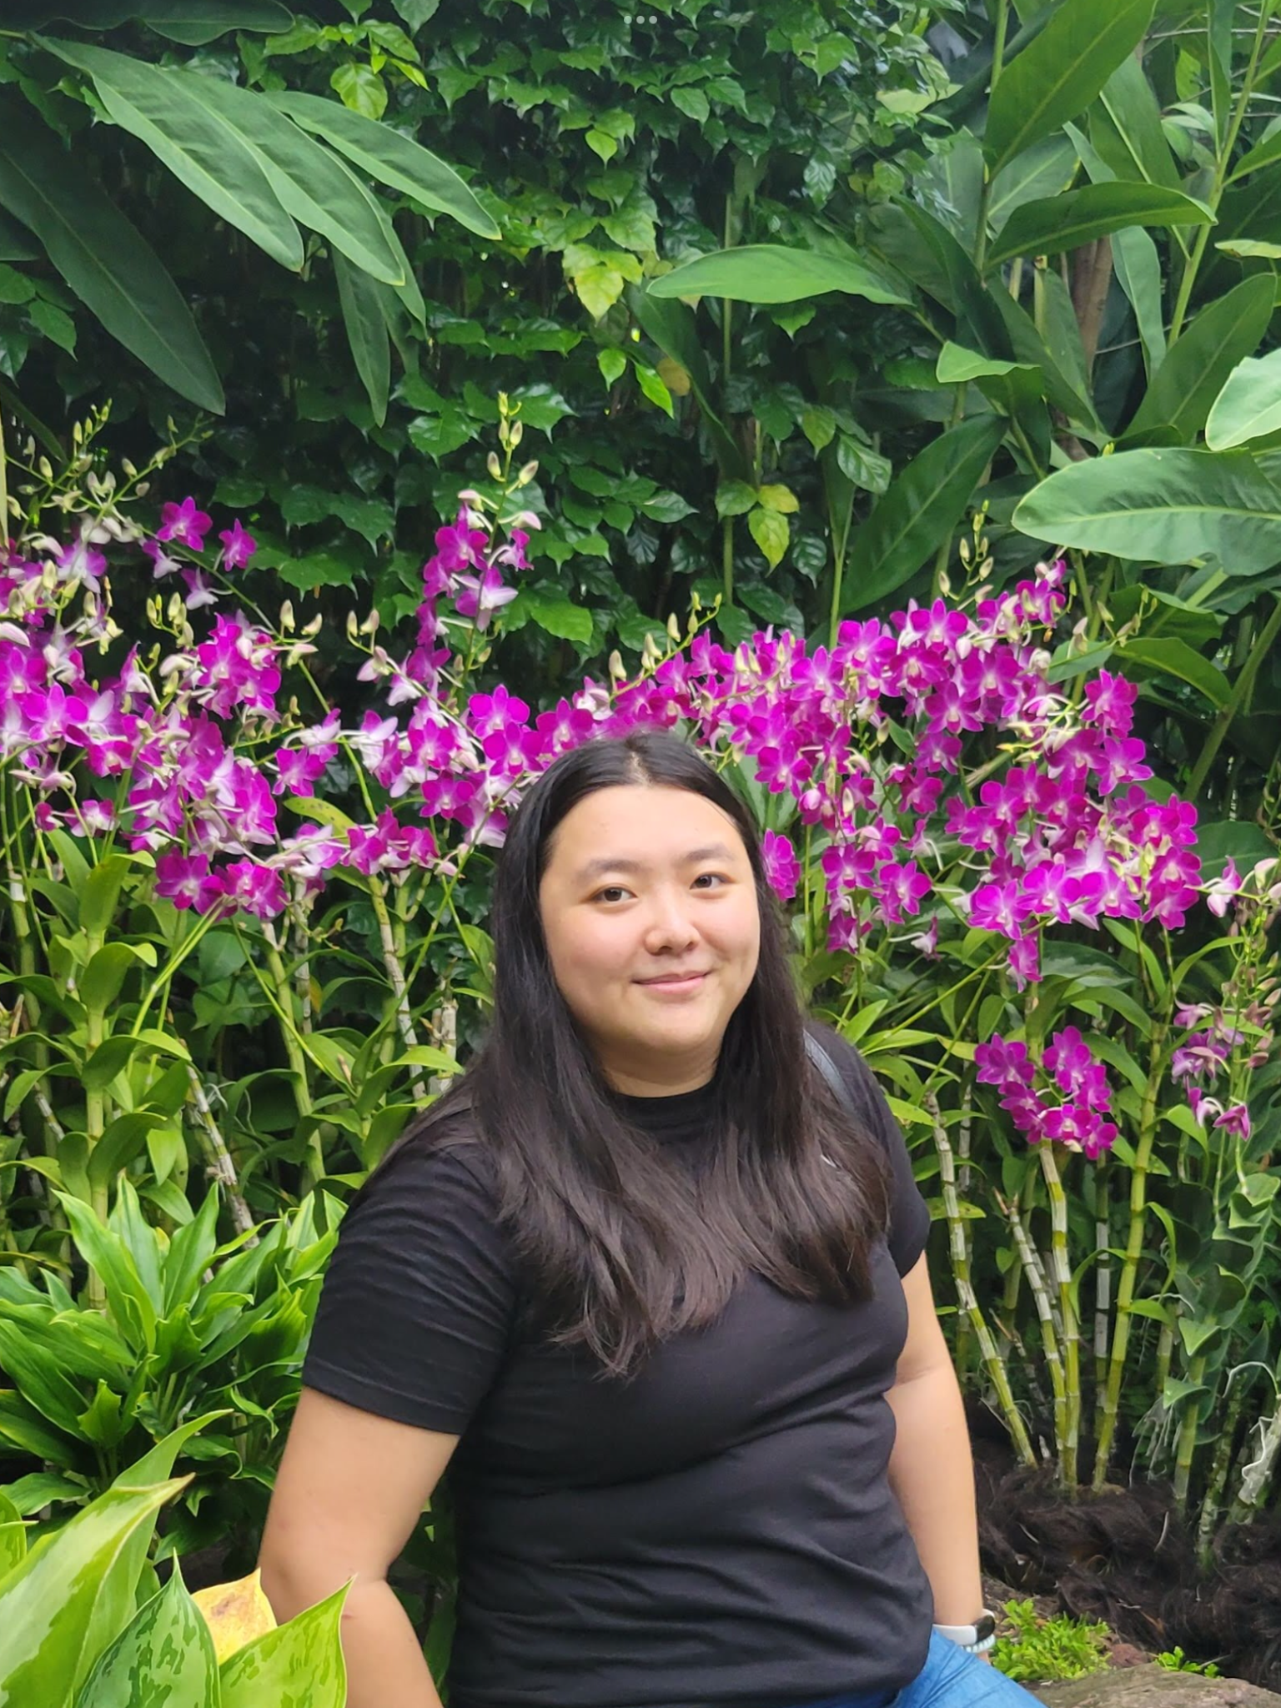
Claudia Chen
Professional Masters of Science, Applied Mathematics
I have met so many amazing people throughout this program and through teaching, and I will always cherish those stories.
I am excited for what lies ahead as I apply my math skills in the biotech field.
Thank you to my friends and family for supporting me through this year. I am so grateful for the support that Brian Zaharatos, Anne Dougherty, Gabriella Kirkley, and Kris Pruitt have provided me in order to be here.
Notes:
INSTRUCTIONS
Click File -> Make a Copy -> Entire Presentation. RENAME the file in this format: “Jones_Indiana_PMD” saving it to your google drive.
Now you have your own editable file. Please make changes to the text in brackets (Click on the purple rectangle and a new action bar above the slide will populate. Please select “Replace image” and upload a portrait image with your face clearly visible, that you are comfortable being displayed publicly. Google Slides will automatically adjust the photo to fit within its size parameters. Please do not to adjust the size of your image or text boxes. (APPM staff will make formatting corrections later.)
Once your personalization is complete, please go to File -> Download -> Microsoft PowerPoint (.pptx) and save the file onto your computer.
Upload the recently downloaded .pptx file to the end of your commencement form

Slide 22
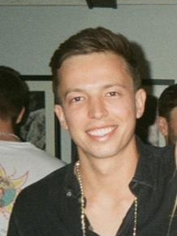
Connor Doyle Flaherty
Professional Masters of Science, Applied Mathematics
I am extremely grateful for my time with the Applied Mathematics Department at the University of Colorado Boulder. The faculty and staff have been nothing short of exceptional, teaching with enthusiasm and fastidiousness. Through completion of this program, I was able to develop a community of lifelong friends, colleagues, and mentors, as well as cultivate a passion for Quantitative Finance and Statistics, which I will expand upon throughout my career in the Quant industry.
I would like to thank my parents, Mark and Angela Flaherty, for their immeasurable love and support throughout my academic pursuits.
Notes:
INSTRUCTIONS
Click File -> Make a Copy -> Entire Presentation. RENAME the file in this format: “Jones_Indiana_PMD” saving it to your google drive.
Now you have your own editable file. Please make changes to the text in brackets (Click on the purple rectangle and a new action bar above the slide will populate. Please select “Replace image” and upload a portrait image with your face clearly visible, that you are comfortable being displayed publicly. Google Slides will automatically adjust the photo to fit within its size parameters. Please do not to adjust the size of your image or text boxes. (APPM staff will make formatting corrections later.)
Once your personalization is complete, please go to File -> Download -> Microsoft PowerPoint (.pptx) and save the file onto your computer.
Upload the recently downloaded .pptx file to the end of your commencement form

Slide 23
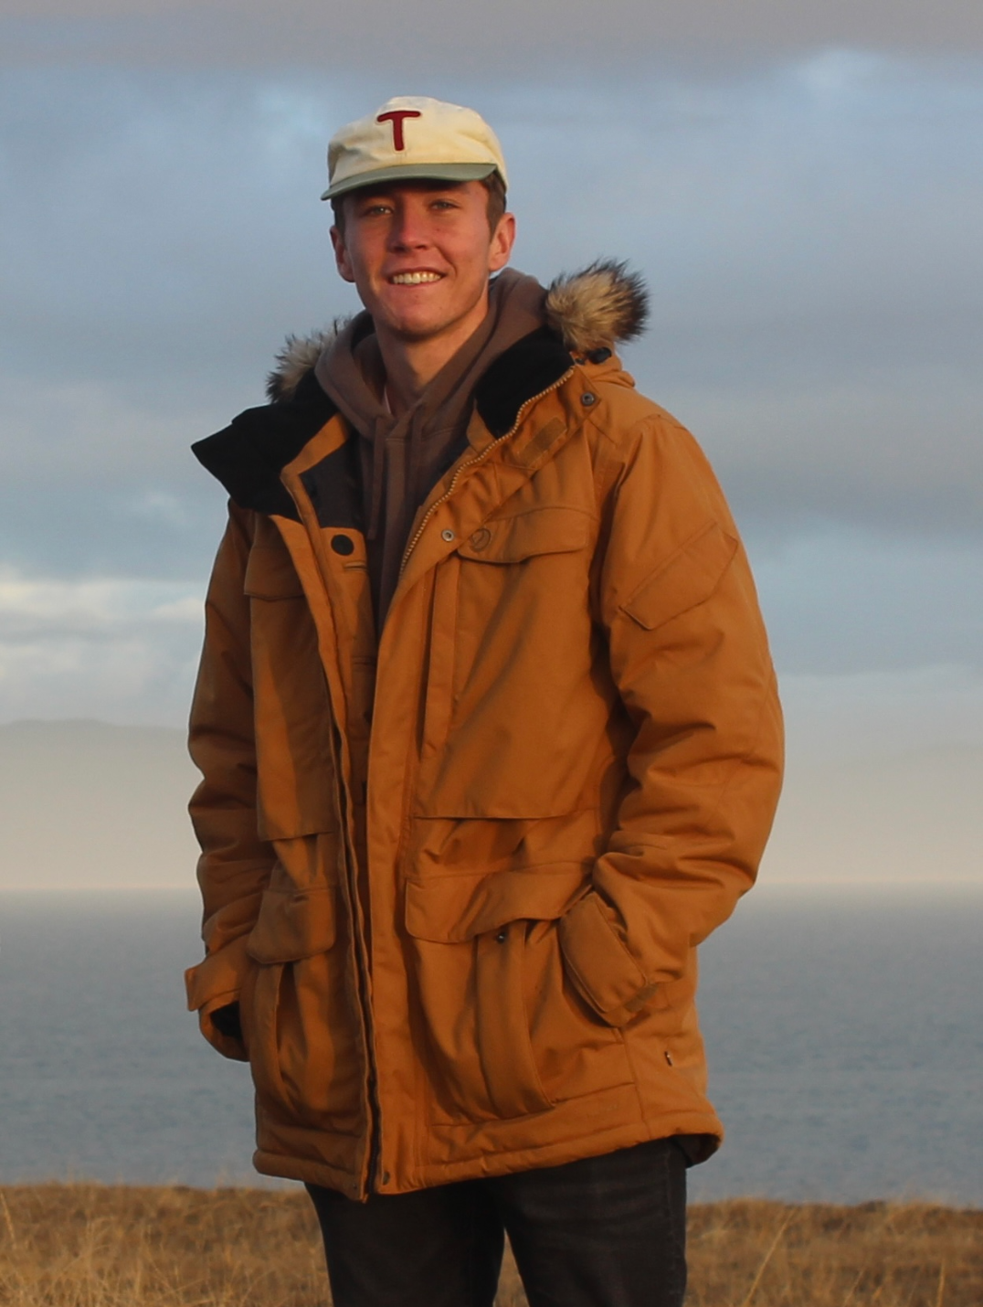
Eric Flaska
Professional Masters of Science, Applied Mathematics
In my past 5 years here, I have made memories and had experiences that I will never forget and have the university and this program to thank. From working on projects with peers and faculty, to Applied Math bowling nights, this program has been a truly amazing experience and something I will never forget. I am tremendously grateful and want to thank all of the peers and faculty that I've gotten to share the experience with and that have helped me so much along the way.
I want to thank all of my friends and family who have shown nothing but support and inspired me every day. I am tremendously grateful for all of you!
Notes:
INSTRUCTIONS
Click File -> Make a Copy -> Entire Presentation. RENAME the file in this format: “Jones_Indiana_MS” saving it to your google drive.
Now you have your own editable file. Please make changes to the text in brackets (Click on the purple rectangle and a new action bar above the slide will populate. Please select “Replace image” and upload a portrait image with your face clearly visible, that you are comfortable being displayed publicly. Google Slides will automatically adjust the photo to fit within its size parameters. Please do not to adjust the size of your image or text boxes. (APPM staff will make formatting corrections later.)
Once your personalization is complete, please go to File -> Download -> Microsoft PowerPoint (.pptx) and save the file onto your computer.
Upload the recently downloaded .pptx file to the end of your commencement form

Slide 24
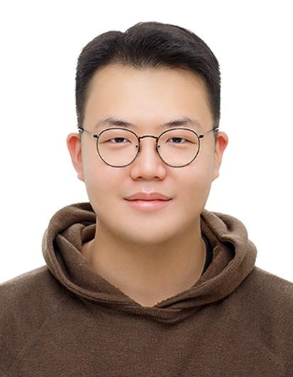
Samuel Kwon
Professional Masters of Science, Applied Mathematics
I am grateful to my fellow graduate colleagues for their support and encouragement. Although ECCR 217 was always chaotic, I will cherish the memories we made together.
Thanks to my parents, sister, and grandma for their support and encouragement. I would also like to express my gratitude towards Dr. Anne Dougherty, Dr. Brian Zaharatos, and Gabriella for being there for me during difficult times.
Notes:
INSTRUCTIONS
Click File -> Make a Copy -> Entire Presentation. RENAME the file in this format: “Jones_Indiana_PMD” saving it to your google drive.
Now you have your own editable file. Please make changes to the text in brackets (Click on the purple rectangle and a new action bar above the slide will populate. Please select “Replace image” and upload a portrait image that you are comfortable being displayed publicly. Google Slides will automatically adjust the photo to fit within its size parameters. Please do not try to adjust the size of your image too much. (APPM staff will make formatting corrections later.)
Once your personalization is complete, please go to File -> Download -> Microsoft PowerPoint (.pptx) and save the file onto your computer.
Upload the recently downloaded .pptx file to the end of your commencement form

Slide 25
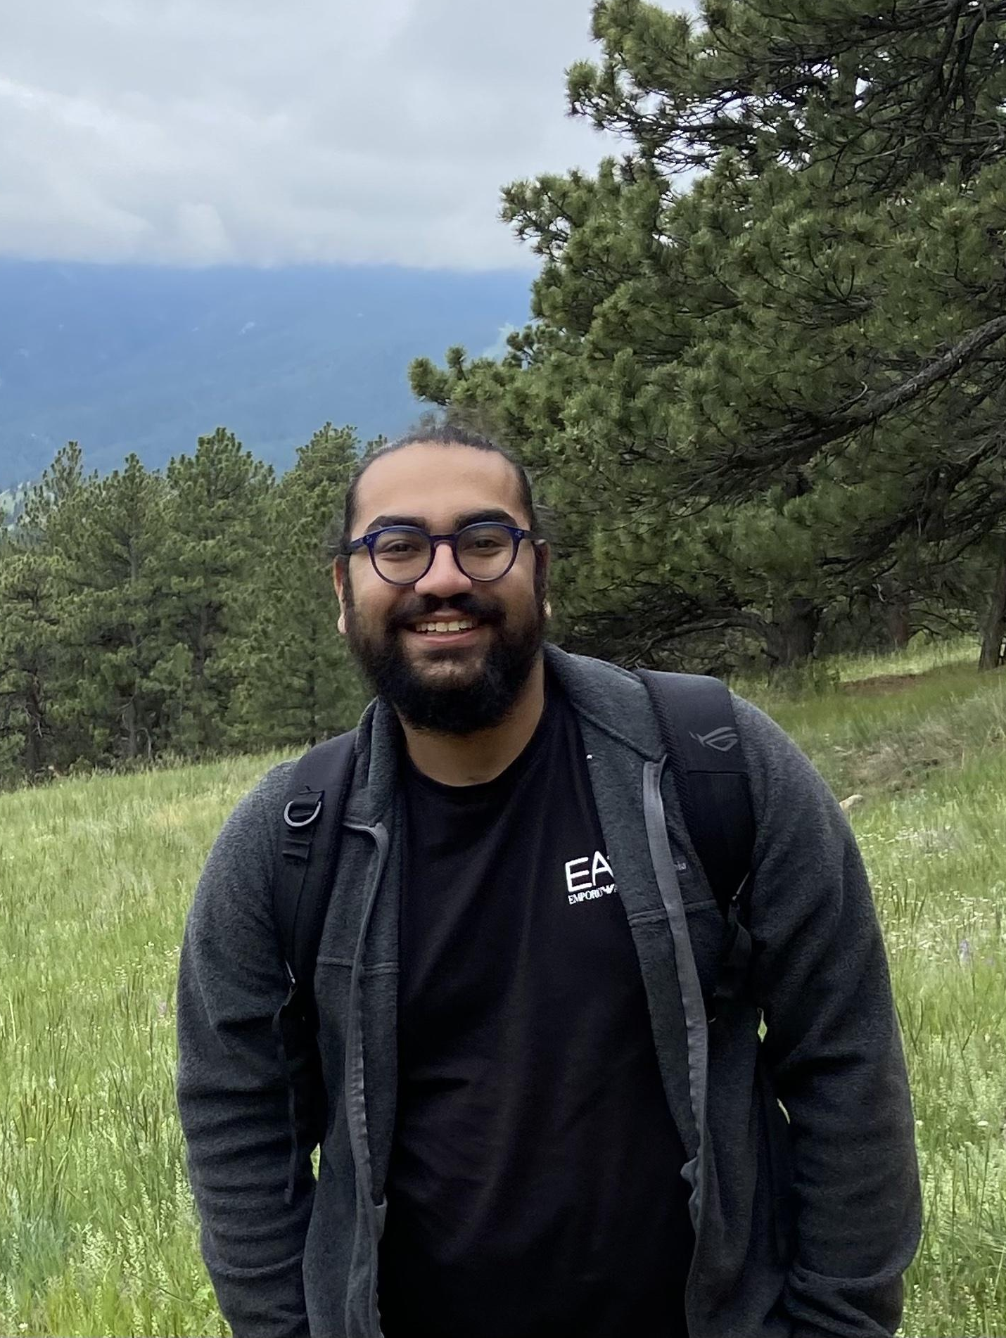
Bisman Singh
Professional Masters of Science, Applied Mathematics
After overcoming challenges in my Network Modeling thesis and completing a rewarding internship at Boeing, I'm excited to start my career as a data scientist.
Thanks to my parents, sisters, friends, faculty, and especially Prof. Aaron clauset!
Notes:
INSTRUCTIONS
Click File -> Make a Copy -> Entire Presentation. RENAME the file in this format: “Jones_Indiana_PMD” saving it to your google drive.
Now you have your own editable file. Please make changes to the text in brackets (Click on the purple rectangle and a new action bar above the slide will populate. Please select “Replace image” and upload a portrait image with your face clearly visible, that you are comfortable being displayed publicly. Google Slides will automatically adjust the photo to fit within its size parameters. Please do not to adjust the size of your image or text boxes. (APPM staff will make formatting corrections later.)
Once your personalization is complete, please go to File -> Download -> Microsoft PowerPoint (.pptx) and save the file onto your computer.
Upload the recently downloaded .pptx file to the end of your commencement form

Slide 26
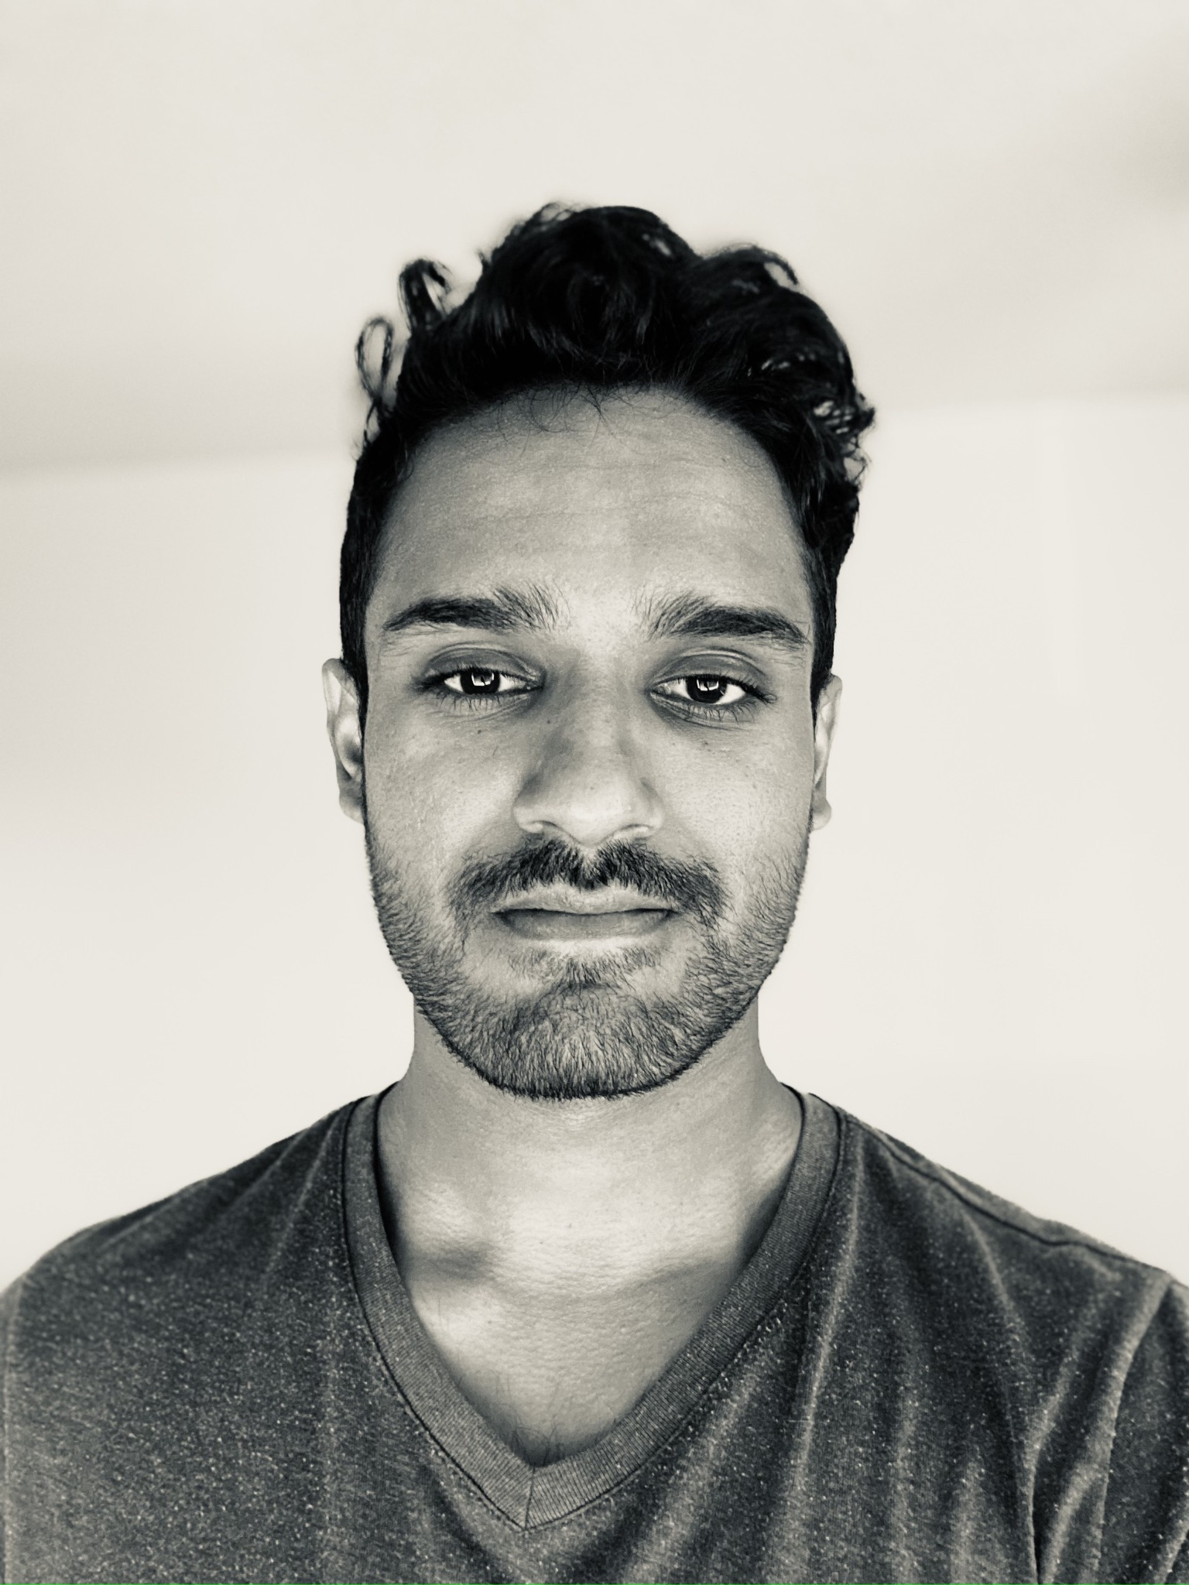
Gregory Tomy
Professional Masters of Science, Applied Mathematics
“He is a self-made man who owes his lack of success to nobody.”
To my parents and family for their support; to Prof. Zaharatos for the conversations; and to the girl at the cafe who misheard my name, which I never bothered to correct - thank you.
Notes:
INSTRUCTIONS
Click File -> Make a Copy -> Entire Presentation. RENAME the file in this format: “Jones_Indiana_PMD” saving it to your google drive.
Now you have your own editable file. Please make changes to the text in brackets (Click on the purple rectangle and a new action bar above the slide will populate. Please select “Replace image” and upload a portrait image with your face clearly visible, that you are comfortable being displayed publicly. Google Slides will automatically adjust the photo to fit within its size parameters. Please do not to adjust the size of your image or text boxes. (APPM staff will make formatting corrections later.)
Once your personalization is complete, please go to File -> Download -> Microsoft PowerPoint (.pptx) and save the file onto your computer.
Upload the recently downloaded .pptx file to the end of your commencement form

Slide 27
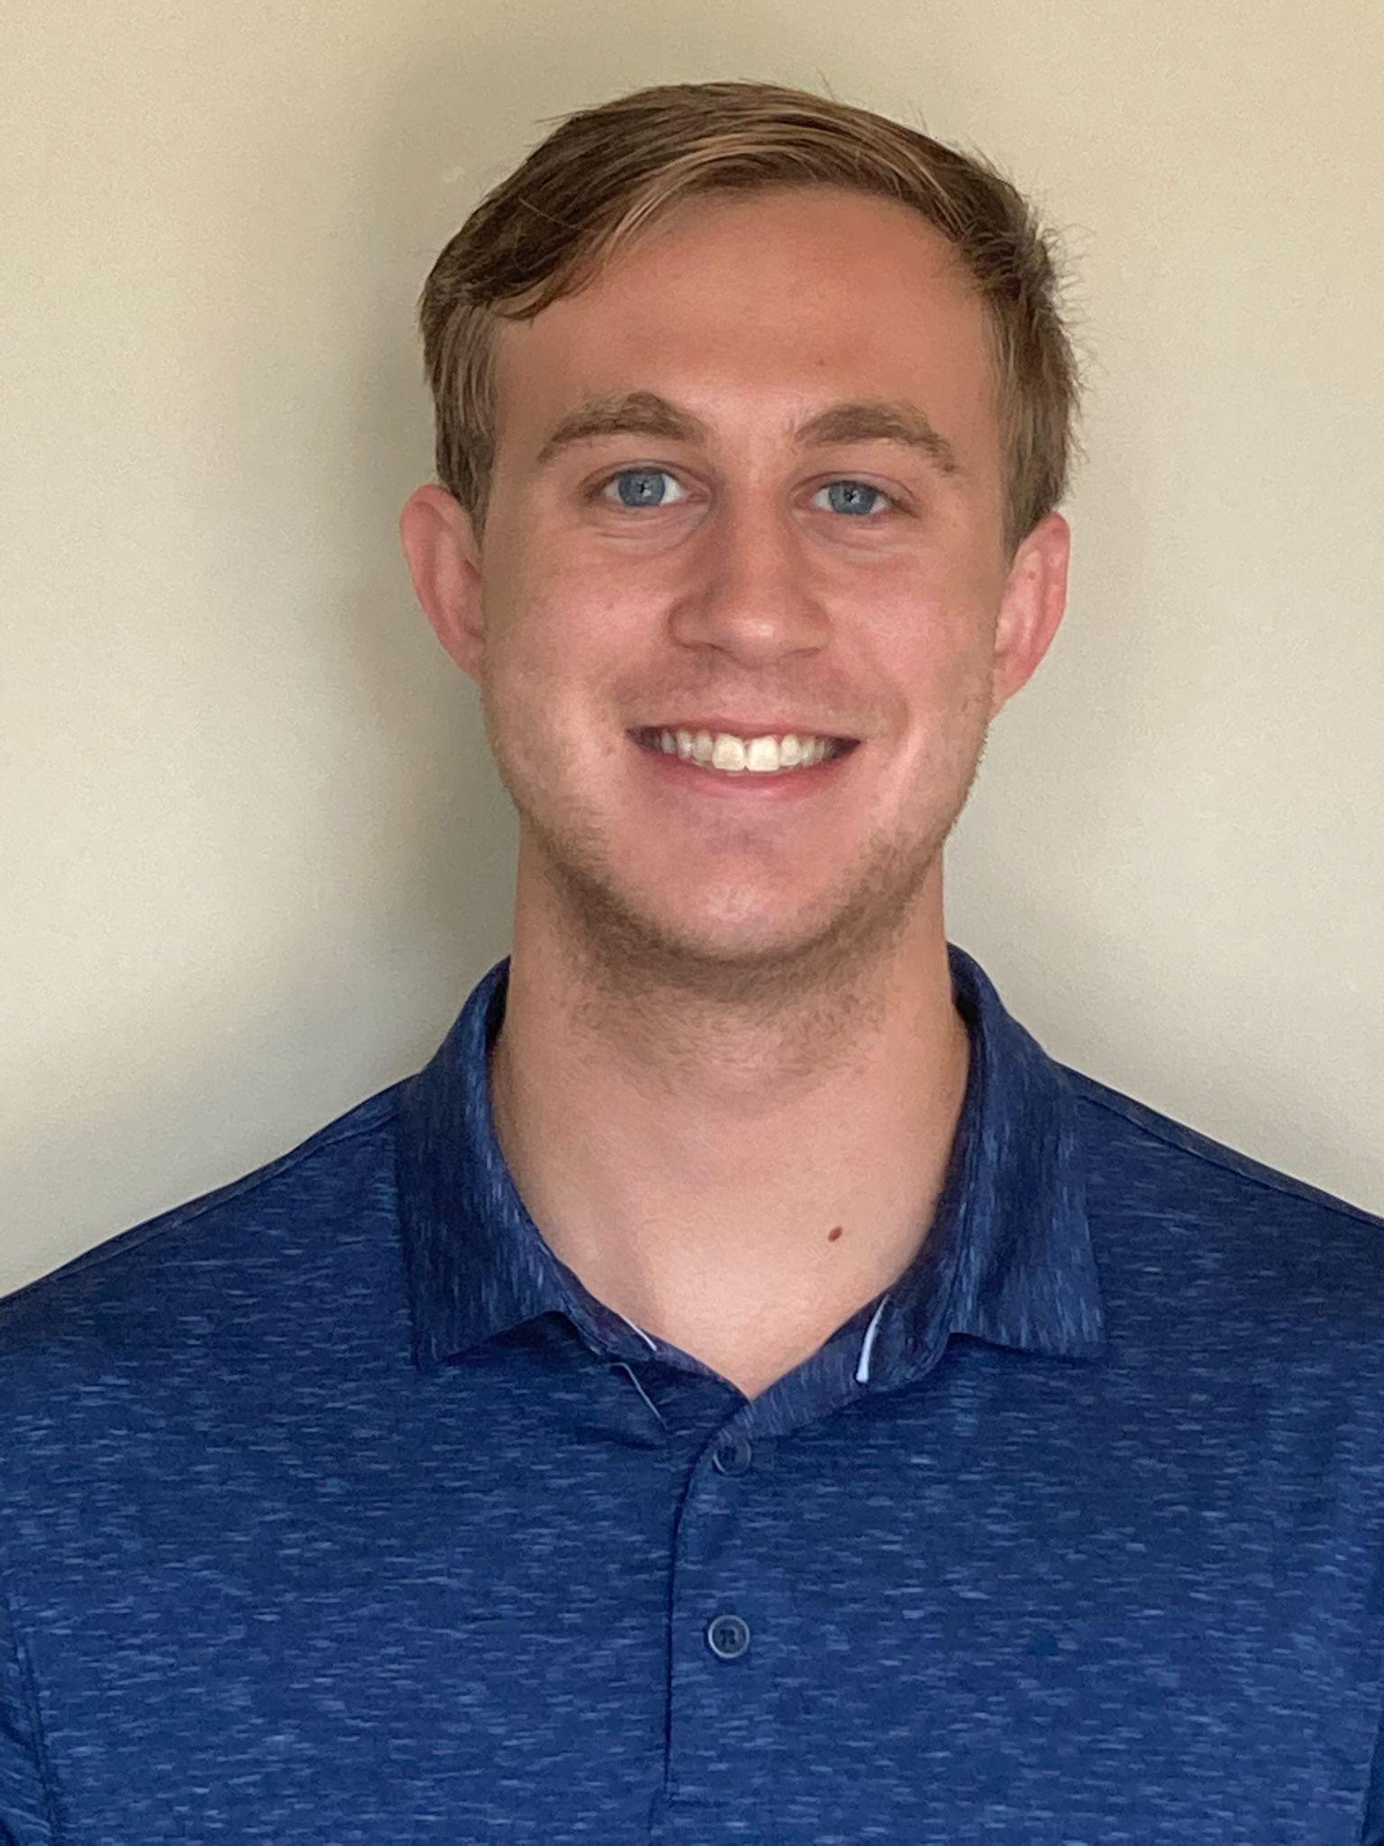
Sam Touvannas
Professional Masters of Science, Applied Mathematics
Culminating Experience: Multinomial Logistic Regression and Neural Networks to Predict Children’s Anemia Levels
Looking forward to working as a data scientist
Thank you to my parents, Dr. Law, and Dr. Zaharatos
Notes:
INSTRUCTIONS
Click File -> Make a Copy -> Entire Presentation. RENAME the file in this format: “Jones_Indiana_PMD” saving it to your google drive.
Now you have your own editable file. Please make changes to the text in brackets (Click on the purple rectangle and a new action bar above the slide will populate. Please select “Replace image” and upload a portrait image that you are comfortable being displayed publicly. Google Slides will automatically adjust the photo to fit within its size parameters. Please do not try to adjust the size of your image too much. (APPM staff will make formatting corrections later.)
Once your personalization is complete, please go to File -> Download -> Microsoft PowerPoint (.pptx) and save the file onto your computer.
Upload the recently downloaded .pptx file to the end of your commencement form

Slide 28
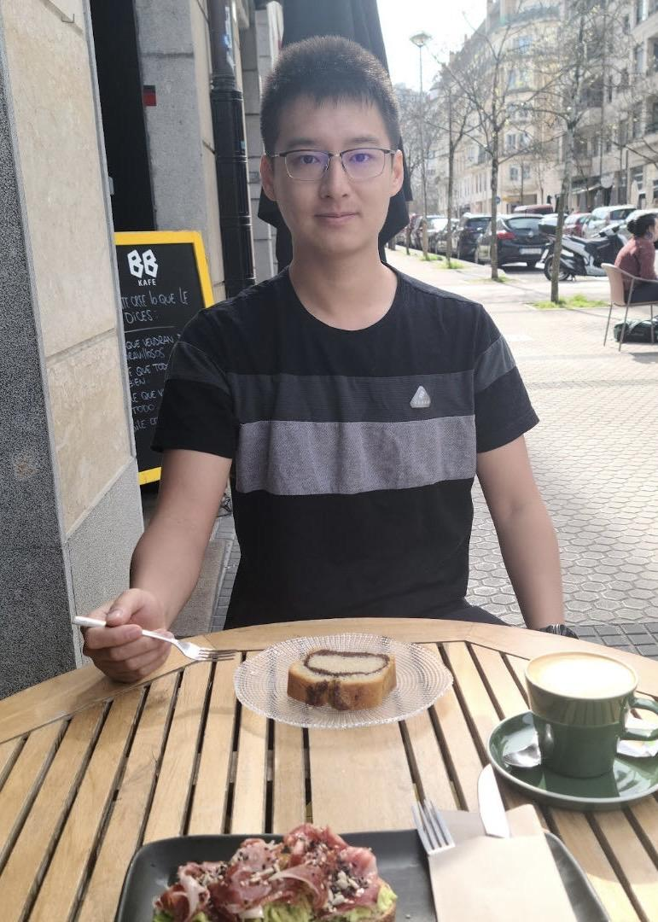
Rodger Zhang
Professional Masters of Science, Applied Mathematics
Rodger switched his field of study from physics to applied math to increase the likelihood of being able to own a couple of sports cars in the future. Apart from acquiring mathematical and statistical skills at CU, this experience also helped to make him a more outgoing person. His CE was about bird strike analysis in collaboration with Frida Muedsam, supervised by Dr. Judith Law and the Boeing Company.
Thanks to all my family, friends, and professors for their support, guidance, and, sometimes, tolerance.
Notes:
INSTRUCTIONS
Click File -> Make a Copy -> Entire Presentation. RENAME the file in this format: “Jones_Indiana_PMD” saving it to your google drive.
Now you have your own editable file. Please make changes to the text in brackets (Click on the purple rectangle and a new action bar above the slide will populate. Please select “Replace image” and upload a portrait image with your face clearly visible, that you are comfortable being displayed publicly. Google Slides will automatically adjust the photo to fit within its size parameters. Please do not to adjust the size of your image or text boxes. (APPM staff will make formatting corrections later.)
Once your personalization is complete, please go to File -> Download -> Microsoft PowerPoint (.pptx) and save the file onto your computer.
Upload the recently downloaded .pptx file to the end of your commencement form

Slide 29
Bachelor of Arts
Statistics & Data Sciences
Honors
♣Maurices Davies Award (American Statistical Association)
Julia Bao
Carmela Carver
Marco Cordero
Zain Elsell
Cam Frederickson
Avery Fulton
Marcus Garcia
Bailey Hall
Ashlynn McGrattan
Molly Molingowski
Emily Palese
Luke Pheneger
Max Silver♣
Lalita Suwattee
Hannah Whaley

Slide 30
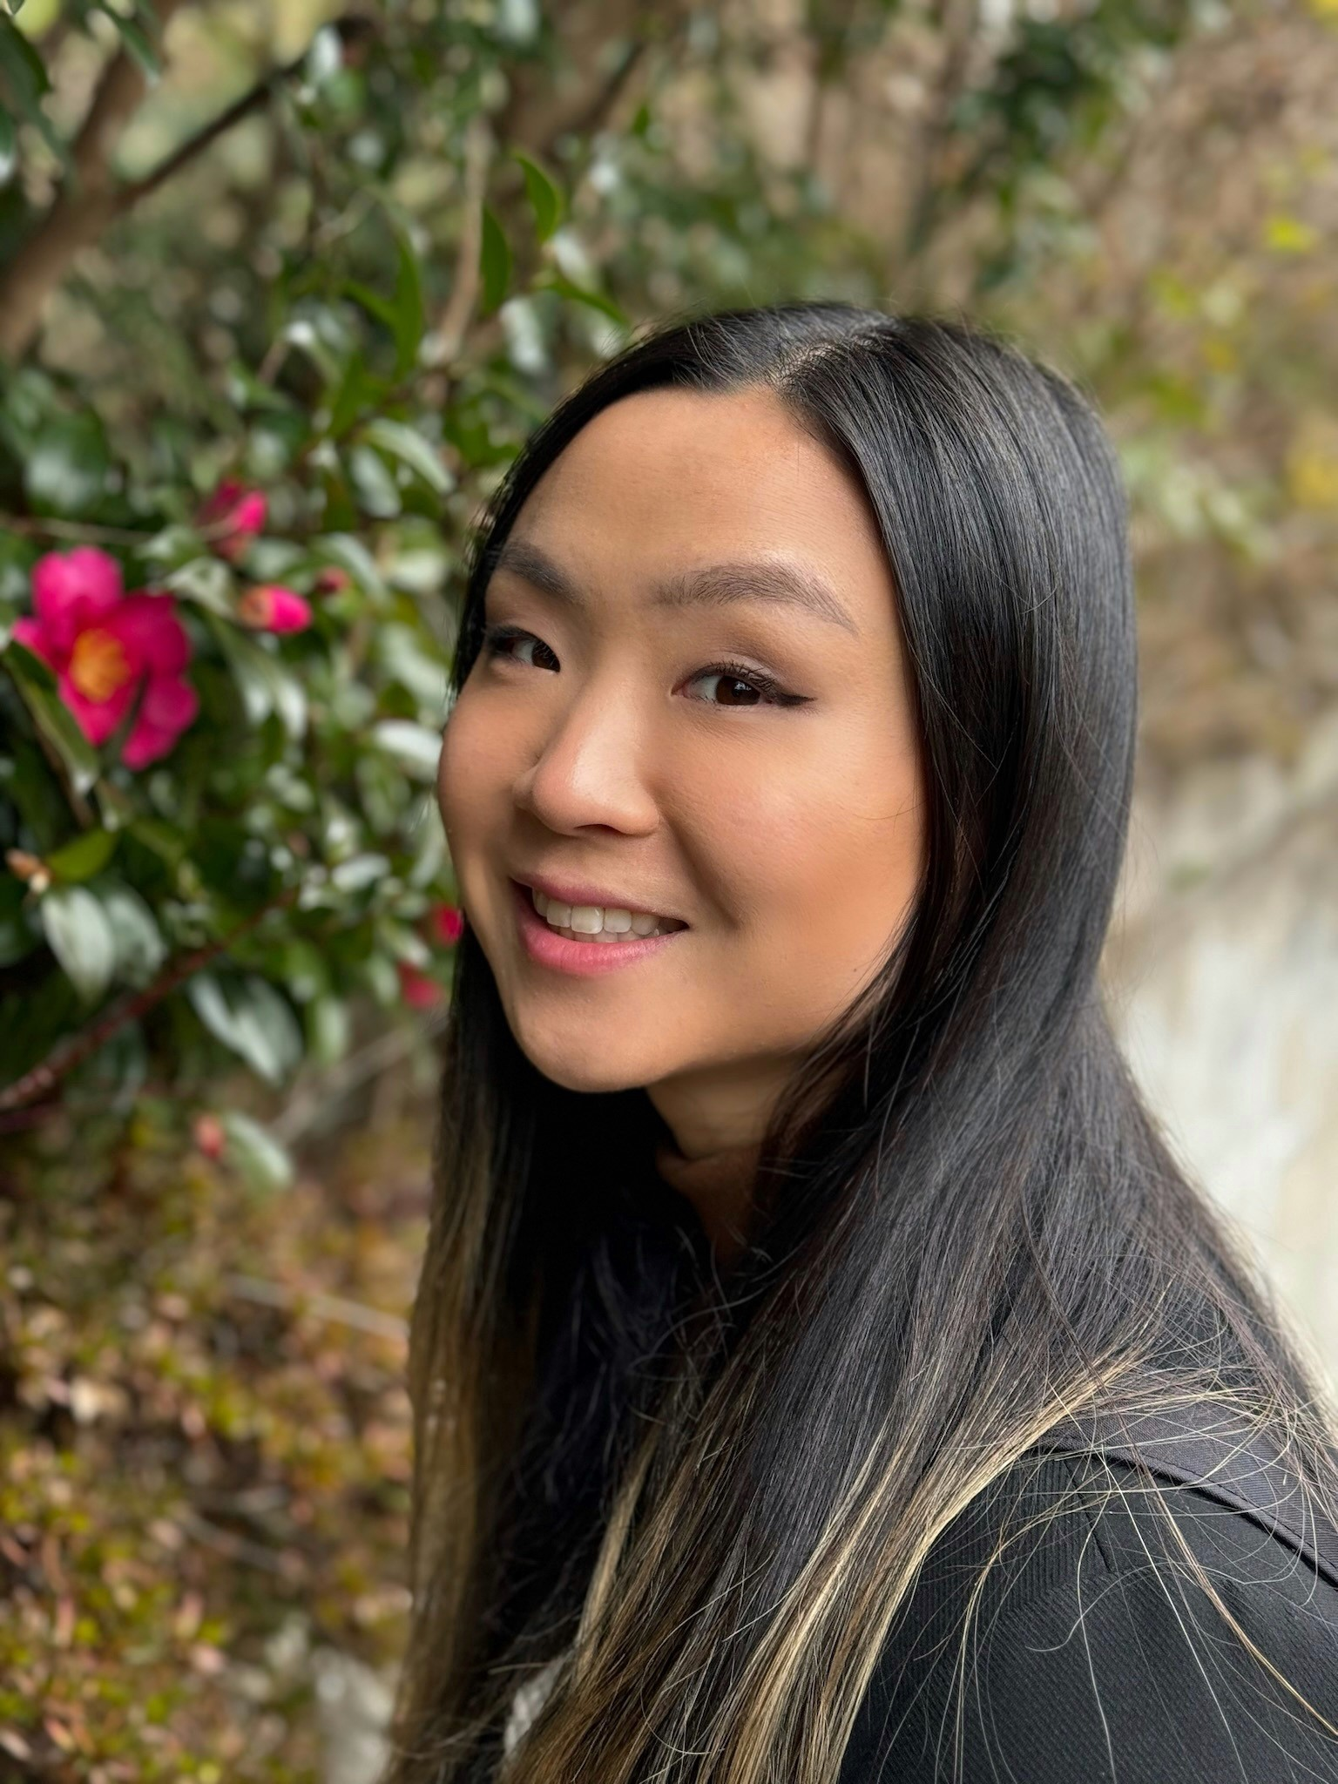
Julia Bao
Bachelor of Arts, Statistics and Data Science
From hammocking by Varsity Lake to conquering challenging coursework, my time at CU has been an unforgettable adventure. As I prepare to graduate, I’m filled with gratitude for the experiences and thankfully no all nighters. Go Buffs!
Special thanks to my family, friends, and professors
Notes:
INSTRUCTIONS
Click File -> Make a Copy -> Entire Presentation. RENAME the file in this format: “Jones_Indiana_BA” saving it to your google drive.
Now you have your own editable file. Please make changes to the text in brackets (Click on the purple rectangle and a new action bar above the slide will populate. Please select “Replace image” and upload a portrait image with your face clearly visible, that you are comfortable being displayed publicly. Google Slides will automatically adjust the photo to fit within its size parameters. Please do not to adjust the size of your image or text boxes. (APPM staff will make formatting corrections later.)
Once your personalization is complete, please go to File -> Download -> Microsoft PowerPoint (.pptx) and save the file onto your computer.
Upload the recently downloaded .pptx file to the end of your commencement form

Slide 31
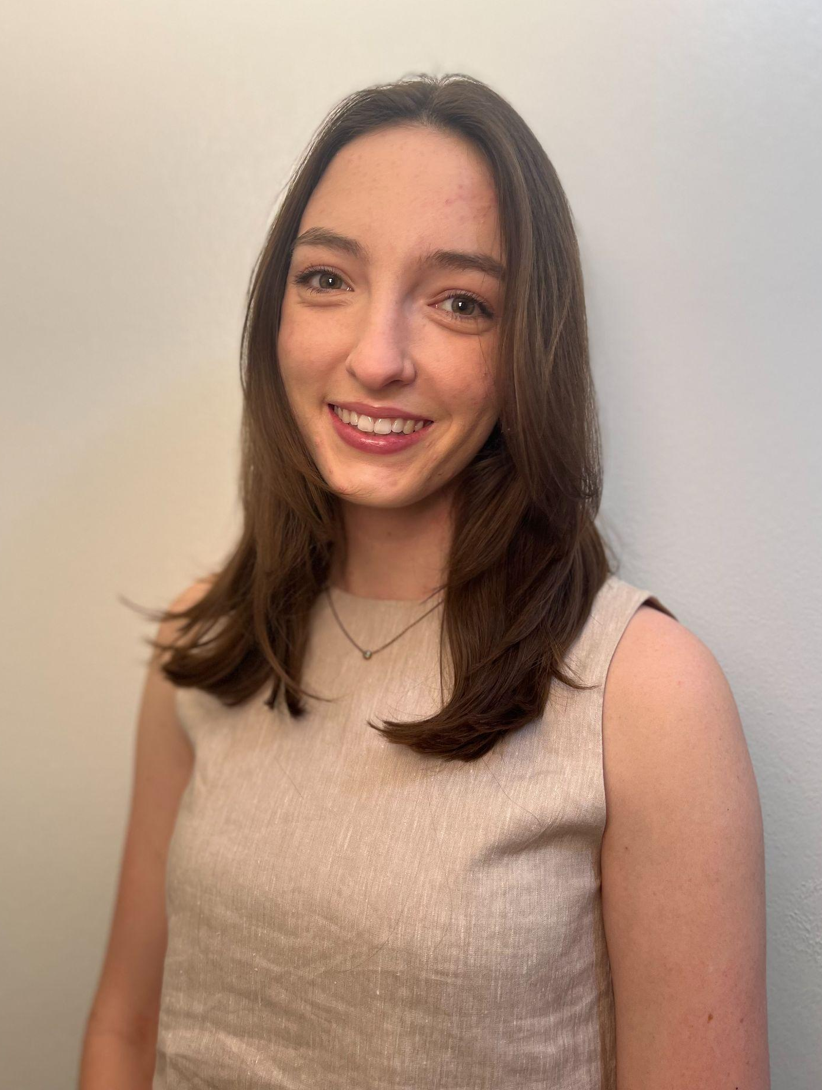
Carmela Carver
Bachelor of Arts, Statistics and Data Science
My favorite activity during my time here was simply walking around campus and looking at the mountains. In 4 years I never got tired of that view!
“Take the moment and taste it. You’ve got no reason to be afraid”
- TS
I would like to thank my family and friends who supported me and got me here today! Without all of you, I would not be here!
Notes:
INSTRUCTIONS
Click File -> Make a Copy -> Entire Presentation. RENAME the file in this format: “Jones_Indiana_BA” saving it to your google drive.
Now you have your own editable file. Please make changes to the text in brackets (Click on the purple rectangle and a new action bar above the slide will populate. Please select “Replace image” and upload a portrait image with your face clearly visible, that you are comfortable being displayed publicly. Google Slides will automatically adjust the photo to fit within its size parameters. Please do not to adjust the size of your image or text boxes. (APPM staff will make formatting corrections later.)
Once your personalization is complete, please go to File -> Download -> Microsoft PowerPoint (.pptx) and save the file onto your computer.
Upload the recently downloaded .pptx file to the end of your commencement form

Slide 32
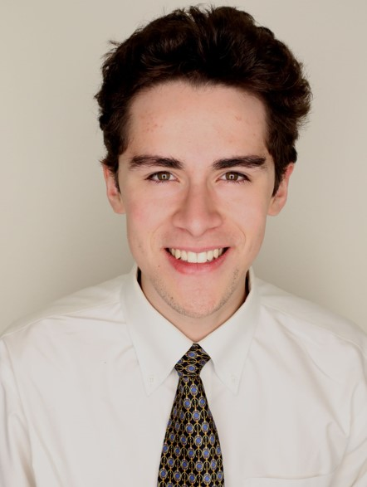
Marco Cordero
Bachelor of Arts, Statistics and Data Science
Shoutout to Telecine, the best band in Boulder!
“Cuando Seas Padre, Comerás Huevos”
Thank you to my parents and all of my friends, without which it would have been impossible to complete this journey!
Notes:
INSTRUCTIONS
Click File -> Make a Copy -> Entire Presentation. RENAME the file in this format: “Jones_Indiana_BA” saving it to your google drive.
Now you have your own editable file. Please make changes to the text in brackets (Click on the purple rectangle and a new action bar above the slide will populate. Please select “Replace image” and upload a portrait image with your face clearly visible, that you are comfortable being displayed publicly. Google Slides will automatically adjust the photo to fit within its size parameters. Please do not to adjust the size of your image or text boxes. (APPM staff will make formatting corrections later.)
Once your personalization is complete, please go to File -> Download -> Microsoft PowerPoint (.pptx) and save the file onto your computer.
Upload the recently downloaded .pptx file to the end of your commencement form

Slide 33
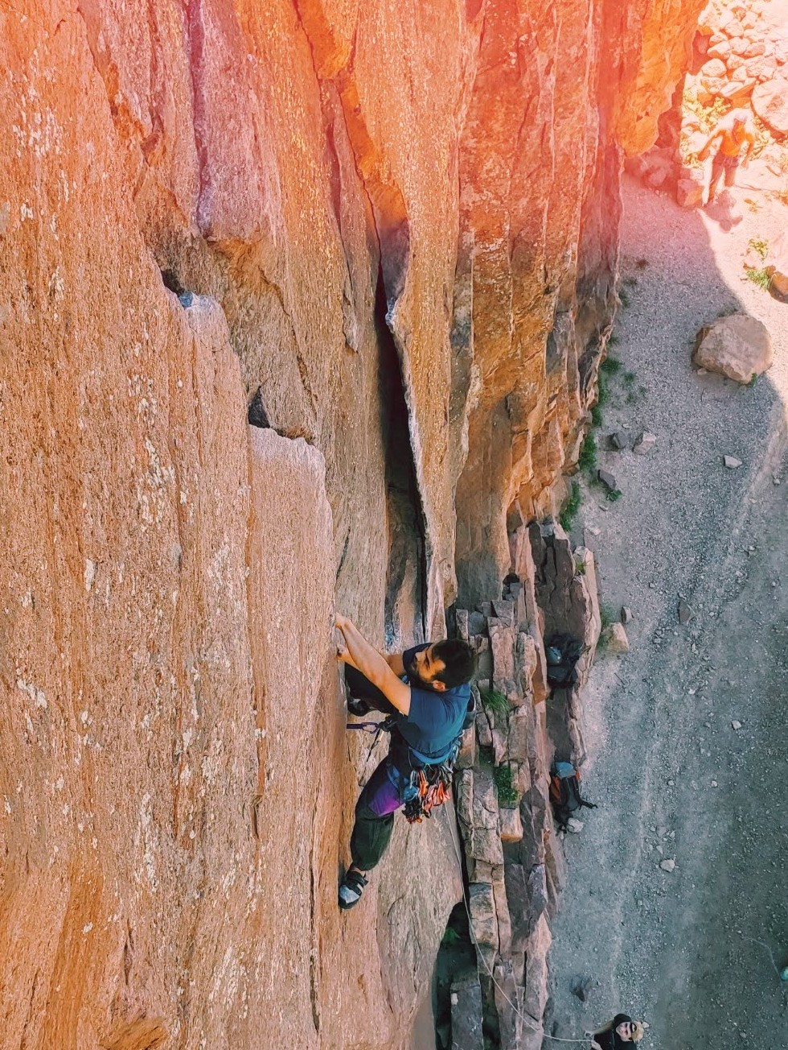
Zain Rojai Elsell
Bachelor of Arts, Statistics and Data Science
Developed skills in Python, R, SQL,C++, and machine learning algorithms.
Analyzed large datasets to glean insights and create dashboards/visualizations
Passionate about applying analytics to solve real-world problems
Excited to begin career leveraging data to help make smarter decisions in the FinTech industry
I am deeply grateful to my family and friends for their unwavering love and support during my studies. Your encouragement helped carry me through the challenges of my coursework. Thank you to my peers for the collaboration, critiques and support throughout our studies. In addition to the rest of the faculty I would especially like to thank Dr. Grooms, Dr. Onyejekwe, and Dr. Law for cultivating my passion in the fields of data science and statistics.
Notes:
Click File -> Make a Copy -> Entire Presentation. RENAME the file in this format: “Jones_Indiana_BA” saving it to your google drive.
Now you have your own editable file. Please make changes to the text in brackets (Click on the purple rectangle and a new action bar above the slide will populate. Please select “Replace image” and upload a portrait image that you are comfortable being displayed publicly. Google Slides will automatically adjust the photo to fit within its size parameters. Please do not try to adjust the size of your image too much. (APPM staff will make formatting corrections later.)
Once your personalization is complete, please go to File -> Download -> Microsoft PowerPoint (.pptx) and save the file onto your computer.
Upload the recently downloaded .pptx file to the end of your commencement form

Slide 34
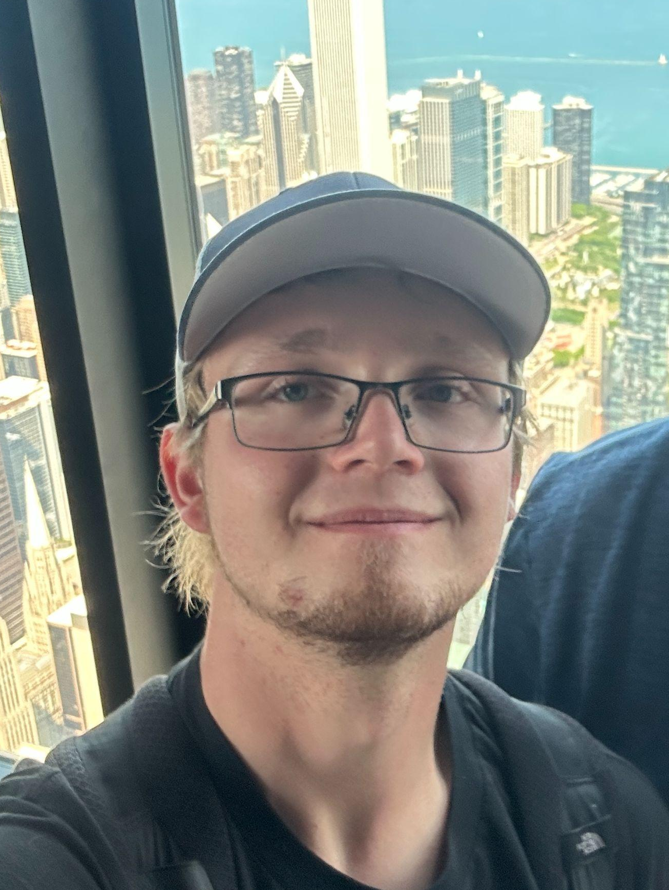
Cam Frederickson
Bachelor of Arts, Statistics and Data Science
My favorite activities during my time at CU have been building my homelab, and hiking with my dog. After graduation I plan on going on a national parks trip through Utah, before starting my career as a software engineer.
Special thank you to my parents for supporting me throughout college
Notes:
INSTRUCTIONS
Click File -> Make a Copy -> Entire Presentation. RENAME the file in this format: “Jones_Indiana_BA” saving it to your google drive.
Now you have your own editable file. Please make changes to the text in brackets (Click on the purple rectangle and a new action bar above the slide will populate. Please select “Replace image” and upload a portrait image with your face clearly visible, that you are comfortable being displayed publicly. Google Slides will automatically adjust the photo to fit within its size parameters. Please do not to adjust the size of your image or text boxes. (APPM staff will make formatting corrections later.)
Once your personalization is complete, please go to File -> Download -> Microsoft PowerPoint (.pptx) and save the file onto your computer.
Upload the recently downloaded .pptx file to the end of your commencement form

Slide 35
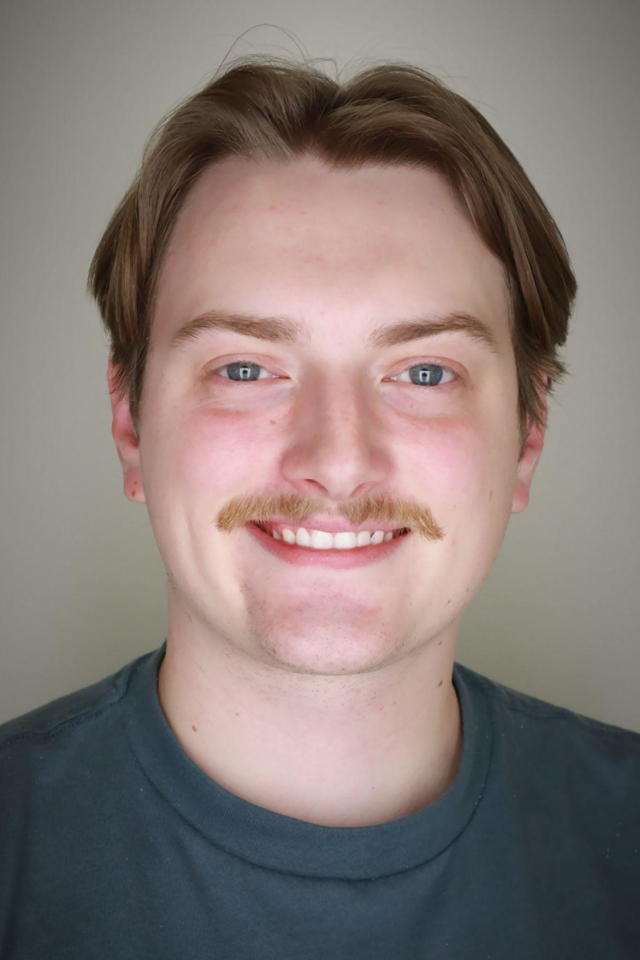
Avery William Fulton
Bachelor of Arts, Statistics and Data Science
Thank you to my classmates and peers for their support, collaboration, and community. My time here taught me how to embrace my failures and also how to better learn from them. I have learned patience, passion, and unwavering perseverance for any challenge that I might face in the future. I would also like to thank my co-workers and mentors at the Career Services and Alumni Center for encouraging my personal and professional endeavors and giving me the tools I need to succeed.
I want to thank my professors Dr. Law, Dr. Grooms, Dr. Pruitt, Dr. Onyejekwe and many others for their guidance and support throughout my studies. I also want to give the biggest thank you to my family whose continued love and support empowered me to be the man who I am today.
Notes:
INSTRUCTIONS
Click File -> Make a Copy -> Entire Presentation. RENAME the file in this format: “Jones_Indiana_BA” saving it to your google drive.
Now you have your own editable file. Please make changes to the text in brackets (Click on the purple rectangle and a new action bar above the slide will populate. Please select “Replace image” and upload a portrait image with your face clearly visible, that you are comfortable being displayed publicly. Google Slides will automatically adjust the photo to fit within its size parameters. Please do not to adjust the size of your image or text boxes. (APPM staff will make formatting corrections later.)
Once your personalization is complete, please go to File -> Download -> Microsoft PowerPoint (.pptx) and save the file onto your computer.
Upload the recently downloaded .pptx file to the end of your commencement form

Slide 36
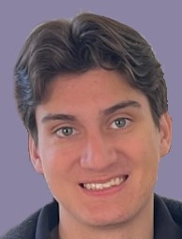
Marcus Garcia
Bachelor of Arts, Statistics and Data Science
I have loved my time here at CU and I will cherish the time spent here dearly. One of my favorite activities to do at CU was to attend football games with friends and family over the years. After college, I hope to get into building AI models specifically in the aviation industry.
Below I’ve include a quote from Marcus Aurelius’ book Meditations which is a collection of personal notes he wrote to himself regarding the stoic philosophy. I personally love this quote as well as his book as reading it would help to ease my mind.
“How ridiculous and what a stranger he is who is surprised at anything which happens in life.”
–Marcus Aurelius Meditations
Special thanks to my grandparents Papa Jones, Papi Garcia and Guinny Garcia for their support. Thanks to my parents for their continued support throughout college and throughout my life.
Notes:
INSTRUCTIONS
Click File -> Make a Copy -> Entire Presentation. RENAME the file in this format: “Jones_Indiana_BA” saving it to your google drive.
Now you have your own editable file. Please make changes to the text in brackets (Click on the purple rectangle and a new action bar above the slide will populate. Please select “Replace image” and upload a portrait image with your face clearly visible, that you are comfortable being displayed publicly. Google Slides will automatically adjust the photo to fit within its size parameters. Please do not to adjust the size of your image or text boxes. (APPM staff will make formatting corrections later.)
Once your personalization is complete, please go to File -> Download -> Microsoft PowerPoint (.pptx) and save the file onto your computer.
Upload the recently downloaded .pptx file to the end of your commencement form

Slide 37
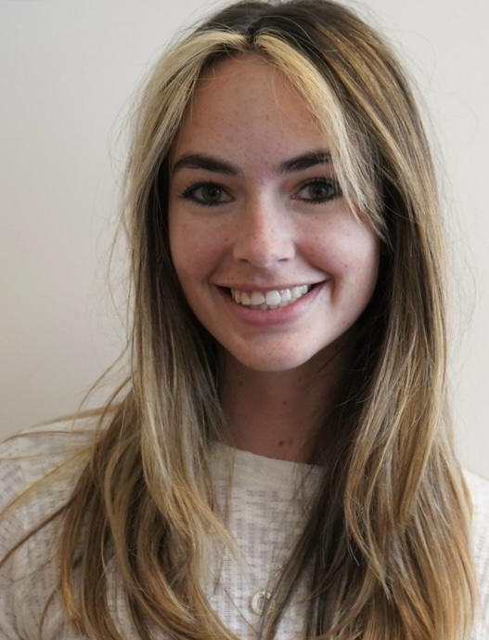
Bailey Hall
Bachelor of Arts, Statistics and Data Science
During my four years I completed as a Minor in Business, TA’d for a business finance analytics course for two semesters, served as Vice President of the Boulder chapter of The Women’s Network, and interned summer and fall of both junior and senior year. I will be working in the Core Analytics team for Willis Towers Watson starting in July.
College brought me my best friends who changed my life. I spent most of my time with my friends or at Norlin Library. I loved going to concerts at Red Rocks, skiing, and traveling.
Thank you to my parents who have always supported me and to my amazing friends who have been there for me through every step of college. I could not have asked for a better support system.
Notes:
INSTRUCTIONS
Click File -> Make a Copy -> Entire Presentation. RENAME the file in this format: “Jones_Indiana_BA” saving it to your google drive.
Now you have your own editable file. Please make changes to the text in brackets (Click on the purple rectangle and a new action bar above the slide will populate. Please select “Replace image” and upload a portrait image with your face clearly visible, that you are comfortable being displayed publicly. Google Slides will automatically adjust the photo to fit within its size parameters. Please do not to adjust the size of your image or text boxes. (APPM staff will make formatting corrections later.)
Once your personalization is complete, please go to File -> Download -> Microsoft PowerPoint (.pptx) and save the file onto your computer.
Upload the recently downloaded .pptx file to the end of your commencement form

Slide 38
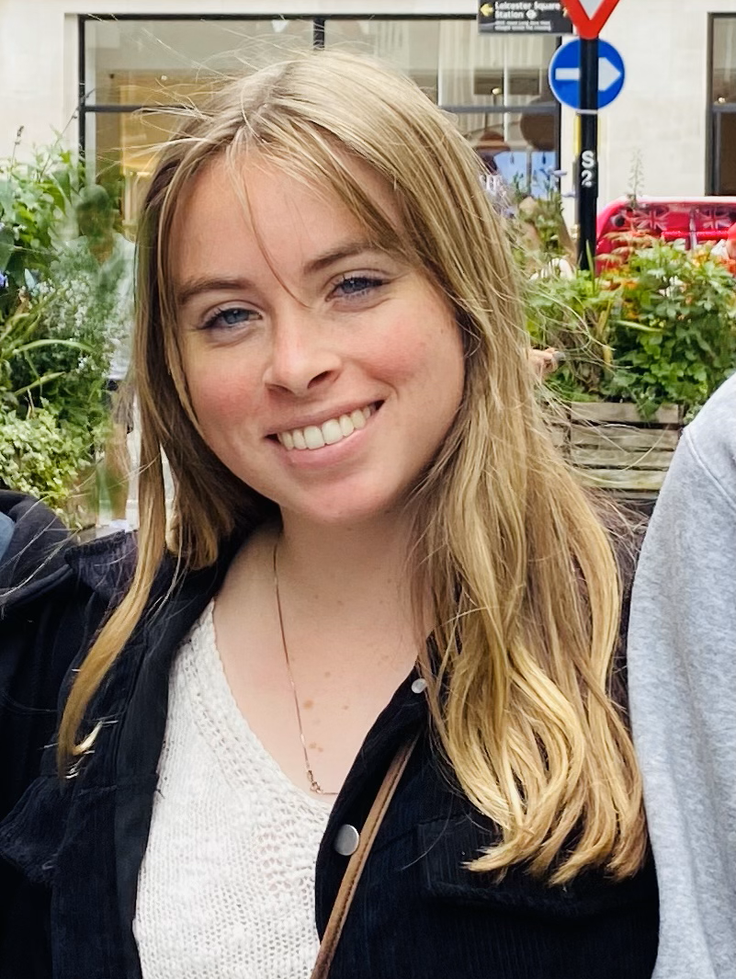
Ashlynn McGrattan
Bachelor of Arts, Statistics and Data Science
I'm grateful for the challenge of this program and the support from my professors, TAs, and classmates. It has been a lot of work but it is very rewarding. I'm glad I choose this major because it helped me get an internship and full time job as a data scientist.
Thank you to my friends and family for supporting me through this degree and thank you to my professors and TAs for challenging and teaching me.
Notes:
INSTRUCTIONS
Click File -> Make a Copy -> Entire Presentation. RENAME the file in this format: “Jones_Indiana_BA” saving it to your google drive.
Now you have your own editable file. Please make changes to the text in brackets (Click on the purple rectangle and a new action bar above the slide will populate. Please select “Replace image” and upload a portrait image with your face clearly visible, that you are comfortable being displayed publicly. Google Slides will automatically adjust the photo to fit within its size parameters. Please do not to adjust the size of your image or text boxes. (APPM staff will make formatting corrections later.)
Once your personalization is complete, please go to File -> Download -> Microsoft PowerPoint (.pptx) and save the file onto your computer.
Upload the recently downloaded .pptx file to the end of your commencement form

Slide 39
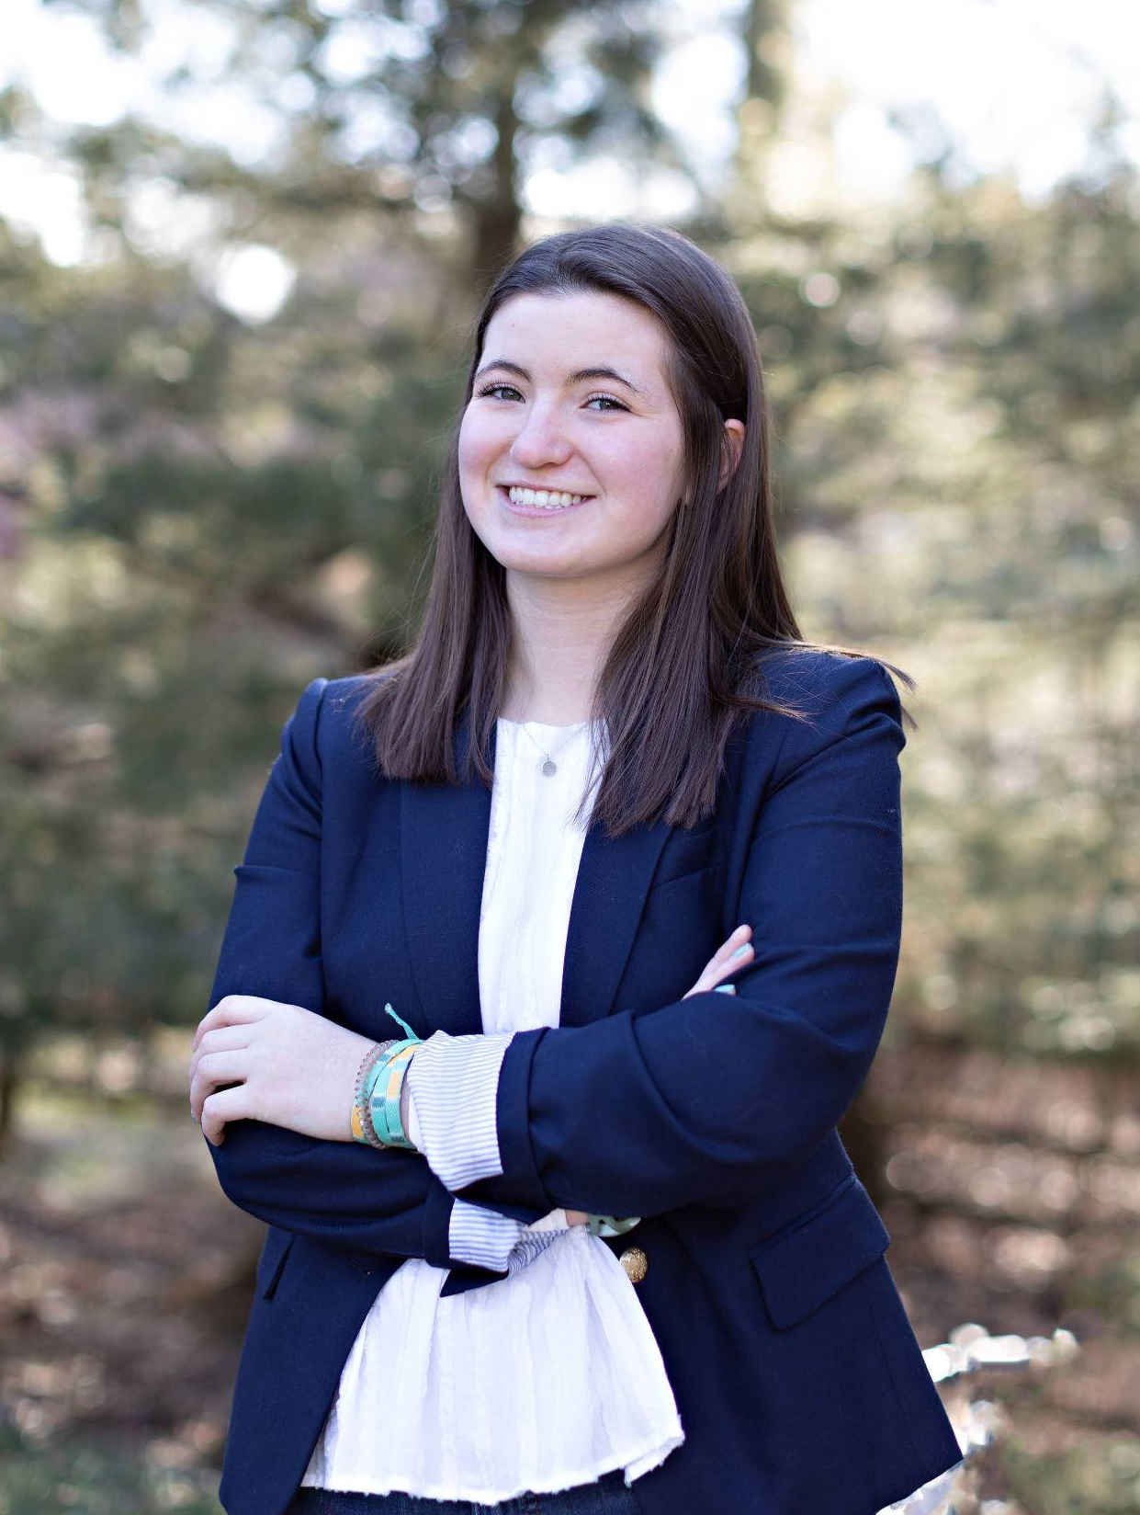
Molly Molingowski
Bachelor of Arts, Statistics and Data Science
I have really enjoyed my 4 years with the APPM department and am so honored to be able to say that I have graduated from such a great program! I've learned so much over the years and am excited to see where it takes me next! In October, I will be moving to Vietnam to teach English with the Peace Corps! Thank you CU!
Thank you to all of the APPM and STAT professors and advisors for essential guidance as well as my parents and family for endless support!
Notes:
INSTRUCTIONS
Click File -> Make a Copy -> Entire Presentation. RENAME the file in this format: “Jones_Indiana_BA” saving it to your google drive.
Now you have your own editable file. Please make changes to the text in brackets (Click on the purple rectangle and a new action bar above the slide will populate. Please select “Replace image” and upload a portrait image with your face clearly visible, that you are comfortable being displayed publicly. Google Slides will automatically adjust the photo to fit within its size parameters. Please do not to adjust the size of your image or text boxes. (APPM staff will make formatting corrections later.)
Once your personalization is complete, please go to File -> Download -> Microsoft PowerPoint (.pptx) and save the file onto your computer.
Upload the recently downloaded .pptx file to the end of your commencement form

Slide 40
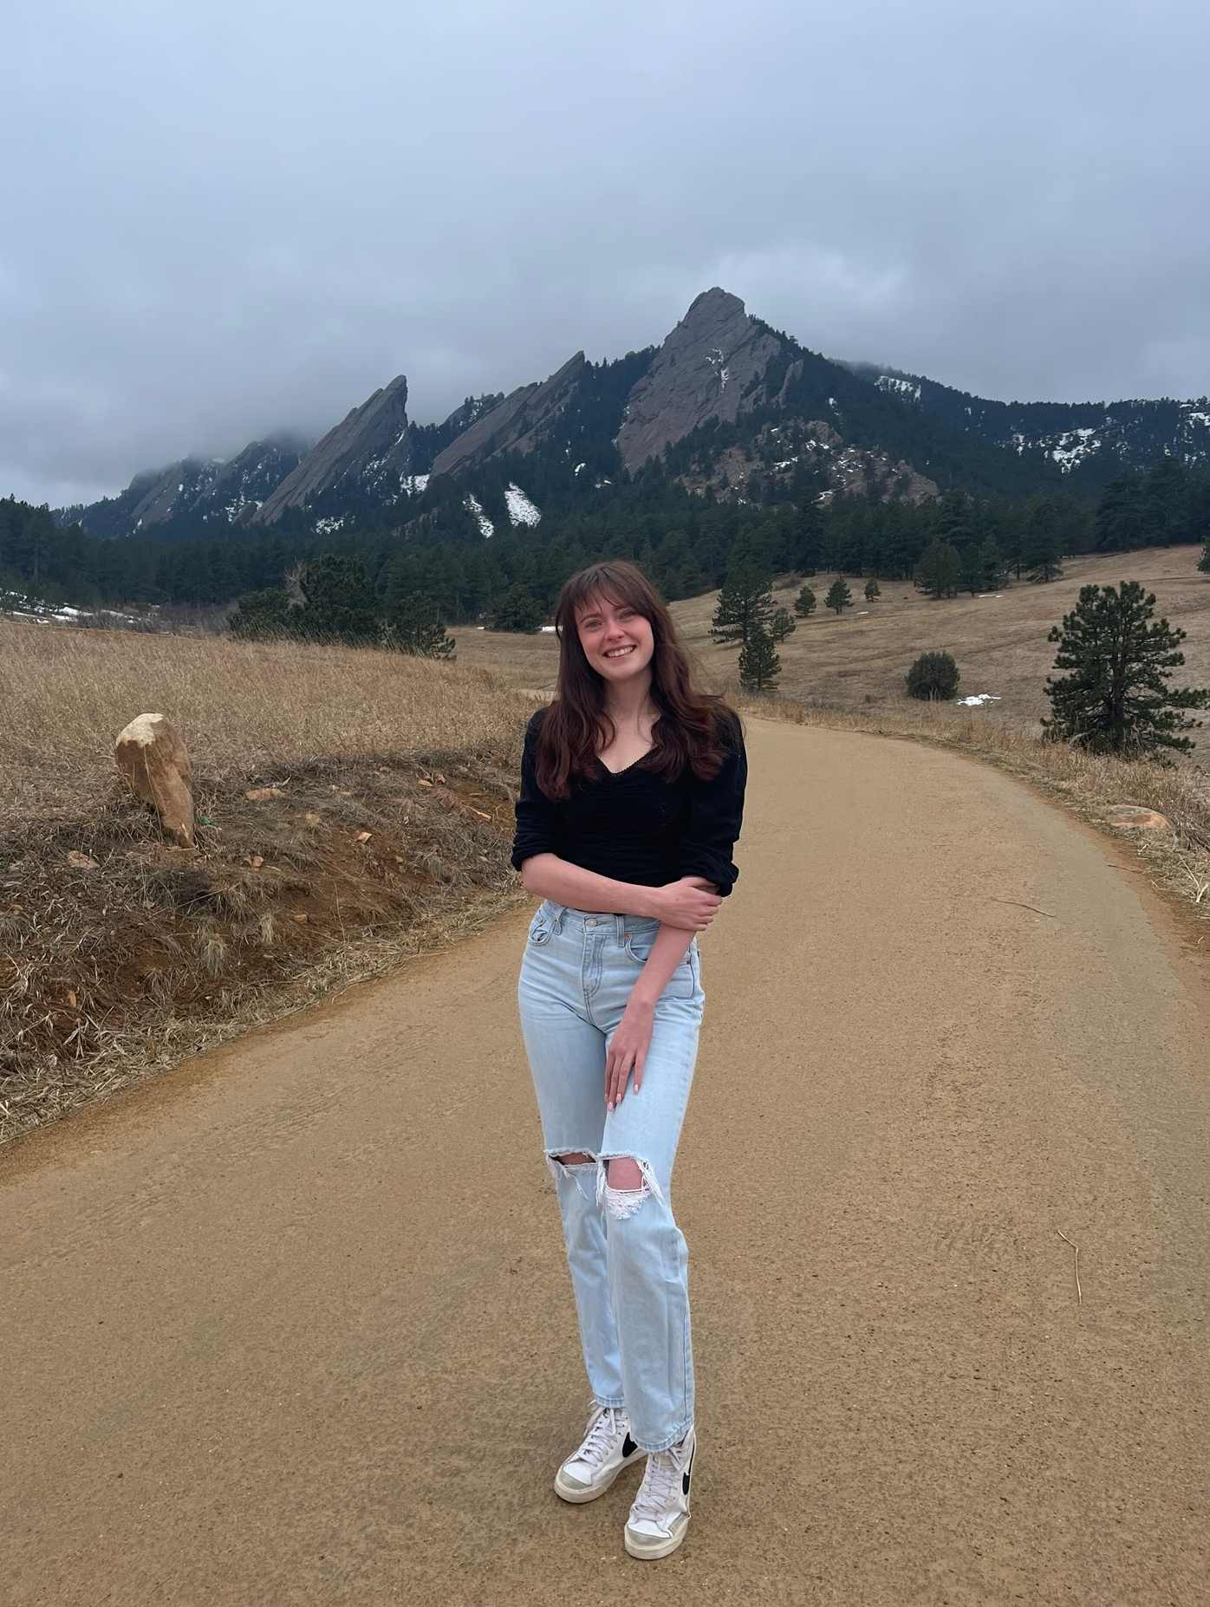
Emily Palese
Bachelor of Arts, Statistics and Data Science
Within my journey at the University I have grown as an individual, academically and personally, and look forward to taking these skills with me into my future endeavors.
I am graduating with a minor in the Leeds School of Business.
Thank you to my Mom, Dad, Sister and Uncle for being there every step of the way.
Notes:
INSTRUCTIONS
Click File -> Make a Copy -> Entire Presentation. RENAME the file in this format: “Jones_Indiana_BA” saving it to your google drive.
Now you have your own editable file. Please make changes to the text in brackets (Click on the purple rectangle and a new action bar above the slide will populate. Please select “Replace image” and upload a portrait image with your face clearly visible, that you are comfortable being displayed publicly. Google Slides will automatically adjust the photo to fit within its size parameters. Please do not to adjust the size of your image or text boxes. (APPM staff will make formatting corrections later.)
Once your personalization is complete, please go to File -> Download -> Microsoft PowerPoint (.pptx) and save the file onto your computer.
Upload the recently downloaded .pptx file to the end of your commencement form

Slide 41
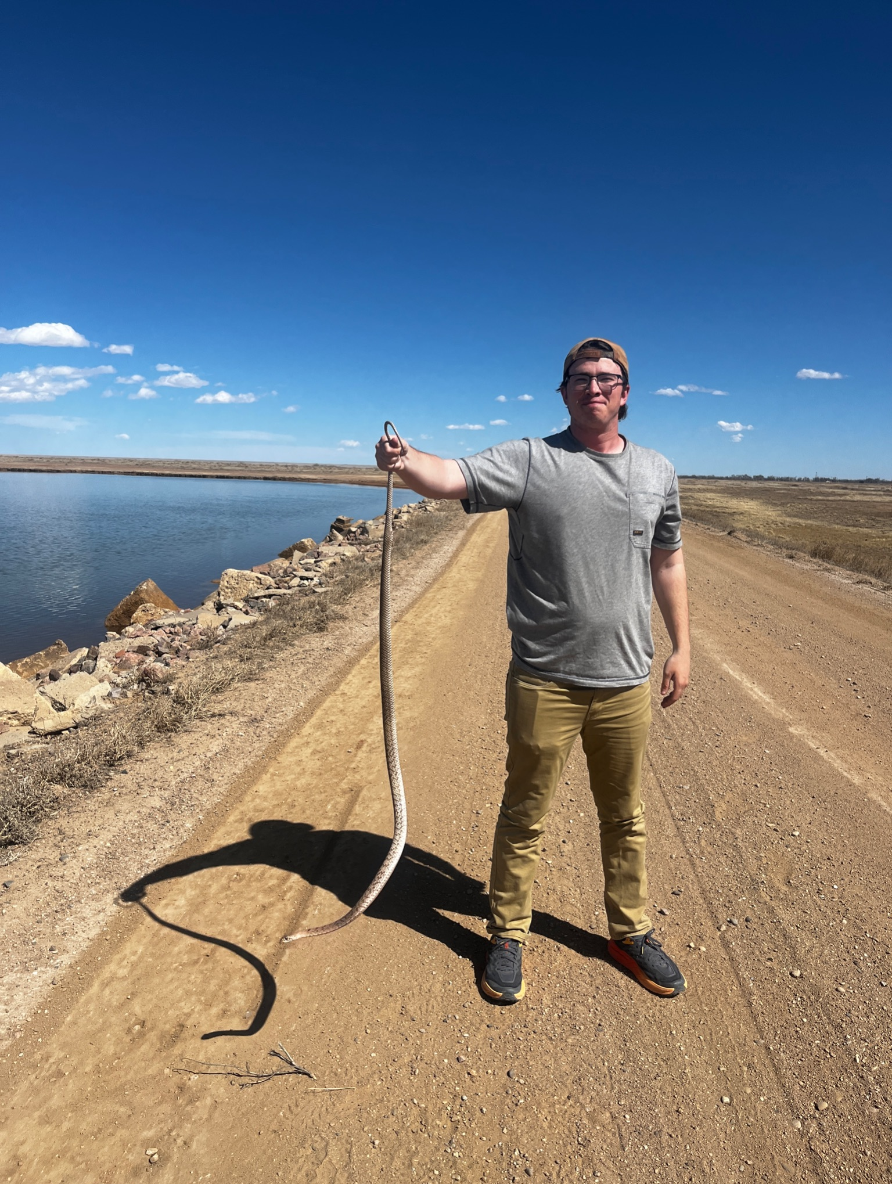
Luke Pheneger
Bachelor of Arts, Statistics and Data Science
Studying mathematics was a journey, and now I'm excited to bring it to wildlife conservation. I’ll always cherish the outdoors adventures with my friends along the way.
I would like to thank my parents, my brother Xander, my Friends, and professors Nathan Pieplow and Jim Curry
Notes:
INSTRUCTIONS
Click File -> Make a Copy -> Entire Presentation. RENAME the file in this format: “Jones_Indiana_BA” saving it to your google drive.
Now you have your own editable file. Please make changes to the text in brackets (Click on the purple rectangle and a new action bar above the slide will populate. Please select “Replace image” and upload a portrait image with your face clearly visible, that you are comfortable being displayed publicly. Google Slides will automatically adjust the photo to fit within its size parameters. Please do not to adjust the size of your image or text boxes. (APPM staff will make formatting corrections later.)
Once your personalization is complete, please go to File -> Download -> Microsoft PowerPoint (.pptx) and save the file onto your computer.
Upload the recently downloaded .pptx file to the end of your commencement form

Slide 42
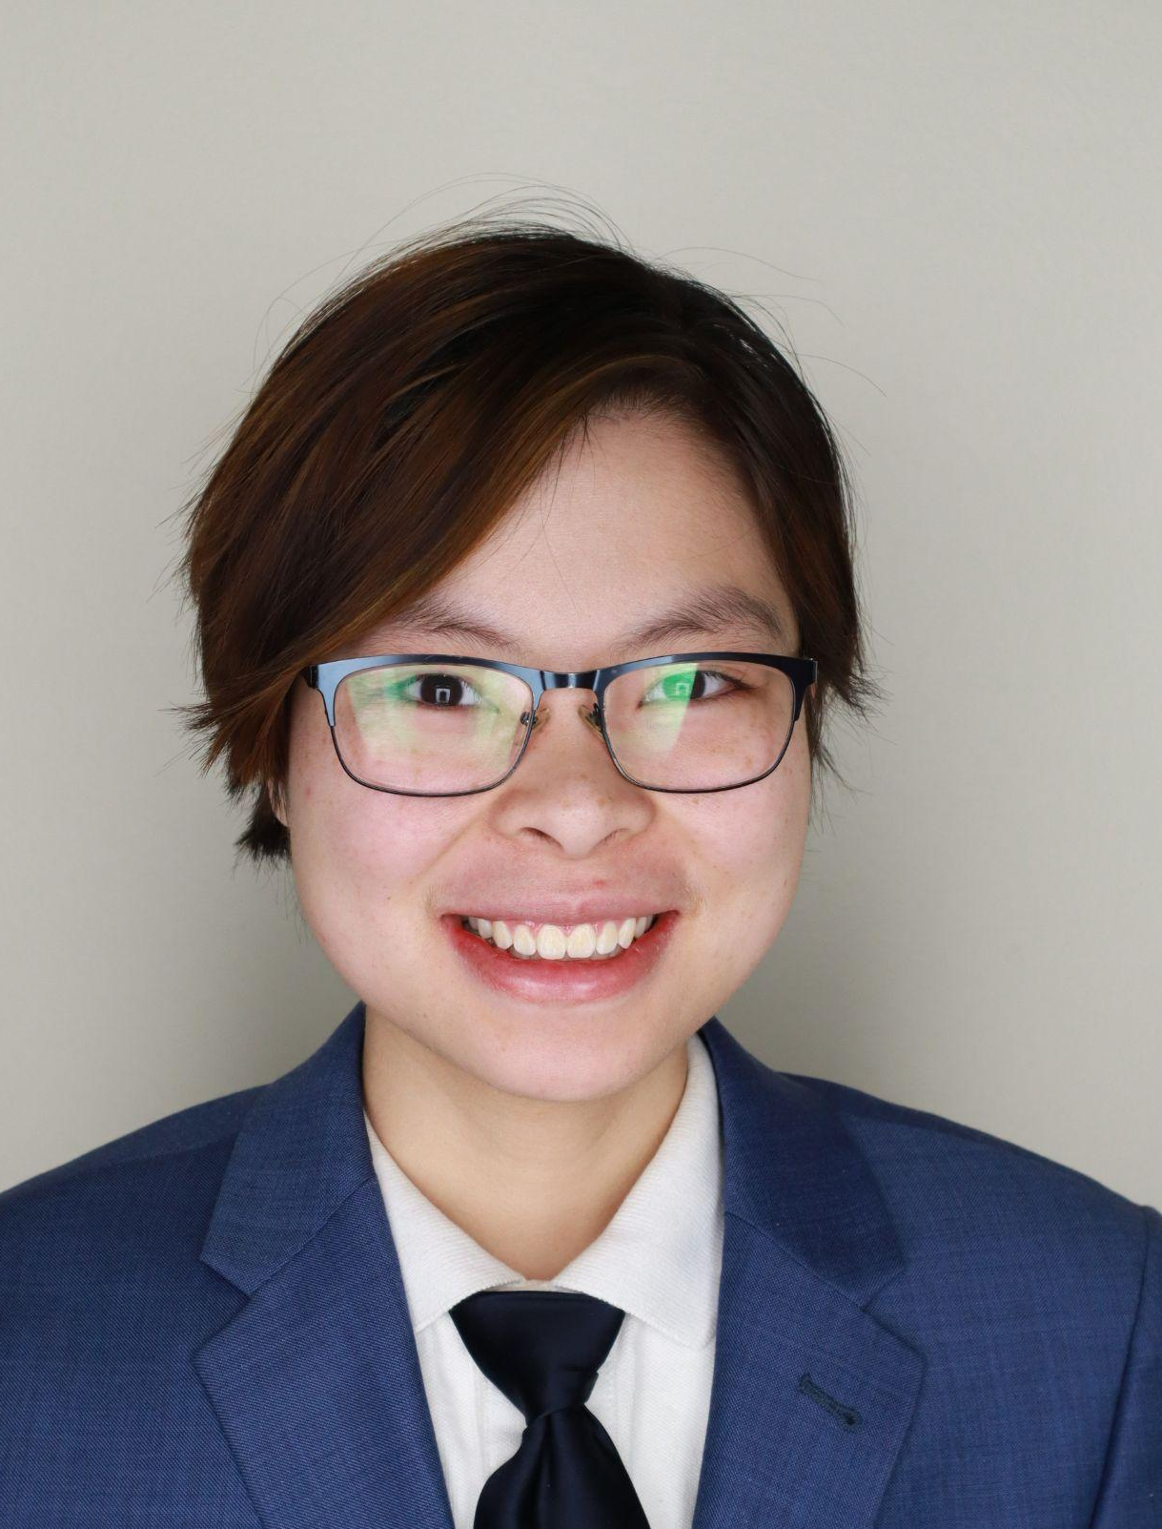
Max Silver
Bachelor of Arts, Statistics and Data Science
Max graduated Summa Cum Laude and With Distinction last fall. He was a member of the CU Honors Scholars Program and the Phi Beta Kappa society. He also served as a course assistant for several classes in the Applied Math department. He defended an honors thesis that analyzed fire weather patterns in Colorado. Last January, he presented that research at the American Meteorological Society conference. Max started graduate school this spring and is excited to continue next year.
I want to thank everyone for their support. I wish I could name you all, but there are just too many of you to list here!
Notes:
Click File -> Make a Copy -> Entire Presentation. RENAME the file in this format: “Jones_Indiana_BA” saving it to your google drive.
Now you have your own editable file. Please make changes to the text in brackets (Click on the purple rectangle and a new action bar above the slide will populate. Please select “Replace image” and upload a portrait image that you are comfortable being displayed publicly. Google Slides will automatically adjust the photo to fit within its size parameters. Please do not try to adjust the size of your image too much. (APPM staff will make formatting corrections later.)
Once your personalization is complete, please go to File -> Download -> Microsoft PowerPoint (.pptx) and save the file onto your computer.
Upload the recently downloaded .pptx file to the end of your commencement form

Slide 43
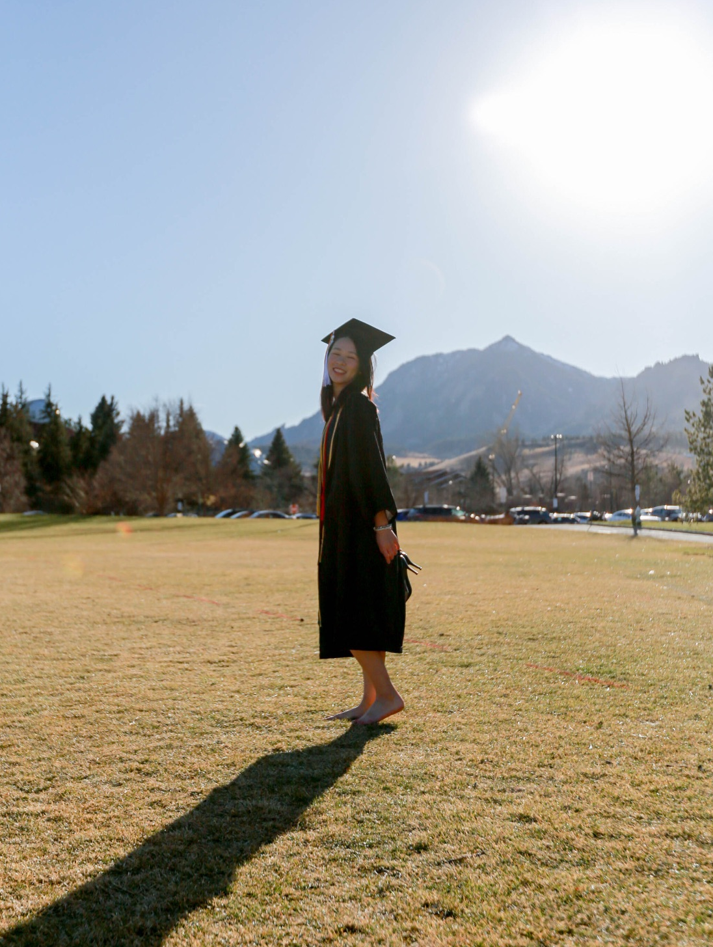
Lalita Suwattee
Bachelor of Arts, Statistics and Data Science
Congrats! We made it to the graduation!!
Special thanks to mom, dad, aunt, my family, bf, and friends I would not come this far without you all. LOVE
Thank you for every opportunities I got at CU
that shape me to be me today
Notes:
Click File -> Make a Copy -> Entire Presentation. RENAME the file in this format: “Jones_Indiana_BA” saving it to your google drive.
Now you have your own editable file. Please make changes to the text in brackets (Click on the purple rectangle and a new action bar above the slide will populate. Please select “Replace image” and upload a portrait image that you are comfortable being displayed publicly. Google Slides will automatically adjust the photo to fit within its size parameters. Please do not try to adjust the size of your image too much. (APPM staff will make formatting corrections later.)
Once your personalization is complete, please go to File -> Download -> Microsoft PowerPoint (.pptx) and save the file onto your computer.
Upload the recently downloaded .pptx file to the end of your commencement form

Slide 44
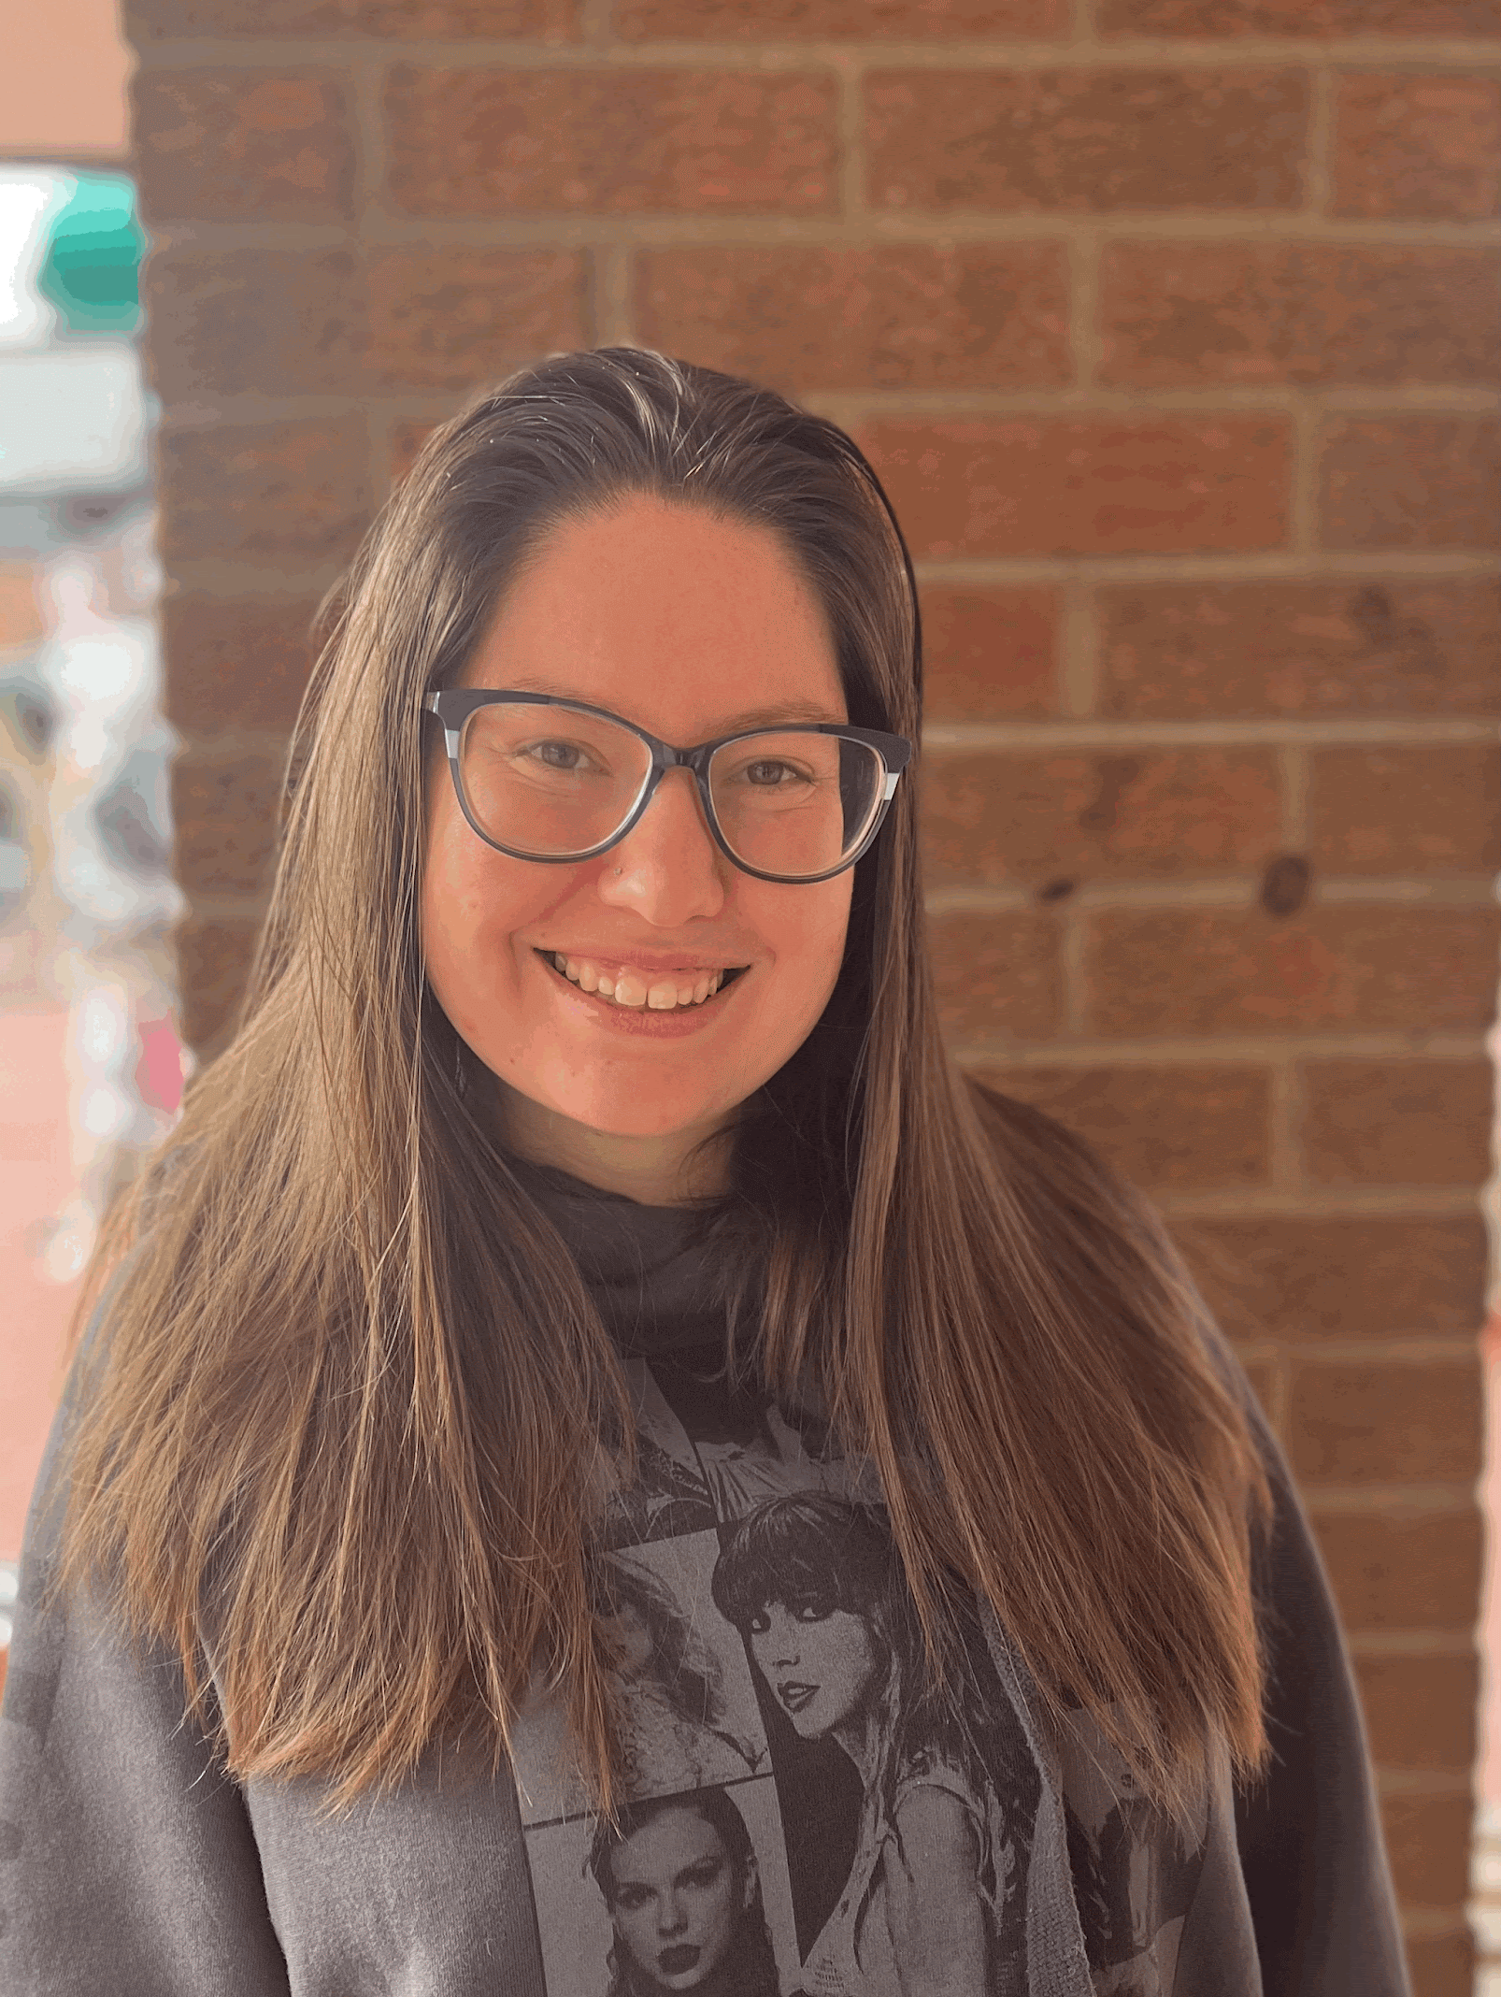
Prue Whaley
Bachelor of Arts, Statistics and Data Science
“The road to success is always under construction.”
-Lily Tomlin This quote is the best summary of what I have learned here at CU and I will take the knowledge I have gained here so I can continue to learn, grow and pursue my success.
I would like to say thank you to my parents, boyfriend, classmates, and all the professors that have made it possible for me to make it to graduation.
Notes:
INSTRUCTIONS
Click File -> Make a Copy -> Entire Presentation. RENAME the file in this format: “Jones_Indiana_BA” saving it to your google drive.
Now you have your own editable file. Please make changes to the text in brackets (Click on the purple rectangle and a new action bar above the slide will populate. Please select “Replace image” and upload a portrait image with your face clearly visible, that you are comfortable being displayed publicly. Google Slides will automatically adjust the photo to fit within its size parameters. Please do not to adjust the size of your image or text boxes. (APPM staff will make formatting corrections later.)
Once your personalization is complete, please go to File -> Download -> Microsoft PowerPoint (.pptx) and save the file onto your computer.
Upload the recently downloaded .pptx file to the end of your commencement form

Slide 45
Bachelor of Science
Applied Mathematics
Honors
∙ Engineering Honors
♦ Summa Cum Laude
* Magna Cum Laude
∇ Cum Laude
†A&S Honors Thesis
Cambria Chaney ♦ ∙
Sophia Clark
Clayton D'Epagnier ♦
Chris Doan
Henry Dyer *†
Ryan Foley
Ella Glebe
Daniel Lisle
Aria Mundy
Victoria Nawalany
Ellen Puzak ∙
Jenna Rae Rothe
Katie Simon
Luke Stuckenbruck
Kevin Stull
Maedee Trank-Greene ∇
Stella Vannier
Santiago Velasco
Walter Virany∇
Gabe Wallon ♦

Slide 46
Cambria Chaney
Bachelor of Science, Applied Mathematics
Minors in Statistics and Economics
Completion of the Actuarial Studies Certificate
President of Delta Delta Delta Sorority
President of the Actuarial Science Club
Member of the Engineering Honors Program
From sporting events, to leading my sorority, to spontaneous adventures, this experience at CU Boulder has allowed me to grow in ways I never thought I could. Thank you to all my friends and family who have supported me throughout this journey. I couldn’t have done it without you!
I want to give a special thanks to my mom and my sister, Kira, who have been there for me every step of the way. I love you both so much!
Notes:
Click File -> Make a Copy -> Entire Presentation. RENAME the file in this format: “Jones_Indiana_BS” saving it to your google drive.
Now you have your own editable file. Please make changes to the text in brackets (Click on the purple rectangle and a new action bar above the slide will populate. Please select “Replace image” and upload a portrait image that you are comfortable being displayed publicly. Google Slides will automatically adjust the photo to fit within its size parameters. Please do not try to adjust the size of your image too much. (APPM staff will make formatting corrections later.)
Once your personalization is complete, please go to File -> Download -> Microsoft PowerPoint (.pptx) and save the file onto your computer.
Upload the recently downloaded .pptx file to the end of your commencement form

Slide 47
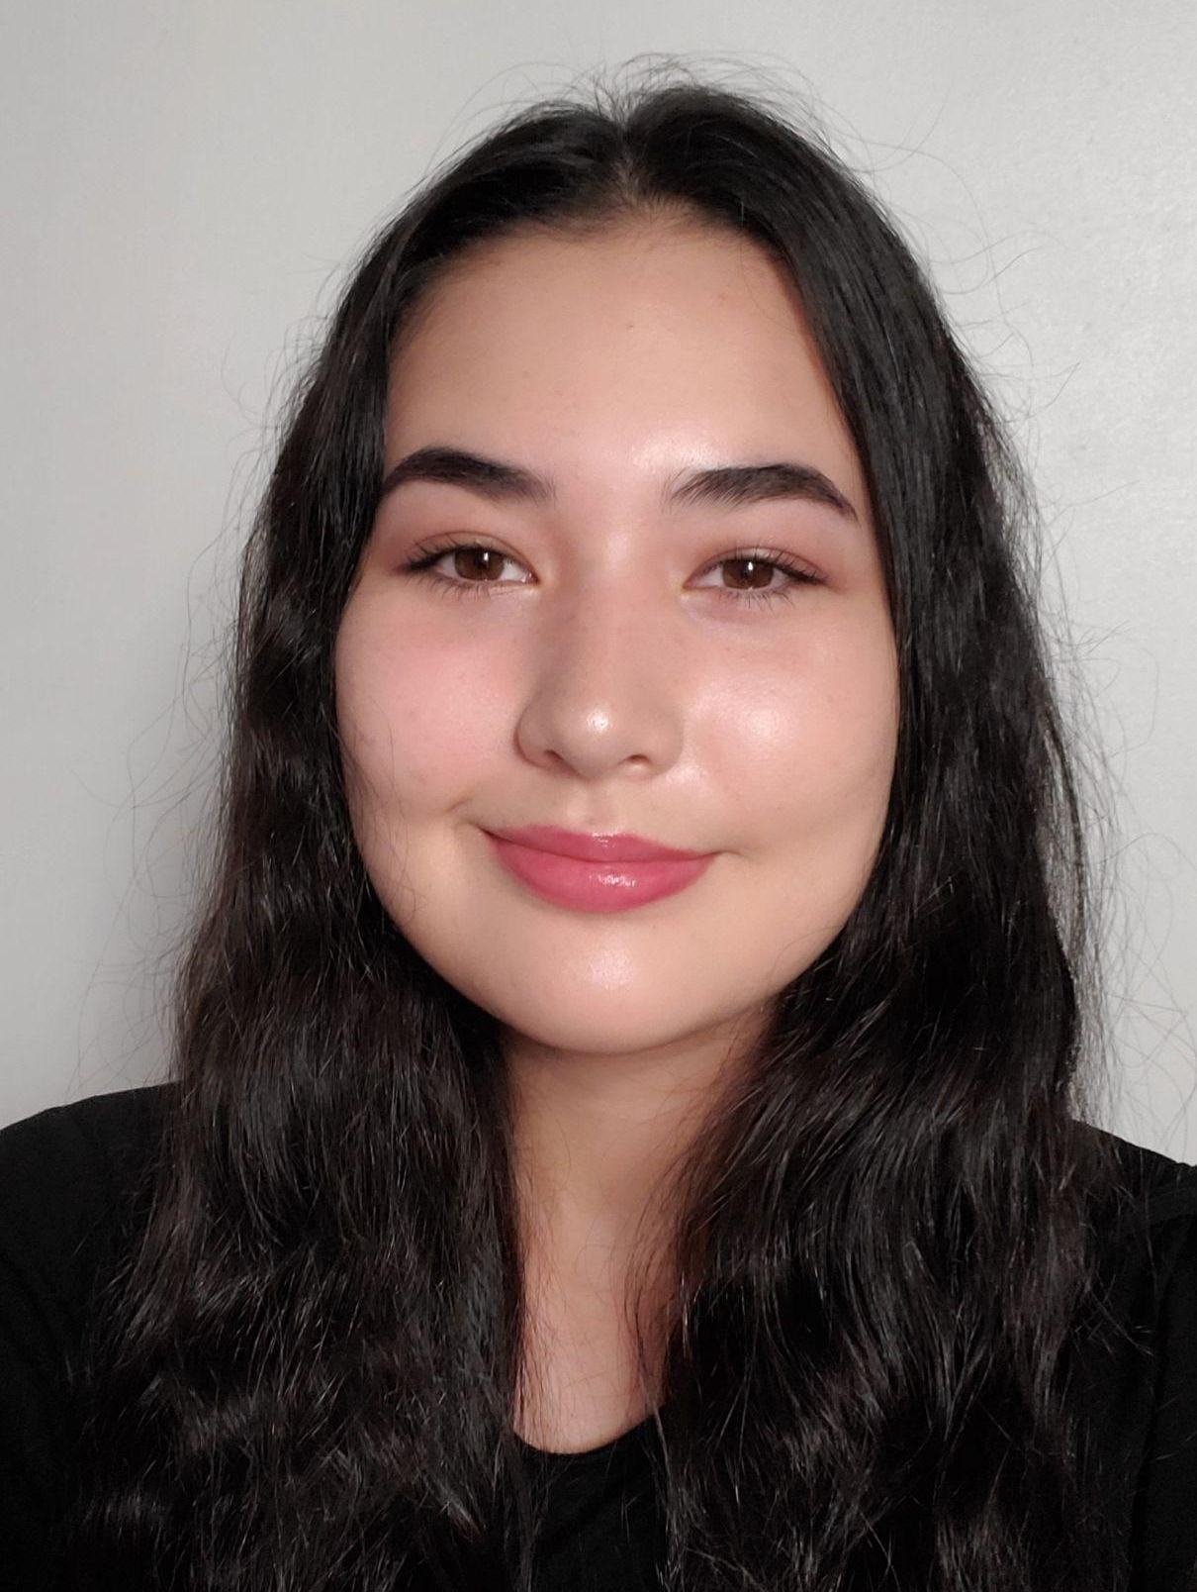
Sophia Clark
Bachelor of Science, Applied Mathematics
With my undergraduate degree, I plan to continue working for an employee benefits company as an actuary as I pursue my actuarial credentials.
Thank you Professor Anne Dougherty for your guidance and encouragement for these past 4 years!
Notes:
INSTRUCTIONS
Click File -> Make a Copy -> Entire Presentation. RENAME the file in this format: “Jones_Indiana_BS” saving it to your google drive.
Now you have your own editable file. Please make changes to the text in brackets (Click on the purple rectangle and a new action bar above the slide will populate. Please select “Replace image” and upload a portrait image with your face clearly visible, that you are comfortable being displayed publicly. Google Slides will automatically adjust the photo to fit within its size parameters. Please do not to adjust the size of your image or text boxes. (APPM staff will make formatting corrections later.)
Once your personalization is complete, please go to File -> Download -> Microsoft PowerPoint (.pptx) and save the file onto your computer.
Upload the recently downloaded .pptx file to the end of your commencement form

Slide 48
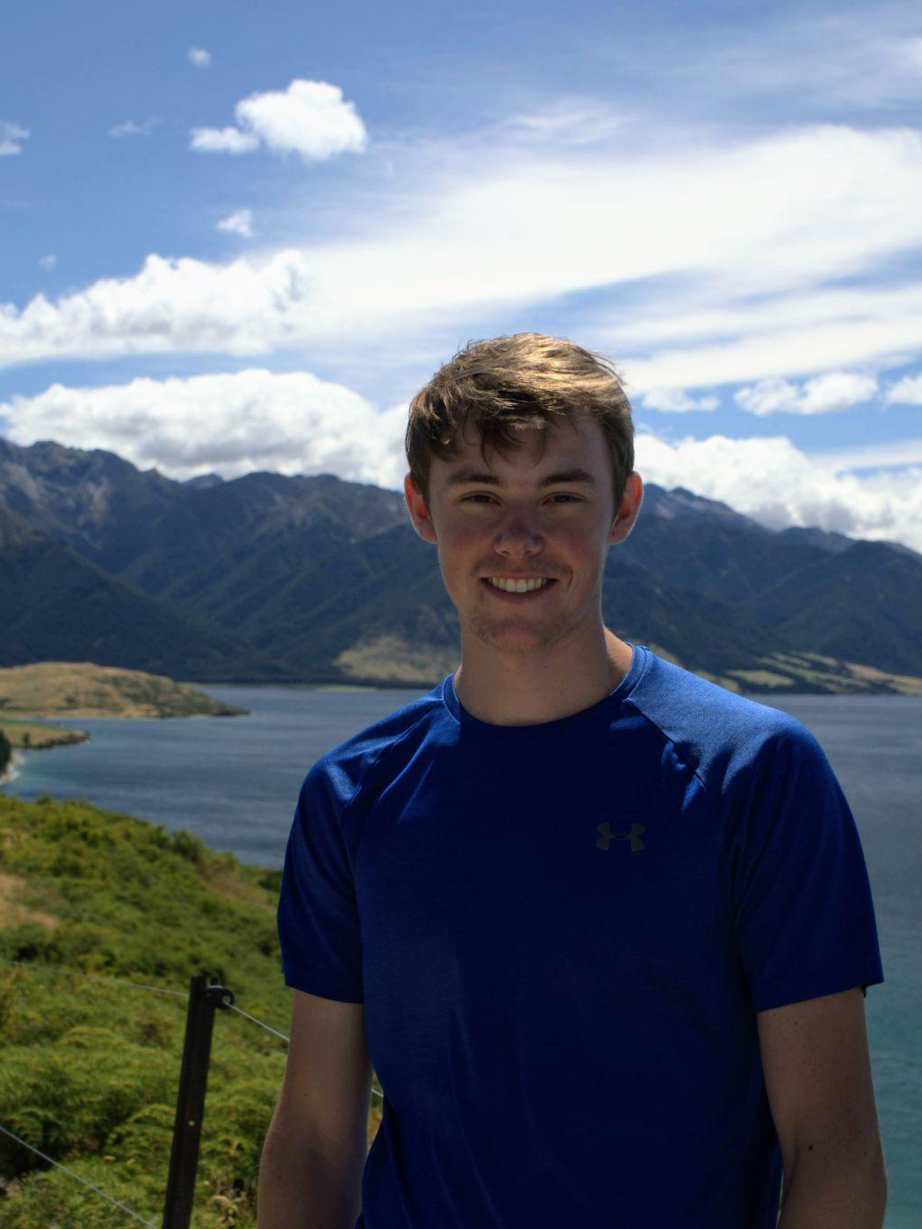
Clayton D’Epagnier
Bachelor of Science, Applied Mathematics
CU Boulder challenged me to learn and acquire the skills necessary to thrive in the future in the math and computer science field. They also supported me as I travelled abroad to Australia to broaden my view on the world.
Thanks to my family, friends, advisor, and professors for the support along the way
Notes:
INSTRUCTIONS
Click File -> Make a Copy -> Entire Presentation. RENAME the file in this format: “Jones_Indiana_BS” saving it to your google drive.
Now you have your own editable file. Please make changes to the text in brackets (Click on the purple rectangle and a new action bar above the slide will populate. Please select “Replace image” and upload a portrait image with your face clearly visible, that you are comfortable being displayed publicly. Google Slides will automatically adjust the photo to fit within its size parameters. Please do not to adjust the size of your image or text boxes. (APPM staff will make formatting corrections later.)
Once your personalization is complete, please go to File -> Download -> Microsoft PowerPoint (.pptx) and save the file onto your computer.
Upload the recently downloaded .pptx file to the end of your commencement form

Slide 49
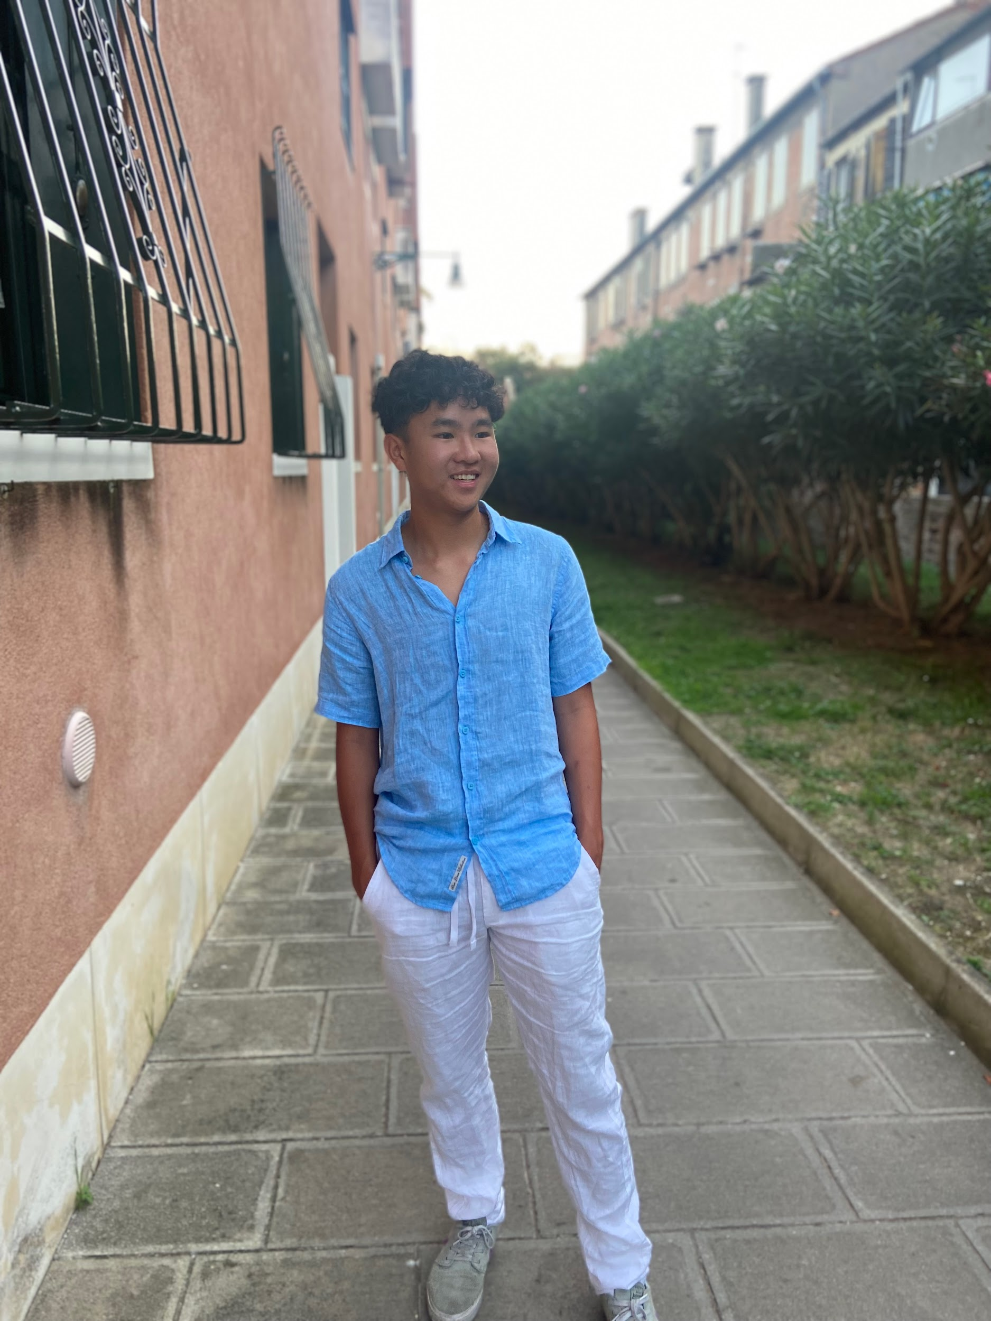
Chris Doan
Bachelor of Science, Applied Mathematics
Chris is graduating in Applied Math with a minor in Statistics and Data Science. He has enjoyed learning and applying these skills to his interests through various projects. Chris has played for CU’s Men’s Ultimate Frisbee team the past four years, where he has built some of his most meaningful relationships. This fall, he will return to CU to pursue a Master’s degree in Applied Mathematics.
I’d like to thank my family for always supporting me, in addition to my friends, teammates, and wonderful professors who have helped me along the way.
Notes:
INSTRUCTIONS
Click File -> Make a Copy -> Entire Presentation. RENAME the file in this format: “Jones_Indiana_BS” saving it to your google drive.
Now you have your own editable file. Please make changes to the text in brackets (Click on the purple rectangle and a new action bar above the slide will populate. Please select “Replace image” and upload a portrait image with your face clearly visible, that you are comfortable being displayed publicly. Google Slides will automatically adjust the photo to fit within its size parameters. Please do not to adjust the size of your image or text boxes. (APPM staff will make formatting corrections later.)
Once your personalization is complete, please go to File -> Download -> Microsoft PowerPoint (.pptx) and save the file onto your computer.
Upload the recently downloaded .pptx file to the end of your commencement form

Slide 50
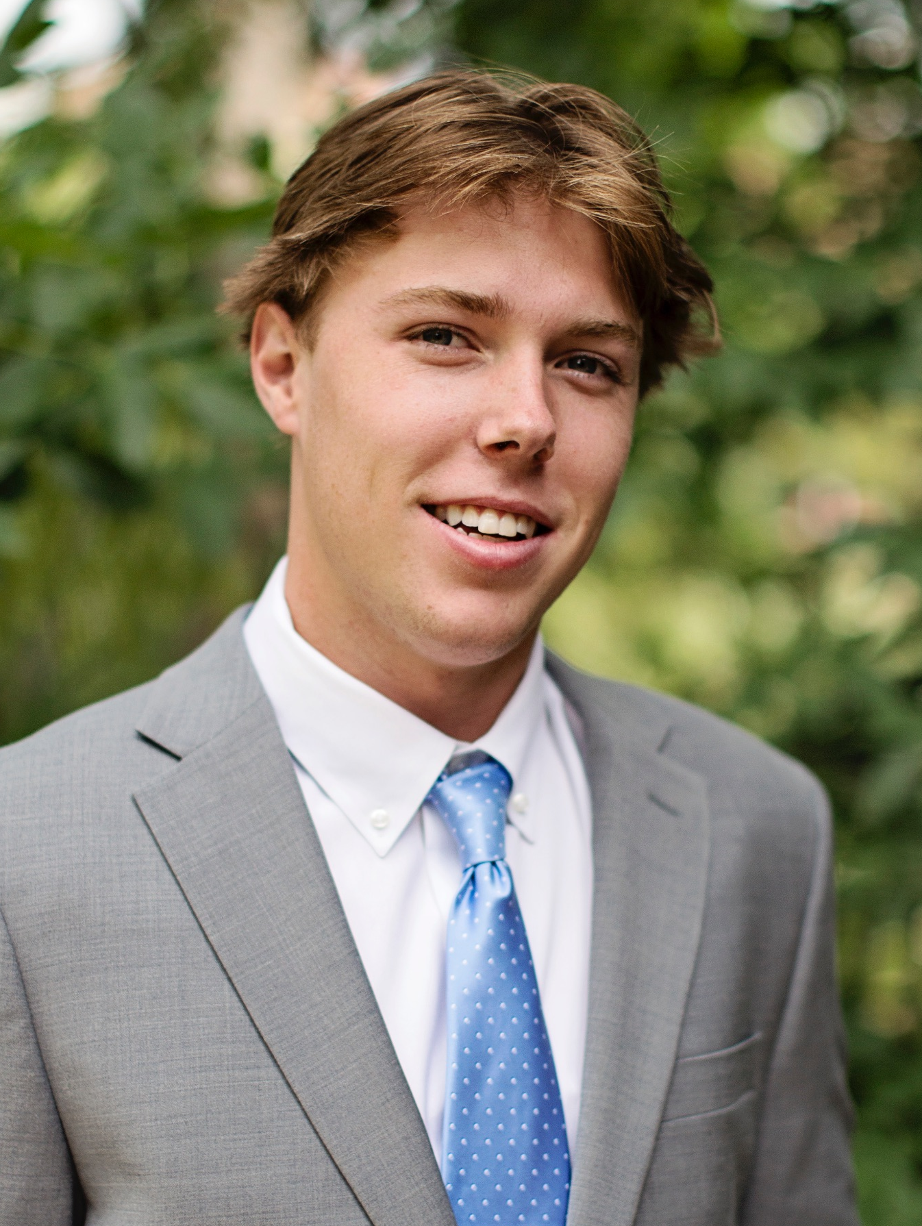
Henry Dyer
Bachelor of Science, Applied Mathematics
Earned a dual emphasis in Computer Science and Quantitative Finance as well as a minor in Economics.
Wrote honors thesis - “GARCH Based Risk Estimation in Emerging Market Foreign Exchange Rates”
Massive thanks to my friends and family for their support over the past couple years and to the faculty, TA’s, and fellow students in APPM for making my time here so great.
Notes:
INSTRUCTIONS
Click File -> Make a Copy -> Entire Presentation. RENAME the file in this format: “Jones_Indiana_BS” saving it to your google drive.
Now you have your own editable file. Please make changes to the text in brackets (Click on the purple rectangle and a new action bar above the slide will populate. Please select “Replace image” and upload a portrait image with your face clearly visible, that you are comfortable being displayed publicly. Google Slides will automatically adjust the photo to fit within its size parameters. Please do not to adjust the size of your image or text boxes. (APPM staff will make formatting corrections later.)
Once your personalization is complete, please go to File -> Download -> Microsoft PowerPoint (.pptx) and save the file onto your computer.
Upload the recently downloaded .pptx file to the end of your commencement form

Slide 51
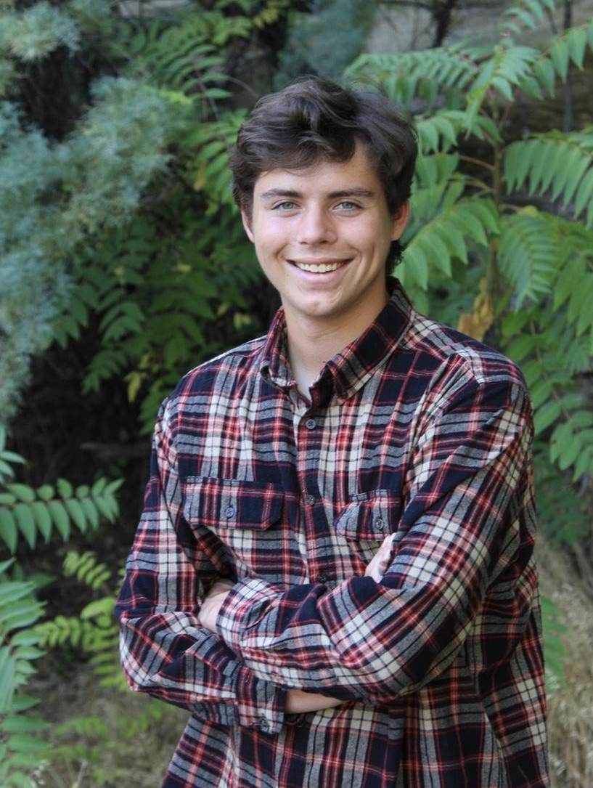
Ryan Foley
Bachelor of Science, Applied Mathematics
I’ll be starting work at cQuant after graduation. cQuant sells quantitative financial software to power suppliers. I look forward to using the skills I learned in Computer Science and Finance while perusing my Applied Math degree at CU!
Special thanks to my family and professors who record their lectures.
Notes:
INSTRUCTIONS
Click File -> Make a Copy -> Entire Presentation. RENAME the file in this format: “Jones_Indiana_BS” saving it to your google drive.
Now you have your own editable file. Please make changes to the text in brackets (Click on the purple rectangle and a new action bar above the slide will populate. Please select “Replace image” and upload a portrait image with your face clearly visible, that you are comfortable being displayed publicly. Google Slides will automatically adjust the photo to fit within its size parameters. Please do not to adjust the size of your image or text boxes. (APPM staff will make formatting corrections later.)
Once your personalization is complete, please go to File -> Download -> Microsoft PowerPoint (.pptx) and save the file onto your computer.
Upload the recently downloaded .pptx file to the end of your commencement form

Slide 52
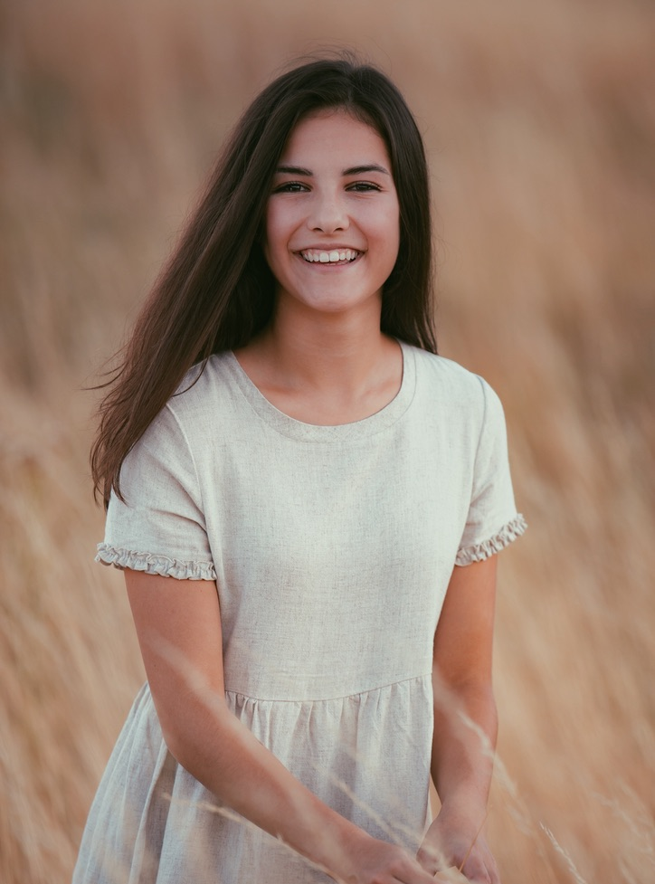
Ella Glebe
Bachelor of Science, Applied Mathematics
Celebrating a major in Applied Math with a minor in Economics and a Quantitative Finance Certificate, Ella is excited for the future. After graduation, she will embark on a month-long European adventure before joining IBM’s Federal Consulting Team as a Financial Consultant.
I would like to thank my parents, sister, grandparents, and friends for all their support and encouragement. Love you all!
Notes:
Click File -> Make a Copy -> Entire Presentation. RENAME the file in this format: “Jones_Indiana_BS” saving it to your google drive.
Now you have your own editable file. Please make changes to the text in brackets (Click on the purple rectangle and a new action bar above the slide will populate. Please select “Replace image” and upload a portrait image that you are comfortable being displayed publicly. Google Slides will automatically adjust the photo to fit within its size parameters. Please do not try to adjust the size of your image too much. (APPM staff will make formatting corrections later.)
Once your personalization is complete, please go to File -> Download -> Microsoft PowerPoint (.pptx) and save the file onto your computer.
Upload the recently downloaded .pptx file to the end of your commencement form

Slide 53
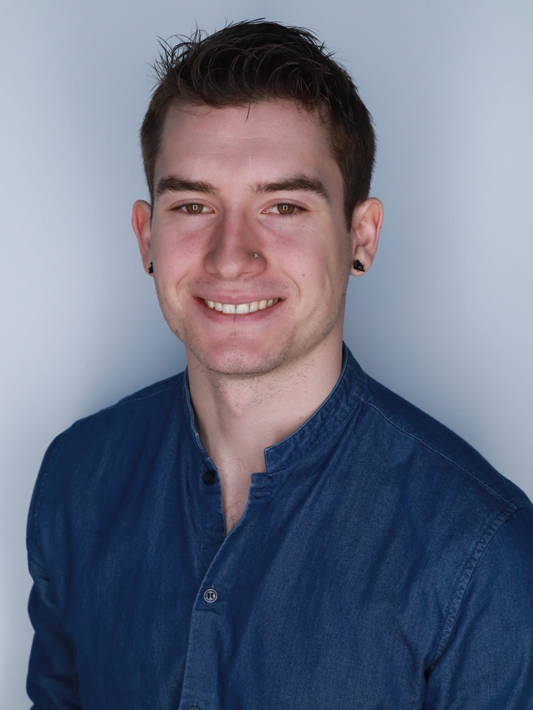
Dani Lisle
Bachelor of Science, Applied Mathematics
“And you will know the truth and the truth will set you free.”
John 8:32
Thanks to Beth Schaubroeck, Daniel O’Keefe, and Spyro Roubos, for helping me spread my wings; to Anne Dougherty, Christina Oerter, and Mark Ablowitz for showing me I could fly, and to my family and friends for believing in me and my vision, even before I did.
Notes:
INSTRUCTIONS
Click File -> Make a Copy -> Entire Presentation. RENAME the file in this format: “Jones_Indiana_BS” saving it to your google drive.
Now you have your own editable file. Please make changes to the text in brackets (Click on the purple rectangle and a new action bar above the slide will populate. Please select “Replace image” and upload a portrait image with your face clearly visible, that you are comfortable being displayed publicly. Google Slides will automatically adjust the photo to fit within its size parameters. Please do not to adjust the size of your image or text boxes. (APPM staff will make formatting corrections later.)
Once your personalization is complete, please go to File -> Download -> Microsoft PowerPoint (.pptx) and save the file onto your computer.
Upload the recently downloaded .pptx file to the end of your commencement form

Slide 54
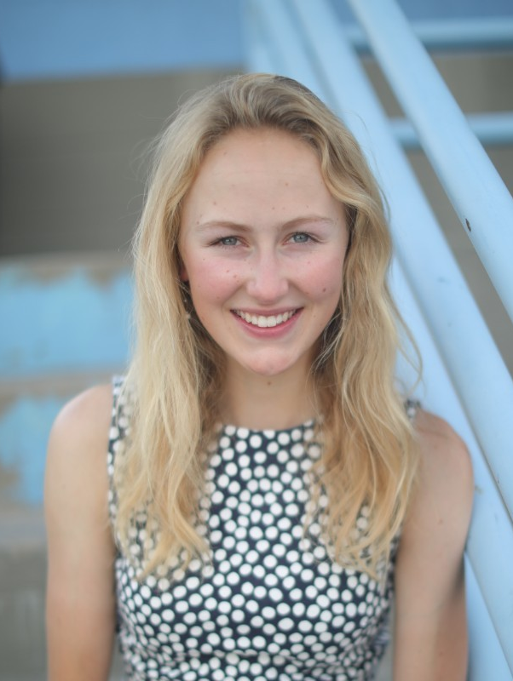
Aria Mundy
Bachelor of Science, Applied Mathematics
As graduation draws near, I reflect on my time at CU with immense gratitude for the opportunities it has provided me. Throughout my undergraduate journey, I've been fortunate to discover how Applied Mathematics and Mechanical Engineering resonate with my passions. From an exciting internship at Siemens Gamesa Renewable Energy, to actively participating in NREL's Collegiate Wind Competition, collaborating with Engineers Without Borders, and contributing to the Project Based Learning in Rural Schools Program, I have felt empowered to make a meaningful impact as an engineer. The support of CU, particularly as a woman in the field, has been instrumental in enabling me to pursue exciting academic and professional opportunities. Beyond academics, my engagement with the CU Cycling and CU Triathlon teams has brought me joy and camaraderie. As I prepare for this next chapter, I'm profoundly grateful for the amazing and transformative experiences that CU has provided.
A heartfelt thank you to my family (Mom, Dad, Trew, and Zia) my friends (especially my roommates, Amanda, Mikaela, and Kaylie), my partner Simon, and my professors, coworkers, and mentors for their support throughout this journey.
I feel incredibly fortunate to have such an amazing support system!
Notes:
INSTRUCTIONS
Click File -> Make a Copy -> Entire Presentation. RENAME the file in this format: “Jones_Indiana_BS” saving it to your google drive.
Now you have your own editable file. Please make changes to the text in brackets (Click on the purple rectangle and a new action bar above the slide will populate. Please select “Replace image” and upload a portrait image with your face clearly visible, that you are comfortable being displayed publicly. Google Slides will automatically adjust the photo to fit within its size parameters. Please do not to adjust the size of your image or text boxes. (APPM staff will make formatting corrections later.)
Once your personalization is complete, please go to File -> Download -> Microsoft PowerPoint (.pptx) and save the file onto your computer.
Upload the recently downloaded .pptx file to the end of your commencement form

Slide 55
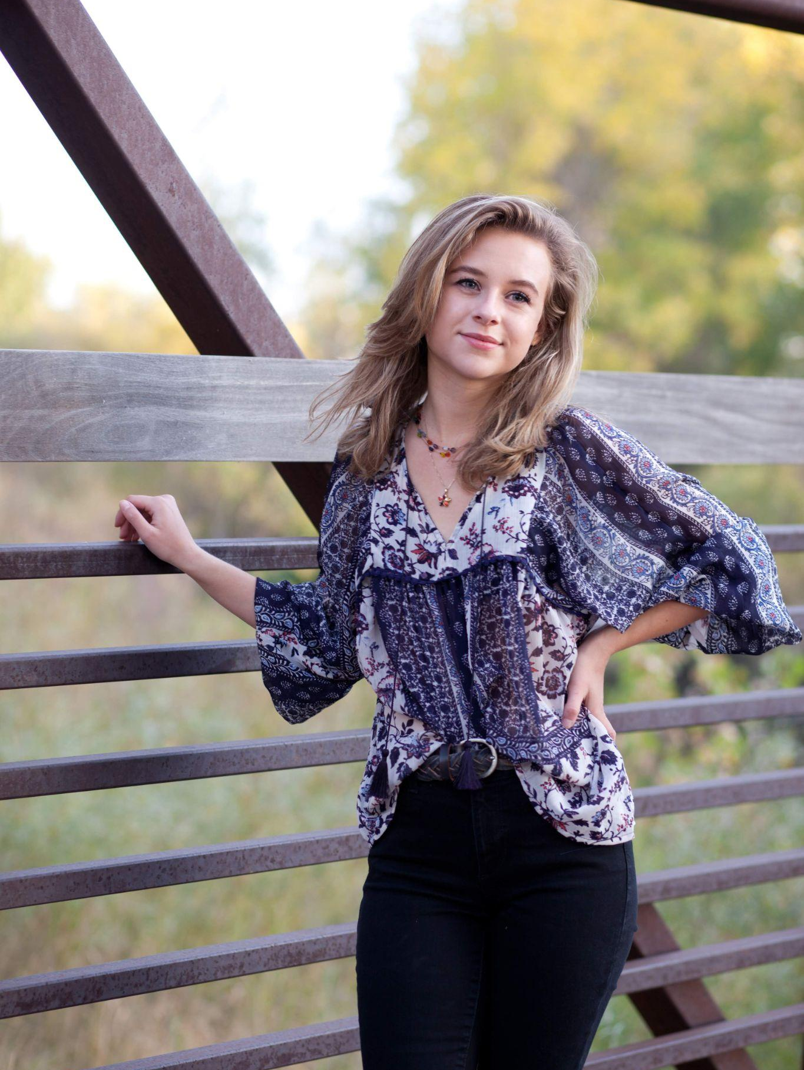
Victoria Nawalany
Bachelor of Science, Applied Mathematics
At CU I’ve learned a lot about myself and learning to be independent and an advocate for myself. I’ve learned that there can be a lot of challenges in life, but most importantly to stop worrying so much, and enjoy the journey while it lasts!
Here’s to a new chapter!
To my parents, to Louis,
to my professors and advisors,
and to everyone who has helped
shape the person that I am today
Notes:
INSTRUCTIONS
Click File -> Make a Copy -> Entire Presentation. RENAME the file in this format: “Jones_Indiana_BS” saving it to your google drive.
Now you have your own editable file. Please make changes to the text in brackets (Click on the purple rectangle and a new action bar above the slide will populate. Please select “Replace image” and upload a portrait image with your face clearly visible, that you are comfortable being displayed publicly. Google Slides will automatically adjust the photo to fit within its size parameters. Please do not to adjust the size of your image or text boxes. (APPM staff will make formatting corrections later.)
Once your personalization is complete, please go to File -> Download -> Microsoft PowerPoint (.pptx) and save the file onto your computer.
Upload the recently downloaded .pptx file to the end of your commencement form

Slide 56
Ellen Puzak
Bachelor of Science, Applied Mathematics
Graduate from the Engineering Honors Program with a major in Applied Mathematics and a minor in Physics. Five year member of CU’s Division I tennis team. Enjoys spending time outside with her dog, Ollie, and playing other sports. Plans to pursue a master’s degree and use her final year of NCAA tennis eligibility in 2024-2025.
Thank you Mom, Dad, Will and Vince for inspiring and encouraging me.
Notes:
INSTRUCTIONS
Click File -> Make a Copy -> Entire Presentation. RENAME the file in this format: “Jones_Indiana_BS” saving it to your google drive.
Now you have your own editable file. Please make changes to the text in brackets (Click on the purple rectangle and a new action bar above the slide will populate. Please select “Replace image” and upload a portrait image with your face clearly visible, that you are comfortable being displayed publicly. Google Slides will automatically adjust the photo to fit within its size parameters. Please do not to adjust the size of your image or text boxes. (APPM staff will make formatting corrections later.)
Once your personalization is complete, please go to File -> Download -> Microsoft PowerPoint (.pptx) and save the file onto your computer.
Upload the recently downloaded .pptx file to the end of your commencement form

Slide 57
Jenna Rae Rothe
Bachelor of Science, Applied Mathematics
I’ll be student teaching in a high school math classroom this fall!
“Knowledge emerges only through invention and re-invention, through the restless, impatient, continuing, hopeful inquiry human beings pursue in the world, with the world, and with each other”
- Paulo Freire
Thank you to my family and friends for your support. Thank you to my professors and advisors for everything you’ve taught me.
Notes:
Click File -> Make a Copy -> Entire Presentation. RENAME the file in this format: “Jones_Indiana_BS” saving it to your google drive.
Now you have your own editable file. Please make changes to the text in brackets (Click on the purple rectangle and a new action bar above the slide will populate. Please select “Replace image” and upload a portrait image that you are comfortable being displayed publicly. Google Slides will automatically adjust the photo to fit within its size parameters. Please do not try to adjust the size of your image too much. (APPM staff will make formatting corrections later.)
Once your personalization is complete, please go to File -> Download -> Microsoft PowerPoint (.pptx) and save the file onto your computer.
Upload the recently downloaded .pptx file to the end of your commencement form

Slide 58
Katie Simon
Bachelor of Science, Applied Mathematics
Katie is extremely grateful to have learned from esteemed professors, mentors, and peers throughout her four years at CU. She has loved the countless opportunity CU has provided her including a study abroad and internship in London, being on the executive board for The Women’s Network, and meeting some of her best friends. She is very excited to start working as a financial consultant post graduation.
Sko Buffs!
I want to thank my family and friends for their unwavering love and support! I am very grateful to my roommates and to Emily and Ella for getting me through!
Notes:
INSTRUCTIONS
Click File -> Make a Copy -> Entire Presentation. RENAME the file in this format: “Jones_Indiana_BS” saving it to your google drive.
Now you have your own editable file. Please make changes to the text in brackets (Click on the purple rectangle and a new action bar above the slide will populate. Please select “Replace image” and upload a portrait image with your face clearly visible, that you are comfortable being displayed publicly. Google Slides will automatically adjust the photo to fit within its size parameters. Please do not to adjust the size of your image or text boxes. (APPM staff will make formatting corrections later.)
Once your personalization is complete, please go to File -> Download -> Microsoft PowerPoint (.pptx) and save the file onto your computer.
Upload the recently downloaded .pptx file to the end of your commencement form

Slide 59
Luke Stuckenbruck
Bachelor of Science, Applied Mathematics
Luke is graduating with a Bachelors in Applied Math and an emphasis in Aerospace Engineering. While at CU he enjoyed outdoor sports, weightlifting, and meeting new people. Luke is grateful for the life experience and connections built both inside and outside the classroom during his time here. He is planning to work as a systems engineer this fall.
Thank you to my family and friends for everything. Love you all!
Notes:
INSTRUCTIONS
Click File -> Make a Copy -> Entire Presentation. RENAME the file in this format: “Jones_Indiana_BS” saving it to your google drive.
Now you have your own editable file. Please make changes to the text in brackets (Click on the purple rectangle and a new action bar above the slide will populate. Please select “Replace image” and upload a portrait image with your face clearly visible, that you are comfortable being displayed publicly. Google Slides will automatically adjust the photo to fit within its size parameters. Please do not to adjust the size of your image or text boxes. (APPM staff will make formatting corrections later.)
Once your personalization is complete, please go to File -> Download -> Microsoft PowerPoint (.pptx) and save the file onto your computer.
Upload the recently downloaded .pptx file to the end of your commencement form

Slide 60
Kevin Stull
Bachelor of Science, Applied Mathematics
Texas A&M Freshman in Applied Mathematics 2013
Academically Dismissed from Texas A&M 2015
Accepted to Fullerton (Community) College 2018
Associates of Arts in Biology Fullerton College 2020
Accepted to CU Boulder Integrated Physiology Program 2020
Accepted to CU Boulder APPM Program 2021
Accepted to CU Boulder APPM Masters Program 2023
Graduated APPM BS Program 2024
NEVER GIVE UP!
Special thanks to…
Mark Hoefer Mohammad Shahin
Jacob Sapiro Earl Henslin
Ann and Roger Stull
Notes:
INSTRUCTIONS
Click File -> Make a Copy -> Entire Presentation. RENAME the file in this format: “Jones_Indiana_BS” saving it to your google drive.
Now you have your own editable file. Please make changes to the text in brackets (Click on the purple rectangle and a new action bar above the slide will populate. Please select “Replace image” and upload a portrait image with your face clearly visible, that you are comfortable being displayed publicly. Google Slides will automatically adjust the photo to fit within its size parameters. Please do not to adjust the size of your image or text boxes. (APPM staff will make formatting corrections later.)
Once your personalization is complete, please go to File -> Download -> Microsoft PowerPoint (.pptx) and save the file onto your computer.
Upload the recently downloaded .pptx file to the end of your commencement form

Slide 61
Maedée Trank-Greene
Bachelor of Science, Applied Mathematics
As I reflect on my time in the APPM department, I can't help but feel immense gratitude for the incredible community I've been a part of these past four years. The support and opportunities I've experienced have truly been remarkable. As I look ahead into my next chapter in the BAM program this fall, I'm reminded of a powerful quote from Jem Corcoran, “No one cares where you’ve been. It’s all about where you are today. Today is time n.”
Thank you to my family and friends for being so supportive and loving. Thank you to all of my past and current professors for fueling my passion for mathematics. And, thank you to my amazing coworkers for making my student assistant job the best job ever.
Notes:
INSTRUCTIONS
Click File -> Make a Copy -> Entire Presentation. RENAME the file in this format: “Jones_Indiana_BS” saving it to your google drive.
Now you have your own editable file. Please make changes to the text in brackets (Click on the purple rectangle and a new action bar above the slide will populate. Please select “Replace image” and upload a portrait image with your face clearly visible, that you are comfortable being displayed publicly. Google Slides will automatically adjust the photo to fit within its size parameters. Please do not to adjust the size of your image or text boxes. (APPM staff will make formatting corrections later.)
Once your personalization is complete, please go to File -> Download -> Microsoft PowerPoint (.pptx) and save the file onto your computer.
Upload the recently downloaded .pptx file to the end of your commencement form
Personal statement, accomplishments: this could be anything from a favorite activity at CU, to something you learned, or an important experience, awards you got, plans for after graduation, or a quote that you really enjoy to celebrate you graduating.
Thank you to my family for being so supportive and loving. Thank you to my Theta Tau brothers for the countless experiences. Thank you to my friends for listening to endless math. Thank you to all of my past and current professors for giving me the most rewarding education. And, thank you to Mary Fentress, Ian Cunningham, and Gabriella Kirkley for being the best and most fun people to work with.

Slide 62
Stella Vannier
Bachelor of Science, Applied Mathematics
These past four years have been the most pivotal years of life. I have grown so much, not only academically, but emotionally. I am incredibly grateful for the people I have met and the opportunities that are now available to me. I am so thrilled to be starting my next chapter of my life.
A special thank you to my family for being my biggest supporters. I love you Mom and Dad!
Notes:
INSTRUCTIONS
Click File -> Make a Copy -> Entire Presentation. RENAME the file in this format: “Jones_Indiana_BS” saving it to your google drive.
Now you have your own editable file. Please make changes to the text in brackets (Click on the purple rectangle and a new action bar above the slide will populate. Please select “Replace image” and upload a portrait image with your face clearly visible, that you are comfortable being displayed publicly. Google Slides will automatically adjust the photo to fit within its size parameters. Please do not to adjust the size of your image or text boxes. (APPM staff will make formatting corrections later.)
Once your personalization is complete, please go to File -> Download -> Microsoft PowerPoint (.pptx) and save the file onto your computer.
Upload the recently downloaded .pptx file to the end of your commencement form

Slide 63
Santiago Velasco
Bachelor of Science, Applied Mathematics
I’m very grateful for the four years I have spent at CU. My involvement with the Applied Mathematics department motivated me to wake up every day and try new ways in which I could incorporate concepts learned in either major to my academic interest in finance.
After graduation, I will be pursuing a one-year master’s degree in Financial History at the London School of Economics. After my time there, I hope to start my career in the financial services industry as an emerging markets fixed income and currencies derivatives trader.
Special thanks to Dr. Daniel Brown who introduced me to the field of Quantitative Finance and Dr. Anne Dougherty whose amazing planning ability made the future seem less daunting.

Slide 64
Walter Virany
Bachelor of Science, Applied Mathematics
Following graduation, I will be spending the summer as a research associate at the Institute for Pure and Applied Mathematics at UCLA. Then, I’ll be returning to CU to pursue an M.S. in Applied Math.
Thank you Mom, Dad, and Robert - I could not have done it without your support.
Notes:
INSTRUCTIONS
Click File -> Make a Copy -> Entire Presentation. RENAME the file in this format: “Jones_Indiana_BS” saving it to your google drive.
Now you have your own editable file. Please make changes to the text in brackets (Click on the purple rectangle and a new action bar above the slide will populate. Please select “Replace image” and upload a portrait image with your face clearly visible, that you are comfortable being displayed publicly. Google Slides will automatically adjust the photo to fit within its size parameters. Please do not to adjust the size of your image or text boxes. (APPM staff will make formatting corrections later.)
Once your personalization is complete, please go to File -> Download -> Microsoft PowerPoint (.pptx) and save the file onto your computer.
Upload the recently downloaded .pptx file to the end of your commencement form

Slide 65
Gabe Wallon
Bachelor of Science, Applied Mathematics
Gabe absolutely loved his experience within the Applied Math and Statistics departments! He enjoyed attending office hours and wrestling through tough problems alongside his peers. He admired his professors, whom he found tremendously smart, inspiring, supportive, and friendly. He was proud to tell people he was an APPM major. He looks forward to applying everything he has learned to a career in data science, and plans to continue in his pursuit of knowledge.
Special thanks to the APPM community - peers, professors, advisors - and to my family.
Notes:
INSTRUCTIONS
Click File -> Make a Copy -> Entire Presentation. RENAME the file in this format: “Jones_Indiana_BS” saving it to your google drive.
Now you have your own editable file. Please make changes to the text in brackets (Click on the purple rectangle and a new action bar above the slide will populate. Please select “Replace image” and upload a portrait image with your face clearly visible, that you are comfortable being displayed publicly. Google Slides will automatically adjust the photo to fit within its size parameters. Please do not to adjust the size of your image or text boxes. (APPM staff will make formatting corrections later.)
Once your personalization is complete, please go to File -> Download -> Microsoft PowerPoint (.pptx) and save the file onto your computer.
Upload the recently downloaded .pptx file to the end of your commencement form

Slide 66
Congratulations to all
2024 graduates,
welcome to the
ForeverBuffs
family!
colorado.edu/alumni

