Slide 1
Test Readiness Review
Notes:
Overall Presenation Notes:
Don’t list components as their chosen component (nobody knows what that means, but it’s provocative, it gets the people going)
Julian should have been aborted

Slide 2
Overview

Slide 3
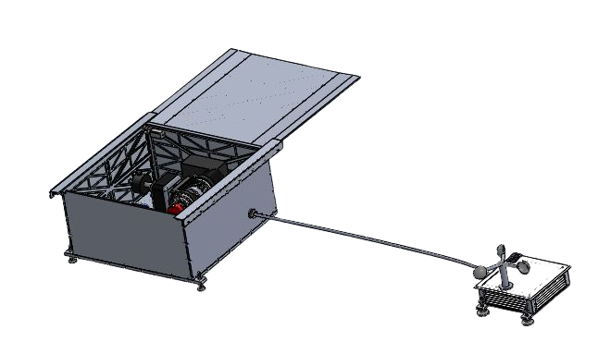
What is WRAITH?
Weather Resistant Autonomous Imaging for Tracking HEOs
Mission Statement:
WRAITH’s mission aims to demonstrate the feasibility of a low cost, autonomous, deployable space situational awareness system.
WRAITH is a Space Situational Awareness System that must:
Predict the orbit of a space object using a TLE
Point a camera at an orbiting space object
Capture 3 images throughout a space object’s transit
Generate and return an estimate of the space object’s orbit
Be capable of a 12 hour overnight deployment
Do all of this autonomously
12”
3”
24”
12 ft
10”
Overview
Schedule
Manufacturing
Budget

Slide 4
Levels of Success
 | Level 1 | Level 2 | Level 3
Scheduler | Once Per Night | Runs Multiple Times | Adaptable to Missed Targets
Automation | Must be Monitored | Human Calibration | No human input after setup
Weather Detection | <95% | <99% | >99%
Weather Protection | Protects Against Rain | All Precipitation, Wind | Protects Against All Weather Types
Expected | Possible | Not Possible
Notes:
Need to color code

Slide 5
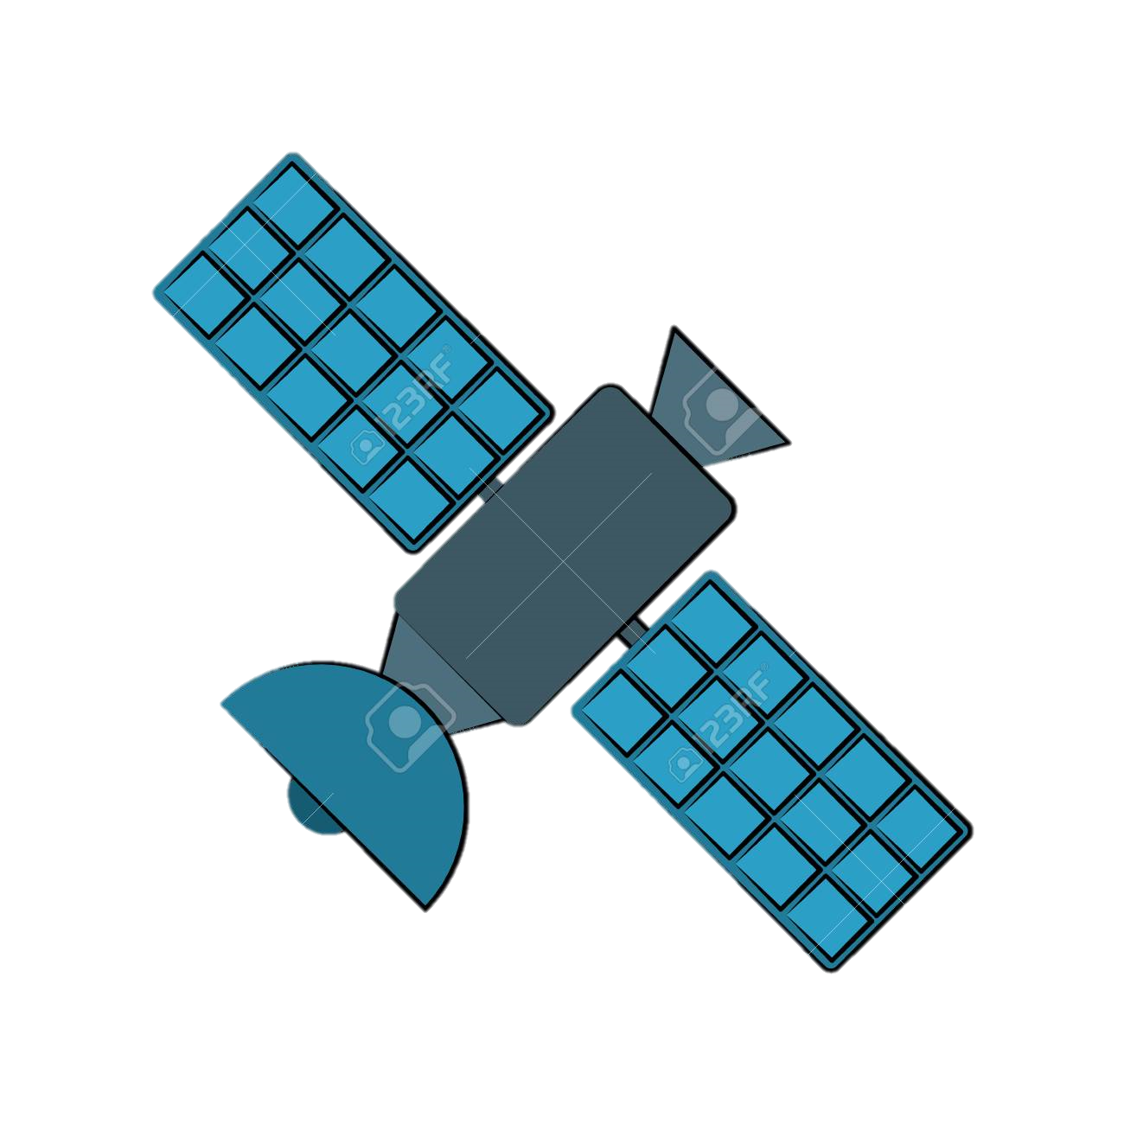
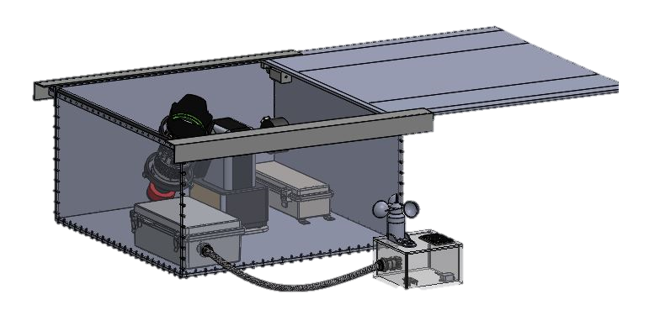
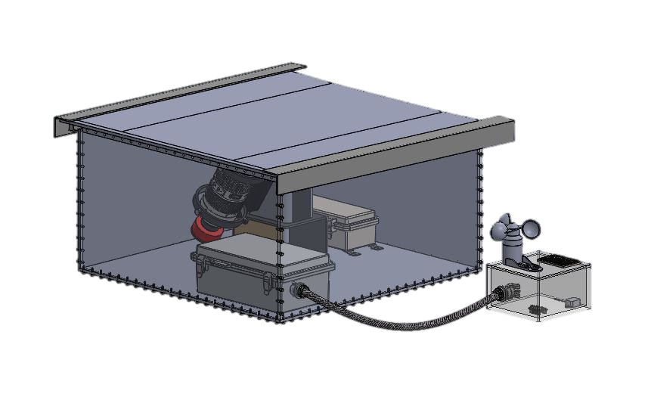
CAPTURED IMAGE
HEO,LEO,GEO,MEO
TAKES THREE LONG EXPOSURES OF OBJECT PATH
IMAGES ANALYZED
NEW ORBIT DETERMINED
AND STORED < 5 mins
WRAITH EXITS SAFE MODE
BEGINS SCHEDULING ALGORITHM
ON BOARD PROCESSING
WRAITH BEGINS 12 HOUR DEPLOYMENT IN SAFE MODE
SENSES FOR ADVERSE WEATHER
REMAINS IN SAFE MODE UNTIL WEATHER HAS PASSED
Read in TLEs from USB drive
RETURNS TO SAFE MODE, WAITS FOR NEXT OBJECT
Predicts orbits and rank pass quality
Activates imaging sequence
NOMINAL SEQUENCE
Notes:
GOOD PASS, EXPLAIN SAFE MODE, HOW IMAGES ARE ANALYZED

Slide 6
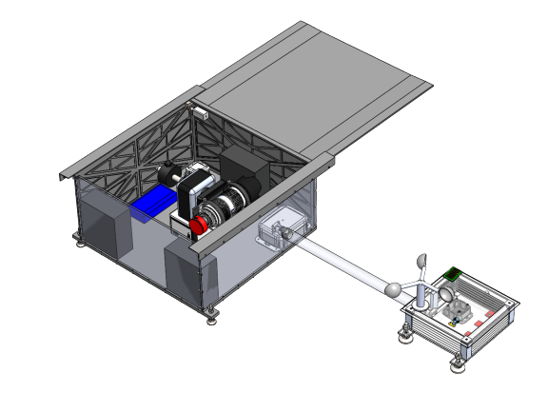
Baseline Design Hardware Overview
Key
24 in
Legacy Hardware
Actuation Stage
New Hardware
Active Protection
Main Processor
Voltage Regulation/Power Distribution
12 in
Weather Detection Sensor Suite
12 ft
Batteries
Camera
Passive Protection
10 in
Overview
Schedule
Manufacturing
Budget
Notes:
Narrate through each component for how it fits into making our design accomplish what it does.
Fix animation

Slide 7
Functional Block Diagram
LEGEND
Remote Manual Override
Weather Detection Suite
Weather Protection
(Roof Stepper Motor)
Shielding Commands
Hardware
Weather Status
OPERATOR
Input
On-board Processor and Memory
(UDOO x86)
Updated
Orbit State
Output
TLEs
Images
= Power
Camera
(ZWO ASI 1600MM)
Imaging Commands
= Data
= Output
Actuation
(iOptron AZ Mount Pro)
Slew Commands
= Command
Notes:
Autonomous but fragile

Slide 8
Software Functional Block Diagram
LEGEND
Image Capture
Image Processing
Orbit Determination
Function
Repeat 3 Times
Hardware Commanding
Input
Output
Roof Close?
= x3
Weather Status
= Data
Scheduler
= Output
TLE’s
Orbit Estimate
= Command
Notes:
Were designing algorithms and logic, measure with timing

Slide 9
Critical Project Elements Review
Active Weather Protection
Weather Detection
Software / Hardware Integration
Automation
Overview
Schedule
Manufacturing
Budget
Notes:
Be nice to GHOST
HANDSOME SLIDE

Slide 10
Schedule
Notes:
Multiple

Slide 11
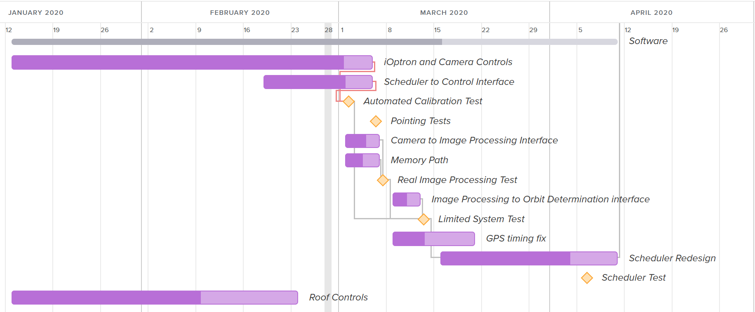
Software Schedule
Critical Path
Assigned Duration
Critical Path
Progress
Margin
Overview
Schedule
Manufacturing
Budget

Slide 12
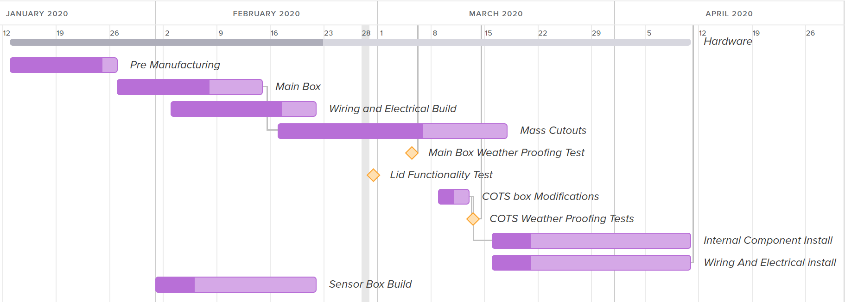
Hardware Schedule
Critical Path
Assigned Duration
Critical Path
Progress
Margin
Overview
Schedule
Manufacturing
Budget

Slide 13
Environmental Schedule
Critical Path
Assigned Duration
Critical Path
Margin
Progress
Overview
Schedule
Manufacturing
Budget

Slide 14
Test Progress
LEGEND
Completed Test In Progress Test Scheduled Test Discussed -
Software
iOptron Calibration Test – 02/26/20
iOptron Slew Speed – 03/4/20
Home Accuracy Test – 03/4/20
Real Image Processing Test – 03/7/20
Partial System Test – 03/13/20
Hardware
Lid Actuation Versatility Test – 02/29/20
Water Proof Test – Main Unit – 03/5/20
Water Proof Test – COTS Boxes – 03/5/20
Batteries – 03/8/20
GPS Testing – 03/16/20
Environmental
Sensor Baseline Functionality – 01/13/20
Individual Sensor Validation & Characterization – 01/27/20
Combined Sensor Validation & Characterization – 03/1/20
Communication Testing – 03/7/20
Sensor Suite Testing – 03/15/20
Overall System Testing
Full System Test – 04/13/20
Long Duration Test – 04/15/20
Overview
Schedule
Manufacturing
Budget

Slide 15
Test Readiness
Notes:
Multiple

Slide 16
Full System
Notes:
Now we will touch on what needs to change for GHOST to become WRAITH

Slide 17
Final System Test
Goal: Show that WRAITH completes the project as designed by:
Detecting adverse weather
Protecting against adverse weather
Integrating GHOST's systems
Operating autonomously
Materials: WRAITH enclosure, stage mount, camera, batteries, main processor, weather station
Requirements Verified: All
ISS & HEO Object
Output: Updated orbital elements of target object, system timing information, system accuracy, weather detection reports
Overview
Schedule
Test Readiness
Budget
Notes:
Autonomous – give ISS tle.txt
- schedule should be created
- system should run through calibration
- system should verify weather is good before opening (print statement)
- camera should slew to ISS location at desired time
- image should be captured
- image should be sent to IP, streak endpoints should be solved
- 3 images should be sent to OD, orbital elements will be created and saved
Weather – simulate rain,
- wraith should detect the water and shut down
- camera should slew to home
- roof should close and remain so for 30 min
- (simulate new image) roof should open again
12 hours
- system will attempt to image other satellites in accordance with scheduler
- importantly: system will not lose power for 12 hours
This should all happen with human input only during deployment (giving .txt and "run ghost" command)

Slide 18
Protection
Notes:
Dalton

Slide 19
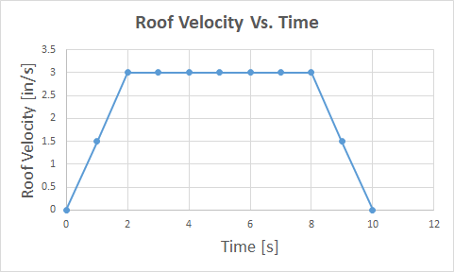
Roof Actuation - Stepper Motor Model
+Y
ROOF
Constant Acceleration
+X
F_{Friction}
Constant Velocity
Gear
Motor Specification Model
Ʃ F_{x} = m a_{x}
F_{Friction} = N µ_{static}
F_{Friction} = N µ
a= α R
T = I α
T_{required} = 146 [oz in]
Gear Rate Model
24 Teeth/Revolution
5 Teeth/Inch
24 Inches of Travel
10 Second Close: 30 [RPM]
Overview
Schedule
Test Readiness
Budget
Notes:
Narrate
FOS
Sliders keep in plane
Verify by timing
Statistical Verification
Add requirement to bottom
Learned to add requirements

Slide 20
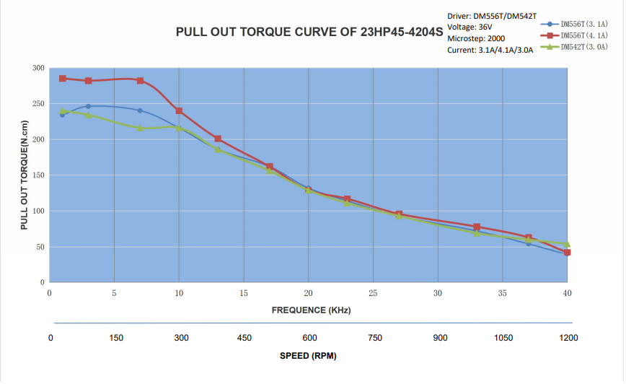
Roof Actuation - Stepper Motor Model
425
425
354
283
Torque [oz in]
212
141
70
10 Second Close: 30 [RPM]
T_{required} = 146 [oz in]
0
Overview
Schedule
Test Readiness
Budget
Notes:
Narrate
FOS
Sliders keep in plane
Verify by timing
Statistical Verification
Add requirement to bottom
Learned to add requirements

Slide 21
Roof Actuation - Stepper Motor Model
Overview
Schedule
Test Readiness
Budget
Notes:
Narrate
FOS
Sliders keep in plane
Verify by timing
Statistical Verification
Add requirement to bottom
Learned to add requirements

Slide 22
Roof Actuation - Stepper Motor Model
24 Teeth/Revolution
5 Teeth/Inch
24 Inches of Travel
10 Second Close: 30 [RPM]
Overview
Schedule
Test Readiness
Budget
Notes:
Narrate
FOS
Sliders keep in plane
Verify by timing
Statistical Verification
Add requirement to bottom
Learned to add requirements

Slide 23
Roof Actuation Test - Overview
Testing Goal: Verify operation of roof motor and gear system through onboard controls
Motivation: Ensure timely and reliable actuation of WRAITH's roof
Materials: Assembled WRAITH enclosure, UDOO, motor controller & roof motor
Requirements Verified: FR 3, DR 3.1
Risks Reduced: Timely roof actuation protects against quickly developing precipitation
Initial Testing: 125 [oz in] motor actuated roof at 1 [in/sec] reliably
Next Steps: Test full length actuation with new motor [425 oz in]
Overview
Schedule
Test Readiness
Budget

Slide 24
Weather Detection
Notes:
Trevor

Slide 25
Environmental System Tests – Overview
FR 3: Autonomously protect itself from adverse weather
What's our confidence in the Environmental System detecting Adverse Weather (AW)?
Adverse Weather Detection Test:
Verify various sensor outputs by comparison with the NWS
Integrate the sensor suite and trigger condition code
Statistically compare weather suite output with qualitative observations
Detected AW ÷ Observed AW ≥ 95%
Materials: Laptop, WRAITH Weather Suite, Project Notebook, Pen/Pencil
Location: Outdoor Clearing
Testing Goal: 95% confidence in the WRAITH Weather Suite
Overview
Schedule
Test Readiness
Budget
Notes:
FR 3: Enter and exit safe mode autonomously to protect from adverse weather
Showcases confidence in detection, further allows for edits to adverse conditions, and verifies all interfacing from the 5* sensors to the environmental suite processor.

Slide 26
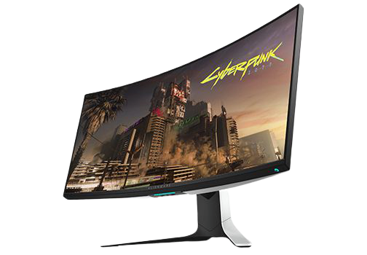
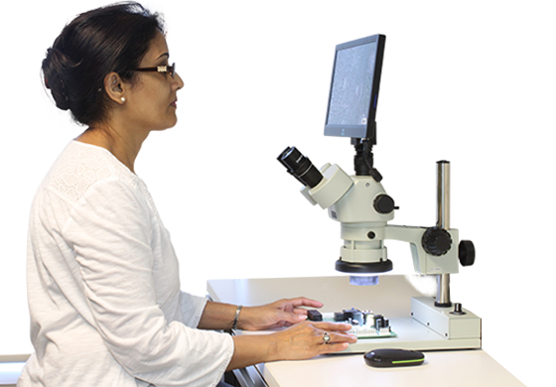
Environmental Systems Test – What's Next
Record Qualitative Observations
[ Including Time of Observation ]
Pull System Data from Time of Observation
[ System is Running during Observations ]
x 100
WRAITH
Run System Data through Trigger Conditions
[ Output to Be Compared with Qualitative Good/Bad ]
Matching the Trigger Condition output to the Qualitative Observation output will yield a positive result.
With 95 out of 100 results positive, the weather detection model will be validated.
This Photo by Unknown author is licensed under CC BY-NC and CC BY-SA..
Overview
Schedule
Test Readiness
Budget

Slide 27
Software
Notes:
Now we will touch on what needs to change for GHOST to become WRAITH

Slide 28
Stage Auto-Calibration Test – Overview
Testing Goal: Quantify the number of calibration points needed in order to ensure streaks will pass within 5% of camera FOV center
Motivation: Maximize the number of streaks capture per image opportunity
Materials: stage, camera, calibration python script
Requirements Verified: FR 4, DR 4.1
Risks Reduced: Missing objects due to a ground system inaccuracy
FOV Camera =4.7 °
Desired Ra and Dec
Streak Placement w/ Bad Calibration
Desired Streak Placement
Accuracy of Calibration= 0.237 °
Overview
Schedule
Test Readiness
Budget
Notes:
Critical to mission for our telescope and camera to autonomously point to the streaking object in the sky and we need to makes sure we are pointing there at the right time.
Needs to be calibrated to know this.
1. The goal of this test is to quantify the number of calibration points needed to ensure our pointing is with in 5% of the camera FOV
2. The stage's manufacture built calibration is done with three stars,Our goal with this test is then to quanitfy how many calibraiton points are needed with our created auto-calibration script.
3. A perfect calibration is key to ensuring that we can achieve a 12 hour deployment and the overall flow of automation
4. example of perfect is green, bad is red this would result in loss of data points and a inability to run OD
We need to actually track this thing.
Don't just jump into auto-calibrating, the thing needs to know where it is and how will we do it.

Slide 29
Stage Calibration Test
1. Power on stage with no onboard Calibration
5. Slew to new Ra and Dec
2. Run Auto Calibrate Script
6. Image Sky, Solve for Ra and Dec
LOOP
3. Image Sky, Solve for Ra and Dec
7. Image Sky, Solve for Ra and Dec
8. Save Actual Ra and Dec and stage Ra and Dec for error quantification
4. Pass into Stage with calibrate cmd
Overview
Schedule
Test Readiness
Budget

Slide 30
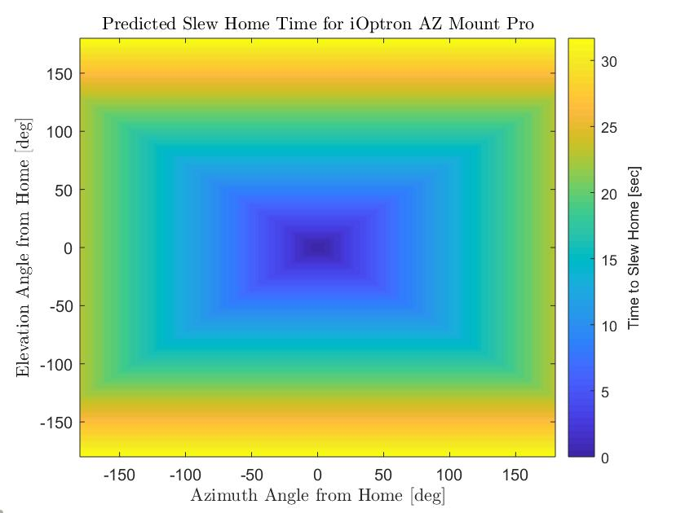
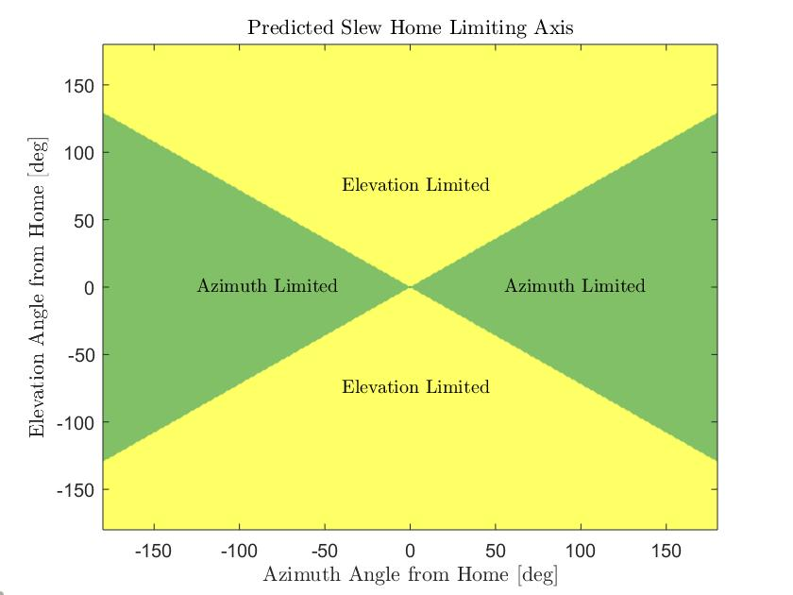
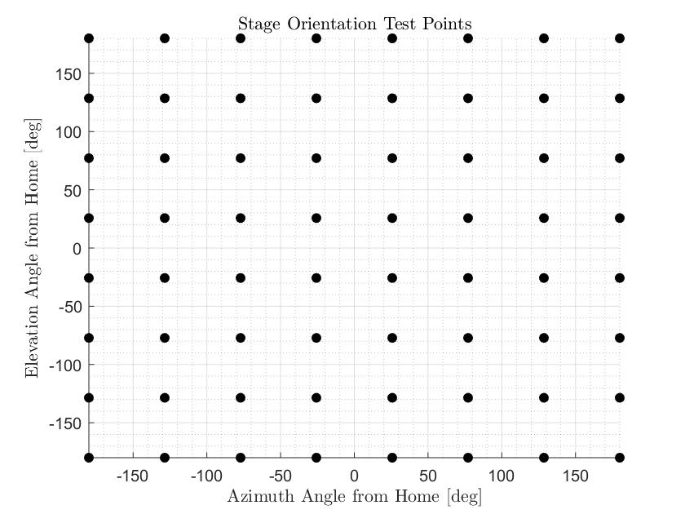
Stage Slewing Home Test - Overview
Goal: Characterize time for stage to slew home from all possible orientations
Motivation: Allows for fastest possible shutdown sequence without roof hitting stage
Materials: Stage, Stopwatch, Bash Script
Requirements Verified: FR 3, DR 4.2 (Autonomous weather protection, acceptable slew speed)
Risks Reduced: Collision between stage or camera and roof, Roof remaining open too long in inclement weather
Overview
Schedule
Test Readiness
Budget
Notes:
The next test is to ensure that we can accurately characterize the amount of time the stage will take to slew to the home position from any other position. This is important because we need to close the box as fast as possible in the event of a weather trigger, however we need to be sure to mitigate the risk of the lid running into the camera. Based on estimated elevation and azimuth slewing rates, the following model for time to slew home based on distance from home in each axis was created. *click* These are the regions that we expect to be limited by each azimuth and elevation. Notice that elevation slewing is more limiting because the elevation slew rate was estimated to be about 33% slower. *click* In order to validate this model, the stage will be commanded to slew to 64 different positions as shown in the plot. The time taken to slew home from each of these positions will be taken and a surface will be fit to that data. We expect that the analytical surface will closely match the model and the maximum slew home time would be 32 seconds corresponding to when the stage is 180 degrees away from the home position.

Slide 31
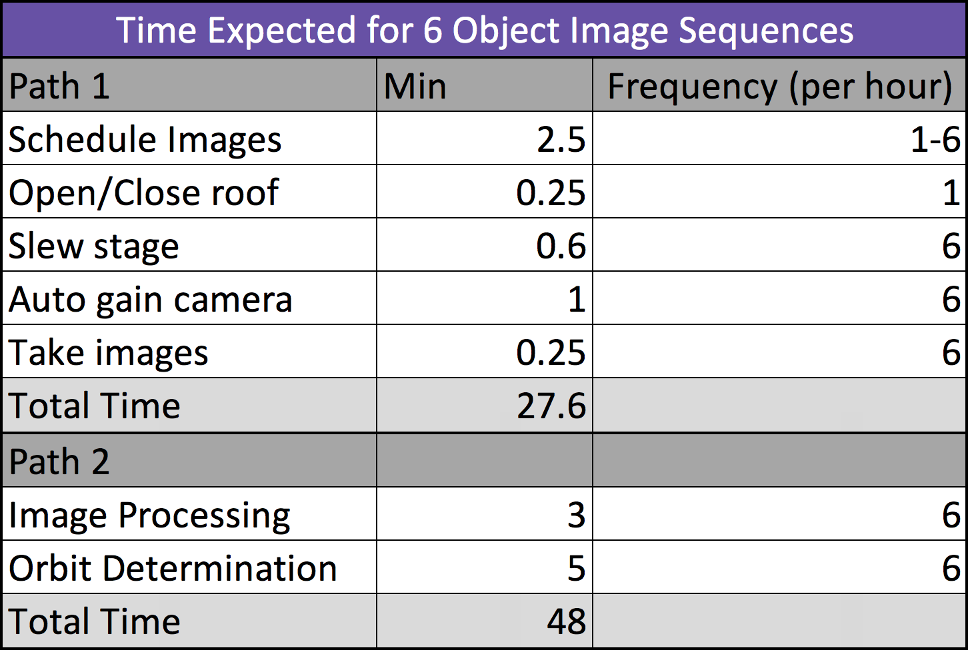
Full System Timing Test - Overview
Testing Goal: Characterize processing time across full system and some individual subsystems
Motivation: Image as many objects as possible without overlapping sequences
Materials: The 'datetime' function in python, completed WRAITH unit
Requirements Verified: FR 5 (At least 6 objects per hour)
Risks Reduced: Overlapping imaging sequence reduces chance of either object's orbit being determined
Path 1
Rerunning Scheduling
Scheduler to HW Interface
Path 2
Image Processing
Astrometry Solver
Orbit Determination
Full System End to End
Overview
Schedule
Test Readiness
Budget
Notes:
Model was created with worst case scenario in mind and without considering hardware commands (to an extent)
Some information from emperical data, some information from models, some from online specs, etc
Two main takeaways from test: 1. Make sure we hit the requirement (or get close at least)
2. Quantify subsystems so that their processing time can be accounted for when building the time-sensitive hardware commands

Slide 32
Budget
Notes:
Julian

Slide 33
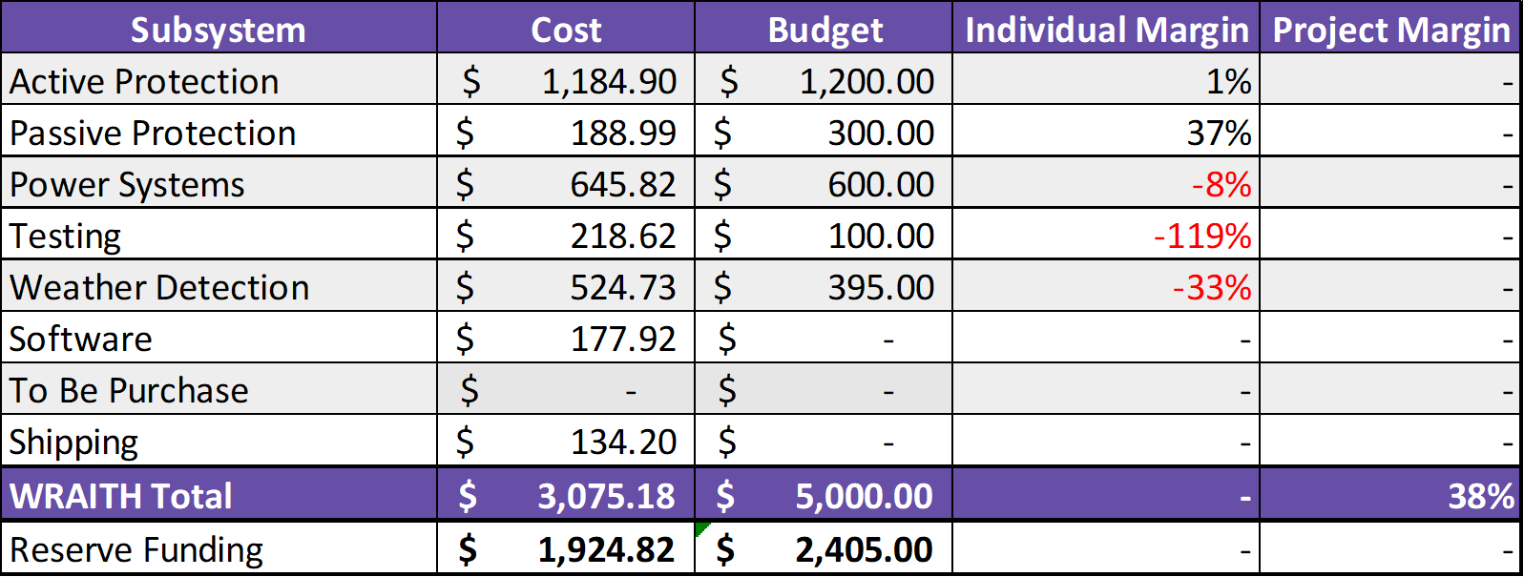
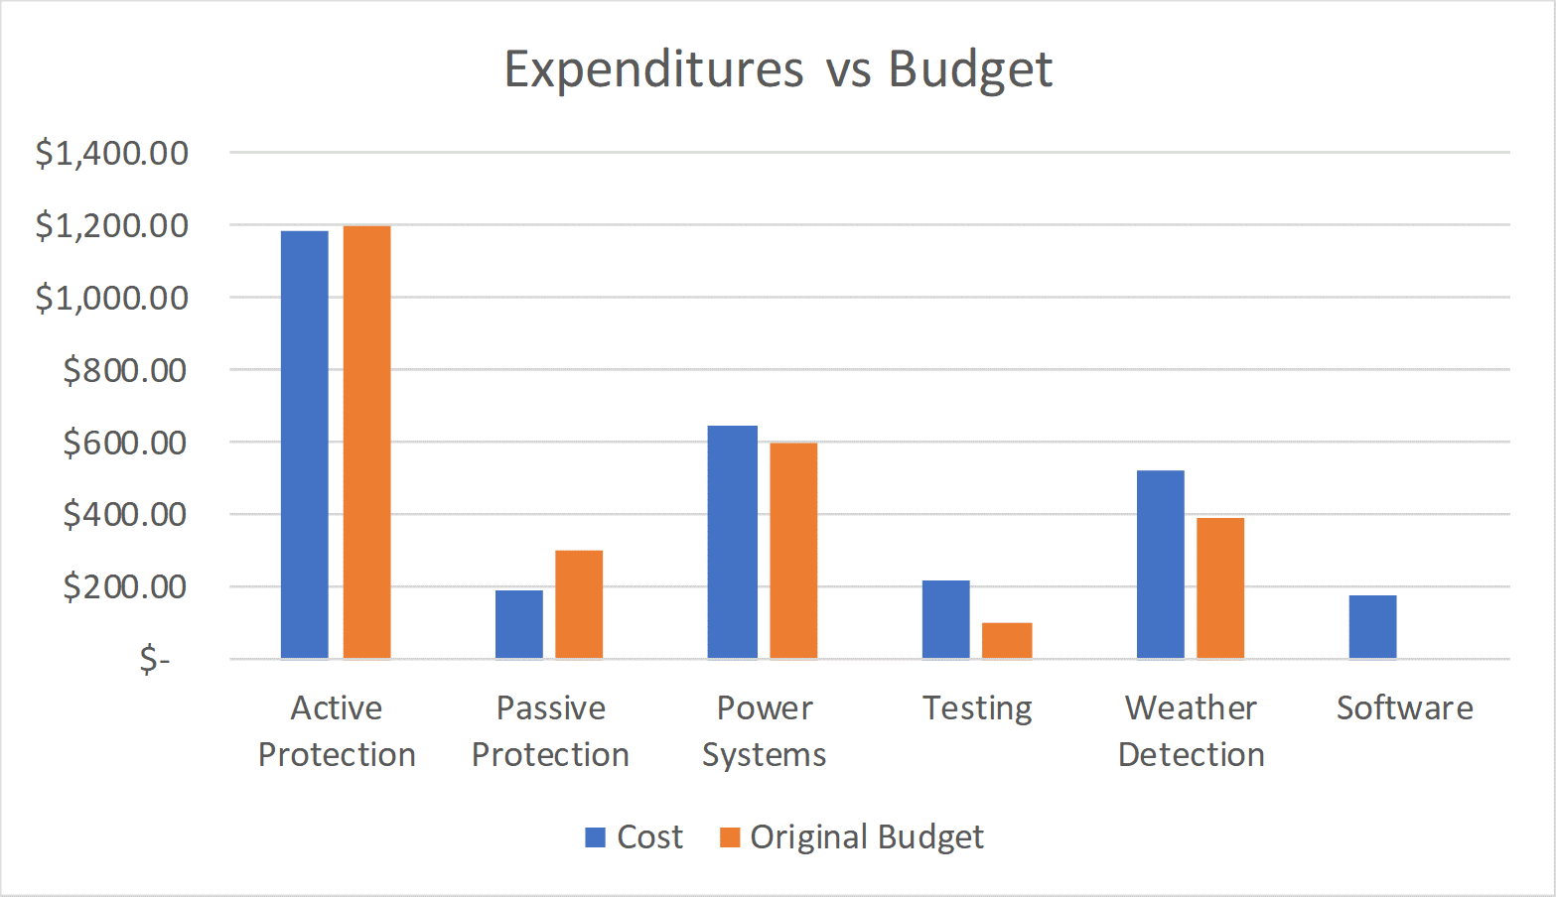
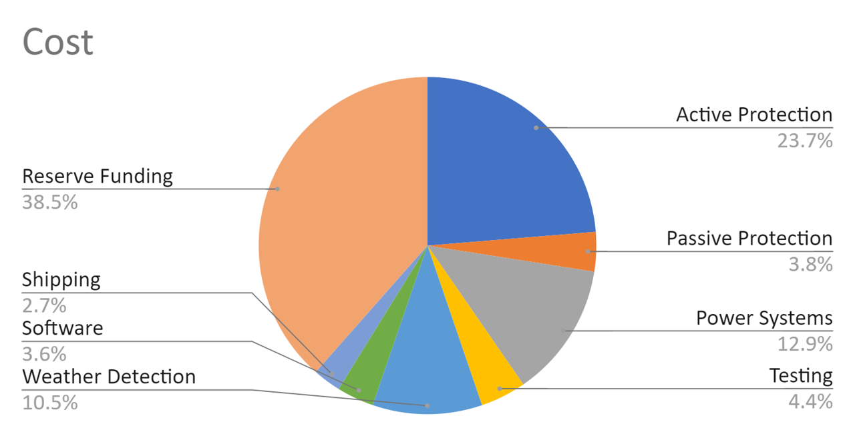
Cost Plan
Overview
Schedule
Manufacturing
Budget

Slide 34
Questions?

Slide 35
Backup Slides

Slide 36
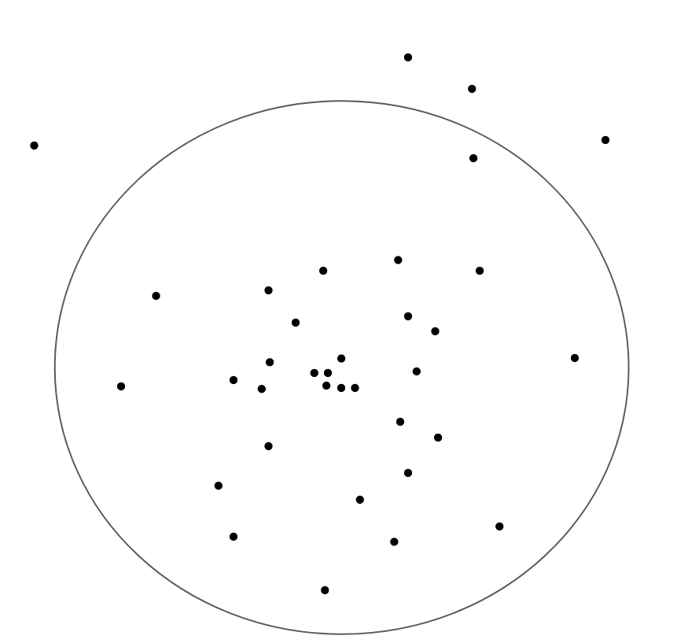
Stage Home Pointing Reliability Test - Overview
Goal: Characterize consistency of home pointing
Motivation: The stage must always slew home to the same orientation to avoid roof collisions
Materials: Stage, Tape Measure, Whiteboard, Marker, Laser Pointer, stage command software
Requirements Verified: FR 3 (Autonomous weather protection)
Risks Reduced: Collision between stage and roof
Within Circle – Collision Avoided

Slide 37
Search Algorithm for Missing Object
Not in Image
1st miss
Do Nothing
2nd miss
Move Camera one FOV ahead in track of predicted position
3rd miss
Move camera two FOV ahead in track
4th miss
Remove all weight from object to allow for other passes
Predicted Object Location
+1 FOV
+2 FOV
Conditions
"Young" TLEs
Atmospheric drag main/sole force
Environmental
1st miss
Increase weight slightly

Slide 38
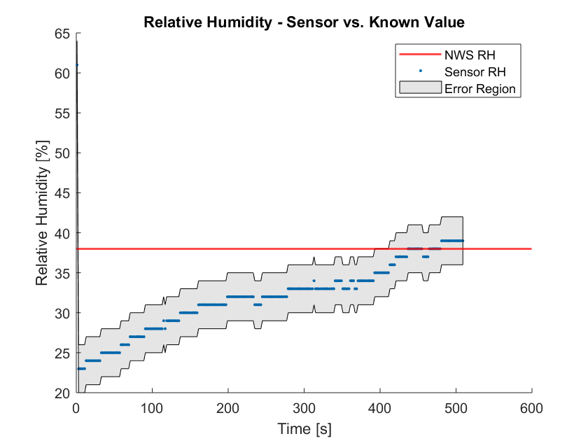
Relative Humidity Testing Data
Requirements Met:
FR 3: Autonomously protect itself
FR 7: Deployed in 30 minutes
Notes:
All 6 sensors have been confirmed as working
RH sensor, barometer, and IR thermometer have been compared against known values

Slide 39
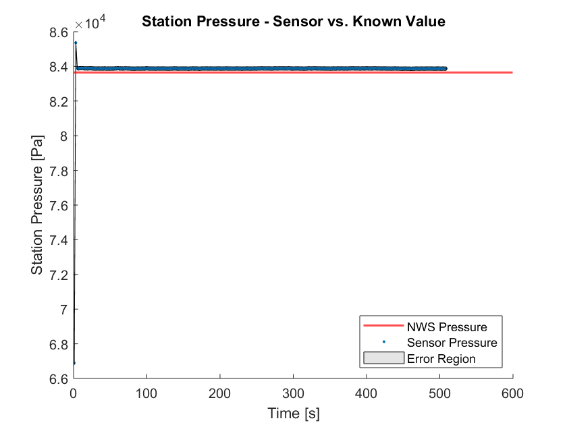
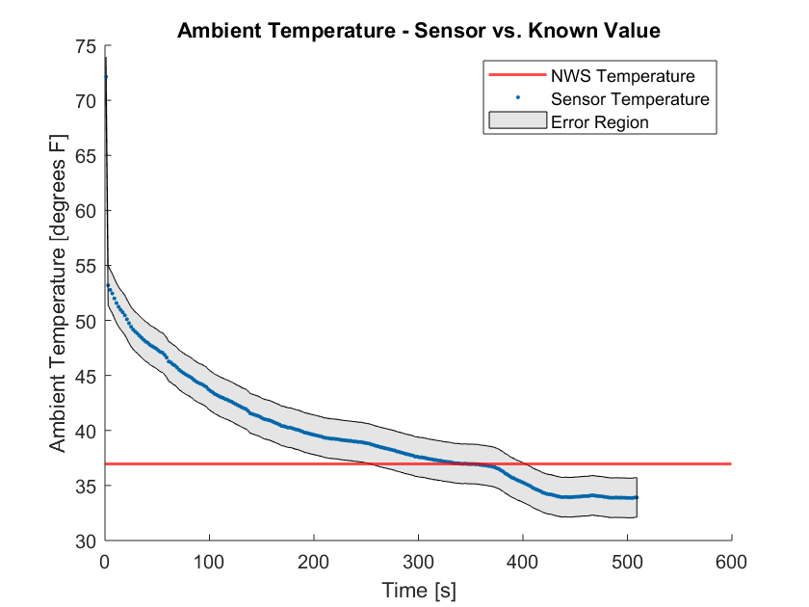
Pressure and Temperature Testing Data

Slide 40
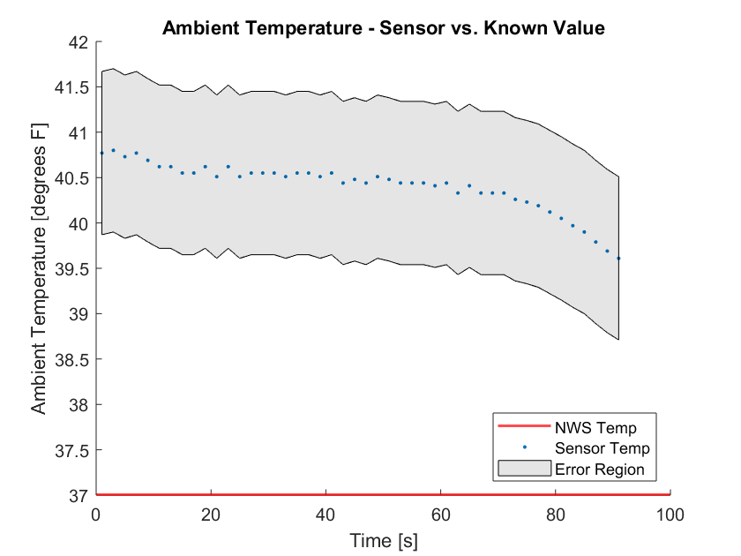
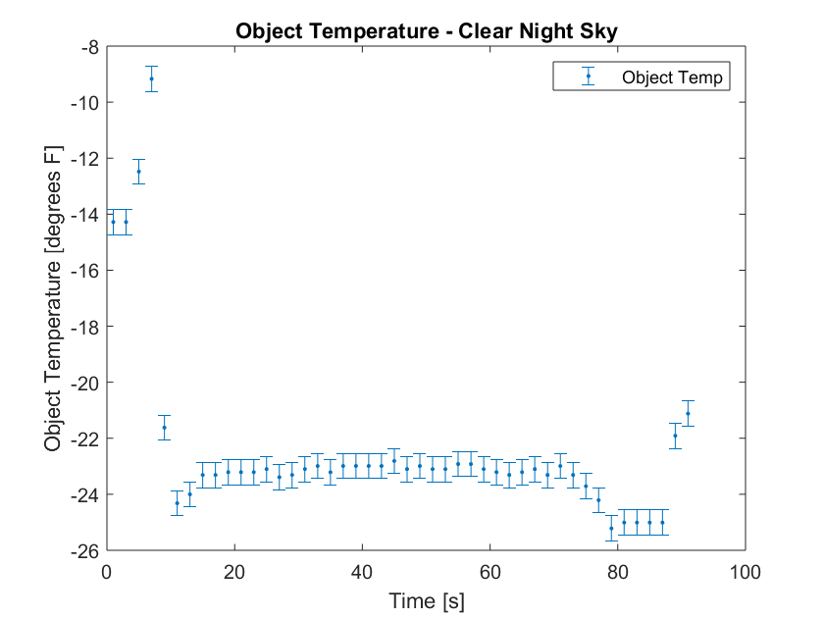
IR Thermometer Testing Data

Slide 41
Updated Weather Shielding Triggers
Single Sensor Safe Mode Trigger:
Lightning detected at any distance
OR
Precipitation detected
OR
Wind speeds detected > 8 m/s
Multiple Sensor Safe Mode Trigger:
Pressure drops by > 3 mb
AND
RH detected above 70%
AND
IR temperature higher than 10°C
1 Hz
Remote Operator Safe Mode Trigger:
Shutdown command received over cellular

Slide 42
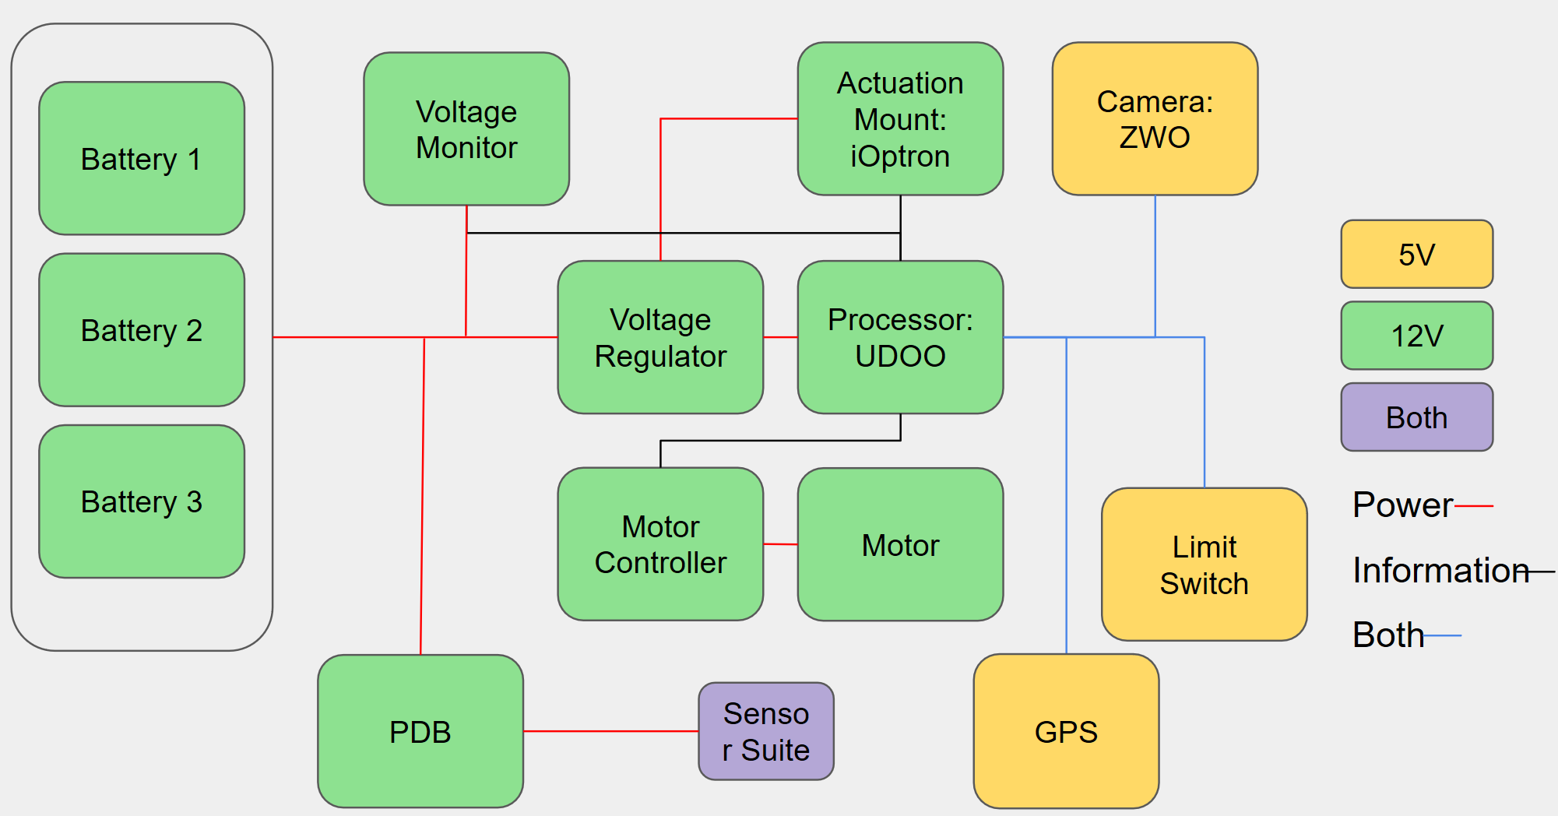
Power
Manufacturing Order:
Components for testing, verification, and validation
Components for full functionality
Components for total Requirement adherence
~20 hr
~30 hr
~10 hr
Model Validation
Material Acquisition
Component Testing
Harness Manufacturing
Component Installation
Done
In Progress
To Do
Notes:
BACK UP

Slide 43
Stage Calibration Test – Test Design
Test 1 Plan :
Power up the stage without any its onboard calibration
Rotate 90 deg from horizontal
Image sky, calculate Ra and Dec
Pass actual Ra and Dec to stage using calibration command
Slew to New Ra and Dec
Image Sky, Calculate actual Ra and Dec
Repeat steps 5-6 Repeatedly
Test 2 Plan:

Slide 44
Full System Test
Testing Goal: Characterize processing time across full system, mainly scheduling and hardware commanding
Motivation: To accomplish WRAITH's mission to demonstrate the feasibility of a low cost, autonomous, deployable SSA system.
Materials: Completed WRAITH hardware & software
Requirements Verified: FR 1-7
Risks Reduced: Integration issues
Notes:
Model was created with worst case scenario in mind and without considering hardware commands (to an extent)

Slide 45
Work Breakdown Structure
Not Started
In progress
Done
WRAITH
Software
Hardware
Software-Hardware Integration
Software Integration
Scheduler Redesign
Sensor Suite
Main Box
Sensor Suite Box
Hardware Commanding
Scheduler to Control Interface
Rerun Function
Sensor Functionality
Enclosure
Construction
COTS Box Modifications
Component Installation
Safety Override
Environmental Shutdown
Uninstalled Characterization
Camera Output
Component Installation
Electrical System
GPS Integration
Cable Wrapping
Installed Characterization
Memory Path
Roof Controls
Shutdown Logic
Electrical System Installation
Image Processing to Orbit Determination
Communications Design
Software ~600 hrs
Hardware ~200 hrs
Environmental System ~150 hrs
Overview
Schedule
Manufacturing
Budget
Notes:
Add in current estimates. Jim crowe

Slide 46
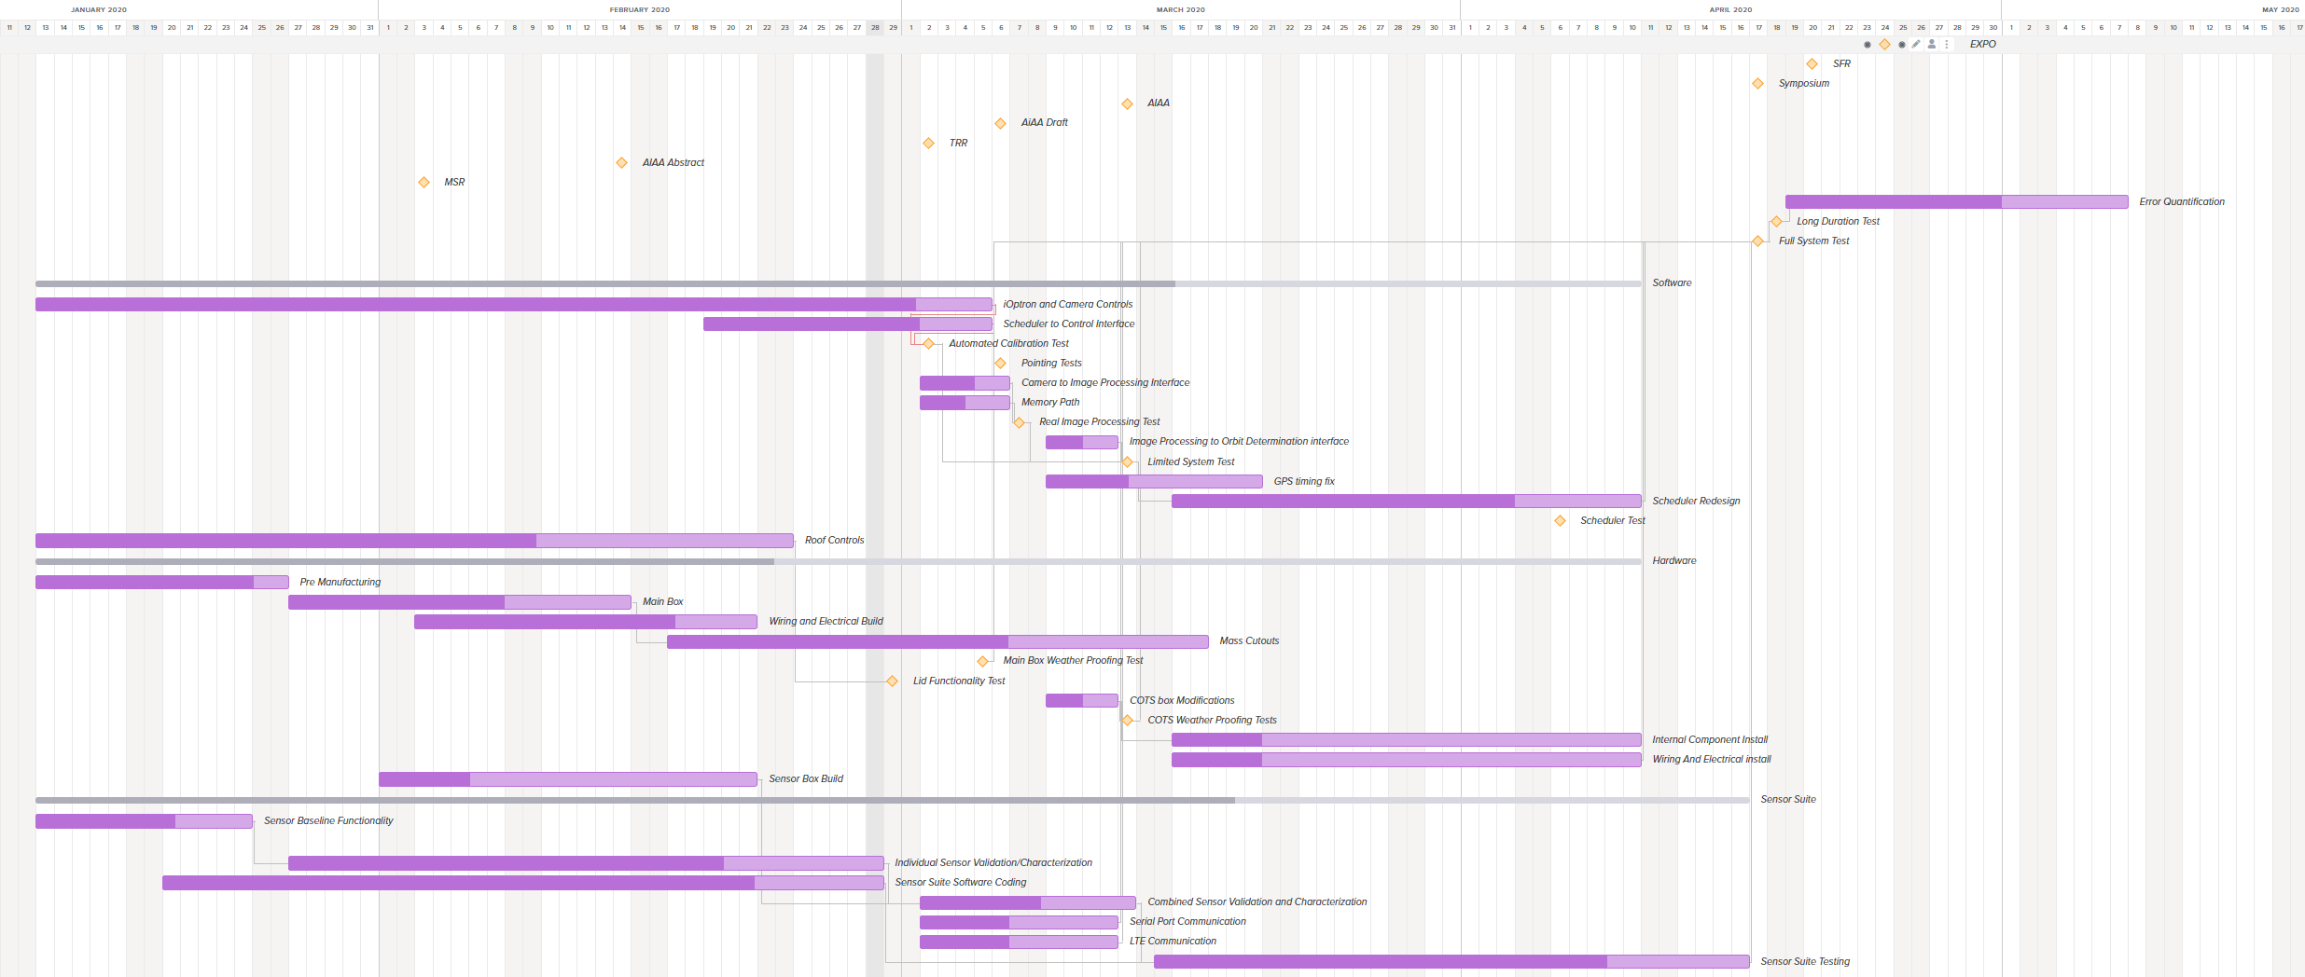
Schedule
Notes:
Show our time available to work by the amount of people we have on sw/hw/enviro to convince that we are going to be able to accomplish this

Slide 47
425
425
354
283
Torque [oz in]
212
141
70
0

