Slide 1
WIRMS
Weather-Balloon Infrared Readings of Moisture in Soil
Test Readiness Review
Sponsor: ASTRA, LLC
Nick Bearns, Emanuele Costantino, Marisa Exnicious,
Jason Li, Brad Lutz, Riley Perez, Lewis Redner, Silvio Rossi, Sevi Senavinin, Sam Shaver, Eric Vanderwolf, Alexis Wall

Slide 2
Overview
Project Overview
Schedule
Testing
Budget
1
Motivation and Objectives
Notes:
6:30 for overview
3:00 for Thermodynamics
2:30 for pointing - 12:00
4:00 for flight

Slide 3
Project Motivation
Problem
Over-watering causes negative environmental impact
Under-watering inhibits crop growth and health
Existing Solutions
Satellite based systems
In-ground measurement
UAS Drones

Slide 4
Project Mission Statement
WIRMS will build a non-intrusive solution to provide IR data that can be used to monitor soil moisture content over a 300 square foot area for one day with 80% up-time.
Solution: Tethered weather balloon system to provide an elevated imaging platform for a NIR camera
Notes:
This will be accomplished by:
Using a tethered balloon to provide an elevated imaging platform for an IR Camera
Capturing images and environmental data that will be downlinked to a ground station for storage
Say what non-intrusive means.
Mention we aren’t making a SM model but delivering data to ASTRA that they can make SM algo with
Upacalable

Slide 5
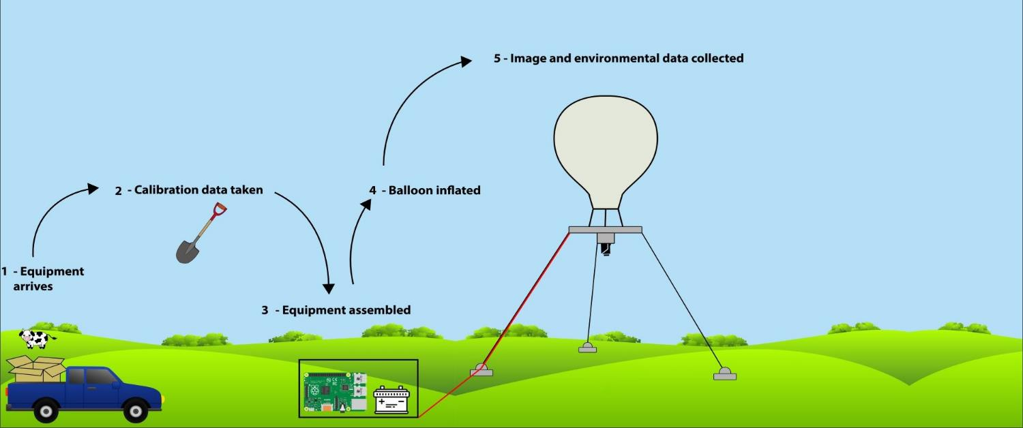
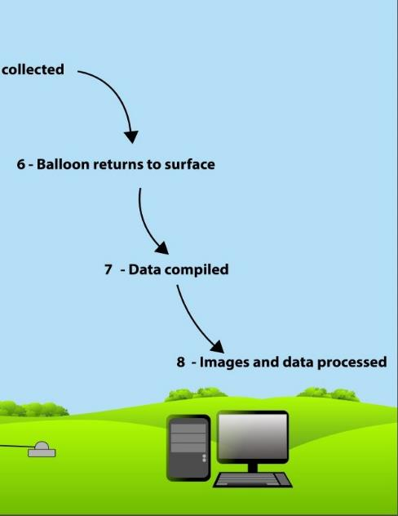
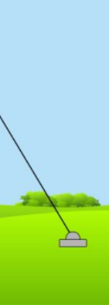
CONOPS
Notes:
MENTION SOLAR PANEL

Slide 6
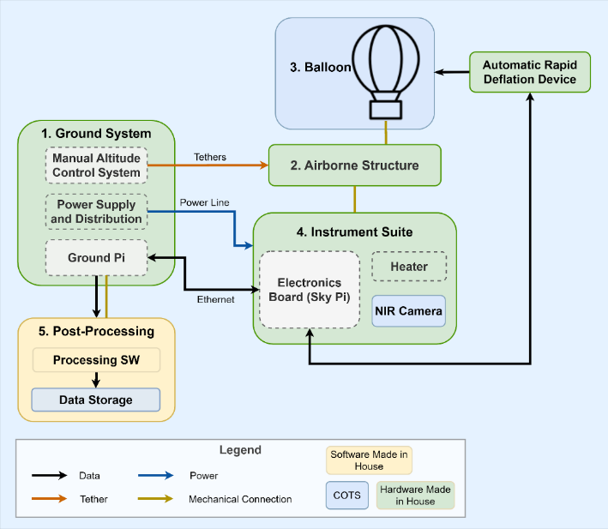
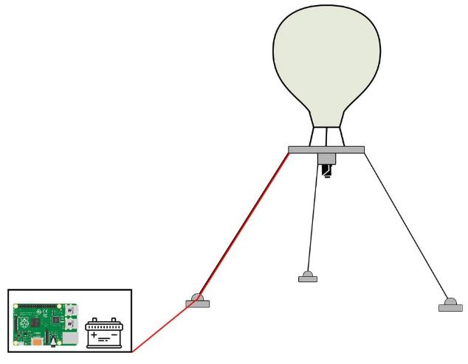
Functional Block Diagram
Notes:
ALEXIS: add boxes around important systems for testing
SPECIFIC QUESTIONS ABOUT baseline design in the backups

Slide 7
Critical Project Elements
Flight Vehicle
Structure
Electronics
Software
Balloon Volume
Airborne Structure
Hardware
Data Transfer
Ground Structure
Power Distribution
Image Alignment
Stresses
Legend
Critical Element
Non-Critical Element
Notes:
Spend more time on these when presenting
Highlight the important testing elements

Slide 8
Concerns from MSR
Camera Liability
Written confirmation from customer, in backup slides
CU South Boulder Testing
Written confirmation from Dan Hesselius
Ground Station CAD
Assembly complete, covered in backup slides
Notes:
Solar charging system -- mention we are still gucci
MATT APPROVAL either mention it verbally or put it in slides before Monday

Slide 9
Schedule
Project Overview
Schedule
Testing
Budget
2
Where We Are & What’s Next

Slide 10
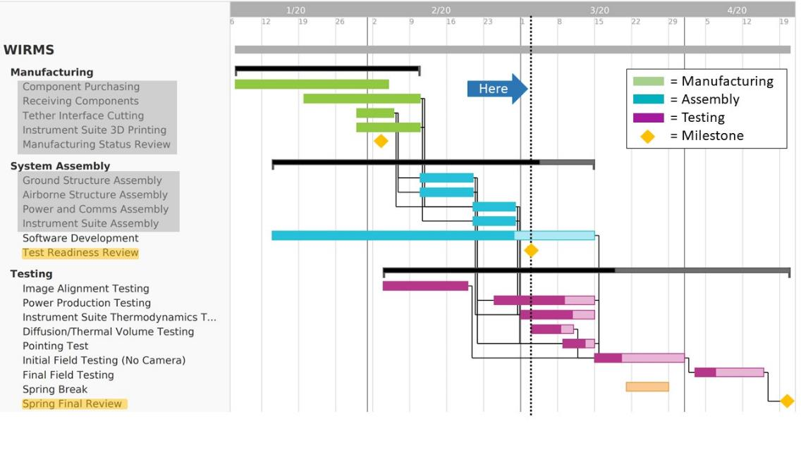
Gantt Chart
Notes:
Green out/grey out the previous sections

Slide 11
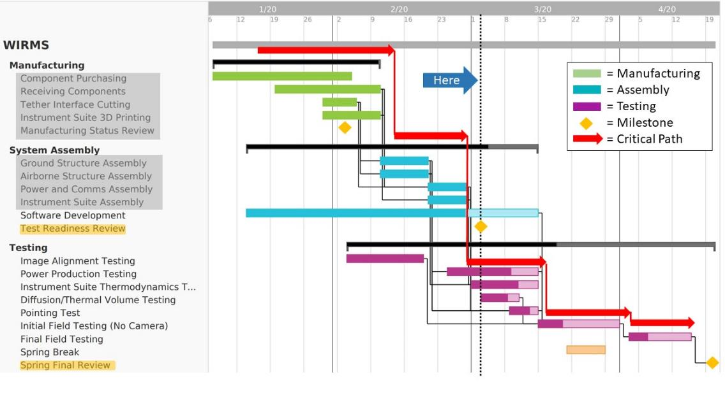
Gantt Chart
Key Tests
Instrument Suite Thermodynamics
Pointing Test
Initial Field Test
Notes:
Highlight the two subtests we are covering on the left.

Slide 12
Test Readiness
Project Overview
Schedule
Testing
Budget
3
Plans and Procedures

Slide 13
Overview of Tests
Model Driven Subsystem Tests
Condensation
Pointing
Volume and Lift (Scale diffusion test)
Power
Additional small-scale tests
Day in the Life Test
Notes:
Make better

Slide 14
Instrument Suite Thermodynamics: Overview
DR 4.2 - The imaging system shall produce images of the ground with dimensions of 300 square feet.
DR 4.3.1 - The camera shall operate within temperatures from 10 to 70 degrees Fahrenheit.
Test Purpose: Verify no condensation on imaging surfaces under worst case operational conditions
Test Status: Initial test complete (February 28th) - further testing required by March 14th
Model Validation: Test will validate thermal model by testing temperature difference between external polycarbonate and ambient air
Initial Result: No condensation during low humidity test
Notes:
ADD LINK TO BACKUPS
Verbally state testing with prescribed humidities SAY IT ITIDOT

Slide 15
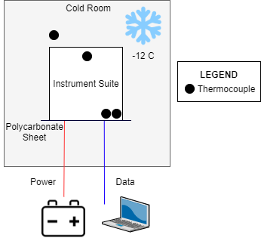
Instrument Suite Thermodynamics: Equipment and Facilities
Facility:
ASTRA Thermal Chamber
Equipment:
Thermal chamber
Battery and power cable
Instrument suite fitted with all electronics, including humidity sensor
Camera
4 thermocouples, 1 ASTRA-provided humidity sensor
Notes:
TABLE?
Update image (more thermocouples) change temp to -12
Actual images of test linked in backups
Make a backup of HOT TEST

Slide 16
Instrument Suite Thermodynamics: Test Procedure Review
Fully Charge Battery
Connect Power to Instrument Suite
Set Cold Room to -12C
Testing Stopped
Inspect Imaging Surfaces for Condensation, 20 Minutes
Install Thermocouples and Instrument Suite
Condensation Observed
Test Conducted Until Steady State
Notes:
Remind of additional humidity tests

Slide 17
Instrument Suite Pointing: Overview
DR 4.2: The imaging system shall produce images of the ground with dimensions of 300 square feet.
Test Purpose: Verify that camera will image the same 300 sqft data calibration area when max operational wind is applied (20 mph)
Test Status: Scheduled for March 9th - March 14th
Model Validation: Test will validate the Instrument Suite Dynamics model for the tri-tethered balloon system
Expected Result: Instrument suite will be able to image the same data calibration area
Notes:
Emphasize worst case
Have we talked to matt about the highbay?

Slide 18
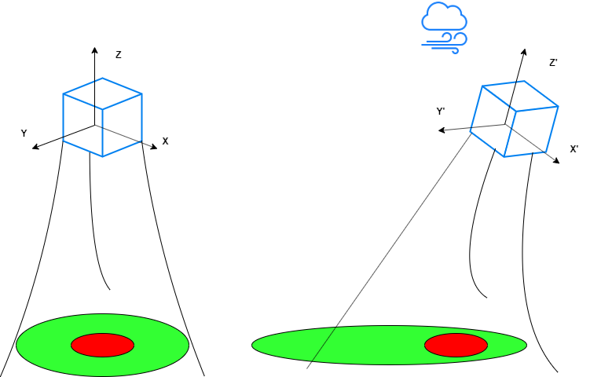
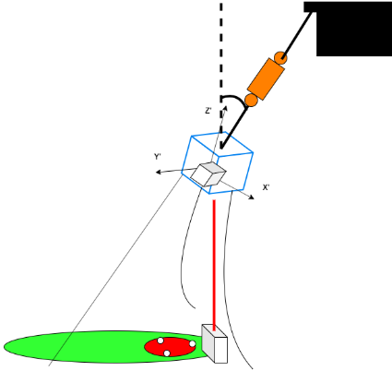
Instrument Suite Pointing: Design
No Wind
Wind
Test Setup
Notes:
Calibrating laser range finder and force gauge?
SCALING UP THIS TEST??

Slide 19
Instrument Suite Pointing: Equipment and Facilities
Facility:
CU Aerospace High bay
Equipment:
ASTRA Thermal Chamber
Instrument suite electronics
Ground stations and tethers
Power supply
Force gauge
Laser range finder
* Full list in backup slides
Set up Scale Structure in High Bay
Mark Soil Calibration Area Below
Record Images
Prescribe Known Force and Angle on Instrument Suite
Verify Pointing Model
Notes:
https://www.google.com/url?sa=i&url=https%3A%2F%2Fwww.southbouldercreekactiongroup.com%2Fcu-south%2F&psig=AOvVaw2rZZcHjFrCrYpzSfqI2Xjg&ust=1582731887604000&source=images&cd=vfe&ved=0CAIQjRxqFwoTCMjB2PeF7ecCFQAAAAAdAAAAABAJ

Slide 20
Instrument Suite Pointing: Scaled Down
NL
The new soil moisture area (SMA) was calculated for TA preservation
Max turning angle (TA) = 5.85 deg
Net lift (NL) and drag D are also the same for small and large scale
D
NL
D
h
TA
h
TA
SMA
SMA
Large Scale: h =118ft, SMA = 300 sqft
Small Scale: h =7ft, SMA = 1.05 sqft

Slide 21
Final Test: High Level Overview
FR1 - FR11
Test Purpose: Demonstrate “day in the life” functionality, supplying required data to customer from instrument suite and ground measurements
Test Status: Scheduled between March 14 - March 31 and April 2 - April 15
Model Validation: Test validates power model, pointing model, thermal model, and lift model
Expected Result: System functionality and requirements verified
Notes:
Add FRs to Backups

Slide 22
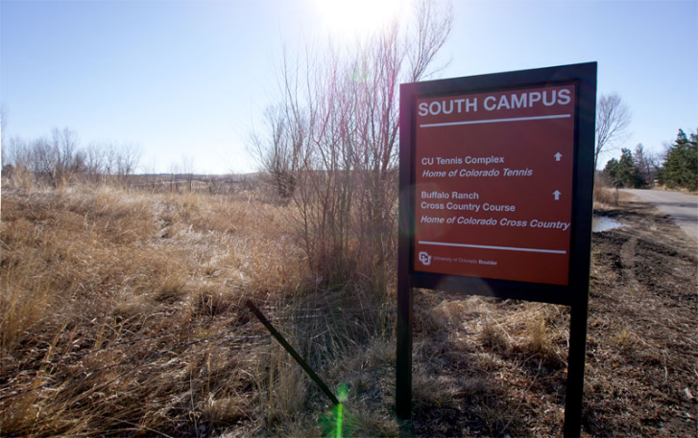
Final Test Flights: Equipment and Facilities
Facility:
CU South Boulder
Equipment: (complete list in backup slides)
Balloon
Airborne structure
Instrument suite
Mooring stations and tethers
Battery, ground station, solar
Helium, fittings, hose, scale
SMC probes
Trowel, scale, bags
Laser range finder
Notes:
https://www.google.com/url?sa=i&url=https%3A%2F%2Fwww.southbouldercreekactiongroup.com%2Fcu-south%2F&psig=AOvVaw2rZZcHjFrCrYpzSfqI2Xjg&ust=1582731887604000&source=images&cd=vfe&ved=0CAIQjRxqFwoTCMjB2PeF7ecCFQAAAAAdAAAAABAJ
MERGE EQUIPMENT AND FLOWCHART

Slide 23
Final Test Flights: Test Procedure
*Full procedure in backup
Review Emergency Procedures: FAA, CU Fire Marshal
Place Structures: Ground structures, tethers, airborne
SMC Data Samples: Place probes, dig samples and mass
Inflate Balloon: Helium tanks, safety moorings, fittings
Monitor Flight:
Wind speed, structure, altitude, condensation
Notes:
Give a range of dates we could do this in: April 2 to …?
Talk to Matt to see if he needs to be there for the test
Walk through this as the day in the life without camera then add a slide to do the same With a camera
Remove conops, replace with flowchart and simplified system diagram
Testing entire system, gathering data, SMC probes, baking method
Preliminary flight with camera substitute resistor
Final flight with camera (REMOVE THIS TEXT)

Slide 24
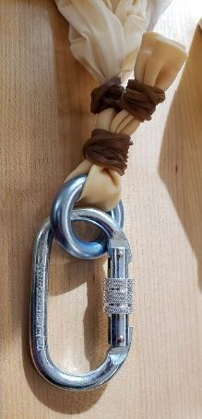
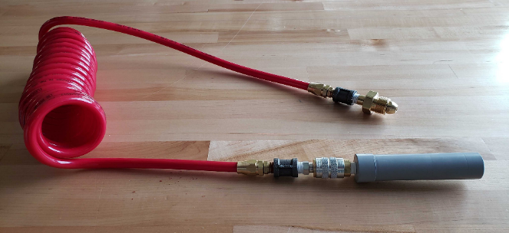
Inflation Materials
Inflation Line
¼” male NPT quick connect socket
¼” male NPT quick connect plug
¼” male to male NPT air hose
¼” male NPT to CGA 580 nipple/nut & regulator
¼” female to female NPT adapter
PVC neck adapter
Securement Tools
Latex rubber bands
Rappel ring
Locking carabiner
Mooring rope
Hanging scale
7
8
5
4
9
3
1,2
6
5
Notes:
Securement

Slide 25
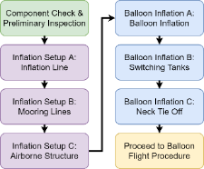
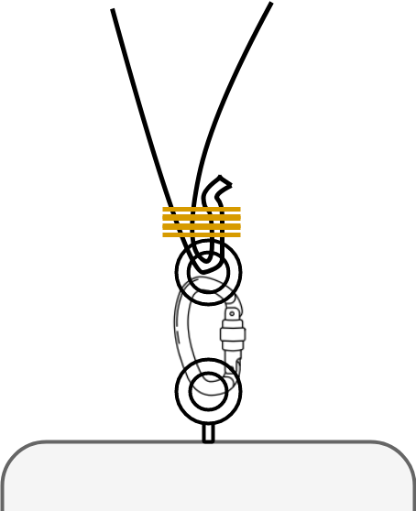
Inflation Procedure
Component Check & Preliminary Inspection
Inflate balloon
Attach all fittings to inflation line
Switch helium tanks during inflation
Secure mooring lines from helium tanks to balloon
Tie-off balloon neck when inflation is complete
Connect tethers to airborne structure
Proceed to Balloon Flight Procedure
Full procedure details & steps in Inflation Procedure document
Notes:
Remove “Inflation Setup A” for each step, and replace with sentence about actual step

Slide 26
Budget
Project Overview
Schedule
Testing
Budget
4

Slide 27
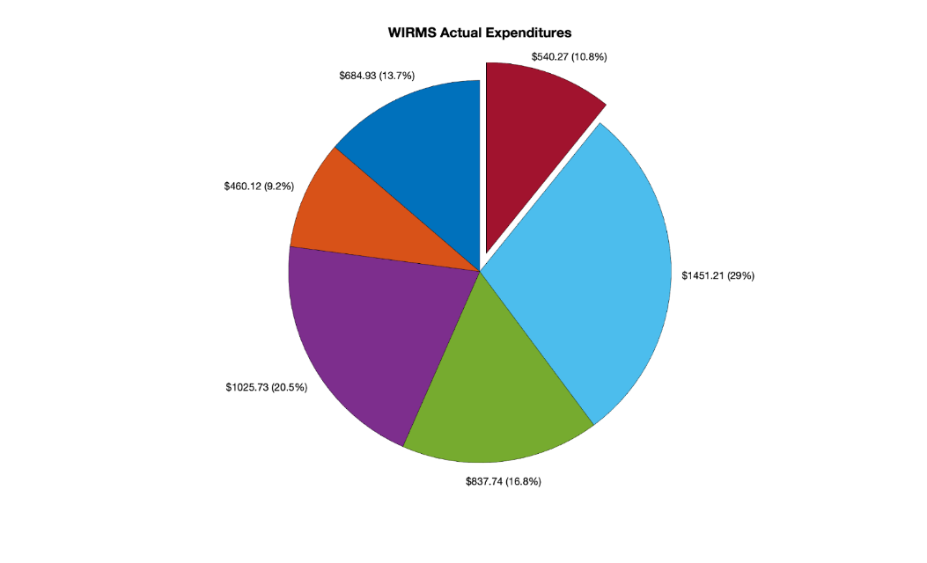
Budget Update
Actual Net Spend: $4459.73
Current Margin: $540.27 (10%)
Margin
Additional Costs since MSR
Instrument suite box price increased by ~$70
Additional items for balloon inflation ~$80
Shipping costs ~$240
Concerns
Balloon ruptures ($230/flight)
Lost helium ($500/flight)
Ground Structure
Airborne Structure
Safety and Testing
Electronics
Flight Vehicle

Slide 28
Thank You
Questions?
Sam eats dick

Slide 29
Backup Slides Table of Contents
Baseline Design
Thermodynamics Model
Functional Requirements
Final Test Equipment and Checklist
Dan Hesselius Email
Battery Discharge Test
Solar Charging Test
Full Power Test
Balloon Neck Loading
Structural Tests
Airborne Structure
Mooring Station
Pointing Test
Balloon Volume & Lift Test
Soil Moisture Testing
Customer Confirmation Email
Software Integration Testing
Automatic Rapid Deflation Device

Slide 30
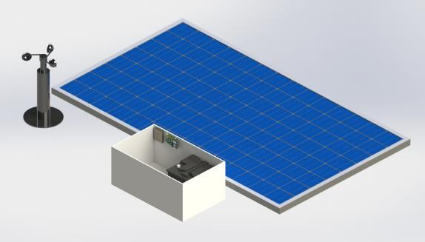
Baseline Design: Ground Station
Return to TOC
49.5 in
20 in
12 in
25.7 in
Notes:
Potentially include words here. Move to backups

Slide 31
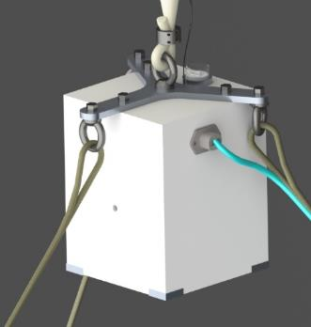
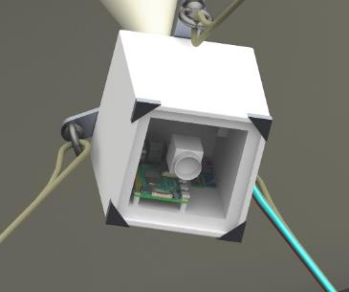
Baseline Design: Airborne Structure/Instrument Suite
Return to TOC
7 in
5.8 in
5.8 in
Notes:
Change this CAD image to under view of polycarbonate/sensors. Keep this as it is high risk for testing, “we can also discuss balloon, ground station etc. in backups”

Slide 32
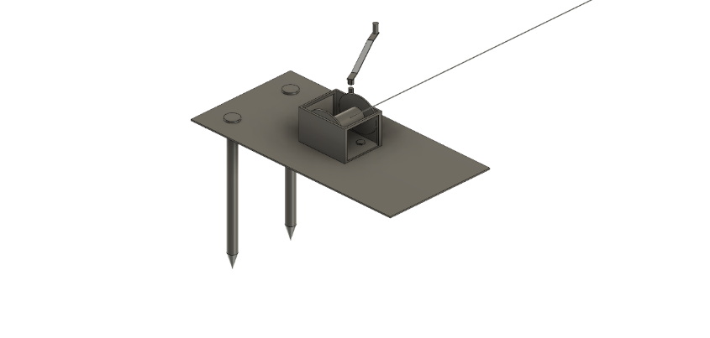
Baseline Design: Mooring Stations
Return to TOC
12”
24”
Notes:
Hey there move this to backups

Slide 33
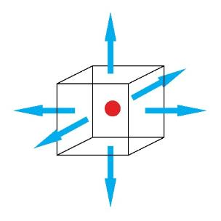
Instrument Suite Thermodynamics: Model
Return to TOC
For no condensation at maximum humidity (50%), a 20 C temperature difference is required across the box faces
Governing Equation:
Solution:
Analysis:
Thermal model suggests no condensation

Slide 34
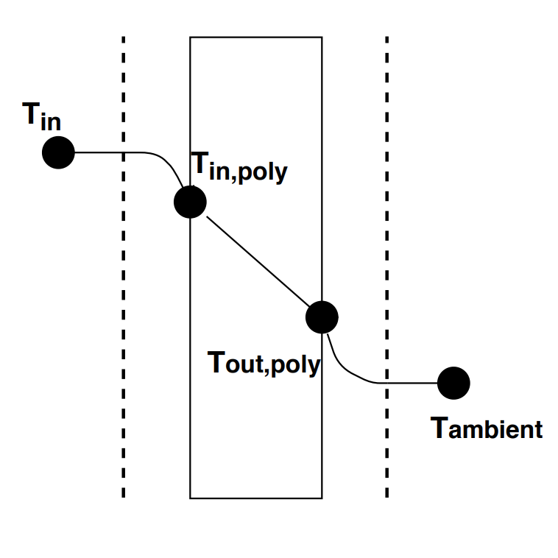
Instrument Suite Thermodynamics: Model
Return to TOC
To prevent condensation at 50% humidity (max required), a temperature difference of 20 C is required between the outside polycarbonate face and ambient air
T_{amb} = 21 C → T_{in} must be 61 C
T_{amb} = -12 C → T_{in} must be 28 C
20 C

Slide 35
Instrument Suite Thermodynamics: Improving Design
Return to TOC
Increased Humidity Test
Yes
Change Configuration Inside Box & Retest
Yes
Add Resistive Mesh & Retest
Condensation
Condensation
No
No
Test Successful
Test Successful
Test Successful

Slide 36
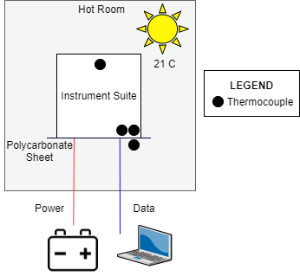
Instrument Suite Hot Test: Equipment and Facilities
Return to TOC
Facility:
ASTRA Thermal Chamber
Equipment:
Thermal chamber
Battery and power cable
Instrument suite fitted with all electronics, including humidity sensor
Camera
4 thermocouples, 1 ASTRA-provided humidity sensor
Notes:
TABLE?
Update image (more thermocouples) change temp to -12
Actual images of test linked in backups
Make a backup of HOT TEST

Slide 37
Instrument Suite Hot Test: Test Procedure Review
Return to TOC
Fully Charge Battery
Connect Power to Instrument Suite
Set Hot Room to 21C
Internal Temperature exceeds 40 C
Measure Internal Temperature
Testing Stopped
Test Conducted Until Steady State
Install Thermocouples and Instrument Suite
Condensation Observed
Inspect Imaging Surfaces for Condensation, 20 Minutes
Notes:
Remind of additional humidity tests

Slide 38
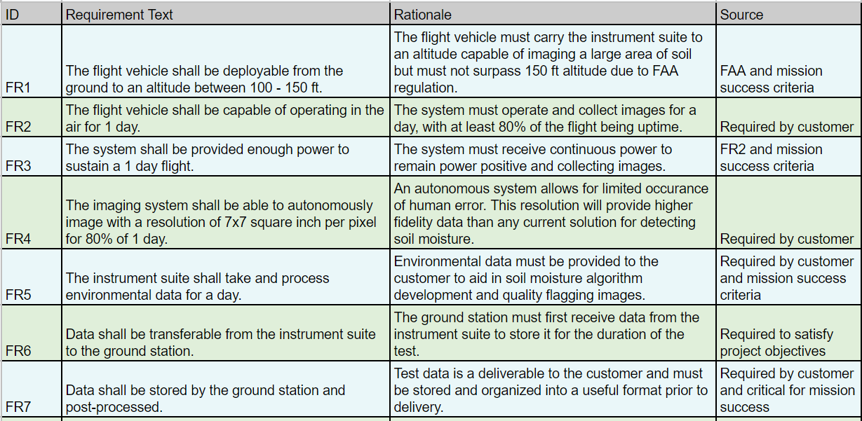
Functional Requirements
Return to TOC

Slide 39
Final Test Equipment Checklist
Return to TOC
Ground station (x3)
Cordless drill (x3)
Stakes (x6)
Sand bags (x6)
Tethers (x3)
Instrument suite / airborne structure
Attachment components (carabiners / hooks)
Latex balloon
Helium tanks
Tank fittings ** see inflation procedure
Temporary tethers for filling procedure
Rubber bands
Neck clamp
Power cable
Data cable Zip ties
Ground station
Battery with lug to alligator connector
Solar panel with charge controller
ARDD
Soil moisture probes (x5)
Trowel for baking method
Scale
10 gallon zip lock bags
Sharpie
Tape measure
Band aids
Laser range finder

Slide 40
Final Test Full Procedure (1/2)
Return to TOC
Measure out and place ground stations evenly spaced 12.6 feet from center
Insert stakes and place sandbags on ground station
Lay tethers to center with some still wound in ground station spool
Place airborne structure in center
Secure tethers to airborne structure eye-loops
Lay power station, battery, and solar panel by one ground station
Connect solar panel to battery and power station
Connect power and data cables from power station to instrument suite
Secure power cables to a tether using zip ties every 3 feet
Ensure air-pi in instrument suite is receiving power
Connect ARDD to airborne structure
See balloon inflation procedure
Unwinch using cordless drills the three worm gears on ground station to marked location
Check instrument suite is deployed at 118 feet with laser range finder
This altitude will ensure that the top of the balloon is under 150 feet
Soil moisture probes are placed into ground evenly over the imaging area

Slide 41
Final Test Full Procedure (2/2)
Return to TOC
SMC probe data recording is initiated
One soil sample is taken by each SMC probe location, bagged, labeled, and massed (recorded)
Imaging is initiated
Test lasts for 20 hours
Take shifts to monitor this test for entire duration, will assign shifts once testing date is confirmed
Monitoring weather for wind warnings: if weather alert then winch down balloon
If balloon flyaway without deflating call FAA phone number (number to call with description and heading at top if test checklist)
After 20 hour test take another soil sample by digging, bagging, massing, and labeling by same location as before
Winch down balloon carefully removing power cable zip ties
Puncture balloon neck to slowly release helium
Organize parts and transport back to aerospace building

Slide 42
Balloon Inflation (1/2)
Return to TOC
Component Check & Preliminary Inspection
Verify all the following components are present.
(1) ¼” male NPT quick connect socket, IL1
(1) ¼” male NPT quick connect plug, IL2
(1) ¼” female to female NPT hose, IL3
(1) ¼” male NPT to nipple/nut CGA 580 regulator, IL4
(1) box of latex rubber bands, SD1
(1) PVC inflation adapter, SD2
(1) roll of electrical tape, SD3
(1) rappel ring, SD4
(1) locking carabiner, SD5
(3) 5 ft kevlar mooring rope
MR1 - figure 8 & triple constrictor to double slipknot
MR2 - triple constrictor to double slipknot
MR3 - quadruple constrictor to double slipknot
(1) hanging tensometer, MD1
(3) helium CGA 580 tank, TK1, TK2, TK3
(1) tarp, TP1
(1) Kaymont HAB 2000 latex weather balloon, WB1
Verify that the weather balloon does not have any defects and is clean.
PLACE TP1 onto the ground.
PLACE WB1 onto TP1.
CHECK WB1 skin for any cuts, tears, and holes.
If any imperfections are spotted, replace the weather balloon immediately.
CHECK WB1 skin for dirt and grime, and clean accordingly.

Slide 43
Balloon Inflation (2/2)
Return to TOC
Inflation Set Up
Set up for Inflation Line
TIGHTEN IL1 into SD2.
TIGHTEN IL2 into IL3.
TIGHTEN IL3 into IL4.
TIGHTEN IL4 into TK1.
Set up for Mooring Line 1
SECURE the triple constrictor end of MR1 between the end of IL3 and IL2.
SECURE the double slipknot end of MR1 to TK1.
SECURE MD1 to the figure 8 loop of MR1.
Set up for PVC Inflation Adapter and Mooring Line 3
INSERT SD2 into the neck of the balloon.
SECURE the quadruple constrictor end of MR3 over the balloon neck on top of SD2.
SECURE the double slipknot end of MR3 to TK3.
Set up for Mooring Line 2
INSERT rubber bands around the neck of the balloon, above SD2.
INSERT the triple constrictor end of MR2 around neck of the balloon, above SD2.
SECURE the double slipknot end of MR2 to TK2.
Set up for airborne structure
PLACE airborne structure next to the balloon.
SECURE the three tethers to the airborne structure.
VERIFY all three tethers are taut.

Slide 44
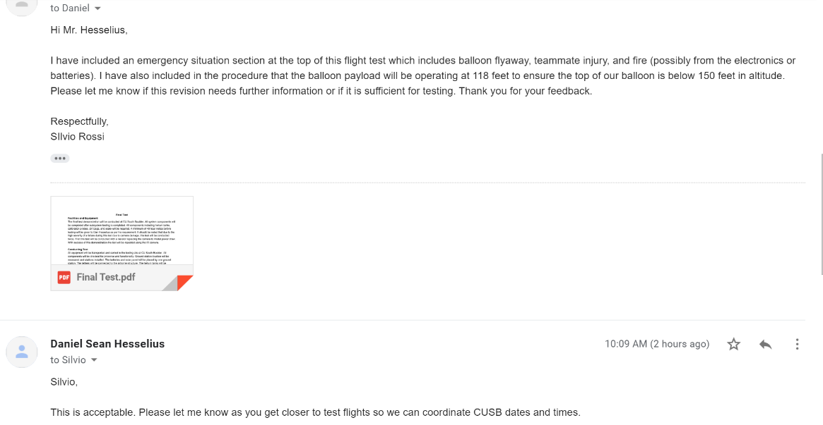
Confirmation email from Daniel Hesselius
Return to TOC

Slide 45
Battery Discharge Test (1/3)
Return to TOC
FR3 - The system shall be provided enough power to sustain a 1 day flight.
DR3.1 - The system shall not draw more power than the battery can provide.
Test Purpose: Obtain a discharge curve for the deep cycle battery over the first 20 hours of discharge from full capacity
Test Status: Completed (2/19/20 - 2/26/20)
Model Validation: Test validates power model by proving that battery can provide enough power for a 20 hour flight
Expected Result: Discharge curve for the first 20 hours of discharge will be obtained and match a typical lead acid battery discharge curve

Slide 46
Battery Discharge Test (2/3)
Return to TOC
Facility: CU Aerospace Electronics Shop
Equipment:
Keithley 2460 SourceMeter
Deep cycle battery
Lug terminal to battery clamp connector
Procedure:
Connect battery to SourceMeter
On SourceMeter, navigate to scripts and select Battery Discharge
Enter prompted parameters (current draw, cutoff voltage, etc.)
Save data to USB when script is finished running
Transfer data from USB to Google Drive
Notes:
TUrn procedure into flowchart

Slide 47
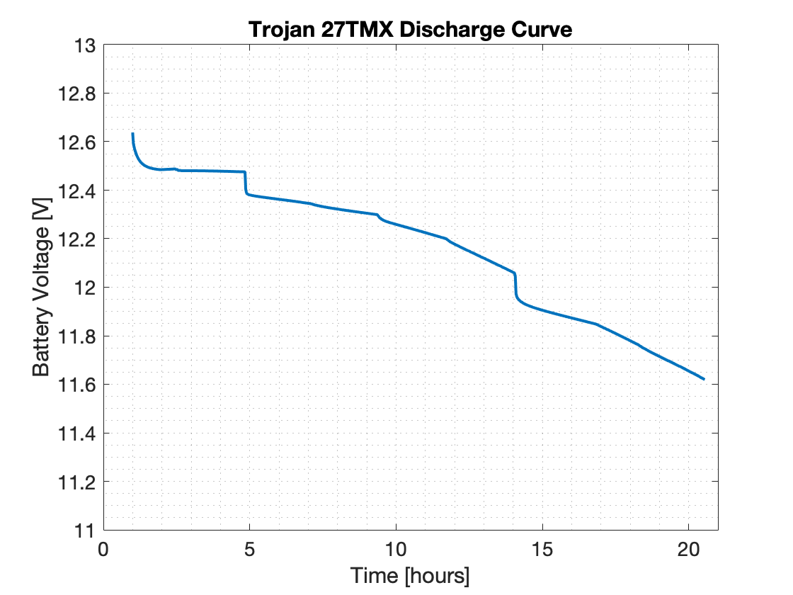
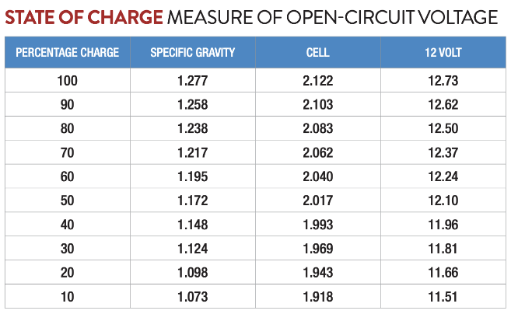
Battery Discharge Test (3/3)
Return to TOC

Slide 48
Solar Charging Test (1/3)
Return to TOC
FR3 - The system shall be provided enough power to sustain a 1 day flight.
DR3.1 - The system shall not draw more power than the battery can provide.
Test Purpose: Verify that solar charging system is capable of fully charging the battery in 1 day in full sun
Test Status: Completed (2/27/20)
Model Validation: Test will validate solar charging aspect of power model
Result: Solar charging system was able to fully charge the battery within 1 day in full sunlight

Slide 49
Solar Charging Test (2/3)
Return to TOC
Facility: Outside CU Aerospace Building
Equipment:
Solar panels
Charge controller
Deep cycle battery
Procedure:
Connect both battery and solar panels to charge controller
Ensure charging voltage and charging current are being read
End test once charging current has dropped below 1.5 A

Slide 50
Solar Charging Test (3/3)
Return to TOC
Solar panels charged battery to full capacity in approximately 5 hours
Matches power model solar charging time for 300W solar panel and 1260 Wh battery

Slide 51
Full Power Test (1/2)
Return to TOC
FR3 - The system shall be provided enough power to sustain a 1 day flight.
DR3.1 - The system shall not draw more power than the battery can provide.
Test Purpose: Verify that power production system is capable of providing enough power to entire system for 20 hour flight by extrapolation
Test Status: Test has not been performed yet, planned for week of 3/2
Model Validation: Test will validate power model for a 20 hour flight with solar charging by extrapolation
Expected Result: Power production system is able to provide enough power for all components to function properly for the duration of the test

Slide 52
Full Power Test (2/2)
Return to TOC
Facility: CU Aerospace Building
Equipment:
Power production system (solar panels, charge controller, battery)
Instrument Suite electronics components
Ground station electronics components
Procedure:
Verify solar charging system is generating power
Connect all electrical components
Ensure all components are operational
Monitor battery capacity with voltmeter and charge controller
Stop test after 5 hours have passed

Slide 53
Structural Tests
Return to TOC
Airborne Structures:
DR 1.3 - The flight vehicle shall maintain an altitude between 100 - 150 feet for flight duration.
DR 1.4.1- The tethering structural elements shall each have their own factor of safety of 3 against failure under inclement conditions.
Ground Structures:
DR 1.4 - The flight vehicle shall be secured to the ground structure.
DR 1.4.1- The tethering structural elements shall each have their own factor of safety of 3 against failure under inclement conditions.
Test Purpose: Ensure that all structural components can withstand expected worst case loading scenario predicted.
Test Status: Completed.
Validation: Tests will validate structural calculations which claimed structural elements would not fail.
Expected Result: All structural components do not fail.

Slide 54
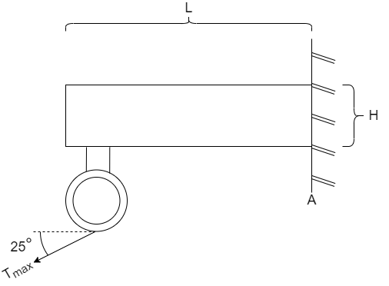
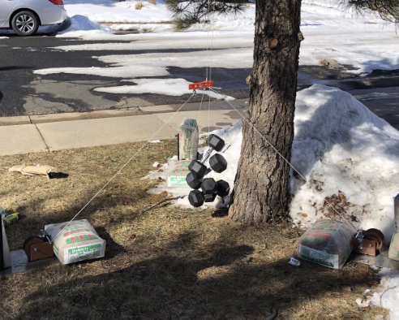
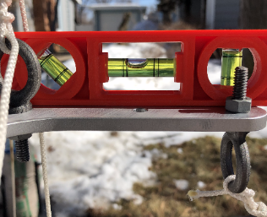
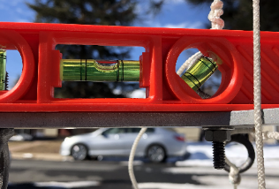
Airborne Structure Test Results
Return to TOC
T_{max} = 90 lbs
Test Results successful
(DR 1.3 and DR 1.4.1)✔️

Slide 55
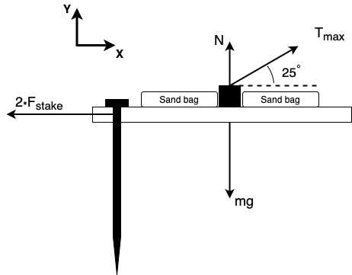
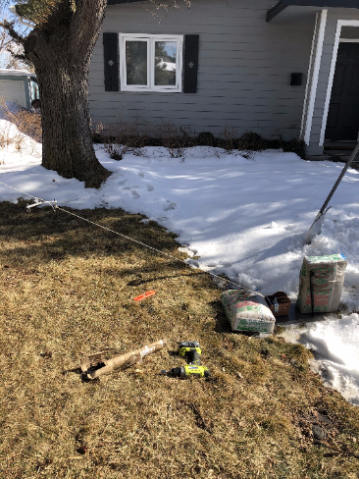
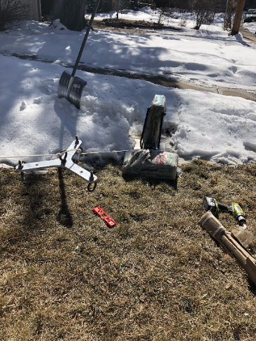
Mooring Stations Test Results
Return to TOC
T_{max} = 90 lbs
mg = 110 lbs
Test Results successful
(DR 1.4 and DR 1.4.1)✔️

Slide 56
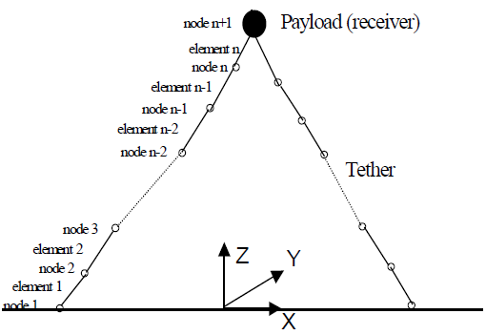
Pointing Test: Model DEM
Return to TOC
Instrument Suite & Balloon
Major Assumptions:
Instrument suite and balloon occupy the same space
Tethers provide no damping
No drag on tethers
Cross sectional area of tethers are constant
Instrument Suite
i+1
j+1
Nahon, 1999
i
m(j+1)g
j
T(j+1)
T(j)
i-1
m(j)g
Notes:
Nahon et al 2019

Slide 57
Pointing Test: Model Pointing
Return to TOC
We used the last nodes on the tether to determine where our camera was pointing
The green triangle represents the plane made by the three points
Blue dot is the centroid of the points
Red vector is the normal of the plane
Purple vector represents the direction from lowest hanging node to the centroid of plane
Rotation axis
*Rotation axis is defined as the cross product of the normal and centroid vectors

Slide 58
Pointing Test: Model Results (1/2)
Return to TOC
Top View
Side View

Slide 59
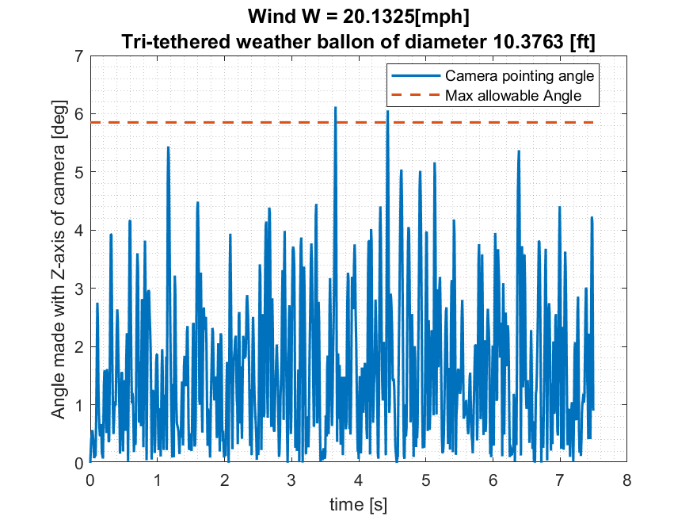
Pointing Test: Model Results (2/2)
Return to TOC
Max allowable angle and modeled angle from zenith:
The angle made with the zenith is not above our maximum

Slide 60
Pointing Test: Equipment
Return to TOC
Equipment:
Instrument suite electronics → Camera, Raspberry Pi, sensors
Ground stations
Stakes will not be present, rather rubber mats to provide lateral resistance
Sandbags to hold down structure
Tethers → Roughly 10 feet of tether per tether
Power supply → Power Supply is needed to power camera and Pi
Force gauge → Digital force gage to prescribe an artificial and drag (laterally)
Laser range finder → Locate the center of the instrument suite to draw SMA
Pulleys → Transfer the force upwards to make artificial lift
Forklift or Scissor Lift
Protractor

Slide 61
Balloon Volume & Lift Test: Rationale
Return to TOC
FR2 - The flight vehicle shall be capable of operating in the air for 1 day.
DR 1.3 - The flight vehicle shall maintain an altitude between 100 - 150 feet for a day long flight.
Test Purpose: Verify lift and volume model, show directly the effects of diffusion and temperature fluctuation.
Test Status: Test will be done in Engine Test Bay March 2nd - March 10th.
Model Validation: Run images through volume calculator, plot volume, lift, and temperature as a function of time. Compare to analytical model.
Expected Result: Negligible diffusion rate, minimal change in volume.
Notes:
Include actual force value for expected result

Slide 62
Balloon Volume & Lift Test: Equipment and Facilities
Return to TOC
Facility: Aerospace Engine Test Bay
Equipment:
Balloon inflation devices
Mooring stations
Camera, force gauge, thermometer
Procedure:
Pre-test: Follow setup and test procedures
Peri-test: Force, temperature, photo will be recorded every 30 mins, for 20 hours
Post-test: Release helium, remove equipment from test bay
Post-processing: Run images through volume calculator, plot volume, lift, and temperature as a function of time. Compare to analytical model.
Notes:
Slap diagram in.

Slide 63
Soil Moisture Probe Testing (1/2)
Return to TOC
No requirements directly met through testing. The following rely on SM probes
FR9 - Soil moisture calibration data and GPS data shall be collected.
DR9.1 - Soil moisture data shall be collected by existing technology once per flight.
DR9.2 - Soil moisture data shall be collected over the testing area of 300 square feet.
Test Purpose: Ensure the soil moisture probes function and characterize each to correlate data to soil moisture percent
Test Status: Scheduled for the week of 3/9 - 3/13
Validation: Tests will validate soil moisture probes yield valuable data and can store data at the desired cadence and duration.
Expected Result: Soil Moisture Probes generate recreatable data and can run/store data for 20 hours

Slide 64
Soil Moisture Testing (2/2)
Return to TOC
Required Materials/Equipment:
Soil
20 containers
Water
Soil moisture probes
Oven
Scale
Expected Results:
Exponential trend of water content to resistivity
Results are repeatable and can be defined by a function.
Can run sensors for 20 hours (while duty cycling every 10 minutes)
1. Bake dirt until dry
2. Separate soil into 20 containers
3. Collect 60 data points for each probe.
4. Wet soil in increments of 5%
5. Define trend with exp./best fit
6. Repeat 1-5 twice to verify repeatability

Slide 65
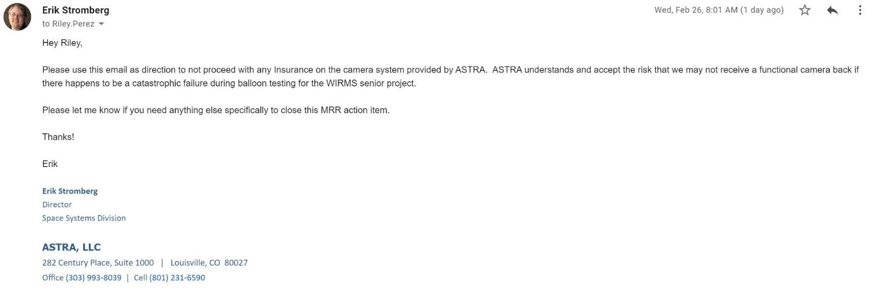
Camera Insurance
Return to TOC

Slide 66
Software/Hardware Integration Testing (1/2)
Return to TOC
DR 4.4.1 - The imaging system shall capture images autonomously.
FR 5 - The instrument suite shall take and process environmental data for a day.
Test Purpose: Verify that the level 1 and any higher level objectives have been met with the software control of the electronics.
Test Status: Completed
Model Validation: No model was developed for software
Expected Result: Autonomous collection and collation with the instrument suite (level 1). Functionality remains with random stop signals, invalid inputs, etc. (level 2+).

Slide 67
Software/Hardware Integration Testing (2/2)
Return to TOC
Facility: CU Aerospace Building
Equipment:
EO 2223 Camera
IMU sensor
Atmospheric Sensor
Raspberry Pi
Procedure:
Verify electrical hardware set-up
Run software and verify data collection process is correct.

Slide 68
Automatic Rapid Deflation Device (ARDD)
Return to TOC
DR 11.1.2 - The flight vehicle shall have a rapid deflation device onboard in the event of an emergency.
Test Purpose: Verify that the rapid deflation device operates properly and will not trigger prematurely
Test Status: Testing scheduled 3/3/20 - 3/13/20
Model Validation: No model was developed for ARDD
Expected Result: ARDD will operate as expected
Notes:
DATES WRONG????

Slide 69
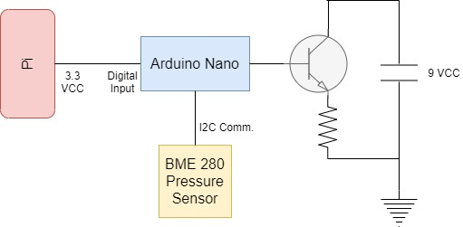
Automatic Rapid Deflation Device (ARDD)
Return to TOC
Facility: CU Aerospace Building
Equipment:
Resistive nichrome wire and MOSFET
Lipo battery
Arduino Nano
Pressure Sensor
Raspberry Pi

Slide 70
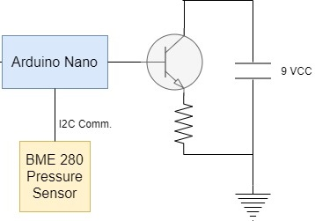
Automatic Rapid Deflation Device (ARDD)
Return to TOC
The AARD will activate if aliveness signal from Air Pi is lost, and pressure sensor detects an altitude difference of x feet
To test, a set up like the one seen to the right will be elevated and the activation of the resistance wire will be observed.

Slide 71
Balloon Neck Loading: (Tensile Test)
Return to TOC
Purpose: Demonstrate full size neck tensile strength calculations are valid, demonstrate neck will not break
Status: Planned for week of March 9-13
Expected Result: Neck will elastically deform and not break
Equipment: Ladder, 2000g balloon, tie off materials, ~5’ tether, 90lbs
Facility: Projects room
Procedure:
Tie top of balloon around top of ladder
Tie off balloon neck
Hang weight from loop
20 Hours

Slide 72
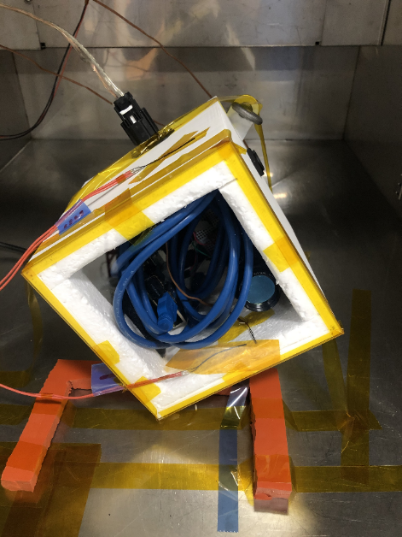
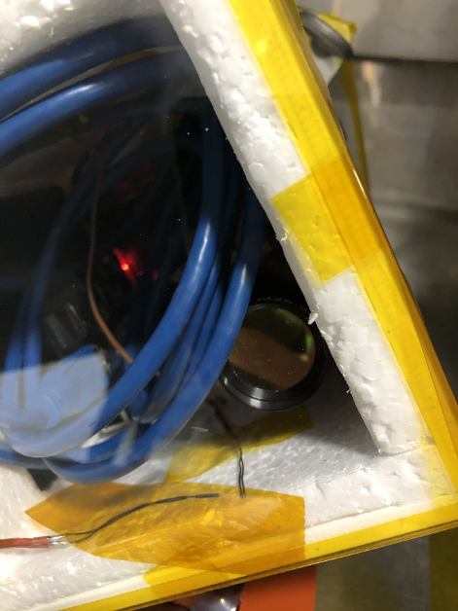
Thermal Condensation Test Set-Up

