Slide 1
WIRMS
Weather-Balloon Infrared Readings of Moisture in Soil
Final Oral Review
Sponsor: ASTRA, LLC
Nick Bearns, Emanuele Costantino, Marisa Exnicious,
Jason Li, Brad Lutz, Riley Perez, Lewis Redner, Silvio Rossi, Sevi Senavinin, Sam Shaver, Eric Vanderwolf, Alexis Wall

Slide 2
Overview
Project Overview
Design Description
Test Overview & Results
Systems Engineering
Project Management
Backup Slides
1
Motivation and Objectives

Slide 3
Project Motivation
Problem
Over-watering causes negative environmental impact
Under-watering inhibits crop growth and health
Existing Solutions
Satellite based systems
In-ground measurement
UAS Drones

Slide 4
Project Mission Statement
WIRMS will build a non-intrusive solution to provide IR data that can be used to monitor soil moisture content over a 300 square foot area for one day with 80% up-time.
Solution: Tethered weather balloon system to provide an elevated imaging platform for a NIR camera
Notes:
This will be accomplished by:
Using a tethered balloon to provide an elevated imaging platform for an IR Camera
Capturing images and environmental data that will be downlinked to a ground station for storage
Say what non-intrusive means.
Mention we aren’t making a SM model but delivering data to ASTRA that they can make SM algo with
Upacalable

Slide 5
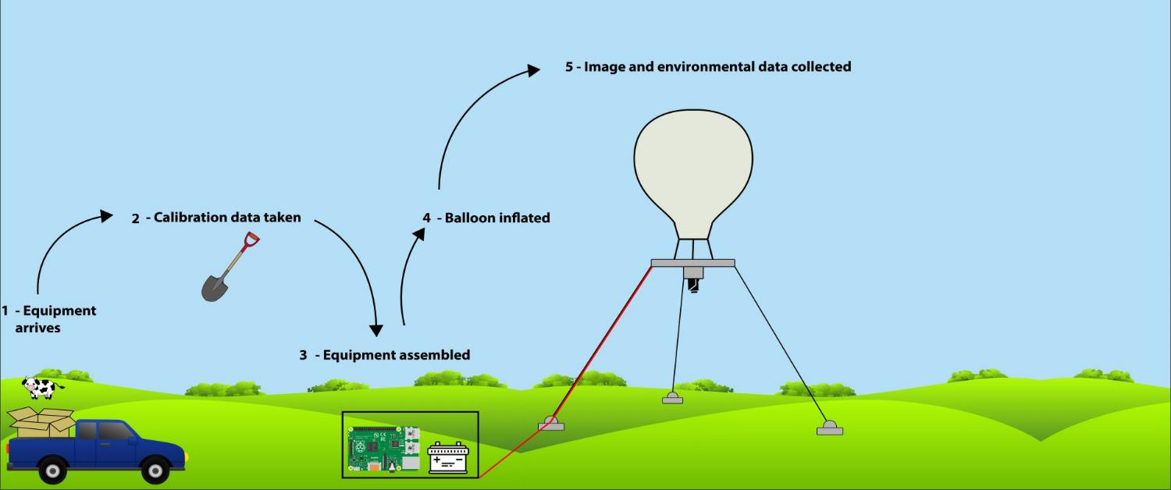
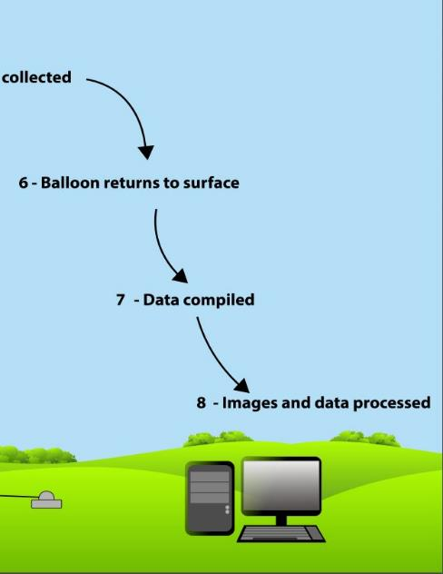
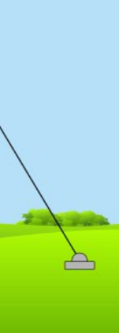
CONOPS
Notes:
MENTION SOLAR PANEL

Slide 6
Levels of Success
 | Level 1 | Level 2 | Level 3
Software | Autonomous imaging/recording environmental data | Data is stored in a consistent/cohesive scientific format (e.g. hdf5) | Software does not require human intervention during operation
Imaging | 7” x 7” per pixel resolution | Minimum of 300 sq ft image area | Images aligned in post processing
Flight Vehicle | 1 hour flight time | 1 day flight time | 1 week flight time (by analysis)
Ground Structure | Setup takes under 24 man hours. No component over 55 lbs | Structure is weather resistant | Structure is resistant to inclement weather
Electronics | System has 1 hour of reserve power | System has 1 day of reserve power | System has 1 week of reserve power by analysis

Slide 7
Levels of Success
 | Level 1 | Level 2 | Level 3
Software | Autonomous imaging/recording environmental data | Data is stored in a consistent/cohesive scientific format (e.g. hdf5) | Software does not require human intervention during operation
Imaging | 7” x 7” per pixel resolution | Minimum of 300 sq ft image area | Images aligned in post processing
Flight Vehicle | 1 hour flight time | 1 day flight time | 1 week flight time (by analysis)
Ground Structure | Setup takes under 24 man hours. No component over 55 lbs | Structure is weather resistant | Structure is resistant to inclement weather
Electronics | System has 1 hour of reserve power | System has 1 day of reserve power | System has 1 week of reserve power by analysis

Slide 8
Design Description
Project Overview
Design Description
Test Overview & Results
Systems Engineering
Project Management
Backup Slides
2

Slide 9
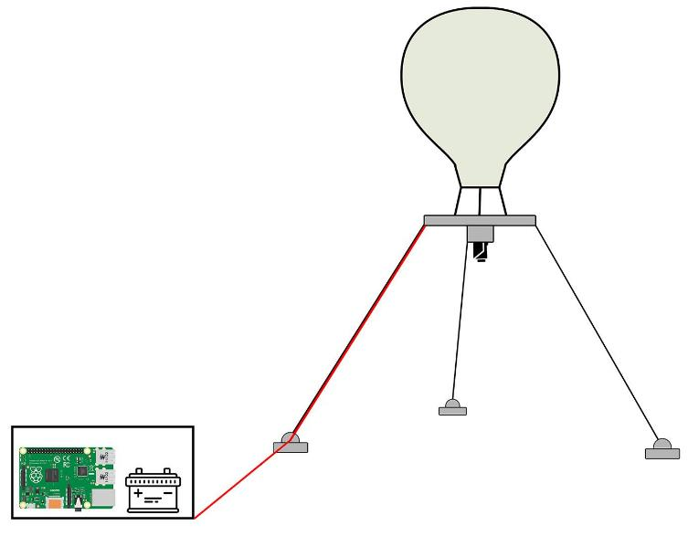
Weather Balloon

Slide 10
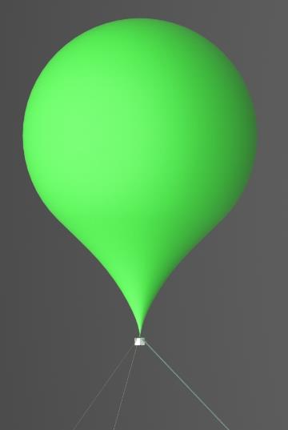
Weather Balloon
18’
Kaymont HAB 2000 latex weather balloon
Helium chosen as lifting gas
Balloon mass: 2000g
12’
Notes:
Include dimensions, mass,

Slide 11
Airborne Structures

Slide 12
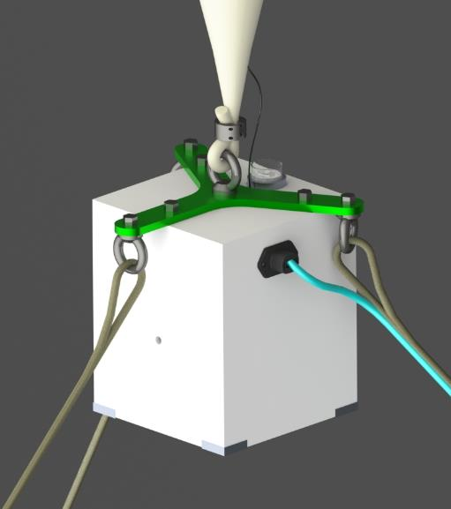
Airborne Structures - Balloon Interface
⅛” shaft collar
M8 eyebolt
Aluminum structure
Interface is bolted to the instrument suite
Interface mass: 223 g
7”
5.8”
5.8”

Slide 13
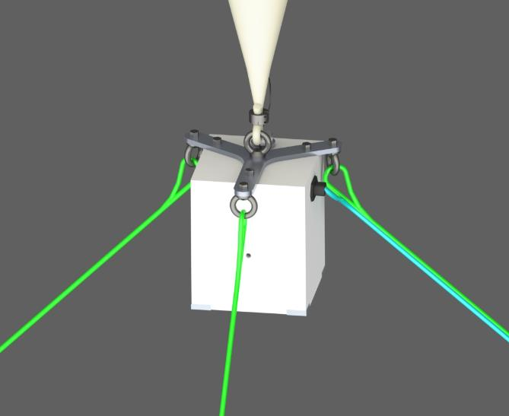
Airborne Structures - Tethers
7/64” braided Kevlar tether with polyurethane coating
2.6 kN kevlar UTS
Wrap through M8 eyebolts, tied in Palomar knot
Power and Ethernet lines run up one tether
Total mass: 6487g
7”

Slide 14
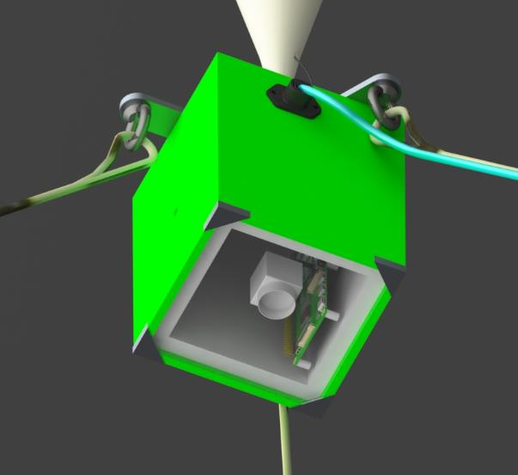
Airborne Structures - Instrument Suite
3D printed PLA plastic
Connection point for tethers and balloon
Houses all electronics
Lower surface is 1/16” clear polycarbonate
Total mass: 569g
7”

Slide 15
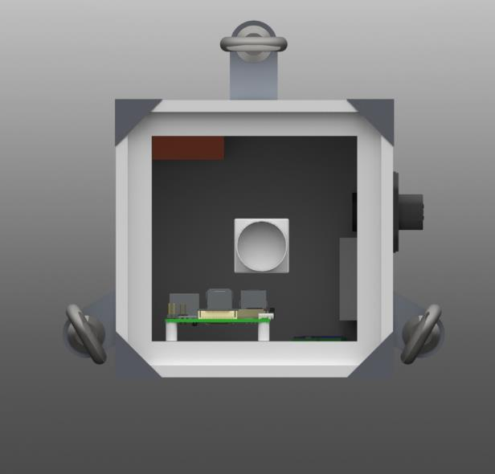
Airborne Structures - Instrument Suite
Instrument suite houses camera, Raspberry Pi, sensors, power distribution
Automatic Rapid Deflation Device (FAA)
Total electronics mass: 208g
Total electronics power draw: ~7W
Heater removed since TRR
4.3”

Slide 16
Mooring Stations

Slide 17
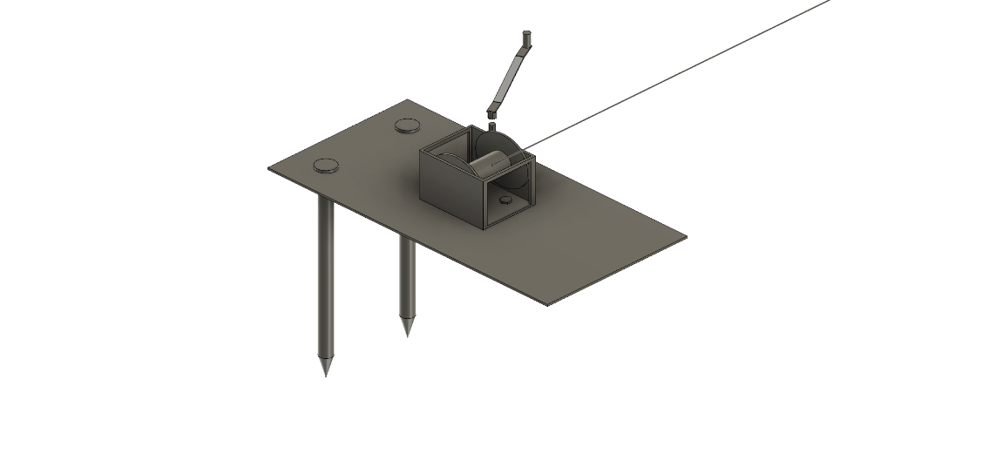
Mooring Stations
2 sandbags (50lb each)
3/16” thick aluminum plate
5/8” diameter carbon steel stakes
~7 minute retraction time
12”
24”
Notes:
Hey there move this to backups

Slide 18
Ground Station

Slide 19
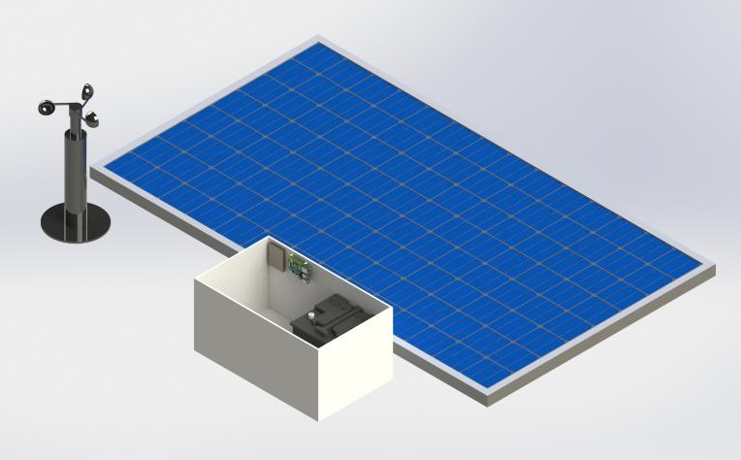
Ground Station
Solar panels
Water-resistant box
Deep cycle battery
Raspberry Pi
Hard drive
Anemometer
Power distribution elements
49.5 in
20 in
25.7 in
12 in
Notes:
Say that this doesn’t show ethernet/power or stakes/tethers
MASS BUDGET

Slide 20
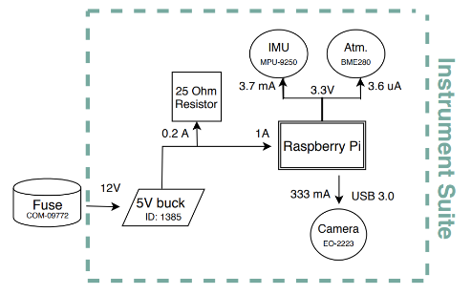
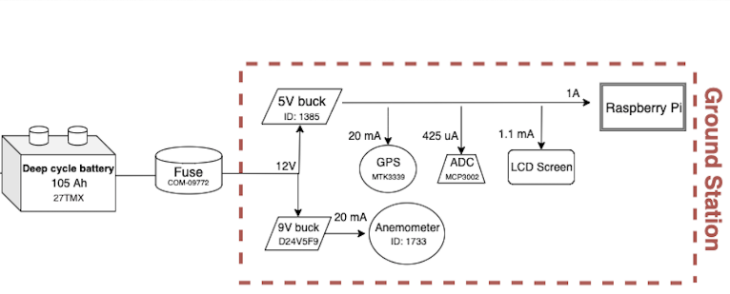
Power Distribution
Deep cycle battery with 105 Ah
Fuse to protect against current spikes
Instrument Suite
5V buck to Raspberry Pi
IMU, Atmospheric sensor, and camera powered from Raspberry Pi
Ground Station
9V buck to anemometer
5V buck to ADC, GPS, LCD screen, and Raspberry Pi
Notes:
Bring back the design requirement to this slide (why we chose each component)
DR3.1 specifies 115 Ah
Marisa fix it later

Slide 21
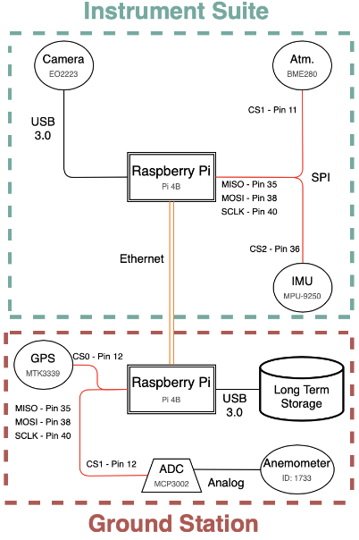
Electronics Layout & Data Transfer
Ethernet link provides high data rate between the two Pi’s (~41.7 MHz)
Pi capable of I2C or SPI communication
SPI - 3 chip select pins
Anemometer is low impedance so no signal conditioning needed
Notes:
2 Pi’s LAN 3 MB, SPI & I2C, all sensors shown in red wiring are SPI, corresponding Pin numbers are shown
Sensors are DIGITIZED so ADCs aren’t needed for the
Is this gucci?

Slide 22
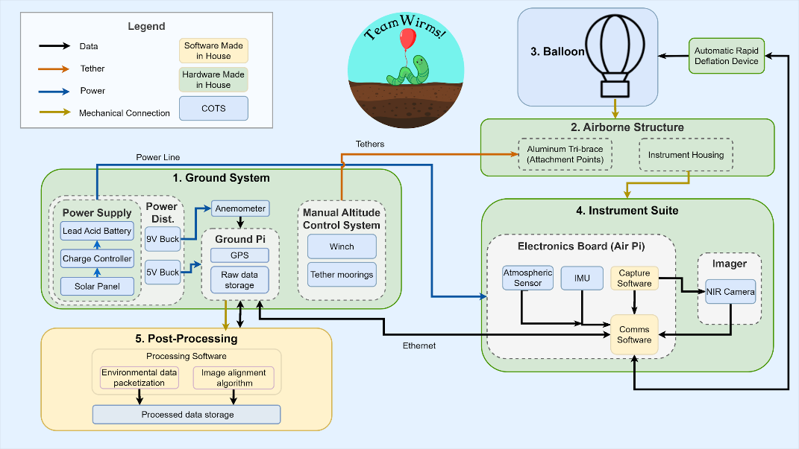
Functional Block Diagram
Notes:
**Get rid of flight GPS
Change ‘PCB’ to power distribution
Move GPS to Eboard
Add anemometer on ground
Add power supply to ground
ARDD: nano has pressure sensor, pi has aliveness sig, if both cut, deflate balogne
Ground PCB - fuse, ADC, 9V buck
ARDD PCB - pressure sensor, MOSFET
FBD - 52 sec rn

Slide 23
Critical Project Elements
Flight Vehicle
Structure
Electronics
Software
Balloon Volume
Airborne Structure
Hardware
Data Transfer
Ground Structure
Power Distribution
Image Alignment
Stresses
Legend
Critical Element
Non-Critical Element
Notes:
Spend more time on these when presenting
Highlight the important testing elements
NOT CONSISTENT HIGHLIGHTING BETWEEN THIS SLIDE AND THE LAST

Slide 24
Test Overview and Results
Project Overview
Design Description
Test Overview & Results
Systems Engineering
Project Management
Backup Slides
3

Slide 25
Test Summary
Test | Component Level Tested | System Level Tested
Thermodynamics | ✔ | ✘
Pointing | ✘ | ✘
Diffusion | ✔ | ✘
Power | ✔ | ✘
Camera | ✔ | ✘
Software | ✔ | ✘
Mooring Station | ✔ | ✘
Day in the Life | N/A | ✘

Slide 26
Test Summary
Test | Component Level Tested | System Level Tested
Thermodynamics | ✔ | ✘
Pointing | ✘ | ✘
Diffusion | ✔ | ✘
Power | ✔ | ✘
Camera | ✔ | ✘
Software | ✔ | ✘
Mooring Station | ✔ | ✘
Day in the Life | N/A | ✘

Slide 27
Condensation Test Overview
DR 4.2 - The imaging system shall produce images of the ground with dimensions of 300 square feet.
DR 4.3.1 - The camera shall operate within temperatures from 10 to 70 degrees Fahrenheit.
Objective: Verify no condensation on imaging surfaces under worst case operational conditions.
Procedure:
Connect power to instrument suite
Install thermocouples and instrument suite into thermal chamber
Set thermal chamber temperature (-12C or 21C)
Inspect imaging surface for condensation every 10 minutes
Stop test if condensation has occurred

Slide 28
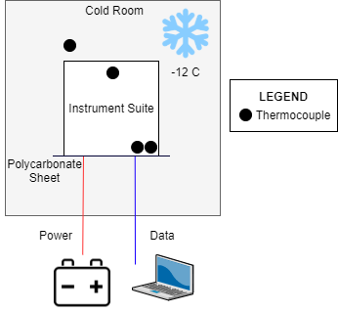
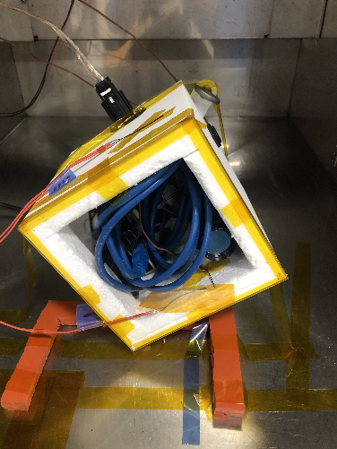
Condensation Test Setup
Notes:
Update diagram: thermocouple on outside

Slide 29
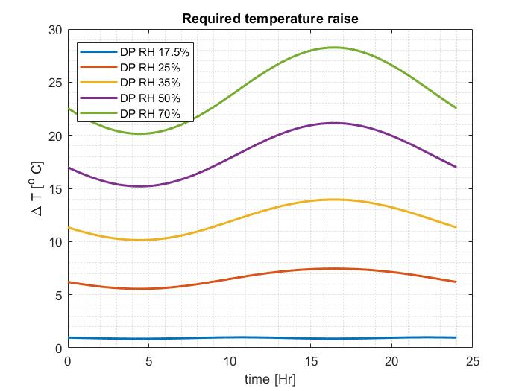
Bögel Condensation Model
Summary: At a relative humidity of 50%, the minimum temperature difference required to prevent condensation is 20°C
Notes:
https://weather-and-climate.com/average-monthly-Humidity-perc,fort-morgan-colorado-us,United-States-of-America
Dont say rural because i hate myself

Slide 30
Condensation Test Results
Non-Humid Cold Test
Ambient temp: -12 C, ambient humidity: 10% →outside polycarb temp: -7.4 C
ΔT = 4.6 C
Temp diff required (Bögel): ≥ 1 C → No condensation expected, no condensation observed
Humid Cold Test
Ambient temp: -12 C, ambient humidity: 50% →outside polycarb temp: -9.5 C
ΔT = 2.5 C
Temp diff required (Bögel): ≥ 20 C → Condensation expected, but not observed
Humid Warm Test
Ambient temp: 21 C, ambient humidity: 30% - 80% (fluctuated) →outside polycarb temp: 22.8 C
ΔT = 1.8 C
Temp diff required (Bögel): ≥ ~20 C → Condensation expected, but not observed
Notes:
Add a slide talking about the assumptions of the Bogel model, google uncertainty of humidity sensors, ploycarb condensation relationship (Mention why we think this model was incorrect

Slide 31
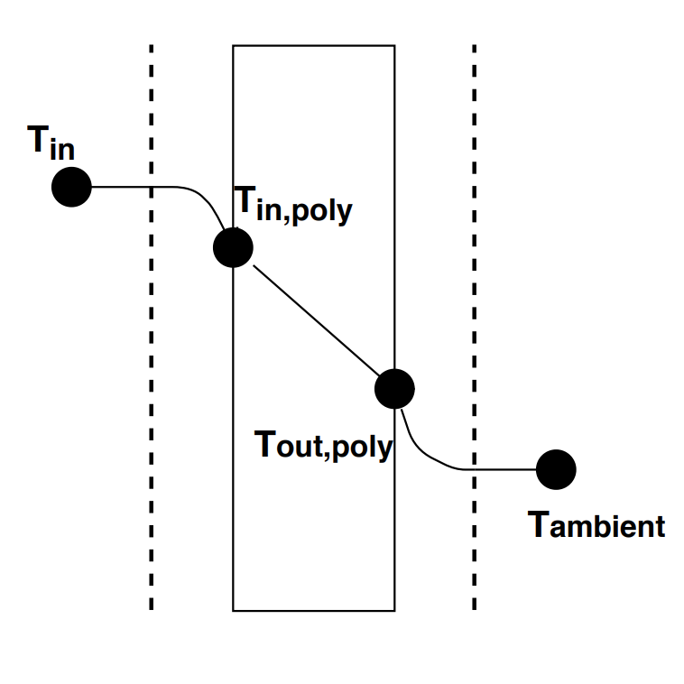
Thermodynamics Model
To prevent condensation at 50% humidity, a temperature difference of 20 C is required between the outside polycarbonate face and ambient air
Assumptions:
Steady state ambient and internal temperatures
Linear temperature gradient through polycarb
1D thermodynamics model with 4 nodes
Convection on inside & outside of box, conduction through polycarbonate
Results using experimental data:
Non-Humid Cold Test
Humid Cold Test
Humid Warm Test
Outside of box
Inside of box
→ Expected T_{out,poly} = -7.1 C, ΔT = 2.9 C
→ Expected T_{out,poly} = -9.6 C, ΔT = 2.4 C
→ Expected T_{out,poly} = 22.8 C, ΔT = 1.8 C
Notes:
Label inside the box and ambient
Assumptions: add Convection/Conduction through polycarb, 1D model, boundary layer and 20 from Bogel model

Slide 32
Condensation Model and Results Reconciliation
Bögel model is not an accurate predictor of condensation within the instrument suite
This is likely due to the use case of the Bögel model - it simply predicts the dew point for water in the atmosphere and doesn’t look into material properties
Material properties include surface area, wettability, tension, and porosity
Moving forward with experimental results
No condensation is expected to occur during flight ✓
DR 4.2 and DR 4.3.1 met ✓
Notes:
New Equations for Computing Vapor Pressure and Enhancement Factor - Arden Buck
Wettability versus roughness of engineering surfaces - K.J. Kubiak

Slide 33
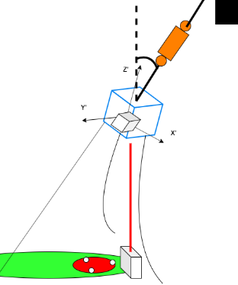
Camera Pointing Test Overview
DR 4.2 - The imaging system shall produce images of the ground with dimensions of 300 square feet.
z
Objective: Ensure that under a worst case force vector, instrument suite would experience same angular displacement as full scale model
Procedure:
Set up small scale tri-tethered balloon system without balloon
Lift modeled using known weight and pulley system suspended from high bay ceiling
Place mooring stations to prescribe desired angle
Measure displacement angle between z and z’ and image the ground to ensure model is accurate and area can be imaged
Notes:
Procedure
set a up a small scale of overall system. This includes the ground stations (without the steaks), instruments suite, tethers, and power lines.
Emulate lift with a pulley system installed in the aerospace high bay
Apply a lateral force with that creates a similar force vector from our large scale model
Measure turn angle and verify imaging area below is imaged

Slide 34
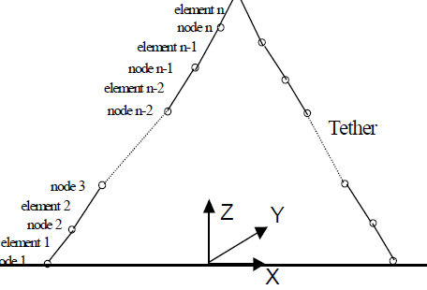
Camera Pointing Model
A model of the tri-tethered balloon system was made using a discrete element method. Using this model, the team could predict where and what the camera is imaging.
Key Equation:
Key Assumptions:
Instrument suite and balloon occupy the same space
Tethers provide no damping
No drag on tethers
Cross sectional area of tethers are constant
Conclusions:
The model showed that the camera would image area of interest under maximum wind load
Instrument Suite & Balloon
Instrument Suite
Nahon, 1999
Notes:
Say “replicated” not “copied” from Nahon
Looked into damping, could follow up for final report

Slide 35
Camera Pointing Test Results
Expected Results:
Direct angular measurements, IMU turning angle, and camera visual information would suggest max turning angle is not reached
Complications:
Potential issues with scaling of error terms from IMU and angular measurements from protractor
Model Validation:
This would have shown us what the camera pointing model was capable of accurately predicting the cameras pointing under external loads on the balloon
Camera will image same 300 sqft.
DR 4.2 met ✔
Notes:
Be more specific on type of data in expected results

Slide 36
Final Day-in-the-Life Test Overview
FR1-FR11
Objective: Demonstrate “day in the life” functionality, supplying required data to customer from instrument suite and ground measurements
Procedure:
Transport to CU South Boulder
Review emergency procedures
Place ground structures
Inflate balloon
SMC data samples
Monitor flight
Retract and deflate

Slide 37
Final Day-in-the-Life Expected Results
Expected Results:
Condensation does not occur (inspection of images)
Camera views entire minimally required area (300 sqft.)
All components powered to function properly
Balloon provides lift to remain at operational altitude
All components retain structural integrity
Possible complications:
Full scale inflation
Balloon dynamics
Successful flight
All functionals met ✔
Notes:
Know where the weaknesses of the power model in case we get Bobby
Component level test
Possible complications: altitude - fixed by cropping out unnecessary images, camera damage, mention waiver

Slide 38
Systems Engineering
Project Overview
Design Description
Test Overview & Results
Systems Engineering
Project Management
Backup Slides
4

Slide 39
Systems Engineering Process - Overview
Feasibility Study & Concept Exploration
Operations & Maintenance
Project Def. & CONOPS
System Validation
Requirements & Sys. Architecture
System Verification
Project Definition
Integration & Test
Detailed Design
Subsystem Verification
Hardware/Software Development & Assembly

Slide 40
Systems Engineering Process - Project Definition
Feasibility Study & Concept Exploration
Operations & Maintenance
Project Def. & CONOPS
System Validation
Requirements & Sys. Architecture
System Verification
Project Definition
Integration & Test
Detailed Design
Subsystem Verification
Hardware/Software Development & Assembly

Slide 41
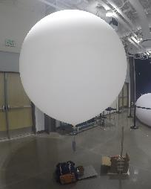
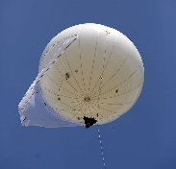
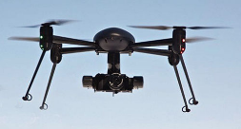
Key Trade - Flight Vehicle
Description:
The system used to carry the payload at altitude for a 24 hour duration
Key Factors:
Cost, Complexity, Autonomy
Result:
Tri-Tethered Weather Balloon allows for simple and fairly inexpensive autonomous system
Traded
Aerostat Balloon
Multirotor UAV
Weather Balloon
Notes:
Aerostat image: https://www.rc-zeppelin.com/aerostat-surveillance.html
UAV image: http://www.thedronesmag.com/responsible-flying-with-multirotors/

Slide 42
Systems Engineering Process - Requirements
Feasibility Study & Concept Exploration
Operations & Maintenance
Project Def. & CONOPS
System Validation
Requirements & Sys. Architecture
System Verification
Project Definition
Integration & Test
Detailed Design
Subsystem Verification
Hardware/Software Development & Assembly

Slide 43
Systems Engineering - Requirements Flow-Down
Level 0
Statement of Mission Objectives
WIRMS shall collect IR data.
Level 1
System Functional Requirements
FR7: Data shall be stored by the ground station and post-processed.
Level 2
Parent Design Requirements (Subsystem FRs)
DR7.3: Images shall be post-processed.
Level 3
Child Design Requirements
DR7.3.1: Images shall be aligned in post-processing.

Slide 44
Systems Engineering Process - Detailed Design
Feasibility Study & Concept Exploration
Operations & Maintenance
Project Def. & CONOPS
System Validation
Requirements & Sys. Architecture
System Verification
Project Definition
Integration & Test
Detailed Design
Subsystem Verification
Hardware/Software Development & Assembly

Slide 45
Project Risks and Associated Challenges
Risk | Mitigation Method
Budget does not allow for adequate testing | Avoid using lifting gas in testing when possible Conduct scale tests when possible
Tether and instrument suite mass is too large for balloon | Decrease balloon altitude to decrease mass of tethers
Unscheduled rapid deflation & camera damage | Written risk acceptance from customer Additional flight

Slide 46
Systems Engineering Process - Subsystem Verification
Feasibility Study & Concept Exploration
Operations & Maintenance
Project Def. & CONOPS
System Validation
Requirements & Sys. Architecture
System Verification
Project Definition
Integration & Test
Detailed Design
Subsystem Verification
Hardware/Software Development & Assembly

Slide 47
Systems Challenges and Lessons Learned
System Level Challenge | Lessons Learned
Keeping subsystem communication flowing while most subsystems are working independently | Small changes at a subsystem level can cause confusion It is worth the extra time to keep people on the same page
Keeping team members aware of their requirements | When developing requirements, make them as simple as possible Stay in the loop when late changes to the design occur

Slide 48
Project Management
Project Overview
Design Description
Test Overview & Results
Systems Engineering
Project Management
Backup Slides
5

Slide 49
Project Management
Semester | Approach | Result
Fall | Frequent full team meetings Few internal deadlines | Team bonding Limited document review
Spring | Fewer full team meetings Sub-team focus More internal deadlines Timesheets to communicate | Increased productivity Communication decreased
Notes:
Increased productivity- documents completed earlier for review

Slide 50
Project Management
Challenges | Lessons Learned
Managing team chemistry | Encouraging bonding while still completing tasks
Low productivity in full team meetings | Limit the amount of full team meetings Keep them brief and have a plan
Limited document review time | Internal deadlines Frequent Gantt chart updates Early PAB review
Notes:
Increased productivity- documents completed earlier for review

Slide 51
Budget Comparison
Notes:
Will talk to Eric about this fam
Loss of Margin was mostly due to shipping costs (~$250)
costs was also increased by the price of ABS 3D printed box(~$60)
Remaining costs was for small materials used for testing, for example plastic tubing for the humidity test

Slide 52
Industry Cost
Source | Rate | Cost
Fall hours - 2,666 | $31.25/hr | $83,313
Spring hours (up to 3/13) - 1,168 | $31.25/hr | $36,500
Overhead | 200% labor | $239,626
Materials | N/a | $4,450
Project Cost | N/a | $244,076

Slide 53
Thank You
Questions?
Sam eats dick

Slide 54
Back-Up Slides
Project Overview
Design Description
Test Overview & Results
Systems Engineering
Project Management
Backup Slides
6

Slide 55
Table of Contents
Balloon Diffusion
Balloon Inflation
Balloon Neck
Power
Structural Testing
Rapid Deflation: AARD
Soil Moisture Sensor
Software and Electronics Integration
Camera and Alignment
Instrument Suite Dynamics/Pointing
Budget

Slide 56
Balloon Diffusion Model
Test Purpose: Verify lift and volume model, show directly the effects of diffusion and temperature fluctuation.
Assumptions:
Cs 95% Helium propellant
C₀ Latex has 0% He
x Inflated membrane thickness of 0.553 mm
D 1.9e-9, 2.5e-9, 3.4e-9, 4.4e-9, 5.5e-9 m²/s (Amerongen, 1946)
Model time for 25% of He to diffuse through latex
10-13 hours at 17°C - 25°C
Solution to Fick’s 2nd Law of Diffusion
Notes:
We are finding time it takes for 25% of Helium to diffuse through latex.
We are using 25% because Positive Lift is 25% of Total Lift, meaning if we lose this 25% we would be neutrally buoyant

Slide 57
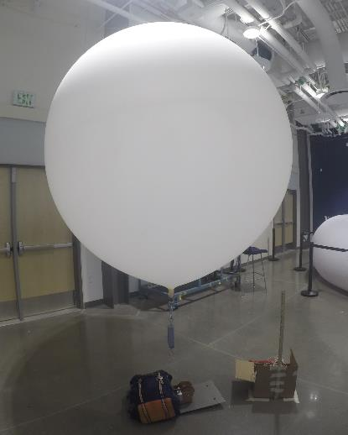
Balloon Diffusion Test Overview
Objective:
Validate diffusion model at scale. Demonstrate the ability of the balloon to withstand long durations and temperature fluctuations
Requirements:
FR2 - The flight vehicle shall be capable of operating in the air for 1 day
DR 1.3 - The flight vehicle shall maintain an altitude between 100-150 feet for a day long flight
Procedure
Inflation balloon to desired force.
Record scale reading, skin temperature, take photo every 30 mins.
Record data for 20 hours.
Validate diffusion data with model.
Validate volume data with model.

Slide 58
Balloon Diffusion Test Results
Model time for 25% of He to diffuse through latex
10-13 hours at 17°C - 25°C
Experimental time for 25% of He to diffuse through latex
20 hours at 9°C - 22°C
Test Status: Test complete ✔, volume validation incomplete ✘.
Model Validation: Run images through volume calculator, plot volume, lift, and temperature as a function of time. Compare to analytical model.
Expected Result: Negligible diffusion rate, minimal change in volume.
FR2 - The flight vehicle shall be capable of operating in the air for 1 day ✔
DR 1.3 - The flight vehicle shall maintain an altitude between 100-150 feet for a day long flight ✔

Slide 59
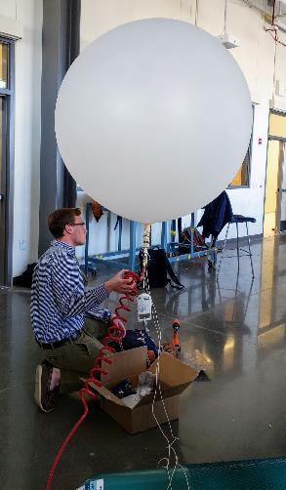
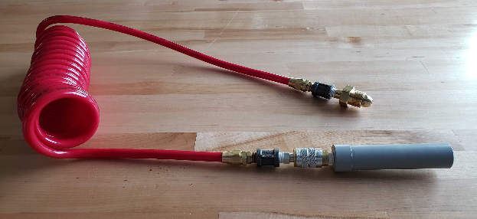
Balloon Inflation Test Overview & Results
Objective: Create a safe and reliable inflation procedure.
Procedure:
1. Attach all fittings to inflation line 2. Secure mooring lines 3. Secure tethers 4. Inflate balloon, switch tanks 5. Tie-off balloon
Results: Successful, but more practice needed.

Slide 60
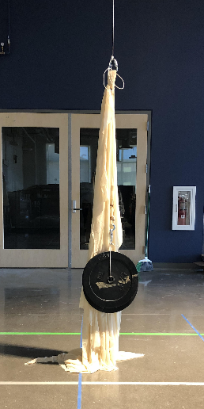
Balloon Neck Testing Overview & Results
Objective: Test strength of neck to compare to estimate calculations.
Procedure:
Tie off balloon neck
Hang from high bay with tether and carabiner
Gradually load neck with weight up to 90 lbs, 24 hours
Results:
Due to allowable neck slippage, significant creep was observed. The neck was securely stopped due to the several rubber band tie-off points. This load was higher in magnitude and duration than expected.
FR2 - The flight vehicle shall be capable of operating in the air for 1 day ✔
DR 1.3 - The flight vehicle shall maintain an altitude between 100-150 feet for a day long flight ✔

Slide 61
Balloon Neck Testing: Structural Analysis
Component | Mass [kg]
Airborne structure | 2.41
Balloon | 2
Tethers, total | 0.75
Data cable | 0.64
Power cable | 4.28
m_{Airborne} | 11.1
m_{Airborne} includes a +10% mass margin.
m_{Airborne} does not include gas mass.

Slide 62
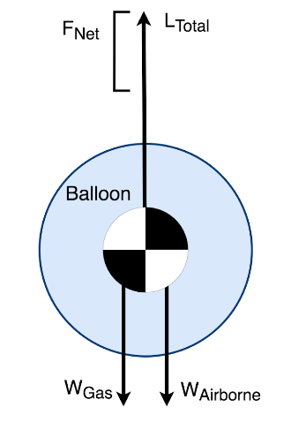
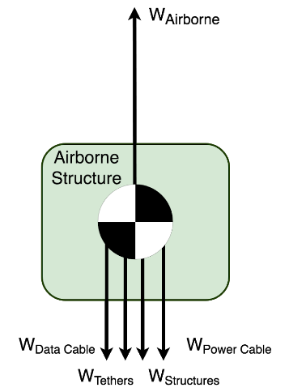
Balloon Neck Testing: Structural Analysis
Balloon Specifications m_{Airborne} = 11.1 kg m_{Gas} = 4 kg V_{Required} = 22.5 m³ L_{Total} = 220 N F_{Net} (W_{Positive Lift}) = 72 N
Notes:
d_{Calculated} = 3.68 m, d_{Burst} = 10.6 m
Positive Lift is 266% of Airborne Mass, because the balloon needs to be stable with a worst case of 20 mph downforce due to wind. This also has a 10% margin added to the positive lift.

Slide 63
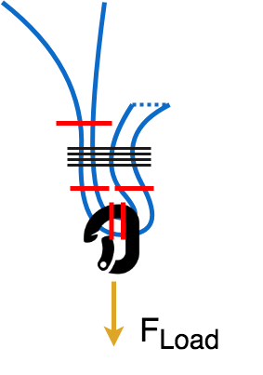
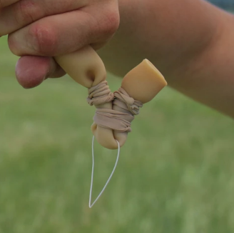
Balloon Neck Testing: Structural Analysis
Tie-Off Method
Lightweight, simple design
1 point of leakage
Failure modes:
Fracture of neck
Shear at load point
Slippage of neck from neck wrap

Slide 64
Balloon Neck Testing: Structural Analysis
Fracture of neck, assumptions:
Constant volume, strain rate
Latex tensile strength from McMaster
Shear at load point, assumptions:
von Mises yield criterion
Slippage of neck, assumptions:
Shear based on screw on shaft collar
FOS = 8 & 25, Neck will not fracture ✔️
FOS = 6 & 18, Neck will not shear ✔️
FOS = 5 & 17, Neck will not slip ✔️

Slide 65
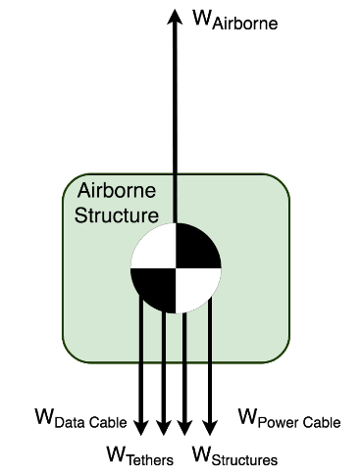
Balloon Neck Testing: Structural Analysis
Balloon Specifications m_{Airborne} = 11.1 kg V_{Required} = 22.5 m³ L_{Total} = V_{Balloon} * ρ_{Ambient} * g = 220 N F_{Net} = L_{Actual} - W_{Airborne} - W_{Gas} F_{Net} (W_{Positive Lift}) = 72 N
Notes:
d_{Calculated} = 3.68 m worst, d=3.5 nominal, d_{Burst} = 10.6 m

Slide 66
Balloon Neck Testing: Structural Analysis
ρSpecific lifting capacity, Helium = 1.0 kg/m³
V_{Balloon} = 22.5 m³
m_{Gas} = ρ_{Helium} * V_{Balloon} = 4.0 kg
m_{final} = m_{Airborne} + m_{Gas} = 15.1 kg

Slide 67
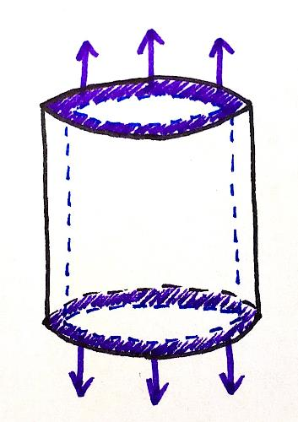
Balloon Neck Testing: Structural Analysis
Failure mode 1: Fracture of neck
σ_{Tensile} = 20.68 MPa
t_{neck, min} = 0.553 mm
A_{neck, axial} = 79.33 mm²
F_{fail} = σ_{Tensile} * A_{neck, axial}
F_{fail} = 1815 N
F_{net} = 92 N
F_{inflation} = 220 N
FOS= 8 & 25, Neck will not fracture ✔️
Notes:
Include calculation when stretching is taken into account

Slide 68
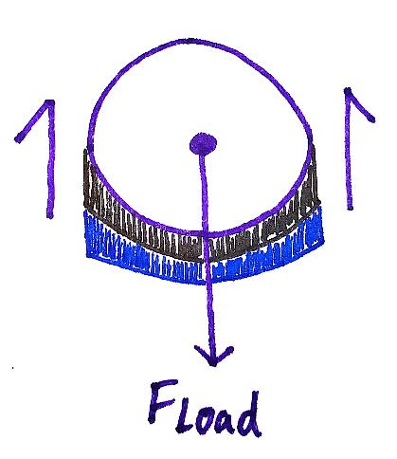
Balloon Neck Testing: Structural Analysis
Failure mode 2: Shear at load point
F_{net} = 92 N
t_{neck} = 0.553 mm
d_{s} = 5 cm
A_{Shear}= 2 * 2* t_{neck} * d_{s} = 111 mm²
τ_{avg} = F_{net} / A_{Shear}
τ_{avg} = 0.65 MPa
τ_{inflation} = 1.99 MPa
τ_{fail} = 12 MPa
FOS= 6 & 18, Neck will not shear ✔️

Slide 69
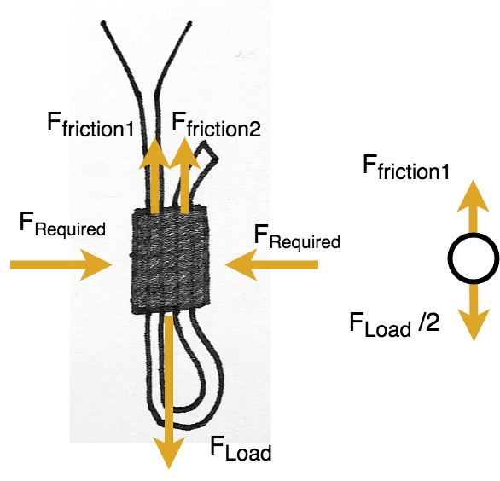
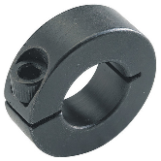
Balloon Neck Testing: Structural Analysis
Failure mode 3: Slippage of neck from neck wrap
μ_{rubber to rubber} = 1.16, μ_{rubber to metal} = 0.64
F_{friction} = μ*F_{required}
Frequired, rubber on rubber slip = F_{Load} / (2*μ_{r2r}) = 95 N
F_{required, rubber on metal slip} = F_{Load} / (2*μ_{r2m}) = 172 N
F_{required, min} = 56 N, 172 N
F_{shear, screw} = 1 kN
FOS= 5 & 17, Neck will not slip ✔️

Slide 70
Power Sub-system Testing Completion
Test | Completion
Battery Characterization/Discharge Test | ✔
Solar Charging Test | ✔
Instrument Suite Full Power Test | ✔
Ground Station Full Power Test | ✘
Full-Scale Power Test (Battery + Solar Panels + All Components) | ✘

Slide 71
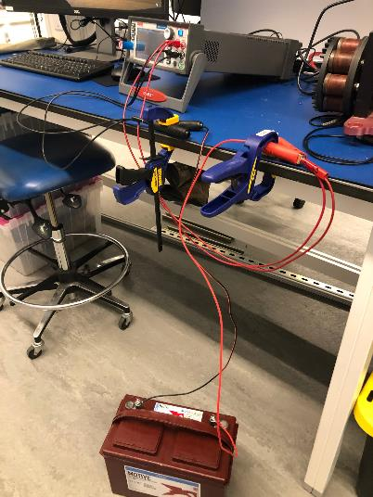
Battery Discharge Test Overview
FR 3 -The system shall be provided enough power to sustain a 1 day flight.
Objective: Obtain a discharge curve for the selected 12V deep cycle battery.
Procedure:
Connect battery to Keithley SourceMeter 2460
Configure SourceMeter to draw 3A at 12V
Allow SourceMeter to run until 20 hours have elapsed or battery has discharged fully

Slide 72
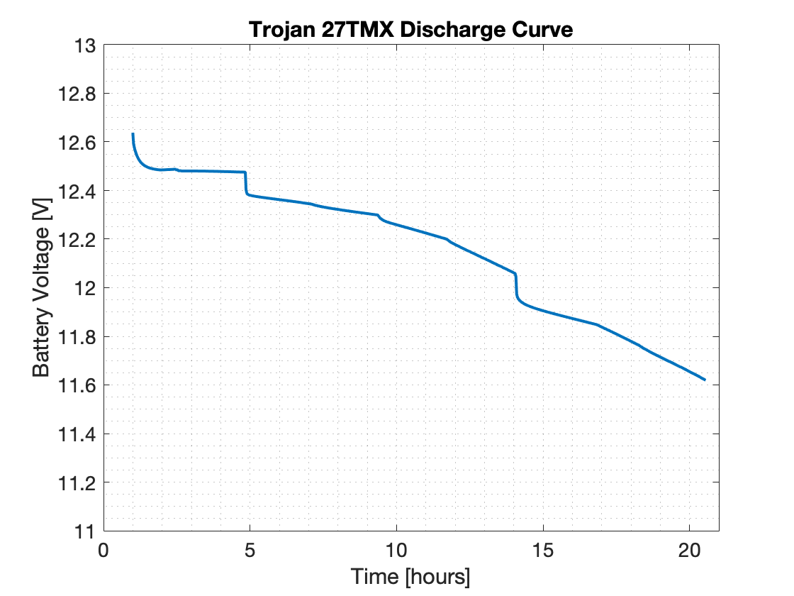
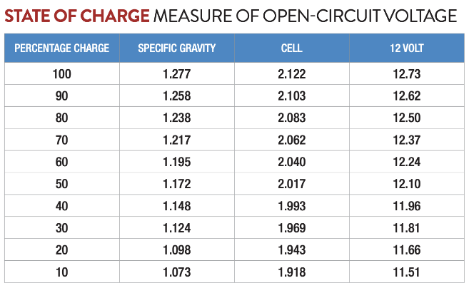
Battery Discharge Test Results
Battery capable of providing sufficient power for 20 hour flight ✓

Slide 73
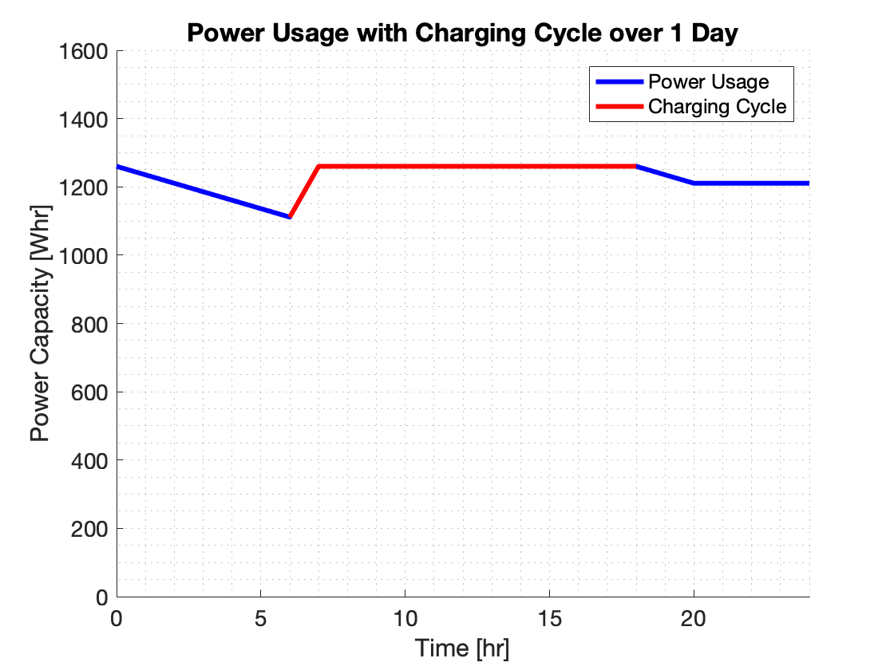
Power Model
105Ah deep cycle battery, 300W solar panel
Total current draw: 2.83 A, total power draw: 15.1 W
Assumptions
Linear battery discharge
Battery maintains capacity for duration of flight
Battery provides capacity as specified on datasheet
All components draw power as specified on datasheets
System has exactly 20 hrs of uptime and 4 hrs of downtime
System draws no power for 4 hrs of downtime
Insolation follows that predicted by NREL Bird Model
Conclusions
Model predicts that the power system will be capable of providing sufficient power for the duration of the flight.

Slide 74
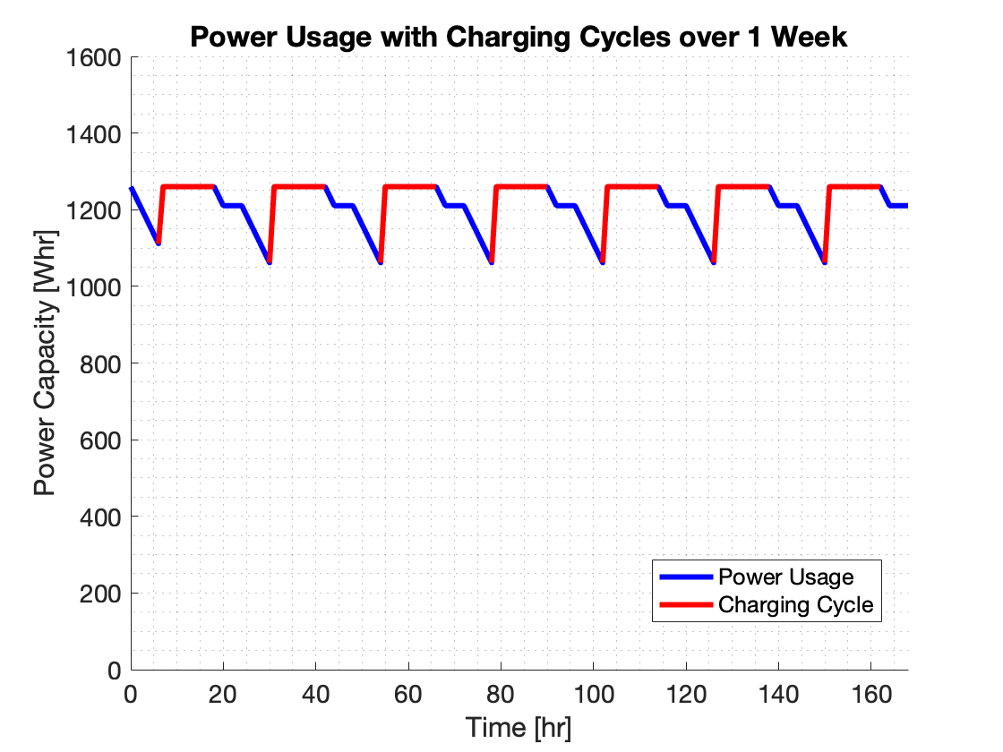
Power Model - 1 Week Extrapolation

Slide 75
Power Systems - Wire Gauge Selection
15 gauge → max current 4.7 A
16 gauge → max current 3.7 A
17 gauge → max current 2.9 A
18 gauge → max current 2.3 A
Expected operational current draw: 2.8 A
With 50% margin → Maximum current draw 3.6 A
Notes:
17 gauge is harder to find in annealed copper
Can find it in aluminum, but has higher resistance → higher power loss
Not gonna run the numbers though

Slide 76
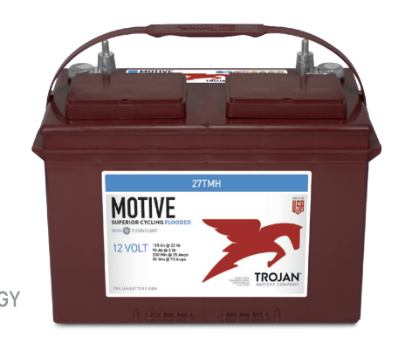
Power Systems - Deep Cycle Battery Selection
Trojan 27TMX
Deep-Cycle Flooded/Wet Lead-Acid Battery
12V w/ 20 hr capacity of 105 Ah
Available w/ automotive post terminals
Battery capacity can be estimated using battery characterization meter

Slide 77
Power Systems - Component Optimal Operating Conditions
Component | Current | Voltage | Power Draw
Raspberry Pi | 1 A | 5 V | 5 W
EO-2223 Camera | 300 mA | 3.3 V | 990 mW
IMU | 3.7 mA | 3.3 V | 12.2 mW
Anemometer | 20 mA | 9 V | 0.18 W
GPS | 20 mA | 5 V | 0.1 W
Atm. Sensor | 3.6 uA | 3.3 V | 11.88 uW
ADC | 426 uA | 5 V | 2.1 mW
5V Buck | 1.5 mA | 5 V | 7.5 mW
9V Buck | 200 mA | 12 V | 2.4 mW

Slide 78
Power Systems - Component Maximum Operating Conditions
Component | Current | Voltage | Power Draw
Raspberry Pi | 1 A | 6 V | 6 W
EO-2223 Camera | 300 mA | 3.6 V | 1.08 W
IMU | Unknown | 4 V | Unknown
Anemometer | Unknown | 24 V | Unknown
GPS | 20 mA | 5 V | 0.1 W
Atm. Sensor | 3.6 uA | 3.6 V | 12.96 uW
ADC | 650 uA | 7 V | 4.55 mW
5V Buck | 1.5 mA | 26 V | 39 mW
9V Buck | 200 mA | 35 V | 7 W

Slide 79
Structural Test Overview
Objective: Ensure that all structural components can withstand expected worst case loading scenario predicted.
Requirements:
Airborne Structures:
DR 1.3 - The flight vehicle shall maintain an altitude between 100 - 150 feet for flight duration.
DR 1.4.1- The tethering structural elements shall each have their own factor of safety of 3 against failure under inclement conditions.
Ground Structures:
DR 1.4 - The flight vehicle shall be secured to the ground structure.
DR 1.4.1- The tethering structural elements shall each have their own factor of safety of 3 against failure under inclement conditions.
Procedure:
Setup the mooring stations
Tie off tethers to tri-brace
Apply 90 lbs load to the tri-brace through pulley.

Slide 80
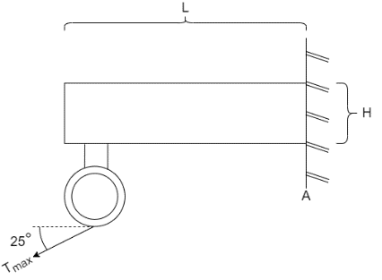
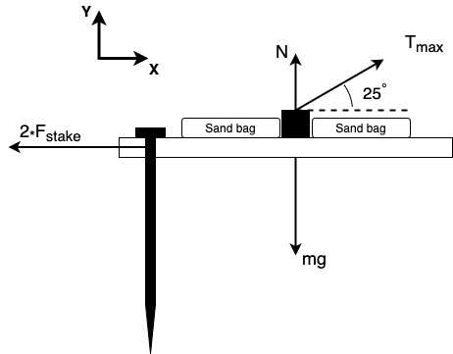
Structural Test Model
Assumptions:
Stakes are fixed in the ground for calculations
Von mises theory (Pure Shear)
Linear elastic material
Validation: Tests will validate structural calculations which claimed structural elements would not fail.
T_{max} = 90 lbs
mg = 110 lbs

Slide 81
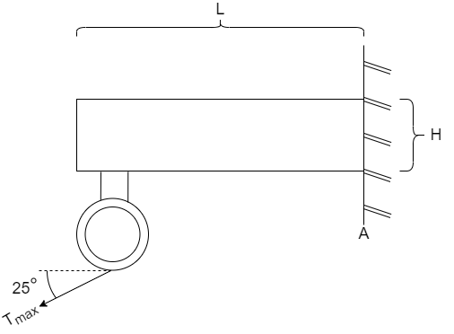
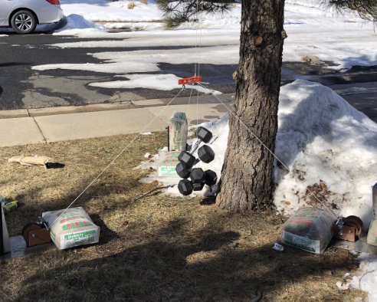
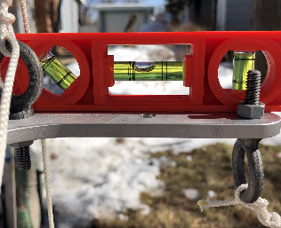
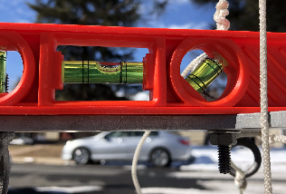
Airborne Structure Test Results
T_{max} = 90 lbs
Test Results successful
(DR 1.3 and DR 1.4.1)✔️

Slide 82
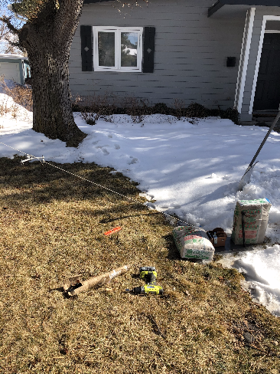
Mooring Stations Test Results
Test Results successful
(DR 1.4 and DR 1.4.1)✔️

Slide 83
Ground Structures
Given:
V_{wind} = 40 mph T_{fail} = 2624 [N]
T_{max} = 403 [N] mg = 469[N]
F_{fail, winch} = 6672 [N]
Calculations:
N = 299 [N] F_{stake} = 183 [N]
Winch SF = 16.5 Tether SF = 6.5
DR 1.4: Ground structure secures the flight vehicle ✔️
DR 1.4.1: Tethers will not fail under inclement conditions ✔️
Notes:
at what wind speed would the tethers break? -> ~82 mph

Slide 84
Structural Analysis
Tensile Failure
Thread Shear Failure
Bending Failure
Notes:
Show Eric’s calculations for the beam and the factors of safety with a super simple pictures and failure modes
597 N for Tmax

Slide 85
Structural Analysis
Failure modes:
Tensile Failure
𝝈_{yield} = 276 MPa, 𝝈_{load} = 2.25 MPa
Eyelet - Thread Failure
𝝈_{yield} = 23.4 MPa, 𝝈_{load} = 1.39 MPa
Bending Failure
𝝈_{yield} = 276 MPa, 𝝈_{load} = 46.1 MPa
FOS = 123 Will not yield in tension ✓
FOS = 16.8 Will not yield in shear ✓
FOS = 6 Will not yield in bending ✓
Notes:
Thread out failure - ¼-20 Galvanized Steel Eyebolt
Using next slide, found A, found stress.
Galvanized steel has tensile strength of 33-35 ksi. Get FOS

Slide 86
Mass Budget

Slide 87
Rapid Deflation Device (AARD) Test Overview
Objective: the AARD is an FAA requirement in case of untethering
Requirements:
DR 11.1.2: The flight vehicle shall have a rapid deflation device onboard in the event of an emergency
Procedure:
Test Pi disconnection and altitude change separately to ensure logic was sound
Test Pi disconnection and altitude change in conjunction to test logic and hardware are properly constructed
AARD Schematic

Slide 88
Rapid Deflation Device (AARD) Test Results
Results:
the AARD prototype was only capable of detecting a disconnection from the Raspberry Pi
Complications:
Access to proper facilities were revoked indefinitely
Pending Progress:
Test/calibrate barometric sensor
Test if power provided by 9V battery will melt the latex
Prototype AARD Schematic

Slide 89
Soil Moisture Sensor Test Overview
Objective: Soil moisture sensors (SMS) are used to collect accurate soil moisture data of photographed area
Requirements:
DR 9.2: Soil moisture data shall be collected over the testing area of 300 square feet.
Procedure:
1. Fill box with dry dirt (reference 0% moisture)
2. Test soil moisture sensor in dirt sample
3. Add water to increase moisture percentage by 5%
4. Repeat

Slide 90
Soil Moisture Sensor Test Results
Results:
Initial soil moisture prototype was only capable of reading soil moisture data without storing
Complications:
Unable to store data easily
Difficult to calibrate accurately
Pending Progress:
Calibrate soil moisture probes to set/known soil moisture values
Add data storage capabilities
Sparkfun soil moisture sensor

Slide 91
Software & Electronics Test Overview
Objective: Determine feasibility of integration between software and electronics.
Requirements:
FR 5: The instrument suite shall observe and record environmental data for the duration of a one day flight.
FR 6: Data shall be transferable from the instrument suite to the ground station.
FR 7: Data shall be stored by the ground station and post-processed.
Procedure:
Verify data output of individual sensors
Verify data output of ground pi and air pi separately
Verify data transfer between air pi and ground pi

Slide 92
Software & Electronics Test Results
Results:
Software communication with individual sensors was successful
Verified that each sensor output meaningful data
Python script for both air pi and ground pi was capable of running and storing data
Unable to run full integration test.
Air Pi Power Draw:
Ground Pi Power Draw:
Complications
Anemometer data output was difficult to calibrate.
Main script multi-threading impacted quality of data from the IMU.
Autonomous camera operation difficult due to interfacing challenges.
Requirements met:
FR 5 The instrument suite shall observe and record environmental data. ✔️
FR 6 Data shall be transferable from the instrument suite to the ground station. ✔️
FR 7 Data shall be stored by the ground station and post-processed. ✔️

Slide 93
Data Transfer - Airborne Pi Cycle
10 minute cycles
Avoidance of maxing out CPU usage for software stability
Worst case CPU usage shown
100 Hz vs 10 or 0.1 Hz
Raspberry Pi 3 vs 4

Slide 94
Data Volume
Data Volume Budget
Data Source | Data Volume | Amount of Data Captured | Total Data Per Capture (every 10 min) | Total Data for 1 Day of Operation
Camera Image(s) | 3.11 MB/image | 10 images | 31.1 MB | 3 GB
GPS | 9.40 kB/minute | 10 Minutes | 94 kB | 9.6 MB
Atmospheric Sensor | 0.94 kB/minute | 10 Minutes | 10 kB | 960 kB
IMU | 10.86 kB/minute | 10 Minutes | 101 kB | 9.7 MB
Anemometer | 2.0 kB/minute | 10 Minutes | 20 kB | 1.92 MB
 |  | Total Data: | 31.3 MB | 4.4 GB
 |  | Expected Data Rate: | 3 MB/sec
 |  | Transfer Time: | 10.4 sec
Notes:
Maybe not?

Slide 95
Data Transfer General Sequence
1. Send startup signal.
2. Record data from sensors and camera.
3. Communicate data from Air Pi to Ground Pi.
4. Send sensor data and images to ground storage.
5. Repeat steps 2-4 in 10 minute cycles until shutdown signal is received.
Notes:
This needs to go away

Slide 96
Camera and Alignment Test Overview
Objective: Test camera and alignment software to ensure correct operation
Requirements:
DR 4.2 - The imaging system shall produce images of the ground with dimensions of 300 square feet.
Procedure:
Image moist dirt with the camera
Align images and perform pixel analytics
Compare pixel values of various moistures against expected values

Slide 97
Camera and Alignment Test Results
Results:
Image alignment was successful in this and other tests
Camera took pictures at acceptable resolution
Pixel values were relatively consistent with expectations. Reflection from water poolings were not expected, but low camera quantum efficiency prevented perfect operation
Pixel values increased over time as water evaporated (expected)
Complications
Non ideal pixel results due to low quantum efficiency. Customer believes they can compensate for this
Requirements met:
The imaging system shall produce images of the ground with dimensions of 300 square feet✔️

Slide 98
Pointing Model- FULL SCALE
Worst Case Oth.
Diameter: 11.28 ft
Speed: 20 mph
Elements: 35
Run time: 20 sec
Notes:
Only one or the other of these two, show test\

Slide 99
Pointing Model
No alignment
No rotation has occurred so the full image can be used
Worst case scenario alignment
Rotations occur so that we only have a circular area covered
y
Min FOV
y
x
These assume no translation*

Slide 100
Pointing Model
Min volume max speed
Nominal volume nominal speed

Slide 101
Pointing Model
Min volume max speed
Nominal volume nominal speed

Slide 102
Pointing Model
Min. volume Max. speed
nominal volume nominal speed
These values are magnitudes of the change in angle. Note the change in magnitude in angle for different speeds.

Slide 103
Pointing Model
Min. volume Max. speed
nominal volume nominal speed
Translates to a max ground speed of 0.7 ft/s

Slide 104
Pointing Model
Force balance for a single node
i+1
j+1
m(j+1)g
i
T(j+1)
j
T(j)
i-1
m(j)g
Element/node diagram
Notes:
Backup, potentially keep the free body diagram

Slide 105
Pointing Model
IS and latex balloon occupy the same space, and tethers meet at their center
Balloon
Point that describes the IS and balloon
Instrument suite
Tether
Notes:
Get rid of abbreviation “IS”

Slide 106
Pointing Model
Kevlar is treated as a linear, isotropic, and brittle material
We calculate the modulus of elasticity by assuming that Kevlar was brittle, so we can roughly estimate the elasticity as:
Where the max tension and strain are easily available- 2624 N & 5% strain
Notes:
Image: https://commons.wikimedia.org/wiki/File:Brittle_v_ductile_stress-strain_behaviour.png

Slide 107
Pointing Model
Tethers provide no damping
We could include the damping do to the tether motion through the equation:
But no values/magnitudes for were found
No drag on tethers
Tether drag would add complexity to the model
We know max tether drag possible is 15% of the
drag experienced by the balloon
From Nahon
Notes:
The velocity changes with height

Slide 108
Pointing Model
Data and power cable not included in model
If theses cable provide an unwanted moment on the IS, which is very likely, we will fix this using the winches to properly change the attitude of the suite.
Constant drag coefficient
The drag coefficient on balloon/IS is the that of a sphere at a Reynold’s number of 2e6
Constant cross sectional area
The cross sectional area of a tether element is constant

Slide 109
Pointing Model
Balloon
Three upright tethers
wind
wind

Slide 110
Pointing Model
We used the last nodes on the tether to determine where our camera was pointing
The green triangle represents the plane made by the three points
Blue dot is the centroid of the points
Red vector is the normal of the plane
Purple vector represents the direction from lowest hanging node to the centroid of plane
Rotation axis
*Rotation axis is defined as the cross product of the normal and centroid vectors

Slide 111
Pointing Model
We picked locations where a change in x associates in the appropriate change in y to make
It was also important to match the end slopes to make the best comparison

Slide 112
Pointing Model
Hanging tether from WIRMS model plotted against the theoretical catenary function.
We plan to check the model with a tri-spring setup that takes the shape of our tri-tethered system. We will compare the tensions from the model to the empirical tension found.
Notes:
sitation : https://mae.ufl.edu/~uhk/HANGING-ROPE.pdf

Slide 113
Instrument Suite Pointing: Design
No Wind
Wind
Test Setup
Notes:
Calibrating laser range finder and force gauge?
SCALING UP THIS TEST??

Slide 114
Instrument Suite Pointing: Equipment and Facilities
Facility:
CU Aerospace High bay
Equipment:
ASTRA Thermal Chamber
Instrument suite electronics
Ground stations and tethers
Power supply
Force gauge
Laser range finder
* Full list in backup slides
Set up Scale Structure in High Bay
Mark Soil Calibration Area Below
Record Images
Prescribe Known Force and Angle on Instrument Suite
Verify Pointing Model
Notes:
https://www.google.com/url?sa=i&url=https%3A%2F%2Fwww.southbouldercreekactiongroup.com%2Fcu-south%2F&psig=AOvVaw2rZZcHjFrCrYpzSfqI2Xjg&ust=1582731887604000&source=images&cd=vfe&ved=0CAIQjRxqFwoTCMjB2PeF7ecCFQAAAAAdAAAAABAJ

Slide 115
Instrument Suite Pointing: Scaled Down
NL
The new soil moisture area (SMA) was calculated for TA preservation
Max turning angle (TA) = 5.85 deg
Net lift (NL) and drag D are also the same for small and large scale
D
NL
D
h
TA
h
TA
SMA
SMA
Large Scale: h =118ft, SMA = 300 sqft
Small Scale: h =7ft, SMA = 1.05 sqft

Slide 116
Pointing Test: Model Results (1/2)
Return to TOC
Top View

Slide 117
Pointing Test: Model Results (2/2)
Return to TOC
Max allowable angle and modeled angle from zenith:
The angle made with the zenith is not above our maximum

Slide 118
Pointing Model
Circle of confusion (CoC) is the spot caused by an imperfectly focussed beam of light
The ideal CoC is calculated using the Zeiss Formula
The actual CoC is found using the subject motion

Slide 119
Pointing Model
With the maximum subject motion of 0.7 ft/s at an altitude of 120 feet and a 1/150 second shutter speed, we predict our images will have 0.11 pixels of blur.
Image is sharp
Circle of Confusion = |resolution|/1500 (Zeiss Equation)
= 1.546 pixels
Pixels of blur at sensor = subject speed * shutter speed * resolution / FOV
= 0.1132 pixels
Image has 0.073x maximum CoC. 1x is acceptably sharp.

Slide 120
Instrument Suite Dynamics: Velocity
Average wind speed in Akron, CO spanning from March 15- October 15 for 2019
Red dashed line is the max wind speed we designed for
We see that ost days will average a wind speed below this wind speed
Notes:
Only one or the other of these two, show test\

Slide 121
Pointing Model
EO-2223 NIR USB 3.0 Camera
16mm C Series VIS-NIR Fixed Focal Length Lens
700nm M25.5 x 0.5 Mounted Longpass Filter
Notes:
Only one or the other of these two, show test\

Slide 122
Full Budget

