Slide 1
WHiMPS
Windmill Hindrance and Maneuverable Propulsion System
Team:
Alec Bosshart
Isobel Griffin
Julia Kincaid
Andrew Meikle
Declan Murray
Alexandra Paquin
Andrew Robins
Liam Sheffer
Jon Weidner
Zoe Witte
Lucas Zardini
Nick Zellmann
Test Readiness Review
Advisor: Dr. Donna Gerren
Customer: Air Force Research Laboratory
POC: 1LT Riley Huff
Notes:
Presenter:

Slide 2
Overview
Overview
Schedule
Manufacturing Status
Electronics/Software Status
Testing Status
Budget
Notes:
Presenter:

Slide 3
Problem Statement
Implement thrust vectoring capabilities to the JetCat P100-RX Engine
Prevent windmilling of the fan blades while under flight conditions of Mach 0.8 flow at 20k feet
Motivation
The United States Air Force Research Lab (AFRL) would like to investigate implementing thrust vectoring capabilities and windmill prevention into the JetCat P100-RX Engine
The ideal solution would be simple, with a single mechanism and controls to accomplish both tasks
Notes:
Presenter:

Slide 4
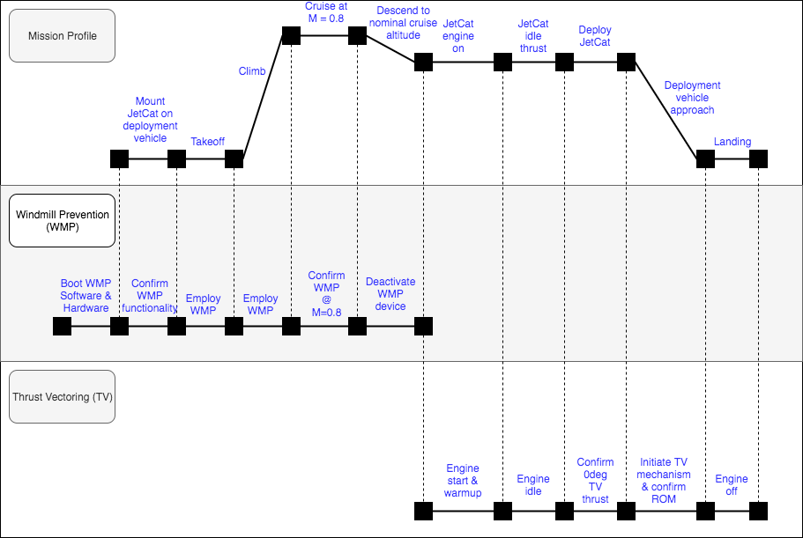
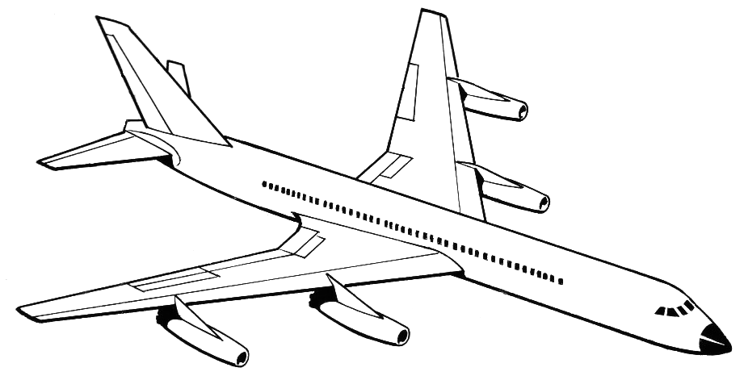
Project Purpose Visualization
Notes:
Presenter:

Slide 5
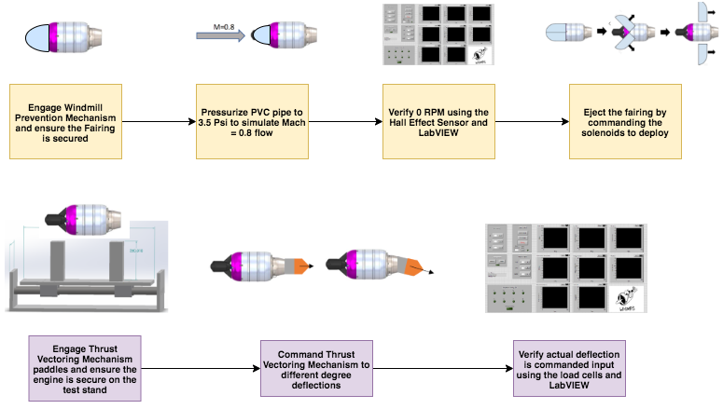
Concept of Operations
Notes:
Presenter:

Slide 6
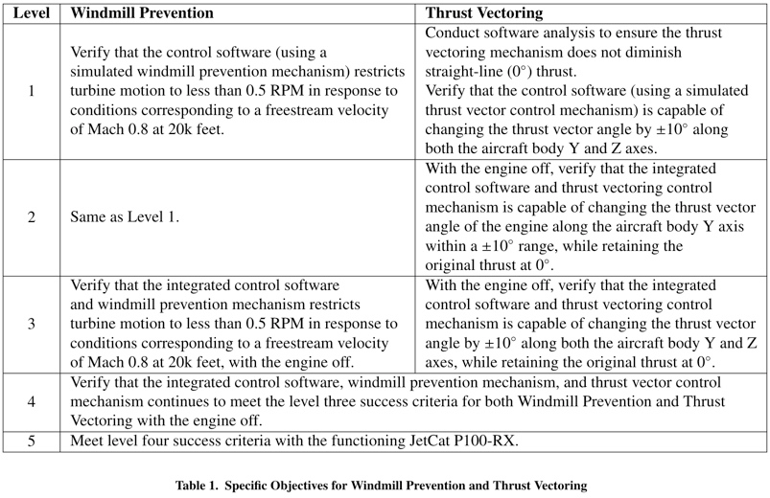
Levels of Success
Notes:
Presenter:

Slide 7
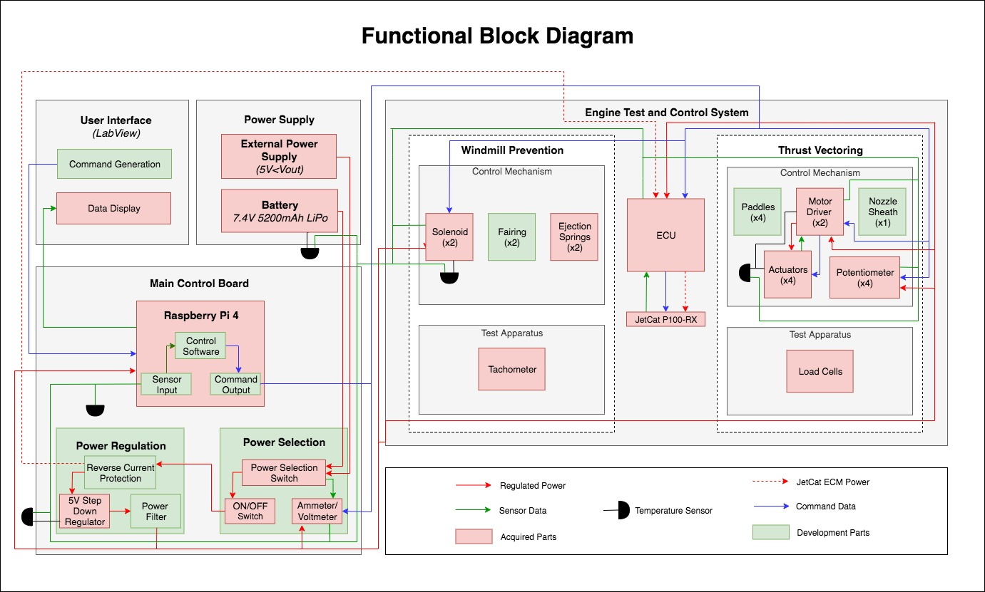
Notes:
Presenter:

Slide 8
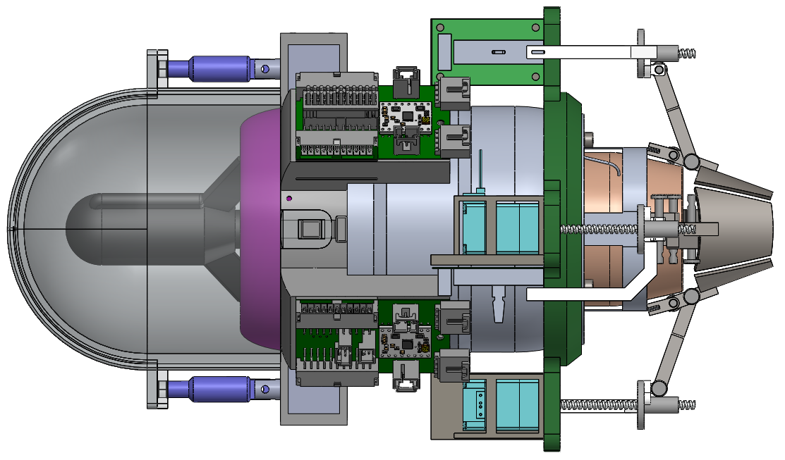
Baseline Design - WPM
Fore Retention Ring
ICUP
Fairing
Solenoid Pins
Solenoid Housing
Notes:
Presenter:

Slide 9
Baseline Design - TVM
Nozzle Sheath
Linear Potentiometer
Paddle
Linear Actuator
Actuator Pod
Linear Potentiometer Arm
Actuator Ring
Linkage Rod
Notes:
Presenter:

Slide 10
Changes Since MSR
Redesign to ICUP component
Due to risk of collision during ejection, along with spacing issues on the engine we have decided to redesign the ICUP
New design will consist of 4 connected PCBs that will go along engine body
This design reduces risk of collision, and decreases form factor of engine
Redesign does not require increase in board complexity
Redesign to fore retention ring
Response to very limited space on the engine
P100-RX is the smallest engine ever used by CU APOP team
Will have to interface with ICUP component
Redesign of actuator housing
Switch from ABS plastic to Aluminum 6061
Response to PAB concerns with the 3D printed housing that holds the actuators
Notes:
Presenter:

Slide 11
Critical Project Elements
Designation | CPE | Critical Characteristics
CPE-1.2 | Windmill Prevention Mechanism (WPM) and Thrust Vectoring Mechanism (TVM) | Thermodynamic and structural analysis require assumptions of materials and operating conditions. Further analysis shall characterize and define risks.
CPE-3.1 | Main Control Board (MCB) | During testing and product development, this will verify safe engine operation and monitor WPM/TVM.
CPE-3.2 | Integrated Communication Unit Panel (ICUP) | Minimizes amount of wires to reduce risk of human error and increases processing speed.
CPE-3.3 | Software | Controls the incorporated mechanisms over the entire operational envelope.
Notes:
Presenter:

Slide 12
Schedule
Overview
Schedule
Manufacturing Status
Electronics/Software Status
Testing Status
Budget
Notes:
Presenter:

Slide 13
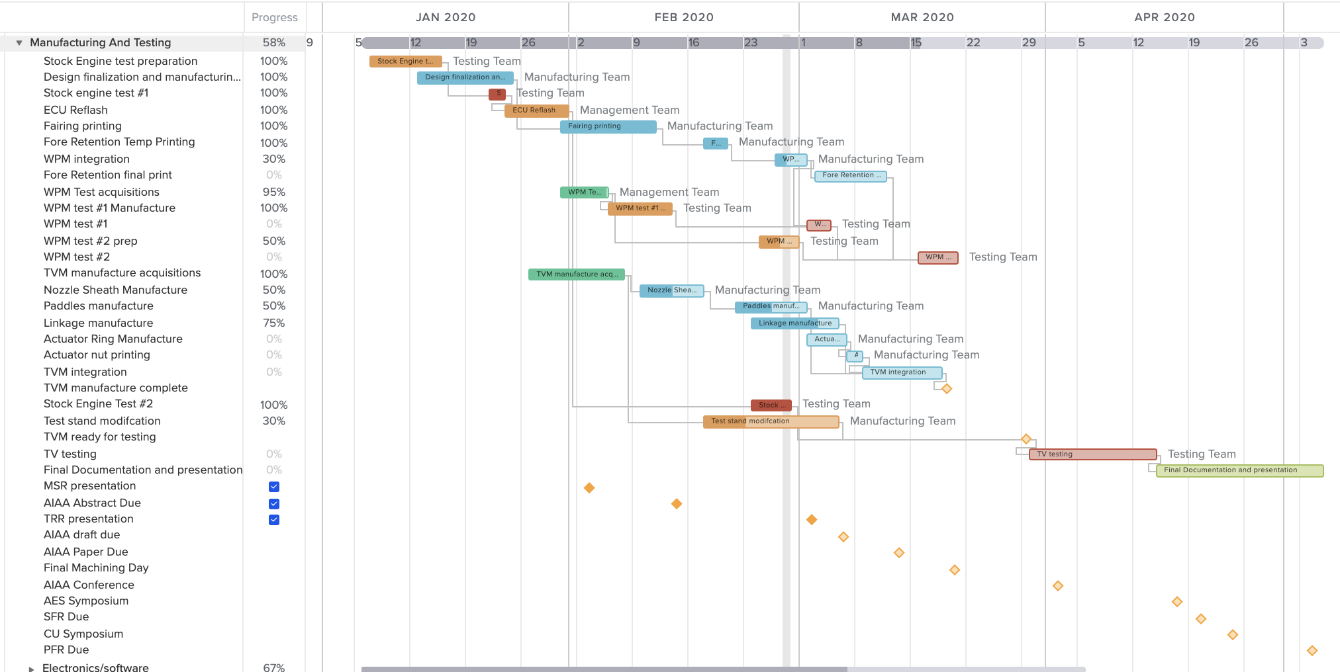
Schedule Overview - Manufacture/Testing
Acquisitions
Manufacturing
WPM manufacture and test
WPM manufacture and test
Test prep
Testing
TVM manufacture and test
Deliverables
Notes:
Presenter:

Slide 14
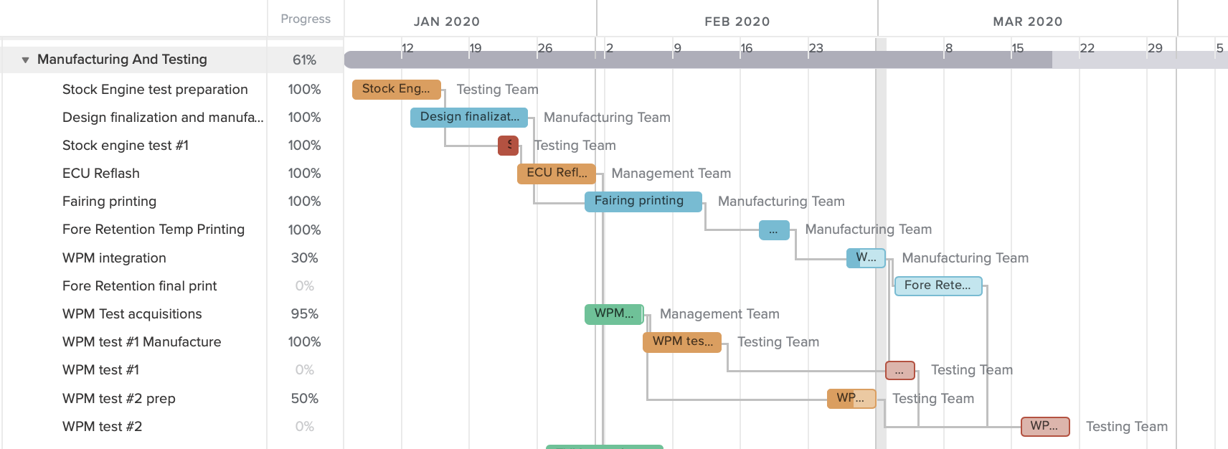
WPM Manufacture and Test Schedule
Acquisitions
Manufacturing
Test prep
Testing
Notes:
Presenter:

Slide 15
TVM Manufacture and Test Schedule
Acquisitions
Manufacturing
Test prep
Testing
Notes:
Presenter:

Slide 16
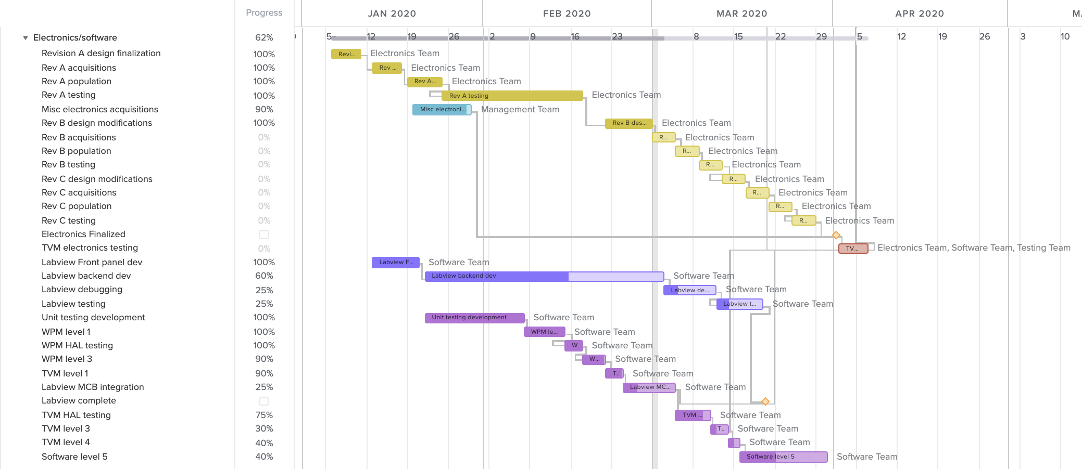
Electronics and Software Schedule
PCB Rev. A
PCB Rev. B
PCB Rev. C
Labview Dev.
MCB Dev.
Notes:
Presenter:

Slide 17
Manufacturing Status
Overview
Schedule
Manufacturing Status
Electronics/Software Status
Testing Status
Budget
Notes:
Presenter:

Slide 18
WPM Manufacturing Overview
Fairing 3D print using carbon fiber reinforced Onyx
Solenoids from Adafruit
Windmill prevention APOP test replica
Ejection springs from McMaster-Carr
Fore retention ring 3D print → 1 week, approximately 2 days printing
Windmill prevention high speed flow test → 1 week acquisitions
Aluminum 6061 ejection pins → 6 hours lathe
Completed
In Progress
Not Started
Notes:
Presenter:
Only really talk about the ones that aren’t completed, breeze over completed ones

Slide 19
TVM Manufacturing Overview
Stock engine test with dummy paddles
3D printed actuator nut attachments
Sheath hinges
Clevis pins from McMaster-Carr
Thrust vectoring test stand → 1 week drilling and assembly
Steel linkage rods → 6 hours milling
3D printed potentiometer arms → 4 hours print
Steel paddles → outsourced, 1 week expected
Steel nozzle sheath → successful prototypes, 1 week
Actuator ring → 2 weeks
Completed
In Progress
Not Started
Notes:
Presenter:
Only really talk about the ones that aren’t completed, breeze over completed ones

Slide 20
Electronics & Software Test Status
Overview
Schedule
Manufacturing Status
Electronics/Software Status
Testing Status
Budget
Notes:
Presenter:

Slide 21
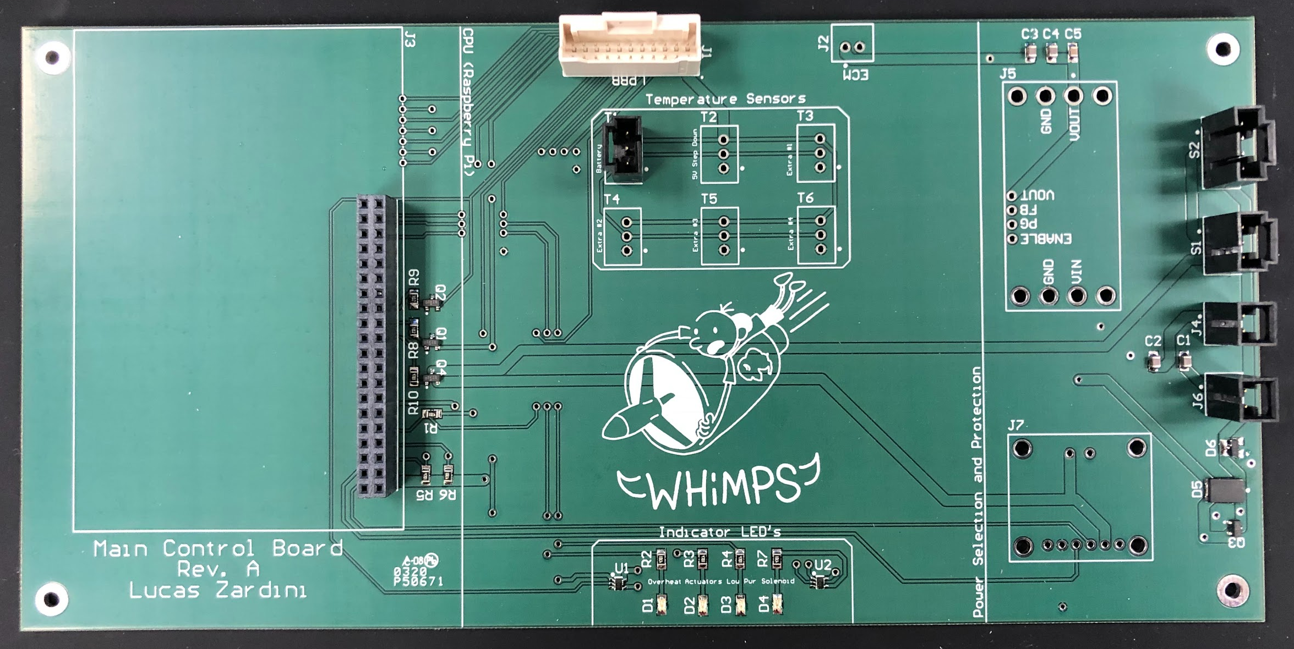
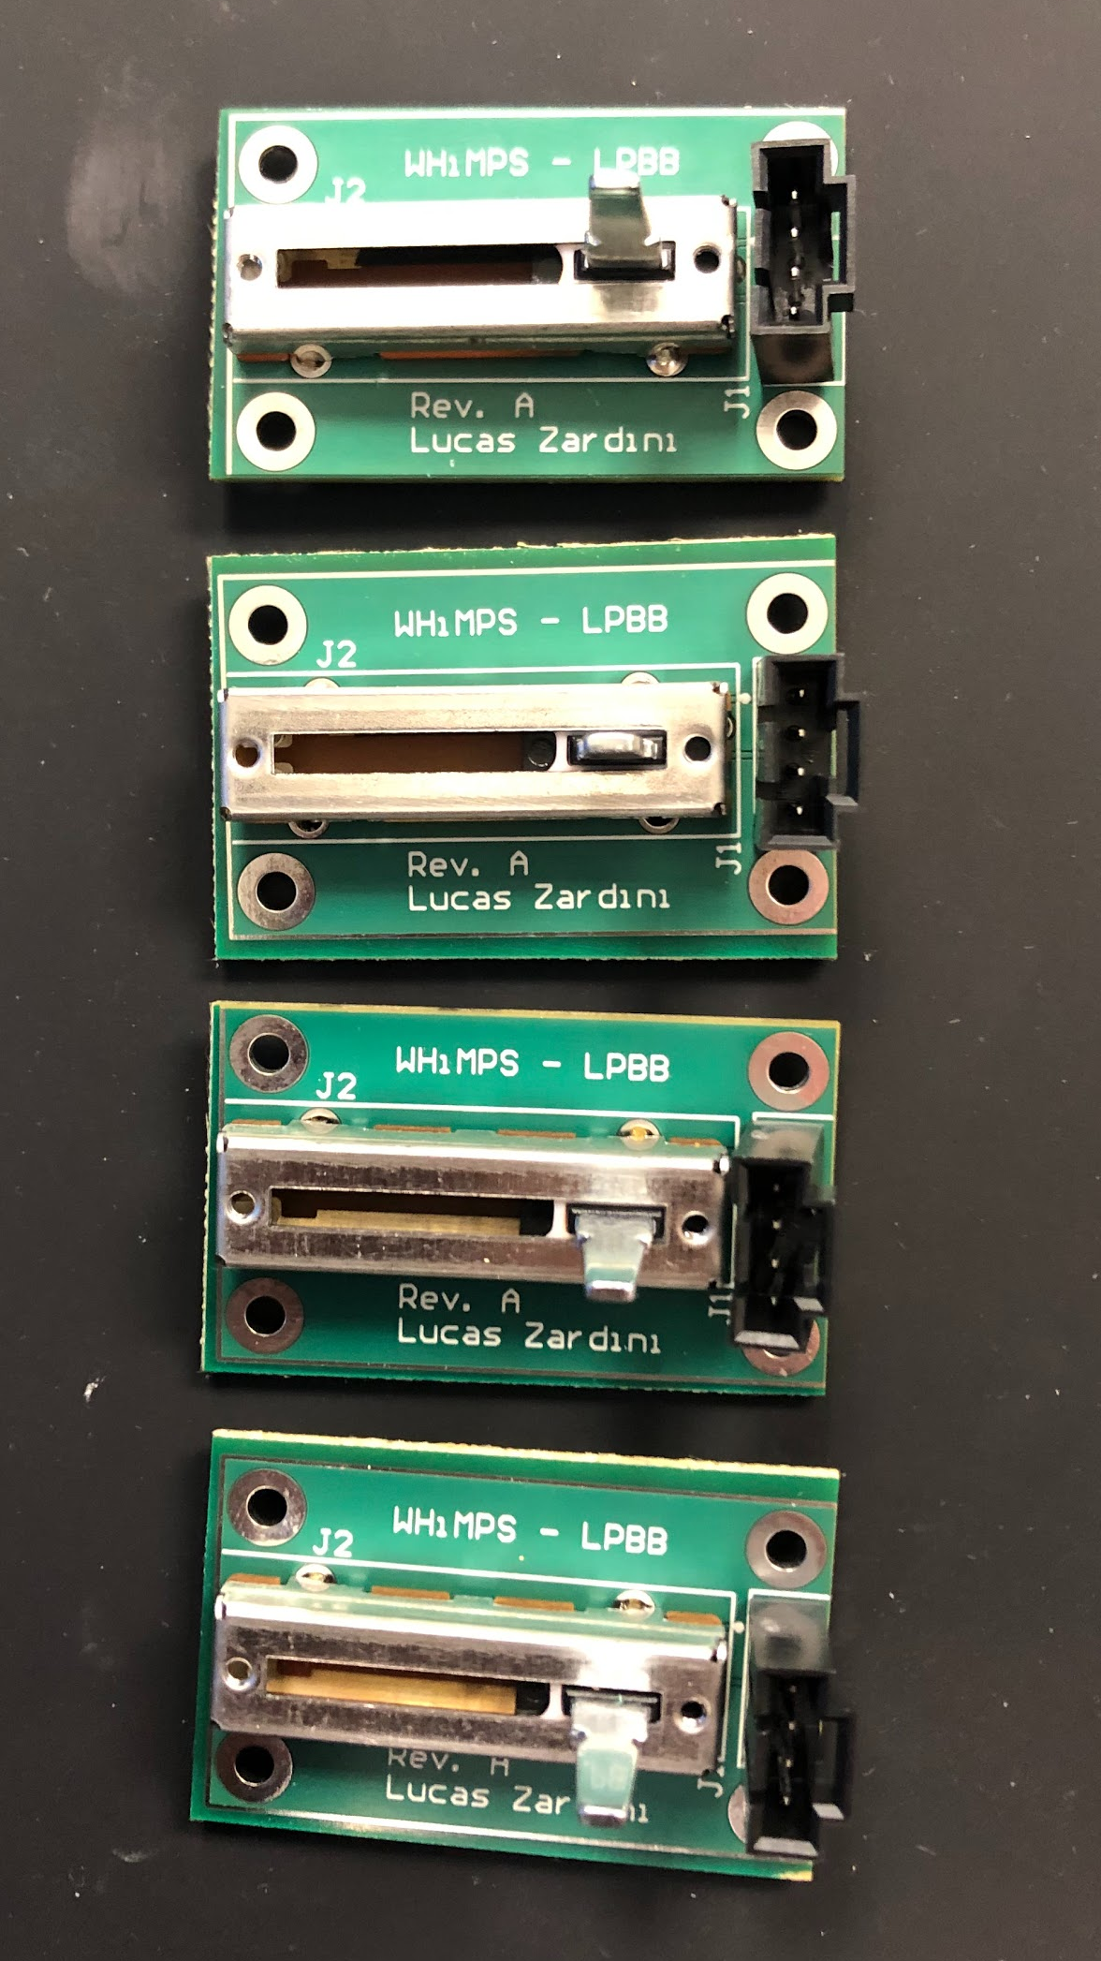
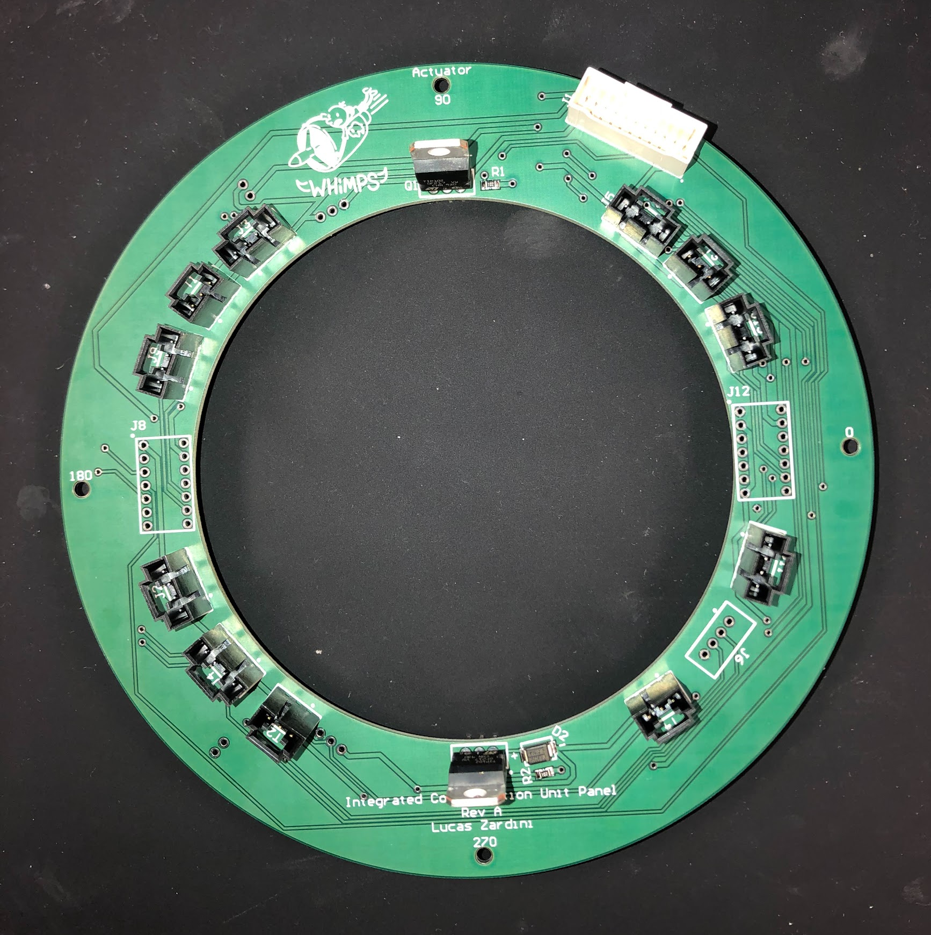
Electronics Overview
Main Control Board (MCB)
Provides WHiMPS’ data processing and power distribution
Integrated Communication Unit Panel (ICUP)
Extends actuators and potentiometers’ data and power lines from the MCB to the engine
Linear Potentiometer Breakout Board (LPBB)
Converts potentiometer analog output to a digital signal (I2C)
MCB
Rev. A
ICUP
LPBB
Notes:
Presenter:

Slide 22
Electronics Testing
Switch functionality
Voltage converter (5V)
Power protection circuit
GPIO/LED circuit
Power MOSFET circuit
Raspberry Pi functionality
I2C functionality
Solenoid circuit
Actuator/motor driver circuit
Linear potentiometer circuit
Harness continuity check
Temperature sensor circuit
MCB
Successful
Successful After Changes
Unsuccessful
ICUP
LPBB
All
Notes:
Presenter:

Slide 23
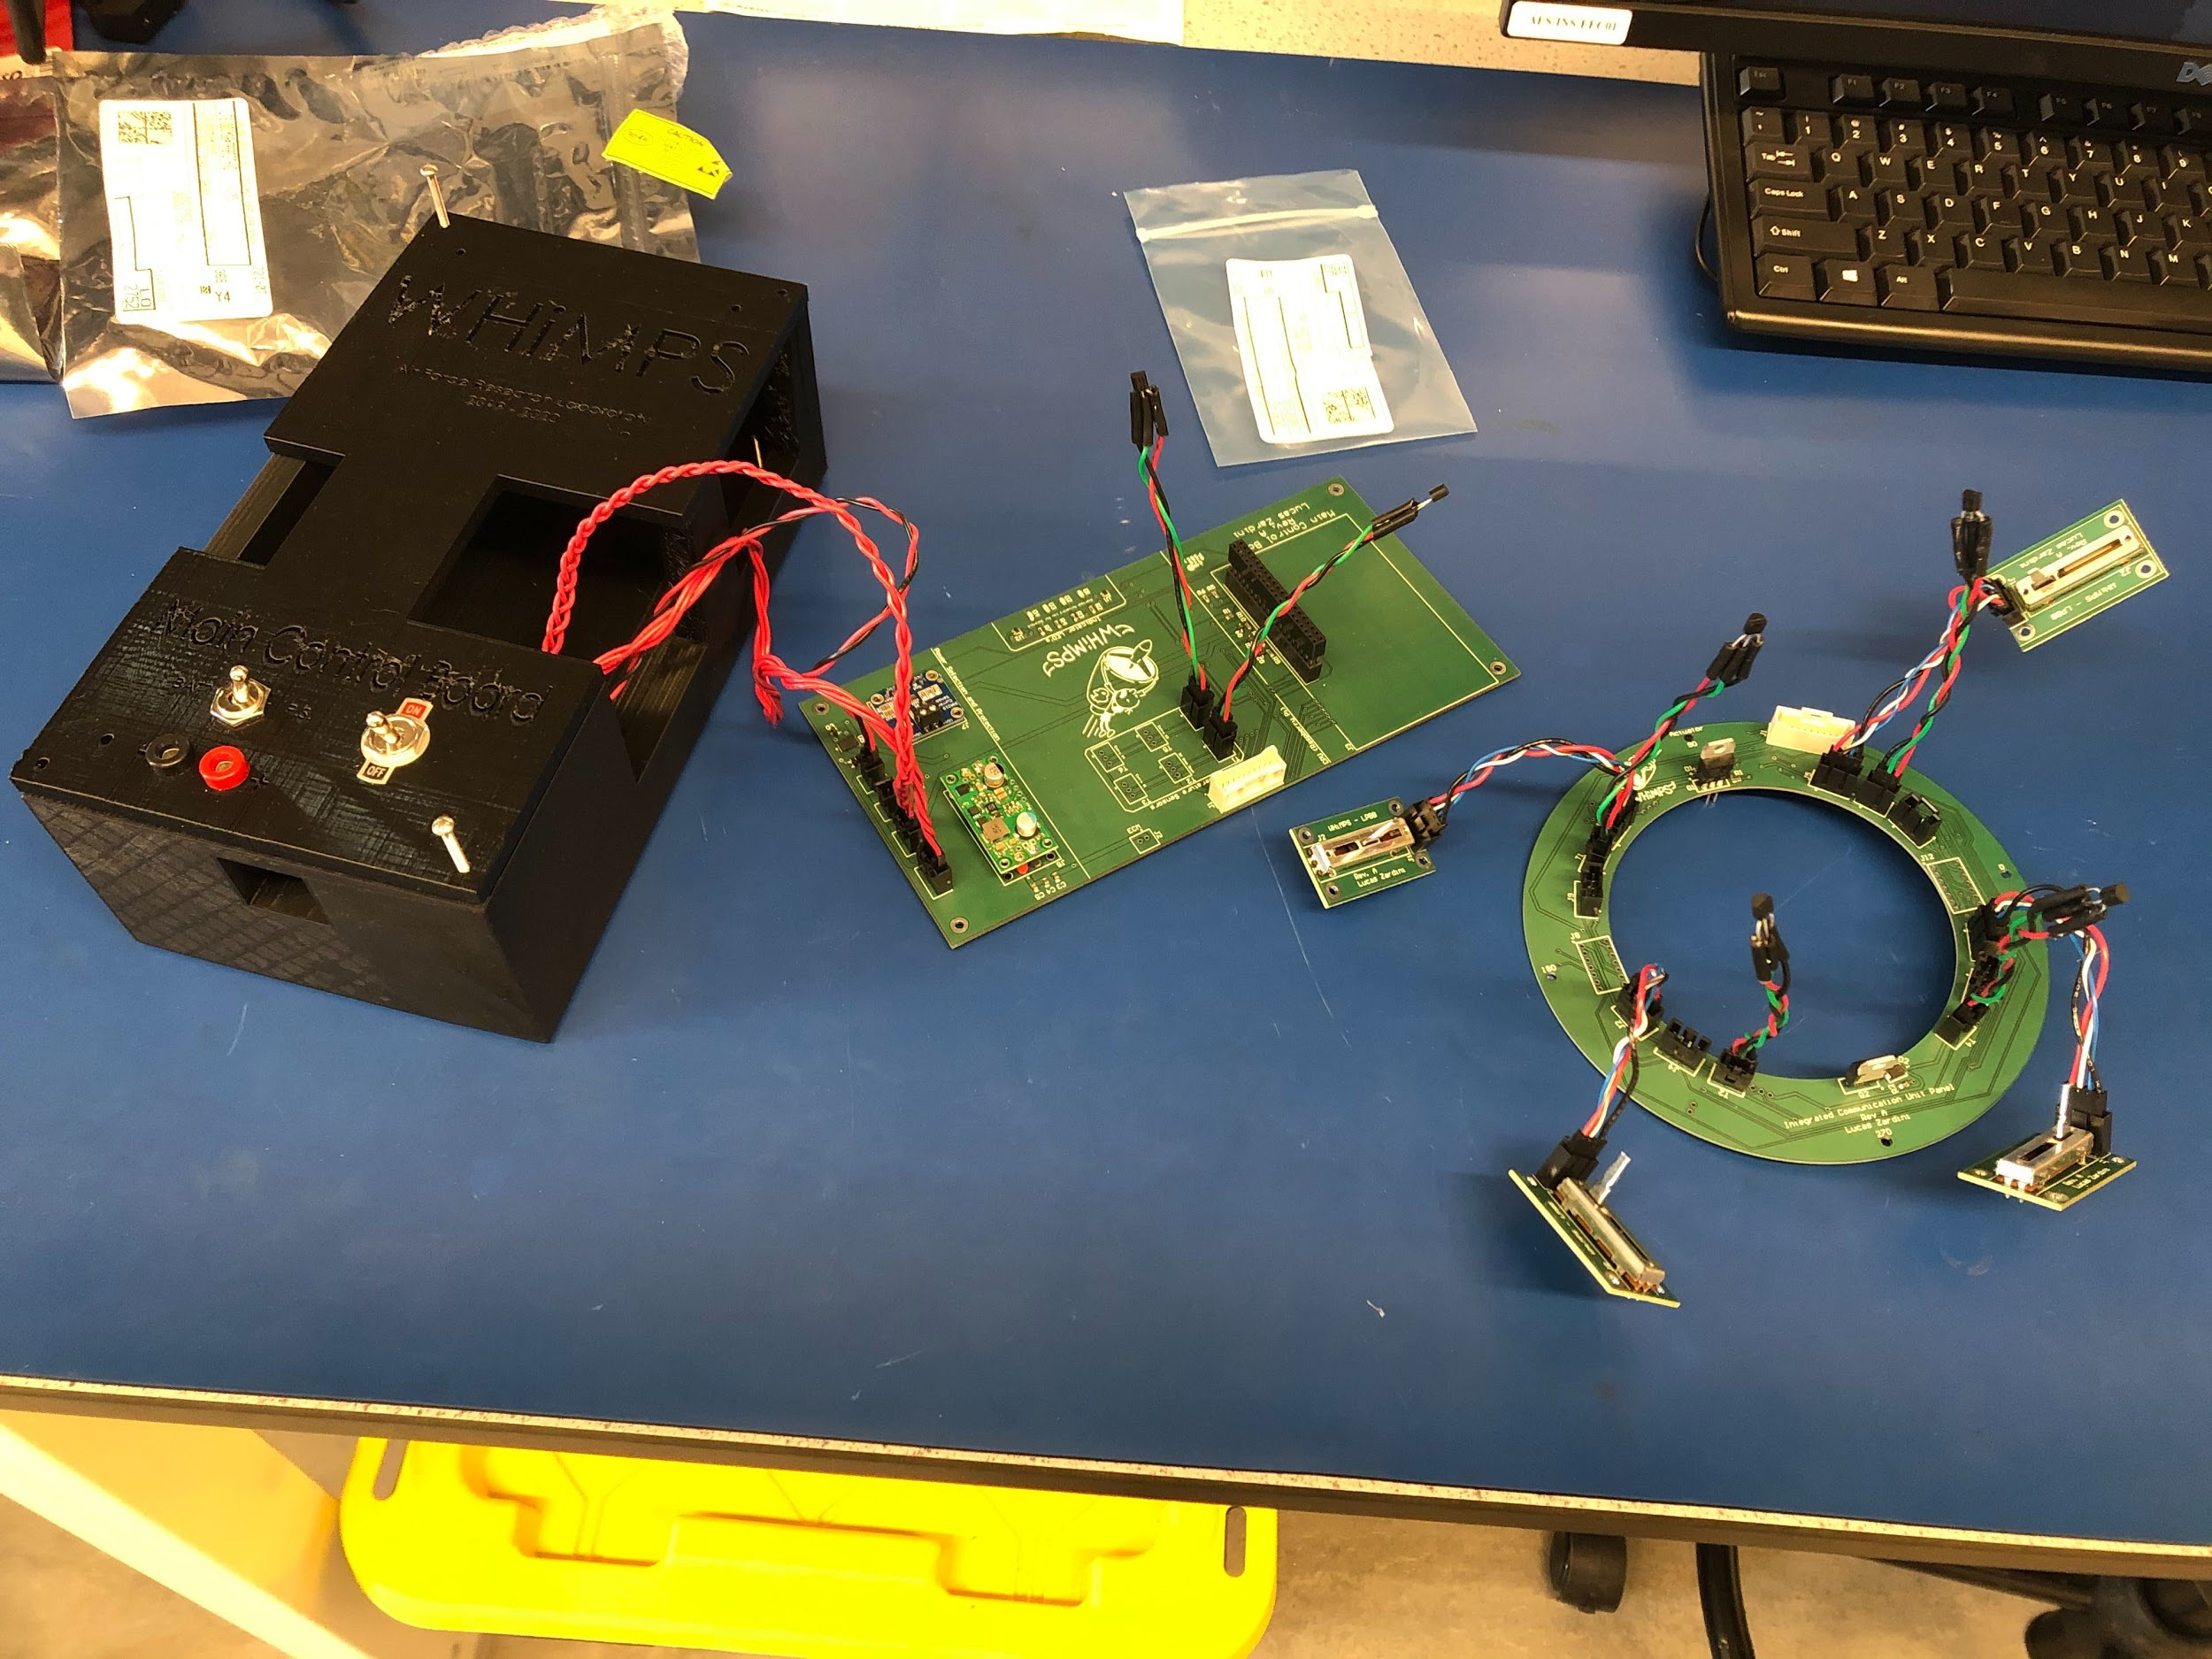
Upcoming Electronic Tests
Temperature sensor addresses
Done by: 3/6/2020
Actuator/motor driver circuit
Done by: 3/6/2020
Load cell/amplifier circuit
Done by: 3/13/2020
Revision B MCB functionality
Done by: 3/13/2020
Revision B ICUP functionality
Done by: 3/13/2020
Revision B LPBB functionality
Done by: 3/13/2020
Revision A PCBs
Notes:
Presenter:

Slide 24
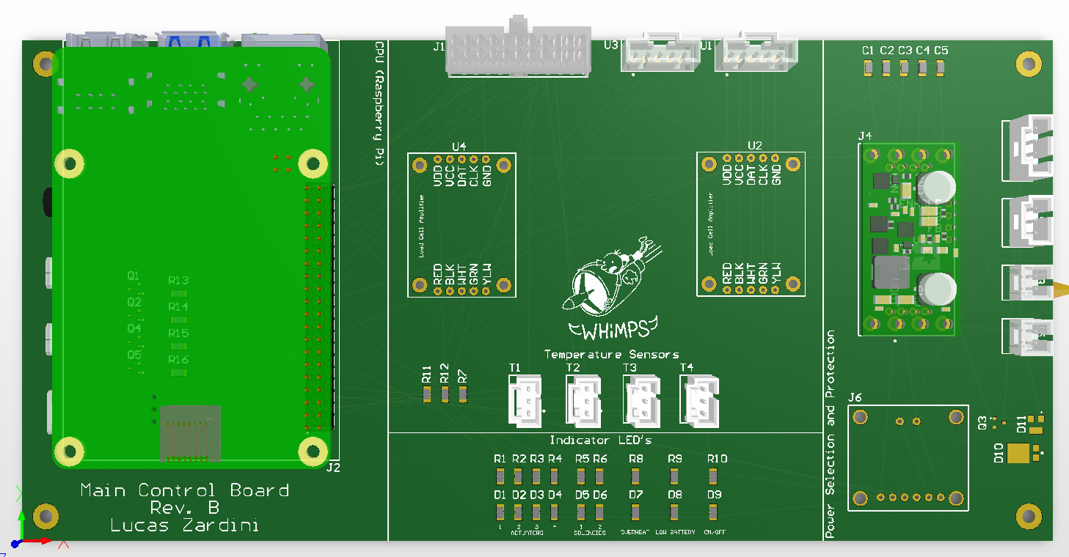
MCB Revision B
Changes from Revision A to B:
Took out MCB <-> ECM connector
Fixed the temperature sensor circuit
Added load cells connectors and amplifiers (2x)
Added more indicator LEDs
Added MOSFETs for all motor drivers/actuators
Took out software control (MOSFET) for Ammeter
Notes:
Presenter:

Slide 25
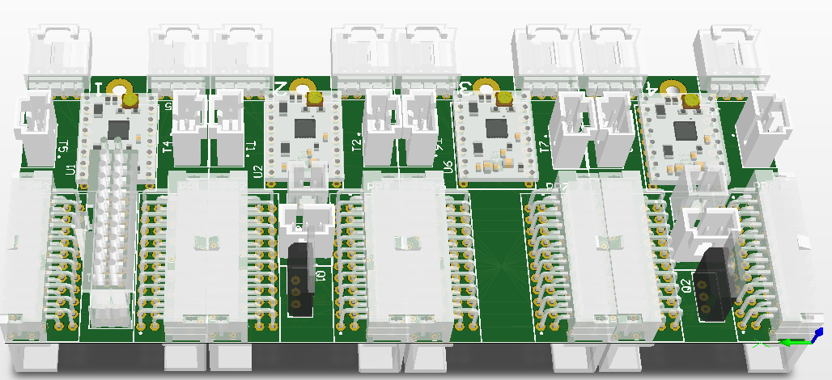
ICUP Revision B
Changes from Revision A to B:
Changed outline from a ring to a 4 panel “bracelet” design
Each panel is connected together through SAMTEC locking connector assemblies
Motor drivers were replaced with the correct stepper motor driver
Fixed solenoid circuit
Using a surface mount rail system with one screw hole instead of 4 screw holes
1
MCB <-> ICUP
Actuator #1
Motor Driver #1
LPBB #1
2
Solenoid #1
Actuator #2
Motor Driver #2
LPBB #2
3
Actuator #3
Motor Driver #3
LPBB #3
4
Solenoid #2
Actuator #4
Motor Driver #4
LPBB #4
Notes:
Presenter:

Slide 26
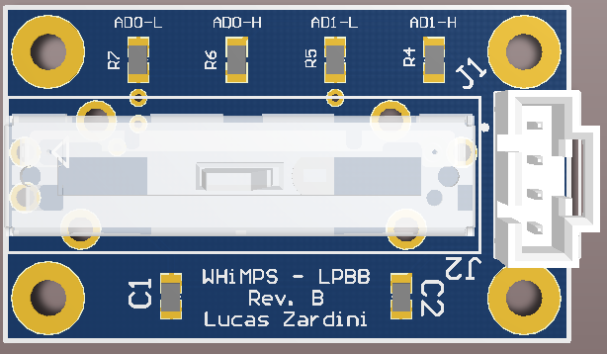
LPBB Revision B
Changes from Revision A to B:
Changed to an ADC with multiple address for I2C
Tie AD0 and AD1 resistors to either HIGH or LOW to get 4 address combinations
18 bit ADC
Notes:
Presenter:

Slide 27
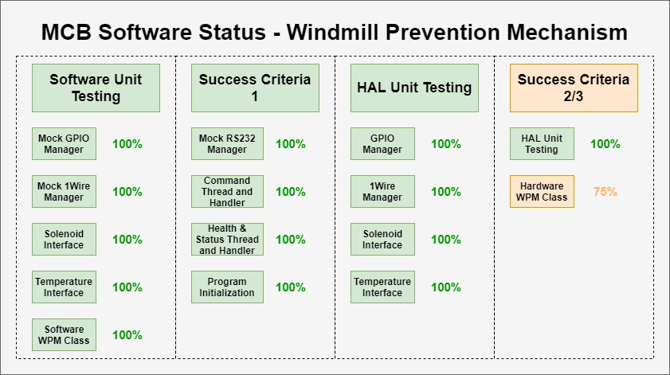
Notes:
Presenter:
Notes: Everything is pretty much done - waiting on having all the hardware integrated together to test Success Criteria 2-3, also need to finish the the Hardware WPM Class (almost done)

Slide 28
Notes:
Presenter:
Most of the work left relies on getting the actuators to work (waiting on hardware), calibrating the potentiometers (waiting on hardware), testing feedback loop with potentiometers and actuators, also need to do the Load cells and finish the software simulated implementation of the thrust vectoring mechanism

Slide 29
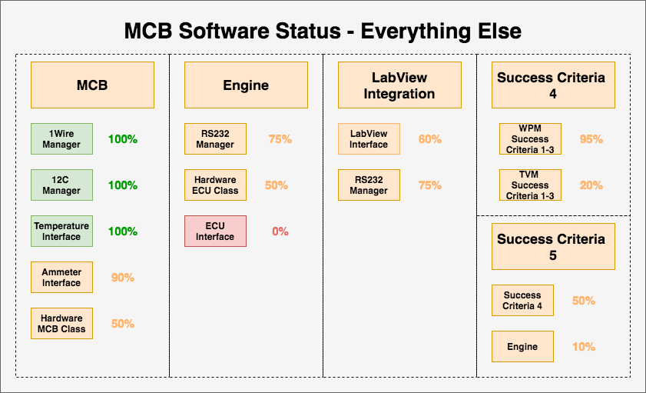
Notes:
Presenter:
For MCB, need to test my calibration code on the hardware (waiting for batteries to be integrated to test this)
For Engine, need to write and test the interface for aquiring data from the ECU as well as test the RS232 driver that is already written with the ECU
For LabView, need to test the RS232 driver that is already written with Labview
For success criteria 4: once previous success criterias have been met just need to run the code with this build configuration and test to make sure everything is working well together
For success criteria 5: need success criteria 4 to be complete and the engine related software to be complete to test to make sure everything is working well together

Slide 30
System Testing Status
Overview
Schedule
Manufacturing Status
Electronics/Software Status
Testing Status
Budget
Notes:
Presenter:

Slide 31
Engine Testing Progression
TVM Testing
WMP Testing
Stock Run, 2/24 ✅
Understand engine operation
APOP Replica Test, 3/3*
Verify fairing prevents airflow under pressure differential
Stock w/ Dummy Paddle, 2/26 ✅
Helps satisfy safe operation and stock engine functionality requirements
Vibration and Thrust Baseline, 3/12*
Characterize vibration and thrust
SABRE Static WPM Test, 3/16*
Validate fairing function at Mach 0.8
Static TVM Test, 4/6*
Validate ability to vector thrust using paddles preset in deflected position
SABRE Dynamic WPM test, 3/19*
Verification of ability to eject fairing at Mach 0.8
Dynamic TVM Test, 4/13*
Verify ability to vector thrust by commanding paddle movement during engine operation
Integration Tests, 4/15*
*tentative
Notes:
Presenter:

Slide 32
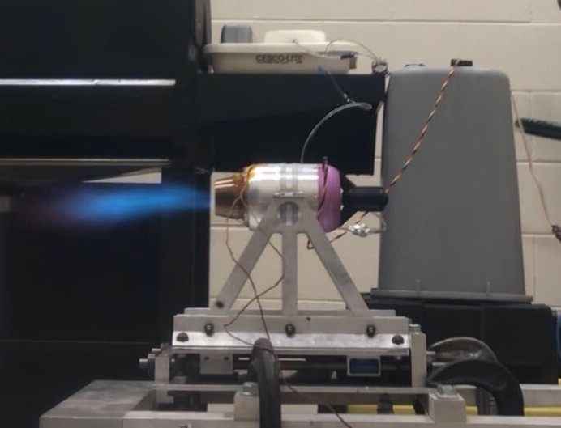
Stock Engine and Dummy Paddle Test
Verified that JetCat P100-Rx is functioning and operating correctly
Validated thermal model before implementation of hardware
Verified engine did not turn off when flow was deflected using dummy paddles
Equipment
Engine, associated tanks and lines
Test stand
Paddles and attachment mechanisms
Fuel and oil, in tank
Thermocouples
GSU and battery
Facilities
CU Aerospace Test Cell
Notes:
Presenter:

Slide 33
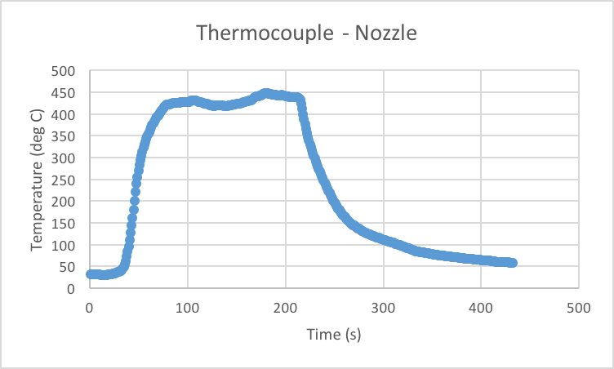
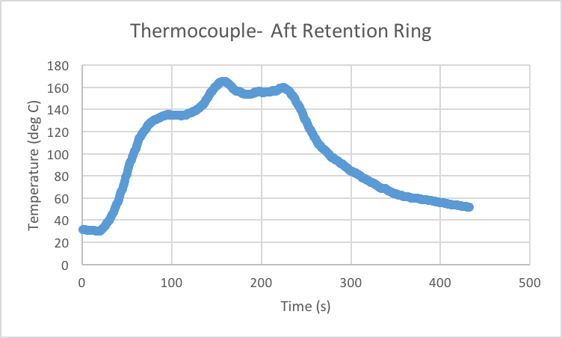
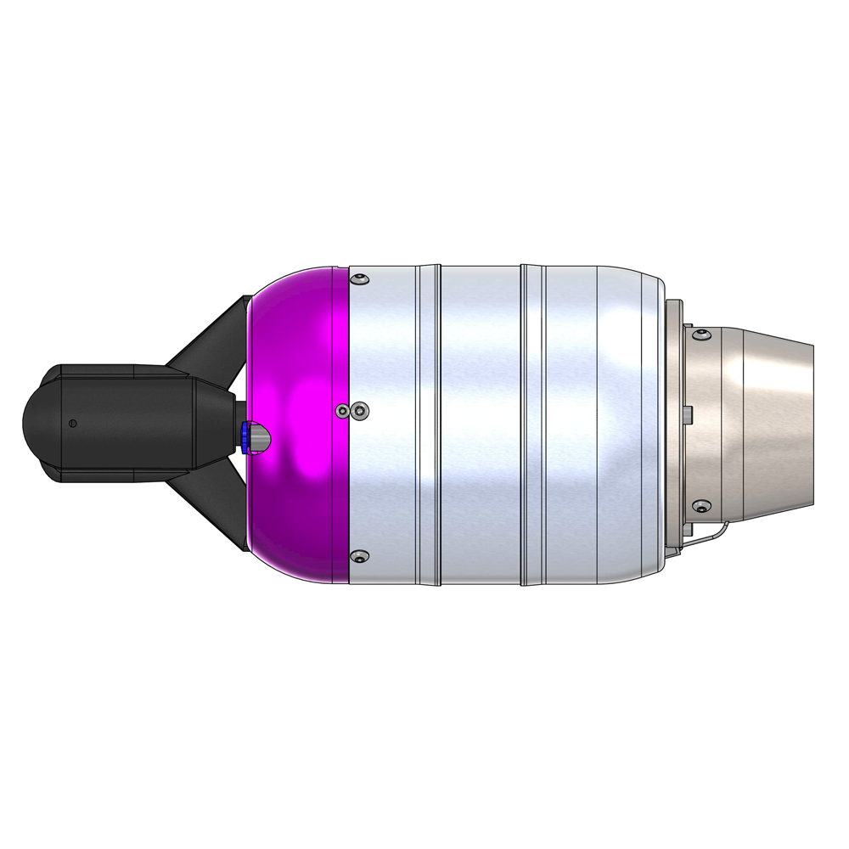
Thermocouple Data
304 SS Max Temp: 925°C
Aluminum Max Temp: 572°C
Max RPM
Max RPM
Idle
Idle
Cooldown
Cooldown
Notes:
Presenter:
Note that 304 steel has a melting point of 1400C, but can be used in continuous manner up to 925C

Slide 34
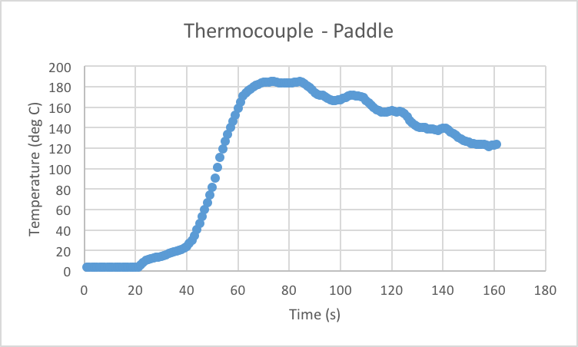
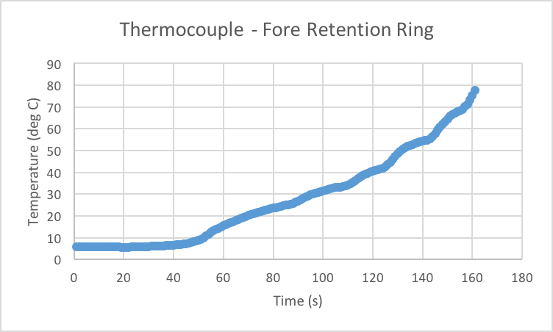
Thermocouple Data
Steel Max Temp: 700°C
Carbon Fiber Reinforced Onyx Max Temp: 145°C
Note: We did have a slight separation of the thermocouple and the paddle around t=90s due to a tape failure, resulting in the slow degradation of the measured temperature
Notes:
Model predicted 400C for back of paddle, so we’re doing fine in that regard

Slide 35
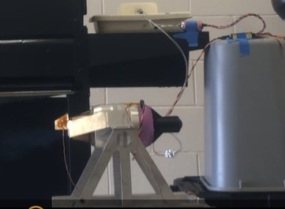
Risk Reduction and Expectations
Risk Reduction
Ensures that operation of the engine is attainable
Demonstrates that flow deflection will not interfere with engine operability
Obtain better understanding on power limitations (run-time) to safely operate engine
Vibrational, thermal, and thrust data mitigates risk of engine components detaching during operation
Expected Results
Engine operation is successful and repeatable
Temperatures will be at or below thermal requirements
Dummy paddles will not interfere with engine operability
Model Validation
Thermal model demonstrating paddles can withstand heat
Dummy paddles
Notes:
Presenter:

Slide 36
Static and Dynamic Thrust Vectoring Tests
Purpose: prove that paddles vector the thrust without altering the engine’s operation
Verifies zero impedance at 0° and two-axis ±10° capabilities
Equipment
Engine, associated tanks and lines
Test stand w/ second axis
Paddles and attachment mechanisms
Fuel and oil, in tank
Thermocouples
GSU and battery
Facilities
CU Aerospace Test Cell
MOST CRUCIAL TVM TEST
Notes:
Presenter:

Slide 37
Risk Reduction and Expectations
Risk Reduction
Progressive testing will reduce mechanical risks
Mechanical risks include fracture of components and melting of ABS components
Paddles will be pre-deflected so no mechanical motion is required during first full TVM test
Expected Results
Thrust will be vectored at ±10° in two body axes
Zero impedance of thrust at 0° deflection
Model Validation
Thrust vectoring CFD model showing necessary paddle angles for desired deflection
Paddle thermal and structural FEA models
P_{p}
P_{r}
Nozzle
P_{s}
𝝰
Notes:
Presenter:

Slide 38
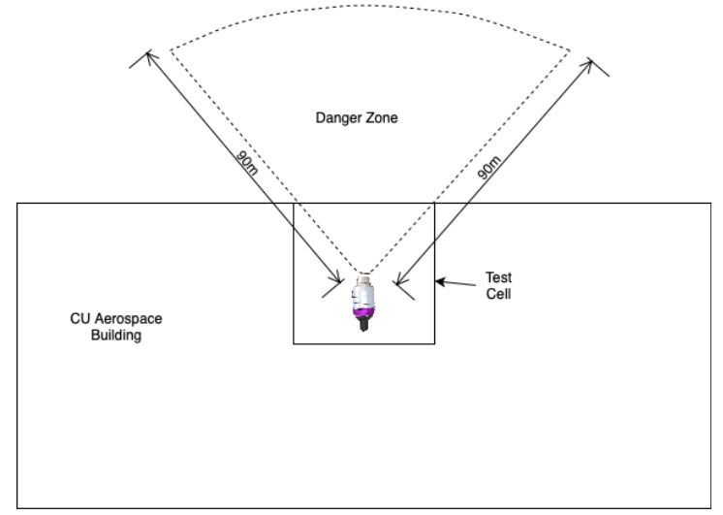
Thrust Vectoring Test Safety Measures
Safety Concerns:
Fuel fire
Engine breaks and throws a fan blade
Safety Measures
All tests performed in CU engine test cell
Matt Rhode present for all tests
Safety officer is only member in test cell once battery is plugged in
Sentries posted outside of test cell to stop passersby from entering danger zone
Notes:
Presenter:

Slide 39
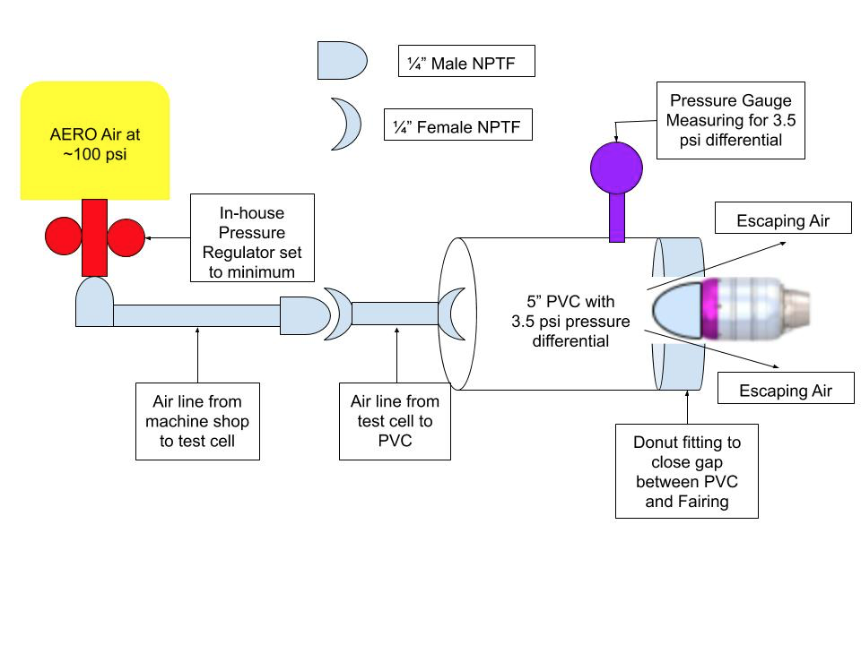
WPM APOP Replica, Test #1
Used to simulate Mach 0.8 airflow at 20,000 ft via a 3.5 psi pressure differential
Engine not operating
Equipment
PVC pipe with attached pressure gauge and foam insert
Air compressor
Air lines and connectors
Pressure regulator
3D printed fairing
Test mount
Facilities
CU Aerospace Test Cell
MOST CRUCIAL WPM TEST
Notes:
Presenter:

Slide 40
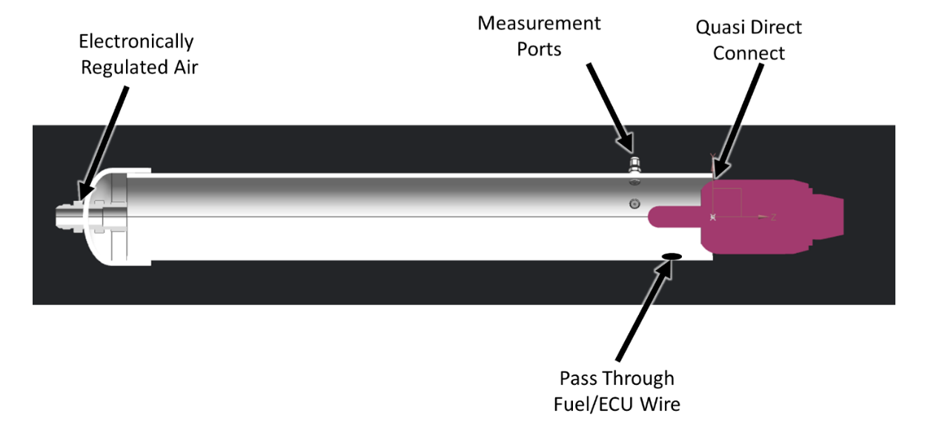
Risk Reduction and Expectations
Risk Reduction
Provides redundancy for APOP demonstration to ensure test will be successful
Provides necessary information to determine if further mitigation is necessary, such as adding in an O-Ring to prevent flow leakage
Expected Results
Fairing will withstand the 3.5 psi pressure differential
The engine will experience 0 RPM of the fan blades
Model Validation
FEA structural model of fairing displacement under 3.5 psi pressure differential
Air Force
Test Diagram
Notes:
Presenter:

Slide 41
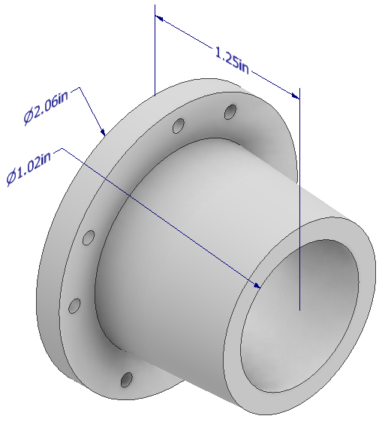
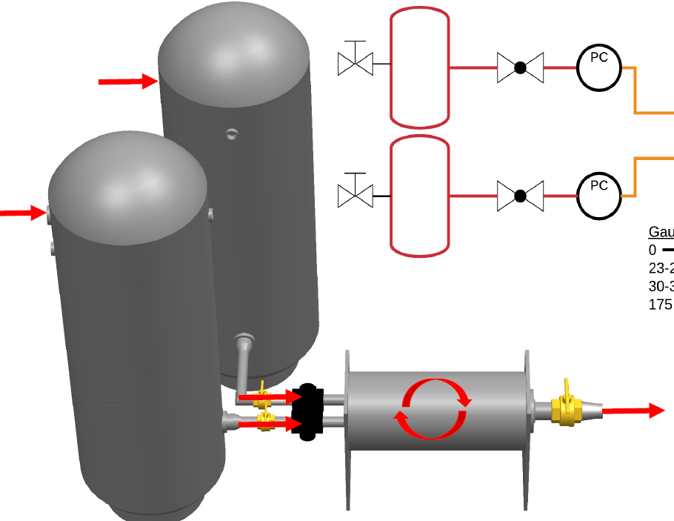
WPM High Speed Flow (SABRE), Test #2
Provides Mach 0.8 airflow for several seconds to test fairing structural integrity and seal
Equipment
2 pressure regulators
2 pressure gauges
Outlet nozzle (3D printed)
SABRE tanks and system
Engine test mount
3D printed fairing mounted on engine
Electronics and software
Facilities
CU Aerospace Test Cell
6ft
Notes:
Presenter:

Slide 42
Risk Reduction and Expectations
Risk Reduction
Ensures ejection mechanism will not damage external components
Shows ICUP redesign is sufficient to avoid damage during ejection
Expected Results
Fairing will withstand Mach 0.8 flow
The engine will experience 0 RPM of the fan blades
Model Validation
FEA structural model of fairing displacement under high speed flow
CFD model confirming the turbulent wake aft of the engine re-entering the nozzle should not be a concern
Notes:
Presenter:

Slide 43
Windmill Prevention Test Safety Measures
Safety Concerns
Over-pressurization of the APOP replica PVC Tube
Failure of SABRE tank
High speed air harming passersby of test cell
Safety Measures
Matt Rhode present for all tests
Pressure gauge on PVC tube
Safety officer radios to valve operator to shut off if differential pressure exceeds 5 psi
Remotely pulling SABRE tank lever
Same sentry/perimeter procedure as engine tests
Complete depressurization of SABRE tanks before any transportation of tanks
Notes:
Presenter:

Slide 44
Budget
Overview
Schedule
Manufacturing Status
Electronics/Software Status
Testing Status
Budget
Notes:
Presenter:

Slide 45
Procurement Status Major Items
JetCat P100-RX engine
Clevis pins
Solenoids
Aluminum 6061 plates
Actuators
Raspberry Pi
Steel Linear Shafting
Stainless Steel 17-4PH
Fairing
Load Cells
WPM APOP test materials
Temperature sensors
Aluminum 6061 stock
Test stand modification rails
Misc electronic population materials
LPBB Rev B
MCB Rev B
ICUP Rev B
Paddles
Paddle Necks
Ejection Springs
Fore Retention Ring Print
WPM SABRE test materials
Procured
Pending
Planned
Notes:
Presenter:
These are the things we are procuring outside of CU (i.e. not manufacturing ourselves)
We can breeze over this slide, just wanted it to appease the rubric

Slide 46
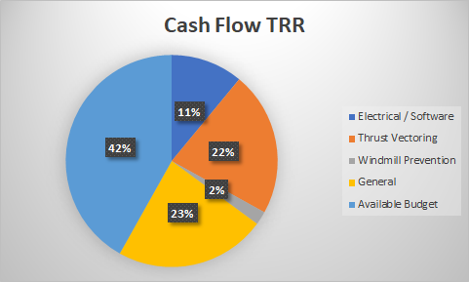
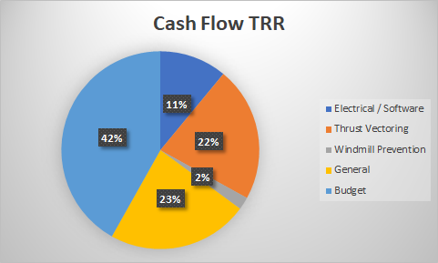
Financial Budget Status
Spent 58% of funds
After running engine multiple times we have decided to abandon the idea of saving for an additional engine.
We will use funds to guarantee thrust vectoring and windmill prevention success as well as allow for all tests possible.
Electrical / Software | $ 459.95
Thrust Vectoring | $ 1101.58
Windmill Prevention | $ 103.78
General / Tests | $ 1153.05
Notes:
Presenter:

Slide 47
Questions?

Slide 48
Backup

Slide 49
Fairing Ejection Animation

Slide 50
TVM Animation

Slide 51
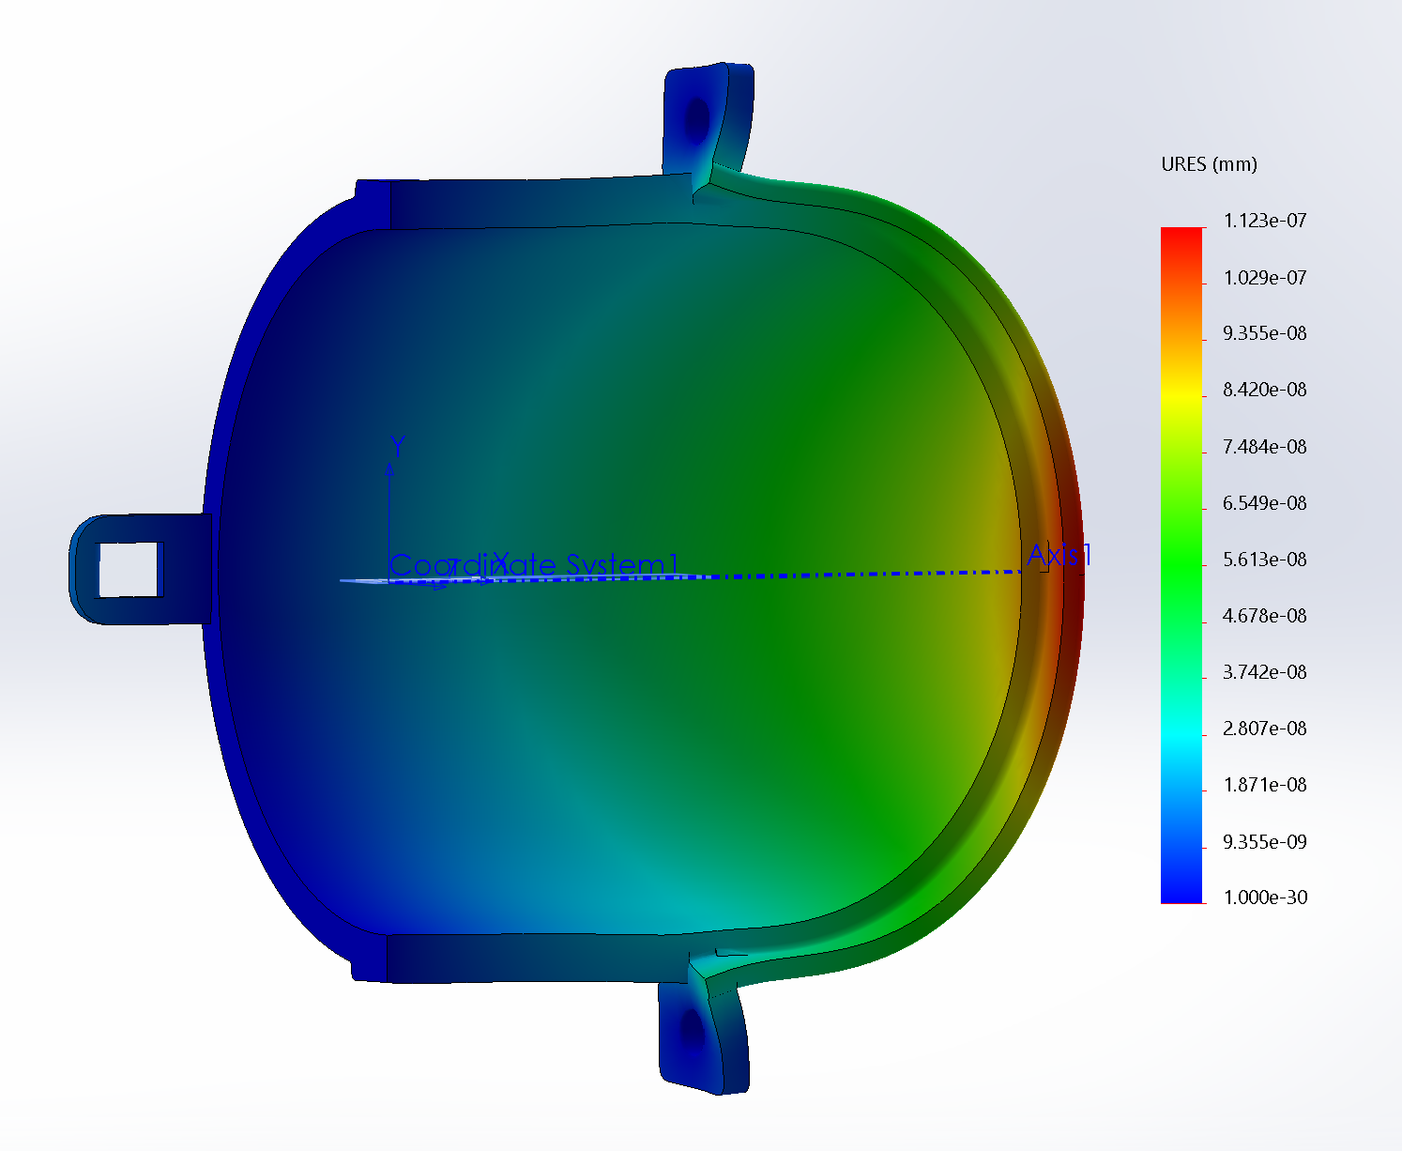
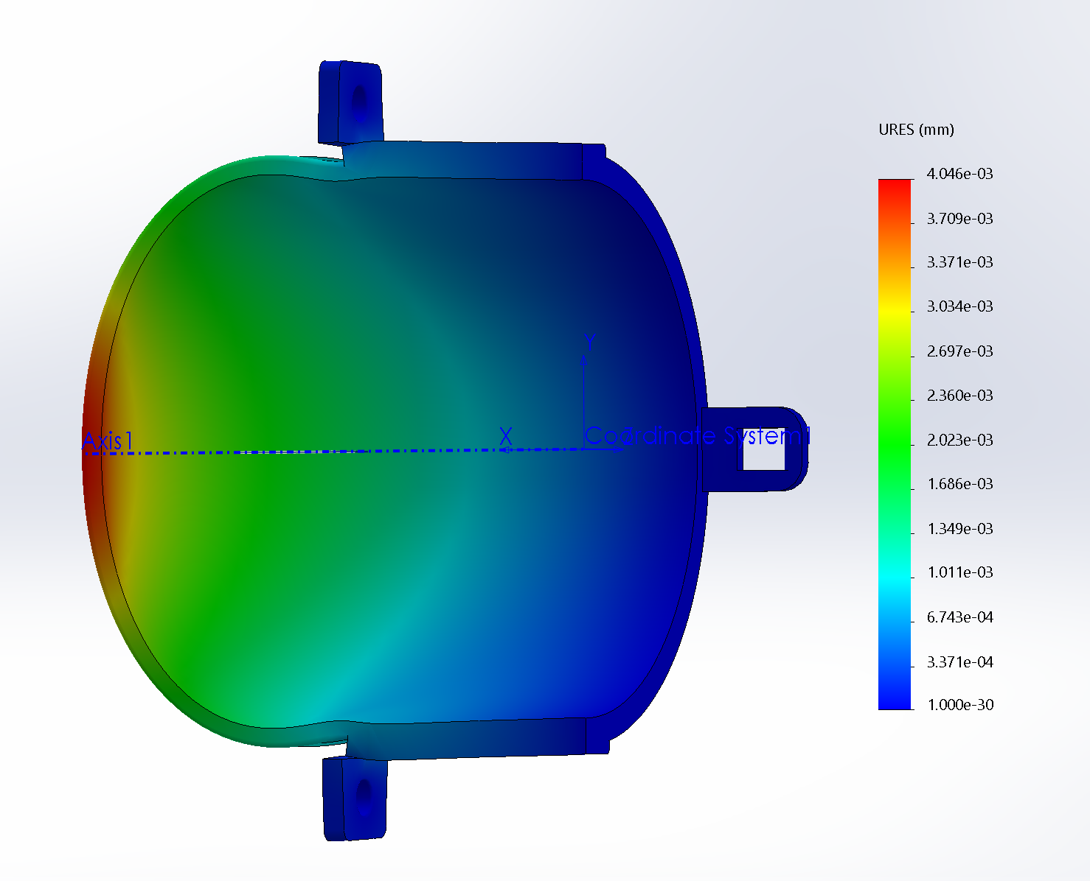
Fairing Displacement
Dr. Maute identified component displacement as most important quality
FEA was conducted for each component separately
Component Displacements:
Left Side Fairing: 1.123e-7 mm
Right Side Fairing: 4.03e-3 mm
These results are with each component acting independently
Mounting the two pieces together will provide additional structural support
Notes:
Zoe

Slide 52
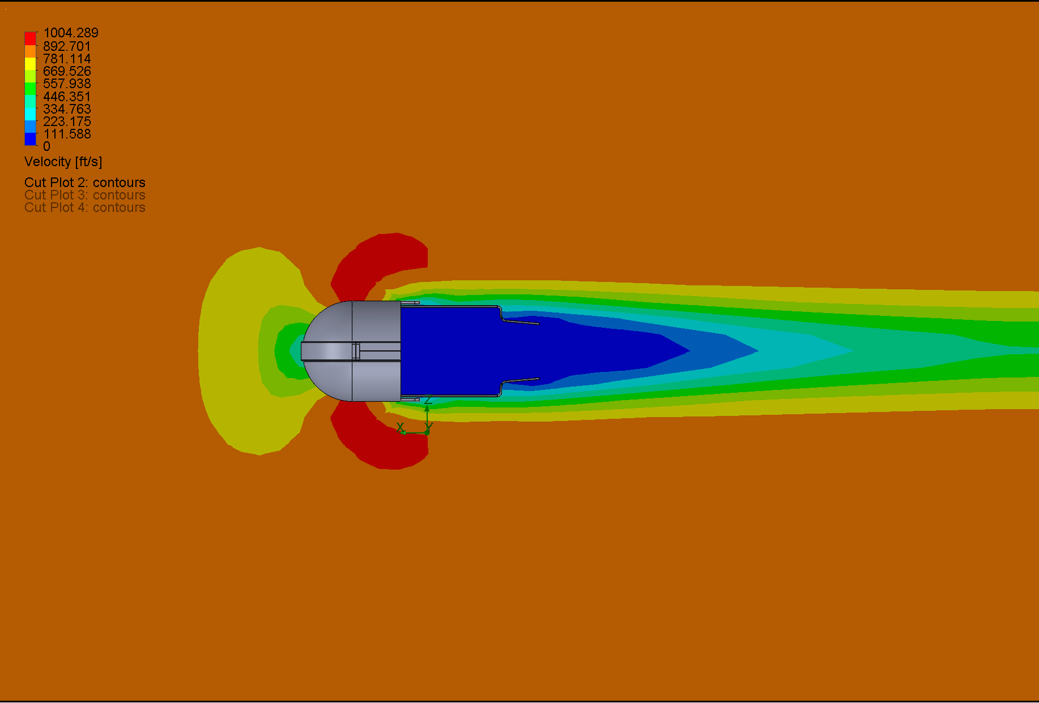
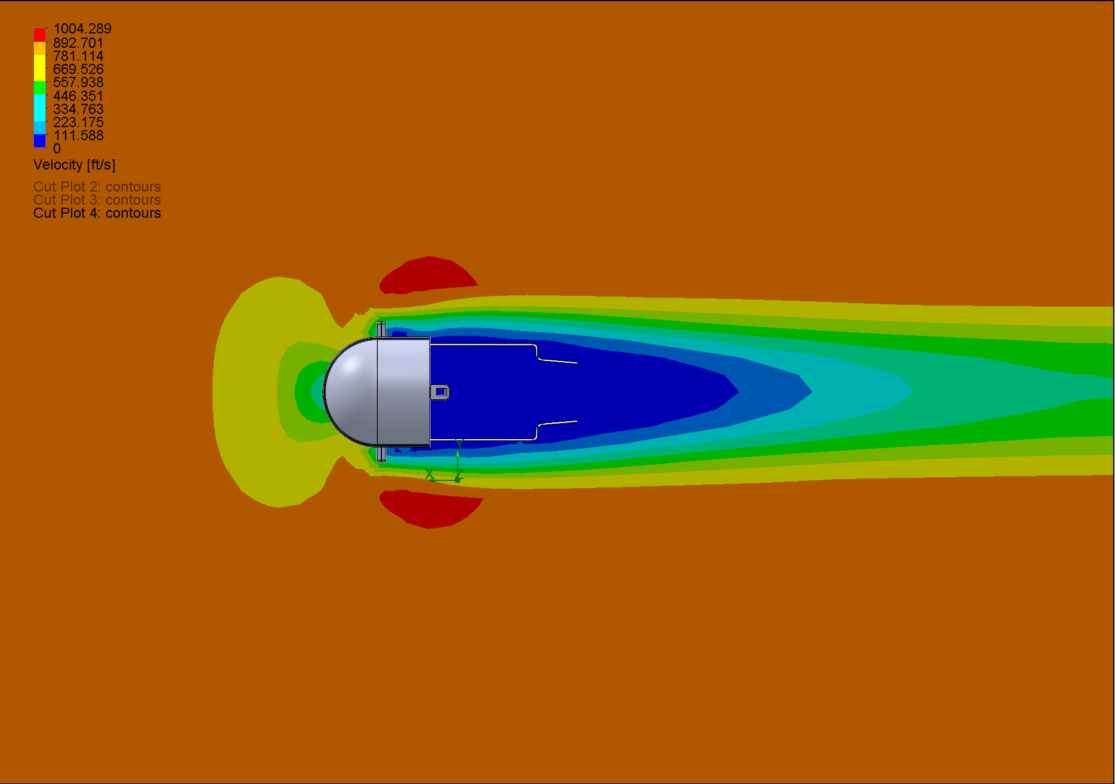
Design Validation
CFD conducted simulating Mach 0.8 at 20,000 ft
Professor John Mah confirmed the turbulent wake aft of the engine re-entering the nozzle should not be a concern
Notes:
Zoe

Slide 53
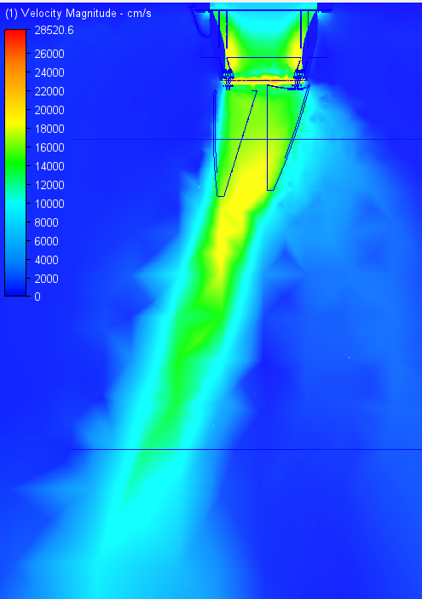
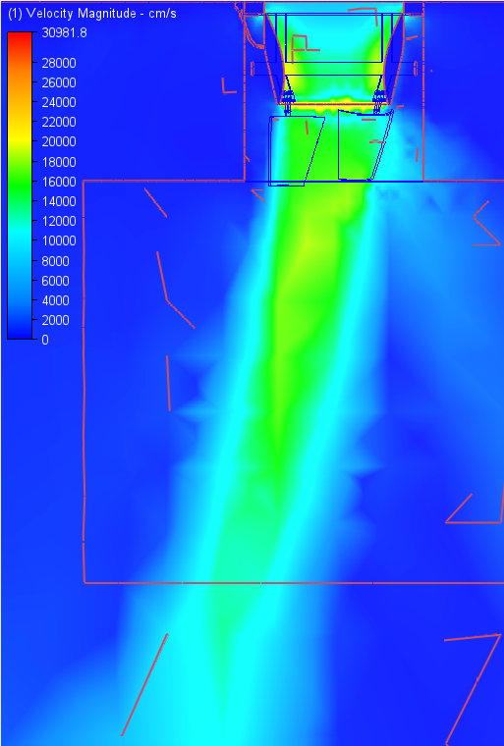
Thrust Vectoring CFD Results
θ = 17°
θ = 11°
A = 1250mm²
A = 850mm²
Paddles are at 20°
Paddles are at 20°
Notes:
Jon

Slide 54
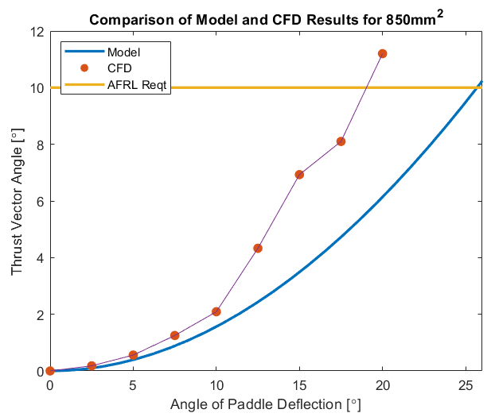
Thrust Vectoring CFD Results Cont.
Probable causes of difference in results
CFD can calculate momentum at each point more accurately
Model does not account for flow entrainment
Using smaller paddle area (850mm²)
More confidence in CFD
Notes:
Jon

Slide 55
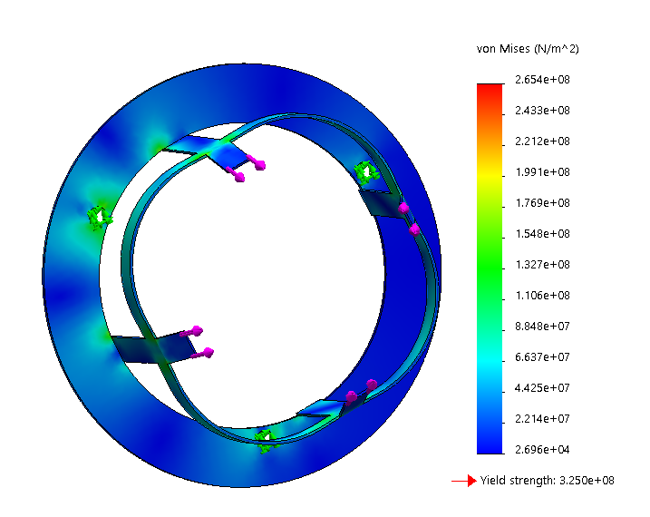
Sheath Structural Analysis
Material modeled as Aluminum 2024
Yield strength - 325 MPa
Max total axial force - 100N+
Failure mode is bending point
Load would be distributed with actuator linkage.
Notes:
Jon

Slide 56
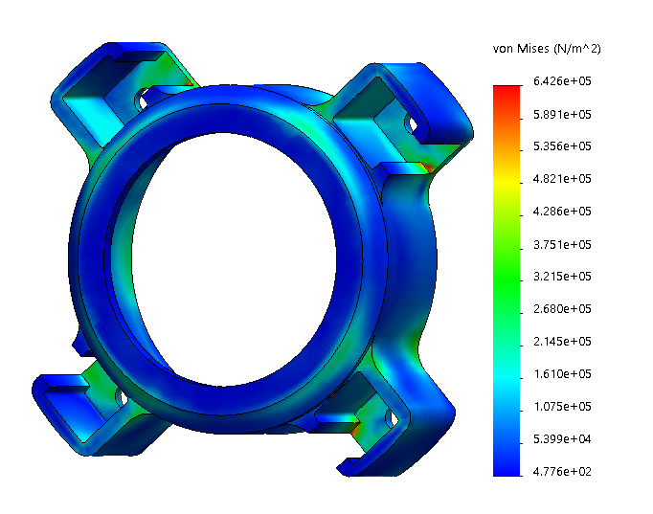
Actuator Housing Structural Analysis
ABS Plastic 3D printed structure
Assumes front lip is fixed; load is dynamic pressure on rear cross sectional area (overestimate).
ABS Strength ~ 40 MPa
Max von Mises stress = 643 kPa
FOS = 62
Glass transition temperature = 98°C
Engine base doesn’t get significantly hotter than ambient conditions in previous tests.
Notes:
Jon
Strength from Simplify3D.com

Slide 57
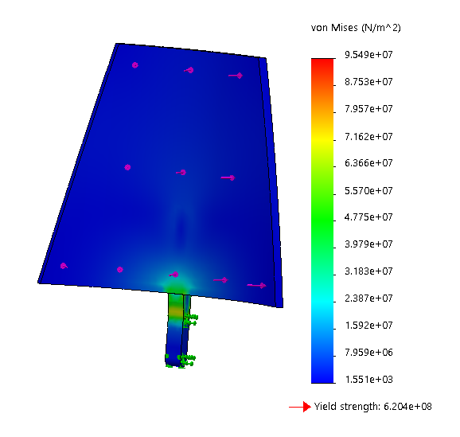
Paddle Structural Analysis
Stainless Steel 0.04” thick sheets cut then rolled into shape.
Service Temp of 700K > 668K max temp from thermal model
From CFD, each paddle experiences 7.31N normal to plane at center of paddle
Similar to base principle estimate
Assumes pins fixed; 8N normal load to paddle
Max von Mises stress of 96 MPa < 620 MPa yield strength (FS = 6.5)
Notes:
Jon

Slide 58
Vibrational Analysis
Engine frequency range between idle and max thrust state (50 N to 100 N)
733.3 Hz ≤ f ≤ 2566.7 Hz
Two main points of concern are the paddle and rod connection between actuator screw and paddle
Actuator and screw will absorb some of the engine excitation (damper)
Material is modeled as T-600 Steel with a modulus of elasticity of ~200 GPa
Paddle: f = 18.28 Hz
Rod: f = 329 Hz
Actuator, screw, nozzle sheath, and plastic housing will act as dampers to dissipate energy, further reducing risk of vibrational failure
Notes:
Because the largest natural frequency is 329 Hz, which is far less than engine idle state, we can accept the components as good to go.
Jon

Slide 59
List of Necessary Materials
Windmill Prevention Mechanism (acquire)
PVC and PVC cap
Pressure regulator
Pressure gauge
Air line (50ft)
NPT connectors (¼”)
Thrust Vectoring Mechanism (acquire)
Load cell/load cell amplifier
Pillow blocks
Steel shafts
Aluminum plates
Compression springs
Electronics/Software (acquire)
Connectors
Motor drivers
Actuators
Windmill Prevention Mechanism (manufacture)
Outlet 3D-printed nozzle (SABRE)
Thrust Vectoring Mechanism (manufacture)
Paddles/linkages
Electronics/Software (manufacture)
MCB
LPBB (x4)
ICUP
MCB housing

Slide 60
Stock engine testing (preheating)

Slide 61
Stock engine testing (visible exhaust)

Slide 62
Risk Reduction
ICUP design is being modified to resemble a bracelet, rather than a donut
Reduces risk of ICUP breaking under load of the Mach 0.8 air and from ejection of the fairing hitting the ICUP
Ensures that fairing ejection does not interfere with the electronic components onboard the engine
New design
Notes:
Presenter:

Slide 63
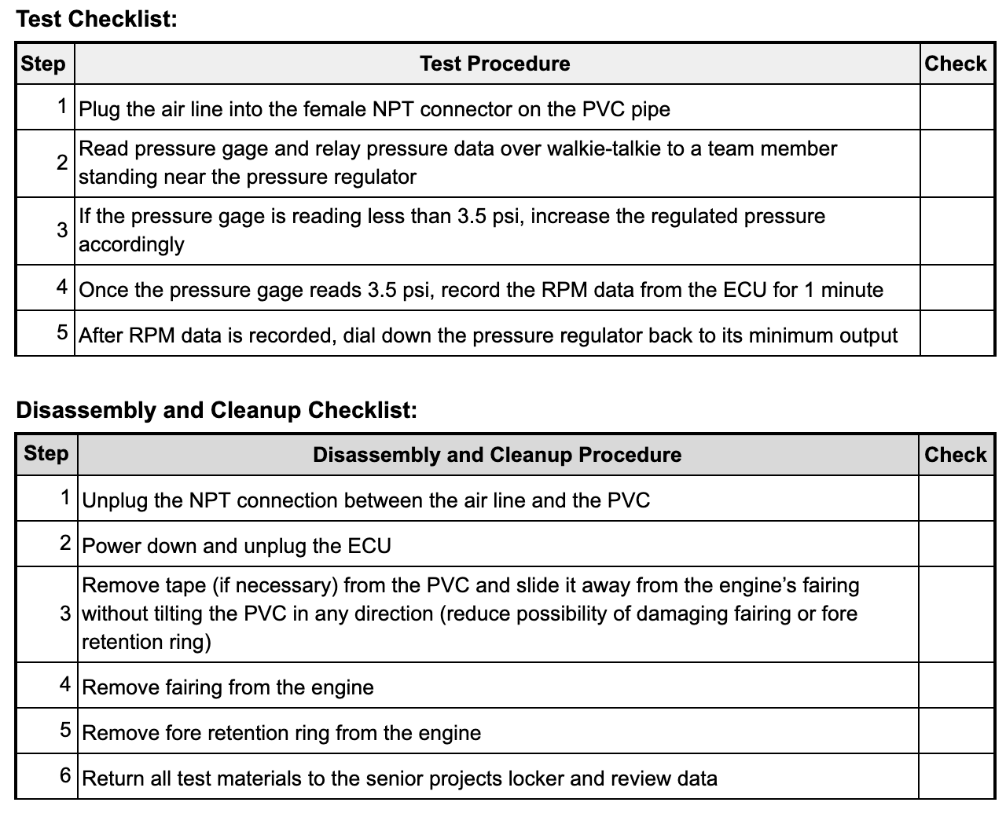
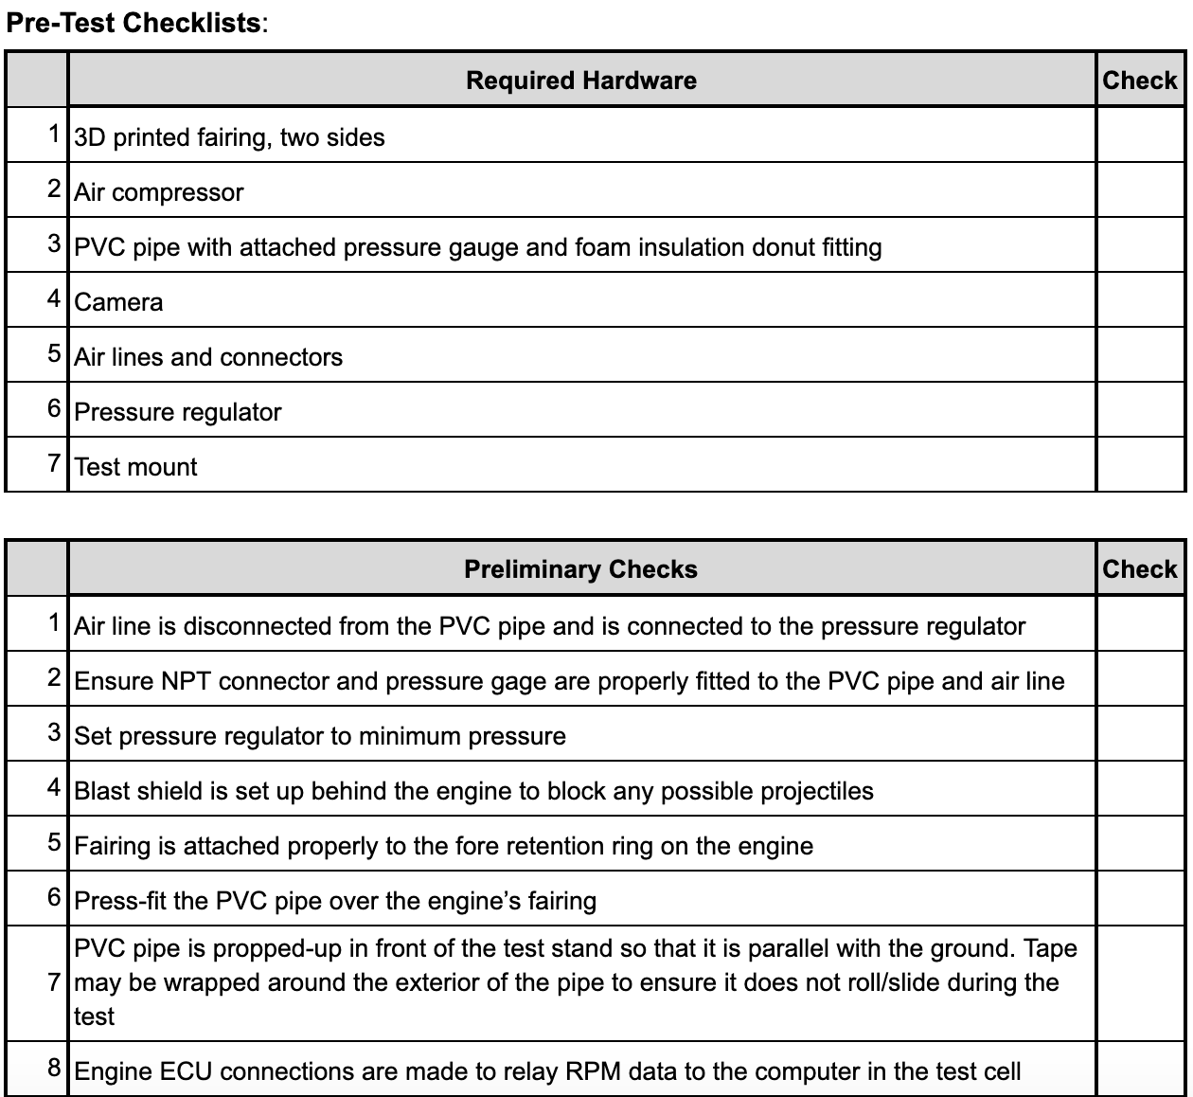
WPM Test #1 plan

Slide 64
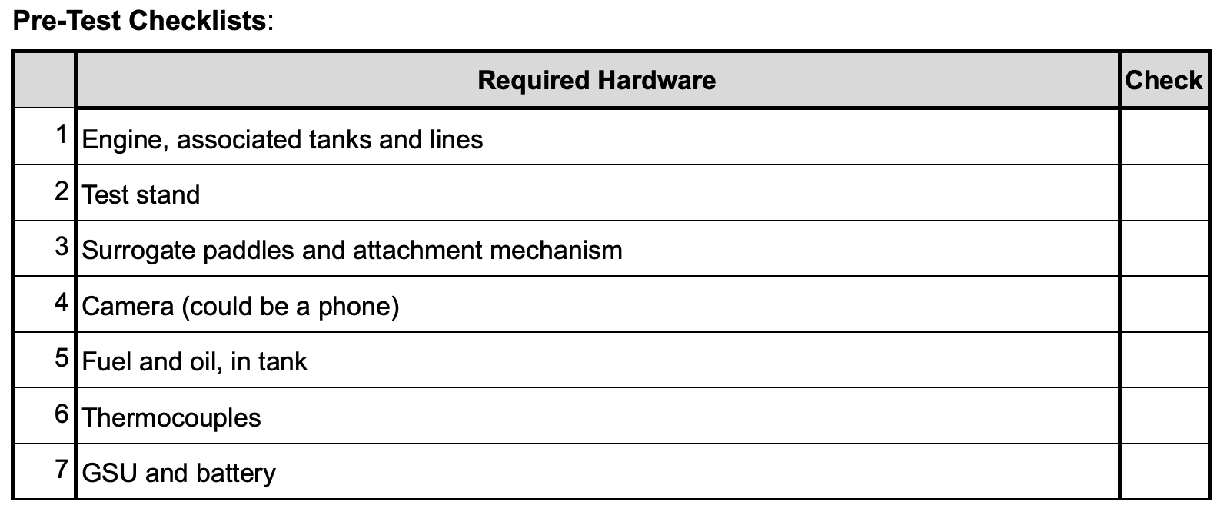
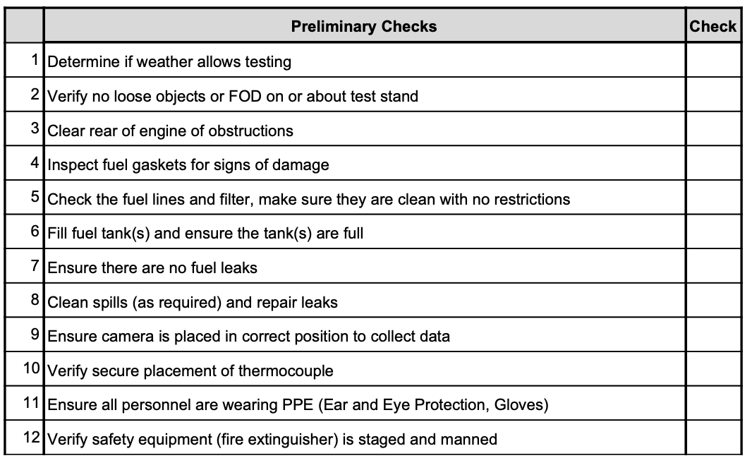
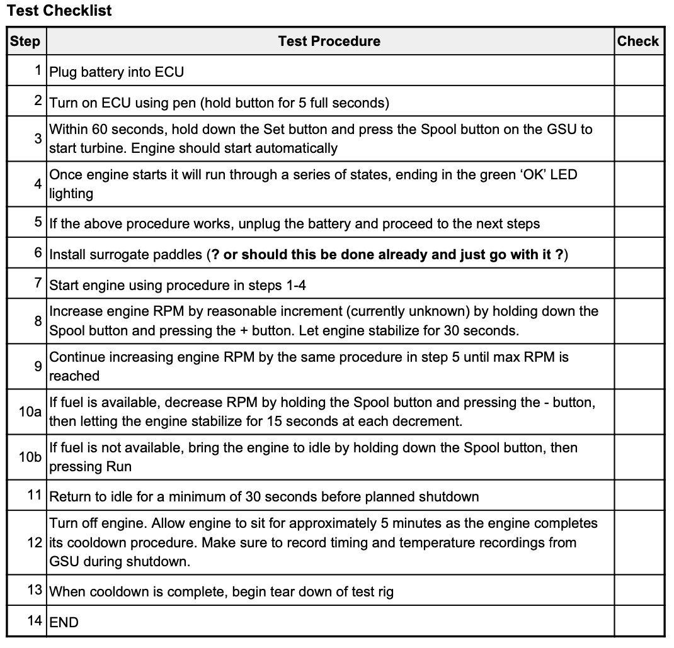
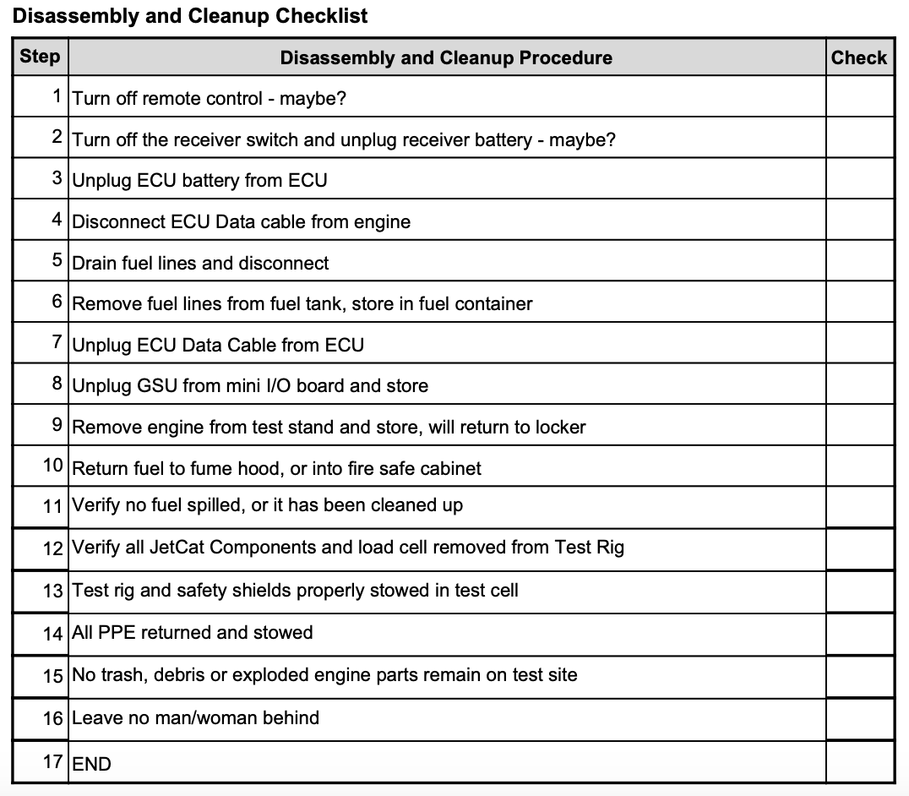
Stock Engine and Dummy Paddle Test

