Slide 1
WHiMPS
Windmill Hindrance and Maneuverable Propulsion System
Team:
Alec Bosshart
Isobel Griffin
Julia Kincaid
Andrew Meikle
Declan Murray
Alexandra Paquin
Andrew Robins
Liam Sheffer
Jon Weidner
Zoe Witte
Lucas Zardini
Nick Zellmann
Final Oral Review
Advisor: Dr. Donna Gerren
Customer: Air Force Research Laboratory
POC: 1LT Riley Huff
Notes:
Presenter:

Slide 2
Overview
Overview
Design Description
Testing
Systems Engineering
Project Management
Notes:
Presenter: nick start

Slide 3
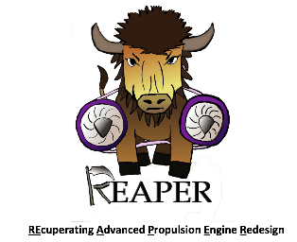
APOP Demonstration
WHiMPS is participating in the annual AFRL sponsored Aerospace Propulsion Outreach Program (APOP) Demonstration
APOP is designed to use small gas turbine engines as a testbed to demonstrate technology that can solve problems experienced by the Air Force on larger gas turbine engines
Heritage projects:
SPECS 2019
ACES 2018
SABRE
2017
REAPER 2016
MEDUSA 2015
Notes:
Presenter:

Slide 4
Problem Statement
Problems
Prevent windmilling of the fan blades while under flight conditions of Mach 0.8 at 20k feet
Implement thrust vectoring capabilities of +/- 10 degrees to the JetCat P100-RX Engine
Motivation
Many small UAVs do not have the capability to fly long distances before completing a mission
To solve this problem, the Air Force often carries drones to their operational environment with a larger carrier aircraft and deploys them from the larger aircraft. This creates the new problem of windmilling, which makes it difficult to start the engine.
Notes:
Presenter:
Should we add in any kind of a picture here?

Slide 5
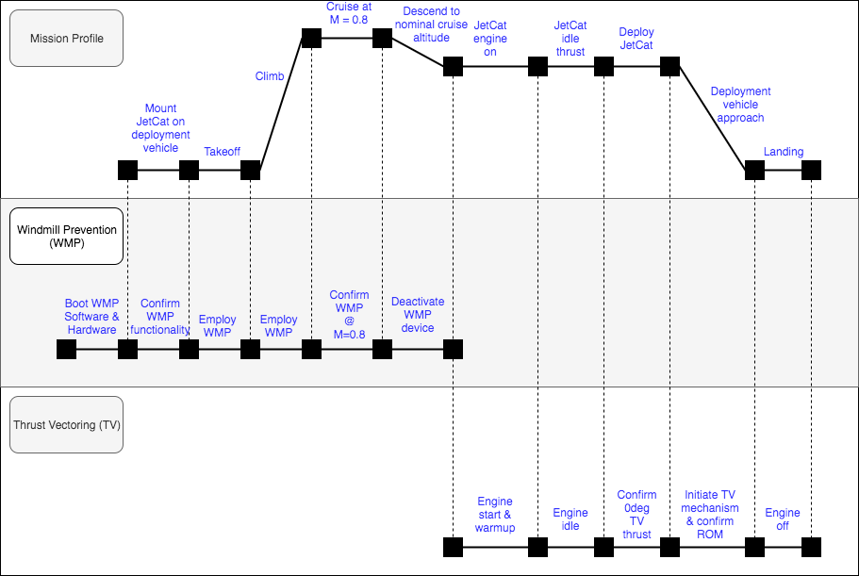
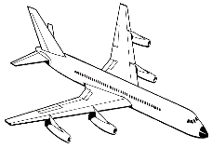
Project Purpose Visualization
Notes:
Presenter:

Slide 6
Project Impact
Improve reliability of UAVs in Air Force applications
Without any form of windmill prevention, the engines need to start at a very high RPM which causes major reliability issues
Increase operational lifespans of small jet engines
When windmilling occurs, turbine shaft spins at a high RPM without any lubrication
Increase performance of drones
Thrust vectoring impacts the maneuverability of drones
Allows for additional control methods in addition to traditional rudder/elevators
Notes:
Presenter:

Slide 7
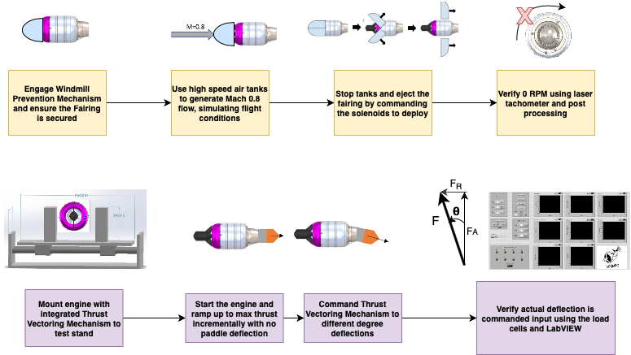
WHiMPS Concept of Operations
Notes:
Presenter:
Tweak TV conops, include more detail about starting engine, etc.

Slide 8
Levels of Success
Level | Windmill Prevention Mechanism | Thrust Vectoring Mechanism
1 | Simulation predicting selected WPM design is capable of preventing engine rotation from exceeding 0.5 RPM under flight conditions of Mach 0.8 at 20kft. Control software able to simulate ejection mechanism. | Simulations predicting zero change in nominal thrust at zero degrees of thrust deflection. Control software capable of vectoring thrust by 10 degrees in a single axis using simulated TVM. /
2 | Same as level 1 | Control software able to move physical TVM system to conditions representative of 10 degrees of vectoring in a single axis.
3 | Physical WPM capable of restricting turbine shaft to less than 0.5 RPM in test environment. Ejection in static environment successful. | Control software able to move physical TVM system to conditions representative of 10 degrees of vectoring in two perpendicular axis.
4 | Reach level 3 of success in both WPM and TVM with engine turned off.
5 | Reach level 4 on a functioning Jetcat P100-RX.
Notes:
Presenter:

Slide 9
Design Description
Overview
Design Description
Testing
Systems Engineering
Project Management
Notes:
Presenter:

Slide 10
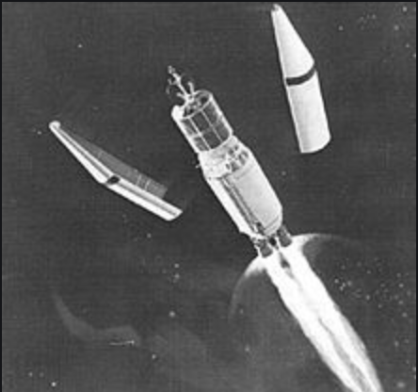
Windmill Prevention Mechanism (WPM)
Design Theory: Prevent windmilling by preventing any uniform mass flow through the core of the engine using a covering mechanism
Challenges:
Need to be able to deactivate remotely
Accomplished through a spring-loaded ejection
Deployed by signal from control panel using solenoids
AFRL desired a system that would have minimal impact on drag and mass
Fairing’s shape reduces drag
Selected carbon fiber reinforced plastic to maximize strength to weight within our budget
Design inspiration: Rocket fairings
Notes:
Presenter:

Slide 11
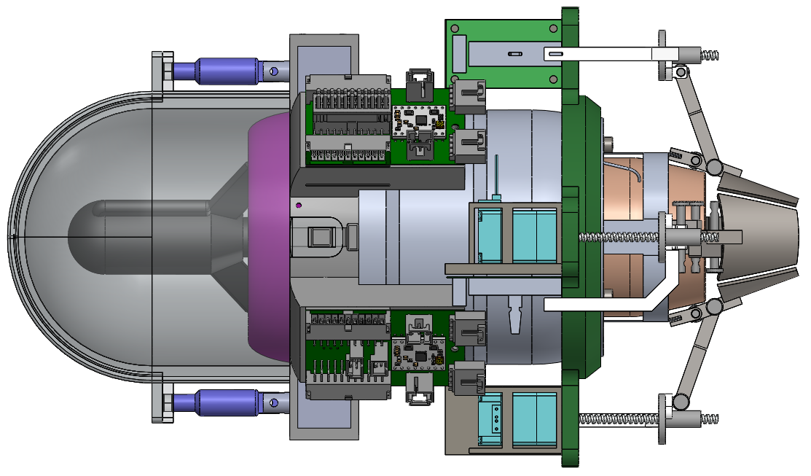
Baseline Design - WPM
Fore Retention Ring
Solenoid Housing
Fairing
Ejection Spring Location
6.8”
Solenoid Pins
11”
Notes:
Presenter:

Slide 12
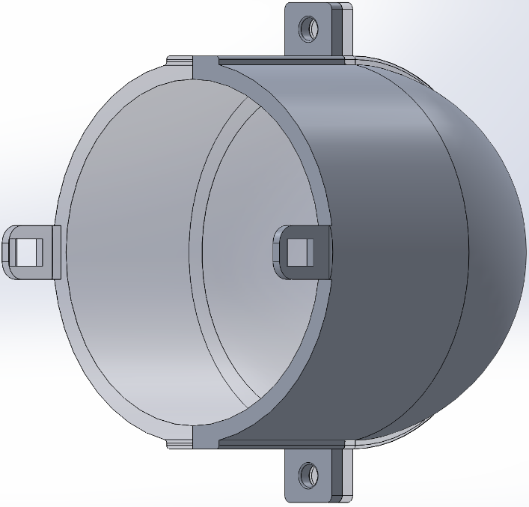
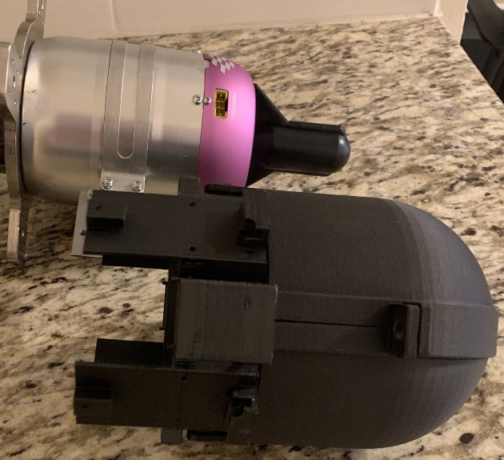
Windmill Prevention Mechanism (WPM)
Fairing
Critical Element: Deflects flow around the body of the engine
Simplified design made for easy integration with JetCat engine
5mm thick
97mm
Manufactured using Carbon Fiber reinforced Onyx
Compressive Strength 320 MPA
50% greater strength to weight than 6061 aluminum
105mm long
Notes:
Presenter:

Slide 13
Windmill Prevention Mechanism (WPM)
Fairing Ejection
Fairing mounted to engine using Fore Retention Ring
Deployed by retracting solenoid pins from fairing
Fairing will be ejected along the sides of the engine
Assisted by internal springs
Attached to inside of fairing, mounted against starter motor
According to CFD, aerodynamic forces will aid in separating fairing and assist in deployment
Notes:
Presenter:

Slide 14
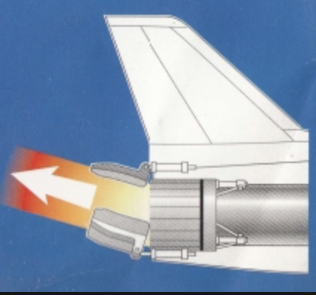
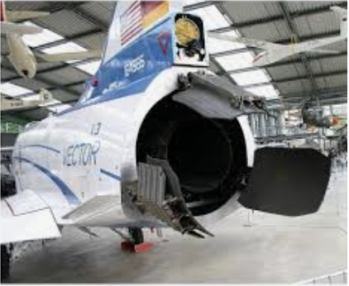
Thrust Vectoring Mechanism (TVM)
Design Theory: Deflect exhaust flow by turning paddles into the flow using an “X” configuration of 4 paddles
Challenges:
Need to be able to relate thrust vectoring angle to paddle deflection angle
Accomplished through model derived from aerodynamic principles and through CFD
Air Force desired a solution that would not impact nominal thrust of the engine
With paddles retracted, there will be no disturbance to exhaust flow
System must be able to handle extreme thermodynamic and aerodynamic loads associated with exhaust of jet engines
Material selection of stainless steel
Design Inspiration: Other paddle thrust vectoring technologies using 3 paddles
Notes:
Presenter:

Slide 15
Baseline Design - TVM
Nozzle Sheath
Linear Potentiometer
Paddle
Linear Actuator
6.8”
Actuator Pod
Linear Potentiometer Arm
Actuator Ring
Linkage Rod
11”
Notes:
Presenter:

Slide 16
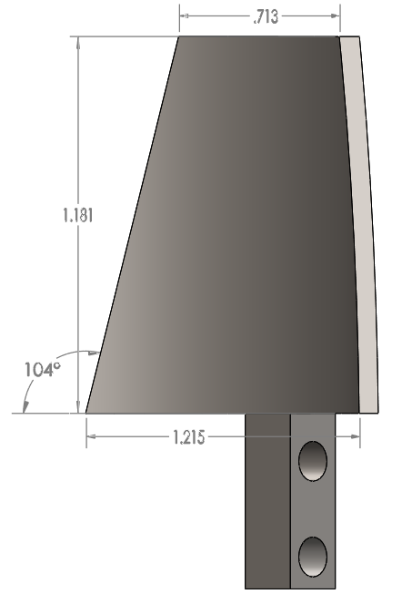
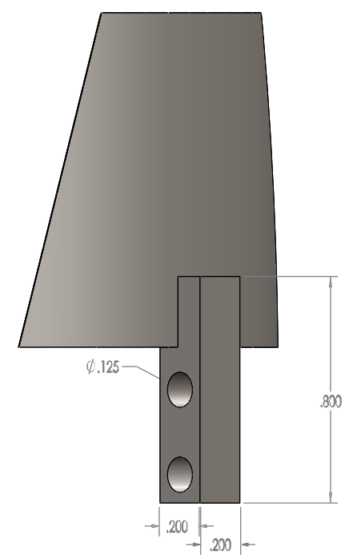
Thrust Vectoring Mechanism (TVM)
Paddles
Most critical element - Physically deflects exhaust flow
Simple design - trapezoid in 85° arc
Exposed to very high thermal stresses
Comprised of 17-4PH stainless steel
Design process began with flat square plate assumption.
Create analytical model to predict paddle area requirements
Notes:
Presenter:

Slide 17
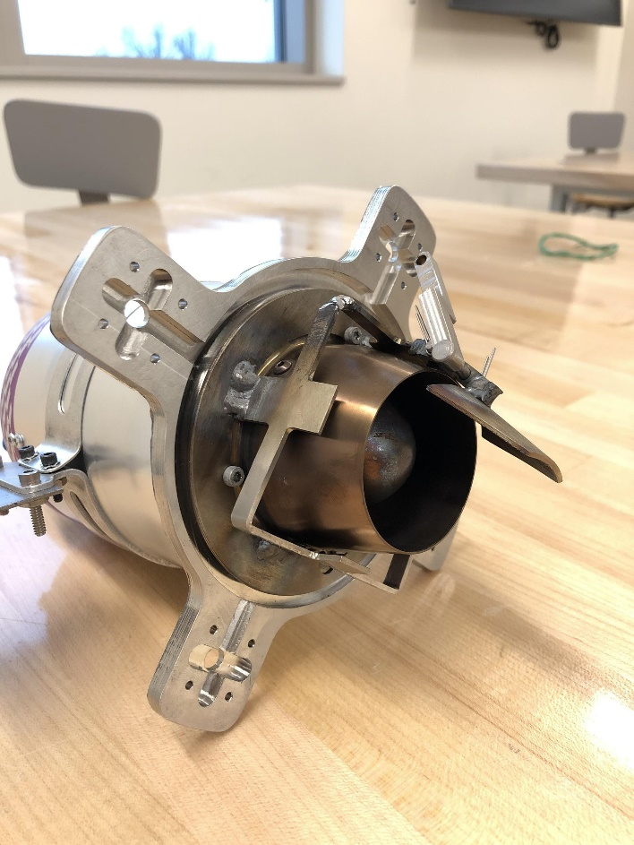
Thrust Vectoring Mechanism (TVM)
Notes:
Presenter:

Slide 18
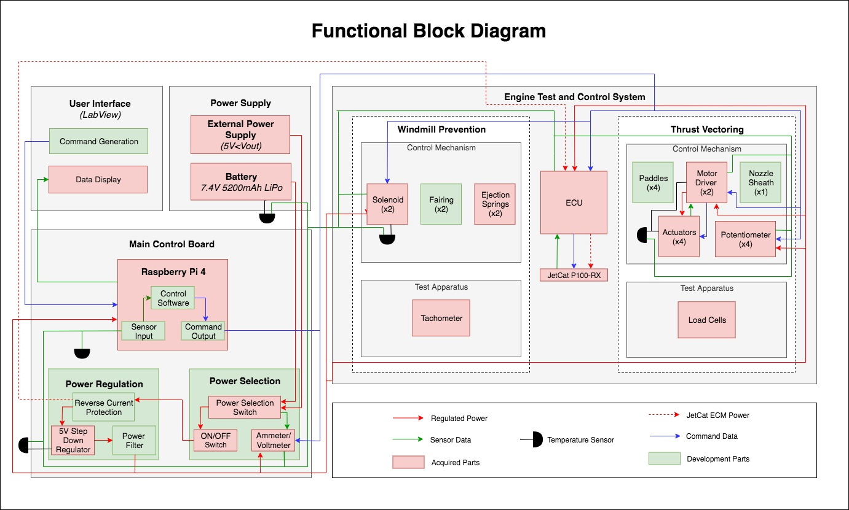
Notes:
Presenter:

Slide 19
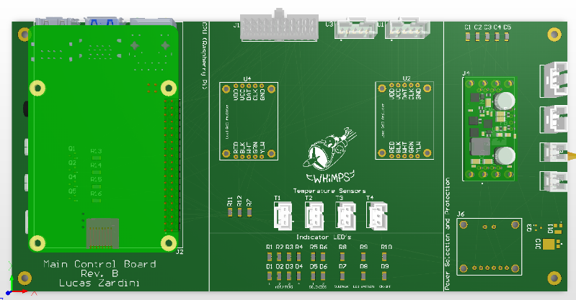
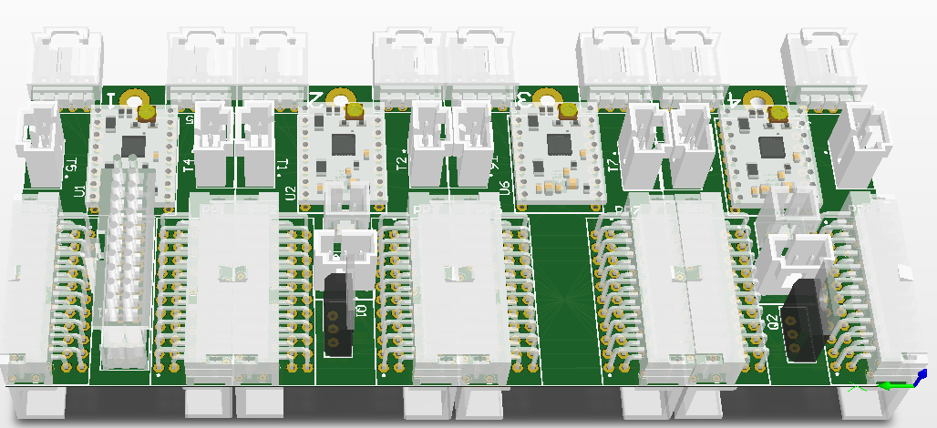
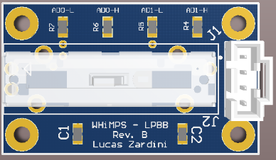
Electronics Overview
Main Control Board (MCB)
Provides WHiMPS’ data processing and power distribution
Integrated Communication Unit Panel (ICUP)
Extends actuators and potentiometers’ data and power lines from the MCB to the engine
Linear Potentiometer Breakout Board (LPBB)
Converts potentiometer analog output to a digital signal (I2C)
Rev. B
MCB
ICUP
LPBB
Notes:
Presenter:
More information
Where they live in main system- more context and anything significant about the boards
Since these are simple, the schematics are in backup
Relate to the FBD
Vague descriptions
Keep referring to everything and what they are doing

Slide 20
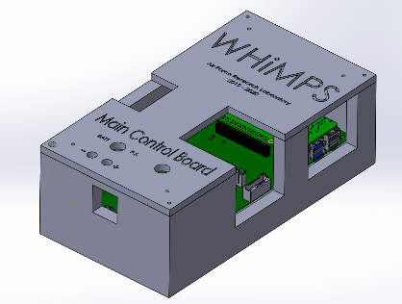
Electronics System CAD
LPBB
ICUP
Test cell safe room
MCB
Notes:
Presenter:

Slide 21
MCB Revision B
Important Functions:
The MCB will be located in the Engine Test Cell/Safe Room
This board has the Raspberry Pi 4
Power Selection (On/Off Switch)
Power Regulation (Converts 7.6V to 5V)
Power Protection (Zener Diode and PMOSFET in power path)
Temperature sensors and warning LEDs
Solenoid LEDs
Power LEDs
Power check FETs (1 for each motor driver)
Load Cells and Amplifier
Connects to ICUP
Notes:
Presenter:

Slide 22
ICUP Revision B
Important Functions:
The ICUP will be in a bracelet design around the Fore Retention Ring
Connects to the MCB
Motor Drivers/Linear Actuators
Connects to LPBB
5V to 2.5 V step down
Solenoids (Panels 2 and 4)
Temperature Sensors
1
MCB <-> ICUP
Actuator #1
Motor Driver #1
LPBB #1
2
Solenoid #1
Actuator #2
Motor Driver #2
LPBB #2
3
Actuator #3
Motor Driver #3
LPBB #3
4
Solenoid #2
Actuator #4
Motor Driver #4
LPBB #4
Notes:
Presenter:

Slide 23
LPBB Revision B
Important Functions:
4 boards
Located in the Actuator Ring
Contain the Linear Potentiometers
Connects to the ICUP
Converts analog output to digital
Notes:
Presenter:

Slide 24
Notes:
Presenter:
How complex is it
How much did you write vs inherit
What were the main things that took time

Slide 25
Software Development
The MCB software was the most time consuming
The LabVIEW for the WHiMPS was mainly focusing on completing calculations, and sending commands and receiving data from the MCB
The MCB software components that were expected to be the most difficult are:
Feedback loop between the linear potentiometers and the linear actuators
Bit banged serial driver for the load cells
It was difficult to have the LabVIEW and MCB Software development so separate, so determining who was in charge of which calculations and getting on the same page about data types and command dictionaries was something our team struggled with.
Notes:
Presenter:

Slide 26
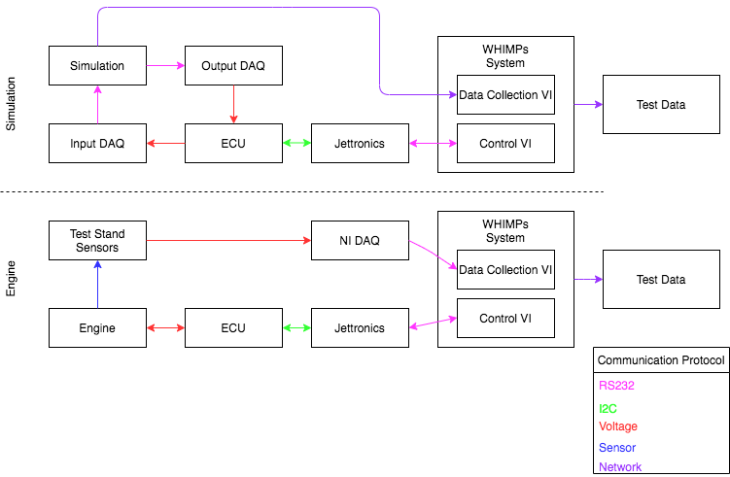
System Integration Diagram
Notes:
Presenter:

Slide 27
Complete Engine System
6.8”
11”
Notes:
Presenter:
Wholistic go over where everything is and functions of components

Slide 28
Changes Since TRR
Switched from using stock Hall Effect sensor to laser tachometer for measuring RPM during WPM testing
Confirmed with Jetcat that Hall Effect sensor would not sufficiently be able to measure engine RPM below 2,000 RPM
Informed Lt. Trenter of this issue during his visit
Mitigations to thermal concerns of electronics were in progress when COVID shutdown occurred
More detail on this will be discussed in the testing section
Notes:
Presenter:

Slide 29
Critical Project Elements
CPE | Critical Characteristics
Windmill Prevention Mechanism (WPM) | Prevents windmilling by preventing freestream air from entering the engine while deployed. Must be remotely disengaged.
Thrust Vectoring Mechanism (TVM) | Turns exhaust flow to vector engine’s thrust to a commanded vectoring angle.
Main Control Board (MCB) | During testing and product development, this will monitor WPM/TVM.
Integrated Communication Unit Panel (ICUP) | Minimizes amount of wires to reduce risk of human error and increases processing speed.
Software | Controls the incorporated mechanisms over the entire operational envelope.
Notes:
Presenter:

Slide 30
Remaining Work
Windmill Prevention
Manufacture solenoid pins → 6 man hours
Integrate system onto engine → 3 man hours
Thrust Vectoring
Finish manufacturing components → 7 man hours
Integrate final 3 paddles → 4 man hours
Electronics
Receive and populate Rev. B of PCB’s → 5 man hours
Subsystem test Rev. B of PCB’s → 15 man hours
Software
Complete LabView → 20 man hours
Complete MCB Software → 45 hours
Remaining testing will be covered in depth in the next section of this presentation
Notes:
Presenter:
Discuss just items and total time left
We should also touch on plans for how we were going to get the software done

Slide 31
Testing
Overview
Design Description
Testing
Systems Engineering
Project Management
Notes:
Presenter:

Slide 32
Engine Testing Progression
TVM Testing
WMP Testing
Stock Run
Understand engine operation
APOP Replica Test
Verify fairing prevents airflow under pressure differential
Vibration and Thrust Baseline /
Characterize vibration and thrust
Stock w/ Dummy Paddle
Mitigate stock engine electronics risks and validate paddle thermal model
SABRE Static WPM Test
Validate fairing function at Mach 0.8
Static TVM Test
Validate ability to vector thrust using paddles preset in deflected position
SABRE Dynamic WPM test
Verification of ability to eject fairing at Mach 0.8
Dynamic TVM Test
Verify ability to vector thrust by commanding paddle movement during engine operation
TVM and WPM Integration Tests
Notes:
Presenter:
Moving the “X” next to integration tests because it was half off the screen

Slide 33
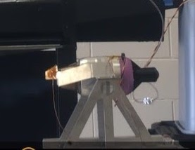
Stock Engine and Dummy Paddle Test
Validated thermal model before implementation of hardware
Verified engine did not turn off when flow was deflected using dummy paddles
Equipment
Engine, associated tanks and lines
Test stand
Paddles and attachment mechanisms
Fuel and oil, in tank
Thermocouples
GSU and battery
Facilities
CU Aerospace Test Cell
Notes:
Presenter:

Slide 34
Notes:
Presenter:

Slide 35
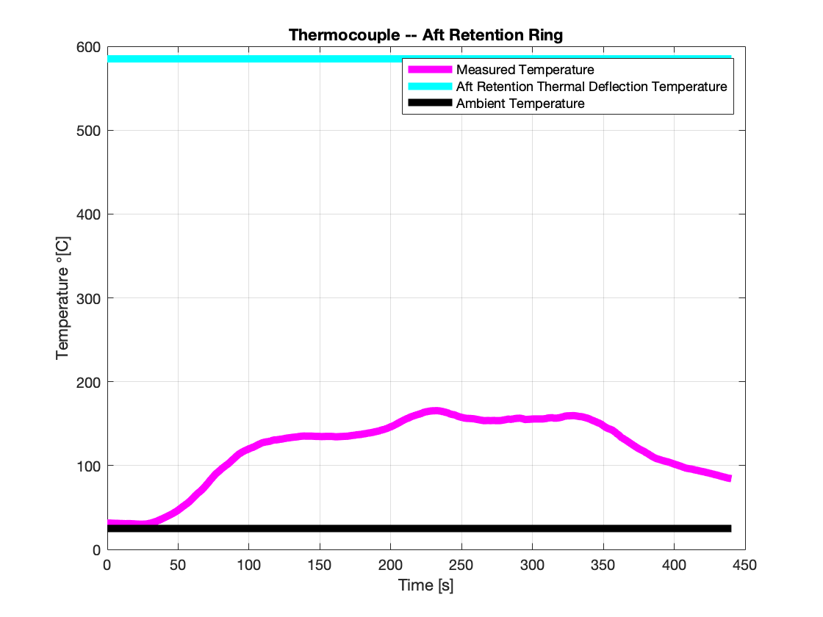
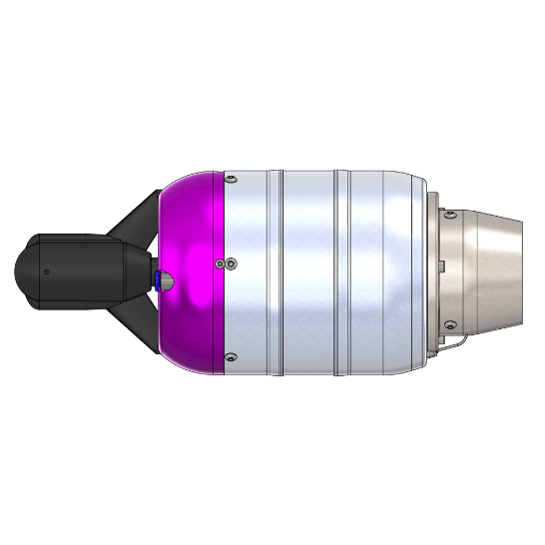
Stock Engine Test Thermocouple Data
Max Temp: 168°C
Notes:
Note that 304 steel has a melting point of 1400C, but can be used in continuous manner up to 925C
Add model expectations and error bars

Slide 36
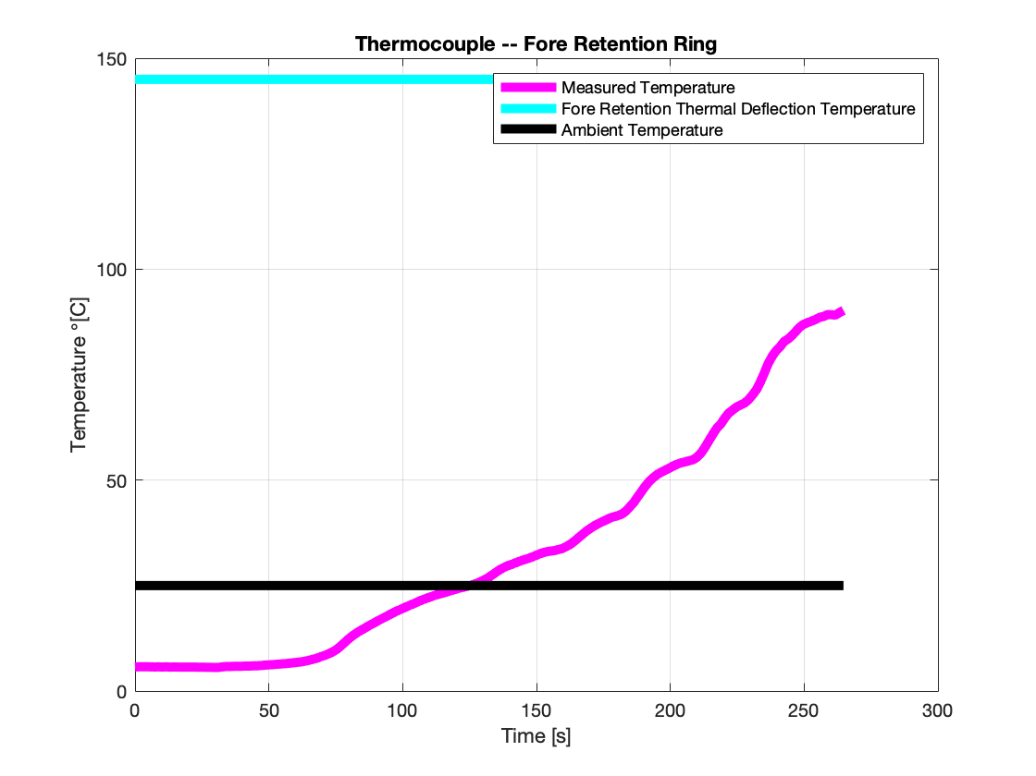
Stock Engine Test Thermocouple Data
Max Temp: 79°C

Slide 37
ICUP Temperature Analysis
25°C
Fore retention ring
Engine
145°C
145°C
Ambient air at 25°C
Conduction through ring
Natural convection to ambient air
=
Result: The temperature at the location of the boards can vary from 59°C to 125°C depending on the convective heat transfer coefficient.
Notes:
Presenter:
Presenter - note that the convective heat transfer coefficient is determined experimentally, so we used values at both extremes of natural convection from a table. Best case scenario is the same as the worst case for forced convection, so a fan could reasonably keep us 30% below the temp limit. Thermal conductivity of material is also unknown, assumed a worst case of twice as high as ABS

Slide 38
Electronics Thermal Mitigations
Electronics have approximate thermal limit of 95°C
Unable to test exact temperatures at electronics attachment locations, but a simple 1D heat transfer for a worst case scenario was conducted
Analysis said that the temperature of the fore retention could exceed the electronics thermal limit, depending on the natural convection heat transfer coefficient
If we use the worst case scenario of convective heat transfer coefficients for forced convection, temperature of the boards would be 60°C
Insulating materials were investigated in the event that this analysis is incorrect due to approximations for convective and conductive heating coefficients that are typically determined experimentally
Ceramic-based foam, provides 60°C temperature reduction -- HeatShields™
Notes:
Presenter:
Definitively decide what we were going to do
Think about if someone next year wanted to implement this
Talk about the results of thermal testing
Tease the audience

Slide 39
Engine Testing Progression
TVM Testing
WMP Testing
Stock Run
Understand engine operation
APOP Replica Test
Verify fairing prevents airflow under pressure differential
Vibration and Thrust Baseline /
Characterize vibration and thrust
Stock w/ Dummy Paddle
Mitigate stock engine electronics risks and validate paddle thermal model
SABRE Static WPM Test
Validate fairing function at Mach 0.8
Static TVM Test
Validate ability to vector thrust using paddles preset in deflected position
SABRE Dynamic WPM test
Verification of ability to eject fairing at Mach 0.8
Dynamic TVM Test
Verify ability to vector thrust by commanding paddle movement during engine operation
TVM and WPM Integration Tests
Notes:
Presenter:
Moving the “X” next to integration tests because it was half off the screen

Slide 40
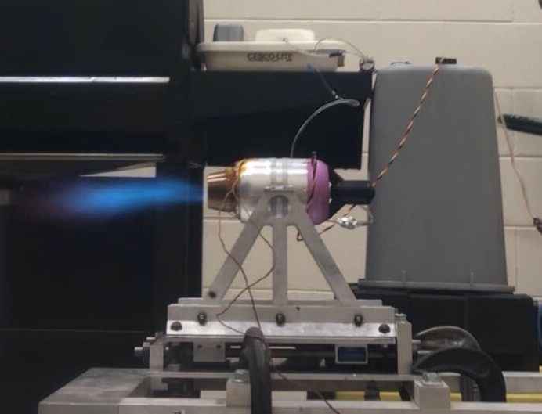
Thrust Baseline Test
Collected thrust data at 100% throttle without exhaust deflection
Would have been used to compare with TVM tests under zero paddle deflection
Used to validate FR1 - Thrust Vectoring
Equipment
Engine, associated tanks and lines
Test stand
Paddles and attachment mechanisms
Fuel and oil, in tank
Thermocouples
GSU and battery
Facilities
CU Aerospace Test Cell
Notes:
Presenter:

Slide 41
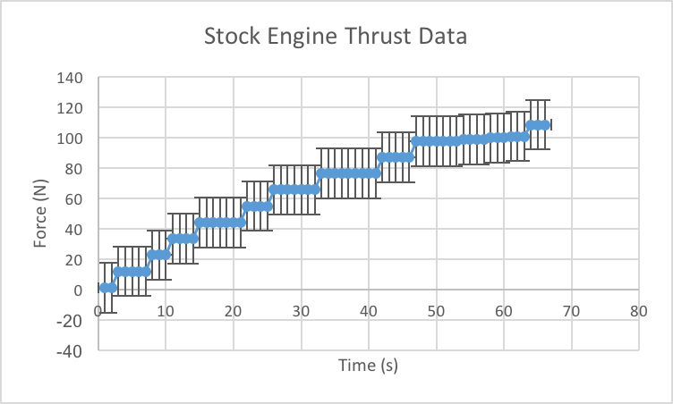
Thrust Baseline Test Data
Max RPM = 154k
Max Thrust = 100N (JetCat)
Idle Thrust =
3N (JetCat)
Idle RPM = 40k
Notes:
The prettiest data I ever did see :)
This step up is due to test profile not resolution

Slide 42
Load Cell Measurement
Initial load cell testing showed finicky nature and low precision measurements on March 12th (day before shutdown)
Further testing was planned to determine severity of load cell precision error
Current error is ±16.35N, which is ±25°
Would prefer error of ±1° - requires error of ±0.7N
Expect losses due to friction along rail system
Further testing using known masses and gravity to quantify error was planned
Notes:
Presenter: consider moving

Slide 43
Vibration Expectations
Vibration models made several predictions
Engine frequency: 733.3 Hz ≤ f ≤ 2566.7 Hz
Material is modeled as T-600 Steel with a modulus of elasticity of ~200 GPa
Paddle: f = 18.28 Hz
Rod: f = 329 Hz
Actuator, screw, nozzle sheath, and housing will act as dampers to dissipate energy, further reducing risk of vibrational failure
Accelerometer would have provided vibration data for all engine states to confirm components would survive
Notes:
Isobel added this in, not sure if it’s what we need, lemme know
Presenter:

Slide 44
Engine Testing Progression
TVM Testing
WMP Testing
Stock Run
Understand engine operation
APOP Replica Test
Verify fairing prevents airflow under pressure differential
Vibration and Thrust Baseline /
Characterize vibration and thrust
Stock w/ Dummy Paddle
Mitigate stock engine electronics risks and validate paddle thermal model
SABRE Static WPM Test
Validate fairing function at Mach 0.8
Static TVM Test
Validate ability to vector thrust using paddles preset in deflected position
SABRE Dynamic WPM test
Verification of ability to eject fairing at Mach 0.8
Dynamic TVM Test
Verify ability to vector thrust by commanding paddle movement during engine operation
TVM and WPM Integration Tests
Notes:
Presenter:
Moving the “X” next to integration tests because it was half off the screen

Slide 45
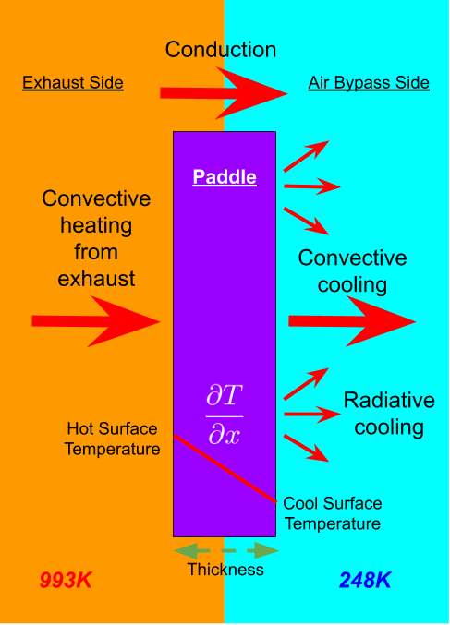
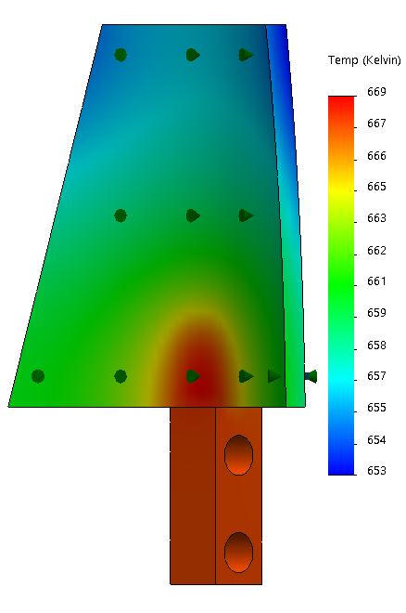
Thrust Vectoring Mechanism (TVM)
Paddles
Inform thickness/material with simple 1D heat transfer model
Refine design with FEA and CFD tools
Result: Max paddle temperature of 400°C
Notes:
Presenter:

Slide 46
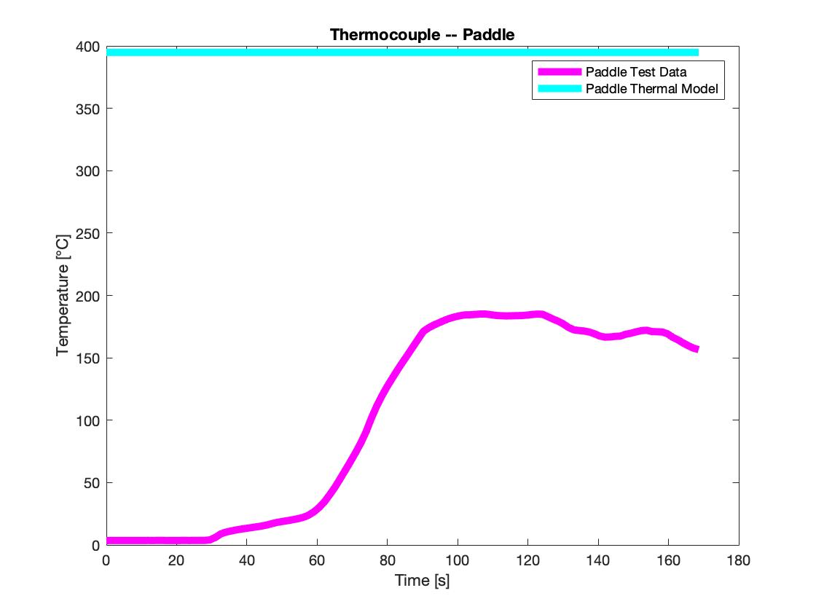
Data Collected
Max Temp: 185°C
Note: There was a failure of the kapton tape holding the thermocouple to the paddle. This resulted in a slight separation of the thermocouple of the paddle, which causes the decrease in temperature around t=90s
Notes:
Presenter:
Matt recommended trying to add a gap of air a few mm thick to the thermal model matches this, but I don’t think that’s super relevant

Slide 47
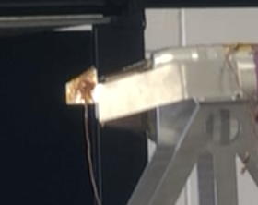
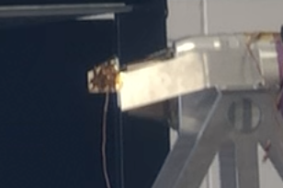
Tape Failure
Before
After
Due to this failure, the team had plans to measure thermal data on an integrated paddle to validate the thermal model more accurately on the completed TVM system.
Notes:
Presenter:
These image qualities are pretty bad when I zoom them in, but Matt said that pictures of the tape failure would be great. Wanted to add it in for now and potentially move it back later

Slide 48
Engine Testing Progression
TVM Testing
WMP Testing
Stock Run
Understand engine operation
APOP Replica Test
Verify fairing prevents airflow under pressure differential
Vibration and Thrust Baseline /
Characterize vibration and thrust
Stock w/ Dummy Paddle
Mitigate stock engine electronics risks and validate paddle thermal model
SABRE Static WPM Test
Validate fairing function at Mach 0.8
Static TVM Test
Validate ability to vector thrust using paddles preset in deflected position
SABRE Dynamic WPM test
Verification of ability to eject fairing at Mach 0.8
Dynamic TVM Test
Verify ability to vector thrust by commanding paddle movement during engine operation
TVM and WPM Integration Tests
Notes:
Presenter:
Moving the “X” next to integration tests because it was half off the screen

Slide 49
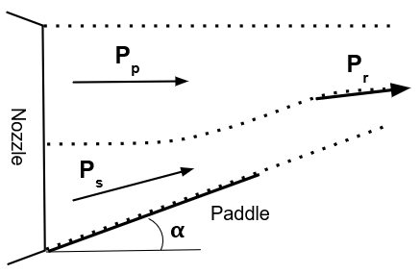
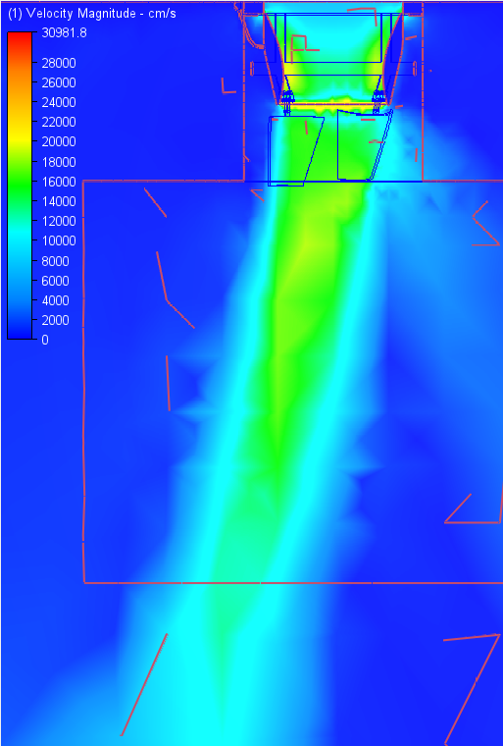
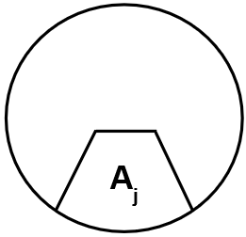
Thrust Vectoring Model
Conservation of Momentum Model
CFD Model
θ = 11°
Nozzle
A = 850mm²
Paddles are at 20°
Paddle

Slide 50
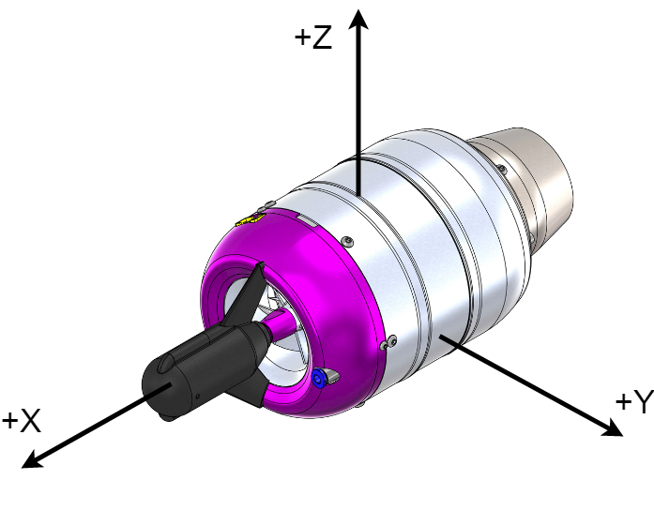
Static & Dynamic Thrust Vectoring Tests
Purpose: prove that paddles vector the thrust without altering the engine’s operation
Verifies zero impedance at 0° and two-axis ±10° capabilities
Equipment
Engine, associated tanks and lines
Test stand w/ second axis
Paddles and attachment mechanisms
Fuel and oil, in tank
Thermocouples
GSU and battery
Accelerometer
Facilities
CU Aerospace Test Cell
Notes:
Presenter:

Slide 51
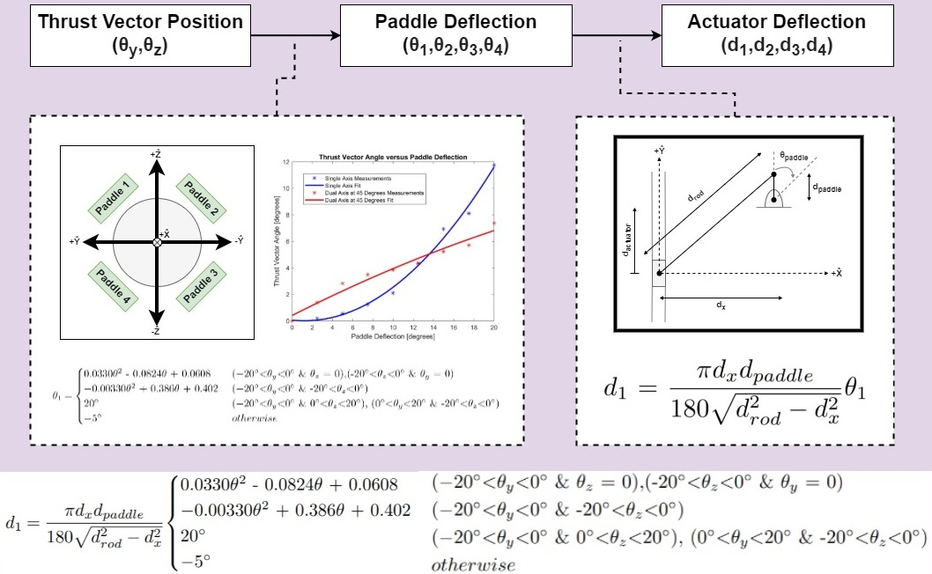
Paddle Deflection Calibration
Notes:
Presenter:
Matt talked about how we should discuss how we know what our paddle angle is, and what our thrust vectoring angle is because these are the axis on the “expected data” slide

Slide 52
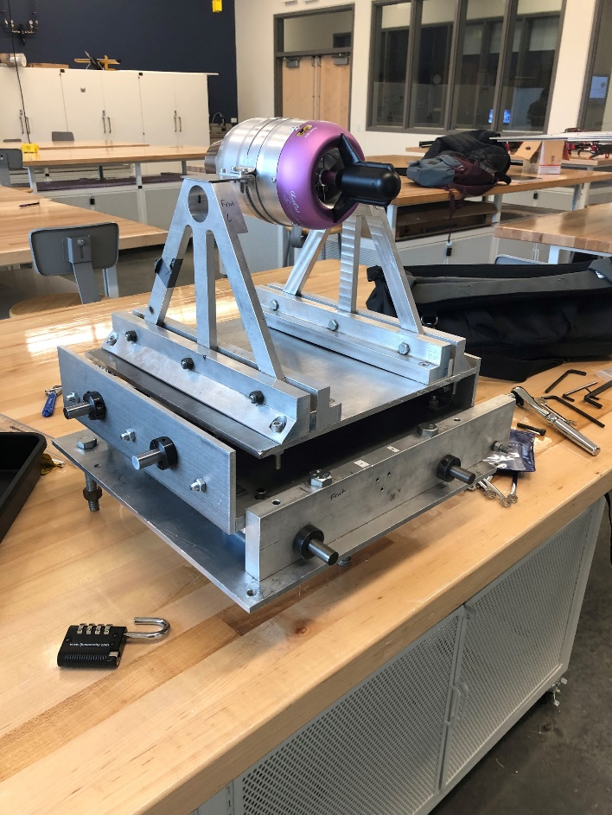
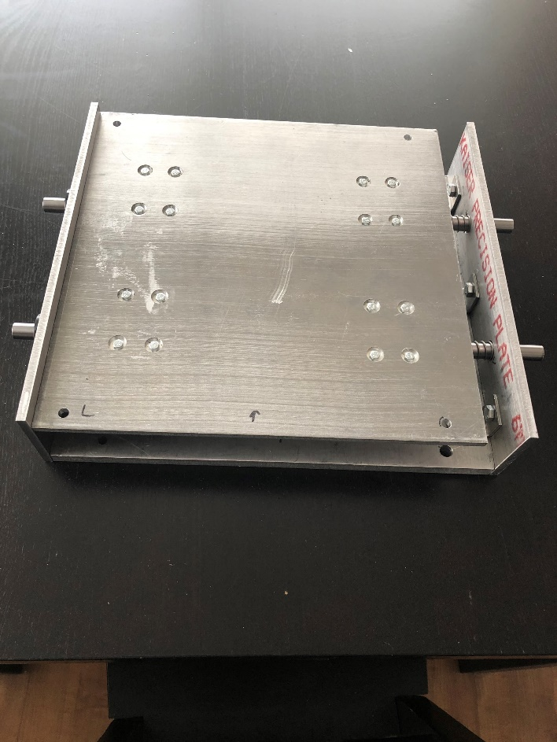
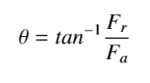
Thrust Vectoring Test Stand
Modified existing test stand to include perpendicular sled to measure off-axis thrust
Based on the two load cell readings, thrust vectoring angle would have been calculated through trigonometry
Manufacturing was completed, friction analysis was planned
X
Y
F_{a}
F_{r}
𝜃
F_{a}
F_{r}

Slide 53
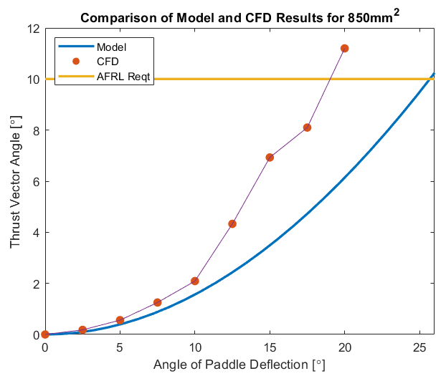
Expected Data
Primarily collect thrust data from test stand load cells
For dynamic test, also collect timing data for paddle deflections
Would have used load cell data to calculate thrust vector in different paddle deflection cases
Would show if system met AFRL vectoring requirement
Would have provided vibrational profile via accelerometer
Confirmed safe vibration ranges for components
Would be used to validate analytical and CFD models
Compare thrust vector angle of models to actual angle at given paddle deflections
Used to validate FR1 - thrust vectoring requirement
Dynamic test would help validate FR3 - MCB control of mechanism
Notes:
Presenter:
Error bars

Slide 54
Engine Testing Progression
TVM Testing
WMP Testing
Stock Run
Understand engine operation
APOP Replica Test
Verify fairing prevents airflow under pressure differential
Vibration and Thrust Baseline /
Characterize vibration and thrust
Stock w/ Dummy Paddle
Mitigate stock engine electronics risks and validate paddle thermal model
SABRE Static WPM Test
Validate fairing function at Mach 0.8
Static TVM Test
Validate ability to vector thrust using paddles preset in deflected position
SABRE Dynamic WPM test
Verification of ability to eject fairing at Mach 0.8
Dynamic TVM Test
Verify ability to vector thrust by commanding paddle movement during engine operation
TVM and WPM Integration Tests
Notes:
Presenter:
Moving the “X” next to integration tests because it was half off the screen

Slide 55
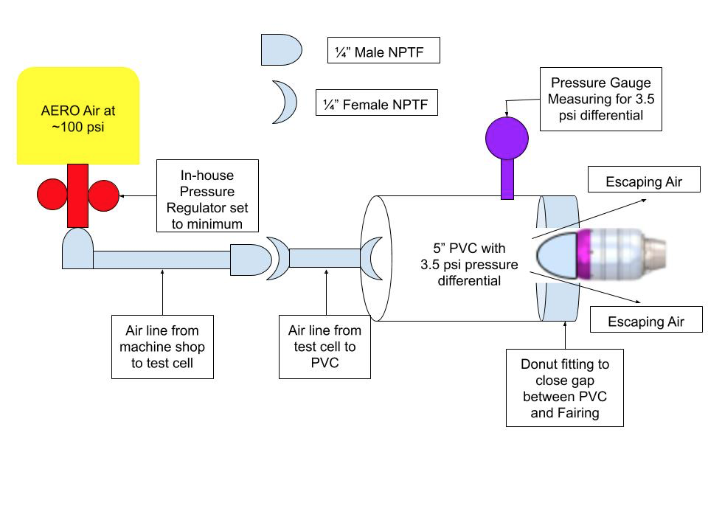
WPM APOP Replica Test
Used to simulate Mach 0.8 airflow at 20,000 ft via a 3.5 psi pressure differential
Engine not operating
Equipment
PVC pipe with attached pressure gauge and foam insert
Air compressor
Air lines and connectors
Pressure regulator
3D printed fairing
Test mount
Facilities
CU Aerospace Test Cell
Notes:
Presenter: mention that this might have not tested exactly what what wanted, but still proved our CFD analysis because all of the air was redirected around the fairing, instead of through the fairing/engine----pressure regulator set to max output and no RPM was observed

Slide 56
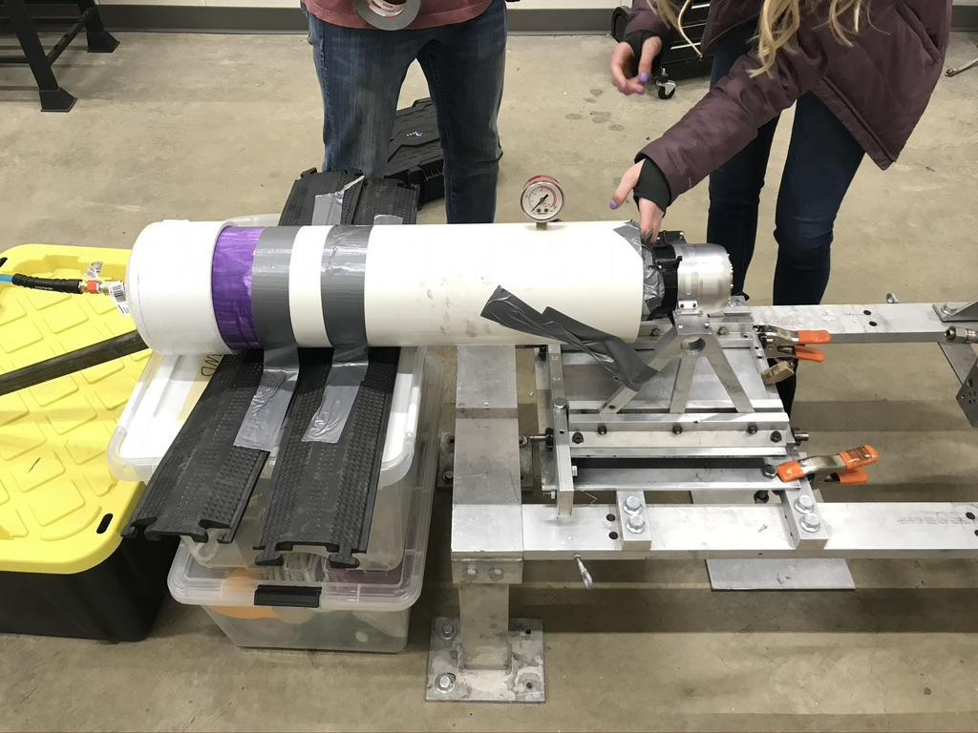
WPM APOP Replica Test Results
Preparation for SABRE test
At max pressure output there was 0 RPM
Partially validated initial CFD Modelling and Assumptions
CFD demonstrated air going around fairing rather than through
APOP test confirmed this, with air escaping through foam insert seam
Attempted to seal foam insert seam using duct-tape for 2nd run, still had 0 RPM
Determined test is broken, Air Force most likely did not predict our external design
Notes:
Presenter: mention that this might have not tested exactly what what wanted, but still proved our CFD analysis because all of the air was redirected around the fairing, instead of through the fairing/engine----pressure regulator set to max output and no RPM was observed
Talk about test method and how we were testing AF test method

Slide 57
Engine Testing Progression
TVM Testing
WMP Testing
Stock Run
Understand engine operation
APOP Replica Test
Verify fairing prevents airflow under pressure differential
Vibration and Thrust Baseline /
Characterize vibration and thrust
Stock w/ Dummy Paddle
Mitigate stock engine electronics risks and validate paddle thermal model
SABRE Static WPM Test
Validate fairing function at Mach 0.8
Static TVM Test
Validate ability to vector thrust using paddles preset in deflected position
SABRE Dynamic WPM test
Verification of ability to eject fairing at Mach 0.8
Dynamic TVM Test
Verify ability to vector thrust by commanding paddle movement during engine operation
TVM and WPM Integration Tests
Notes:
Presenter:
Moving the “X” next to integration tests because it was half off the screen

Slide 58
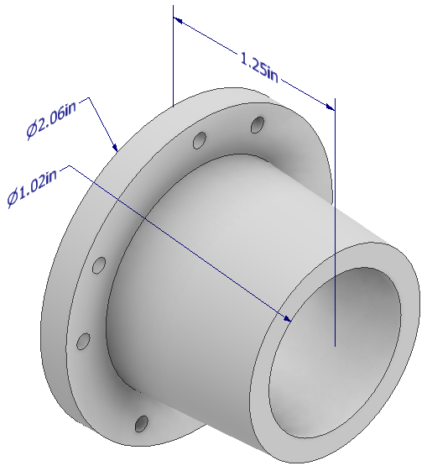
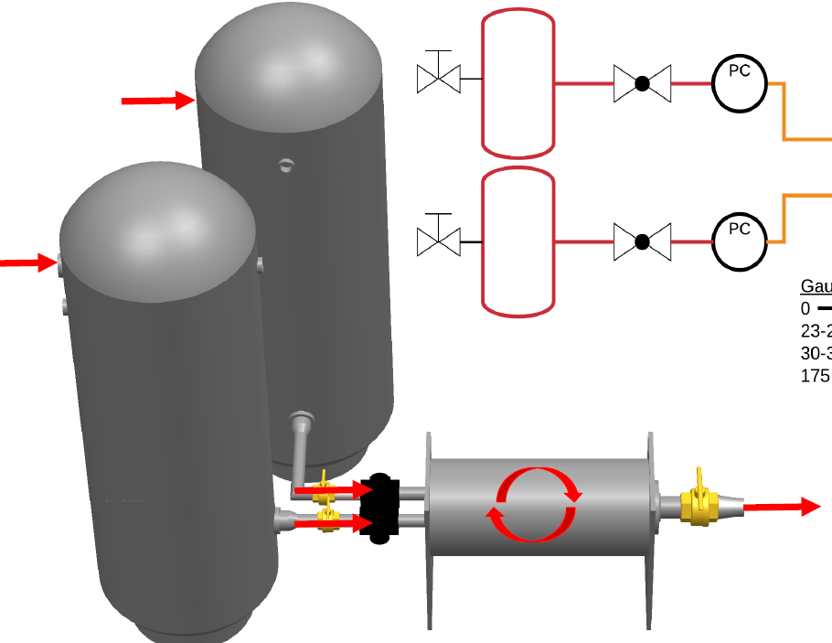
WPM High Speed Flow (SABRE) Tests
Pressure gauges
Provides Mach 0.8 airflow for several seconds to test fairing structural integrity and seal
Equipment
2 pressure regulators
2 pressure gauges
Outlet nozzle (3D printed)
SABRE tanks and system
Engine test mount
3D printed fairing mounted on engine
Electronics and software
Laser tachometer and/or video camera
Facilities
CU Aerospace Test Cell
6ft
M=0.8
Pressure regulators
Notes:
Presenter:
Promote that CU has resources through heritage project

Slide 59
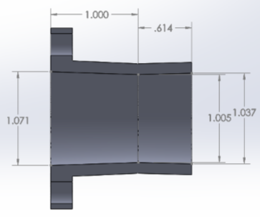
SABRE Test Airflow
Based calculations on work done by SABRE team
Large tank pressure - 175psi
Settling tank pressure - 35psi
SABRE used 3D printed nozzle with 1.005” throat diameter
Used Mach-Area relationship to calculate outlet diameter to reach M=0.8
SABRE had run time of 20s at supersonic conditions
Expect longer run time at lower velocity for WPM tests
WHiMPS nozzle is to the left of blue line
Same inlet to fit SABRE tank, outlet diameter of 1.024”
Planning on using pitot tube to verify velocity
Would occur in separate test before testing WPM
Notes:
Presenter:

Slide 60
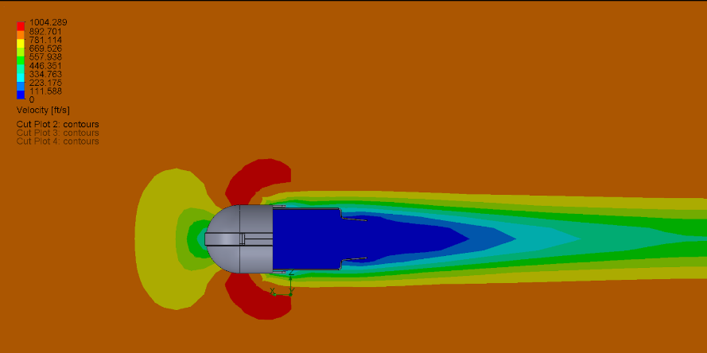
SABRE Tests Expected Data
Primarily collect RPM data using a laser tachometer and video at rear
For dynamic test, also collect video data of fairing ejection
Would have used RPM data to determine if fairing system works - expected to succeed based on APOP test results
Would show if system met AFRL windmilling requirement
Would be used to validate CFD model of air leakage
Show if air leaks through fairing or enters back of engine
Used to validate FR2 - incorporated WPM to limit rotation
Dynamic test would help validate FR3 - MCB control of mechanism
Notes:
Presenter:

Slide 61
Systems Engineering
Overview
Design Description
Testing
Systems Engineering
Project Management
Notes:
Presenter:

Slide 62
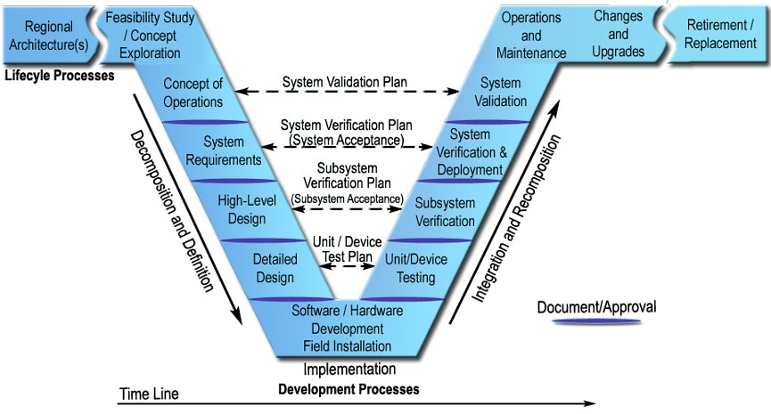
Systems Engineering “V”
Design Solution:
Customer Design Requirements
Functional Requirements
Levels of Success
Design Concept
Prevent windmilling of the fan blades under M=0.8 flow at 20k ft
Vector the thrust of the engine by ±10° on at least one axis
Cannot impede nominal thrust
Risk Analysis
Thermodynamic and Structural Model
CFD and FEA analysis
Document, Integration, and Testing:
Unit testing electronics and software
Design test stand for thrust measurements on two axes
Document test plans and test results on GUI
Notes:
Presenter:

Slide 63
Trade Studies
WPM key trades:
Performance (30%)
Ensure no fan blade rotation under set conditions
Simplicity (21%)
Reduces risk of damaging engine
Main Concern | WPM % Weight | TVM % Weight
Performance | 30% | 31%
Simplicity | 21% | 24%
TVM key trades:
Performance (31%)
Ensure the flow is vectored to preferred angle
Simplicity (24%)
Reduces risk of damaging engine
Main concern was affecting the internal components and balancing of the engine
Notes:
Presenter:
Too small of text
Either separate to two slides, or come up with a summarized table

Slide 64
Design Flowdown
FR 1: The JetCat P-100RX engine shall have a thrust vectoring mechanism
Design Requirements
Change in nominal thrust is zero - cannot have mechanism that impedes nominal flow
Does not affect engine operation - reduces risk of engine/project failure
FR 2: The JetCat engine shall have a windmill prevention mechanism
Design Requirements
Can be engaged/disengaged upon command - does not prevent airflow/fan blade rotation at all times
Does not affect engine operation - reduces risk of engine/project failure
FR 3: The MCB shall control and monitor both of the incorporated mechanisms.
Design Requirements
Controls power to both mechanisms and incorporated electronics
Sends and receives health/status data for both mechanisms and incorporated test apparati
FR 4: The MCB shall run the engine such that it remains within the nominal operating conditions.
Design Requirements
Maintains RPM limit - controls engine’s RPM
FR 5: The MCB shall receive data from and send data to the user interface.
Design Requirements
Controls engine, WPM, and TVM - permits team members to test at a safe distance from the engine
Notes:
Presenter: talk about what they should be taking away from it
How did requirements flow down

Slide 65
Design Flowdown
FR 1: The JetCat P-100RX engine shall have a thrust vectoring mechanism
Design Requirements
Change in nominal thrust is zero - cannot have mechanism that impedes nominal flow
Does not affect engine operation - reduces risk of engine/project failure
FR 2: The JetCat engine shall have a windmill prevention mechanism
Design Requirements
Can be engaged/disengaged upon command - does not prevent airflow/fan blade rotation at all times
Does not affect engine operation - reduces risk of engine/project failure
FR 3: The MCB shall control and monitor both of the incorporated mechanisms.
Design Requirements
Controls power to both mechanisms and incorporated electronics
Sends and receives health/status data for both mechanisms and incorporated test apparati
FR 4: The MCB shall run the engine such that it remains within the nominal operating conditions.
Design Requirements
Maintains RPM limit - controls engine’s RPM
FR 5: The MCB shall receive data from and send data to the user interface.
Design Requirements
Controls engine, WPM, and TVM - permits team members to test at a safe distance from the engine
Commenced four-paddle design that does not impede exhaust flow when no vector angle is requested
Notes:
Presenter: talk about what they should be taking away from it
How did requirements flow down

Slide 66
Design Flowdown
FR 1: The JetCat P-100RX engine shall have a thrust vectoring mechanism
Design Requirements
Change in nominal thrust is zero - cannot have mechanism that impedes nominal flow
Does not affect engine operation - reduces risk of engine/project failure
FR 2: The JetCat engine shall have a windmill prevention mechanism
Design Requirements
Can be engaged/disengaged upon command - does not prevent airflow/fan blade rotation at all times
Does not affect engine operation - reduces risk of engine/project failure
FR 3: The MCB shall control and monitor both of the incorporated mechanisms.
Design Requirements
Controls power to both mechanisms and incorporated electronics
Sends and receives health/status data for both mechanisms and incorporated test apparati
FR 4: The MCB shall run the engine such that it remains within the nominal operating conditions.
Design Requirements
Maintains RPM limit - controls engine’s RPM
FR 5: The MCB shall receive data from and send data to the user interface.
Design Requirements
Controls engine, WPM, and TVM - permits team members to test at a safe distance from the engine
Commenced fairing-ejection design that would be ejected after reaching the target air velocity and altitude
M = 0.8 @ 20k ft
Notes:
Presenter: talk about what they should be taking away from it
How did requirements flow down

Slide 67
Design Flowdown
FR 1: The JetCat P-100RX engine shall have a thrust vectoring mechanism
Design Requirements
Change in nominal thrust is zero - cannot have mechanism that impedes nominal flow
Does not affect engine operation - reduces risk of engine/project failure
FR 2: The JetCat engine shall have a windmill prevention mechanism
Design Requirements
Can be engaged/disengaged upon command - does not prevent airflow/fan blade rotation at all times
Does not affect engine operation - reduces risk of engine/project failure
FR 3: The MCB shall control and monitor both of the incorporated mechanisms.
Design Requirements
Controls power to both mechanisms and incorporated electronics
Sends and receives health/status data for both mechanisms and incorporated test apparati
FR 4: The MCB shall run the engine such that it remains within the nominal operating conditions.
Design Requirements
Maintains RPM limit - controls engine’s RPM
FR 5: The MCB shall receive data from and send data to the user interface.
Design Requirements
Controls engine, WPM, and TVM - permits team members to test at a safe distance from the engine
Regulates power going to each component and reports data from sensors (thermocouples, RPM, etc.) back to one location for ease of operation
Notes:
Presenter: talk about what they should be taking away from it
How did requirements flow down

Slide 68
Design Flowdown
FR 1: The JetCat P-100RX engine shall have a thrust vectoring mechanism
Design Requirements
Change in nominal thrust is zero - cannot have mechanism that impedes nominal flow
Does not affect engine operation - reduces risk of engine/project failure
FR 2: The JetCat engine shall have a windmill prevention mechanism
Design Requirements
Can be engaged/disengaged upon command - does not prevent airflow/fan blade rotation at all times
Does not affect engine operation - reduces risk of engine/project failure
FR 3: The MCB shall control and monitor both of the incorporated mechanisms.
Design Requirements
Controls power to both mechanisms and incorporated electronics
Sends and receives health/status data for both mechanisms and incorporated test apparati
FR 4: The MCB shall run the engine such that it remains within the nominal operating conditions.
Design Requirements
Maintains RPM limit - controls engine’s RPM
FR 5: The MCB shall receive data from and send data to the user interface.
Design Requirements
Controls engine, WPM, and TVM - permits team members to test at a safe distance from the engine
-Monitors the engine’s condition during operation
- Permits users to increase/decrease RPM
Notes:
Presenter: talk about what they should be taking away from it
How did requirements flow down

Slide 69
Design Flowdown
FR 1: The JetCat P-100RX engine shall have a thrust vectoring mechanism
Design Requirements
Change in nominal thrust is zero - cannot have mechanism that impedes nominal flow
Does not affect engine operation - reduces risk of engine/project failure
FR 2: The JetCat engine shall have a windmill prevention mechanism
Design Requirements
Can be engaged/disengaged upon command - does not prevent airflow/fan blade rotation at all times
Does not affect engine operation - reduces risk of engine/project failure
FR 3: The MCB shall control and monitor both of the incorporated mechanisms.
Design Requirements
Controls power to both mechanisms and incorporated electronics
Sends and receives health/status data for both mechanisms and incorporated test apparati
FR 4: The MCB shall run the engine such that it remains within the nominal operating conditions.
Design Requirements
Maintains RPM limit - controls engine’s RPM
FR 5: The MCB shall receive data from and send data to the user interface.
Design Requirements
Controls engine, WPM, and TVM - permits team members to test at a safe distance from the engine
Allows users to coherently collect and observe engine data (temperature, RPM, etc.)
Notes:
Presenter: talk about what they should be taking away from it
How did requirements flow down

Slide 70
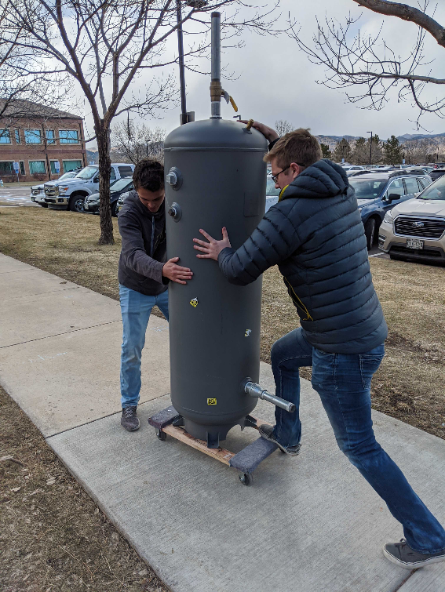
Engineering Challenges
APOP Replica Test
Obtaining a pressure differential with fairing design
Air leaks around the sides (tried to cover with duct tape!)
Two Projects in One
Divided team to work on different parts of the project
Worked on both mechanisms simultaneously
Effectively doubled the work for deliverables
Machining TVM Components
Took lots of man/woman-hours to machine all components
Tedious and time-consuming
Notes:
Presenter:
Mailing engine back and getting it fixed - time constraint
Change pictures - I like the tank picture, it is actually related to acquiring testing equipment

Slide 71
Systems - Lessons Learned
Understanding all aspects of the project
Varying levels of experience within team
Offer advice and assistance to unfamiliar subjects when necessary
Asked a lot of questions - Software/Electronics
Problem mitigation
Contingency plans
Highly useful in the event that something does not go as planned
Used for WPM testing (APOP test did not go as planned - Had SABRE test as contingency)
In-depth research
Understanding what materials and capabilities are necessary for engine/testing functionality - test stand
Testing plans
Very specific
Important to cover your bases
Results in better preparation and ultimately greater time efficiency
Risk reduction
Notes:
Presenter:
Make this more descriptive and project specific

Slide 72
Project Management
Overview
Design Description
Testing
Systems Engineering
Project Management
Notes:
Presenter: nick start

Slide 73
Management Approach
Broke team into sub-teams early based on interest
Originally TVM, WPM, and software/electronics
In spring, moved to manufacturing, testing, and software/electronics
Meeting Schedule
Bi-weekly meetings in the fall, switched to weekly meetings in the spring to maximize time conducting tests and manufacturing components
Encouraged team members to take leadership roles over every major item
Ex. someone would take charge of the WPM APOP test, and others would help out
Allow delegation of tasks to happen primarily through individual interests/volunteering
Keep schedule margins relatively tight (~20%), with large margin at the end to allow for adjustments as issues occur
Notes:
Presenter:

Slide 74
Management Lessons Learned
Flexibility is crucial
Our team was hit with a number of unexpected delays including:
2 months longer to receive an engine than distributor specified
P-card received 2 weeks later than other teams due to clerical error in the finance dept.
Engine ECU broke week after that, which put stock testing behind an additional week
Planning is needed, but schedule adjustments are important too
Can’t trust information from outside sources without verifying
We didn’t evaluate APOP WPM test with respect to our design, which made it an effective “test of a test” but did not verify/validate requirements and models
Testing will often take longer than planned and issues will occur
Examples we experienced: ECU breaking and thermocouple tape failing
Notes:
Presenter:
Give examples

Slide 75
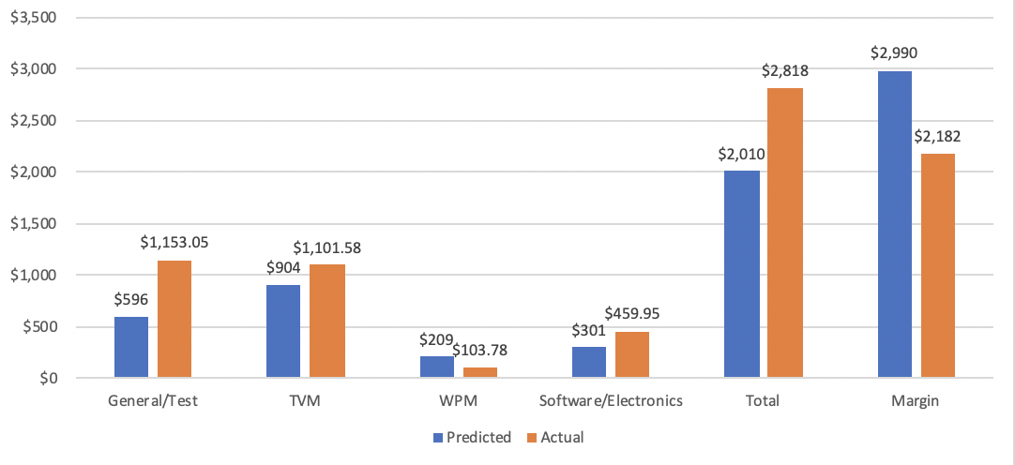
Budget Comparison
Notes:
Presenter:
What took the margin-bring up next slide

Slide 76
Major Unexpected Expenses
Replacing ECU
$660 for repair and shipping
Test stand development
Additional $200 in materials to modify test stand
Electronics PCB
Each revision of PCBs cost $200, which was not originally budgeted for
Risky Project
Our project has a very expensive, fragile engine which increases budgetary risk
Extreme thermal and aerodynamic loads on all manufactured components
Left a large margin because of this, which kept us safe despite large unexpected expenses
Notes:
Presenter:
What took the margin-bring up next slide

Slide 77
Estimated Industry Cost
 | Current | Predicted Without Shutdown
Total Team Hours | 3456 | 4342
Hourly Wage | $30.77 | $30.77
Total Salary (without overhead) | $106,341 | $133,603
Total Salary (with overhead) | $319,023 | $400,810
Planned/Spent Expenses (Materials) | $2,818 | $2,818
Total Cost | $321,841 | $403,628
Notes:
Presenter:
Consider putting fall/spring hours into a backup to be able to answer questions

Slide 78
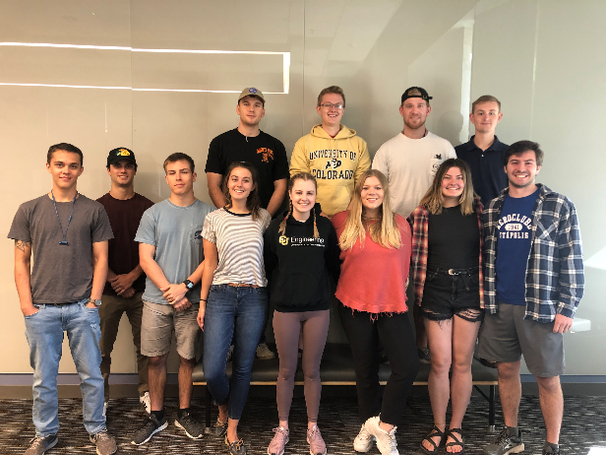
Final Thoughts
WHiMPS was not able to achieve many levels of success, but we were at the brink of reaching WPM level 3 and TVM levels 1 & 2
Reaching our maximum level of success was possible within our remaining budget and schedule
Concerns of TVM affecting engine operation were mostly mitigated
Although project was not completed due to COVID-19 shutdown, it was a great learning experience for the team
We would like to thank the entire PAB for their support and guidance throughout the project
Notes:
Presenter:
What took the margin-bring up next slide

Slide 79
Questions?
Notes:
Talk about models we didn’t get to validate

Slide 80
Backup

Slide 81
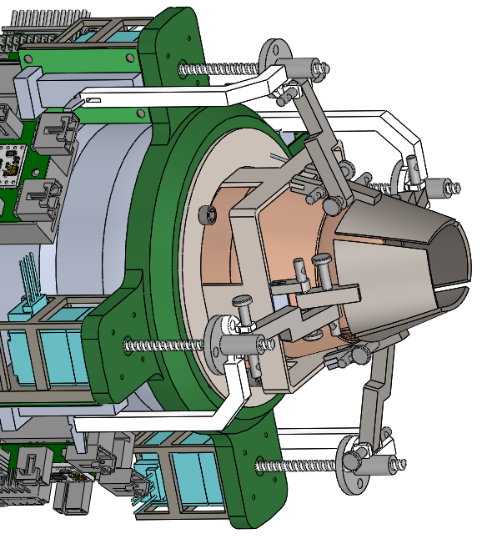
Thrust Vectoring Mechanism (TVM)
Design Process
Trade approaches to satisfy requirements.
Create simple component with manufacturability in mind, using first-principle models.
Use thermal requirements to inform material choice.
Use FEA tools to predict performance in array of expected loading cases.
Iterate design toward appropriate safety factor values.
Notes:
Presenter:

Slide 82
Vibrational Analysis
Engine frequency range between idle and max thrust state (50 N to 100 N)
733.3 Hz ≤ f ≤ 2566.7 Hz
Two main points of concern are the paddle and rod connection between actuator screw and paddle
Actuator and screw will absorb some of the engine excitation (damper)
Material is modeled as T-600 Steel with a modulus of elasticity of ~200 GPa
Paddle: f = 18.28 Hz
Rod: f = 329 Hz
Actuator, screw, nozzle sheath, and housing will act as dampers to dissipate energy, further reducing risk of vibrational failure
Notes:
Because the largest natural frequency is 329 Hz, which is far less than engine idle state, we can accept the components as good to go.

Slide 83
Stock Engine Test Thermocouple Data
Notes:
Should we add gridlines to graph? Might make it easier for PAB to see what the actual temps were
Note that 304 steel has a melting point of 1400C, but can be used in continuous manner up to 925C
Add model expectations and error bars

Slide 85
Thrust Vectoring Test Safety Measures
Safety Concerns:
Fuel fire
Engine breaks and throws a fan blade
Safety Measures
All tests performed in CU engine test cell
Matt Rhode present for all tests
Safety officer is only member in test cell once battery is plugged in
Sentries posted outside of test cell to stop passersby from entering danger zone
Notes:
Presenter:

Slide 86
Windmill Prevention Test Safety Measures
Safety Concerns
Over-pressurization of the APOP replica PVC Tube
Failure of SABRE tank
High speed air harming passersby of test cell
Safety Measures
Matt Rhode present for all tests
Pressure gauge on PVC tube
Safety officer radios to valve operator to shut off if differential pressure exceeds 5 psi
Remotely pulling SABRE tank lever
Same sentry/perimeter procedure as engine tests
Complete depressurization of SABRE tanks before any transportation of tanks
Notes:
Presenter:

Slide 87
Fairing Displacement
Dr. Maute identified component displacement as most important quality
FEA was conducted for each component separately
Component Displacements:
Left Side Fairing: 1.123e-7 mm
Right Side Fairing: 4.03e-3 mm
These results are with each component acting independently
Mounting the two pieces together will provide additional structural support
Notes:
Zoe

Slide 88
Design Validation
CFD conducted simulating Mach 0.8 at 20,000 ft
Professor John Mah confirmed the turbulent wake aft of the engine re-entering the nozzle should not be a concern
Notes:
Zoe

Slide 89
Thrust Vectoring Paddle Model
Conservation of Momentum
Assumptions
Steady, uniform flow
No leakage around paddles
Subsonic exhaust
Paddle is flat
Notes:
Jon

Slide 90
Thrust Vectoring Paddle Model
Notes:
Jon

Slide 91
Thrust Vectoring CFD
Fluid inlet
Nozzle inlet
Fluid exit
Notes:
Desire to corroborate data via CFD
Jon

Slide 92
Thrust Vectoring CFD Setup
Assumptions: steady, turbulent, sea level
Boundary Conditions: nozzle inlet mass flow is 0.23 kg/s, nozzle exit velocity is M=0.7, fluid inlet gage pressure and velocity is zero
Initial Conditions: fluid inlet and exit velocity is zero
Turbulence Model: k-epsilon
Autodesk CFD Characteristics: solves Navier-Stokes equations (approximates Euler conditions by using slip conditions with low viscosity), defaults to a slip condition on undefined surfaces
Notes:
Desire to corroborate data via CFD
Jon
Turbulence model info - https://en.wikipedia.org/wiki/K-epsilon_turbulence_model
Emphasize BCs represent how we will be testing with compressed air if we are not able to run the engine

Slide 93
Thrust Vectoring CFD Results
θ = 17°
θ = 11°
A = 1250mm²
A = 850mm²
Paddles are at 20°
Paddles are at 20°
Notes:
Jon

Slide 94
Sheath Structural Analysis
Material modeled as Aluminum 2024
Yield strength - 325 MPa
Max total axial force - 100N+
Failure mode is bending point
Load would be distributed with actuator linkage.
Notes:
Jon

Slide 95
Sheath Structural Analysis
Principle: Rate of conduction = rate of convection
25°C
145°C
K = 0.25 W/m*k
H = 2 & 25 W/m^2*k for best and worst case scenario natural convection
H = 25 for worst case forced convection
Conduction
Convection
Notes:
Jon

Slide 96
Actuator Housing Structural Analysis
ABS Plastic 3D printed structure
Assumes front lip is fixed; load is dynamic pressure on rear cross sectional area (overestimate).
ABS Strength ~ 40 MPa
Max von Mises stress = 643 kPa
FOS = 62
Glass transition temperature = 98°C
Engine base doesn’t get significantly hotter than ambient conditions in previous tests.
Notes:
Jon
Strength from Simplify3D.com

Slide 97
Paddle Structural Analysis
Service Temp of 700K > 668K max temp from thermal model
From CFD, each paddle experiences 7.31N normal to plane at center of paddle
Similar to base principle estimate
Assumes pins fixed; 8N normal load to paddle
Max von Mises stress of 96 MPa < 620 MPa yield strength (FS = 6.5)
Notes:
Jon

Slide 98
List of Necessary Materials
Windmill Prevention Mechanism (acquire)
PVC and PVC cap
Pressure regulator
Pressure gauge
Air line (50ft)
NPT connectors (¼”)
Thrust Vectoring Mechanism (acquire)
Load cell/load cell amplifier
Pillow blocks
Steel shafts
Aluminum plates
Compression springs
Electronics/Software (acquire)
Connectors
Motor drivers
Actuators
Windmill Prevention Mechanism (manufacture)
Outlet 3D-printed nozzle (SABRE)
Thrust Vectoring Mechanism (manufacture)
Paddles/linkages
Electronics/Software (manufacture)
MCB
LPBB (x4)
ICUP
MCB housing

Slide 99
Stock engine testing (preheating)

Slide 100
Stock engine testing (visible exhaust)

Slide 101
Risk Reduction
ICUP design is being modified to resemble a bracelet, rather than a donut
Reduces risk of ICUP breaking under load of the Mach 0.8 air and from ejection of the fairing hitting the ICUP
Ensures that fairing ejection does not interfere with the electronic components onboard the engine
New design
Notes:
Presenter:

Slide 102
WPM Test #1 plan

Slide 103
Stock Engine and Dummy Paddle Test

Slide 104
First Semester Focus
Notes:
Presenter:

Slide 105
First Semester Focus
Feasibility Study/Concept Exploration:
Trade studies conducted with ~6 solutions to both the WPM and TVM (total of 13 solutions)
Risk, performance, profile, and safety were set with specific weights as to which was more important than another
For the WPM, a fairing-cover was chosen
For the TVM, a system of four paddles on the exhaust nozzle was chosen
Trade Studies and Key Trades in backup slides
Notes:
Presenter:

Slide 106
First Semester Focus
Concept of Operations:
No actual mission set by the customer to utilize the incorporated mechanisms
AFRL explained how they would test the developed mechanisms to simulate it’s target environment
No windmilling of the fan blades at M=0.8 @20k ft
Vector the thrust by ±10° on at least one axis
Cannot decrease nominal thrust
This resulted in the WHiMPS creating a CONOPS based on how the mechanisms could be utilized
One CONOPS for WPM that leads into the CONOPS for TVM
First developed CONOPS
Notes:
Presenter:

Slide 107
First Semester Focus
System Requirements:
Some requirements set by AFRL
No fan blade rotation under set flight conditions
Vector the thrust by ±10°
Do not impede nominal thrust
Some requirements set by WHiMPS
The MCB shall control both mechanisms and read-in data from thermocouples and GSU
Levels of Success based on:
Getting the engine to run
Getting one vs. two axes of thrust vectoring
Incorporating the mechanisms onto a working engine
Functional and Design Requirements are in backup slides
Notes:
Presenter:

Slide 108
First Semester Focus
High-Level Design (PDR):
Baseline design of WPM
First iteration of fairing designed and used for structural analysis testing on Solidworks
Baseline design of TVM
Material selection of paddles
Paddle deflection angle as a function of flow deflection angle
Effect of paddle area on flow-turning efficiency
Baseline design of MCB
Software flowcharts
Power and data feasibility analyses
Analyses
Structural analysis on Solidworks (WPM)
Fairing ejection feasibility analysis (WPM)
Thermal modelling of the paddles (TVM)
Analyses shown in backup slides
Notes:
Presenter:

Slide 109
First Semester Focus
Detailed Design (CDR):
Detailed Electronics and Software
Functional Block Diagram, Software Flowchart
MCB, MCB Housing, ICUP, and LPBB designed
GUI layout
Completion of Components
Fore and Aft Retention Rings
Designed to hold WPM and TVM to engine body
Actuator Housing, Nozzle Sheath, Paddles
Detailed Analyses
CFD and FEA performed on WPM
CFD and structural analysis performed on components for TVM (actuator housing, sheath, paddles)
Vibrational analysis
Components act as dampers during operation to reduce vibrational effects
Largest natural frequency less than engine idle state
Full System Verification and Validation
Test stand development (2-axis thrust measurement)
WPM and TVM preliminary test design
Risk mitigation
Notes:
Presenter:

Slide 110
Second Semester Focus
Notes:
Presenter:

Slide 111
Trade Studies
Notes:
Presenter:

Slide 112
Trade Studies
Notes:
Presenter:

Slide 113
Electronics & Software Slides

Slide 114
Electronics Testing
Switch functionality
Voltage converter (5V)
Power protection circuit
GPIO/LED circuit
Power MOSFET circuit
Raspberry Pi functionality
I2C functionality
Solenoid circuit
Actuator/motor driver circuit
Linear potentiometer circuit
Harness continuity check
Temperature sensor circuit
MCB
Successful
Successful After Changes
Unsuccessful
ICUP
LPBB
All
Notes:
Presenter:

Slide 115
Upcoming Electronic Tests
Temperature sensor addresses
Done by: 3/6/2020
Actuator/motor driver circuit
Done by: 3/6/2020
Load cell/amplifier circuit
Done by: 3/13/2020
Revision B MCB functionality
Done by: 3/13/2020
Revision B ICUP functionality
Done by: 3/13/2020
Revision B LPBB functionality
Done by: 3/13/2020
Revision A PCBs
Notes:
Presenter:

Slide 116
Electronics Overview
Main Control Board (MCB)
Provides WHiMPS’ data processing and power distribution
Integrated Communication Unit Panel (ICUP)
Extends actuators and potentiometers’ data and power lines from the MCB to the engine
Linear Potentiometer Breakout Board (LPBB)
Converts potentiometer analog output to a digital signal (I2C)
MCB
Rev. A
ICUP
LPBB
Notes:
Presenter:

Slide 117
MCB Revision B
Changes from Revision A to B:
Took out MCB <-> ECM connector
Fixed the temperature sensor circuit
Added load cells connectors and amplifiers (2x)
Added more indicator LEDs
Added MOSFETs for all motor drivers/actuators
Took out software control (MOSFET) for Ammeter
Notes:
Presenter:

Slide 118
ICUP Revision B
Changes from Revision A to B:
Changed outline from a ring to a 4 panel “bracelet” design
Each panel is connected together through SAMTEC locking connector assemblies
Motor drivers were replaced with the correct stepper motor driver
Fixed solenoid circuit
Using a surface mount rail system with one screw hole instead of 4 screw holes
1
MCB <-> ICUP
Actuator #1
Motor Driver #1
LPBB #1
2
Solenoid #1
Actuator #2
Motor Driver #2
LPBB #2
3
Actuator #3
Motor Driver #3
LPBB #3
4
Solenoid #2
Actuator #4
Motor Driver #4
LPBB #4
Notes:
Presenter:

Slide 119
LPBB Revision B
Changes from Revision A to B:
Changed to an ADC with multiple address for I2C
Tie AD0 and AD1 resistors to either HIGH or LOW to get 4 address combinations
18 bit ADC
Notes:
Presenter:

Slide 120
Test LabVIEW Front Panel

Slide 121
Test LabVIEW Block Diagram

Slide 122
WHiMPS LabVIEW Front Panel

Slide 123
WHiMPS LabVIEW Flowchart

Slide 124
Paddle Control Law
Notes:
Presenter:

Slide 125
Gantt – Manufacture & Test
Notes:
Presenter:

Slide 126
Gantt – Software & Electronics
Notes:
Presenter:

