Slide 1
Offset S-duct PRopulsion Inlet
Team:
Tim Breda
Joey Derks
Zak Dmitriyev
Ryan Joseph
Dishank Kathuria
Harrison Methratta
Joshua Seedorf
Michael Vogel
William Watkins
John Wissler
Advisor: Professor John Mah
Customer: Air Force Research Laboratory
POC: Capt. Riley Huff

Slide 2
Section 1
Purpose and Objectives
Project Purpose
Design Solutions
Design Satisfaction
Project Risks
Verification & Validation
Project Planning
Notes:
Sec 1 - 6 minutes

Slide 3
Problem Statement
The purpose of the OSPRI project is to:
Design and build an S-duct inlet for use with the JetCat P100-RX turbojet engine, for the Air Force Research Lab’s (AFRL’s) Aerospace Propulsion Outreach Program (APOP)
Additionally, OSPRI will design and build a testing apparatus to measure total pressure and distortion distributions, and measure fuel flow and thrust produced
Motivation
Integrating engines into the fuselage would reduce exposed surface area and overall drag
S-ducts are susceptible to severe flow separation and poor total pressure recovery
The Air Force Research Lab (AFRL) has asked 12 schools to come up with potential solutions

Slide 4
Functional Requirements
OSPRI functional requirements stem from the APOP’s Statement of Work provided to the CU Aerospace Engineering Department and the OSPRI team:
Design, build, and validate an S-duct inlet for use with the JetCat P100-RX turbojet engine that performs according to AFRL’s objectives.
Design, build, and validate a test rig capable of measuring critical inlet performance metrics and inform inlet design.

Slide 5
Inlet Design Requirements
The inlet shall interface with the AFRL transition piece.
The nearest outside edge of the capture area shall have a 6-inch offset from the centerline of the engine.
The inlet shall have a total pressure recovery ≥98% across the RPM sweep of the engine.
The maximum thrust decrement of the engine shall be ≤5% while the inlet is attached.
The maximum TSFC increment of the engine shall be ≤5% while the inlet is attached.
The inlet shall have an axial length between 20 inches and 28 inches, with the objective being 20 inches (or shorter, if feasible).*
Requirements changed from PDR

Slide 6
Test Apparatus (TA) Design Requirements
The TA shall be capable of mapping the total pressure distribution at the inlet entrance, the Aerodynamic Interface Plane (AIP), and between the first and second turns, at a minimum.
The TA shall be capable of mapping the distortion distribution throughout the inlet.
The TA shall be capable of measuring key JetCat engine parameters.
TA shall be capable of measuring the thrust produced by the engine.
TA shall be capable of measuring the Thrust Specific Fuel Consumption (TSFC) of the engine.
The TA shall be capable of interfacing with multiple different inlet designs.

Slide 7
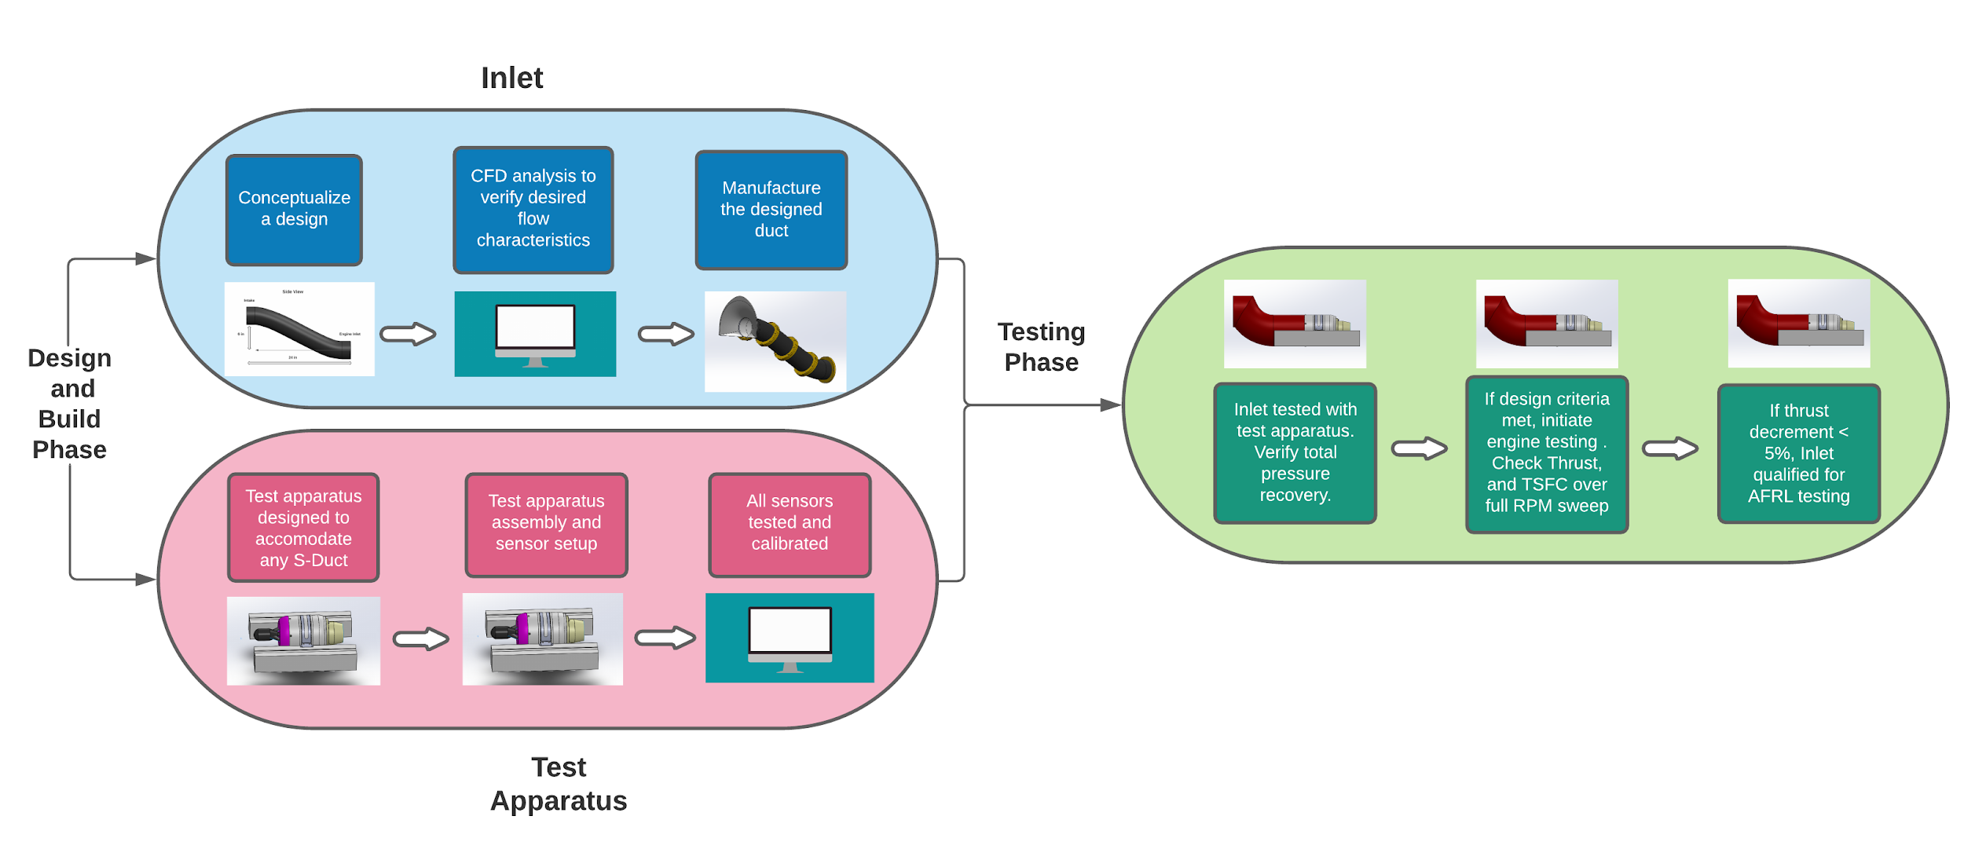
Concept of Operations (CONOPS)

Slide 8
Section 2
Design Solutions
Project Purpose
Design Solutions
Design Satisfaction
Project Risks
Verification & Validation
Project Planning
Notes:
Sec 2 - 2 minutes

Slide 9
Section 2.1
Inlet Design Solution
Project Purpose
Design Solutions
Design Satisfaction
Project Risks
Verification & Validation
Project Planning
Notes:
Sec 2 - 2 minutes

Slide 10
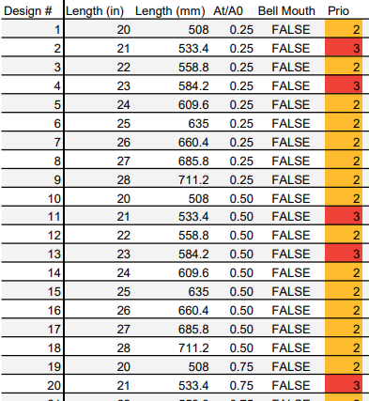
Design Process
Inlet Test Matrix to compare different designs.
Major Areas of Interest:
Area Ratio Comparison (A_{t}/A_{E})
Length Variation
Bell-Mouth Addition
Organizes and Streamlines CAD and CFD Process

Slide 11
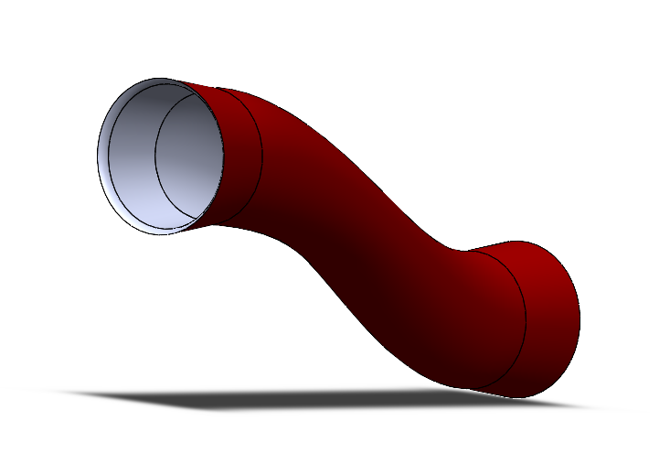
Inlet Design Critical Elements
CFD:
CFD Simulations and Modelling
Flow Control:
Passive Flow Control System
Geometry and Shape:
Major aspects affecting design and performance (Bell Mouth, Length, Area Ratio)
Manufacturing:
Method of Manufacturing

Slide 12
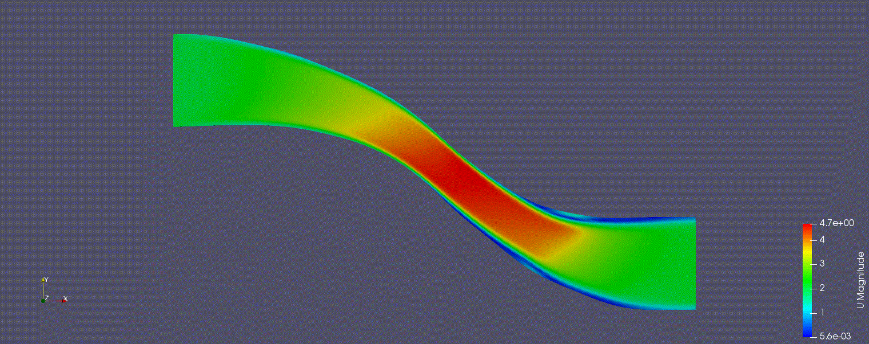
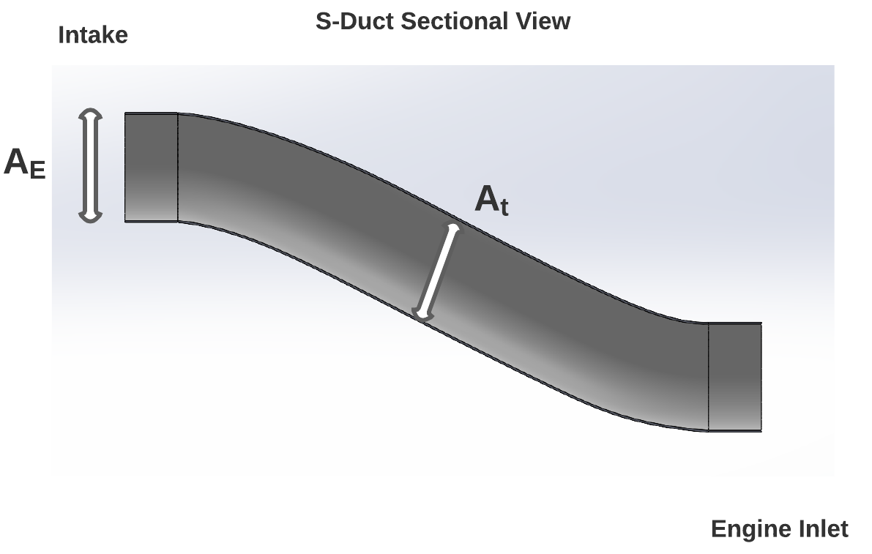
Inlet Area Ratio
Initial Design: Converging Diverging Duct
Area ratio comparison (A_{t}/A_{E})
Area ratios analyzed 0.25, 0.5, 0.75, 0.8, 0.9, 1
Higher area ratios resulted in less flow separation
Higher total pressure recovery
60.4% -> 98.2%
Chosen AR: 1

Slide 13
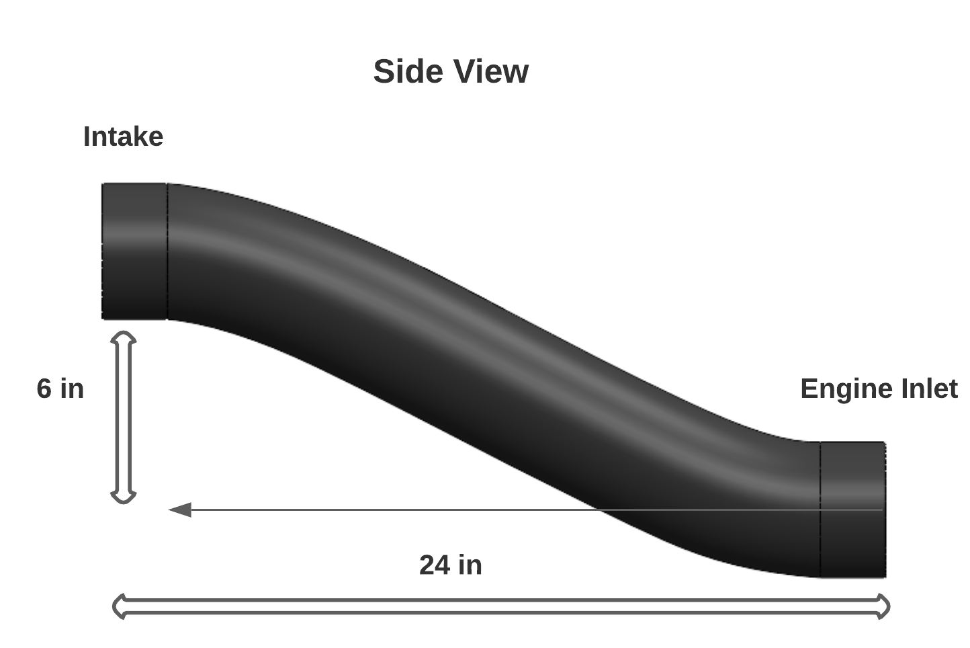
Inlet Length
Initial Estimate: 12 < x < 24 in
Lengths of 20, 22, 24, 26, and 28 inches were tested
Chosen Length: 24 in

Slide 14
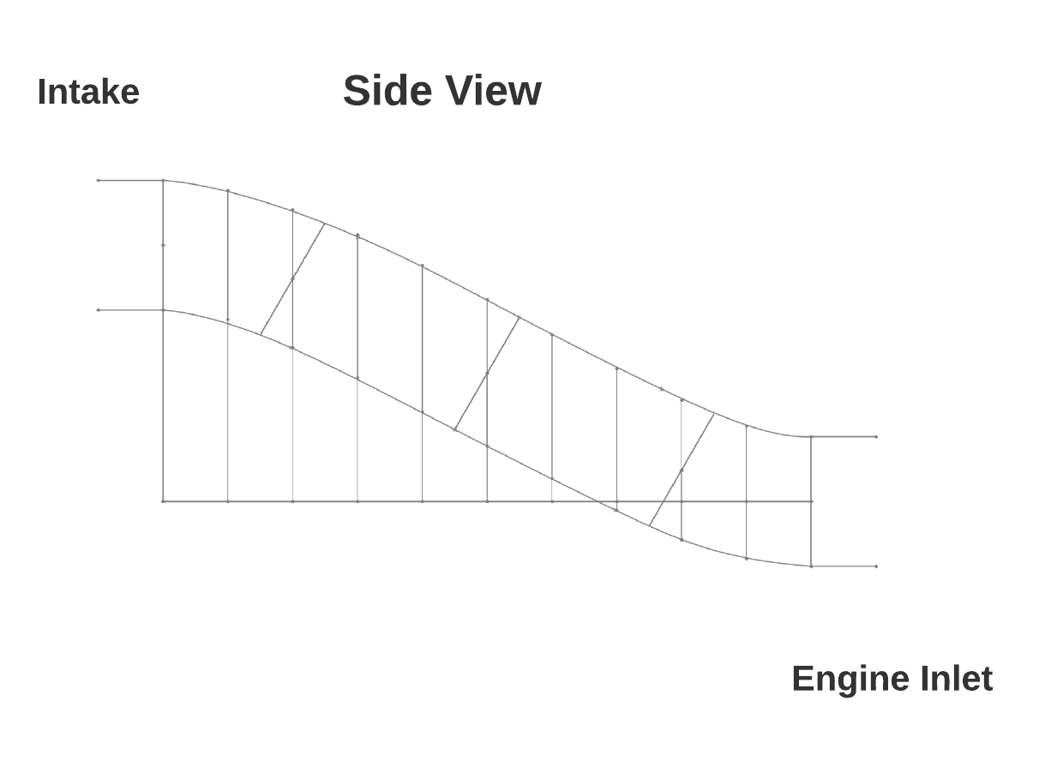
Data Point Generation
X and Y coordinates are recorded in a 2D cross-section
Geometry coordinates are then transcribed into a .txt file
MATLAB is used to convert the coordinates into a blockMesh for CFD analysis
CFD run at desired conditions

Slide 15
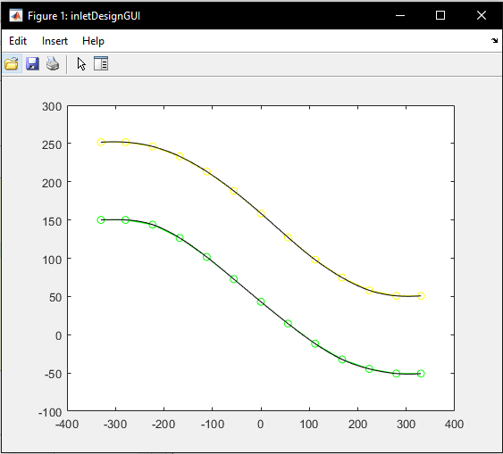
CFD Setup
Set-up
Design in CAD
Spline Smoothed in MATLAB
Print into openFOAM compatible .txt
Algorithm
SIMPLE (Semi-Implicit Method for Pressure-Linked Equations)
Navier-Stokes and divergence of the Momentum Equation for pressure
Steady-state solution
Assumptions
No Slip Boundaries (Walls)
Axial Static Free-Stream flow (e.g., 25m/s +x-dir)
Static Pressure on Compressor Face

Slide 16
CFD Results
Fidelity
One section is 30 vertical cells, there are 200 sections.
Spline Smoothed in MATLAB
Results
Increased understanding of flow behaviour through s-duct
Understanding expected changes from manipulated variables (throat area variation, length variation, etc.)
Limitations and Further Improvements
More realistic boundary conditions
Finer mesh and mesh grading towards interesting areas (ie. walls)
3D internal flow
Notes:
2D flow analysis results, assumptions made, fidelity talk, what worked and what didnt
What information we gained and what information still needs to be sought

Slide 17
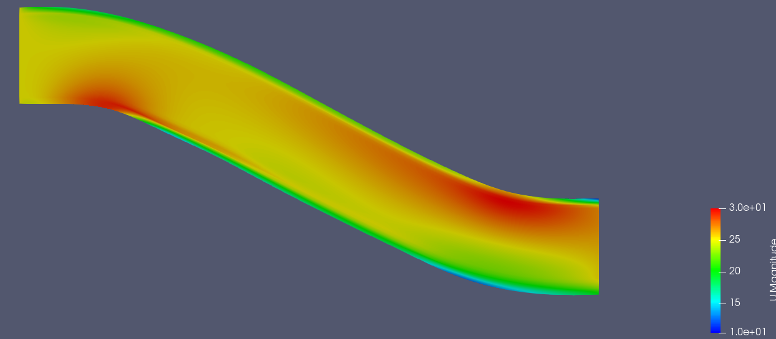
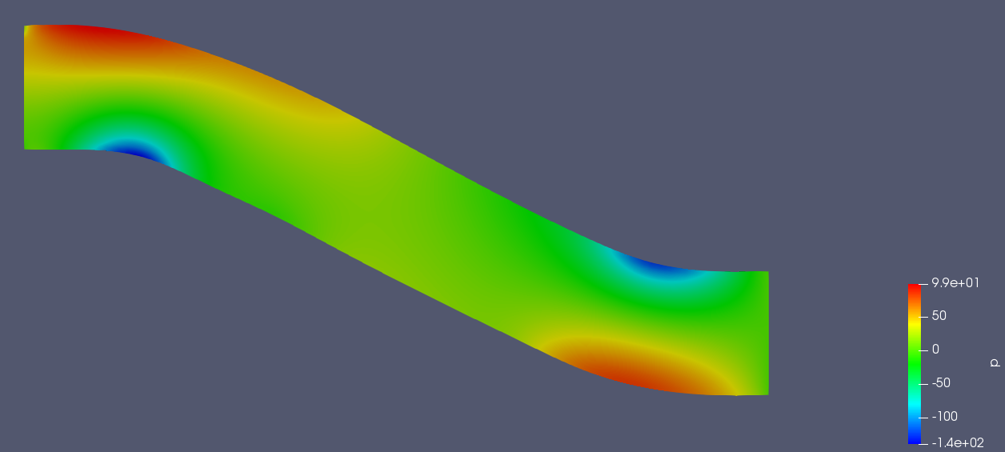
Baseline Design 1
Length: 24 inches
At/A2 ratio: 1
Bellmouth: None
Velocity Magnitude (m/s)
Re#: 250,000 (Turbulent Flow)
Relative Pressure* to Compressor Face (m^2/s^2)

Slide 18
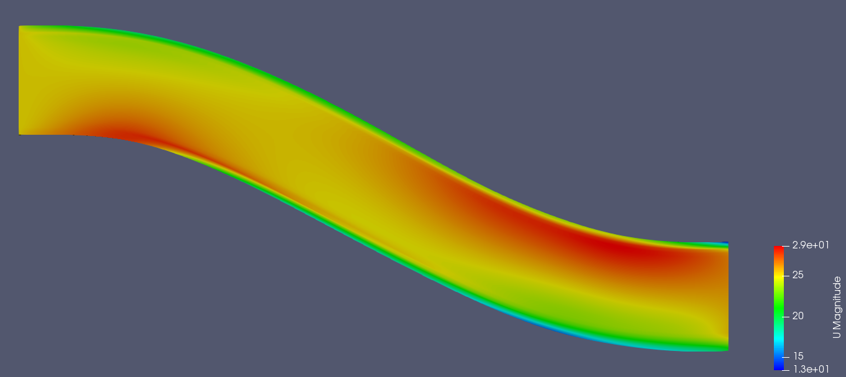
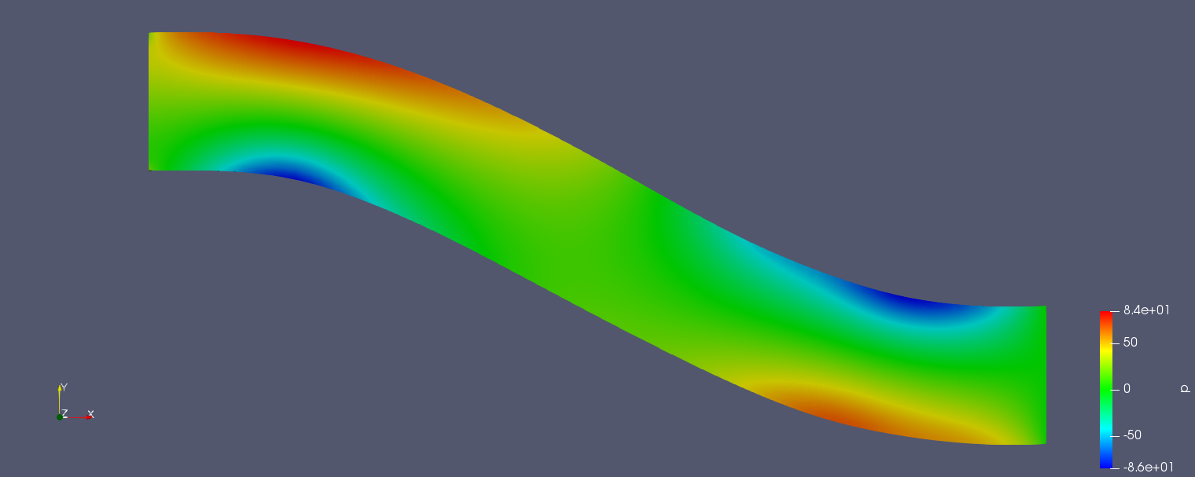
Baseline Design 2
Length: 26 inches
At/A2 ratio: 1
Bellmouth: None
Velocity Magnitude (m/s)
Re#: 250,000 (Turbulent Flow)
Relative Pressure* to Compressor Face (m^2/s^2)

Slide 19
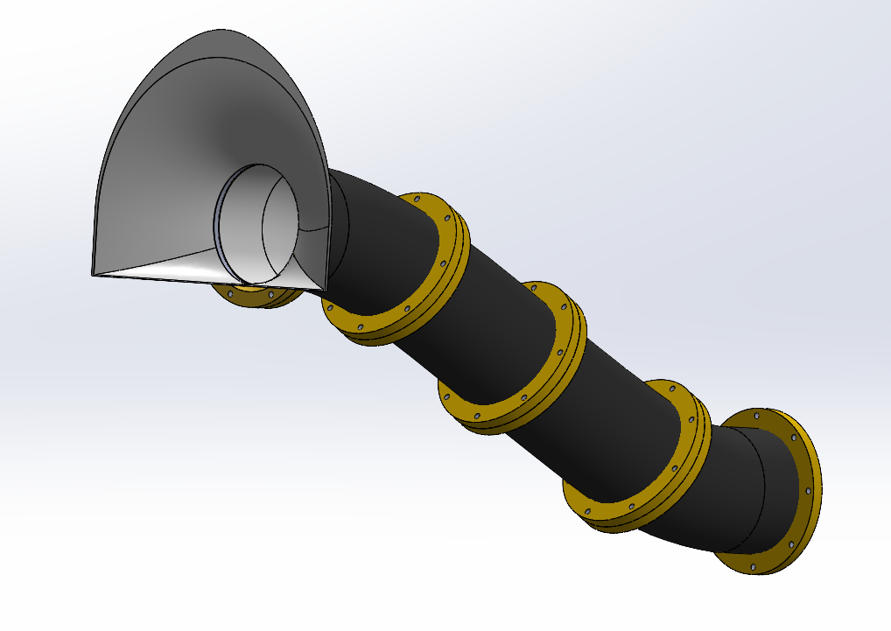
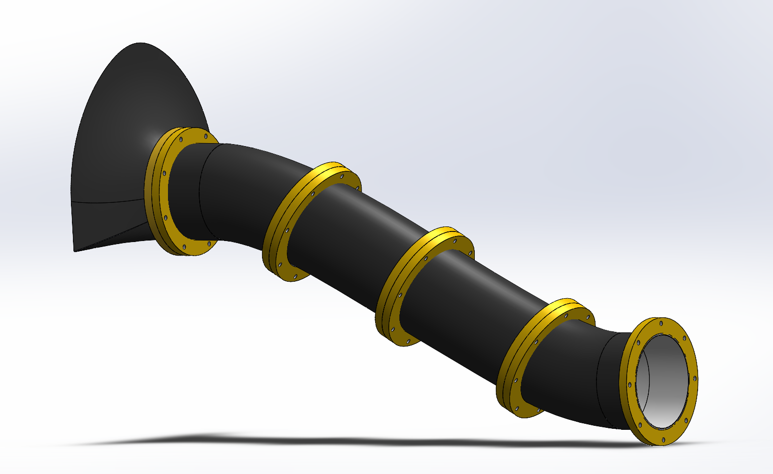
Addition of Bellmouth
Accessory for a static test
Increased mass flow rate
Half Bell Design
Helps maintain offset length
Notes:
Running with a straw vs. running with a trash bag (Hahahahaha)

Slide 20
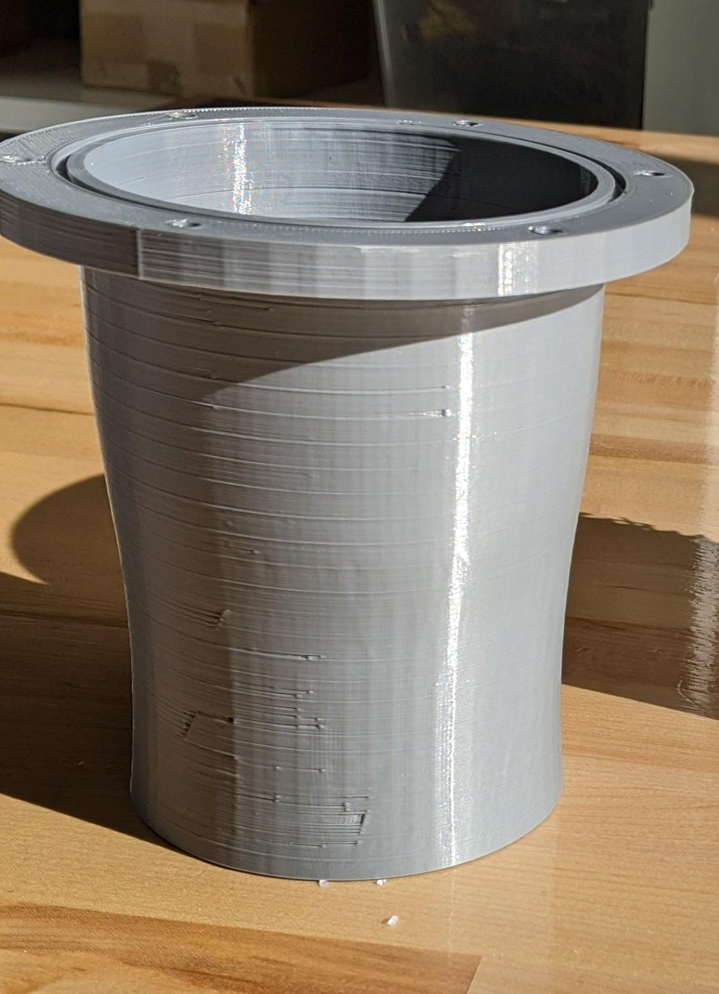
Manufacturing - PLA (Prototyping)
FDM
Advantages
Fast
Disadvantages
Low Resolution
Lulzbot Mini (2.0 - 0.18 mm)
MarkTwo (0.1-0.2mm)
Smaller print volume
Extensive post-processing
Acetone vapor treatment

Slide 21
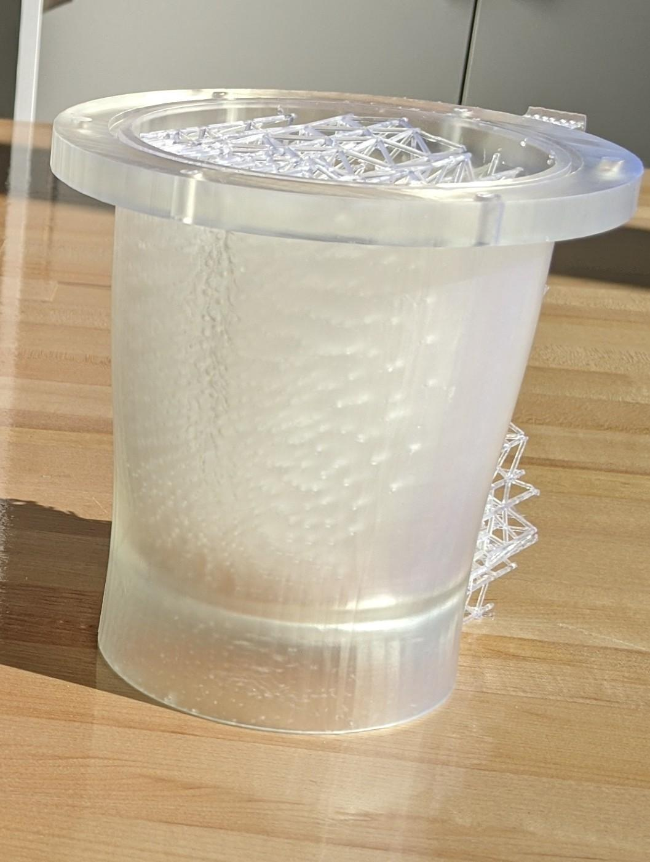
Manufacturing - SLA (Final Design)
SLA
Advantages
High Resolution
Form3B - 0.025 - 0.05 mm
Less intensive post-processing
Build scaffolding will be needed
Disadvantages
Slow
1-2 week lead time per print

Slide 22
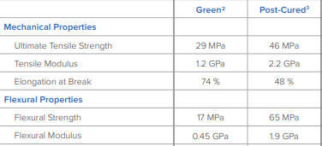
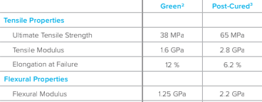
Manufacturing - SLA
Standard Resin
Clear - allows for visual flow analysis
More likely to fail due to deformation
Tough 2000 Resin
No clear options
Greater capacity for flexing

Slide 23
Manufacturing- Assembly
Inlet printed in four 6 in sections
Sections assembled together using eight 5mm bolts
Modular design provides flexibility
Bellmouth can be removed

Slide 24
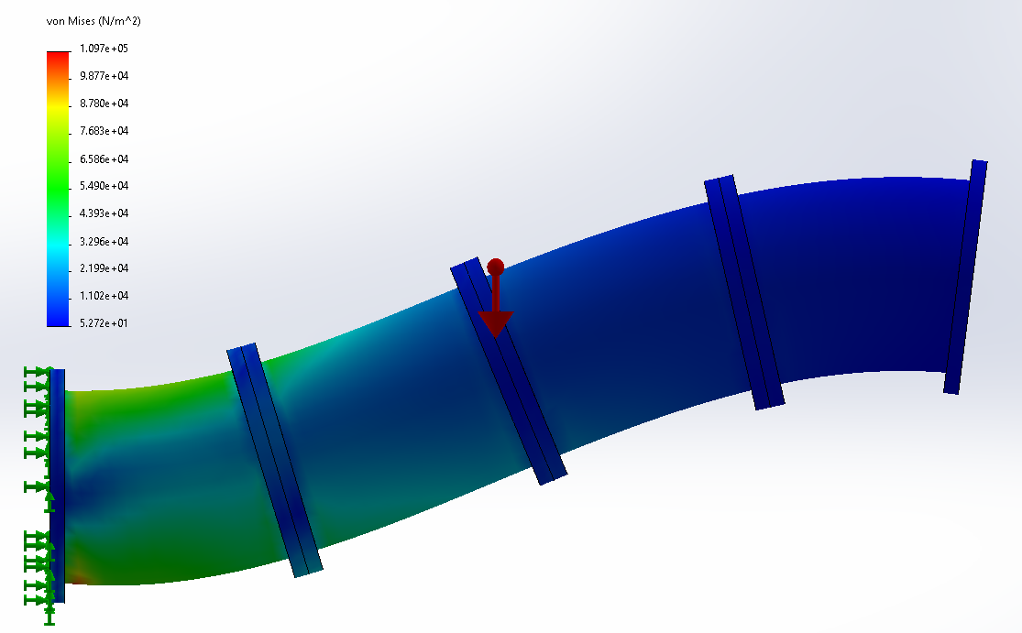
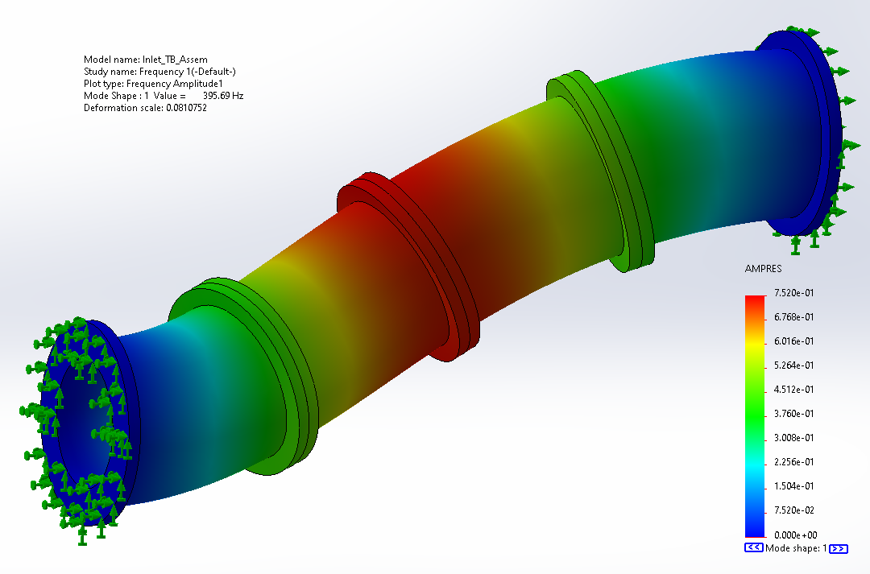
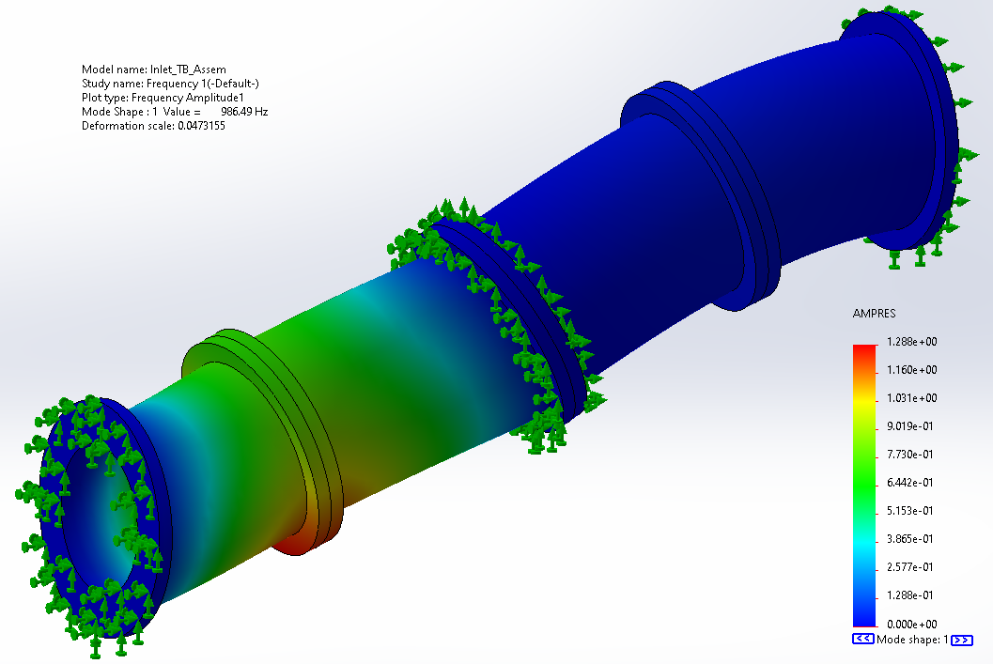
Stress and Vibration Analysis
Free standing Static
Restrained at ends only
1st failure mode at 396 Hz
Restrained at ends and throat
1st failure mode at 986 Hz
Tests conducted with Formlabs Standard (Clear) material properties
Inlet: L = 24 in AR = 1

Slide 25
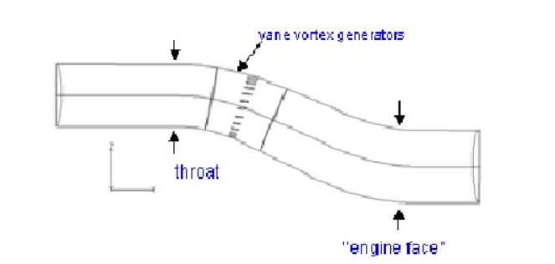
Vortex Generators
Too difficult to model in CFD
Future testing using an iterative process
Added to baseline
Manufactured separately
Epoxy or tape integration
Circumferential at first bend
Compare test results with baseline to analyze difference
Add if significant pressure recovery results are shown
Example of vortex gen. placement

Slide 26
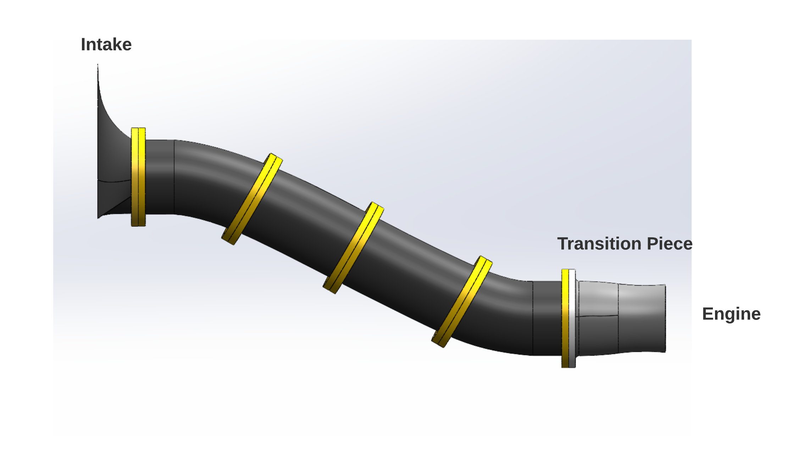
Final Assembly

Slide 27
Section 2.2
Test Apparatus Design
Project Purpose
Design Solutions
Design Satisfaction
Project Risks
Verification & Validation
Project Planning
Notes:
Sec 2 - 2 minutes

Slide 28
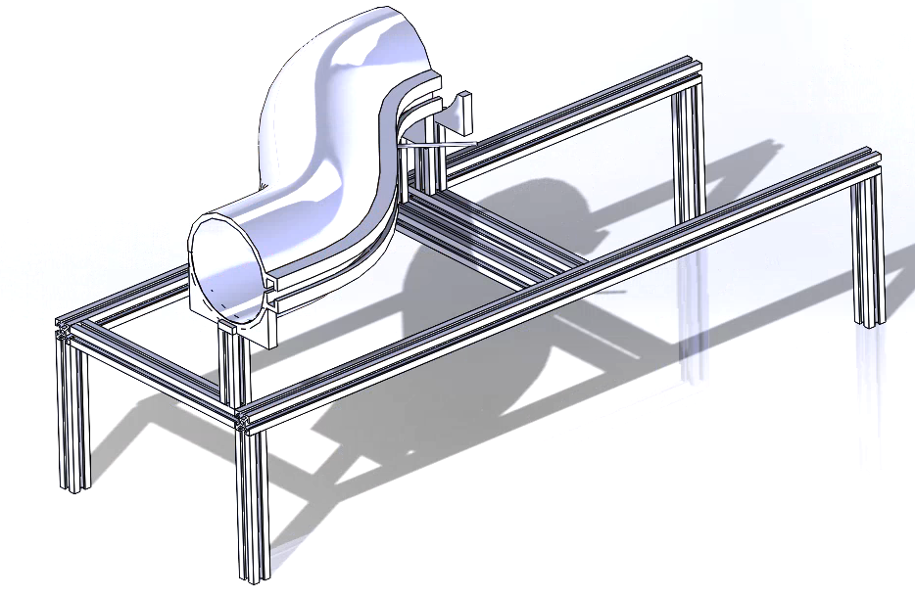
Test Apparatus Design Critical Elements
Pressure Measurement:
Static tap manufacturing, integration and flow separation identification
Slotted Inlet Concept:
Slotted inlet manufacturing and testing capabilities
Mass Flow Surrogate:
Engine condition replication using Electric Ducted Fans
DAQ & EDF Control:
Data Acquisition system and EDF control setup
Notes:
Presented by: Michael
Timed: 30s
The testing apparatus has 4 critical elements,
First, we will look at pressure measurement, specifically static taps.
Second will be the slotted inlet concept feasibility of manufacturing and test capabilities.
We will also look at a mass flow surrogate to replicate operating engine conditions in the inlet,
And lastly we will look at the data acquisition system and the electric ducted fan control setup.

Slide 29
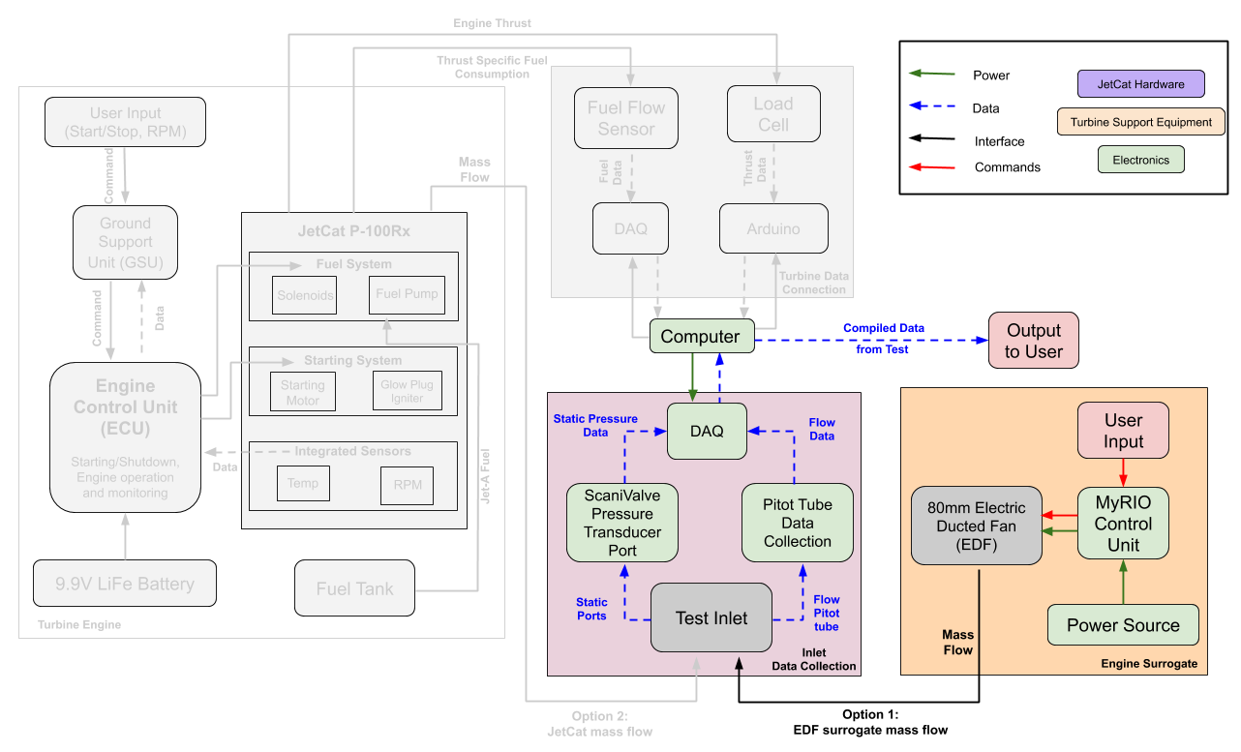
Test Apparatus FBD
Legend

Slide 30
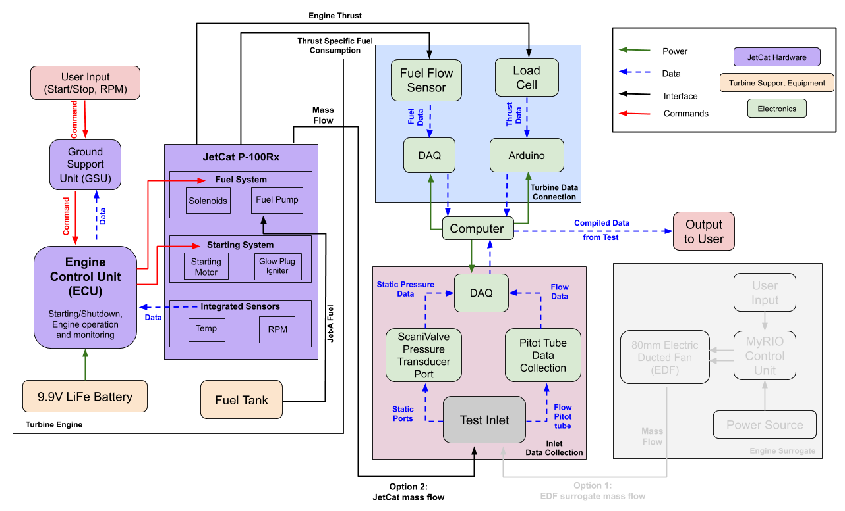
Test Apparatus FBD
Legend

Slide 31
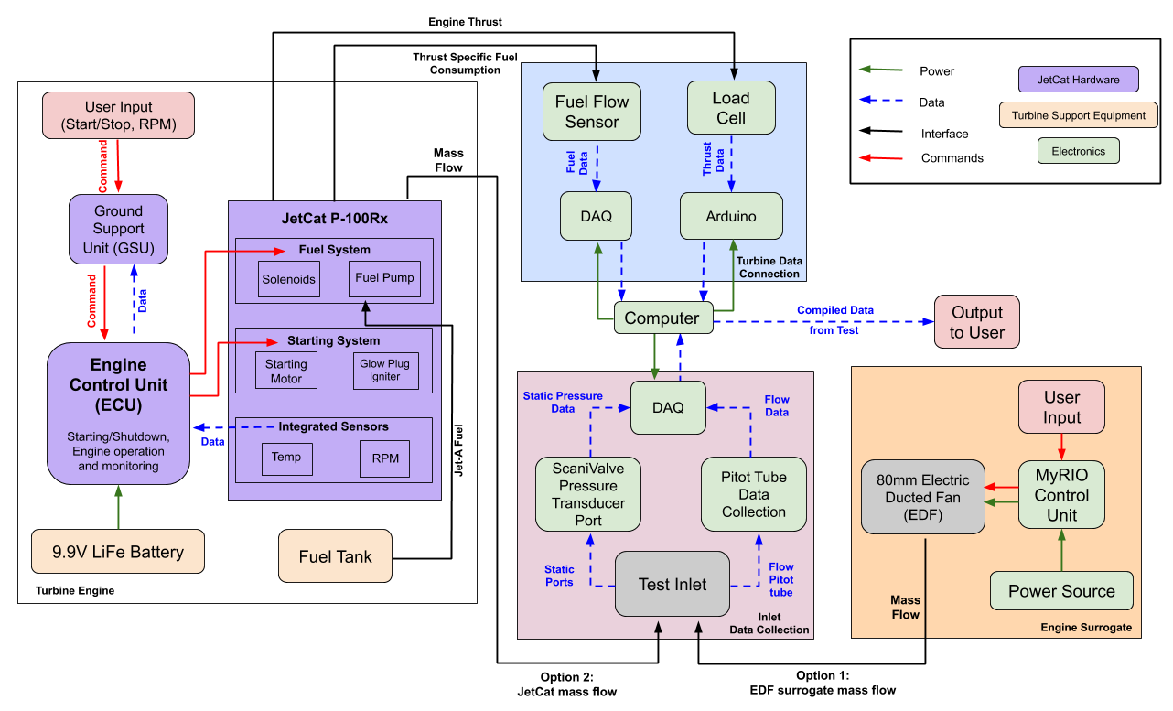
Test Apparatus FBD
Legend

Slide 32
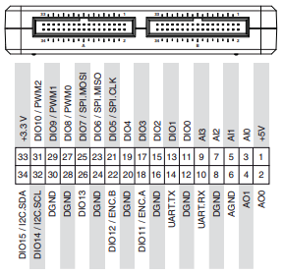
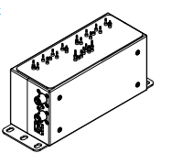
Data Acquisition Hardware
myRIO - 1900
PWM capabilities (3 DIO)
100kHz, 20 ns pulse width
Analog Signal capabilities (4 AI)
500 kS/s
ADC capabilities (1 multiplexed)
12 bit resolution
USB / Wireless (TCP/IP) Networking
Scanivalve DS 3217
16 input channels
0 - 750 psi pressure range
Ethernet TCP/IP & UDP Networking
±.05% on 5-500 PSI measurements
Notes:
Scanivalve and pitot tube rail system??

Slide 33
EDF Model and Control
Initial Mass Flow Approximation
Assumptions:
p_{e} = p∞
v∞ = 0
constant v_{e} across fan
Used to select an EDF
Mass Flow Control for Testing
Experimentally relate RPM to mass flow
Simple straight inlet
Aim to match Jetcat mass flow
Closed-Loop RPM Control
Mass flow can be affected by inlet
Unreliable between designs
Method used by the Jetcat

Slide 34
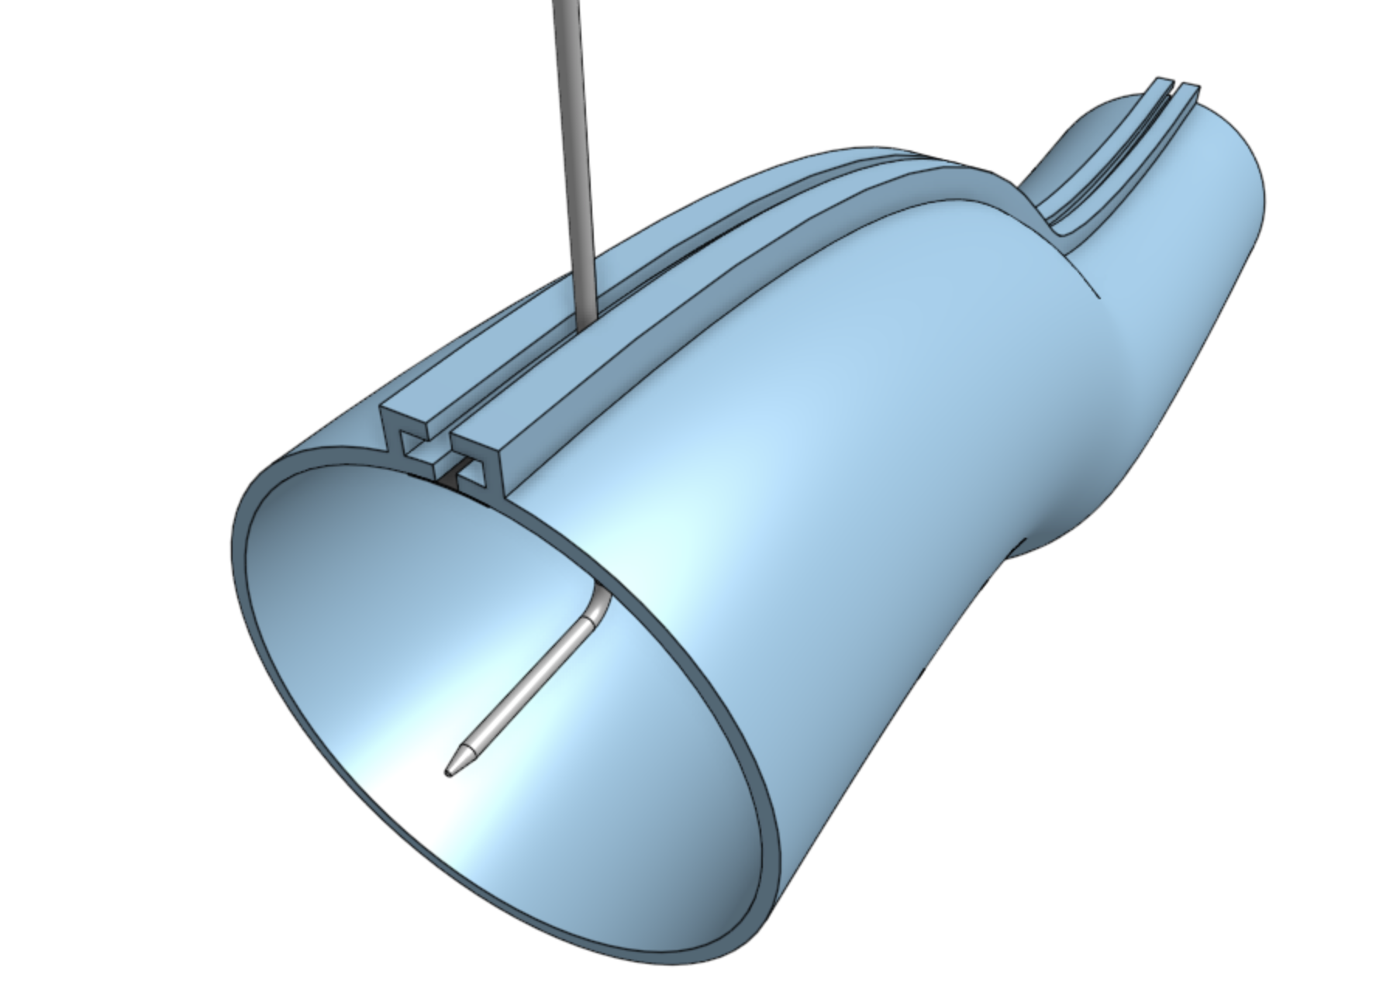
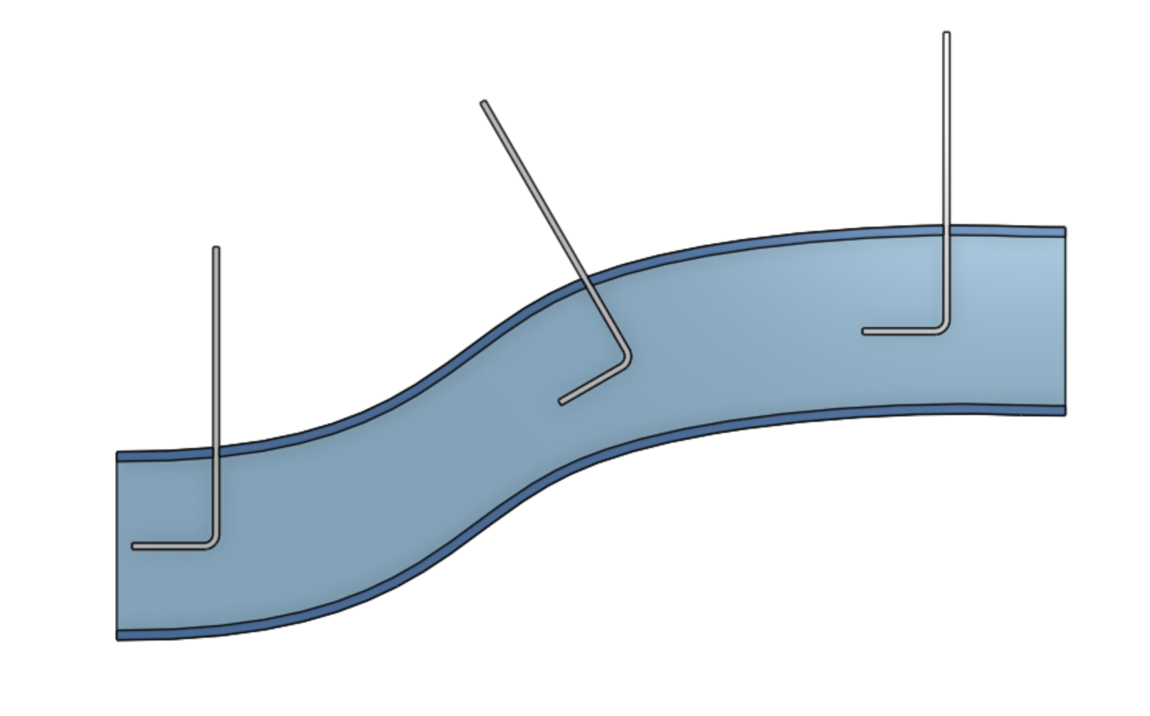
Slotted Inlet Design
Pitot tube perpendicular to inlet walls at all times
Allows for full 2D range of motion across inlet cross section
Rail slides primarily along x axis
Y axis adjusted up or down along length of pitot tube
y
x
z

Slide 35
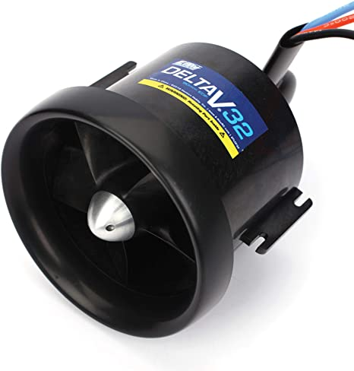
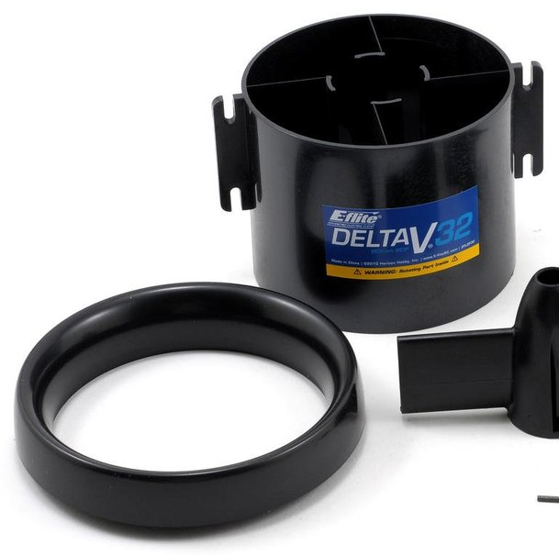
EDF Selection
E-flite: Delta V 32
80 mm
2450g of thrust
Expected mass flow
0.36 kg/s (need 0.23 kg/s)
Factor of safety of 1.56
Excluding motor area
Bell mouth can be removed to interface with transition piece

Slide 36
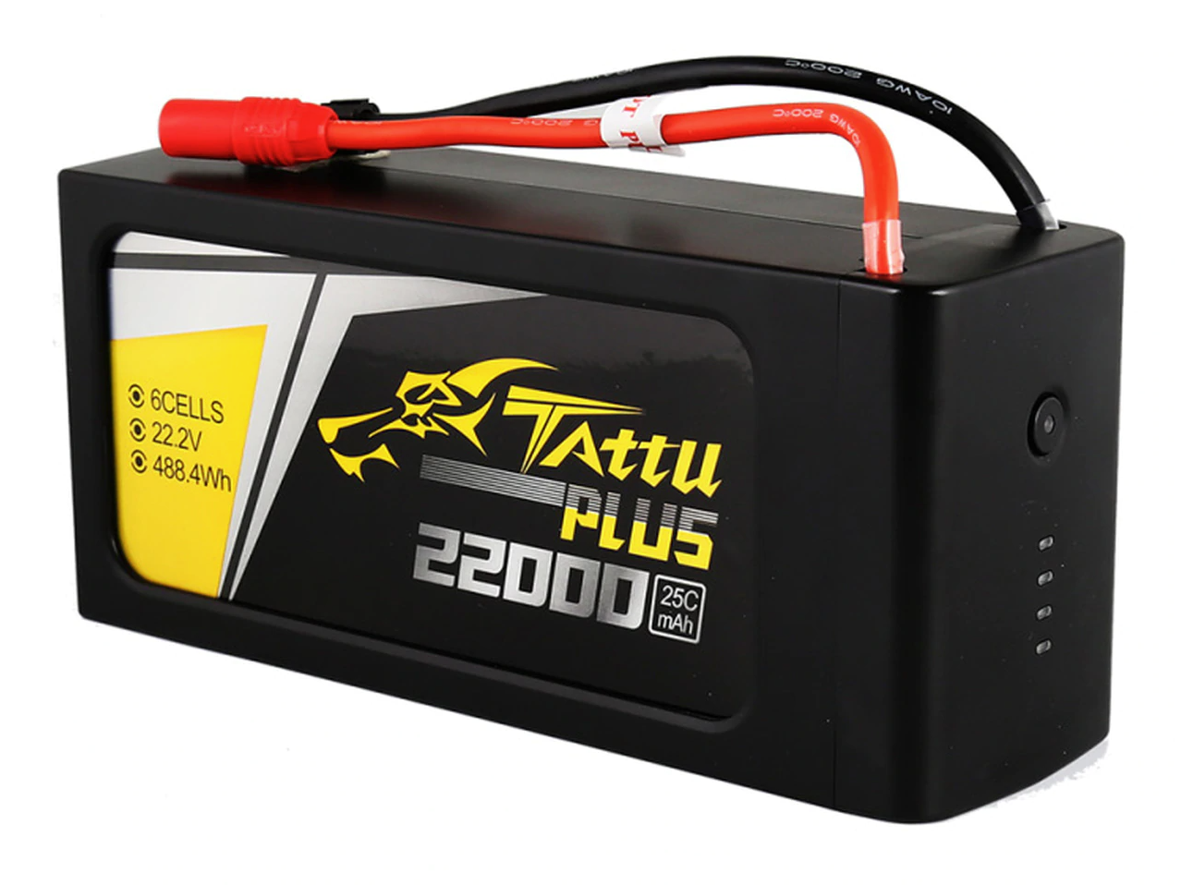
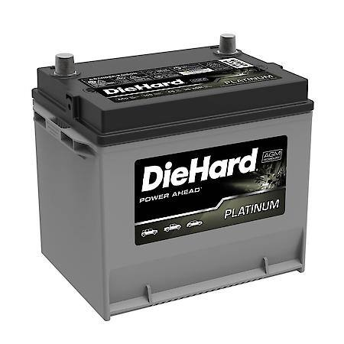
EDF Control and Power
Speed Controller
E-Flite recommends an 80A ESC
Max sustained current is 53A
Estimates motor RPM via back EMF
6 Cell LiPo
22.2V
22000 mah
25 minutes of runtime
Car batteries
Two in series provide 24.0V
2 x 55000 mAh
2 hours of runtime

Slide 37
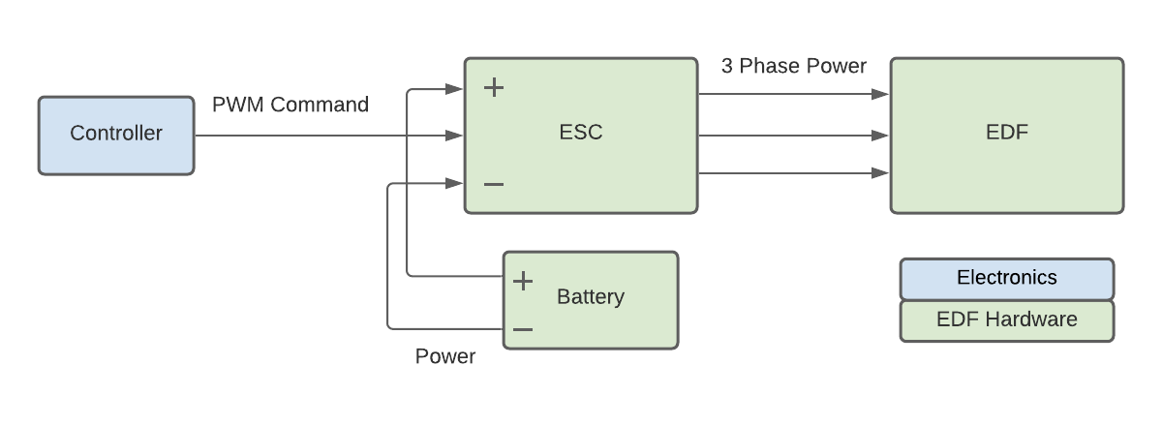
EDF Control and Power
myRIO Control
Input: Controler sets throttle using LABView GUI
Output: 50 Hz PWM, 5-10% duty cycle
Test Setting
Throttle
Ramp Up
Ramp Down
Arm ESC
(4s)
Time
Safe

Slide 38
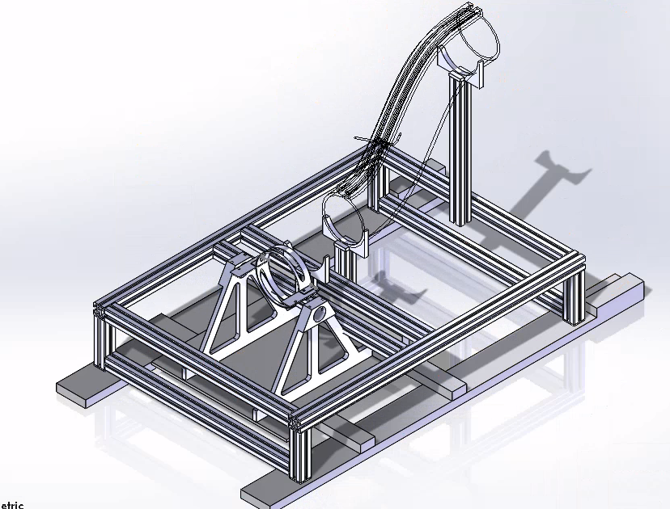
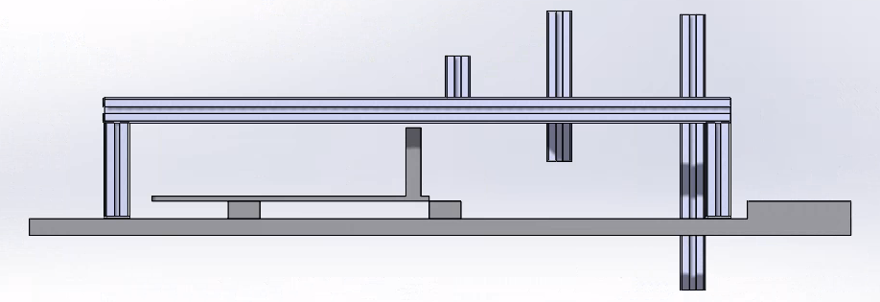
Test Stand Frame
Compatible with EDF tests and the JetCat test stand (without effects on the load cell)
Material: Aluminum 30x30 extrusion
Adaptable to a variety of inlets for testing (modular design)
Different lengths, offsets, etc
Vertical and horizontal test configurations possible
Dimensions finalized
Parts ordered (precut from factory)
Cost: ~$200
483.5 mm
750 mm
Transition piece holder
Inlet holder short
Inlet holder long

Slide 39
Section 3
Design Satisfaction
Project Purpose
Design Solutions
Design Satisfaction
Project Risks
Verification & Validation
Project Planning

Slide 40
Section 3.1
Inlet Design Satisfaction
Project Purpose
Design Solutions
Design Satisfaction
Project Risks
Verification & Validation
Project Planning

Slide 41
≥ 98% Total Pressure Recovery
Primary scoring criteria for AFRL.
CFD program allows for the computation of total pressure throughout duct interior.
Trial and error method for characterizing ideal total pressure recovery within certain duct designs.
CFD results will be verified via experimentation.

Slide 42
≤ 5% Max Thrust & TSFC Decrement
Primary AFRL scoring criteria.
Inlet design must provide necessary mass flow across RPM sweep of the engine.
Addition of a removable bell mouth to ensure proper mass flow at static test conditions.
Upon inlet design verification (EDF, test stand integration), inlet will be attached to JetCat to ascertain TSFC and Max Thrust Decrement parameters.

Slide 43
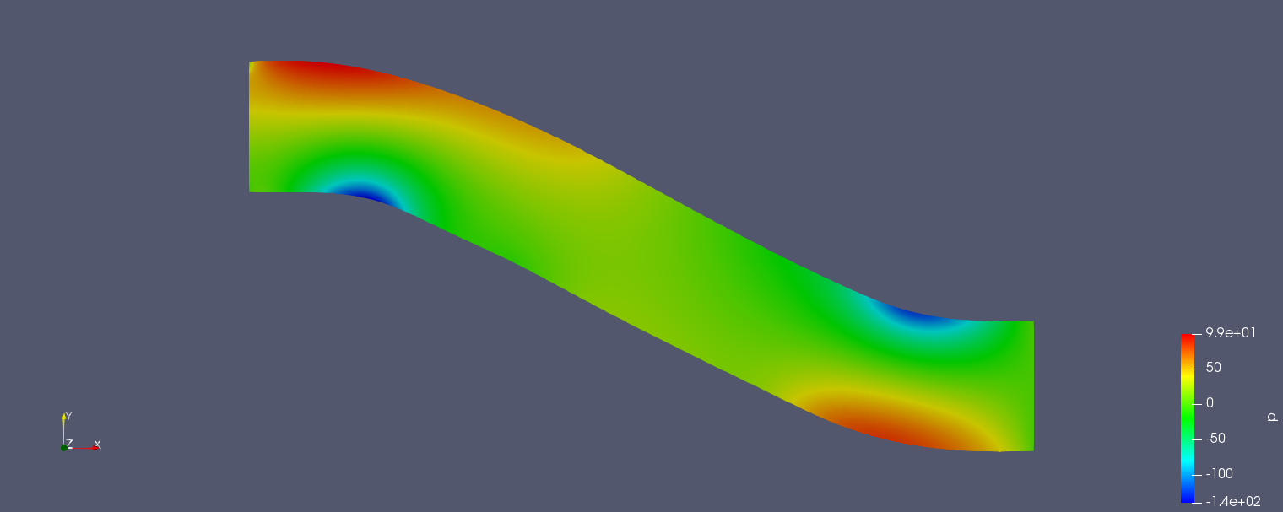
Short Axial Length
Secondary AFRL scoring criteria.
Modeled several iterations of baseline design in 2 inch increments to observe flow effects. (Flow separation, adverse pressure gradients, turbulence).
CFD simulations give credence to a 24 in length duct for ideal performance metrics.

Slide 44
Section 3.2
Test Apparatus Design Satisfaction
Project Purpose
Design Solutions
Design Satisfaction
Project Risks
Verification & Validation
Project Planning

Slide 45
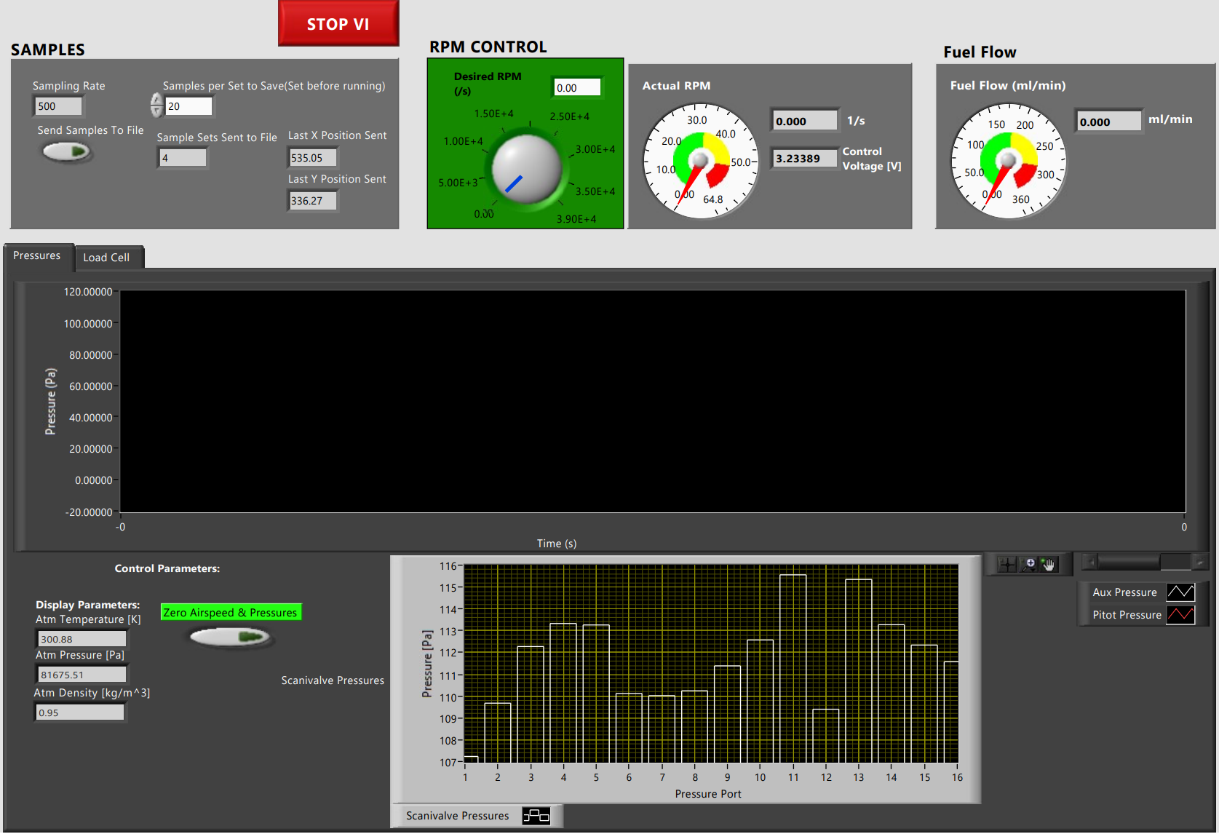
LABView GUI

Slide 46
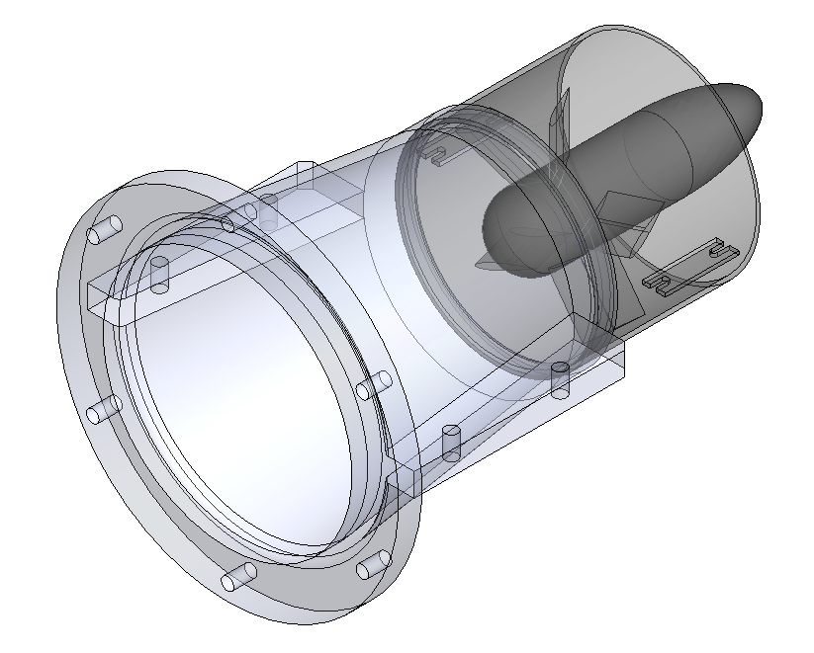
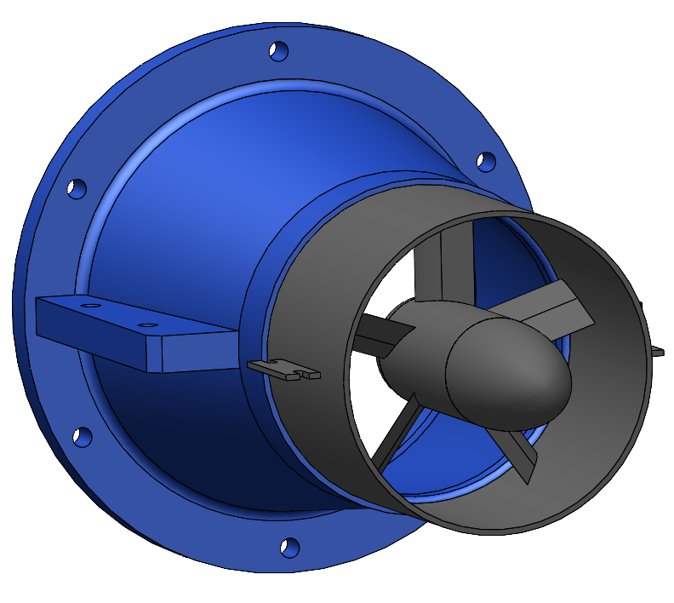
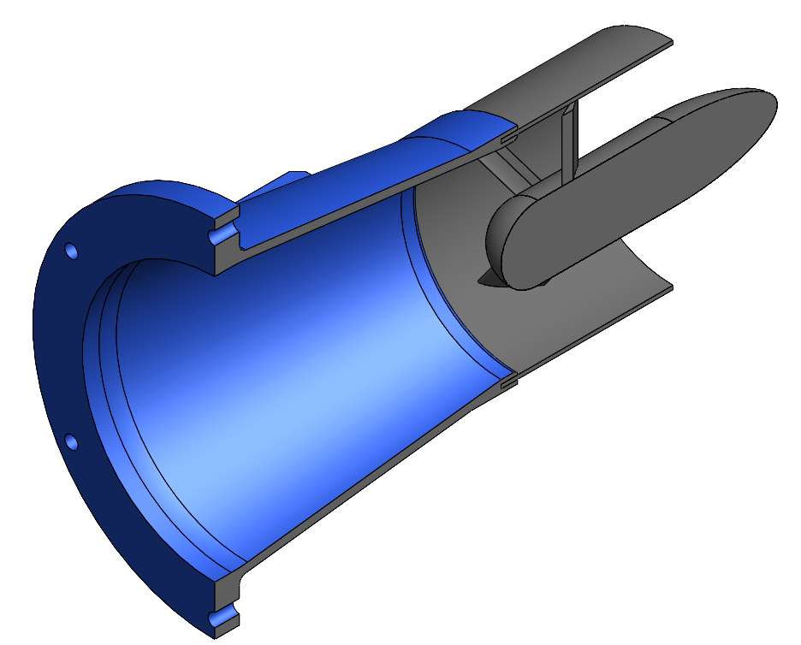
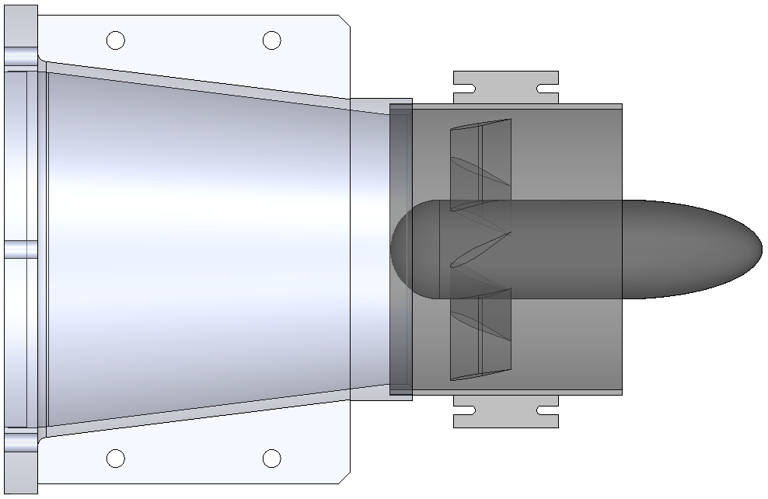
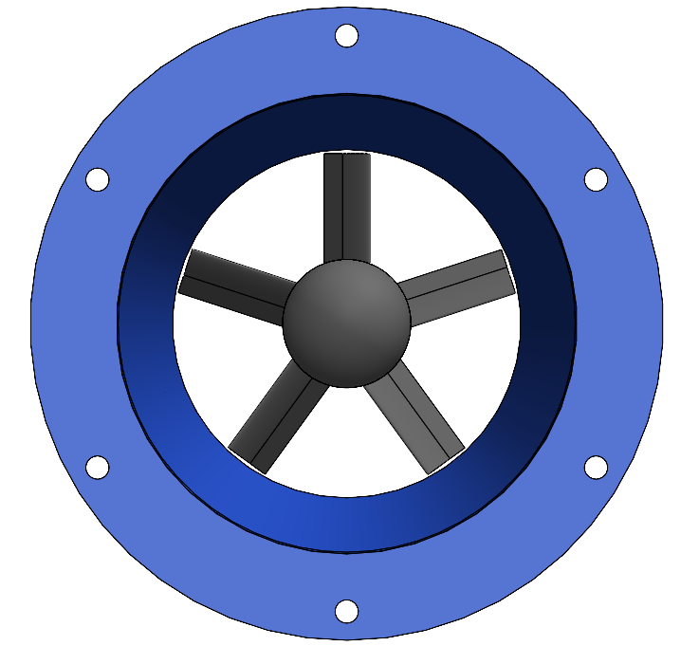
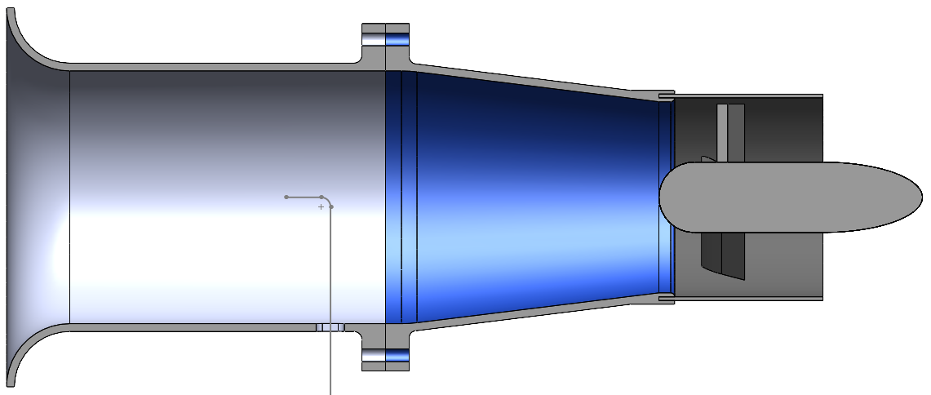

Slide 47
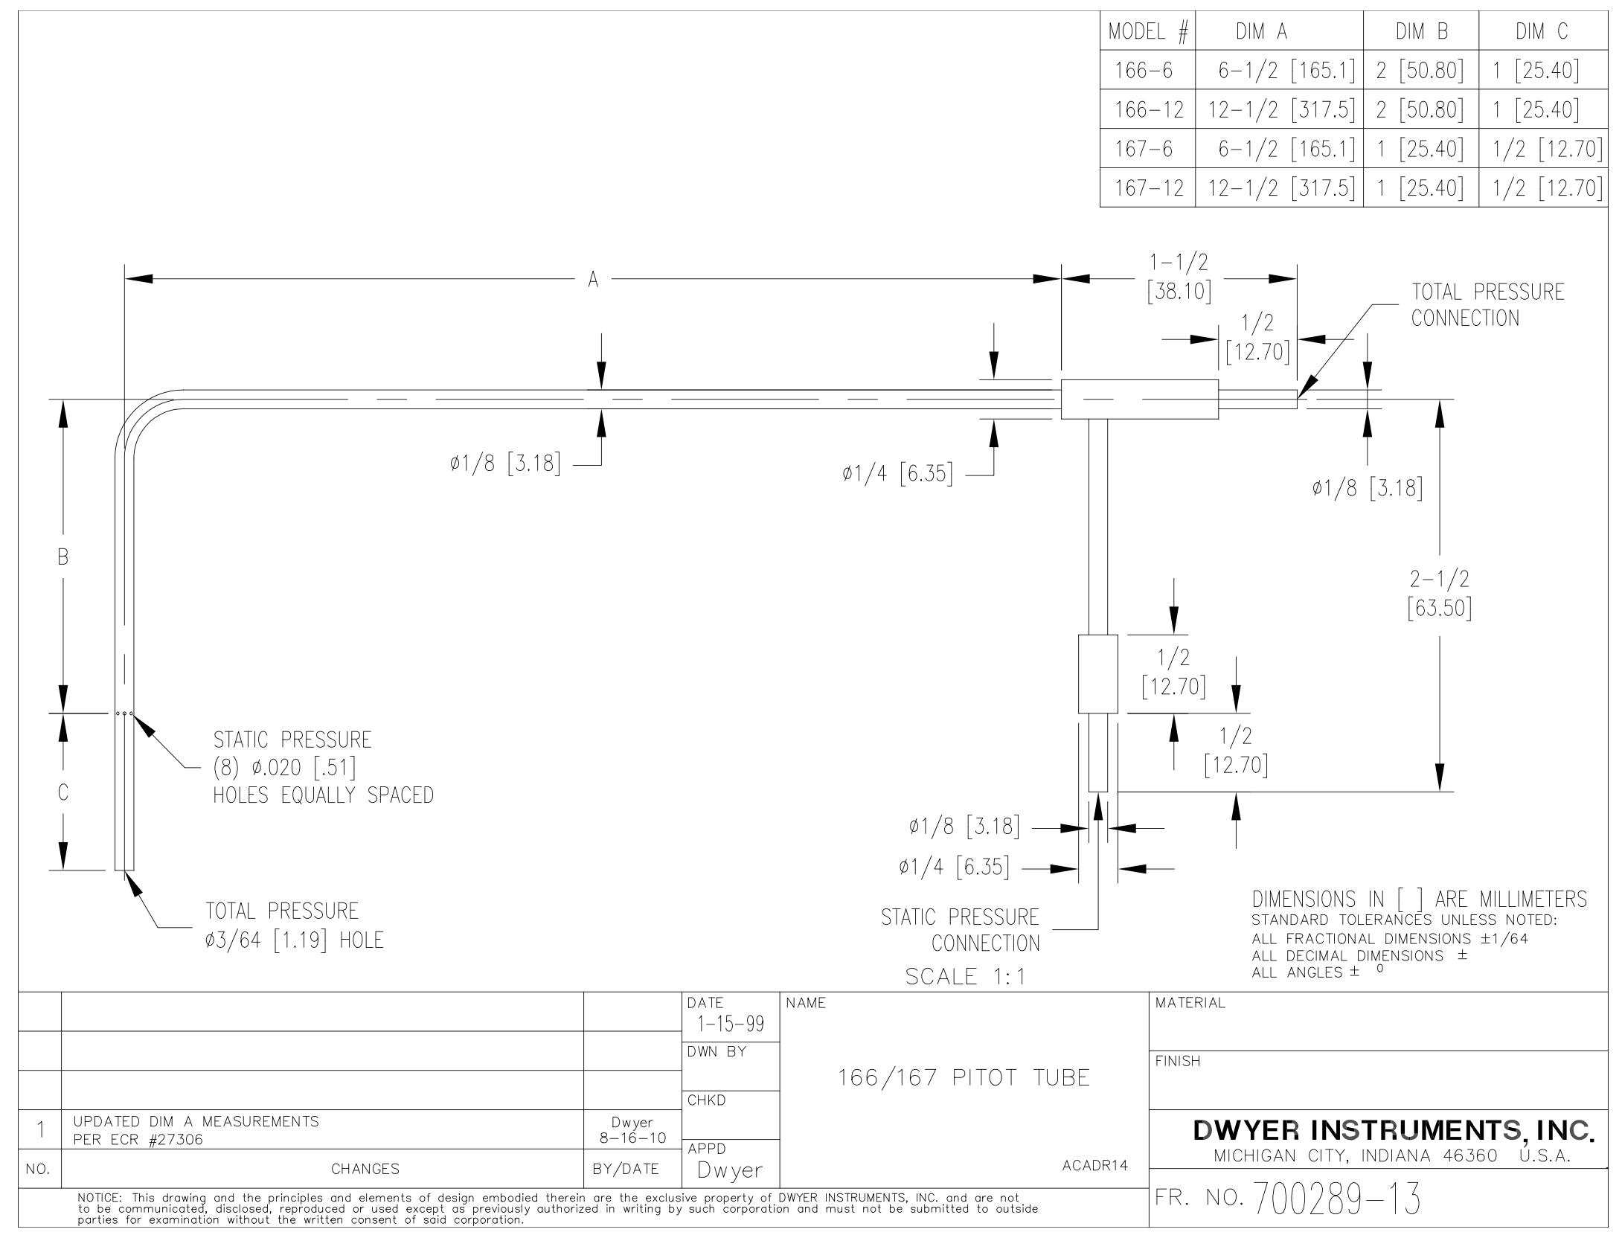
Total Pressure Measurement: Pitot Probe
Dwyer 167-6 pitot probe
⅛_{th} inch diameter probe
1.5 inch probe length
6 inch insertion length
0.00098 ≤ A_{probe}/A_{inlet} ≤ 0.0099
Area of probe over area of inlet at minimum and maximum insertion
Minimal flow interference
Probe accurate to within 0.5%
Only accurate at minimum of 5 m/s airflow
Accuracy converges above this speed
Total & static pressure measured using scanivalve

Slide 48
Mapping Pressure Distribution
Major distortions expected at wall interface
Observable using surface pressure taps
Minimal distortions expected at inlet center
Observable using slot pitot

Slide 49
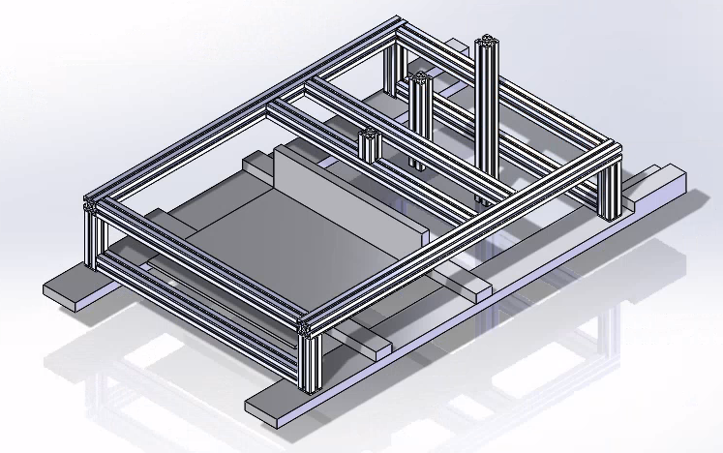
TA interface with Multiple Inlets
Modular design
Holders capable of 2 and 3 degrees of freedom
Allows for any inlet to be supported in vertical or horizontal orientations
Different offsets are accommodated
Can also hold different inlet lengths
To adjust in any dimension simply loosen and re-tighten bolts
Made possible through special sliding nuts
483.5 mm
750 mm

Slide 50
Section 4
Project Risks
Project Purpose
Design Solutions
Design Satisfaction
Project Risks
Verification & Validation
Project Planning
Notes:
Sec 5 -
Presented by: Will

Slide 51
Inlet Risks and Mitigation
Inlet Material Failure
Soiling Effects
FLow leakage through surface or integration with TA
Risk Matrix |  | Impact
 |  | Insignificant | Minor | Major | Catastrophic
 | Certain >90%
 | Likely 30-85% |  | 3 | 2
 | Unlikely 10-30% |  |  |  | 1
 | Rare <10%
Probability

Slide 52
Inlet Risks and Mitigation
Inlet Material Failure
Increase thickness to avoid failure
Soiling Effects
Flow leakage through surface or integration with TA
Risk Matrix |  | Impact
 |  | Insignificant | Minor | Major | Catastrophic
 | Certain >90%
 | Likely 30-85% |  | 3 | 2
 | Unlikely 10-30%
 | Rare <10% |  |  |  | 1
Probability

Slide 53
Inlet Risks and Mitigation
Inlet Material Failure
Soiling Effects
Vortex Generator, Sand paper
Flow leakage through surface or integration with TA
Risk Matrix |  | Impact
 |  | Insignificant | Minor | Major | Catastrophic
 | Certain >90%
 | Likely 30-85% |  | 3
 | Unlikely 10-30% |  |  | 2
 | Rare <10% |  |  |  | 1
Probability

Slide 54
Inlet Risks and Mitigation
Inlet Material Failure
Soiling Effects
Flow leakage through surface or integration with TA
HVAC tape for short term, re-manufacture or design for long term
Risk Matrix |  | Impact
 |  | Insignificant | Minor | Major | Catastrophic
 | Certain >90%
 | Likely 30-85%
 | Unlikely 10-30% | 3 |  | 2
 | Rare <10% |  |  |  | 1
Probability

Slide 55
Test Apparatus Risks and Mitigation
Short EDF battery duration and performance
Too little mass flow from EDF surrogate
Inaccurate EDF mass flow control
Non-negligible error introduced with slotted inlet concept
JetCat engine unable to function for testing
Engine explosion (damage to compressor blades with test inlet)
Risk Matrix |  | Impact
 |  | Insignificant | Minor | Major | Catastrophic
 | Certain >90%
 | Likely 30-85% |  | 1 |  | 5
 | Unlikely 10-30% |  | 4 | 2 | 6
 | Rare <10% |  | 3
Probability

Slide 56
Test Apparatus Risks and Mitigation
Short EDF battery duration and performance
Multiple batteries or DC power supply
Too little mass flow from EDF surrogate
Inaccurate EDF mass flow control
Not negligible error introduced with slotted inlet concept
JetCat engine unable to function for testing
Engine explosion (damage to compressor blades with test inlet)
Risk Matrix |  | Impact
 |  | Insignificant | Minor | Major | Catastrophic
 | Certain >90%
 | Likely 30-85% |  |  |  | 5
 | Unlikely 10-30% | 1 | 4 | 2 | 6
 | Rare <10% |  | 3
Probability

Slide 57
Test Apparatus Risks and Mitigation
Short EDF battery duration and performance
Too little mass flow from EDF surrogate
Purchase new fan (larger than 80mm)
Inaccurate EDF mass flow control
Not negligible error introduced with slotted inlet concept
JetCat engine unable to function for testing
Engine explosion (damage to compressor blades with test inlet)
Risk Matrix |  | Impact
 |  | Insignificant | Minor | Major | Catastrophic
 | Certain >90%
 | Likely 30-85% |  |  |  | 5
 | Unlikely 10-30% | 1 | 4 |  | 6
 | Rare <10% |  | 3 | 2
Probability

Slide 58
Test Apparatus Risks and Mitigation
Short EDF battery duration and performance
Too little mass flow from EDF surrogate
Inaccurate EDF mass flow control
Implement quality RPM sensor and integrate into closed loop control
Not negligible error introduced with slotted inlet concept
JetCat engine unable to function for testing
Engine explosion (damage to compressor blades with test inlet)
Risk Matrix |  | Impact
 |  | Insignificant | Minor | Major | Catastrophic
 | Certain >90%
 | Likely 30-85% |  |  |  | 5
 | Unlikely 10-30% | 1 | 4 |  | 6
 | Rare <10% |  | 3 | 2
Probability

Slide 59
Test Apparatus Risks and Mitigation
Short EDF battery duration and performance
Too little mass flow from EDF surrogate
Inaccurate EDF mass flow control
Not negligible error introduced with slotted inlet concept
Reduce slot width, cover open slot and reduce pitot diameter
Move from slotted concept to distinct locations
JetCat engine unable to function for testing
Engine explosion (damage to compressor blades with test inlet)
Risk Matrix |  | Impact
 |  | Insignificant | Minor | Major | Catastrophic
 | Certain >90%
 | Likely 30-85% |  |  |  | 5
 | Unlikely 10-30% | 1 |  |  | 6
 | Rare <10% | 4 | 3 | 2
Probability

Slide 60
Test Apparatus Risks and Mitigation
Short EDF battery duration and performance
Too little mass flow from EDF surrogate
Inaccurate EDF mass flow control
Not negligible error introduced with slotted inlet concept
JetCat engine unable to function for testing
Send engine for JetCat approved service to get any issues fixed by qualified personnel
Engine explosion (damage to compressor blades with test inlet)
Risk Matrix |  | Impact
 |  | Insignificant | Minor | Major | Catastrophic
 | Certain >90%
 | Likely 30-85%
 | Unlikely 10-30% | 1 |  |  | 6
 | Rare <10% | 4 | 3 | 2 | 5
Probability

Slide 61
Test Apparatus Risks and Mitigation
Short EDF battery duration and performance
Too little mass flow from EDF surrogate
Inaccurate EDF mass flow control
Not negligible error introduced with slotted inlet concept
JetCat engine unable to function for testing
Engine explosion (damage to compressor blades with test inlet)
Perform all initial inlet tests on EDF surrogate until aerodynamic effects are understood
Risk Matrix |  | Impact
 |  | Insignificant | Minor | Major | Catastrophic
 | Certain >90%
 | Likely 30-85%
 | Unlikely 10-30% | 1
 | Rare <10% | 4 | 3 | 2 | 5,6
Probability

Slide 62
Section 5
Verification & Validation
Project Purpose
Design Solutions
Design Satisfaction
Project Risks
Verification & Validation
Project Planning

Slide 63
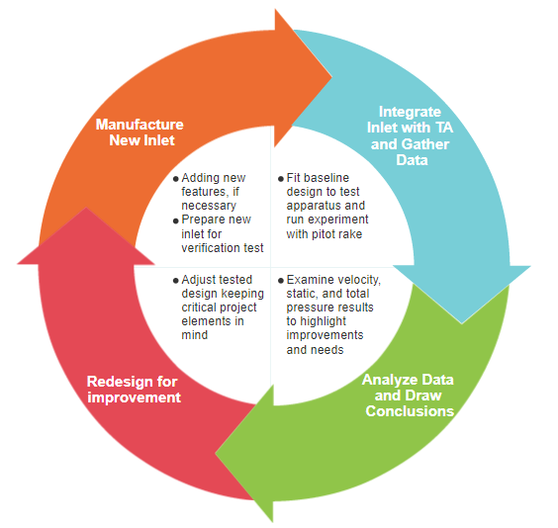
Inlet Verification and Validation Plan

Slide 64
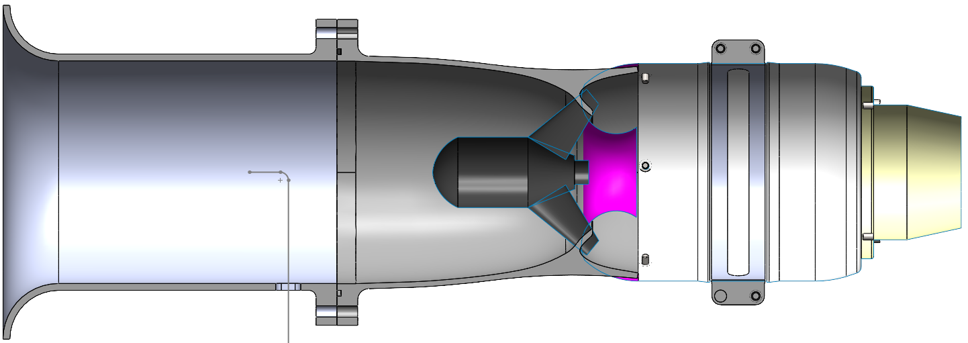
Test Stand Calibration and Verification Plan
EDF mass flow calibration
Test several throttle settings for the EDF
Straight inlet with bell mouth
Calculate mass flow with pitot probe
Steady 1-D approximation
Record useful battery duration (EDF)
Repeat the test with the Jetcat engine
Identify the EDF settings which align with JetCat’s settings
Pitot Tube Verification
Test in Aerospace wind tunnel
Compare against pitot tubes and other pre calibrated and proven sensors
(D = 4in)
(D = 4in)

Slide 65
CFD Calibration
Simple converging-diverging inlet
Simple ASEN 2002 analytical calculations
Estimate flow speeds at key locations (before throat, throat, after throat) with hand calculations
Compare and verify
CFD
Analytical (back of the envelope)
Experimental results
Balancing CFD calculations
Higher Reynolds Number
P₀ = P∞ = P₁

Slide 66
Turbine Engine Sensors Calibration
Load Cell
Calibrate cell with known weights
Run JetCat engine through RPM sweep without and without inlet test stand
Ensures inlet test stand has negligible error on thrust data
Fuel Flow Sensor (fuel flow rate)
Equiflow PFA Click Housing Flowmeter
With JetCat fuel pump run into graduated cylinder at set rate with stopwatch for flow rate verification

Slide 67
Section 6
Project Planning
Project Purpose
Design Solutions
Design Satisfaction
Project Risks
Verification & Validation
Project Planning

Slide 68
Org Chart
AFRL Rep: Capt Huff
Advisor: Professor John Mah
Inlet Lead: Tim Breda
PM: Will Watkins
TA Lead: Michael Vogel
Systems Engineers:
Dishank Kathuria
Harrison Methratta
CFD: Zak Dmitriyev
Testing: Joey Derks
Finance:
Ryan Joseph
Safety/Manufacturing: John Wissler
Structures:
Josh Seedorf

Slide 69
Work Breakdown Structure
OSPRI
Project Management
Inlet
Test Apparatus
JetCat Engine
Fall Final Report
CFD Design/Verification
Assembly
Stock Engine Runs
Manufacturing Status Review
Initial Manufacture
Verification
Thrust
TSFC
Testing Readiness Review
Initial Testing
EDF Mass Flow
Mass Flow
Sensors
Spring Final Review
Redesign
Integration with TA
Data Analysis
Project Final Report
Final Testing on JetCat
Dimensional
Instrument Verification

Slide 70
Work Plan
Notes:
Presented by: WILL

Slide 71
Cost Plan
$1,500
Unused Funds - ($0) Plenty of extra room in budget to be reallocated
$1,000
Inlet Manufacturing - ($0) This budget gives enough room for 25 prints at current estimates
$500
Test Apparatus - ($225) Test stand fully purchased, room for another if necessary
$1,000
Instrumentation - ($166) Most instruments borrowed from Aero Dept, plenty of budget in case
$1,000
Engine Maintenance - ($250) Engine sent to JetCat & fixed. Extra budget given engine

Slide 72
Test Plan
Test | Date | Materials | Location | Special Access
Engine Operation | 1 Dec 2020 | JetCat Engine | Engine Test Cell | Yes - R2R Schedule*
TA Instrument Verification | 27 Dec 2020 | Test App, Wind Tunnel | Aero Wind Tunnel | Yes - R2R Schedule*
TA EDF Verification | 3 Jan 2020 | Test App, EDF, JetCat | Engine Test Cell | Yes - R2R Schedule*
Inlet EDF Testing | 17 Jan - 20 Feb 2020 | Test App, Inlet, EDF | Wind Tunnel | Yes - R2R Schedule*
Inlet JetCat Testing | 21 Feb - 20 Mar 2020 | Test App, Inlet, JetCat | Engine Test Cell | Yes - R2R Schedule*
* - R2R Schedule only allows Team OSPRI to be on campus 2 days/week

Slide 73
Resources
[1] Lee, J., Cho, J. ”Effect of aspect ratio of elliptical inlet shape on performance of subsonic diffusing S-duct,” J Mech Sci Technol 32, 1153–1160 (2018). https://doi.org/10.1007/s12206-018-0218-5.
[2] Anderson, J., Introduction to Flight Eighth Edition, New York City:McGraw Hill education, 2016
[3] Sun, S., Guo, R.W. 2006. “Serpentine Inlet Performance Enhancement Using Vortex Generator Based Flow Control,” Chinese Journal of Aeronautics
[4] Tanguy, G. 2016. “Passive flow control study in a convoluted intake using Stereo Particle Image Velocimetry,” The French Aerospace Lab
[5] Kirk, A. M. 2006. “Active flow control in an advanced serpentine jet engine inlet duct Master's thesis”, Texas A&M University
[6] Shaw, R., “The Influence of Hole Dimensions on Static Pressure Measurements,” Department of Mechanical Engineering, University of Liverpool, 1 July 1959.
[7] “Delta-V 32 80mm (EFLDF32) Fan Unit Instructions,” Horizon Hobby, retrieved November 12, 2020.
[8] Reichert, B.A., and Wendt, B.J., 1994, “Improving Diffusing S-Duct Performance by Secondary Flow Control,” AIAA 32nd Aerospace Sciences Meeting and Exhibit.
[9] Basawaraj, Hosur, S., 2016. “CFD Analysis of Serpentine Inlet Duct to Enhance the Flow Properties Using Vortex Generator,” International Journal of Innovative Research in Science, Engineering and Technology
[10] Rabe, A. 2003. “Effectiveness of a Serpentine Inlet Duct Flow Control Scheme at Design and Off-Design Simulated Flight Conditions,” Virginia Polytechnic Institute and State University
[11] Anderson, B. H., and Gibb, J., "Vortex Generator Installation Studies on Steady State and dynamic Inlet Distortion," AIAA Paper 96-3279, July 1996.
[12] Dudek, J. C., "Empirical Model for Vane-Type Vortex Generators in an Navier-Stokes Code", AIAA Journal, Vol. 44, No. 8, pp 1779-1789,August 2006.
Notes:
Presented by: Will

Slide 74
Resources
[13] HARRINGTON-CRESSMAN, PETER J.M., “AIRCRAFT SYSTEM COMPARTMENT DIAGRAM.” Retrieved 10 September 2020. https://www.airlinereporter.com/2015/09/requiem-trijet-masterpiece-lockheed-l-1011-tristar/aircraft-system-compartment-diagram/
Notes:
Presented by: Will

Slide 75
Additional Slides

Slide 76
AFRL Testing Conops

Slide 77
Mass Flow Surrogation
Assumptions:
Circular cross section
Constant area cross section
Standard atmospheric conditions
Notes:
Presented by: Joey Or Josh??

Slide 78
Original Horizontal Slotted Inlet Concept
760 mm
EDF mount
Vertical Test Setup
Inlet mounts rails
230 mm
Probe mount rails
Notes:
Joey Presented by: JOEY

Slide 79
Test Stand Design Process

Slide 80
Test Stand Design Process

Slide 81
Test Stand Frame
483.5 mm
Inlet holder short
Inlet holder long
750 mm
Transition piece holder

Slide 82
Test Stand Design Process
Worried about force from EDF on teststand mounts
https://us.misumi-ec.com/pdf/fa/2012/p2_0493.pdf
Notes:
After using the flexure formula, and comparing the results to the values provided in the specifications, the 30x30mm extruded aluminum framing will have no issues holding up to the stresses of the EDF with this design at a 120 mm length and we will have 2 pillars to hold edf.

Slide 83
EDF Control
Electronic Speed Control (ESC)
Exact components dependant on EDF
ESC Signal for RC EDFs
50 Hz PWM, 5-10% duty cycle
Notes:
Maybe Use for the EDF control and Power slide above
Looking at EDF control, in the top right corner you can see the integration of the EDF with the test inlet and the electronic speed control or ESC, with a more detailed depiction of the EDF ESC interface in the bottom right.
We will be utilizing the ESC to control the EDF rpm and thus mass flow rate to maintain consistent testing conditions.
ESCs are commonly used in RC aircraft and as such the signals are fairly standardized, with ordinary edfs running off a 50 hz pulse width modulated signal, with a 5-10% duty cycle. Depending on the exact EDF the ESC and battery may vary.
Slide Please

Slide 84
Sensor Trade Study

Slide 85
Sensor Utilization Trade Study

Slide 86
Mass Flow Surrogate Trade study

Slide 87
Inlet Trade Studies

Slide 88
Equflow Flow Measurement Instrument
Working closely with professor Trudy Schwartz to understand how to properly use the provided sensor
Instrument output is a square wave and counting the frequency will provide that flow rate measurement.
Typically use a microcontroller or NI DAQ with a counter/timer channel is used to read these types of square wave, encoder, etc measurements.
In the past teams have used the NI 9401 digital input module to read data.
Disposable to reduce clogging and inaccuracies. Will need to purchase new test sections for subsequent tests.
Max turbine flow rate: 0.36 L/min
Min turbine flow rate: 0.06 L/min (at idle)
0045 model flow rate: 0.1 - 1.8 L/min (with minimum flow of 0.06 L/min)
Pack of 10 Replacements (€ 400.00 ~ $470)
https://www.equflow.com/product/pfa-click-housing-flow-sensor
https://www.equflow.com/product/pfa-flow-tube-4-5-for-click-housing-tubeholder-clamp-10-pack-7-mm-hose-barb

Slide 89
JetCat Engine FBD

Slide 90
Integrated Engine Test
Pressure Distribution
Continuous 2D pressure data from slotted inlet allows for pressure distribution modelling
Load cell
25 lb load cell which functions to measure the turbine’s thrust. AES department provided equipment with Arduino to read data into computer program. Already integrated into test stand and functioning from previous years. Engine capable of 22.4 lbf of thrust.
Fuel Flow Sensor
The fuel flow sensor will only be required for integrated engine tests.
Notes:
Presented by: Michael

Slide 91
Test Apparatus Spending

Slide 92
Instrumentation & Maintenance Spending

Slide 93
Inlet Length Guide

Slide 94
Vortex Generator Example Visualization [10]

Slide 95
CFD Results (Design 05) using icoFoam
Length: 24 inches
At/A2 ratio: 0.25
Bellmouth: None
Re#: ~2350 (Transition-Turbulent Flow)
Notes:
WIBBLY WOBBLY

Slide 96
TA initial test plan
Test Inlet via CFD
No location
Test Inlet via EDF test procedure
Located in wind tunnel room (coordinate with Bobby, and Katie Rae/ Have accessed already)
Scanivalve transducer
Test stand in EDF configuration
Data to collect:
Static pressure from static taps
Flow data from pitot tube in middle of inlet
Ambient temperature
Ambient pressure
Info want from test:
Air density
Pressure distortion
Mass flow
Identification of flow separation (static ports)
3.Test Inlet via JetCat engine test procedure
Located in Engine test cell (coordinate with Matt Rhode. Have had regular access already)
Test stand in turbine configuration
Data to collect
Static pressure from static taps
Flow data from pitot tube in middle of inlet
Ambient temperature
Ambient pressure
Turbine thrust (load cell)
Fuel flow
Info want from test:
Air density
Pressure distortion
Mass flow
Identification of flow separation (static ports)
Thrust specific fuel consumption

