Slide 1

FOR
Advisor: Morteza Lahijanian Customer: Penina Axelrad (CCAR)
Senior Projects Team: Adam Boylston, Adrian Perez, Andrew Pfefer, Bao Tran, Ben Hagenau, Cameron Baldwin, Ian Thomas, Mathew van den Heever, Max Audick, Tanner Glenn, Ted Trozinski, Zhuoying Chen
Notes:
Make sure to introduce everyone…..

Slide 2
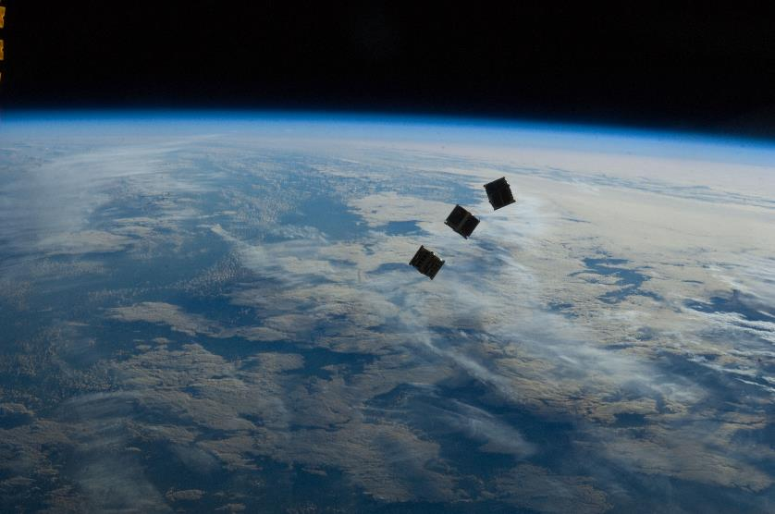
Objectives
VISION is a working prototype device that will monitor CubeSats from a launch provider as they deploy. VISION will deliver timely Two-Line Elements which will reduce the time between deployment and identification and eliminate ambiguity amongst CubeSats.
Mission Statement:
Project VISION will improve Space Situational Awareness (SSA) by developing an in-situ, autonomous prototype that tracks and estimates individual CubeSat trajectories during deployment.
Notes:
Feel free to reword

Slide 3





Concept of Operation: Mission Overview
Deployed CubeSat
CubeSat Orbit
5. Data Processing
4: Data Collection
6: Data Transfer to
Launch Provider
$t_{0}+$ 2
$$t_{0}+1$$
$$t_{0}$$
3: CubeSat Deployment
CubeSat TLE, state estimates
7: Data Relay
to Ground
Ground
Based Tracking
Systems
2: Boot and Calibration
8: Ground Tracking of Deployed CubeSat
1: Dormant
VISION
0: Launch
Deployer Orbit
Deployer
Notes:
Don’t animate and just throw it up

Slide 4
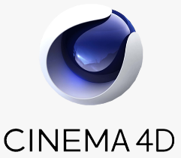
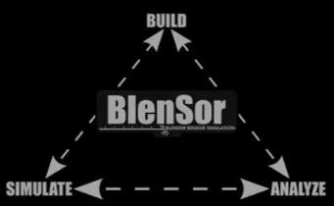
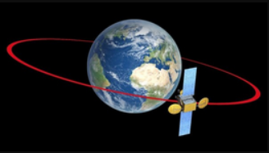
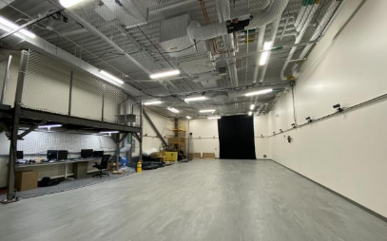
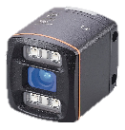

VISION Team CONOPS
Initial Conditions
Compare
Truth Data:
(SPG4)
Simulated
Sensor Data
Generation
Centroid Identification
State Estimation
Calculate Orbital Elements
Generate TLEs
VISION SYSTEM
Truth Data:
ASPEN Lab Vicon
Compare
Sensor Data
Collection
Notes:
Redo slide and focus on this
Break into we have software and hardware -> at a highlevel this is what we are doing in our project and how we will validate
Distinguish between us and vantage
For sure re-do this
Add ticker based on this slide

Slide 5
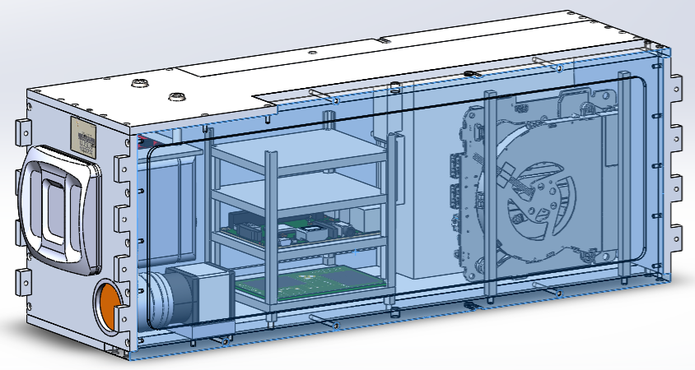
Changes from VANTAGE (2018/19 Senior Project)
Integration of Subsystems
Single power source
PCB: Soldered-in components
Raspberry Pi used to power/control
Fully autonomous system
State Estimation Software → TLEs
Implemented nonlinear batch filter
New Structure/Chassis
Reduced size by 45%
Complete design rework
New external mounting mechanism
Simulation
Non-linear CubeSat trajectories
Integrated GPS
Attitude/Position determination
Testing
Centroid detection
Vibrational/Shock testing of chassis
Advanced NASA TRL
Notes:
Replace with visual representation

Slide 6
Levels of Success
Level 1 | Level 2 | Level 3
All components fit within volumetric constraints of a chassis Mechanical Interface with NanoRacks Deployer | Chassis certified TRL-4 | Chassis certified TRL-5 Interfaces with multiple deployers
TLEs using known state data | TLEs using simulated optical data & attitude data | TLEs using experimental optical and deployer inertial state data
Stores raw sensor data | Store raw & processed data for 1 deployment | Electronics have a space-grade counterpart
Communicates data over interface | Flight software assigns markers & coordinate system | Integrated simulation and physical tests

Slide 7
Critical Project Elements

Slide 8
Critical Project Elements
Software Simulation
Simulate sensor data inputs in relevant environment
Sensor Data Collection
Automated data collection of sensors: TOF, Monochrome, GPS
Data Processing
Determine centroid positions and filter relative states
TLE Estimation
Deliverable to enable integration with existing SSA solutions
Notes:
What is sensing? What are we processing? Why the software Simulation? Here is the end result….

Slide 9
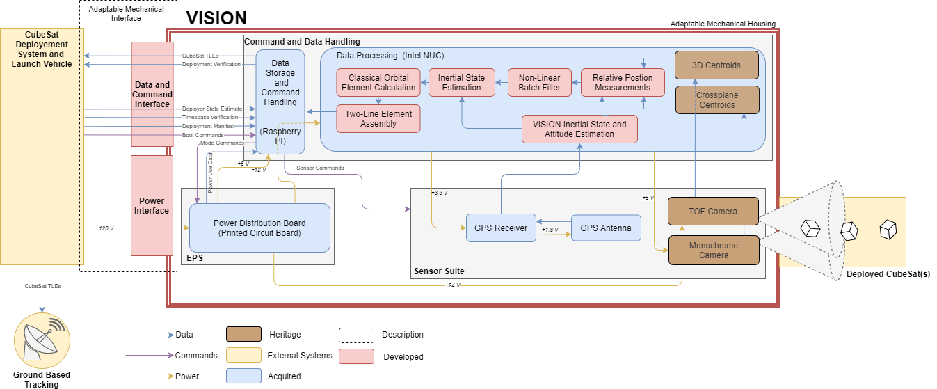
Functional Block Diagram
Notes:
Keep?

Slide 10
Design Overview

Slide 11
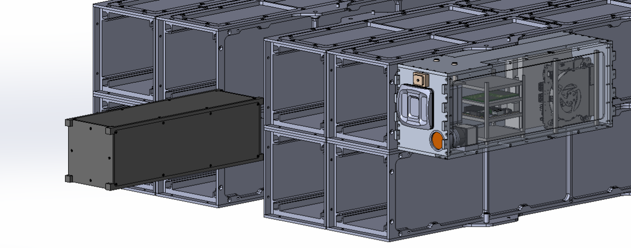
Structural Overview
Deployment
System
CubeSat
VISION

Slide 12
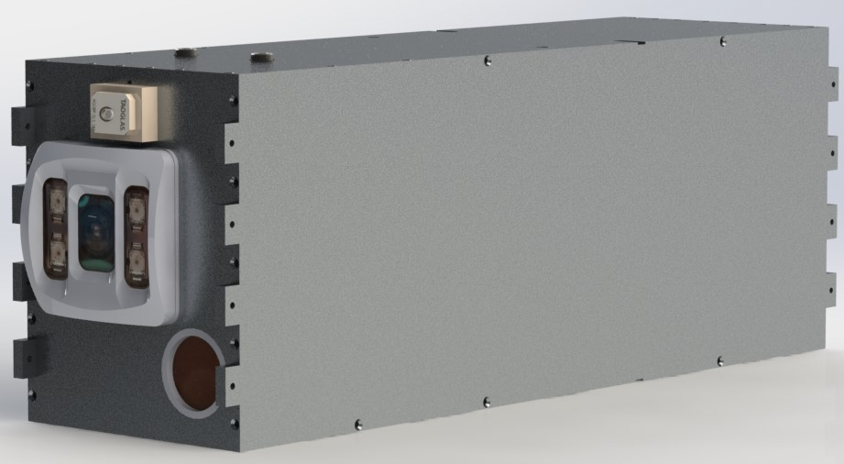
Structural Design Overview
Parameter | Dimension
Material | Al 7075
Mass | 3.27 kg
Vol | 5,204.1 cm³
Length | 38.16 cm
Height | 13.8 cm
Width | 11.1 cm
GPS Antenna
TOF Camera
Monochrome Camera

Slide 13
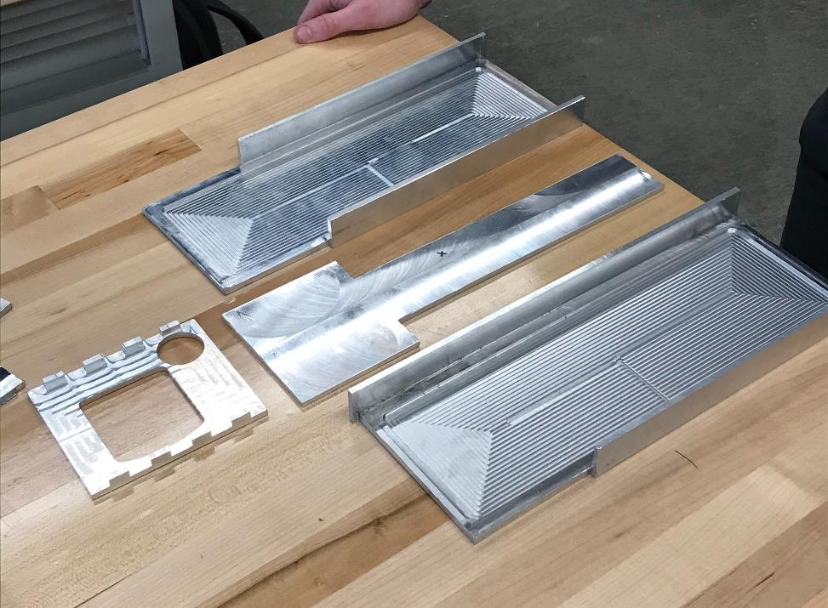
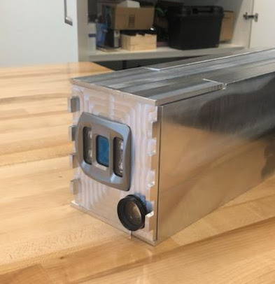
Structural Overview
Notes:
Could keep

Slide 14
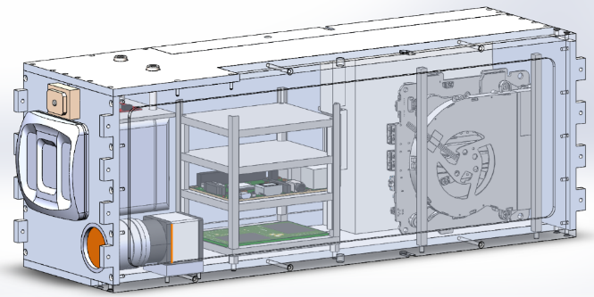

Electronics Overview – Telemetry System
1. Before Launching CubeSats
ToF camera
Raspberry Pi
Intel NUC
Monochrome Camera
Deployer/Simulated PC
GPS
2. Launch CubeSats
Sensors: Collect Data
NUC : Processing -> Transferring -> Turn off Automatically
3. Raspberry Pi: Transfer results to Deployer
Notes:
Could

Slide 15
Software Overview
Centroid Determination
TOF Data Collection
TOF Data Processing
TOF Centroids
Start
VANTAGE
Optical Data Collection
Image Processing
Optical Centroids
State Estimation
CubeSat Inertial State
Inertial State Estimation
CubeSat Relative State
Relative State Estimation
Deployer Inertial State
VISION
CubeSat Parameters
TLE Calculation
Orbital Element Estimation
Assemble TLE
Deliver TLE
End
NORAD Designator
Legend
Process
Input/
Output
Notes:
We use centroids to estimate relative orbital states which are combined with the deployer inertial state to obtain in inertial estimates for each cubesat. These inertial estimates are then converted to orbital elements which make up the bulk of each TLE.

Slide 16
Test Overview

Slide 17
Testing Overview
Power
Chassis
Inertial State
State Estimation
Component Level
Avionics Voltage Breakdown
Vibrational Analysis Test
GPS Verification
TOF Camera Verification
Avionics Voltage Breakdown
Subsystem Level
Avionics Power System Test
Attitude Test
Centroid Determination Test
Avionics Power System Test
System Level
State Estimation Verification
System Integration Test
State Estimation Verification
Power: Hardware operation
Chassis: Increase TRL and survive a launch
Inertial Position: Proof of Concept for a SmallSat solution
State Estimation: Produces TLE

Slide 18
Avionics Voltage Breakdown and Power Tests
Power
Chassis
Inertial State
State Estimation
Component Level
Avionics Voltage Breakdown
Vibrational Analysis Test
GPS Verification
TOF Camera Verification
Subsystem Level
Avionics Power System Test
Attitude Test
Centroid Determination Test
System Level
System Integration Test
State Estimation Verification
Purpose:
Avionics Voltage Breakdown Test:
Verifies all output voltages are compatible with individual sensors
Avionics Power System Test:
Verifies the system can operate 15 min (one deployment cycle) under given wattage without damages on sensors and converters.
Design Req.​ | Summary​
DR 4.2 ​ | The system shall operate with no more than 120VDC, 3Vpp ripple voltage, and 5A.​
DR 4.3​ | The system shall draw no more than 520 Watts.​

Slide 19
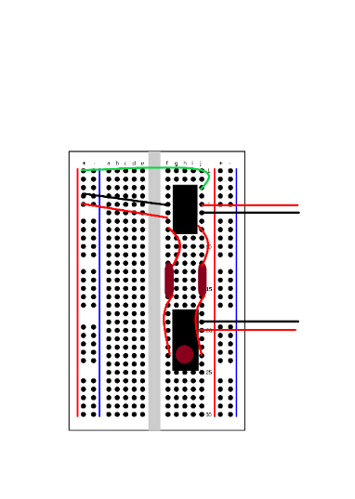
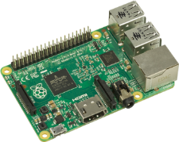
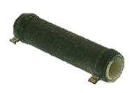
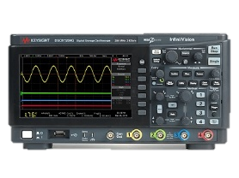
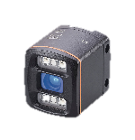
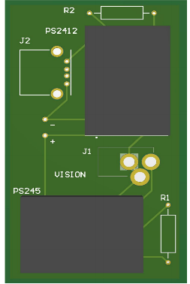
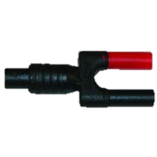
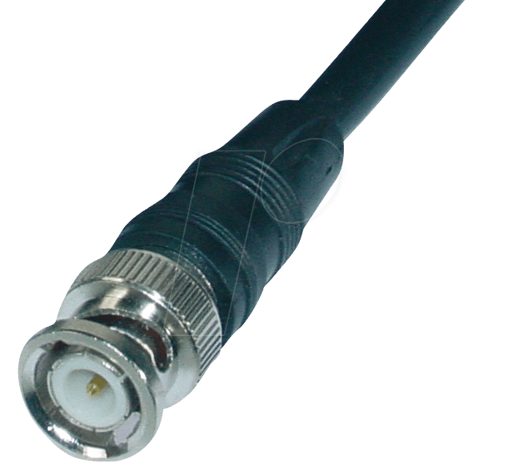
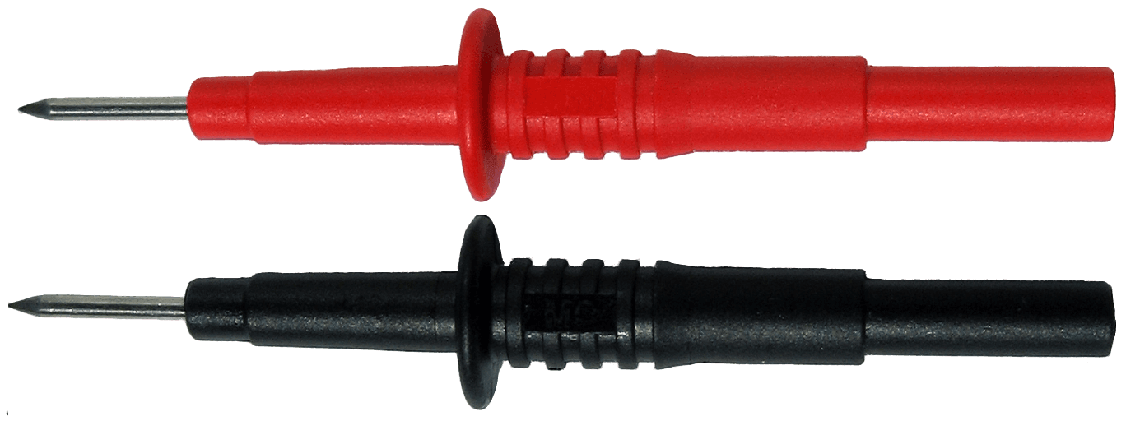

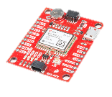
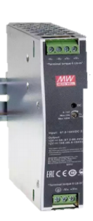
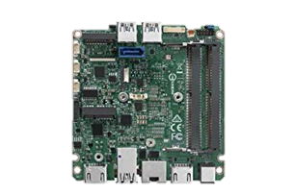
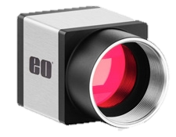
Avionics Voltage Breakdown and Power Tests
Breadboard Circuit
(24-5V) & (24-12V) DC/DC
PCB
(24-5V) & (24-12V) DC/DC
Oscilloscope
TOF Sensor
5.0 V
4.8 V
4.7 – 5.2V
Raspberry Pi
Raspberry Pi
Intel NUC
120 V
120 V
12.0 V
12.3 V
12-24V
GPS Receiver
24.0 V
24.9 V
20.4-28.4V
300 VDC Power Supply
Current Limit = 4 A
120V * 4A = 480 W
120-24
DC/DC
Monochrome Camera
GREEN - Expected Results
RED - Actual Results
PURPLE - Acceptable voltage range
Intel NUC
Notes:
Step through with animations and add information about acceptable voltage range and the power restrictions. How did we measure these things?

Slide 20
Vibrational Analysis Test
Power
Chassis
Inertial State
State Estimation
Vibrational Analysis Test
GPS Verification
TOF Camera Verification
Component Level
Avionics Voltage Breakdown
GPS Verification
TOF Camera Verification
Avionics Voltage Breakdown
Subsystem Level
Centroid Determination Test
Avionics Power System Test
Attitude Test
Centroid Determination Test
Avionics Power System Test
Attitude Test
System Level
State Estimation Verification
System Integration Test
State Estimation Verification
System Integration Test
Purpose:
Verifies the chassis’ ability to survive a launch
Component testing in relevant environment
Information on environmental requirements for ICD
Design Req.​ | Summary​
DR-6.1 | Chassis structure shall reach an advanced TRL certification, or equivalent.
DR-6.2 | Chassis structure shall maintain structural integrity within a safety factor of 2.

Slide 21
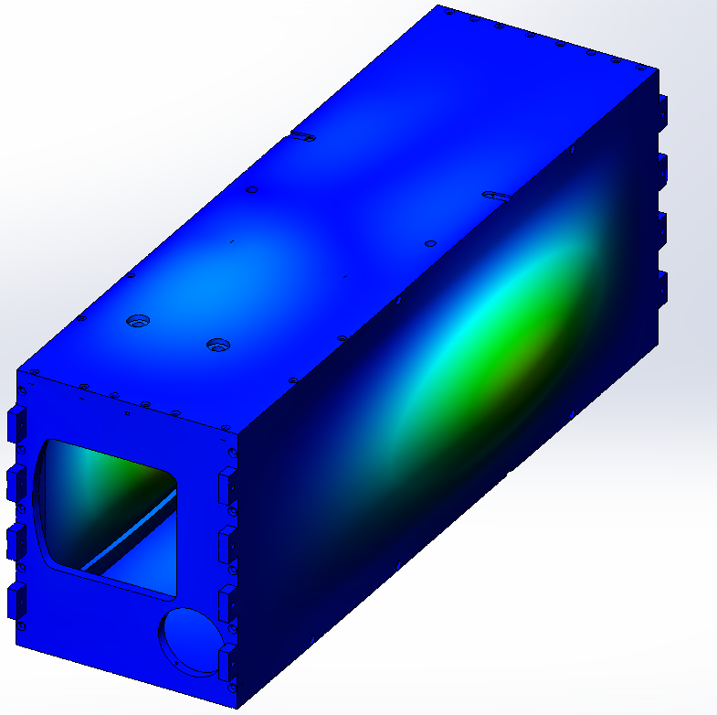
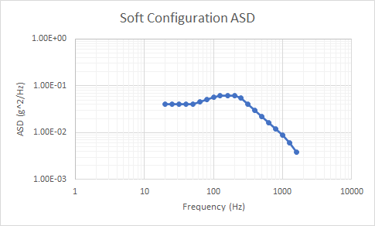
Vibrational Analysis Test
Determine eigenfrequencies for vibe table force analysis
Test chassis in relevant environment to increase TRL
Also test NanoRacks acceleration spectral density (ASD) profile for launch environment
Mode: | 1 | 2 | 3 | 4 | 5
Frequency (Hz) | 887.73 | 926.21 | 1020.9 | 1044.1 | 1132

Slide 22
Centroid Determination Test
Centroid Determination
Component Level
Avionics Voltage Breakdown
Vibrational Analysis Test
GPS Verification
TOF Camera Verification
Subsystem Level
Avionics Power System Test
Attitude Test
Centroid Determination Test
System Level
System Integration Test
State Estimation Verification
Purpose:
Verifies VISION’s capability to determine a centroid for up to 6 CubeSats in order to perform state estimation
Design Req.​ | Summary​
DR-1.1​ | VISION shall characterize and differentiate up to 6 CubeSats of 1U and up to 3U sized CubeSats.​
DR-1.2​ | VISION shall estimate the centroid of each CubeSat of 1U up to 3U size​

Slide 23
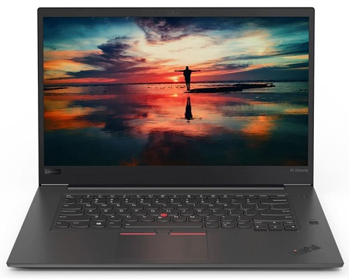
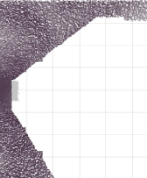
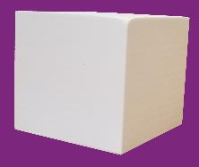



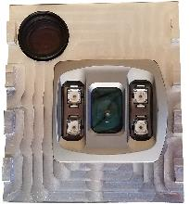
Centroid Detection Test Overview
Multi-Body Static Test
Orient mock CubeSats
Determine centroid of each CubeSat
Determine system centroid
Single Body Static Test
Orient CubeSat at known distance
Determine centroid
Sensor Suite
3D Printed CubeSat
23
Notes:
Needs better narration, explain place, what we are VALIDATING
This is what is required,
Conduct this test to verify cameras are accurate, and giving appropriate inputs to the filter so that it is

Slide 24

Centroid Detection Test: Expected Results
Potential Risks:
Monochrome capturing more than deployed CubeSats (ie. rail system, walls, external IR noise)
Software cannot identify CubeSats
Possible Solutions:
Dark blankets, different lighting to shade areas of room
Dynamically or manually crop sensor data
Sensor Suite
3D Printed CubeSat
Notes:
These results are a sample data set of VANTAGE's modular test, we expect similar results. First animation: raw sensor data, second: centroid position of one cubesat over time, third: a table of average error, fourth: concerns and possible solutions
POTENTIAL SCRUB

Slide 25
State Estimation Test
Component Level
Avionics Voltage Breakdown
Vibrational Analysis Test
GPS Verification
TOF Camera Verification
Subsystem Level
Avionics Power System Test
Attitude Test
Centroid Determination Test
System Level
System Integration Test
State Estimation Verification
Req. | Summary
DR-2.2 | VISION shall estimate the inertial position of each CubeSat such that the STD conforms to the Inertial Position Uncertainty Map.
DR-2.6 | VISION shall produce Two-Line Elements that can be propagated using the SGP4 propagation tool.
Notes:
Goal of state estimation testing is to validate accuracy requirement to ensure estimates are useful when predicting where cubesats will be and being able to produce TLE

Slide 26
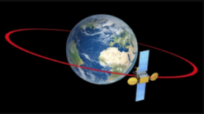
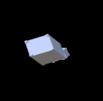
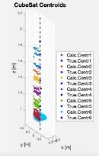
State Estimation: Test Procedure
Test Procedure
Orbit Simulation
Truth Motion
C4D/Blensor
TOF Point Clouds
Centroid
Determination
Centroids
State Estimation
Algorithm
Notes:
For these test we use simulated sensor data so we can model the expected dynamics.
Truth orbital data -> sensor modelling -> centroids -> filtering

Slide 27
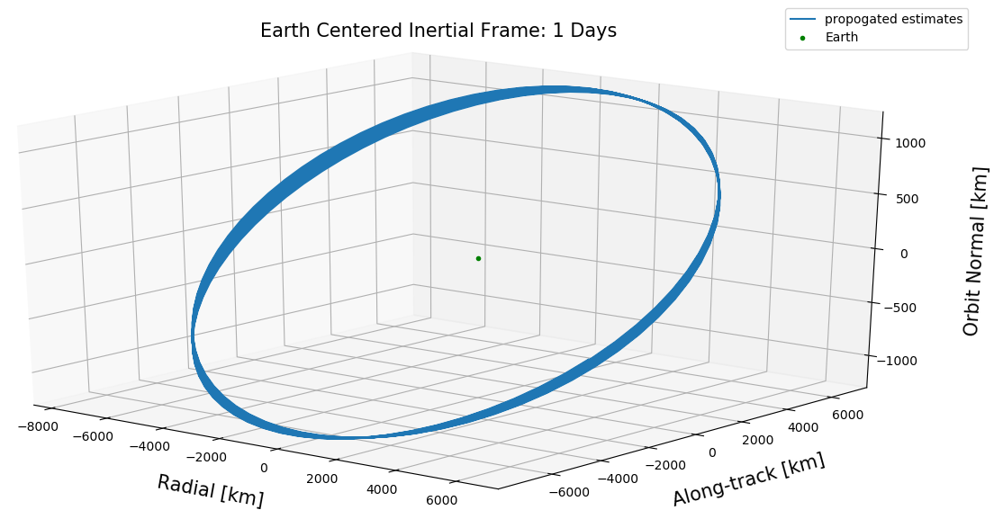
State Estimation: Test Procedure
Test Procedure
Orbit Simulation
Truth Motion
C4D/Blensor
TOF Point Clouds
Centroid
Determination
Centroids
State Estimation
Algorithm
Notes:
Simulating truth data in all frames

Slide 28

State Estimation: Test Procedure
Test Procedure
Orbit Simulation
Truth Motion
C4D/Blensor
TOF Point Clouds
Centroid
Determination
Centroids
State Estimation
Algorithm
Notes:
Visually simulating cubesat deployment using true orbital data

Slide 29
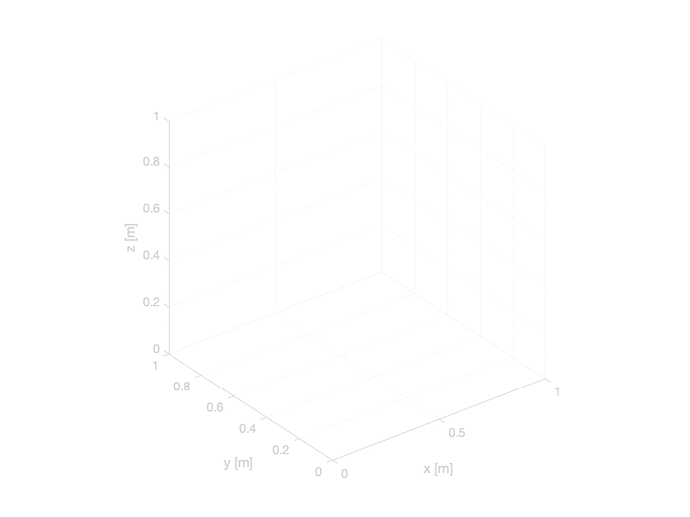
State Estimation: Test Procedure
Test Procedure
Orbit Simulation
Truth Motion
C4D/Blensor
TOF Point Clouds
Centroid
Determination
Centroids
State Estimation
Algorithm
Notes:
Simulate TOF raw measurements using visual simulation

Slide 30
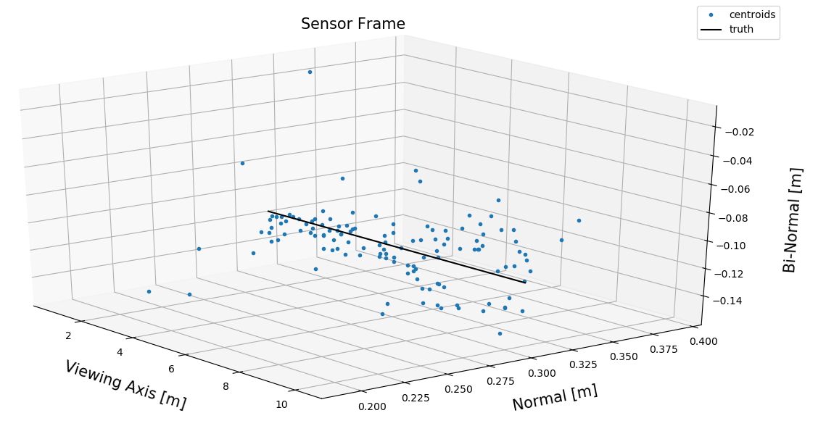
State Estimation: Test Procedure
Test Procedure
Orbit Simulation
Truth Motion
C4D/Blensor
TOF Point Clouds
Centroid
Determination
Centroids
State Estimation
Algorithm
Notes:
Compute centroids from simulated centroid data

Slide 31
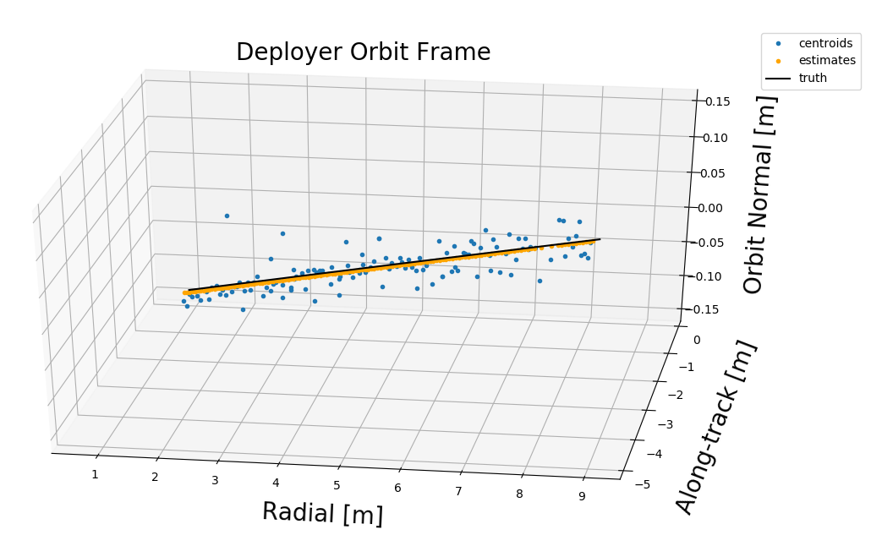
State Estimation: Test Procedure
Test Procedure
Orbit Simulation
Truth Motion
C4D/Blensor
TOF Point Clouds
Centroid
Determination
Centroids
State Estimation
Algorithm
Notes:
Using centroids to estimate Cubesat motion

Slide 32
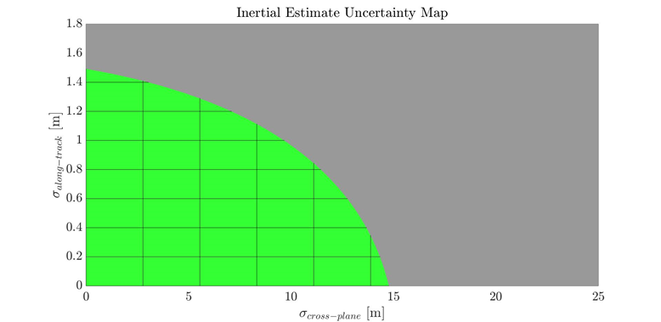
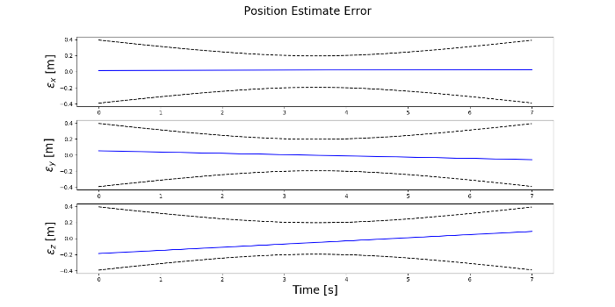
State Estimation: Test Overview
Test Procedure
Verification and Validation
Orbit Simulation
Truth Motion
C4D/Blensor
TOF Point Clouds
Estimates and Covariance (DR-2.2)
Centroid
Determination
Centroids
State Estimation
Algorithm
Notes:
Comparing filter results to truth data produced by orbit sim yields error on each axis and overlaid with filter covariance. The errors and covariance for the relative positions of an example run on each axis is shown here.
Compare covariance to uncertainty requirements map. Combinations of alongtack and cross plane uncertainties that reside in green region mean that estimates sampled from this distribution can be propagated accurately enough to be trackable by ground stations. Everything outside the green region cannot be.

Slide 33
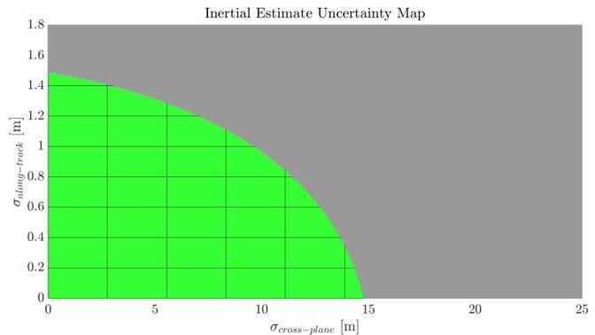
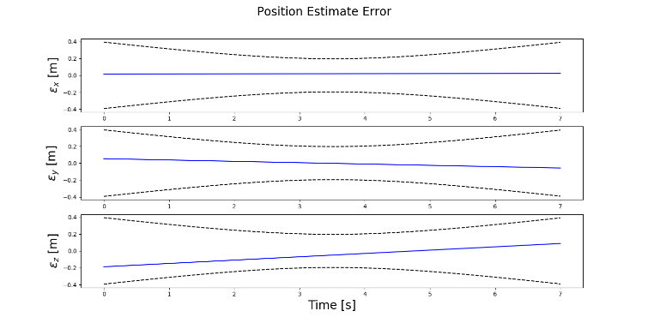
State Estimation: Performance Results
Req. | Summary
DR-2.2 | VISION shall estimate the inertial position of each CubeSat such that the STD conforms to the Inertial Position Uncertainty Map.
 | Along-track σ [m] | Cross-plane σ [m]
Max | 0.31 | 0.29
Min | 0.02 | 0.01
Notes:
Using out preliminary data sets re observed results in the purple region. Each point in this region corresponds to uncertainties produced by the filter shown in this plot. We observed max erros of 0.31 and 0.29 m in the along track and crossplane.

Slide 34
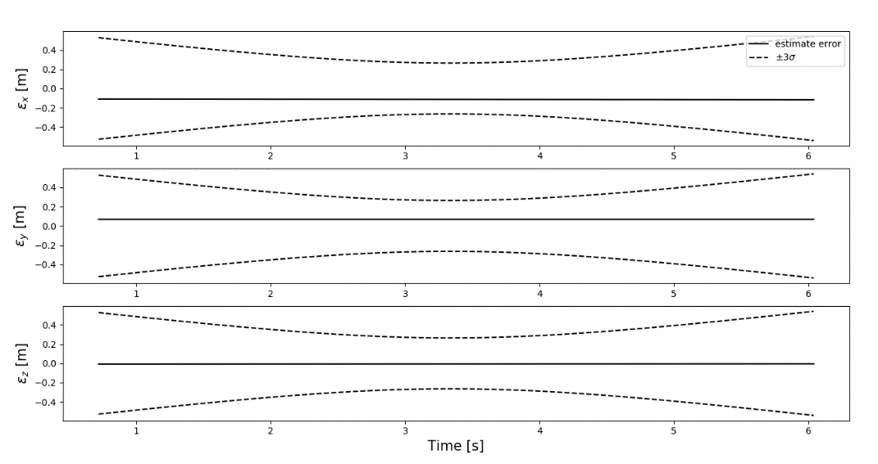
State Estimation: Performance Results
Req. | Summary
DR-2.2 | VISION shall estimate the inertial position of each CubeSat such that the STD conforms to the Inertial Position Uncertainty Map.
 | Along-track σ [m] | Cross-plane σ [m]
Max | 0.31 | 0.29
Min | 0.02 | 0.01
Notes:
Using out preliminary data sets re observed results in the purple region. Each point in this region corresponds to uncertainties produced by the filter shown in this plot. We observed max erros of 0.31 and 0.29 m in the along track and crossplane.

Slide 35


State Estimation: Test Overview
Test Procedure
Verification and Validation
SPG4 Orbit Propagation
Orbit Simulation
Truth Motion
C4D/Blensor
TOF Point Clouds
Estimates and Covariance (DR-2.2)
Centroid
Determination
Two-Line Elements (DR-2.6)
Centroids
State Estimation
Algorithm
Run Time (DR-2.7)
Notes:
Now we validate that we can build TLE using the information we have. And then check that they can be propagate by the standard propagation method. We didn’t get to this but did propagate with 2-body and J2.

Slide 36
State Estimation: Two-Line Element Results
Req. | Summary
DR-2.6 | VISION shall produce Two-Line Elements that can be propagated using the SGP4 propagation tool.
1
Sat. #
Epoch
nd
ndd
BStar
Type
El. #
sum
2
INC
RAAN
ECC
AOP
M
n
Rev. #
sum
Notes:
TLE are composed of many quantities and we will only go into detail about the properties we are directly estimating.

Slide 37
State Estimation: Two-Line Element Results
1
Sat. #
Epoch
nd
ndd
BStar
Type
El. #
sum
2
INC
RAAN
ECC
AOP
M
n
Rev. #
sum
Notes:
These properties are designation numbers and drag parameters that will be know prior to launch for each cubesat

Slide 38
State Estimation: Two-Line Element Results
Deployment Epoch
1
Sat. #
Epoch
nd
ndd
BStar
Type
El. #
sum
2
INC
RAAN
ECC
AOP
M
n
Rev. #
sum
Notes:
The first property we handle is the epoch associated with the sate in the TLE which we obtain from time stamps collected during deployment.

Slide 39
State Estimation: Two-Line Element Results
Deployment Epoch
1
Sat. #
Epoch
nd
ndd
BStar
Type
El. #
sum
2
INC
RAAN
ECC
AOP
M
n
Rev. #
sum
Inclination
µ : 3.2e-7 [deg]
σ: 1.7e-7 [deg]
RAAN
µ : 6.9e-7 [deg]
σ: 3.7e-7[deg]
Eccentricity
µ : 2.4e-7
σ: 1.8e-7
AOP
µ : 2.3e-4 [deg]
σ: 5.2e-4 [deg]
True Anomaly
µ : 2.3e-4 [deg]
σ: 5.2e-4 [deg]
Semi-Major Axis
µ: 2.0 [m]
σ: 1.4 [m]
Notes:
The bulk of the TLE that we estimate are the orbital elements at that epoch that are produced from relative state estimates. We gathered statistics on the error in these quantities for the data that we have. The most important item is the error of the semi-major axis which is extremely sensitive to velocity. During development we reduced the error in this quantity by changing how we handled velocity inside the filter and adjusting tuning parameters.

Slide 40
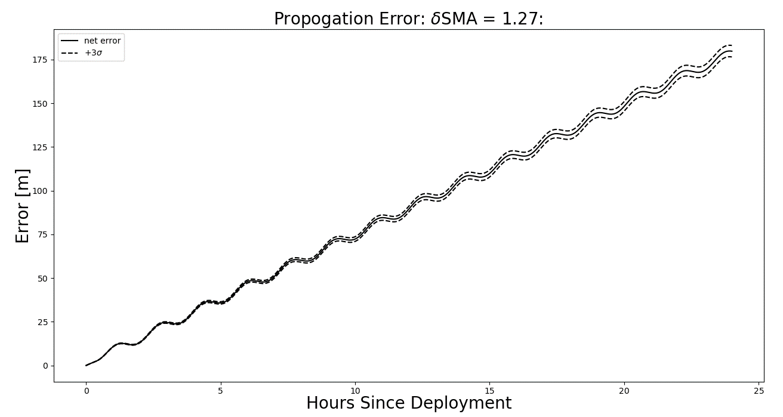
State Estimation: Propagation Results
Notes:
In order to study propagation error in more detail we propagated the estimates forward in time. This figure shows the total propagation error and the uncertainty associated with it for a semi-major axis error of 1.27 meters. This Is an important value because SMA error causes a difference in orbital period and produces the secular drift observed here that accounts for the majority of propagation error growth with time.

Slide 41
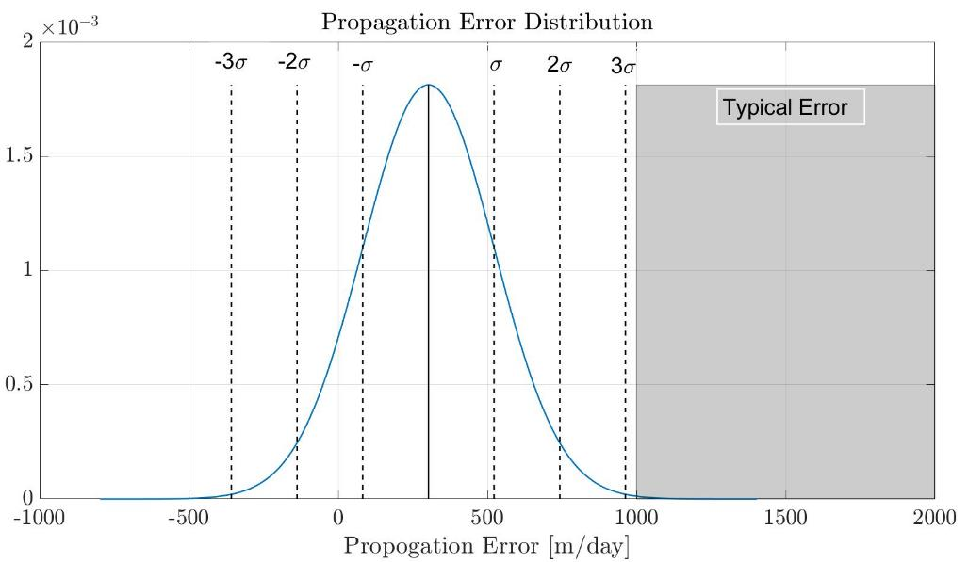
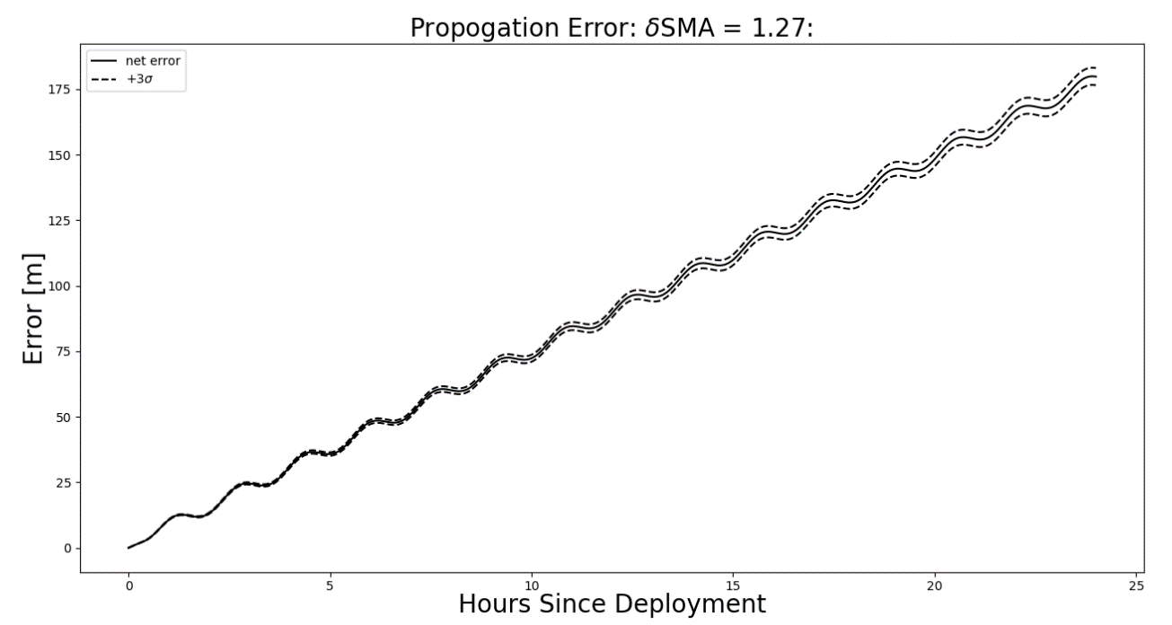
State Estimation: Propagation Results
Take Away:
Average is 46.7 % better than typical error for NanoSat TLE. (Celestrack)
SMA is extremely sensitive to velocity errors.
Propagation error secular drift is a product of error in SMA
Tuning is sensitive to initial guess accuracy. (assumed accurate)
Propagation Error Statistics
Average Propagation Error [m/day] | Standard Deviation [m/day]
302 | 220
Notes:
We compared our results to the standard propagation error associated with smallsat TLE from celestrack which is on the order of 1000 to 2000 m/day. Using the data sets we had we observed an average 46% increase in accuracy. We also learned that SMA is sensitive to velocity and drives propagation error. Adding velocity measurements would improves results significantly (currently only using position estimates). With more information about the deployment velocity uncertainty, the filter can be tuned for each mission.

Slide 42
System Integration Test
Component Level
Avionics Voltage Breakdown
Vibrational Analysis Test
GPS Verification
TOF Camera Verification
Subsystem Level
Avionics Power System Test
Attitude Test
Centroid Determination Test
System Level
System Integration Test
State Estimation Verification
Req. | Description
DR-2.7 | VISION shall deliver TLE estimates within fifteen minutes after the end of the deployment period.
DR-3.1 | VISION Shall deliver a still image of each CubeSat in a deployment.
DR-4.4 | VISION Shall store all data gathered for the duration of the deployment period.
Notes:
Going to run through

Slide 43
System Integration Test: Expected Results
Show full integration of VISION as a single package
Autonomous functionality after initialization
Test accuracy and uncertainty profiles of real sensors and state estimation software integration

Slide 44


System Integration Test Overview
Overview of Test:
Compare
8 m

Slide 45
System Integration Test Overview
Overview of Test:
Compare
8 m

Slide 46

System Integration Test
Phase 1: Boot Up and Ready
Provide power to all components
Verify avionics are operational
System ready to collect data
Expected Results:
Validate Avionics Power System Test
results
 | NUC | Raspberry Pi | TOF
Required Range | 12-24 V | 4.7-5.2 V | 20.4-28.4 V
Measurement | 12.3 V | 4.8 V | 24.9 V
Notes:
Show expected results are what we got in modular testing,

Slide 47
System Integration Test
Phase 2: Data Capture and Centroid Detection
CubeSats move along track
Identify and track CubeSats
Capture data for 10 meters
Expected Results
Validate results from Centroid Determination Test
Notes:
Show expected results are what we got in modular testing,

Slide 48
System Integration Test
Notes:
Show expected results are what we got in modular testing,

Slide 49
System Integration Test
Phase 3: State Estimation
Quantify Noise Profile of sensor input
Assess automation/integration
of state estimation
Expected Results
Demonstrate filter improves relative
velocity estimates
Tune Filter
Notes:
Show expected results are what we got in modular testing,

Slide 50
System Integration Test
Notes:
Show expected results are what we got in modular testing,

Slide 51
System Integration Test
Phase 4: Communication and Final Results
Deliver Still Images
Verify TLEs were delivered in under
15 minutes
Expected Results:
Pictures of deployed CubeSats and
estimates delivered in under 15 minutes
Notes:
Show expected results are what we got in modular testing,

Slide 52
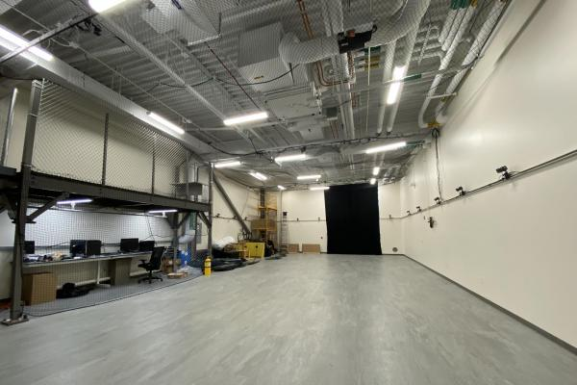
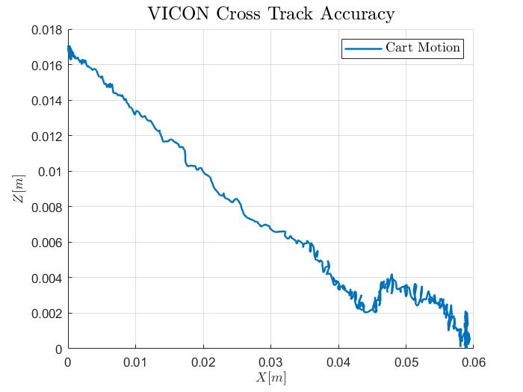
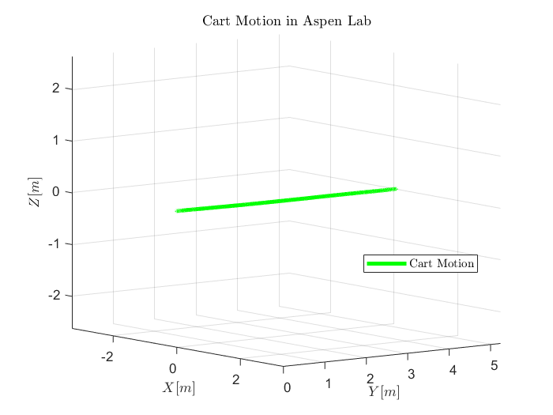


System Integration Test Overview
< [mm]
accuracy

Slide 53




System Integration Test Results: Uncertainty Profile
1. Collect Centroids For Many Tests
3. Anderson-Darling Test
2. Compute Error In Centroids
4. Compute Standard Deviation Using all Error
Expected Results (from VANTAGE data)
~80% gaussian with 95% significance
$σ_{x}=$ 0.03 [m]
$σ_{y}=0.008$ [m]
$σ_{z}=0.001$ [m]

Slide 54
Systems Engineering

Slide 55



Systems Engineering Tools
Requirements Traceability Matrix
Compliance, Req. Flowdown, Testing Methods, Validation Tracking, Version Control
Master Equipment List
Subsystem Components, System Mass Tracking, Mass Contingency Value, Power Consumption
Risk Mitigation Matrix
Major Risk, Severity & Probability, Mitigation Paths
Testing Req’s Allocation List
Component Level Validation, Design Req. Allocation, Level of Success Tracing
Trade Study Tables
Weighted Design Decisions, Sensitivity Analysis, Quantitative Design Analysis

Slide 56
Verification & Validation Process
Dr. Axelrad Requirements
Validation
System Integration Test
System Specification
System Integration Verification
System Integration
State Estimation Requirements
Verification thru Simulation
Compiling Software on NUC
Centroid Detection & State Estimation Algorithm Design
Test Centroid Detection & State Estimation
Unit Code Testing & Verification
Sensor Suite & Avionics Design
Test Components
Detail Design Verification
Build Components & Software

Slide 57
System Engineering Challenges & Issues
Risk: Hardware Failure
Critical Components = $$$
Made design decisions to allow for budget allocation
Instances with high probability of component failure (PCB & TOF Camera)
Risk: Estimate Error
Confidence in Measurements that don't match Estimate Error
Expected Mitigation: Normalized Estimate Error Squared (NEES) → Uncertainty matches Error (Tuning the Filter)
Results: COVID-19, confidence in uncertainty results not achieved
Key Lessons: Continuing Heritage Project
Replicating results took more time than expected
Offset between code
Communication with heritage team members was difficult:
TOF Code
Simulation Code/Software Parameters
Actions moving forward: Creating documentation of code parameters, functions, results, potential error, ICDs, system needs

Slide 58

Trade Studies
External Mounting/Interface
Drove structure design
Produced cheaper cost to deployer (Cubesat = $20k)
More freedom to dictate volume
Onboard Processing Board
Have experience with NUC model
Provided storage space with margin
Handles processing of Python/Matlab code
State Estimation Software
Kalmann Filter initially selected
Switched to Non-Linear Batch Filter
Trade studies are performed with best of knowledge, but not concrete
Subystem/Component Quantitative Trade Study Table
 |  | Internal |  |  | External |  |  | Tube Replacement |  |  | Modular
Metric | Weight | Performance | Score | Points | Performance | Score | Points | Performance | Score | Points | Performance | Score | Points
Required Volume | 10% | 5 | 0 | 0 | 10 | 10 | 1 | 10 | 10 | 1 | 5 | 0 | 0
Tolerancing/Manufacturability | 5% | 3 | 0 | 0 | 5 | 10 | 0.5 | 5 | 10 | 0.5 | 4 | 5 | 0.25
Development Time | 20% | 8 | 10 | 2 | 3 | 2.86 | 0.57 | 4 | 4.29 | 0.86 | 1 | 0 | 0
Universality | 20% | 9 | 8.57 | 1.71 | 4 | 1.42 | 0.28 | 3 | 0 | 0 | 10 | 10 | 2
Structural Integrity | 15% | 8 | 6.67 | 1.00 | 8 | 10 | 1.5 | 8 | 10 | 1.5 | 6 | 0 | 0
Opportunity Cost | 15% | 2 | 1.11 | 0.17 | 10 | 10 | 1.5 | 1 | 0 | 0 | 6 | 5.56 | 0.83
Thermal Management | 15% | 2 | 0 | 0 | 10 | 10 | 1.5 | 10 | 10 | 1.5 | 7 | 6.25 | 0.94
Wt. Total | 100.00% |  |  | 4.88 |  |  | 6.86 |  |  | 5.36 |  |  | 4.02
Embedded System Trade Table
 |  | Nividia Jetson Nano |  |  | Intel NUC8I7BEH |  |  | Intel NUC8I7HNK |  |  | Intel NUC8I7HVK
Metric | Weight | Performance | Score | Points | Performance | Score | Points | Performance | Score | Points | Performance | Score | Points
Integration | 15% | ~ 4 [Weeks] | 5 | 0.75 | ~ 2 [Weeks] | 7.5 | 1.125 | ~ 2 [Weeks] | 7.5 | 1.125 | ~ 2 [Weeks] | 7.5 | 1.125
Performance | 30% |  | 5.4 | 1.62 |  | 4.566666667 | 1.37 |  | 6.8 | 2.04 |  | 6.8 | 2.04
RAM | 10% | 4 GB | 1.3 | 0.13 | 32 GB | 10 | 1 | 32 GB | 10 | 1 | 32 GB | 10 | 1
GPU Rank | 10% | 240 | 4.9 | 0.49 | 293 | 3.7 | 0.37 | 116 | 7.5 | 0.75 | 98 | 7.9 | 0.79
Benchmark CPU | 10% | 5732 | 10 | 1 | 3661 | 0 | 0 | 4271 | 2.9 | 0.29 | 4181 | 2.5 | 0.25
Storage Capabilities | 10% | 16 GB | 1.3 | 0.13 | >128 GB | 10 | 1 | >128 GB | 10 | 1 | >128 GB | 10 | 1
Heat Generation | 15% | 10 W | 10 | 1.5 | 28 W | 8 | 1.2 | 65 W | 3.9 | 0.585 | 100 W | 0 | 0
Power Consumption | 10% | 20 W | 9.2 | 0.92 | 78 W | 7 | 0.7 | 230 W | 1.2 | 0.12 | 212 W | 1.8 | 0.18
Interchangeability | 20% |  | 2 | 0.4 |  | 6 | 1.2 |  | 6 | 1.2 |  | 6 | 1.2
Wt. Total | 100.00% |  |  | 5.32 |  |  | 6.595 |  |  | 6.07 |  |  | 5.545
State Estimation Method Quantitative Trade Study Table
 |  | Weighted Least Squares |  | Recursive Least Squares |  | Classical Kalman Filter |  | Extended Kalman Filter |  | H_infinity Filter
Metric | Weight | Score | Points | Score | Points | Score | Points | Score | Points | Score | Points
Robustness | 30% | 1 | 0.3 | 1 | 0.3 | 3 | 0.9 | 4 | 1.2 | 5 | 1.5
Optimizability | 20% | 3 | 0.6 | 2 | 0.4 | 4 | 0.8 | 4 | 0.8 | 5 | 1
Learnability | 30% | 5 | 1.5 | 4 | 1.2 | 3 | 0.9 | 2 | 0.6 | 1 | 0.3
Computational Expense | 20% | 3 | 0.6 | 5 | 1 | 4 | 0.8 | 3 | 0.6 | 2 | 0.4
Wt. Total | 100.00% |  | 3 |  | 2.9 |  | 3.4 |  | 3.2 |  | 3.2

Slide 59
Project Management

Slide 60

Project Management
Traditional/Waterfall approach
Initiation
Systems Engineering
Requirement development from customer wants/needs
Team Development
Subgroup teams built based on technical skill set
Planning
Design based on Requirements
Heritage project completion with added features
Executing
Manufacturing
Software automation/development
Controlling
Monitoring and Scheduling
Testing and Integrating
Closing
V & V
Closing the project with successful demonstration and reporting
Initiation
Planning
Executing
Controlling
Closing

Slide 61
Management Takeaways
Teams
Team Building
Subgroup Building
Flexibility
Phases
Meetings
Preparation
Feedback
Schedule
Leads
Based on Skills/Desires
Based on major functions of project
Phases require varied managerial execution
Allow for subgroup execution
Varying frequency and duration through phases
Size and duration vary through phases as well
Self Chosen Roles
Phase Breakdown
Established realistic goals
PAB member reviews
Inter-project communication
PM chatter
Gantt Chart
Updating regularly kept big picture in view
Difficulties
Chaotic Meetings
Established an agenda
Subgroup development
Calm and positive atmosphere
Communication
Subgroups status between groups
Increased status updates in meetings and action items

Slide 62
Budget analysis
Most expensive Components Purchased:
Item | Price
Intel NUC8i7BEH | $641.84
Aluminum Stock | $388.42
GPS Reciever and Antenna | $272.32
Cart Wheels | $156.00
PCB | $109.00

Slide 63
Compared Budget
$4,313.66
Redundancy
Processor
Time of flight camera
Aluminum
Etc.
$2,009.58
$2,304.08
$2,349.95
Predicted Spending as of CDR
Actual Spending

Slide 64

“Industry” Cost
Project Hours:
Recorded over 23 weeks
Stopped the week of Mar 16
Total Hours:
3743 hrs
Entry Level Engineers
Assumed Salary of $65k & 40hrs/week
$31.25/hr
Cost of Manhours
$116,968.75
Total of Materials
Heritage Costs
$2,772.00
Material Costs
$2,349.95
Assume 200% Overhead
Total Industry Cost:
$116,968.75 (Manhours)
+$15,578.85 (Materials)
$132,547.60

Slide 65
Backup Slides

Slide 66


State Estimation: Filter Consistency Results
Monte-Carlo Truth Model Testing
Chi-Squared Analysis of NEES:$ε_{x,0}= {ε_{x,0}^{T}(P_{0}^{+})}^{−1}ε_{x,0}$ (normalized estimation error squared)
Control Variable: $R= \left[\begin{matrix}{(0.2)}^{2} & 0 & 0 \\ 0 & {(0.3)}^{2} & 0 \\ 0 & 0 & {(0.4)}^{2}\end{matrix}\right]$ [$m^{2}$] -> dependent on initial guess error
$N → ∞, {\overline{ε}}_{x,0}→6$
$N →25, {\overline{ε}}_{x,0}→5.9389$
Initial Position Estimate Error and Covariance
Take Away:
Filter is tunable to produce statically significant results.
Further refine based on knowledge of initial state.
More Monte-Carlo data sets.
Notes:
Estimation is a balancing act. There are many means to changing how the estimator weights measurements and nominal measurements to produce estimates and with an accurate level of confidence.
Tie back to needing white noise as an input

Slide 67

Avionics Power Test - Still

Slide 68

Electronics – Power Distribution Board

Slide 69
GPS Verification and Attitude Determination Test
Power
Chassis
Inertial State
State Estimation
Component Level
Avionics Voltage Breakdown
Vibrational Analysis Test
GPS Verification
TOF Camera Verification
Subsystem Level
Avionics Power System Test
Attitude Test
Centroid Determination Test
System Level
System Integration Test
State Estimation Verification
Req. | Description
DR-2.3 | The VISION system shall measure its own single axis inertial attitude using a civilian grade Global Positioning System.
DR-2.4 | The VISION system shall measure its own inertial position using a civilian grade Global Positioning System.
Purpose
GPS Verification: Verifies the GPS can provide an inertial position
Attitude Test: Verifies the method used to estimate VISION’s attitude
Notes:
In order to determine orbits, independent of the deployer, etc, be honest, conceptually, gps to know position, not accurate enough, level 3, put the structure together, feasibility analysis, not going to develop testing etc, COVID interrupted this, platform for further growth

Slide 70



GPS Verification and Attitude Determination Test
Req. | Description
DR-2.3 | The VISION system shall measure its own single axis inertial attitude using a civilian grade Global Positioning System.
DR-2.4 | The VISION system shall measure its own inertial position using a civilian grade Global Positioning System.
Justification:
Must know pointing of cameras
Testing capability to provide attitude and position
Boresight Vector
Boresight Vector
Antenna
α
α
“Ground” Plane
2
1
Notes:
PROBABLY TAKE OUT

