Slide 1
Test Readiness Review
Mechanically Engineered Grappling Arm to Capture Litter and Atmospheric Waste
Presenters: Benjamin Elsaesser, Sheridan Godfrey, Andy Kain, Cedric Leedy
Team: Luke Beasley, Joseph Beightol, Benjamin Elsaesser, Sheridan Godfrey, Caleb Inglis, Jack Isbill, Andy Kain, Cedric Leedy, Chris Leighton, Daniel Mastick, Bailey Topp
Customer: TJ Sayer - Sierra Nevada Corporation (SNC) Advisor: Francisco Lopez Jimenez
Notes:
Sheridan

Slide 2
Overview
Overview
Schedule
Testing Readiness
Overview
Testing Readiness
Subsystems
Testing Readiness
Integration
Budget
Notes:
SHeridan

Slide 3
Project Motivation & Statement
MEGACLAW is a proof of concept for mitigating debris by capturing then deorbiting debris or performing maintenance on broken spacecraft.​
Heritage: CASCADE, KESSLER
MEGACLAW shall use a robotic arm equipped with an end effector to capture a grapple point, a flat plate spinning on a motor at a constant rate, which simulates a solar panel on a 6U CubeSat rotating about a single axis of rotation.
Notes:
Present: Sheridan

Slide 4
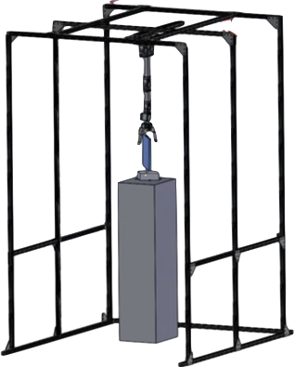
Robotic arm mounted to GSE base
Primary Sensor
Baseline Design
Secondary Sensor
End effector
(EE)
x̂
Slip
Ring
ŷ
Coordinate
Frame
ẑ
Grapple point (GP)
mounted to turntable motor
Ground Support Equipment (GSE)
Notes:
Sheridan

Slide 5
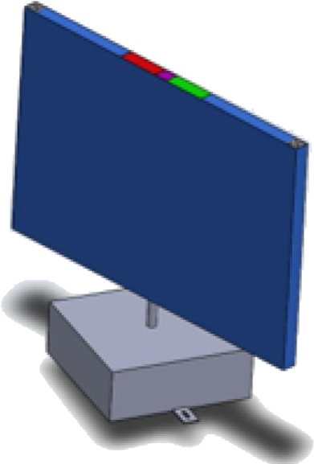
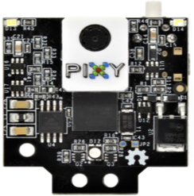
Hardware Baseline Overview
Depth Sensors
RGB
Pixy 2
AR Tags
Robotic Arm, Slip Ring and EE with AR tags to be sensed by the Intel D435 (Located on GSE Base)
Ball Joint Grippers
Slip ring
Colored markers
Pixy 2
AR tag
GP on rotating turntable with AR tags as well as colored markers to be sensed by the Pixy 2
Grapple Point
Turntable Base
Notes:
Sheridan
Create: Sheridan
- update; account for slip ring
-Working on Solidworks model of arm with slip ring and mount, ball joints on ends, will update pic when complete
Cedric

Slide 6
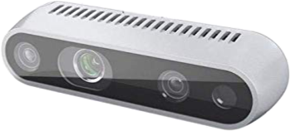
CONOPS
1. Intel D435 determines state of EE and GP using AR tags
2. Robotic arm actuates to commanded position
3. At 10" from GP, secondary camera takes over to determine spin rate
Primary Camera
Secondary Camera
Slip Ring
ẑ
Notes:
Sheridan

Slide 7
CONOPS
1. Intel D435 determines state of EE and GP using AR tags
2. Robotic arm actuates to commanded position
3. Secondary camera takes over to determine spin rate
Primary Camera
Secondary Camera
Slip Ring
ẑ
Notes:
Sheridan

Slide 8
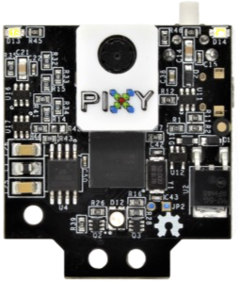
CONOPS
3. Secondary camera takes over to determine spin rate
4. EE is spun up to match GP spin rate
5. Arm actuates forwards and force sensors determine if successful grapple is achieved
Determined Spin Axis
x̂
ŷ
(X,Y,Z) AR positions
Notes:
Sheridan

Slide 9
CONOPS
3. Secondary camera takes over to determine spin rate
4. EE is spun up to match GP spin rate
5. Arm actuates forwards and force sensors determine if successful grapple is achieved
ẑ
Notes:
Sheridan

Slide 10
CONOPS
3. Secondary camera takes over to determine spin rate
4. EE is spun up to match GP spin rate
5. Arm actuates forwards and force sensors determine if successful grapple is achieved
Force Sensors
Force Sensors
ẑ
Notes:
Sheridan

Slide 11
Levels of Success
 | Control Loop Input | Control Loop Execution
Level 1 Success | Identify and report EE location at a rate of 0.916 [Hz] with a tolerance of 1.5 [cm]. | EE responds to given controlled input position, converging within 1.5 [cm].
Level 2 Success | Identify and report the locations of the EE and the stationary GP. | EE makes arbitrary contact with stationary GP on object within 255 [s].
Level 3 Success | Identify and report the location and angle of the EE and the rotating GP revolving at 0.578 [rad/s]. | Successful grapple of rotating GP, confirmed using force sensors on EE.
Notes:
Andy
Control loop input:
at a rate of 0.916 [Hz] with a tolerance of 1.5 [cm]
Present: Andy

Slide 12
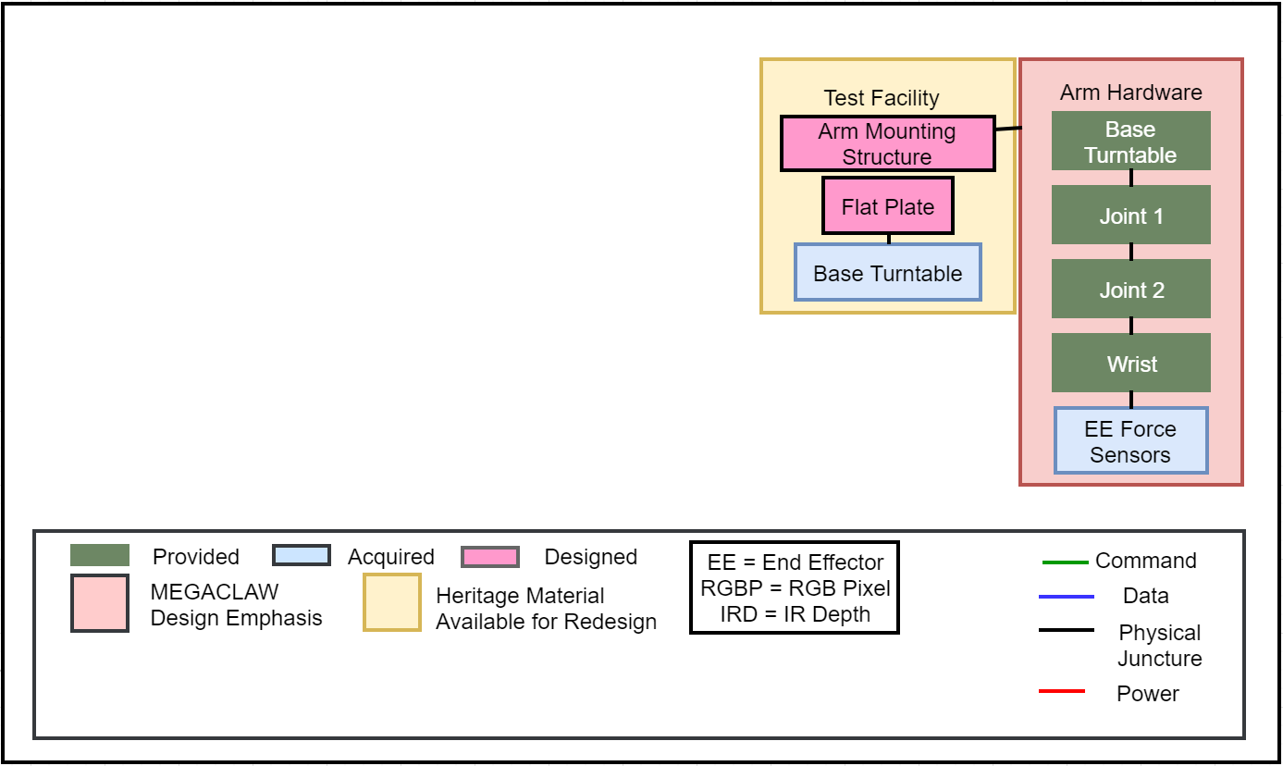
FBD
Notes:
Andy

Slide 13
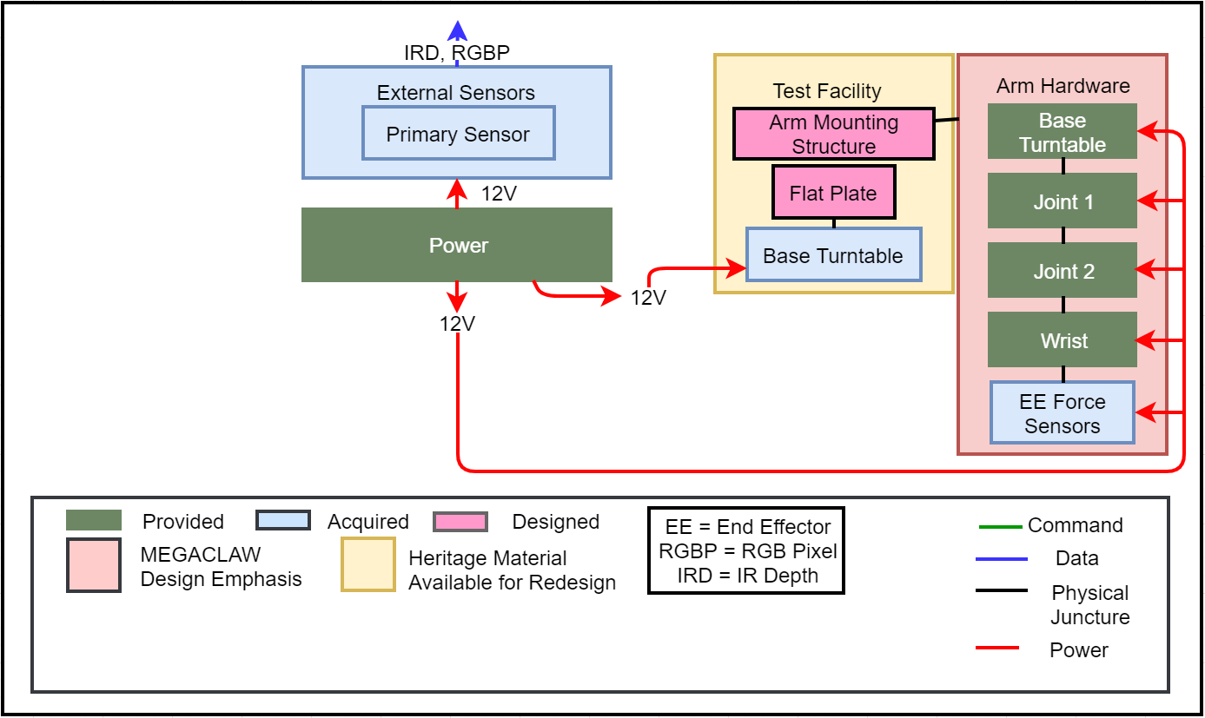
FBD
Notes:
Andy

Slide 14
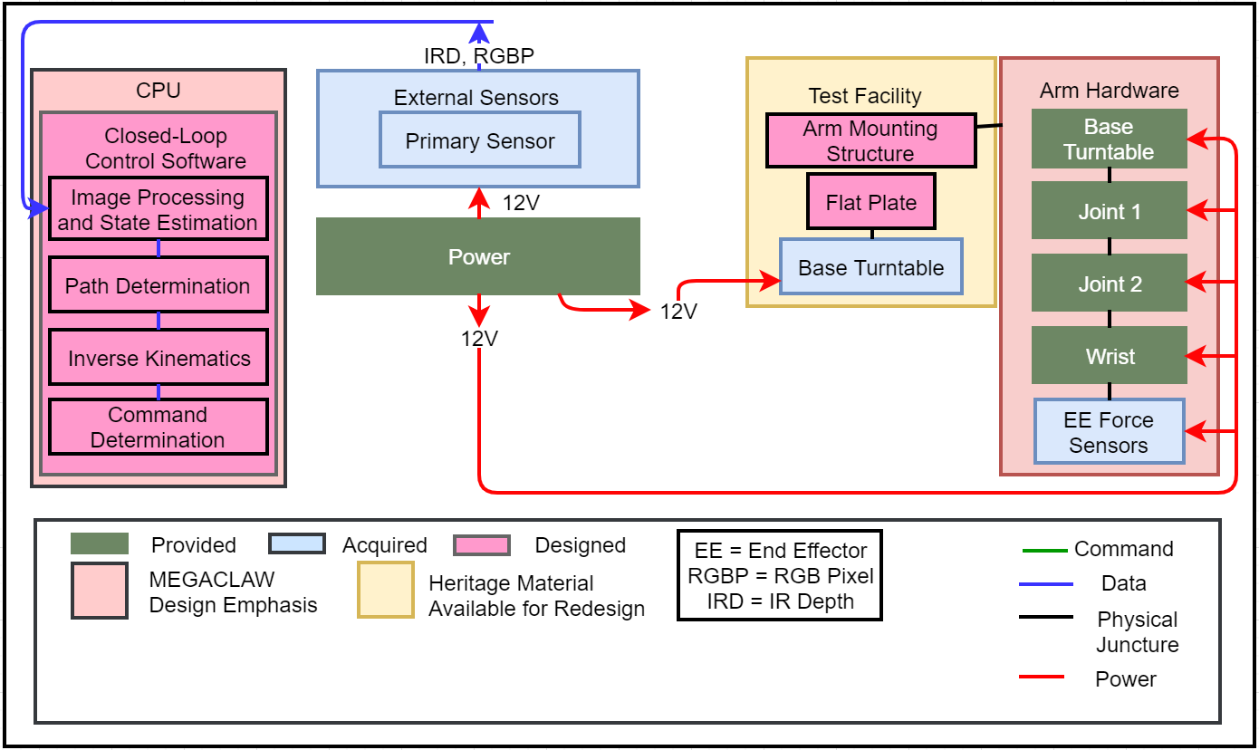
FBD
Notes:
Andy

Slide 15
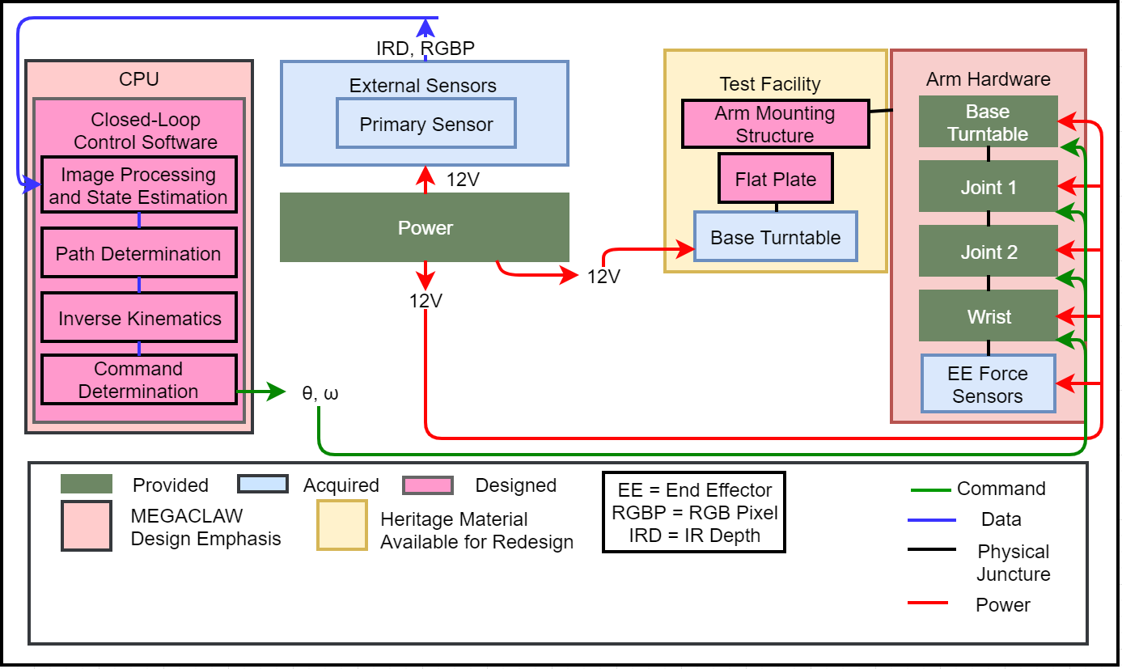
FBD
Notes:
Andy

Slide 16
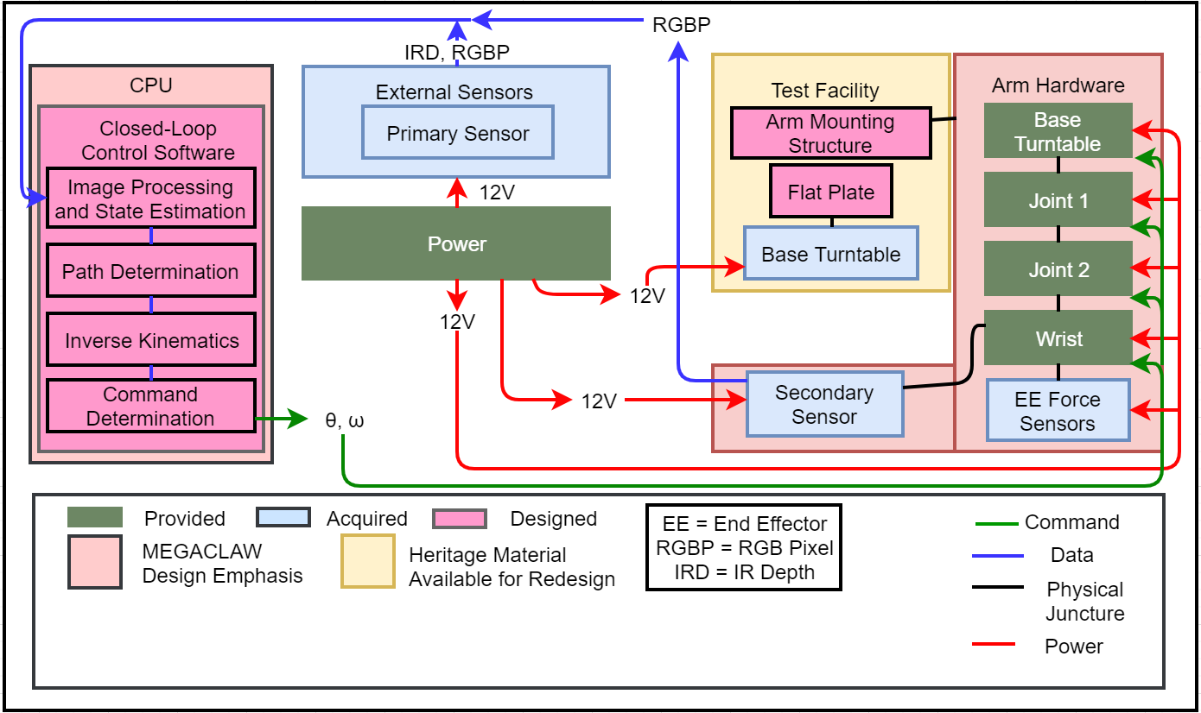
FBD
Notes:
Andy

Slide 17
Critical Hardware Update from MSR
GP attachment to rotating turntable has been updated to reduce risk of damaging GP or actuators
Magnetic attachment points will now secure the solar panel model to the turntable actuator
The breakaway grapple point will prevent damage to the system in the event of uncoordinated grapple
Grapple Point
Embedded Magnets
Detachment
Line
Turntable Base
Notes:
Cedric
Jack
- add diagram showing magnets
Cedric

Slide 18
Project Elements
Software | Hardware | Software + Hardware
​CPE​​ | ​Justification​ | Relation to Testing
Sensors – Accuracies​​ | Error tolerance is very small, multiple components contribute​ | Sensor mounts must be stable, interpretation software must be accurate
Sensors – Feature Recognition | Inability to find AR tags prevents closed loop operation | Software must be reliable enough to find AR tags in view
Software – State Determination | Converting sensor information to state information is sensitive | All implemented software must be accurate enough to grapple target
Actuator Thermal Requirements | Any damage to components in the project can cause week long delays​ | Emergency stop button and actuator limits must be understood and utilized
Software – Speed​​ | Image processing and 3D modeling are time intensive processes; minimum GP angular velocity sampling rate​ | All implemented software must be fast to meet time requirements
Notes:
Cedric
Blue bad
Change third column to testing (not manufacturing)
CHRIS:
First up, under software, which we have highlighted in yellow, we have feature recognition – our software needs to be able to reliably recognize AR tags when they're in the frame, and that's obviously something we've had to think about as we've built our vision system – though it doesn't seem like it's going to be a problem.
Next, in terms of (Point at state determination) we've had to make sure that our software is accurately localizing the AR tags on our system in cartesian space, and reconstructing the state of the grappling point and end effector, and our maximum allowable error here is only about 1.5cm, so this is one of our primary focuses in the manufacturing of that subsystem, and once we've done some testing, we'll be able to tweak how this system works.
(Point at speed) We also have timing requirements that define a minimum speed our control loop can be operating at, and that's around 1 Hz. However, our separate subsystems are each running in excess of 10 Hz, so this isn't a huge worry for us anymore.
(Point at sensors accuracies) Kind of in a mix between hardware and software, another critical element is the sensor mounts being stable and our software having accurate information about how everything is situated relative to each other just because that affects our state determination and coordinate transformations.
(Finally, in terms of hardware), we were always worried about the thermal limits of the actuators in our arm, which we're addressing by making the arm shorter than it was last year, implementing an emergency stop button, and limiting the timespan of a grapple, and now I'll hand it over to Luke to talk about another piece of hardware that's given us some headaches.
Cedric

Slide 19
Schedule
Overview
Schedule
Testing Readiness
Overview
Testing Readiness
Subsystems
Testing Readiness
Integration
Budget
Notes:
Cedric

Slide 20
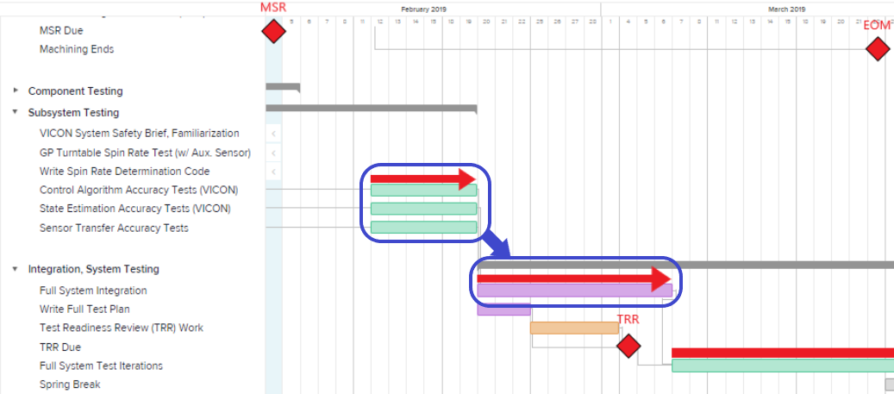
Project Schedule – MSR to EOM (Original)
Delays in preliminary VICON testing; rolled into integration/testing schedule, which is now fleshed out
Notes:
Cedric
Delays with VICON, tests got rolled into integration
We expected VICON to take a day to setup, but most has now been integration work in order to get setup

Slide 21
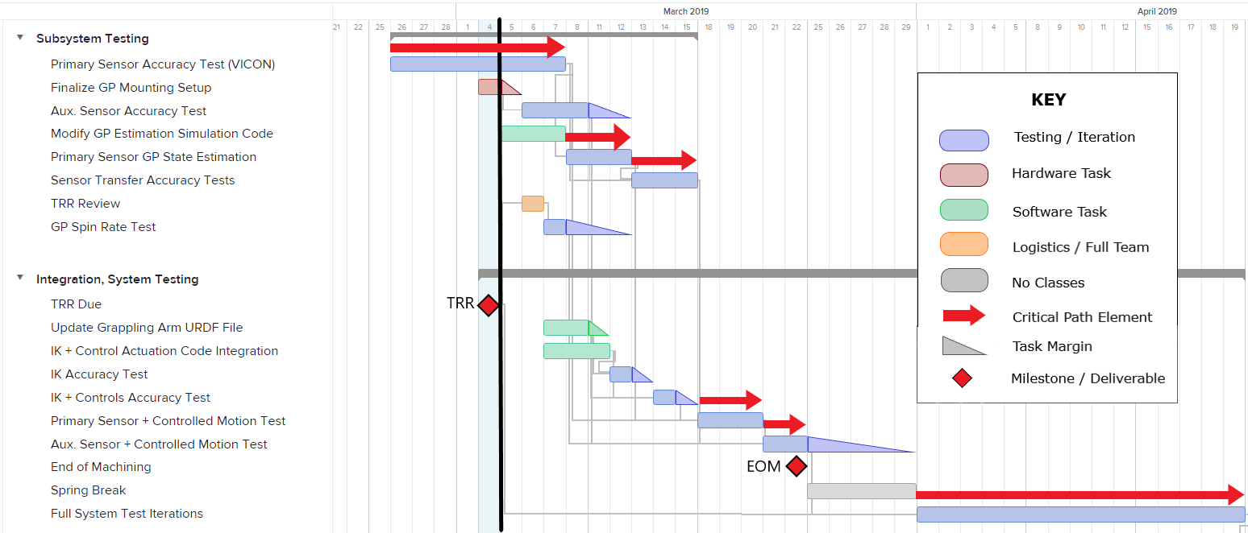
Project Schedule – Testing (TRR to EOM)
Notes:
Cedric

Slide 22
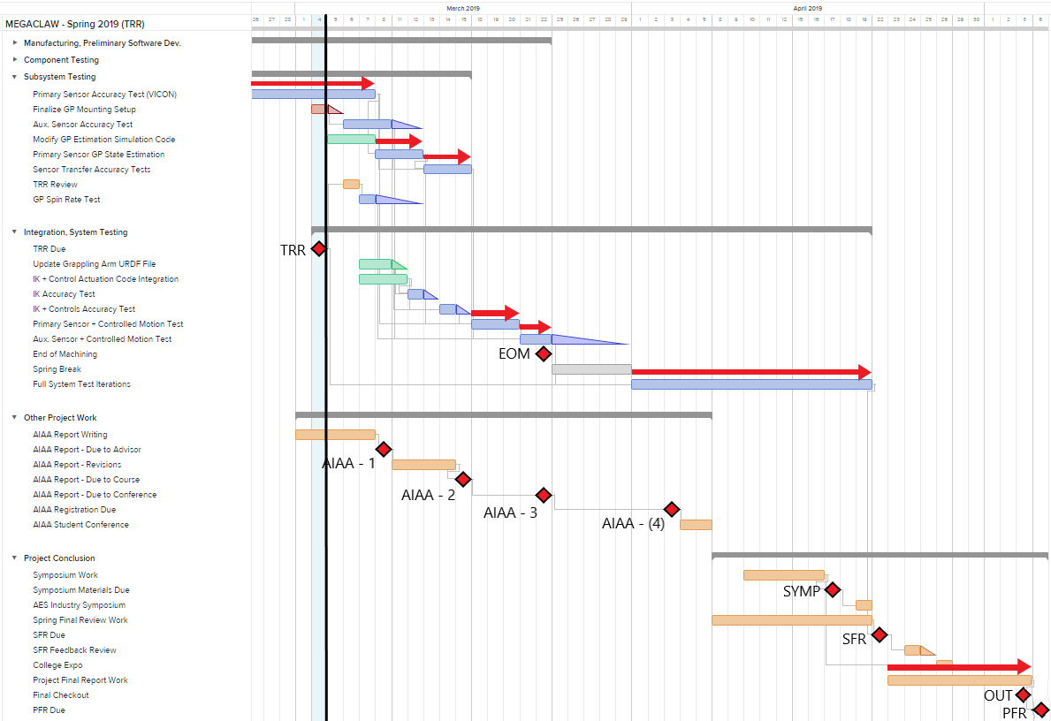
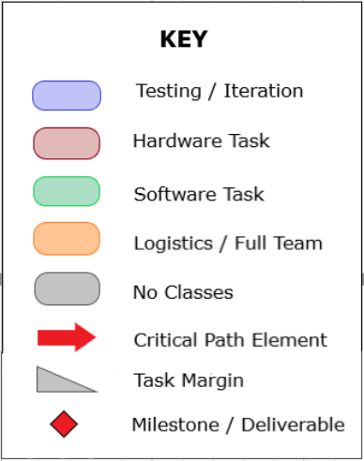
Project Schedule
-
TRR to PFR
Notes:
Cedric

Slide 23
Test Readiness Overview
Overview
Schedule
Testing Readiness
Overview
Testing Readiness
Subsystems
Testing Readiness
Integration
Budget
Notes:
Ben

Slide 24
Overview
Component Tests | Subsystem Tests | Integration Tests
Actuation of individual motors | Sensor coordinate transfer test | Uncontrolled accuracy tests
Intel and Pixy functionality tests | Arm thermal test | Controlled accuracy tests
Infinite rotation of EE using slip ring | Intel D435 accuracy test | Secondary sensor and EE spin up tests
AR tag identification test | EE and GP state determination test | Full system levels of success test
Complete | Incomplete
Notes:
Ben

Slide 25
Test Readiness - Subsystems -
Overview
Schedule
Testing Readiness
Overview
Testing Readiness
Subsystems
Testing Readiness
Integration
Budget
Notes:
Ben

Slide 26
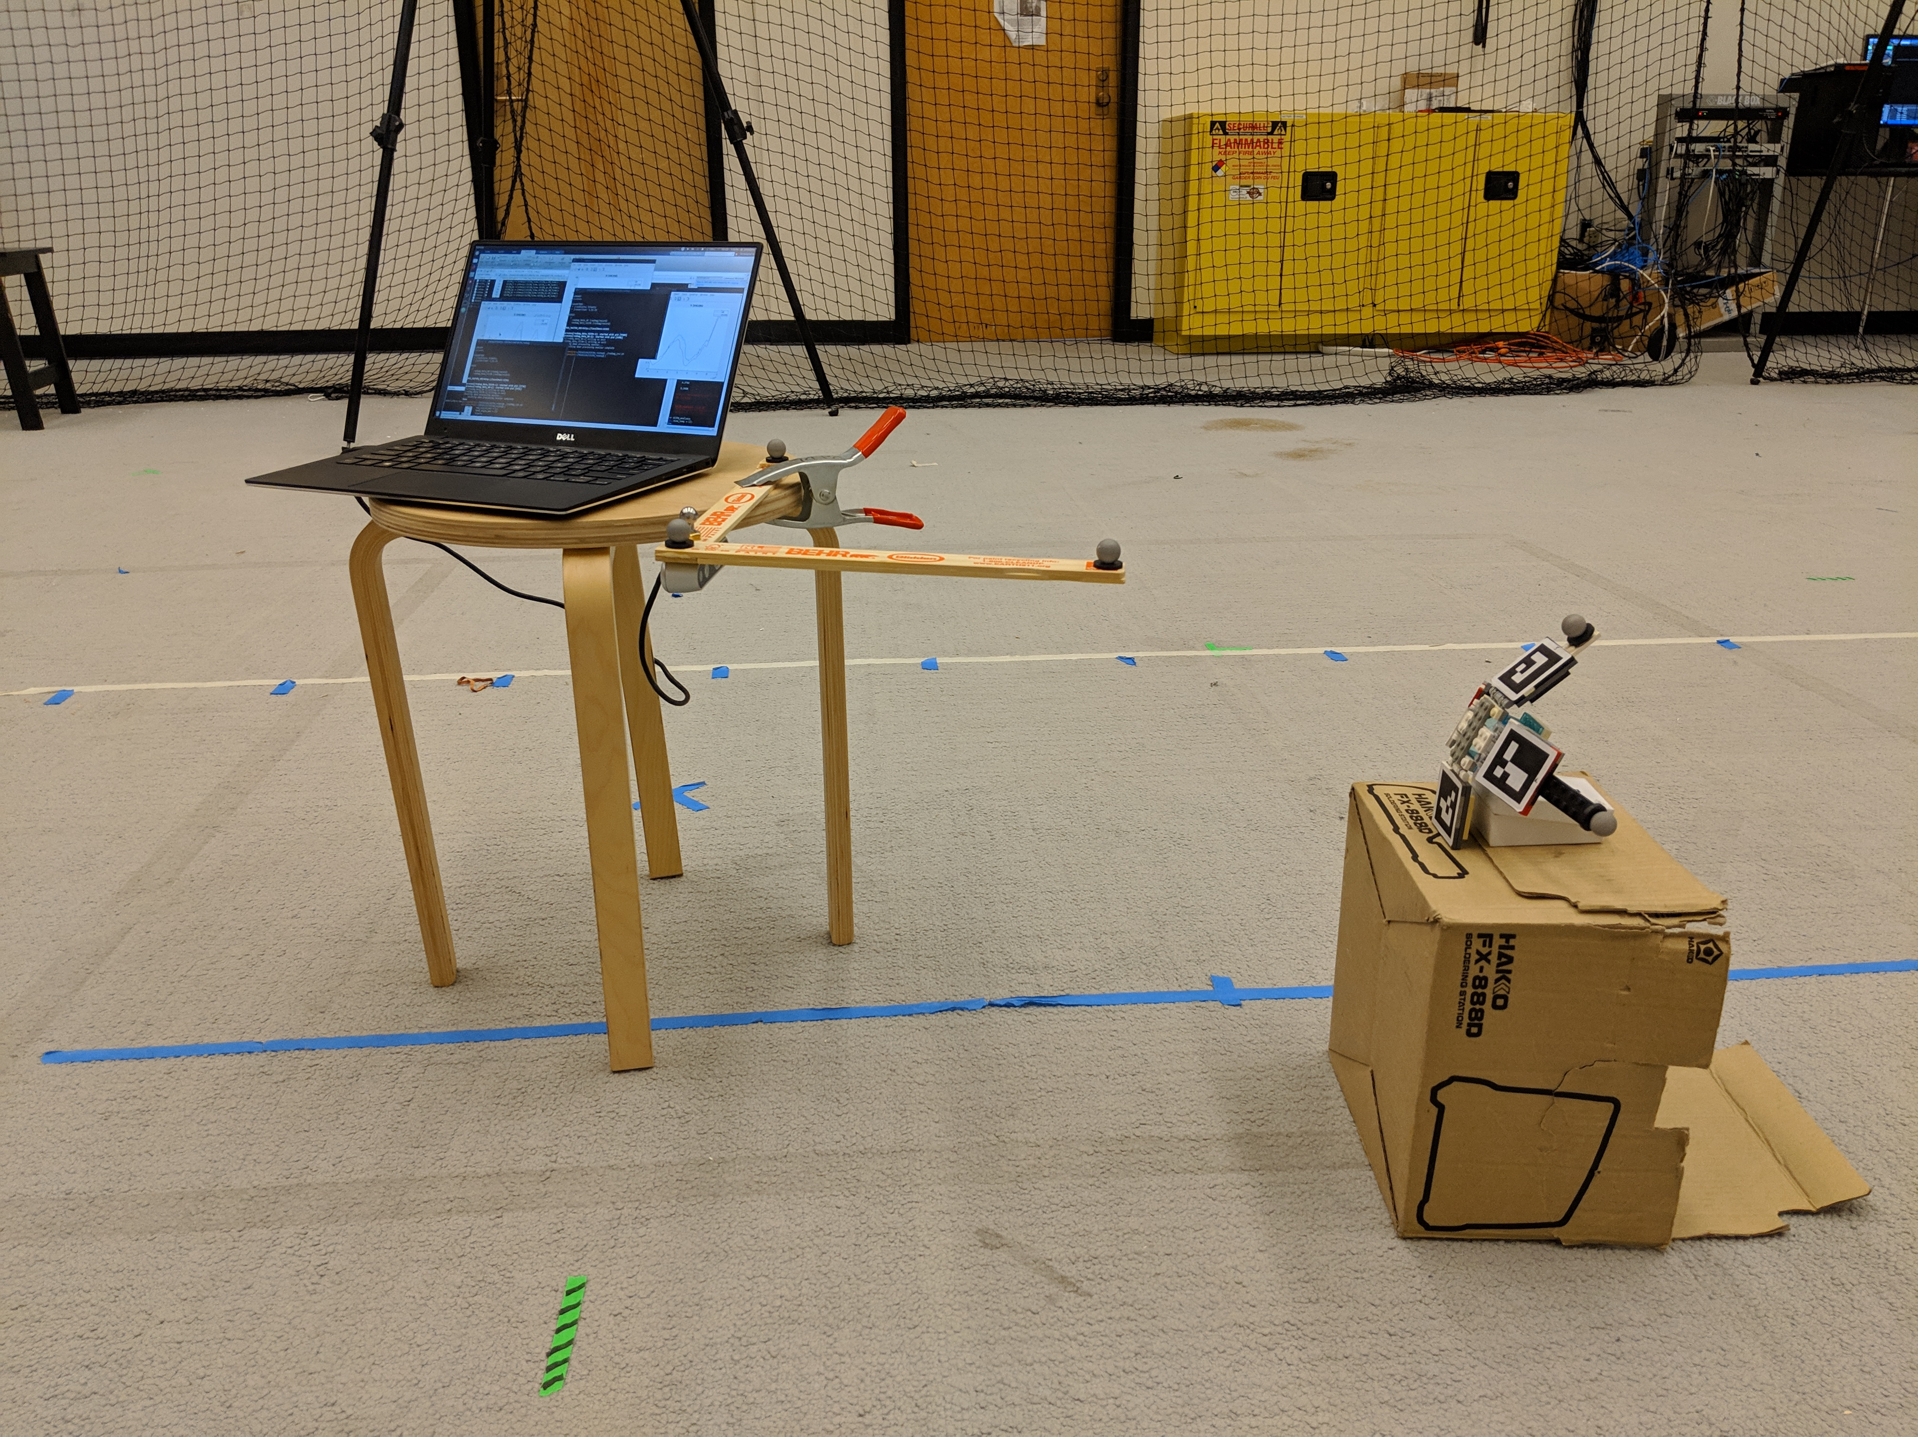
Intel D435 Accuracy Test
Purpose: Ensure that the accuracy requirements from DR 2.2 and DR 2.3 are met by the Intel D435
Facility | RECUV Lab
Equipment | VICON, Pearl Markers, Intel D435
Measures | VICON vs Intel D435 location/orientation data (mm and °)
Requirement | Position error: <1.5 cm Orientation error: <10°
Expected Completion Date | 3/7
VICON axes
Intel D435 Mockup EE
Notes:
Add picture
Ben

Slide 27
Intel D435 Accuracy Test Results
Position and body-axes determined by:
Intel D435
VICON
Notes:
Point out the lag

Slide 28
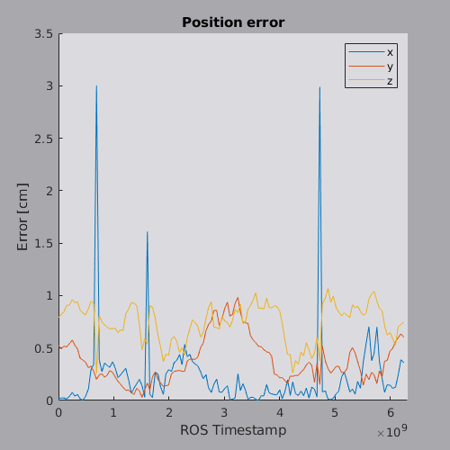
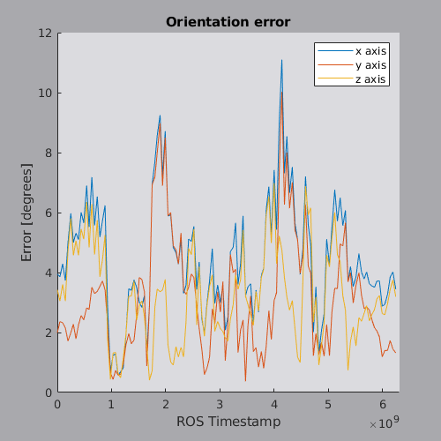
Intel D435 Accuracy Test Results
Tolerable error in position: 1.5 cm Tolerable error in orientation: 10°
Notes:
-Talk about how the AR tag readings are lagging behind VICON due to VICON having a way faster feedback rate and how we're going to deal with it (not sure I have a super impressive answer for that)
-This is kind of preliminary and the calibration needs to be tweaked

Slide 29
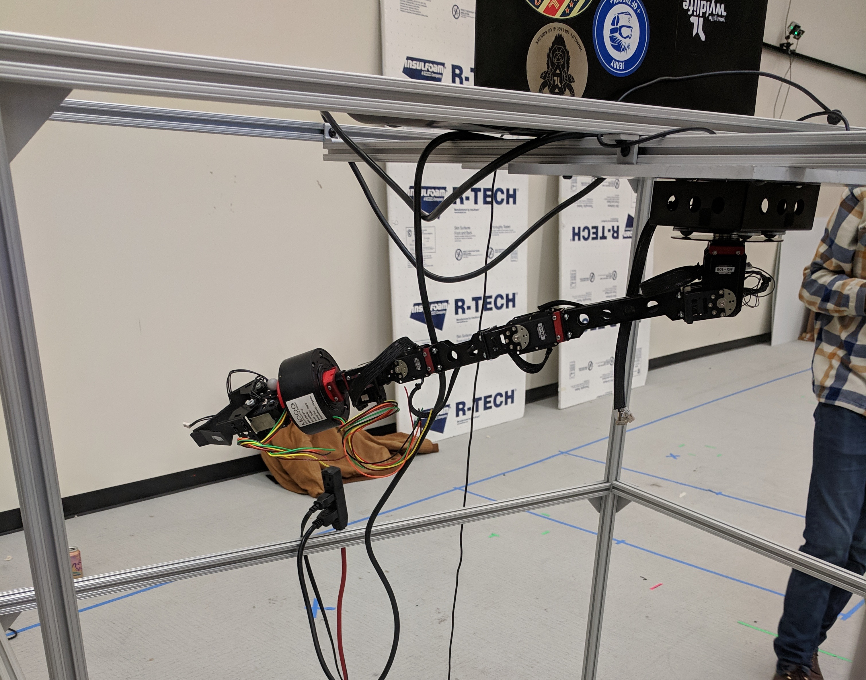
Arm Thermal Test
Purpose: Reduce the risk of actuators overheating and going into safety shut-off mode
Facility | N/A
Equipment | Arm, GSE, timer
Measures | Time till automatic shut-off (seconds)
Measurement time | > 600 seconds
Requirement time | < 255 seconds
Expected Completion Date | Completed as of 2/28
Model Validation: This test will validate the thermal model that DR 3.1.1.1 (the arm shall finish its operations in under 255s) is based on.
Notes:
Sheridan
Used CASCADE heritage model, acknowledge that it is inaccurate due to invalid assumptions between their tests and our tests. Hard to figure out it was wrong until actually tested.
3.1.1.1 actuators shall operate no longer than 255s

Slide 30
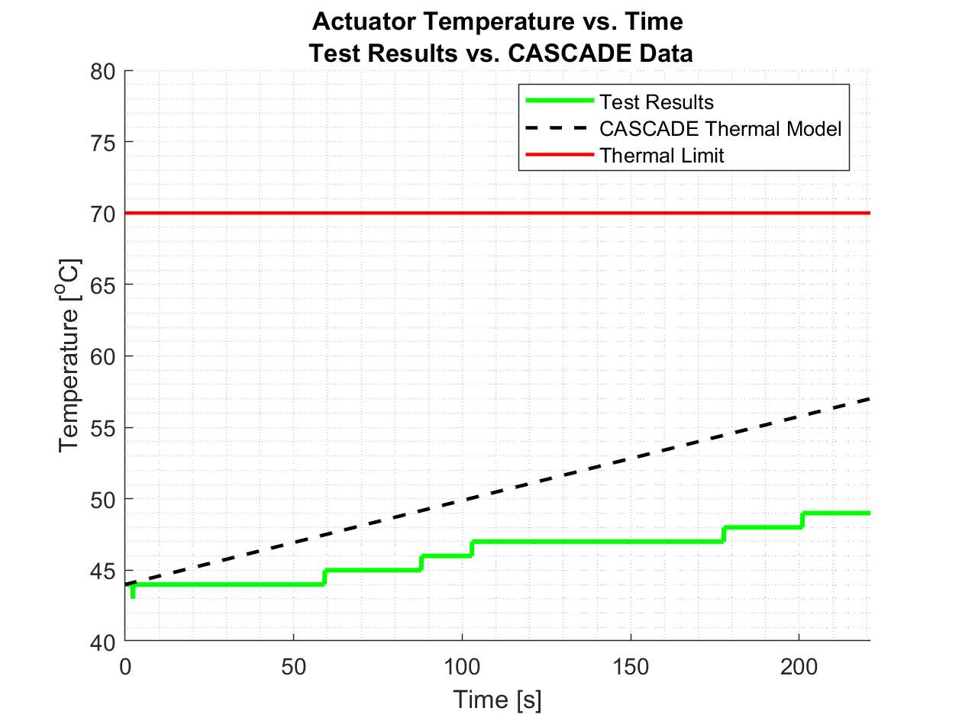
Arm Thermal Test
Expected Results: Based on CASCADE's thermal model actuators will last up to 255s
Results: At worst case 90 degrees, actuators lasted over 10 minutes.
Expected results inaccurate due to invalid assumptions.
Considering redefining requirement 3.1.1.1 but we are still confident we can perform the full system test in under 255s.
Notes:
Sheridan
Used CASCADE heritage model, acknowledge that it is inaccurate due to invalid assumptions between their tests and our tests. Hard to figure out it was wrong until actually tested.
3.1.1.1 actuators shall operate no longer than 255s

Slide 31
Test Readiness - Integration -
Overview
Schedule
Testing Readiness
Overview
Testing Readiness
Subsystems
Testing Readiness
Integration
Budget

Slide 32
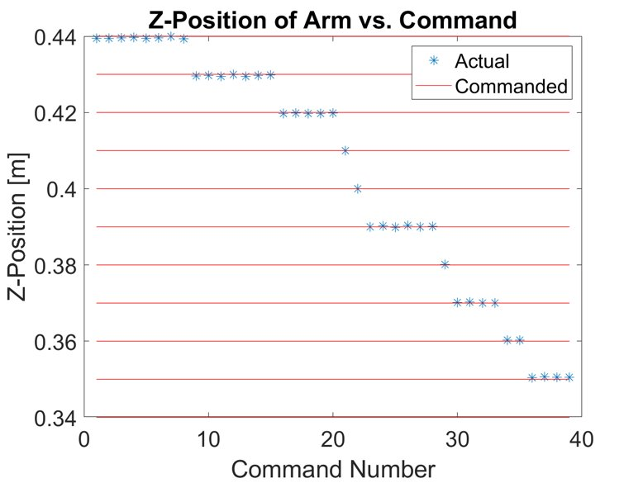
Controlled Accuracy Test
Purpose: Verify that the EE can reach a commanded position and orientation within ±15mm and ±9 degrees as specified by DR 2.2
Feedback Control Simulation Results
Model Validation:
This test will validate that the arm's motion matches our simulation when feedback control is applied model
Expected Results:
DR 2.2 will be met
The test results will not match up with our original simulation results due to differences between the actuator error applied to the simulation and the real actuator error
Notes:
Add pre-req of uncontrolled (now in BUS)
Ben

Slide 33
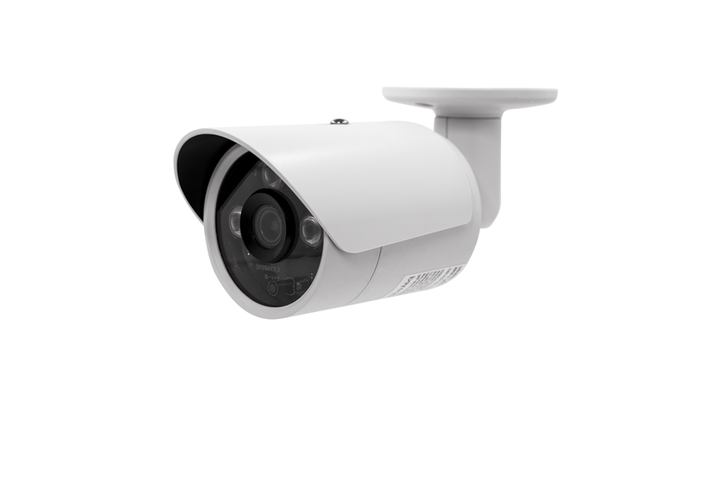
Controlled Accuracy Test Setup
Purpose: Verify that the EE can reach a commanded position within the accuracy specified by DR 2.2
VICON Cameras
Facility | RECUV Lab
Equipment | Arm, Pearl Markers, VICON, GSE
Measures | Position (mm) Orientation (degrees)
Measurement Accuracy | Position: ±1 mm Orientation: ±0.5 degrees
Requirement Accuracy | Position: ±15 mm Orientation: ±9 degrees
Expected Completion Date | 04/15
Pearl
Markers
Notes:
Add pre-req of uncontrolled (now in BUS)
Ben

Slide 34
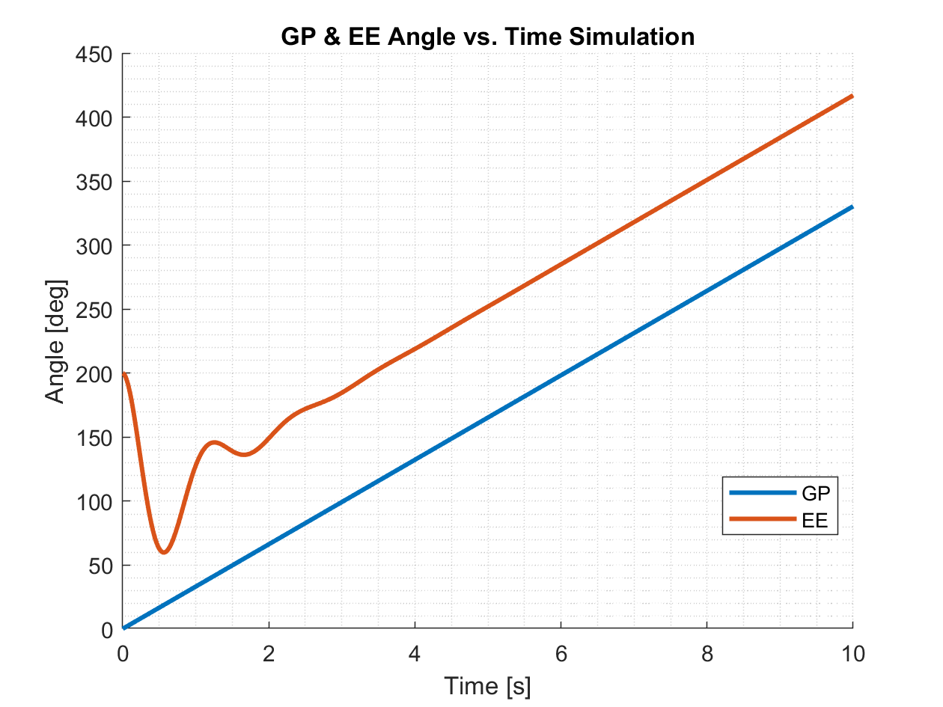
Secondary Sensor + EE Spin Up Test
Purpose: Validate that the EE will spin up to a rate equal to that of the GP while maintaining the 90±10° offset as required by DR 2.3 and 2.3.1
Model Validation:
EE spin up controller will be validated by comparing test data to simulation results
EE Spin Up Simulation Results
Risk Reduction:
Meeting DR 2.3 will reduce the risk of damaging the GP by decreasing angular offset between the EE and GP when attempting to perform the grapple maneuver
Expected Results:
DR 2.3 will be met
Test results may not match up with the simulation results due to differences in the simulated system error and the actual error in the system.
Notes:
Spinning up wrist to match rotation rate and 90 degree angle offset between EE and GP
Cedric

Slide 35
Secondary Sensor + EE Spin Up Test Setup
Pixy2
Facility | RECUV Lab
Equipment | Arm, GP, Pixy2, Pearl Markers, VICON, GSE
Measures | Relative Orientation (degrees)
Measurement Accuracy | ±0.5 degrees
Requirement Accuracy | ±10 degrees
Expected Completion Date | 04/14
VICON
Cameras
Pearl
Markers
Relative
Orientation
Grapple Point (GP)
Notes:
Spinning up wrist to match rotation rate and 90 degree angle offset between EE and GP
Cedric

Slide 36
Budget
Overview
Schedule
Testing Readiness
Overview
Testing Readiness
Subsystems
Testing Readiness
Integration
Budget

Slide 37
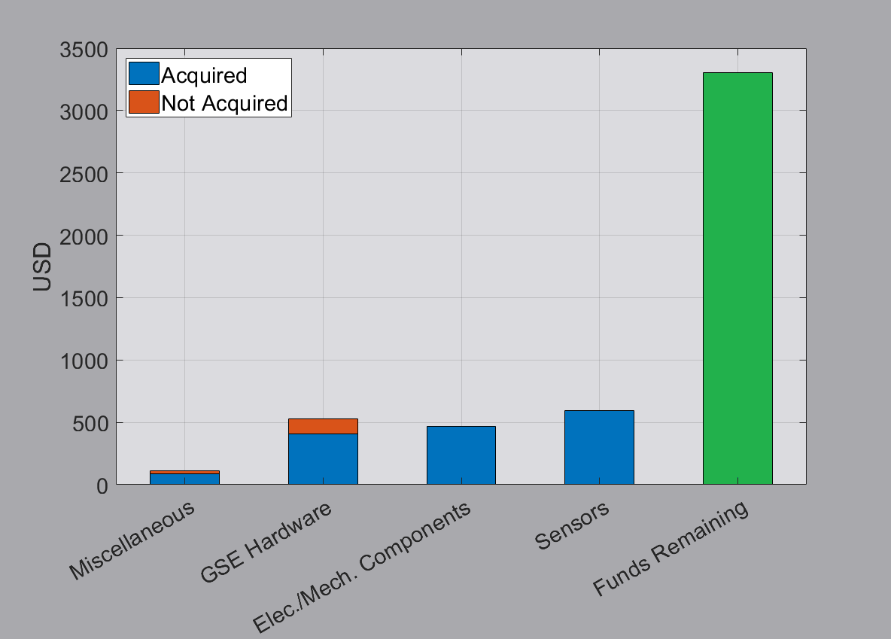
Updated Budget
Items not yet purchased:
Lighting for GSE
GitHub Pro for remainder of semester
Remaining funds:
$3,301.20
Notes:
Cedric

Slide 38
Questions?

Slide 39
Back Up Slides

Slide 40
Overview
Overview
Schedule
Testing Readiness
Software
Testing Readiness
Hardware
Testing Readiness
Integration
Budget
Notes:
SHeridan

Slide 41
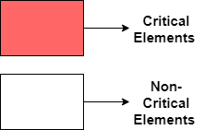
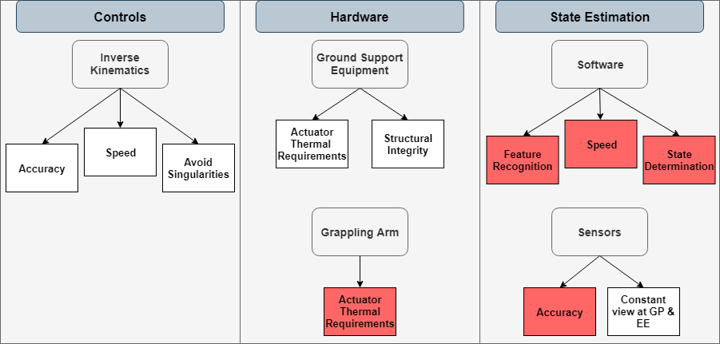
Project Elements

Slide 42
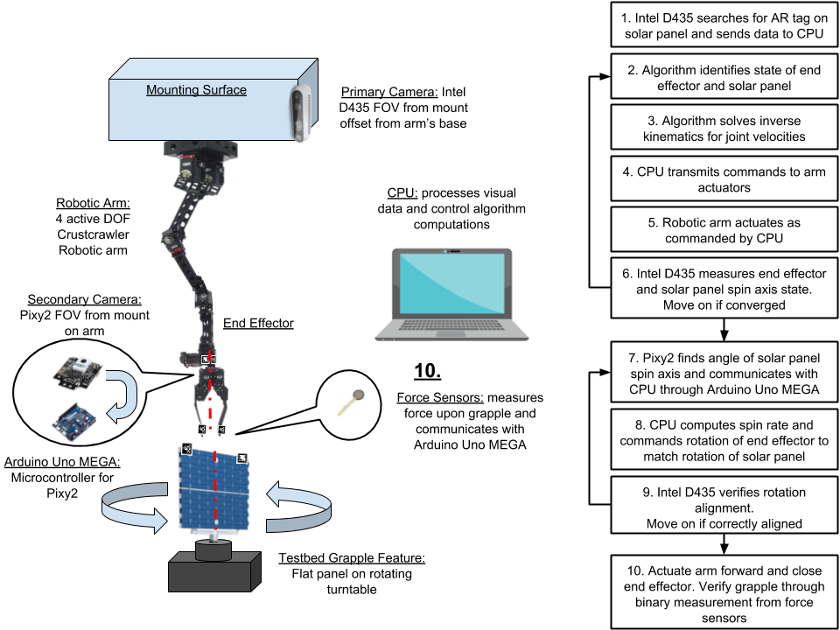
Updated CONOPS

Slide 43
Software Baseline Overview
Control Loop represented in a software block diagram
Each function block is a software manufacturing deliverable
Notes:
Cedric
Ben
- full software block diagram
Cedric

Slide 44
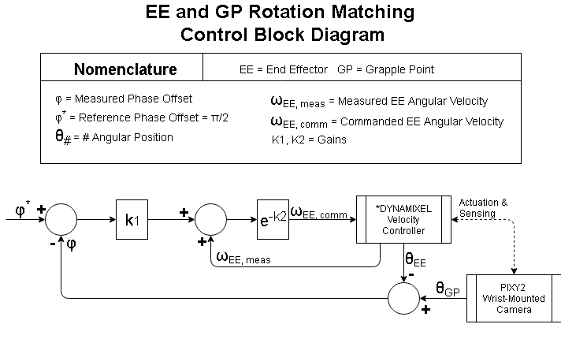
Notes:
Cedric
Ben
- full software block diagram
Cedric

Slide 45
Levels of Success
 | Control Loop Input | Control Loop Execution
Level 1 Success | Identify and report EE location at a rate of 0.916 [Hz] with a tolerance of 1.5 [cm] | EE responds to given controlled input position, converging within 1.5 [cm]
Level 2 Success | Identify and report EE location, and location of stationary GP at a rate of 0.916 [Hz] with a tolerance of 1.5 [cm] | EE makes arbitrary contact with stationary GP on object within 255 [s]
Level 3 Success | Identify and report EE location (with a tolerance of 1.5 [cm]) and angle (with a tolerance of 10 degrees), as well as rotating GP revolving at 0.578 [rad/s], at 0.916 [Hz] rate within 1.5 [cm] | Successful grapple of rotating GP at 0.578 [rad/s], confirmed using force sensors on EE
Notes:
Full Levels of success

Slide 46
Schedule
Overview
Schedule
Testing Readiness
Software
Testing Readiness
Hardware
Testing Readiness
Integration
Budget
Notes:
Cedric

Slide 47
Test Readiness - Software -
Overview
Schedule
Testing Readiness
Software
Testing Readiness
Hardware
Testing Readiness
Integration
Budget
Notes:
Ben

Slide 48
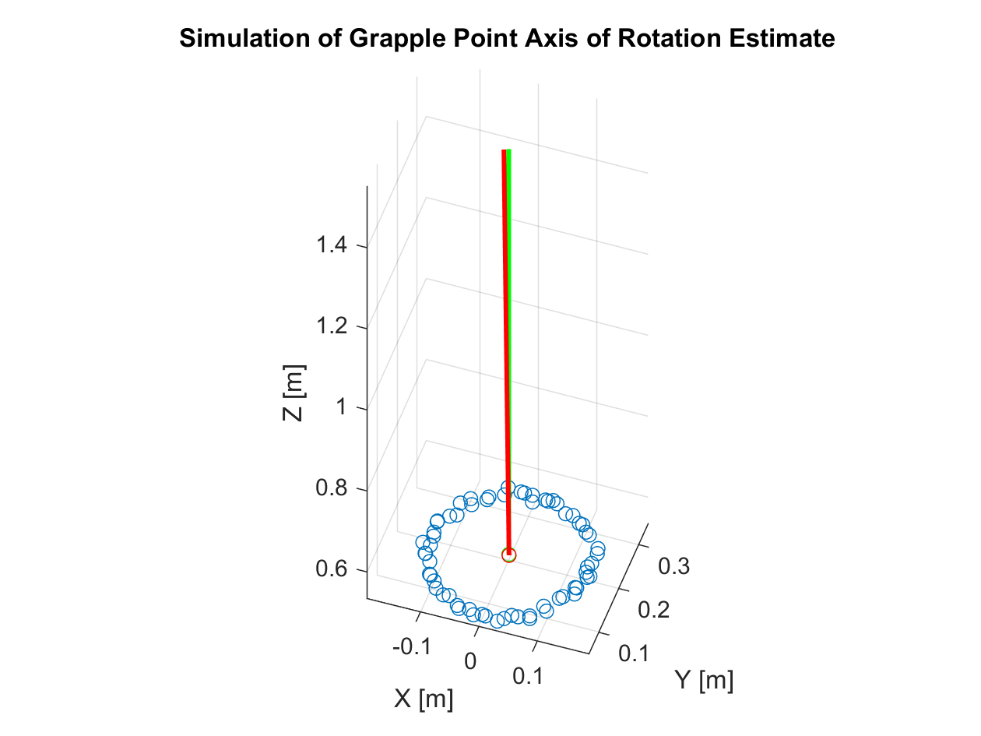
GP Location Estimation Test
Purpose: Verify that the location and orientation of the grapple point can be determined as specified by DRs 2.2.1 and 2.3.2 using primary sensor data
Facility: RECUV Lab
Equipment: Intel D435
GP
Pearl markers
Measure: Position (mm)
Requirement Verification: DR 2.2.1
Notes:
Add picture
Ben

Slide 49
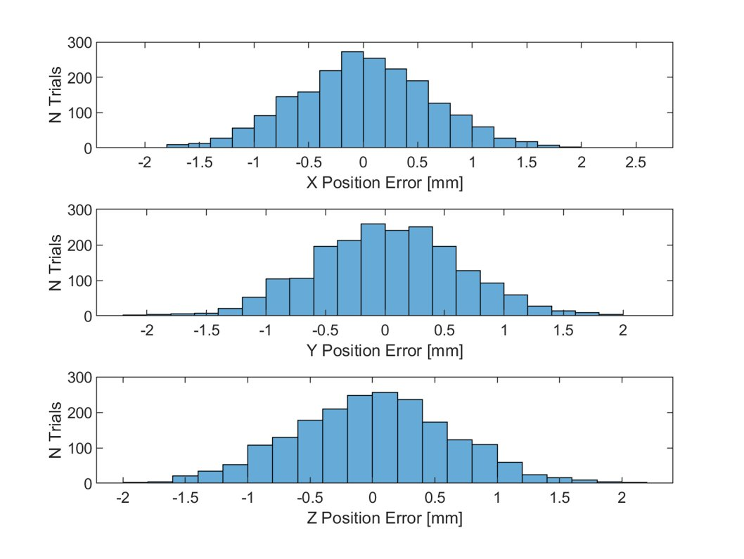
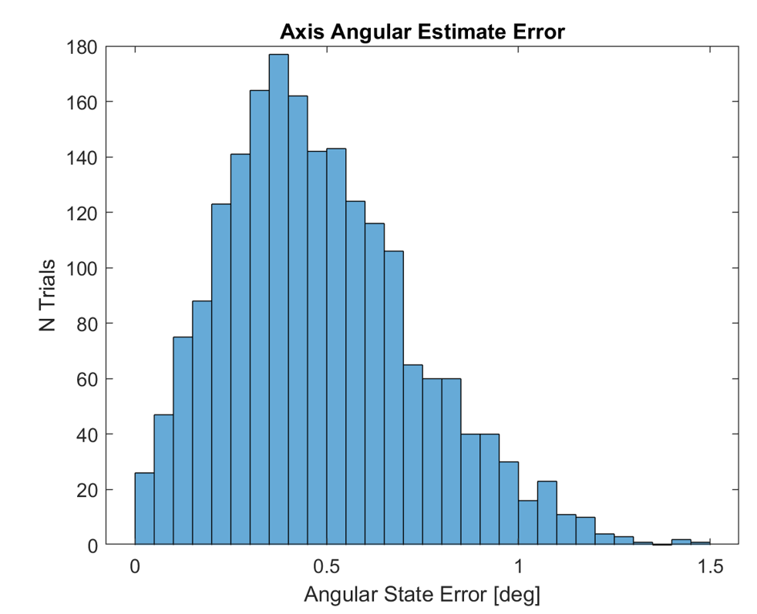
GP Location Estimation Test Status: Incomplete
Expected Result: The data recorded by VICON will have lower resolution that our simulation, but the mean and standard deviations of the test and simulation data will roughly match.
GP Location Estimation Simulation Results
Notes:
Add short description of simulation
Ben

Slide 50
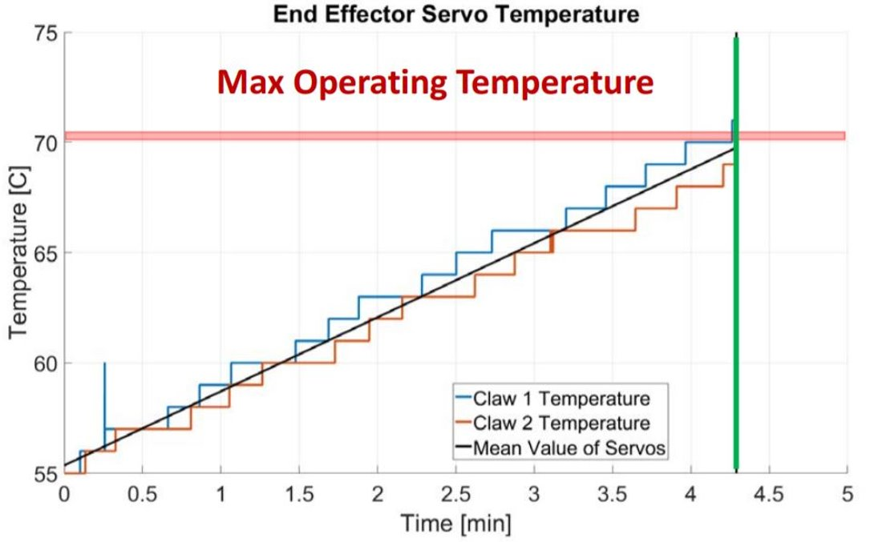
Arm Thermal Test
CASCADE Actuator Thermal Model
Notes:
Sheridan
Used CASCADE heritage model, acknowledge that it is inaccurate due to invalid assumptions between their tests and our tests. Hard to figure out it was wrong until actually tested.
3.1.1.1 actuators shall operate no longer than 255s

Slide 51
Pixy2 Accuracy Test
Purpose: Verify that the Pixy 2 can calculate the GP's spin rate with accuracy specified by DR 2.3.1 (±0.33 °/s)
Model Validation:
This test will validate the determined spin rate by the Pixy2 is within our allowable tolerance.
Expected Results:
The spin rate determined by the actuator encoder data will be within 0.33 °/s to the spin rate determined by the Pixy2
DR 2.3.1 will be met.
Notes:
Add picture
Move status to this slide
Andy

Slide 52
Pixy2 Accuracy Test Setup
Purpose: Verify that the Pixy 2 can calculate the GP's spin rate with accuracy specified by DR 2.3.1 (±0.33 °/s)
Facility | Senior Design room
Equipment | Pixy2, Mockup solar panel, actuator, computer
Measures | Angle (deg), time (s)
Measurement Accuracy | Angle: 0.088°
Requirement Accuracy | Angular velocity: ±0.33 °/s
Expected Completion Date | March 6th, 2019
Notes:
Add picture
Move status to this slide
Andy

Slide 53
Test Readiness - Hardware -
Overview
Schedule
Testing Readiness
Software
Testing Readiness
Hardware
Testing Readiness
Integration
Budget

Slide 54
Slip Ring Change from CDR
 | MX-64T | MX-64T | MX-28T Single Axis | MX-28T Dual Axis
Stall Torque [Nm] | 6 | 6 | 2.5 | 2.5
CDR Torque | 0.854 | 0.522 | 0.236 | 0.139
MSR Torque | 3.072 | 1.238 | 0.539 | 0.355
CDR FOS | ~7 | ~11 | ~10 | ~18
MSR FOS | ~2 | ~5 | ~4.5 | ~7
Slip Ring mass: 0.44 Kg
FOS decreased, but still acceptable

Slide 55
Slip Ring Adapter Strength - Procedure
Verify that the slip ring adapter will not fail under stress
Print a spare slip ring adapter
Create procedure on Partner software
Insert slip ring mount on one side of the machine clamping the grip to the slip ring mount.
Slide the other grip and clamp down on the other side of the slip ring mount.
Click start test.
Confirm the mount does not slip within grips.
When the specimen breaks, click stop test, verify there is minimal load on specimen and remove it.
Notes:
Add picture

Slide 56
Slip Ring Adapter Torsion Test
Purpose: Verify the slip ring mount will not shear do to torsion from the slip ring.
Facility | ITLL 2B Plaza
Equipment | Intron Torsion Machine, Slip Ring mount
Measures | Torque (In-lb), time (s)
Completion Date | February 20th, 2019
Expected Results:​
The slip ring mount should be able to withstand more than 26.55 [In-lb] of torque.
Notes:
Create: Andy
Add picture
Back Up

Slide 57
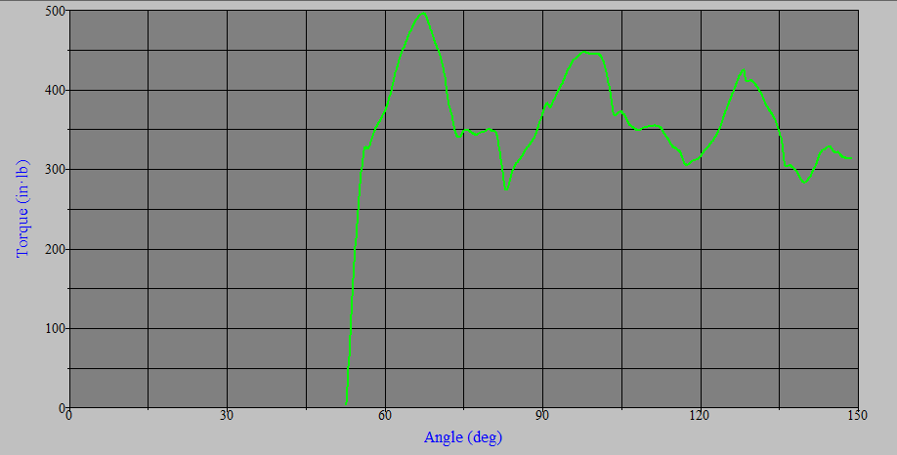
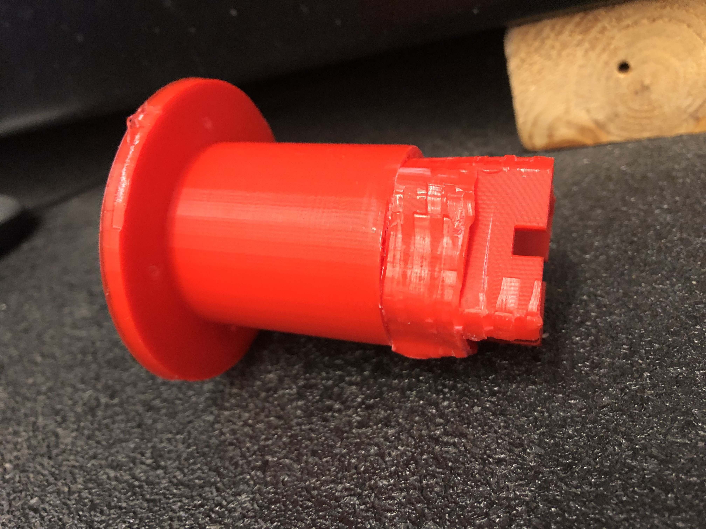
Slip Ring Adapter Torsion Test Results
Purpose: Verify the slip ring mount will not shear do to torsion from the slip ring.
Slip ring mount after completed test
Torque Vs Time for slip ring mount test
Notes:
Create: Andy
Add picture
Back Up

Slide 58
GP Spin Rate Test
Purpose: Verify that the GP can spin up to the commanded rate within the accuracy specified by DR 3.4
Facility: RECUV Lab
Equipment: Grapple Point
Pearl Markers
VICON
Measure: Rotation Rate (rad/s)
Notes:
Cedric
Allowable error
Validation

Slide 59
GP Spin Rate Test - Procedure
Verify that the GP can spin up to the commanded rate within the accuracy specified by DR#
Attach a pearl marker to both top corners of the GP
Command the GP to rotate at a constant rate
Measure the GP's angle over time using VICON
Convert VICON data to angular velocity and subtract the commanded rate to get the rate error
Repeat trial N times for statistical significance
Notes:
Add picture

Slide 60
GP Spin Rate Test Status: Incomplete
Verify that the GP can spin up to the commanded rate within the accuracy specified by DR#
Expected Result: The actuator's internal velocity control loop will achieve the desired velocity with sufficient accuracy.
Concerns: There may be measurement errors introduced by inaccuracies in pearl marker placement and VICON's calibration.
Notes:
Add picture

Slide 61
EE Spin Rate Test
Purpose: Verify that the EE can spin up to the commanded rate within the accuracy specified by DR 2.3.1
Facility: RECUV Lab
Equipment: Wrist Actuator + EE
Pearl Markers
VICON
Measure: Rotation Rate (rad/s)
Notes:
Cedric

Slide 62
EE Spin Rate Test - Procedure
Verify that the EE can spin up to the commanded rate within the accuracy specified by DR#
Attach a pearl marker to both ends of EE grippers
Command the wrist actuator to rotate at a constant rate
Measure the EE's angle over time using VICON
Convert VICON data to angular velocity and subtract the commanded rate to get the rate error
Repeat trial N times for statistical significance
Notes:
Add picture

Slide 63
EE Spin Rate Test Status: Incomplete
Verify that the EE can spin up to the commanded rate within the accuracy specified by DR#
Expected Result: The actuator's internal velocity control loop will achieve the desired velocity with sufficient accuracy.
Concerns: There may be measurement errors introduced by inaccuracies in pearl marker placement and VICON's calibration.
Notes:
Cedric
Add picture

Slide 64
Sensor Transfer Test
Purpose: Verify that the errors introduced by transferring data between the primary and secondary camera frames is less than that specified by DR 2.4.2 and DR 2.4.3
Facility: RECUV Lab
Equipment: Fully assembled test bed
Assembled arm
Pixy2, Intel D435
Pearl markers
Measure: Position (mm)
Notes:
Add picture
Andy

Slide 65
Test Readiness - Integration -
Overview
Schedule
Testing Readiness
Software
Testing Readiness
Hardware
Testing Readiness
Integration
Budget

Slide 66
Uncontrolled Accuracy Test
Purpose: Determining how accurately the EE arrives at a commanded position before applying the control law
Facility: RECUV Lab
Equipment: Arm
Pearl Markers
VICON
Measure: Position (mm)
Model Verification: This data will greatly aid in tuning the control law and provide us a baseline dataset allowing us to quantify the improvement that applying our control provides
Notes:
Add picture
Ben

Slide 67
Primary Sensor + Controlled Motion Test
Purpose: Validate that we can control the position of the EE using data from the primary sensor with the accuracy required by DR 2.2
Facility: RECUV Lab
Equipment: Arm
Intel D435
Pearl Markers
VICON
Measure: Position (mm)
Notes:
Add picture
Ben

Slide 68
Controlled Accuracy Test - Procedure
Verify that the EE can reach a desired position within the accuracy specified by DR#
Attach pearl markers to the EE and base coordinate frame
Command EE to a position within the arm's range of motion
Use VICON to measure the EE's position over time
Feed VICON data plus an error back into the control system to simulate the primary sensor data
Repeat test until statistical significance is achieved, varying the EE position each time
Subtract the commanded position from the VICON data in the base frame to obtain errors
Run arm simulation using tested commands and compare data
Notes:
Add picture

Slide 69
Pixy2 Accuracy Test - Procedure
Verify that the Pixy 2 can calculate the GP's spin rate with accuracy specified by DR 2.3.1
Notes:
Add picture

Slide 70
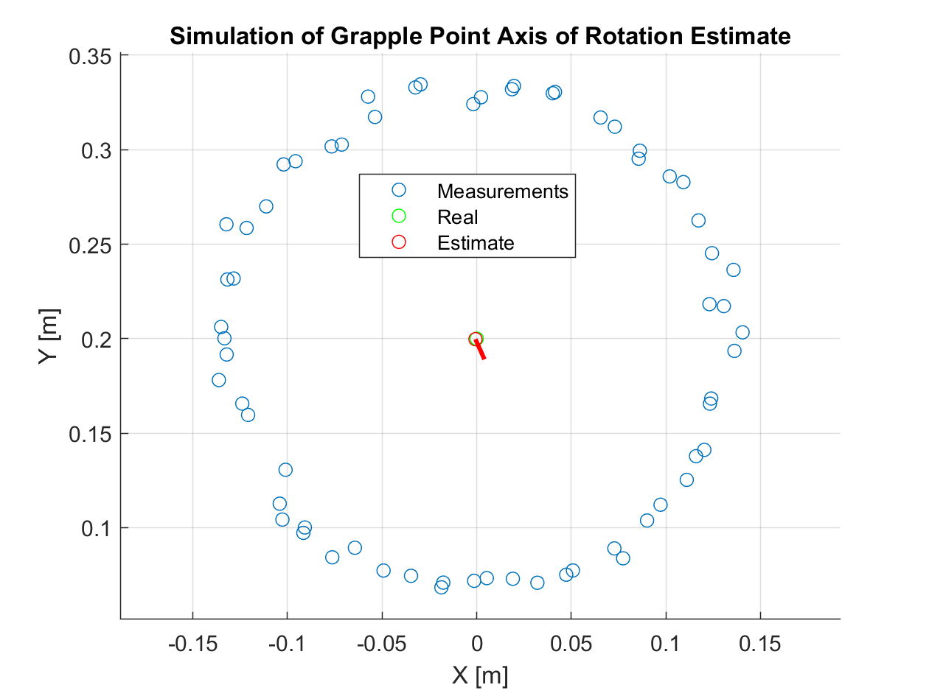
Spin Axis Alignment
MATLAB simulation incorporating error in measurements.
Measured X,Y,Z position from AR tags and intel
Black circle is true path of the AR tags on the GP
Top View
Path of AR tags on solar panel

Slide 71
Spin Axis Alignment
MATLAB simulation incorporating error in measurements.
Measured X,Y,Z position from AR tags and intel
Black circle is true path of the AR tags on the GP
Calculated Spin Axis
Actual Spin Axis
Side View
Notes:
Create: Cedric
Present: Sheridan
Example of the data Matlab will get from the intel sensing the AR tags, the blue dots are all XYZ position data pulled from the AR tags. These points are then averaged to get centroid location. A "best fit" plane is then found based on this centroid and the data points, and the spin axis is assumed to be the vector normal to this plane through the centroid
Accuracy plots are in backup slides

Slide 72
Secondary Sensor + EE Spin Up Test - Procedure
Validate that we can spin up the EE such that it's rate and phase match that of the GP using data from the PIXY2 secondary sensor within the accuracy specified by DRs # and #
Notes:
Add picture

Slide 73
Secondary Sensor + EE Spin Up Test Status: Incomplete
Validate that we can spin up the EE such that it's rate and phase match that of the GP using data from the PIXY2 secondary sensor within the accuracy specified by DRs # and #
Expected Result: The control law in combination with feedback from the secondary sensor will match the rotation of the GP within the bounds specified by DRs # and # after N seconds
Concerns: The acceleration of the wrist actuator may render our control law ineffective.
Notes:
Add picture

Slide 74
Primary Sensor + Controlled Motion Test - Procedure
Validate that we can control the position of the EE using data from the primary sensor with the accuracy required by DR #
Attach pearl markers to the EE and base coordinate frame
Command EE to a position within the arm's range of motion, utilizing position data from the Intel D435 as feedback
Use VICON to measure the EE's position over time
Repeat test until statistical significance is achieved, varying the EE position each time
Subtract the commanded position from the VICON data in the base frame to obtain total errors
Subtract Intel D435 measurements from VICON measurements to obtain sensor errors
Run arm simulation using tested commands and compare data
Notes:
Add picture

Slide 75
Primary Sensor + Controlled Motion Test Status: Incomplete
Validate that we can control the position of the EE using data from the primary sensor with the accuracy required by DR #
Expected Result: The control law in combination with feedback from the primary sensor will reach the commanded position within the bounds specified by DR#
Concerns: We may encounter high settling times that require extensive tuning of the control system to fix
Notes:
Add picture

Slide 76
Full Integration Testing Procedure
1. Mount arm to GSE
2. Computer plugged into arm
3. Power plug in / Emergency off ready
4. ROS and controls ready
5. Cameras on
6. Actuate arm to starting position
7. Spin up GP
8. Track AR tags using Intel D435
9. Actuate arm
10. Switch to Pixy 2 at 3" from GP to tip of EE
11. Determine spin rate
12. Spin up EE
13. Switch back to Intel
14. Actuate arm forwards
15. Force sensors determine binary grapple
16. Magnets fail or system shut down
17. Power off

Slide 77
GP Location Estimation Test - Procedure
Verify that the errors introduced by transferring data between the primary and secondary camera frames is less than that specified by DR#
Notes:
Add picture

Slide 78
Sensor Transfer Test - Procedure
Verify that the errors introduced by transferring data between the primary and secondary camera frames is less than that specified by DR#
Notes:
Add picture

Slide 79
Sensor Transfer Test Status: Incomplete
Verify that the errors introduced by transferring data between the primary and secondary camera frames is less than that specified by DR#
Notes:
Add picture

Slide 80
Uncontrolled Accuracy Test - Procedure
Determining how accurately the EE arrives at a commanded position before applying the control law
Attach pearl markers to the EE and base coordinate frame
Command EE to a position within the arm's range of motion
Use VICON to measure the EE's position over time
Repeat until statistical significance is achieved, varying the EE position each time
Subtract the commanded position from the VICON data in the base frame to obtain errors
Notes:
Add picture

Slide 81
Uncontrolled Accuracy Test Status: Incomplete
Determining how accurately the EE arrives at a commanded position before applying the control law
Expected Result: There will be significant errors between the measured and commanded positions. These errors are likely to be biased in the direction of the force of gravity acting on the arm.
Concerns: It will be difficult to determine how much of the error is caused by the inverse kinematics and how much is caused by the actuators.
Notes:
Add picture

Slide 82
Arm Thermal Test - Procedure
Verify the arm can remain actuated at 90° for at least 255 seconds.
Calibrate actuators
Command arm to hold the base actuator at 90° and all others at 0°
Hold this position until actuator thermal failure or until 10 minutes have elapsed.
Notes:
Add picture

Slide 83
Intel D435 Accuracy Test - Procedure
Verify the Intel's measurement accuracy
Notes:
Add picture

Slide 84
Full System Test
Verify the system can grapple the spinning mock solar panel.
Purpose: Run full system to
check level of success.
Facility: N.A.
Equipment: Fully assembled test bed
Assembled arm and GP
Test computer
Measure: Level of success
Notes:
Add picture
Sheridan

