Slide 1
HERMES Hazard Examination and Reconnaissance Messenger for Extended Surveillance
Testing Readiness review
March 4th, 2019
Presenters: Alexis Sotomayor , Alex Sandoval , Ashley Montalvo, Quinter Nyland
Customer: Barbara Streiffert and Jet Propulsion Laboratory (JPL)
Advisor: Dr. Kathryn Anne Wingate
Team: Alexander Sandoval, Alexis Sotomayor, Ashley Montalvo, Brandon Santori, Brindan Adhikari, Chase Pellazar, Colin Chen, Junzhe He, Katelyn Griego, Marcos Mejia, Michely Tenardi, Quinter Nyland
Notes:
Intro: conops: design

Slide 2
Project Purpose and Objectives
Notes:
2 minutes, 28 mins left

Slide 3
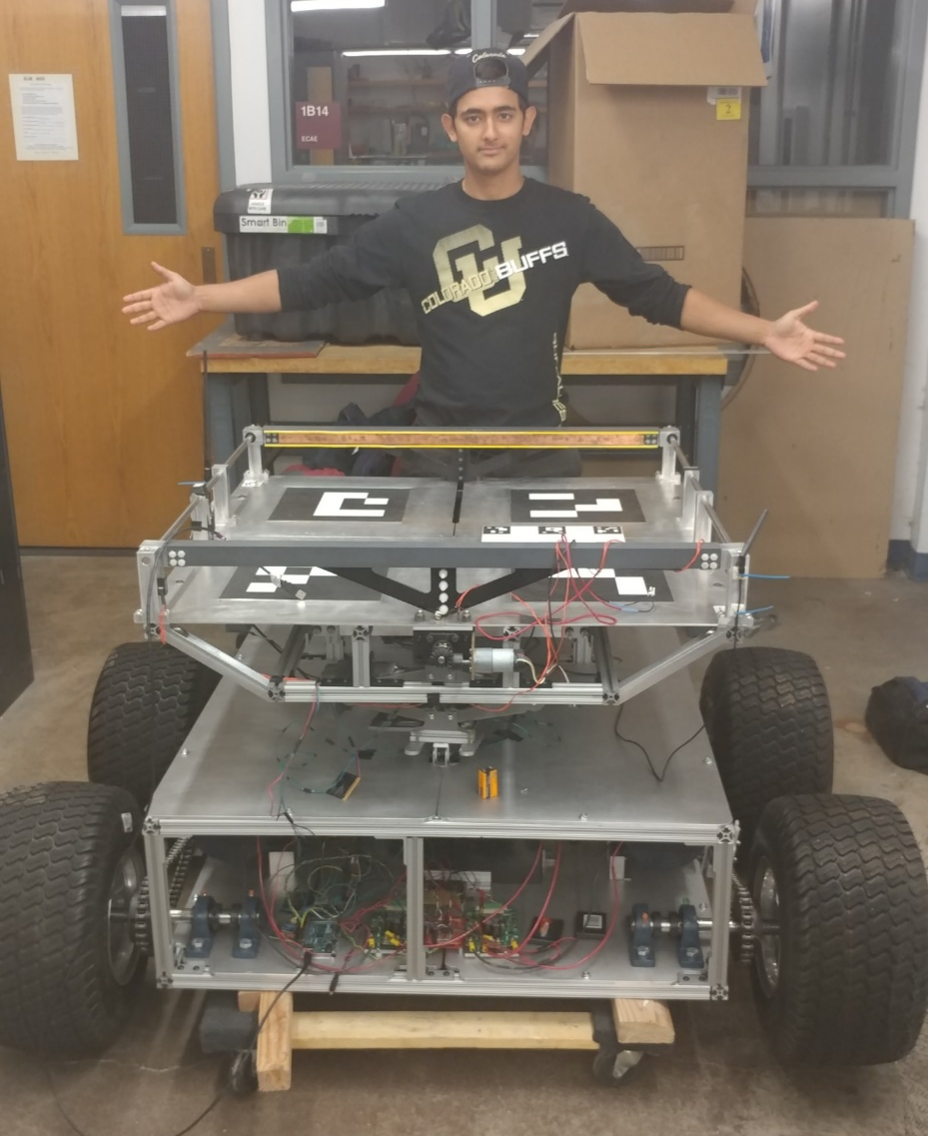
Project Motivation and Statement
The mother rover created by DRIFT is large and difficult to navigate through forest like areas.
The HERMES team will design, build and test a child scout rover (CSR) that will deploy, take images/videos of the surrounding terrain, determine a viable path to a location of interest (LOI), and upon arrival to the LOI, the CSR will send the viable path to the mother rover.
CHIMERA
DRIFT
Note: Blue used for emphasis

Slide 4
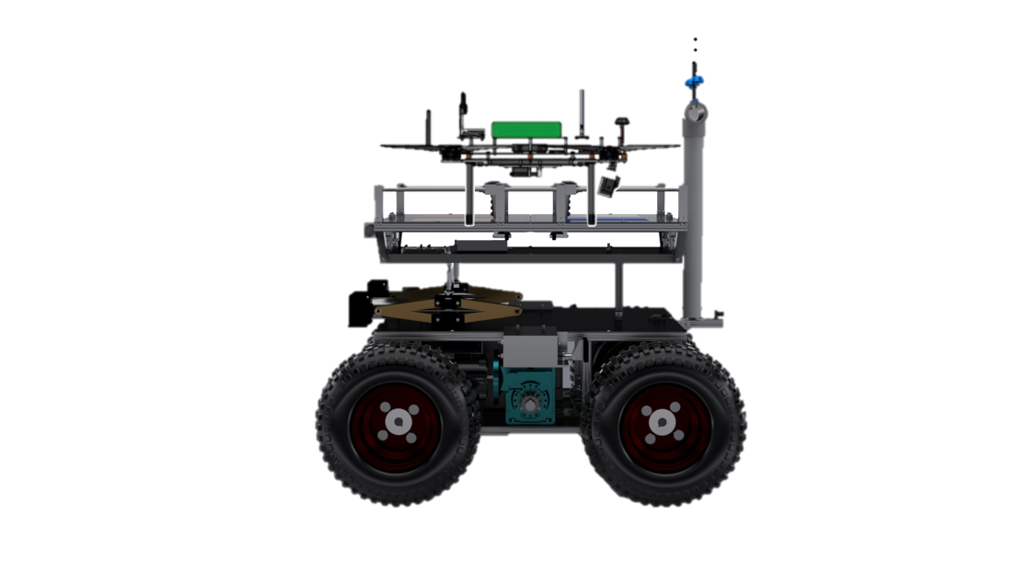
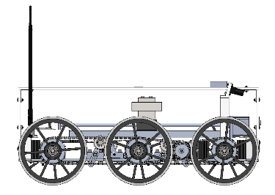
CONOPS: Arriving to Location of Interest
1
2
3
4
5
Deploy from Ground Station and drop a pathpoint
Receive Location of Interest (LOI) from GS
User commands CSR to point towards LOI
User commands CSR to travel towards the LOI in semi autonomous mode. The CSR will travel until it reaches the LOI.
Upon arrival it will stop, and notify the GS and drop a pathpoint
Ground
Station
Mother Rover
2
3
5
LOI
1
4
Child Scout Rover
En route to the LOI, the CSR may encounter one or more of the following:
Obstacles
Discontinuities
Slopes
Loss of communications
Legend
Mission Terrain
Pathpoint
Stop and request user intervention
Requirements
Comm between GS and MR
Functions
Comm between GS and CSR
Comm between CSR and MR
October 2018
Manually controlled path
Up to 250 m radius (820 ft)
4
Autonomously controlled path
4
Notes:
Fix picture,

Slide 5
CONOPS: Other Terrain
Non-Traversable Obstacles
Discontinuities
Slopes
If the CSR detects an obstacle, the CSR will stop
The user will take control, and manually control the CSR around the obstacle
Every time the CSR turns, a pathpoint is recorded
After traveling around the obstacle, the user commands the CSR to point towards the LOI, and command it into semi- autonomous mode
If the CSR detects a discontinuity, the CSR will stop
The user will then send a command to the CSR to enter the discontinuity traversal mode
Then the CSR autonomously crosses the discontinuity
A pathpoint is recorded since a mobility command was received and executed
After crossing the discontinuity, the CSR stops and requests user intervention
If the CSR detects a slope, the CSR will stop
The user will control the CSR to get onto the slope and command the CSR into semi autonomous mode
The CSR will travel on the slope in semi autonomous mode
Once the CSR detects flat ground, it will stop
The user will control the CSR to return to flat ground
1
1
1
2
2
2
3
3
3
4
4
5
Obstacle
1
1
3
CSR crosses autonomously
3
1
4
2
4
2
5
User sends command to change mode
Greater than 2.4 in deep
Operator manually controls the CSR onto or off-of slope
Up to a 20° slope
3
2
Up to 9 inches wide
Operator manually controls CSR around obstacle
= Point where sensor detects
obstacle or discontinuity
= Pathpoint
= Stop and request
user intervention
= Manual Control
5
= Autonomous Control
Notes:
Fix picture

Slide 6
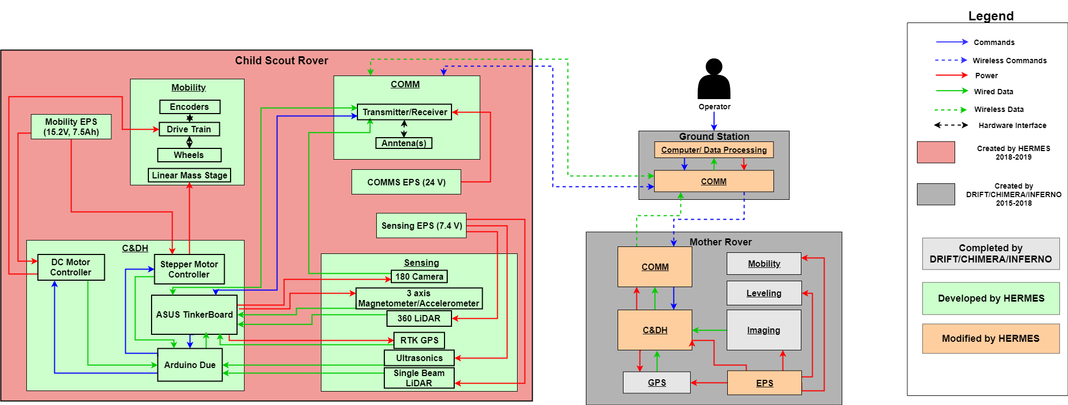
Functional Block Diagram

Slide 7
Functional Requirements
Requirement ID | Description
CSR.1 | The CSR shall receive commands from the GS
CSR.2 | The CSR shall send video, GPS coordinates, and sensor data to the GS through mission defined terrain
CSR.3 | The CSR shall drive to a location of interest through mission defined terrain
CSR.4 | The CSR shall travel back to the last reported pathpoint upon loss of communications with the GS
CSR.5 | The CSR shall take video in position hold
Notes:
CSR.2 – specify sensor data

Slide 8
Critical Project Elements
Critical Project Element (CPE) | Rationale
Mobility | The CSR must be able to travel forward and backwards and perform 360° turns.
Software | The CSR software must read in, process, and execute commands from the GS. The CSR must also process data on-board to react to obstacles and discontinuities.
Guidance, Navigation, and Control (GNC) | The CSR must be controlled remotely by one operator, and must read its own attitude accurately.
Environment Sensing | The CSR must accurately sense the terrain and obstacles around it to navigate around them.
Communications | The CSR must communicate with the GS to send the viable path, images and videos to the GS.

Slide 9
Success Levels
Criteria | Level 1 | Level 2 | Level 3
Control | The CSR shall navigate by received control commands from the GS The CSR shall perform a 360 ° turn The CSR shall drive forward and reverse | The CSR shall navigate to a LOI and shall detect obstacles en route to the LOI, but manual control is needed to circumvent the obstacles. | The CSR shall autonomously return to the last known GPS location if connection to the GS and MR is lost.
Communication | The CSR shall verify connection to the MR/GS. The CSR shall send at least one GPS data packet to MR/GS upon command. The CSR shall have functional communication up to a 250 meter radius from the deployment point in an open area. The CSR shall be able receive control commands from MR/GS | The CSR shall record and send waypoint locations after encountering an obstacle | The CSR shall transmit continuous video feed. The CSR shall verify its location from the LOI within +/- 5 meters The CSR shall communicate through type D terrain up to a 250 meter radius from the deployment point
= Completed

Slide 10
Success Levels Continued
Criteria | Level 1 | Level 2 | Level 3
Environment | The CSR shall traverse the following: Open areas Up to 20 ° incline slopes | The CSR shall traverse the following: Type A underbrush Roots up to a 2.4 inch(6 cm) diameter | The CSR shall traverse the following: Type D underbrush Up to a 9 inch wide discontinuities with depths greater than 2.4 inches (6 cm)
Range | The CSR shall drive up to a 250 meter radius from the deployment point on flat terrain | The CSR shall drive up to a 250 meter radius from the deployment point on flat terrain with obstacles present | The CSR shall be able to drive in a 250 meter radius from the deployment point at a 20 ° inclined slope
Video/ Image | The imaging system on the CSR shall capture a FOV greater than 100 ° The imaging system shall send time-stamped images to the MR/GS | The CSR shall send videos to the GS The GS shall toggle the video capture from the CSR on or off | The CSR shall send continuous video feed to the GS
= Completed
= To be Completed

Slide 11
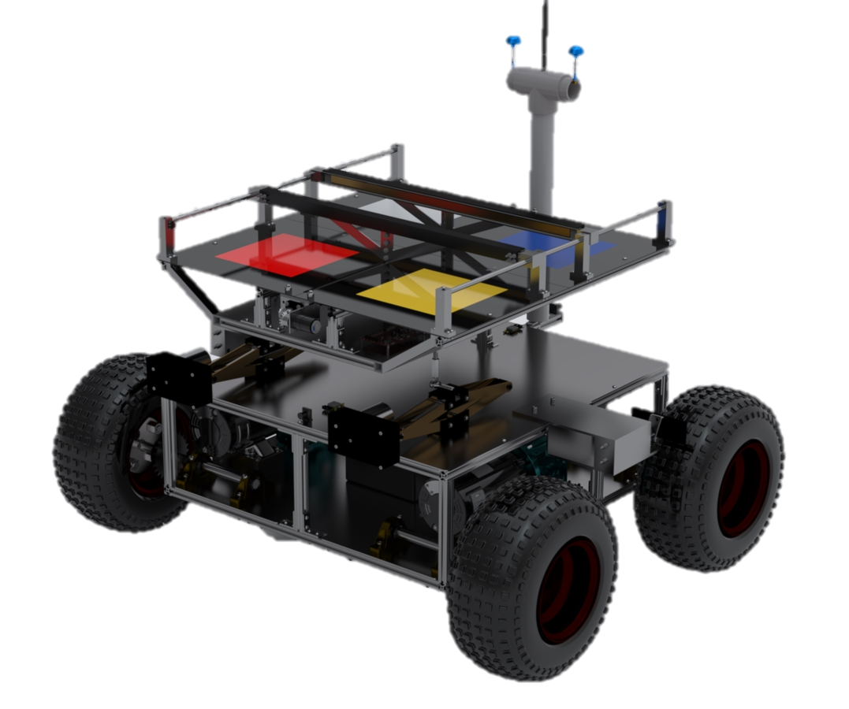
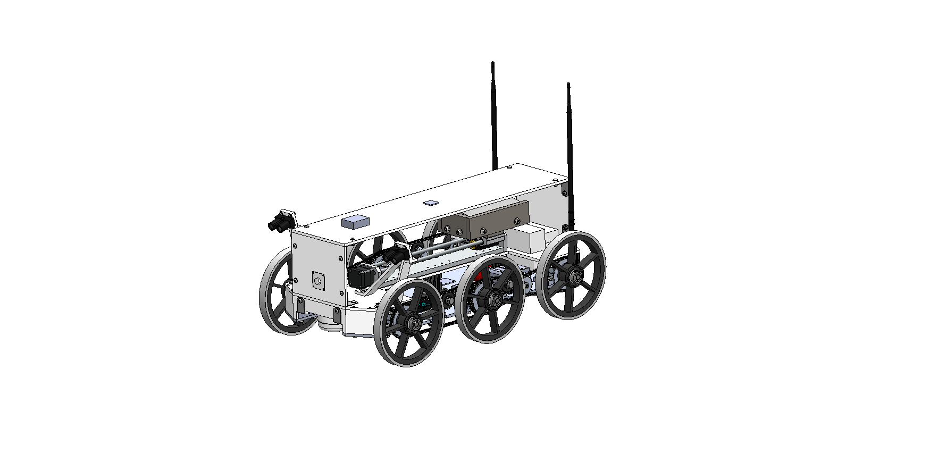
Design Recap: System Interface
MR Comm System
1 6.5W 900MHz Ubiquiti Radio
Command Options
CSR Status
MR
GS Software System
Function: ROS Slave Machine
Displays a GUI for operation
Mission Log
Video Feed
GS
MR Comm System
1 6.5W 900MHz Ubiquiti Radio
MR Comm System
1 6.5W 900MHz Ubiquiti Radio
CSR
MR Software System
Function: ROS Slave Machine
CSR Software System
Function: ROS Host Machine
= Wireless Comms.
= Outlines components
Notes:
I’d say emphasize less on comms and expand more on software. Fix, and talk better. Animate

Slide 12
Design Recap: CSR Hardware
Drivetrain:
Design
One drivetrain per side
Composed of 6 wheels, 2 chains, chain tensioners, sprockets, 1 motor + gearbox
Chassis:
Design
Top housing is 0.25” laser cut acrylic
Bottom Chassis is 0.25” 6061 Aluminum (CNC)
Linear Mass Stage:
Why?
The COM is shifted as necessary using the linear mass stage to cross discontinuities. The mass is shifted when the ultrasonic sensors detect ground under a certain set of wheels.
Design
A COTS linear mass stage is utilized which is controlled by a stepper motor controller. The mass being used is 5 kg.
CSR Physical Properties Summary:
Overall Dimensions: 28 in x 15 in x 11 in
Total Mass: 17 kg
20.2 in
28 in
15.5 in
Notes:
Don't assume anyone knows what everything is for. Why is the linear mass stage there? Why are we using ROS in the first place? Why do we need to operate in different modes? We need to make sure to build our presentation in such a way that everything has a purpose when it is presented.

Slide 13
Design Recap: CSR Hardware
Single Beam LiDAR Sensors:
Why?
To detect discontinuities
360 ° Lidar Sensor:
Why?
To detect obstacles
Ultrasonic Sensor:
Why?
Used for crossing discontinuities to determine what position the mass
from the linear mass stage should be in
Placed on the bottom on the CSR (not shown in diagram)
GPS – RTK Sensor:
Why?
To determine the CSR’s position up to a 0.025 m accuracy
Magnetometer/ 3 Axis Accelerometer:
Why?
Magnetometer used for determining the CSR’s heading
Accelerometer used to determine if the CSR is on level ground or a slope
Notes:
Don't assume anyone knows what everything is for. Why is the linear mass stage there? Why are we using ROS in the first place? Why do we need to operate in different modes? We need to make sure to build our presentation in such a way that everything has a purpose when it is presented.

Slide 14
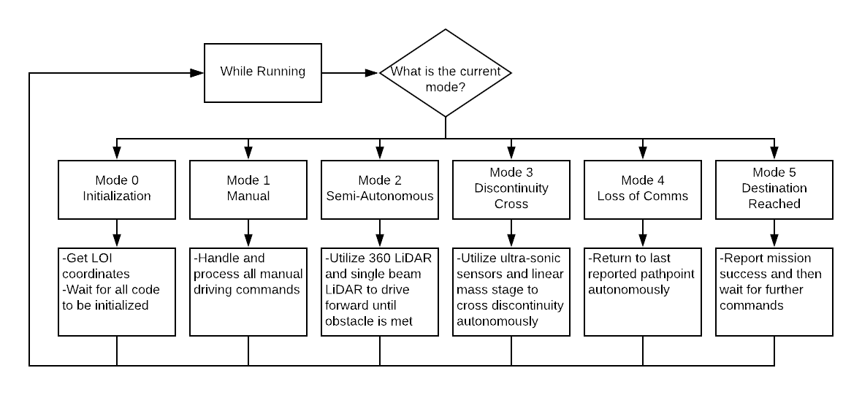
Design Recap: Software Architecture
CSR can run in 6 different modes:
- Initialization
- Manual
- Semi-Autonomous
- Discontinuity Cross
- Loss of Comms
- LOI Reached
Benefits of the Mode Architecture:
- Allows for a reduction in the amount of code running at any point in time
- Allows for data to only be processed from sensors when needed
Notes:
She expects us to explain why ROS is being used in a previous slide somewhere so that when we see the software diagram, it is not shocking to people looking at it.

Slide 15
Scheduling

Slide 16
Software Schedule
Current Day. March , 4 2019
= Completed
= Future Work
= In Progress
= Margin
= Milestone
Unfinished Software
Hours: 2/10
Hours: 0/5
Hours:8/15
Remaining hours: 20 hours
Note: Does not include integration of software

Slide 17
Integration & Test Schedule
Current Day. March , 4 2019
= Completed
= Future Work
Unit Testing
= In Progress
= Margin
= Milestone
Subsystem Integrated Tests

Slide 18
Integration & Test Schedule
= Completed
= Future Work
Mechanical integration
= In Progress
Current Day. March , 4 2019
= Margin
TRR
= Milestone
Spring Break
Full System Integration and Test
SFR

Slide 19
Critical Path
Jan 2019
February 2019
March 2019
April 2019
Current Day. March , 4 2019
Software
= Critical Path
Unit Testing
Subsystem Integrated Tests
Mechanical integration
Full System Integration and Test

Slide 20
Testing Readiness

Slide 21
Overall Testing Status
Phase 1: Components and Subsystems Testing
Phase 2: Subsystem Integration and Testing
Phase 3: Full System Integration and Testing
1/14/19 - 2/24/19
Mobility Testing
Motor validation - Torque curve characterization
Coefficient of Friction Testing
Linear Mass stage moving
C&DH and Software V&V
Individual mode testing
Driving software tests
GNC Testing
GPS accuracy
Magnetometer accuracy
Camera operations testing
Sensing Testing
Single beam accuracy
360 ° lidar accuracy
Ultrasonic sensor accuracy
Communications Testing
Communications testing
Attenuation characterization
2/24/19 - 3/19/19
Mobility Integration & Testing
Motor mounting to chassis
Drive train integration
Forward & backwards motion
C&DH and Software Integration
Loss of communication navigation testing
Integrated mode testing
Sensing Integration
Integrating all sensors and microcontrollers
3/19/19 - 4/22/19
Full System Integration
Combined Environment maneuverability and object detection integration
Full System Mobility Testing
Environmental maneuverability testing
Endurance Testing
Obstacle maneuverability testing
Rover functional testing
= Completed
= Future Work
= In Progress
Notes:
Tests that are planned, tests that have been completed
Current status of testing
Might help in the form of a flowchart?

Slide 22
Flow down from CPEs
CPEs
Phase 1: Component Testing
Phase 2: Subsystem Testing
Phase 3: Full System Testing
Mobility
Motor validation - Torque curve characterization
Linear Mass stage moving
Motor mounting to chassis
Drive train integration
Forward & backwards motion
Software
Individual mode testing
Driving software tests
Environmental maneuverability testing
Endurance Testing
Obstacle maneuverability testing
Rover functional testing
Combined Environment maneuverability and object detection integration
ASUS and Arduino Integration tests
Heading correction tests
Loss of communication
navigation testing
Integrated mode testing
GNC
GPS accuracy
Magnetometer accuracy
Camera operations testing
Environment Sensing
Single beam accuracy
360 ° lidar accuracy
Ultrasonic sensor accuracy
Integrating all sensors and microcontrollers
Communication
Communications testing
Attenuation characterization
Notes:
Tests that are planned, tests that have been completed
Current status of testing
Might help in the form of a flowchart?

Slide 23
Phase 1 Tests

Slide 24
Communications – Scope and Status
Purpose:
To verify and validate the communications model and determine if video, GPS coordinates, and sensor data can be transmitted/received through open areas and wooded areas of 250 m.
Requirements being validated:
Primary Model Requirements
COMM 1.1: The CSR Communication system shall receive command packets up to 250 m in Mission Defined Terrain with no more than a 10 dB link margin
COMM 2.3: The CSR Communication system shall send video from up to 250 m (820 ft) to the GS or the MR
Secondary Model Requirements
CSR 2 & CSR 5 (General mission requirements)
SENS 5.1 - 5.1.2 (Camera related)
COMM 2.1, COMM 2.2, 2.4, 2.5 (Sending video, GPS, and sensor data)
Status:
COMPLETED & PASSED
Risk Reduction:
By testing communications we can verify that the CSR can travel up to a 250 m distance
Improve manually operated situational awareness from camera resolution and bandwidth
Notes:
These requirements not listed should go in the back up slides

Slide 25
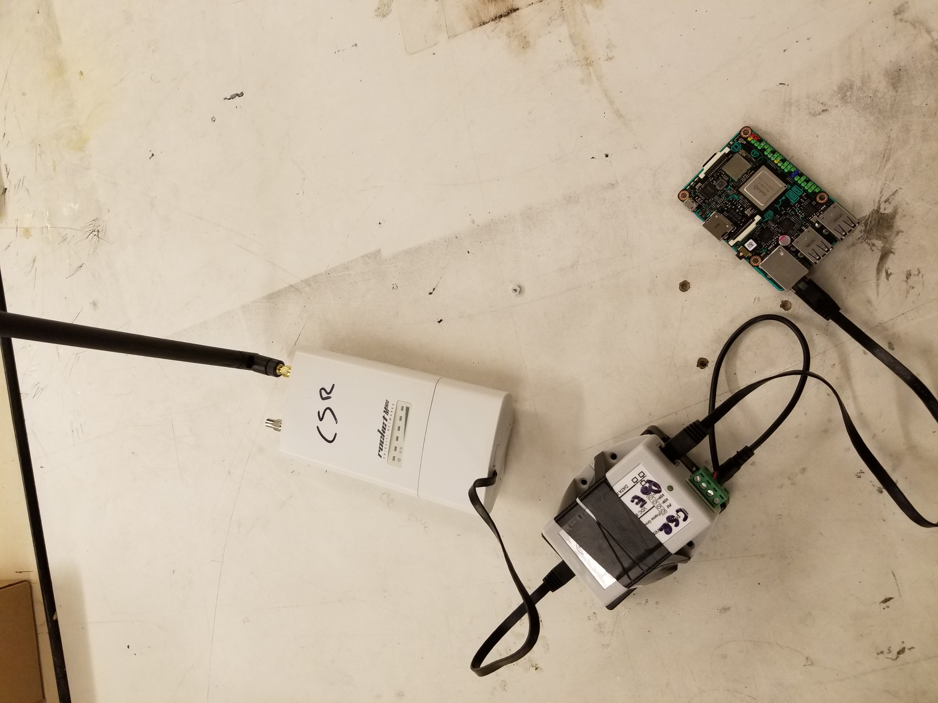
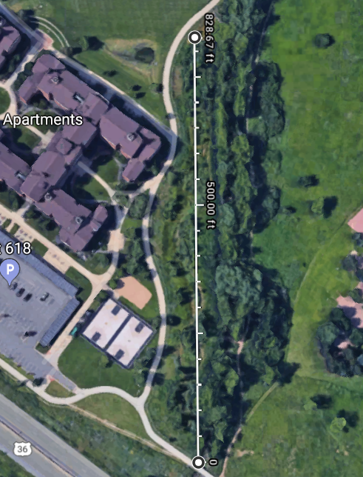
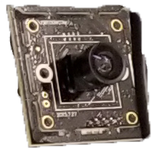
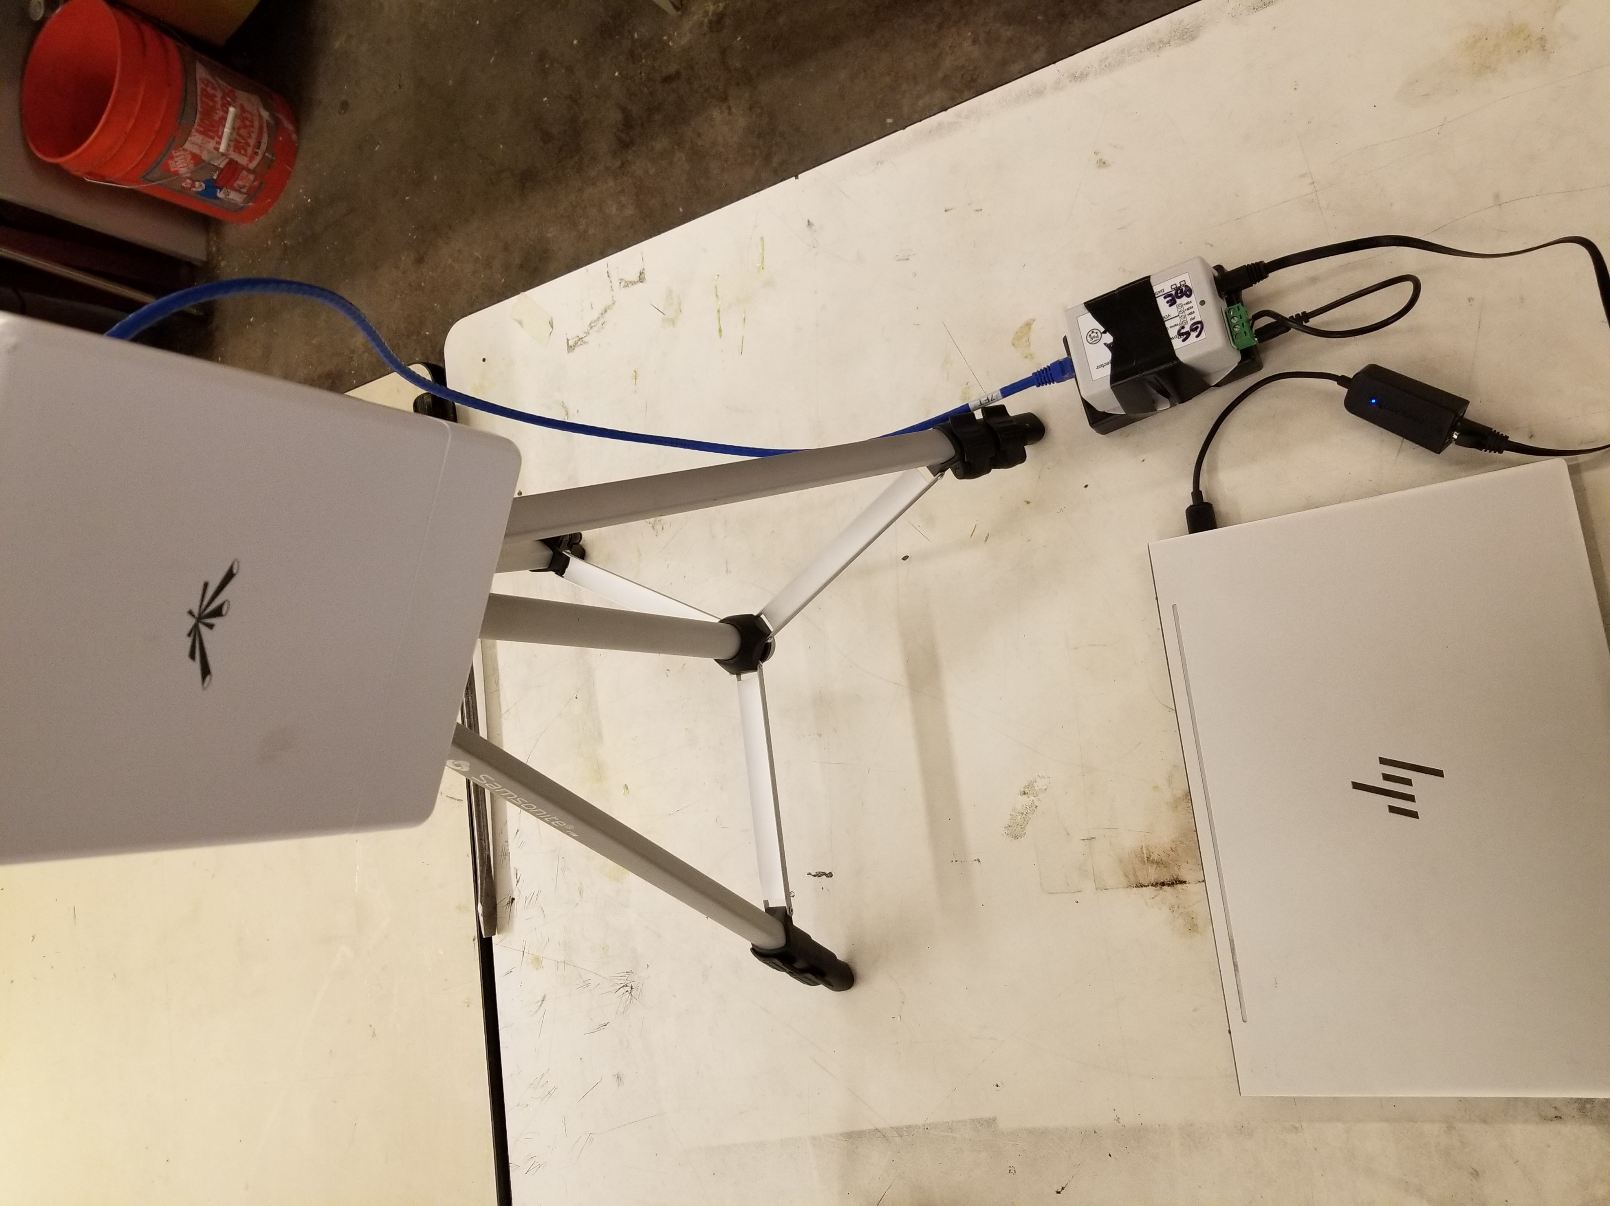
Communications – Test Design
Child Scout Rover
Test Location:
Bear Creek Trail
Testing for:
Video stream delay
Distance between radios
Bandwidth consumption
Key Variables:
Received signal strength
Latency of communication
Transmission rate
Procedure:
Deploy GS equipment at distance 0 ft (0 m) and deploy CSR equipment at 828 ft (252.37 m)
Transmit in open area (no trees), then transmit in tree area
Transmit video and simulated sensor data from the CSR to the GS
CSR Radio
CSR Camera
CSR POE
CSR ASUS
828 ft
(252.37 m)
Comm. Link
GS Radio
GS POE
GS Laptop
Ground Station
Notes:
Key variables distance
Testing for latency
The design of the test fixtures
What test equipment and facilities are needed
What results do we expect?
An overview of the test procedures
Critical elements of the design

Slide 26
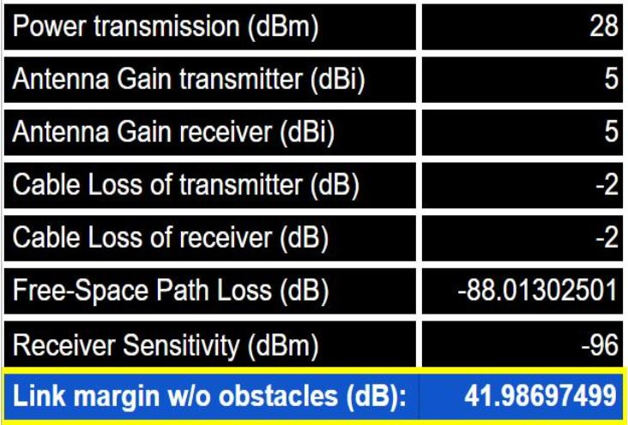
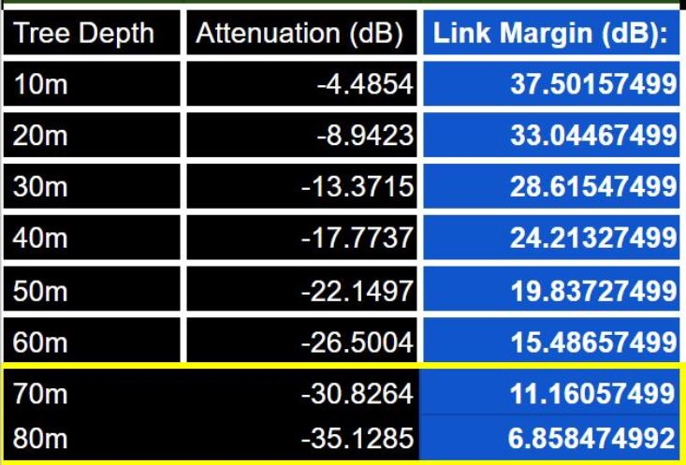
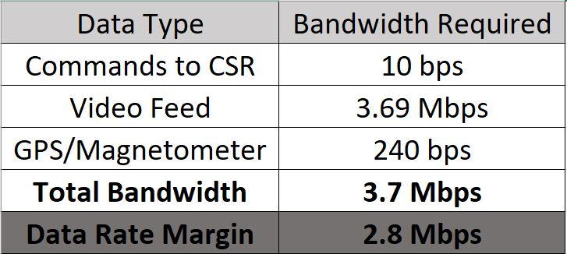
Communications – Model
Link Budget:
Needed a link margin of 10 dB in open areas and in tree areas
Maximum tree depth allowed is 70 m
Data Budget:
Data being sent for only commands, video stream, and magnetometer heading
Grayscale image to reduce bits per pixel
640x480, 30 FPS
Maximum data rate for our radios is ~6.5Mbps
Open Areas
Tree Areas
Model Assumptions:
Downlink and uplink parameters are equal
The Radio Science Model used is a reliable source to calculate attenuation due to trees
(“Radio wave propagation through vegetation: Factors influencing signal attenuation” Radio Science, Vol. 38, No.5. Retrieved from https://agupubs.onlinelibrary.wiley.com/doi/pdf/10.1029/2002RS002758)
Notes:
Validation of Model –Does it work?
Verification of Model - How well does it work?
Test Results
Critical elements of the design

Slide 27
Communications – Model Validation
Overall goal is to receive a signal strength above the radio’s receiver sensitivity which is -96 dBm
Meeting a 10 dB link margin then requires a received strength of no less than -86 dBm
Tree Area Test:
Average Transmission Rate: 3.264 Mbps
Standard Deviation of the Mean: 0.077 Mbps
Tree Separation: 12.25 ft
Results
Minimum recorded signal strength was -86 dBm to meet a 10 dB link margin. Passes Comm 1.1.
Transmission rate supported live video stream. Passes Comm 2.3.
Video latency increased as distance increased.
Notes:
Validation of Model –Does it work?
Verification of Model - How well does it work?
Test Results
Critical elements of the design

Slide 28
Power – Scope and Status
Purpose:
To validate the mobility power model to ensure a mission can be completed successfully.
Requirements being validated:
POW 3.1: The CSR Power system shall provide at least 5400 mAh to the CSR
Status:
COMPLETED & PASSED
Risk Reduction:
Test estimates mission duration and ensures the LiPO battery will not be over-discharged during mission

Slide 29
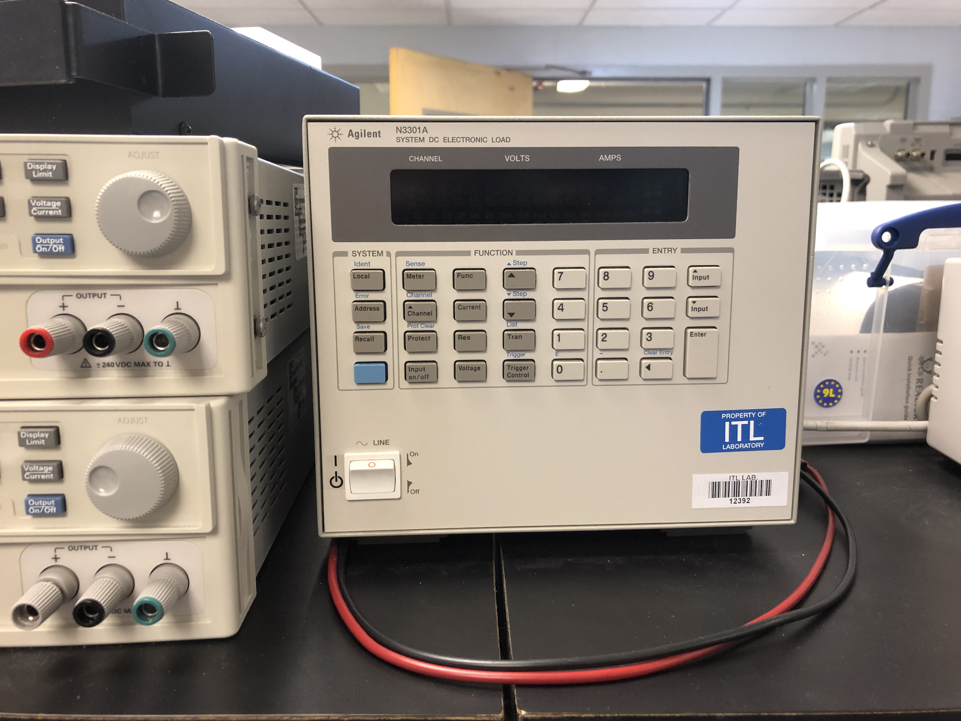
Power – Test Design
Key Variables:
Constant Current
Testing for:
Battery life of 60 minutes
Equipment:
7500 mAH, 100C LiPO battery
Agilent N3301A DC Electronic Load
Procedure:
Set the Agilent N3301A DC Electronic Load to continuously pull 5.4 A current from the battery
Attached fully charged LiPO battery Electronic Load Tester
Recorded voltage measurements every 30 seconds
Stopped test when voltage readings drop to threshold voltage (12V)
Agilent N3301A DC Electronic Load
Notes:
Held constant current, tested time. Talk more about the variables
The design of the test fixtures
What test equipment and facilities are needed
What results do we expect?
An overview of the test procedures
Critical elements of the design

Slide 30
Power Model
Legend Red = 1 min Incline Slope Blue = Flat Ground Purple = 4 Second Obstacle Traversal
22,860 mA
Using power model on dirt
Integrate power spikes, gives I_{avg}
11,200 mA
5.4 A
3000 mA
Total Current Consumption = 5.4Ah
Notes:
Still working on it, we had a few changes
-40 minute mock mission, when we integrate over all of these obstacle durations

Slide 31
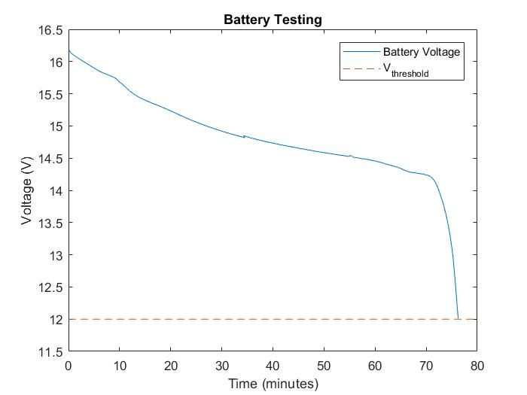
Power– Model Validation
Description of Model:
Battery was discharged at a constant current of 5400 mA (I_{avg}) to determine the maximum mission duration
Model Assumptions:
Average current being drawn
Test Results:
Measured mission duration ~ 76 minutes > Desired mission duration = 40 minutes (1 hour with F.O.S)
Performance exceeded expectations by 16 minutes
Notes:
Validation of Model –Does it work?
Verification of Model - How well does it work?
Test Results
Critical elements of the design

Slide 32
Sensing – Scope and Status
Purpose:
Determine the accuracy of all sensors (360° LiDAR, Single beam LiDARs, Ultrasonic sensors, GPS, and Magnetometer)
Requirements being validated:
SENS 3.1.2: The CSR Sensing system shall detect objects at least 1 inch wide
SENS 3.2: The CSR Sensing system shall detect discontinuities at least 2.4 inches (6.1 cm) deep
CDH 3.3: The CSR C&DH system shall determine if the CSR is within +/- 5 meters of the location of interest
CDH 3.4: The CSR C&DH system shall determine the heading of the CSR
Status:
Single beam LiDARs, Ultrasonic sensors, GPS, Magnetometer tests - COMPLETED & PASSED
360° LiDAR test - TO BE COMPLETED 3/7
Risk Reduction:
LiDAR and Ultrasonic accuracy measurements ensure obstacles and discontinuities can be detected at correct distance so CSR can stop in advance
GPS and magnetometer accuracies ensure the CSR is able to reach LOI within desired +/- 5 m

Slide 33
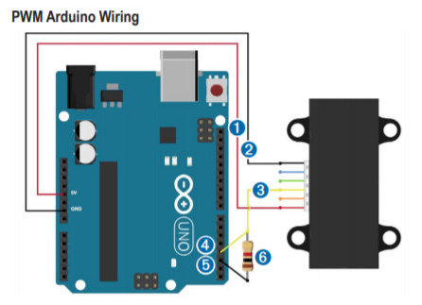
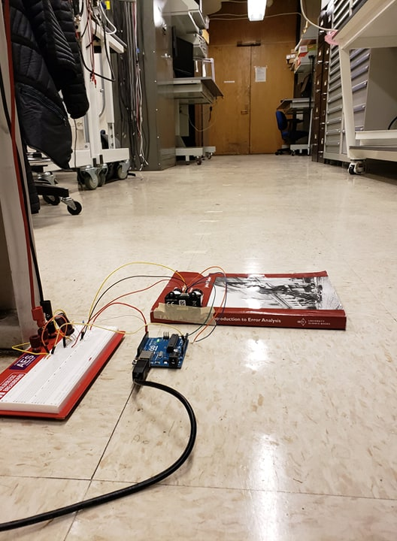
Single Beam LiDAR – Test Design
Key Variables:
Distance reading from LiDAR
Testing for:
Accuracy of lidar
Equipment:
Single beam LiDAR, Arduino Due, breadboard, power source, 1 KΩ resistor, 1 680 µF capacitor
LiDAR Lite V3 Arduino Setup
LiDAR Lite
0
Procedure:
Set up LiDAR in combined I2C and PWM setup on breadboard and connect to power source
While recording LiDAR data, hold notebook in front of LiDAR for 10 seconds at distances of 1 m increments
Find average and std of measurements at each distance and subtract the actual distance to determine error
Circuit
Arduino Uno
Notes:
Held constant current, tested time. Talk more about the variables
The design of the test fixtures
What test equipment and facilities are needed
What results do we expect?
An overview of the test procedures
Critical elements of the design

Slide 34
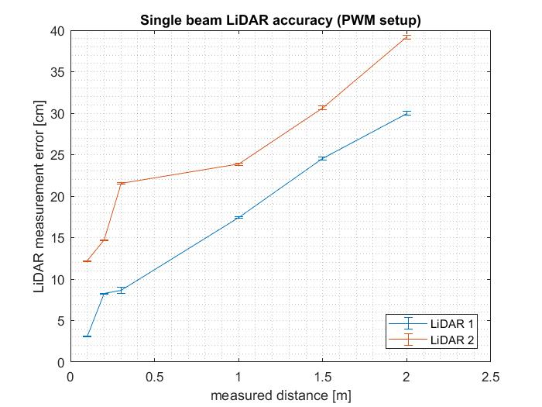
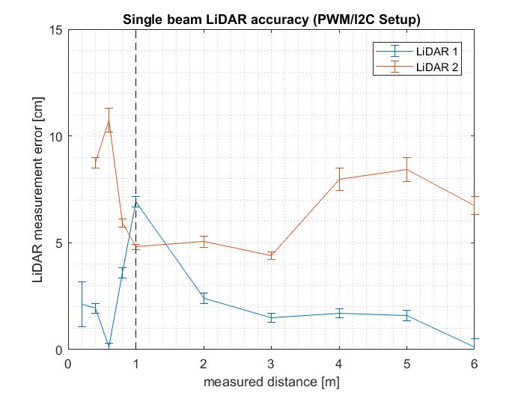
Single Beam LiDAR – Performance Characterization
Sensor | Required Accuracy | Rationale | Measured Accuracy
Single beam LiDAR | Error must be < 23.7 cm (9.3 in) in ideal conditions | To detect a 22.9 cm (9 in) wide discontinuity | Error at 1 m: LiDAR 1: 6.91 cm +/- 0.25 cm LiDAR 2: 4.81 +/- 0.12 cm
2.4 in
9.3 in
9 in
After setup revision
Notes:
Validation of Model –Does it work?
Verification of Model - How well does it work?
Test Results
Critical elements of the design

Slide 35
Sensing– Performance Characterization
Sensor | Required Accuracy | Rationale | Measured Accuracy
GPS | Error must be < 5 m | Requirement based | Without correction: 1.26 +/- 0.1 m With correction: 1.79 +/- 0.1 m
Magnetometer | 2.29° < accuracy < 18.32° | To reach an LOI from: 250 m < 31 m | +/- 1.27° accuracy
Ultrasonic sensor | Error < 6.1 cm (2.4 in) | In order to detect a discontinuity | 0.05 cm error at 6.1 cm (2.4 in)
Notes:
Validation of Model –Does it work?
Verification of Model - How well does it work?
Test Results
Critical elements of the design

Slide 36
360° LiDAR - Test Design
Testing for:
Angular measurement error
Distance measurement error
Key Variables:
Shape of objects
Size of objects
Measured distance
Procedure:
Procure objects and secure on cutting mat in pre-calculated locations
Secure RPLIDAR at a desired measuring distance
Perform 10 seconds of scans at 5 Hz to capture distance measurements of 50 scan frames
Calculate angular measurement and distance measurement error for each expected measurement per scan
Overlay captured data on expected results
Rock
Cylinder Objects
A > 1 in
A
Square Cardboard box
B
B = 1 in
C < 1 in
C
Gridded Cutting Mat
Desired Measuring Distance
Adjustable
Distance
Measurement Angle
360 ° LiDAR
Facility: Lockheed Martin Room
Notes:
Reformat with emphasis on purpose, variables,measurements, etc.
The design of the test fixtures
What test equipment and facilities are needed
What results do we expect?
An overview of the test procedures
Critical elements of the design

Slide 37
360° LiDAR - Test Design
Testing for:
Angular measurement error
Distance measurement error
Key Variables:
Shape of objects
Size of objects
Measured distance
Rock
Cylinder Objects
A > 1 in
A
Square Cardboard box
B
B = 1 in
C < 1 in
C
Gridded Cutting Mat
Desired Measuring Distance
Recorded data point could have distance measurement error
Adjustable
Distance
Measurement Angle
360 ° LiDAR
Zoomed in View
= Expected LiDAR Data point
= Recorded LiDAR Data point
Notes:
Reformat with emphasis on purpose, variables,measurements, etc.
The design of the test fixtures
What test equipment and facilities are needed
What results do we expect?
An overview of the test procedures
Critical elements of the design

Slide 38
Phase 2 Tests

Slide 39
Hardware Integration – Scope and Status
Purpose:
To determine if the software modes work with the integrated hardware (motor, ASUS, Arduino DUE). This will be done by comparing commanded versus measured motor speeds.
Requirements being validated:
CDH.1.1: The CSR C&DH software shall identify the intended receiving subsystem (i.e. Mobility, Sensing, Communication) for received commands
CDH.1.2: The CSR C&DH software shall distribute commands to the intended receiving subsystem (i.e. Mobility, Sensing, Communication)
Status:
TO BE COMPLETED before 3/17
Risk Reduction:
Verifying the integration of hardware and software modes allows for further integration between the rest of the modes and hardware

Slide 40
Hardware Integration – Test Design
Testing for:
Linear Velocity
Key Variables:
Software mode
Procedure:
Upload software to ASUS and Arduino DUE
Connect ASUS, Arduino DUE, motor controllers and motors
Command software into various modes where each mode corresponds to a different expected speed
Measure the speed at each mode with the encoders
Serial Command
ASUS
Arduino DUE
Mode 1
Mode 2
Mode 3
Motor Controller
0 m/s
.5 m/s
1 m/s
Motors
Measurement
Encoders

Slide 41
Hardware Integration – Performance Characterization
Expected Results
Measured velocity should match the commanded velocity
Commanded velocity is based on no load lab testing measurements
Performance characterized by how closely commanded velocity matches expected RPM and linear velocity
The software mode will be verified based on the measured and commanded speed of the motors
Equipment
ASUS, Arduino DUE, motor controllers and motors, external power supply or mobility battery, keyboard and monitor
Facilities
Trudy’s Lab

Slide 42
Phase 3 Tests

Slide 43
Day In The Life Test (DITLT)
1
2
3
4
5
6
Receive Location of Interest (LOI) from GS
User commands CSR to point towards LOI
User commands CSR into semi autonomous mode
CSR travels up a 20 ° slope
The CSR detects a discontinuity and stops
The CSR crosses the discontinuity after being commanded to from the GS
Ground
Station
5
1
6
4
3
Child Scout Rover
1.42 m
20º Slope
.953 m
2
Legend
Length of CSR + .953 m
Length of CSR
Mission Terrain
Up to a 9 in wide, with a depth greater than 2.4 in
Plywood pieces stacked up to be 2.4 in. Inclined piece of plywood allows for a 20 ° slope
Pathpoint
Requirements
Stop and request user intervention
Functions
Comm between GS and CSR
LIDAR sensor
October 2018
Manually controlled path
25 meters from deployment point to LOI
* Lengths not to scale
Autonomously controlled path

Slide 44
Day In The Life Test (DITLT)
7
8
9
10
The CSR will encounter an obstacle and stop
The user will take control, and manually control the CSR around the obstacle
Every time the CSR turns, a pathpoint is recorded
After traveling around the obstacle, the user commands the CSR to point towards the LOI, and commands it into semi- autonomous mode
The CSR will travel towards the LOI, until it arrives within a 5 m radius. It will then stop and alert the GS
Cardboard Box
Each test will be individually tested between:
March 17th – April 9th
The full system test will be conducted between:
April 10th – April 20th
7
9
10
.953 m
LOI
5m
9
8
Legend
Mission Terrain
8
Pathpoint
Stop and request user
intervention
Comm between GS and CSR
LIDAR sensor
25 meters from deployment point to LOI
* Lengths not to scale
Manually controlled path
Autonomously controlled path

Slide 45
Safety
Safety Risk | Mitigation | Procedure
Lose control of mobility system | Kill switch implementation | Operations
Over-discharge of battery | Check battery levels before and between tests | Operations
Circuit shortages | Ensure power is off until connections have been verified | Operations
Temporary electronics housing, metal components in contact with baseplate | Secure to CSR with adjustable Velcro/tape only on acrylic platforms | Operations
Hazards to exposed connections in testing phase | Tape all connections | Operations
Non-wireless communication USB cord | Have a member hold the USB above CSR and be cautious, do not let the cord drag or rapidly turn CSR | Operations
Damage when transporting CSR | Use the mobile toolbox when transporting the CSR | Transportation
Safety of team members | Must be able to carry up to 40 lbs, must wear closed toed shoes, carry only from middle two wheels | Transportation
Note: Blue means emphasis

Slide 46
Budget

Slide 47
Cost Plan
Subsystem Expenses
Mobility - $2255.71
Sensing - $1266.73
Comms - $731.00
CDH - $113.39
Power - $295.87
Misc - $120
Expenses to Date: $5254.49
Original Budget: $5000.00
Budget w/ EEF Funds: $6000.00
Remaining Funds: $745.51

Slide 48
Cost Plan
Major Procurements
Mobility – Motors, Wheel, Chassis
Communication – Radios, Long Range Antennas
Power – Mobility System Battery, Testing Materials
CDH – Arduino Due, ASUS Computer
Sensing – 360 LiDAR, Single Beam LiDARs, Cameras, Replacement LiDAR
Future Procurements
360 LiDAR test set-up, DITLT Testing Materials (~$100)

Slide 49
Notes:
Can add video of the CSR driving

Slide 50
Project Heritage
The Jet Propulsion Laboratory’s Fire Tracker System is a system that is designed to be a low-cost, hands-off approach to forest fire identification.
There have been three previous years of heritage:
INFERNO (2015-2016)
- Built a semi-autonomous drone capable of transporting and deploying sensor packages
CHIMERA (2016- 2017)
- Built a landing, securing, and deployment system for the inherited semi-autonomous drone from INFERNO
DRIFT (2017-2018)
- Developed a mother rover to secure, carry, and level the semi-autonomous drone from INFERNO using the landing platform from CHIMERA
Note: Blue used for emphasis
Notes:
Wingate: take this out

Slide 51
Definitions
Pathpoint – A point after a mobility command is received and executed by the CSR.
This point is recorded onboard the CSR and sent to the GS as a GPS coordinate.
An operator from the ground station initially issues the command.
Previously referred to as ‘waypoint’, and changed for clarity
Obstacle – Roots, trees, rocks, shrubs, and inclined slopes with type A terrain (only leaves are present on type A terrain)
Traversable Obstacles
Any root or rock less than 2.4 inches (6 cm) - (6 cm is based on average root diameter from ‘Tree Root Systems’ from the Arboricultural Advisory and Information Service)
Non-Traversable Obstacles
All trees
All shrubs
All roots and rocks greater than 2.4 inches
Discontinuity – A 9 inch wide gap with a depth larger than 2.4 inches. The width was previously 12 inches, however a model proved that the MR could only cross a 9 inch discontinuity (.229 m).
Note: Blue used for emphasis

Slide 52
Terrain Definition

Slide 53
CONOPS: Loss of Comms
1
2
3
4
5
6
CSR detects no comms
CSR initiates last recorded pathpoint as a new temporary LOI
CSR turns to point towards new temporary LOI
CSR proceeds to travel towards new LOI
Upon arrival it will stop, and wait for acquisition of communications
Upon acquisition of signal, the operator takes control of the CSR
Ground
Station
6
2
Last recorded Pathpoint
=
Temporary location of Interest
5
1
=
4
Front of CSR
Front of CSR
Front of CSR
Child Scout Rover
Legend
3
Mission Terrain
Pathpoint
Stop and request user intervention
Requirements
Comm between GS and MR
Functions
Comm between GS and CSR
Comm between CSR and MR
October 2018
Manually controlled path
53
Autonomously controlled path

Slide 54
Power Model Visualization
Obstacle Totals:
Current Draw: 22,860 mA
Time 2 min
Required Capacity: 762 mAh
Flat Ground Totals:
Current Draw: 3000mA
Time 52 min
Required Capacity: 2600mAh
Slope Totals:
Current Draw: 11200 mA
Time 6 min
Required Capacity: 1120 mAh
x30
x6
30 obstacles 2.4 inches in height
4 seconds per obstacle
Flat ground
52 min on gravel and dirt
Six 20 ° inclined slopes
1 minute per slope
Total Required Capacity: 5400 mAh

Slide 55
Additional Testing

Slide 56
Coefficient of Friction

Slide 57
Test – Scope and Status
Purpose: Determine whether the coefficient of friction of the wheels meets the expected values for the mobility models.
Requirements being validated:
MOB 3.3: The CSR shall drive up or down a slope of up to 20 °s.
MOB 3.4.1: The CSR shall drive over an traversable obstacle up to 2.4 inch (0.06096 m) in height.
Status: Completed tests using unmodified wheels.
Risk Reduction: Validate models and coefficient range to ensure that the CSR can traverse terrain easily and without fatal slippage

Slide 58
Test – Test Design
Facilities: Bobby's Lab
Equipment:
2x4 Wood Planks
Brick
100 lbf scale, +/- 0.1 lbf accuracy
CSR without chains installed
Analog force gauge, 0.1 lbf accuracy
Procedure:
Place test material (wood or brick) onto scale
Tear the scale to set to 0 in order to only read the force from the CSR
Place the front wheel from the CSR onto the scale
Place excess wood under the remaining wheels to level the CSR
Record the weight on the scale
Add excess weight to the CSR and record scale again
Attach the force gauge with a string to the bottom axel of the wheel
Slowly pull the gauge parallel to the floor until slippage occurs and record force.
Expected Results:
µwood =0.7, µbrick =0.7
Weight
CSR
Force Gauge
Wood
Brick
Wood
Scale
Notes:
The design of the test fixtures
What test equipment and facilities are needed
What results do we expect?
An overview of the test procedures
Critical elements of the design

Slide 59
Test – Model Validation
Description of Model: The coefficient of friction was used to run the torque and power analysis of the CSR travelling over various terrains (flat ground, slopes, traversable obstacles.)
Model Assumptions: Assuming coulombic friction.
Test Results:
The coefficient of friction of brick well surpassed the estimated value of 0.6. The coefficient of friction of the wood averaged to be 4% lower than the estimated value. However, there was also significant deviation based on the orientation of the wood. Moving forward, the tires will be modified by slitting the rubber to increase traction.
 | Wood | Brick
Mean | 0.67 | 1.3
Standard Deviation % | 27% | 8.7%
Notes:
Validation of Model –Does it work?
Verification of Model - How well does it work?
Test Results
Critical elements of the design

Slide 60
Encoders

Slide 61
Test – Scope and Status
Purpose:
Characterize motor controller defined speed range in terms of meters-per-second,
Track the speed of each motor to maintain constant speed over obstacles
Status:
Completed characterization for all speeds

Slide 62
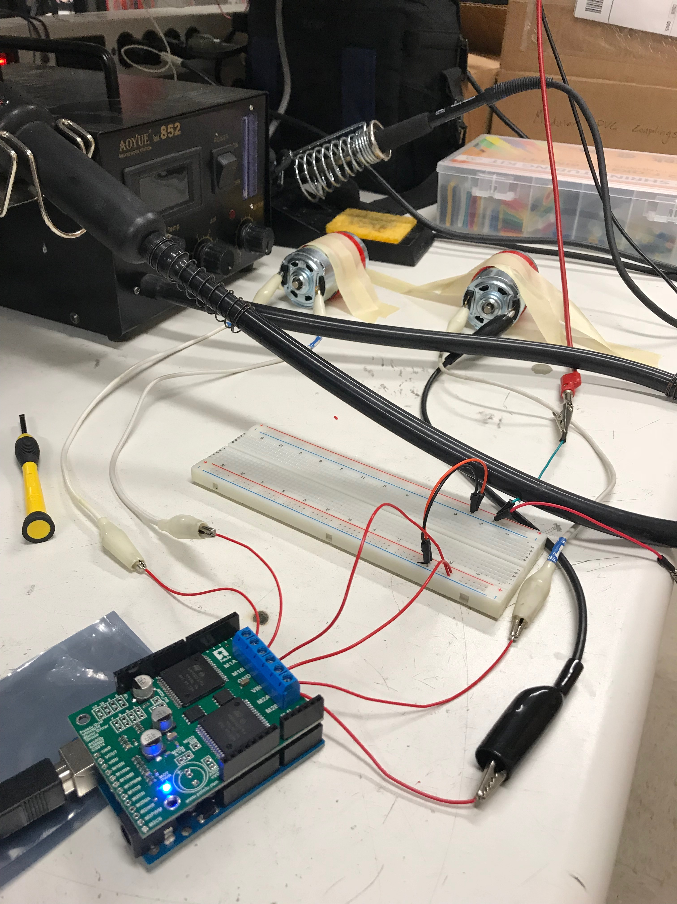
Test – Test Design
Facilities: Trudy's lab
Equipment: Motor controller, Arduino Due, AndyMark Motors, AndyMark Encoder, 10A Power Supply
Procedure:
Mount motor controller on arduino due
Mount encoders on motors
Wire encoders to Due (+5V, GND, 2 Digital Pins)
Run code to drive motors
Serial input for different speeds
Track readings on arduino serial monitor
Expected Results: Current supplied to motors and encoder reading in RPS
Notes:
The design of the test fixtures
What test equipment and facilities are needed
What results do we expect?
An overview of the test procedures
Critical elements of the design

Slide 63
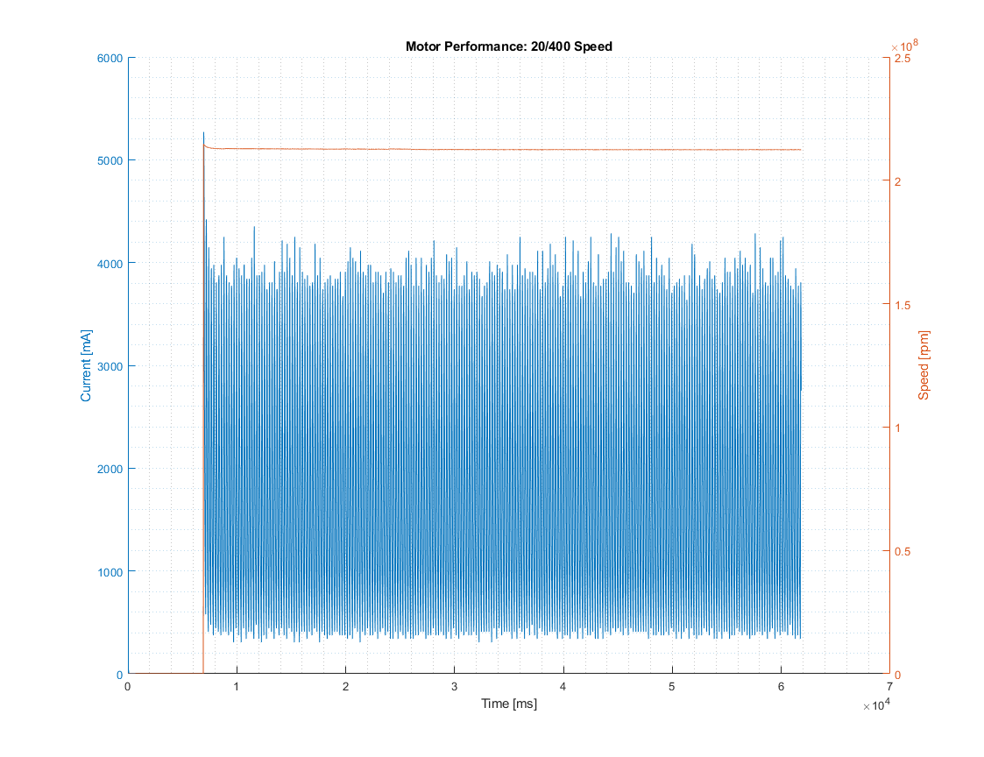
Test – Model Validation
Description of Model: Two points 90 °s from each other about the shaft of the motor. One can track the speed of the motor by tracking the time it takes for a point on the motor to pass one of these tracking points.
Model Assumptions: No noise
Validation of Model:
Test Results:
Encoder 1:
Reaches noisy steady state within 1 minute of motor startup
Encoder 2:
Reaches steady state within 1 minute of motor startup without noise
Notes:
Validation of Model –Does it work?
Verification of Model - How well does it work?
Test Results
Critical elements of the design

Slide 64
Encoder Plots

Slide 65
GPS

Slide 66
Test – Scope and Status
Purpose:
Ensure the GPS is meeting its accuracy requirements
Requirements being validated:
CDH 3.2: The CSR C&DH system software shall store the Location of Interest’s GPS coordinates in memory.
CDH 3.3: The CSR C&DH system shall determine if the CSR is within +/- 5 meters of the location of interest
Status: COMPLETED
Risk Reduction:
Verifies the GPS is accurate enough before final testing so the CSR can meet the requirement of reaching the LOI within +/- 5 meters

Slide 67
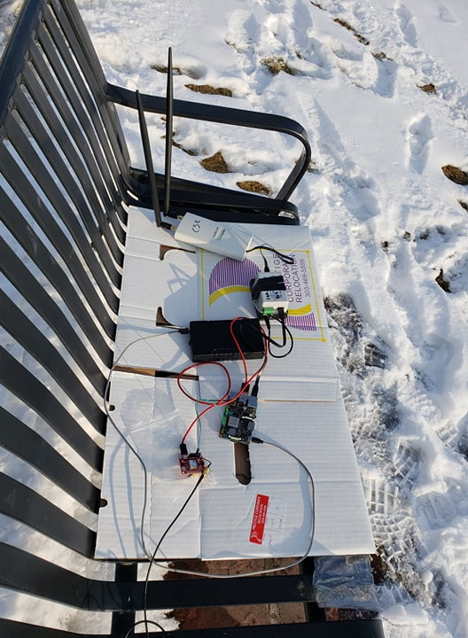
Test – Test Design
Equipment:
GPS, ground station, ASUS Tinker board, Arduino Due, GPS RTK modules and antennas
Procedure:
Set up GPS, antennas, ASUS, and ground station
Place the GPS at a location that can be verified by google maps. Measure the GPS reading 50 times and take the mean and std of the results
Compare GPS and google maps reading to determine accuracy
Expected Results:
GPS expected to have accuracy of at least +/- 5 m
GPS "with correction" expected to be more accurate than GPS "without correction"
Results:
GPS accuracy without correction: 1.26 +/- 0.1 m
GPS accuracy with correction: 1.79 +/- 0.1 m
Ground station
GPS setup with antennas
Notes:
The design of the test fixtures
What test equipment and facilities are needed
What results do we expect?
An overview of the test procedures
Critical elements of the design

Slide 68
Ultrasonic

Slide 69
Test – Scope and Status
Purpose:
Determine the accuracy of the Ultrasonic sensor
Requirements being validated:
SENS 3.2: The CSR Sensing system shall detect discontinuities at least 2.4 inches (6.1 cm) deep
Status: COMPLETED & PASSED
Risk Reduction:
Ultrasonic accuracy measurements ensure obstacles and discontinuities can be detected at correct distance so CSR can stop in advance

Slide 70
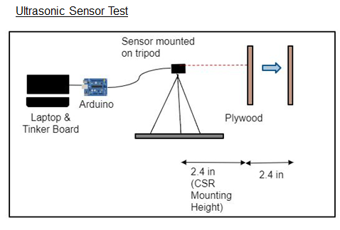
Test – Test Design
Facilities:
Trudy's lab
Equipment:
Laptop, Arduino Due, Ultrasonic sensors, plywood, (tripod optional)
Procedure:
Place the plywood at measured distance from the ultrasonic sensor
Record the output reading from the ultrasonic sensor and compare with measured distance to find ultrasonic accuracy
Expected Results:
Ultrasonic sensor should have an accuracy of at least 2.4 in (6.1 cm)
Notes:
The design of the test fixtures
What test equipment and facilities are needed
What results do we expect?
An overview of the test procedures
Critical elements of the design

Slide 71
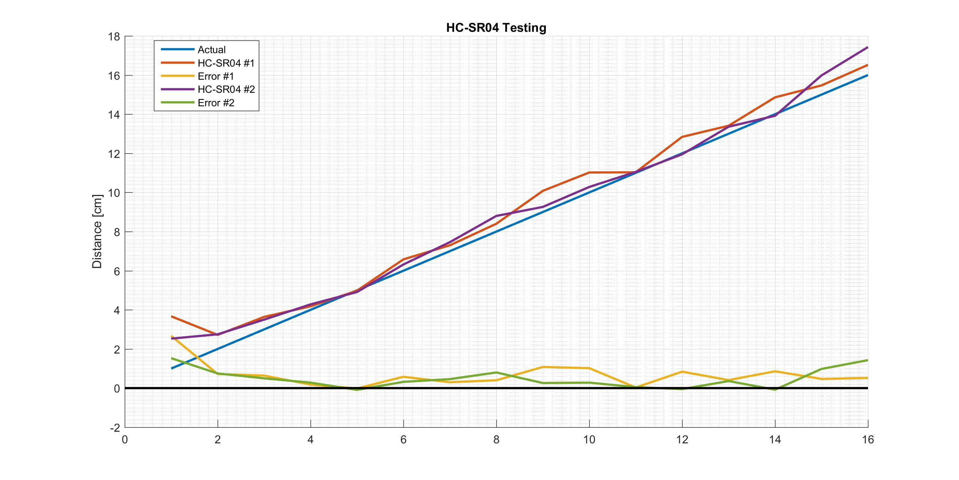
Test – Test Results
Ultrasonic sensor error is 0.05 cm at 6.1 cm (2.4 in) < required 6.1 cm (2.4 in) error
Distance [cm]
Notes:
Validation of Model –Does it work?
Verification of Model - How well does it work?
Test Results
Critical elements of the design

Slide 72
Magnetometer

Slide 73
Test – Scope and Status
Purpose: Verify the magnetometer can report a heading within a specific accuracy of the actual heading.
Requirements being validated:
CDH.3.4: The CSR C&DH system shall measure heading within 2.39 degrees of the actual heading
Status:
Reports to required precision
Reports inaccurate heading

Slide 74
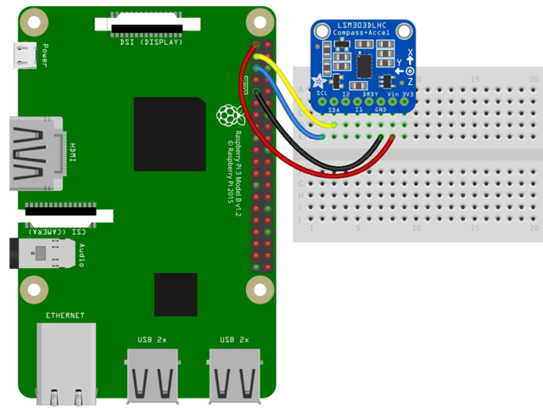
Test – Test Design
Facilities: Senior Projects Room
Equipment:
Raspberry Pi 3B
Adafruit LSM303 Magnetometer/Accelerometer
5V USB Power Supply
Procedure:
Wire Raspberry Pi to monitor and power supply
Wire LSM303 to Raspberry Pi per hookup schematic
Run heading read-in script and record results
Expected Results:
Reports due south (180degrees) to within +/- 2.39 degrees
Pi 3v3 to sensor VIN
PI GND to sensor GND
PI SCL to sensor SCL
PI SDA to sensor SDA
Notes:
The design of the test fixtures
What test equipment and facilities are needed
What results do we expect?
An overview of the test procedures
Critical elements of the design

Slide 75
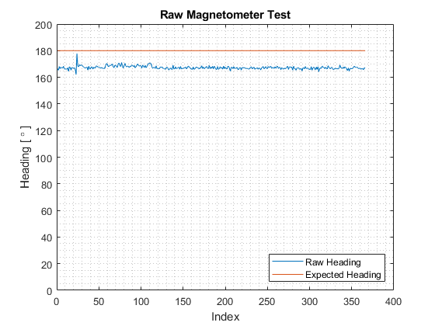
Test – Model Validation
Notes:
Validation of Model –Does it work?
Verification of Model - How well does it work?
Test Results
Critical elements of the design

Slide 76
Motor Test

Slide 77
Test – Test Design
Facilities: Trudy's Lab
Equipment:
Motor Controller
(2x) Motors
Arduino Uno
Power Supply (10A)
Expected Results:
Forward command turns motors in same direction
Turn command turns motors in opposite direction
Backward command turns motors in same direction
Notes:
The design of the test fixtures
What test equipment and facilities are needed
What results do we expect?
An overview of the test procedures
Critical elements of the design

Slide 78
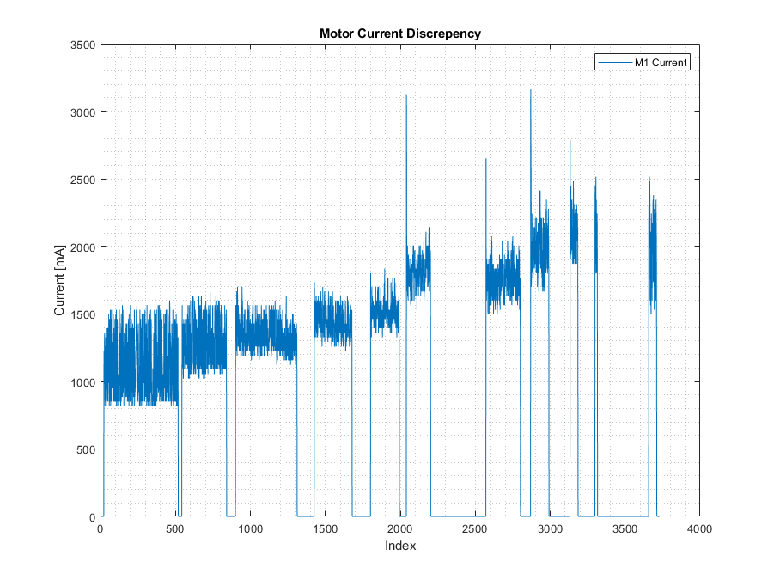
Test – Model Validation
Notes:
Validation of Model –Does it work?
Verification of Model - How well does it work?
Test Results
Critical elements of the design

Slide 79
Linear Moving Mass Test

Slide 80
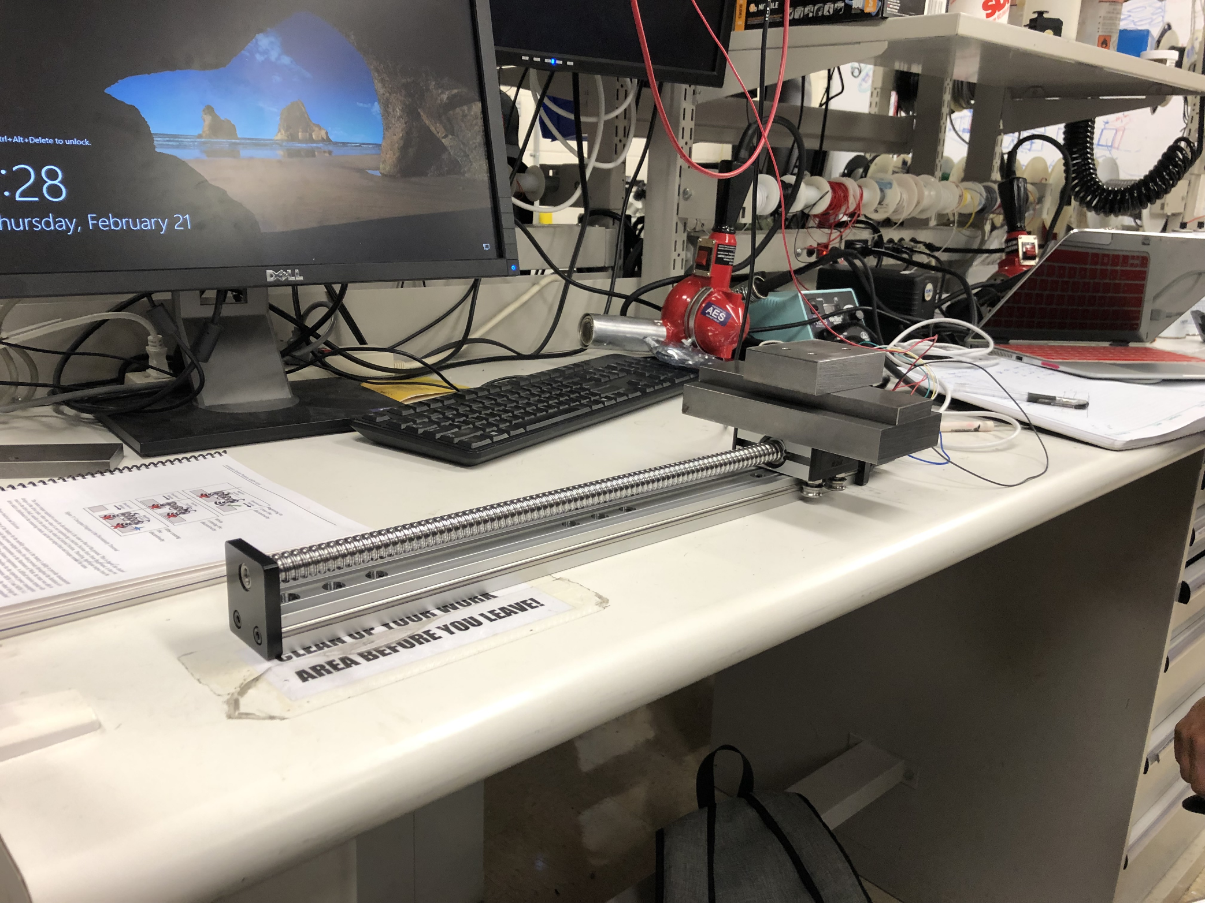
Test – Test Design
Facilities: Trudy's Lab
Equipment:
Linear Mass Stager
Linear Mass Controller
Multimeter
Power Supply (15 V)
5kg Steel Mass Configuration
Procedure:
Control moving mass from one end of stage to to the other; repeat 3 times
Results:
Maximum current consumption was 0.40 Amps
Average time for mass transition = 60 seconds
Backward command turns motors in same direction
Notes:
The design of the test fixtures
What test equipment and facilities are needed
What results do we expect?
An overview of the test procedures
Critical elements of the design

Slide 81
Single Beam LiDAR

Slide 82
Test – Test Design
Facilities: Trudy's lab
Equipment:
Single beam LiDAR, Arduino Due, breadboard, power source, 1 KΩ resistor, 1 680 µF capacitor
Procedure:
Set up LiDAR in combined I2C and PWM setup on breadboard and connect to power source
While recording LiDAR data, hold notebook in front of LiDAR for 10 seconds at distances of 1 m increments
Find average and std of measurements at each distance and subtract the actual distance to determine error
Expected Results:
Single beam LiDAR accuracy less than 23.7 cm (9.1 in)
The given PWM Arduino wiring produced very inaccurate results
The given I2C Arduino wiring did produced "not acknowledging" errors
Combining the I2C and PWM Arduino wirings yielded accurate data
Realized the Arduino UNO was producing accurate LiDAR readings but the Arduino DUE was not
Notes:
The design of the test fixtures
What test equipment and facilities are needed
What results do we expect?
An overview of the test procedures
Critical elements of the design

Slide 83
Test – Test Results
Sensor | Required Accuracy | Rationale | Measured Accuracy
Single beam LiDAR | Error must be < 23.7 cm (9.3 in) in ideal conditions | To detect a 22.9 cm (9 in) wide discontinuity | Error at 1 m: LiDAR 1: 6.91 cm +/- 0.25 cm LiDAR 2: 4.81 +/- 0.12 cm
2.4 in
9.3 in
9 in
After setup revision with Arduino Uno
Notes:
Validation of Model –Does it work?
Verification of Model - How well does it work?
Test Results
Critical elements of the design

Slide 84
ASUS Thermal Test

Slide 85
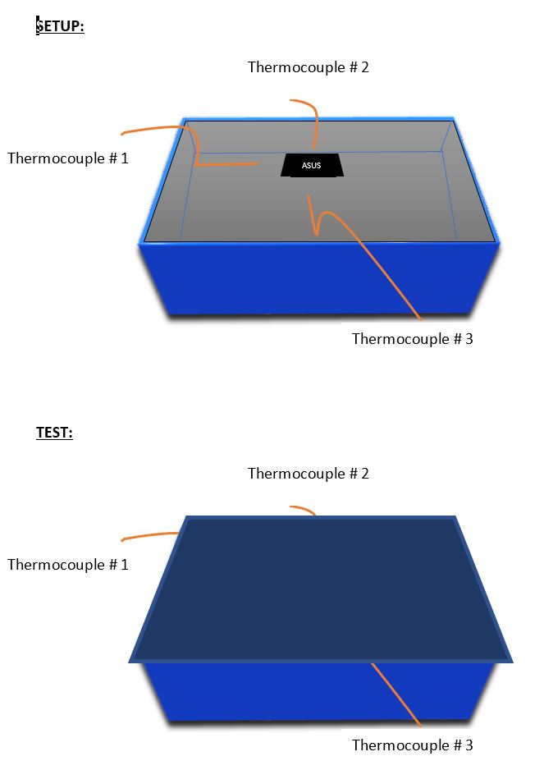
Test – Test Design
Facilities:
Trudy's Lab
Equipment:
ASUS tinker board, shoebox, thermocouples
Procedure:
Run complicated script on ASUS that will cause the component to heat up
Measure the internal temperature with thermocouples at different distances from the ASUS
Expected Results:
Internal temperature of the shoebox should not exceed the maximum working temperature of other internal electronic components (Arduino due, magnetometer, etc.)
Notes:
The design of the test fixtures
What test equipment and facilities are needed
What results do we expect?
An overview of the test procedures
Critical elements of the design

Slide 86
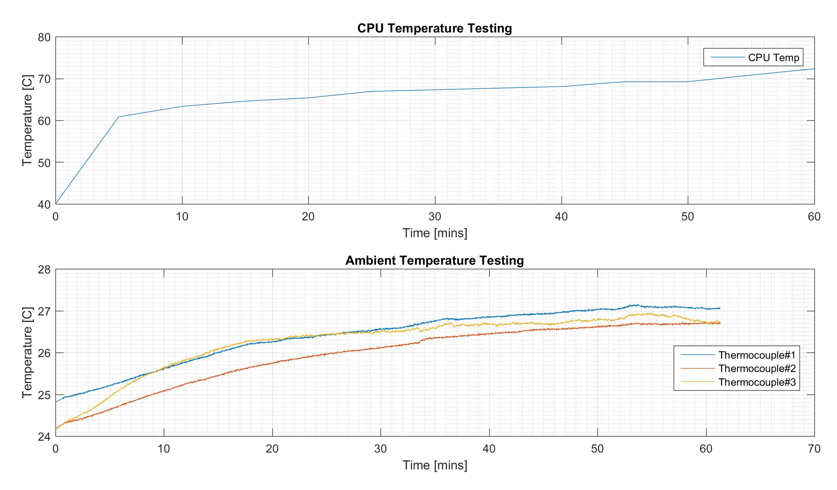
Test – Test Results
Description of Model:
Shown in the right are plots of both CPU temperature and ambient temperature over the test duration
Model Assumptions:
The script being run on the ASUS is more complicated than what will actually be running during our mission
Test Results:
Ambient temperature of the shoebox did not exceed 28 degrees celcius
This temperature does not exceed the maximum working temperature of any other electronic components
For precaution, a heat sink or a fan may be added to the CSR later on
Notes:
Validation of Model –Does it work?
Verification of Model - How well does it work?
Test Results
Critical elements of the design

Slide 87
Sensing Accuracy Summary

Slide 88
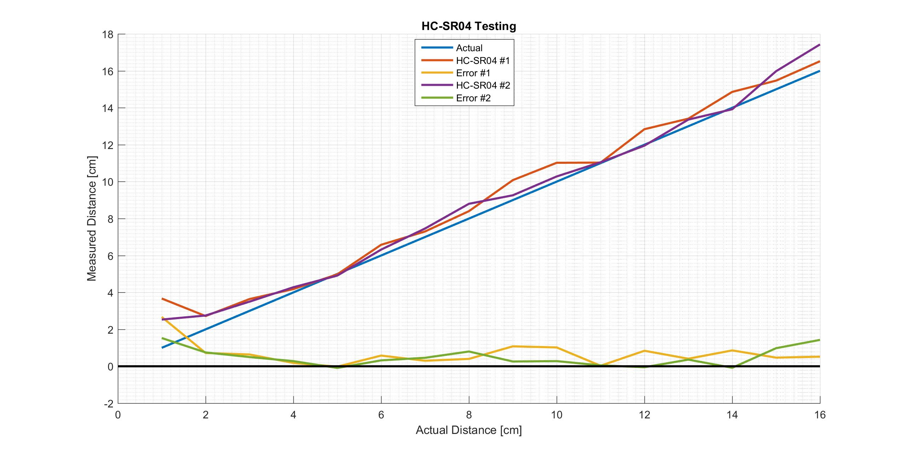
Sensing– Performance Characterization
Required Accuracy | Results
Single beam LiDAR must have an error < 23.7 cm (9.3 in) in ideal conditions to detect a 22.9 cm (9 in) wide discontinuity | Measured Accuracy: Error at 1 m: LiDAR 1: 6.91 cm +/- 0.25 cm LiDAR 2: 4.81 +/- 0.12 cm
Ultrasonic sensor must have an error < 6.1 cm (2.4 in) in order to detect a discontinuity | Measured Accuracy: 0.05 cm error at 6.1 cm (2.4 in)
2.4 in
9.3 in
9 in
2.4 in
2.4 in
9 in
Notes:
Validation of Model –Does it work?
Verification of Model - How well does it work?
Test Results
Critical elements of the design

Slide 89
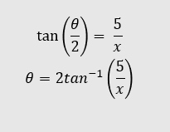
Sensing– Performance Characterization
Required Accuracy | Results
GPS must have an error < 5 m (requirement based) | Measured Accuracy: Without correction: 1.26 +/- 0.01 m With correction: 1.79 +/- 0.01 m
CSR stops at least 8 times (6 slopes, 2 discontinuities) which is ~ every 31 m Magnetometer must have at least an 2.29° < accuracy < 18.32° | Measured Accuracy: STD: 1.27°
LOI
5 m
5 m
x
At x = 250 m, Θ = 2.29°
At x = 31 m, Θ = 18.32°
θ
CSR
Notes:
Validation of Model –Does it work?
Verification of Model - How well does it work?
Test Results
Critical elements of the design

Slide 90
Safety Procedures – Operation Checklist
Check the charge of the LiPo battery before testing
6.
With non-wireless communication, be cautious of the USB cord. Make sure someone is holding it during operation and do not command multiple turns.
1.
In the testing phase: tape all exposed connections
7.
Double check the connections from the battery to the electronics before turning the battery on
2.
Use Velcro to temporarily place all electronics being used on the CSR, making sure that any exposed metal is not touching the baseplate, the middle acrylic plate is a good place to house these in the testing phase
8.
Again double check no metal is touching the baseplate
3.
9.
If the motors begin to stall for any reason, send a ”stop” command
Double check that the battery is secure, this is heavy and likely to move
4.
10.
If the CSR does not respond to a “stop” command, two people must lift the baseplate in the front and back until kill switch is implemented
5.
Tape wires as needs to secure them to the CSR to avoid interference with the drive train
Notes:
Put one of these in the main slides

Slide 91
Safety Procedures - Transportation
1.
Must be wearing closed toed shoes
6.
To protect all extruding parts, orient the front of the CSR with the handle of the toolbox
2.
Must be able to lift 40lbs
7.
Secure the top of the toolbox when transporting outside
3.
Check to ensure mass is in the middle position
8.
Do not place anything over 5lbs on the top of the CSR
4.
Lift the CSR from only the middle two wheels
9.
When removing from the toolbox, again use the middle wheels
5.
The toolbox must be utilized in order to transport the CSR long distances / outside

Slide 92
Offramp – Ultra Sonic Sensors

Slide 93
Offramp Ultra Sonic Sensors
Due to fast progress on Manufacturing, work has begun on the offramp option for Object Detection
Preparation in case 360 LiDAR is not able to be integrated properly
Each sensor only requires one pin (I/O)
2-6 of these Parallax Ultra Sonics Sensors will be used on the CSR for object detection.

Slide 94
Off-Ramp Ultrasonic Lidar, Ground Interference
Ultrasonic
The PING)))™ Ultrasonic Distance Sensor cannot accurately measure the distance to an object if the surface is reflective and has a shallow angle (Θ<45°) such that the sound does not reflect back
The ultrasonic sensor has a conic FOV of 20°, meaning it will hit the ground at this angle and not reflect back to the sensor
The smallest distance this occurs is at 2.25 inches, which is smaller than the 1 meter requirement and thus sufficient (the 1 meter required is the stopping distant requirement for the CSR upon its encounter with an obstacle)
2.4 inches
20°
2.25 inches
Testing procedure to validate this

Slide 95
PID Controller Development

Slide 96
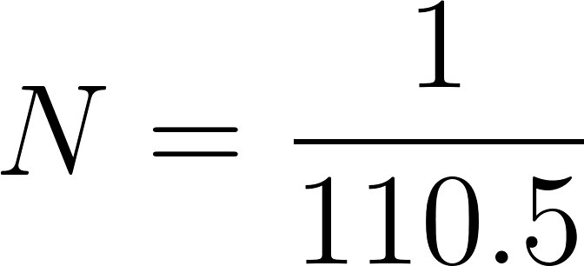
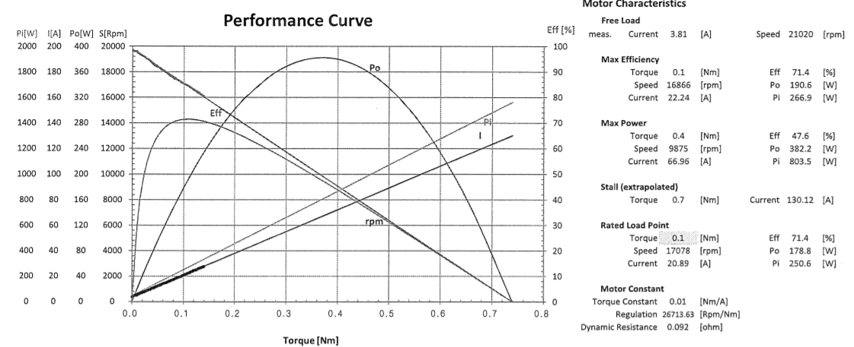
PID Controller – Required Constants
Known
Educated Guess

Slide 97
PID Controller – Developing the Model
1) Fundamental Equations
2) Combine Equations
3) Laplace Transform for Open Loop Response

Slide 98
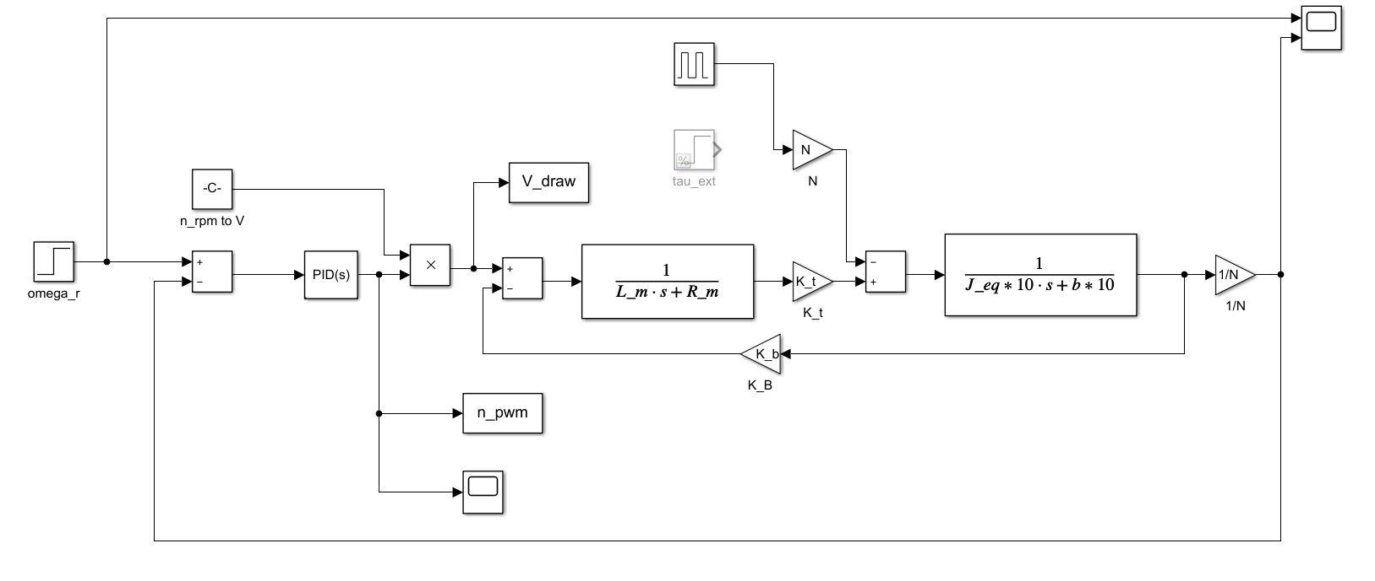
PID Controller – Developing the Model
4) Block Diagram

Slide 99
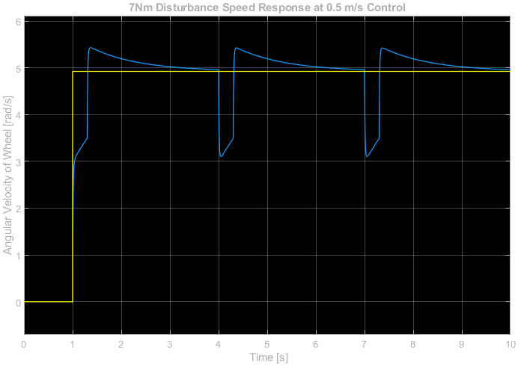
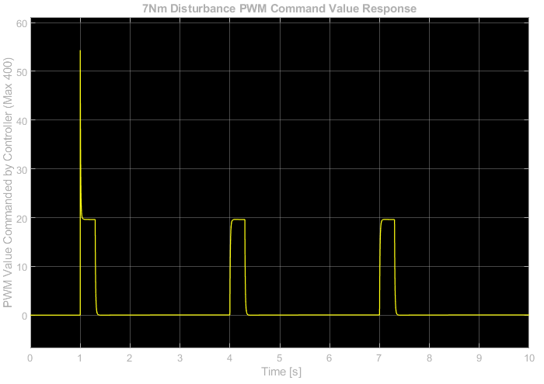
PID Controller – Control Development
Using Kp = 10, Ki = 10, Kd = 0.01

