Slide 1
Test Readiness Review

Slide 2
Project Overview

Slide 3
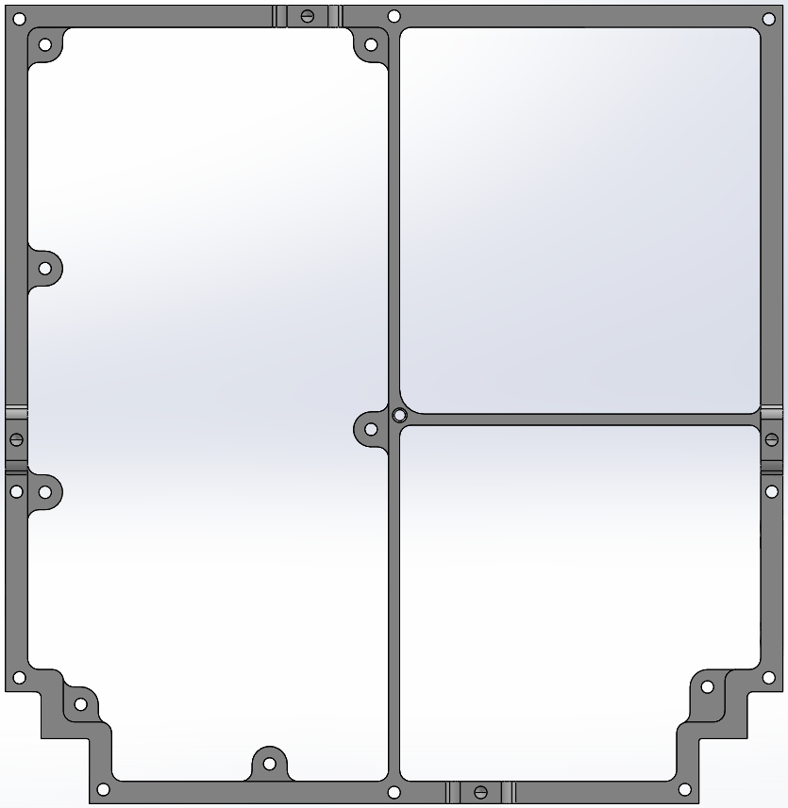
Project Objectives
Primary Objective: Design a Small Communications Satellite
Specific Objectives:
Design software-defined radio (SDR) communication system
Design system to perform and survive a balloon flight
Design software to use CCSDS format (Space Packet Protocol)
Manufacture system to ThinSat frame shape
114.2mm
111.1 mm
Notes:
Jake

Slide 4
GOAL: Constant 2-way
communication
30 km
TOMCAT Flight System
⬆ Take Data Commands
⬇ Science / Health Data
TOMCAT Ground Station
Notes:
Jake

Slide 5
FBD and Data Flow
TOMCAT Flight System
Battery
Custom TOMCAT
PCB
IMU
COMM
Hardware
Microcontroller
TOMCAT Ground Station
SDR
Signal Processing Software
Flight Software
Laptop
Ground Software
COMM
Hardware
SDR
Signal Processing Software
Notes:
Matt

Slide 6
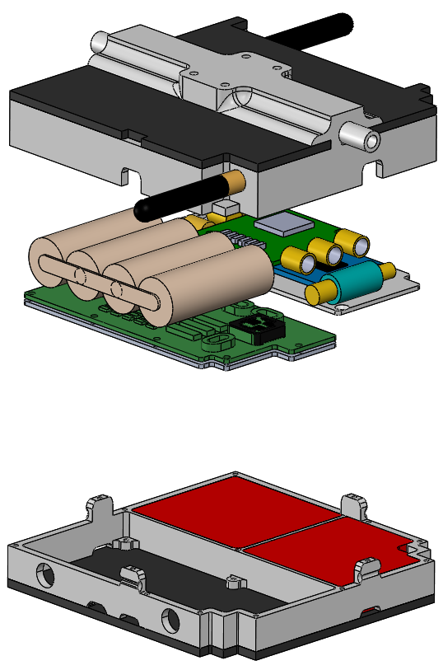
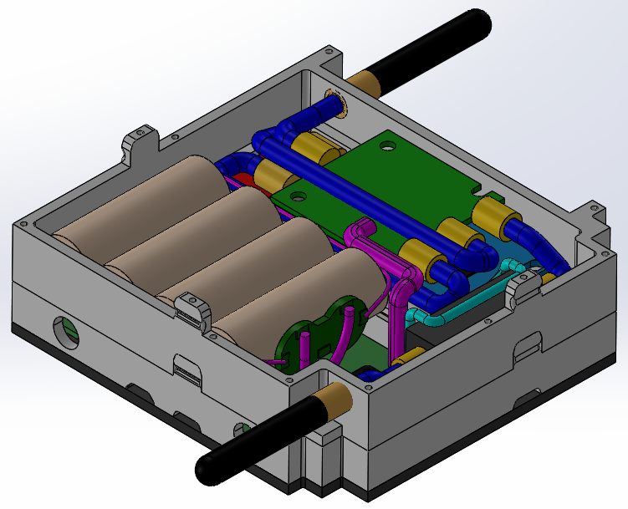
Satellite Model
TOMCAT Slice
Full Satellite
33.12 mm
114.2 mm
111.1 mm
ThinSat Kit Slice
Notes:
Matt

Slide 7
Schedule

Slide 8
MSR Updates - FSW Schedule
Today
UDP Communication on BeagleBone
IMU Integrated and Data Parsed
KubOS
Boot/Reset/Error Handling
Lightweight
Full System Testing (L1 Success)
HIL Simulated Flight
Notes:
Cole

Slide 9
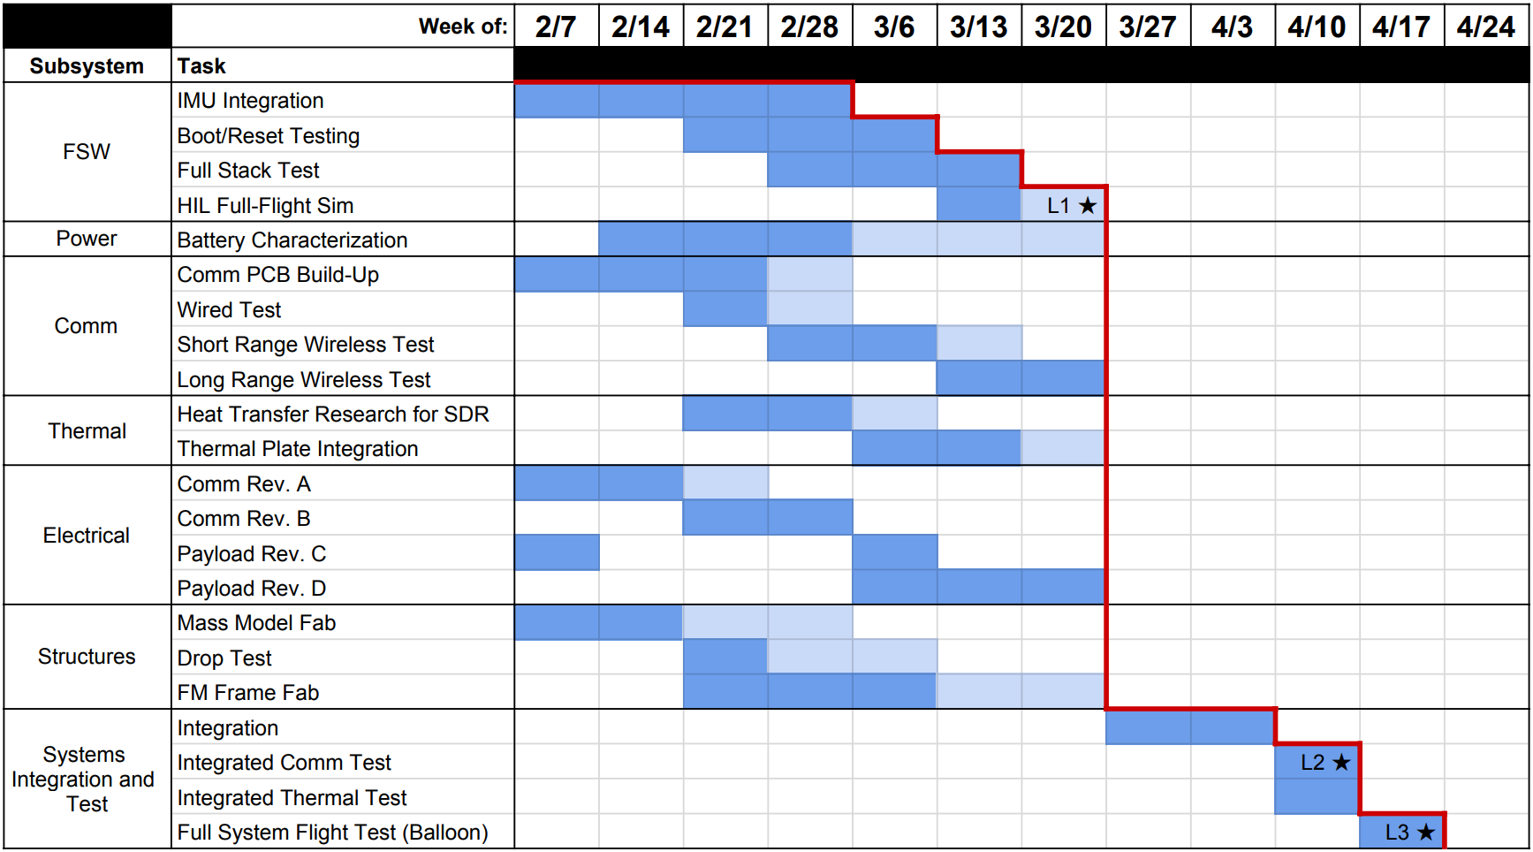
Testing Schedule
Complete
Behind
Today
Notes:
Cole

Slide 10
Test Readiness

Slide 11
Testing Pyramid
COMPONENT TESTING
OBJECTIVE:
Build understanding, reduce risk
Communication Hardware
Communication Software
Payload Board Electrical Design
Battery Characterization
Science Sensor Algorithm
FSW Comm Service
FSW Telemetry Collection and Storage
Mass Model Drop Test
Thermal Cold Test
INTEGRATION TESTING
FLIGHT TESTING
Notes:
Cole

Slide 12
Testing Pyramid
COMPONENT TESTING
OBJECTIVE:
Validate models, verify design
Meets L1 and L2 success criteria as well as all requirements
Communication Short Range Test
Communication Long Range Test
FSW IMU Data Parsing
FSW Comm CCSDS Packetization
Integrated Cold Test
INTEGRATION TESTING
FLIGHT TESTING
Notes:
Cole

Slide 13
Testing Pyramid
COMPONENT TESTING
OBJECTIVE:
Characterize project performance
Meets L3 success criteria
Full System Verification Test
Hardware-in-the-Loop Simulated Flight
Balloon Flight
INTEGRATION TESTING
FLIGHT TESTING
Notes:
Cole

Slide 14
COMM Hardware Testing
Component Testing
Low Pass Filter
Low Noise Amplifier
Power Amplifier
Custom COMM PCB
Short Range Testing
Bench Top Test
(1 Meter)
Attenuated Test
(1 Meter)
Field Test
(30 Meters)
Long Range Testing
Long Range Test
(7 Kilometers)
Attenuated Test
(7 Kilometers)
Functional Requirement 2:
The payload shall communicate with the ground system during the balloon flight
Notes:
Trevor

Slide 15
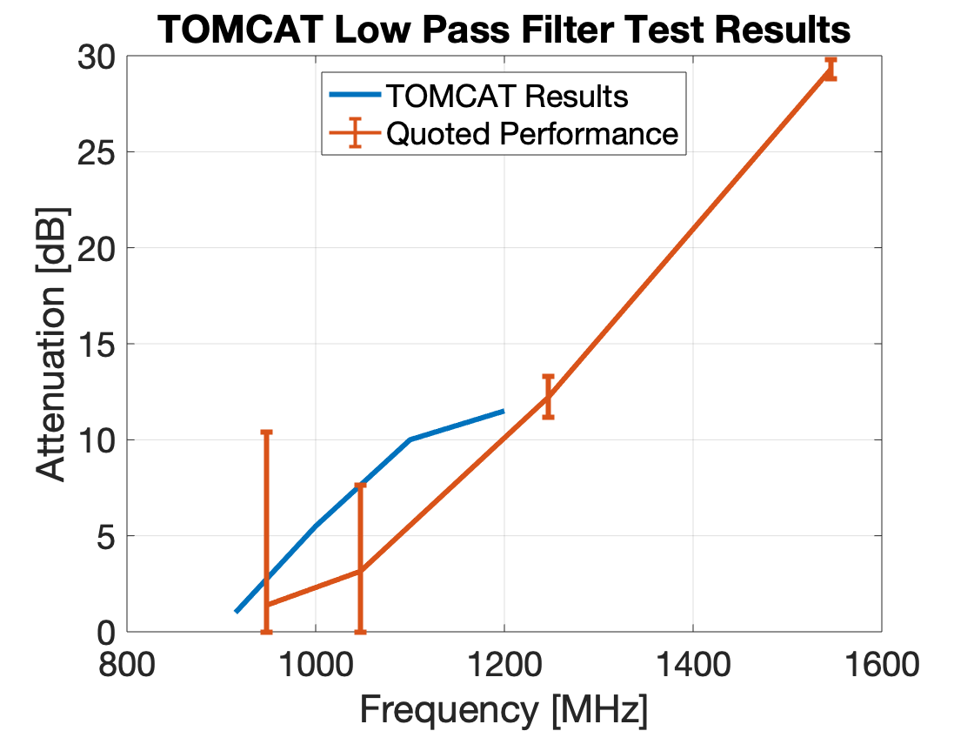
Component Testing
Attenuation Testing
Loss Testing
Models Verified
Link Budget Model
Low Pass Filter
Expected Insertion Loss
1.38 dB
Actual Insertion Loss
1 dB
Margin is acceptable!
Since we are below the expected insertion loss
Test Supplies
Two SDRs
Transmitter
Spectrum Analyzer
Low Pass Filter
Attenuators
40 dB
Location
Electronics Lab
Notes:
Trevor

Slide 16
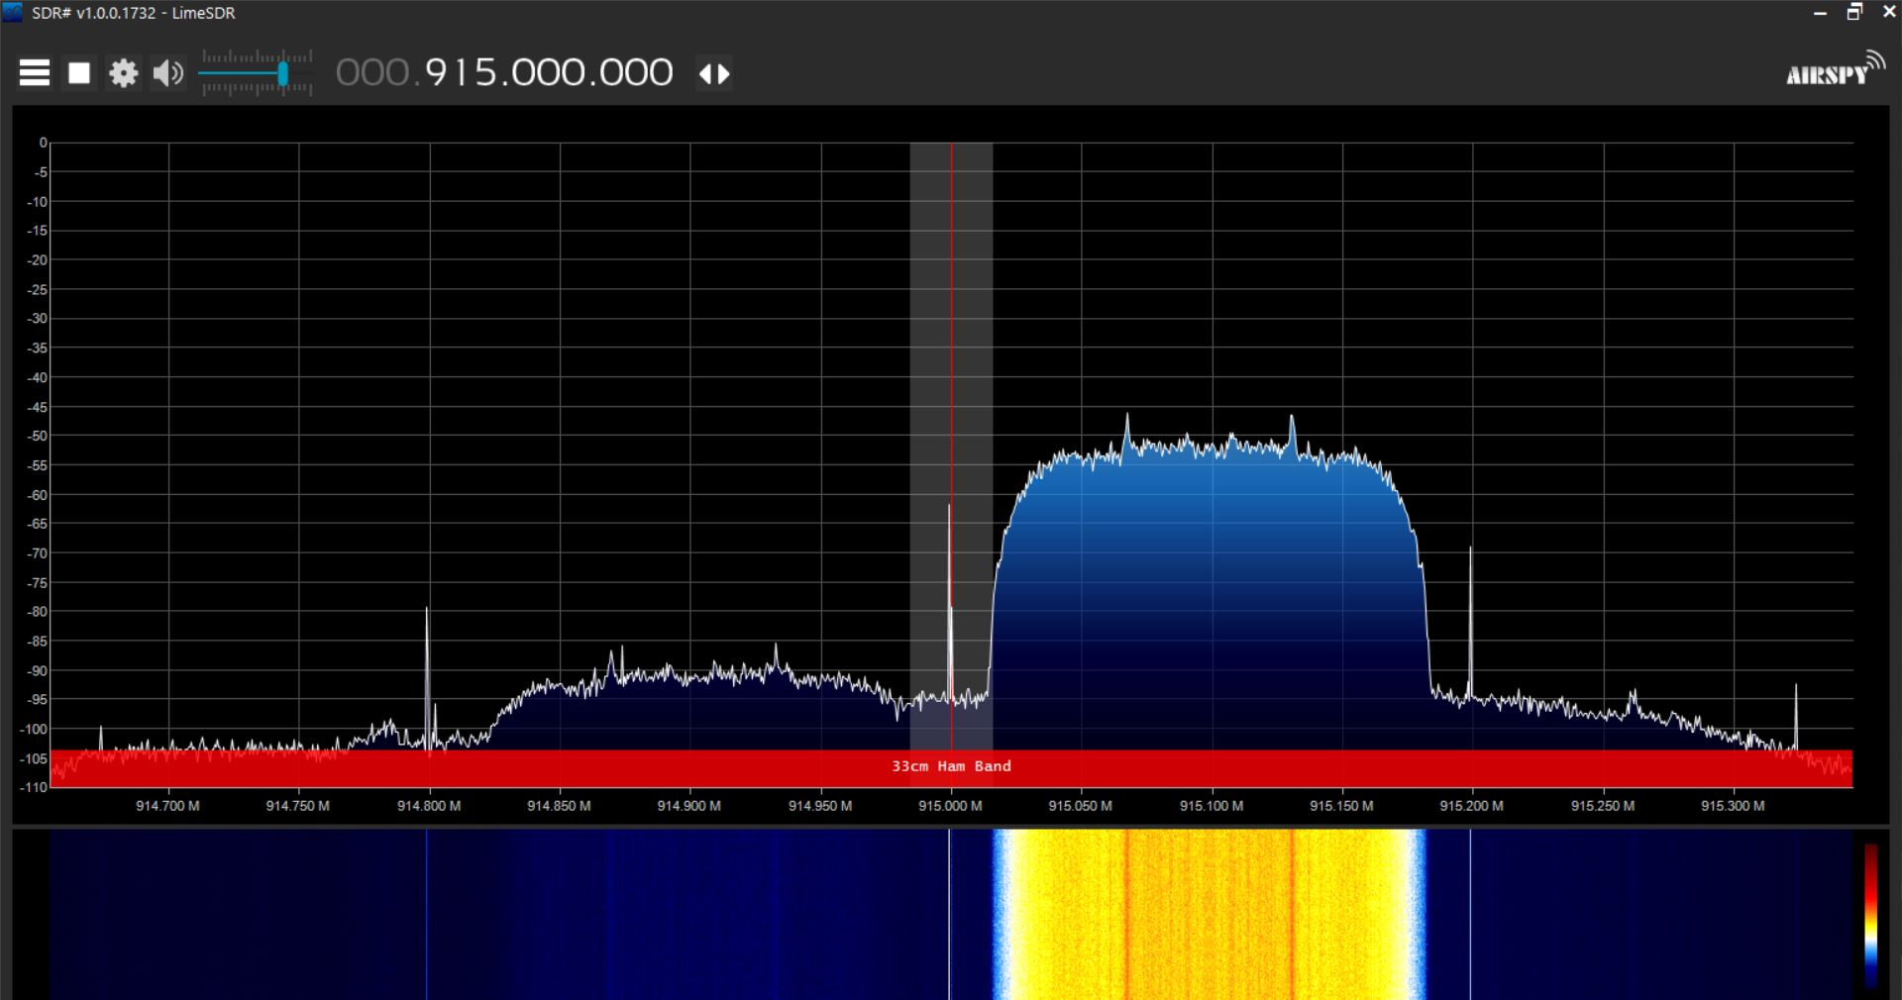
Component Testing
Low Noise Amplifier
Gain Testing
Models Verified
Link Budget Model
0
Expected Gain
38.5 dB
Actual Gain
31.5 dB
Margin is acceptable!
Power at SDR expected to be -93 dBm in the worst-case scenario
Test Supplies
Two SDRs
Transmitter
Spectrum Analyzer
Low Noise Amplifier
Attenuators
40 DB
Location
Electronics Lab
50
40
Expected: 38.5 dB
Actual: 31.5 dB
Output Gain [ dB]
30
20
10
914.7
914.8
914.9
915.0
915.1
915.2
915.3
Frequency [ MHz]
Notes:
Trevor

Slide 17
Component Testing
LNA Testing
Power Amplifier Testing
Models Verified
Link Budget Model
COMM PCB
Manufacturing in Progress
Footprint mismatch in Rev A
New board ordered
Arrives this week
Test Supplies
Two SDRs
Transmitter
Spectrum Analyzer
COMM PCB
Attenuators
40 dB
Location
Electronics Lab
Notes:
Trevor

Slide 18
Short Range Testing
Models Verified
Link Budget Model
Lab Bench
(1 meter)
Signal Strength (6.81 dBm)
Attenuated Test
(1 meter)
Signal Strength (-93 dBm)
Test Supplies
Two SDRs
Transmitter
Spectrum Analyzer
RF Chain
Attenuators
140 dB
Location
Electronics Lab
BioTech Field
Field Test
(30 meters)
Signal Strength (-53 dBm)
Goals:
Validate RF design is capable of communicating wirelessly
Introduce system to real world interference
On Schedule:
Margin in schedule allows extra time to complete COMM PCB
Notes:
Trevor

Slide 19
Long Range Testing
Models Verified
Link Budget Model
Long Range Test
(7 Kilometers)
Signal Strength (-70 dBm)
Attenuated Test
(7 Kilometers)
Signal Strength (-93 dBm)
Test Supplies
Two SDRs
Transmitter
Spectrum Analyzer
RF Chain
Attenuators
140 dB
Location
US 36 Overlook
LASP roof
Goals:
Validate RF design is capable of fulfilling link budget wirelessly long range
Introduce system to real world interference
On Schedule:
No foreseeable scheduling conflicts
Notes:
Trevor

Slide 20
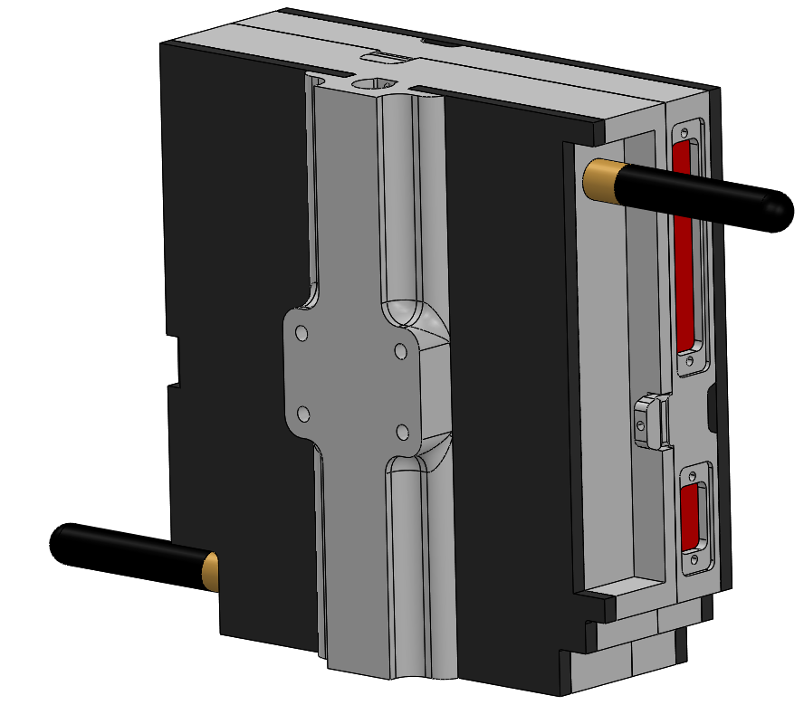
Full System Verification Test
Milestones Met
L2 Success
Requirements 2 and 4
Ready for Balloon Flight
Full Integrated System
System Functionality
Test Variables
Command rate (1-10 cmd/sec)
Downlink rate (1-100 kbps)
Expectations
100% command accept rate
Less than 1e-6 bit error rate
Goal Beyond System Testing
Characterize performance
Datasheet for customer
Test Supplies
TOMCAT ThinSat
TOMCAT Ground Station
Attenuators
140 dB
Location
US 36 Overlook
CU Boulder
~7 km actual
100 km simulated
with attenuators
[140 dB]
Notes:
Lucas

Slide 21
Budget

Slide 22
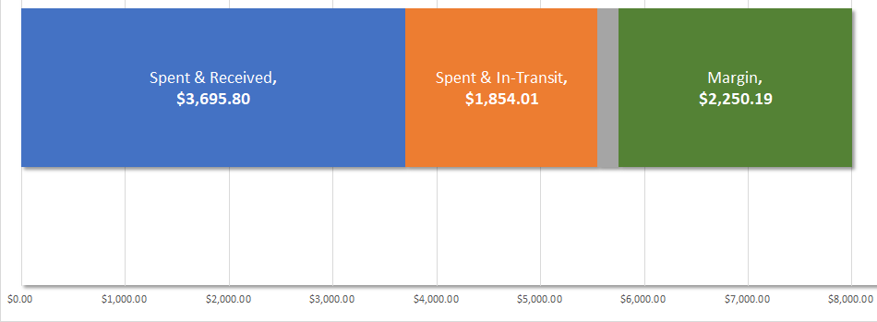
Financials by Acquisition Status
Major Change Since MSR: ThinSat Kit price has decreased ($3,000 $1,000)
Spent & In-Transit ($1,845.01)
ThinSat Kit: Est. delivery Mar 6, 2020
Payload Board: Est. delivery Mar 21, 2020
COMM Hardware: Est. delivery Mar 5, 2020
Power: Est. delivery Mar 10, 2020
Future Spending (~$200)
COMM Hardware: Est. purchase Mar 6, 2020
Ground station materials
Coverage for any other breakages
Notes:
Lucas

Slide 23
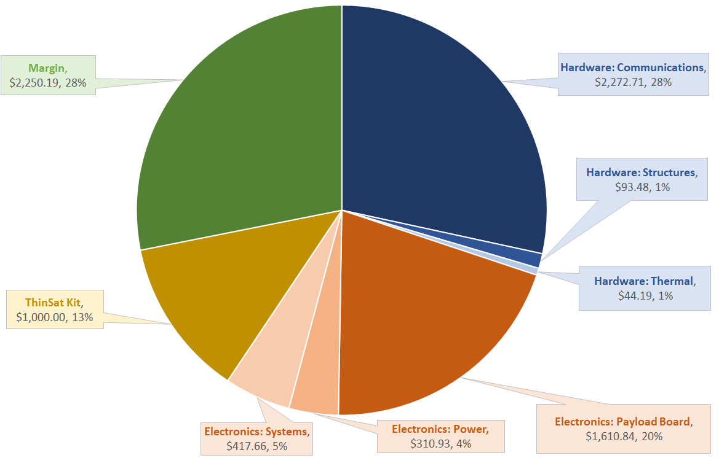
Financials by Subsystem
Notes:
Lucas

Slide 24
Test Review
Review of Major Test Activities

Slide 25
Testing Pyramid
COMPONENT TESTING
Critical Upcoming Tasks:
Required for L1 Success and beyond
Finish up Communications component testing
Perform short- and long-range testing on full Communications system
Integrate tested subsystems
Perform Full System Verification (simulated flight)
INTEGRATION TESTING
FLIGHT TESTING
Builds Up To:
L3 Success: Balloon flight test
Notes:
Cole

Slide 26
Questions?

Slide 27
Backup

Slide 28
Main Table of Contents
Objectives
CONOPS
FBD
CAD
FSW Updates
Schedule
Testing Methodology
Comm Component Testing
Comm Integration Testing
Full System Verification Test
Budget
Test Recap

Slide 29
Backup Table of Contents
Levels of Success
FSW Split Details
Risk Matrix (Testing)
Comm Component
Comm Integrated
Comm Software
KubOS Overview
KubOS IMU Tests
KubOS Database
KubOS UDP Packet
KubOS CCSDS
GSW Overview
GSW Commands
GSW Telemetry
Payload Board Fab
Payload Board Testing
Power Cold Test Result
Power Characterization
Power Integration
Power Budget
Science Algorithm
Xbus Packet Format
Structures Drop Test
Structures Whip Test
CAD Animation
Thermal Testing Overview
Thermal Model Recap
Thermal Baseline Testing
Thermal Cold Test #2 Results
Thermal Cold Test #3 Plan
Thermal Integrated Cold Test
Thermal Risks
Finance

Slide 30
Systems
Backup Slides

Slide 31
Levels of Project Success
Level 1 | Wired SDR communication (Full-system bench test) Formatted commands & telemetry 2-ways
Level 2 | Wireless short-range SDR communication (Full-system bench test 2) Command counters
Level 3 | Long-range SDR communication (Balloon flight) Command error detection Full system survives balloon flight environment

Slide 32
Updates Since MSR
Flight Software Split into 2 teams:
KubOS FSW: Raytheon preferred, longer development time
Have to build on top of established framework
Multiple services connected by GraphQL Endpoints
3 languages (Rust, C++, Python), team unfamiliar with Rust
Lightweight FSW: Faster development time, can use in place of KubOS for testing
UDP connection between softwares
2 languages (C++, Python)
Notes:
Katie?

Slide 33
KubOS FSW Margin
Today
UDP Communication on BeagleBone
Previous FSW risk mitigated!
Lightweight FSW can be used to meet L1 & L2 Milestones
KubOS FSW (Customer preferred) can be used for L3 Milestones as development continues
IMU Integrated and Data Parsed
KubOS
Boot/Reset/Error Handling
Integration Test
Balloon Flight
Notes:
Cole?

Slide 34
Top Level Testing Risks
Risks
Board Revs: Additional Payload Board revisions required
Comm Slip: Communications testing delays resulting in slower system verification
Both risks result in delays to L1 success completion and contribute to higher launch risks
Board Revs
Comm Slip

Slide 35
Communications Hardware
Backup Slides

Slide 36
LNA Gain Testing Plot
0
-20
-40
Output Gain [ dBFS]
-60
-80
-100
914.7
914.8
914.9
915.0
915.1
915.2
915.3
Frequency [ MHz]

Slide 37
Component Testing
Power Amplifier
Gain Testing
Models Verified
Link Budget Model
Expected Gain
20 dB (-67 dBFS)
Actual Gain
17.3 dB (-69.7 dBFS)
Effect on Link Margin
1 dB drop in uplink margin
16.67 dB -> 15.53 dB
Margin is acceptable!
Test Supplies
Two SDRs
Transmitter
Spectrum Analyzer
Power Amplifier
SMA Cables
Attenuators
40 dB
Location
Electronics Lab

Slide 38
Communications Final Verification
Range Testing - range verification
Objective | Measure bit error rate as a function of downlink rate Verify Signal Processing Model Verify RF Chain Power Level
Plan | Vary: File send rate (1-100 kbps) Measure: Bit error rate
Materials | 2 LimeSDR Minis 2 Laptops 2 LNAs 2 Low Pass Filters 2 Power Amplifiers 140 dB Attenuation
* This test occurs after wired, and short
range wireless testing
Test Setup
Test file receive
5 km actual
100 km simulated
Test file transmit
[140 dB]
Notes:
Presenter: Trevor
Not sure if this FBD is too small or should have its own slide. - LD
Takeaway: This test verifies the link budget

Slide 39
Communications Software
Backup Slides

Slide 40
Communications Software Testing
Models Verified
Signal Processing Model
Target Data Rate: 144 kbps
Result: 218 kbps
Simulation Testing
Wired Testing
Test Supplies
Two SDRs
Attenuators
40 dB
Functional Requirement 2:
The payload shall communicate with the ground system during the balloon flight

Slide 41
KubOS Flight Software
Backup Slides

Slide 42
FSW Testing
Software Module Testing
Sample UDP packet across Beaglebone
CCSDS Packet formatting
Receive command from GNU Radio for sample data retrieval
Retrieving sample data from DB and sending it to GNU Radio through UDP
System Integration
Connection established between KubOS and GNU Radio Software on the Beaglebone
Integration between IMU and GNU Radio with actual data and CCSDS formatting
Functional Requirement 4:
The OnBoard Computer, SDR, and FSW shall perform all necessary software tasks for the balloon flight.

Slide 43
FSW Testing
Sample UDP
packet across Beaglebone
Establish a connection between GNU/KubOS
Send an example UDP Packet across
CCSDS format packet header
Models Verified
FSW Command and Collection
Testing Status
Health Data
Generate Health data
Downlink health regularly
Testing Status
Test Supplies
Laptop
Beaglebone
SDR
Supplies:
MiniUSB
FTDI cable
Jumper wires
Retrieving sample data from DB and sending it to GNU Radio (UDP)
Store telemetry in DB
Call data from DB
Send stored telemetry to GNU Radio
Testing Status
Receiving command from GNU Radio for sample data retrieval
Create command to collect data
Properly process command from GNU
Testing Status

Slide 44
FSW IMU Testing
Software Module Testing
Parse IMU Data from XBus
Output IMU data to Socket in C/C++
Python IMU API listens to Socket
IMU data stored in database
Software Integration
IMU data fully accessible to KubOS and stored in database
Functional Requirement 4:
The OnBoard Computer, SDR, and FSW shall perform all necessary software tasks for the balloon flight.

Slide 45
FSW IMU Testing
Find I2C address and bus number of IMU
Build Xsens gcc project on Beaglebone
Models Verified
IMU Data Processing
Parse IMU Data from XBus
Testing Status
Output IMU data to Socket in C/C++
Testing Status
Create Socket in C/C++
Test Supplies
Laptop
Beaglebone
IMU
Supplies:
MiniUSB
FTDI cable
Jumper wires
Python IMU API listens to Socket
Testing Status
Read from Socket in Python
Data in KubOS format
Accessing IMU data using API
Storing/Retrieving to/from DB
Storing data in DB
Testing Status

Slide 46
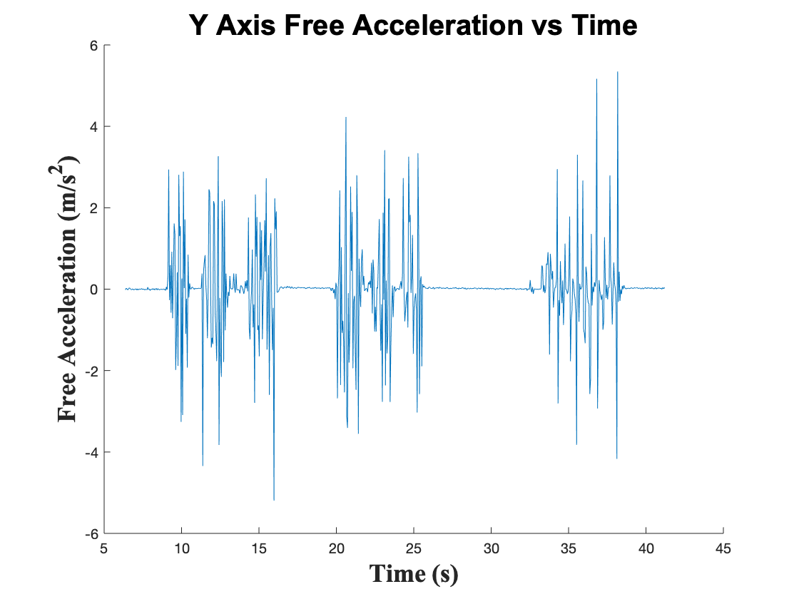
Parse IMU Data from XBus
Objective
Collect Euler Angles from XSens IMU at specified rate
Key Requirements
FR 4 The OnBoard Computer, SDR, and FSW shall perform all necessary software tasks for the balloon flight.
How it Reduces Risk
Demonstrates ability to correctly collect our telemetry data to be sent to our GNU Radio at later stage
Status: Completed
Find image
Result: Full Success

Slide 47
Storing data in DB
Objective
Storing any data generated by KubOS Services to telemetry database
Key Requirements
FR 4 The OnBoard Computer, SDR, and FSW shall perform all necessary software tasks for the balloon flight
How it Reduces Risk
Demonstrates ability to store all telemetry generated during flight in order to confirm scientific model, and measure the error rate of our comms system
Status: Completed
Dummy data stored into Telemetry DB
Result: Full Success

Slide 48
Sample UDP Packet across Beaglebone
Objective
Establish a connection between GNU/KubOS, and send an example UDP Packet across
Key Requirements
FR 4 The OnBoard Computer, SDR, and FSW shall perform all necessary software tasks for the balloon flight
How it Reduces Risk
Demonstrates ability to perform the backbone operation of our FSW system, that drives commands and telemetry requests
Status: Completed
Result: Full Success

Slide 49
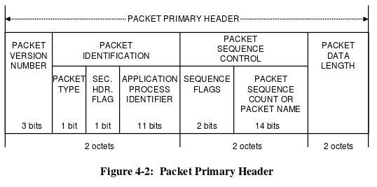
CCSDS Packet Formatting
Objective
Format packet header in required CCSDS protocol
Key Requirements
FR 4 The OnBoard Computer, SDR, and FSW shall perform all necessary software tasks for the balloon flight
How it Reduces Risk
Demonstrates ability to correctly format our ground station commands and requested telemetry in space industry protocol
Status: Completed
Maybe another pic that our project produced
Result: Full Success

Slide 50
Ground Software
Backup Slides

Slide 51
GSW Command Testing
Software Capability Testing
CCSDS command format verified
Command Sender application
Command & Telemetry Server Connection Testing
System Integration
Command sent over UDP to GNU Radio Software
Collect command sent directly through FSW to the IMU
Command sent through full system, including Comm hardware
Functional Requirement 2:
The payload shall communicate with the ground system during the balloon flight

Slide 52
GSW Command Component Testing
Command
Sender
Creating CCSDS formatted command
Sending a command to an example external target
Models Verified
CCSDS Formatted Packets
Testing Status
Test Supplies
Chromebook
COSMOS
Command & Telemetry Server
Configure the server to connect to a target over a UDP port
Establish a connection with GNU Radio Software
Testing Status

Slide 53
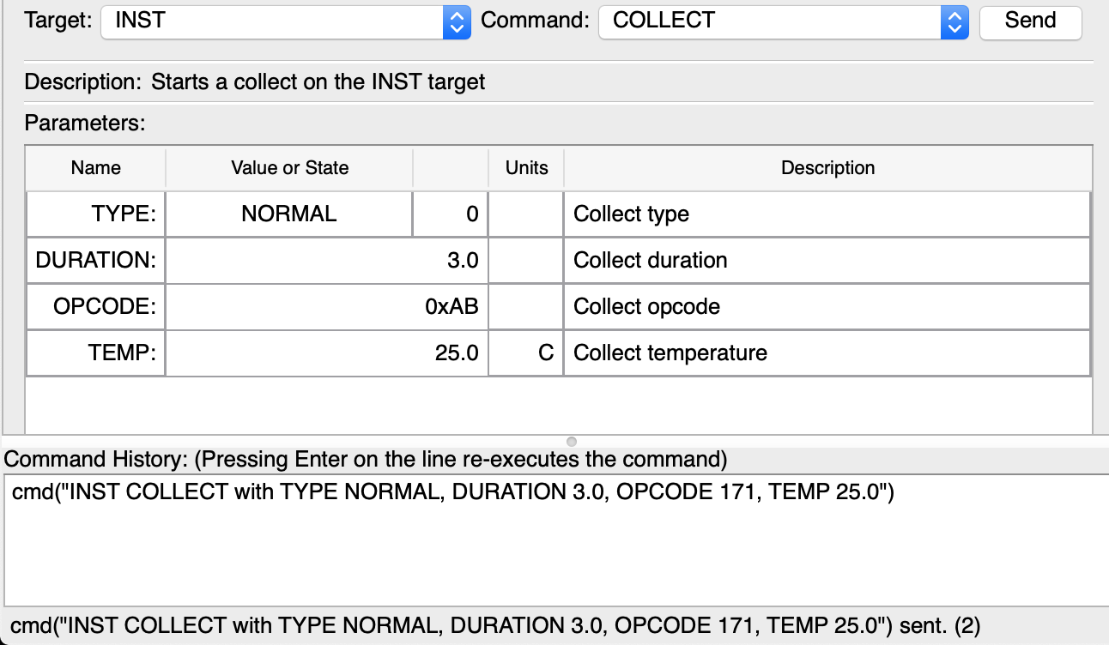
GSW Command Tests
Command Sending Test:
Created a target system to interface with in COSMOS
Configured the system to take example data measurements
Used the Command Sender tool to send a command to the system to start a collection of telemetry
Screenshot of COSMOS Command Sender

Slide 54
GSW Telemetry Testing
Software Capability Testing
CCSDS telemetry packet format verified
Telemetry Grapher, Telemetry Viewer, & Telemetry Extractor applications
Command & Telemetry Server Connection Testing
System Integration
Telemetry received over UDP with an external system
Data packet received from IMU through direct connection
Telemetry sent through full system, including Comm hardware
Functional Requirement 2:
The payload shall communicate with the ground system during the balloon flight

Slide 55
GSW Telemetry Component Testing
Telemetry Grapher
Graph example incoming live telemetry
Models Verified
CCSDS Formatted Packets
Testing Status
Telemetry Viewer
View example incoming live telemetry
Testing Status
Telemetry
Extractor
Testing Status
Extract logged telemetry from .bin to .txt files
Test Supplies
Chromebook
COSMOS
Command & Telemetry Server
Connect to a target over a UDP port
Start/stop logging incoming data
Connect specifically with GNU Radio Software
Testing Status

Slide 56
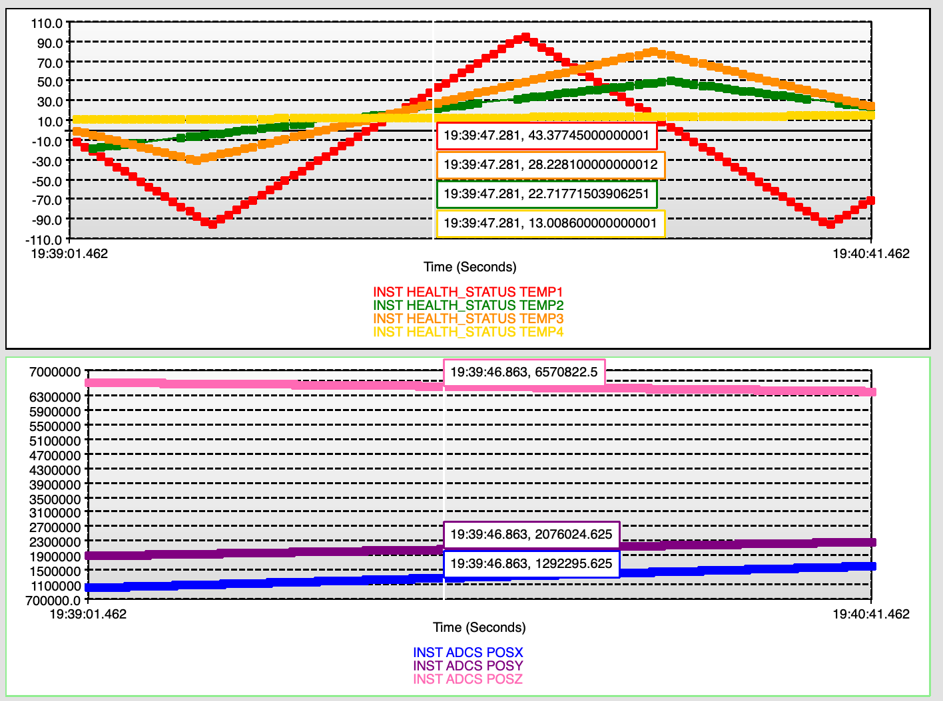
GSW Telemetry Tests
Telemetry Viewing Test:
Created a target system in COSMOS
Began taking real-time data through a UDP port into the Command & Telemetry Server
Used Telemetry Grapher tool to plot real-time telemetry
Screenshot of COSMOS Telemetry Grapher

Slide 57
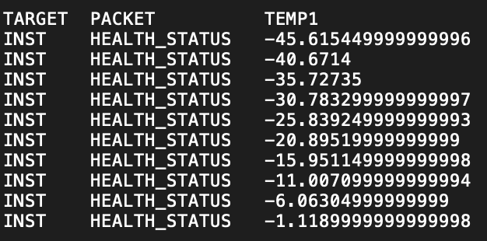
GSW Telemetry Tests
Telemetry Logging Test: ✅
Created a target system to interface and began collecting live telemetry ✅
Manually started and stopped logging in the Command & Telemetry Server ✅
Extracted the telemetry data into a text file using the Telemetry Extractor tool ✅
Verified the data was logged successfully ✅
Screenshot of logged telemetry data

Slide 58
Payload Board
Backup Slides

Slide 59
Payload Board Testing
Board Testing
Manufacturing tests
Observe indicators for a successful flash of KubOS kernel on MCU
Software defined tests for confirming successful IMU connection
Software defined tests for successful SDR connection
System Integration
Use battery supplied power
Make SDR connections
Place into thinsat bus
Functional Requirement 4:
The payload shall perform all necessary software and hardware tasks for system operation

Slide 60
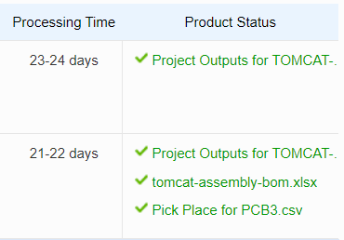
Manufacturing Tests
Manufacturing Tests:
Altium files compiled w/o errors
Passed Altium design rules checks
Gerber files passed inspection
Assembly files passed inspection
Board passed visual inspection
Board passed electrical inspection
Screenshot of PCBWay Tests

Slide 61
Software-Defined Testing
Software-Defined Testing:
Linux kernel flashed onto MCU indicated by debug outputs
Software defined tests moved from dev board to custom board
IMU software tests passed on custom board
SDR software tests passed on custom board
Screenshot of UART0 Serial login indicating successful Linux boot

Slide 62
Power
Backup Slides
Notes:
Describe the scope of the testing tasks in the project: what tests are being planned, specifically:
what is being tested for (your rationale for performing the test)
the design of the test fixtures
what test equipment and facilities are needed
an overview of the test procedures
Describe how the test(s) will reduce risk to your project, what results do you expect, and what models will be validated.
Describe the status of the testing tasks, showing engineering details as needed to convey a solid understanding of the design (and the ability to reduce risk), requirements to be verified or validated, and what V&V is most important for project success.

Slide 63
Power System Testing
Cold Testing
Cold Test #2
Cold Test #3
Characterization Testing
Battery Characterization Test
PCB Power Distribution Test
Integration Testing
Battery with PCB Test
ThinSat without Battery
ThinSat with Battery
Functional Requirement 3:
The payload shall be operational throughout the duration of the balloon flight

Slide 64
Cold Testing
Models Verified
Battery Discharge Model
Cold Test #2
State of Charge Test
Temperature Test
Test Supplies
Battery Pack
Ammeter
Voltmeter
BNC Cables
iMAX B6AC Charger
Breadboard
Dry Ice
4 Thermocouples
Cold Test #3
Capacity Test
Voltage Test
Temperature Test

Slide 65
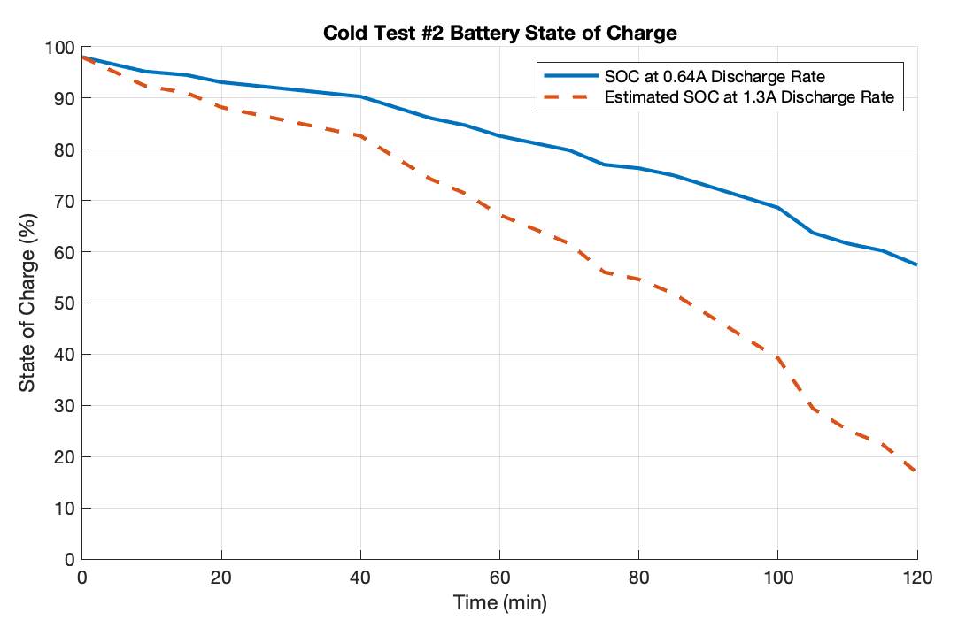
Cold Test #2
Objective
Verify that the battery is able to discharge in the low temperatures expected in the ThinSat during the balloon flight
Key Requirements
FR 3 The payload shall be operational throughout the duration of the balloon flight
How it Reduces Risk
Demonstrates that the battery is capable of powering all components in the low temperatures expected in flight
Result: Full Success - Battery did not reach 0% state of charge at any point during the 2 hour test
Status: Completed

Slide 66
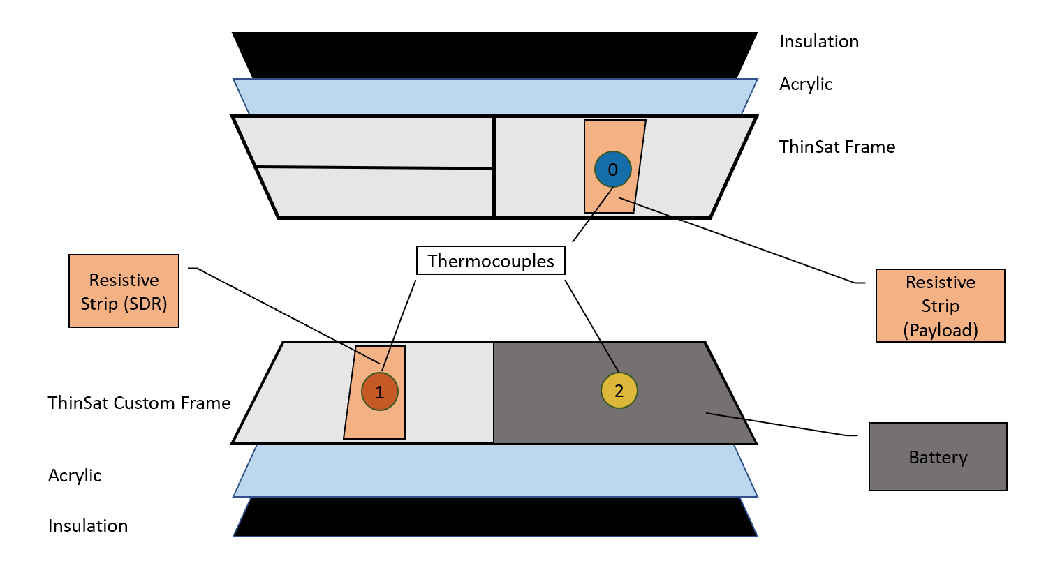
Cold Test #3
Objective
Verify that the battery is able to discharge in the low temperatures expected in the ThinSat during the balloon flight with updated discharge rate
Key Requirements
FR 3 The payload shall be operational throughout the duration of the balloon flight
Success Criteria
Full Success: Battery doesn’t fully discharge prematurely
How it Reduces Risk
Demonstrates that the battery is capable of powering all components in the low temperatures expected in flight
Completion Date: 3/6/20
Full Success: Battery does not reach 0% state of charge at any point during the 2 hour test

Slide 67
Component Testing
Models Verified
Battery and PCB Specifications
Battery Characterization Testing
Voltage Test
Capacity Test
Current Draw Test
Test Supplies
Battery Pack
PCB
Ammeter
Voltmeter
BNC Cables
iMAX B6AC Charger
Breadboard
Voltage Test
Current Draw Test
PCB Power Distribution Test

Slide 68
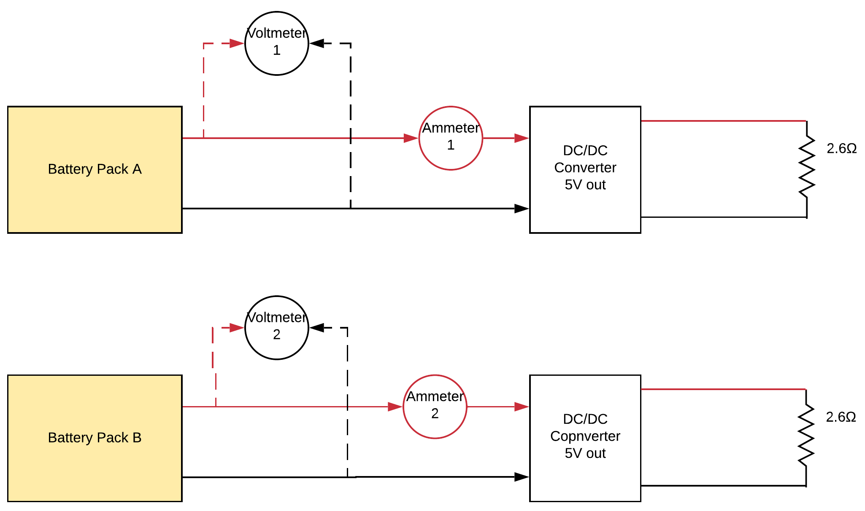
Battery Characterization Test Logistics
Test Procedure for Voltage, Current, & Capacity
Complete the circuit as shown in the test diagram
Record initial state of charge and voltage
Record voltage and current draw every 5 minutes throughout test
Test ends when batteries stop discharging ~ 2.5 hours
Fully charge the batteries again and measure peak voltage
Test Supplies for Voltage, Current, & Capacity
Battery Pack
Ammeter
Voltmeter
BNC Cables
iMAX B6AC Charger
Breadboard
Electrical Setup for Characterization and Cold Test #3

Slide 69
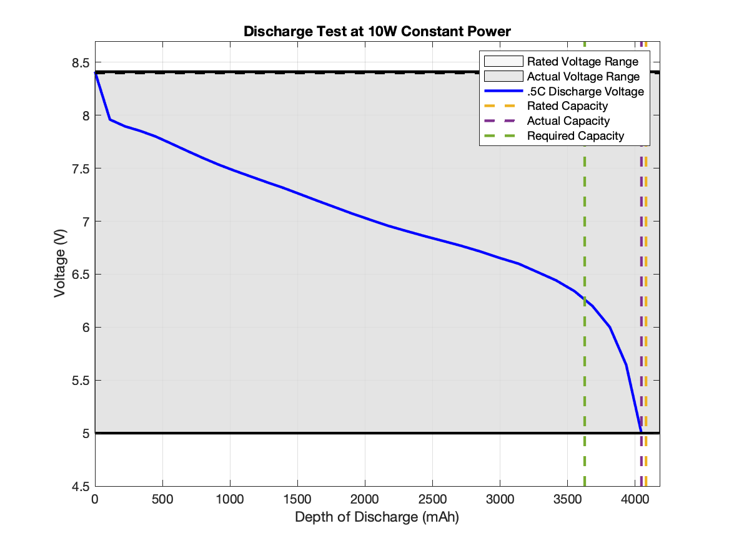
Battery Voltage Range Test
Objective
Verify that the battery range matches the manufacturer’s specifications: 8.4V max to 6V min
Key Requirements
FR 3 The payload shall be operational throughout the duration of the balloon flight
Success Requirements:
Full Success: The voltage range is within 5% of the rate range of 5V to 8.4V
How it Reduces Risk
Demonstrates that the battery is meets manufacturer specifications for voltage and will therefore act as expected
Status: Completed
Results: Full Success - Actual Voltage Range: 4.99V to 8.41V

Slide 70
Battery Capacity Test
Objective
Verify that the battery capacity matches the manufacturer’s specifications: 4080 mAh
Key Requirements
FR 3 The payload shall be operational throughout the duration of the balloon flight
Success Criteria
Full Success: Battery capacity is within 100 mAh of the rated max 4080 mAh
Partial Success: Battery capacity is greater than or equal to the required 3626 mAh
How it Reduces Risk
Demonstrates that the battery is meets manufacturer specifications for voltage and will therefore act as expected
Status: Completed
Results: Full Success - Actual Capacity: 4046 mAh

Slide 71
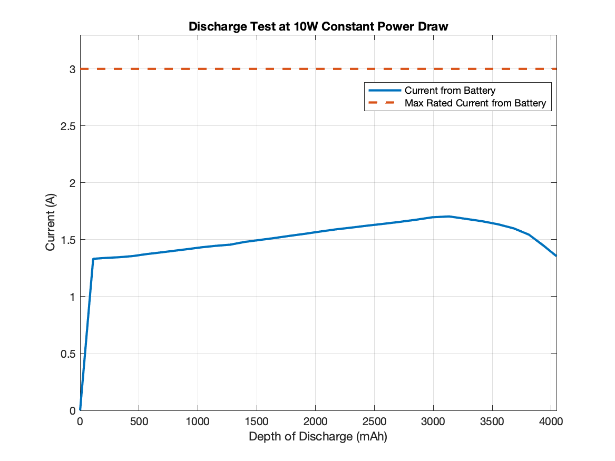
Current Draw Test
Objective: Verify that the battery current draw does not exceed the rating from the battery manufacturer
Key Requirements:
FR 3 The payload shall be operational throughout the duration of the balloon flight
Levels of Success:
Full Success: Max Current Draw is below 2.5A
Partial Success: Max Current Draw is below 3A
Model Verified: System Level Power Budget
How it Reduces Risk: Demonstrates that the battery is meets manufacturer specifications for voltage and will therefore act as expected
Status: Completed
Results: Full Success - Max Current Draw: 1.704 A

Slide 72
PCB Power Distribution Test
Objective
Verify that PCB converts power from a power supply to 5V and 3.3V, and verify current draw requirements are met
Key Requirements
FR 3 The payload shall be operational throughout the duration of the balloon flight
Current Requirements: 2.0A from 5V out, .08A from 3.3V out
Associated Model
Component Level Power Budget
Success Criteria
Full Success: 2.0A and .08A available from 5V and 3.3V ports respectively
Partial Success: Greater than 1.6A and .065A available from 5V and 3.3V ports respectively
How it Reduces Risk
Demonstrates that PCB is able to supply adequate power to all subsystems
Completion Date: 3/13
Results Matrix For Test:
Component | Current [A] | Success? Y/N
3.3 V Out
5 V Out

Slide 73
Integration Testing
Models Verified
Battery Discharge Model
Component and System Level Power Budget
PCB Tests
PCB with Power Supply
PCB with Battery
Full System Tests
ThinSat with Power Supply
ThinSat with Battery
Full System Cold Test

Slide 74
PCB with Battery Test
Objective: Verify that PCB converts power from the battery to 5V and 3.3V, and verify current draw requirements are met
Key Requirements:
FR 3 The payload shall be operational throughout the duration of the balloon flight
Current Requirements: 2.0A from 5V out, .08A from 3.3V out
Associated Model: Component Level Power Budget
Success Criteria:
Full Success: Greater than 2.0A and .08A available from 5V and 3.3V ports respectively
Partial Success: Greater than 1.6A and .065A available from 5V and 3.3V ports respectively
How it Reduces Risk: Demonstrates that PCB is able to supply adequate power to all subsystems from battery
Completion Date: 4/3
Results Matrix for Test:
Component | Current [A] | Success? Y/N
3.3 V Out
5 V Out

Slide 75
ThinSat with Battery Test
Objective: Verify that the battery can fully power the ThinSat with all systems running
Key Requirements:
FR 3 The payload shall be operational throughout the duration of the balloon flight
Success Criteria:
Full Success: All subsystems are fully operational throughout the test
How it Reduces Risk: Demonstrates battery is capable of fully powering the ThinSat
Completion Date: 4/3
Results:
Battery Discharge Plot

Slide 76
Full System Integration
Objective: Verify that the ThinSat is fully operational in the Cold Test environment with all subsystems operating as they will during the Balloon Launch
Key Requirements:
FR 3 The payload shall be operational throughout the duration of the balloon flight
Success Criteria:
Full Success: All subsystems are fully operational throughout the test
How it Reduces Risk: Demonstrates the ThinSat can fully satisfy Functional Requirement 3
Completion Date: 4/10
Results:
Battery Discharge Plot

Slide 77
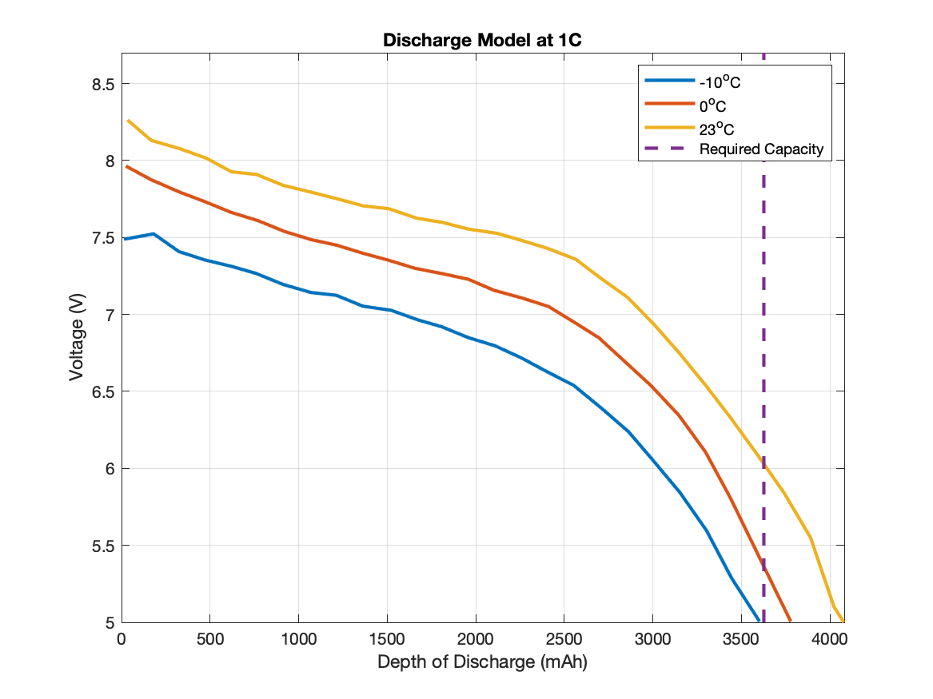
Battery Discharge Model
Battery Discharge Model:
Shows expected voltages and available capacities at varying temperatures
From Cold Test #2, the expected temperature of the battery is between 0°C and 23°C
Expected Battery Discharge

Slide 78
System Level Power Budget
Category | Component | Voltage Req. [V] | Max Current Draw [A] | Max Power Draw [W] | Max Energy Required (2hrs) [Wh]
Science | XSens MTi-3 AHRS | 3.3 | 0.015 | 0.0495 | 0.099
 |  | Science Total: | 0.015 | 0.0495 | 0.099
Comms | SDR | 5 | 0.9 | 4.5 | 9
 | LNA | 5 | 0.152 | 0.76 | 1.52
 | Power Amp | 5 | 0.05 | 0.25 | 0.5
 |  | Comms Total: | 1.102 | 5.51 | 11.02
FSW/OBC | MCU | 5 | 0.5 | 2.5 | 5
 |  | FSW/OBC Total: | 0.5 | 2.5 | 5
 |  | Total: | 1.617 | 8.0595 | 16.119
 |  | 50% Margin: | 2.4255 | 12.08925 | 24.1785

Slide 79
Component Level Power Requirements
Voltage Conversion: | [A] |  | [A]
Current Through 5V Converter: | 1.6119 | Current Through 3.3V Converter: | 0.065
With 20% Margin: | 1.93428 | With 20% Margin: | 0.078
Battery Specifications: | [V] |  | [A]
Typical Battery Voltage | 7.4 | Typical current draw: | 1.633682432
Low Battery Voltage | 5 | Max current draw: | 2.41785

Slide 80
Science
Backup Slides

Slide 81
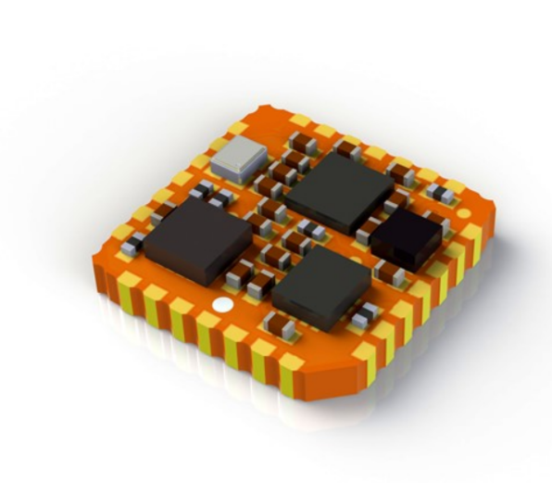
Scientific Sensor Specifications
Sensor Model: Xsens MTi-3 Attitude & Heading Reference System (AHRS)
Data Outputs:
Temperature
Timestamps
Orientation (quaternion, rotation matrix, Euler angles)
Acceleration (delta v, acceleration, free acceleration, acceleration HR)
Angular Velocity (rate of turn)
Sensor Packet Type: Xbus (Xsens’ proprietary packetization method)
Depacketized and transferred into CCSDS Space Packet Format by FSW
Sensor Communication Protocol: I²C

Slide 82
Scientific Sensor Algorithm
Mission: Determine phase of flight based on acceleration data
Phases: Pre-Flight, Ascent, Descent, Post-Flight
Algorithm:
Pre-Flight phase
Acquire ten seconds of data to acquire average pre-flight motion
Ascent begins when the three-second average acceleration doubles the pre-flight average
Ascent phase
Acquire 100 seconds of data to average ascent motion
Descent begins when the three-second average acceleration exceed 4x the ascent average
Descent phase
Descent continues until 3 second difference in acceleration is less than 0.1g
Post-Flight phase

Slide 83
Scientific Sensor Algorithm
MCU sends mission status data to communications hardware
for telemetry
Turn on IMU, begin data generation
I²C
MCU receives data packets
MCU analyzes vertical acceleration data to determine flight phase
Send rotation, magnetometer, pitch/roll/yaw to
SD card
When
|a_{Z}| > 2⋅PF_{AVG}
When
|a_{Z}| < 4⋅ASC_{AVG}
When
|Δa_{x},Δa_{y},Δa_{Z}| < .1g
Start
“pre-flight”
then
“ascent”
then
“descent”
then
“post-flight”
83

Slide 84
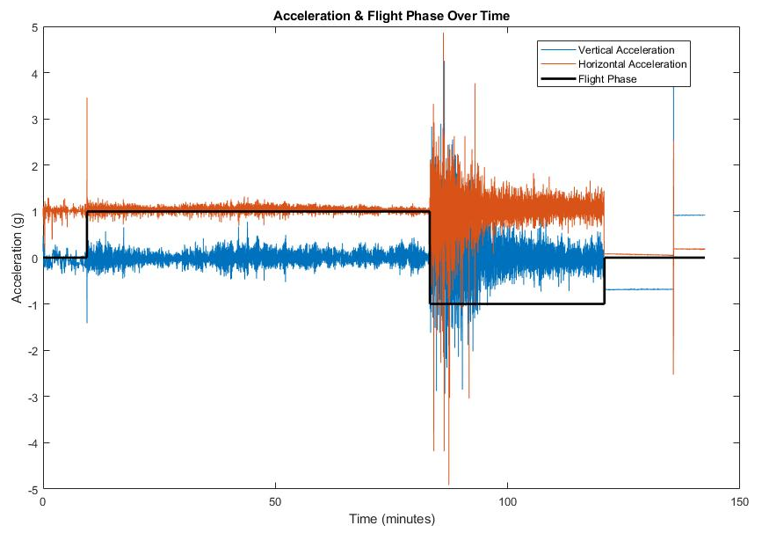
Scientific Sensor Algorithm
ASCENT
POST-FLIGHT
PRE-FLIGHT
DESCENT
84

Slide 85
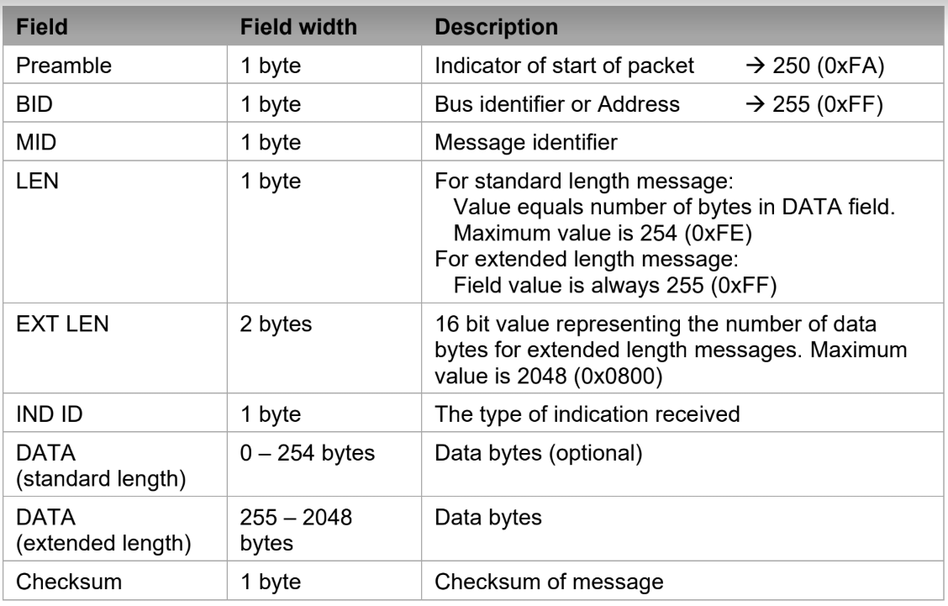
Scientific Sensor Packetization
This is the composition of a standard Xbus message

Slide 86
Scientific Sensor Testing
Sample IMU Testing
Configured SparkFun IMU
Uploaded sample “mission code” with Arduino
Specified data types to send
Full System Integration Testing
IMU integrated onto Payload Board
Integration between IMU and GNU Radio with actual data and CCSDS formatting
Functional Requirement 3.4
The IMU shall generate rate telemetry during ascent and descent.

Slide 87
Structures
Backup Slides

Slide 88
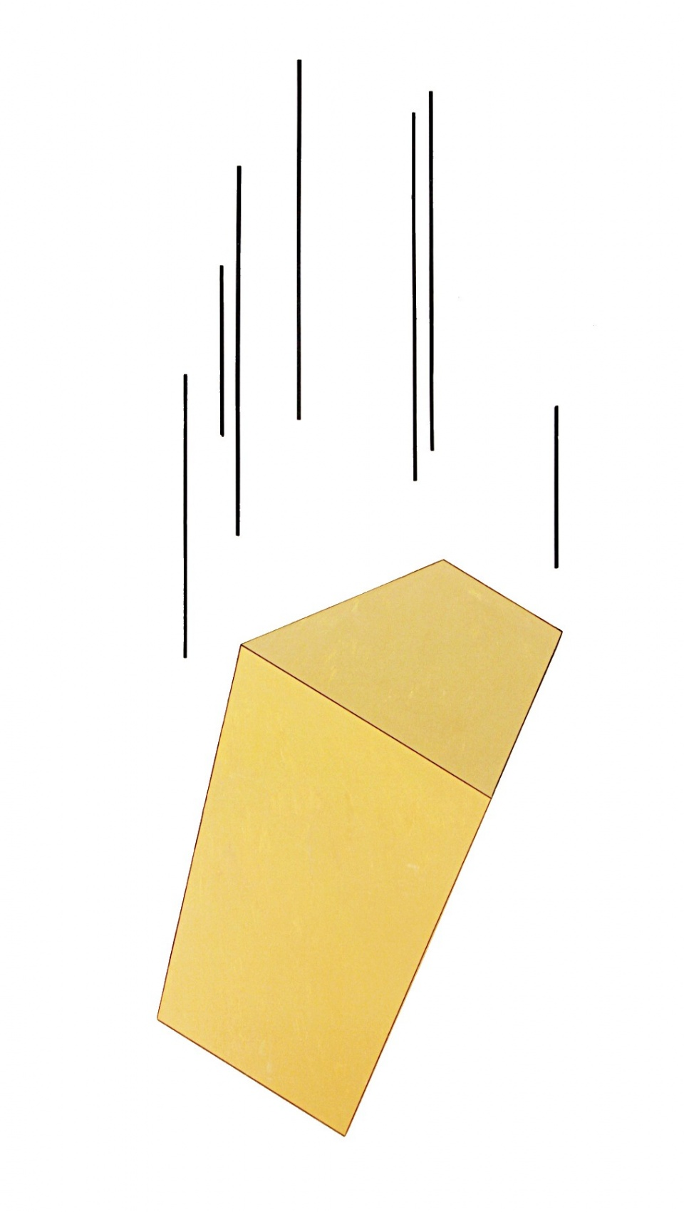
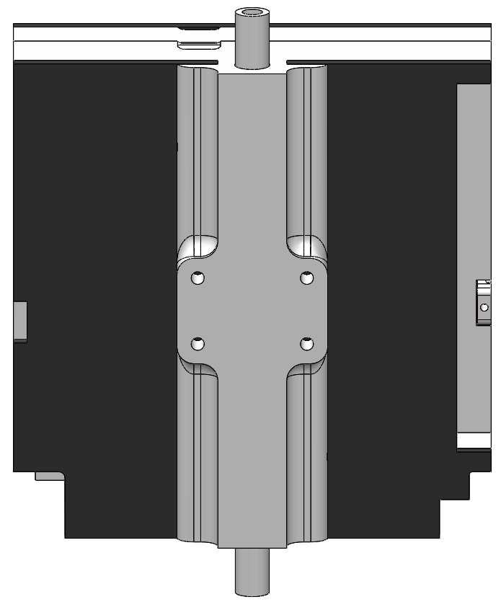
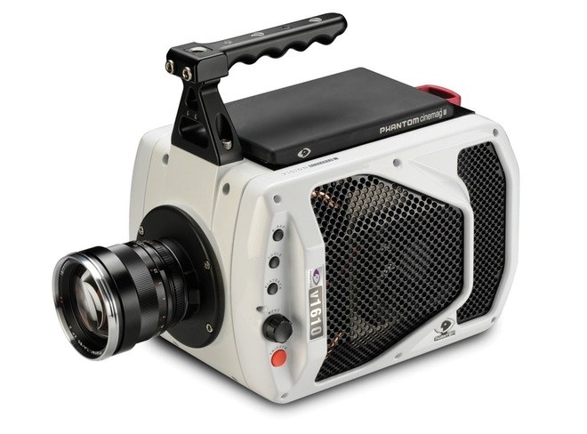
Drop Test
Purpose:
Ensure component survivability
Equipment:
Ladder
Ruler
High speed camera
Facilities:
ITLL
15 ft
Functional Requirement 3.2
Notes:
Survivability:
Components do not break loose of their attachment mechanism
Structure does not sustain significant damage

Slide 89
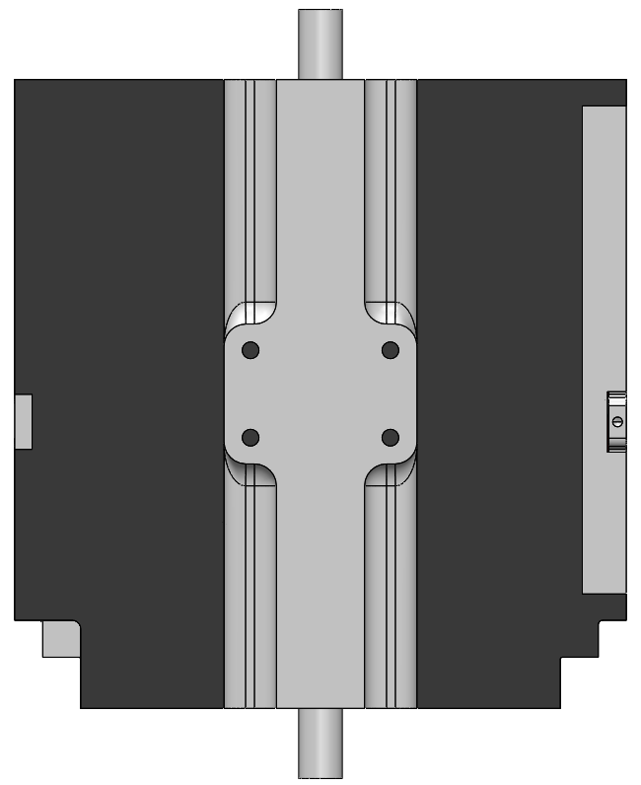
Whip Test
Purpose:
Comply with Gateway launch requirements
Equipment:
String
Mounting hardware
Facilities:
Open space
Functional Requirement 3
Notes:
Mounting Hardware: Flight tube, Washers x2, Paper clips x2

Slide 90
Structures Testing
Components do not break free
Minimal damage to the frame
Drop Test
Models Verified
Strength Interpolation, Datasheets
ThinSat remains attached to flight string
Whip Test

Slide 91
Assembly Animation

Slide 92
Thermal
Backup Slides
Notes:
Start with PDR model, progress through the two thermal tests, talk about future work and tests (integrated cold test?)

Slide 93
Thermal Testing
Preliminary Thermal Modeling
Steady-State 1D Model
Baseline Test
Cold Testing
Cold Test #2
Cold Test #3
Integration Testing
Fully Integrated Thermal Test
Functional Requirement 3:
The payload shall survive and operate in the environment during all stages of the balloon flight

Slide 94
Thermal Testing
Baseline Cold Test
Maintain nominal operating temperatures
Obtain baseline data for future tests
Models Verified
Baseline Thermal Test, Datasheets
Cold Test #2
Maintain nominal operating temperatures
Characterize hot and cold areas

Slide 95
Thermal Testing
Cold Test #3
Confirm Cold Test #2 Results
Battery state of charge test
Models Verified
Baseline Thermal Test, Datasheets
Thermal day in the life test
Battery state of charge test
Component thermal monitoring
Fully System Thermal Test

Slide 96
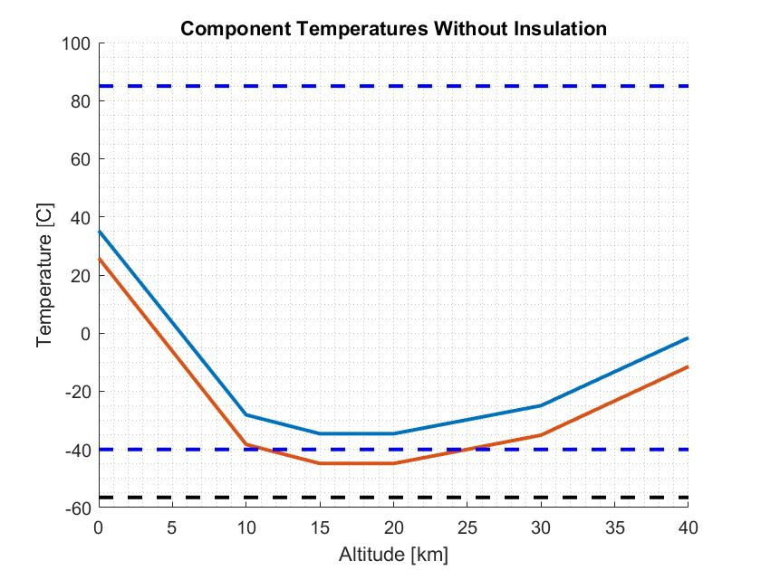
Thermal Modeling
Steady State, 1D Thermal Model
Accounts for radiation, convection, conduction (with insulation)
Does not account for sun loading or Earth’s albedo
Insulation required for above-nominal operating temperatures of both the payload and the SDR

Slide 97
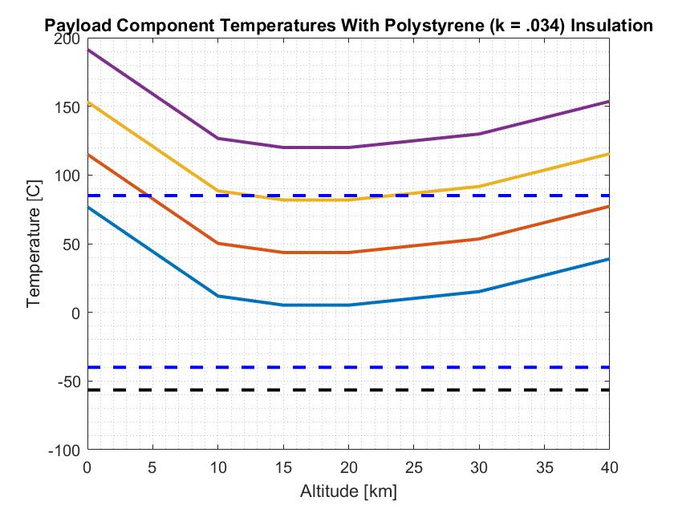
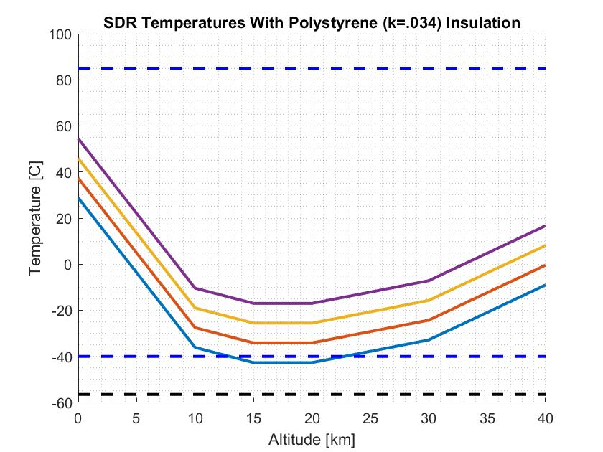
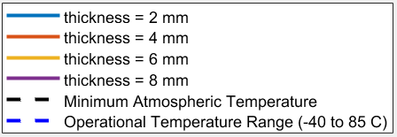
Thermal Modeling

Slide 98
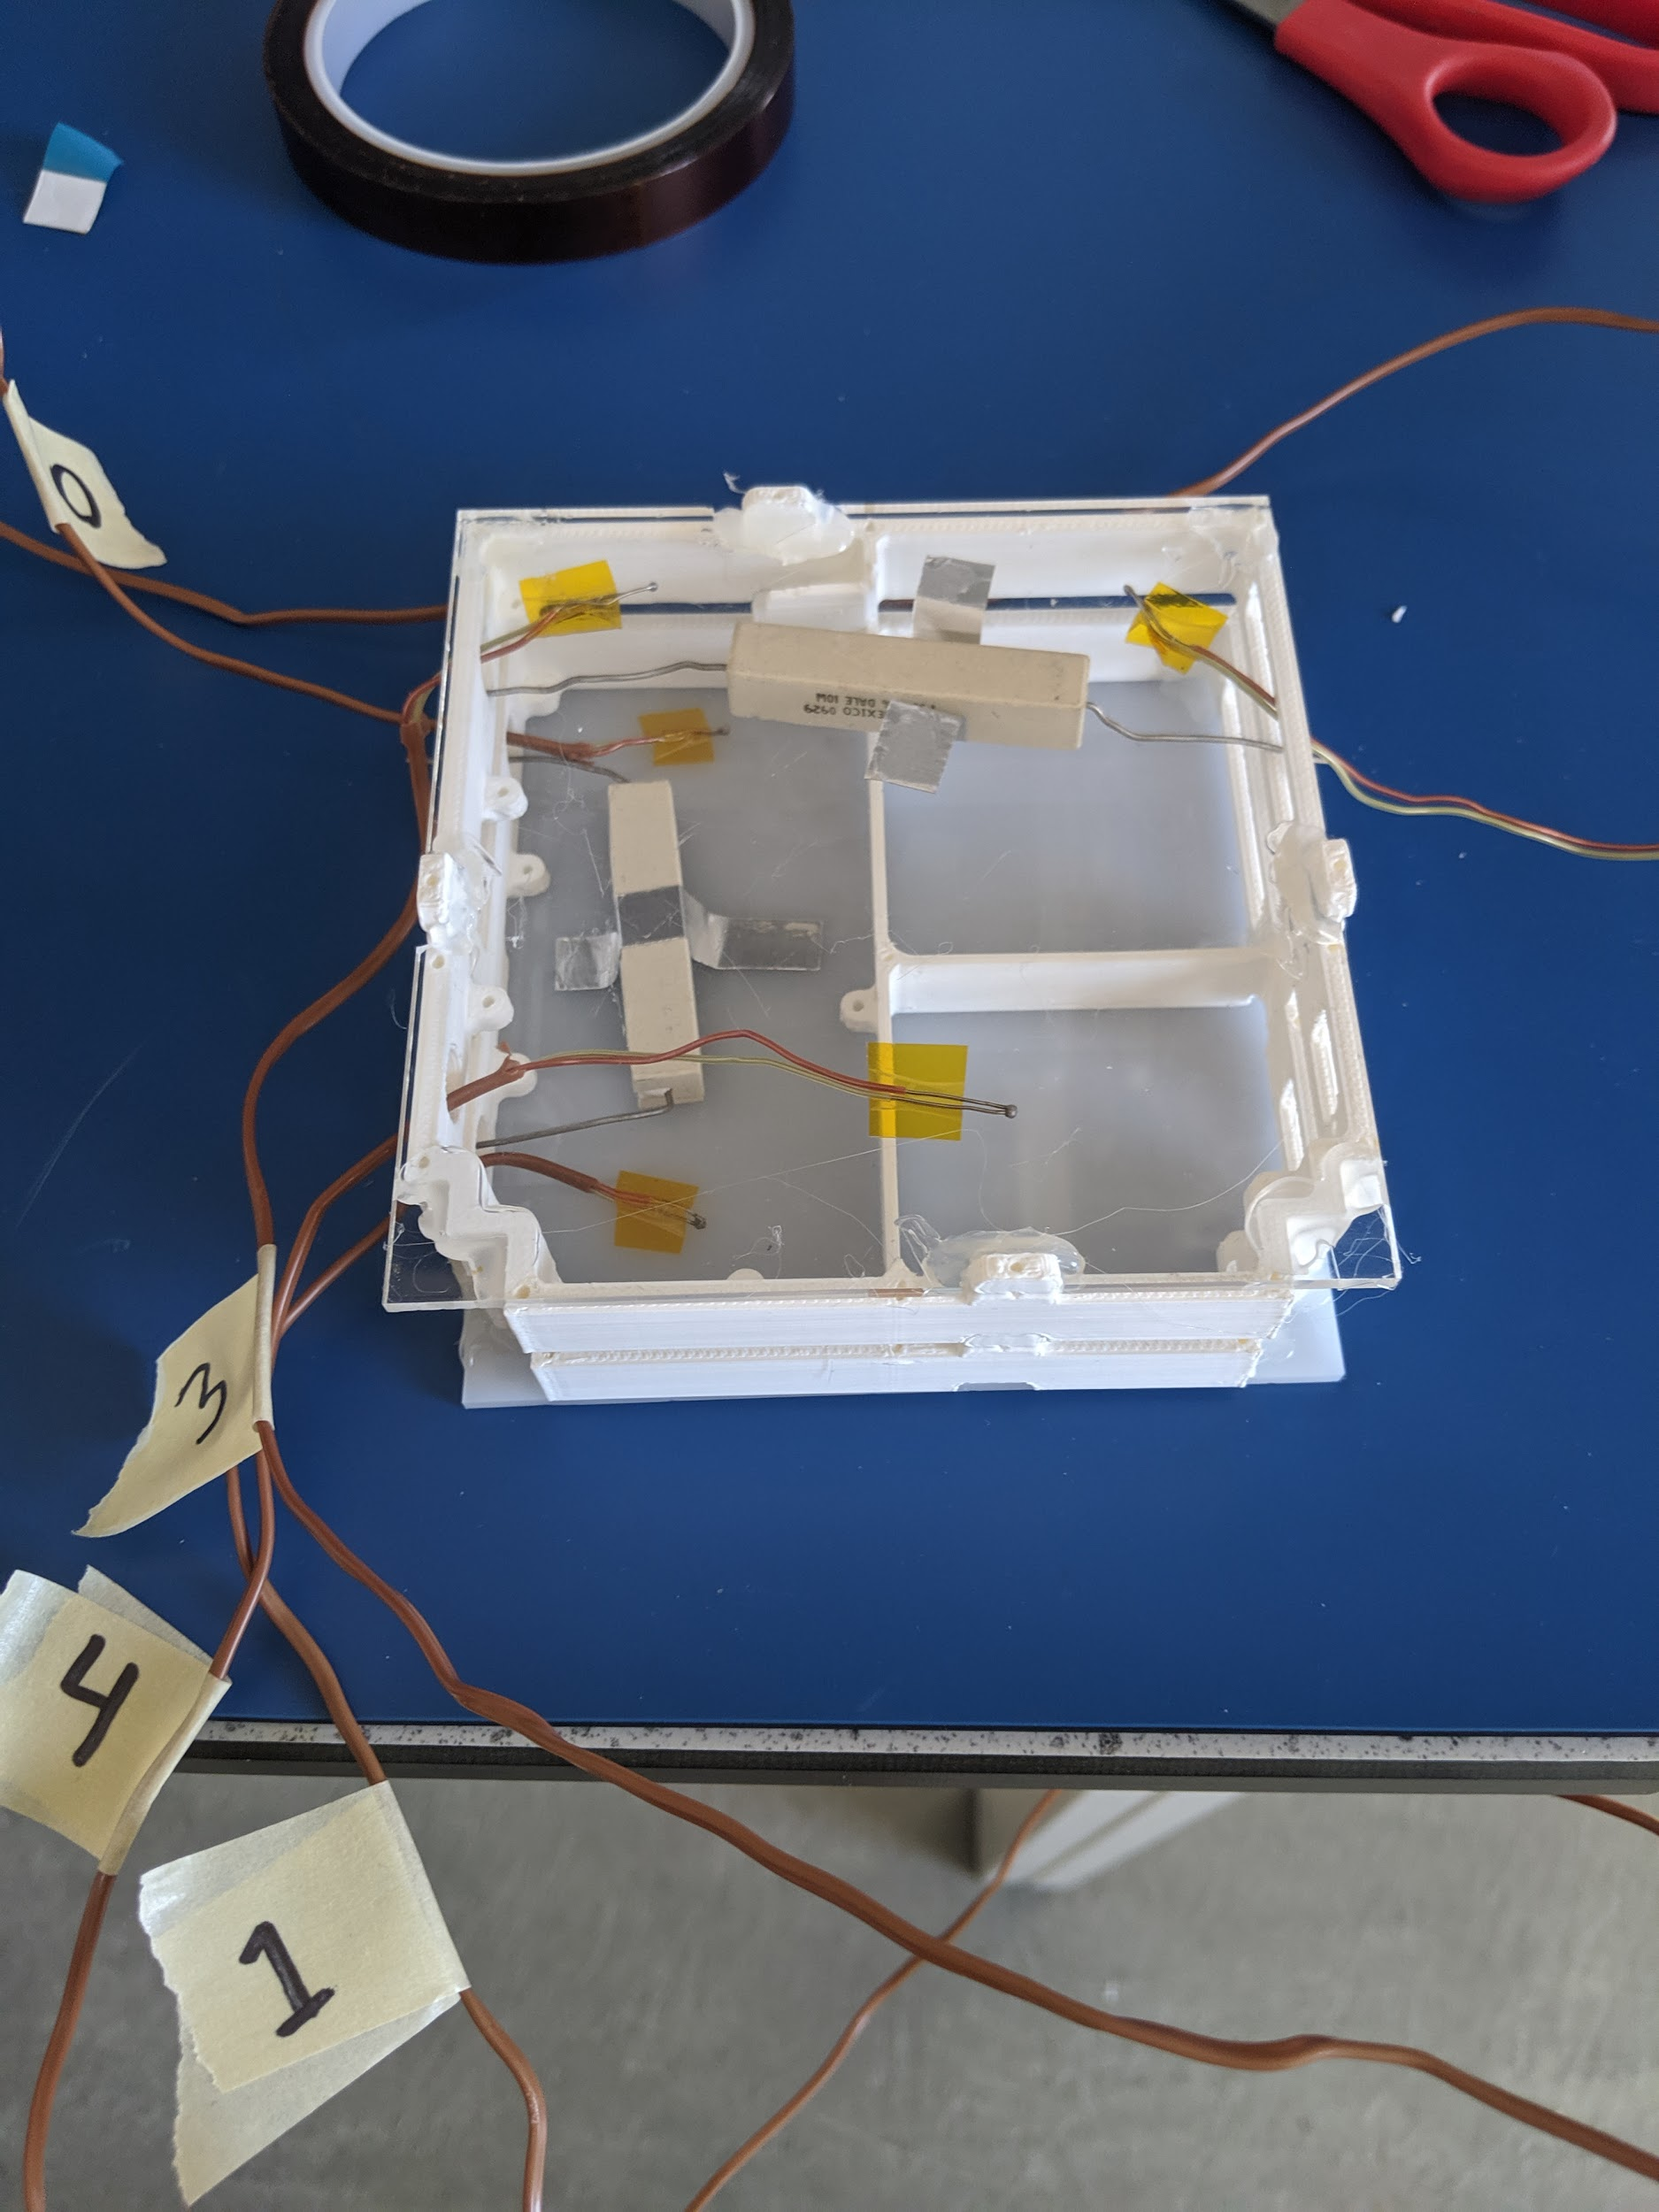
Baseline Test
Relevant Design Requirement:
The payload shall be able to withstand the ambient temperature range of flight (-56°C, 38°C)
Control Test:
No insulation, acrylic backing
Insulation Test:
3/16 inch polystyrene
Test Conditions:
Dry ice inside cooler
Ambient temperature of -60°C
No direct contact between dry ice and test specimen.
Power Resistors
Test Status
Complete
Models Verified
Effect of Insulation on Temperature (Preliminary Model)
Thermocouples

Slide 99
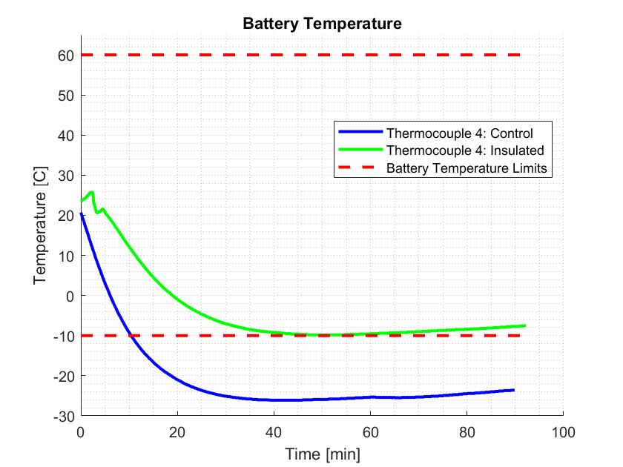
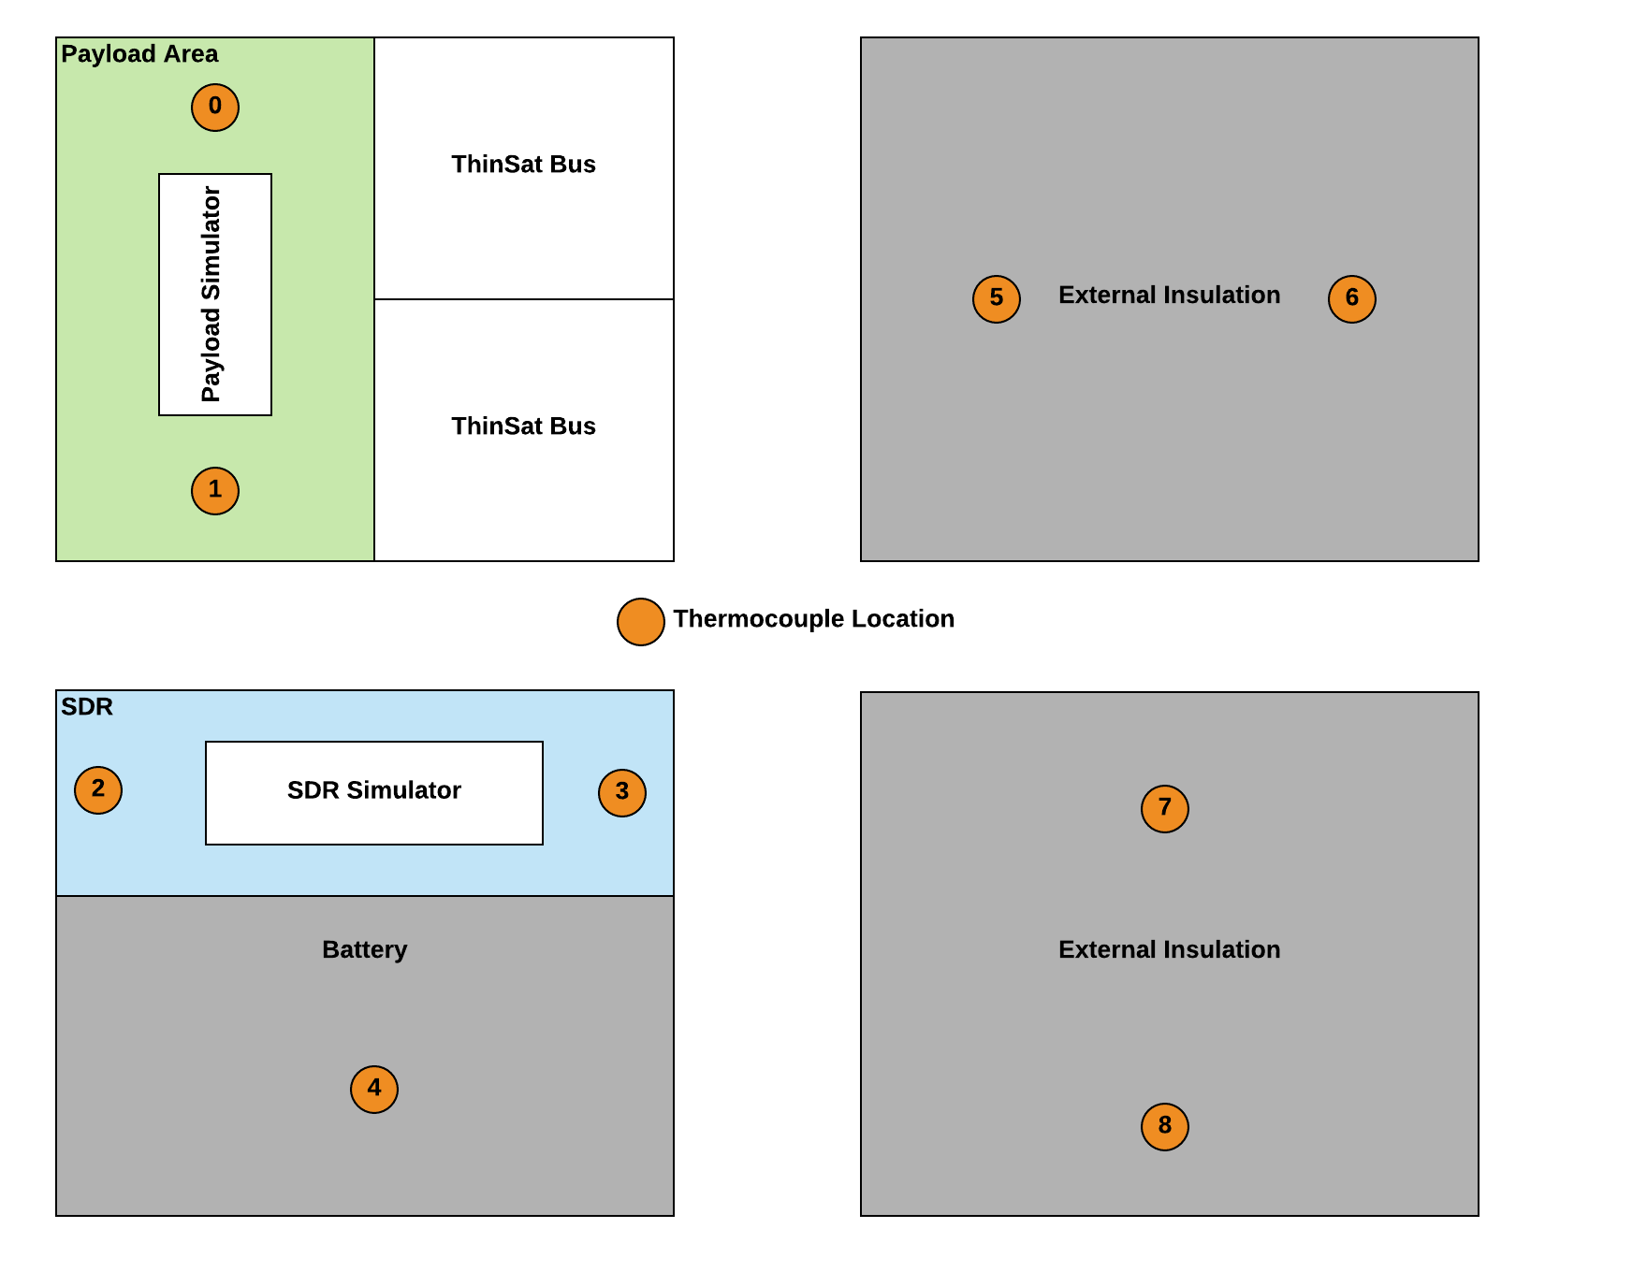
Baseline Test
Notes:
Presenter: Lara
TAKEAWAY: Presents the test results for the battery area, shows why we added thermal as a risk (no margin on low temp even with insulation).
First present the tests, then the test setup (bottom left), then the plot. Present the axes first, then the colors, then the actual results.
Battery temperature cannot go below -10 according to power budget.
Adding insulation raises the temperature almost 15 C. Adding more layers should be able to keep the battery warm enough
Insulating the battery directly could also help keep it warm.
Further testing will explore more layers of insulation and/or different types of insulation.
Other option is to directly insulate battery
Rest of results are in the backups
Heritage data is in the backup slides
No TVAC - talked to Dr. Li, Jackson, and thermal engineers at LASP. Also, heritage flights have had no TVAC testing.
Talk about errors in test.

Slide 100
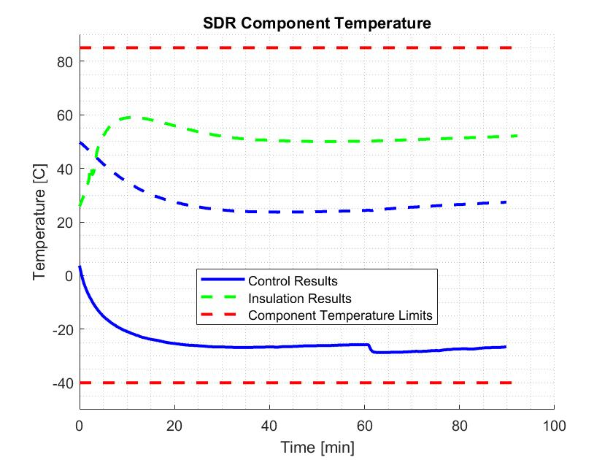
Baseline Test
*Thermocouple 2 fell off during insulation test, therefore not shown.
Notes:
TAKEAWAY: This slide presents the test results for the SDR
Solid line is T2
Dashed line is T3

Slide 101
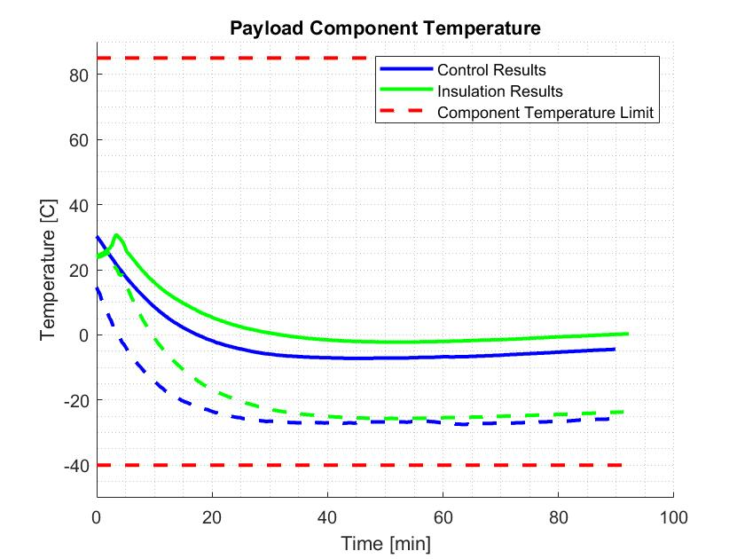
Baseline Test
Notes:
TAKEAWAY: This slide presents the test results for the payload
Solid line is T0
Dashed line is T1

Slide 102
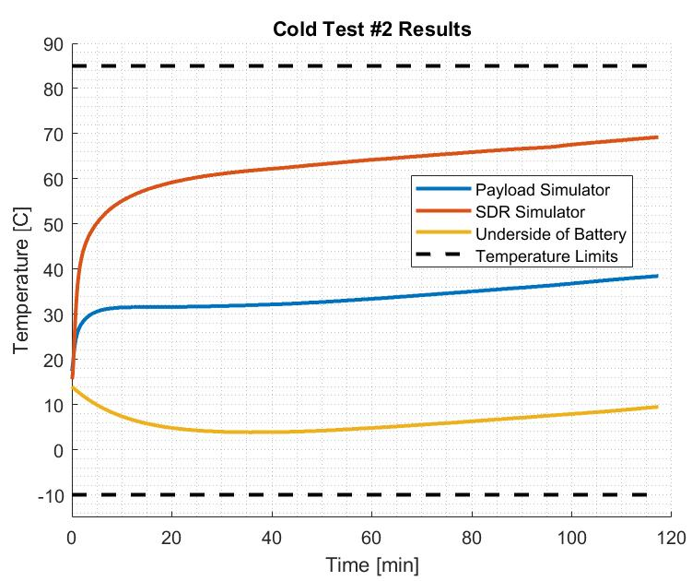
Cold Test #2
Relevant Design Requirement:
The payload shall be able to withstand the ambient temperature range of flight (-56°C, 38°C)
Test Status
Complete
Models Verified
Baseline Test Results
Notes:
Proper insulation and fully stocked ThinSat reduces risk of cold temperatures
Heat needs to be transferred away from SDR

Slide 103
Cold Test #3
Relevant Design Requirement:
The payload shall be able to withstand the ambient temperature range of flight (-56°C, 38°C)
Expected Completion Date: March 6th, 2020
Objective: Characterize battery performance at low temperatures
Key Requirements:
FR 3 The payload shall be operational throughout the duration of the balloon flight
Success Criteria:
Full Success: Battery doesn’t fully discharge prematurely
How it Reduces Risk: Demonstrates integrated ThinSat can operate in extreme environment of near-space
Test Status
Incomplete
Models Verified
Baseline Test Results
Notes:
Proper insulation and fully stocked ThinSat reduces risk of cold temperatures
Heat needs to be transferred away from SDR

Slide 104
Integrated Cold Test
Objective: Verify Requirements 3 and 3.1, ensure all components operate under thermal environment
Key Requirements:
FR 3 The payload shall be operational throughout the duration of the balloon flight
Success Criteria:
Full Success: All subsystems are fully operational throughout the test
How it Reduces Risk: Demonstrates integrated ThinSat can operate in extreme environment of near-space
Expected Completion Date: April 10th, 2020
Relevant Design Requirement:
The payload shall be able to withstand the ambient temperature range of flight (-56°C, 38°C)
Test Status
Incomplete
Models Verified
Baseline Test Results, Cold Test #2 Results
Notes:
Proper insulation and fully stocked ThinSat reduces risk of cold temperatures
Heat needs to be transferred away from SDR

Slide 105
Thermal Risk Status
Cold: Cold temperatures result in off-nominal operation of components and loss of battery performance
Heat: Heat from the SDR or payload board is localized and builds up in components, leading to overtemps and component failure
Mitigations:
Test results show cold temperature is a low risk
Added copper heat sink will reduce heat risk
Cold
Heat

Slide 106
Finance
Backup Slides

Slide 107
Finance Fall Expenditures

Slide 108
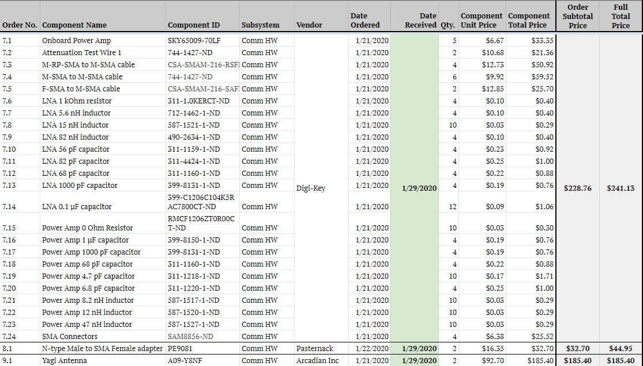
Finance Spring Expenditures

Slide 109
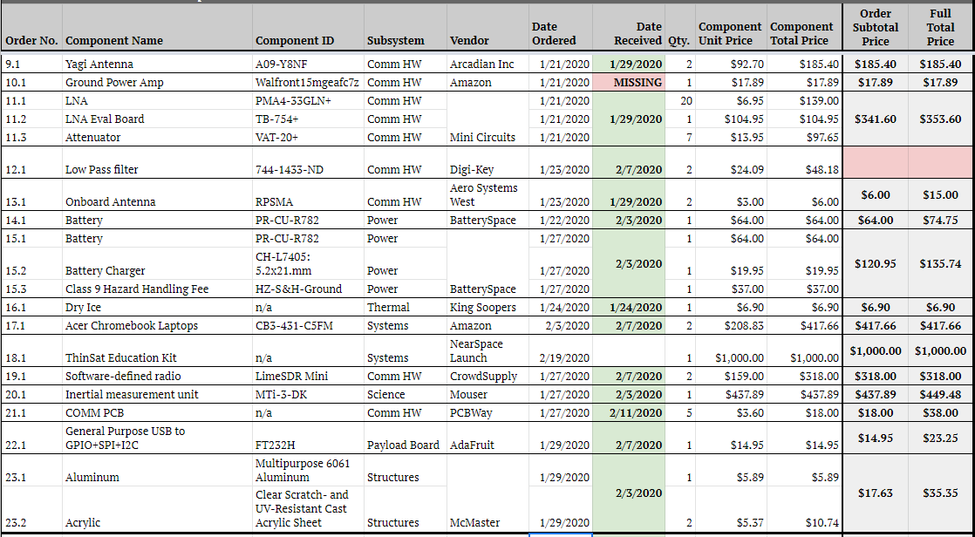
Finance Spring Expenditures

Slide 110
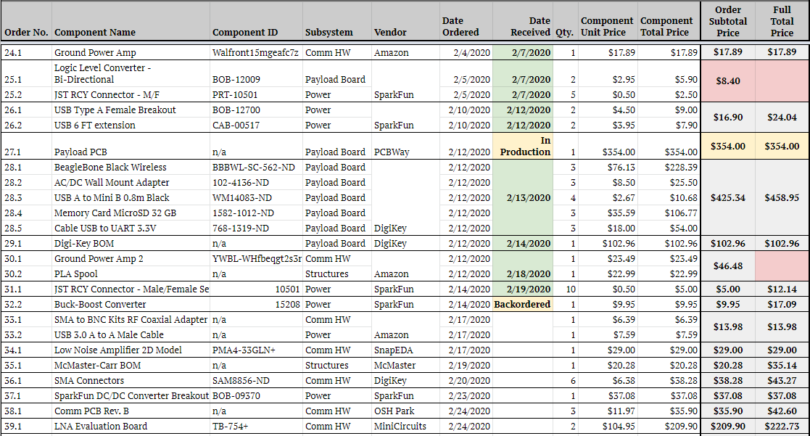
Finance Spring Expenditures

