Slide 1
Final Oral Review

Slide 2
Project Purpose
Notes:
Katie

Slide 3
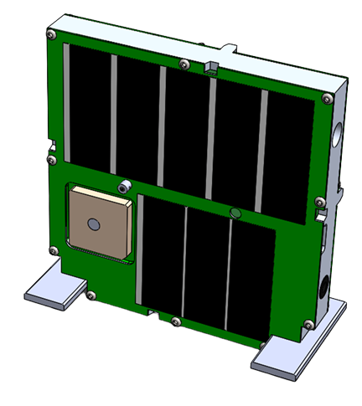
TOMCAT Mission
Raytheon Mission
Low-Earth Orbit
Test Commands
Test Telemetry
30 km
Test Commands
Test Telemetry
TOMCAT Ground System
Raytheon Test Ground System
Notes:
Katie

Slide 4
GOAL: Constant 2-way
communication
30 km
TOMCAT Flight System
⬆ Take Data Commands
⬇ Science / Health Data
TOMCAT Ground Station
Notes:
Katie

Slide 5
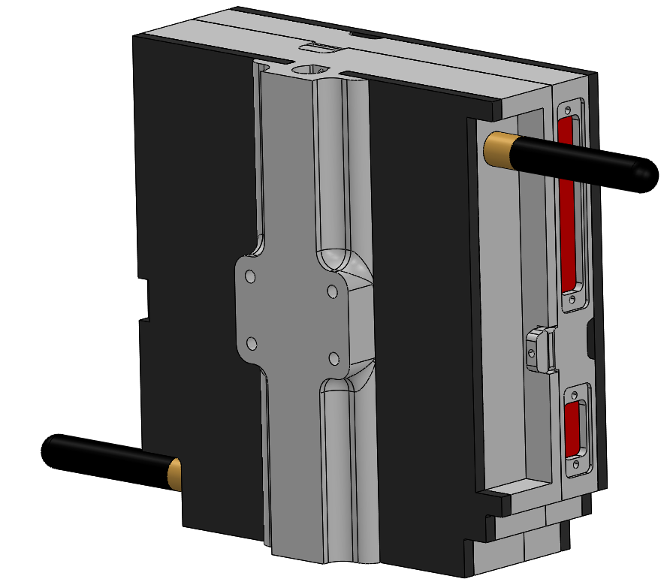
Levels of Success
Level 1 (L1)
Wired benchtop communication
Level 2 (L2)
Wireless communication (short range)
Level 3 (L3)
Wireless communication (long range)
Balloon survivability
Notes:
Katie

Slide 6
Top Level Design
Notes:
Katie

Slide 7
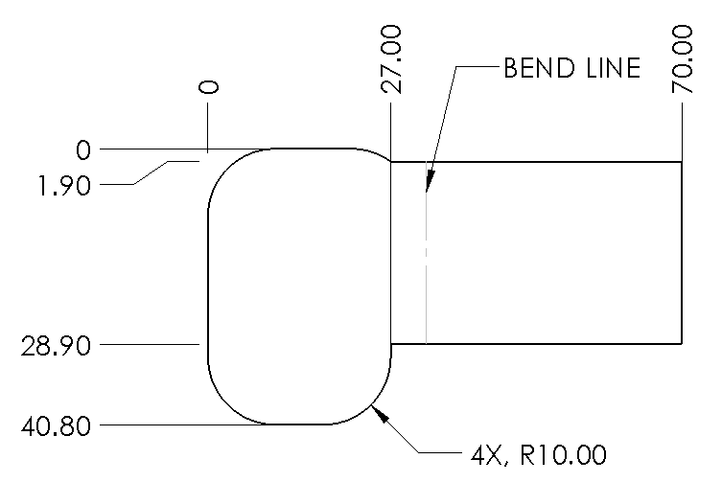
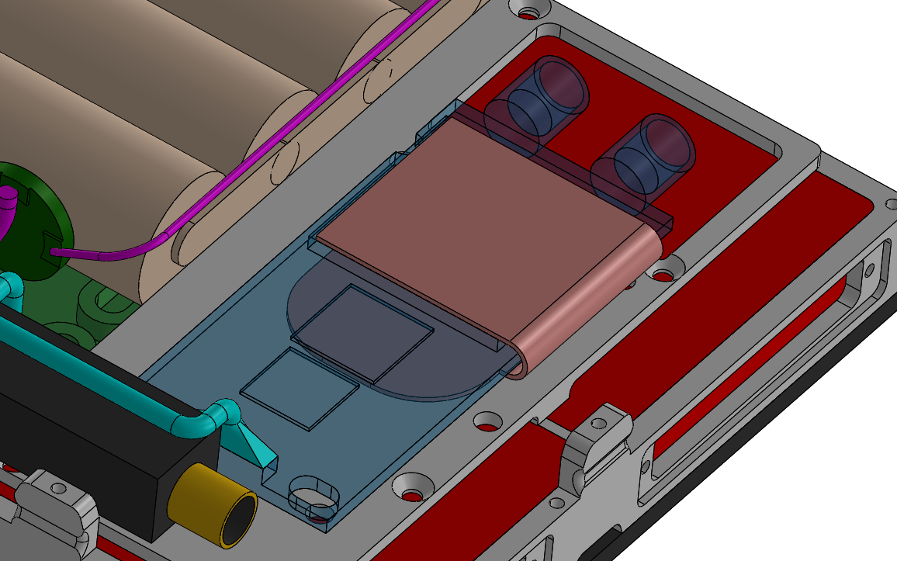
Post-TRR Changes
Thermal Design:
Finalized plans to address overheating
Copper strip
acts as heat pipe
Primary concern
Secondary concerns
In the TOMCAT Satellite
Notes:
Srikanth

Slide 8
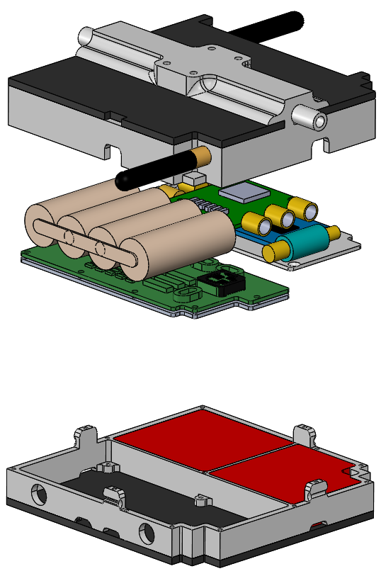
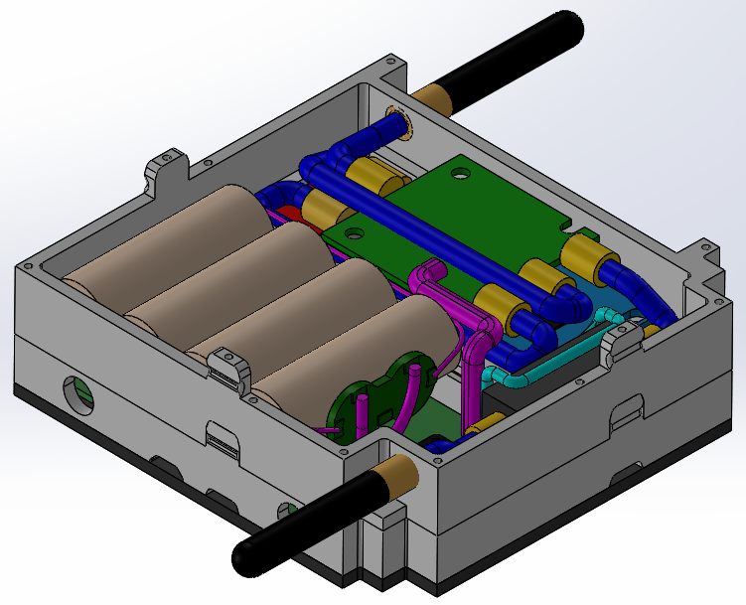
Satellite Model: Physical Specifications
TOMCAT Slice
Full Satellite
33.1 mm
114.2 mm
111.1 mm
Mass: estimated 650g
ThinSat Kit Slice
Notes:
Srikanth

Slide 9
Satellite Model: Electrical Specifications
Comm Board
Battery
Specification | Result | Margin
Link Margin: | 31.30 dB-Hz (downlink) | 3.13
 | 15.53 dB-Hz (uplink) | 1.55
Data Rate: | 72,000 bps (downlink) | N/A
 | 128 bps (uplink) | N/A
Battery Capacity: | 4046 mAh | 1.12
Absolute Max Current: | 3 A | 1.8
Payload Board
Notes:
Srikanth

Slide 10
FBD and Data Flow
TOMCAT Flight System
Battery
Custom TOMCAT
PCB
IMU
COMM
Hardware
Microcontroller
TOMCAT Ground Station
SDR
Signal Processing Software
Flight Software
Laptop
Ground Software
COMM
Hardware
SDR
Signal Processing Software
Notes:
Srikanth

Slide 11
FOR Critical Elements
TOMCAT Flight System
Battery
Custom TOMCAT
PCB
IMU
COMM
Hardware
Microcontroller
TOMCAT Ground Station
SDR
Signal Processing Software
Flight Software
Laptop
Ground Software
COMM
Hardware
Thermal Materials
SDR
Signal Processing Software
Notes:
Srikanth

Slide 12
Communications Testing
Notes:
Srikanth

Slide 13
Communications Testing
Link Budget Model
Wired Tests
Power Test
Short Range Test
Long Range Test
Verify
COMM Software
Hardware Functionality
Verify
Expected Power Outputs
Verify
Wireless Transmission Performance
Verify
Wireless Transmission with Increased Noise
Model Components
Modulation Technique
Component Gain
Component Loss
Model Components
Total Power Output
Component Power
Model Components
Bit Error Rate
Data Rate
Model Components
Bit Error Rate
Data Rate
Function Requirement 2: The payload shall communicate with the ground system during the balloon flight
Notes:
Lauren

Slide 14
Testing Overview - COMMS Wired
Component Testing
Low Pass Filter
Low Noise Amplifier
Power Amplifier
Custom COMM PCB
Primary Objectives
Characterize the performance of critical communication system components in terms of expected attenuation, losses, and gains
Update Link Budget model as necessary
Functional Requirement 2:
The payload shall communicate with the ground system during the balloon flight
Notes:
Lauren

Slide 15
Testing Overview - COMMS Power
Component Testing
SDRs
Total Transmit Power
Primary Objectives
Compare the power output to what is reported in the datasheets and what is propagated through the chain
Update Link Budget model as necessary
Functional Requirement 2:
The payload shall communicate with the ground system during the balloon flight
Notes:
Lauren

Slide 16
Testing Results - COMMS Power
Expected Results:
Models Verified
Link Budget Model
SDR Power Test
Power output: 0 dBm
Test Supplies
One SDR
Transmitter
Spectrum Analyzer
RF Chain
Attenuators
40 dB
Location
Dr. Palo’s Lab
Full Transmit Chain
Power output (onboard): 33 dBm
Power output (ground): 27 dBm
Goals:
Validate power transmission level from SDRs and from entire transmission RF chain
Model Assumptions:
SDR Power output matches what is reported in the datasheet
Power Changes through chain are as is expected from the component performance previously documented
Notes:
Lauren
Dr. Rainville suggested 17 dB margin -- to keep this, ground chain can go down to 15 dBm onboard should not change.

Slide 17
Testing Overview - COMMS Long Range
COMM Long Range Testing
Long Range Test
(7 Kilometers)
Attenuated Test
(7 Kilometers)
Primary Objective
Characterize wireless communication performance capabilities with increased noise and range
Functional Requirement 2:
The payload shall communicate with the ground system during the balloon flight
Notes:
Lauren

Slide 18
Testing Results - COMMS Long Range
Expected Results:
Models Verified
Link Budget Model
Long Range Test
(7 Kilometers)
Data Rate (Uplink): 256 bps
Data Rate (Downlink): 144 kbps
Bit Error Rate (Uplink): 10^(-6) per bit
Bit Error Rate (Downlink): 10^(-5) per bit
Attenuated Test
(7 Kilometers)
Test Supplies
Two SDRs
RF Chain
Attenuators
140 dB
Antennae
Location
US 36 Overlook
LASP roof
Goals:
Validate RF design is capable of fulfilling link budget wirelessly long range
Introduce system to real world interference
Changes to Model:
Expect transmission over Boulder to be subject to a higher noise level than transmitting into near space
The model will not be updated based on this test
Notes:
Lauren

Slide 19
Link Budget Model vs. Results
Link Budget Model Assumptions
Impact on Results
Component performance matches datasheet (gain, loss, output power)
Could increase or decrease predicted Link Margin
Environmental noise matches what is as predicted with the free space loss equation
Not likely for long range tests with antennas pointed across Boulder
Likely will not receive signal for 7km attenuated test
Noise will be higher than predicted (unable to predict how much higher due to variability in this open ISM band)
Notes:
Lara

Slide 20
Thermal Testing
Notes:
Lauren

Slide 21
Thermal Testing Overview
Preliminary Thermal Modeling
Steady-State 1D Model
Characterize performance of insulation
Baseline Physical Model
Create a model to characterize temperature
Cold Tests
Verify baseline physical model
Improve physical model
Provide test platform for battery
Integrated Cold Test
Verify physical models
Meet requirement 3, 3.1
Characterize actual component performance
Functional Requirement 3:
The payload shall survive and operate in the environment during all stages of the balloon flight
Notes:
Lara

Slide 22
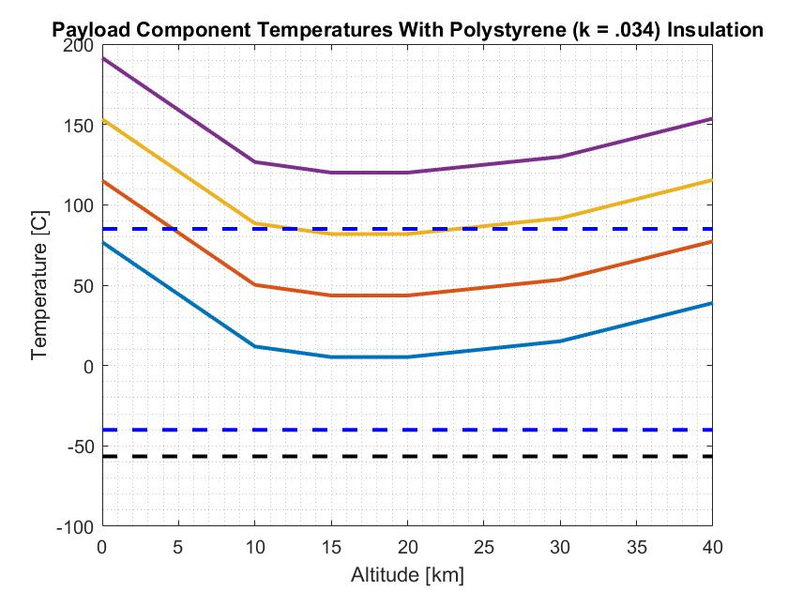
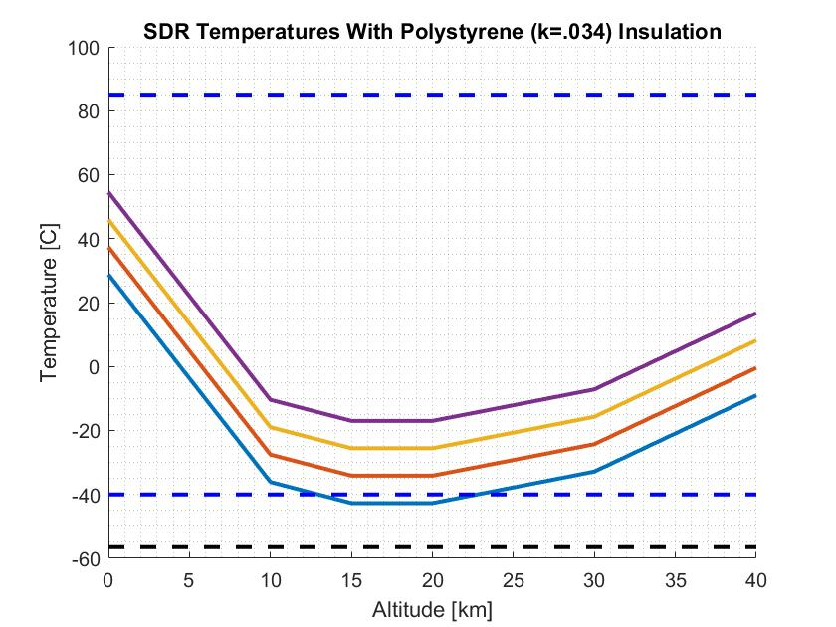
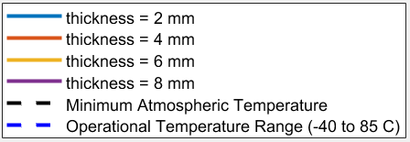
Preliminary Thermal Model
Takeaways:
Insulation will raise the temperature
Testing is needed for more accurate temperatures
Steady-State, 1D is a poor assumption
Notes:
Lara

Slide 23
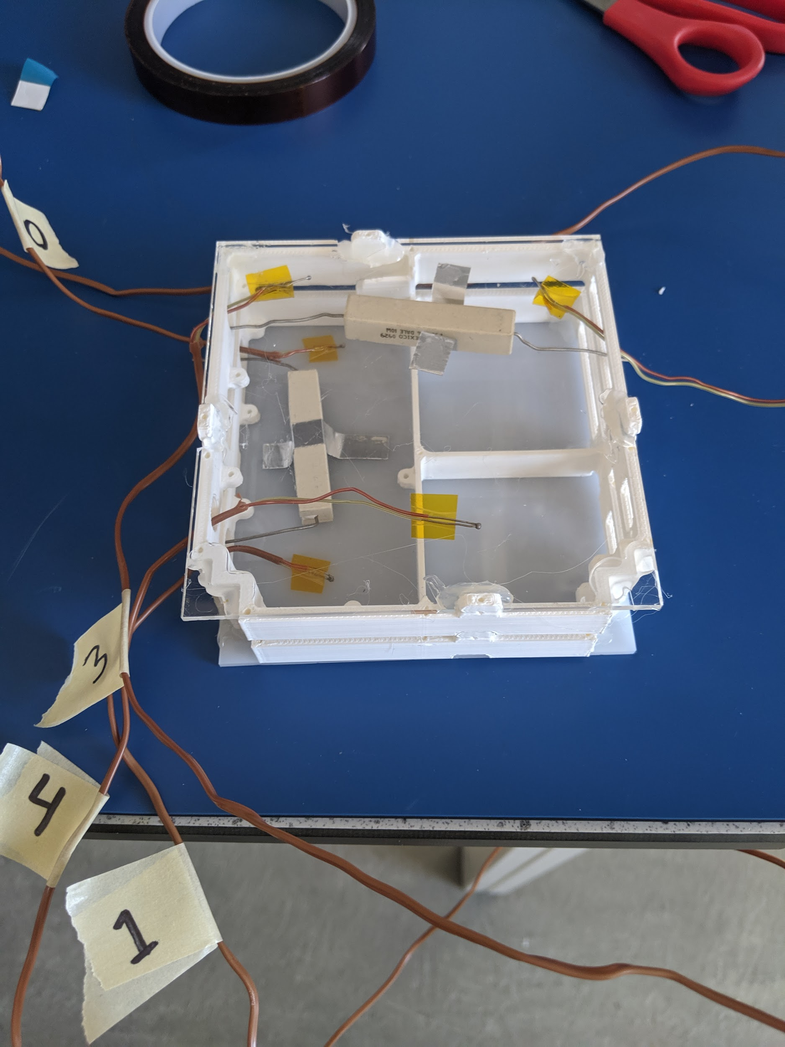
Baseline Physical Model
Control Test:
No insulation, acrylic backing
Insulation Test:
3/16 inch polystyrene
Test Conditions:
Dry ice inside cooler
Ambient temperature of -60°C
No direct contact between dry ice and test specimen
TOMCAT Test Specimen (Control Configuration)
Power Resistors
Thermocouples
Notes:
Lara

Slide 24
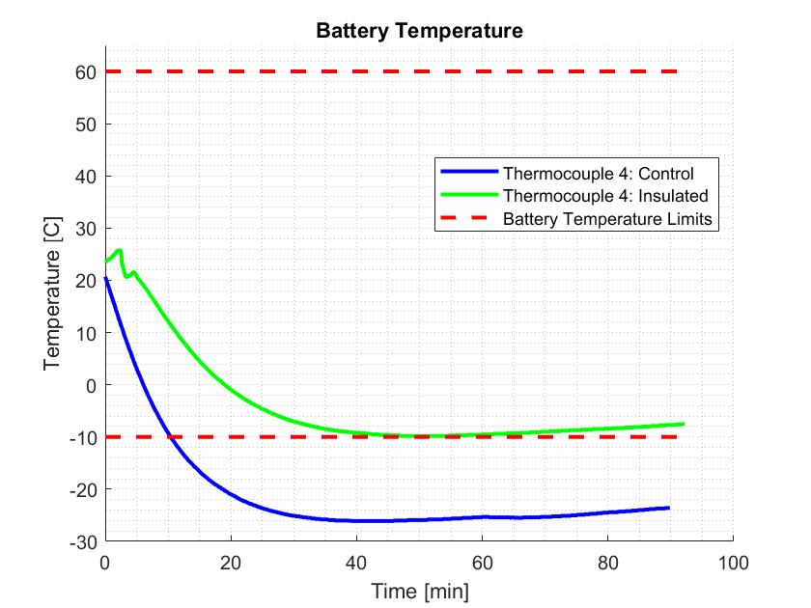
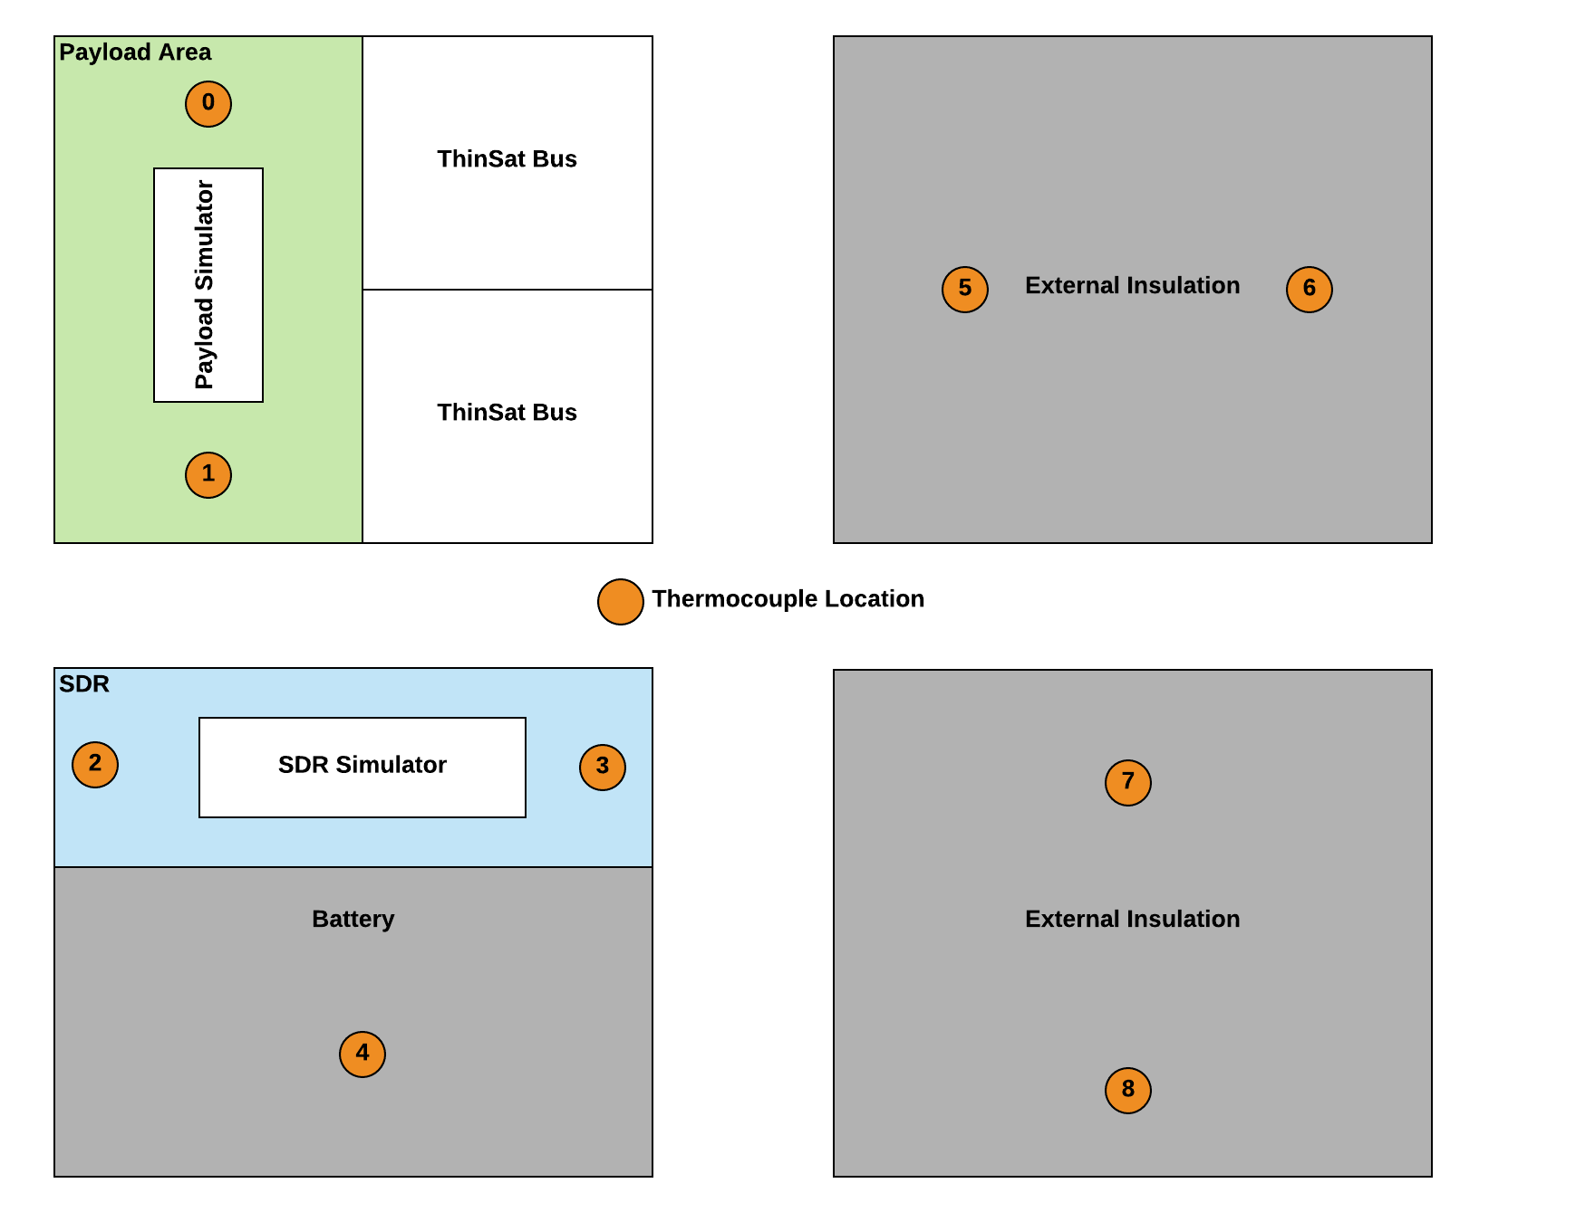
Baseline Physical Model
*Full results in backup slides
Takeaways:
No margin on battery, imperfect model may cause errors
Risk of cold temperatures affecting battery performance
Notes:
Lara
TAKEAWAY: Presents the test results for the battery area, shows why we added thermal as a risk (no margin on low temp even with insulation).
First present the tests, then the test setup (bottom left), then the plot. Present the axes first, then the colors, then the actual results.
Battery temperature cannot go below -10 according to power budget.
Rest of results are in the backups

Slide 25
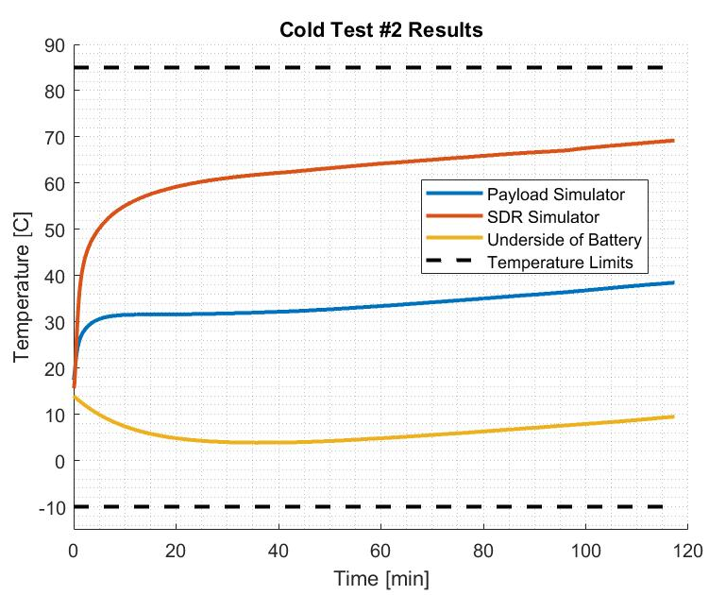
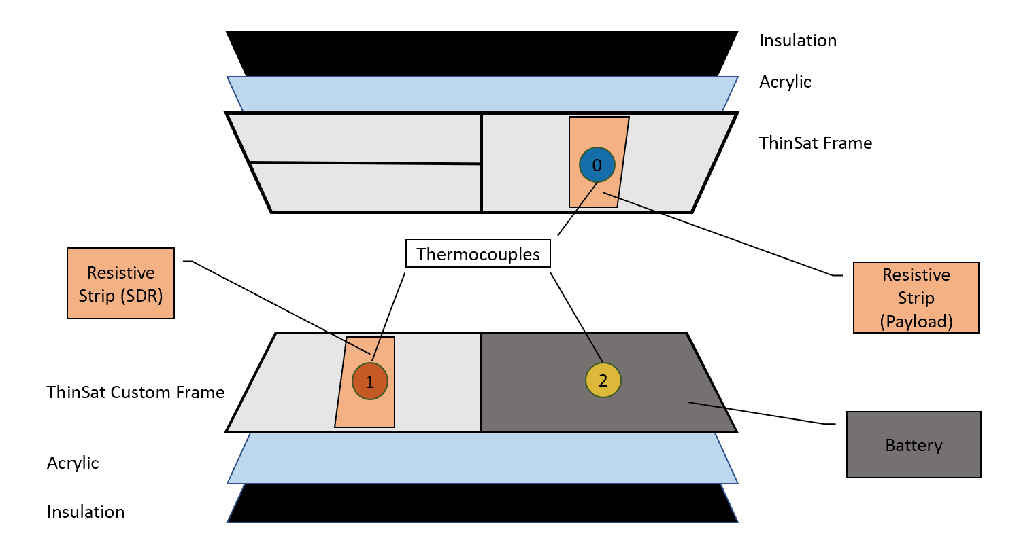
Cold Test #2
*Images of test set up in backup slides
Takeaways:
Improvement of baseline physical model
Addition of components leads to risk of overheating
Notes:
Lara
Proper insulation and fully stocked ThinSat reduces risk of cold temperatures
Cold Test #3 is emphasized in Power backup slides (more of a battery cold test than a full thermal system test)
Heat needs to be transferred away from SDR

Slide 26
Thermal Integration Test
Integration Testing
Fully Integrated Thermal Test
Models Verified
Preliminary Thermal Model
Physical Models
Component Datasheets
Thermal day in the life test
Battery state of charge test
Component thermal monitoring
Test Supplies
Thermocouples (minimum 3)
All ThinSat Hardware
DAQ and LabView Software
Location
LASP Freezer or BioServe Freezer
Goals:
Validate physical thermal models
Verify Requirements 3 and 3.1
Ensure all components operate under thermal environment
Results:
Thermocouple temperature readings for each component
Data should be similar to physical model (Cold Tests)
Notes:
Lara
Testing Overview

Slide 27
Thermal Model vs. Results
Physical Model Assumptions/Errors
Impact on Results
Resistive strips dissipate heat throughout entire length.
Actual components may have smaller areas of heat concentration.
Convection inside cooler may not replicate actual conditions.
Error would not change for integration test, but would show up in balloon flight.
All components assumed to draw maximum power.
Components may draw less power, lowering amount of heat dissipated.
Notes:
Lara

Slide 28
Integration Testing
Notes:
Lara

Slide 29
Testing Overview - Full System
Full System Long Range Integration Testing
CU East Campus to US 36 Overlook
Primary Objective
Simulate and characterize actual flight performance with full integration of subsystems
Fully Assembled and Independent ThinSat Module
7 km
Fully Assembled Ground Station
Notes:
Lauren

Slide 30
Testing Results - Full System
Expected Results:
Long Range Test
(7 Kilometers )
Bit Error Rate (Uplink: 256 bps Downlink: 144 kbps)
Data Rate (Uplink: 10^(-6) per bit Downlink: 10^(-5) per bit )
Batteries can support ~5 hours of operation
Commands sent from ground and executed on onboard
Telemetry collected and transmitted to ground station
Test Supplies
COMM System
Hardware
Software
Power System
Thermal System
Ground Software
Flight Software
Location
US 36 Overlook
LASP roof
Goals:
Validate full system integration
Verify all requirements are met
Notes:
Lauren

Slide 31
Systems Review
Notes:
Lauren

Slide 32
Project Formulation
Scope development
Requirements derivation
5 major functional requirements
37 additional design sub-requirements
Technical and logistical trade studies
Custom PCB vs. Off-the-shelf
Communications Frequency
Balloon flight: Indiana vs. Gateway
September
April
Project Formulation
Integration and Test
Design Iteration
October
March
Notes:
Katie

Slide 33
Design Iteration
Develop and continuously update CAD model
Help ensure candidate designs fulfil physics size requirements and limitations
Develop software architecture and flowchart
Guide software design and interface to meet project requirements
Component testing where possible
Verify and validate models as soon as possible
Modify design as needed to meet requirements
September
April
Project Formulation
Integration and Test
Design Iteration
October
March
Notes:
Katie

Slide 34
Integration and Test
System testing to ensure proper assembly
Make sure combined components still meet requirements
Characterization of the design
Creating a “datasheet” for the customer
Not just checking the V+V box, but quantifying how well requirements were met
Quantifying effectiveness of the models
September
April
Project Formulation
Integration and Test
Design Iteration
October
March
Notes:
Katie

Slide 35
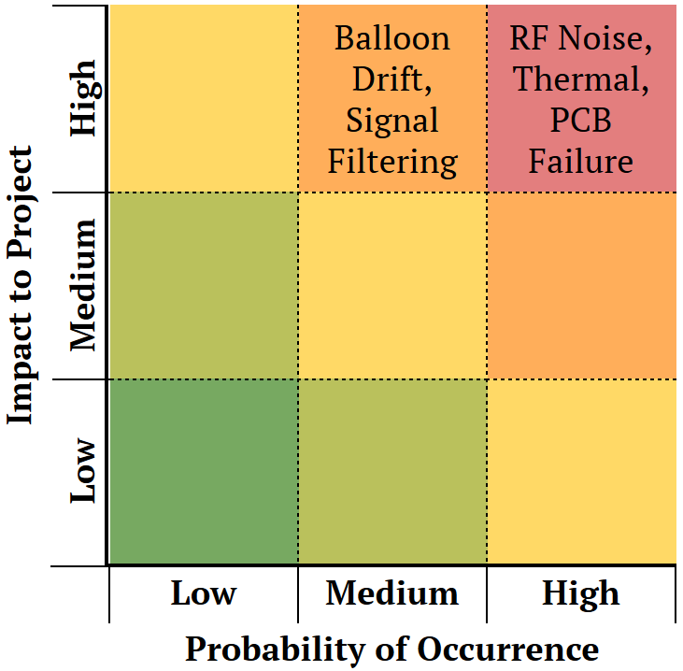
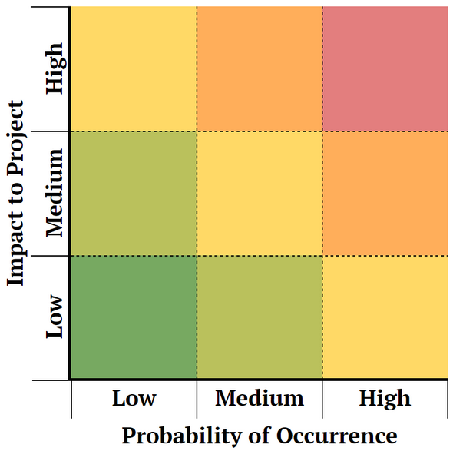
Risk Evolution
Thermal
Shipping
Shipping
PCB Delays
Structure
CDR Risks
Current Risks
Risks identified at CDR were similar, but not exact
Thermal: ❄️ → 🔥
PCB: Shifted from failure to delays (mostly caused by COVID-19 in China)
Structure: New risk! Failure on landing would not impact ability to fulfill comm requirements, but does jeopardize survivability requirements
Notes:
Katie

Slide 36
Lessons Learned
Clear requirements!
Allow requirements to guide design
Major example: KubOS vs. Lightweight FSW
KubOS was not specified as a requirement. Either should have been or switch to Lightweight should have been made sooner
Make sure to limit project scope
Some scope creep from customer (handled fairly well)
Hidden source of creep from within team
Examples include added complexity of Comm PCB, requirements for testing some systems to desired levels (structures, communications system)
Notes:
Katie

Slide 37
Management
Notes:
Katie

Slide 38
Fundamentals of Team Leadership
Project management triangle
Treat time, cost, and quality like currency. Trade off between all 3 to meet requirements
Remove roadblocks
Team leads manage their subsystems, ensure nothing gets in their way
Fail early, fail often
The sooner you can make a mistake, the more time there is to learn from it and fix it
Time
Quality
Cost
Note: Cost only tradable because of recognizing utility of the additional Raytheon funding early.
Not often available in Senior Projects
Notes:
Cole

Slide 39
Management Analysis
Major Success:
Parallel development
Fast design pivots
Technical and leadership roles for all
Major Shortcomings:
Team member isolation
Backend/prep obscured
Summary:
Aggressively on schedule, often to the detriment of team morale
Smooth sailing on the surface, but at the cost of behind-the-scenes work going largely unnoticed
Notes:
Cole

Slide 40
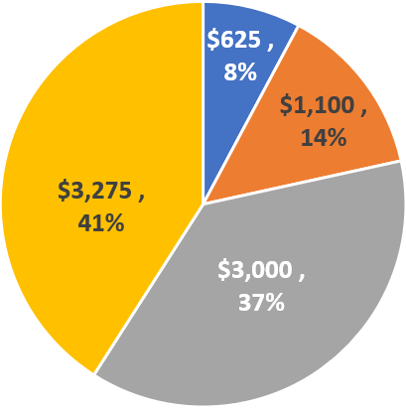
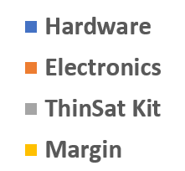
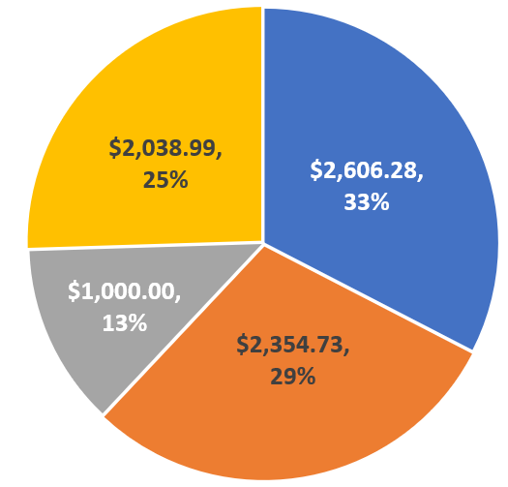
Budget Comparison
CDR Financials:
Total Cost: $4,725
Final Financials:
Total Cost: $5,961
+ $1,236 costs
Major Differences:
Thinsat Kit: $3,000 → $1,000
No more balloon launch
Payload Board: $860 → $1,611
Custom assembly charges
Communications: $530 → $2,273
Communications PCB, more spare parts
Notes:
Cole

Slide 41
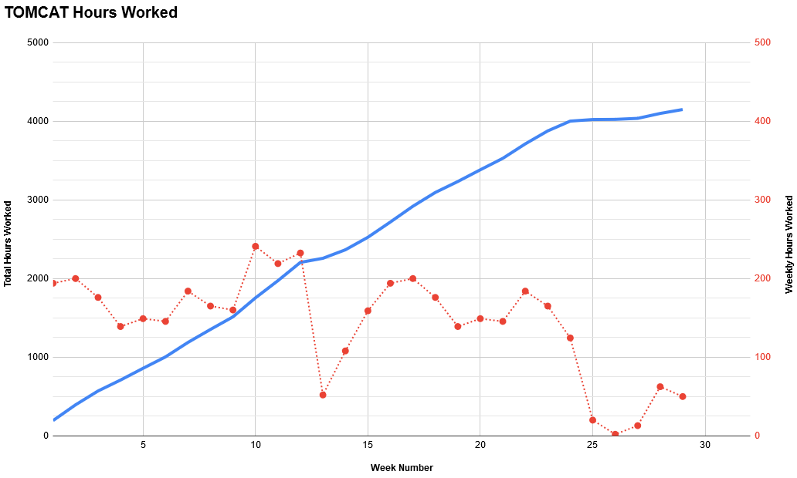
Equivalent Project Cost
Total Hours:
4149 hrs
Material Costs:
$5961
Equivalent Labor:
$129,656
Overhead (200%):
$259,313
4149 hrs
COVID
$394,930
Winter Break
Notes:
Cole

Slide 42
Questions?
Notes:
Cole

Slide 43
Backup Slides

Slide 44
Main Table of Contents
CONOPS
Levels of Success
Post-TRR Changes
Top Level Design
FBD and Data Flow
Comm Testing Overview
Transmit Power Testing
Range Testing
Comms Modeling vs. Testing
Thermal Testing Overview
1D Analytical Model
Physical Baseline Model
Cold Test #2
Cold Integration Test
Thermal Modeling vs. Testing
Full System Testing
Systems V
Risk Evolution
Management Review
Budget

Slide 45
Backup Table of Contents
Comm Hardware
Comm Software
Flight Software
Ground Software
Payload Board
Power
Science
Structures
Thermal
Finance

Slide 46
Comm Hardware

Slide 47
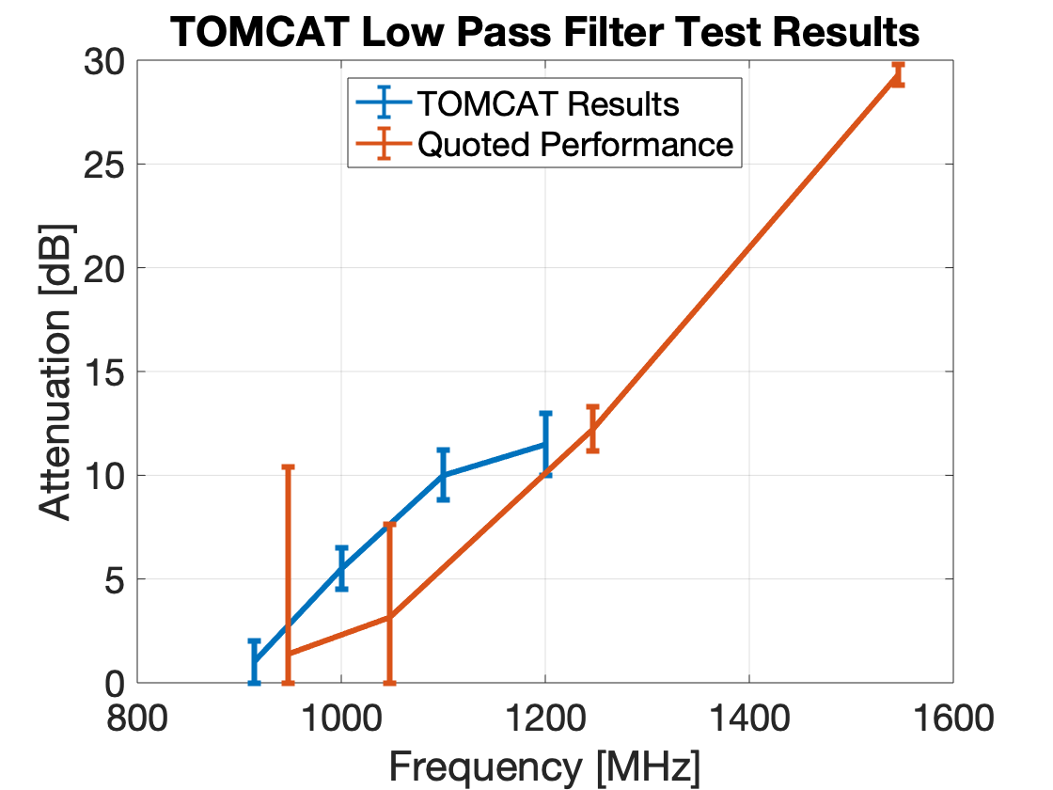
Testing Results - COMM Wired
Attenuation Testing
Loss Testing
Models Verified
Link Budget Model
Low Pass Filter
Expected Insertion Loss
1.38 dB
Actual Insertion Loss
1 dB
Margin is acceptable!
Since we are below the expected insertion loss
Test Supplies
Two SDRs
Transmitter
Spectrum Analyzer
Low Pass Filter
Attenuators
40 dB
Location
Electronics Lab

Slide 48
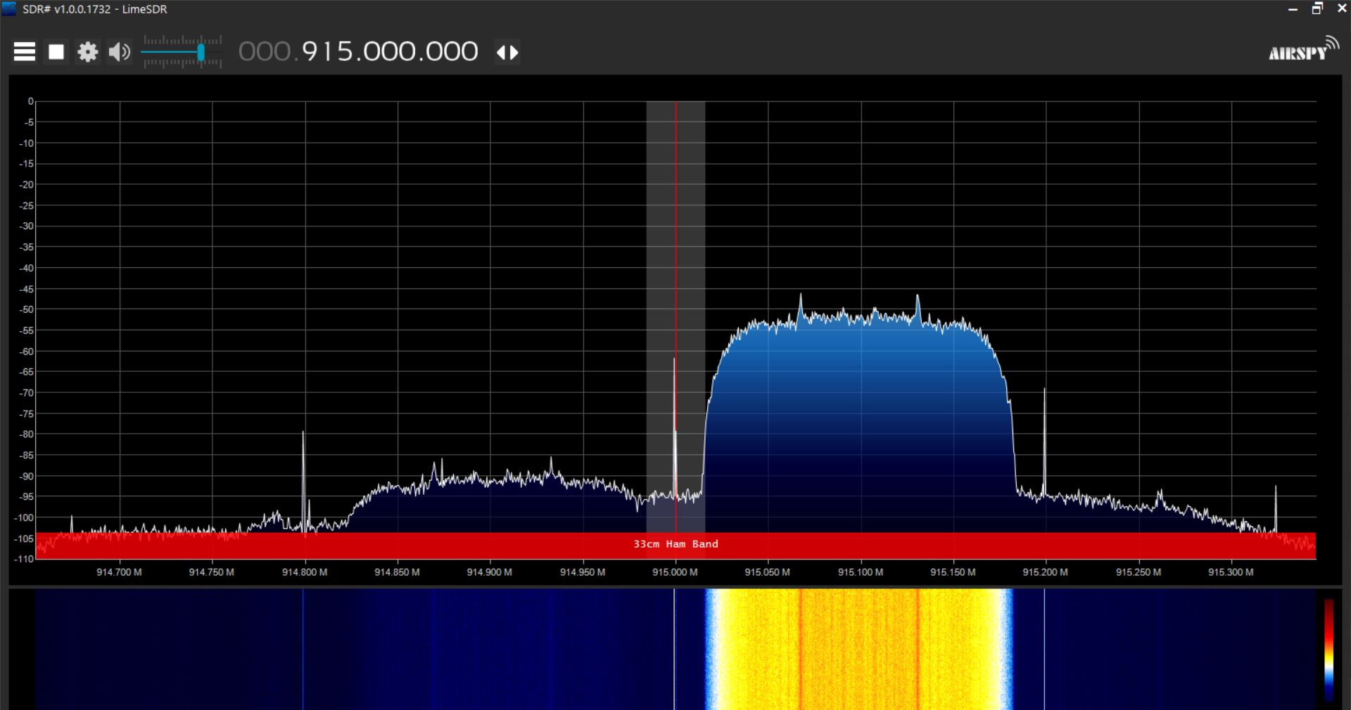
Testing Results - COMMS Wired
Low Noise Amplifier
Gain Testing
0
Expected Gain
38.5 dB
Actual Gain
31.5 +/- 0.5 dB
Margin is acceptable!
Power at SDR expected to be -93 dBm in the worst-case scenario
Test Supplies
Two SDRs
Transmitter
Spectrum Analyzer
Low Noise Amplifier
Attenuators
40 DB
Location
Electronics Lab
50
40
Expected: 38.5 dB
Output Gain [ dB]
30
20
Actual: 31.5 dB
10
914.7
914.8
914.9
915.0
915.1
915.2
915.3
Frequency [ MHz]
Changes to Model
Link Budget updated by replacing expected values with actual values (worst case scenario)
Notes:
Lauren

Slide 49
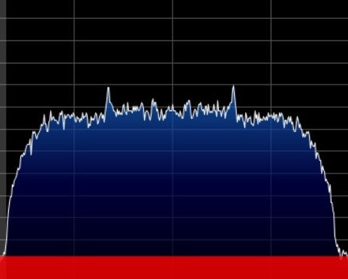
Testing Results - COMMS Wired
Models Verified
Link Budget Model
Power Amplifier
Gain Testing
0
Expected Gain
20 dB
Actual Gain
18 +/- 0.5 dB
Margin is acceptable!
Power at SDR expected to be -93 dBm in the worst-case scenario
Test Supplies
Two SDRs
Transmitter
Spectrum Analyzer
Power Amplifier
Attenuators
40 DB
Location
Electronics Lab
Expected: 20 dB
20
Actual: 18 dB
Output Gain [ dB]
10
914.7
914.8
914.9
915.0
915.1
915.2
915.3
Frequency [ MHz]
Changes to Model
Link Budget updated by replacing expected values with actual values (worst case scenario)

Slide 50
Testing Overview - COMMS Short Range
Short Range Testing
Bench Top Test (1 Meter)
Attenuated Test (1 Meter)
Field Test (30 Meters)
Primary Objective
Characterize changes in noise over various ranges that may not have been present in the wired tests.
Determine impact on system functionality.
Functional Requirement 2:
The payload shall communicate with the ground system during the balloon flight
Notes:
Lauren

Slide 51
Testing Results - COMMS Short Range
Expected Results:
Models Verified
Link Budget Model
Lab Bench
(1 meter)
Data Rate (Uplink): 256 bps
Data Rate (Downlink): 144 kbps
Bit Error Rate (Uplink): 10^(-6) per bit
Bit Error Rate (Downlink: 10^(-5) per bit
Test Supplies
Two SDRs
RF Chain
Attenuators
140 dB
Two Antennae
Locations
Electronics Lab
BioTech Field
Attenuated Test
(1 meter)
Field Test
(30 meters)
Goals:
Validate RF design is capable of communicating wirelessly
Introduce system to real world interference
Model Assumptions:
Referenced text provided for ASEN 3300 for noise values
Noise over distance can be assumed to follow free space loss equation
Notes:
Lauren

Slide 52
Comm Software

Slide 53
Communications Software Testing
Models Verified
Signal Processing Model
Target Data Rate: 144 kbps
Result: 218 kbps
Simulation Testing
Wired Testing
Test Supplies
Two SDRs
Attenuators
40 dB
Functional Requirement 2:
The payload shall communicate with the ground system during the balloon flight

Slide 54
Flight SW

Slide 55
Communications Testing
Link Budget Model
IMU Test
Communications Test
Integration Testing
Verify
IMU Data Retrieval/Storage
Verify
Commandability and Health Status
Verify
Full System Integration
Model Components
Parsing IMU data
Storing IMU data on KubOS Database
Model Components
Health Beacon
CCSDS Packets
UDP Command/Response
Database Access
Model Components
GNU Radio Software, IMU Hardware, and KubOS Software integration
Function Requirement 4: The OnBoard Computer, SDR, and FSW shall perform all necessary software tasks for the balloon flight.
Notes:
Manuel

Slide 56
FSW Communications Testing
Software Module Testing
Sample UDP packet across Beaglebone
Receiving command from GNU Radio
Retrieving sample data from database and send it to GNU Radio via UDP
Health Beacon
System Integration
Integration between IMU and GNU Radio with actual data and CCSDS formatting
Commandability of KubOS database
Assessment of ThinSat’s health
Functional Requirement 4:
The OnBoard Computer, SDR, and FSW shall perform all necessary software tasks for the balloon flight.
Notes:
Manuel

Slide 57
FSW Communications Testing
Sample UDP
packet across Beaglebone
Establish a connection between GNU/KubOS
Send an example UDP Packet across
CCSDS format packet header
Models Verified
FSW Command and Collection
Testing Status
Receiving command from GNU Radio
Create command to collect data
Properly processed command from GNU
Testing Status
Test Supplies
Laptop
Beaglebone
SDR
Supplies:
MiniUSB
FTDI cable
Jumper wires
Retrieving sample data from DB and send it to GNU Radio via UDP
Store telemetry in DB
Call data from DB
Send stored telemetry to GNU Radio upon command
Testing Status
Health Beacon
Generate Health data
Downlink health regularly
Testing Status
Notes:
Manuel

Slide 58
FSW IMU Testing
Software Module Testing
Parse IMU Data from XBus
Output IMU data to Socket in C/C++
Python IMU API listens to Socket
IMU data stored in database
Software Integration
IMU data fully accessible to KubOS and stored in database
Functional Requirement 4:
The OnBoard Computer, SDR, and FSW shall perform all necessary software tasks for the balloon flight.
Notes:
Manuel

Slide 59
FSW IMU Testing
Find I2C address and bus number of IMU
Build Xsens gcc project on Beaglebone
Models Verified
IMU Data Processing
Parse IMU Data from XBus
Testing Status
Output IMU data to Socket in C/C++
Testing Status
Create Socket in C/C++
Test Supplies
Laptop
Beaglebone
IMU
Supplies:
MiniUSB
FTDI cable
Jumper wires
Python IMU API listens to Socket
Testing Status
Read from Socket in Python
Data in KubOS format
Accessing IMU data using API
Storing/Retrieving to/from DB
Storing data in DB
Testing Status
Notes:
Manuel

Slide 60
Sample UDP Packet across Beaglebone
Objective
Establish a connection between GNU/KubOS, and send an example UDP Packet across
Key Requirements
FR 4 The OnBoard Computer, SDR, and FSW shall perform all necessary software tasks for the balloon flight
How it Reduces Risk
Demonstrates ability to perform crucial tasks required of our FSW system, and proves how KubOS is a useful middleman to process commands/telemetry requests
Status: Completed
Result: Full Success - A UDP socket was opened from KubOS, a ping of 6 bytes of data were written over the opened socket, then the socket was opened back up and the data was read from the socket

Slide 61
Receiving command from GNU Radio
Objective
Send a ping command (created in the Ground Software) from GNURadio to be received, processed, and forwarded by the Comms Service in KubOS
Key Requirements
FR 4 The OnBoard Computer, SDR, and FSW shall perform all necessary software tasks for the balloon flight
How it Reduces Risk
Demonstrates the Flight Software’s ability to receive a command over a UDP socket from GNURadio, then forward that command to another KubOS service
Status: Incomplete
Test Supplies
Laptop
Beaglebone
SDR
Supplies:
MiniUSB
FTDI cable
Jumper wires
Location
Electronics Lab
Result: For a Full Success: Read the ping command from the UDP socket, then ping the requested service and receive a pong response to ensure the command was received

Slide 62
Retrieving sample data from DB and send it to GNU Radio via UDP
Objective
Retrieving sample data from the Telemetry Database with a query, then sending that data over an opened UDP socket to GNURadio
Key Requirements
FR 4 The OnBoard Computer, SDR, and FSW shall perform all necessary software tasks for the balloon flight
How it Reduces Risk
Demonstrates the Flight Software’s ability to communicate smoothly between its services as well as an external software.
Confirms that the system will be able to downlink stored IMU telemetry data during the balloon flight
Status: Incomplete
Test Supplies
Laptop
Beaglebone
SDR
Supplies:
MiniUSB
FTDI cable
Jumper wires
Location
Electronics Lab
Result: For a Full Success: Query the telemetry database manually, receive a JSON response, then sent the response through the UDP socket to GNURadio and get a confirmation

Slide 63
Health Beacon
Objective
Measure/Assess overall health of software components of KubOS in a periodic fashion.
Key Requirements
FR 4 The OnBoard Computer, SDR, and FSW shall perform all necessary software tasks for the balloon flight
How it Reduces Risk
Reduces uncertainty and impact of bit errors in commands received from the ground, allowing the ground team to understand if it’s a problem with Flight Software or Signal Processing/Communications System.
Status: Incomplete
Test Supplies
Laptop
Beaglebone
SDR
Supplies:
MiniUSB
FTDI cable
Jumper wires
Location
Electronics Lab
Result: For a Full Success: Query the Monitor and Applications services to gain health data such as memory/RAM, Applications status, etc. then send these continually and successfully to GNURadio

Slide 64
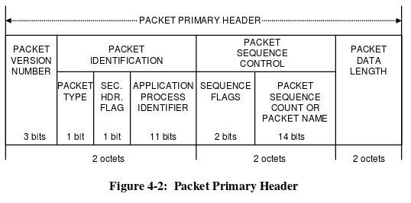
CCSDS Packet Formatting
Objective
Format packet header in required CCSDS protocol
Key Requirements
FR 4 The OnBoard Computer, SDR, and FSW shall perform all necessary software tasks for the balloon flight
How it Reduces Risk
Demonstrates ability to correctly format our ground station commands and requested telemetry in space industry protocol
Status: Completed
Test Supplies
Laptop
Location
Lucas and Katie’s Desk
Result: Full Success - Completed CCSDS formatting of a dummy data packet with hexadecimal information

Slide 65
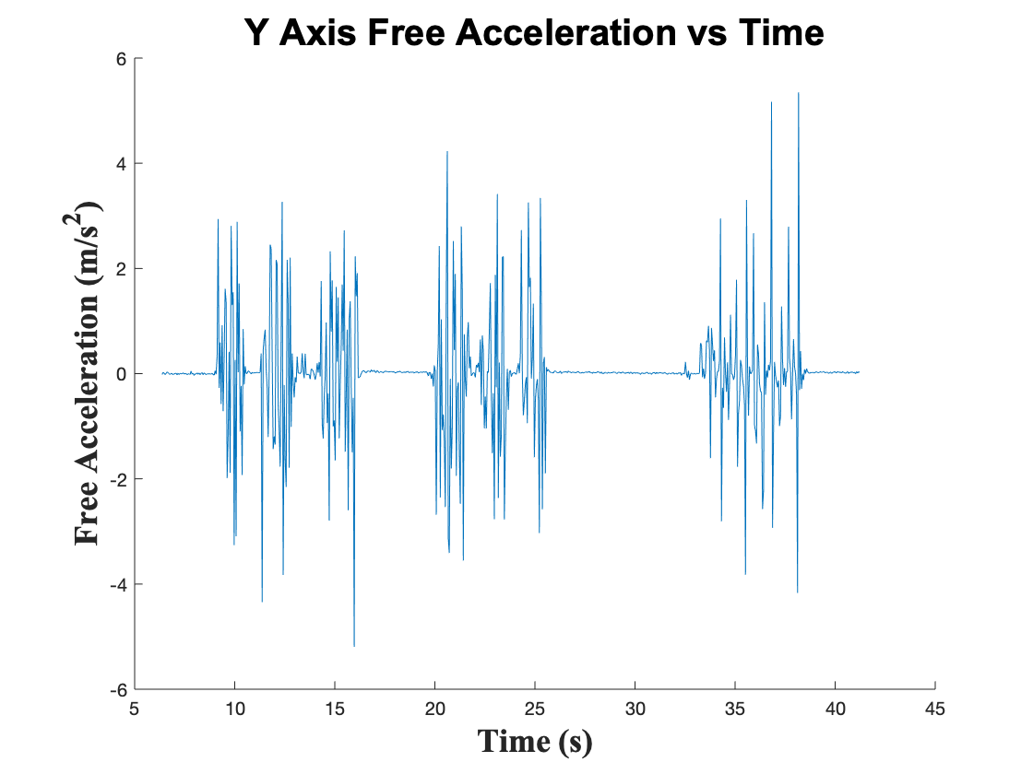
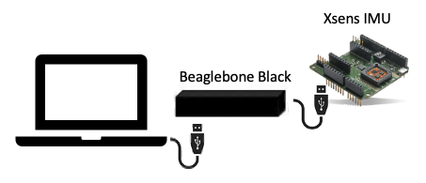
Parse IMU Data from XBus
Objective
Collect Euler Angles from XSens IMU at specified rate and make sure data is supported by KubOS.
Key Requirements
FR 4 The OnBoard Computer, SDR, and FSW shall perform all necessary software tasks for the balloon flight.
How it Reduces Risk
Demonstrates ability to correctly collect our telemetry data to be sent to our GNU Radio at later stage upon command
Status: Completed
Test Supplies
Laptop
Beaglebone
IMU
Supplies:
MiniUSB
FTDI cable
Location
Manuel’s Desk
Result: Full Success - Collected 40 seconds of continuous measurements of euler angles ( 1 measurement per gcc project execution )
Notes:
Manuel

Slide 66
Storing/Retrieving IMU data in KubOS DB
Objective
Storing real IMU data into KubOS Telemetry Database Service at a specific data rate ( 1 measurement per ~0.045 seconds )
Key Requirements
FR 4 The OnBoard Computer, SDR, and FSW shall perform all necessary software tasks for the balloon flight
How it Reduces Risk
Demonstrates ability to store all telemetry generated during flight in order to confirm scientific model, and measure the error rate of our comms system
Status: Completed
Test Supplies
Laptop
Beaglebone
IMU
Supplies:
MiniUSB
FTDI cable
Location
Manuel’s Desk
Result: Full Success - Stored 40 seconds worth of real IMU data into KubOS database. Retrieved database data for verification/validation purposes.
Notes:
Manuel

Slide 67
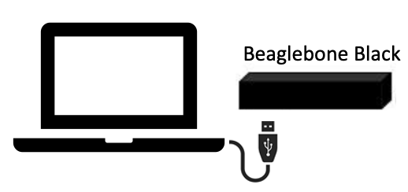
Error Handler - Bit Errors/Flips
Objective
Detect improperly formatted command and send a flag response to ground station, as the request to the database raises a system error.
Key Requirements
FR 4 The OnBoard Computer, SDR, and FSW shall perform all necessary software tasks for the balloon flight
How it Reduces Risk
Prevent runtime errors of waiting indefinitely for a database response and mitigating risk of full system collapse/freeze as a result of error.
Status: Incomplete
Test Supplies
Laptop
Beaglebone
Supplies:
MiniUSB
FTDI cable
Location
Electronics Lab
Result: For a Full Success: Handle without wider system interference improperly formatted commands through flag telemetry

Slide 68
Error Handler - Full System
Objective
Detect full system error - no commanability of KubOS database and absence of Health beacon - and reboot system with appropriate timestamp.
Key Requirements
FR 4 The OnBoard Computer, SDR, and FSW shall perform all necessary software tasks for the balloon flight
How it Reduces Risk
Mitigate full system error during flight and, consequent, inability to confirm science model and communications systems.
Status: Incomplete
Test Supplies
Laptop
Beaglebone
Supplies:
MiniUSB
FTDI cable
Location
Electronics Lab
Result: For a Full Success: Handle full system corruption without intervention from ground station.

Slide 69
FSW Requirement Flow
IMU Testing
Communications Testing
Functional Requirement 4:
The OnBoard Computer, SDR, and FSW shall perform all necessary software tasks for the balloon flight.
Full System Integration Tests

Slide 70
Ground SW

Slide 71
Ground SW Testing
Ball COSMOS Ground Software Model
COSMOS Application Tests
Integration Testing
Verify
Command sending, telemetry graphing, and telemetry logging all function smoothly
Verify
Full System Integration between ground and flight softwares
Model Components
Command & Telemetry Server
Command Sender Tool
Telemetry Grapher Tool
Telemetry Extractor Tool
CCSDS formatted packets
Model Components
- GNU Radio Software
- COSMOS Software
- KubOS Software
Functional Requirement 2: The payload shall communicate with the ground system during the balloon flight
Notes:
Lucas

Slide 72
GSW Command Testing
Software Capability Testing
CCSDS command format verified
Command Sender application
Command & Telemetry Server Connection Testing
System Integration
Command sent over UDP to GNU Radio Software
Collect command sent directly through FSW to the IMU
Command sent through full system, including Comm hardware
Functional Requirement 2:
The payload shall communicate with the ground system during the balloon flight
Notes:
Lucas

Slide 73
GSW Command Component Testing
Command
Sender
Creating CCSDS formatted command
Sending a command to an example external target
Models Verified
CCSDS Formatted Packets
Testing Status
Test Supplies
Chromebook
COSMOS
Command & Telemetry Server
Configure the server to connect to a target over a UDP port
Establish a connection with GNU Radio Software
Testing Status
Notes:
Lucas

Slide 74
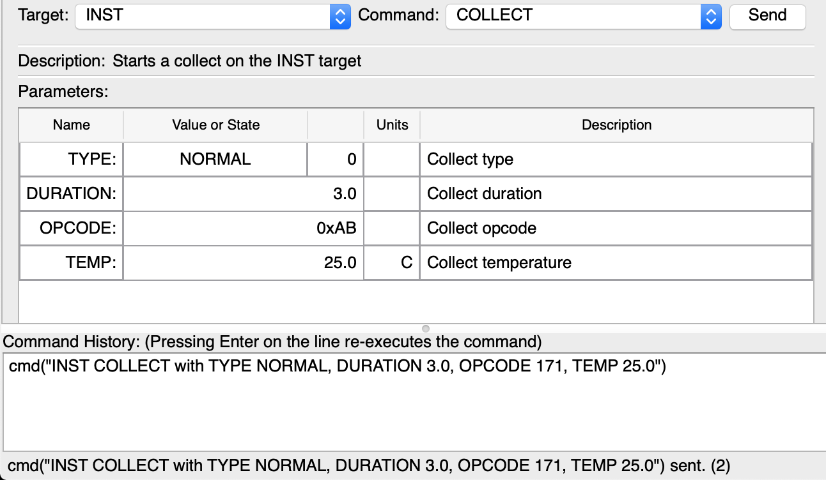
GSW Command Tests
Command Sending Test:
Created a target system to interface with in COSMOS
Configured the system to take example data measurements
Used the Command Sender tool to send a command to the system to start a collection of telemetry
Screenshot of COSMOS Command Sender
Notes:
Lucas

Slide 75
GSW Telemetry Component Testing
Software Capability Testing
CCSDS telemetry packet format verified
Telemetry Grapher, Telemetry Viewer, & Telemetry Extractor applications
Command & Telemetry Server Connection Testing
System Integration
Telemetry received over UDP with an external system
Data packet received from IMU through direct connection
Telemetry sent through full system, including Comm hardware
Functional Requirement 2:
The payload shall communicate with the ground system during the balloon flight
Notes:
Lucas

Slide 76
GSW Telemetry Component Testing
Telemetry Grapher
Graph example incoming live telemetry
Models Verified
CCSDS Formatted Packets
Testing Status
Telemetry Viewer
View example incoming live telemetry
Testing Status
Telemetry
Extractor
Testing Status
Extract logged telemetry from .bin to .txt files
Test Supplies
Chromebook
COSMOS
Command & Telemetry Server
Connect to a target over a UDP port
Start/stop logging incoming data
Connect specifically with GNU Radio Software
Testing Status

Slide 77
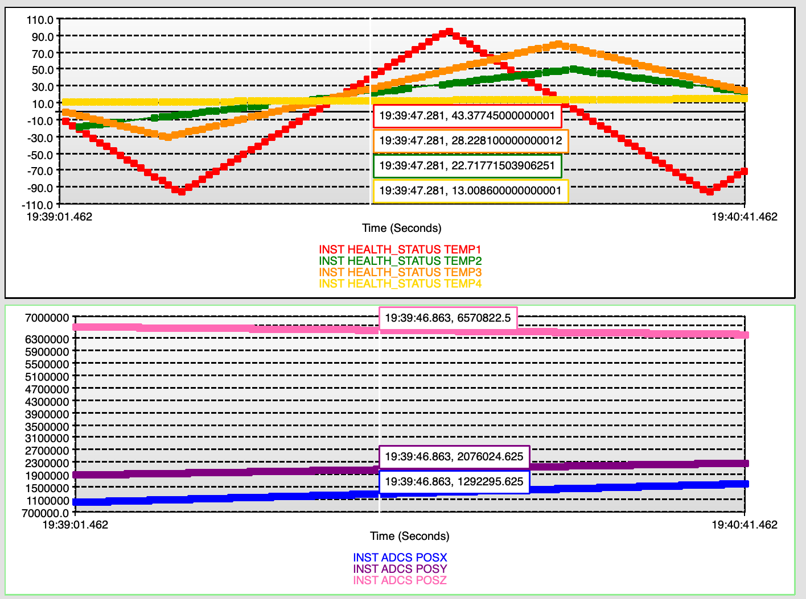
GSW Telemetry Tests
Telemetry Viewing Test:
Created a target system in COSMOS
Began taking real-time data through a UDP port into the Command & Telemetry Server
Used Telemetry Grapher tool to plot real-time telemetry
Screenshot of COSMOS Telemetry Grapher
Notes:
Lucas

Slide 78
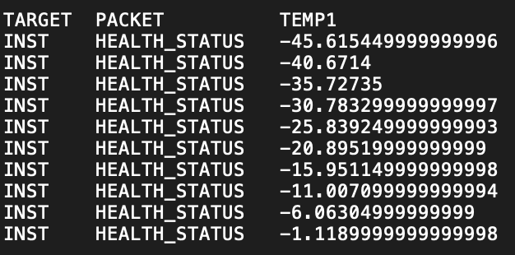
GSW Telemetry Tests
Telemetry Logging Test:
Created a target system to interface and began collecting live telemetry
Manually started and stopped logging in the Command & Telemetry Server
Extracted the telemetry data into a text file using the Telemetry Extractor tool
Verified the data was logged successfully
Screenshot of logged telemetry data
Notes:
Lucas

Slide 79
GSW Final Integration Test Plan
Stage 3: Full System
Send a collect telemetry data through the GNU Radio software, then the Comms Hardware, then KubOS, then the IMU, and back
Verify the data is correct and the error is within expected range
Test Not Completed
Stage 1: KubOS ping test
Connect with the Beaglebone as a target in COSMOS
Send a ping command from the command sender
Use the telemetry viewer to read the pong response
Stage 2: CCSDS
Repeat the steps of Stage 1, but this time packetize the command in CCSDS format to be read in by KubOS
Equipment:
Chromebook with COSMOS and GNURadio
BeagleboneBlack PCB with KubOS and GNURadio
Comms Hardware
Location:
Senior Projects Room
Electronics Lab

Slide 80
GSW Final Integration Test Results
Test Not Completed
Stage 3: Full System
Retrieve IMU data from the BBB within the error margin expected
The ground system and payload have the ability to accomplish all communications on the balloon flight
Stage 1: KubOS ping test
Encounter no errors while sending the command, and receive a “pong” response from KubOS
The ground system can at the least, communicate with the payload
Stage 2: CCSDS
Encounter no errors packetizing/depacketizing CCSDS formatted uplink/downlink
The payload can be communicated with in the format we want
Functional Requirement 2:
The payload shall communicate with the ground system during the balloon flight
Legend
________ Ideal Test Results
________ How FR2 is satisfied
Notes:
Tells us how the ideal results of this test would have satisfied the functional requirement

Slide 81
GSW Requirement Flow
COSMOS Application Testing
CCSDS Formatted Packets Verification
Functional Requirement 2:
The payload shall communicate with the ground system during the balloon flight
Full System Integration Tests
Notes:
Lucas

Slide 82
Payload Board

Slide 83
Payload Board Testing
PCB Bring-Up, Troubleshoot, Debug, and Integration
Boot Test
Software Test
Integration Testing
Verify
Hardware powers on and MCU functions with KubOS
Verify
Software can control I/O to send/receive data from IMU and SDR
Verify
Full System Integration with the battery
Model Components
Indicator LEDs
Shell access
Model Components
Same as FSW to verify that software behavior is consistent with the dev board
Model Components
1.3 V output
3.3 V output
5 V output
Battery V input
Function Requirement 4: The OnBoard Computer, SDR, and FSW shall perform all necessary software tasks for the balloon flight.
Notes:
Manuel

Slide 84
Payload Board Boot Test (P/F)
After visually inspecting the PCB and populating the board:
Apply power to the board and visually inspect indicator LEDs
Flash KubOS and test the presence of a shell terminal
Partially populated payload board
Objective: Confirm MCU hardware design and assembly was done correctly.

Slide 85
Payload Board Software Test
Testing FSW on the board:
Conduct FSW tests on the payload board and confirm consistent behavior
Objective: Learn if connections to the IMU and SDR were made correctly
UART0 serial login prompt on MCU that has been successfully flashed

Slide 86
Payload Board Integration Test
Integration testing with battery power:
Board fits in thinsat bus
Voltage measurements:
1.3 V output
3.3 V output
5 V output
Battery V input
Objective: Find out if PCB dimensions are correct and power electronics design is adequate.
Battery wired to PCB w/ example oscilloscope wired to take 5 V output measurement

Slide 87
Payload Board Revisions
A payload board test failure may result in the need for a new revision
Alternate PCB vendors were considered:
PCBWay was being affected by COVID-19
Used Oshpark to create rev. B of comm board
Advanced Circuits

Slide 88
Payload Board Requirement Flow
Payload Board Boots KubOS
FSW follows expected behavior
Functional Requirement 4:
The OnBoard Computer, SDR, and FSW shall perform all necessary software tasks for the balloon flight.
Payload Board Integrates w/ System

Slide 89
Power
Notes:
Test Overview (15%):
Describe the testing tasks in the project: what tests were conducted, specifically what each test was designed to determine (relate to requirements), and how and where the tests were conducted. Organize the discussion to focus on what tests were most important and why (relate to project success). Do not spend much time on simple acceptance tests, but dwell on more informative characterization and model validation tests, since these convey more understanding of the important engineering aspects of project success.
Adjustments:
Focus on describing in detail the tests planned, the data that would have been gathered
Test Results: (45%):
Present test results in a concise format that explains what the results are and how they compare to what was expected from prior analysis/modeling, and how they compare to project requirements, i.e. the test data should show how well your design requirements have been satisfied and validation of predictions from model(s). Include estimates of uncertainty in the data, and its implications on requirements verification.
Describe how the tests provide a validation of your project functional requirements. Did you achieve what your customer said they wanted in the PDD? If not, provide an engineering explanation of why, i.e. back up your explanation with engineering reasoning, data, etc. In this course, achieving all functional requirements is not as important as understanding why (and being able to convey it).
Adjustments:
Focus on how the data would be used to verify and validate the requirements, along with how the data would be used to verify and refine the modeling done during the design phase.
Include information on test procedure (location, facilities, instruments, etc.)

Slide 90
Power System Testing
Cold Testing
Cold Test #2
Cold Test #3
Characterization Testing
Battery Characterization Test
PCB Power Distribution Test
Integration Testing
Battery with PCB Test
ThinSat without Battery
ThinSat with Battery
All battery tests that didn’t require the PCB were completed
Functional Requirement 3:
The payload shall be operational throughout the duration of the balloon flight

Slide 91
Power System Testing
Battery Discharge Model
Cold Test #2
Cold Test #3
Characterization Test
ThinSat with Battery
Verify
Expected capacity in ThinSat
Verify
Worst case expected capacity
Verify
Manufacturer Specifications
Verify
Peak Current
Actual Performance
Model Components
Total Capacity
Model Components
Total Capacity
Varying Temperatures
Varying Discharge Current
Model Components
Voltage Range
Current Draw Range
Total Capacity
Model Components
Current Draw Range
Total Capacity
Function Requirement 3: The payload shall be operational throughout the duration of the balloon flight

Slide 92
System Level Power Budget
Category | Component | Voltage Req. [V] | Max Current Draw [A] | Max Power Draw [W] | Max Energy Required (2hrs) [Wh]
Science | XSens MTi-3 AHRS | 3.3 | 0.015 | 0.0495 | 0.099
 |  | Science Total: | 0.015 | 0.0495 | 0.099
Comms | SDR | 5 | 0.9 | 4.5 | 9
 | LNA | 5 | 0.152 | 0.76 | 1.52
 | Power Amp | 5 | 0.05 | 0.25 | 0.5
 |  | Comms Total: | 1.102 | 5.51 | 11.02
FSW/OBC | MCU | 5 | 0.5 | 2.5 | 5
 |  | FSW/OBC Total: | 0.5 | 2.5 | 5
 |  | Total: | 1.617 | 8.0595 | 16.119
 |  | 50% Margin: | 2.4255 | 12.08925 | 24.1785
Required Capacity in Room Temperature Test: 3267 mAh (with 20% margin and built in 30% add. capacity)
Required Capacity in Cold Temperature Test: 2613 mAh (without built in 30% add. capacity)

Slide 93
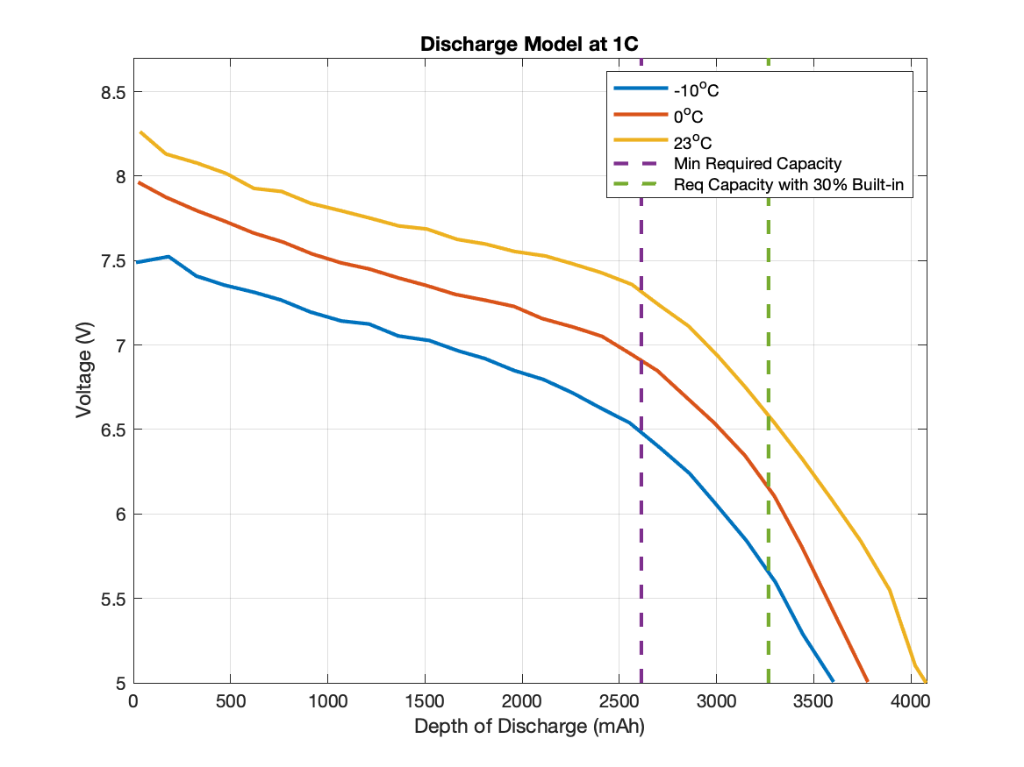
Battery Discharge Model
Battery Discharge Model:
Shows expected voltages and available capacities at varying temperatures
From Cold Test #2, the expected temperature of the battery is between 0°C and 23°C
Expected Battery Discharge

Slide 94
Component Level Power Requirements
Voltage Conversion: | [A] |  | [A]
Current Through 5V Converter: | 1.6119 | Current Through 3.3V Converter: | 0.065
With 20% Margin: | 1.93428 | With 20% Margin: | 0.078
Battery Specifications: | [V] |  | [A]
Typical Battery Voltage | 7.4 | Typical current draw: | 1.633682432
Low Battery Voltage | 5 | Max current draw: | 2.41785
Maximum Current Draw Expected: 2.42 A - leaves 0.58 A (20%) margin for any peaks in current draw

Slide 95
Cold Testing
Models Verified
Battery Discharge Model
Cold Test #2
State of Charge Test
Temperature Test
Test Supplies
Battery Pack
Ammeter
Voltmeter
BNC Cables
iMAX B6AC Charger
Breadboard
Dry Ice
4 Thermocouples
Cold Test #3
Capacity Test
Voltage Test
Temperature Test

Slide 96
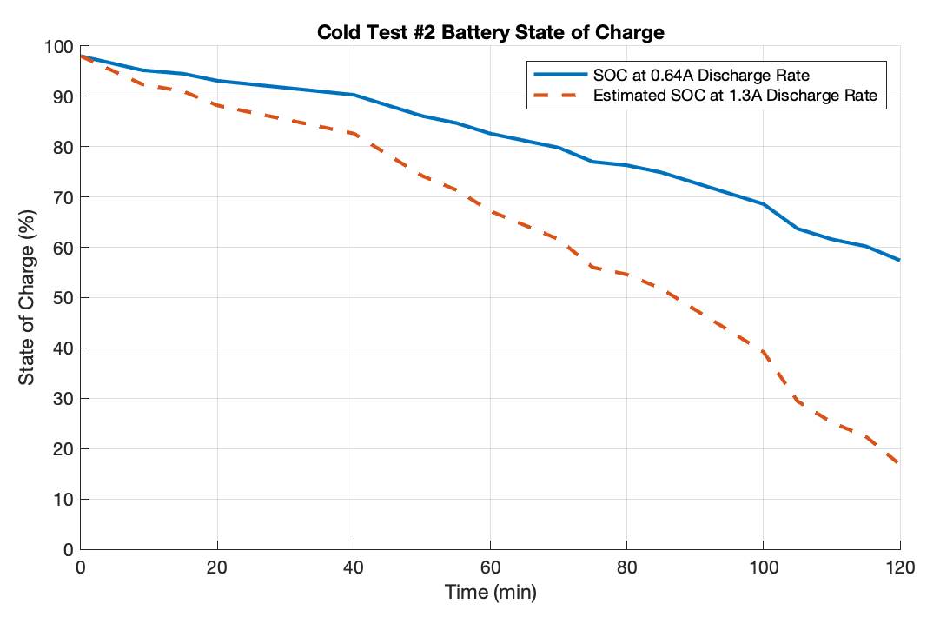
Cold Test #2
Objective
Verify that the battery is able to discharge in the low temperatures expected in the ThinSat during the balloon flight
Key Requirements
FR 3 The payload shall be operational throughout the duration of the balloon flight
How it Reduces Risk
Demonstrates that the battery is capable of powering all components in the low temperatures expected in flight
Result: Full Success - Battery did not reach 0% state of charge at any point during the 2 hour test
Status: Completed

Slide 97
Cold Test #3
Objective
Verify that the battery is able to discharge in the low temperatures expected in the ThinSat during the balloon flight with updated discharge rate
Key Requirements
FR 3 The payload shall be operational throughout the duration of the balloon flight
Success Criteria
Full Success: Battery doesn’t fully discharge prematurely
How it Reduces Risk
Demonstrates that the battery is capable of powering all components in the low temperatures expected in flight
Full Success: Battery discharges more than the required 2500 mAh

Slide 98
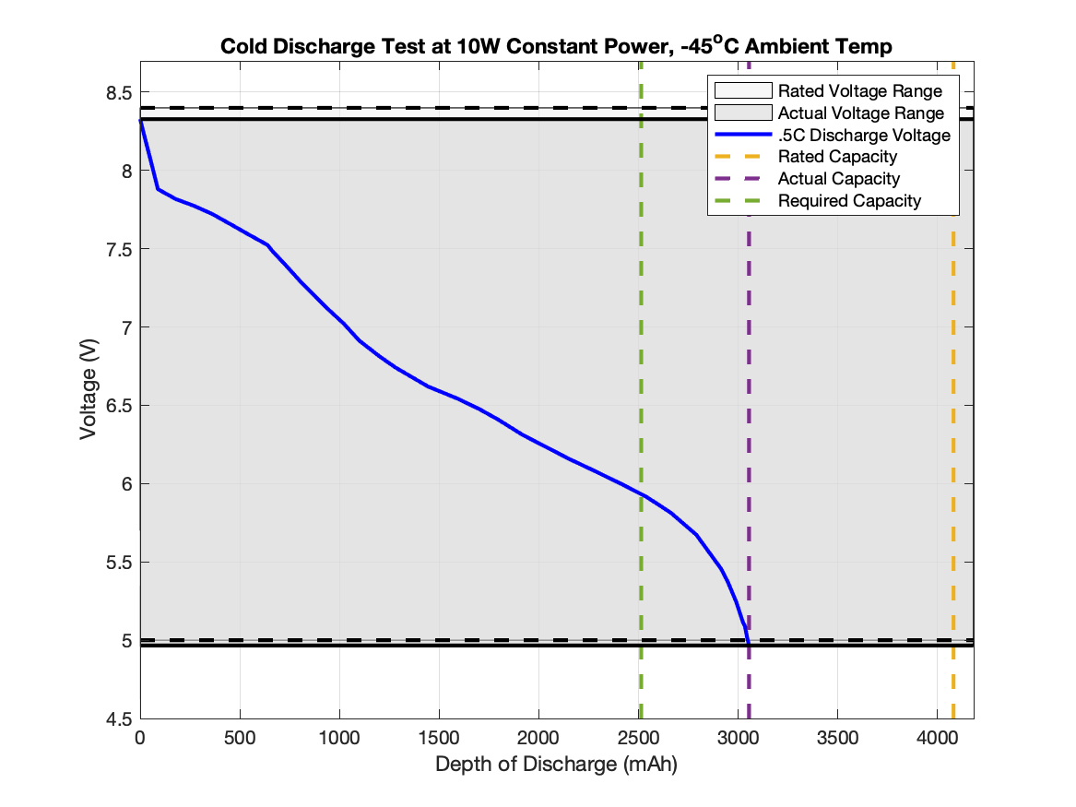
Cold Test #3
Objective
Verify that the battery is able to discharge in the low temperatures expected in the ThinSat during the balloon flight in the worst case scenario that the internal temperature is equal to the outside temperature
Key Requirements
FR 3 The payload shall be operational throughout the duration of the balloon flight
How it Reduces Risk
Demonstrates that the battery is capable of powering all components in the low temperatures expected in flight
Result: Full Success - Battery discharged over 3000mAh, with 2500 mAh being the minimum required
Status: Completed

Slide 99
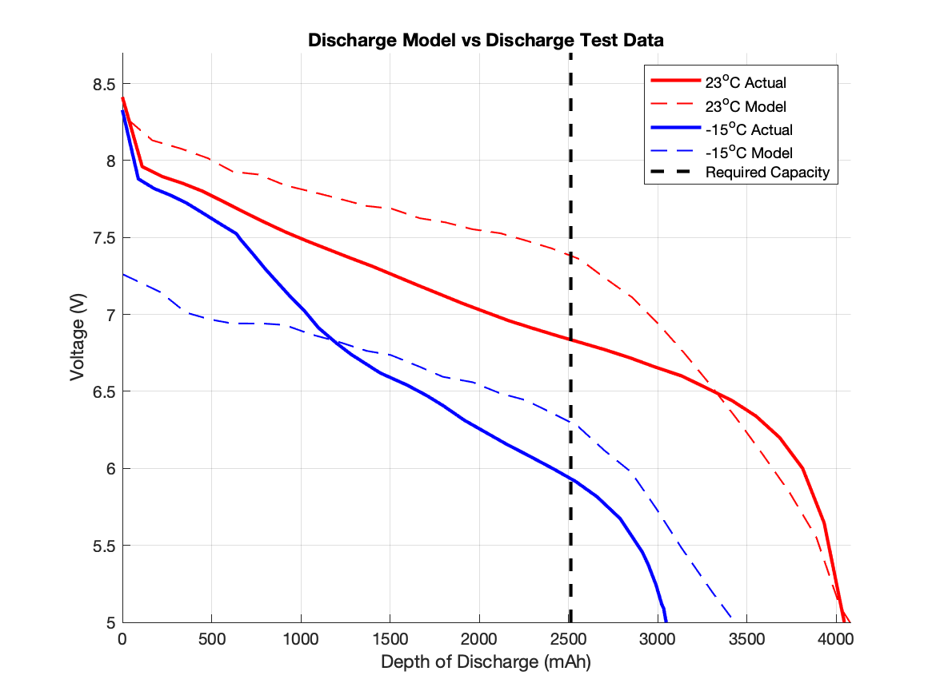
Battery Discharge Model vs Measurement
Model vs Measurement
Depth of discharge capacities were more accurate at room temperature
Thermal Testing shows battery temperature more likely to be around room temp in flight
Model shows constant current discharge, while Measurement is constant power discharge
Average discharge rate is the same, but is likely why plot shapes are slightly different
Most likely curve for balloon flight

Slide 100
Component Testing
Models Verified
Battery and PCB Specifications
Battery Characterization Testing
Voltage Test
Capacity Test
Current Draw Test
Test Supplies
Battery Pack
PCB
Ammeter
Voltmeter
BNC Cables
iMAX B6AC Charger
Breadboard
Voltage Test
Current Draw Test
PCB Power Distribution Test

Slide 101
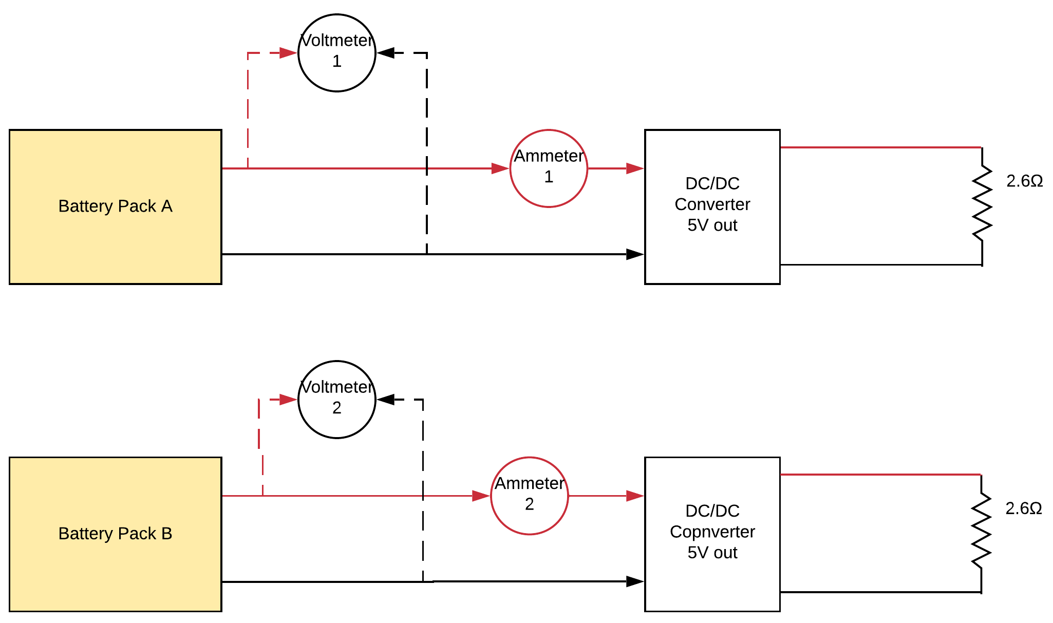
Battery Characterization Test Logistics
Test Procedure for Voltage, Current, & Capacity
Complete the circuit as shown in the test diagram
Record initial state of charge and voltage
Record voltage and current draw every 5 minutes throughout test
Test ends when batteries stop discharging ~ 2.5 hours
Fully charge the batteries again and measure peak voltage
Test Supplies for Voltage, Current, & Capacity
Battery Pack
Ammeter
Voltmeter
BNC Cables
iMAX B6AC Charger
Breadboard
Electrical Setup for Characterization and Cold Test #3

Slide 102
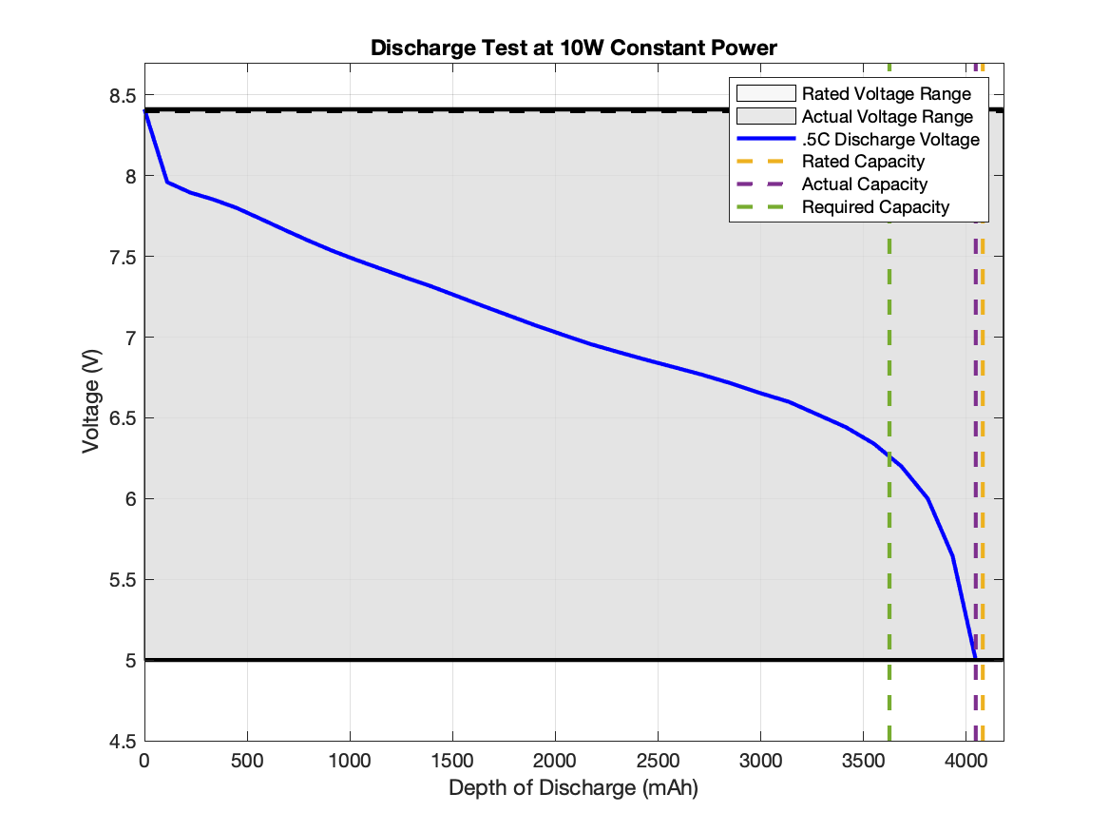
Battery Voltage Range Test
Objective
Verify that the battery range matches the manufacturer’s specifications: 8.4V max to 6V min
Key Requirements
FR 3 The payload shall be operational throughout the duration of the balloon flight
Success Requirements:
Full Success: The voltage range is within 5% of the rate range of 5V to 8.4V
How it Reduces Risk
Demonstrates that the battery is meets manufacturer specifications for voltage and will therefore act as expected
Status: Completed
Results: Full Success - Actual Voltage Range: 4.99V to 8.41V

Slide 103
Battery Capacity Test
Objective
Verify that the battery capacity matches the manufacturer’s specifications: 4080 mAh
Key Requirements
FR 3 The payload shall be operational throughout the duration of the balloon flight
Success Criteria
Full Success: Battery capacity is within 100 mAh of the rated max 4080 mAh
Partial Success: Battery capacity is greater than or equal to the required 3626 mAh
How it Reduces Risk
Demonstrates that the battery is meets manufacturer specifications for voltage and will therefore act as expected
Status: Completed
Results: Full Success - Actual Capacity: 4046 mAh

Slide 104
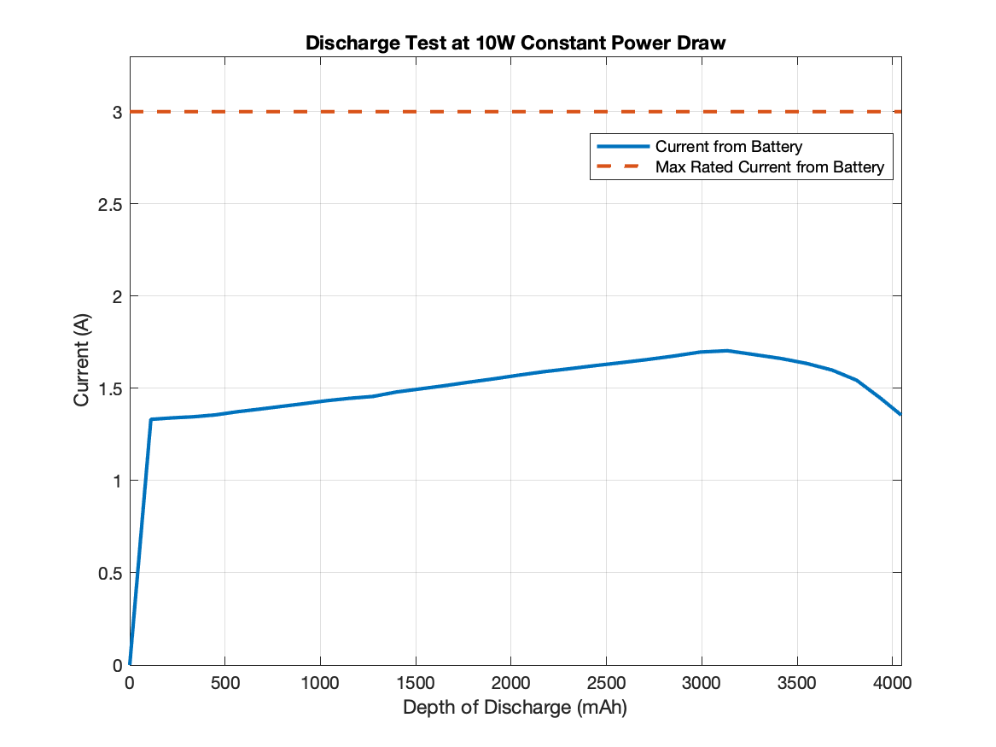
Current Draw Test
Objective: Verify that the battery current draw does not exceed the rating from the battery manufacturer
Key Requirements:
FR 3 The payload shall be operational throughout the duration of the balloon flight
Levels of Success:
Full Success: Max Current Draw is below 2.5A
Partial Success: Max Current Draw is below 3A
Model Verified: System Level Power Budget
How it Reduces Risk: Demonstrates that the battery is meets manufacturer specifications for voltage and will therefore act as expected
Status: Completed
Results: Full Success - Max Current Draw: 1.704 A

Slide 105
PCB Power Distribution Test
Objective
Verify that PCB converts power from a power supply to 5V and 3.3V, and verify current draw requirements are met
Key Requirements
FR 3 The payload shall be operational throughout the duration of the balloon flight
Current Requirements: 2.0A from 5V out, .08A from 3.3V out
Associated Model
Component Level Power Budget
Success Criteria
Full Success: 2.0A and .08A available from 5V and 3.3V ports respectively
Partial Success: Greater than 1.6A and .065A available from 5V and 3.3V ports respectively
How it Reduces Risk
Demonstrates that PCB is able to supply adequate power to all subsystems
Results Matrix For Test:
Component | Current [A] | Success? Y/N
3.3 V Out
5 V Out
Status: Uncompleted

Slide 106
Integration Testing
Models Verified
Battery Discharge Model
Component and System Level Power Budget
PCB Tests
PCB with Power Supply
PCB with Battery
Full System Tests
ThinSat with Power Supply
ThinSat with Battery
Full System Cold Test

Slide 107
PCB with Battery Test
Objective: Verify that PCB converts power from the battery to 5V and 3.3V, and verify current draw requirements are met
Key Requirements:
FR 3 The payload shall be operational throughout the duration of the balloon flight
Current Requirements: 2.0A from 5V out, .08A from 3.3V out
Associated Model: Component Level Power Budget
Success Criteria:
Full Success: Greater than 2.0A and .08A available from 5V and 3.3V ports respectively
Partial Success: Greater than 1.6A and .065A available from 5V and 3.3V ports respectively
How it Reduces Risk: Demonstrates that PCB is able to supply adequate power to all subsystems from battery
Results Matrix for Test:
Component | Current [A] | Success? Y/N
3.3 V Out
5 V Out
Status: Uncompleted

Slide 108
ThinSat with Battery Test
Objective: Verify that the battery can fully power the ThinSat with all systems running
Key Requirements:
FR 3 The payload shall be operational throughout the duration of the balloon flight
Success Criteria:
Full Success: All subsystems are fully operational throughout the test
How it Reduces Risk: Demonstrates battery is capable of fully powering the ThinSat
Results:
Status: Uncompleted
Example Current Draw Plot

Slide 109
ThinSat with Battery Test Model Improvement
Objective: Verify that the battery can fully power the ThinSat with all systems running
Model Verification:
Test verifies that the battery is capable of discharging even during peak power situations
Test verifies system performance during peak demand
Model Improvement:
Instead of constant power draw, this test allows for a model that uses time-varying power draw
This test tells us:
How close we are to the 3A current rating for the battery
When to expect peak power draw
Multiple tests would tell us the margin we have from peak power draw to exceeding the 3A limit
Results:
Example Current Draw Plot

Slide 110
Full System Integration
Objective: Verify that the ThinSat is fully operational in the Cold Test environment with all subsystems operating as they will during the Balloon Launch
Key Requirements:
FR 3 The payload shall be operational throughout the duration of the balloon flight
Success Criteria:
Full Success: All subsystems are fully operational throughout the test
How it Reduces Risk: Demonstrates the ThinSat can fully satisfy Functional Requirement 3 and validates that FR 3 is sufficient to the ThinSat operation in a high-altitude environment
Results:
Example Discharge Draw Plot
Status: Uncompleted

Slide 111
Science

Slide 112
Science Testing Conducted
Sample IMU Testing
Configured SparkFun IMU
Uploaded sample “mission code” with Arduino
Specified data types to send
COMPLETED
FR3.4: The IMU shall generate rate telemetry during ascent and descent.
Notes:
Testing Overview

Slide 113
Science Testing Planned
Full System Integration Testing
IMU integrated onto Payload Board
Integration between IMU and GNU Radio with actual data and CCSDS formatting
IDEAL OUTCOME
Physical integration is successful
Communication to MCU is correctly configured
Data is transferred in proper format
Work halted before this milestone
If physical connection was unsuccessful:
Re-evaluate IMU mount model, reattach to MCU
Revise the anchoring points
If communications incorrectly configured:
Review pin connections on IMU, make corrections
Refer to datasheets for I2C specifications
Review bit-by-bit breakdown
If data format improper
Revise Python code outputs
Refer to datasheet for specification of data type
FR3.4: The IMU shall generate rate telemetry during ascent and descent.
Notes:
Testing Overview

Slide 114
Science Testing Planned
Work halted before this milestone
IMU does not drop below operating temperatures
Data is being consistently generated
Data is accurate
IMU does not exceed operating temperatures
Data is being consistently generated
Data is accurate
IDEAL OUTCOME
Final Cold Test
Whole system integrated, including IMU
If temperature drops below:
Request copper wire interaction with IMU/payload board
Revise quality/quantity of thermal insulation
Revise internal layout of TOMCAT for closer proximity to battery
If temperature exceeds:
Request keeping copper wires away from payload board
Revise quality/quantity of thermal insulation
Revise internal layout of TOMCAT for further distance from battery
FR3.4: The IMU shall generate rate telemetry during ascent and descent.
Notes:
Testing Overview

Slide 115
Science Testing Planned
Level Two Full System Testing
Fully-simulated balloon flight
IMU & MCU communicating using mission code
IDEAL OUTCOME
Mission code accurately detects ascent/descent
Downlinked data is in correct format
Ascent/Descent data
Accelerometer data
Gyroscopic data
Work halted before this milestone
If mission code inaccurate:
Review and study testing data which detected the flaw
Re-construct algorithm to account for the conditions
Conduct IMU-only test using BeagleBone Black as MCU to test revised mission code in simplified, controlled environment
Test revised mission code against historical ASEN 1400 data
If downlinked data in incorrect format:
Review IMU datasheet for data-type specifications and syntax
Communicate between FSW and GSW to determine if expected data types and sizes are matching up
FR3.4: The IMU shall generate rate telemetry during ascent and descent.
Notes:
Testing Overview

Slide 116
Science Model Algorithm
Mission: Determine phase of flight based on acceleration data
Phases: Pre-Flight, Ascent, Descent, Post-Flight
Algorithm:
Pre-Flight phase
Acquire ten seconds of data to acquire average pre-flight motion
Ascent begins when the three-second average acceleration doubles the pre-flight average
Ascent phase
Acquire 100 seconds of data to characterize ascent motion
Descent begins when the three-second average acceleration exceed 4x the ascent average
Descent phase
Descent continues until 3 second difference in acceleration is less than 0.1g
Post-Flight phase
Notes:
Testing Overview

Slide 117
Science Model Algorithm
MCU sends mission status data to communications hardware
for telemetry
Turn on IMU, begin data generation
I²C
MCU receives data packets
MCU analyzes vertical acceleration data to determine flight phase
Send rotation, magnetometer, pitch/roll/yaw to
SD card
When
|a_{Z}| > 2⋅PF_{AVG}
When
|a_{Z}| < 4⋅ASC_{AVG}
When
|Δa_{x},Δa_{y},Δa_{Z}| < .1g
Start
“pre-flight”
then
“ascent”
then
“descent”
then
“post-flight”
Notes:
Testing Overview

Slide 118
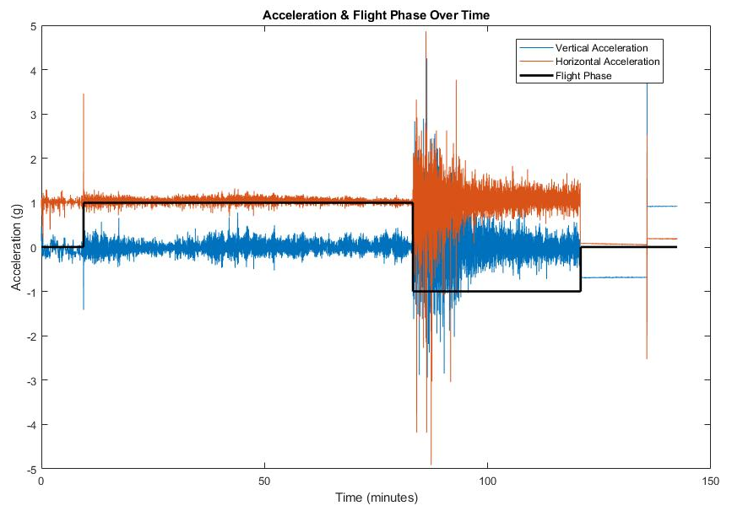
Science Model Algorithm
ASCENT
POST-FLIGHT
PRE-FLIGHT
DESCENT
Notes:
Testing Overview

Slide 119
Structures

Slide 120
Structures Testing
Components do not break free
Minimal damage to the frame
Test revealed that additional battery support and/or external frame padding would be necessary
Drop Test
Models Verified
Strength Interpolation, Datasheets
ThinSat remains attached to flight string
Test not conducted due to drop test destroying frame. Would have been conducted with a new frame
Whip Test

Slide 121
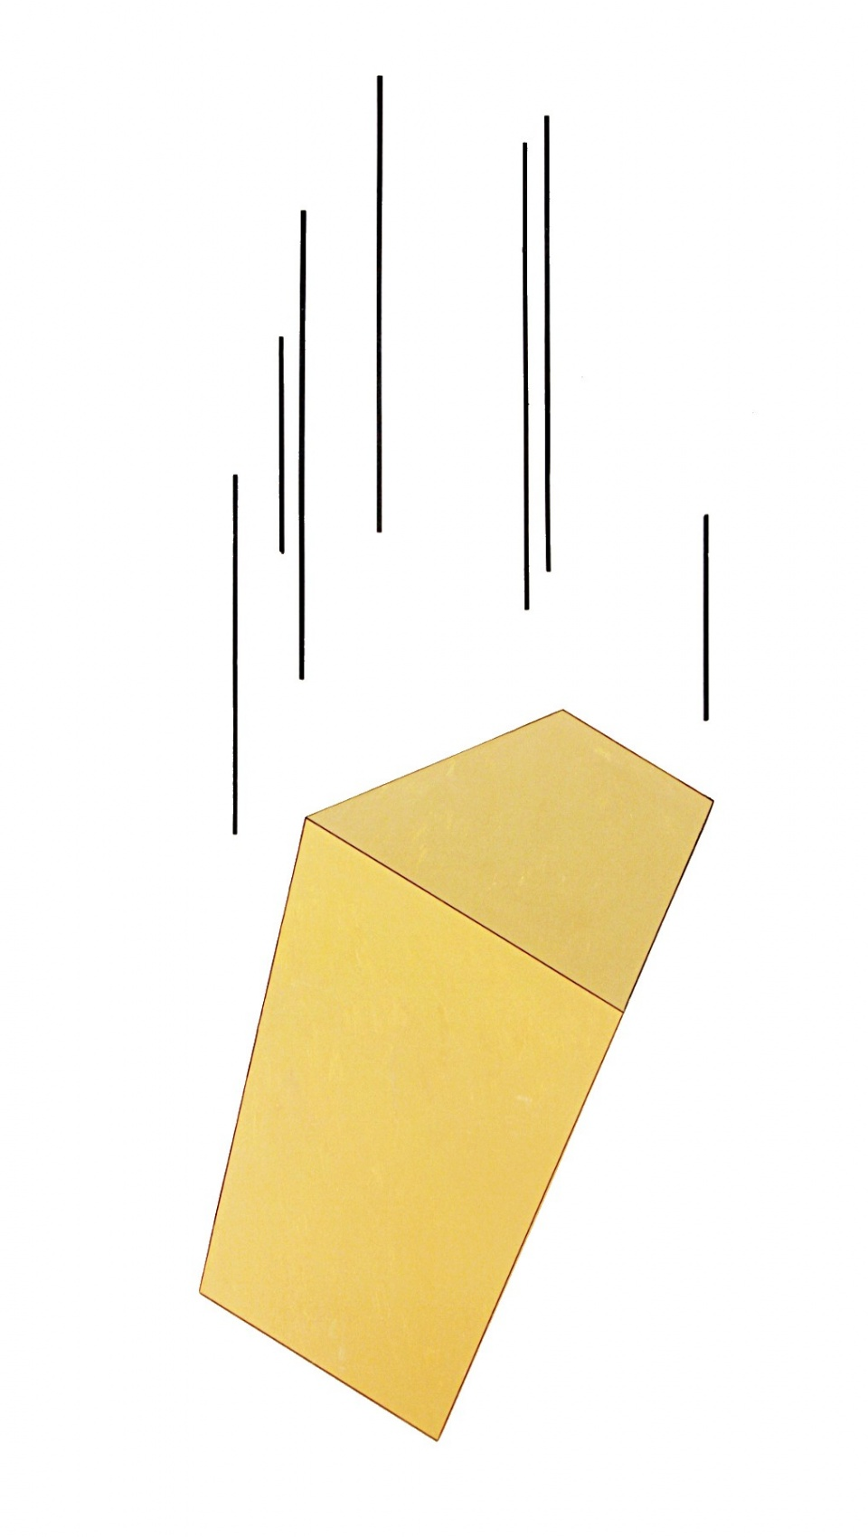
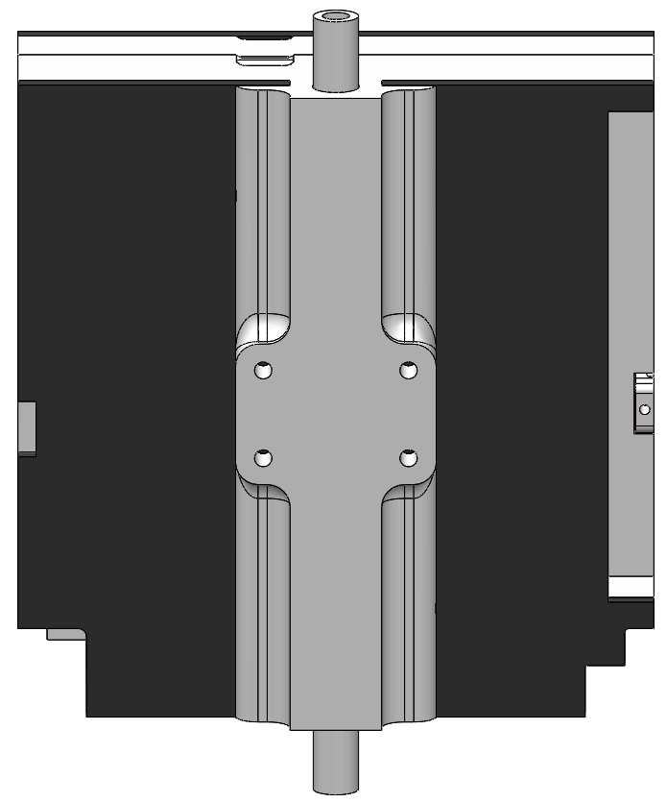
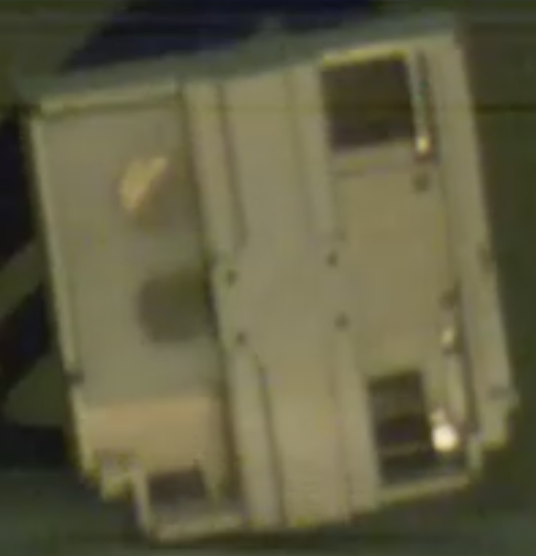
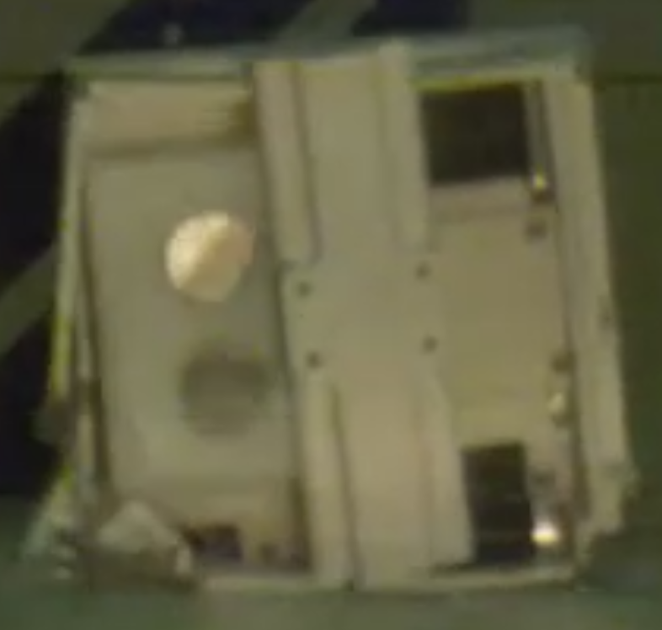
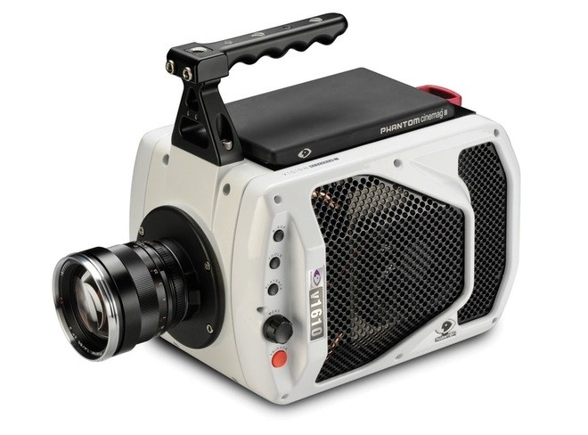
Drop Test
The frame broke in a few spots:
Through hole for bolt
Corners near impact
Where the balloon mount meets the frame
15 ft
Pre-Impact
Post-Impact
Functional Requirement 3.2
Notes:
Survivability:
Components do not break loose of their attachment mechanism
Structure does not sustain significant damage

Slide 122
Larger Pictures

Slide 123
Modelling
Pre-Test:
Joint Strength: 57 Newtons
Force values need an impact time
Impact time approximation: 1 ms
Predicted needing 2.5 times more support than what was known to be good
Post-Test
Impact time measured: 2-8 ms
Number of joints required:
Payload Board: 5 joints
Comm HW: 4 joints
Second test with external padding can be performed
?
Impulse = Force x Time = ΔMomentum
Time = No. of Frames x (sec/Frame)
Notes:
Payload board has 7 joints
Comm HW has 4 joints

Slide 124
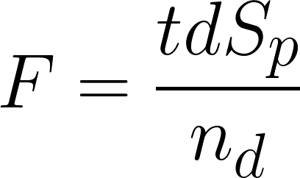
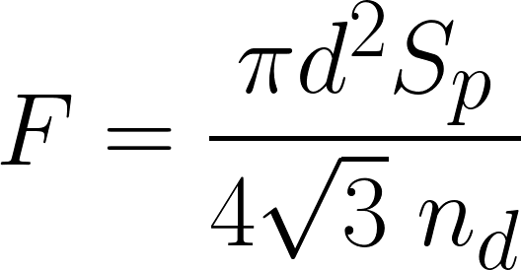
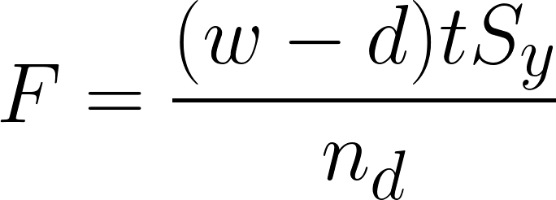
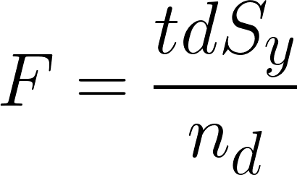
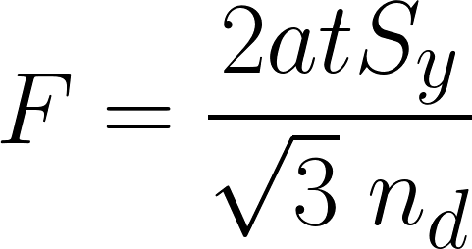
Component Connection Calculations
Bearing in Bolt
Shear of Bolt
Tensile Yielding of Member
Bearing in Member
Edge Shearing of Member
Weakest failure mode yields at:
57 Newtons
Notes:
Section: Manufacturing (60%)
Purpose: Provide CAD model / Diagram of system —> Highly detailed, include everything
Rubric: The manufacturing status was presented with strong engineering support for all important tasks and address the critical elements of the design. (52 - 60 pts)
Takeaway:
Slide Primary Author:
Presenter:

Slide 125
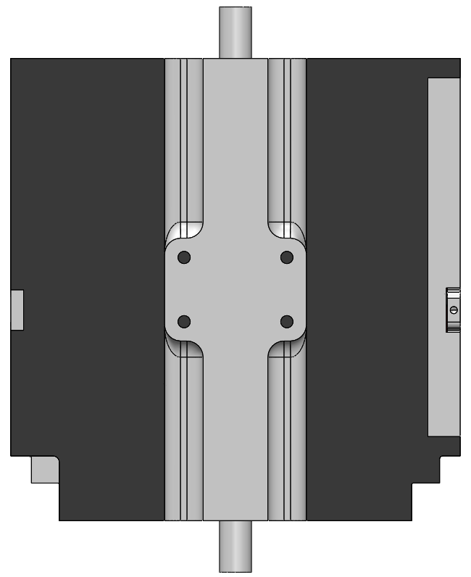
Whip Test
Expectations:
Should work as connector is known to be good from previous missions
Failure Points:
Knot slips past retaining bar
Mounting adapter shears off
This happened on drop test
Solutions to Failure:
Larger knot or smaller gap
Increase area connecting adapter to frame
Functional Requirement 3
Notes:
Mounting Hardware: Flight tube, Washers x2, Paper clips x2

Slide 126
Thermal

Slide 127
Preliminary Thermal Modeling
Requirement 3
The payload shall survive and operate in the environment during all stages of the balloon flight
Requirement 3.1
The payload shall be able to withstand the temperature range of flight (-56°C to 38°C).
Assumptions
Steady State, 1D Thermal Model
Standard Atmosphere
Accounts for radiation, convection, conduction (with insulation)
Does not account for sun loading or Earth’s albedo

Slide 128
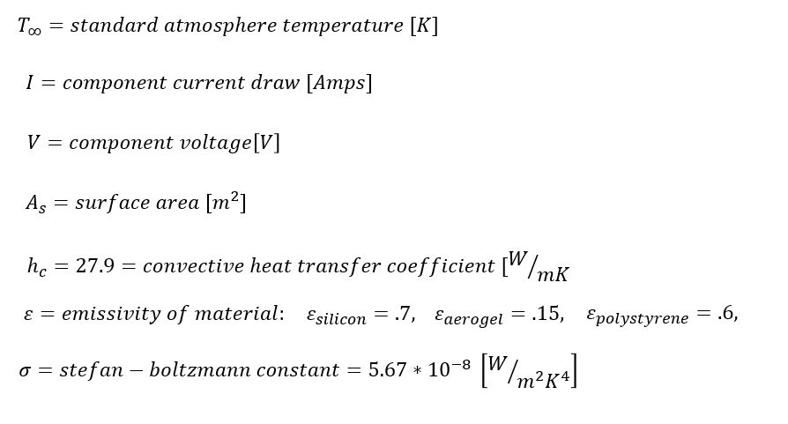
Preliminary Thermal Modeling
Constants/Known Values
Overview
Baseline
SDR
FSW
MCU
Science
Top Level
Next Steps
Backup

Slide 129
Preliminary Thermal Modeling
Modeling with No Insulation
Overview
Baseline
SDR
FSW
MCU
Science
Top Level
Next Steps
Backup
Notes:
This looks good Lara! -Katie
Thanks!

Slide 130
Preliminary Thermal Modeling
Modeling with Insulation
*Method also applies to SDR, though the SDR was modeled in a box with different dimensions.
Overview
Baseline
SDR
FSW
MCU
Science
Top Level
Next Steps
Backup
Notes:
This looks good Lara!

Slide 131
Preliminary Thermal Modeling
No insulation: components become too cold
Insulation needed to keep temperatures within operating range

Slide 132
Baseline Test
*Thermocouple 2 fell off during insulation test, therefore not shown.
Notes:
TAKEAWAY: This slide presents the test results for the SDR
Solid line is T2
Dashed line is T3

Slide 133
Baseline Test
Notes:
TAKEAWAY: This slide presents the test results for the payload
Solid line is T0
Dashed line is T1

Slide 134
Cold Test #2
Resistive Heater simulating
Payload Board
3D Printed Mock-Board
Thermocouple

Slide 135
Cold Test #2
Thermocouple
Thermocouple (underneath)
Resistive Heater simulating SDR
Test Battery
3D-Printed Mock Board

Slide 136
Finance

Slide 137
Finance Categorized Spending Breakout

Slide 138
Finance Fall Semester Spending

Slide 139
Finance Spring Semester Spending (1)

Slide 140
Finance Spring Semester Spending (2)

Slide 141
Finance Spring Semester Spending (3)

Slide 142
Finance Spring Semester Spending (4)

Slide 143
Finance Spring Semester Spending (5)

