Slide 1

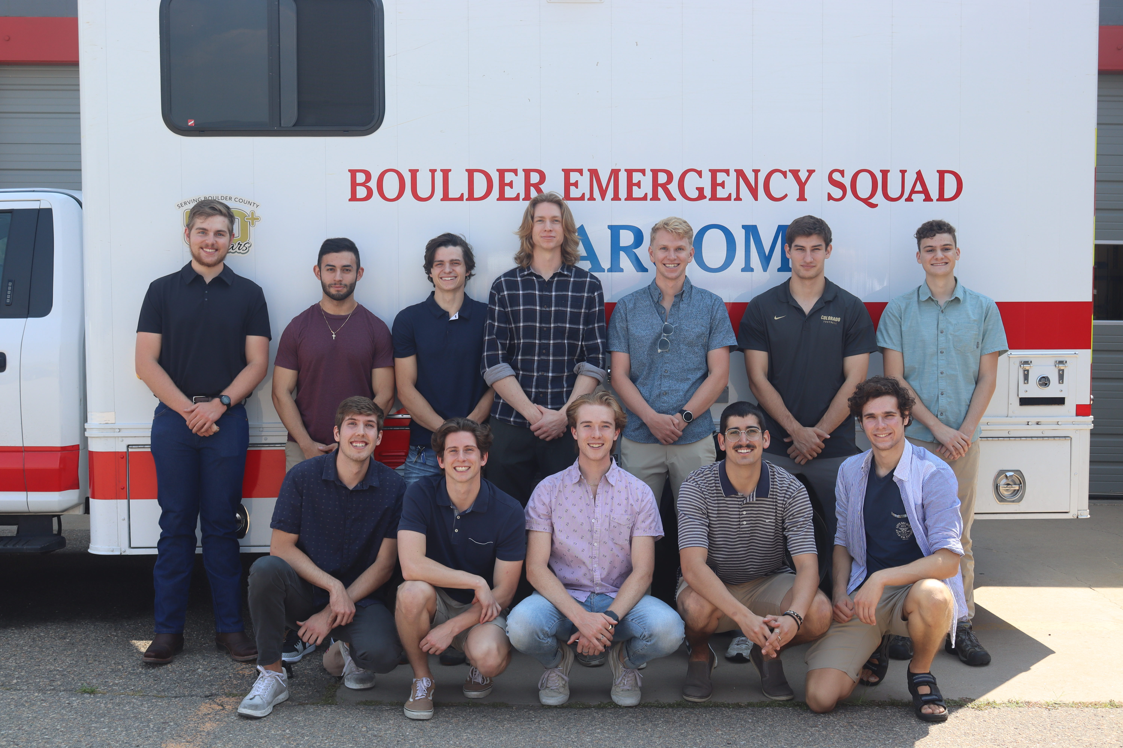
TEAM SEVEN Preliminary Design Review
Trajectory Efficient Autonomous Mission for Surveillance, Endurance, and Vehicle Energy Needs

Slide 2
Agenda
01
02
01 Introduction
02 Trades
Provide a holistic view of the problem and what must be accomplished
Levels of closed loop flight control trade study
03
04
03 Future Work
04 Current Design Space
Discuss plans for developing high-fidelity simulations
Review how trades have contributed to narrowing the design space and highlight some possible design architectures
Introduction
Trades
Future Work
Current Design Space

Slide 3

Mission Overview
Problem
Objective
Communications in remote areas
Lack of low-cost, energy efficient UAS
Limited personnel
Develop energy and mission management software
Implement energy efficient flight controls
Introduction
Trades
Future Work
Current Design Space
Notes:
Verbally say the program objectives

Slide 4
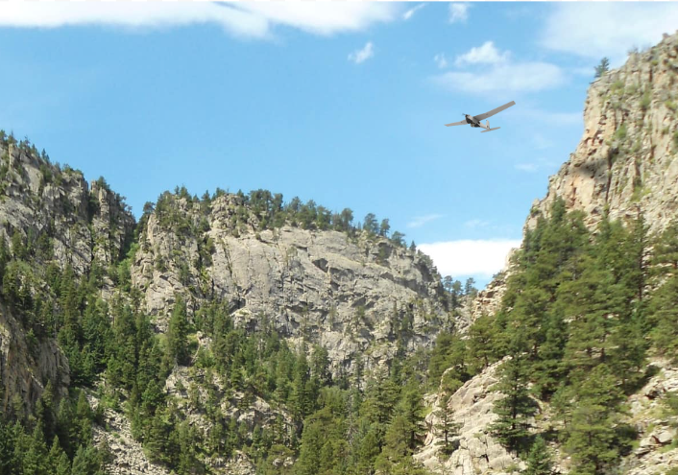
Motivation and Goals
Goal: Develop a controls system capable of extending the endurance of a small UAS over a standard mission profile
Improve mission persistence
Manage aircraft trajectory based on energy state
Maintain constant line of sight (LOS)
Introduction
Trades
Future Work
Current Design Space

Slide 5
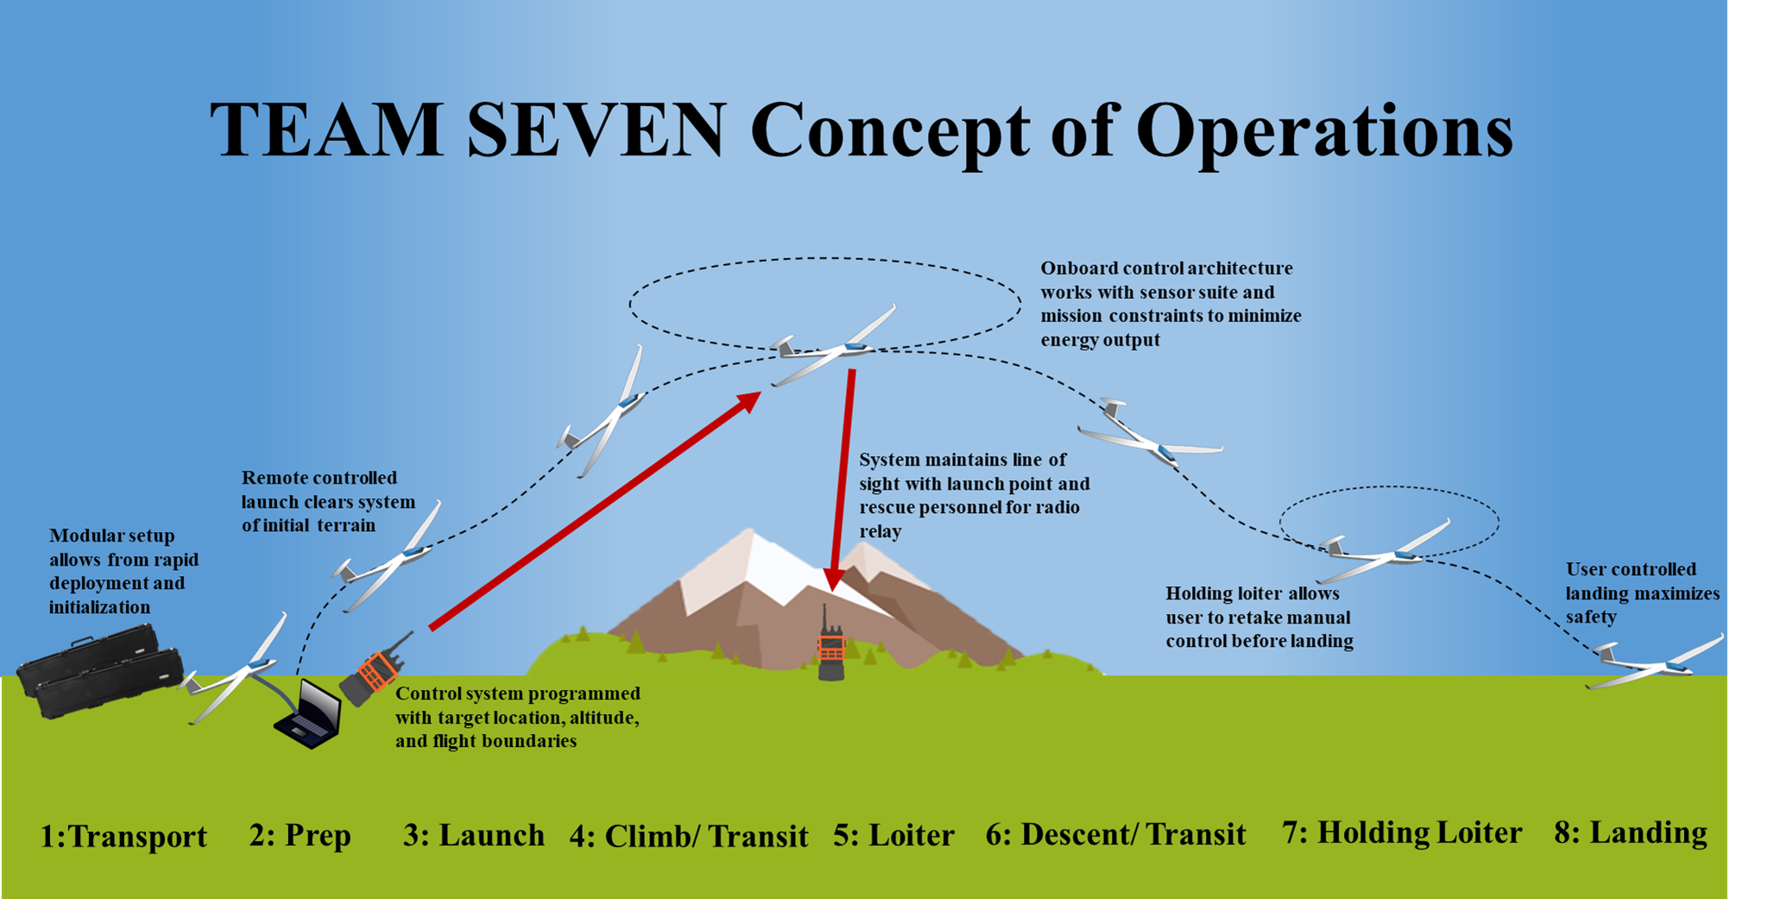
Introduction
Trades
Future Work
Current Design Space

Slide 6
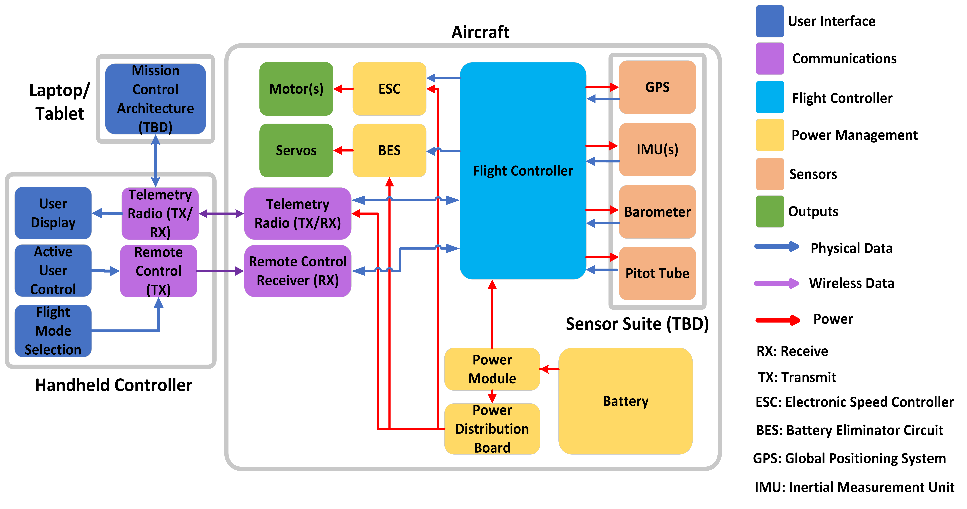
Functional Block Diagram
Introduction
Trades
Future Work
Current Design Space

Slide 7
Functional
Requirements
FR # | Requirement
1 | The UAS shall be capable of receiving commands and transmitting telemetry to and from a controller
2 | The UAS shall manage aircraft trajectory based on energy state and specified mission parameters to improve flight endurance
3 | Flight operation shall minimize user workload and need for active user input throughout its entire mission profile
4 | The UAS shall adhere to all relevant guidelines and implement measures to protect the safety of the UAS itself as well as people and objects in the surrounding area
5 | The UAS shall be fully operational in austere environments with the ability to adapt to varied conditions and remain in a continual standby posture when unused
6 | The initial cost and complexity for users to assemble, configure, operate, and maintain the UAS system shall be minimized and shall seek to significantly undercut prices of existing long endurance drone systems
Introduction
Trades
Future Work
Current Design Space

Slide 8
Critical Project Elements
Energy Management
Flight Boundaries
Stability Augmentation System
FR 2 | FR 3 | FR 6
FR 3 | FR 4 | FR 6
FR 1 | FR 4 | FR 5
Driven by the primary goal of the program, energy management is at the forefront of the project
To simplify user workload and improve safety of the system, SAS becomes a focus for the project
Preserving LOS with the aircraft is essential for safety and constant telemetry downlink, thus determining and maintaining flight boundaries becomes a top priority
Introduction
Trades
Future Work
Current Design Space

Slide 9
Critical Project Feasibility Elements
High Risk Items
System Dependencies
Integrating custom software
(CPE 2)
Implementing algorithms
(CPE 1 & 2)
Developing mission management framework
(CPE 1 & 3)
Development of user interface to practically make use of energy management solutions
Interfacing sensor suite with a flight controller
Communication systems between multiple systems
Introduction
Trades
Future Work
Current Design Space
Notes:
Integrating custom software with existing autopilot framework
Implementing algorithms without solid foundation of knowledge in those fields
Developing mission management framework to determine mission constraints

Slide 10
Trade Overview
Trade Performed | Brief Description | Dependencies
Levels of Closed Loop Energy Optimization | Narrow which phases require focus | Independent
Path Generation | Which phase benefits most from generation | Independent
Path Constraint | How to establish flight boundaries | Independent
Control Theories | Which control architecture to use | Levels of Closed Loop Energy Optimization
Communication Devices | Explore different devices used for TX/RX | Independent
Antenna Frequencies | Establishing a base in frequency analysis | Communication Devices
Flight Controller | Analyze commercial or in-house controllers | Independent
Levels of Closed Loop Energy Optimization
Determine key phases in which to focus efforts for mission management and planning
Explore the risks associated with energy management (CPE 1)
Fundamental trade to narrow scope
Control Theories
Inconclusive trade
Motivated modeling/simulation framework
Introduction
Trades
Future Work
Current Design Space

Slide 11
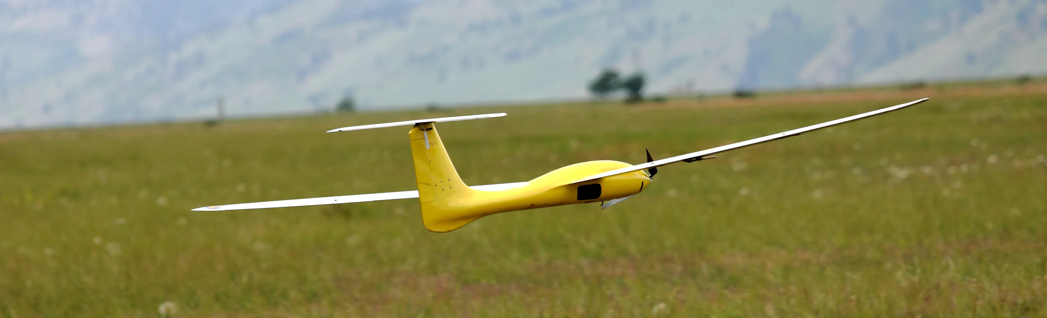
Levels of Closed Loop Energy Optimization
Explore the capabilities of implementing closed loop control for path optimization in different flight phases
Solutions and values partially determined by MATLAB flight performance model using the Tempest aircraft

Slide 12
Key Requirements and Constraints
Key Requirements
Constraints
Flight Endurance
Levels of optimization
Time, power, and energy spent in each phase
Feasibility
Available open-source software
Development time/cost
Safety
Optimized paths are also safe
Limit danger to environment/user
Degree of Optimization
Few ways to optimize endurance
Related Work
Previous information to reference
Solution Space
Limited by safety requirements
Flight plans that maintain LOS, altitude, etc
Introduction
Trades
Future Work
Current Design Space

Slide 13
Design Risk and Assumptions
Risks
Assumptions
Optimization Failure
Diverging solutions impact UAS endurance
Complexity
Development time
Not enough resources
Integration of custom software
Implementation of optimization algorithms
Agnostic of Flight Controller
Energy optimization will work independently of flight controller
Baseline Flight Plan
Standard flight plan is not updated / optimized during the mission
Automatic
Path optimization is automated
Optimized path can be flown by user
Introduction
Trades
Future Work
Current Design Space

Slide 14
Design Metrics & Weightings
Metric Scoring
Title | Functional Requirement | Weighting | Rationale
Implementation Simplicity | All FRs | 25% | The success of the project is largely dependent on our ability to learn and implement the solution.
Flight Endurance Improvement | FR 2 | 35% | Improvement of the endurance of the UAS is a top functional requirement.
Improvement on User Workload | FR 3 | 15% | Baseline solution assumes the user must manually optimize the path without a control system, which they may not try to do. Therefore, it is not weighted as much.
Safety | FR 4 | 25% | Safety of the user, system, surrounding environment, and bystanders is extremely important. The system will not be used if it is not safe.
Introduction
Trades
Future Work
Current Design Space
Introduction
Trades
Current Design Space
Future Work

Slide 15
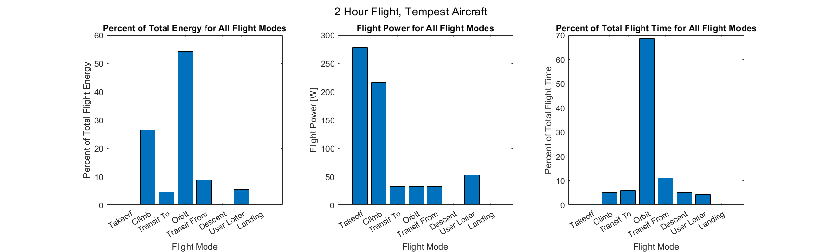
Engineering Analysis
Additional Analysis
Tempest Aircraft Flight Performance Analysis
Parameters: Launch altitude: 5000 ft Orbit Altitude: 10000ft Target Distance: 10km User Distance From Target: 15km
User Loiter: 5 min, 30m radius Orbit: 1km radius Takeoff Pitch: 30 deg Climb Pitch: 20 deg
Assumptions: Minimum Power Lift/Drag Coefficients and Velocities for all Flight Phases
Introduction
Trades
Future Work
Current Design Space
Introduction
Trades
Current Design Space
Future Work

Slide 16
Design Options
No Automatic Path Optimization
Automatic Orbit Path Optimization
Automatic Orbit and Climb Optimization
Predetermined flight path is followed
Optimized path using aerodynamics
Baseline energy conservation
Orbit is the only flight phase with automatic path optimization
Orbit is 1st in energy consumption
Orbit and climb are the only phases with automatic path optimization
Climb is 2nd in energy consumption
Automatic Orbit, Climb, and Transit Optimization
Automatic Orbit, Climb, Transit, and Takeoff Optimization
Orbit, climb, and transit use path optimization
Transit is 3rd in energy consumption
Orbit, climb, transit, and takeoff use path optimization
Takeoff is 4th in energy consumption
Introduction
Trades
Future Work
Current Design Space

Slide 17
Final Trade Matrix
Metrics | Weight | No Automatic Path Optimization | Automatic Orbit Path Optimization | Automatic Orbit and Climb Path Optimization | Automatic Orbit, Climb, and Transit Path Optimization | Automatic Orbit, Climb, Transit, and Takeoff Path Optimization
 |  | Value | Value | Value | Value | Value
Implementation Simplicity | 25.00% | 5 | 4 | 3 | 3 | 1
Effect on Flight Endurance | 35.00% | 1 | 3 | 4 | 5 | 5
Improvement on User Workload | 15.00% | 1 | 4 | 5 | 5 | 5
Safety | 25.00% | 4 | 4 | 4 | 3 | 2
Score Total | 100% | 2.75 | 3.65 | 3.9 | 4 | 3.25
Introduction
Trades
Future Work
Current Design Space
Introduction
Trades
Current Design Space
Future Work

Slide 18
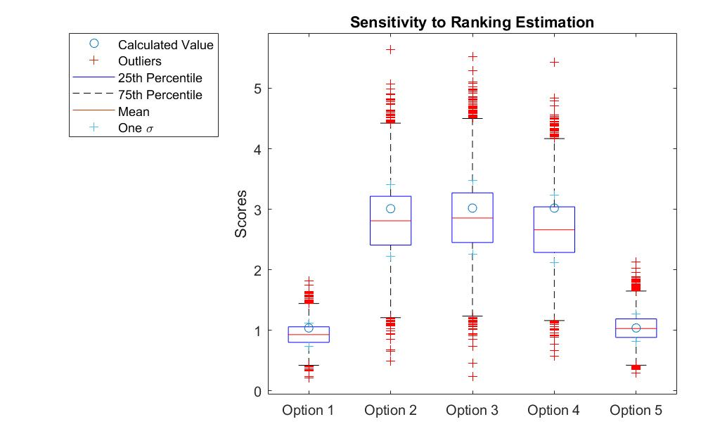
Final Trade Matrix – Sensitivity Analysis
10,000 trials were performed
Trials were varied within one metric (20%)
All Calculated values were within 1 STD
Same results were derived from average of trials
Introduction
Trades
Future Work
Current Design Space

Slide 19
Final Selection
Automatic Orbit and Climb Path Optimization
Flight Profile
Focus Phases
Less Critical
Phases
Launch
Climb
Transit
Orbit
Descent
Hold
Landing
Introduction
Trades
Future Work
Current Design Space

Slide 20
Future Work

Slide 21
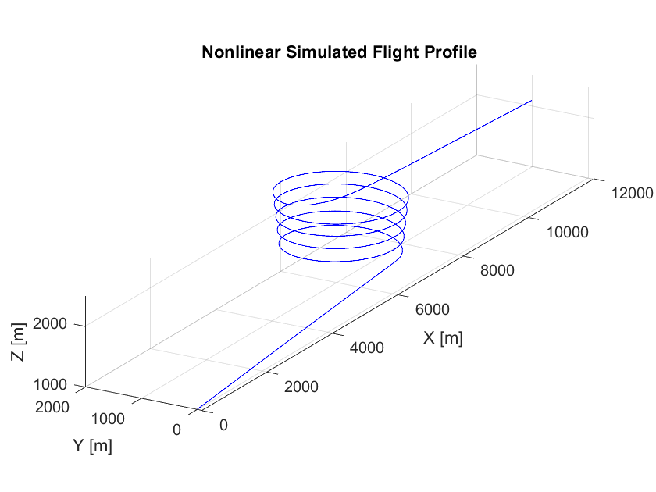
Simulation and Modelling
Planned Simulations
Nonlinear Flight Model
Control Architecture Models
Prospective Results
Nonlinear flight model will be utilized to simulate and verify control loops and implementation
Control architecture models will provide first-steps to implementation and inform an architecture trade
Risk Buy Down
Nonlinear flight model helps verify functionality of aircraft trajectories in real world dynamics
Control Architecture Models demonstrate human and computational resources required for implementation
Introduction
Trades
Future Work
Current Design Space
Introduction
Trades
Current Design Space
Future Work

Slide 22
Simulation Benefits
Verification
Specificity
Testing our control models with the nonlinear flight model will help verify that they perform in nonlinear environments
Control architecture models will enable gain tuning by mathematical methods
Comparison
Optimization
Quantitatively calculating performance metrics related to control driven flight will help inform control architecture trades and performance metrics
Nonlinear and control architecture models will help determine energy optimization efficacy
Introduction
Trades
Future Work
Current Design Space
Current Design Space
Future Work

Slide 23
Nonlinear Flight Model Milestones
Before CDR
Nonlinear flight model based on Tempest aircraft
Power estimation throughout entire flight and per phase
Phases of flight in nonlinear flight model
Introduction
Trades
Future Work
Current Design Space
Introduction
Trades
Current Design Space
Future Work

Slide 24
Control Architecture Model Milestones
Before CDR
Reduced order model of Tempest aircraft dynamic modes
Linearized flight model of Tempest aircraft
Control architectures implemented in reduced order model
Select control architectures for implementation in linearized flight model
Introduction
Trades
Future Work
Current Design Space
Introduction
Trades
Current Design Space
Future Work

Slide 25
Prototyping Tools
Simulink
MATLAB
Allows for rapid prototyping and comparison of control architectures
Provides platform to quickly change control loops and system parameters to inform a first-order trade
Parallelize investigation of Simulink modelling feasibility with flight control modelling
Low cost to schedule due to the support of Simulink within MATLAB
Allows for full simulation and calculation of energy use of controlled non-linear aircraft dynamics
Primary tool for nonlinear simulation; provides functionality for state-space modeling of complex systems
Large number of resources and examples of control loops in MATLAB to facilitate learning and implementation
Introduction
Trades
Future Work
Current Design Space
Introduction
Trades
Current Design Space
Future Work

Slide 26
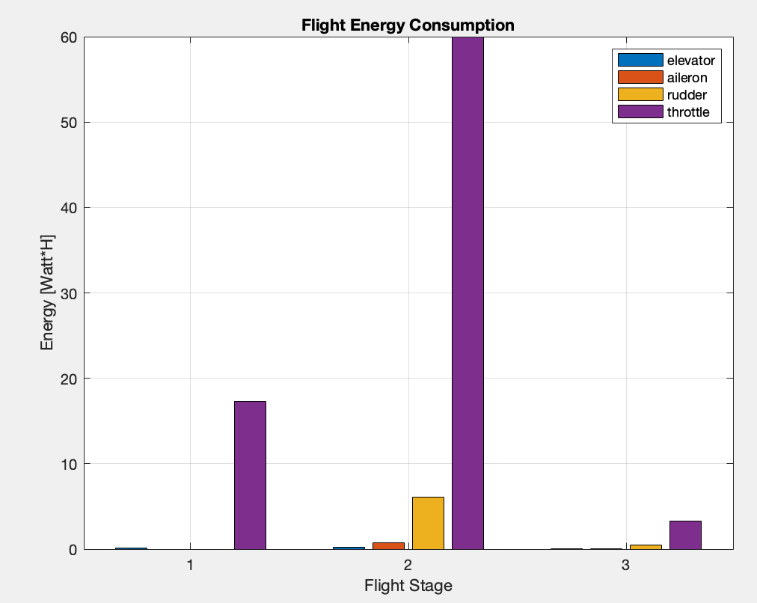
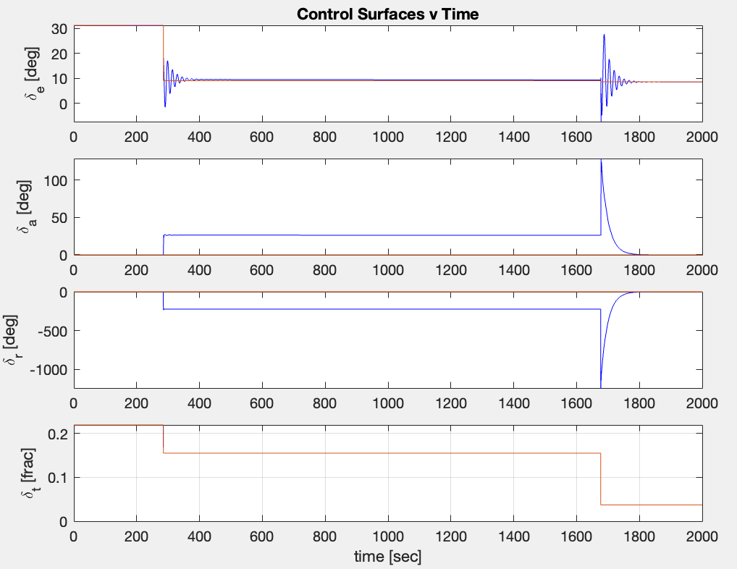
Nonlinear Flight
Model – Progress
Capabilities
  Discrete mission plan
  Nonlinear simulation following plan
  Measure control inputs and state
  Calculate total energy consumption
Limitations
  Manual Mission Planning
  Control surface power estimations
Next Steps
  Mission generation from waypoints
  Additional Control Architectures
  Simulated Sensor Input
  Dynamic Mid-Mission Plan Feedback
  Simulated Takeoff W/ Ground Forces
Introduction
Trades
Future Work
Current Design Space
Introduction
Trades
Current Design Space
Future Work
Notes:
Example mission:
Climb at 5 degrees for 500m
Spiral Climb at 2deg for 1000m yaw rate of 1 deg/s
Glide descent at –2deg for 300m
All at 21m/s

Slide 27
Control Architecture Models – Progress
Additional Slides
Proportional-Integral-Derivative (PID) Control
Optimal Control
Adaptive Control
Well known control architecture, can be tuned with linearized flight models, and reliable performance and disturbance rejection after gains tuning
Control function is optimized via a cost function, calculates optimal control function based on current and desired aircraft state, and considers the system and aircraft constraints
Excels at operation in uncertain and changing conditions, updates system parameters in-flight, and can be optimized to minimize aircraft energy use
Introduction
Trades
Future Work
Current Design Space

Slide 28
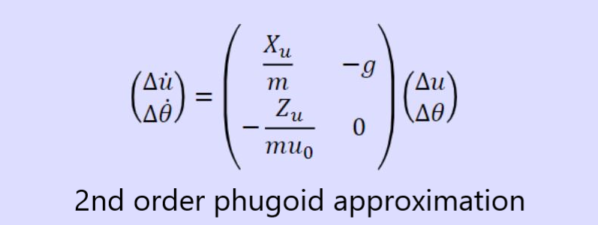
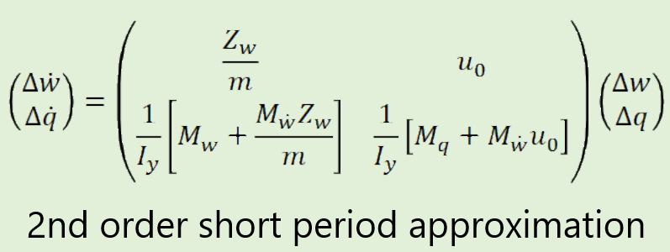
Control Architecture Models – Progress
Proposed Implementation
Reduced order models of dynamic flight modes
Inform future control architecture trades
  Ease of implementation
  Computational intensity
  Power usage
  Stability
Introduction
Trades
Future Work
Current Design Space
Introduction
Trades
Current Design Space
Future Work
Notes:
Reduced order models of the dynamic modes of the Tempest aircraft will be created for each of the control architecture families. These will help inform future control architecture trades. feasibility of fully implementing of each of the different architectures

Slide 29
Current Design Space

Slide 30
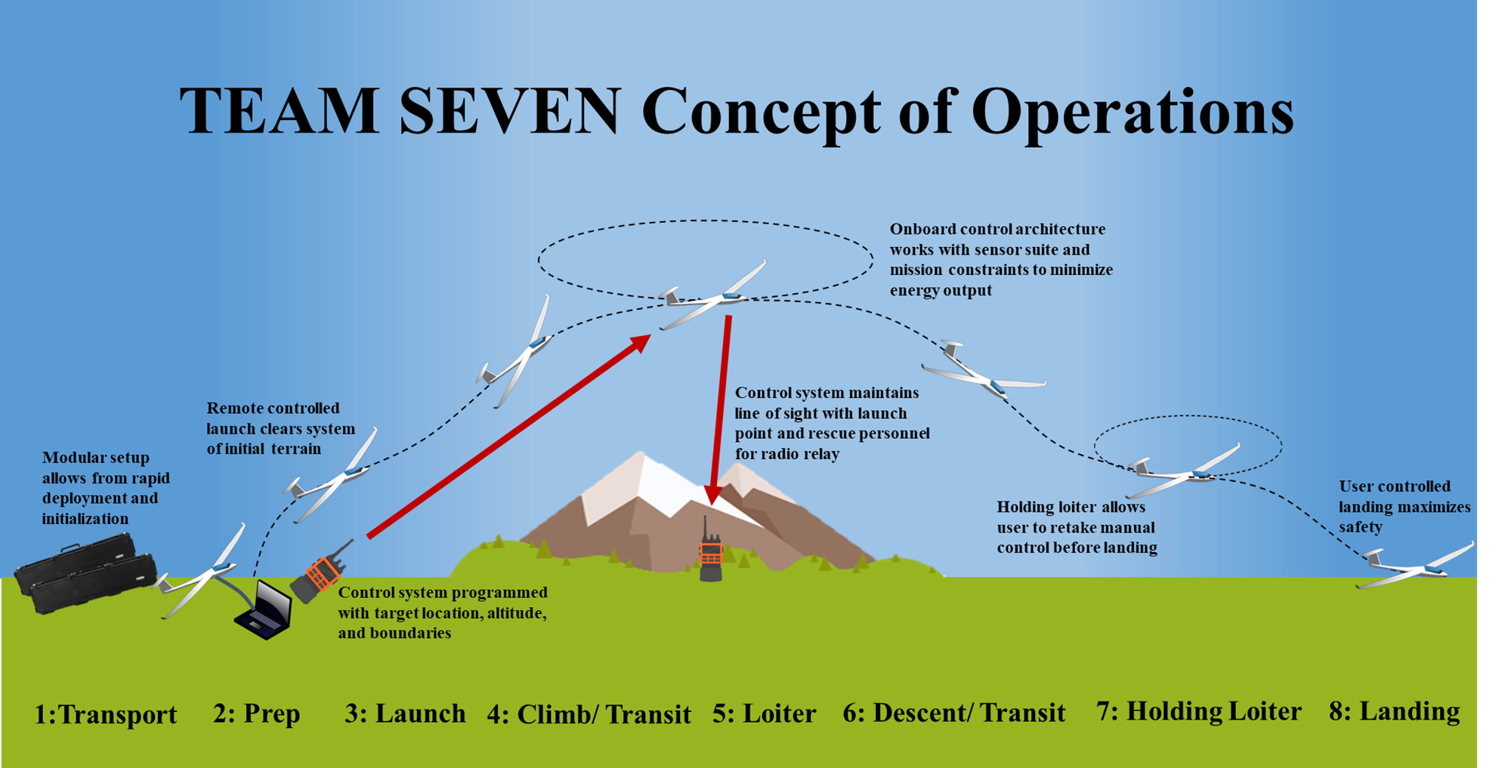
Trade Integration
Levels of Closed Loop Energy Optimization
Focus on climb and orbit flight phases
Saves development time
Scopes away from complicated transit pathing algorithms (riding updrafts, following ridgelines)
Scopes away from challenging takeoff/landing protocols
Introduction
Trades
Future Work
Current Design Space

Slide 31
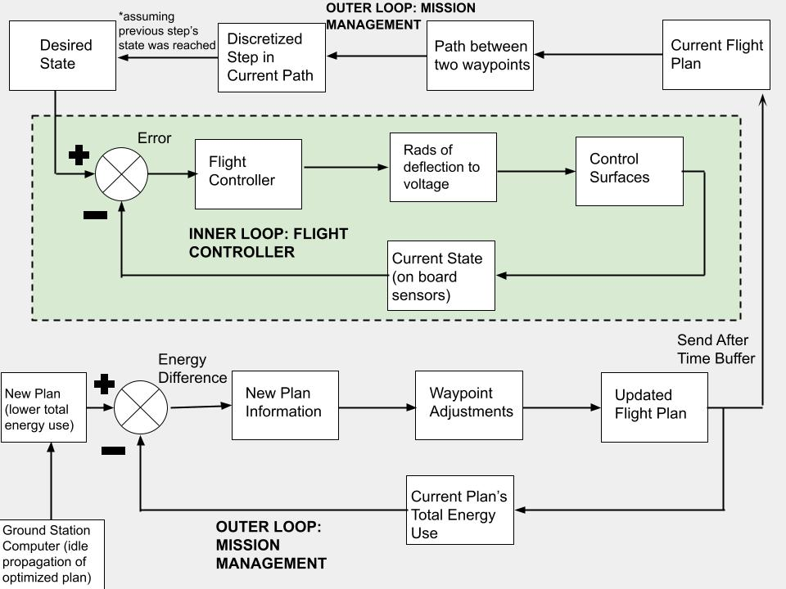
Possible Controls Loop Architecture
Waypoint Following
Inner-loop and outer-loop configuration
  Inner-loop: Flight Controller
  Outer-loop: Mission Management
Mission Management asynchronously determines optimized flight plans
Flight Controller receives states from current flight plan and follows them
Potential approach to integrate optimized plans with any controller
Introduction
Trades
Current Design Space
Introduction
Trades
Current Design Space
Future Work
Future Work

Slide 32
Future Trades
Controls System
In Progress
Completed
Dependency
Levels of Energy Optimization
Controls Architecture
Flight Boundary Implementations
Path Planning
Autopilot
Path Generation
Hardware Trades
Flight Controller
Mission Planning Software
Sensor Suite
Surrogate Airframe
User Interface
Communication Devices
Introduction
Trades
Future Work
Current Design Space

Slide 33
Table of Contents
In this Presentation
Additional Slides
Introduction
Mission Management
ConOps
Functional Block Diagram
Functional Requirements
Critical Project Elements
Aircraft Performance Summary
SLUF Energy Analysis
Climb Energy Analysis
Orbit Energy Analysis
Full Flight Analysis
Future Models/Simulations
Waypoint Following
Trade
Key Requirements/Constraints
Design Risks/Assumptions
Design Metrics & Weightings
Final Trade Matrix
Flight Controls
Flight Control Architecture Overview
Addition Simulation Outputs
Flight Controls Pros/Cons
Modeling/Simulation
Model Overview
Model/Simulation Plans
Non-Linear Flight Model Progress
Control Architecture Model Progress
Additional Trades
Communications/Antenna Trades
Preliminary Flight Controller Trade
Current Design Space
Trade Integration
Possible Control Architecture
Future Trades

Slide 34
Backup Slides

Slide 35
Mission Management Flight Performance Analysis

Slide 36
Design Metrics & Scoring
1 (Worst) | 2 | 3 | 4 | 5 (Best) | Description
Extremely difficult implementation (from scratch) | Difficult implementation (little pre-existing work, mostly from scratch) | Moderately difficult implementation (some pre-existing work, modifying for our system) | Relatively simple implementation (lots of pre-existing work, slight adjustments from us) | Easy Implementation (open-source / pre-existing solution) | Measure of how simple/easy we think this solution will be to implement in our design. This accounts for topics such as available information, time spent in development, and cost.
Flight endurance only determined by pre-made flight path. (baseline solution) | Little improvement from pre-determined flight path. | Endurance is somewhat improved from pre-determined flight path. | Flight endurance is improved from pre-determined flight path. | All phases of flight see improvement from closed loop path updates, and endurance is greatly improved. | Measure of how much we think the solution will improve our flight endurance.
User spends a very large amount of time managing UAS trajectory if they wish to extend endurance. | User spends significant time managing the UAS trajectory. | User spends moderate time managing the UAS trajectory. | User spends some time managing the UAS trajectory. | User spends little to no time trying to optimize path. | Measure of how the solution will reduce user workload based on the time they will spend changing flight path without a suggested path. This assumes the user will be trying to improve endurance themselves.
System is not safe for users, surrounding environments, or bystanders | System is somewhat safe | System is moderately safe | System is safe | System is very safe for surrounding environments or bystanders | Measure of how safe we think the solution will be.

Slide 37
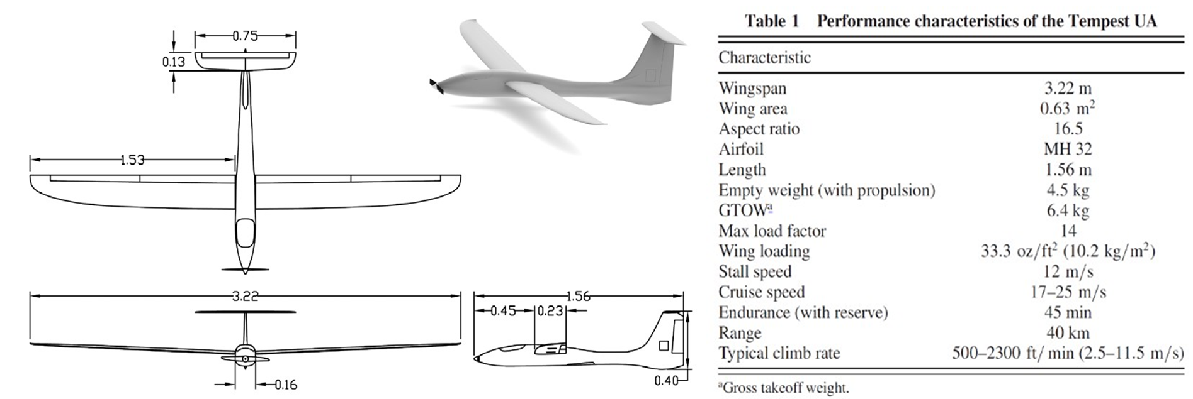
Aircraft Performance Summary
Back to Table of Contents

Slide 38
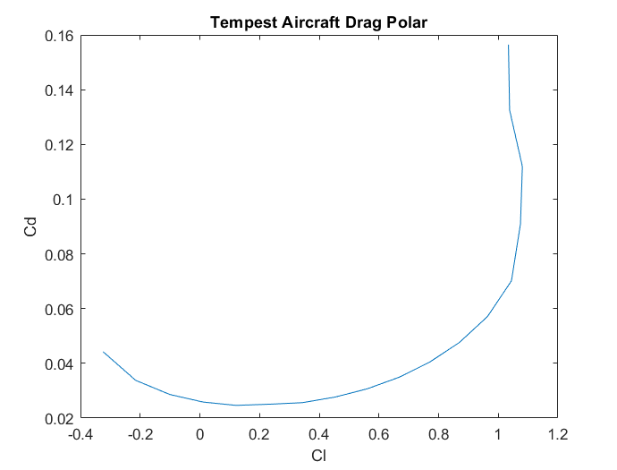
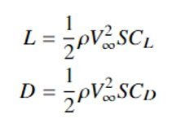

Aircraft Performance Summary
Back to Table of Contents

Slide 39
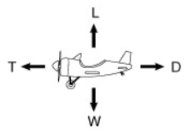
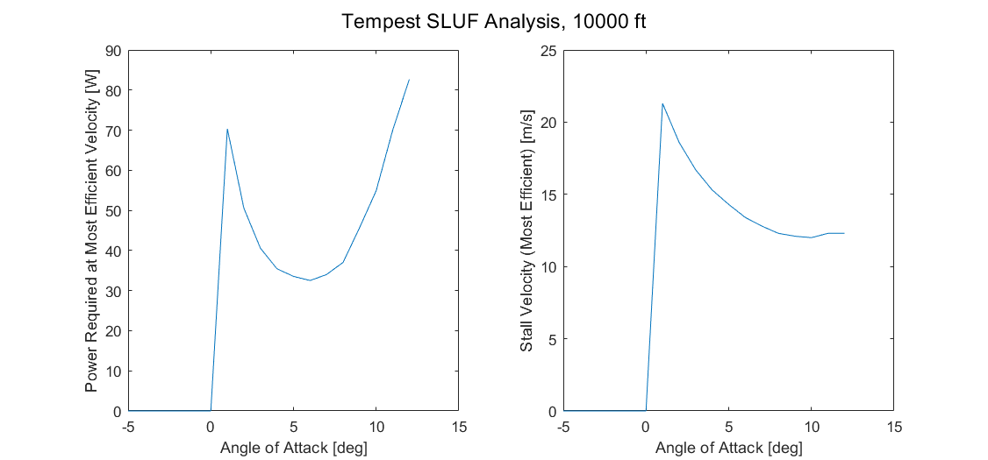
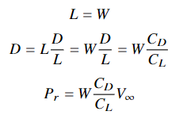


SLUF Energy Analysis
Pr min: AOA of 6 degrees @ 13.4 m/s
Back to Table of Contents

Slide 40
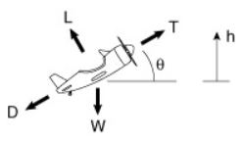



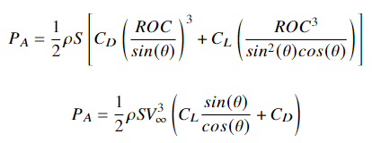
Climb Energy Analysis
Modeling climb as constant ROC
Pr to overcome drag only (same as before).
Any excess power will increase energy (kinetic and/or potential).
Since forces are balanced, excess power will only increase potential energy.
Back to Table of Contents

Slide 41

Climb Energy Analysis
Goal: find Pa and associated airspeed and climb angles that results in the smallest energy expenditure for altitude change.
Assumptions
  Pa is constant
  Air density is averaged between altitudes
Back to Table of Contents

Slide 42
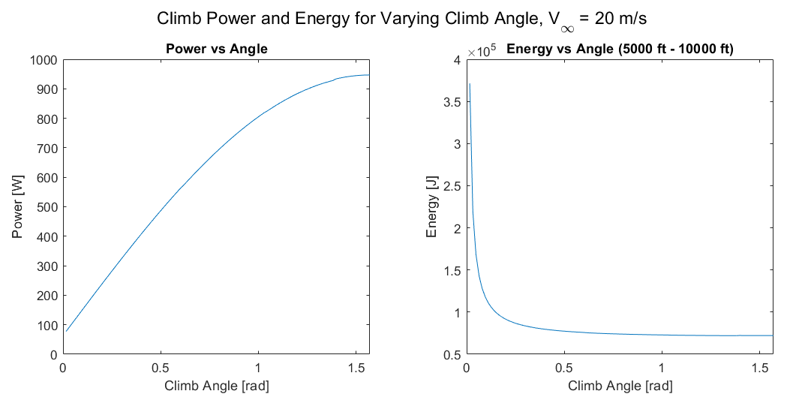
Climb Energy Analysis
Minimum energy expenditure at maximum climb angle -> will we actually have enough power to do this? (probably not)
Back to Table of Contents

Slide 43
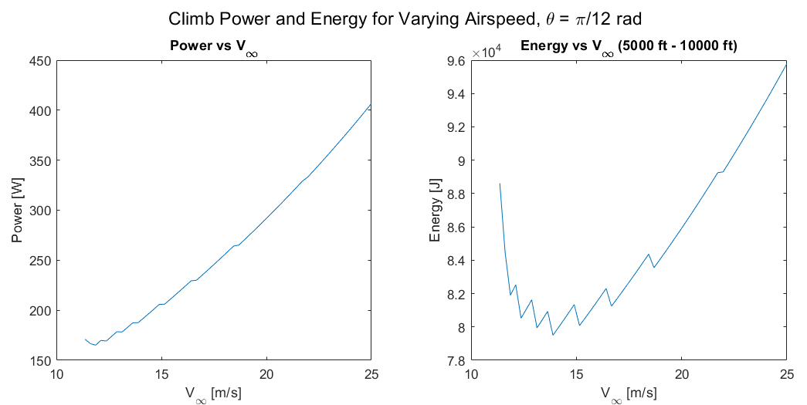
Climb Energy Analysis
Jagged because the DP is discrete
  Find L according to constant ROC condition and solving for Cl --> using DP to get Cd.
  Stall when Cl_req > Cl_max
Back to Table of Contents

Slide 44
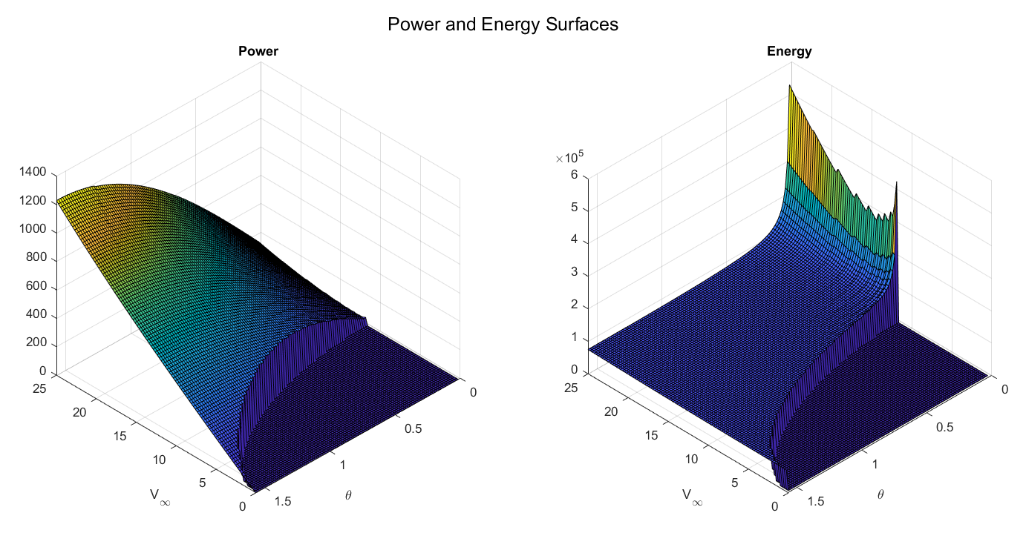
Climb Energy Analysis
Back to Table of Contents

Slide 45
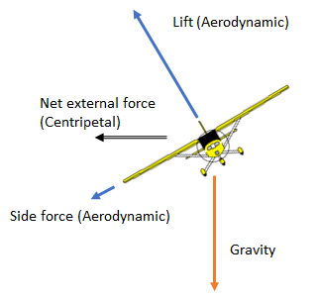


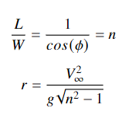
Orbit Energy Analysis
Modeling orbit as a constant radius flat turn (equilibrium of vertical forces)
Ignoring slide force
Orbit defined by velocity and coefficient of lift
Back to Table of Contents

Slide 46
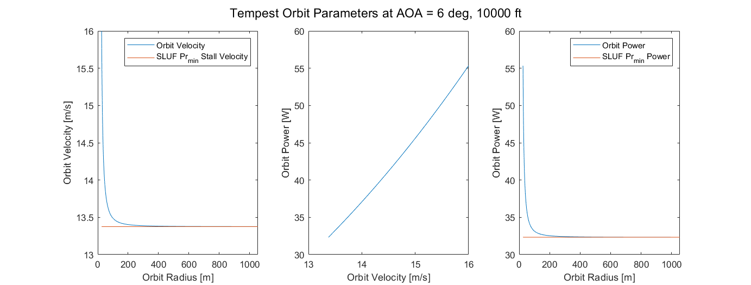
Orbit Energy Analysis
Back to Table of Contents

Slide 47
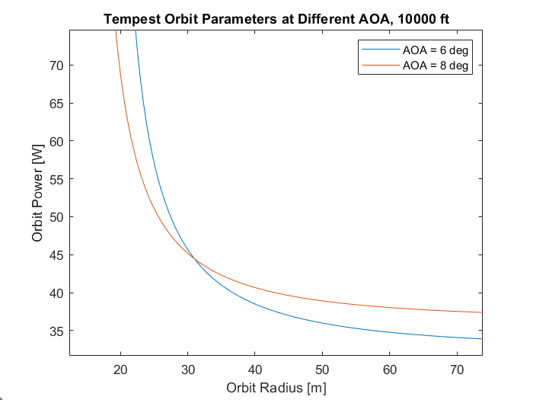
Orbit Energy Analysis
Back to Table of Contents

Slide 48
Full Flight Analysis
From CONOPS (and other analysis) -> Eight main flight modes
  Takeoff
  Climb
  Transit To
  Orbit
  Transit From
  Descent
  Loiter above user (safety feature, not optimized)
  Landing
Back to Table of Contents

Slide 49








Full Flight Analysis: Takeoff and Climb
Takeoff
Climb
50 ft
5000 ft
Always flying at minimum power lift and drag coefficients
Airspeed is a function of angle and coefficient of lift like we saw earlier
Back to Table of Contents

Slide 50


Full Flight Analysis: Transits
Case 1
Case 2
Back to Table of Contents

Slide 51
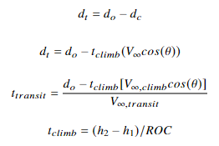

Full Flight Analysis: Transits
Case 1
Case 2
Always flying at minimum power required
Back to Table of Contents

Slide 52
Full Flight Analysis: Orbits
Always flying at minimum power required
Time of flight is a variable we can change in the code (simulates battery life in a way)
  Time of flight is a function of energy/power, so it works for now
In reality, time of orbit will depend on how much energy we have in our battery to spend on it.
Back to Table of Contents

Slide 53
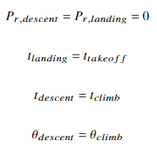
Full Flight Analysis: Descent and Landing
Assumptions not great, but good enough for now
Back to Table of Contents

Slide 54
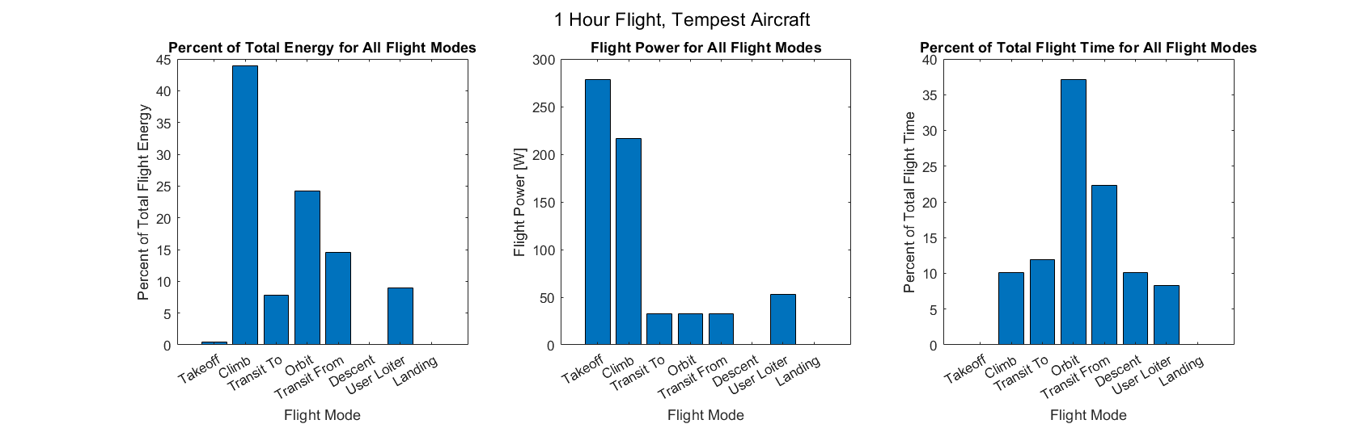
Full Flight Analysis: Results
Parameters: Launch altitude: 5000 ft Orbit Altitude: 10000ft Target Distance: 10km User Distance From Target: 15km
User Loiter: 5 min, 30m radius Orbit: 1km radius Takeoff Pitch: 30 deg Climb Pitch: 20 deg
Assumptions: Minimum Power Lift/Drag Coefficients and Velocities for all Flight Phases
Back to Table of Contents

Slide 55
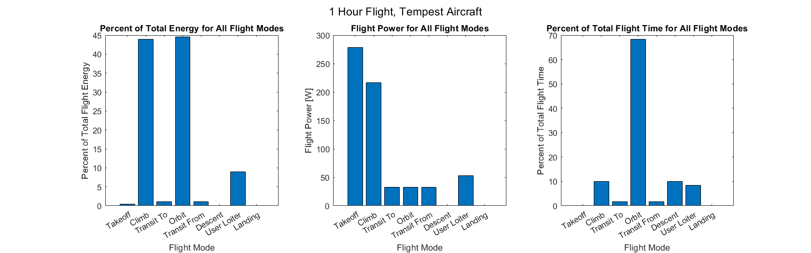
Full Flight Analysis: Results
Parameters: Launch altitude: 5000 ft Orbit Altitude: 10000ft Target Distance: 5km User Distance From Target: 5km
User Loiter: 5 min, 30m radius Orbit: 1km radius Takeoff Pitch: 30 deg Climb Pitch: 20 deg
Assumptions: Minimum Power Lift/Drag Coefficients and Velocities for all Flight Phases
Back to Table of Contents

Slide 56
Full Flight Analysis: Results
Parameters: Launch altitude: 5000 ft Orbit Altitude: 10000ft Target Distance: 10km User Distance From Target: 15km
User Loiter: 5 min, 30m radius Orbit: 1km radius Takeoff Pitch: 30 deg Climb Pitch: 20 deg
Assumptions: Minimum Power Lift/Drag Coefficients and Velocities for all Flight Phases
Back to Table of Contents

Slide 57
Mission Management: Future Models / Trades
Types of closed loop path generation algorithms
Propeller power and efficiency with altitude
Full ODE45 simulation of flight
Modeling descent and landing power/energy
Modeling flight modes with wind
Back to Table of Contents

Slide 58
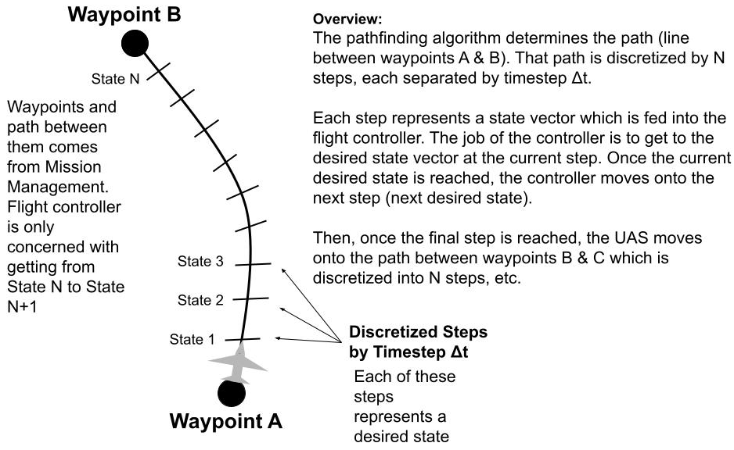
Waypoint Following
Back to Table of Contents

Slide 59
Flight Controls

Slide 60
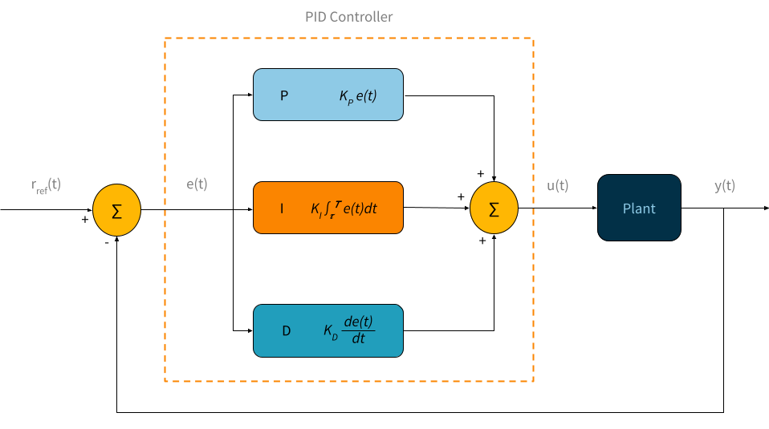
Flight Control Architecture Overview
Proportional-Integral-Derivative (PID) Control Loop
Well known, well documented control architecture
Reliable performance and disturbance rejection after gains tuning
Cannot guarantee optimal control for uncertain system dynamics
Closed-loop stability can be proven by inspecting system poles
r_{ref}(t) - setpoint
e(t) - error value
u(t) - control variable
y(t) - process value
Back to Table of Contents

Slide 61
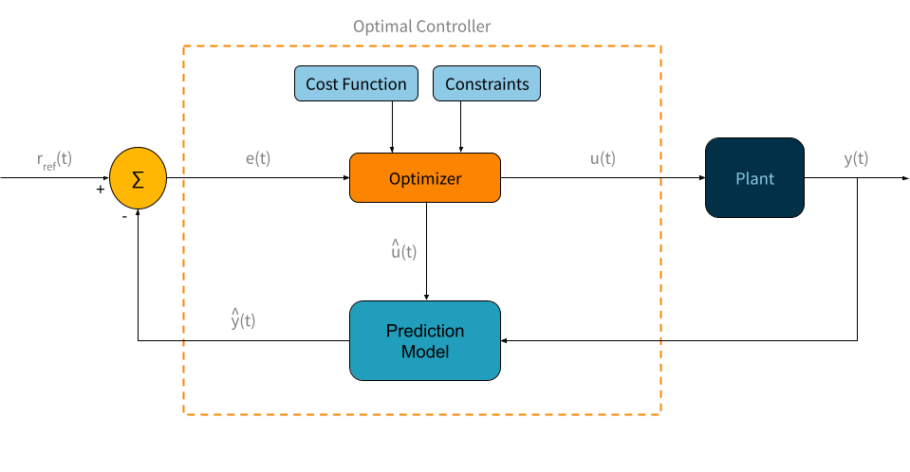
Flight Control Architecture Overview
Optimal Control Loop
Calculates optimal control based on Cost Function and Constraints
Optimization of energy is a flow-down from FR 2
Fidelity of control based on fidelity of Cost Function and Prediction Model
Increase in necessary computational resources from PID Control
û(t) - optimal control variable
ŷ(t) - optimal process value
Back to Table of Contents

Slide 62
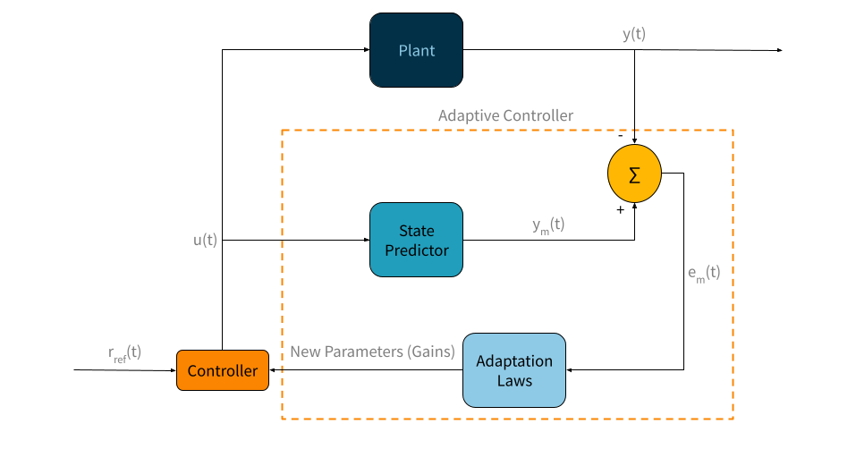
Flight Control Architecture Overview
Adaptive Control Loop
Control Architecture designed to operate in uncertain and changing system dynamics
Outer-loop added onto an existing controller; could still optimize for energy with inner-loop
Fidelity of control dependent on the State Predictor and Adaptation Laws
Stability of new system parameters must be calculated before implementation; increases necessary computational resources and time
e_{m}(t) - modeled error value
y_{m}(t) - modeled process value
Back to Table of Contents

Slide 63
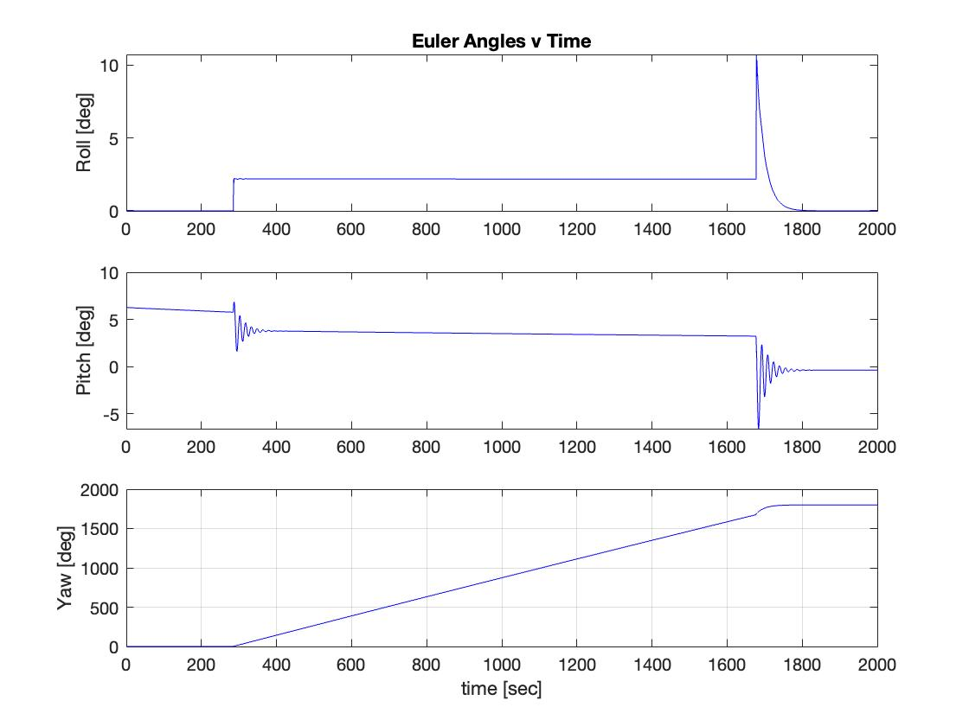
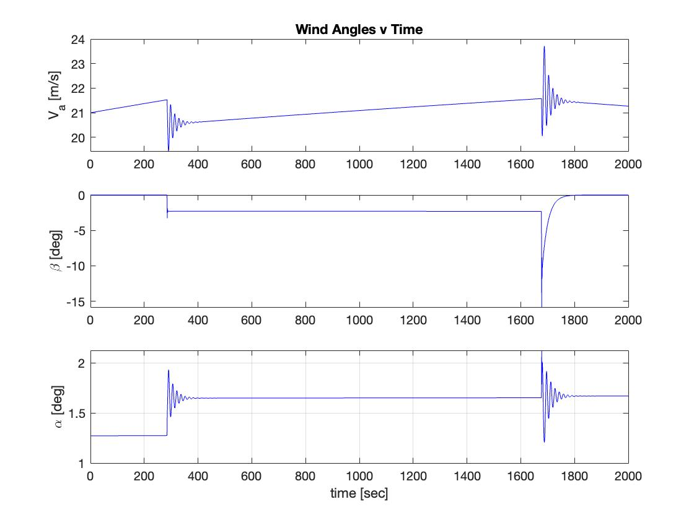
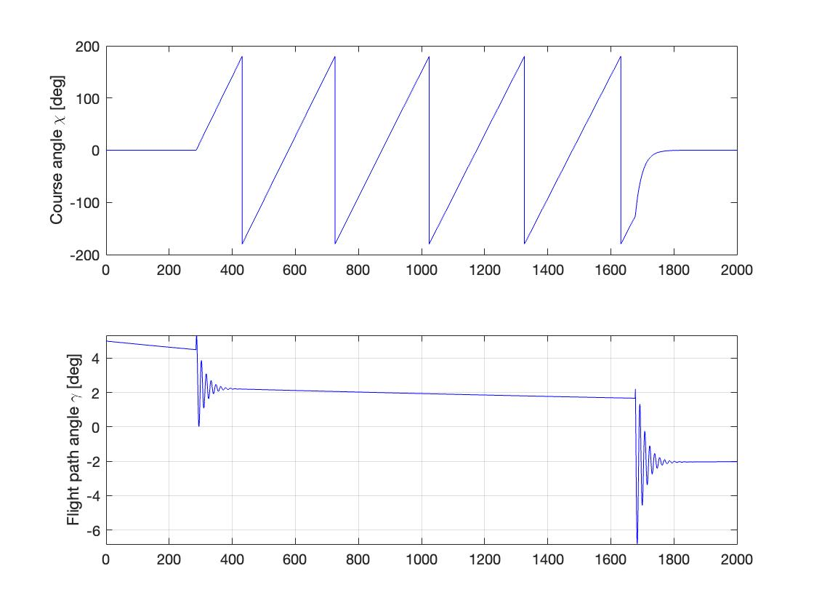
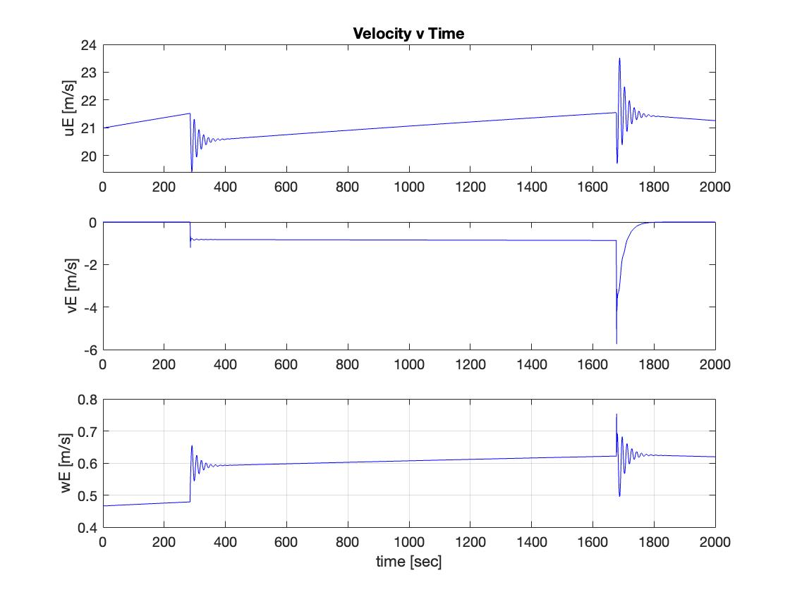
Additional Simulation Outputs:
Back to Table of Contents

Slide 64
Flight Controller Overview
 | PID Family | Optimal Controls | Adaptive Controls
Pros | - Allows for feedback to the system - Independent of any models, the tuned gains remain constant and are usually set in relation to the real-world process - On-line estimation allows PID controllers to implement disturbance rejection - Large number of resources and prior understanding from classes | - Finds best control based on a user defined cost function (can make this related to energy state) - Cost function can consider many system constraints as well as various system states - Fits our mission objective for minimizing energy use of the system | - Really good at controlling unknown conditions/plants (on-line estimation inherent) - Can still optimize performance vs a developed model that the system attempts to track - Self tuning, changes its gains overtime to adapt to the closed loop feedback it receives and improve its performance - Can implement robust control in parallel to counter uncertainty
Cons | - Do not provide optimal control, can optimize for certain parameters but overall optimality of control cannot be guaranteed - "Set" system, must tune gains by hand and for a specific flight mode - Can only handle linear time-invariant SISO systems, degraded performance for any non-linear system | - Not great at rejecting disturbances in flight (on-line estimation only in MPC) - Computational intensity is a function of the user defined cost function, a more restricted function takes more resources - Optimization limited to the fidelity of the model the function is based on | - Inherently non-linear, maybe can be linearized? - Adaptive controls checks vs a model, fidelity of model influences how well adaptive control functions
Back to Table of Contents

Slide 65
Flight Energy References (Clipart Images)
https://ocw.mit.edu/ans7870/16/16.unified/propulsionS04/UnifiedPropulsion4/UnifiedPropulsion4.htm
https://www.google.com/url?sa=i&url=https%3A%2F%2Fwww.pinterest.com%2Fpin%2F156359418300750065%2F&psig=AOvVaw2lgmSxBFWKVYXJbdSUcPTG&ust=1664734943756000&source=images&cd=vfe&ved=0CAwQjRxqFwoTCLCw3onTv_oCFQAAAAAdAAAAABAF
https://www.google.com/url?sa=i&url=https%3A%2F%2Fpngtree.com%2Ffreepng%2Fyellow-snow-mountain-clip-art_6028850.html&psig=AOvVaw3EM3kOlVHHqzhwoTYXByc1&ust=1664736057701000&source=images&cd=vfe&ved=0CAwQjRxqFwoTCOCJ3JzXv_oCFQAAAAAdAAAAABAF
https://www.google.com/imgres?imgurl=https%3A%2F%2Fclipart.world%2Fwp-content%2Fuploads%2F2020%2F06%2Fset-of-hand-draw-clouds.jpg&imgrefurl=https%3A%2F%2Fclipart.world%2Fcloud-clipart%2Fset-of-hand-draw-clouds%2F&tbnid=UqqCBVhWqUIguM&vet=12ahUKEwi8gpC317_6AhVWj2oFHSQIBL4QMygMegUIARDDAg..i&docid=tSaSqFqwSis2FM&w=1000&h=796&q=clouds%20clipart&ved=2ahUKEwi8gpC317_6AhVWj2oFHSQIBL4QMygMegUIARDDAg
https://www.google.com/url?sa=i&url=https%3A%2F%2Faviation.stackexchange.com%2Fquestions%2F79338%2Fwhat-are-the-forces-present-in-a-coordinated-turn&psig=AOvVaw38WeB3aTQt7-wUanH6xfF4&ust=1664675010515000&source=images&cd=vfe&ved=0CAwQjRxqFwoTCJi2ivDzvfoCFQAAAAAdAAAAABAN
Back to Table of Contents

Slide 66
Additional Trades

Slide 67
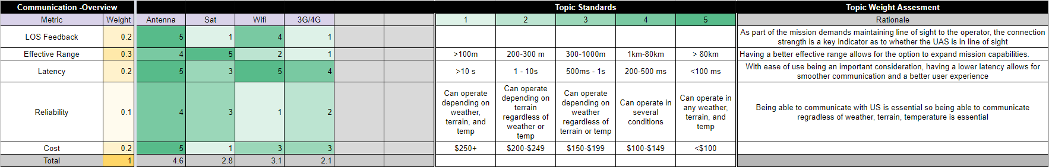
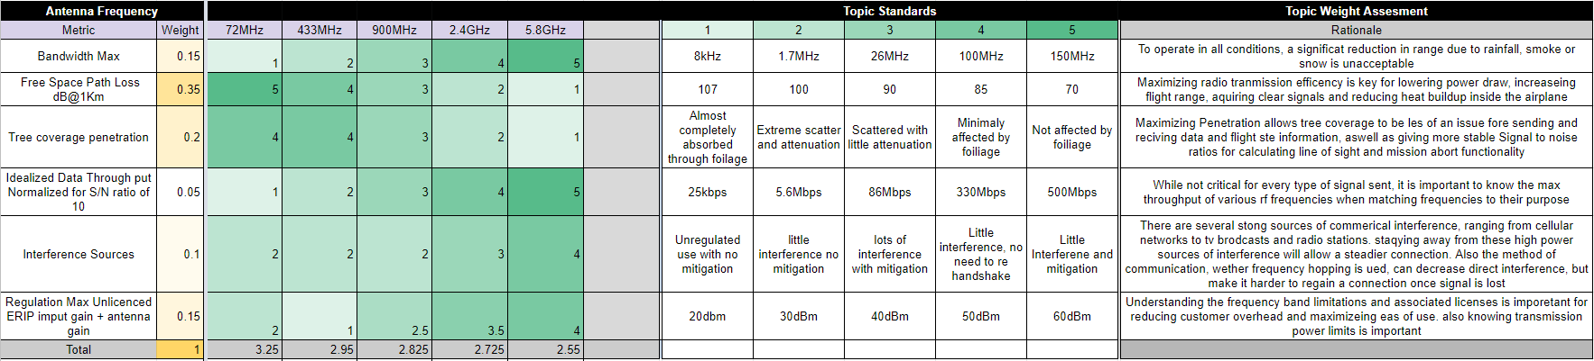
Communications/Antenna Trades
Back to Table of Contents

Slide 68
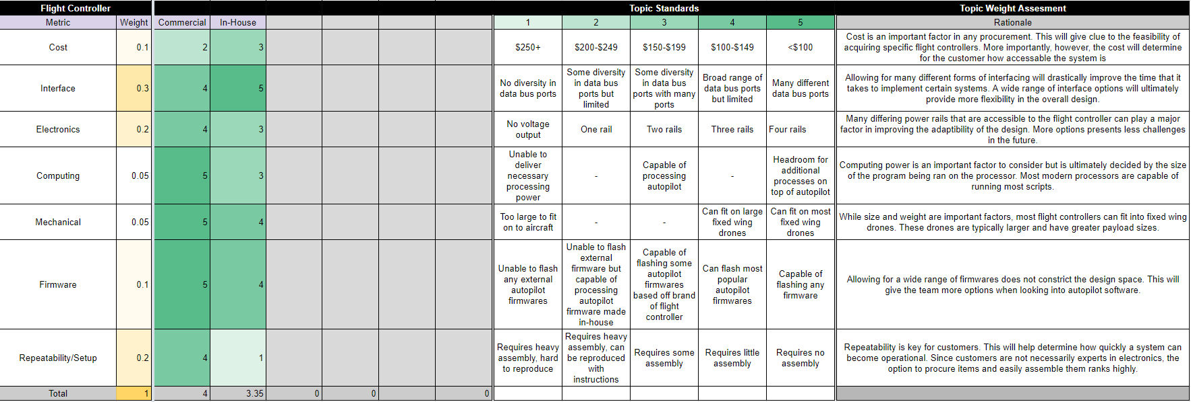
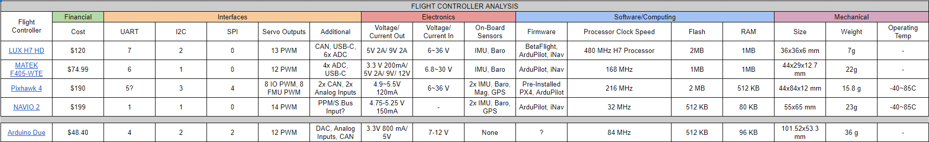
Flight Controller Trade
Back to Table of Contents

Slide 69
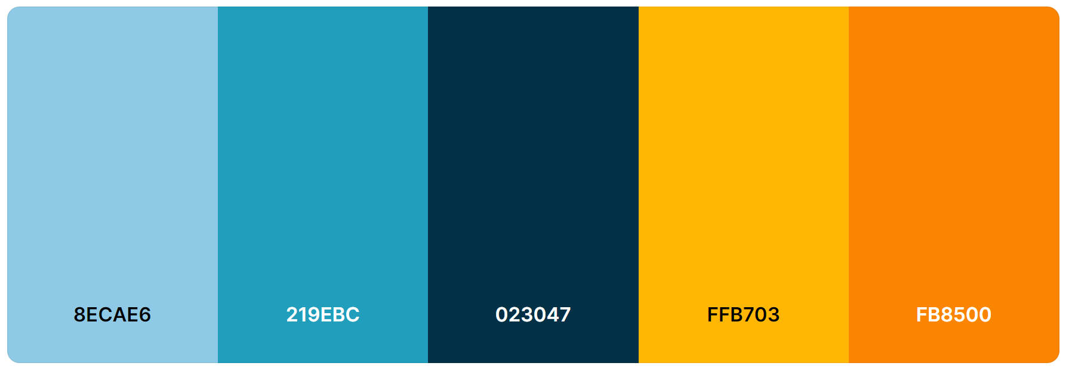
Color and Format Guide for Slides
Back to Table of Contents

