Slide 1
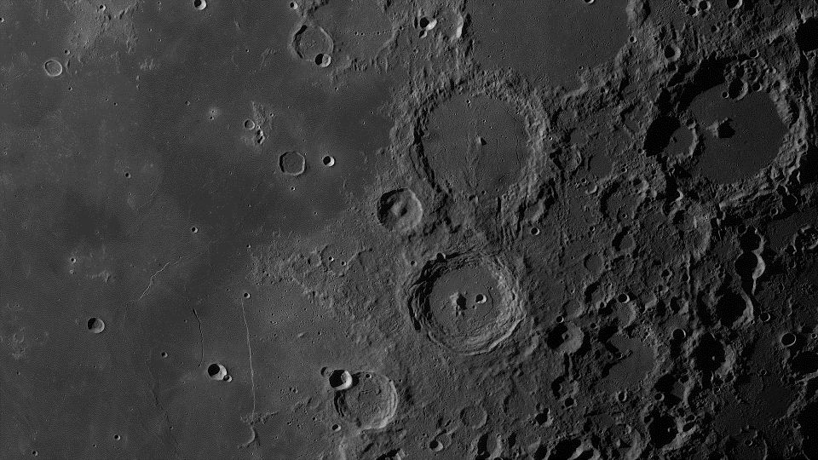
CTHREEPIO
Preliminary Design Review
October 10, 2022
ASEN 4018 Team 6
Team Advisor: Dr. Allie Anderson
Team Sponsor: Blue Origin
Presenters: Lily Allen, Luca Bonarrigo, Geoff Lord, Hannah Obolsky, Nathaniel Shiba, Elijah Stubbs
Other team members: Nick Bottieri, Andrew Czekay, Skylar Edwards, Autumn Martinez, Sarah Martinez, Thomas O’Connor

Slide 2
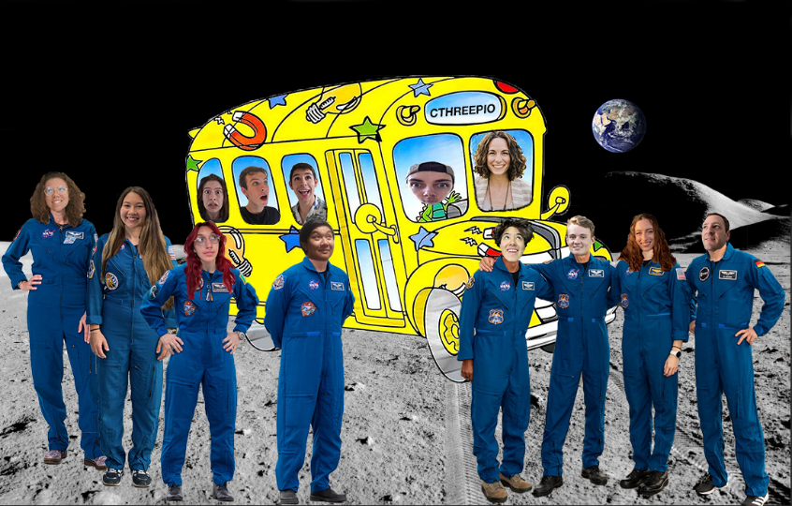
Capabilities Training in Hybrid Reality Extraterrestrial Environments in Preparation for Interplanetary Operations

Slide 3
Outline
PROJECT OVERVIEW
TRADE
STUDIES
CURRENT DESIGN SPACE
MODELING & PROTOTYPING
Geoff, Lily
Nathan, Elijah, Luca
Hannah
Lily
I: Project Overview
II: Trade Studies
III: Design Space
IV: Modeling & Prototyping

Slide 4
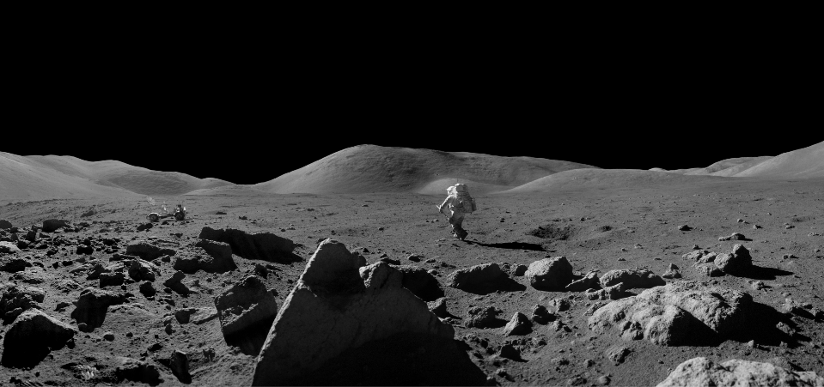
Project Overview
I: Project Overview
II: Trade Studies
III: Design Space
IV: Modeling & Prototyping

Slide 5
Nomenclature
Virtual Reality (VR):
The software developed to virtually recreate a lunar environment
Back End: The Unity and other software development tools used to create the infrastructure for the software
Front End: The rendering software used to visualize the data and software infrastructure - what the user will actually see and interact with
Hybrid Reality (HR):
The physical tools and sensors used to track interactions between the user, real life and virtual objects
Training Simulation (CTHREEPIO):
The project as a whole - the combination of virtual environment and hybrid reality
Extravehicular Activity (EVA):
This is the official term for any activity that an astronaut conducts outside of a safe habitat/vehicle.
Derived Requirement (DR):
A lower level requirement under a high level functional requirement (FR). DRs can be found in backup slides.
I: Project Overview
II: Trade Studies
III: Design Space
IV: Modeling & Prototyping
Notes:
The software that “will” be developed

Slide 6
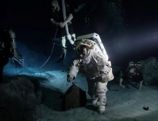
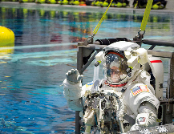
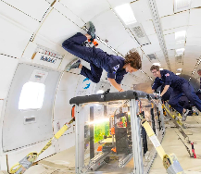
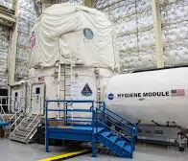
Background - Lunar/Astronaut Training
Increased interest in lunar operations comes with an increased need for operational training.
Current training methods include (not limited to):
Neutral Buoyancy Lab¹
Field Simulations (Analogs)²
Parabolic flight³
These methods are costly and operate on strict time schedules.
I: Project Overview
II: Trade Studies
III: Design Space
IV: Modeling & Prototyping

Slide 7
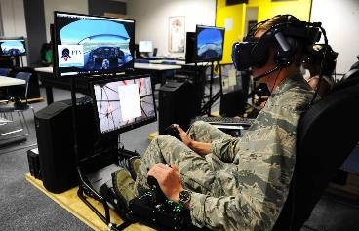
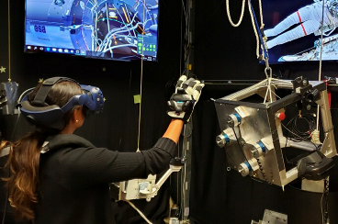
Background - VR
VR systems have been successfully applied to training exercises across many fields:
Aviation Training/Maintenance⁴
Surgical/Medical Training⁵
This technology allows for:
Complicated visual environments
Flexibility
Immersiveness
Simulated gravity in an altered way
…all at a much lower cost than other operational training methods
I: Project Overview
II: Trade Studies
III: Design Space
IV: Modeling & Prototyping
Notes:
1 pic - (Jennifer Spradlin/Air Force Academy)
2nd pic - https://spacecenter.org/how-nasa-uses-virtual-reality-to-train-astronauts/

Slide 8
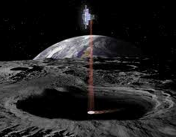
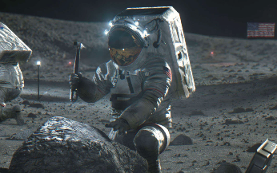
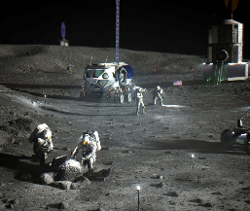
Project Definition - Objective
To develop a virtual reality lunar surface environment incorporating hybrid reality interactions and embedded environmental constraints specifically focused on the lunar south polar region.
I: Project Overview
II: Trade Studies
III: Design Space
IV: Modeling & Prototyping

Slide 9
Specific Mission Objectives
Level I:
VR Environment
Provide a realistic virtual representation of the lunar surface
Model high-fidelity VR objects for physical objects
Level II:
VR Environment
Include accurate lighting & topography
Create specific mission objectives utilizing HR objects
Hybrid Integration
Utilize object tracking during simulation
Represent physical interactions in the VR environment
Hybrid Integration
Allow user to interact with the physical objects of individual objects
I: Project Overview
II: Trade Studies
III: Design Space
IV: Modeling & Prototyping

Slide 10
Specific Mission Objectives
Level I:
Usability/Adaptability
Provide user-friendly interface along with an outlet for feedback
Level II:
Usability/Adaptability
Compact and mobile
Act as a framework for creating various training exercises
Human Constraints
Safely incorporate variables that would impact an astronaut during an EVA
Human Constraints
Address human factors limitations, such as mobility constraints
Display EVA information to user from a virtual display
I: Project Overview
II: Trade Studies
III: Design Space
IV: Modeling & Prototyping

Slide 11
High Level Functional Requirements
 | Functional Requirement
F1 | The VR environment shall simulate the south polar region of the lunar surface.
F2 | The training simulation shall include physical, real-world objects.
F3 | The training simulation shall accurately portray interactions with physical objects in the VR environment.
F4 | To accurately simulate EVA activities on the lunar surface, the training simulation shall portray spacesuit features and small scale lunar objects.
F5 | The training simulation, including the VR environment and all physical aspects, shall keep the user, operator, and itself safe from harm.
F6 | The training simulation shall be appropriate for a laboratory environment.
I: Project Overview
II: Trade Studies
III: Design Space
IV: Modeling & Prototyping

Slide 12
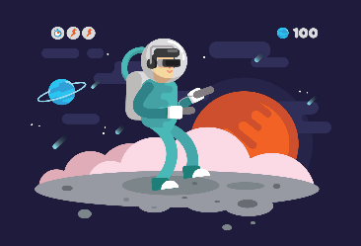
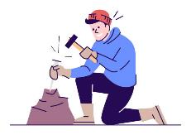
Concept of Operations
CTHREEPIO High-Level Use Cases
Classroom Education
CTHREEPIO Training
Hardware Evaluation
Supplement knowledge with hands-on experience
Test astronaut adaptation to environmental constraints
Run mission tasks with hybrid reality objects
Evaluate new hardware and mission protocols

Slide 13
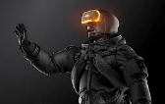
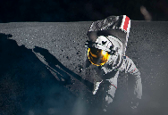
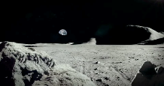
Concept of Operations
User Interaction with CTHREEPIO
Training Setup
Inside the Simulation
Physical
Set up physical space and VR environment
Check equipment
Select capabilities, begin training
Realistic Movement Constraints
Feedback
Interaction with Hybrid Reality Objects
Exiting the Simulation
Doff all hardware
Break down physical space
Packup hardware
Evaluate user experience and provide feedback
Realistic Missions Training
Virtual
High-Fidelity Lunar Environment
Notes:
Change bullets to 1-2-3

Slide 14
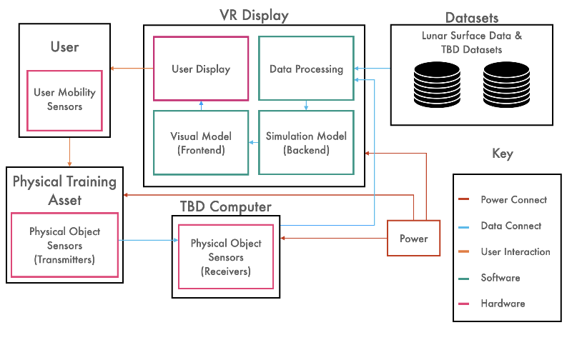
Functional Block Diagram
I: Project Overview
II: Trade Studies
III: Design Space
IV: Modeling & Prototyping

Slide 15
Critical Project Elements
 | Element | Description | Why?
E1 | Virtual Environment | Recognizable as the moon Integratable with real-world equipment | Failure to successfully integrate will impede the ability of astronauts to have a high-fidelity and safe training experience
E2 | User-Associated Equipment | Integration of equipment will not impede on overall functionality or safety | Oversight could impair HR effectiveness or result in person/equipment damage
E3 | Hybrid Reality (HR) Support Equipment | Tracks user’s interaction/actions Integrates with VR instruments | Oversight would lead to integration challenges and quality-impeding obstacles
I: Project Overview
II: Trade Studies
III: Design Space
IV: Modeling & Prototyping
Notes:
HR support equipment shall track user actions/interactions with utilized tools and integrate with virtual reality instruments
User-associated equipment shall integrate such that all equipment does not impede on overall functionality or safety
Training simulation will utilize a virtual environment that is recognizable by the user as a lunar surface and must integrate with the real-world equipment

Slide 16
Critical Project Elements
 | Element | Description | Why?
E4 | Testing | Accessible, intuitive, and operable by human user Possess the ability to test, validate, and verify requirements | Failure would impede the training capability and overall mission as well as put the users at greater risk
E5 | Safety | Must not cause any physical or mental harm to user | Must ensure hazards are minimized to user, operator, and equipment
E6 | Financial | Total cost of the simulation must not exceed $4,000. * Extra funds may be secured from the University of Colorado Boulder College of Engineering if necessary | Maintaining to budget and schedule is non-negotiable
I: Project Overview
II: Trade Studies
III: Design Space
IV: Modeling & Prototyping
Notes:
Simulation must be accessible, intuitive, and operable by a human user and must have the ability to test, validate, and verify requirements as set forth in the PDD and in future documents
The training simulation must not cause any physical or mental harm to any user or operator

Slide 17
Trades Performed
 | Trade Space | Parent FRs | Related CPEs
1 | Virtual Reality Display | F2, F3, F5, F6 | E1, E2, E4, E5, E6
2 | Virtual Reality Headset | F3, F5 | E1, E2, E4, E5, E6
3 | Lunar Data | F1 | E3
4 | Rendering Software | F2, F3, F4 | E3
5 | Unity Templates | F1 | E3, E6
6 | Object Tracking | F2 | E1, E2, E4, E6
7 | Physical Constraints | F2 | E2, E4, E5, E6
8 | Manufacturing of Physical Objects | F2, F3 | E1, E2, E5, E6
9 | Physical Objects | F2, F3 | E2, E5, E6
VR
HR
I: Project Overview
II: Trade Studies
III: Design Space
IV: Modeling & Prototyping

Slide 18
Trades Performed
 | Trade Space | Parent FRs | Related CPEs
1 | Virtual Reality Display | F2, F3, F5, F6 | E1, E2, E4, E5, E6
2 | Virtual Reality Headset | F3, F5 | E1, E2, E4, E5, E6
3 | Lunar Data | F1 | E3
4 | Rendering Software | F2, F3, F4 | E3
5 | Unity Templates | F1 | E3, E6
6 | Object Tracking | F2 | E1, E2, E4, E6
7 | Physical Constraints | F2 | E2, E4, E5, E6
8 | Manufacturing of Physical Objects | F2, F3 | E1, E2, E5, E6
9 | Physical Objects | F2, F3 | E2, E5, E6
VR
HR
I: Project Overview
II: Trade Studies
III: Design Space
IV: Modeling & Prototyping

Slide 19
Virtual Reality Display
Tools and Equipment
Suit/Physical Constraints
VR Headset
Object Tracking
Unity Templates
Lunar Data
Manufacturing Methods
Rendering SW
Future Trades
- Complete
- Future Trades
- Interdependencies
19
I: Project Overview
II: Trade Studies
III: Design Space
IV: Modeling & Prototyping
Notes:
Highlight 5 main ones show interdep. On the 4
Branch off on each TS

Slide 20
Trade Studies
I: Project Overview
II: Trade Studies
III: Design Space
IV: Modeling & Prototyping

Slide 21
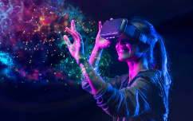
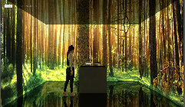
Trade 0 - Virtual Reality Display
BASELINE
Focus: Which type of VR display will be used to present the virtual environment to the user
The VR display must maximize user immersion and be suitable for a laboratory environment
Constraints:
Must be compatible with Unity engine
Must be capable of incorporating physical objects
Must be able to operate in a 9’ x 10’ floor area
Must be capable of operating continuously for minimum 2 hrs
Total cost of equipment must not exceed $4,000
VS
FR: F2, F3, F5, F6 | CPE: E1, E2, E4, E5, E6
I: Project Overview
II: Trade Studies
III: Design Space
IV: Modeling & Prototyping
Notes:
User Immersion
Head-mounted display
Can add real objects into simulation
Portability
Light weight
Quick to set up
Cost Efficiency

Slide 22
Trade 0 - Virtual Reality Display
DESIGN METRICS AND WEIGHTINGS
Design Metric | Weight | Reasoning
User Immersion | 60% | As CTHREEPIO aims to provide a highly immersive, high-fidelity and realistic environment, user immersion and overall immersivity is a key metric for the VR display system.
Portability | 25% | As per F6, CTHREEPIO must be appropriate for a laboratory environment, and part of this requirement is portability. The VR display system must be easily portable and fit within volume constraints provided.
Cost | 15% | While some displays might have excellent capabilities in regards to the previous metrics, they may be prohibitively expensive (outside of budget options will be removed due to noncompliance).
I: Project Overview
II: Trade Studies
III: Design Space
IV: Modeling & Prototyping

Slide 23
Trade 0 - Virtual Reality Display
TRADE MATRIX
 |  | Virtual Reality Headsets | Augmented Reality Glasses | Projector Displays | Mounted Screen Displays
Metric | Weight | WT | WT | WT | WT
Immersion | 60% | 5.4 | 4.2 | 2.4 | 1.2
Portability | 25% | 2.0 | 2.0 | 0.25 | 1
Cost | 15% | 1.05 | 0.75 | 0.6 | 0.75
Total (0-10) | 100% | 8.45 | 6.95 | 3.25 | 2.95
Final Selection
*WT = Weighted Total Score
Uncertainty:
Variety among VR Headsets in cost and quality (trade space)
Potential physical discomfort and motion sickness
I: Project Overview
II: Trade Studies
III: Design Space
IV: Modeling & Prototyping

Slide 24
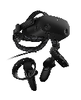
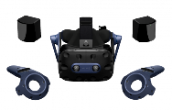
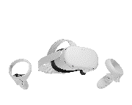
Trade 1 - VR Headset
BASELINE
HP Reverb G2
Focus: The VR headset that will be used to present the virtual environment to the user
The headset will immerse the user in the VR environment and mitigate discomfort to the wearer
Reflect physical interactions in VR environment (DR 3.3)
Avoid causing simulation sickness in user (DR 5.1)
Constraints:
Must be compatible with Unity engine
Must have object tracking capabilities
Must be able to operate in a 9’ x 10’ floor area
Must be capable of operating continuously for minimum 2 hrs
HTC Vive Pro 2
HTC Vive Focus 3
Oculus Quest 2
FR: F3, F5, F6 | CPE: E1, E2, E4, E5, E6
I: Project Overview
II: Trade Studies
III: Design Space
IV: Modeling & Prototyping

Slide 25
Trade 1 - VR Headset
DESIGN METRICS AND WEIGHTINGS
Design Metric | Weight | Reasoning
External PC Required (yes/no) | 25% | The hindrance of an external PC outweighs the benefit of additional computing power.
Cost ($400-$1400) | 20% | One of the project’s largest expenses, so this metric is weighed heavily. Prices ranged from $400 to $1400 for basic headset packages.
Refresh Rate (60-144 Hz) | 15% | Higher refresh rate reduces motion blur and makes movement and action clearer. The most common refresh rates for computer screens vary between 60 and 144Hz.
Horizontal FOV (100°-130°) | 15% | Maximizing FOV helps mitigate the “screen door effect”. Minimum FOV of all headsets was 100° and FOV for a human’s dual eye overlap region is 130°.
Resolution per Eye | 15% | Higher number of pixels per eye increases virtual fidelity of simulation.
Weight | 10% | Minimizing weight on head reduces user fatigue.
I: Project Overview
II: Trade Studies
III: Design Space
IV: Modeling & Prototyping
Notes:
Should this be a backup slide?

Slide 26
Trade 1 - VR Headset
TRADE MATRIX
Final Selection
 |  | Oculus Quest 2 | HTC Vive Focus 3 | HP Reverb G2 | HTC Vive Pro 2 | Sony Playstation VR | Valve Index VR Kit
Metric | Weight | WT | WT | WT | WT | WT | WT
Requires External PC | 25% | 2.5 | 2.5 | 0.3 | 0.3 | 0.3 | 0.3
Cost [$] | 20% | 1.4 | 0.1 | 1.3 | 0 | 1.5 | 0.2
Resolution [per eye] | 15% | 0.8 | 1.5 | 1.1 | 1.5 | 0 | 0.4
Refresh Rate [Hz] | 15% | 0.5 | 0.5 | 0.5 | 1.1 | 1.1 | 1.1
Horizontal FOV [°] | 15% | 0.2 | 1 | 0.7 | 1 | 0 | 1
Weight [lb] | 10% | 1 | 0.2 | 0.9 | 0 | 0.7 | 0.1
Total (0-10) | 100% | 6.4 | 5.9 | 4.8 | 3.8 | 3.6 | 3.0
*WT = Weighted Total Score
I: Project Overview
II: Trade Studies
III: Design Space
IV: Modeling & Prototyping

Slide 27
Trade 1 - VR Headset
UNCERTAINTIES
External PC requirement
Benefit - Superior processors, unlimited battery life
Drawbacks - Additional costs, wired connections, increased power consumption
Headset prices and availability
Prices and availability may fluctuate between now and purchase
Additional battery packs
Increase costs
Add additional weight if attached to head strap
Extends length of simulation and/or allows multiple simulations to be run back-to-back
I: Project Overview
II: Trade Studies
III: Design Space
IV: Modeling & Prototyping

Slide 28
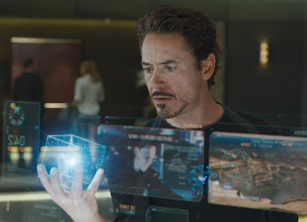
Trade 2 - Object Tracking
BASELINE
Focus: Map an object from the physical world to the virtual world via sensors (DR 2.2.2)
Accurately reflect movement of physical object and user interaction with object
Physical object(s)/equipment shall represent actual training utilities (DR 2.1)
Constraints:
Must be compatible with Unity engine
Must be capable of operating continuously for minimum 2 hrs
Must have minimum tracking range of 3 m
FR: F2, F3 | CPE: E1, E2, E4, E6
I: Project Overview
II: Trade Studies
III: Design Space
IV: Modeling & Prototyping
Notes:
Image from: https://fi.cheapsaleonline2022.ru/category?name=iron%20man%20augmented%20reality

Slide 29
Trade 2 - Object Tracking
DESIGN METRICS AND WEIGHTING
Design Metric | Weight | Reasoning
Per Unit Cost ($20 - $300) | 35% | Potentially another hefty expense; in combination with the VR headset, object tracking hardware could create risk for being over budget.
Ease of Integration (0.5 - 1) | 25% | Integrability is key; less integratable object-tracking sensors may institute an additional learning curve associated with integration software.
Battery life (2hrs - 8hrs) | 20% | A longer battery life enables multiple users to use the equipment/training simulation without having to charge or replace batteries.
Size (50mm - 90mm) | 10% | The size can affect the VR experience should it get in the user’s way, and would decrease the realistic feel of the object. It could also potentially affect the manufacturability of the object.
Weight (0g - 100g) | 10% | Similar to size, a large weight on an object because of a tracker affects the realistic feel of the object.
I: Project Overview
II: Trade Studies
III: Design Space
IV: Modeling & Prototyping
Notes:
Lily
Design Metrics
Risks
Engineering Analyses
Weightings

Slide 30
Trade 2 - Object Tracking
TRADE MATRIX
 |  | VIVE Tracker (3.0) | Manus Pro Tracker | IMU (6DOF MPU 6050) | Xbox Kinect Sensor
Metric | Weight | WT | WT | WT | WT
Cost [$] | 35% | 2.125 | 0.128 | 3.125 | 3
Ease of Integration | 25% | 2.5 | 2.5 | 0.5 | 0.5
Battery Life [hrs] | 20% | 1.833 | 0.833 | 1 | 0
Size [mm] | 10% | 0.275 | 0.375 | 0.875 | 0
Weight [g] | 10% | 0.25 | 0.38 | 0.8 | 0
Total (0-10) | 100% | 6.983 | 4.216 | 6.425 | 3.5
Uncertainty:
Ease of Integration hinges heavily on the amount of existing documentation and open source software
All metrics for the IMU are dependent on the additional hardware necessary to use the IMU for wireless tracking
Final Selection
*WT = Weighted Total Score
I: Project Overview
II: Trade Studies
III: Design Space
IV: Modeling & Prototyping

Slide 31
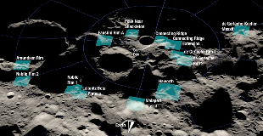
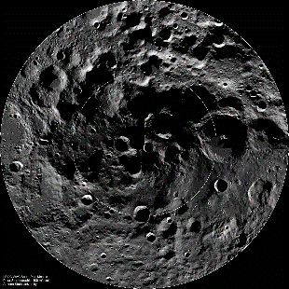
Trade 3 - Lunar Data
BASELINE
Focus: Lunar surface mapping data collected by lunar orbiters
Data will be implemented to create an accurate visual of the lunar surface location in the simulation
Accurate lighting conditions (DR 1.1.1)
Accurate topographical & geological conditions (DR 1.1.2)
Constraints:
Must include topographical data
Must include data from south polar region (-84ºS to -90ºS)
FR: F1 | CPE: E3
I: Project Overview
II: Trade Studies
III: Design Space
IV: Modeling & Prototyping

Slide 32
Trade 3 - Lunar Data
DESIGN METRICS AND WEIGHTING
Design Metric | Weight | Reasoning
Data resolution (0 - 500 meters/pixel) | 45% | This is perhaps the most important metric for data, as we need very high resolution data to be able to create something that realistically resembles the lunar surface.
Dataset size (0 - 100k products available) | 30% | Too much data will be difficult to parse, but too little will not give enough data to create a simulation.
Relevance (0 - 2, ranked on % of data around lunar south pole) | 25% | Needs to include lunar south pole data for Artemis III location relevance.
I: Project Overview
II: Trade Studies
III: Design Space
IV: Modeling & Prototyping

Slide 33
Trade 3 - Lunar Data
TRADE MATRIX
Final Selection
 |  | Lunar Reconnaissance Orbiter (2009-pres) | Lunar Orbiters (1960s) | Clementine (1994) | Kaguya (2007-pres)
Metric | Weight | WT | WT | WT | WT
Resolution (m/px) | 45% | 4.4955 | 3.96 | 3.438 | 0.234
Dataset size (1000s of products) | 30% | 1.102 | 0.00252 | 0.01007 | 1.117
Relevance (0,1,2) | 25% | 2.5 | 1.25 | 1.25 | 1.25
Total (0-10) | 100% | 8.098 | 5.213 | 4.698 | 2.601
*WT = Weighted Total Score
Uncertainty:
Determine usable data (raw vs derived, sensor vs photo data, etc.)
Need to test integrability with Unity platform
I: Project Overview
II: Trade Studies
III: Design Space
IV: Modeling & Prototyping
Notes:
Four orbiters were considered for this trade: the Lunar Reconnaissance Orbiter, or LRO, which has been operating since 2009; the lunar orbiters used to map Apollo landing sites in the 1960s; Clementine, which was a 2-month lunar orbiting mission, and Kaguya, which is JAXA’s lunar orbiter, also currently in service. As you can see, the Lunar Reconnaissance Orbiter had the best results. It scored highest in relevance and resolution, and second best in dataset size, providing ample high-quality data to use for implementation in the CTHREEPIO lunar environment simulation. The uncertainty in this selection lies in its integration with the whole system; trades and research must still be conducted to determine the best way to use the data from the LRO, whether it is raw, derived, or photographical data, as well as how to integrate this data into the Unity platform and backend of the virtual reality environment.

Slide 34
Current Design Space
I: Project Overview
II: Trade Studies
III: Design Space
IV: Modeling & Prototyping
Notes:
Hannah + Andrew

Slide 35
Virtual Reality Display
Tools and Equipment
Suit/Physical Constraints
VR Headset
Object Tracking
Unity Templates
Lunar Data
Manufacturing Methods
Rendering SW
Future Trades
- Complete
- Future Trades
- Interdependencies
35
I: Project Overview
II: Trade Studies
III: Design Space
IV: Modeling & Prototyping
Notes:
Highlight 5 main ones show interdep. On the 4
Branch off on each TS

Slide 36
Virtual Reality Display
Tools and Equipment
Suit/Physical Constraints
VR Headset
Object Tracking
Unity Templates
Lunar Data
Mission Tasks
Rendering SW
Hand Tracking
Tracker Integration
Mission Specific Tools and Equipment
Data Integration
- Complete
- Future Trades
- Interdependencies
Manufacturing Methods
36
I: Project Overview
II: Trade Studies
III: Design Space
IV: Modeling & Prototyping
Notes:
Highlight 5 main ones show interdep. On the 4
Branch off on each TS

Slide 37
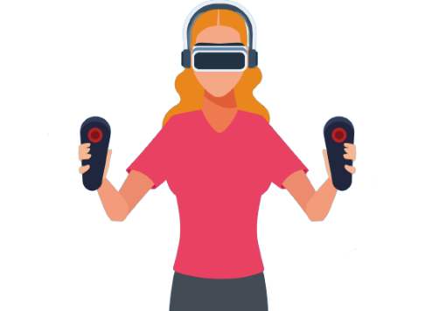
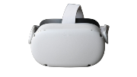
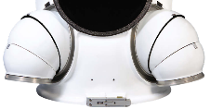
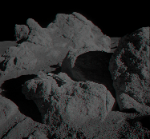
Virtual Reality Headset
Initial Configuration
Hand Tracking (TBD)
Geological Tools (TBD)
Object Tracking
Physical Constraints (TBD)
Lunar Data
Virtual Reality Display
Geological Objects (TBD)
I: Project Overview
II: Trade Studies
III: Design Space
IV: Modeling & Prototyping

Slide 38
Modeling and Prototyping Plans
I: Project Overview
II: Trade Studies
III: Design Space
IV: Modeling & Prototyping

Slide 39
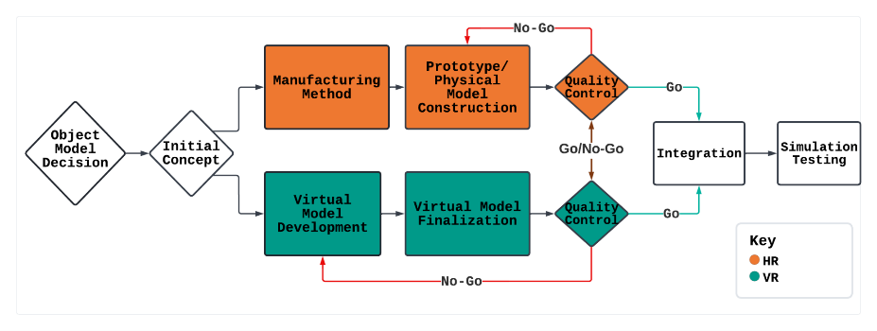
Modeling & Prototyping Procedure Illustration
I: Project Overview
II: Trade Studies
III: Design Space
IV: Modeling & Prototyping
Notes:
Darker shade of pink, on presentation screen the pink got much lighter, closer to the white

Slide 40
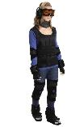
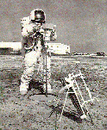
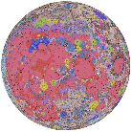
Prototyping/Modeling - Look Ahead
 | Purpose | Importance | Examples
Space suit (Mobility constraints) | Help simulate the mobility constraints imposed on user due to essential lunar gear/ space equipment | Allow for iterations of suit aspects: - Adjustability - Restraint type/amount - Area of restraint | - Resistance band suit with full body focus - Upper-body-focused joint mobility constraints
Geological Tools | Simulate realistic tools that the user will use to complete the training | Allow for iterations to create realistic tools: - Weight - Sizing - Functionality | - Large storage crate - Flood lights - Transportation units
Lunar Data | Integrate lunar surface data into Unity to implement realistic visuals in the training simulation | Ensure that the data integration is as streamlined as possible: - Ease of analysis - Reduce analytical uncertainties | - Manually read data into: - Tables - Structures/Cells - Use for loops to read in & organize data
I: Project Overview
II: Trade Studies
III: Design Space
IV: Modeling & Prototyping
Notes:
Add vr prototype? How do these reduce uncertainty?
Note:
Purpose/importance - In relation to prototyping (purpose/importance for/of prototype)
For the examples, these are purely examples r what we could do and not what we are going to do. Make sure to make that clear since we cant actually pic what objects we are going to prototype until we have decided on a full mission/training outline.

Slide 41
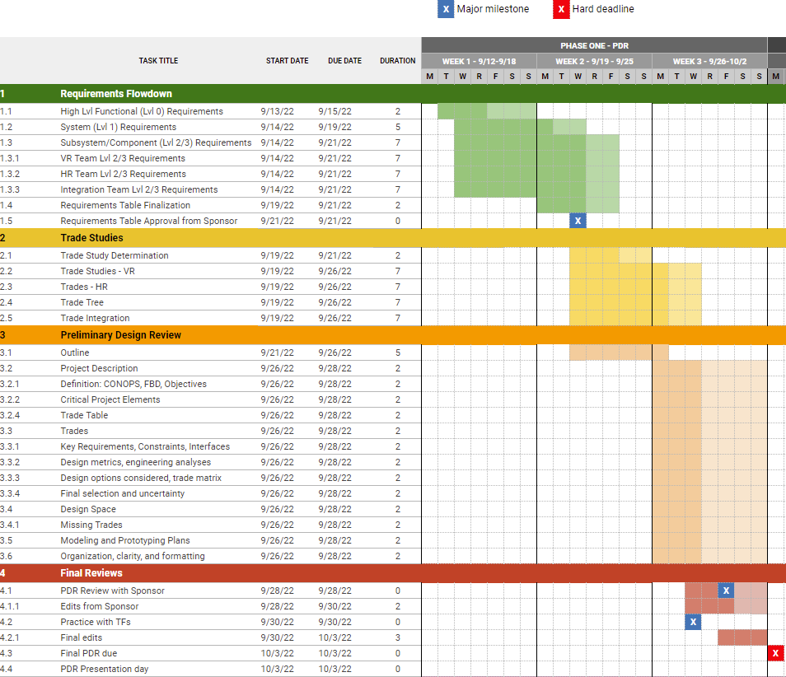
Gantt Chart
MANAGEMENT
Requirements
Major milestone
Trades
Hard deadline
Critical path
Lighter color = margin
PDR

Slide 42
References
Smith, Y. (2022, February 3). Dark mode activated! NASA. Retrieved October 2, 2022, from https://www.nasa.gov/image-feature/dark-mode-activated
Mars, K. (2016, February 17). About analog missions. NASA. Retrieved October 2, 2022, from https://www.nasa.gov/analogs/what-are-analog-missions
Encyclopædia Britannica, inc. (n.d.). See how astronauts train on parabolic flights to prepare for the weightlessness experienced in space. Encyclopædia Britannica. Retrieved October 2, 2022, from https://www.britannica.com/video/153024/Description-weightlessness-astronauts
Virtual reality pilot training. VRpilot. (2022, September 15). Retrieved October 2, 2022, from https://vrpilot.aero/
VR Medical Simulation. Oxford Medical Simulation. (2020, June 25). Retrieved October 2, 2022, from https://oxfordmedicalsimulation.com/product/vr-medical-simulation/

Slide 43
Acknowledgements
We would like to thank our team advisor and sponsor, Dr. Anderson, our Blue Origin sponsors, Christine Reilly and Tim Lloyd, as well as Dr. Wingate, Professor Muldrow, and the ASEN 4018 teaching fellows for their assistance in completing this Preliminary Design Review.

Slide 44
Questions

Slide 45
Backup Slides

Slide 46
Project Definition
Motivation:
CTHREEPIO will provide a realistic lunar surface operation training simulation to aid in preparation for the NASA Artemis missions.
Capabilities:
CTHREEPIO allows users to interact with real-world objects in a hybrid environment, thus allowing for the rapid creation and alteration of various lunar training exercises.
Notes:
Summarize what CTHREEPIO is in a single sentence.
Provide a brief overview of our objectives. (Not too much detail but enough to lead into the next slides)

Slide 47
Critical Project Elements - Full
CPE | Element | Description
E1 | Hybrid Reality (HR) Support Equipment | The HR support equipment must be able to track user actions and interactions with utilized tools. The equipment shall integrate with the virtual reality instruments to provide visual cues that match user motion. Oversight would lead to integration challenges and obstacles that may impede on the overall immersiveness and quality of the training simulation.
E2 | User-Associated Equipment | The user-associated equipment shall integrate such that all equipment does not impede on overall functionality. The user-associated equipment must follow the prescribed safety requirements. Oversight could impair HR effectiveness or result in person/equipment damage.
E3 | Virtual Environment | The training simulation will utilize a virtual environment that is recognizable by the user as a lunar surface. This virtual environment must integrate with the real-world equipment such that the user’s actions are paralleled in the virtual environment . Failure to successfully integrate the virtual environment will impede the ability of astronauts to have a high-fidelity and safe training experience.

Slide 48
Critical Project Elements - Full
CPE | Element | Description
E4 | Testing | The simulation must be accessible, intuitive, and operable by a human user. The simulation must have the ability to test, validate, and verify requirements as set forth in the PDD and in future documents. Failure to have a user-friendly simulation would impede the training capability and may put the users at greater risk. Failure to have a simulation that can test, validate, and verify requirements would impede the ability for this project to be considered a success by the customer.
E5 | Safety | The training simulation must not cause any physical or mental harm to any user or operator. Precautions will be employed to ensure that while in the simulation, hazards are minimized to user, operator, and equipment.
E6 | Financial | The total cost of the simulation equipment, integration system, and testing, along with any costs from research and development processes, must not exceed $4000. Extra funds may be secured from the University of Colorado Boulder College of Engineering if necessary. To stay within budget, the cost and time for the project will be carefully managed and balanced by a team Chief Financial Officer.

Slide 49
CTHREEPIO Requirements
FR | L1 | L2 | L3 | Requirement | Verification/Validation | Level
F1 |  |  |  | The VR environment shall simulate the south polar region of the lunar surface. |  | Level 0
 | 1.1 |  |  | Shall incorporate accurate location characteristics that resemble the south polar region of the lunar surface | Demonstration | Level 1
 |  | 1.1.1 |  | Shall accurately portray lighting characteristics one would experience on the south polar region of the lunar surface | Demonstration | Level 2
 |  |  | 1.1.1.1 | Shall accurately portray suit-mounted lighting | Demonstration | Level 3
 |  |  | 1.1.1.2 | Shall portray accurate solar lighting conditions. | Demonstration | Level 3
 |  |  | 1.1.1.2.1 | Shall accurately portray high-contrast lighting conditions similar to those seen on the south polar region of the lunar surface. | Demonstration | Level 3
 |  |  | 1.1.1.2.2 | Shall accurately portray low-angle lighting conditions similar to those seen on the south polar region of the lunar surface. | Demonstration | Level 3
 |  | 1.1.2 |  | Shall accurately generate lunar topographical and geographical features | Demonstration | Level 2
 |  |  | 1.1.2.1 | Shall generate topographical and geographical features with raw lunar scan data. | Demonstration | Level 3
 |  |  | 1.1.2.2 | Shall ensure the texture of the lunar surface in the simulation is visually indicative of lunar regolith | Demonstration/Analysis | Level 3
 |  | 1.1.3 |  | Shall accurately portray the movement of celestial objects as seen from the lunar surface | Demonstration | Level 2
 |  |  | 1.1.3.1 | Shall accurately portray the Earth's movement as seen from the lunar surface | Demonstration | Level 3
 |  |  | 1.1.3.2 | Shall accurately portray the Sun's movement as seen from the lunar surface and track its light as it moves | Demonstration | Level 3

Slide 50
CTHREEPIO Requirements - Cont.
F2 |  |  |  | The training simulation shall include physical, real-world objects. |  | Level 0
 | 2.1 |  |  | Shall include TBD physical object(s)/equipment that represent training utilities used in the VR simulation | Demonstration/Inspection | Level 1
 |  | 2.1.1 |  | Physical training object(s)/equipment shall be user compatible | Demonstration/Inspection | Level 2
 |  |  | 2.1.1.1 | TBD physical model(s) of VR tools shall be ergonomic | Demonstration/Inspection | Level 3
 |  |  | 2.1.1.2 | TBD physical model(s) of VR tools shall be mechanically illustrative of VR counterpart | Demonstration/Inspection | Level 3
 |  |  | 2.1.1.3 | TBD physical model(s) of VR environment shall be relevant to training simulation | Demonstration/Inspection | Level 3
 |  |  | 2.1.1.4 | TBD physical model(s) of VR equipment shall be non-invasive | Demonstration/Inspection | Level 3
 |  |  | 2.1.1.5 | TBD physical model(s) of VR equipment shall be mechanically illustrative of VR counterpart | Demonstration/Inspection | Level 3
 |  |  | 2.1.1.6 | TBD physical model(s) of VR equipment shall be relevant to a Lunar training environment | Demonstration/Inspection | Level 3
 |  |  | 2.1.1.7 | TBD physical model(s) of the VR spacesuit shall incorporate restricted mobility as present in an EVA spacesuit | Demonstration/Inspection | Level 3
 |  |  | 2.1.1.8 | TBD physical model(s) of the VR spacesuit shall be non-invasive | Demonstration/Inspection | Level 3
 |  |  | 2.1.1.9 | TBD physical model(s) of the VR spacesuit shall be user adjustable | Demonstration/Inspection | Level 3
 |  |  | 2.1.1.10 | TBD physical model(s) of the VR spacesuit shall be able to house any HR support hardware | Demonstration/Inspection | Level 3
 | 2.2 |  |  | Shall include physical hardware designed to support VR and user actions | Test/Inspection/Analysis | Level 1
 |  | 2.2.1 |  | Physical hardware shall include sensor(s) to track user(s) activities and motions | Test/Inspection | Level 2
 |  |  | 2.2.1.1 | User motion sensor(s) shall not inhibit user mobility | Test/Inspection | Level 3
 |  |  | 2.2.1.2 | User motion sensor(s) shall have TBD sensitivity | Test/Analysis | Level 3

Slide 51
CTHREEPIO Requirements - Cont.
F2 |  |  |  | The training simulation shall include physical, real-world objects. |  | Level 0
 |  |  | 2.2.1.3 | User motion sensor(s) shall be scalable to spacial augmentation of the physical training environment | Test/Analysis | Level 3
 |  |  | 2.2.1.4 | User motion sensor(s) shall have TBD minimum battery life | Test/Inspection | Level 3
 |  | 2.2.2 |  | Physical hardware shall include sensor(s) to track object(s) motions | Test/Inspection | Level 2
 |  |  | 2.2.2.1 | Object motion sensor(s) shall have the ability to track large objects (TBD size constraints) | Test/Analysis | Level 3
 |  |  | 2.2.2.2 | Object motion sensor(s) shall have the ability to track medium sized objects (TBD size constraints) | Test/Analysis | Level 3
 |  |  | 2.2.2.3 | Object motion sensor(s) shall have the ability to track small objects (TBD size constraints) | Test/Analysis | Level 3
 |  |  | 2.2.2.4 | Object motion sensor(s) shall not inhibit object handling | Test/Inspection | Level 3
 |  |  | 2.2.2.5 | Object motion sensor(s) shall have TBD sensitivity | Test/Analysis | Level 3
 |  |  | 2.2.2.6 | Object motion sensor(s) shall be scalable to spacial augmentation of the physical training environment | Test/Analysis | Level 3
F3 |  |  |  | The training simulation shall accurately portray interactions with physical objects in the VR environment. |  | Level 0
 | 3.1 |  |  | Shall include auditory feedback for user interactions | Test/Demonstration | Level 1
 | 3.2 |  |  | Shall include visual feedback for user interactions | Test/Demonstration | Level 1
 | 3.3 |  |  | Shall include virtual objects representing the physical training objects | Demonstration/Inspection | Level 1
 |  | 3.3.1 |  | Shall include virtual representations of rocks and geological objects | Demonstration/Inspection | Level 2
 |  | 3.3.2 |  | Shall include virtual representations of tools and equipment used | Demonstration/Inspection | Level 2

Slide 52
CTHREEPIO Requirements - Cont.
F4 |  |  |  | To accurately simulate EVA activities on the lunar surface, the training simulation shall portray spacesuit features and small scale lunar objects. |  | Level 0
 | 4.1 |  |  | Shall include an accurate visual representation of the user within the simulation | Demonstration | Level 1
 |  | 4.1.1 |  | Shall include a realistic visual of current astronaut gear | Demonstration | Level 2
 |  |  | 4.1.1.1 | Shall include realistic spacesuit features (TBD) | Demonstration | Level 3
 |  |  | 4.1.1.2 | Shall include a field-of-view constraint closely resembling current astronaut gear. | Demonstration | Level 3
 |  | 4.1.2 |  | Shall include suit shadows | Demonstration | Level 2
 | 4.2 |  |  | Shall integrate capabilities to monitor simulated health parameters of user during simulation | Demonstration | Level 1
 |  | 4.2.1 |  | Shall have capabilities that reflect future as well as current biometric/simulation displays | Demonstration | Level 2
 |  |  | 4.2.1.1 | Shall include biometrics that measures EKG | Demonstration | Level 3
 |  |  | 4.2.1.2 | Shall include metrics of the total time on EVA | Demonstration | Level 1
 |  | 4.2.2 |  | Shall have capabilities that reflect simulated suit system status | Demonstration | Level 2
 |  |  | 4.2.2.1 | Shall include biometrics that measures suit oxygen levels | Demonstration | Level 3
 |  |  | 4.2.2.2 | Shall include biometrics that measures suit pressure levels/integrity | Demonstration | Level 3
 |  |  | 4.2.2.3 | Shall include biometrics that measures humidity | Demonstration | Level 3
 |  |  | 4.2.1.4 | Shall include metrics of the internal spacesuit temperature | Demonstration | Level 3
 | 4.3 |  |  | Shall include physical surface features indicative of the lunar surface (Topography/Geological Features/ROCKS) | Inspection | Level 1

Slide 53
CTHREEPIO Requirements - Cont.
F5 |  |  |  | The training simulation, including the VR environment and all physical aspects, shall keep the user, operator, and itself safe from harm. |  | Level 0
 | 5.1 |  |  | Shall implement proper methods to avoid causing simulation sickness in user | Test/Analysis | Level 1
 |  | 5.1.1 |  | Shall implement proper depth perception and scaling. | Test/Analysis | Level 2
 |  |  | 5.1.1.1 | Shall implement a TBD latency | Test/Inspection/Analysis | Level 3
 |  |  | 5.1.1.2 | Shall implement a TBD frame rate/refresh rate | Test/Inspection/Analysis | Level 3
 |  |  | 5.1.1.3 | Shall implement a TBD resolution | Test/Inspection/Analysis | Level 3
 | 5.2 |  |  | The VR environment shall have task-related boundaries that match the physical boundaries of the training space | Test/Demonstration | Level 1
 | 5.3 |  |  | Shall keep the user physically safe | Test/Analysis | Level 1
 |  | 5.3.1 |  | Shall have a TBD protocol for maintaining communication with user | Demonstration/Inspection | Level 2
 |  | 5.3.2 |  | Shall have a procedure to terminate simulation | Inspection | Level 2
 |  | 5.3.3 |  | The user shall have guidance on how to complete the task | Demonstration/Inspection | Level 2
 |  | 5.3.4 |  | The user shall have the ability to control auditory environment within the headset | Demonstration/Inspection | Level 2
 |  | 5.3.5 |  | The environment shall have TBD decibel limit | Test/Inspection | Level 2
 |  | 5.3.6 |  | Equipment used shall be adjustable to accommodate different user anthropometry (TBD ranges) | Demonstration/Analysis | Level 2
 | 5.4 |  |  | Shall have tools that are safe to operate | Inspection | Level 1
 |  | 5.4.1 |  | Tools shall be modified to prevent injury | Inspection/Demonstration | Level 2

Slide 54
CTHREEPIO Requirements - Cont.
F6 |  |  |  | The training simulation shall be appropriate for a laboratory environment. |  | Level 0
 | 6.1 |  |  | The physical training environment shall be no larger than 9ft by 10ft | Inspection | Level 1
 |  | 6.1.1 |  | All hybrid reality equipment/objects shall fit within the physical training environment | Inspection | Level 2
 |  | 6.1.2 |  | All hybrid reality equipment/objects shall be appropriately scaled | Test/Inspection | Level 2
 | 6.2 |  |  | The physical training environment shall be designed such that it will not damage its occupied space | Inspection | Level 1
 | 6.3 |  |  | The physical training environment shall not be a permanent installation | Inspection | Level 1
 |  | 6.3.1 |  | All individual physical equipment shall be movable by one person | Demonstration | Level 2
 |  |  | 6.3.1.1 | Hybrid reality components that need to be vertically lifted shall be no more than TBD weight | Test | Level 3

Slide 55
Trade 0 - Virtual Reality Display
FULL TRADE MATRIX
 |  | Virtual Reality Headsets |  | Augmented Reality Glasses |  | Projector Displays |  | Mounted Screen Displays
Evaluation Criteria | Weight | Score | WT | Score | WT | Score | WT | Score | WT
Immersion | 60% | 9 | 5.40 | 7 | 4.2 | 4 | 2.40 | 2 | 1.20
Portability | 25% | 8 | 2.00 | 8 | 2.000 | 1 | 0.25 | 4 | 1.00
Cost | 15% | 7 | 1.05 | 5 | 0.75 | 4 | 0.6 | 5 | 0.75
Total | 100% |  | 8.45 |  | 6.95 |  | 3.25 |  | 2.95
*WT = Weighted Total Score

Slide 56
Trade 1 - VR Headset
FULL TRADE MATRIX
 |  | Oculus Quest 2 |  | HTC Vive Focus 3 |  | HP Reverb G2
Metric | Weight | Score | WT | Score | WT | Score | WT
Requires External PC | 25% | 10 | 2.5 | 10 | 2.5 | 1 | 0.3
Cost [$] | 20% | 7.1 | 1.4 | 1 | 0.1 | 6.5 | 1.3
Resolution [per eye] | 15% | 5.0 | 0.8 | 10 | 1.5 | 7.3 | 1.1
Refresh Rate [Hz] | 15% | 3.6 | 0.5 | 3.6 | 0.5 | 3.6 | 0.5
Horizontal FOV [°] | 15% | 1.3 | 0.2 | 6.7 | 1 | 4.7 | 0.7
Weight [lb] | 10% | 10 | 1 | 1.8 | 0.2 | 8.7 | 0.9
Total (0-10) | 100% |  | 6.4 |  | 5.9 |  | 4.8
*WT = Weighted Total Score

Slide 57
Trade 1 - VR Headset
FULL TRADE MATRIX
 |  | HTC Vive Pro 2 |  | Sony Playstation VR |  | Valve Index VR Kit
Metric | Weight | Score | WT | Score | WT | Score | WT
Requires External PC | 25% | 1 | 0.3 | 1 | 0.3 | 1 | 0.3
Cost [$] | 20% | 0 | 0 | 8 | 1.5 | 1.1 | 0.2
Resolution [per eye] | 15% | 10 | 1.5 | 0 | 0 | 2.6 | 0.4
Refresh Rate [Hz] | 15% | 7.1 | 1.1 | 7.1 | 1.1 | 7.1 | 1.1
Horizontal FOV [°] | 15% | 6.7 | 1 | 0 | 0 | 6.7 | 1
Weight [lb] | 10% | 0 | 0 | 0.7 | 0.7 | 1.2 | 0.1
Total (0-10) | 100% |  | 3.8 |  | 3.6 |  | 3.0
*WT = Weighted Total Score

Slide 58
Trade 2 - Scoring Techniques
Design Metric | Scoring | Weight | Reasoning
Cost ($) | 0 for expensive hardware ($300) and 10 for cheap hardware ($20) | 35% | Potentially another hefty expense, in combination with the VR headset, object tracking hardware could put us at risk for being over budget
Size (mm) | 0 for larger pieces of equipment (90 mm) and 10 for smaller equipment (50 mm) | 10% | The size can affect the VR experience should it get in the users way and would decrease the realistic feel of the object. It could also potentially affect the manufacturability of the object
Weight (g) | 0 for heavy (100 g) pieces of equipment and 10 for lighter pieces (0 g) | 10% | Similar to size, a large weight on an object because of a tracker affects the realistic feel of the object
Ease of Integration | Subjective, 0.5-1 | 25% | An additional learning curve associated with software associated with object tracking sensors requires more man hours
Battery life (hr) | 10 for long battery life (8 hrs) and 0 for short battery life (2 hrs) | 20% | A longer battery life enables multiple users to use the equipment/training simulation without having to charge or replace batteries
Notes:
Lily
Design Metrics
Risks
Engineering Analyses
Weightings

Slide 59
Trade 2 - Object Tracking
FULL TRADE MATRIX
 |  | VIVE Tracker (3.0) |  |  | Manus Pro Tracker |  |  | IMU (6DOF MPU 6050) |  |  | Xbox Kinect Sensor
Metric | Weight | Value | Score | WT | Value | Score | WT | Value | Score | WT | Value | Score | WT
Cost [$] | 35% | 129.99 | 6.072 | 2.125 | 289.73 | 0.367 | 0.128 | 50 | 8.929 | 3.125 | 60 | 8.571 | 3
Ease of Integration | 25% | 1 | 10 | 2.5 | 1 | 10 | 2.5 | 0.6 | 2 | 0.5 | 0.6 | 2 | 0.5
Battery Life [hrs] | 20% | 7.5 | 9.167 | 1.833 | 4.5 | 4.167 | 0.833 | 5 | 5 | 1 | n/a | 0 | 0
Size [mm] | 10% | 79 | 2.75 | 0.275 | 75 | 3.75 | 0.375 | 55 | 8.75 | 0.875 | n/a | 0 | 0
Weight [g] | 10% | 75 | 2.5 | 0.25 | 62 | 3.8 | 0.38 | 20 | 8 | 0.8 | n/a | 0 | 0
Total (0-10) | 100% |  |  | 6.983 |  |  | 4.216 |  |  | 6.425 |  |  | 3.5
*WT = Weighted Total Score

Slide 60
Trade 3 - Scoring Techniques
Design Metric | Scoring | Weight | Reasoning
Data resolution (0 - 500 meters/pixel) | S = 10 - 0.01*V 0 m/px → S = 10 500 m/px → S = 0 | 45% | This is perhaps the most important metric for data, as we need very high resolution data to be able to create something that realistically resembles the lunar surface.
Dataset size (0 - 100k products available) | S = 10*(1-1/50^2)*(V-50)^2 0, 100k prod → S = 0 50k prod → S = 10 | 30% | Too much data will be difficult to parse, but too little will not give enough data to create a simulation.
Relevance (0 - 2, ranked on % of data around lunar south pole) | S = 5*V 0 → S = 0 2 → S = 10 | 25% | Needs to include lunar south pole data for Artemis III location relevance.

Slide 61
Trade 3 - Lunar Data
FULL TRADE MATRIX
 |  | Lunar Reconnaissance Orbiter (2009-pres) |  |  | Lunar Orbiters (1960s) |  |  | Clementine (1994) |  |  | Kaguya (2007-pres)
Evaluation Criteria | Weight | Value | Score | WT | Value | Score | WT | Value | Score | WT | Value | Score | WT
Resolution (m/px) | 45% | 0.5 | 9.99 | 4.4955 | 60 | 8.8 | 3.96 | 118 | 7.64 | 3.438 | 474 | 0.52 | 0.234
Dataset size (1000s of products) | 30% | 89.766 | 3.674 | 1.102 | 0.021 | 0.0083 | 0.0025 | 0.084 | 0.0335 | 0.0100 | 10.384 | 3.722 | 1.116
Relevance (0,1,2) | 25% | 2 | 10 | 2.5 | 1 | 5 | 1.25 | 1 | 5 | 1.25 | 1 | 5 | 1.25
Total (0-10) | 100% |  |  | 8.098 |  |  | 5.213 |  |  | 4.698 |  |  | 2.601
*WT = Weighted Total Score

Slide 62
Full Modeling & Prototyping Procedure
Decision to develop HR object
From physical object trade study
Design
Initial Concept
Manufacturing Decision
COTS - purchase and conduct necessary aftermarket modifications
3D Printing - Utilize Fusion 360/Blender to model or open source models (Ex: Thingiverse)
General Manufacturing - Develop technical drawings and plans
Virtual Model Development
Create separate virtual model or enhance existing manufacturing model
Prototype/Model Construction
Account for lunar weight differences
Verify physical sensor integration with object is viable
Quality Control
Independently verify objects meet expectations/requirements
Model & Virtual Integration
Combine motion tracking and VR hardware with physical object
Develop object specific motion tracking software

