Slide 1
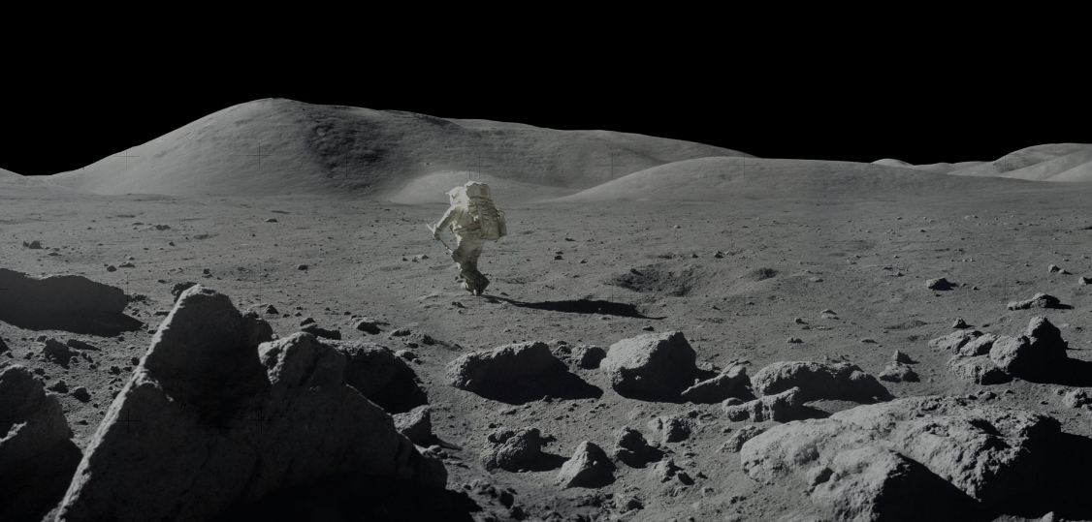
LunaSim
Preliminary Design Review
University of Colorado Boulder
October 5th, 2022
Presenters: Parker Randolph, James Perkins, Ian Wong, Blake Wilson,
Zoe Bloomfield, Lauren Daniels, Mia Lawrence
Academic Advisor: Dr. Anderson
Sponsor: EchoStar & Blue Origin
Notes:
Parker (PM), James (SE), Ian (Software), Blake (Suspension), Zoe (Structures), Lauren (Electrical, CFO), Mia (Suspension+Safety)
Hello and welcome to the LunaSim PDR.

Slide 2
Overview
Project Introduction (FBD & CONOPS)
Requirements and Dependencies
Trade Studies
Current Design Space
Prototyping Plans
Notes:
Parker
So before we dive in, I’d like to lay out a plan for where we’re going. First we’ll cover some of our high level project diagrams like our FBD and CONOPS which inform our requirements and dependencies. Then we will dive into our trade study space where we will discuss several of our primary design considerations in a weighted trade analysis. Finally, we will close off by discussing our current design space and future prototyping plans within this space.

Slide 3
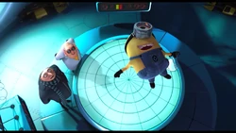
Project Description
Notes:
Lauren

Slide 4
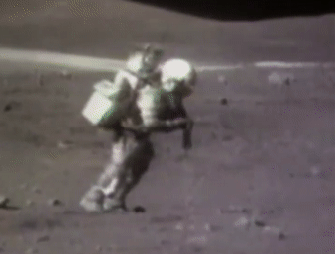
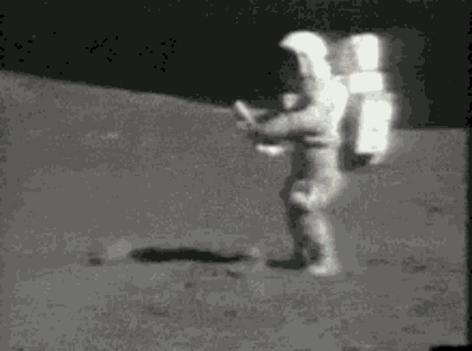
Background
NASA Artemis Mission: Humanity is soon going back to the moon, this time to stay
New generation of untrained astronauts
Gravity in particular is difficult to train for, and can cause serious safety concerns
Apollo astronauts experienced difficulties maneuvering in lunar gravity.
Notes:
Lauren

Slide 5
Current NASA Solutions
Notes:
Lauren

Slide 6
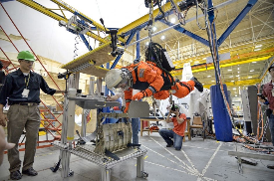
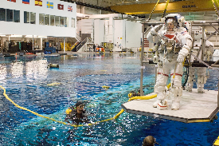
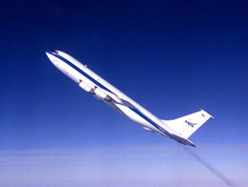
Current NASA Solutions
ARGOS Neutral Buoyancy Lab Vomit Comet
Vomit comet and NBL are impractical
Safety and integration concerns
Following an ARGOS-inspired design
Notes:
Lauren
The Vomit Comet and NBL are impractical for a university laboratory with a limited budget. They also have safety and integration concerns that can’t be reasonably addressed within our scope. Thus, we are following an ARGOS style design, with modifications made to match our scope.

Slide 7
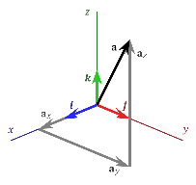
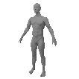
Project Definition & Objectives
01
Vertical gravity offloading to replicate lunar gravity for crew training.
02
3 dimensional translational movement (ability to jump/fall)
03
Low cost - meets university lab budget
Notes:
Parker
This year, our project is partnering working with Dr. Anderson to design and fabricate a gravity offloader that can be utilized in astronaut training environments. Currently, astronauts training practices are limited within our earth environment as they do not accurately represent the weakened gravity environment in which their actual missions will take place. Therefore, our team serves as a subset of a greater project attempting to create the most realistic lunar environment possible here on earth through the integration of our gravity offloader and a VR Hybrid reality landscape. For our subteam to be successful, we must create a vertical gravity offloader that permits 3 dimensional movement at an affordable cost with minimal advanced manufacturing techniques. I’ll go ahead and pass it off to James to cover the requirements in more detail as well as the mission conops.

Slide 8
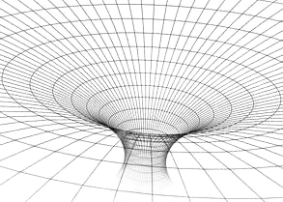
Mission CONOPS
User is attached to offloading system and enters into hybrid reality
User is presented with a virtual training situation
Upon training completion, user exits system
Virtual environment updates based on interaction and movement
During task, user moves in and interacts with physical world while viewing virtual environment
User experiences gravity offloading
LunaSim Scope
Full Mission Scope
Notes:
James

Slide 9
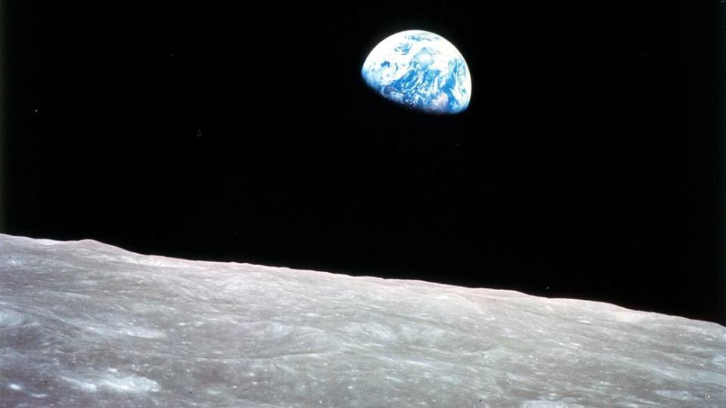
LunaSim CONOPS
User-side Functionality
System Functionality
Control system determines the necessary forces to apply to simulate reduced gravity
Movement system applies necessary forces
Sensors detect direction and speed of user movement
Sensor data is
fed to control system
User experiences a reduced gravity environment
User is secured to system
User moves in physical space
Notes:
James

Slide 10
Control Software
System Operator
Category
Personnel
Physical interface
Electrical Power System
Supporting Structure
Control
Data
Power
Movement System
Emergency Stop
Control Hardware
User Attachment
Sensors
User
Environment Simulation
FBD
Notes:
James

Slide 11
Control Software
System Operator
Connection
Category
Power
Data
Electrical Power System
Supporting Structure
Control
Physical interface
Person
Personnel
Movement System
Emergency Stop
Control Hardware
User Attachment
Sensors
User
Environment Simulation
FBD
Notes:
James

Slide 12
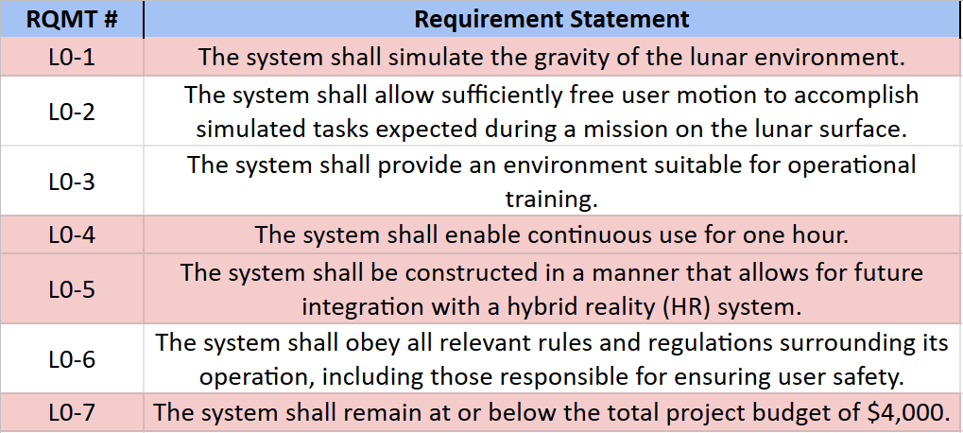
Functional Requirements
Notes:
James

Slide 13
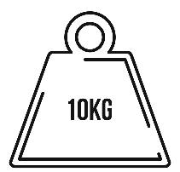
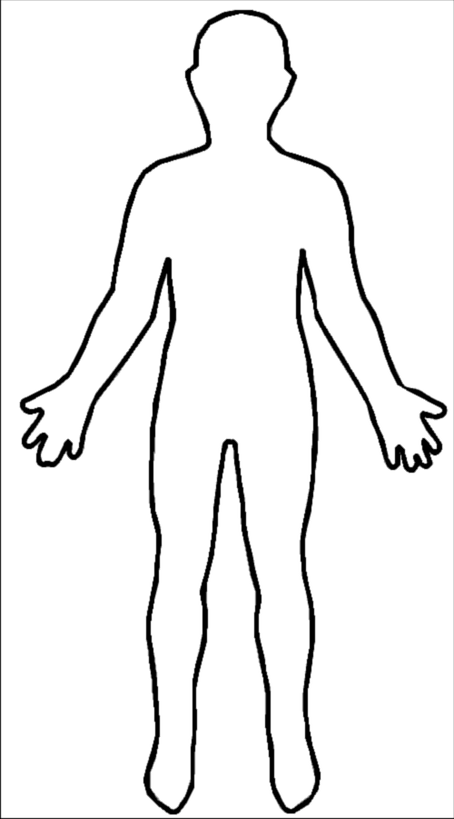
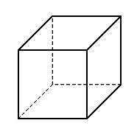
Critical Project Elements
Gravity Offloading
Usable Volume
User Safety
Cost
Notes:
Parker (anthropometry’s the word) <- Idk who put this here but i love it!! -Parker
With this mission in mind, we can now highlight some of our more limiting requirements. Primarily, the cost will be an immense limiting factor. In our research thus far, we’ve discovered that it would be extremely easy to exceed our budget on our structural system alone. Thus, we will be working closely with our customer to design the system with the best engineering practices on the affordable side of our budget.
Additionally, the offloader will need to be accessible to astronauts in the 5 to 95th percentile of body dimensions. Finally, as mentioned above, the system will need to allow 3 dimensional translational movement which has presented a complex engineering problem.
Structural Cost
Offloading System
User Harness Safety
Restriction of user by harness or structure
Suspension mechanism following user
Stability of structure

Slide 14
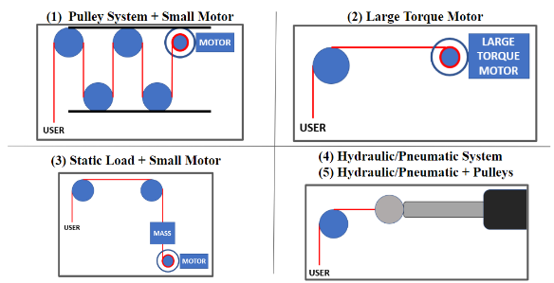
Trade Studies
Notes:
Parker

Slide 15
Trades
Trade | Independent/Dependent | Dependent On
(1) Type of Structure | Independent | -
(2) Z-Translation System | Dependent | (1) Structure
(3) Software Platform | Independent | -
(4) Ceiling vs. Floor Structure | Independent | -
(5) Rotation System | Dependent | (2) Z-Translation System
(6) User Interface | Independent | -
(7) Programming Languages | Dependent | (3) Software Platform
Covered
Appendix
Notes:
Parker

Slide 16
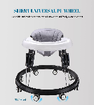
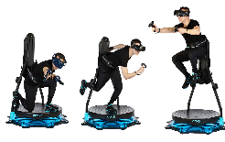
Primary Trade 1: Type of Structure - Design Options
(1) 2 Axis Staged Gantry
(2) Circular Gantry
(3) Mobile Walker
(4) Skycam Tethers
Notes:
Zoe

Slide 17
Primary Trade 1: Type of Structure - Trade Matrix
Metric | Weight | Two Axis Gantry | Circular Gantry | Mobile Walker | Skycam Tethers
User Movement | 0.30 | 5 | 4 | 2 | 5
Cost | 0.25 | 3 | 3 | 5 | 3
Stability | 0.20 | 5 | 3 | 3 | 5
Use of space | 0.10 | 4 | 2 | 5 | 3
Complexity | 0.10 | 3 | 1 | 2 | 2
Weight | 0.05 | 3 | 1 | 5 | 3
Weighted Total | 1.00 | 4.10 | 2.90 | 3.40 | 3.90
Key Requirements:
L0-1: Gravity offloading
L0-2: Free user motion
L0-7: Remain within budget
Key Constraints:
Cost
User movement
Key Interfaces:
Electrical
Rotation system
Notes:
Zoe

Slide 18
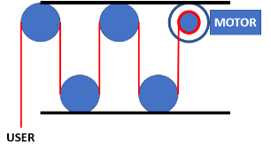
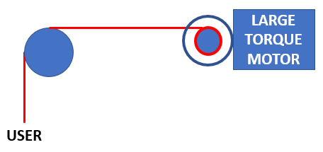
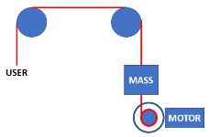
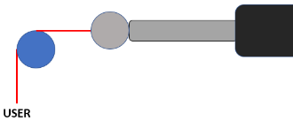
Primary Trade 2: Z-Translation System - Sketches
(1) Pulley System + Small Motor
(2) Large Torque Motor
(3) Static Load + Small Motor
(4) Hydraulic/Pneumatic System
(5) Hydraulic/Pneumatic + Pulleys
Notes:
Blake

Slide 19
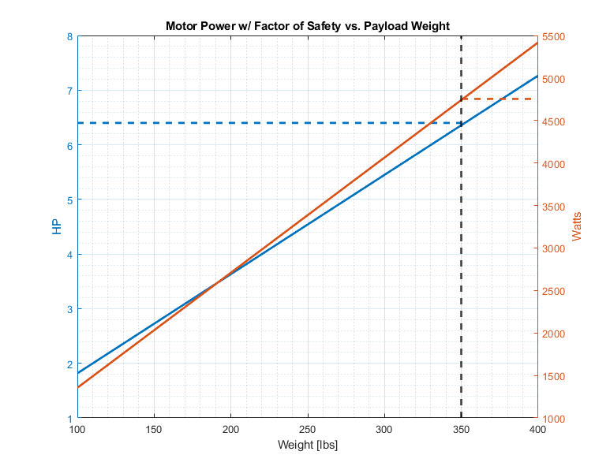
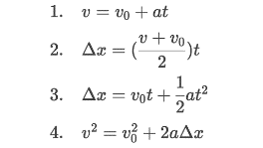
Primary Trade 2: Z-Translation System - Analysis
Bounding Conditions
3 ft maximum fall
Max fall speed: 5.67 ft/s
Max load: 350 lb * ⅚= 300 lb
FoS of 2 (advisor)
Result: ~6.4 HP/4740 W motor
Notes:
Blake
(9 ft maximum height 5 ft user - 1ft for User Attachment System and margin)
(244 lb + 100 lb for User Attachment System)

Slide 20
Primary Trade 2: Z-Translation System - Trade Matrix
Metric | Weight | Pulley System + Small Motor | Large Torque Motor | Static Load + Small Motor | Hydraulic System | Hydraulic + Reverse Pulley System
Weight Pulling Capability | 0.20 | 3 | 4 | 5 | 5 | 4
Electrical Requirements | 0.20 | 5 | 3 | 5 | 3 | 3
Smooth Operation/Control Integration | 0.15 | 4 | 5 | 4 | 3 | 4
Manufacturing Simplicity | 0.15 | 4 | 5 | 4 | 4 | 3
Reliability | 0.10 | 4 | 5 | 4 | 3 | 2
Space Requirements | 0.10 | 4 | 4 | 3 | 5 | 4
Safety (Power Loss) | 0.05 | 3 | 3 | 5 | 4 | 4
Cost | 0.05 | 5 | 3 | 4 | 3 | 3
Weighted Total | 1.00 | 4.00 | 4.10 | 4.35 | 3.80 | 3.40
Key Requirements:
L0-1: Gravity offloading
L0-4: 1-hour continuous use
Key Constraints:
Power
Cost
Key Interfaces:
Electrical
Structural
Notes:
Mia
After considering what options exist for gravity offloading, we conducted a trade as you can see here. Our most crucial metrics are how much weight the system is capable of pulling, and how much power is required to do so. This point ties directly into requirements L-zero 1 and L-zero 4 to ensure that the user’s weight is offloaded at lunar gravity continuously for one hour or more. If the gravity offloading system cannot pull the full range of expected body weights, which is included in the level 3 requirements, the task at hand cannot be achieved. Also, we must ensure that the gravity offloading system does not consume too much of the power budget to allow for software and other electrical components to fully function. Looking specifically at the trade matrix values, both the static load with the small motor and the hydraulic system have the highest weight pulling capability according to initial research. Subsequently, the pulley and static load paired with a small motor will draw the least amount of power, as indicated by the ‘fives’ in each of those cells. Besides power, another constraint is cost. Since this project is largely hardware-oriented, there must be enough budget left for the support structure, the rotation system, and all other components. As shown in the table, the two trade options with a small motor are favorable in terms of cost. After totaling the scores with the appropriately weighted metrics, the gravity offloading system that will best meet or exceed our requirements is the static load with the small motor.
Hey Mia, I’ll read your script during this presentation and give you the advice the TA’s have - Brennan

Slide 21
Primary Trade 3: Software Platform - Trade Matrix
Metric | Weight | Microcontroller | Microprocessor | Laptop | FPGA
Reliability | 0.30 | 3 | 5 | 4 | 5
Capability to Run Software | 0.25 | 3 | 5 | 5 | 5
Power Consumption | 0.15 | 5 | 5 | 2 | 5
Speed | 0.10 | 1 | 4 | 5 | 4
Ease of Use | 0.10 | 4 | 4 | 4 | 3
Cost | 0.10 | 4 | 3 | 5 | 3
Weighted Total | 1.00 | 3.30 | 4.60 | 4.15 | 4.50
Key Requirements:
L0-1: Gravity offloading
L0-3: Training environment
L0-4: 1-hour continuous use
Key Constraints:
Supply Chain
Processing Speed
Key Interfaces:
User-interface
Gravity offloading system
Notes:
Ian

Slide 22
Current Design Space Trade Tree
Harness
User Attachment
Rotation System
Full Body Suit
Gantry
Two Axis
Block and Tackle
C-Clamp
Circular
Above Head
Skycam
Hydraulics
Window
Z Translation System
Weight + Motor
Swing
Structural Design
Ceiling Mount
Large Motor
Puppet
Below User
Hydraulics
Mobile Walker
Z Translation System
Static Weight
Notes:
Red Box: (Mia) In understanding the various mechanical components, the gantry structure will connect to the rotation system, which attaches to a harness on the user at their center of gravity. We conducted a trade for the rotation system design and determined that a rigid structure in a “C-Clamp” shape that attaches to the user from behind will allow for the most user mobility. Im not quite sure on that part of the script I typed above…feedback would be great; I don’t know if we should mention this other trade or if it will only confuse them…the more I wrote the more I thought they would just be confused.

Slide 23
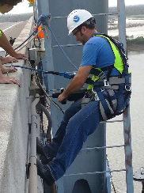
Future Trades
These will need prototyping/modeling
Sensors
IMU/Accelerometer
Position Sensor
Force Sensors
Structural Materials
Material properties vs cost vs weight vs manufacturing
Manufacturing Techniques
Harness
Construction
Climbing
Physical therapy
Custom
Notes:
Parker

Slide 24
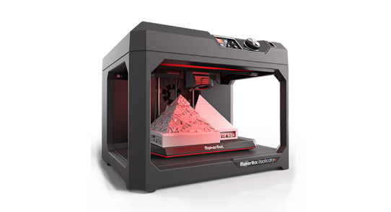
Modeling & Prototyping
Notes:
Parker

Slide 25
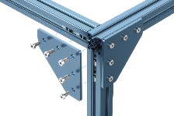
Modeling and Prototyping Plans
Structural Models:
MATLAB code for structural analysis
Vention for model design
Suspension Models:
FBD for gravity Z-translation system capabilities (analysis)
Suspension Prototypes:
Small scale prototype for Z-translation system to verify:
Motor power required
Cable routing
User attachment device adjustability (5th - 95th Percentile)
Modeling/Prototyping will help narrow down close trades
Notes:
Zoe
Suspension Prototypes: Suspension interface thingy (adjustability)
Small electronic prototype testing to test each individual component being used as well as system wide testing to make sure everything interfaces properly before implementing in the overall system

Slide 26
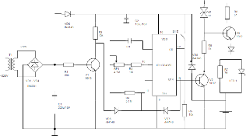
Modeling and Prototyping Plans
Electrical Models:
Circuit diagram to analyze power needs
Small prototyping testing
Individual electronic component testing
Electronic system testing
Software Models:
Analyze equations of motion
Translating the analysis into control laws and algorithms (code)
Modeling/Prototyping will help narrow down close trades
Notes:
Zoe

Slide 27
Acknowledgements
Dr. Anderson - CU Boulder Professor
Sandor Nemethy - VP, Mission Management at EchoStar
Dr. Wingate - CU Boulder Professor
Dr. Muldrow - CU Boulder Professor
Jasmin Chadha - CU Boulder Masters Student & TF
TF Team - CU Boulder Senior Design
Notes:
James
INITIAL RUN: 17 minutes

Slide 28
Thank you
Notes:
Parker

Slide 29
Questions?
Notes:
Parker

Slide 30
Additional Slides
Notes:
Parker

Slide 31
Primary Trade 1: Type of Structure - Scale Definitions
Metric | 1 | 2 | 3 | 4 | 5
User movement | Extreme difficulty moving for user | Difficulty moving for user | Hinders user | Hinders user slightly | Does not hinder user at all
Cost | Over $4000 | $3000-4000 | $2000-$3000 | $1000-$2000 | $0-$1000
Stability | Structure does not hold weight | Structure would bend under weight | Structure flexes or wobbles but is stable | Structure is mostly sound | Structure is completely sound
Use of space | Uses <50% of design space or is stationary | Uses 50-80% of design space | Uses >80% of design space | Uses 100% of design space | Fully Mobile
Complexity | Extremely intricate, difficult to machine parts, complete assembly | Machined parts with intricate designs, complete assembly | Machined parts, complete assembly | Machined parts, little assembly | Off the shelf parts, little assembly
Mass of Structure | Greater than 2500 lbs | 1500-2500 lbs | 1000-1500 lbs | 500-1000 lbs | 0-500 lbs

Slide 32
Primary Trade 2: Z-Translation System - Scale Definitions
Metric | 1 | 2 | 3 | 4 | 5
Weight Pulling Capability | The system meets <75% of the designed load | The system meets 75% of the designed load | The system meets 100% of the designed load | The system meets 150% of the designed load | The system meets 200+% of the designed load
Smooth Operation/Control Integration | The system can only operate at predetermined fixed positions, and/or cannot generate tension quickly | The system has significant delay between user movement and response, and/or cannot move cable quickly enough to properly simulate maximum movement speed. | The system has minimal delay between user movement and system response, and/or can move cable at the maximum speed a user will experience. | The system responds very rapidly to input sensor data, and effectively manages cable under all movement conditions | The system responds quick enough for any delay to be imperceivable, and effectively manages cable under all movement conditions
Price | The system costs more than $2000, and/or is highly expensive to repair | The system costs more than $1000, and/or is very expensive to repair | The system costs more than $500 and is moderately expensive to repair | The system costs more than $250 and is easily repairable | The system has minimal initial and repair costs
Manufacturing Simplicity | The system requires manufacturing capability beyond the capability of Smead AES and costs more than budget would allow | The system can be manufactured using entirely professional and in-house assistance | The system can be manufactured entirely within Smead AES capability, but requires significant research and training | The system requires little assistance from manufacturing experts, and requires special equipment training | The system can be constructed entirely by the team using Smead AES workshops
Reliability | ≥9 points of failure | 7-8 potential points of failure | 5-6 potential points of failure | 3-4 potential points of failure | 1-2 potential points of failure
Safety (power loss) | The system jeopardizes user safety | The system is unreliable and prone to breaking itself | The system is safe to use only during nominal operation | The system is safe to use during nominal operation, and can have emergency protocol built in | The system is entirely safe to use, and will operate safely in the event of a power loss
Electrical Requirements | The system requires greater than 240 V to operate. | The motor system can operate at 240 V | The system can operate between 120-240 V | The motor system can operate at 120 V | The system can operate on less than 120 V
Space | The system takes more space than the user has access to. | The system impedes significantly on the space available to the user, or takes up significant space outside of the structure | The system limits the users space by no more than 1 ft in any direction, or has a moderate footprint outside of the structure | The system limits the users space by no more than 6 inches in any direction, or has a minimal footprint outside of the structure | The system can be implemented in any space given, and take no space away from the user, and requires no space outside of the structure.

Slide 33
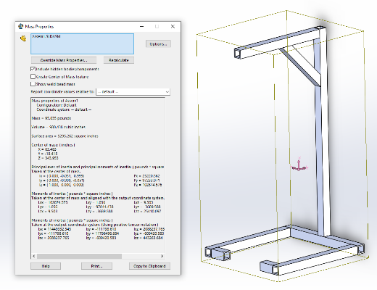
Primary Trade 2: Rotation System Mass Model
Mass: 93.635 lbs
6 ft
3 ft

Slide 34
Primary Trade 3: Software Platform - Scale Definitions
Metric | 1 | 2 | 3 | 4 | 5
Reliability | Platform is very prone to breaking/creating obstacles | Platform is prone to breaking/creating obstacles | Platform is fairly independent of possible obstacles | Platform is mostly independent of possible obstacles | Platform is completely independent of possible obstacles
Capability to Run Software | Cannot run any software | Can run 1-2 languages | Can run 3-4 languages | Can run any language | Can run any language and multiple Operating Softwares
Power Consumption | >100W | >50W | >10 | >5W | <5W
Speed | >100MHz | <100MHz | <500MHz | <1GHz | <1.3 GHz
Ease of Use | Team is not knowledgeable at all in how to use platform | Team is slightly knowledgeable in how to use platform | Team is fairly knowledgeable in how to use platform | Team is very knowledgeable in how to use platform | Team is extremely knowledgeable in how to use platform
Cost | >$100 | <$100 | <$60 | <$30 | Free/Would not have to pay money for

Slide 35
Secondary Trade 1: Ceiling vs. Floor Structure
Metric | Weight | Ceiling | Floor
Approval | 0.30 | 1 | 4.5
Cost | 0.25 | 1 | 3
Stability | 0.20 | 4.5 | 4.5
Use of space | 0.15 | 4.75 | 4
Complexity | 0.10 | 2 | 4
Weighted Total | 1.00 | 2.36 | 4.00
Key Requirements:
L0-2: Free user motion
L0-6: Safety
Key Constraints:
Schedule
Cost
Key Interfaces:
Rotation system
Gravity offloading system
Electrical
Notes:
Zoe

Slide 36
Secondary Trade 1: Ceiling vs. Floor Structure - Scale Definitions
Metric | 1 | 2 | 3 | 4 | 5
Approval | Long approval waiting period, risky approval | long waiting period, normal approval | Average waiting, normal approval | short waiting period, normal approval | short waiting period, good approval
Cost | Over $4000 | $3000-4000 | $2000-$3000 | $1000-$2000 | $0-$1000
Stability | Structure does not hold weight | Structure would bend under weight | Structure flexes but is stable | Structure is mostly sound | Structure is completely sound
Use of space | Uses <50% of design space or is stationary | Uses 50-80% of design space | Uses >80% of design space | Uses 100% of design space | Fully Mobile
Complexity | Assembly and installation too difficult for professionals, cannot be installed | Difficult to assemble and install, needs professional approval and installation | Average difficulty to assemble and install, needs professional approval, but team installation. | Some installation worries in assembly, no approval and team installation | No installation worries, no approval and team installation

Slide 37
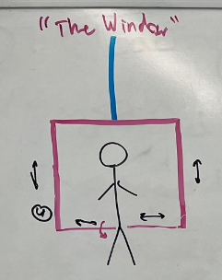
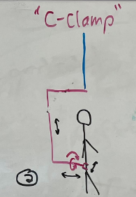
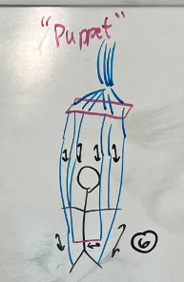
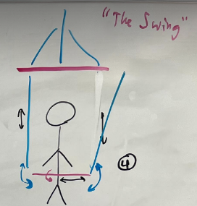
Secondary Trade 2: Rotation System - Sketches
Notes:
Mia
Key requirements, constraints, and interfaces that determined design metrics, risks, and
Weightings
A simple offloading system that allowed for rotational ability and comfort of a variety of users.
2.2 Design metrics, risks, engineering analyses, and weightings that feed into trade matrix
2.3 Design options considered and final trade matrix
2.4 Final selection and uncertainty around it

Slide 38
Secondary Trade 2: Rotation System - Trade Matrix
Key Requirements:
L0-2: Free user motion
L0-3: Training environment
Key Constraints:
Future HR integration
Cost
Key Interfaces:
Structural
Electrical
Metric | Weight | The Window | The C-Clamp | The Puppet | The Swing
Range of Arm Motion | 0.20 | 3 | 5 | 2 | 3
Z-Axis Rotation (yaw) | 0.20 | 5 | 5 | 1 | 4
Y-Axis Rotation (pitch) | 0.15 | 5 | 3 | 2 | 5
Control Simplicity | 0.15 | 5 | 5 | 1 | 3
Manufacturing Simplicity | 0.12 | 4 | 3 | 2 | 3
Material Cost | 0.10 | 1 | 2 | 5 | 3
X-Axis Rotation (roll) | 0.08 | 2 | 5 | 2 | 3
Weighted Total | 1.00 | 3.84 | 4.16 | 1.95 | 3.50
Notes:
Mia
Key requirements, constraints, and interfaces that determined design metrics, risks, and
Weightings
A simple offloading system that allowed for rotational ability and comfort of a variety of users.
2.2 Design metrics, risks, engineering analyses, and weightings that feed into trade matrix
2.3 Design options considered and final trade matrix
2.4 Final selection and uncertainty around it

Slide 39
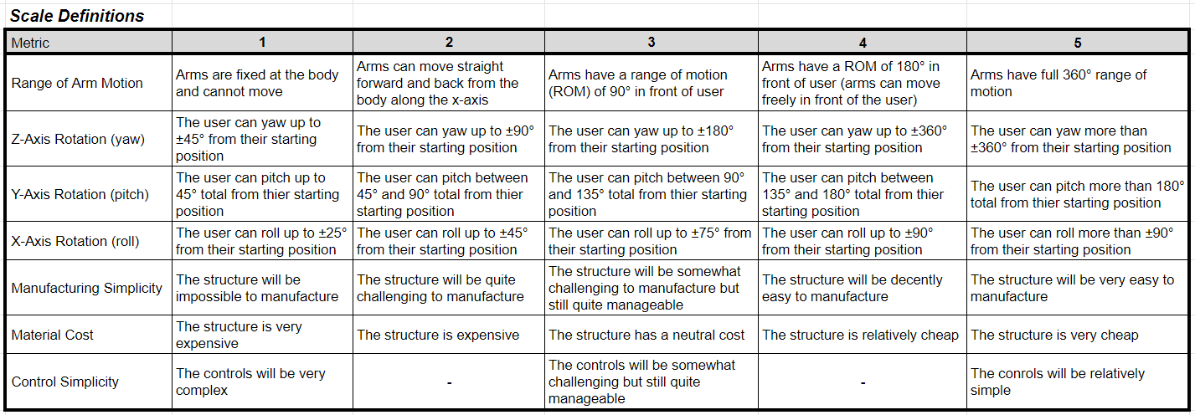
Secondary Trade 2: Rotation System - Scale Definitions
Notes:
Mia
Key requirements, constraints, and interfaces that determined design metrics, risks, and
Weightings
A simple offloading system that allowed for rotational ability and comfort of a variety of users.
2.2 Design metrics, risks, engineering analyses, and weightings that feed into trade matrix
2.3 Design options considered and final trade matrix
2.4 Final selection and uncertainty around it

Slide 40
Secondary Trade 3: Microprocessor Boards - Trade Matrix
Metric | Weight | Arduino Uno | Raspberry Pi 4 | Xilinx Spartan 7 FPGA | BeagleBone Black Industrial | Teensy 4.1
Processing Speed | 0.25 | 1 | 5 | 3 | 4 | 3
RAM | 0.25 | 1 | 5 | 1 | 3 | 1
Compatabile Langauges | 0.15 | 3 | 5 | 1 | 4 | 3
Ease of Use | 0.15 | 4 | 4 | 1 | 3 | 4
Cost | 0.10 | 4 | 3 | 3 | 4 | 4
Supply Chain/ Availability | 0.10 | 5 | 2 | 3 | 5 | 5
Weighted Total | 1.00 | 2.45 | 4.35 | 1.90 | 3.70 | 2.95
Key Requirements:
L0-1: Gravity offloading
L0-3: Training environment
L0-4: 1-hour continuous use
L0-5: HR Integration
Key Constraints:
Supply Chain
Processing Speed
Key Interfaces:
User-interface
Gravity offloading system

Slide 41
Secondary Trade 3: Microprocessor Boards - Scale Definitions
Metric | 1 | 2 | 3 | 4 | 5
Processing Speed | >100MHz | <100MHz | <500MHz | <1GHz | <1.3 GHz
RAM | <100 MB | >100 MB | >500 MB | >1 GB | >2 GB
Compatible Languages | Cannot run any Language | Can run 1-2 languages | Can run 3-4 languages | Can run any language | Can run any language and multiple Operating Softwares
Ease of Use | Team is not knowledgeable at all in how to use microprocessor | Team is slightly knowledgeable in how to use microprocessor | Team is fairly knowledgeable in how to use microprocessor | Team is very knowledgeable in how to use microprocessor | Team is extremely knowledgeable in how to use microprocessor
Cost | >$100 | <$100 | <$60 | <$30 | Free/Would not have to pay money for
Supply Chain/Availability | Not available | Hard to come by | Fairly easy to come by | Very easy to come by | Extremely easy to come by
Notes:
Mia
Key requirements, constraints, and interfaces that determined design metrics, risks, and
Weightings
A simple offloading system that allowed for rotational ability and comfort of a variety of users.
2.2 Design metrics, risks, engineering analyses, and weightings that feed into trade matrix
2.3 Design options considered and final trade matrix
2.4 Final selection and uncertainty around it

Slide 42
Secondary Trade 4: Electrical and Software User Interface
Metric | Weight | Ground Station | Touchscreen | Physical Buttons
Complexity | 0.40 | 3 | 3 | 4
Safety | 0.30 | 2 | 4 | 4
Ease of Use | 0.10 | 4 | 5 | 5
Cost | 0.10 | 5 | 4 | 4
Aesthetic | 0.10 | 4 | 5 | 3
Weighted Total | 1.00 | 3.10 | 3.80 | 4.00
Key Requirements:
L0-4: continuous 1 hour use
L0-5: HR Integration
Key Constraint:
Future HR integration
Ease of use
Key Interfaces:
Operator
Software
Notes:
Lauren

Slide 43
Secondary Trade 4: Electrical and Software User Interface - Scale Definitions
Metric | 1 | 2 | 3 | 4 | 5
Complexity | Extremely complex | Very complex | Fairly complex | Slightly complex | Not complex at all
Safety | Very slow response | Slightly slow response | Slightly quick response | Very quick response | Instantaneous response
Ease of Use | Interface is very difficult to understand | Interface is fairly difficult to understand | Interface is fairly easy to understand | Interface is very easy to understand | Interface is extremely easy to understand
Cost | >$100 | <$100 | <$60 | <$30 | Free/Would not have to pay money for
Aesthetic | Interface has very non-intuitive readability and lacks visual appeal. | Interface is either very non-intuitive or lacks visual appeal. | Interface is moderately intuitive and visually neutral. | Interface is either extremely intuitive or very visually appealing. | Interface is extremely intuitive and very visually appealing.

Slide 44
Secondary Trade 5: Coding Language
Key Requirements:
L0-4: Continuous 1 hour use
L0-5: HR Integration
Key Constraints:
Speed
Memory
Team Member Knowledge
Key Interfaces:
Electrical
Sensors
Actuators
User Interface
Metric | Weight | C++ | Python | Matlab | JavaScript
Speed | 0.30 | 5 | 4 | 3 | 3
Signal Processing | 0.30 | 4 | 5 | 5 | 3
Ease of Use | 0.20 | 4 | 3 | 5 | 3
Memory Used for Code | 0.10 | 3 | 4 | 4 | 3
Rapid Prototyping | 0.10 | 3 | 5 | 5 | 1
Weighted Total | 1.00 | 4.10 | 4.20 | 4.30 | 2.80
Notes:
Ian

Slide 45
Secondary Trade 5: Coding Language - Scale Definitions
Metric | 1 | 2 | 3 | 4 | 5
Computational Speed¹ | >70 ms | >50 ms | >30 ms | >10 ms | <10 ms
Signal Processing | Language is able to process and manipulate data very slowly | Language is able to process and manipulate data fairly slowly | Language is able to process and manipulate data fairly quickly | Language is able to process and manipulate data very quickly | Language is able to process and manipulate data extremely quickly
Ease of Use | Team is not knowledgeable at all in how to use language | Team is slightly knowledgeable in how to use language | Team is fairly knowledgeable in how to use language | Team is very knowledgeable in how to use language | Team is extremely knowledgeable in how to use language
Memory Used for Code¹ | > 16 Mb | >12 Mb | > 8 Mb | > 4 Mb | <4 Mb
Rapid Prototyping | Near impossible to prototype | -- | Moderately difficult to prototype | -- | Simple to prototype
¹Values found in “Ranking Programming Languages by Energy Efficiency”, Pereira et al, 2021.

Slide 46
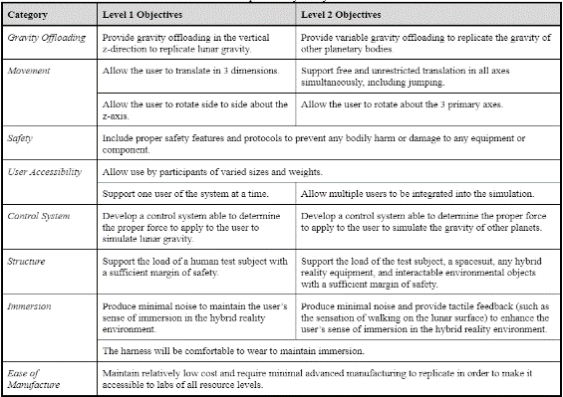
Specific Objectives

Slide 47
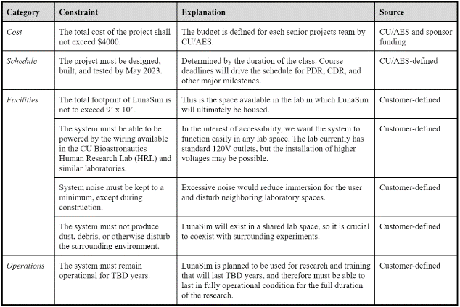
Constraints

Slide 48
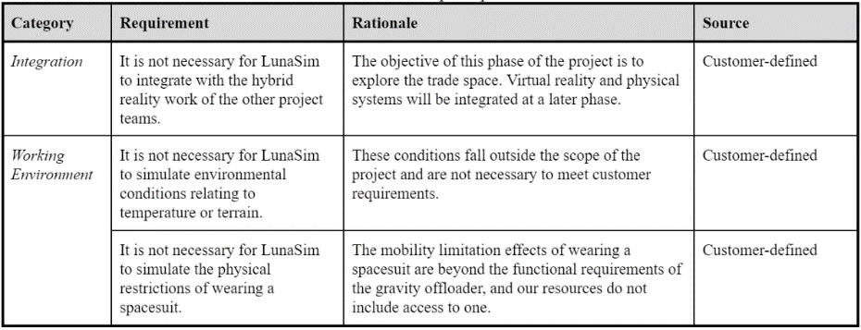
Out of Scope Requirements

Slide 49
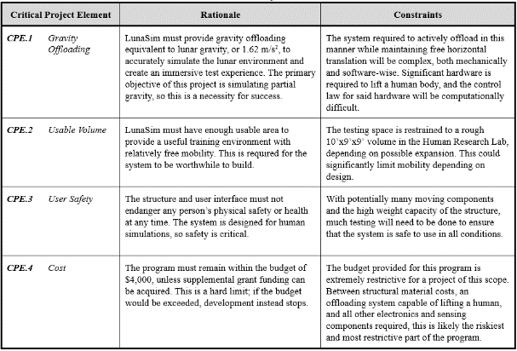
Critical Project Elements
Notes:
Remove 7-8 and 5?

Slide 50
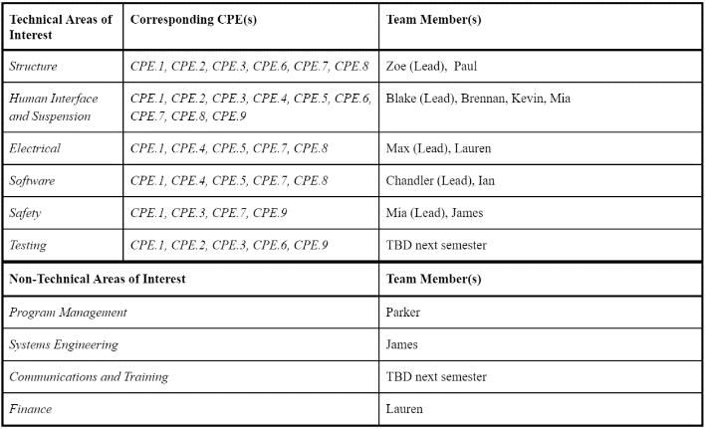
Team Skills & Interests / Interdependence

