Slide 1
Preliminary Design Review
Alayna
The Icebox
---
Lewis bittner, Willy gettinger, collin hayes,
reina krumvieda, Alayna Lauffer, Zach reichenbach,
fabrizio roberts, Andrew sapuppo, Amir tillis
SponSors: Lockheed Martin, Aerospace Corporation, Ball Aerospace
Notes:
-proper intro
-include presenter (my name) and team name
-include sponsor , revisor, what our team name means
-include review type (PDR, CDR)
-add slide numbers and progress bar

Slide 2
Project Definition
Problem: There is a need for fuel and resources on the Moon to sustain long term missions (> a few weeks)
Solution: Our objective is to create a cost-effective way to supply fuel and refined byproducts for lunar missions better than current methods (launching X kg of fuel from Earth)
The following is a preliminary design for the solution
Trade space
Constraints and interdependencies
High risk items
Project Definition
Project Description
CONOPS
Trade Table
FBD
CPEs

Slide 3
Project Description – Systems of Systems Analysis
High level objectives
Specific Objectives
Fuel mining, production, and storage logistics and services
Space-based power logistics and services
Return on investment
Mission will be able to generate fuel on the Moon for less than what it costs to launch it from Earth
Receiving enough power to operate the infrastructure with some margin
Reduce cost of resources, and supply/sell additional power to customers
Project Definition
Project Description
CONOPS
Trade Table
FBD
CPEs

Slide 4
High-Level CONOPs
Solar power generation
Excavation
Transport
Processing
Distribution
Power beaming
* Surface elements dramatized, actual locations are part of trade space
Project Definition
Project Description
CONOPS
Trade Table
FBD
CPEs
Notes:
Zak
Should power beaming be earlier in the process (maybe solar power generation and supply)? - willy

Slide 5
Project Description
Project definition
CONOPs
Trade table
Functional block diagram
Critical project elements
Notes:
From Jasmin: Mention how project name "Icebox" came to be (be clear that it's not an acronym)

Slide 6
Low-Level CONOPs
System Level:
Power collection
Excavation
Transport
Material processing
Distribution
Project Definition
Project Description
CONOPS
Trade Table
FBD
CPEs
Notes:
Zak

Slide 7
Trade Table (table)
Trade:
Excavation methods | Dependent
Transport | Dependent
Processing | Dependent
Distribution | Independent
Ground Based Power | Dependent
Orbital Based Power | Dependent
Satellites & Orbit Determination | Independent
Solar Arrays | Dependent
Beaming Method | TBD
Materials | Independent
Pressure Vessels | Dependent
Remote Sensing | Dependent
Resource/Mineral Evaluation | Independent
Batteries | Dependent
Project Definition
Project Description
CONOPS
Trade Table
FBD
CPEs
Notes:
Independent
- Power system
- Policy
Dependent:
- ROI
- Fuel Mining system

Slide 8
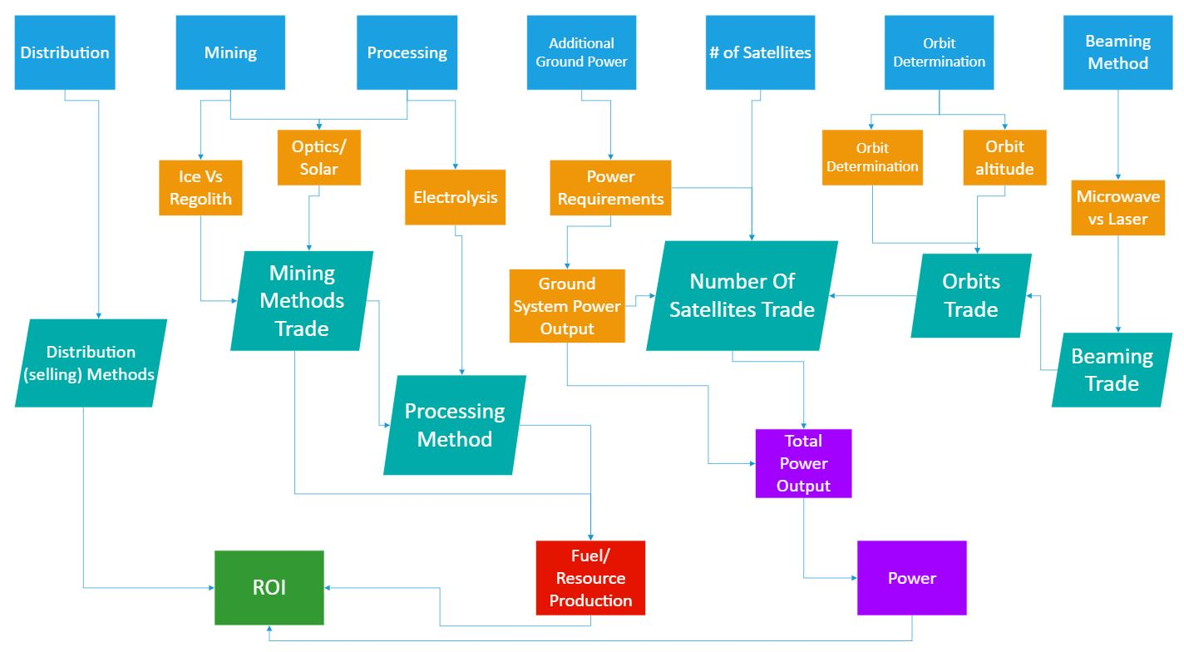
Functional Block Diagram
Project Definition
Project Description
CONOPS
Trade Table
FBD
CPEs
Notes:
- improve graphics
-make readable and bigger
-use more slide space
Possibly make graphic flow from left to right to improve space usage...

Slide 9
Critical Project Elements - Technical
CPE | Description
Fuel Mining, Processing, and Storage System | Mining system for collecting fuel resources Transportation system to move to primary facility Processing system to turn into desired products Storage system for product Method of distribution to customers
Space Based Power System | Power collection Power storage Power transmission to other systems
Multi-level Objective Analysis | Model inputs, outputs, constraints Verify success for each sub-system Power, cost, location, communication, risk management, efficiency
Project Definition
Project Description
CONOPS
Trade Table
FBD
CPEs
Notes:
-Attempt to minimize words
-number CPE,
1-3 bullet points for each CPE
Highlight most limiting CPE's (dependent vs. independent)
- power system
- fuel mining systems
- policy

Slide 10
Critical Project Elements - Logistical
CPE | Description
Risk Reduction Hardware Demonstration | Assess infrastructure risk Research and testing to minimize risk Building hardware prototype
Land Rights and Policy | Minimum policy to make infrastructure possible Laws and regulations around launching and cislunar infrastructure
Project Definition
Project Description
CONOPS
Trade Table
FBD
CPEs

Slide 11
Critical Project Elements - Financial
CPE | Description
Return on Investment | Cost of current resources Most necessary resources Most valuable resources Distribution processes
Project Definition
Project Description
CONOPS
Trade Table
FBD
CPEs
Notes:
-end of section, should include a tavle of trades

Slide 12
CPE Limiting Requirements & Risk
Limiting Requirements:
Cislunar Space
Resource Availability
Technology
Risk:
Financial (ROI)
Infrastructure Deployment
Operations
Project Definition
Project Description
CONOPS
Trade Table
FBD
CPEs

Slide 13
Project Trades
Policy
Grounds systems
Power Systems
Return on investment (ROI)

Slide 14
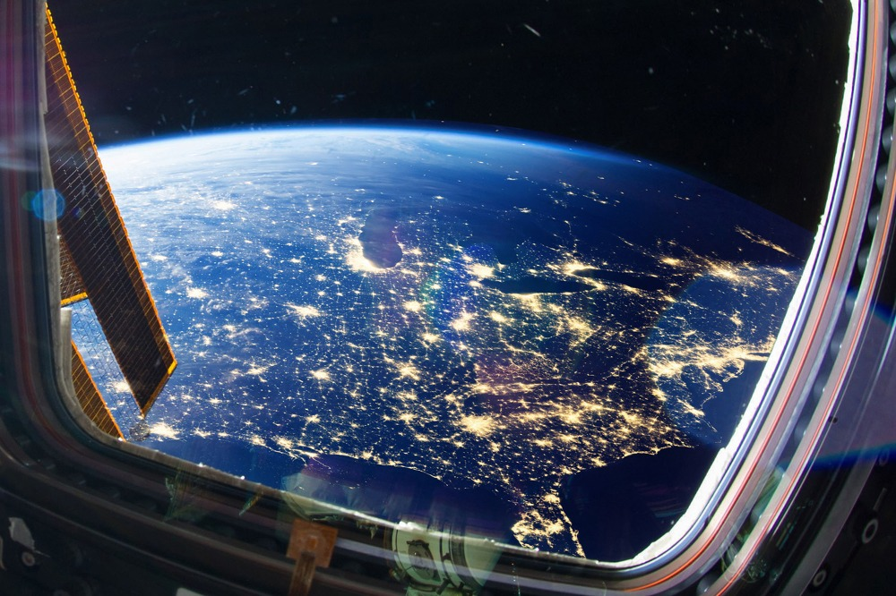
Policy: Key Requirements
Determine Minimum Policy to achieve functional infrastructure on lunar surface
Build from previous policy to ensure a correct design choice
Maintain safety and peace between nations
Policy
Power
Ground
ROI
Notes:
It is critical that we create a design space that meets these requirements
Keeping things simple will lessen any confusion or conflict once implemented

Slide 15
Policy: Constraints and Interfaces
Policy constrained by Cislunar space
Constrained by international opinions and heritage policy design
Policy interfaces with all aspects of the infrastructure
Laws and regulations are overarching
Policy
Power
Ground
ROI
Notes:
Policy interfaces with everything we do.
Our systems of systems design will be contrained by the overarching policy
We are required to meet the current laws and regulations in order for our business to be profitable

Slide 16
Policy Design 1: Previous Policy
Build from what has already been permitted – heavily weighted
Outer Space Treaty (1966)
Outer space cannot be governed by one nation
Lu Initiative (2016)
Private companies can explore space and use resources
Artemis Accords (2020)
Utilize space resources from Moon
Policy
Power
Ground
ROI
Notes:
The ICEBox will build from international policy that has already permitted
OST: Includes that "outer space is not subject to national appropriation by claim of sovereignty, by means of use or occupations, or by any other means."
LI: Initialized a "unique legal, regulatory, and business environment enabling private investors and companies to explore and use space resources."
AA: Set a precedent to "extract and utilize resources on the Moon, Mars, and asteroids."
AA: Faces critique from Outer Space Treaty purist

Slide 17
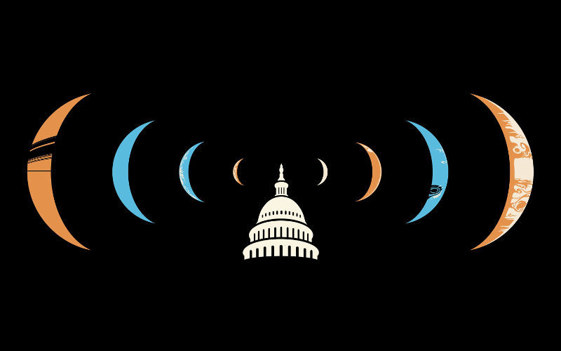
Policy Design 2: New Policy
Cislunar space = L2 = 1,500,00 km Earth-centered SOI
Distance from Earth to JWST
Surveys for international opinions
Will help improve our ROI
First come first serve
Discussed by other lunar mining companies
No land ownership
Our policy design will follow previous policy and add the new items listed above
Medium-low uncertainty since we are building off of previous space policies
Policy
Power
Ground
ROI
Notes:
Cislunar infrastructure system defined by L2 = Sphere Of Influence
- location of JWST
Design according to international trade (decadal survey – propose most important items)
- how can we make this beneficial for everyone/nation?
- recieivning input
FSFS – this is what is being discussed by current lunar mining companies,
Utilize the resources but whoever is there cannot add/make laws to the plot of land
- live off the land
How were these analyzed? - using what is current and ethical

Slide 18
Power: Key Requirements
Must be able to supply whole ground infrastructure with adequate power to operate continuously
Must be able to supply customers with sufficient power to operate on the ground
Must be able to maintain a constant output
Beginning of life requirements must account for degradation of power components to support systems for duration of mission
Policy
Power
Ground
ROI
Notes:
-include constraints and dependencies, and interfaces

Slide 19
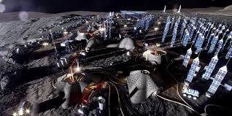
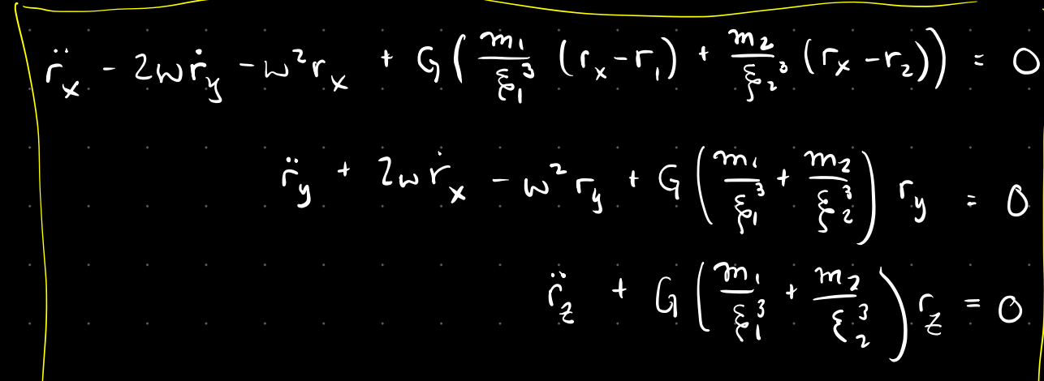
Power: Design Options
Option one: Orbital solar satellite system
Main Trades:
Number of satellites
Solar array design (shape, size, material, etc.)
Power beaming method (Microwave vs Laser)
Orbit parameters (shape, size, period, 2 body vs 3 body, etc.)
Option two: Surface power generation
Main Trades:
What kind of power?
Solar vs RTG
Policy
Power
Ground
ROI

Slide 20
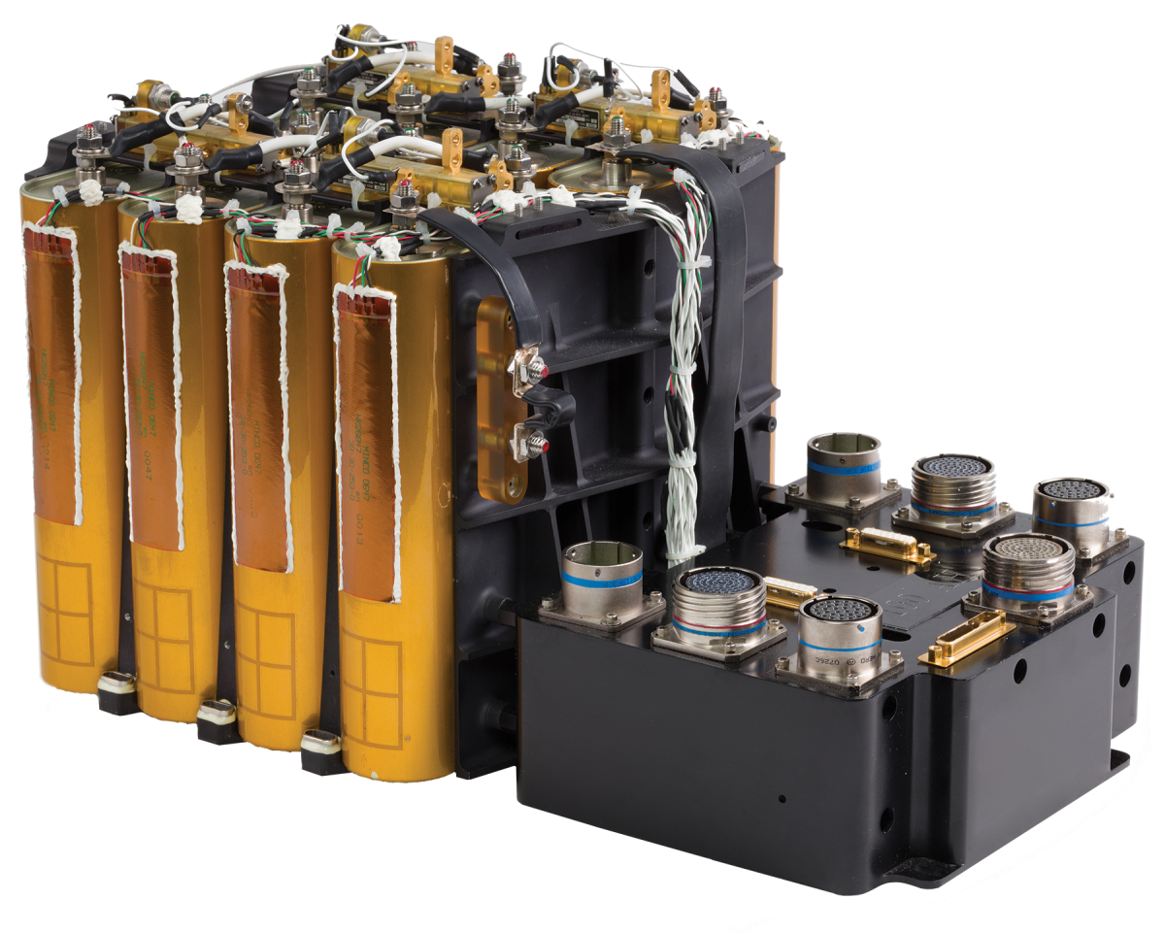
Power: Energy Storage
All of the proposed systems will need to have some kind of power storing methodology
Determine energy storage requirements for each component
Select type of batteries (Lithium-ion, Nickel Cadmium, etc.)
Determine size of batteries/battery capacity
Determine energy distribution methods
Policy
Power
Ground
ROI

Slide 21
Power: Orbital Satellite System
This system proposes using a number of satellites in Lunar orbit to collect solar power, and then beam it down to the station on the moon
Pros:
Can always collect energy from the sun (except for the short occasional eclipses)
Cheaper than building large scale on surface solar infrastructure
Cons:
Power beaming isn't 100% efficient, and will require the satellites to collect more energy in total than what is required to operate the base
Each satellite can't beam power at all times, and must store power during non-transmission times
Policy
Power
Ground
ROI
Notes:
-add in graphics (throughout)
-add in tables (trade matrix)
-rubric
General stuff:
-describe CONOPS and FBD
-always define acroynomys
-show clear labels, arrows and annotations
-use equations, and list them
-cite values that are not given
-end slide: "questions ?"
-backupslides
-modeling
- extra info
-resources
-no PM stuff
-trade studies are high level, how we are narrowing down solution spaceto design space
-flow chart to viualize software

Slide 22
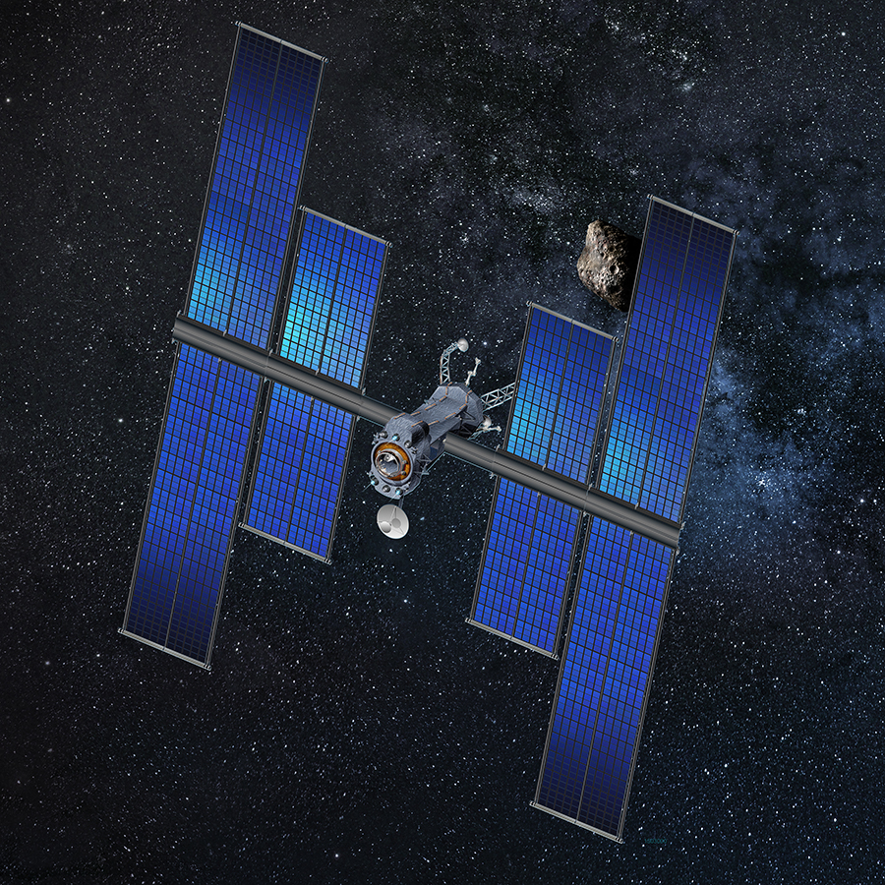
Power: Solar Array Design
Determine requirements and constraints
Calculate power that must be produced
Choose planar, cylindrical, or omnidirectional shape
Estimate power output with sun normal to surface of cells
Determine beginning-of-life (BOL) and end-of-life (EOL) power production (30% over 10 years is typical for degradation of solar array)
Estimate solar array area required for power production
Estimate mass of solar array
*Equations in table 11-34 on page 412 of Space Mission Analysis and Design (SMAD)
Policy
Power
Ground
ROI

Slide 23
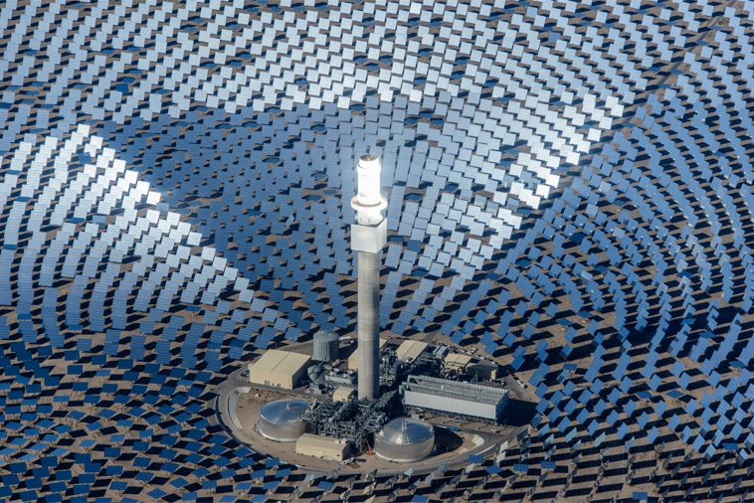
Power: Ground Systems
Solar ground system
Create a large solar farm on the moon
Pros:
Large scale energy production (Can collect a lot of energy)
Cons:
Can only collect during the lunar day, and won't work at night (14 days in the dark)
RTG
Pros:
Could power smaller system components (like rovers)
Cons:
Small scale Power generation
Radioactive materials
Policy
Power
Ground
ROI

Slide 24
Power: Trade Matrix
Power | Efficiency | Feasibility | Cost | Reasoning | Score
Orbital | 4/10 | 10/10 | 5/10 | Beaming power has a lot losses, will power during the night, expensive to build and launch satellites | 19/30
Ground | 7/10 | 1/10 | 7/10 | Solar power has relatively high efficiency, will not power during the night, cheap due to advances in a common technology | 15/30
Combination of both | 5/10 | 10/10 | 6/10 | Efficiency should be in between both values ,will power during the night, Cost should be in between both values since less satellites will be required | 21/30
Policy
Power
Ground
ROI

Slide 25
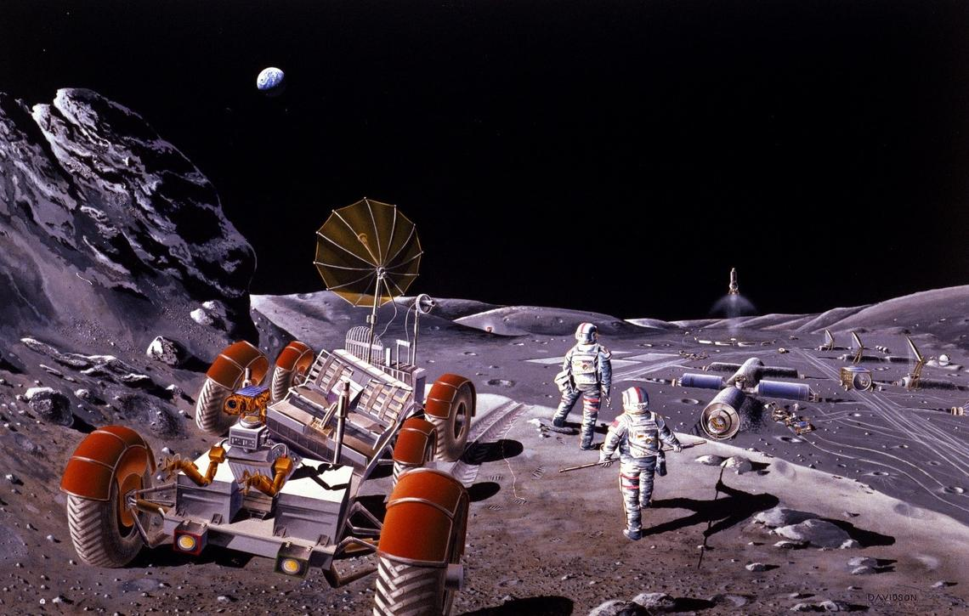
Ground Systems: Key Requirements and Constraints
Collect lunar resources more cost effectively than if they launched these supplies from Earth.
Transport resources through extreme lunar environment
Process material and provide a sustainable amount of resources for lunar operations
Distribute and store product in an easily accessible/usable package.
Produce for longevity on the lunar surface
Policy
Power
Ground
ROI

Slide 26
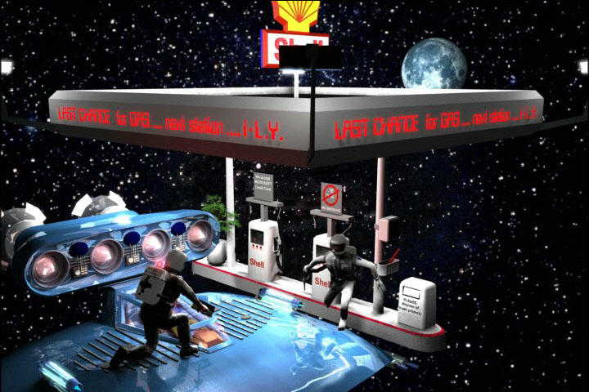
Ground Systems: Trades
Material Selection
Radiation
Temperature variations
Ground Based Power
Integrated with power team to find needed values to maintain ground systems
Processing Method
Electrolysis
Hydrolysis
Purification
Excavation Method
Solar based mining
Mechanical based mining
Targeted deposits
Regolith Vs. Crater Ice
Transport Method
Conveyer Belt
Rover/vehicle transport
Distribution
Orbital Refueling
Ground Refueling
Pressure Vessels & Gas Storage
Conveyer Belt
Rover/vehicle transport
Policy
Power
Ground
ROI
Notes:
TRADE MATRIX

Slide 27
Ground Systems: Trade Space Analysis
Excavation Method
Compare mechanical Vs. solar mining. Mechanical has utilized forever, but solar mining options for ice may be more efficient for our application
Distribution
A cost benefit analysis will be done assessing what combination of ground and orbital based distribution methods will provide us the largest ROI and value for potential customers.
Processing Method
Lunar material is challenging to process with many contaminants. Various methodologies have been in research and tested (hydrolysis, electrolysis, and purification). Analysis will be done to try to find the most effective method(s) to enable our infrastructure.
Policy
Power
Ground
ROI

Slide 28
Ground Systems: Trade Matrix
Trades | Efficiency | Feasibility | Cost | Reasoning | Score
Mechanical Mining | 5/10 | 8/10 | 7/10 | Mechanical mining is a tried-and-true method used for missions happening at many space agencies. it is low cost, but sufferers from dust build up and energy efficiency. | 20/30
Solar Mining | 9/10 | 7/10 | 6/10 | Research shows that solar may be more energy efficient and be less prone to dust issues. But it may require more setup and materials to operate. | 22/30
Regolith | 6/10 | 8/10 | 9/10 | Regolith is easy to access in large quantities but may be is troublesome to process and collect in mass. | 23/30
Crater Ice | 8/10 | 6/10 | 5/10 | Can potentially yield large amounts of resources, but is less researched, more uncertain, and difficult to access. | 19/30
Orbital Distribution | 9/10 | 6/10 | 4/10 | Accessible to more lunar missions by reaching customers without needing to land, costly infrastructure to provide with more technicalities. | 19/30
Ground Distribution | 7/10 | 8/10 | 7/10 | Easier to refuel on the ground but cannot reach orbitally restricted missions/customers. | 22/30
Policy
Power
Ground
ROI

Slide 29
ROI: Key Requirements (In our Control, testable, verifiable)
The infrastructure shall be able to support X number of customers and provide Y/kg per customer per period
The resource collection system shall be the most cost-efficient method for acquiring said resources on the lunar surface
The power distribution system shall provide uninterrupted power in the most cost-efficient method for revenue generating operations
Policy
Power
Ground
ROI
Notes:
-Bold important words (uninterrupted power, cost efficient method)
-these are informed by our functional requirments
-include constraints, and interfaces between other areas in the project

Slide 30
ROI: Constraints and Interfaces
ROI is fully dependent on the infrastructure as a whole
Every Subsystem interfaces and contributes to the overall ROI
The ROI is constrained by the efficiency, scale, and use of said infrastructure.
Use of Infrastructure= Revenue
Efficiency= Less Cost to Produce
Scale=More Product to Sell
Policy
Power
Ground
ROI

Slide 31
ROI: Design Risk and Analysis
Design Risk:
Initial Infrastructure Cost
Profitability/Usage
Scalability and long-term growth
Risk Analysis:
To minimize financial risk:
Stated Customer Need and Usage MUST be Verified
Cost of Goods Sold (COGs) MUST have high margins
Policy
Power
Ground
ROI

Slide 32
ROI: Design Metrics (performance, rate of return, investable)
The price per resource/kg shall be 3x the mine to cost/kg
Shall be able to scale from X of customers to Y number within a span of Z years.
The annual infrastructure cost shall be no greater then $.x/kg mined (no greater than 33%)
Policy
Power
Ground
ROI
Notes:
-bold important, things that matter

Slide 33
ROI: Trade Matrix
Products | Supply | Feasibility | Cost | Reasoning | Score
Resources | 8/10 | 8/10 | 6/10 | All resources mined contribute directly to supply, storage and infrastructure are depended on resources feasibility so this must be highest, expensive to gain resources | 22/30
Storage | 6/10 | 5/10 | 8/10 | Supply depends on how much excess storage is left from resources we sell to other customers, we can only store product for future use is we have enough resources, holding resources is inexpensive | 19/30
Infrastructure | 4/10 | 3/10 | 4/10 | Must make our infrastructure first and make multiple structures to lend, can only lend infrastructure if we have enough to sustain our own product, very expensive to recreate infrastructure | 11/30
Policy
Power
Ground
ROI

Slide 34
ROI: Final Selection and Uncertainty
1. Selling resources
Uncertain how much processing will cost
2. Selling storage holding resources
Uncertain how much product will we have to hold for bulk storage
We will identify the necessary trade spaces to resolve these uncertainties
Policy
Power
Ground
ROI

Slide 35
ROI: Design Options (business model, what are the steps to make this a viable business)
Business Plan:
Establish Power
Establish Ground Infrastructure
Accumulate Resources
Market Resources to Consumers
Partnerships?
ROI/Product Line:
Resources for Sale
Storage for Sale
Infrastructure for Lease
Policy
Power
Ground
ROI
Notes:
-chosen, make sure to note that this is differently scoped before

Slide 36
Current Design Spaces
Ground systems
Power systems
Multi-level objective analysis

Slide 37
Power: Design Metrics and Trade Space Analysis
With these possible solutions, we can start to figure out which options give the best results
Orbital system
Find optimal size and number of satellites based upon power requirements and solar energy available in Lunar orbit
Ground Solar
Find required size to power systems continuously in light and dark periods
Ground RTG
Find power required by rovers to see if RTG's take a significant power burden
Power
Ground

Slide 38
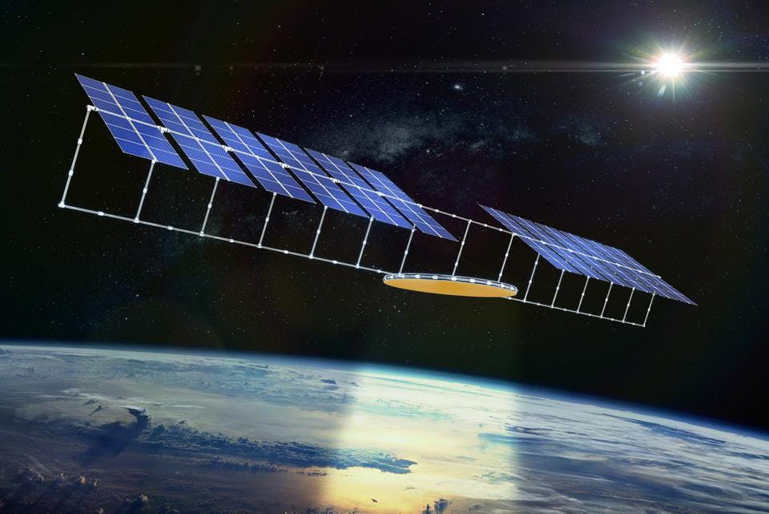
Power: Current Design Space
Due to the long lunar nights, the only feasible system to continuously operate our architecture is the orbital system
Other ground power systems can help alleviate some of the power burden on the system
Main Orbital design space
Number of satellites
Size of satellites
Beaming method
We will use research and computational optimization to narrow down to an optimal satellite constellation
Power
Ground

Slide 39
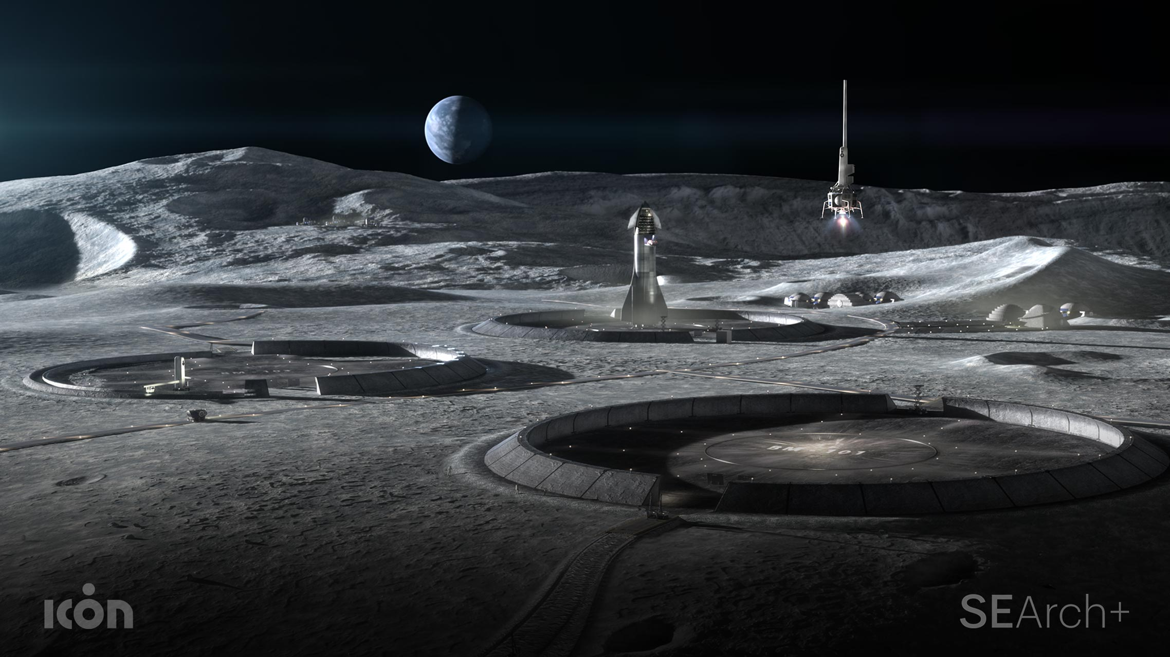
Ground Systems: Design Space Overview
Mining/Processing
Option A: Mining Water Ice and Process Into Rocket Fuel
Option B: Extract Regolith and Process into Oxygen and Rocket Fuel
Distribution
Option A: Orbital Refueling
Option B: Ground Refueling
Option C: Combination Refueling
Power
Ground

Slide 40
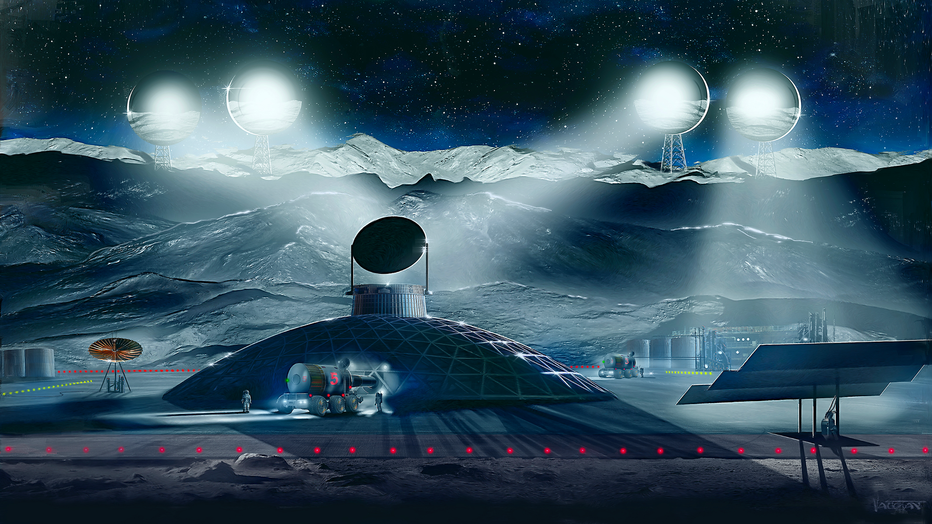
Ground Systems: Mining/Processing - Option A
Mine Water Ice and Process Into Rocket Fuel
Sublimation
Build large towers topped with concave mirrors
Reflect sunlight
Capture water vapor
Move into large aluminum units
Purify
Electrolysis
Liquify for use as propellant
Power
Ground
Notes:
Utilize sublimation for extracting water from lunar surface
Build large towers topped with concave mirrors around crater edges
Reflect sunlight into permanently shadowed regions
Turn ice into vapor
Tent covers to capture water vapor and move into large aluminum units
Water Ice to be purified
Water Ice to be split into hydrogen and oxygen through electrolysis
Hydrogen and Oxygen to be liquified to be used as propellant

Slide 41
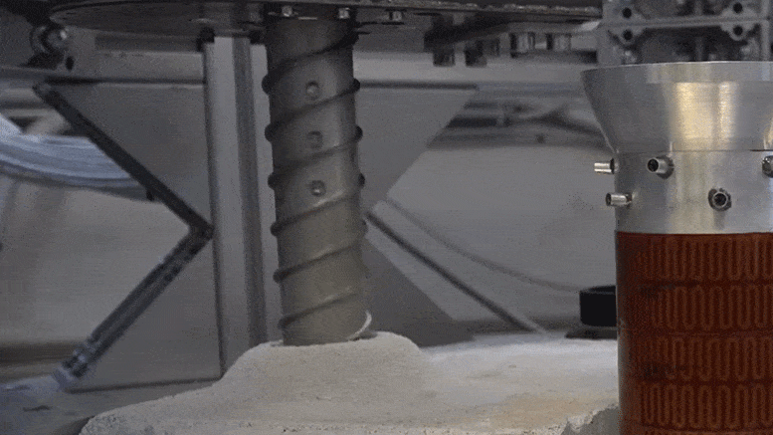
Ground Systems: Mining/Processing - Option A
Mine Water Ice and Process Into Rocket Fuel
Drilling
Mechanical drilling mechanism
Collect ice from craters and areas around the south pole of the moon
Collect cores or large chunks of water ice
Store and transport for processing
Purify
Electrolysis
Liquify for use in propellant
Power
Ground

Slide 42
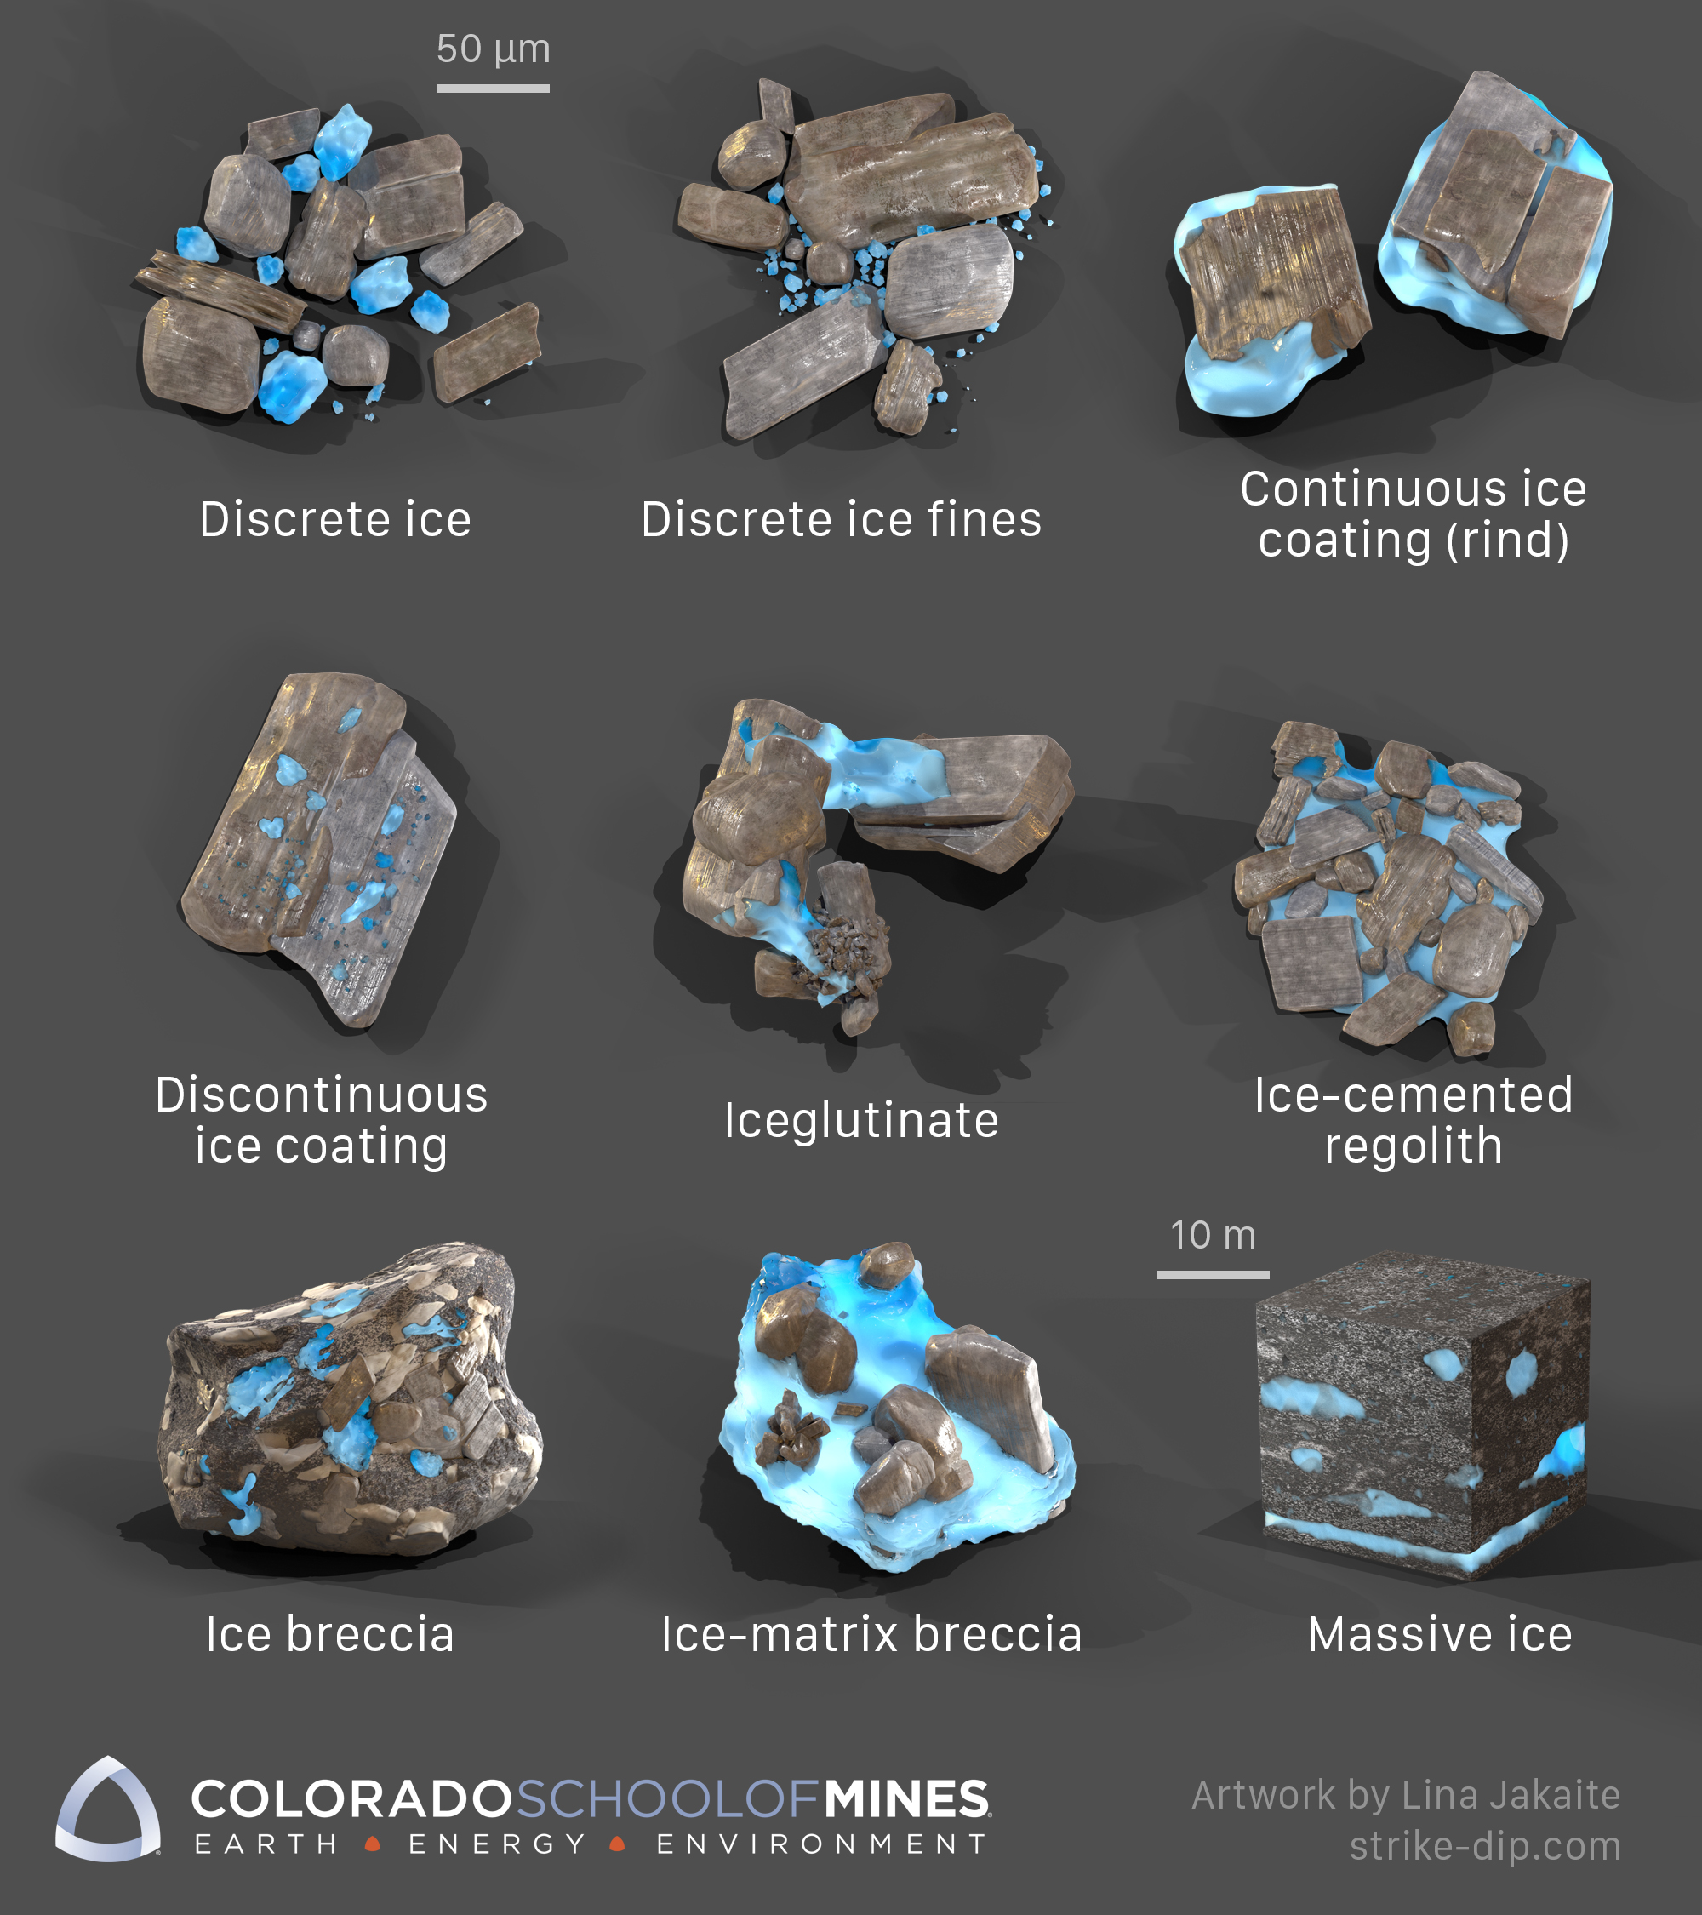
Ground Systems: Mining/Processing - Option A
Mine Water Ice and Process Into Rocket Fuel
Design Concerns
Regolith
Cannot be fully automated
Knowledge Gaps
Large Infrastructure on the Moon
Will need to go searching for "gold"
Purification
Ice not in a pure, easy-to-access form
Lack of lunar samples on Earth
Power
Ground
Notes:
Regolith
interferes with and clogs instruments and mechanisms
Cannot be fully automated
Manned operations will require tremendous resources and energy
Knowledge Gaps
Large Infrastructure on the Moon:
Don’t know if huge infrastructure can last long
Each region of moon sits in darkness for 2 weeks of the month – it’s hard to wake tech from 40K slumber
Will need to go searching for "gold" :
We only theoretically know about the locations of water ice on the moon
Purification
Image shows various forms the lunar water ice could take
If contaminants are left in water then it can ruin fuel – worst case it will be unstable and explosive
Because of lack of lunar samples to test tech with on Earth it will be hard to develop membranes to filter out contaminants specific to the moon

Slide 43
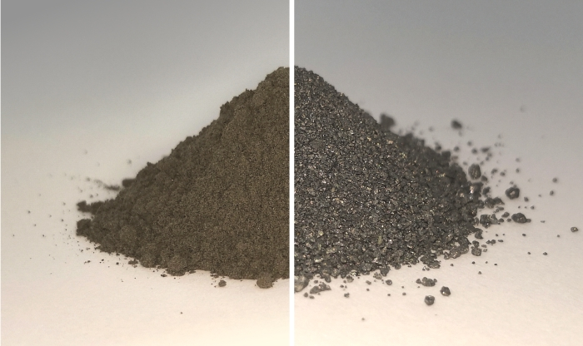
Ground Systems: Mining/Processing - Option B
Extract Regolith and Process into Oxygen and Rocket Fuel
Small Mobile Systems
Excavating rover for first 10cm of lunar surface​
Electrolysis to Extract Oxygen
Recycles hydrogen and methane by-products​
Almost entirely automated​
Metal alloys by-products useful for building structures ​
Power
Ground
Notes:
Stats
- Regolith is 40-45% oxygen
Small Mobile Systems
we will Utilize Small Mobile Systems for Regolith Extraction
Cratos is an existing small mobile excavation system which was successfully tested in simulated regolith for a variety of conditions
Electrolysis to Extract Oxygen
Methods already exist for this
ESA has facility in operation for fine-tuning electrolysis oxygen extraction
Oxygen-from-Regolith System at Technology Readiness Level of at least 4 on NASA's 9-Level Scale
Structures such as solar panels can be built from by-products
Image shows regolith before and after oxygen extraction

Slide 44
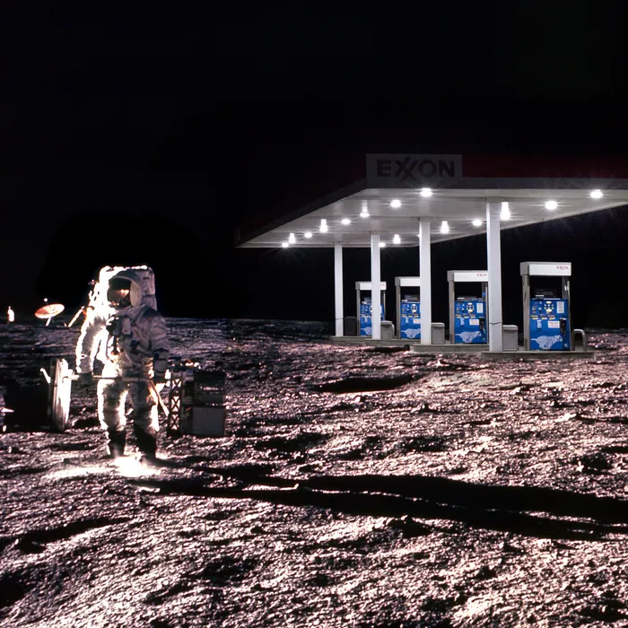
Ground Systems: Design Space- Distribution
Option A: Orbital Refueling
Can increase asset utilization/lifetime and defer capital costs
Option B: Ground Refueling
Locate near lunar South Pole by NASA's proposed Artemis Base Camp
Option C: Combination Refueling
Considerations:
Packaging
Sales Model (Subscription, pay with use)
Location
Power
Ground
Notes:
Option A
- Lockheed Martin Orbit Fab
Option B
- this location is a Region with max available solar power and regions of high scientific interest

Slide 45
Multi-Level Objective Analysis

Slide 46
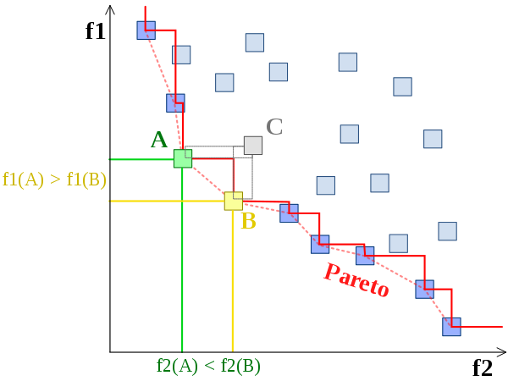
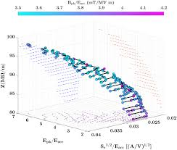
Multi-level Objective Analysis
Use trades to optimize more than one objective function simultaneously
Pareto front shows how making one objective better affects other objectives
3-D Pareto front optimizing space based power, fuel, and ROI
All objectives will have a quantifiable measure of success
Pareto front will be utilized to choose most optimal design
Notes:
-talk about developing code to implement said analysis

Slide 47
Modeling and Prototyping Plans
Software
Hardware
other

Slide 48
Deliverables
Engineering analysis of trade space
Technology demonstration
Version-controlled python code generating analysis and results
Summary of national/international policy requirements for infrastructure
Develop, design, demonstrate hardware investigating high risk aspect of selected design

Slide 49
Sources
Larson, Wiley J., and James R. Wertz. Space Mission Analysis and Design. Kluwer Academic Publishers, 2005.
Images
Solar Arrays on Moon, Halbach, Eric, 2020, https://ttu-ir.tdl.org/bitstream/handle/2346/86471/ICES-2020-385_v22jul.pdf?sequence=5
Battery, Eaglepicher Technologies, 2021, https://www.eaglepicher.com/blog/batteries-enabling-planetary-and-deep-space-exploration/
Lunar Resources, USGS, 2019, https://www.usgs.gov/news/usgs-prepares-assess-resources-moon

Slide 50
Sources
Images
Ground Systems, SciTechDaily, 2020, https://scitechdaily.com/nasa-advancing-3d-printing-construction-systems-for-bases-on-the-moon-and-mars/
Ice Mining Towers, Space.com, 2020, https://www.space.com/trump-moon-mining-space-resources-executive-order.html
Regolith, Science Alert, 2019, https://www.sciencealert.com/scientists-have-figured-out-how-to-extract-oxygen-from-moon-dirt
Water Ice Forms, Kakaite, Lina, Colorado School of Mines, https://kevincannon.rocks/lunarmining/
Lunar Gas Station, New York Intelligencer, 2018, https://nymag.com/intelligencer/2018/02/wilbur-ross-moon-should-be-a-gas-station-for-outer-space.html
Solar Array, NASA, 2016, https://www.nasa.gov/feature/roll-out-solar-array-technology-benefits-for-nasa-commercial-sector/

