Slide 1
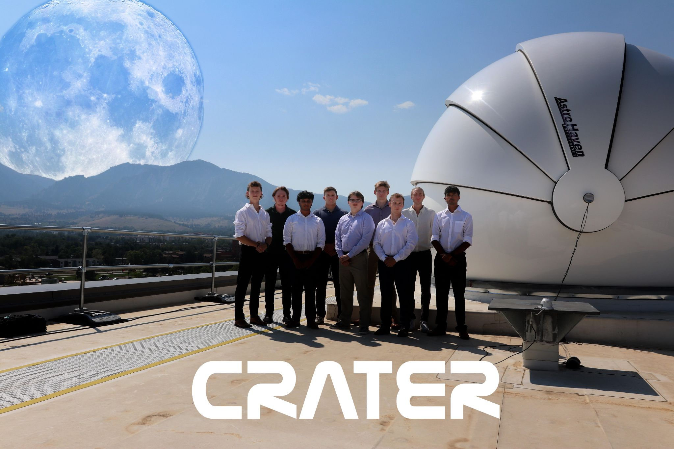
Faculty Advisor:
Dr. Marcus Holzinger
Industry Advisor
Dr. Ryan Coder
Preliminary Design Review
Team:
Henri Wessels
Mark Walvoord
Nathan Tonella
Ashwin Raju
Cameron King
Abraham Jaet
Aadhit Gopinath
Alec Church
Mathieu Brawley
Notes:
Henri
Hi all, welcome to team CRATER’s preliminary design review
Im Henri
I’m joined today by Mark, Ashwin, Cam, Abe, Adi

Slide 2
Outline
3-5 Project Summary
6 PDR Summary
7 CONOPS
8-10 Performance …………………..Quantification
11-12 Requirements Discussion
13 Trade Tree
14 Multi-Objective …………………..Optimization as a Model
15 FBD
16-19 Models
Meets Requirements
Quantifying Performance
Assumptions
Inputs/Outputs
Connections
20 Risk Matrix
21-24 Pre-MOO Trades
25-28 MOO
29 Future Work
30 Expected Outcomes
31 Policy
32 Open Questions/Problems
Notes:
Henri
High level until slide 12
Trades & multi objective optimization (moo)
MOO
Outcomes

Slide 3
Project Summary - Need
For mankind to inhabit the Moon permanently, a communications network and power infrastructure will need to be set up.
As this has not been done before, there is very little heritage that we can use as a foundation for our project .
We hope to demonstrate the feasibility of lunar infrastructure using both lab tests, modelling, and academic research.
PDR Requirement 1.1
Notes:
Henri
Solution

Slide 4
Project Summary - Solution
CRATER’s objective is to provide an optimized lunar based power and communications network utilizing a constellation of satellites as a delivery system. The infrastructure aims to encourage permanent human presence on the Moon by providing a preferable technical and financial solution.
PDR Requirement 1.1
Notes:
Henri
Need

Slide 5
Project Summary - Objectives
Comms
Power
Return on Investment (ROI)
Maximize Coverage (Figure of Merit)
Maximize Transmission Rate (bits/sec)
Maximize kWh to receiver (kWh)
Maximize Revenue to Cost Ratio ($)
PDR Requirement 1.1
Notes:
Henri

Slide 6
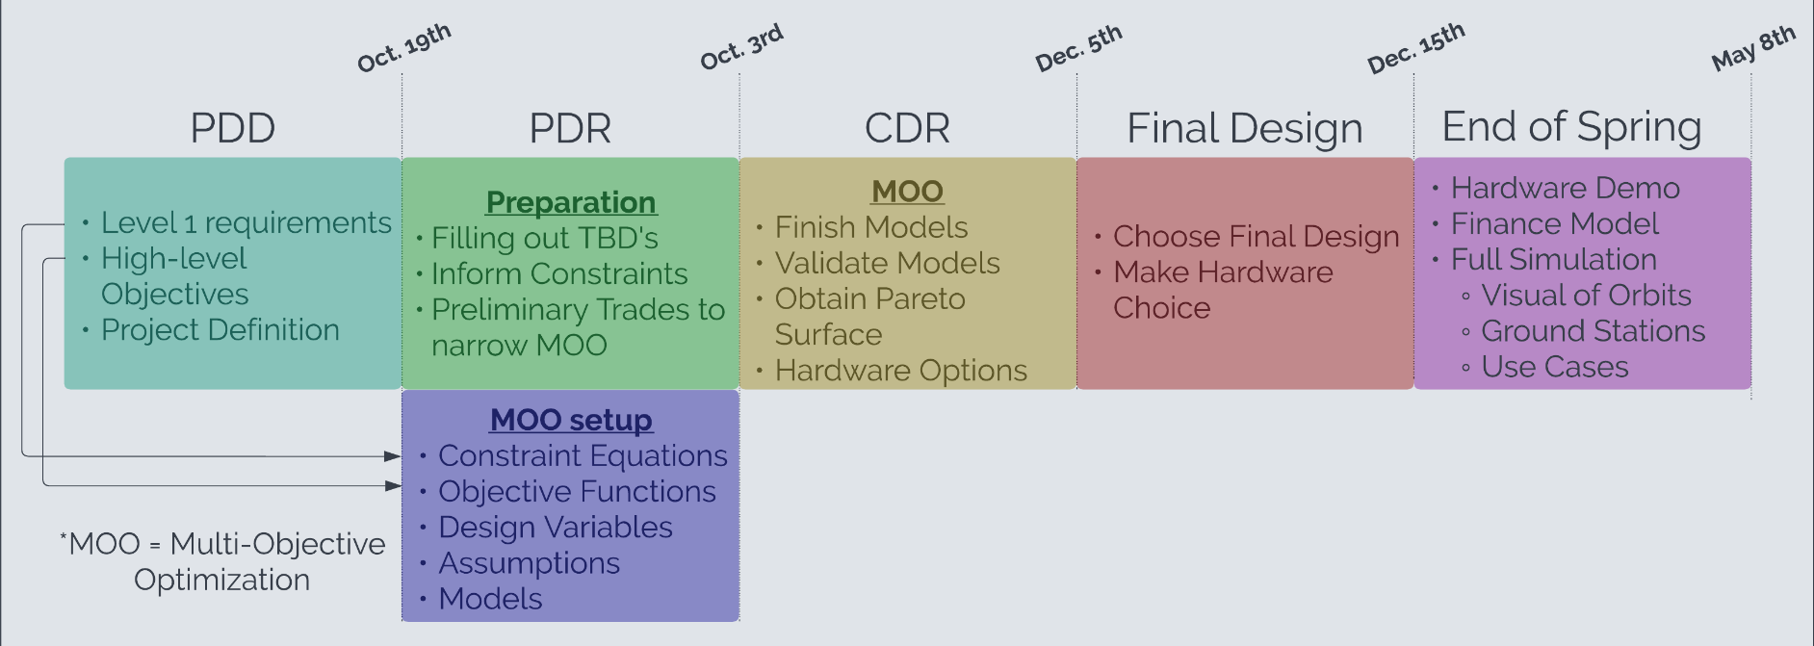
CRATER Timeline
PDR Requirement 1.1
Notes:
Henri

Slide 7
CONOPS
PDR Requirement 1.1
Notes:
Ashwin
Systems of Systems
Big Technical Systems: Communications, Power Delivery, constellation
Constellation: Lunar orbit
Communications: Enable contact between Earth and Satellites, Satellites and Satellites, Satellites and a ground receiver
Power: Solar Power harnessing, then Wireless power transmission from satellites to ground receiver

Slide 8
Performance Quantification
Power
Power team is defined by the capability of sending electric power to a ground station from a satellite
Objective: Maximizing power received by ground stations
Measured by how many kWh are received by the lunar ground station
PDR Requirement 1.2
Notes:
Cameron
The first of our performance quantifications is power. Our power team will work on our capability of wirelessly transmitting power from a satellite in our system to the lunar surface. We will work on maximizing the power received by ground stations, measured in kWh

Slide 9
Performance Quantification
Communications
Comms team is defined by its capability to create a network that can communicate with the lunar surface, the constellation and the Earth
Objective: Maximize transmission rate & maximize coverage
Measured in Mbps, km²
PDR Requirement 1.2
Notes:
Mark

Slide 10
Performance Quantification
Return on Investment (ROI)
The ROI team’s role is to ensure the economic potential of the project remains feasible
Objective: Maximizing profitability
Measured in USD earned per year
PDR Requirement 1.2
Notes:
Matt

Slide 11
Critical Project Elements and Power Requirements
Satellite integrity - Satellites must be able to withstand the cislunar environment through both material choice and radiator design.
Power transmission efficiency - Viability of remote powering since it is hardly used in real life.
Power usage of comms & survivability - Must allocate enough power to ensure comms can send a large amount of data while keeping some power to the radiator.
Power Constraints:
Collect ≥ 30% of solar flux
Collect ≥ 250 kWh/day
Store ≥ 500 kWh (both comms & transmission)
Deliver power to ≥ 2 customers simultaneously
Transmission to ground station location in Lunar Southern hemisphere
Receive ≥ 30% of power transmitted (laser transmission efficiency)
PDR Requirement 1.2 & 2.1
Notes:
Matt

Slide 12
ROI and Comms Requirements
Comms Constraints:
Signal-Noise-Ratio ≥ 10 dB
Carrier-Noise-Ratio ≥ 75 dB
Bit Error Rate ≤ 10⁻⁶
Uplink ≥ 3 Mbps; Downlink ≥ 20 Mbps; Crosslink ≥ 20 Mbps
ROI Constraints:
Weight per satellite & lunar ground station (total less than 3200 kg)
Cash break-even ≤ 3 years
Book break-even ≤ 10 years
PDR Requirement 2.1
Notes:
Mark & Matt
Source: ITU-R S.2099-0 https://www.itu.int/dms_pubrec/itu-r/rec/s/R-REC-S.2099-0-201612-I!!PDF-E.pdf
Lvl 1 & lvl 2 defined by PDD
Maybe just lvl 1 & lvl 2 where appropriate

Slide 13
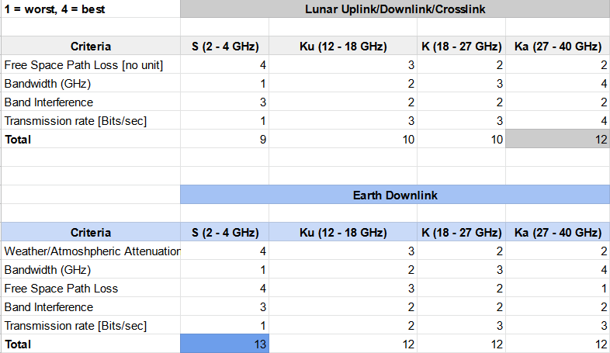
Communication Trades
PDR Requirement 1.3
Notes:
Mark

Slide 14
Multi Objective Optimization (MOO) as a Model
Goal: Optimize decision making involving more than one conflicting objectives.
Pareto optimal: Solutions that can no longer be improved in one objective without decreasing another. Non-Dominated designs.
Big picture, the purpose of MOO is to present to the team the feasible design choices that satisfy a set of constraints. These choices shall be pareto optimal since our objectives are conflicting. The team will then decide on one of the pareto optimal solutions to present a hardware demonstration of the most critical component.
MOO uses constraints, objective, design variables, and their specific equations to find the optimal solution
Trades used to determine design variables
Models used to determine equations
PDR Requirement 1.3 & 2.1
Notes:
Abe
High level overview of what MOO is, and what it’s supposed to accomplish
Slides on how we’re implementing it come later in the presentation

Slide 15
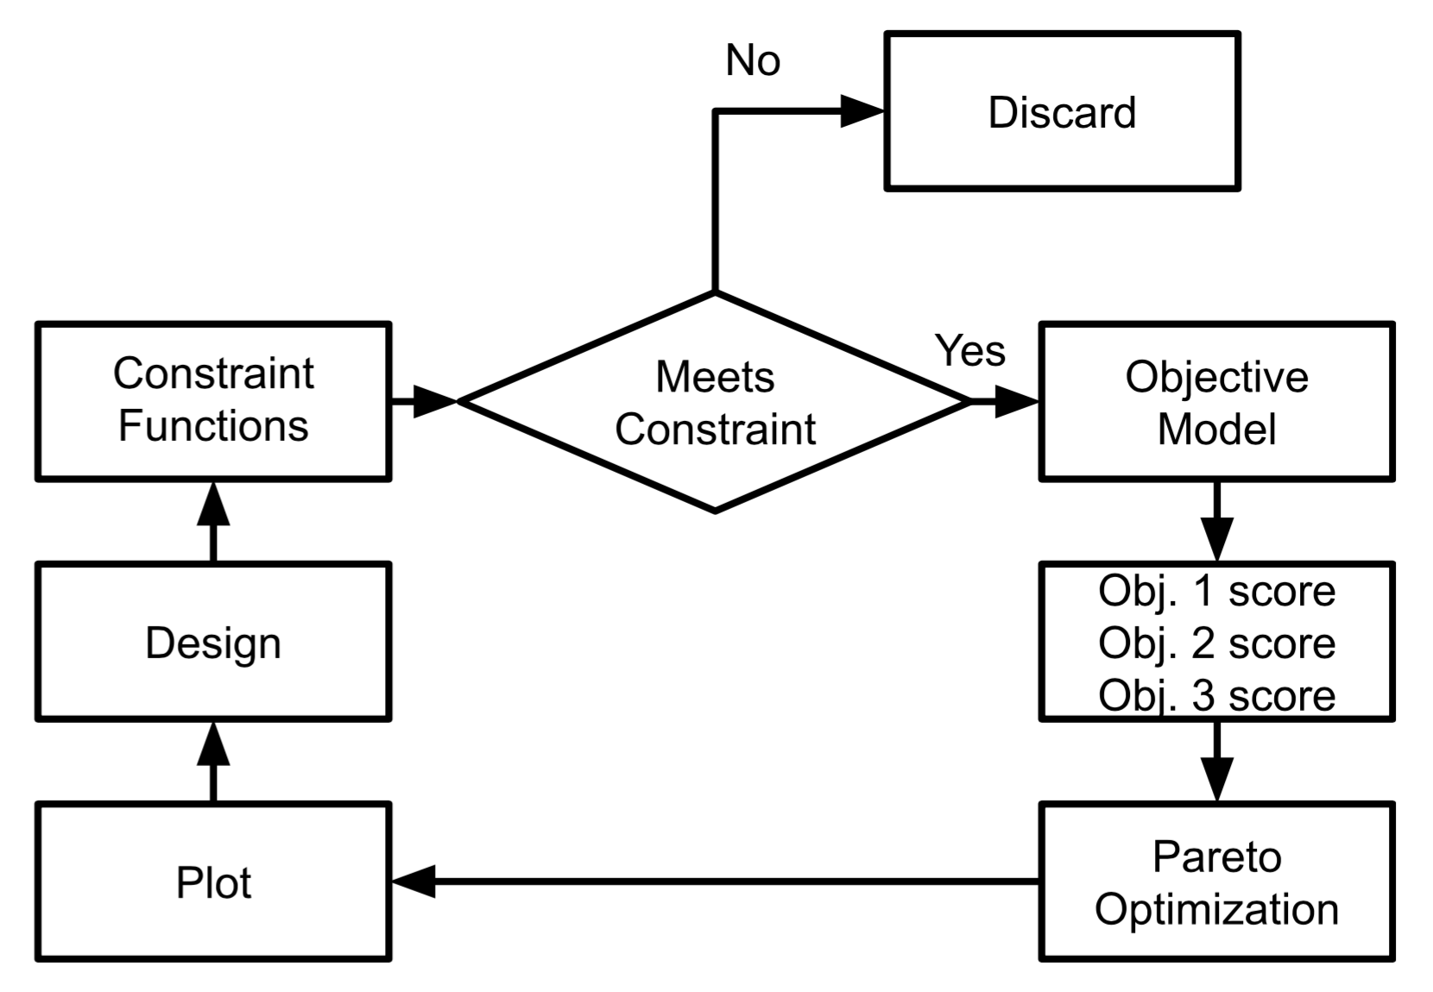
Functional
Block
Diagram
Start/End
PDR Requirement 1.1
Notes:
Abe

Slide 16
Power Models
Output | Inputs | Connection
Total Power Collected | -Power Required -Satellite Life -Power Use Profile | Power Required -> Energy Storage -> Battery Type -> Battery Capacity
Total Power Transmitted | -Laser Configuration & Power -Altitude -Receiver Size -Transmission Time | Setting up laser configuration to transmit most possible power to ground receiver
Total Power Received Pointing Angle and Speed | -Receiver type, size & Location -Orbit Parameters -Beam Condition at surface -Attitude tolerances -Transmission Time | Weighs orbit, transmitted power, receiver type, and attitude control choices against overall power received
Assumptions:
No atmospheric losses in cislunar space
Laser beam focused area at an average distance will be chosen to match the changing distance between satellite and ground location
Transmission Period:
Altitude, velocity, & beam Conditions are constant
Curvature of the moon is negligible
Receiver is a flat, stationary, circular surface
PDR Requirement 2.1, 2.2 & 2.3
Notes:
Cam
The first of our models we will talk about is our power models. We have a few different models to determine if all aspects of our power system are within our constraints. The first of these is our collection model. This model takes in the power profile and lifetime information of our satellite to determine the battery type and capacity needed to transmit power, as well as losses involved in power collection and storage. The next model models our power transmission system. This model takes in the design choices of our laser type and orbit to maximize power transmitted and determine power density on the surface. The third and final model utilizes the previous two to determine how all design choices made, in laser and orbit, affect our power objective of maximizing kWh received at the surface. This model also outputs the necessary pointing angle and pointing speed that the attitude control system on the satellite would need to perform to maintain an accurate transmission. The assumptions involved with these models involve no atmospheric losses, our average beam size matches the receiver size, and that during transmission period altitude velocity and beam conditions are constant, curvature of the moon is negligible, and our receiver is a nice flat circular surface.

Slide 17
Comms Models
Output | Inputs | Connection
Data Rates | -Type of Transmission -Orbit Parameters | Data transmitted-> limits total data
Total Data Transmitted | -Data Rate -Time to Transmit | Infrastructure trades-> Infrastructure type
Interference | - Original signal - Signal + simulated interference | Laser and comms subsystems-> limits compatibility
Power Required | -Antenna: gains, losses,SNR -noise temperature -data rate | Power budget -> limiting factor
Assumptions:
Earth receiver is a black box
Or in orbit to avoid looking at atmospheric interference
No atmospheric losses in cislunar space
Isotropic antenna for initial model (PDR)
Comms ideal power transmission power efficiency model (PDR)
Comms can work at any point on the Moon’s surface within view
Area shape is a circle
PDR Requirement 2.1, 2.2 & 2.3
Notes:
Mark
DISCUSS ANTENNA SIZING → MASS AND POWER DRAW
We have identified four key communication models in order to determine our mission architecture: data rates, total data transmitted, system interference, and powered required
Data rates and total data transmitted are tied together, and are also determined by orbital parameters. As such, their models mainly rely on the satellite constellation design
Our interference model … It limits the compatibility of the laser and communication subsystems
The power required is based on the total power transmitted and the antenna design, as well as the data rate. It is currently a limiting factor on the power budget which will affect the wireless power system.
These are our key assumptions. We are also using prior research such as SMAD to determine key values in our models.

Slide 18
ROI Models
Output | Inputs | Connection
Revenue | - Price ($) per kWh - Price ($) for comms access - Number of customers | How much power will be purchased and how much the comms system will be used
Launch Cost | - Weight per satellite - Number of satellites | Weight of our payload will affect launch system and therefore costs
Other Costs | - Satellite price | Main cost aside from launch costs
Assumptions:
Satellite lifespan of 10 years (15 years on average Brown University study on satellite lifespan)
take on 1/10 of launch cost every year
No maintenance costs
PDR Requirement 2.1, 2.2 & 2.3
Notes:
Matt
We have identified four key communication models in order to determine our mission architecture: data rates, total data transmitted, system interference, and powered required
Data rates and total data transmitted are tied together, and are also determined by orbital parameters. As such, their models mainly rely on the satellite constellation design
Our interference model … It limits the compatibility of the laser and communication subsystems
The power required is based on the total power transmitted and the antenna design, as well as the data rate. It is currently a limiting factor on the power budget which will affect the wireless power system.
These are our key assumptions. We are also using prior research such as SMAD to determine key values in our models.

Slide 19
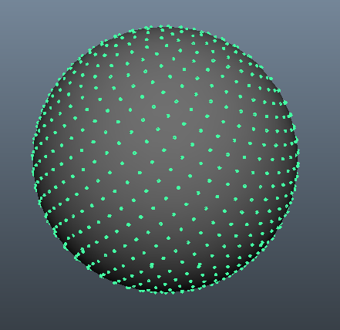
Point Coverage Simulation
Create a grid of points on the surface of the Moon, fly one or more spacecraft over the grid and track the observations by each grid point.
Verified with ground track analysis.
Constellation Design Assumptions:
Circular orbit
No oblateness
Uniform constellation spacing
Satellites are placed into orbit and do not require orbital maintenance.
Earth geometry equations valid for Moon
ACR=AAR
Both power & comms infrastructure on the same satellite
(SMAD)
PDR Requirement 2.1, 2.2 & 2.3
Notes:
Abe

Slide 20
Risk Matrix
 | Low Probability | Medium Probability | High Probability
Low Impact |  | Satellite Self-Shadowing
Medium Impact | Thermal Dissipation | Data Loss | Laser Accuracy
High Impact |  | MOO Overconstrained
PDR Requirement 2.2
Notes:
Henri
Survivability, med impact since it would lower it to 90% efficiency for example
Satellite Shadowing -> When the satellite’s own infrastructure gets in the way of the solar panels
Theres a high probability that the laser/antennas/heat radiator get in the way, but we expect this to be minimal
https://ntrs.nasa.gov/api/citations/20050169151/downloads/20050169151.pdf

Slide 21
Pre-MOO Trades: Laser over Microwave
Cheaper, production costs are higher for microwave
1 to 10 MW per satellite
Main concern of laser blinding people is not a concern as there will be no people in this area
Still concern about the lasers being classified as a weapon
No direct mention in Outer Space Treaty 1967 about lasers (see policy)
Allows for a small ground based receiver
Microwave interferes with radio astronomy
PDR Requirement 1.3, 2.2, & 2.3
Notes:
Matt

Slide 22
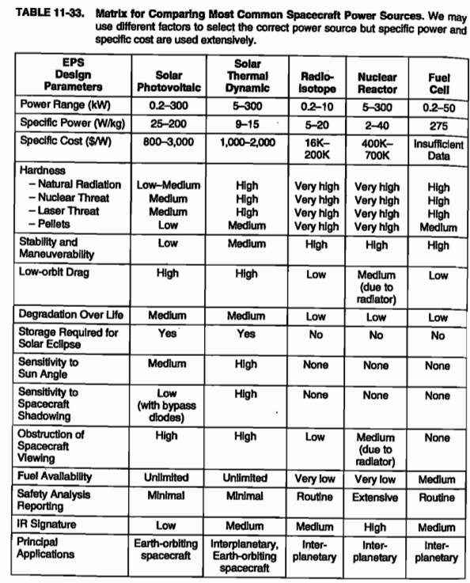
Pre-MOO Trades: Power Source Selection
Poor options
Radio-isotope and Nuclear Reactor
Low Specific Power (W/kg)
Very Low Fuel Availability
Need Routine/Extensive Safety Analysis Reporting
Fuel Cell
Medium Fuel Availability
Solar Thermal Dynamic
Lack of Modeling
Low Spec. Power
Not Applicable
Not Applicable/Orbit Design
Process of elimination produces:
Solar Photovoltaic
SMAD III : Space mission analysis and design, 3rd edition : workbook. Authors: Wiley J. Larson, James Richard Wertz, Brian D'Souza.
PDR Requirement 3.1
Notes:
Henri
Safety Analysis Reporting
Launch accident scenarios and accident environments that can affect potential release and dispersal of radioactive materials include blast waves, impact of the RPS onto hard surfaces, impact of debris onto the RPS, rocket propellant fires, high-speed reentry from sub-orbit or orbit, lofting of radioactive aerosols, atmospheric dispersal and settling of those aerosols, inhalation and ingestion of released material, and subsequent health effects and land contamination.

Slide 23
Pre-MOO Trades: Modulation
Data Losses vs Data Speed
Need BER <`10e-6 (ITU recommendation S.2099-0)
Limited to Modulation with low bits/signal
BPSK (binary phase-shift keying), QPSK (Quad phase-shift keying), NRZ (non-return to zero) meet requirements and have heritage
Heritage data from SMAD pg 564
PDR Requirement 3.1
Notes:
Mark

Slide 24
Pre-MOO Trades: Coverage Figures of Merit
Rank: 1-5; 1 = best, 5 = worst, (SMAD)
Criteria | Percent Coverage | Maximum Coverage Gap | Mean Coverage Gap | Time Average Gap | Mean Response Time
Pros | Shows directly how much of time a point or region on the ground is covered. | Conveys worst-case information. | Accounts for coverage and gap statistics. | Accounts for coverage and gap statistics. | Accounts for coverage and gap statistics.
Cons | No information about the distribution of gaps. | Can incorrectly rank constellations. | Misleading, can incorrectly rank constellations. | Random sampling can decrease accuracy. | Information loss due to averaging.
Rank | 3 | 4 | 5 | 2 | 1
PDR Requirement 3.1 & 3.2
Notes:
Ashwin
Perce

Slide 25
MOO
Each combination of design variables constitutes a design.
Design Variables are inputs to MOO.
Grid Search: evaluation of each unique design
Design Variables:
# of satellites
Altitude
Inclination
Satellite longitude/latitude
# of orbit planes
Satellite phasing
Antenna type
Antenna radius
Antenna length
Laser power
Solar panel area
PDR Requirement 3.1, 3.2, & 4.1
Notes:
Ashwin
First step of MOO are the design variables
Design variables constitute a design
Each design has a unique combination of these variables

Slide 26
Constraint Model
Maximum or minimum amount that has to be met.
Inequalities that are functions of the design variables.
Will identify feasible solutions.
C1 >= f(X,Y,Z)
C2 <= f(X,Y,Z)
Constraints will be level 1 objectives (minimum to be successful)
If a design solution does not satisfy the constraint, the solution is discarded
Example: The system should store at least 2.5 kWh
PDR Requirement 3.1, 3.2, & 4.1
Notes:
Ashwin

Slide 27
Objective Model
Maximize 3 individual different objectives
Power Objective
Comms Objective
ROI Objective
Objective function are scores, each design will have its own score for the three objectives. A greater score means the design does better at that objective.
Power Objective
Quantified by kWh received by the receiver
Each design variable can be related to total amount of kWh received.
Comms Objective
Quantified by the FOM and by the bits/sec.
Each design variable can be linked to a transmission rate in bits/sec and a coverage score in FOM.
Since we have two objectives, the total score will be equal to the average of these two objectives.
ROI Objective
Quantified in ratio of usd amounts.
Each design variable can be linked to a cost function and a revenue function.
PDR Requirement 3.1, 3.2, & 4.1
Notes:
Ashwin

Slide 28
MOO: Pareto Optimization
Non-Dominated designs will be pareto optimal.
Algorithm to identify non-dominated designs.
Triple if-statement comparing objective scores for different designs
Obj₂ (maximize)
Non-dominated/Pareto Optimal
Obj₁ (maximize)
PDR Requirement 3.1, 3.2, & 4.1
Notes:
Abe
Once we have designs with their corresponding scores, we find pareto optimal designs by performing a non-dominated algorithm
Basically we compare each feasible design against all the others while keeping track if its dominated or not.
If a design solution is dominated by any other solution, it is not pareto

Slide 29
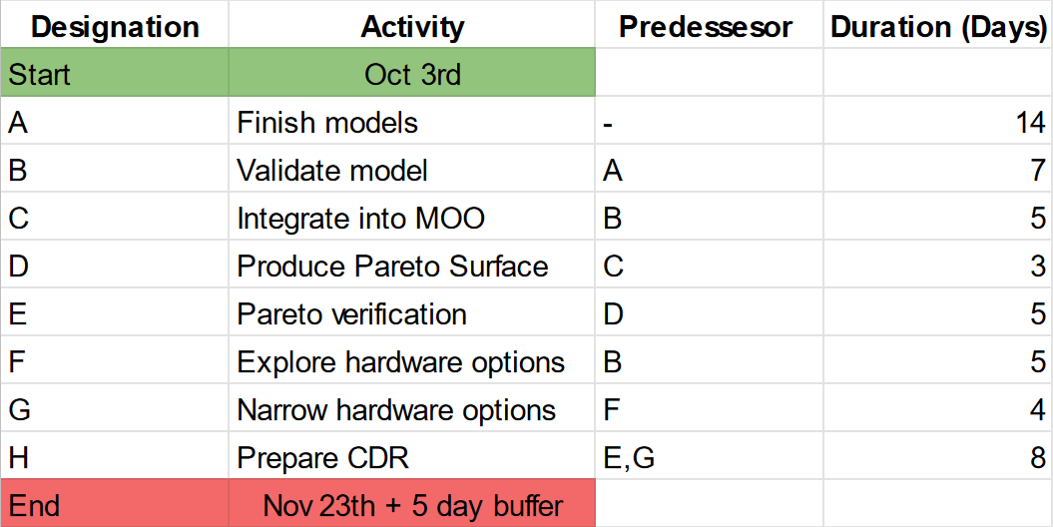
Future Work
More research into receiver type & design
Ground station design
Implementation of MOO
Goal | Time to Complete
Finish and Validate Models | End of October
Complete MOO | Start of November
Produce Pareto Surface | Start of November
Narrow Hardware Demonstration | Mid November
Finish CDR | Fall Break
PDR Requirement 3.2 & 4.1
Notes:
Henri

Slide 30
Expected Outcomes
To have MOO completed for CDR
Have expected values
Solidify ROI model
Hardware Demo:
Testing highest risk elements
Power receiving system
Power transmission
Neither have heritage
PDR Requirement 3.2 & 4.1
Notes:
Henri
Summary of work by CDR and critical path / schedule. Convince Holz that we can do this.

Slide 31
Policy
Article III of the Outer Space Treaty, Space Weapons and the Law by the US Naval War College speaks of the potential of lasers as weapons in outer Space
Guidelines for the Long-term Sustainability of Outer Space Activities of the Committee on the Peaceful uses of Space worried about accidental illumination of passing objects in near-Earth space
Shielded zone on the Moon, to not interfere with radio astronomy work. (World Administrative Radio Conference for Space Telecommunications)
NASA SELENE mission (Space Laser Energy)
PDR Requirement 2.1
Notes:
Matt
PULS Peaceful Use of Lasers in Space
https://www.itu.int/hub/2022/05/moon-based-radio-astronomy-spectrum/
https://www.unoosa.org/documents/pdf/PromotingSpaceSustainability/Publication_Final_English_June2021.pdf
https://digital-commons.usnwc.edu/cgi/viewcontent.cgi?article=1703&context=ils
Professor Jack Burns

Slide 32
Open Questions & Problems
Summary of technical open questions:
Attitude Control
Pointing and Mapping Budget
Pointing and Mapping Error
Problems:
Hard to make progress on Antenna design
Reliant on MOO output
Concerns:
Large scope, lot of different moving pieces to integrate together
Notes:
Henri
Summary of technical open questions / problems / concerns you have as of PDR

Slide 33
Thanks!

Slide 34
Backup Slides Outline
35 Definitions
36 System Block Diagram
37-41 Comms Trades
42-43 Power Accuracy Model
43-44 Data Transmitted/Received
46-50 Constellation simulation techniques
Ground track analysis
51 Planned missions until 2030
52 Precedence Chart and Critical Path
53-56 slides of MOO
Notes:
Ashwin

Slide 35
Appendix - Definitions
The system – Refers to the entire satellite constellation developed by CRATER working with ground receiver units sold by CRATER.
The constellation – Refers to the entire satellite constellation developed by CRATER.
MOO - Multi Object Optimization
Trade - Analysing options of type of variable to maximize efficiency
Model - Quantification of capabilities of system
Constraint - Limiting factor of the system
Notes:
Ashwin

Slide 36
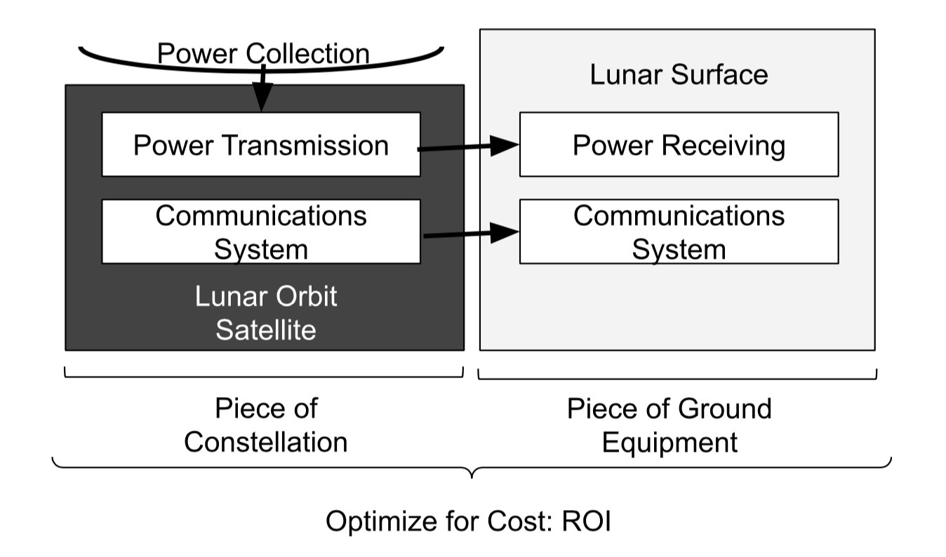
System
Block
Diagram
Notes:
Ashwin

Slide 37
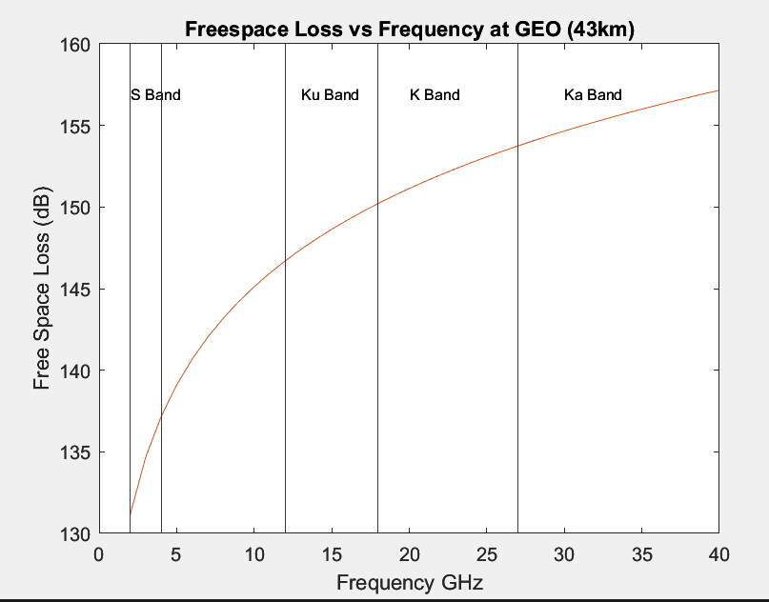
Communications Trade - Free Space Loss
Notes:
Mark

Slide 38
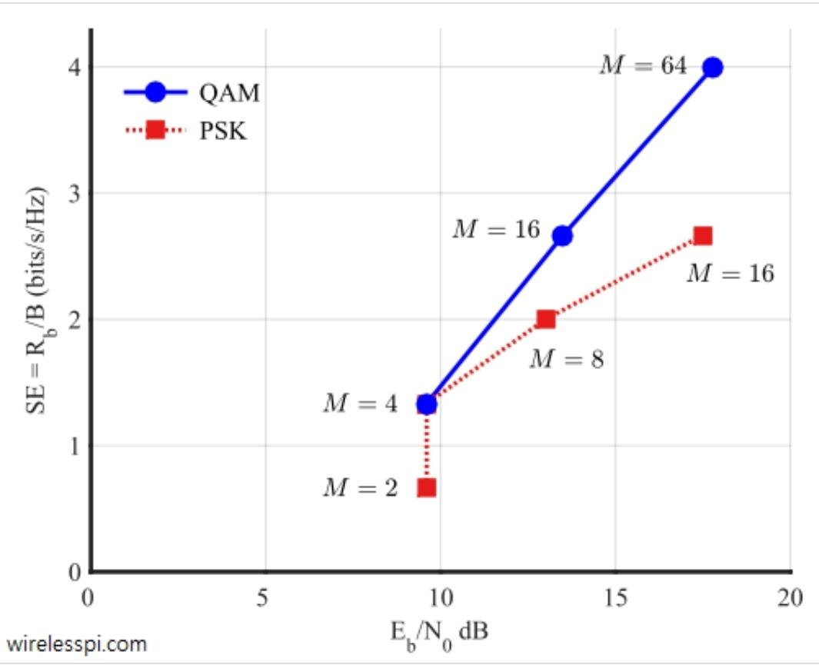
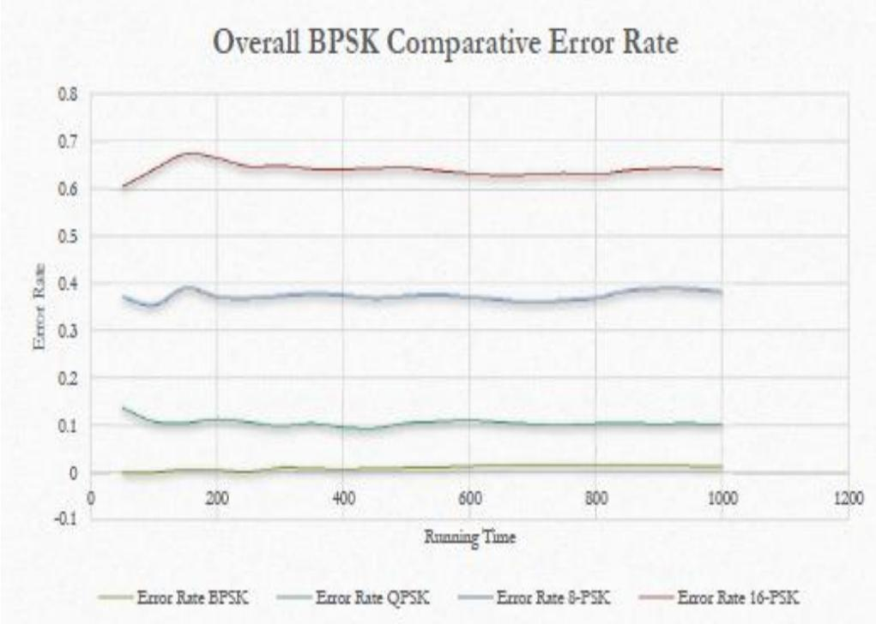
Communications Trade (Modulation methods)
Figure 1: Spectral efficiency vs SNR
for different modulation
methods
Figure 2: Error rate as a function of time
for PSK modulation
Fig 1, Chaudhari, Q., “Computing error rates ,” Wireless Pi Available: https://wirelesspi.com/computing-error-rates/
Fig 2, “Computer-based comparative analysis of BPSK versus other PSK modulation ”Available: https://www.researchgate.net/publication/283617835_Computer-Based_Comparative_Analysis_of_BPSK_versus_other_PSK_Modulation_Models.
Notes:
Mark

Slide 39
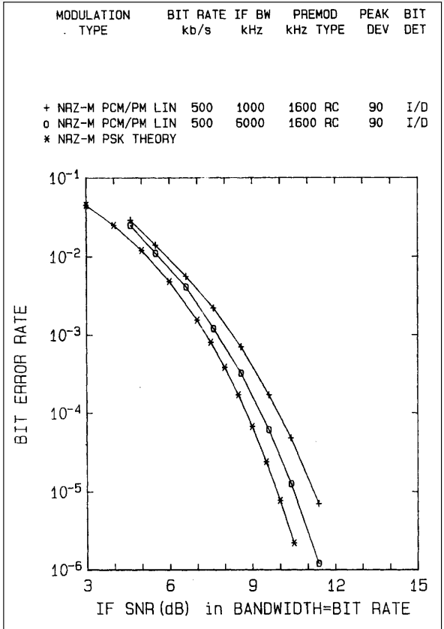
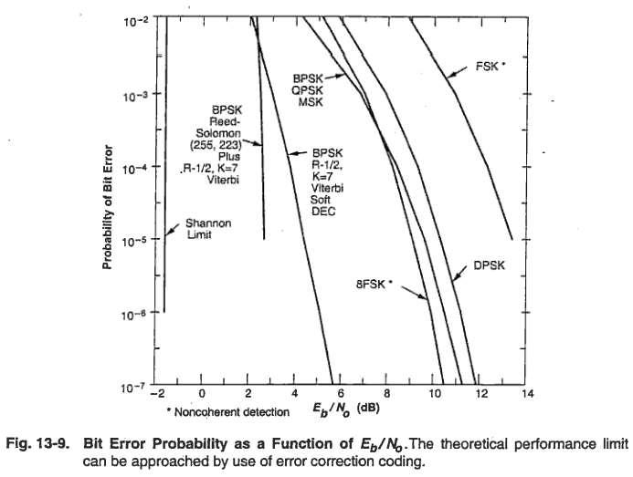
Modulation Trade
Minimize Eb/No at 10e-6 BER
Telemetry Applications Handbook DOCUMENT 119-06 Pg. 47
Space Mission Analysis and Design Pg. 561
Notes:
Mark

Slide 40
Modulation Trade - Data Transmission Model
R_{max} = Blog₂(1+C/N)
Where C/N = E_{b}/N_{O}*(f_{b}/B_{w})
Variables
R_{max} = max data rate by Shannon Hartley Theorem
B = Bandwidth
C/N = carrier to noise ratio
E_{b}/N_{o} = Energy per Bit to Spectral Noise Density
(how much noise is in the city)
f_{b} = bit rate
B_{w} = receiver noise bandwidth
Assumptions
B_{W} = 3db Bandwidth
f_{b} limited by transmission power
Sources
SMAD
U Montana EE447 Course SLides
Notes:
Mark

Slide 41
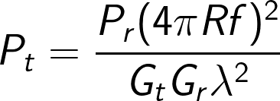
Modeling Communications Power
Key Variables:
P_{r} = Power Received (W)
P_{T} = Power Transmitted (W)
C/N_{o} = Carrier to Noise Ratio
k = Boltzmann's constant
T = Antenna Temperature
EIRP = Effective Isotropic Radiated Power
G_{R} = Receiver Gain
G_{T} = Transmitter Gain
Assumptions:
Non freespace losses are negligible
Notes:
Mark

Slide 42
Power Accuracy Model
Transmission Period Assumptions:
Altitude, velocity, & beam Conditions are constant
Altitude negligible relative to the curvature of the moon
Receiver is a flat, stationary, circular surface
Necessary Model Inputs:
Receiver Radius & Absorptivity
Receiver Ground Location
Orbit Altitude
Orbit Ground Track
Beam Radius & Flux Dispersion
Maximum Allowable Attitude Errors
Transmission Time
Model Outputs:
Pointing Angle
Pointing Angle Speed
Receiver Field of View
Total Power Received
Efficiency of Power Transmission
PDR Requirement 2.1 & 4.1
Notes:
Cam
What models are required to take a given architecture choice, show it meets your requirements, and quantify it's performance vis-a-vis your objectives? What assumptions are necessary for these models? What are the inputs / outputs of the models? How do they connect or relate to one another, architecture choices, and performance objectives?
To ensure our system hits our power objectives, the power transmission process needs to be modeled. The assumptions for this model allow for a simplified approach that can verify success of our objectives. With these inputs, we can determine the relationship between orbit choice, receiver size/material, and laser design, as well as show how combinations of these design choices affect our core performance objectives of maximizing power received and minimizing power lost during transmission.

Slide 43
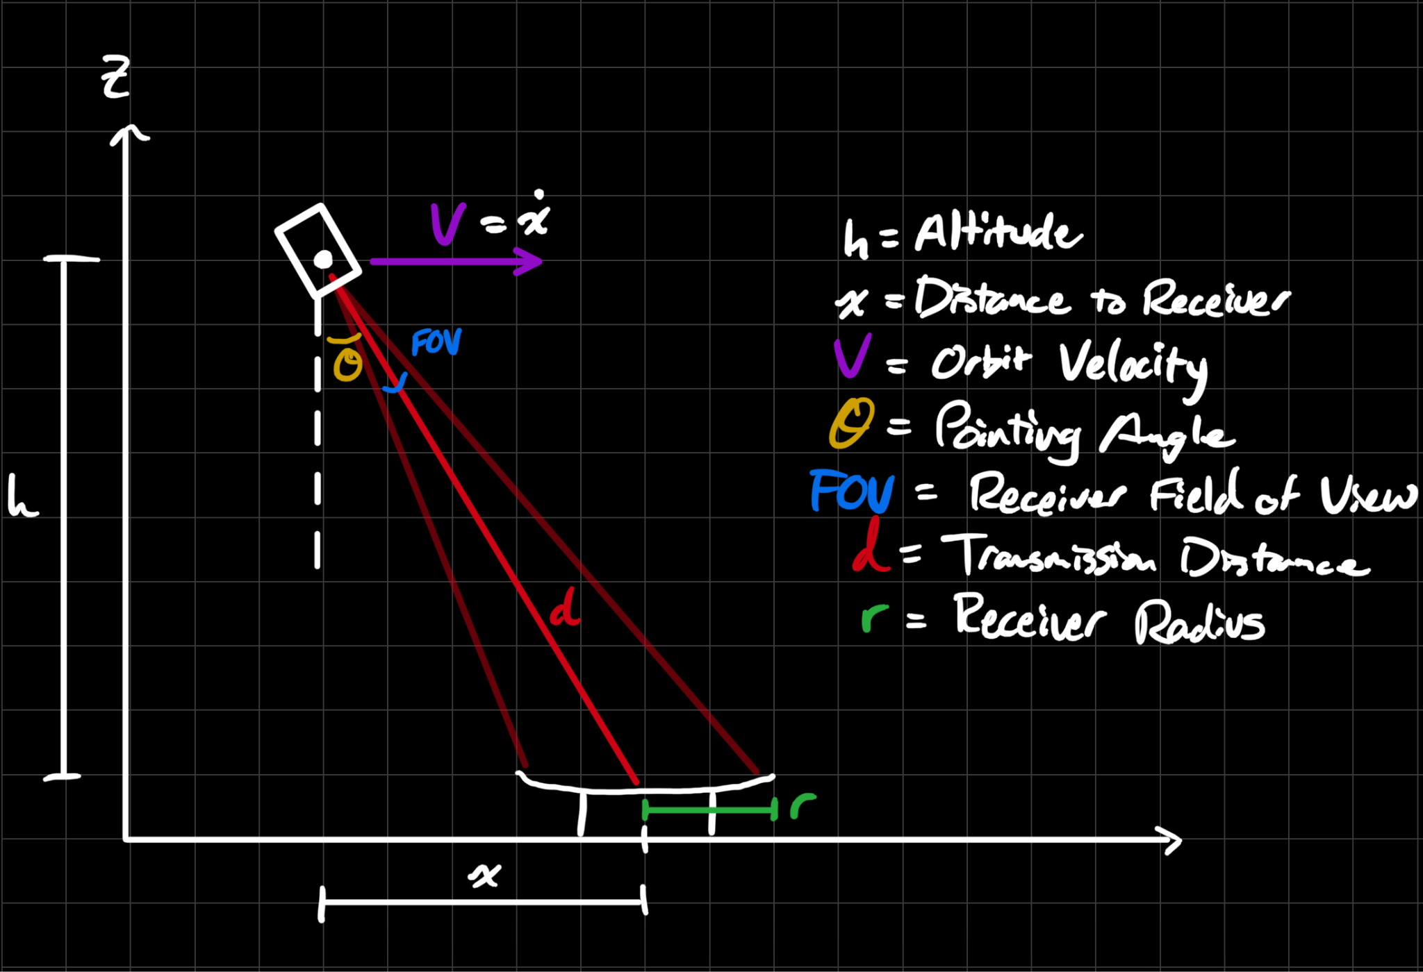
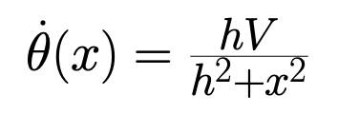
Power Accuracy Model

Slide 44
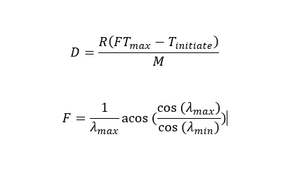
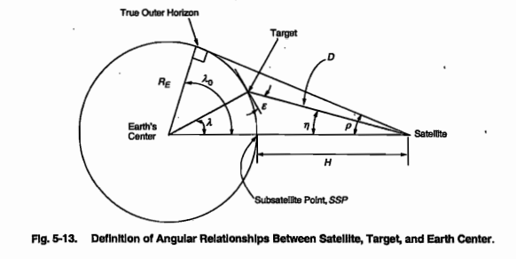
Modeling the Total Data Transmitted/Received
λ_{max} and λ_{min} are functions of the orbit
Key Design Variables:
D: Data Transmitted [bits]
R: Data Rate [bps]
F: Fractional Reduction in Viewing Time
T_{max}: Maximum time in view [s]
λ_{max}: Maximum central angle [rad]
λ_{min}: Minimum central angle [rad]
Example of angles used for calculation (SMAD)
Notes:
This is our model for the total data transmitted for a single ground station pass. T_{initiate} and M are both experimentally determined values. For now, we are using values given in Space mission analysis and design, where the time to initiate transmission is two minutes and the margin for missed passes is 2-3
T_{max} F are based on the orbit of the satellite. T_{max} will be determined by our constellation satellite speed, F is due to orbit geometry
Lambda max and Lambda min are due to the orbital geometry of the satellite. There are a few different models to find lambda max and min, which is largely dependent on the constellation design.

Slide 45
Interference Model
Cross-Correlation Function (relation to other wave)
Key Design Variables:
C_{fg}(τ): Correlation metric
f(t): Waveform 1
g(t): Waveform 2
T: Time
Noise transmission
Key Design Variables:
y(t): Output signal
x(t): Input signal
h(t): Impulse response (using sample noise)
Auto-Correlation Function (relation to itself)
Key Design Variables:
R_{f}(τ): Correlation metric
f(t): Waveform 1
f*(t): Complex conjugate of f(t)
T: Time
Noise in Communication Systems –Principles - Kit. https://www.ihe.kit.edu/img/studium/4Noise_Principles.pdf
Notes:
The correlation function identifies if noise is present and the transmission equation describes how the signal is affected by an impulse (short burst cuz of laser) noise signal.

Slide 46
Constellation Simulation Techniques
Notes:
Abe

Slide 47
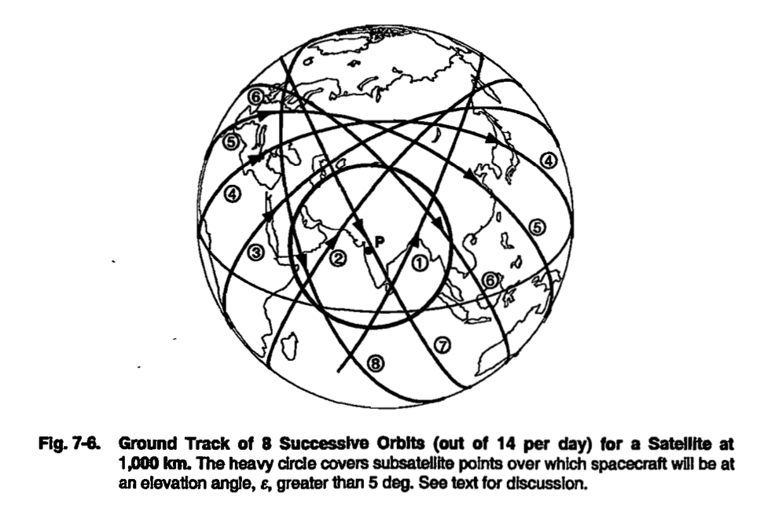
Ground Track analysis
Ground track plot of mission geometry
Rapidly assess performance
Longitudinal spacing
ΔL = (P / 1436 min)* 360 deg, [deg]
P = period
Will verify point coverage simulation
Notes:
Abe

Slide 48
Point Coverage Simulation
Create a grid of points on the surface of the Moon, fly one or more spacecraft over the grid and track the observations by each grid point.
Statistical coverage results as a function of latitude
3 pitfalls
Grid points must cover equal areas over the surface of the Moon
Use grid points at constant latitude spacing, number of points at each latitude proportional to the cosine of that latitude.
Adjust for gaps where the simulation begins and ends.
Run the simulation long enough to minimize impact
Statistical analysis of non statistical data can lead to incorrect conclusions
Ex. no context to coverage %
Ground track analysis to verify
Notes:
Abe

Slide 49
Moon Geometry Seen From Space
Determine SSP longitude and latitude: (L_{S}, δ_{S})
Determine T longitude and latitude: (L_{T}, δ_{T})
From (L_{S}, δ_{S}) and (L_{T}, δ_{T}) we can solve for:
Angular Radius: ⍴ [deg]
Nadir Angle: η [deg]
Earth Central Angle: λ [deg]
Spacecraft elevation angle: ε [deg]
Distance to Target: D
Azimuth: Az [deg]
Notes:
Abe

Slide 50
Constellation Analytical Methods
Key Variables:
H = Spacecraft Altitude [km]
R_{moon} = Radius of Moon [km]
θ = Beam Angle [rad]
ε = Spacecraft Elevation Angle [rad]
η = Nadir Angle [rad]
D = Distance to Horizon
P = Orbit Period
λ_{max}: Maximum Earth Central Angle [rad]
λ: Earth Central Angle [rad]
T = Time Over Target
L_{f} = Footprint Length
W_{f} = Footprint Width
F_{A} = Footprint Area
ACR = Average Coverage Rate
Assumptions
Neglect rotation of Moon
Neglect Oblateness of Moon
Notes:
Ashwin

Slide 51
Lunar Spectrum Management: Enabling and Protecting Lunar Science & Exploration, Cathy Sham, Spectrum Policy and Planning Division
7-9 June 2022
Notes:
Henri

Slide 52
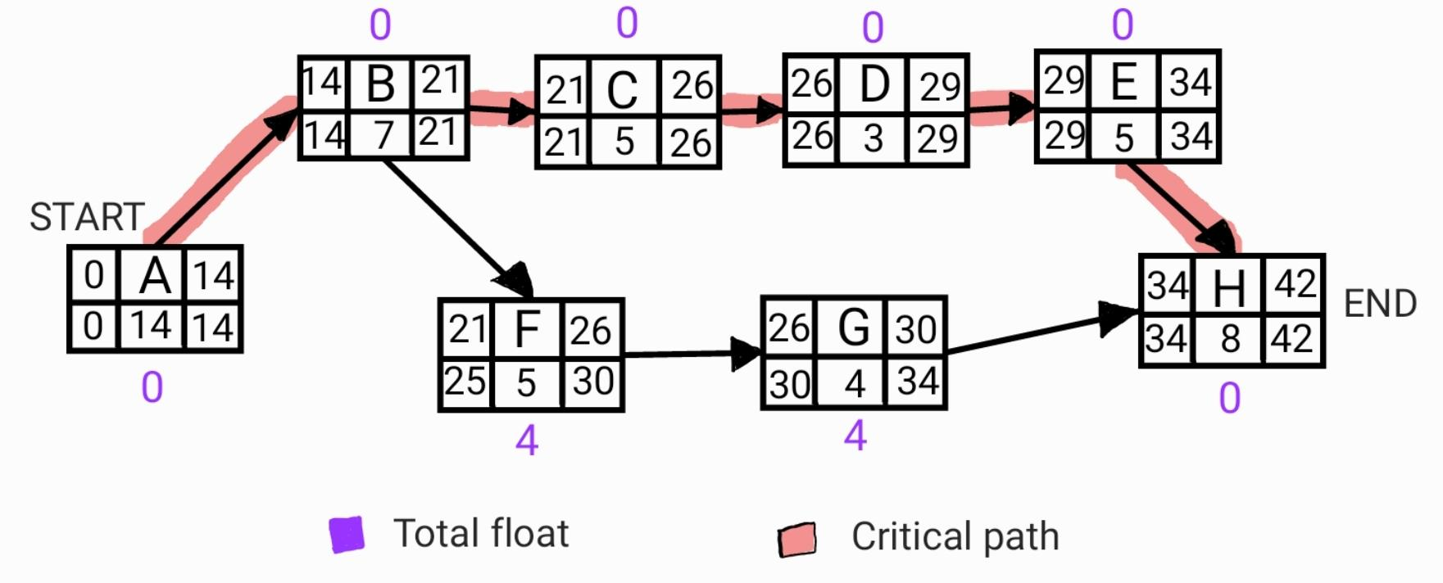
Precedence Diagram & Critical Path
Notes:
Henri
Total float aka slack = how many days the activity can be moved without affecting the end date
Critical path = Activity path where a delay will delay the whole project
Top left = Early start day; Top right = Early finish day
Bottom left = Late start day; Bottom right = Late finish day

Slide 53
MOO
Notes:
Abe & Ashwin
Total float aka slack = how many days the activity can be moved without affecting the end date
Critical path = Activity path where a delay will delay the whole project
Top left = Early start day; Top right = Early finish day
Bottom left = Late start day; Bottom right = Late finish day

Slide 54
Multi Objective Optimization (MOO)
Goal: Optimize decision making involving more than one conflicting objectives.
Pareto optimal: Solutions that can no longer be improved in one objective without decreasing another.
Big picture, the purpose of MOO is to present to the team the feasible design choices that satisfy a set of constraints. These choices shall be pareto optimal since our objectives are conflicting. The team will then decide on one of the pareto optimal solutions to present a hardware demonstration of the most critical component.
Notes:
Abe & Ashwin

Slide 55
MOO breakdown
Design Variables
Actual design components
Components of the same variable will compete to maximize/minimize an objective
Constraints
Maximum or minimum viable quantities
Define the Design Space and feasibility
Inequalities
Objectives
Functions we want to maximize/minimize
Defines the Criterion Space
Notes:
Abe & Ashwin

Slide 56
Design Variables - Detailed description
Actual Design Components
X = [X1, X2, X3, …, Xn]
Y = [Y1, Y2, Y3, …, Yn]
Z = [Z1, Z2, Z3, ..., Zn]
X, Y, Z are design variable categories
X1, X2, X3 are different design choices for each category
Example: X category is transmission type
X1 = Laser Power Beaming
X2 = Microwave Power Transmission
Notes:
Abe & Ashwin

