Slide 1
GAINS
General Atomics Inertial Navigation System
Presenters:
Ben McHugh, Alex Pichler, Derek Popich, Jason Popich, Brian Trybus, Addison Woodard
Team Members:
Cannon Palmer, Kaylie Rick, Ross White, Tucker Peyok, Alfredo Restrepo, Bennett Grow
Sponsor:
General Atomics (GA)
Faculty Advisor:
Dr. Dale Lawrence
Preliminary Design Review
October 3, 2022

Slide 2
Agenda
Project Overview - Addison Woodard, Alex Pichler, and Ben McHugh
Trades - Jason Popich
Gyroscope
Accelerometer
Flash Memory
Current Design Space - Derek Popich
Modeling and Testing - Brian Trybus
Notes:
Addi

Slide 3
Project GAINS Overview

Slide 4
Mission Statement
Project GAINS aims to develop an Inertial Navigation System (INS) prototype for installation on cube-satellites in cislunar applications. The GAINS prototype will be developed to maximize accuracy of estimated position and velocity with the aid of external error corrections.
Overview
Notes:
Addi
Say what INS is: Sensor suite with computations
Cislunar = orbit trajectory between the Earth and Moon

Slide 5
Full Mission CONOPS

Slide 6
Mission Objectives
1
Provide accurate inertial position and velocity to a CubeSat in a cislunar orbit with an INS, outside of GPS range
2
Modularity, such that the system can be installed in a variety of standardized General Atomics cubesats
3
Ground segment to receive INS data and display trajectory in a Graphical User Interface (GUI)
Overview
Notes:
Addi
TBD
Modularity such that the size and power provide a standardize

Slide 7
GAINS Project CONOPS
Attitude Drift Corrections
Star Tracker
Parent Cubesat
Downlink computed AD data package
Satellite polling @ 100Hz
(Position and velocity calculations)
GAINS
Replicated for testing
Measurement
Positional Drift Corrections
GS Contact Maintained
Computed AD solution and data
Computation
GS Contact Achieved (send all storage)
Storage
Positional Drift Corrections
Ground Station
Overview
Notes:
Addi (-> Alex)
“Going to zero in on our portion and what components we need to be successful in making those on the next slides"

Slide 8
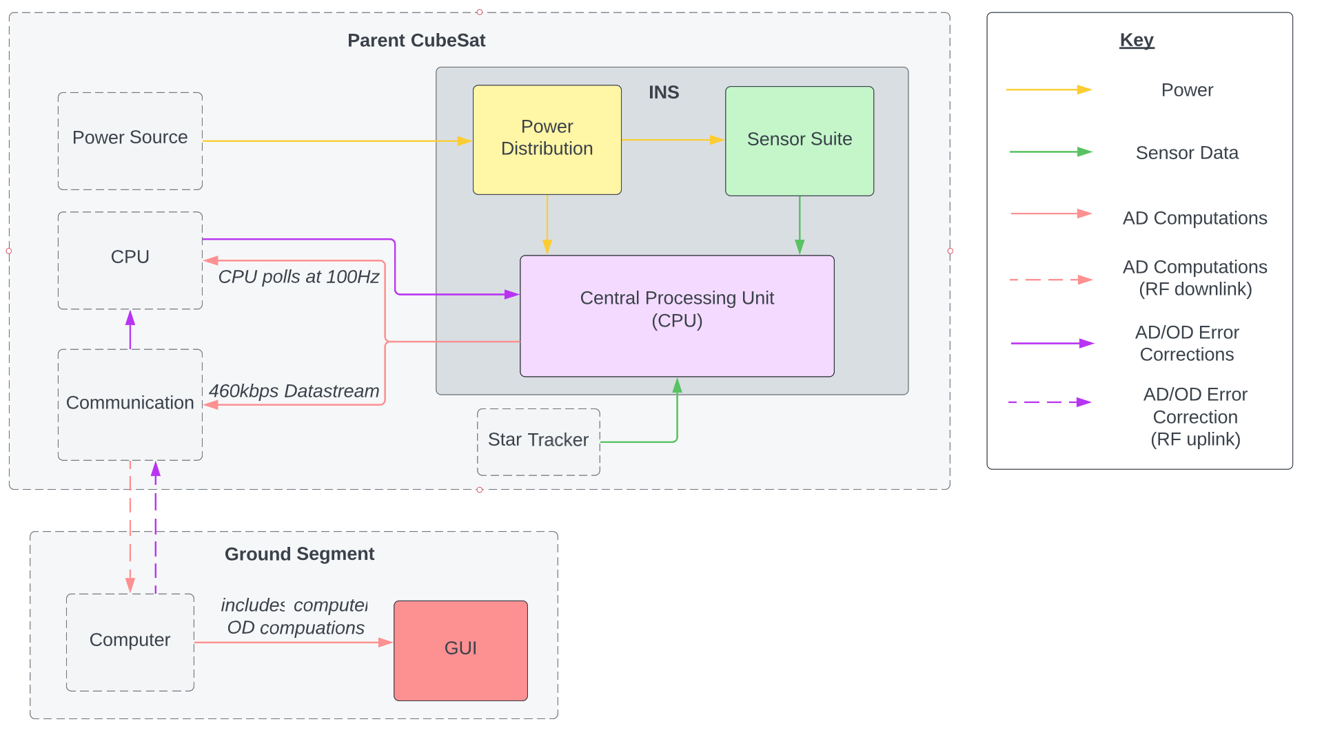
Functional Block Diagram
Overview
Notes:
Alex (-> Ben)
(Describe which part we are developing, which not.
Go over key to explain the different interdependencies
Go from sensors to CPU to CubeSat to Ground
CubeSat CPU polls the INS CPU at 100Hz for AD Computations
Looking at our FDB we can see that it is necessary for our project to have interdependencies with systems that are outside of our project scope. These are represented by the translucent, grey boxes. The solid colour boxes represent the system blocks that are in the scope of our project.
Diving into the specific connections, we can see that: blah blah blah

Slide 9
Critical Project Elements
Critical Element | Constraint Rationale
E1: Accuracy | The GAINS system should have a peak position error of no more than 1 km and peak velocity error of no more than 0.1 m/s.
E2: Calculation | The GAINS system will have to calculate its inertial position and velocity in real time using measurements from its integrated sensors.
E3: Communication | The GAINS system must have uplink and downlink capabilities with the ground station, as well as data transmission to the parent satellite.
E4: Display | The GAINS ground station must include a Graphical User Interface with a real time status, trajectory, and power on/off switches.
E5: Integration | The GAINS system must be compatible with a variety of GA’s satellite bus structures.
E6: Testing | The GAINS system shall be tested to ensure project elements fulfill customer mission objectives.
Overview
Notes:
Ben
Here are the six critical elements that will be essential for our project to complete the mission objectives outlined by our customer
One element I wanted to draw your attention to is the Calculation element, E2
Since the navigational system will be taking measurements in the body frame, the system will need to be capable of translating those movements into the Earth Centered Inertial Frame
To do this, we will not only require translational measurements, but also rotational measurements to determine the attitude of the spacecraft relative to the inertial frame

Slide 10
Limiting Requirements
Design | The GAINS system must provide an inertial navigation system
Accuracy | Position shall be determined within 1km of true position, Velocity shall be determined within 0.1 m/s
Weight | INS shall not exceed 500 g
INS Power | INS shall not exceed a 1 watt power budget
Storage | The GAINS system shall store a maximum of 2 hours of calculated data between ground station contacts
Size | INS shall not exceed 3 x 10 x 10 cm in size
Overview
Notes:
Ben
Here are the requirements that are going to be the most constraining on our project design
The first of those being: the Design
Our customer is looking specifically for an inertial navigation system that can be housed on board their cis-lunar satellites
This will help provide essential redundancy and support to their existing navigational technology

Slide 11
Storage Requirement
Storage | The GAINS system shall store a maximum of 2 hours of calculated data between ground station contacts
24 hrs
6 hrs of contact
2 hrs Loss of Contact
6 hrs of contact
2 hrs LoC
6 hrs of contact
2 hrs LoC
Overview
Notes:
Ben
Next, the storage constraint will require us to allocate power toward data preservation between ground station contacts
Further specified by our customer are our contact windows:
As shown in this graphic, we will be in contact with the ground station for no longer than 6 hours at a time, and loss of contact periods no greater than 2 hours
Some preliminary calculations for our data storage have estimated we will require 22 megabytes of flash memory to meet this requirement.

Slide 12
Accuracy Requirement
Accuracy | Position shall be determined within 1km of true position, Velocity shall be determined within 0.1 m/s
𝛿velocity
Error Correction
Upward trending random walk-off
Kalman Filtered Error Correction
Time
Overview
Notes:
Ben
Third most significant is the error constraint
Sensor drift is an inherent quality to any inertial navigation system
Continuous corrections from external sources such as the ground station and attitude sensors onboard the parent satellite are essential to meeting this constraint

Slide 13
Risk Matrix
Very Likely |  |  |  | Sensor drift, sensor uncertainty
Likely |  |  | Lack of expertise
Possible |  |  |  |  | Part availability
Unlikely |  | Testing safety |  | Schedule
Very Unlikely |  |  | Budget
 | Negligible | Minor | Moderate | Significant | Severe
Risk Level
Acceptable
Concerning
Unacceptable
Probability
Impact/Consequence
Overview
Notes:
Ben (-> Alex)
*We will be utilizing the expertise of our GA contacts, and continuing to learn from Dr. Axelrad and Dr. Holzinger in the department here, too!

Slide 14
All Trades to be Completed
Trade | Completion Status | Dependency
Uplink/Downlink Communication Protocol | In-Progress | N/A
Microprocessor | Not Started | Accelerometer, Gyroscope, Flash Memory, Update Rate, Update Timing
RAM Chip | Not Started | Microprocessor
Onboard PCB Communication Protocol | Not Started | Microprocessor
Power Distribution Network | Not Started | Uplink/Downlink Comm. Protocol, Microprocessor
Voltage Regulator | Not Started | Power Distribution Network
PCB Form Factor | Not Started | RAM Chip, Onboard PCB Comm. Protocol, Voltage Regulators
Numerical Integration Method | In-Progress | N/A
Overview
Notes:
Alex
Notes:
This table represents the trades that our team will complete in order to ensure the fulfilment of our project requirements and the satisfaction of constraint.
This ranges from the selection the communication protocol used to the PCB from factor to thermal dissipation methods.

Slide 15
All Trades to be Completed (Cont.)
Trade | Completion Status | Dependency
Kalman Filter Options | Not Started | Numerical Integration Method
Flight Software Update Rate | Not Started | Kalman Filter Options
Flight Software Update Timing | Not Started | Kalman Filter Options
Housing Material | In-Progress | N/A
Housing Accessibility Method | In-Progress | N/A
Temperature Control | Not Started | N/A
Orbital Simulation Fidelity | Not Started | N/A
Drift Test Method | Not Started | Accelerometer, Gyroscope, PCB Form Factor, Housing Material and Accessibility
Overview
Notes:
Alex

Slide 16
Trades

Slide 17
Trade Tree Breakdown - Electronics
RAM Chip
Gyroscope
Accelerometer
Microprocessor
Onboard PCB Comm Protocol
PCB Form Factor
Flash Memory
Flight Software trades
Uplink/Downlink Comm Protocol
Power Distribution Network
Voltage Regulators
Key
Completed
In Work
Not Started
Trades

Slide 18
Trade Tree Breakdown - Flight Software
Update Rate
Electronics trades
Type of Numerical Integration
Kalman Filter Options
Microprocessor
Update Timing
Key
Completed
In Work
Not Started
Trades

Slide 19
Trade Tree Breakdown
Mechanical
Ground Software
Testing
Material of Housing
Drift Test Method
Electronics trades
Accessibility Method
Orbital Simulation Fidelity
Component Verification
Temperature Control
Key
Completed
In Work
Not Started
Trades

Slide 20
Gyroscope Trade Matrix
Evaluation Criteria | Weight | I3G4250D | ADXRS450 | HKE21000/S | IAM-20380
Volume (cm) | 0.10 | 0.4 x 0.4 x 0.11 | 1.03 x 1.04 x 0.3 | 0.3 x 0.3 x 0.09 | 0.3 x 0.3 x 0.075
Power (mW) | 0.20 | 14.6 - 22 | 18.9 - 52.5 | 7.5 - 30 | 2.7 - 9.4
Cost (dollars) | 0.08 | $10.99 | $91.54 | $7.82 | $14.93
DPS Range (°/sec) | 0.16 | 245, 500, 2000 | 300-400 | 125, 250, 500, 1000, 2000 | 250, 500, 1000, 2000
Sensitivity (LSB/[°/sec]) | 0.20 | 17.5 | 80 | 120 | 131
Rate Noise Spectral Density (°/sec / √Hz) | 0.20 | 0.03 | 0.015 | 0.045 | 0.01
Output Type | 0.06 | I²C, SPI | SPI | I²C, SPI | I²C, SPI
Trades
Notes:
No sensors with limited availability were evaluated!
Into detail why analog vs digital
evaluation criteria are the component specifications are derived from our project’s requirements.

Slide 21
Weighted Gyroscope Trade Matrix
Evaluation Criteria | Weight | I3G4250D | ADXRS450 | HKE21000/S | IAM-20380
Dimensions (cm) | 0.10 | 2 | 1 | 3 | 3
Power (mW) | 0.20 | 1.5 | 1 | 2.5 | 3
Cost (dollars) | 0.08 | 2.5 | 1 | 3 | 2.5
DPS Range (°/sec) | 0.16 | 3 | 2 | 3 | 3
Sensitivity (LSB/[°/sec]) | 0.20 | 1 | 2 | 3 | 3
Rate Noise Spectral Density (°/sec / √Hz) | 0.20 | 1.5 | 2.5 | 1 | 3
Output Type | 0.06 | 3 | 2.5 | 3 | 3
Weighted Total: |  | 1.96 | 1.76 | 2.58 | 2.96
($14.93)
Trades
Notes:
Into detail why analog vs digital

Slide 22
Accelerometer Trade Matrix
Evaluation Criteria | Weight | 4030-002-120 | IIM-42352 | KX134-1211 | ADXL357
Dimensions (cm) | 0.1 | 5.6 x 7.05 x 1.5 | 0.25 x 0.3 x 0.09 | 0.2 x 0.2 x .09 | 0.6 x 0.56 x 0.22
Power (mW) | 0.2 | 20 - 120 | 0.513 - 1.1 | 0.513 - 1.1 | 0.5 - 1.03
Cost (dollars) | 0.08 | $231 | $10.97 | $16.90 | $70.85
Acceleration Range | 0.16 | 士2g | 士2g, 士4g,士8g,士16g | 士8g,士16g,士32g,士64g | 士10g,士20g,士40g
Sensitivity (At most precise g setting) | 0.20 | 1000 mV/g | 16,384 LSB/g | 4096 LSB/g | 51,200 LSB/g
Noise Spectral Density (µg / √Hz) | 0.20 | 32 | 70 | 300 | 75
Output Type | 0.06 | Analog Voltage | I²C, I3C, SPI | I²C,SPI | I²C, SPI
Trades
Notes:
NOTES:
Green: high confidence in factor to positively contribute to satisfaction of our requirements and fulfilment of constraints
Yellow: medium confidence
Red: no confidence of factor to positively contribute to satisfaction of our requirements and fulfilment of constraints
Explain individual evaluation criteria and how it ties in to constraints (in general)

Slide 23
Weighted Accelerometer Trade Matrix
Evaluation Criteria | Weight | 4030-002-120 | IIM-42352 | KX134-1211 | ADXL357
Volume (cm) | 0.10 | 1 | 3 | 3 | 3
Power (mW) | 0.20 | 1.5 | 3 | 3 | 3
Cost (dollars) | 0.08 | 1 | 3 | 3 | 2.5
Acceleration Range | 0.16 | 1 | 3 | 3 | 3
Sensitivity (At most precise g setting) | 0.20 | 2 | 2 | 1 | 3
Noise Spectral Density (µg / √Hz) | 0.20 | 3 | 2 | 1 | 2
Output Type | 0.06 | 1 | 3 | 3 | 3
Weighted Total: |  | 1.7 | 2.6 | 2.2 | 2.76
($70.85)
Trades
Notes:
Into detail why analog vs digital

Slide 24
Flight Software - Memory Requirements
Inertial frame state vector - sent to parent cubesatellite and ground station:
20 above + 19 associated errors = ~40 variables
40 variables x 8 bytes/variable = 320 bytes
Send at most 10 states/second to ground station
100 states/second to parent
Store 2 hours of data to send to ground station when not in contact
320 bytes * 10 state/sec * 3600 sec/hr * 2 hr = ~22 MB stored in on-board memory
Trades

Slide 25
Flash Memory Trade
NAND Flash Memory
Cheap
More memory in one package typically due to a much higher density
Read, Erase, and Write speeds about equal
NOR Flash Memory
Expensive
Comes in smaller memory packages due to a lower density
Faster read, but much slower erase and write speeds compared to NAND
Trades
Notes:
Jason (-> Derek)

Slide 26
Flash Memory Trade Matrix
Evaluation Criteria | Weight | GD5F1GQ5xExxG | W25Q02JV-DTR | S35ML04G3 | TC58BVG2S0HBAI6
Storage | 0.12 | 1 G-bit = 125 MB | 2 G-bit | 4 G-bit | 4 G-bit
Cost (dollars) | 0.08 | $6.27 | $25.24 | $4.47 | $5.23
Max Power Consumption (W) | 0.2 | 0.099 W per chip | ~0.4 W per chip | 0.09 W per chip | 0.108 W per chip
Erase Time (ms) | 0.18 | 3 | 400 | 4 | 2.5
Comms Protocol | 0.16 | SPI | SPI | SPI | Parallel
Type | 0.12 | NAND Flash | NOR Flash | NAND Flash | NAND Flash
Operating Voltage (V) | 0.14 | 1.8 V or 3.3 | 2.7 - 3.6 | 2.7 - 3.6 | 2.7 - 3.6
Trades

Slide 27
Weighted Flash Memory Trade Matrix
Evaluation Criteria | Weight | GD5F1GQ5xExxG | W25Q02JV-DTR | S35ML04G3 | TC58BVG2S0HBAI6
Storage | 0.1 | 1 | 2 | 3 | 3
Cost (dollars) | 0.2 | 3 | 2.5 | 3 | 3
Max Power Consumption (W) | 0.08 | 3 | 1 | 2 | 2.5
Erase Time (ms) | 0.16 | 3 | 1 | 2.5 | 3
Comms Protocol | 0.18 | 3 | 3 | 3 | 1
Type | 0.16 | 3 | 1 | 3 | 3
Operating Voltage (V) | 0.12 | 3 | 2 | 2 | 2
Weighted Total: |  | 2.80 | 1.88 | 2.72 | 2.48
($6.27)
Trades
Notes:
Mention we have the math available in a backup slide!!
Into detail why analog vs digital

Slide 28
Current Design Space

Slide 29
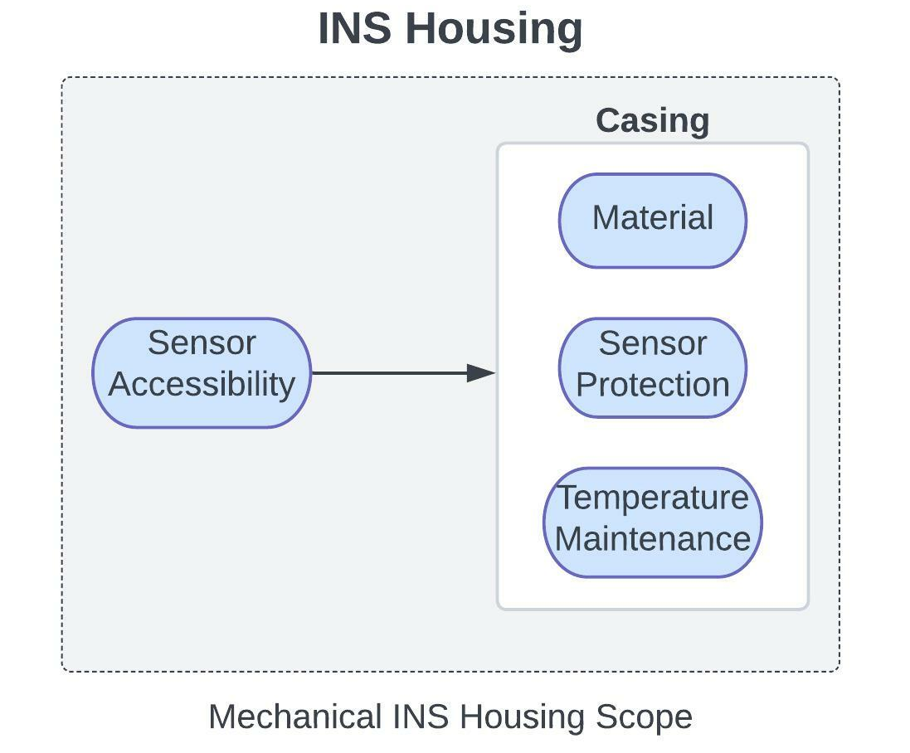
Design Space - Mechanical
Key Considerations:
Sensor Protection
Electrostatic Discharge (ESD)
Proximity to other sensors
Heat dissipation
Orientation
Magnetic interference
Component accessibility
Prototyping
Testing
Maintenance
Material
Off gassing
Composite
Metal
Plastic
Design
Notes:
3.1 Show how trade selections narrow your design space, and your current design space
and/or possible initial configuration(s).
3.2 Highlight trades that still need to be completed due to advanced prototyping or modeling
Needs
Should we mention no vibe test is required?
ESD pro

Slide 30
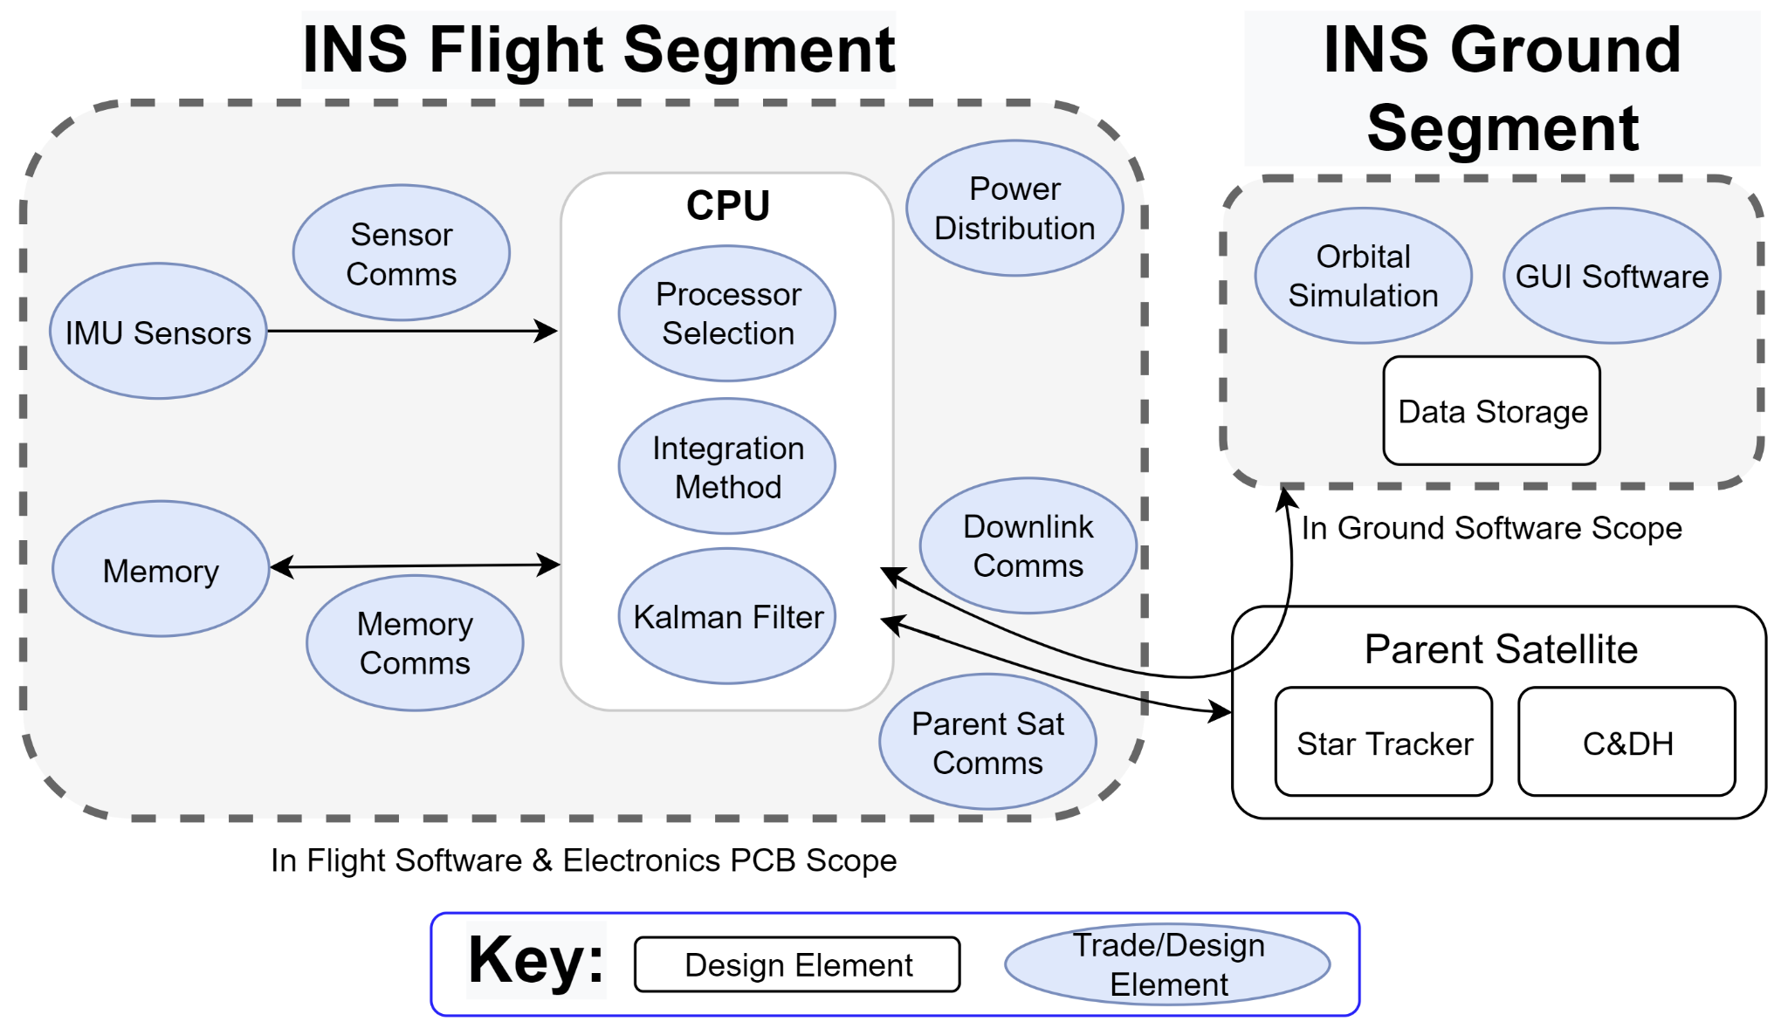
Design Space
Design

Slide 31
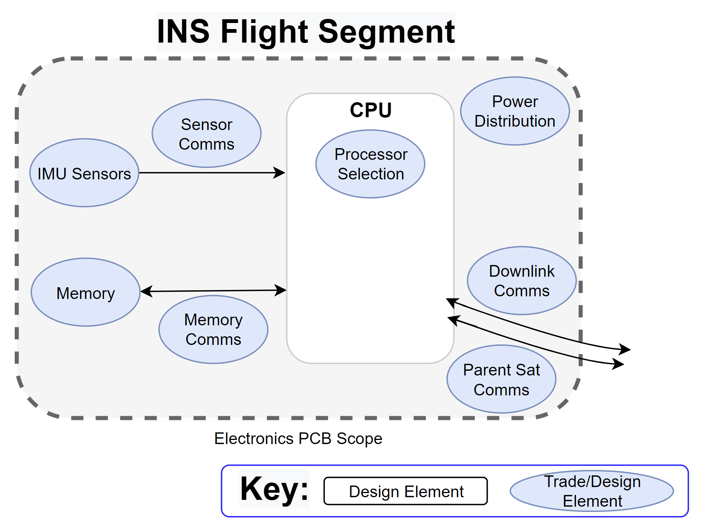
Design Space - Electronics
PCB Architecture depends on Flight Software CPU
Communications Port coordinated with Flight and Ground Software
PCB and Components must fit within the INS housing
Inertial Measurement Unit (IMU) constructed from accelerometers and gyroscopes
Design

Slide 32
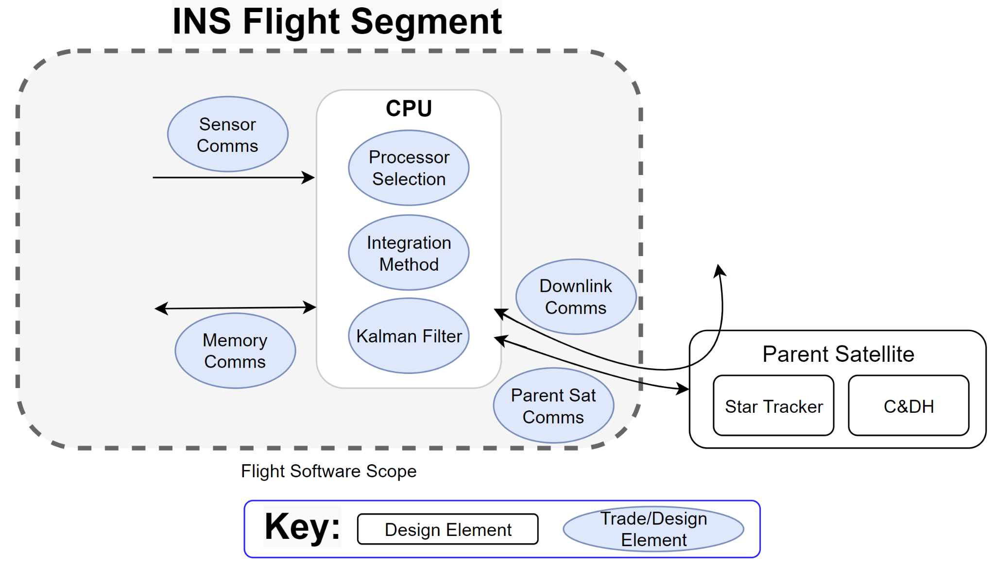
Design Space - Flight Software
Communications protocols & data packaging all interact with flight software
Kalman filtering, integration methods will need to be prototyped before a processor can be selected with electronics
Star tracker data will be simulated by the flight software team for attitude corrections
Design

Slide 33
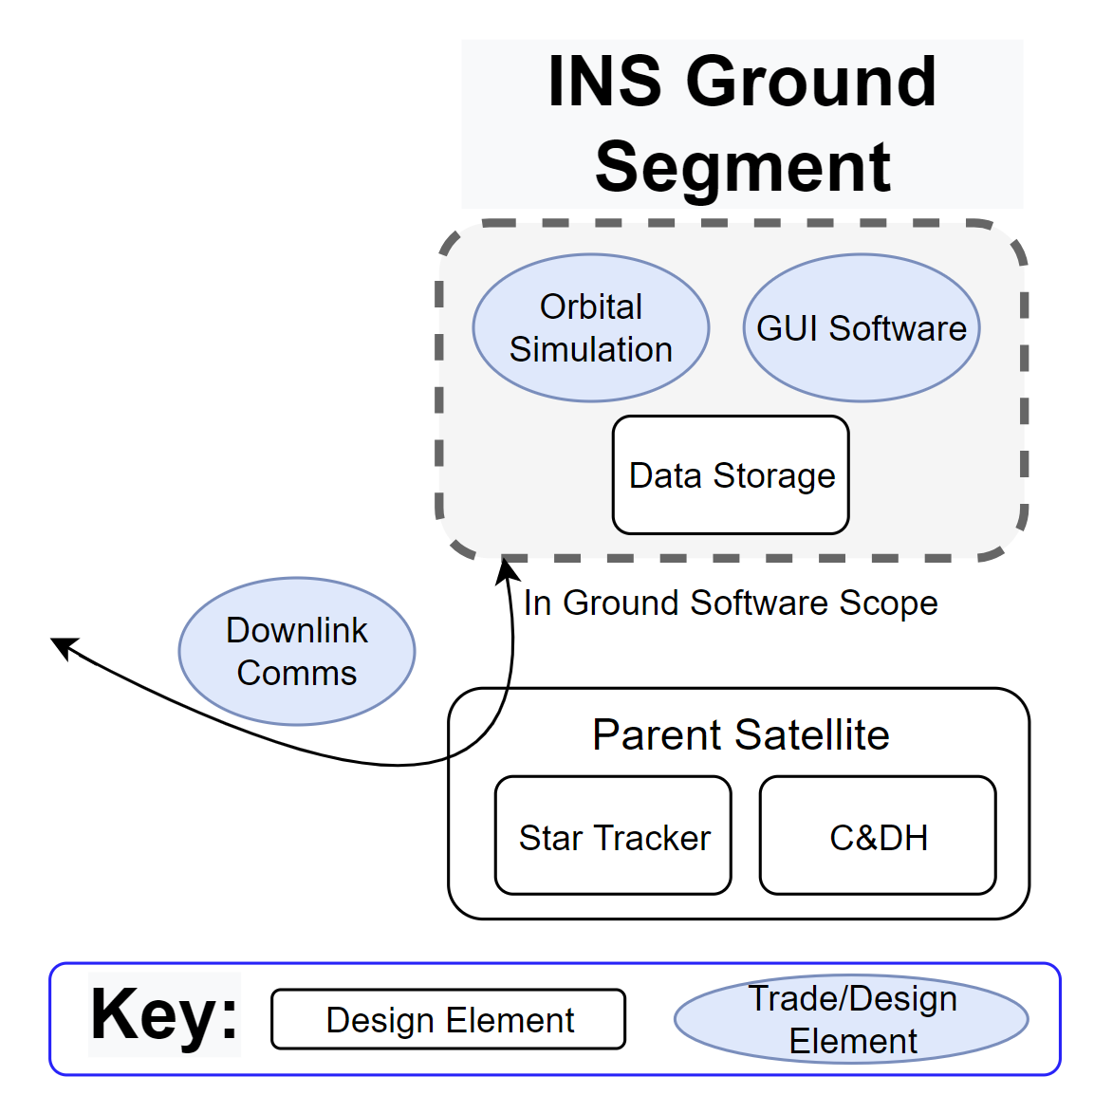
Design Space - Ground Software
Dependent on communications protocols and data packaging
Orbital Simulation Complexity trade will determine the depth of code required for trajectory calculations and predictions
Will need to simulate flight data to send to INS for testing
Software design choice research points towards using C++ and ImGui. Will need to implement a basic render engine to determine feasibility
Design

Slide 34
Modeling and Testing

Slide 35
Modeling and Testing - Software
Test | Render Engine | Simulated Flight Data | Integration and Filtering Test
Description | Make a basic implementation of OpenGL with ImGui. | Make simulated data sets of expected sensor and communication data. | Compare the performance of multiple filter and integration combinations
Objectives | Verify feasibility of selected software, and Inform CDR | Generate data for other test, and Inform CDR | Quantify difficulty, Calculate Computational Requirements and Accuracy
Cost | No direct cost | No direct cost | No direct cost
Sub Teams | Ground Software | Ground Software, Flight Software | Flight Software
Modeling
Notes:
Temp Slide: Brian
Render: Build the render engine to inform overall program planning, and verify its the correct route.
Simulationed Data: Simulate the flight data to inform backend design. There will be multiple different models for different purposes, flight and ground will make separate for there need.
Integration: Compare Omega Arithmetic Integration , Adams-Bashforth, and Filtering before integration. Explore Kalman Filtering
Component: Use Breadboards and lab tools to verify component performance.
Mockup: Build mockups out of easy to work with materials such as wood, PLA, and acrylic to ensure ease of assembly, and to inform testing plans
Drift Test: Exacts are still under trades, but we might consider
(-> “Welcome to any questions you may have”)

Slide 36
Modeling and Testing - Hardware/Electronics
Test | Component Verification | Mockup | Drift Test
Description | Compare component behavior to expected outputs | Make physical models of planned parts | Run the sensors under varying conditions
Objectives | Verifly individual parts work as expected | Ensure fit, Manufacturability, and Inform fixturing for Drift Test | Quantify drift, and Verify system function
Cost | Low material cost | Low material cost | TBD cost
Sub Teams | Electronics | Mechanical | All
Modeling
Notes:
Temp Slide: Brian
Render: Build the render engine to inform overall program planning, and verify its the correct route.
Simulationed Data: Simulate the flight data to inform backend design. There will be multiple different models for different purposes, flight and ground will make separate for there need.
Integration: Compare Omega Arithmetic Integration, Adams-Bashforth, and Filtering before integration. Explore Kalman Filtering
Component: Use Breadboards and lab tools to verify component performance.
Mockup: Build mockups out of easy to work with materials such as wood, PLA, and acrylic to ensure ease of assembly, and to inform testing plans
Drift Test: Exacts are still under trades, but we might consider
(-> “Welcome to any questions you may have”)

Slide 37
Questions?

Slide 38
Backup

Slide 39
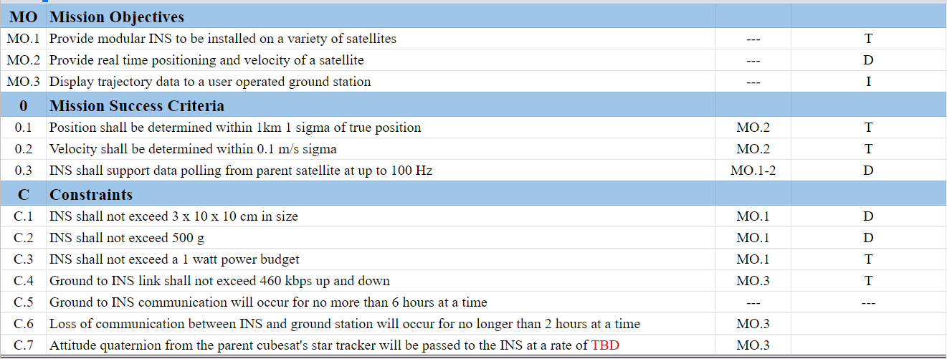
Requirements - Level 0
Backup
Notes:
Temp Slide: Brian
Render: Build the render engine to inform overall program planning, and verify its the correct route.
Simulationed Data: Simulate the flight data to inform backend design. There will be multiple different models for different purposes, flight and ground will make separate for there need.
Integration: Compare Omega Arithmetic Integration, Adams-Bashforth, and Filtering before integration. Explore Kalman Filtering
Component: Use Breadboards and lab tools to verify component performance.
Mockup: Build mockups out of easy to work with materials such as wood, PLA, and acrylic to ensure ease of assembly, and to inform testing plans
Drift Test: Exacts are still under trades, but we might consider
(-> “Welcome to any questions you may have”)

Slide 40
Requirements - Level 1
Backup
Notes:
Temp Slide: Brian
Render: Build the render engine to inform overall program planning, and verify its the correct route.
Simulationed Data: Simulate the flight data to inform backend design. There will be multiple different models for different purposes, flight and ground will make separate for there need.
Integration: Compare Omega Arithmetic Integration, Adams-Bashforth, and Filtering before integration. Explore Kalman Filtering
Component: Use Breadboards and lab tools to verify component performance.
Mockup: Build mockups out of easy to work with materials such as wood, PLA, and acrylic to ensure ease of assembly, and to inform testing plans
Drift Test: Exacts are still under trades, but we might consider
(-> “Welcome to any questions you may have”)

Slide 41
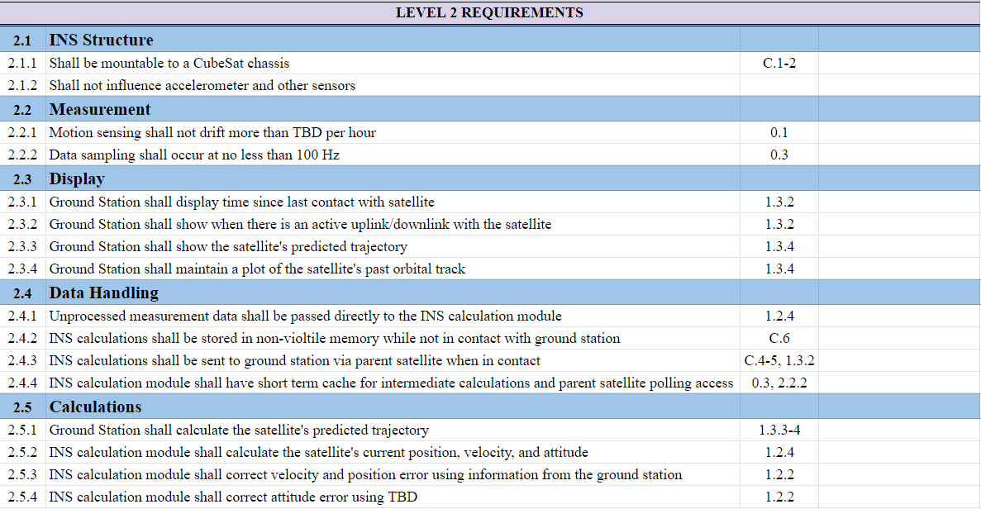
Requirements - Level 2
Backup
Notes:
Temp Slide: Brian
Render: Build the render engine to inform overall program planning, and verify its the correct route.
Simulationed Data: Simulate the flight data to inform backend design. There will be multiple different models for different purposes, flight and ground will make separate for there need.
Integration: Compare Omega Arithmetic Integration, Adams-Bashforth, and Filtering before integration. Explore Kalman Filtering
Component: Use Breadboards and lab tools to verify component performance.
Mockup: Build mockups out of easy to work with materials such as wood, PLA, and acrylic to ensure ease of assembly, and to inform testing plans
Drift Test: Exacts are still under trades, but we might consider
(-> “Welcome to any questions you may have”)

Slide 42
Flight Software - Calculations
Backup

Slide 43
Ground Station Base Software Trade
Evaluation Criteria | Weight | C++ | Python | Matlab | Java
Team Familiarity | 0.3 | High | Medium | High | Low
Processing Speed | 0.2 | High | Medium | Low | Medium
Library Availability | 0.15 | High | High | Low | Low
Vector Math | 0.15 | High | High | Best | Medium
Gui Options | 0.2 | Many | Some | Built-In | Some
Backup

Slide 44
Ground Station Base Software Trade
Evaluation Criteria | Weight | C++ | Python | Matlab | Java
Team Familiarity | 0.3 | 2.5 | 2 | 3 | 1
Processing Speed | 0.2 | 3 | 2 | 1.5 | 2
Library Availability | 0.15 | 3 | 3 | 1.5 | 1.5
Vector Math | 0.15 | 2.5 | 2.5 | 3 | 2
Gui Options | 0.2 | 2.5 | 2.5 | 2 | 1.5
Weighted Total: |  | 2.675 | 2.325 | 2.275 | 1.525
Backup

Slide 45
GUI Selection Trade
Evaluation Criteria | Weight | ImGui | Elements | Labview | Orbital STK | MATLAB
Team Familiarity | 0.10 | Medium | Medium | Low | Medium | Medium
Efficiency | 0.15 | Fast | Fast | Slow | Medium | Slow
Professional Look | 0.20 | Medium | Medium | High | Medium | Medium
Code Compatibility | 0.20 | C++ | C++ | Independent | Independent | MATLAB
Ease of Licensing / Cost | 0.15 | Open Source | Open Source | Available Through CU | Available Through CU | Available Through CU
3D Rendering Capability | 0.20 | Yes - Full Rendering | Yes - Full Rendering | Yes - Limited | Yes - Full Rendering | Yes - Limited
Backup
Notes:
We should probably mention that ImGui uses openGL so that they can see why we chose to use openGL

Slide 46
GUI Selection Trade
Evaluation Criteria | Weight | ImGui | Elements | Labview | Orbital STK | MATLAB
Team Familiarity | 0.10 | 2 | 2 | 1.5 | 2 | 2
Efficiency | 0.15 | 2.5 | 2.5 | 1.5 | 2 | 1.5
Professional Look | 0.20 | 2 | 1.5 | 3 | 2 | 2
Code Compatibility | 0.20 | 2.5 | 2.5 | 1 | 1 | 1
Ease of Licensing / Cost | 0.15 | 3 | 3 | 2.5 | 2.5 | 2.5
3D Rendering Capability | 0.20 | 3 | 3 | 2 | 3 | 2
Weighted Total: |  | 2.525 | 2.425 | 2.15 | 1.875 | 1.800
Backup

Slide 47
IMU Trade Matrix
Evaluation Criteria | Weight | LSM6DSLTR | BMI085 | ADIS16507 | ADIS16477
Volume (㎤) | 6 | 0.25 x 0.3 x 0.08 | 0.45 x 0.3 x 0.095 | 1.5 x 1.5 x .5 | 1.1 x 1.5 x 1.1
Power (mW) | 0.2 | 2.3 - 0.684 | 4.8 - 7.2 | 158.4 - 198 | 158.4 - 198
Cost (dollars) | 4 | $6.37 | $10.70 | $378.18 | $698.46
Digital or Analog | 9 | Analog | Analog | Digital | Digital
Bandwidth (Hz) | 2 | 245 - 937 | 12 - 523 | 480 - 640 | 600
Output Type | 6 | I²C,SPI | I²C,SPI | SPI | SPI
Backup

Slide 48
Communications Trade Matrix
Evaluation Criteria | Weight | I²C | SPI | MIL-STD-1553 | CAN-BUS
Comms Complexity | 0.15 | Half-Duplex | Full-Duplex | Multiplex | Half-Duplex
Data Rate | 0.3 | 100k-1M bps | 1Mbps | 1 Mbps | 1Mbps
Number of Wires | 0.1 | 2 (bus) | 4+1 per node (daisy chain) | 2 (bus with redundancy) | 2 (bus)
Error Detection | 0.1 | Ack bit | None | Status Word | 15 bit CRC
Addressing? | 0.05 | Yes | No | tbd | Yes
Backup

Slide 49
Hardware Enclosure Trade
Evaluation Criteria | Ultra-High Molecular Weight Polyethylene | Selective Laser Sintering | Aluminum 6061 | Fused Deposition Modeling
Cost | Sourced easily/moderate cost | Long lead time/significant cost | Sourced easily/moderate cost | Sourced easily/low cost
Density ( ) | 0.97 | < 10 | 2.7 | < 2
Manufacturability | In-House | Outsourced | In-House | Rapid, In-House
Robustness | Further analysis needed | Flight heritage | Flight heritage | Further analysis needed
Backup

Slide 50
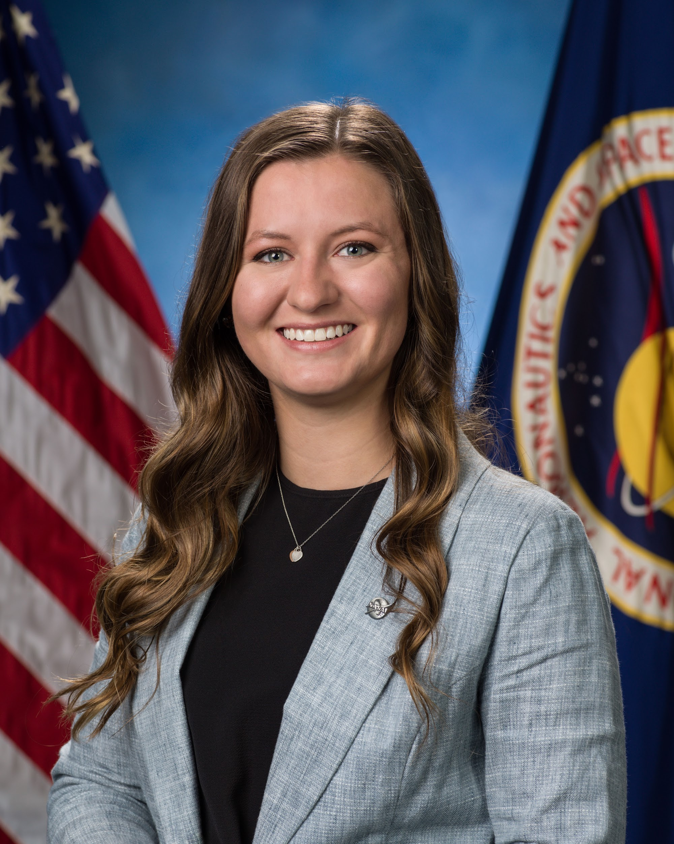
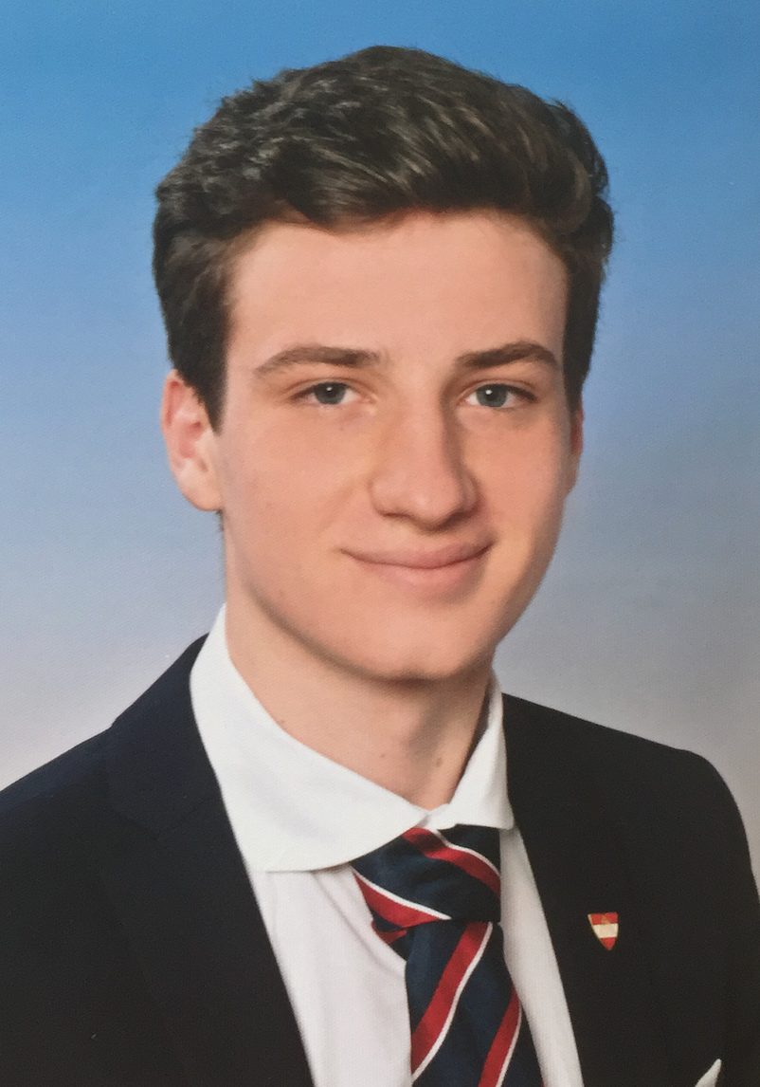
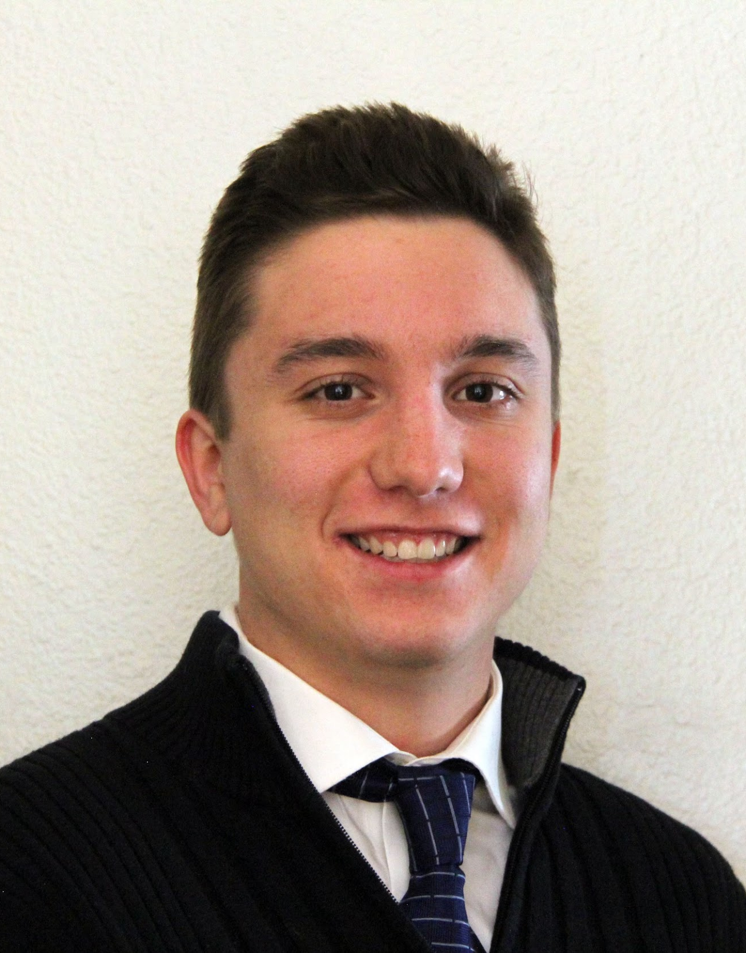
Project GAINS Org. Structure
System Engineer
Project Manager
Chief Financial Officer
Flight Software
Ground Software
Electronics
Mechanical
Backup

Slide 51
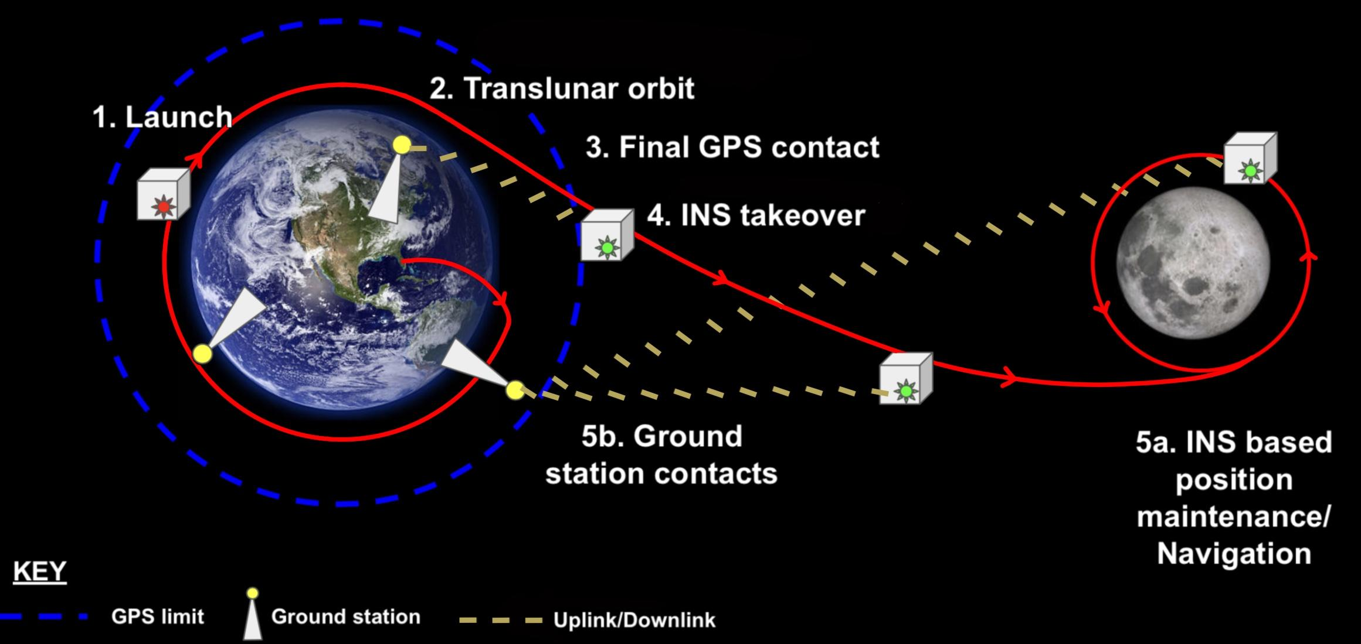
Full Mission CONOPS (no key)
Ground Stations
Uplink/Downlink
GPS Limit
Uplink/Downlink
Trajectory
Trajectory
Backup
Notes:
Addi

Slide 52
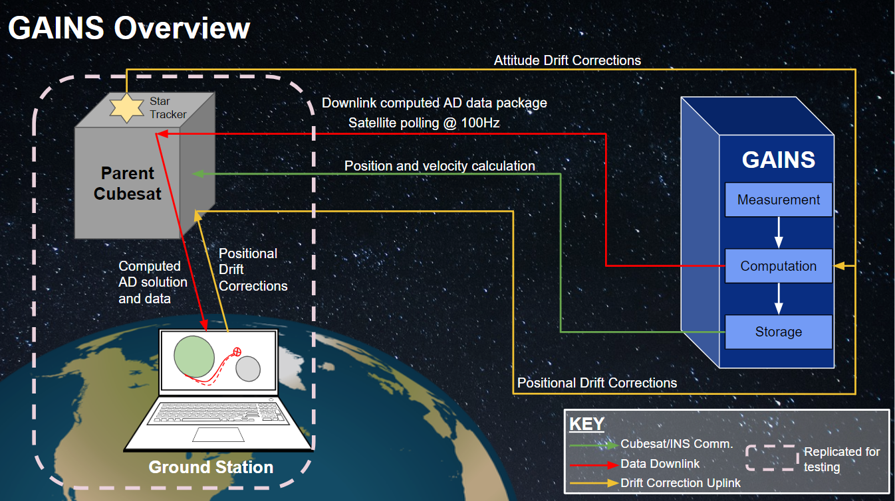
Project Overview (w/key, w/o steps)
Backup

