Slide 1
Preliminary Design Review
Bi-Functional On-Orbit Space Transfers (BOOST)
By: Tycho Cinquini, Riana Gagnon, Avery Gillespie, Wesley Gilliam, Luca Herlein, Chieri Kamada, Colton Massic, Rishi Mayekar, Zach Rochman
Customer/Sponsor: Marcus Holzinger | Mentor: Ball Aerospace

Slide 2
Overview
1. Project Description
2. Trades
3. Current Design Space
4. Modeling & Prototyping Plans

Slide 3
Project Description
1

Slide 4
Mission Introduction
Potential overpopulation of cislunar regime
Projected number of satellites to increase by 800%
High demand for commercial & scientific infrastructure
Value placed within trillions of dollar by 2040
Many investment opportunities within 20 years
Operation costs are currently very high
Few options in place for non-private use
What systems can be developed to provide transportation infrastructure to customers

Slide 5
Mission Statement
The Bi-Functional On Orbit Space Transfer (BOOST) Team will be developing cost-effective space-based transportation infrastructure capable of providing spacecraft with the ability to conduct orbit transfers and provide navigation services in the Cislunar regime.

Slide 6
Specific Objectives
Performance
Energy Transfer
Level 1 | The infrastructure shall provide users with the capability of transferring/navigating to Trajectories of Interest (TOI) in low lunar orbit (LLO) and the lunar corridor
Level 2 | The infrastructure shall provide users with the capability of moving bidirectionally between two TOI
Level 1 | The infrastructure shall provide the necessary ΔV for transfer between the desired TOI
ff | The infrastructure shall facilitate the storage/transfer of the kinetic, potential, and/or chemical energy required for transfers between the desired TOI
Level 2 | The infrastructure shall facilitate the minimum energy transfer between the desired TOI within the max time specified by the customer
ff | The infrastructure shall have a maximum energy consumption of TBD per TBD Earth years

Slide 7
Specific Objectives Con.
Return on Investment (ROI)
Navigation Services
Level 1 | The infrastructure shall have an annualized internal compounded ROI of 30 (TBR) percent over a total of 19 (TBR) Earth years
Level 2 | The infrastructure shall have an initial cost of no more than TBD in real 2023 USD
Level 1 | The infrastructure shall provide navigation services to customer spacecraft within the lunar corridor and LLO
ff | The infrastructure shall provide customers with position and time measurements with up to TBD accuracy at a frequency of TBD
Level 2 | The system shall provide service for at least TBD years
ff | The infrastructure shall prevent service blackouts from disrupting more than TBD percent of full system coverage
 | The infrastructure shall provide at least TBD percent coverage of the determined regions

Slide 8
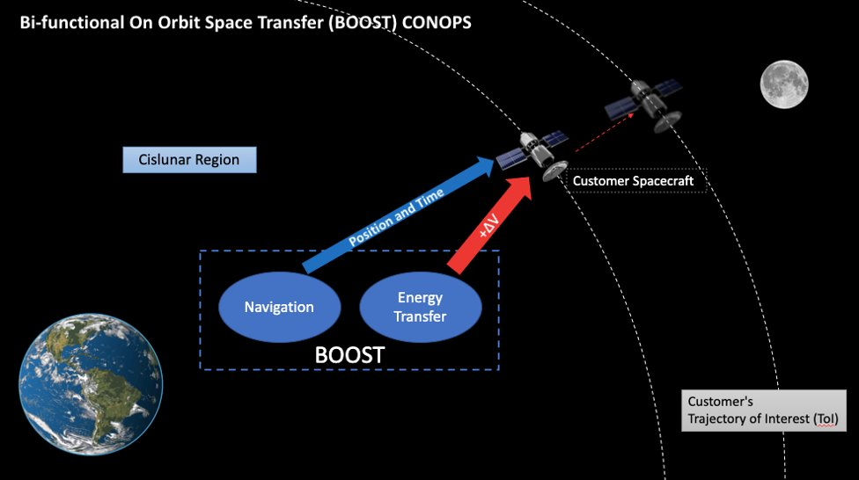

Slide 9
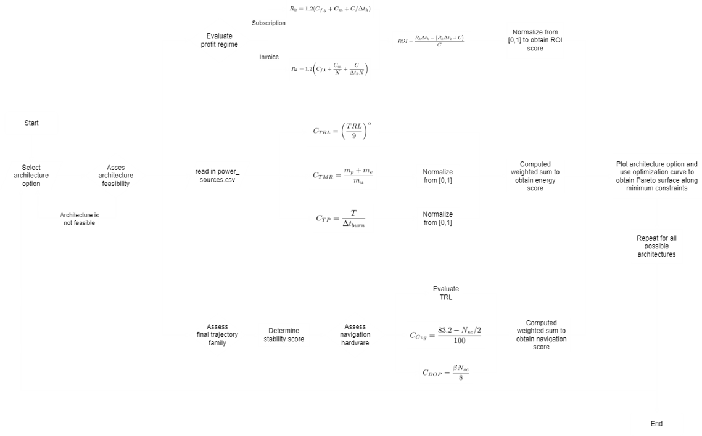
Functional Block Diagram

Slide 10
Critical Project Elements
CPE Number | CPE | Description
CPE.1 | Trade Space Analysis | Determine optimal solution Balance performance, cost, use, and ROI Three cost functions for energy, navigation, and ROI
CPE.2 | Navigation | Model system trajectories using orbital simulations Model system dynamics and relative motion
CPE.3 | Energy Transfer | System will transfer energy to use Optimal energy transfer will be chosen to maximize efficiency and minimize losses
CPE.4 | Policy Requirements | Team will write a paper detailing required policy environment for mission
CPE.5 | ROI | Selected system will have optimal ROI over lifespan
CPE.6 | Hardware Demonstration | Demonstrate feasibility of high-risk hardware element

Slide 11
Risk Matrix
 | User vehicle can’t interface with system
 | System does not work in a time effective manner | Navigation system has blackout periods | Navigation and power system not compatible
 | Low TRL for navigation system |  | User vehicle too massive for transport vehicle | Hardware failure on system
 | Low Return on Investment (ROI) | Positive ROI in more than 20 years | System can’t achieve enough thrust for desired orbit | Navigation system can’t function in Cislunar domain
 | Low TRL for power system |  | Optimized system does not exist | Power system can’t function in Cislunar domain
Likelihood
Severity

Slide 12
Current Trade Space
Independent
Dependent
Propulsion System
Vehicle
Number of Spacecraft
Business Model
Bi-Functional On Orbit Space Transfers
Orbital Family
Navigation System
Orbital Period

Slide 13
Trades
2

Slide 14
Trade 1: Navigation System
Design Option | Benefits | Design-Specific Risks | Trade-Specific Risks
GPS | Very high accuracies on measurements | Accuracy dependent on number of satellites Low TRL in Cislunar space | System unable to operate in Cislunar domain Cannot achieve desired accuracy of navigation services Low system coverage System not compatible with rest of architecture Instability
In-Space Optical Navigation | Accuracy not dependent on number of spacecraft | Low TRL in Cislunar space
Ground Tracking | High TRL: functionality demonstrated in multiple missions | Coverage gaps Bandwidth limitations

Slide 15
Navigation System Requirements
2.1: The navigation service shall achieve the position accuracy of TBD
2.2: The navigation service shall achieve the time accuracy of TBD
2.3: The system shall provide the navigation coverage of TBD
2.4: The navigation service shall have an availability of TBD
2.5: The system shall be capable of providing the navigation service to TBD customer spacecraft simultaneously

Slide 16
Navigation Design Metrics
Design Metrics | Description | Weights | Rationale | Scaling
Coverage | Total volume of TOIs the navigation system can cover | 0.3 | Important in evaluating the feasibility of architecture for BOOST's project scale | 0 = no TOI volume covered 0.5 = half coverage 1 = full coverage
Dilution of Precision (DOP) | indicator of the quality of the satellite constellation geometry | 0.25 | To assess of architecture can effectively communicate navigation data with the customer spacecraft | 0 = customer receives completely unusable data 1 = customer receives perfect data
Stability | Ability of staying on desired orbit | 0.25 | Determines service schedule Cislunar orbits: inherently unstable due to moon-earth gravitational sphere | Inverted stability index: 0 = worst 1 = perfect stability
Technology Readiness Level (TRL) | Maturity of the technology | 0.2 | Low TRL = high risk | 0 = technology will not be ready in 20 years 1 = technology currently works in orbit

Slide 17
Navigation Engineering Analysis
TRL | Dilution of Precision (DOP) | Stability | Coverage
Based off NASA’s TRL scale (1-9) Low TRL = high risk TRL score normalized to 1 TRL level provided from research of similar systems. | Computation of error based geometric properties of the system. Compounded analysis factoring in orbit family, orbit period and number of spacecraft. Scores of 1 assigned to largest orbit path, and highest number of spacecraft. | Calculated stability index score [1-inf] of the orbit. Stability index of 1 = stable Higher the index the less stable. Stability = 1/stability index Stability index provided by JPL. | Numeric quantification of the system's ability to provide navigation to the customer SC within an orbital volume. (0-100%) Based on line-of-site calculations with selective weighting based on subsystem needs. Coverage region designated as the lunar corridor and low lunar orbit.

Slide 18
Trade 2: Vehicle
Design Option | Benefits | Design-Specific Risks | Trade-Specific Risks
Tug | Greater precision when placing user into TOI | User vehicle to massive for transport vehicle System can’t achieve enough thrust to transfer user into desired TOI | System does not work in a time-effective manner Propulsion system/vehicle experiences hardware failure User vehicle can’t interface with system
Fuel Station | Faster operation times Requires less operational energy than a Tug | Must be refueled much more frequently than other designs
Tether | Don’t have to refuel Requires substantially less operational energy than other design options | Very low TRL Very low accuracy when depositing user into desired TOI

Slide 19
Vehicle System Requirements
1: The system shall provide the user with positive $ΔV$ to transfer between the TOI
1.1: The system shall have a transfer service coverage of TBD percent
1.2: The transfer service shall have an availability of TBD
1.3: The system shall be capable of providing the transfer service to TBD customer spacecraft simultaneously
1.4: The system shall store energy to be transferred to the user spacecraft

Slide 20
Vehicle Design metrics
Design Metric | Description | Rationale | Weights | Scaling
Technology Readiness Level (TRL) | Maturity of the technology | Based off NASA’s TRL scale (1-9) Low TRL = high risk Penalize low TRLs | 0.2 | 0 = technology purely conceptual 1 = technology regularly tested in space
Thrust to Mass Ratio (TMR) | Ratio between user mass and required system mass | Getting mass into space is expensive Optimal system will have more thrust per unit mass | 0.5 | 0 = largest system mass per user unit mass 1 = smallest system mass per unit mass of user
Time-Propulsive Efficiency (TP) | Time propulsion system must fire to reach required ΔV | Customers expect system to work within a specified amount of time Optimal system will provide effective propulsion in a time-efficient manner | 0.3 | 0 = slowest burn time per unit thrust 1 = fastest burn time per unit thrust
Notes:
Design Metrics:
Technology Readiness Level (TRL)
Similar justification to TRL assessment for navigation
As many propulsion and vehicle design were considered of varying TRLs, a skew normalization exponent factor was introduced
Creates a nonlinear normalization, placing much higher value on high TRL vs low
Thrust to Mass Ratio (TMR)
Measures the mass ratio between required propellant and user mass
Back solved for propellant mass using data for Isp, the ΔV for the TOI
Thus, TMR acts as a measure of propulsive efficiency as well
Time Propulsive Efficiency (TP)
Customers are expecting the system to work but may also expect a quick transfer to the TOI
TP measures the time the propulsion system must fire to reach desired ΔV
Metric Weights:
Weighting values chosen based off the expected parameter importance to the outcome of the mission

Slide 21
Engineering Analysis - Vehicle
Add skew normalization exponent
Technology Readiness Level:
Normalize to [0,1]
$$\frac{TRL}{9}$$
$$c_{TRL}={\left(\frac{TRL}{9}\right)}^{α}$$
$$TRL$$
$$m_{p}=\left(m_{u}+m_{v}\right)\left[1−\frac{1}{\text{exp}\left(\frac{ΔV}{gI_{sp}}\right)}\right]$$
Thrust to mass ratio (TMR):
Calculate TMR
$$c_{TMR}=\frac{m_{u}}{m_{p}+m_{v}}$$
Calculate time-propulsive efficiency
Time-Propulsive Efficiency:
Convert to burn score
$$c_{TP}=\frac{T}{{10}^{−β}}$$
$$Δt_{burn}$$
$$β_{burn}$$
Table in Appendix

Slide 22
Trade 3: Business Model
Design Option | Description | Benefits | Design-Specific Risks
Subscription Service | Single annual fee allows unlimited* use of BOOST by a customer | Easier to project profits and construct financial models | Poor estimate of yearly uses could lead to underpriced annual fee
Fee for Service | BOOST customers pay a fee for each mission they wish to use with our system | Ensures payments cover all operational costs associated with each use | Less incentive for continual use of system and more difficult to project profits
*may not actually be unlimited if BOOST gains customers/demand faster than the system can expand

Slide 23
Business Requirements
3: The system shall have a net positive ROI
3.1: The system shall have an initial cost of no more than TBD real 2023 USD
3.2: The system shall have an annualized internal compounded ROI of TBD over TBD Earth years

Slide 24
Business Design Metrics
Design Metric | Description | Rationale
Cost of Fuel | Cost of Fuel for the either the mission | Need to quantify the energy transfer costs from system to user
Maintenance Costs | Cost of Maintenance of the infrastructure | Need to account for inevitable maintenance costs of the infrastructure
Fixed Costs | Initial infrastructure costs including launch and build costs | A large percentage of the costs for the infrastructure will be initial fixed costs and therefore must be accounted for
Number of uses | Number of times a customer uses the system | For the mission-based service we need to factor in how many times the customer uses the infrastructure

Slide 25
Business Design Metrics
Both Designs Account For:
Estimated fuel usage for 1 year
Estimated maintenance/operational costs
Estimated distribution of investments for fixed costs
$$c_{annual}=1.05\left(C_{fuel,yr}+{Maint}_{yr}+\frac{C_{fixed}}{lifespan}\right)$$
$$c_{fee}=1.05\left(C_{fuel}+\frac{{Maint}_{yr}}{N_{uses}}+\frac{C_{fixed}}{lifespan∙N_{uses}}\right)$$

Slide 26
Design Permutations and Score Examples
Propulsion System | Vehicle | Orbital Period | Orbit Family | Number of Spacecraft | Navigation System | Business Model
Hydrazine Chemical | Tugs | 7 Days | L2 Southern Halo | 4 | GPS | Subscription
Mono/Bi Chemical | Fuel Station | 14 Days | L1 Lyapunov | 6 | In Space Optics | Fee for Service
Electrospray | Tethers | 29 Days | L4 Short Period | 8 | Ground Tracking
Permutation 1:
Permutation 2:
Stability: 0.593
DOP: 0.495
Coverage: 1
TRL: 0.88
Navigation Score: 0.75
TP: 1
TMR: 0.08
TRL: 0.2026
Energy Score: 0.43
Stability: 0.019
DOP: 0.5974
Coverage: 1
TRL: 0.88
Navigation Score: 0.63
TP: 0
TMR: 1
TRL: 0.4479
Energy Score: 0.48

Slide 27
Current Design Space
3

Slide 28
Design Space Features
Completed Features:
Initial trades and design options selected
Initial versions of cost functions and weights created
Future Features:
Revise and finalize trades for optimization
Pick solution(s) using multi-objective optimization
2187 possible solutions before eliminating incompatible permutations
Eliminate solutions with incompatible components

Slide 29
Trade Study Plan
Finalize trades and cost functions
Populate trade table (retrieve necessary data from research or simulation)
Verify data collected properly
Eliminate solutions with incompatible components
Calculate cost for each solution
Create pareto surface and select improved solution

Slide 30
Modeling & Prototyping plans
4

Slide 31
Path to CDR
Check feasibility of solution by modeling and prototyping
Eliminate all TBDs and TBRs from objectives/requirements
Identify high risk components
Develop design configuration
Perform research on space policy and laws

Slide 32
Proposed Models Overview
Model | Purpose | Required Tools/Resources
Cislunar Orbit Simulation | Perform sensitivity analysis of service coverage/accuracy for various design parameters | Python, STK, SMAD, faculty advisor
Revenue | Calculate revenue over time for various infrastructure design | Python, research papers, faculty advisor
Feasibility Analysis | Ensure that the trade options are compatible with each other, and the high-risk items are feasible for our design | CAD, ANSYS, machine shops, faculty advisor

Slide 33
References
[1] Architecture development - DODAF - DOD architecture framework version 2.02 - DOD deputy chief information officer Available: https://dodcio.defense.gov/Library/DoD-Architecture-Framework/dodaf20_arch_development/.
[2] Dunbar, B., “Space tethers,” NASA Available: https://www.nasa.gov/centers/marshall/capabilities/space-tethers.html.
[3] “Exploring the design space of lunar GNSS in frozen orbit conditions” Available: https://www.researchgate.net/publication/344757079_Exploring_the_Design_Space_of_Lunar_GNSS_in_Frozen_Orbit_Conditions.
[4] “Global Navigation Satellite System (GNSS) - princeton university” Available: https://www.princeton.edu/~alaink/Orf467F07/GNSS.pdf.
[5] Hsu, J., “Kilometer-long space tether tests fuel-free propulsion,” Scientific American Available:https://www.scientificamerican.com/article/kilometer-long-space-tether-tests-fuel-free-propulsion/.
[6] “In-space propulsion gy s momentum-exchange electrodynamic ... - NASA” Available:https://www.nasa.gov/centers/marshall/pdf/115871main-MXER-TS.pdf.
[7] “Refueling Satellites in Space.” Lockheed Martin, Lockheed Martin, 13 Sept. 2021, https://www.lockheedmartin.com/en-us/news/features/2021/refueling-satellites-in-space.html.
[8] Macleod, Caitlin. “How the Explosive Growth in Satellites Could Impact Life on Earth.” The Hustle, Caitlin MacLeod, 7 Aug. 2021, https://thehustle.co/how-the-explosive-growth-in-satellites-could-impact-life-on-earth/.
[9] “Miniature Tether Electrodynamics Experiment (Mitee) proof-of-concept space mission design,” VIP Consortium Available: https://www.vip-consortium.org/teams/miniature-tether-electrodynamics-experiment-mitee-proof-concept-space-mission-design.
[10] Montenbruck, O., and Ramos-Bosch, P., “Precision real-time navigation of LEO SATELLITES USING Global Positioning System measurements - GPS solutions,” SpringerLink Available: https://link.springer.com/article/10.1007/s10291-007-0080-x.
[11] “NASA seeks wider use of GPS: Not from space, but in space - via satellite -,” Via Satellite Available: https://www.satellitetoday.com/government-military/2019/06/21/nasa-seeks-wider-use-of-gps-not-from-space-but-in-space/.
[12] “Orbit Fab: Gas Stations in SpaceTM.” Orbit Fab | Gas Stations in SpaceTM, Orbit Fab, https://www.orbitfab.com/.
[13] Vedda, James. “Cislunar Development: What to Build and Why.” Cislunar Development: What to Build and Why| Aerospace Center for Space Policy and Strategy, Aerospace Center for Space Policy and Strategy, 18 Apr. 2018,https://csps.aerospace.org/papers/cislunar-development-what-build-and-why.
[14] Yi Chen, Rui Huang, Xianlin Ren, Liping He, Ye He, "History of the Tether Concept and Tether Missions: A Review", International Scholarly Research Notices, vol. 2013, Article ID 502973, 7 pages, 2013.https://doi.org/10.1155/2013/502973
[15] Architecture Development – DODAF: https://dodcio.defense.gov/Library/DoD-Architecture-Framework/dodaf20_arch_development/#step1

Slide 34
Appendices
5

Slide 35
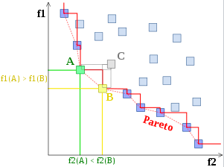
Appendix A: Multi-Objective Optimization
Three objectives to optimize: power, navigation, ROI
Three equations that calculate "cost" for each objective, which are a function of variables such as TRL, cost, mass, etc.
Each trade has a different impact on the functions
E.g. Vehicle type affects the mass and cost
Find optimal solution using Pareto surface
Each axis: cost function

Slide 36
Appendix B: Vehicle Cost Function
$$c_{vehicle}=0.2c_{TRL}+0.5c_{TP}+0.3c_{TMR}$$
Burn Time | Burn Time Score ($β$)
1+ years | 0
182.5+ days | 1
1+ day | 2
12+ hours | 3
1+ hour | 4
30+ minutes | 5
1+ minute | 6
30+ seconds | 7
1+ second | 8
$$c_{TRL}={\left(\frac{TRL}{9}\right)}^{α}$$
$$c_{TP}=\frac{T}{{10}^{−β}}$$
$$c_{TMR}=\frac{m_{u}}{m_{p}+m_{v}}$$

Slide 37
Appendix c: Navigation Cost Function
$$c_{vehicle}=0.3c_{coverage}+0.25c_{DOP}+0.25c_{stability}+0.2c_{TRL}$$
Code for calculating design metrics available on BOOST’s Github: https://github.com/Team-One-BOOST/Boost_Code

Slide 38
Appendix D: Business Cost Function
$$c_{annual}=1.05\left(C_{fuel,yr}+{Maint}_{yr}+\frac{C_{fixed}}{lifespan}\right)$$
$$c_{fee}=1.05\left(C_{fuel}+\frac{{Maint}_{yr}}{N_{uses}}+\frac{C_{fixed}}{lifespan∙N_{uses}}\right)$$
Code for calculating design metrics available on BOOST’s Github: https://github.com/Team-One-BOOST/Boost_Code

Slide 39
Functional Requirements
FR ID | Requirement | Rationale
1 (Power) | The system shall provide the user with positive ΔV to transfer between the Trajectories of Interest (ToI). | This corresponds to one of the high-level objectives provided by the customer: Space-based Power Logistics and Services.
1.1 | The system shall have a transfer service coverage of TBD percent.
1.2 | The transfer service shall have an availability of TBD.
1.3 | The system shall be capable of providing the transfer service to TBD customer spacecraft simultaneously.
1.4 | The system shall store energy to be transferred to the user spacecraft.
2 (Navigation) | The system shall provide the user with navigation services (location and time). | This corresponds to one of the high-level objectives provided by the customer: Communication and Navigation Services.
2.1 | The navigation service shall achieve the position accuracy of TBD.
2.3 | The navigation service shall achieve the time accuracy of TBD.
2.3 | The system shall provide the navigation coverage of TBD.
2.4 | The navigation service shall have an availability of TBD.
2.5 | The system shall be capable of providing the navigation service to TBD customer spacecraft simultaneously.

Slide 40
Functional Requirements (cont.)
FR ID | Requirement | Rationale
3 (ROI) | The system shall have a net positive Return on Investment (ROI). | This corresponds to one of the high-level objectives provided by the customer: Net Positive Return on Investment.
3.1 | The system shall have an initial cost of no more than $TBD.
3.2 | The system shall have an ROI of TBD over TBD Earth years.
4 (Performance) | The system shall operate in TBD regions of Cislunar space. | The customer specified the operational area to the Cislunar 7region.
4.1 | The system shall retain its full functionality for TBD years in Cislunar region.
4.2 | The system shall complete the operations for TBD number of cycles.
4.3 | The system's mean time between maintenance shall be TBD days.
4.4 | The system shall achieve an overall factor of safety of TBD.
5 (Others) | The system shall comply with applicable space laws and policies. | This is necessary for the successful operation of the infrastructure.
5.1 | The system shall comply with the international and US telecommunication standards.

