Slide 1
DAISy Cam
(Docking Arm Integration System for Scoutcam Camera)
Preliminary Design Review
October 5, 2022
ASEN 4018 - Team 19
Company Sponsor
Astroscale
Faculty Advisor
Dr. Melvin Rafi
Presenters
Kiley Beckwith, Lucas House, Ketan Kamat,
Jacob Moncada, & Nate Sanchez
Notes:
Presenter: Kiley

Slide 2
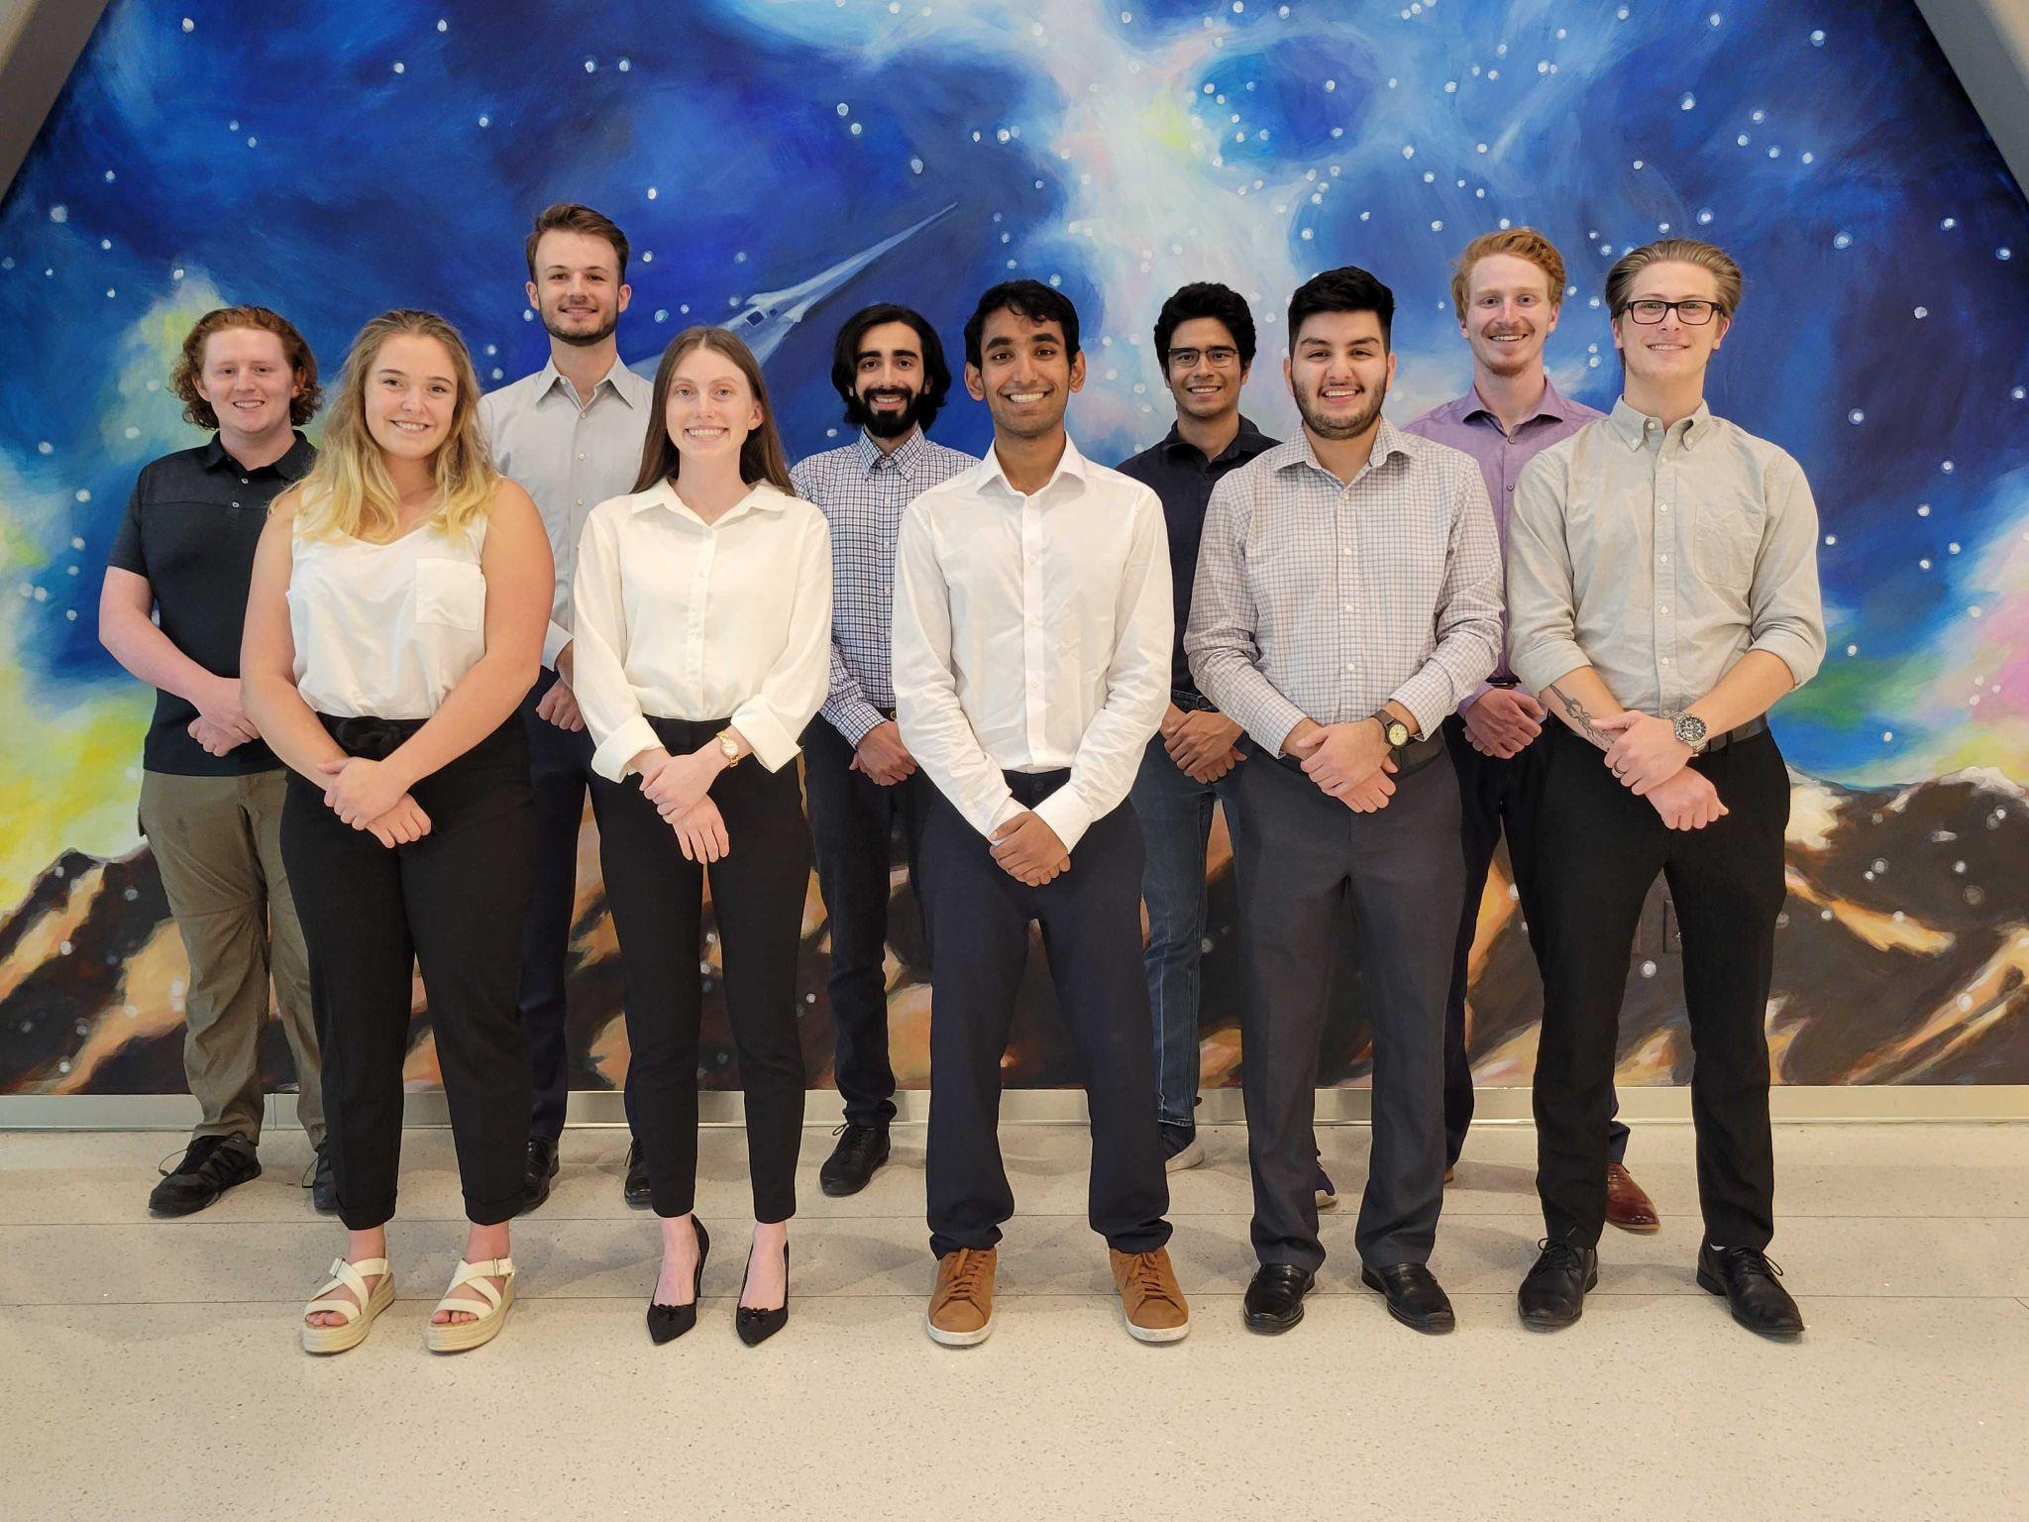
The Team
Front Row (left-to-right)
Abby Durell
(Mechanical Lead)
Kiley Beckwith
(Project Manager)
Ketan Kamat
(Electrical Lead)
Jacob Moncada
(Electrical Sub/CFO)
Peyton Early
(Software Lead)
Back Row (left-to-right)
Lucas House
(Manufacturing Lead)
Mason Lemler
(Electrical Lead)
Mohammed Alnasser
(Testing Lead)
Nate Sanchez
(Mechanical Sub)
Samuel Barrette
(Systems Engineer)
Notes:
Presenter: Each introduce themselves
Rafi’s feedback: Add who is doing what

Slide 3
Presentation Outline
Project Overview
Trades - Video Card Solutions
Trades - Model Materials
Design Space
Modeling and Prototyping Plan
Notes:
Presenter: Kiley

Slide 4
Project Overview
Notes:
Presenter: Kiley

Slide 5
Project Overview
Project Definition:
DAISy Cam will integrate a Scoutcam micro camera into the LEXI vehicle’s docking arm and develop a video card solution to support multiple cameras to assist LEXI in its final stages of docking with a client satellite.
Objectives
Integrate the camera and practical video card into a half scale model of the docking arm.
Provide a solution for a radiation hardened video card that can withstand the temperature and radiation hazards of a geostationary orbit (GEO).
Ensure the practical video card solution and radiation hardened video card solution are capable of transmitting video data to the on board computer.
1. Project Overview
2. Trade - Video Card
3. Trade - Model
4. Design Space
5. Modeling Plan
Notes:
Presenter: Kiley

Slide 6
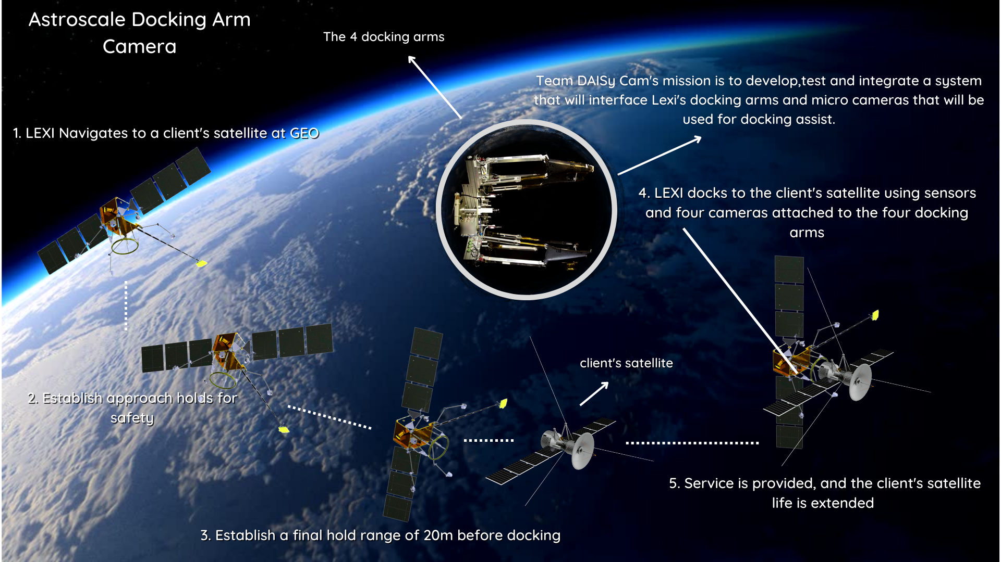
High Level CONOPS
1. Project Overview
2. Trade - Video Card
3. Trade - Model
4. Design Space
5. Modeling Plan
Notes:
Presenter: Kiley

Slide 7
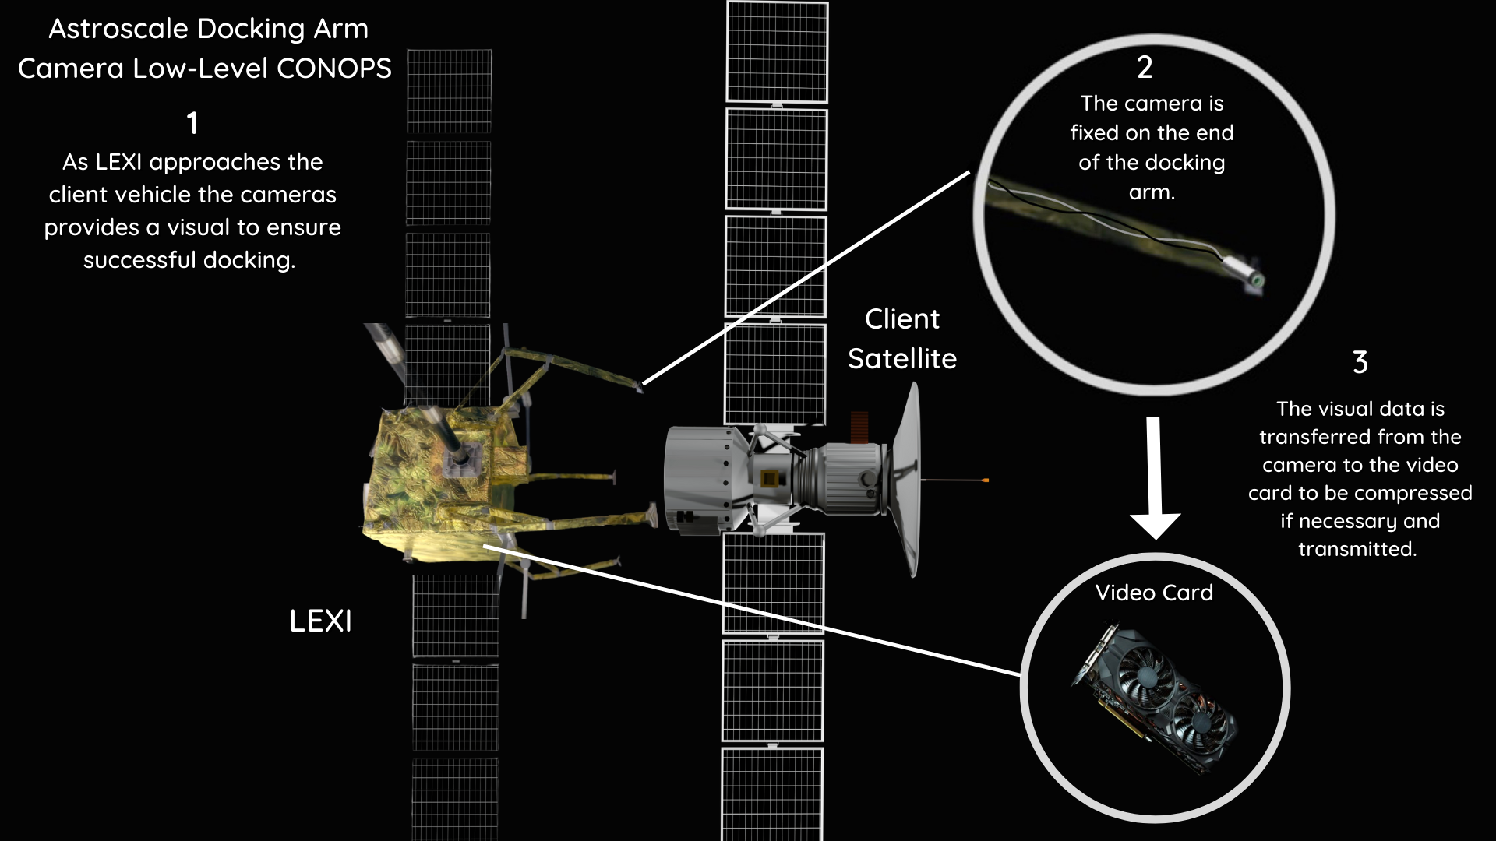
Low Level CONOPS
1. Project Overview
2. Trade - Video Card
3. Trade - Model
4. Design Space
5. Modeling Plan
Notes:
Presenter: Kiley

Slide 8
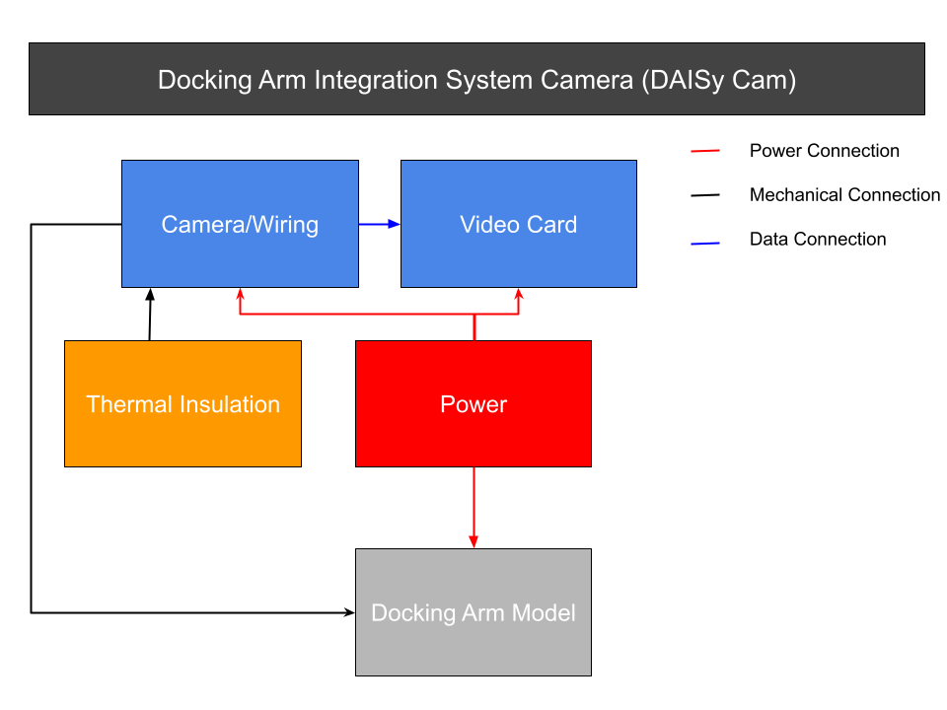
Functional Block Diagram
1. Project Overview
2. Trade - Video Card
3. Trade - Model
4. Design Space
5. Modeling Plan
Notes:
Presenter: Kiley

Slide 9
Critical Project Elements
Identifier | Critical Project Element
T.1 | Camera and harnessing stays attached to the docking arm.
T.2 | Camera attachment does not obstruct docking capabilities.
T.3 | Video compression must occur if necessary.
T.4 | Both video card solutions must collect correct image, e.g. image is clear.
T.5 | Radiation hardened video card can withstand a temperature range of 0-50 C and radiation loads at GEO (~100 krad/year) for a 15 year time span.
1. Project Overview
2. Trade - Video Card
3. Trade - Model
4. Design Space
5. Modeling Plan
Notes:
Presenter: Kiley

Slide 10
Risk Analysis
Very Likely
Likely
Possible |  |  | Cables become damaged at arm joints due to bending fatigue. | Image received from the camera is incorrect.
Unlikely |  |  | Video card is not able to compress data. | Camera/harnessing detaches from the arm. | Camera location alters the way the hand grabs. Harnessing interferes with arm mobility.
Very Unlikely
 | Negligible | Minor | Moderate | Significant | Severe
Risk Level
Acceptable
Watch
Unacceptable
Probability
Impact/Consequence
1. Project Overview
2. Trade - Video Card
3. Trade - Model
4. Design Space
5. Modeling Plan
Notes:
Presenter: Kiley
Main concerns are the “severe-unlikely” and “significant-possible”

Slide 11
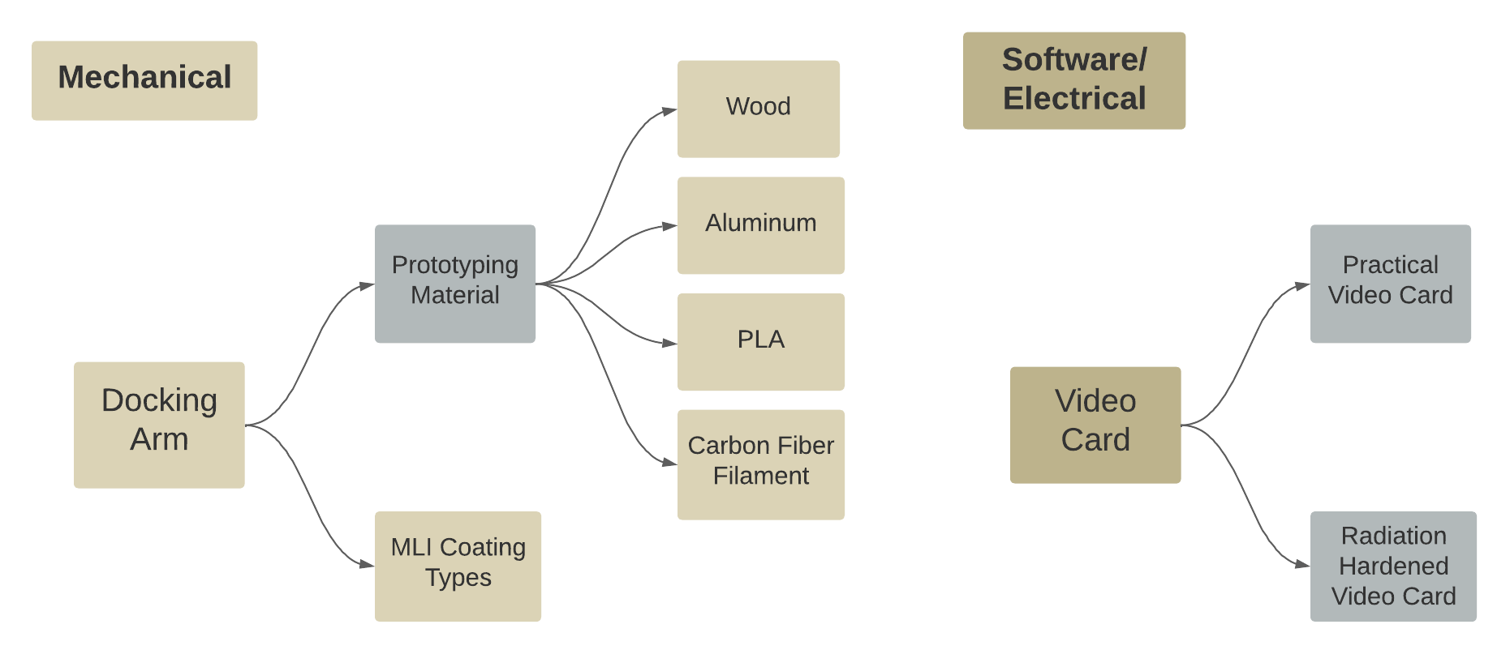
Necessary Trades
1. Project Overview
2. Trade - Video Card
3. Trade - Model
4. Design Space
5. Modeling Plan
Notes:
Presenter: Kiley

Slide 12
Trade - Video Card Solutions
Notes:
Presenter: Ketan

Slide 13
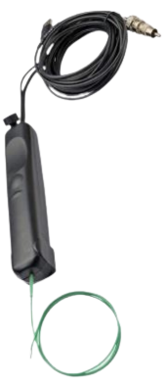
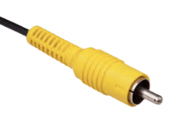
ScoutCam Micro-Camera Specs
Voltage | 2.1 A
Current Draw | 5 V
Power Draw | 10.5 W
Resolution | 160 kpx
Frame Rate | 30 fps
Camera Head Length | 6.0 mm
Camera Head Diameter | 1.8 mm
Cable Length | 2.0 m
Output | PAL composite video
* Penny for scale
1. Project Overview
2. Trade - Video Card
3. Trade - Model
4. Design Space
5. Modeling Plan
Notes:
Speaker: Ketan
On the right you can see the ScoutCam Micro-Camera starter kit

Slide 14
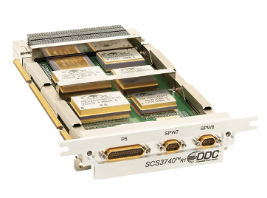
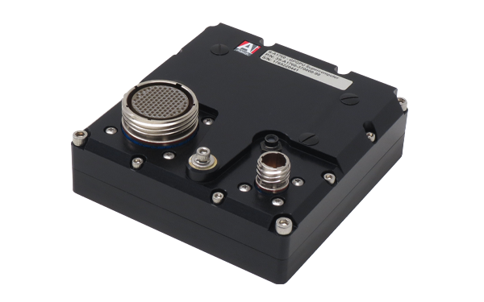
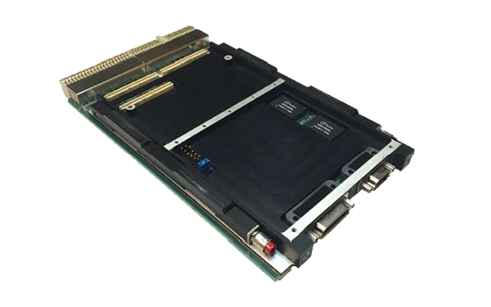
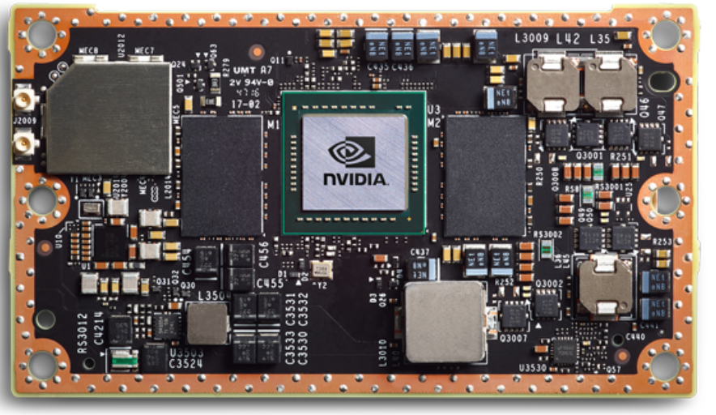
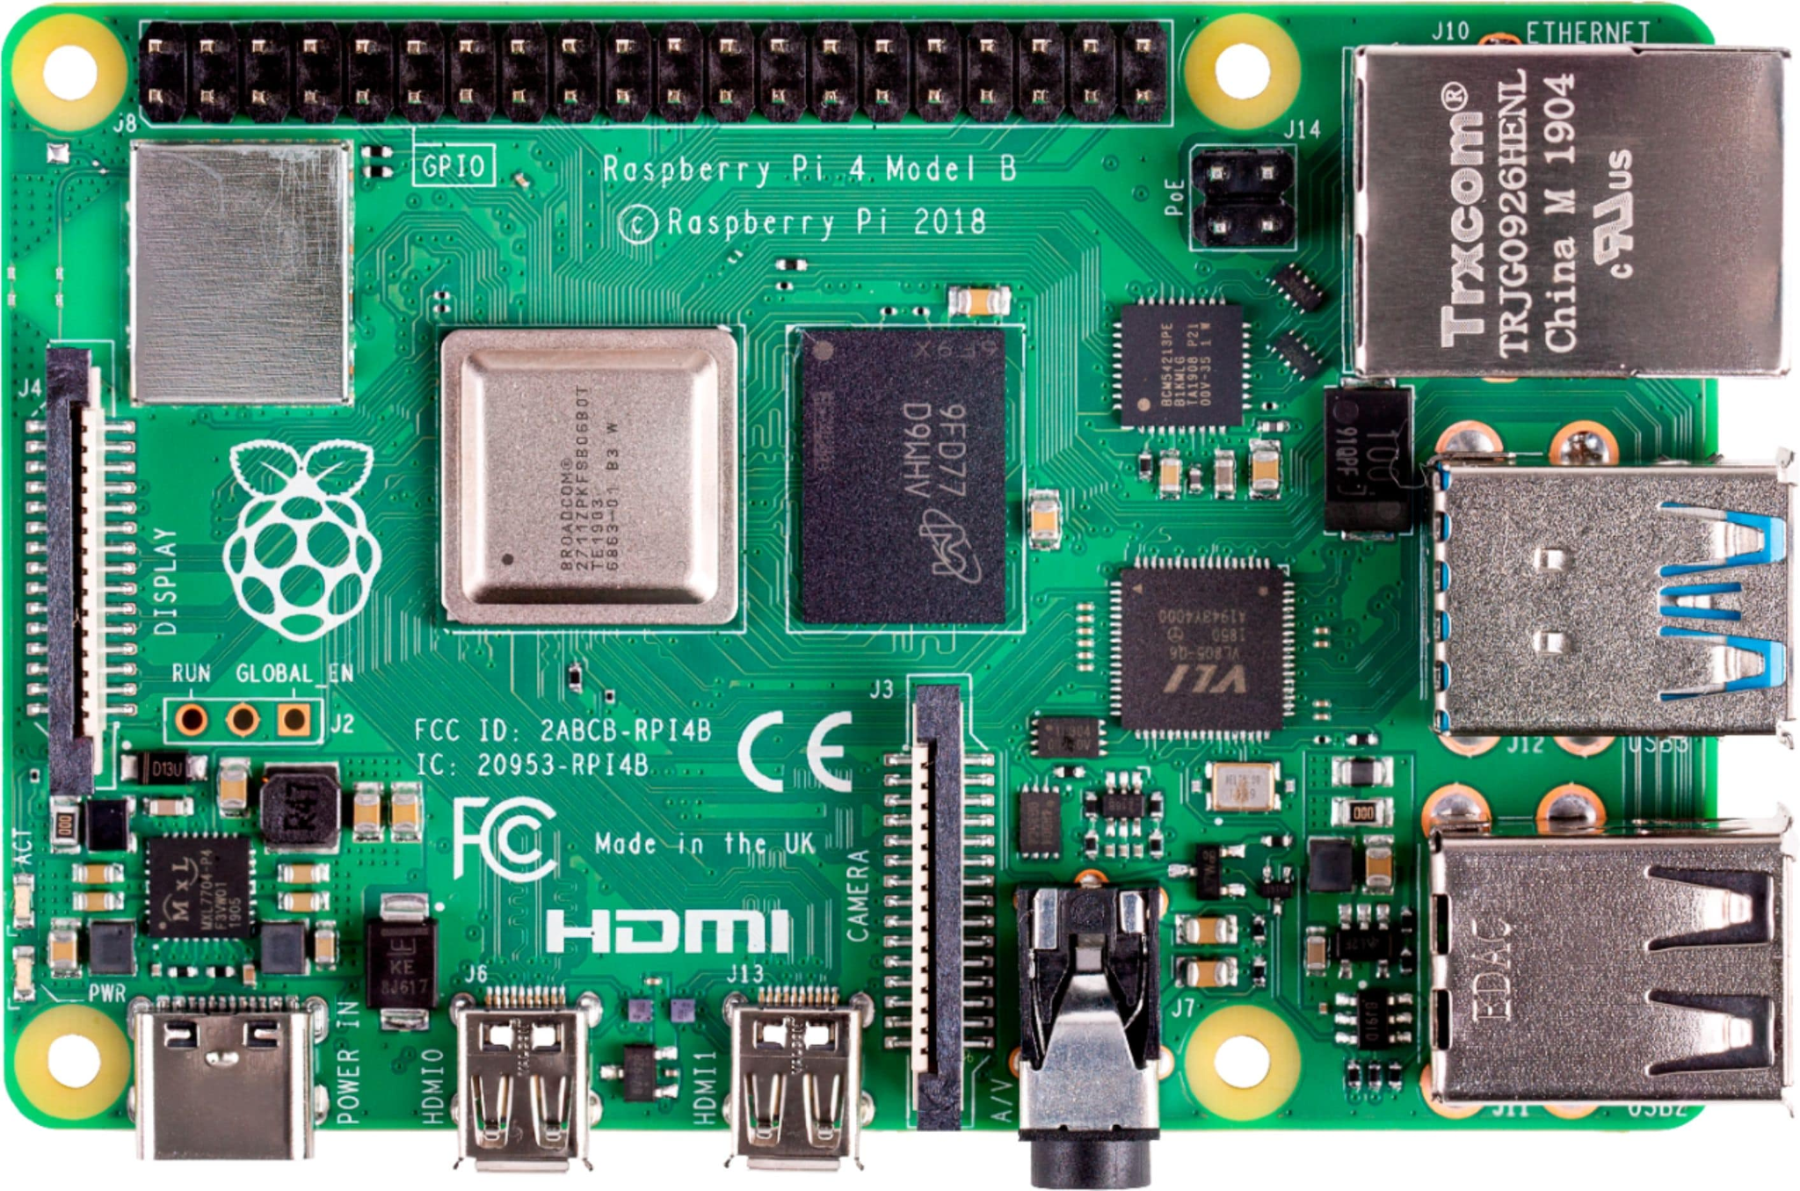
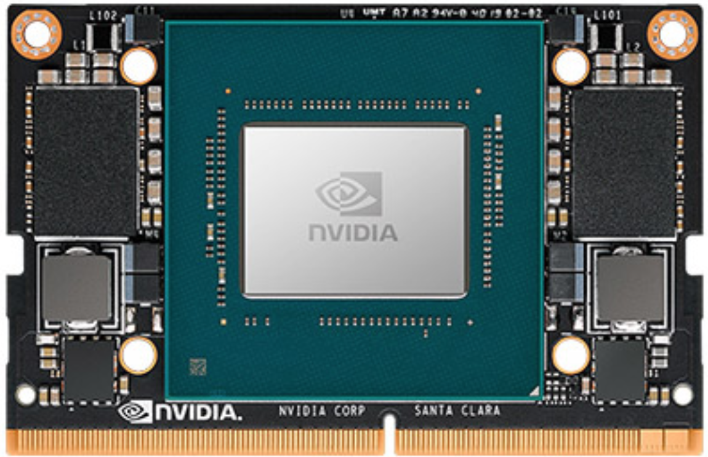
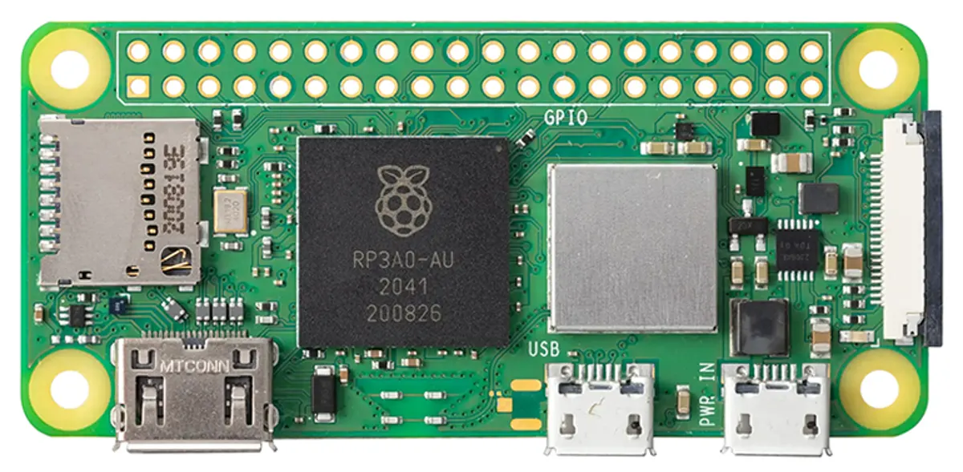
Possibilities - Video Card Solutions
DDC SCS3740
S-A1760 Venus
SP0-S
Radiation-Hardened
DDC SCS3740
S-A1760 Venus
SP0-S
Practical
Nvidia Jetson TX2
Nvidia Jetson Nano
Raspberry Pi 4
Raspberry Pi Zero 2 W
Nvidia Jetson TX2 (top) and Nano (bottom)
Raspberry Pi 4 (top) and Zero 2 W (bottom)
1. Project Overview
2. Trade - Video Card
3. Trade - Model
4. Design Space
5. Modeling Plan
Notes:
Presenter:

Slide 15
Overview - Radiation Hardened Video Card Solution
A video card is critical to mission success via camera image processing
Team is tasked with finding a video card solution that exists within sponsor’s budget
Capable of connecting to multiple camera inputs and processing their image data
Radiation hardened for GEO orbit
Relatively small, with reasonable power usage
Able to function in extreme temperatures
1. Project Overview
2. Trade - Video Card
3. Trade - Model
4. Design Space
5. Modeling Plan
Notes:
Presenter: Ketan

Slide 16
Overview - Rad Hardened Video Card Solution
Goal: Determine which PCB will be integrated with the ScoutCam on actual mission
Metric | Description | Weight | Scale
Cost | The price at which the PCB will be bought from the vendor | 0.3 | 0-5
Power Consumption | Total power consumption of PCB | 0.1 | 0-5
I/O Ports | The variety and number of ports that can be utilized (Space-Wire needed) | 0.1 | 1-3
Radiation Hardening | Whether the component is GEO radiation hardened or not | 0.5 | 1-2
1. Project Overview
2. Trade - Video Card
3. Trade - Model
4. Design Space
5. Modeling Plan
Notes:
Presenter: Ketan

Slide 17
Scale Logic for Rad Hard Video Card
Rating | Cost | Power Consumed | I/O Ports | Radiation Hardening
1 | 5x more expensive than cheapest solution | 5x more power consumed than lowest power solution | 1 Space-Wire port | Not GEO-rated
2 | 2.5x more expensive than cheapest solution | 2.5x more power consumed than lowest power solution | 2-3 Space-Wire port | GEO-rated
3 | 66% more expensive than cheapest solution | 66% more power consumed than lowest power solution | 4 Space-Wire port
4 | 25% more expensive than cheapest solution | 25% more power consumed than lowest power solution
5 | Cheapest solution | Lowest power consumption
1. Project Overview
2. Trade - Video Card
3. Trade - Model
4. Design Space
5. Modeling Plan
Notes:
Cost Weight()
5 = Cheapest solution (Min Cost)
Rating = float(5/(Cost/MinCost),2)
Power Consumed Weight()
5 = Least power consuming solution (Min Power)
Rating = float(5/Power/Min Power),2)
I/0 Ports (0-3)
How many USB’s does the video card solution have?
Radiation Hardening (0-1)
Either it is GEO rated or not

Slide 18
Radiation Hardened Video Card Comparison
Video Card | Price | Power Requirement | Spacewire Support | I/O Ports | Radiation Hardened
S-A1760 Venus | $75,000 | 5-20 W | Yes | 2x USB 2.0 2x Spacewire | LEO rated
DDC SCS3740 | $210,000 - $415,000 | 5-9 W | Yes | 2x UART 8x Spacewire | GEO rated
SP0-S | $150,000 | < 12.5 W | Yes | 2x Ethernet 3x Spacewire | GEO rated
1. Project Overview
2. Trade - Video Card
3. Trade - Model
4. Design Space
5. Modeling Plan
Notes:
Presenter:
Add Jetson Xavier, Aitech SP0-S
Make sure to distinguish between practical and rad-hard solutions (maybe by making the horizontal line between them thicker

Slide 19
Trade Matrix - Rad Hardened Video Card Solution
PCB Model | Cost (0.2) | Power Consumed (0.1) | I/0 Ports (0.1) | Radiation Hardening (0.6) | Score (Unweighted) | Score (Weighted)
S-A1760 Venus | 5.0 | 1.0 | 2.0 | 1.0 | 9.0 | 19.0
DDC SCS3740 | 1.0 | 5.0 | 3.0 | 2.0 | 11.0 | 22.0
SP0-S | 2.5 | 4.1 | 2.0 | 2.0 | 10.6 | 23.1
*Total Weighted Score out of 30
1. Project Overview
2. Trade - Video Card
3. Trade - Model
4. Design Space
5. Modeling Plan
Notes:
Presenter:

Slide 20
Overview - Practical Video Card Solution
Radiation hardened solution is too expensive for team to use
Will exceed budget by orders of magnitude
Need to find cost-effective replacement that team can use for integration and testing.
Needs to have comparable I/O ports, thermal range, and power consumption of theoretical card
Doesn’t need to be exact size or rad hardened
1. Project Overview
2. Trade - Video Card
3. Trade - Model
4. Design Space
5. Modeling Plan
Notes:
Presenter: Ketan
Clarify that rad-hardening is why theoretical solution is too expensive to use

Slide 21
Interdependencies - Practical Video Card Solution
The video card selection will determine what programming language(s) can be used in the solution
The wiring used to interface the video card with the camera will affect the stress and strain needed to be accounted for
1. Project Overview
2. Trade - Video Card
3. Trade - Model
4. Design Space
5. Modeling Plan
Notes:
Presenter:

Slide 22
Overview - Practical Video Card Solution
Goal: Determine which PCB will be integrated with the ScoutCam for this Project
Metric | Description | Weight | Scale
Cost | The price at which the PCB will be bought from the vendor | 0.3 | 0-5
Power Consumption | Total power consumption of PCB | 0.1 | 0-5
I/O Ports | The variety and number of ports that can be utilized | 0.1 | 1-3
Accessibility | The complexity of working with the device and its software | 0.2 | 1-2
1. Project Overview
2. Trade - Video Card
3. Trade - Model
4. Design Space
5. Modeling Plan
Notes:
Cost - Cost as a percentage of budget
Power consumption - Power needs
I/O ports - What ports exist on device or could be added. Spacewire gets bonus points.
Ease of use - How easy it would be to work with the solution. Takes into account coding language used, if modifications need to be made for solution to work (primarily for raspberry pi solutions), and what support exists from the manufacturer or general public.
Functionality - What capabilities does the solution have; cpu, gpu, ram info considered, as well as potential for expanded use (i.e. AI video enhancement for Nano or backpack boards for raspberry pi)
Presenter: Ketan

Slide 23
Scale Logic for Practical Video Card
Rating | Cost | Power Consumption | I/O Ports | Accessibility
1 | 5x more expensive than cheapest solution | 5x more power consumed than lowest power solution | 1 USB port | Open source and/or clear documentation
2 | 2.5x more expensive than cheapest solution. | 2.5x more power consumed than lowest power solution | 2-3 USB ports | Group member has experience with the language
3 | 66% more expensive than cheapest solution | 66% more power consumed than lowest power solution | 4 USB ports
4 | 25% more expensive than cheapest solution | 25% more power consumed than lower power solution
5 | Cheapest solution | Lowest power consumption
1. Project Overview
2. Trade - Video Card
3. Trade - Model
4. Design Space
5. Modeling Plan

Slide 24
Practical Video Card Comparison
Video Card | Price | Power Requirement | Spacewire Support | I/O Ports
Nvidia Jetson TX2 | $1,000 | 7.5-15 W | No | 3x USB 3.0 3x USB 2.0
Nvidia Jetson Nano | $400 | 5-10 W | No | 1x USB 3.0 3x USB 2.0
Raspberry Pi 4 Model B | $35 | 15 W | No | 2x USB 3.0 2x USB 2.0
Raspberry Pi Zero 2 W | $15 | 12.5 W | No | 1x Micro USB 1x Mini HDMI
1. Project Overview
2. Trade - Video Card
3. Trade - Model
4. Design Space
5. Modeling Plan
Notes:
Presenter:
Add Jetson Xavier, Aitech SP0-S
Make sure to distinguish between practical and rad-hard solutions (maybe by making the horizontal line between them thicker

Slide 25
Trade Matrix - Practical Video Card Solution
PCB Model | Cost (0.3) | Power Consumed (0.1) | I/0 Ports (0.1) | Ease of Use (0.2) | Score (Unweighted) | Score (Weighted)
NVIDIA Jetson TX2 | 1.0 | 1.0 | 3.0 | 1.0 | 6.0 | 9.0
NVIDIA Jetson Nano | 3.4 | 5.0 | 3.0 | 1.0 | 12.4 | 20.2
Raspberry Pi 4 Model B | 4.9 | 1.0 | 3.0 | 2.0 | 10.9 | 22.7
Raspberry Pi Zero 2 W | 5.0 | 3.0 | 1.0 | 2.0 | 11.0 | 23.0
*Total Weighted Score out of 27
1. Project Overview
2. Trade - Video Card
3. Trade - Model
4. Design Space
5. Modeling Plan
Notes:
Presenter:

Slide 26
Trade - Model Materials
Notes:
Presenter:

Slide 27
Interdependencies - Model and Materials
The material the arm is made of may impact how the electrical team can attach their wiring harness to it.
The time in which the model can be manufactured will impact how soon the electrical team can validate and test their design.
The accuracy of the model’s physical geometry will impact the movement of the arm its general functionality.
Limiting movement limits harness testing
1. Project Overview
2. Trade - Video Card
3. Trade - Model
4. Design Space
5. Modeling Plan
Notes:
Presenter: Nate

Slide 28
Overview - Model Design
Goal: Determine material and size of the LEXI Docking Arm model, which will drive the prototyping plan.
Metric | Description | Weight* | Scale
Material Cost | Total cost of material as percentage of project budget | 0.10 | 1-5
Production Time | Time to manufacture in terms of hands-on hours and total time. | 0.20 | 1-5
Manufacturability | How easy would this be to manufacture accurately | 0.25 | 1-5
Structural integrity | How durable the model is mechanically | 0.15 | 1-5
Overall model accuracy | How close does this model effectively represent the actual product. | 0.30 | 1-5
* See supplemental slides for weighting rationale
1. Project Overview
2. Trade - Video Card
3. Trade - Model
4. Design Space
5. Modeling Plan
Notes:
Presenter: Nate

Slide 29
Model Trade - Scale Breakdown
Rating | Cost (% of budget) | Manufacturability (Effort needed, failure risk) | Structural Integrity (Testing possibility) | Production Time | Model Accuracy (To Actual Arm)
1 | > 50% | Extremely high effort, high risk | No testing, cannot hold weight | Greater than 4 Weeks | Nowhere close to accurate
2 | < 50% | High effort, high risk | No testing, can hold weight | 3-4 Weeks | Looks accurate, cannot move
3 | < 40% | Medium effort, medium risk | Minimal testing possible | 1-2 Weeks | Closed/open states accurate
4 | < 30% | Low effort, medium risk | Full testing on certain parts | 3-5 Days | Mobility accurate, material somewhat
5 | < 20% | Minimal effort, negligible risk | Full model can be tested | 1-2 Days | Near exact to actual arm
1. Project Overview
2. Trade - Video Card
3. Trade - Model
4. Design Space
5. Modeling Plan

Slide 30
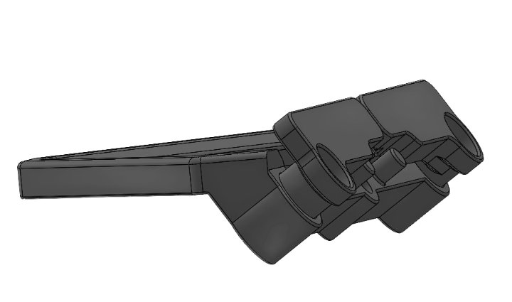
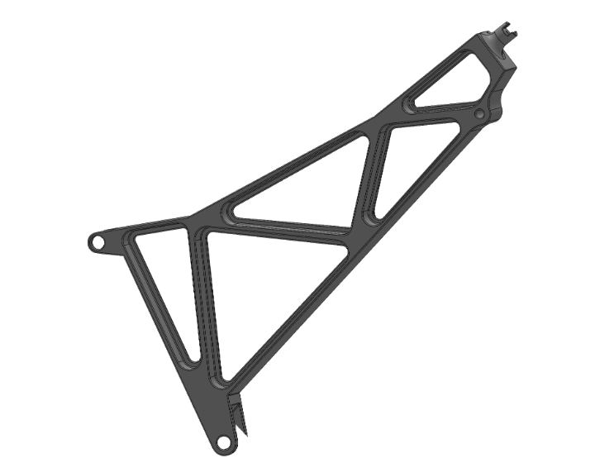
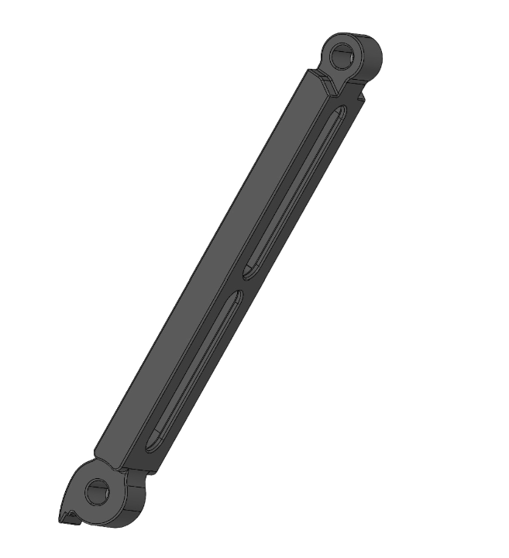
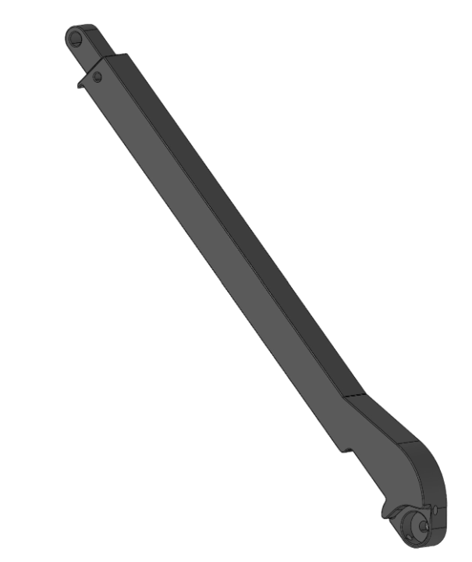
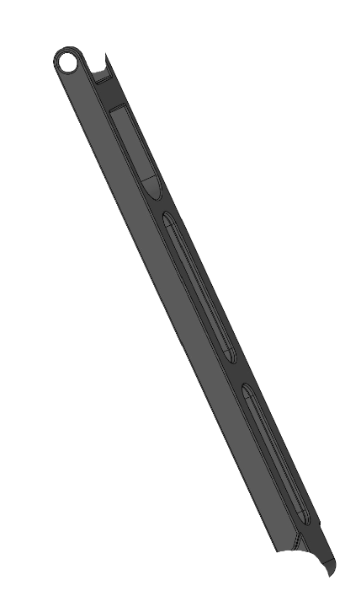
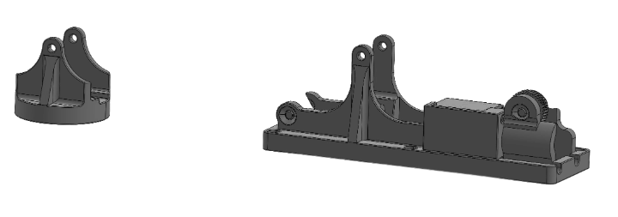
Possibilities - Model Design of Arm
Aluminum
Wood
PLA
Carbon Fiber Filament
1. Project Overview
2. Trade - Video Card
3. Trade - Model
4. Design Space
5. Modeling Plan
Notes:
Presenter:
Compress into singular tables

Slide 31
Possibilities - Table concept pt 1
Material and Process | Material Cost | Time (Manufacturing Time) | Manufacturability (Degree of Construction Difficulty)
Aluminum (Milled/CNC) | ~$600 - Large solid aluminum blocks | Long wait for ordering and machining time | Requires cnc experience and/or external sources
Wood (Laser Cut) | Very Low - Thin laser cut spliced sheets | Quick to machine Time consuming to model | Difficult to prepare laser cut mode Easy to laser cut files
PLA Filament (FDM Print) | ~$80 - 2 Rolls of 2.85mm tough pla filament (2kg) | Easily ordered and printed on any standard printer | Can print with high definition and quality
Carbon Filament (FDM Print) | ~$140 - 2 Rolls of 2.85mm carbon blend filament (1.5kg) | Easily ordered Requires specialized printer | Simple printing process Possible quality issues
1. Project Overview
2. Trade - Video Card
3. Trade - Model
4. Design Space
5. Modeling Plan
Notes:
Presenter:
Compress into singular tables

Slide 32
Possibilities - Table concept pt 2
Material and Process | Structural Integrity (Mechanics and Build Quality) | Overall Model Accuracy (Representation of Actual Arm) | Other notes
Aluminum (Milled/CNC) | Good structural integrity Good part tolerances if done well | Identical in composition to actual arm Can be vibration tested | Notable risk of critical failure
Wood (Laser Cut) | Acceptable structural integrity | Very low detail Does not represent model well | Only useful for modelling movement of joints and size
PLA Filament (FDM Print) | Acceptable structural integrity and tolerances | Good representation of model Some loss in finite detail expected | Easy to work with overall
Carbon Filament (FDM Print) | Good structural integrity with acceptable tolerances | Good representation of model Some loss in finite detail expected | Possible difficulties in finding compatible printers
1. Project Overview
2. Trade - Video Card
3. Trade - Model
4. Design Space
5. Modeling Plan
Notes:
Presenter:
Compress into singular tables

Slide 33
Trade Matrix - Arm Model Material Solution
Material | Cost (0.10) | Time (0.20) | Manufacturability (0.25) | Structural Integrity (0.15) | Model accuracy (0.30) | Score (Unweighted) | Score (Weighted)
Aluminum | 3 | 1 | 2 | 5 | 5 | 16 | 3.25
Wood | 5 | 3 | 2 | 2 | 1 | 13 | 2.20
PLA Filament | 5 | 4 | 5 | 3 | 3 | 20 | 3.90
Carbon Filament | 4 | 3 | 4 | 4 | 4 | 19 | 3.80
1. Project Overview
2. Trade - Video Card
3. Trade - Model
4. Design Space
5. Modeling Plan
Notes:
Presenter:

Slide 34
Design Space
Notes:
Presenter:

Slide 35
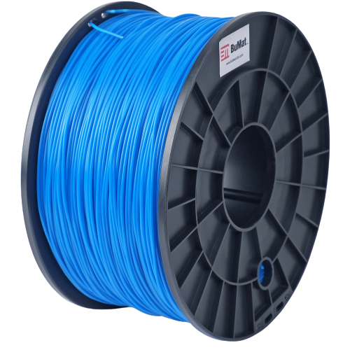
Current Design Space
Model Material Trade
PLA is the best choice for model material based on:
High manufacturability
Low cost and risk of failure
Relatively short manufacturing time
Concerns:
Model accuracy
Part tolerances
1. Project Overview
2. Trade - Video Card
3. Trade - Model
4. Design Space
5. Modeling Plan
Notes:
Presenter: Nate

Slide 36
Preliminary Design Space
Practical Video Card
Jetson Nano
Fairly low cost
Similar to radiation hardened options
Concerns:
Somewhat high power requirements
Software uses unfamiliar programming language
Radiation Hardened Video Card
SP0-S is thus far the best choice for rad hard solution
GEO rated
Cheapest option
Concerns:
Only three spacewire outputs
1. Project Overview
2. Trade - Video Card
3. Trade - Model
4. Design Space
5. Modeling Plan
Notes:
Presenter:

Slide 37
Harnessing Considerations
ScoutCam’s provided camera includes 2 meter USB cable
The Design and Manufacturing Standard for Harnesses [1]
Indicates a maximum of 1 inch diameter harness
Harnessing is often attached via lacing tape or tie wraps
This will be determined by functional mobility of the arm after the arm prototype is built
[1] “DESIGN AND MANUFACTURING STANDARD for ELECTRICAL HARNESSES,” NASA / Goddard Space Flight Center, Engineering Directorate Electrical Harness Working Group, GSFC-733-HARN-01, Rev A, January 1995
1. Project Overview
2. Trade - Video Card
3. Trade - Model
4. Design Space
5. Modeling Plan
Notes:
Presenter: Nate

Slide 38
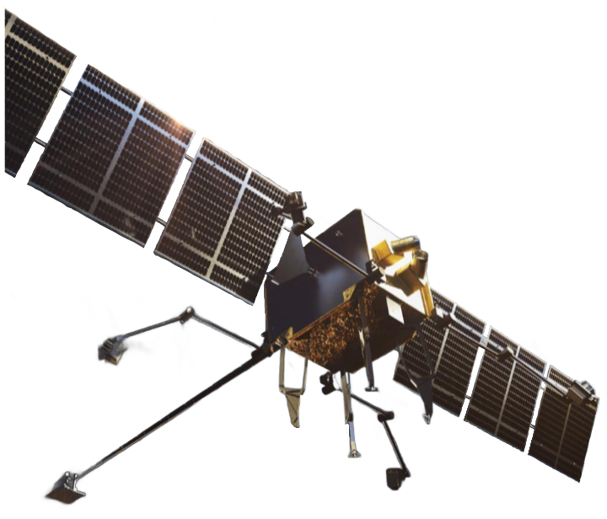
Future Work
Trades to be Completed:
Practical Video Card
Radiation Hardened Video Card
MLI Coating Types
Once a mobile SOLIDWORKS version has been received:
Design the interface between the camera and the arm
Determine the location of the harnessing attachments
Finalize which type of harnessing attachments will be used
Once dimensions and materials of camera housing have been received:
Determine MLI Coating type
Determine how housing will be attached
1. Project Overview
2. Trade - Video Card
3. Trade - Model
4. Design Space
5. Modeling Plan
Notes:
Presenter(s): Nate and Ketan

Slide 39
Modeling and Prototyping Plan
Notes:
Presenter:
Will be doing half-scale 3D printed model, and then a full scale hand out of 6061 aluminum, look into requirements for this section

Slide 40
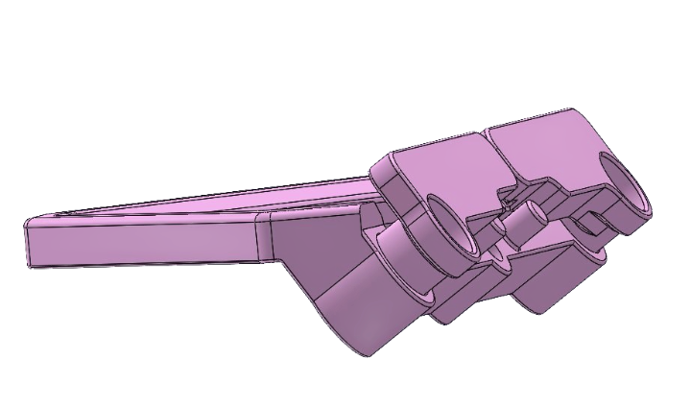
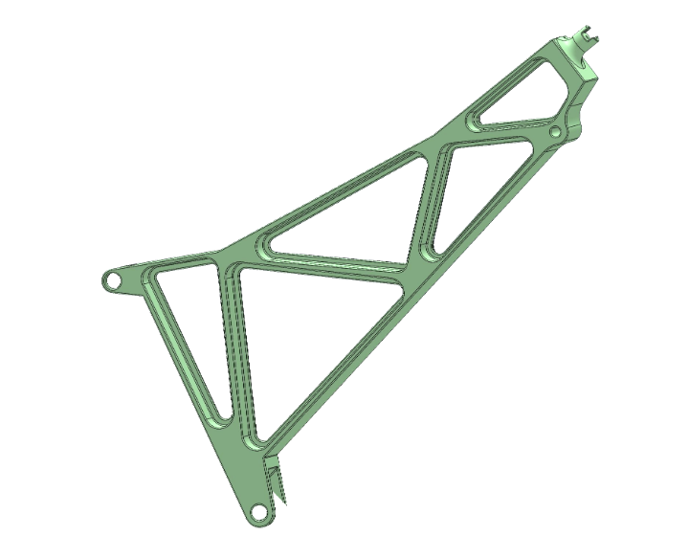
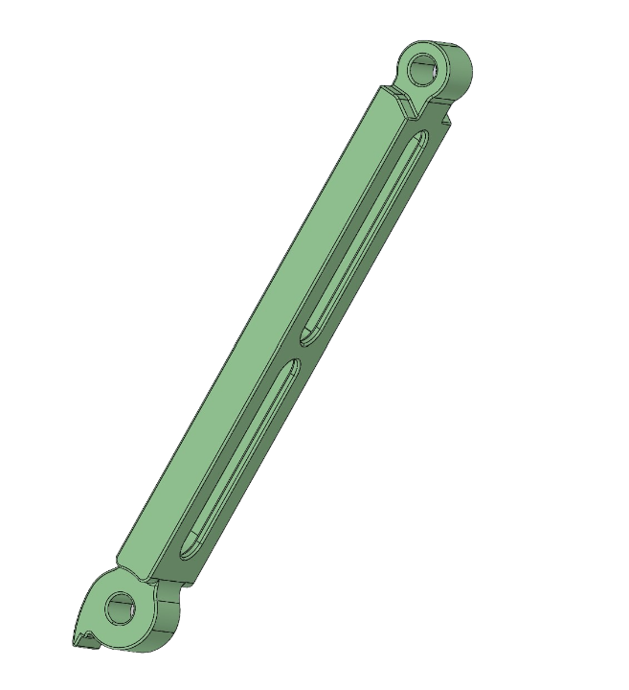
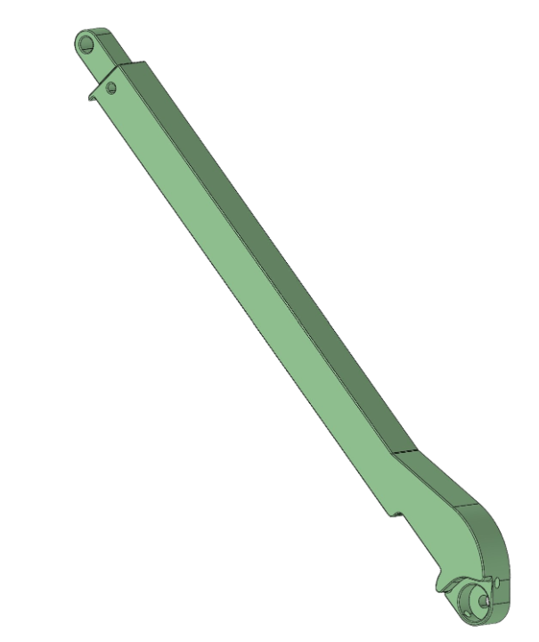
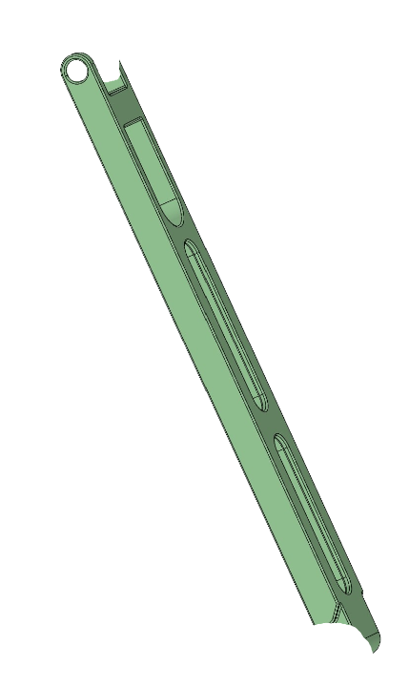
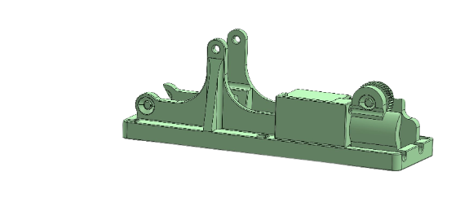
Docking Arm Modeling and Prototyping Plan
(Preliminary)
Full-Scale Arm
Half-scale 3D printed rigid arm (“Prototype”) for proof-of-concept harnessing on deployed layout using Astroscale’s provided SOLIDWORKS arm model
6061 Aluminum hand attached to full-scale arm for vibrations testing and camera interface testing
Still waiting on specifications for vibe testing from Astroscale
Full-scale mobile arm (“Model”) for proof-of-concept on mobility of harnessing
Material TBD
Prepare CAD model for CNC manufacturing
~1m
1. Project Overview
2. Trade - Video Card
3. Trade - Model
4. Design Space
5. Modeling Plan
Notes:
Presenter: Nate
Claw highlighted in pink to differentiate what will be made exactly how it will be irl
Rest is green bc it’s astroscale’s cad

Slide 41
Video Card Modeling and Prototyping Plan
(Preliminary)
Even though the Raspberry Pi Zero 2 W is the best option according to the trade matrix, not using the NVIDIA’s AI capabilities is a lost opportunity to further enhance the solution beyond sponsor expectations
The software and electronics subteam plans to create a design based in the Raspberry Pi Zero 2 W that meets sponsor requirements and potentially incorporate an additional NVIDIA solution in order to enhance the overall solutions’s capability
1. Project Overview
2. Trade - Video Card
3. Trade - Model
4. Design Space
5. Modeling Plan
Notes:
Presenter: Nate
Claw highlighted in pink to differentiate what will be made exactly how it will be irl
Rest is green bc it’s astroscale’s cad

Slide 42
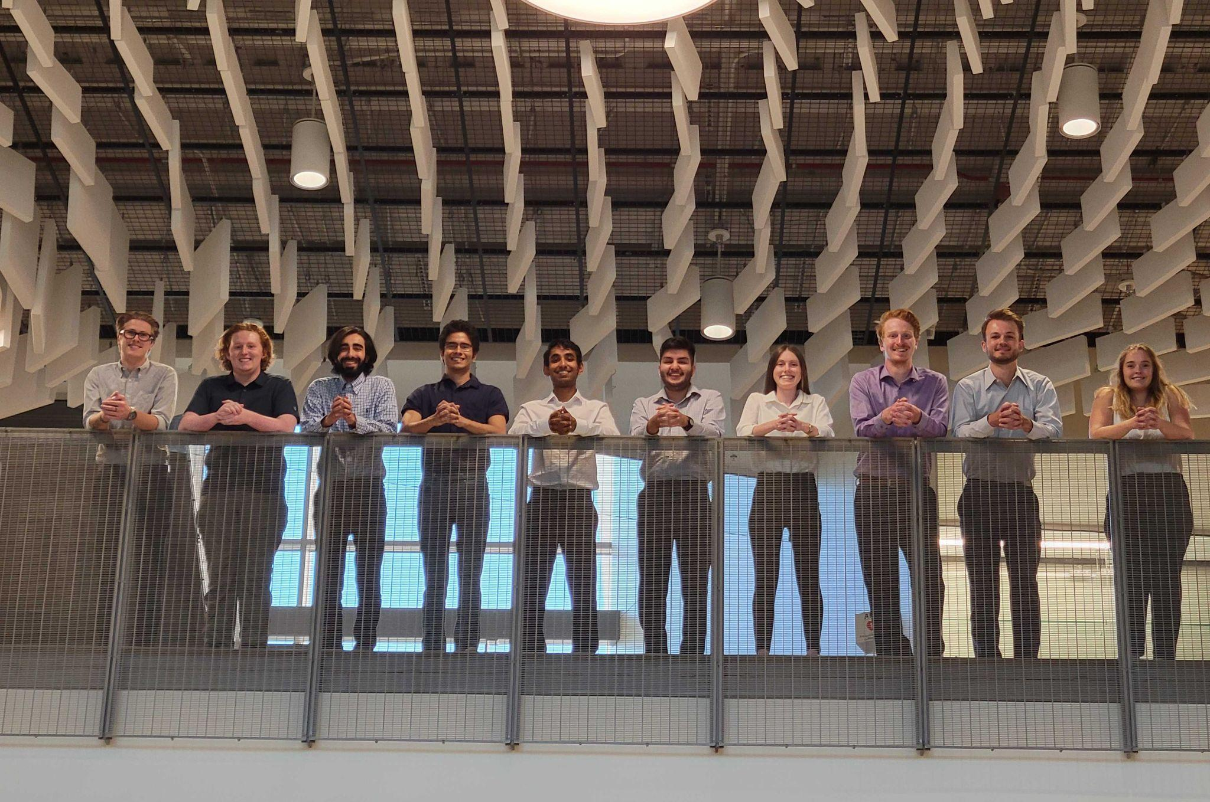
Acknowledgements
Advisors
Dr. Melvin Rafi
Dr. Kathryn Wingate
Dr. Chris Muldrow
Sponsors
Astroscale
Rebecca Griego
Jon Buschur
Teaching Fellows
Andreas Brecl
Jasmin Chadha
Gina Staimer
1. Project Overview
2. Trade - Video Card
3. Trade - Model
4. Design Space
5. Modeling Plan
Notes:
Presenter: Kiley

Slide 43
Questions?

Slide 44
Backup Slides

Slide 45
Risk Matrix Rationale: Impact
Negligible - Effect does not alter progress of mission or an objective
Minor - Effect may cause concern or call for minor adjustments but does
not alter success of an objective.
Moderate - Secondary objective fails
Significant - Primary objective fails
Severe - High level mission fails
High Level Mission:
Successfully dock with client vehicle/successfully move arm into necessary position to dock.
Primary Objectives:
Attach camera to docking arm
Attach harnessing
Secondary Objectives:
Compress video data
This is secondary because the data may not necessarily need to be compressed

Slide 46
Risk Matrix Rationale: Probability
Harness detaches from arm
Thorough modeling and testing makes this event unlikely
Video card cannot compress data
Video card research will ensure it is capable of compressing data, issues may arise with writing software to do so. With code iteration this issue is unlikely
Image received from camera is corrupted/incorrect
More possible due to unforeseen issues with data transfer and local storage that may occur down the line
Camera location impacts ability of arm to dock with satellites
Unlikely with proper modeling
Harnessing interferes with arm mobility
Unlikely with proper modeling
Notes:
Didn’t provide rationale for probability levels because such levels are commonly used in risk analysis and don’t really need rationale - Sam

Slide 47
Model Trade - Weighting Rationale
Material cost: Low concern
Budget is allocated for materials and video card
Low cost-to-total budget ratio
Production time: Medium concern
Harnessing depends on model and prototype build time
Limited build time
Manufacturability: High concern
Model must be feasible to build
Team members must be capable of manufacturing the model
Structural integrity: Medium concern
Model must survive vibration testing
Model must hold its weight
Overall model accuracy: High concern
Model must function as a flight model
Prototype material choice shouldn’t impact geometric accuracy

Slide 48
Video Card-Methodology of Trade Matrix
General Video Card Factors
CPU Performance
Ram
Temperature Range
Increasing Focus
Radiation Hardening
Rad Hard Video Card Factors
Power
I/O Ports
Cost
Practical Video Card Factors

Slide 49
More trades - Mechanical (just a notes slide)
Trades being worked on:
Finding the best MLI coating for the camera housing.
Determine which MLI coating is best to meet the 0-50 celsius rating for the electronics within the black box (camera housing)
Finding the best exposed wire harnessing type
Determine which harnessing type is best to ensure minimal wires interference with the docking arm movement
Criteria being looked for both the harnessing types and coating:
Cost
Functionality
Material
Notes:
Slide created by Mohammed

Slide 50
Trades - Electrical/Software (just a notes slide)
Trades being worked on:
Finding the best compatible video card solution.
Determining if solution is or could be rad-hard (at this stage, looking for rad-hard is extra. We plan on finding a practical solution and developing a rad-hard solution based on that)
Criteria being looked at:
(planning to pick minimum specs based on current research on 09/26)
Cost
GPU type and speed
CPU type and speed
Weight and size
RAM
Temperature range
Power consumption
Other considerations: I/O ports, accessibility, radiation tolerance
Notes:
Notes about research so far:
Most rad-hard solutions seem to be made for LEO, so need to keep digging for GEO rated or figure out how products could be hardened further.
Most solutions found so far seem to be focused on AI-enhanced image processing. This is beyond the scope of our requirements, but means that whatever solution we go with should be more than capable of handling the data that we need to handle. Also gives us the opportunity to go above and beyond if time/energy permits.
Prices are expensive, especially with the current chip shortage. We may have difficulties acquiring whatever solution we go decide on. This isn’t something I think we need to worry about by PDR (we should be looking at all available options atm), but may be a import criteria come CDR.

