Slide 1
ABSTRACT - Preliminary Design Review
Automated Battery System For Testing Reliability And Continuity Tool
Customer: EnerSys / ABSL
October 12th, 2022
ASEN 4018-012 Team 18
Presenters: Jeffrey Azuma, Nick Dembiczak, Hrithik Hiranandani, Alex Miceli, Andrew Peterson
Additional Members: Haotian Chen, Jack Davis, Ryan Gao, Ryan Sievers
Advisor: Matt Rhode

Slide 2
Presentation Outline
Project Description
Trades
Measurement Device
Electrical Switches for Interface Board
Current Design Space
Modeling & Prototyping
Presentation Outline || Project Description || Trades || Current Design Space || Modeling & Prototyping || Summary

Slide 3
Project Description

Slide 4
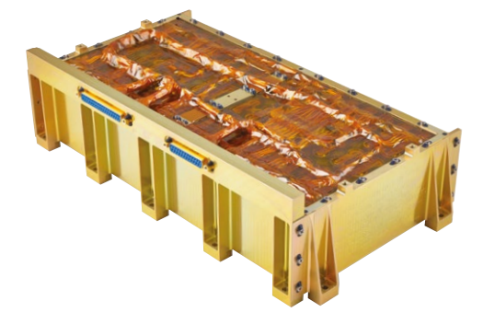
Problem / Need
Battery’s performance is manually tested by Technician
Battery is manufactured
Battery hand-off to customer
Our Goal is to automate Battery Performance Testing
Presentation Outline || Project Description || Trades || Current Design Space || Modeling & Prototyping || Summary
Notes:
NARRATION FOR THIS SLIDE:
EnerSYS is a spaceflight grade lithium-ion battery manufacturer that provides power supplies for spaceflight missions to a variety of customers in the aerospace industry. EnerSys produces batteries that are extremely reliable, and have never had a failure on orbit. In order to test these batteries, technicians must hand test continuity, voltage, resistance, and isolation. For the 8s16p battery, which is one of their smaller batteries and the battery used in this project, validation requires successfully testing 190 discrete pin combinations, up to three separate occasions. This is where ABSTRACT will be useful; creating a fully autonomous process of testing and data storage, saving EnerSys both time money.

Slide 5
Mission Statement
Team ABSTRACT shall provide EnerSYS with a system that can interface with their 8s16p battery, autonomously test the battery for continuity, resistance, voltage, and isolation, and provide data to verify whether or not the battery is qualified for space-flight.
Presentation Outline || Project Description || Trades || Current Design Space || Modeling & Prototyping || Summary

Slide 6
Project Objectives
Presentation Outline || Project Description || Trades || Current Design Space || Modeling & Prototyping || Summary
Notes:
HRITHIK

Slide 7
 | Level 1 | Level 2
Hardware | ABSTRACT interfaces with an 8s16p battery through the required test points for battery testing | ABSTRACT is modular and flexible in design, which enables it to interface with multiple batteries or different kinds of batteries
 | ABSTRACT measures voltage, continuity, resistance, and isolation from each required test point of a 8s16p battery
 | ABSTRACT features a form factor capable of fitting on a standard workbench used by Enersys for battery testing | ABSTRACT’s design is finalized to the point that it has the potential of being a commercialized device
Software | ABSTRACT will start/stop/pause a test under the command of a technician
 | ABSTRACT collects the measured data on voltage, continuity, resistance, isolation, and abnormal/faulty readings, from an 8s16p battery, to enable a technician to judge the flight readiness of the tested battery | ABSTRACT not only collects and measures data on voltage, continuity, resistance, isolation, and abnormal/faulty readings, from an 8s16p battery, but ABSTRACT can also autonomously verify the flight readiness of the tested battery
 | ABSTRACT displays live data acquired during testing in the form of graphs/plots
 | ABSTRACT outputs the results of the battery test in a .csv file | ABSTRACT has the ability to output a result file in any format the user requests
Notes:
HRITHIK

Slide 8
Concept of Operations (CONOPS)
Presentation Outline || Project Description || Trades || Current Design Space || Modeling & Prototyping || Summary
Notes:
HRITHIK

Slide 9
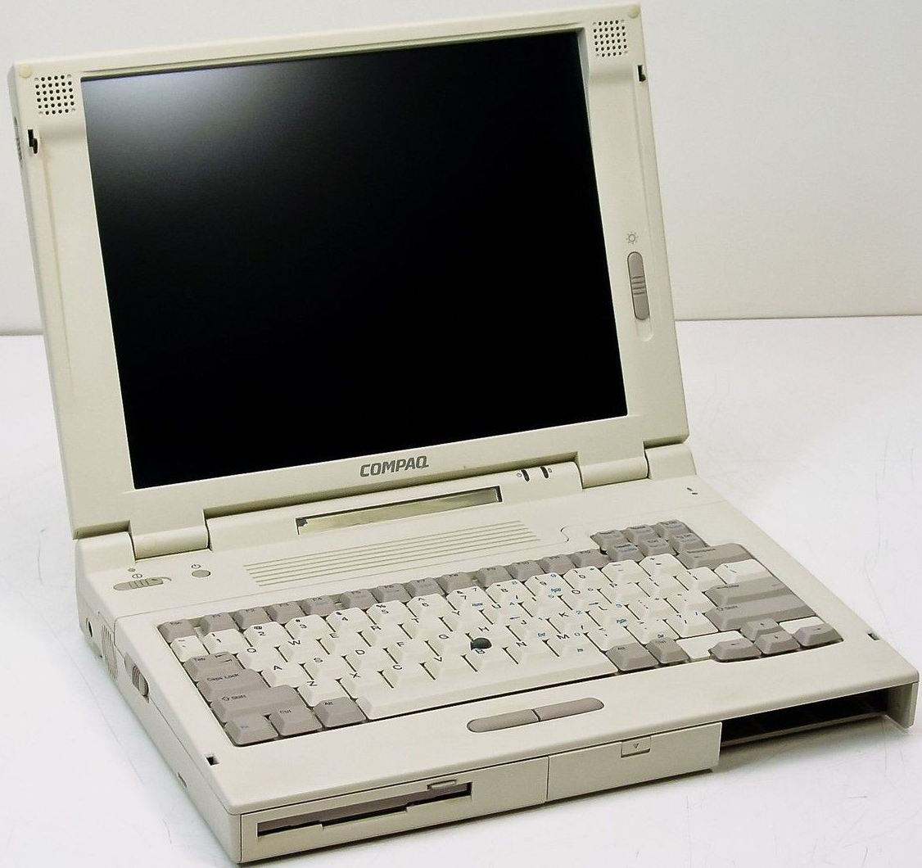
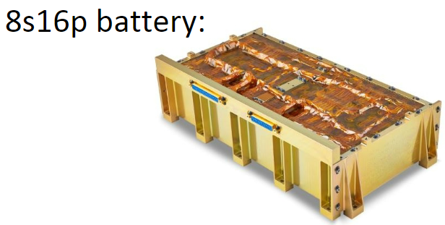
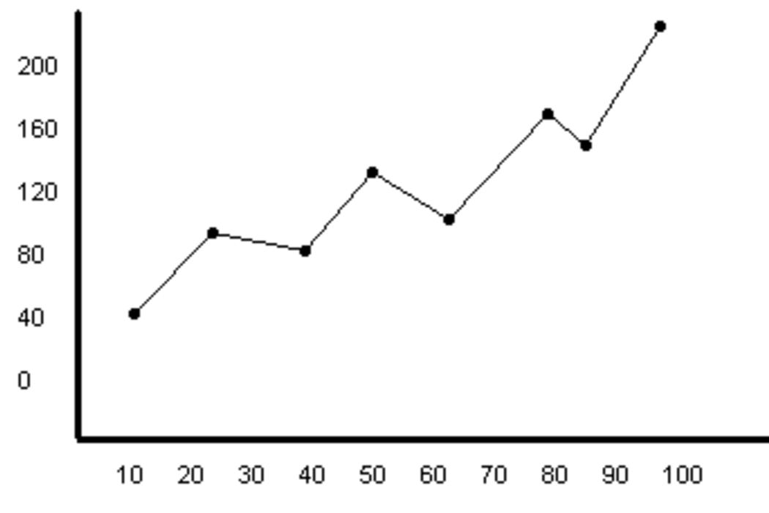
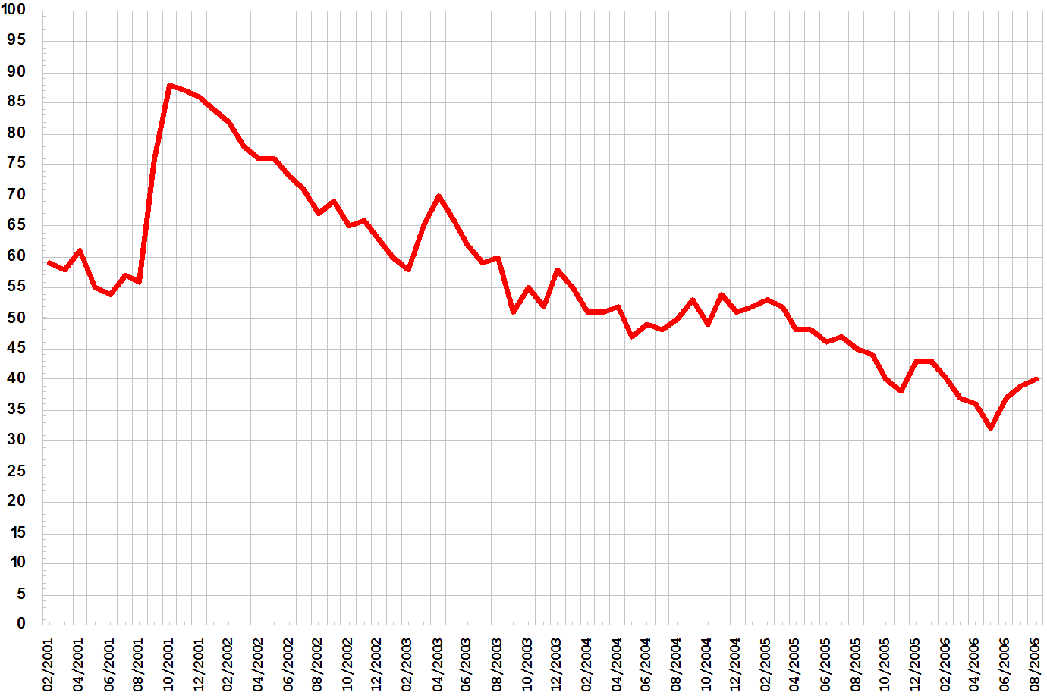
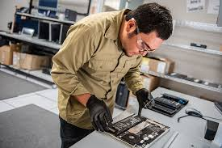
TEST SETUP
TESTING PROCESS
DATA OUTPUT
Pin 3
ABSTRACT
1. Technician connects battery to ABSTRACT.
Pin 15
Live voltage readings
Live current readings
Etc.
3. ABSTRACT runs an algorithm that cycles through the required test points on the 8s16p battery.
5. ABSTRACT displays live data and graphical results.
15V
Result_File.csv
Pin 3 will run for 45s
1.2Ω
ABSTRACT
ABSTRACT
Pin 4 is isolated
4. ABSTRACT measures battery performance.
2. Technician sets up the test to be performed on ABSTRACT
6. ABSTRACT outputs resulting battery data in the form of a .csv file at the end of the test.
Notes:
HRITHIK

Slide 10
High Level Requirements
Presentation Outline || Project Description || Trades || Current Design Space || Modeling & Prototyping || Summary

Slide 11
High Level Requirements
ID | Requirement | Description
R1 | Battery Testing | System shall test battery for continuity, voltage, resistance, and isolation
R2 | Autonomous Testing | System shall autonomously test each individual test point for all performance parameters
R3 | Testing Reliability | System shall not report any false passes or false failures for test criteria
R4 | Product Efficiency | System shall be cost effective compared to current solution
R5 | Power Consumption | System shall not discharge the battery below its nominal voltage range
R6 | User Interface | System shall have technician user interface
R7 | Failure response | System shall respond to test failure by completing full battery test and returning faulty data for technician
R8 | Data display | System shall display live data throughout test
R9 | Data output | System shall have return finalized report of all collected information
R10 | Form Factor | System shall be able to fit on a standard technician workbench
R11 | ESD Compliance | System shall be ESD compliant
R12 | Power Compatibility | System shall employ a power supply compatible with standard wall outlet, ground pin included
R13 | Thermal Control | System shall not cause the battery to exceed operational temperature range
Data
Acquisition
System
A
A
A
A
a
User
Interface
A
A
A
A
A
Lab
Environment
Compatibility
Notes:
EE - let me know your thoughts on the red boxes

Slide 12
Data Acquisition System
1.1 | Battery Testing: System shall test battery for continuity, voltage, resistance, and isolation
1.1.1 | System shall test for power, positive, and negative continuity
1.1.1.1 | System shall test for power continuity by measuring voltage in the range of [24.0V - 33.6V]
1.1.1.2 | System shall test for positive continuity by measure resistance across test points in the range of <1 Ω
1.1.1.3 | System shall test for negative continuity by measure resistance across test points in the range of <1 Ω
1.1.2 | System shall measure voltage across test points in the range of [24.0V-33.6V]
1.1.3 | System shall measure resistance across test points in the range of [0Ω-10kΩ]
1.1.4 | System shall measure isolation by applying a high-voltage across a test point and reaching a steady-state (constant) measurement of voltage and resistance across the test point
1.1.4.1 | System shall measure a constant resistance of >10Ω for 10 seconds
1.1.4.2 | System shall measure exactly 100V for 60 seconds or until resistance measurement is stable (minimum 10 seconds)
Notes:
Level 2 highlighting will not be done on other slides because everything would be highlighted, but on this slide it looks good and will be presented. Thought?
For the timing, is it just those two measurements?
Narrate this slide well to make sure its known this is one flow down example

Slide 13
Critical Project Elements (CPEs)
Presentation Outline || Project Description || Trades || Current Design Space || Modeling & Prototyping || Summary

Slide 14
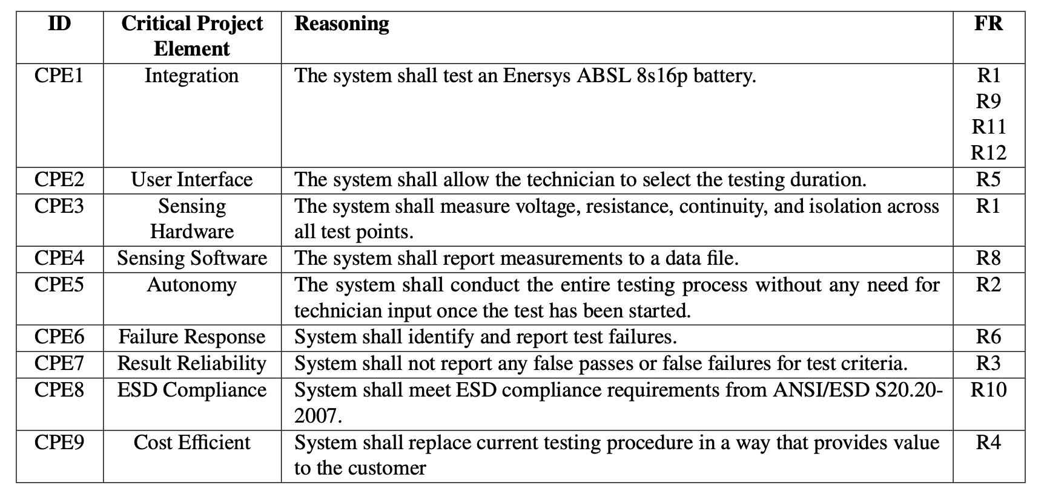
Presentation Outline || Project Description || Trades || Current Design Space || Modeling & Prototyping || Summary

Slide 15
Functional Block Diagrams
Presentation Outline || Project Description || Trades || Current Design Space || Modeling & Prototyping || Summary

Slide 16
Notes:
I am going to pretty this up -AP

Slide 17
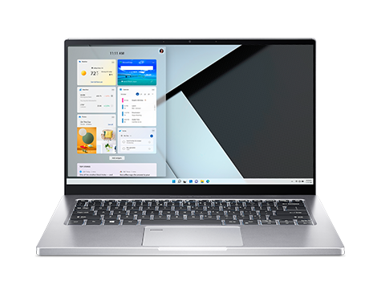
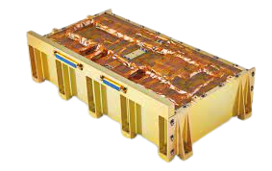
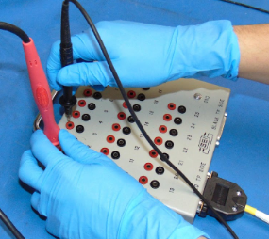
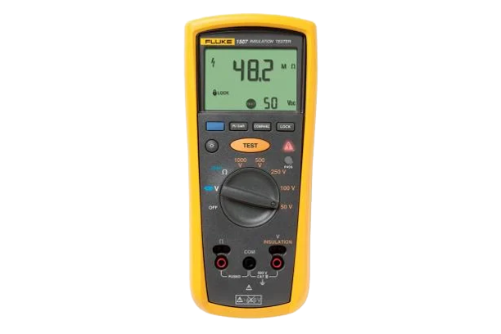
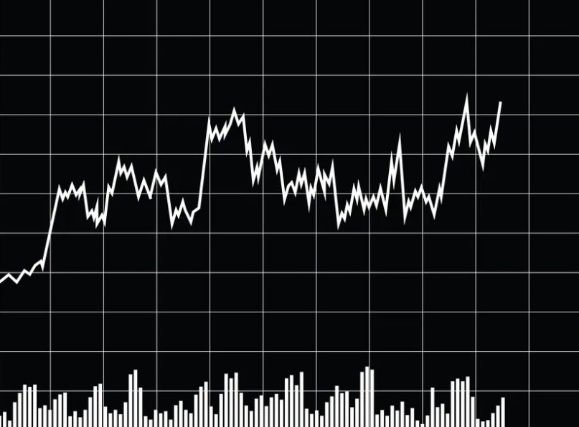
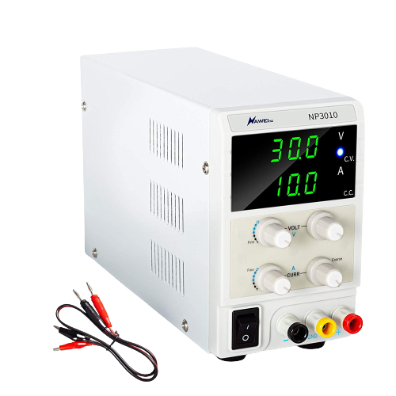
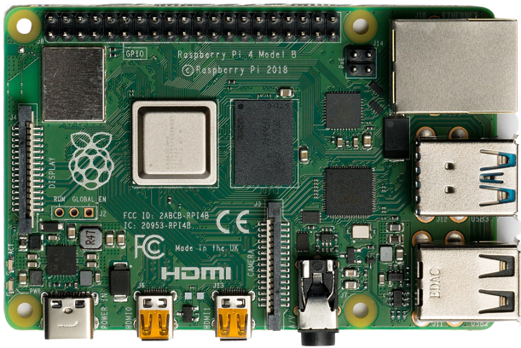
Measurement Device
Measurement Probes
Raw Data
Harnessing
Signal to change measurement type
EnerSys 8s16p Battery
Signal to specify data output parameters
Live Plotting / .csv File Output
Signal to change pin combination
GUI
TBD
Power
Power Supply
Microcontroller
Signal to input specific test parameters
Notes:
This one too -AP

Slide 18
Trade Studies, Design, and Modeling/Prototyping

Slide 19
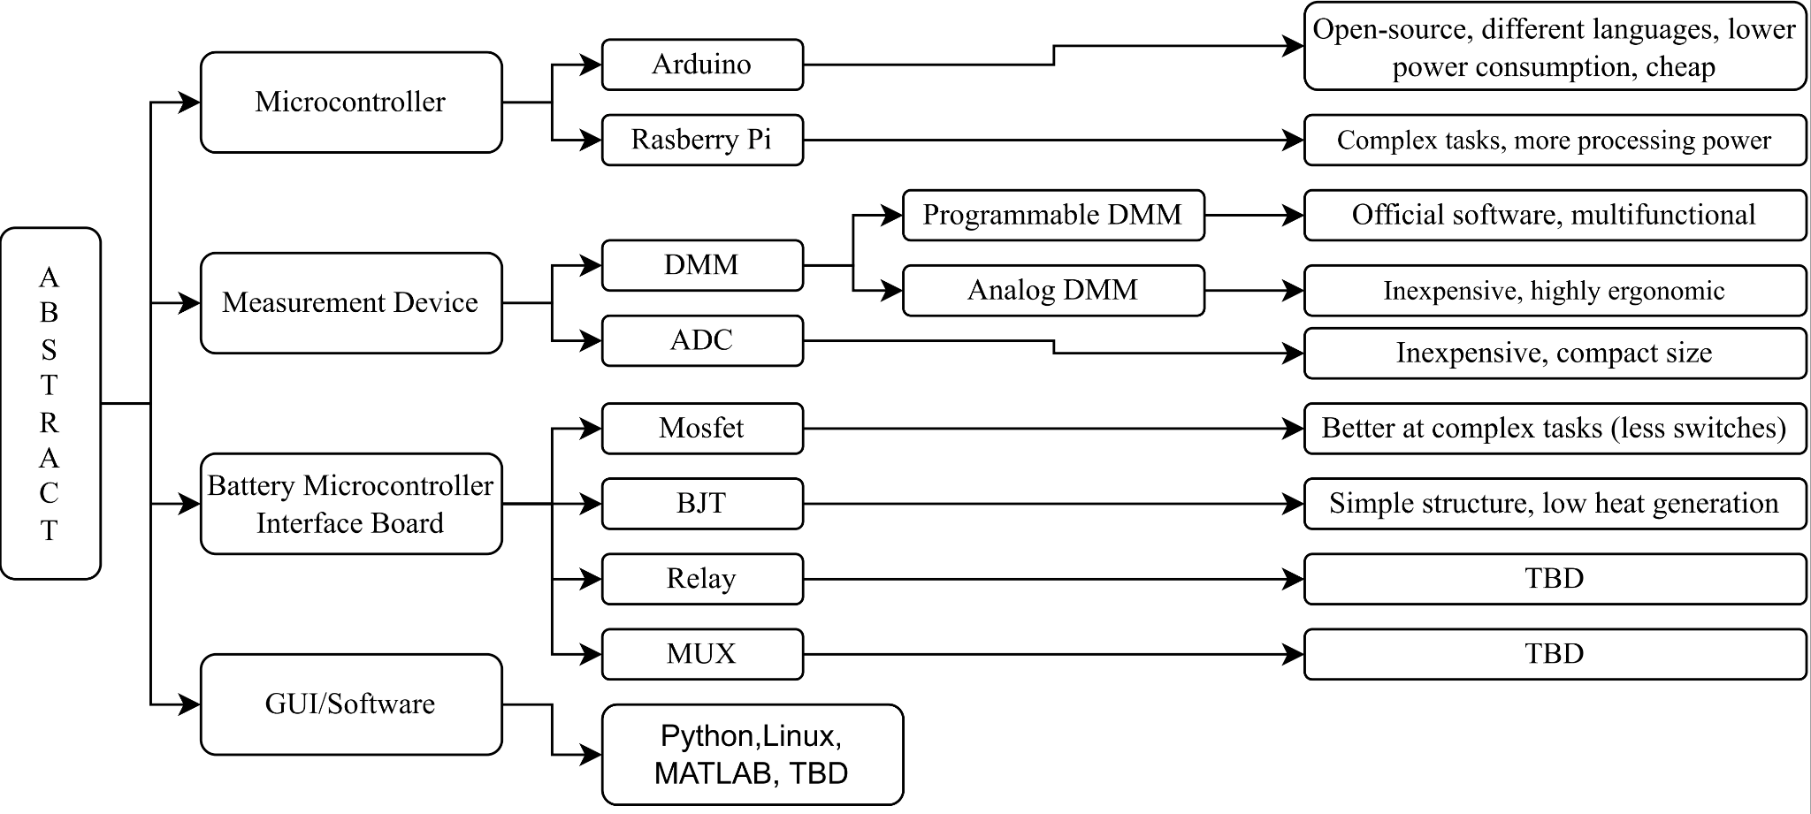
Trade Tree
Presentation Outline || Project Description || Trades || Current Design Space || Modeling & Prototyping || Summary
Notes:
Do we need preferred? Why preferred?

Slide 20
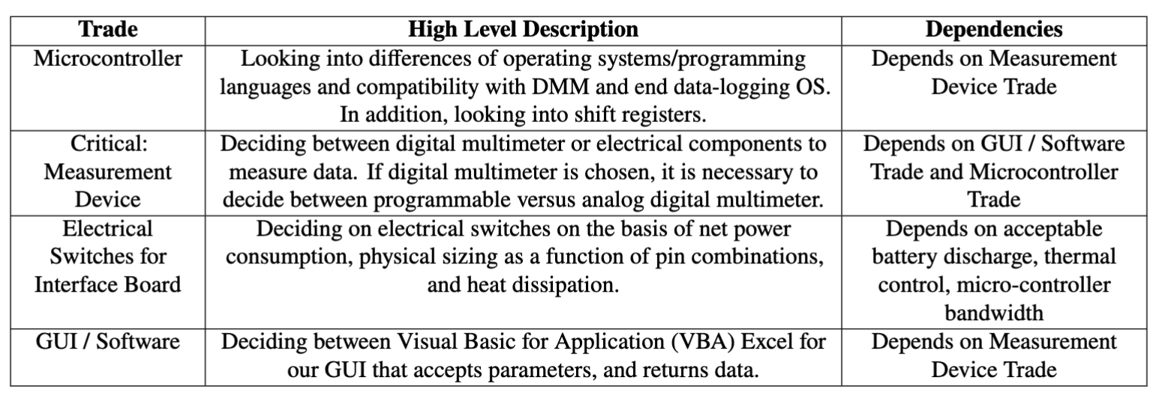
Trade Matrix
Presentation Outline || Project Description || Trades || Current Design Space || Modeling & Prototyping || Summary
Notes:
Make this not ugly

Slide 21
Trade Matrix
Presentation Outline || Project Description || Trades || Current Design Space || Modeling & Prototyping || Summary
Notes:
Make this not ugly

Slide 22
Trade Study: Measurement Device
Key Requirements
The Measurement Device shall:
Automation
Automate the test of an 8s16p battery (CPE 5, R2)
Weight: 40%
Rationale: ABSTRACT’s main purpose is to automate the testing process of a 8s16p battery
Functionality
Acquire voltage, resistance, isolation, and continuity of a 8s16p battery (CPE 3, R1)
Weight: 20%
Rationale: The measurement device must be able to measure the same kinds of data as a manual battery test done by EnerSys
Presentation Outline || Project Description || Trades || Current Design Space || Modeling & Prototyping || Summary
Notes:
Should we introduce new requirements, or should we reference the old ones?
We need continuity within all of our trade studies - similar format, do we do risks with all of them? Could be a good question for TA
Add visual stuff
Make it more visual

Slide 23
Trade Study: Measurement Device
Key Requirements Continued
The accuracy of the data must be comparable to, or surpass the original, manual testing process (CPE 7, R2, R3)
Weight: 20%
Rationale: ABSTRACT would not be useful if the automated results do not provide comparable data quality to the manual tests done by Enersys
Accuracy
Communication
Connect and communicate with a computer and/or microcontroller (R8, R9, R10)
Weight: 10%
Rationale: The measurement solution would not be useful if cannot connect to a processing system that runs the test, but as workarounds could be theoretically developed, it is of relatively low concern
Cost
Measurement device shall keep budget within the cost range (CPE 9)
Weight: 10%
Rationale: Cost is a continuous trade aspect that must be considered; low concern
Presentation Outline || Project Description || Trades || Current Design Space || Modeling & Prototyping || Summary
Notes:
Should we introduce new requirements, or should we reference the old ones?
We need continuity within all of our trade studies - similar format, do we do risks with all of them? Could be a good question for TA
Add visual stuff
Make it more visual

Slide 24
Trade Study: Measurement Device
Risks
Fail to meet the accuracy requirements (Accuracy is TBD)
Fail to communicate with the computing unit
Fail to communicate with the Interface Board
Presentation Outline || Project Description || Trades || Current Design Space || Modeling & Prototyping || Summary
Notes:
Make this not ugly

Slide 25
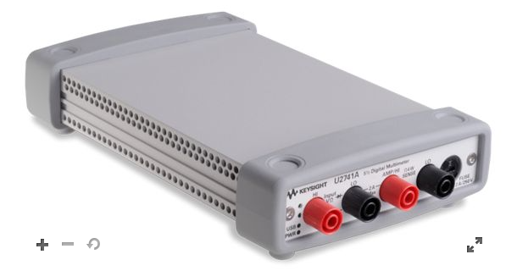
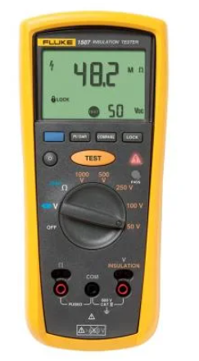
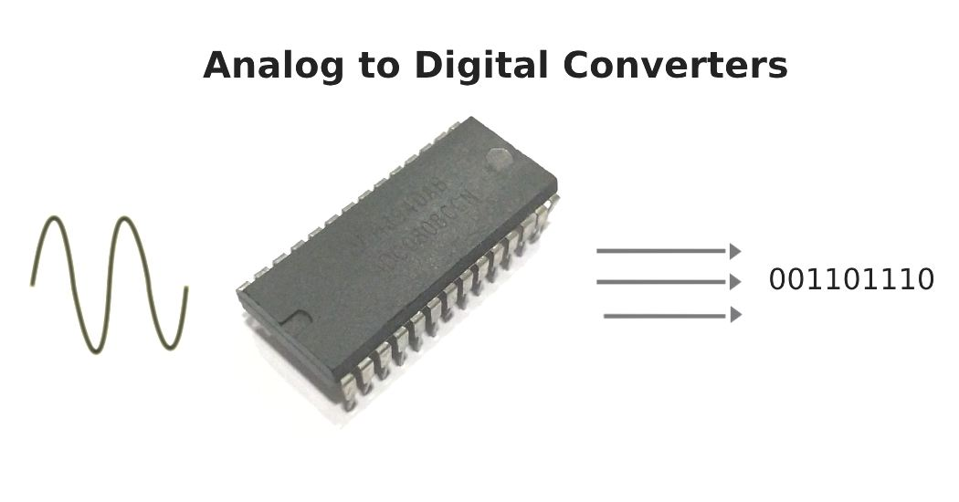
Trade Study: Measurement Device
Options Considered
Potential Solution: Digital Multimeter (Programmable, Analog)
Potential Solution: Analog to Digital Converter (ADC)
Presentation Outline || Project Description || Trades || Current Design Space || Modeling & Prototyping || Summary
Notes:
Make this not ugly

Slide 26
Trade Study: Measurement Device
Metric | 1 | 2 | 3
Automation Availability | Unable to be automated | Capable of being modified to be automated | Fully automated by design
Functionality | Can acquire few, if any of the required battery data | Can acquire some data, or needs multiple of the same solution to acquire all required data | Can acquire all required data for battery testing
Accuracy | Accuracy is significantly inferior to original process [ Over TBD%] | Accuracy is comparable to original process [±TBD%] | Accuracy surpasses original process [within TBD% ]
Communication | Cannot communicate to a computer and/or microcontroller | Could be modified to communicate to a computer and/or microcontroller | Capable of communication with a computer and/or microcontroller
Cost | Grossly over budget [Over $3000] | Expensive, but within budget [$1000~$2000] | Minimal effect on project cost [Below $1000]
Presentation Outline || Project Description || Trades || Current Design Space || Modeling & Prototyping || Summary
Notes:
Make this not ugly

Slide 27
Trade Study: Programmable DMM
Trade Aspect | Weight | Ratings | Comments
Automation Availability | 40% | TBD | Need research on how to control a programmable DMM
Functionality | 20% | TBD | Can measure current, voltage, resistance
Accuracy | 20% | TBD | Need research on measurement accuracy
Communication | 10% | TBD | USB port, official software support
Cost | 10% | TBD | Expensive
Overall Rating: TBD
Presentation Outline || Project Description || Trades || Current Design Space || Modeling & Prototyping || Summary
Notes:
If your trade is not to this point, make that clear and fill out as much as you can and we can narrate it from there
Reason of 4 star on comm: don’t know if it’s easy to interact with keysight sofeware

Slide 28
Trade Study: Analog DMM
Trade Aspect | Weight | Ratings | Comments
Automation Availability | 40% | TBD | Likely needs a mechanical device for cycling measurement modes
Functionality | 20% | TBD | Designed for human use, thus highly ergonomic
Accuracy | 20% | TBD | EnerSys uses an analog DMM for their manual battery test
Communication | 10% | TBD | Computer data link capabilities depend on model
Cost | 10% | TBD | Affordable, depending on model
Overall Rating: TBD
Presentation Outline || Project Description || Trades || Current Design Space || Modeling & Prototyping || Summary
Notes:
If your trade is not to this point, make that clear and fill out as much as you can and we can narrate it from there
Reason of 4 star on comm: don’t know if it’s easy to interact with keysight sofeware

Slide 29
Trade Study: Analog to Digital Converter
Trade Aspect | Weight | Ratings | Comments
Automation Availability | 40% | TBD | Need research on how to control ADCs
Functionality | 20% | TBD | Need research on what an ADC can measure in a circuit
Accuracy | 20% | TBD | Need research on ADC measurement accuracy
Communication | 10% | TBD | Simple integration with microcontrollers
Cost | 10% | TBD | ADC integrated circuits are low-cost
Overall Rating: TBD
Presentation Outline || Project Description || Trades || Current Design Space || Modeling & Prototyping || Summary
Notes:
If your trade is not to this point, make that clear and fill out as much as you can and we can narrate it from there
Reason of 4 star on comm: don’t know if it’s easy to interact with keysight sofeware

Slide 30
Trade Study: Measurement Device
Final Selection: TBD
Uncertainties:
Interfacing analog DMM with computer
Rate of data collection
Programming the programmable DMM or ADC
Presentation Outline || Project Description || Trades || Current Design Space || Modeling & Prototyping || Summary
Notes:
Make this not ugly

Slide 31
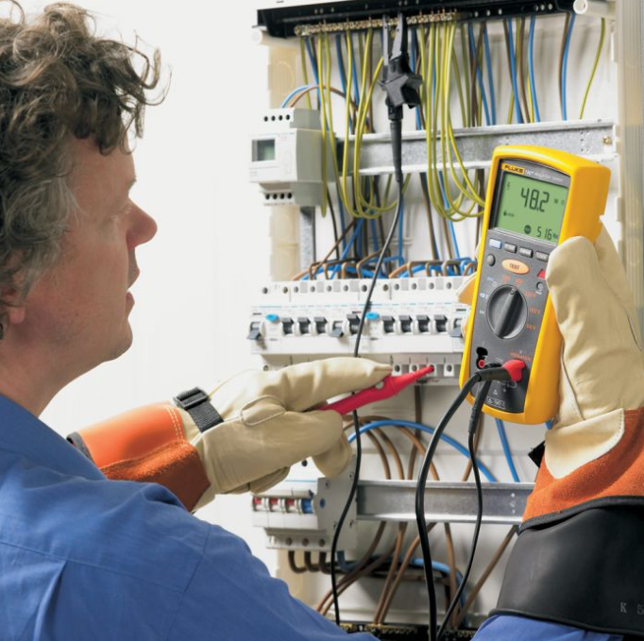
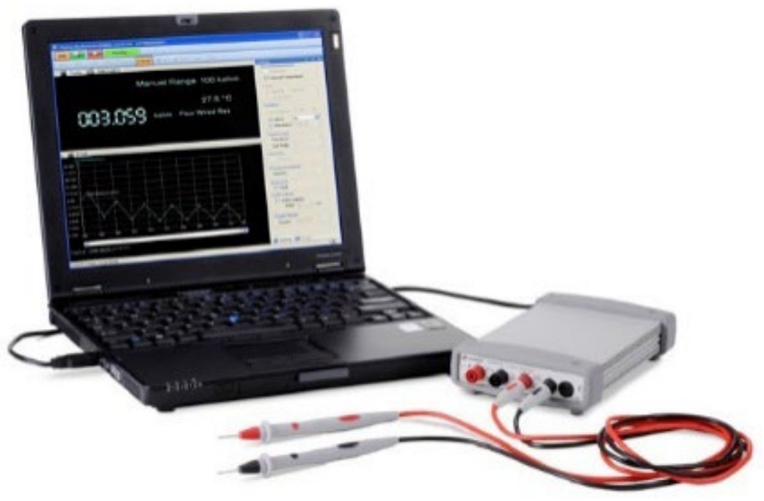
Current Design Space: Measurement Device (DMM)
Example set-up of a Keysight U2741A USB Modular Digital Multimeter
Example setup of Fluke 1507 Insulation Resistance Tester
Presentation Outline || Project Description || Trades || Current Design Space || Modeling & Prototyping || Summary
Notes:
Make this not ugly

Slide 32
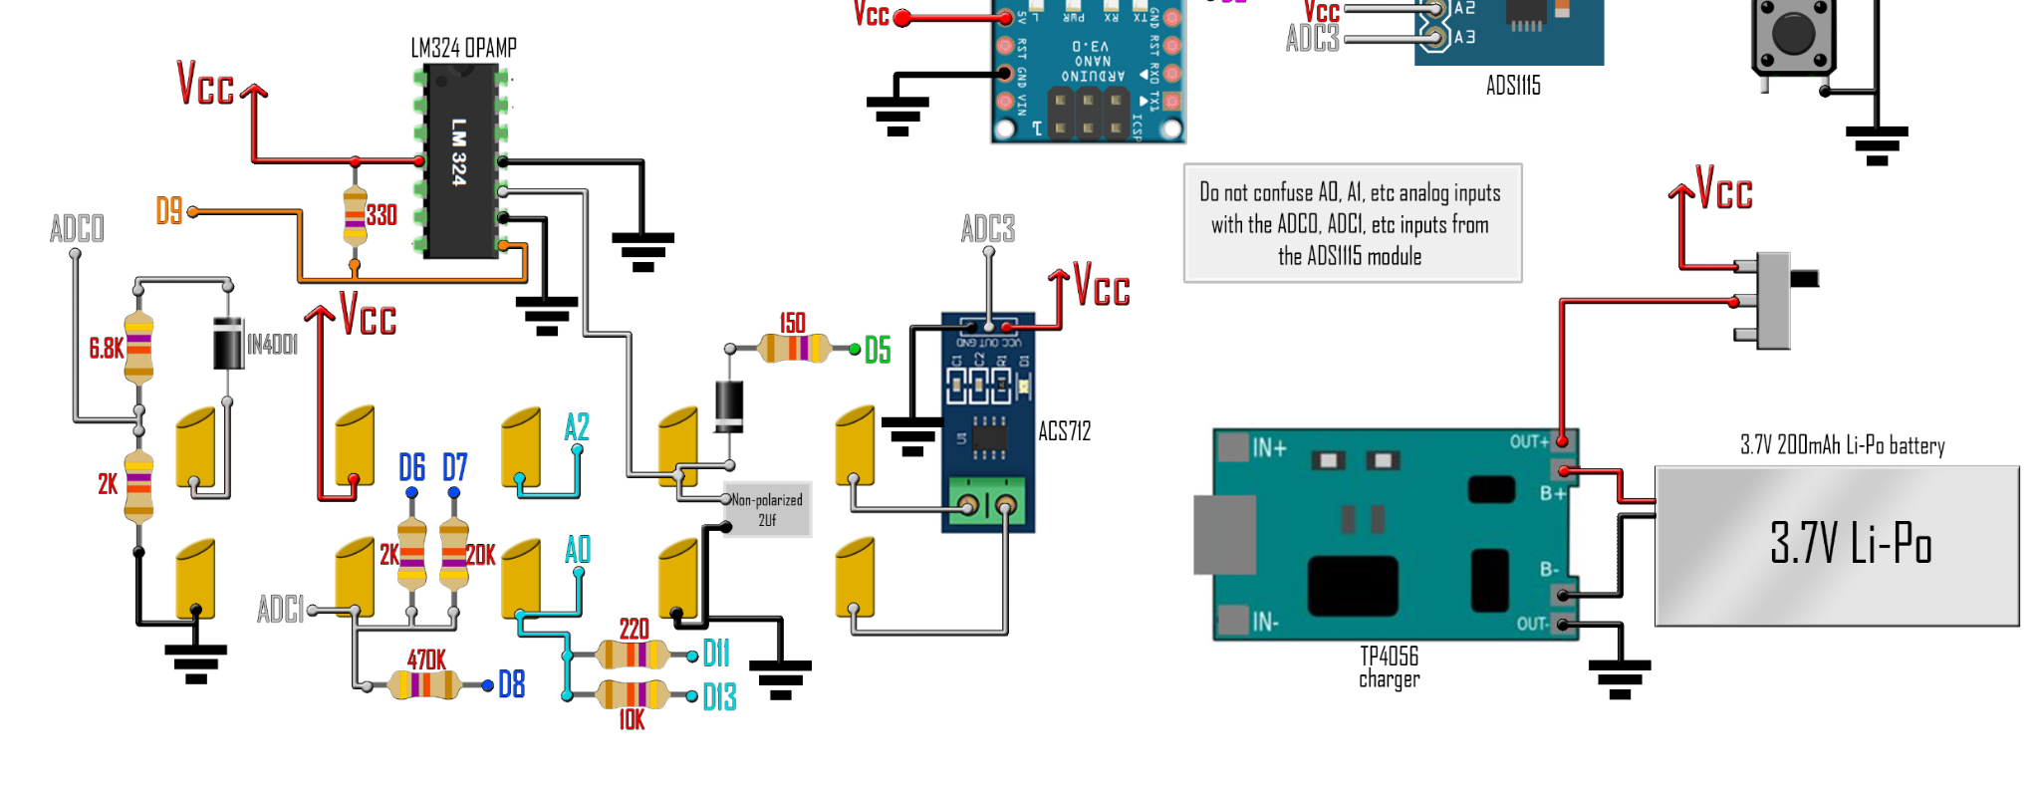
Current Design Space: Measurement Device (ADC)
Sample image of an analog to digital converter based multimeter circuit
Presentation Outline || Project Description || Trades || Current Design Space || Modeling & Prototyping || Summary
Notes:
Make this not ugly

Slide 33
Trade Matrix
Presentation Outline || Project Description || Trades || Current Design Space || Modeling & Prototyping || Summary
Notes:
Make this not ugly

Slide 34
Trade Study: Electrical Switches for Interface Board
Key Requirements
The Interface Board shall:
Power
ABSTRACT will not discharge the battery below its nominal voltage range (R5)
Weight: 45%
Rationale: Power dissipation across the switches discharges the battery, and produces heat which can damage the components & produces error in the system
The interface board will not create significant error in the final measurements (R3)
Weight: 45%
Rationale: Interface Board components (primarily switches) have inherent noise which affect the accuracy of the final measurement
Interface board electrical switches shall keep budget within the cost range (CPE 9)
Weight: 10%
Rationale: Cost is a continuous trade aspect that must be considered, but has relatively low concern
Error
Cost
Presentation Outline || Project Description || Trades || Current Design Space || Modeling & Prototyping || Summary
Notes:
CHECK IF KEY REQUIREMENTS DEPEND ON ANY CPEs
Should we introduce new requirements, or should we reference the old ones?
We need continuity within all of our trade studies - similar format, do we do risks with all of them? Could be a good question for TA
Add visual stuff
Make it more visual

Slide 35
Trade Study: Electrical Switches for Interface Board
Risks
Interface Board discharges the battery below its nominal voltage range [24.0V - 33.6V]
Electrical components on the Interface Board introduce error into battery performance measurements
Presentation Outline || Project Description || Trades || Current Design Space || Modeling & Prototyping || Summary
Notes:
ADD RISKS

Slide 36
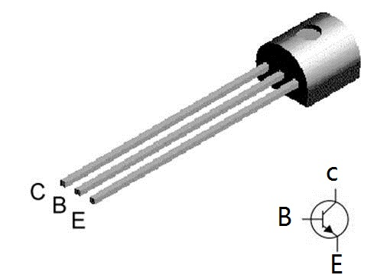
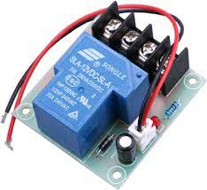
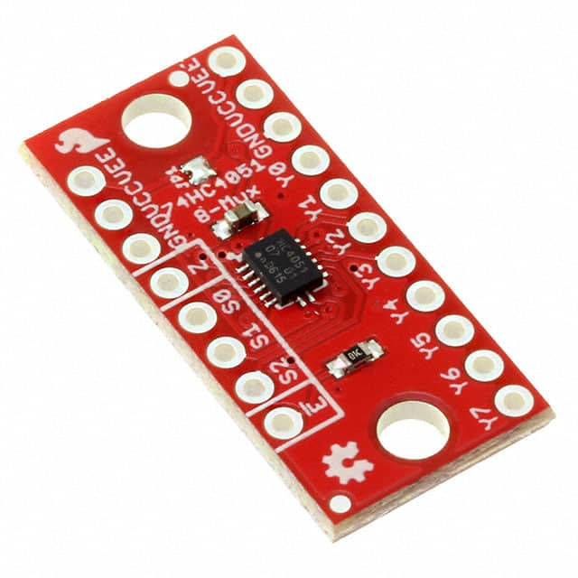
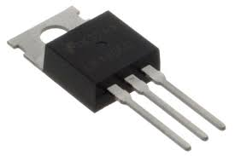
Trade Study: Electrical Switches for Interface Board
Options Considered
Potential Solution: BJTs
Potential Solution: MOSFETs
Potential Solution: Relays
Potential Solution: Multiplexer
Presentation Outline || Project Description || Trades || Current Design Space || Modeling & Prototyping || Summary
Notes:
ADD PICTURES

Slide 37
Trade Study: Electrical Switches for Interface Board
Metric | 1 | 2 | 3
Power Draw | Biggest power draw allowable (TBD) | Better power draw than before (TBD) | Ideal power draw possible (TBD)
Measurement Accuracy | Voltage: +/-0.5% of true value Resistance: +/-0.9% of true value | Voltage: +/-0.5-0.05% of true value Resistance: +/-0.9-0.09% of true value | Voltage: < +/-0.05% of true value Resistance: < +/-0.09% of true value
Cost | Greater than $200 | Between $100 - $200 | Less than $100
*Note: Level 1 Accuracy is derived from datasheet of measurement device currently used at EnerSYS
Presentation Outline || Project Description || Trades || Current Design Space || Modeling & Prototyping || Summary
Notes:
ADD Descriptions?

Slide 38
Trade Study: Bipolar Junction Transistor (BJT)
Trade Aspect | Weight | Ratings | Comments
Power Draw | 45% | TBD | Need more research
Measurement Accuracy | 45% | TBD | Need more research
Cost | 10% | TBD | Cheapest option
Overall Rating: TBD
Presentation Outline || Project Description || Trades || Current Design Space || Modeling & Prototyping || Summary
Notes:
Alex: I know we talked about waiting on Weight/Ratings, but these slides would be really empty. I’ll let you decide

Slide 39
Trade Study: MOSFET
Trade Aspect | Weight | Ratings | Comments
Power Draw | 45% | TBD | Need more research
Measurement Accuracy | 45% | TBD | Need more research
Cost | 10% | TBD | Very cheap
Overall Rating: TBD
Presentation Outline || Project Description || Trades || Current Design Space || Modeling & Prototyping || Summary
Notes:
Alex: I know we talked about waiting on Weight/Ratings, but these slides would be really empty. I’ll let you decide

Slide 40
Trade Study: Relay
Trade Aspect | Weight | Ratings | Comments
Power Draw | 45% | TBD | Need more research
Measurement Accuracy | 45% | TBD | Need more research
Cost | 10% | TBD | More expensive, still very affordable
Overall Rating: TBD
Presentation Outline || Project Description || Trades || Current Design Space || Modeling & Prototyping || Summary
Notes:
Alex: I know we talked about waiting on Weight/Ratings, but these slides would be really empty. I’ll let you decide

Slide 41
Trade Study: Multiplexer
Trade Aspect | Weight | Ratings | Comments
Power Draw | 45% | TBD | Need more research
Measurement Accuracy | 45% | TBD | Need more research
Cost | 10% | TBD | More expensive, still very affordable
Overall Rating: TBD
Presentation Outline || Project Description || Trades || Current Design Space || Modeling & Prototyping || Summary
Notes:
Alex: I know we talked about waiting on Weight/Ratings, but these slides would be really empty. I’ll let you decide

Slide 42
Trade Study: Electrical Switches for Interface Board
Final Selection: TBD
Uncertainties:
Transistor implementation with respective battery harness pinouts and the microcontroller
Interdependencies with other subsystems
Presentation Outline || Project Description || Trades || Current Design Space || Modeling & Prototyping || Summary
Notes:
Make this not ugly

Slide 43
Current Design Space: Electrical Switches - Interface Board
Example of BJT Transistor
Example of MOSFET Transistor
Example of Relay Switch
Example of 8 Channel Multiplexer
Presentation Outline || Project Description || Trades || Current Design Space || Modeling & Prototyping || Summary
Notes:
ADD SOMETHING HERE TO DESCRIBE IF OUR DESIGN SPACE CHANGED***

Slide 44
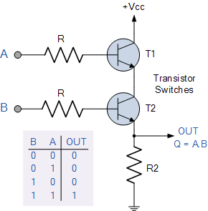
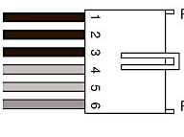
Digital Logic Switch Model: Power Draw from Battery
Power Dissipation through Resistors
Power Dissipation through Transistors
Battery Power Connector
How much battery power is being dissipated from our electrical interface?
Measurement made here: Power is dissipated through measurement device
Presentation Outline || Project Description || Trades || Current Design Space || Modeling & Prototyping || Summary

Slide 45
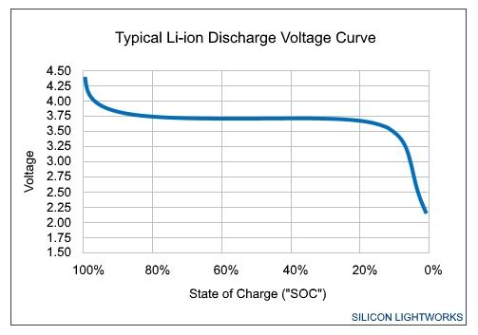
Digital Logic Switch Model: Power Draw from Battery
The EnerSYS battery will naturally discharge over time. Our system will contribute to power dissipation from:
Current flow through transistors
Current flow through resistors
Current flow through measurement device
Presentation Outline || Project Description || Trades || Current Design Space || Modeling & Prototyping || Summary

Slide 46
Digital Logic Switch Model: Power Dissipation from Battery
Mathematical Modeling:
Where
Term 1 represents the total power dissipation from the resistors in the system
Term 2 represents the total power dissipation from the individual measurements and transistors in the system
Presentation Outline || Project Description || Trades || Current Design Space || Modeling & Prototyping || Summary

Slide 47
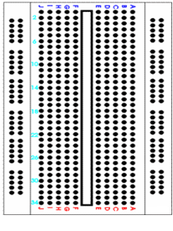
Switch Digital Logic Prototype
Power
Supply
Verifies:
Switches can be used to access discrete pin combinations
Characterizes:
Measurement Error
Presentation Outline || Project Description || Trades || Current Design Space || Modeling & Prototyping || Summary
Notes:
HRITHIK

Slide 48
Summary

Slide 49
Summary: Completed Work
Trade Studies
Parts of each study
Microcontroller
Project Description
Problem/Need
Objectives
CONOPS
Requirements
FBDs
Preliminary Design Document
Presentation Outline || Project Description || Trades || Current Design Space || Modeling & Prototyping || Summary
Notes:
Make this not ugly

Slide 50
Summary: Remaining Work
Trade Studies
Measurement Device
Electrical Switches for Interface Board
GUI
Prototyping & Modelling
Power Draw (Digital Switch Logic)
Switch Digital Logic
Daisy Chain (Microcontroller Trade)
Critical Design Review
Presentation Outline || Project Description || Trades || Current Design Space || Modeling & Prototyping || Summary
Notes:
Make this not ugly

Slide 51
Thanks

Slide 52
Appendix Slides

Slide 53
Functional Requirements

Slide 54
High Level Requirements
ID | Requirement | Description
R1 | Battery Testing | System shall test battery for continuity, voltage, resistance, and isolation
R2 | Autonomous Testing | System shall autonomously test each individual test point for all performance parameters
R3 | Testing Reliability | System shall not report any false passes or false failures for test criteria
R4 | Product Efficiency | System shall be cost effective compared to current solution
R5 | Power Consumption | System shall not discharge the battery below its nominal voltage range
R6 | User Interface | System shall have technician user interface
R7 | Failure response | System shall respond to test failure by completing full battery test and returning faulty data for technician
R8 | Data display | System shall display live data throughout test
R9 | Data output | System shall have return finalized report of all collected information
R10 | Form Factor | System shall be able to fit on a standard technician workbench
R11 | ESD Compliance | System shall be ESD compliant
R12 | Power Compatibility | System shall employ a power supply compatible with standard wall outlet, ground pin included
R13 | Thermal Control | System shall not cause the battery to exceed operational temperature range
Data
Acquisition
System
A
A
A
A
a
User
Interface
A
A
A
A
A
Lab
Environment
Compatibility
Notes:
EE - let me know your thoughts on the red boxes

Slide 55
Data Acquisition System
1.1 | Battery Testing: System shall test battery for continuity, voltage, resistance, and isolation
1.1.1 | System shall test for power, positive, and negative continuity
1.1.1.1 | System shall test for power continuity by measuring voltage in the range of [24.0V - 33.6V]
1.1.1.2 | System shall test for positive continuity by measure resistance across test points in the range of <1 Ω
1.1.1.3 | System shall test for negative continuity by measure resistance across test points in the range of <1 Ω
1.1.2 | System shall measure voltage across test points in the range of [24.0V-33.6V]
1.1.3 | System shall measure resistance across test points in the range of [0Ω-10kΩ]
1.1.4 | System shall measure isolation by applying a high-voltage across a test point and reaching a steady-state (constant) measurement of voltage and resistance across the test point
1.1.4.1 | System shall measure a constant resistance of >10Ω for 10 seconds
1.1.4.2 | System shall measure exactly 100V for 60 seconds or until resistance measurement is stable (minimum 10 seconds)
Notes:
Level 2 highlighting will not be done on other slides because everything would be highlighted, but on this slide it looks good and will be presented. Thought?
For the timing, is it just those two measurements?
Narrate this slide well to make sure its known this is one flow down example

Slide 56
Data Acquisition System Cont.
1.2 | System shall autonomously test each test point for all test parameters
1.2.1 | TBD based on electrical vs mechanical design solution
1.3 | System shall not report false passes or false failures for test criteria
1.3.1 | Use statistics to create probability and confidence levels for product success
1.4 | System shall be cost effective compared to current solution
1.4.1 | System shall allow EnerSys to complete battery testing in TBD% of the time it currently takes
1.5 | System shall not discharge the battery below its nominal voltage range
1.5.1 | System shall not discharge the battery below 24V
Notes:
1.3 may not be necessary - will maybe delete
1.5.1 is something we are waiting on EnerSYS to give us. Might be worth reaching out to them

Slide 57
User Interface
2.1 | System shall have technician user interface
2.1.1 | Technician shall be able to start/stop/pause ABSTRACT
2.1.2 | Technician shall be able to view and export data throughout test duration
2.1.3 | Technician shall be able to define test and testing duration
2.1.4 | Technician shall be able to define data post processing options
2.2 | System shall respond to test failure by completing full battery test and returning faulty data for technician
2.2.1 | System shall notify technician of failure via user interface
2.2.2 | System shall notify technician of failed test(s) and pin location(s) in text pop-up on GUI

Slide 58
User Interface Cont.
2.3 | System shall display live data throughout test
2.3.1 | System shall display live data of voltage and resistance vs time
2.3.2 | System shall plot data of voltage and resistance vs time
2.3.3 | System shall display live reading of total time elapsed
Notes:
Ambient temperature reading requirement removed

Slide 59
User Interface Cont.
2.4 | System shall have return finalized report of all collected information
2.4.1 | System shall output raw data in .csv file
2.4.2 | System shall produce tabulated summary report with pass fail criterion
2.4.3 | System shall produce plots of finalized voltage and resistance vs time data
2.4.4 | System shall output the total test time elapsed
Notes:
Maybe do not need 2.4.4 as it relates to temperature

Slide 60
Lab Environment Compatibility
3.1 | Form Factor: System shall be able to fit on a standard technician workbench
3.1.1 | System shall occupy a footprint no larger than (SIZE)
3.2 | ESD Compliance: System shall be ESD compliant
3.2.1 | System shall be ESD compliant relative to the ANSI/ESD S20.20 standard
3.3 | Power Compatibility: System shall employ a power supply compatible with standard wall outlet, ground pin included
3.3.1 | System shall be compatible with any power supply that can integrate to a standard 120V lab bench outlet with ground pin
3.4 | Thermal Control: System shall function within operational temperature range
3.4.1 | System shall operate between the temperatures of [0℃-40℃]
Notes:
If you can find size of footprint that would be great, if not then a TBD works for now
3.1.1 will be referenced to the square footage of a lab bench in PILOT

Slide 61
Trade Study: Microcontroller

Slide 62
Trade Study: Microcontroller
Key Requirements
The Microcontroller shall:
Processing
Possess the processing power to complete the test autonomously (R2, CPE5)
Weight: 40%
Rationale: Different processing speeds, needs to be sufficient for speed of test
Be able to index the interface board to open all pin combinations (R1, R2, CPE3)
Weight: 40%
Rationale: Microcontroller needs to complete entire test with all test points
Be more cost effective than the current solution (R4, CPE9)
Weight: 10%
Rationale: Microcontroller and time spent programming/testing to be minimized
Draw less power than the total amount available (R12)
Weight: 10%
Rationale: Must be able to be powered by a standard wall outlet
Compatibility
Cost
Power
Notes:
Note: relative error for a hot switch compared to the inherent error in a transistor. Which is more, this will help drive which should be weighted higher
Maybe add CPE’s here as well
Add visual stuff
Make it more visual

Slide 63
Trade Study: Microcontroller
Risks
Unable to process all the necessary commands
Not powerful enough to open gates in electronic interface
Not enough digit input/output pins for measurements across all pins
Severe clock delay/error due to large number of pins
Presentation Outline || Project Description || Trades || Current Design Space || Modeling & Prototyping || Summary
Notes:
ADD RISKS

Slide 64
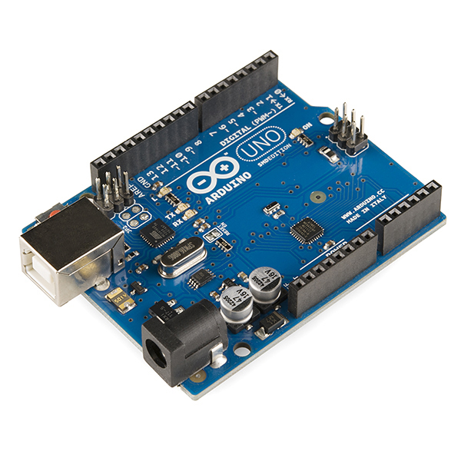
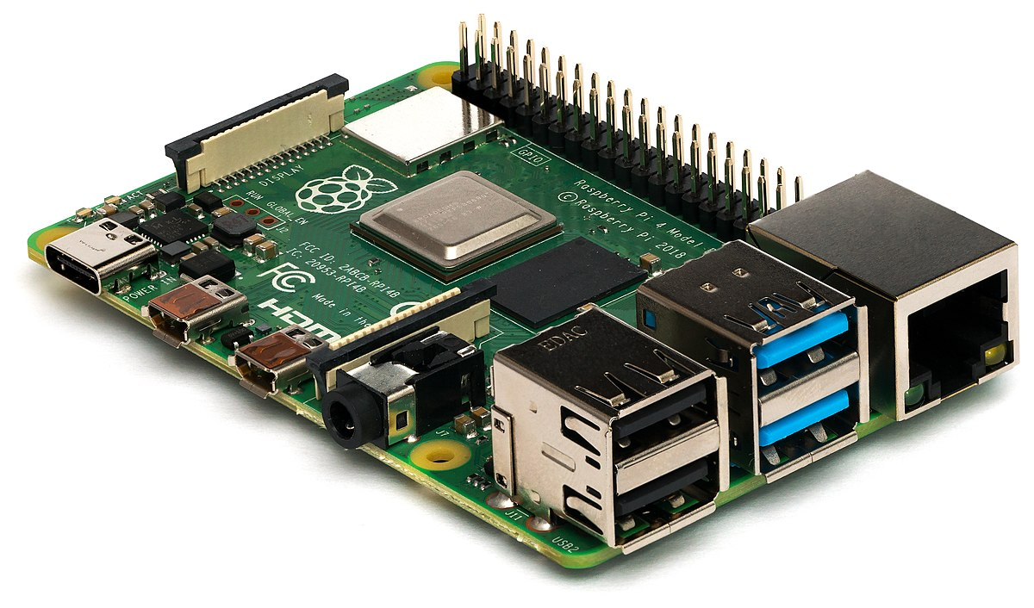
Trade Study: Microcontroller
Options Considered
Potential Solution: Arduino (Microcontroller)
Potential Solution: Raspberry Pi (Microprocessor)
Presentation Outline || Project Description || Trades || Current Design Space || Modeling & Prototyping || Summary
Notes:
ADD PICTURES

Slide 65
Trade Study: Microcontroller
Metric | 1 | 2 | 3
Processor Speed | < 400 MHz | 400 MHz - 1 GHz | > 1 GHz
Compatibility | Closed-source software | - | Open-source software
Cost | > $50 | $10 - $50 | < $10
Power | - | 5V | -
Presentation Outline || Project Description || Trades || Current Design Space || Modeling & Prototyping || Summary
Notes:
ADD Descriptions?

Slide 66
Trade Study: Arduino
Trade Aspect | Weight | Ratings | Comments
Processing | 40% | 1 | 16MHz, 14 digital I/O pins, 8-bit
Compatibility | 40% | 3 | Arduino IDE is open-source
Cost | 10% | 2 | ~$30
Power | 10% | 2 | Standard USB (Regulated 5V)
Overall Rating: 2
Presentation Outline || Project Description || Trades || Current Design Space || Modeling & Prototyping || Summary
Notes:
Alex: I know we talked about waiting on Weight/Ratings, but these slides would be really empty. I’ll let you decide

Slide 67
Trade Study: Raspberry Pi
Trade Aspect | Weight | Ratings | Comments
Processing | 40% | 3 | 1.5 GHz, 40 digital I/O pins, 64-bit
Compatibility | 40% | 1 | Raspberry Pi OS is closed-source
Cost | 10% | 2 | ~$35
Power | 10% | 2 | Standard USB (Regulated 5V)
Overall Rating: 2
Presentation Outline || Project Description || Trades || Current Design Space || Modeling & Prototyping || Summary
Notes:
Alex: I know we talked about waiting on Weight/Ratings, but these slides would be really empty. I’ll let you decide

Slide 68
Trade Study: Microcontroller
Final Selection: Either, but leaning towards Arduino
Uncertainties:
Transistor implementation with respective battery harness pinouts and the microcontroller
Shift registers to access more than 14 digital I/O pins
Interdependencies with other subsystems
Presentation Outline || Project Description || Trades || Current Design Space || Modeling & Prototyping || Summary
Notes:
Make this not ugly

Slide 69
Current Design Space: Microcontroller
Custom microcontroller design and build is too high-risk without team experience building a microprocessing unit
Presentation Outline || Project Description || Trades || Current Design Space || Modeling & Prototyping || Summary
Notes:
ADD SOMETHING HERE TO DESCRIBE IF OUR DESIGN SPACE CHANGED***

Slide 70
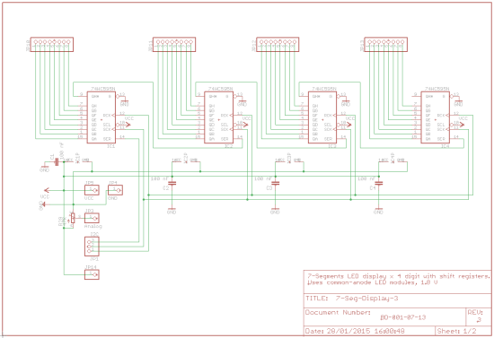
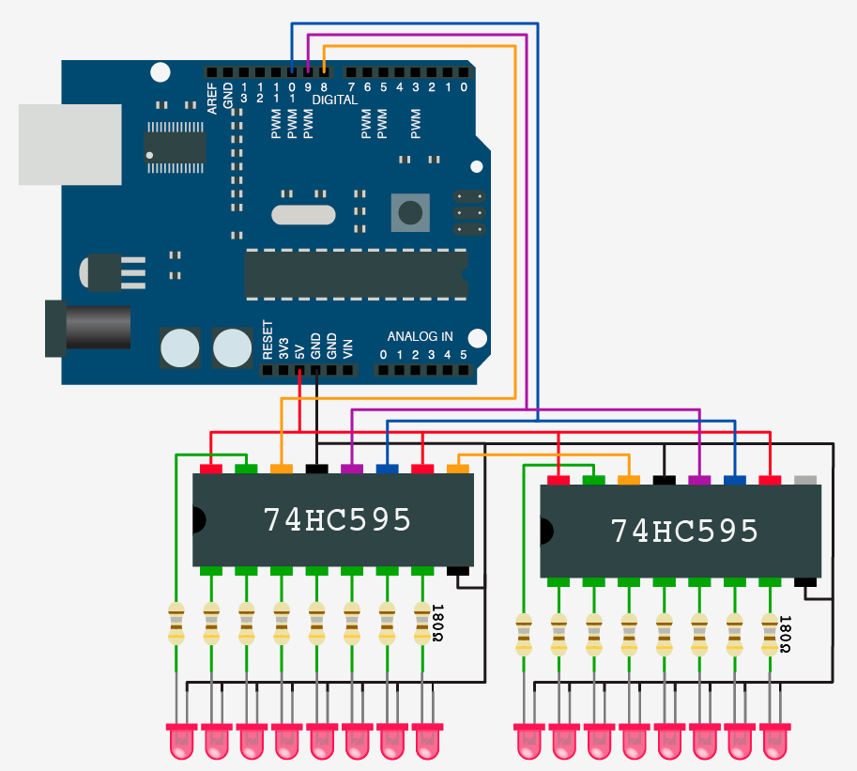
Modeling & Prototyping: Shift-Register Daisy Chain
Presentation Outline || Project Description || Trades || Current Design Space || Modeling & Prototyping || Summary

