Slide 1
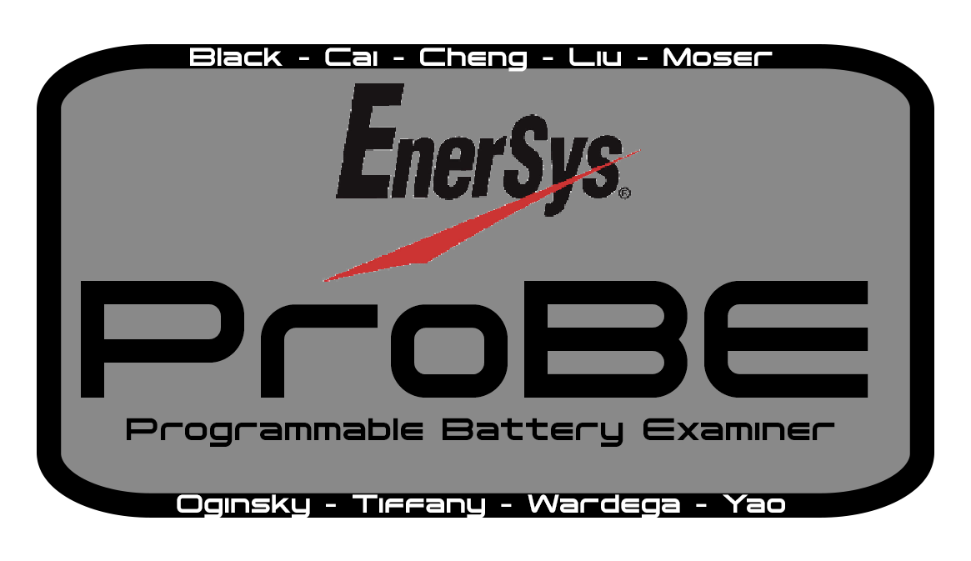
Andruss Black, Qihan Cai, Alex Cheng, Ruize Liu, Joe Moser, Z Oginsky, Walker Tiffany, Bartek Wardega, Zhixing Yao
With Many Thanks to Our Advisor: Matt Rhode
Notes:
I added the main sections of the Format section of the PDR document in the form of the slides bellow. Feel free to create new slides to work on existing requirements and leave the slides detailing the requirements until the team agree that it has been met. This way we make sure we cover everything.

Slide 2
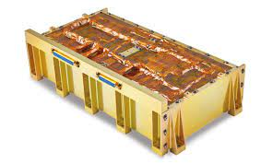
Project Definition and Objectives:
Customer: EnerSys; a global leader in stored energy solutions with a large impact in Aerospace industries [1]
Currently one of their most popular products is the ABSL 18650E35 8s16p Lithium-ion battery.
Objective: ProBE exists to automate the current industry readiness test implemented by EnerSys, for this battery.
The ProBE team is developing an automated functional battery tester that would be used to verify flight readiness of Li-Ion batteries. We aim to provide a GUI controlled tool that would automate this otherwise tedious process in a safe and reliable manner.
EnerSys 8s16p Lithium-ion Battery

Slide 5
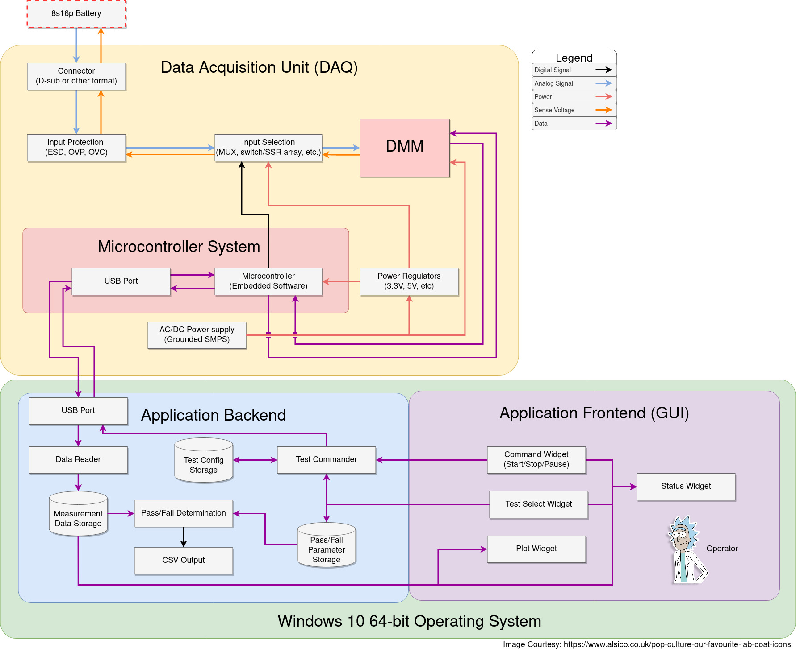
Notes:
Notes:
1. Move power to the end. - Functions first.
2. Practice narration!
3. Matt approves.
4. Be clear and specific
5. Put simplified one on next slide

Slide 6
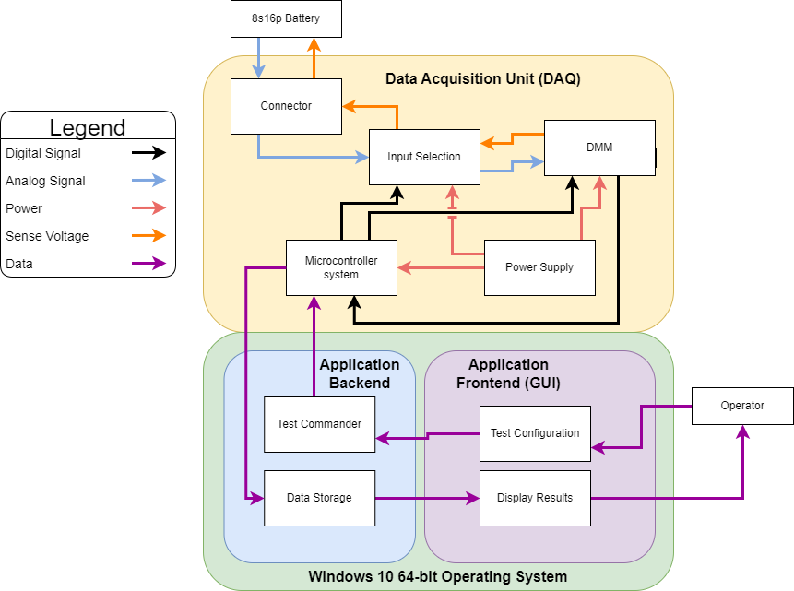
Notes:
Andruss

Slide 7
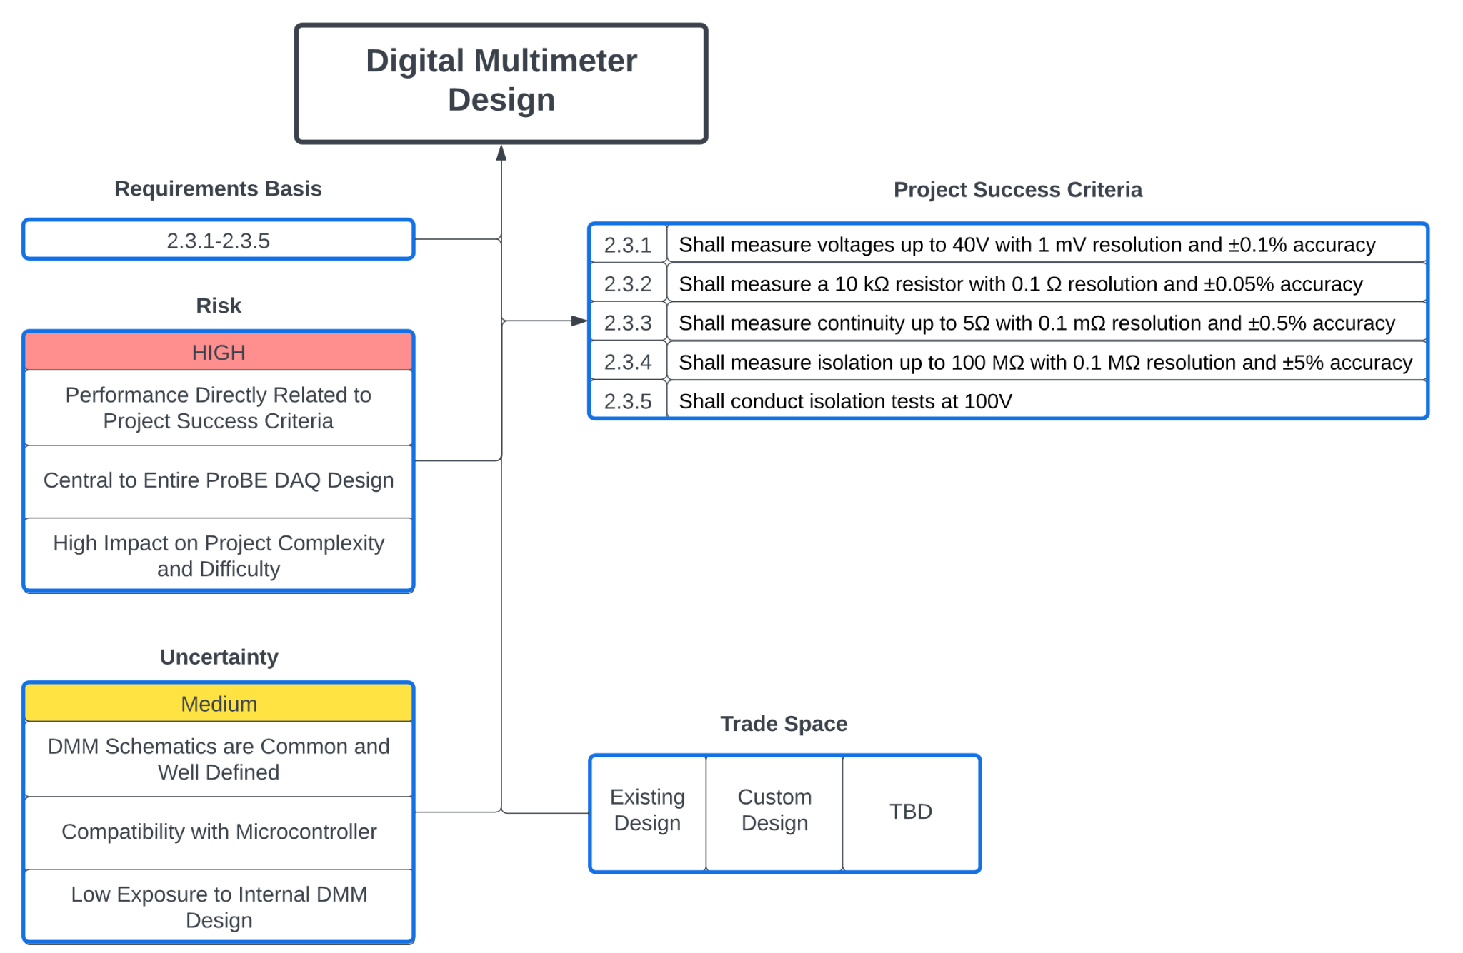
Critical Project Element 1
Notes:
Andruss

Slide 8
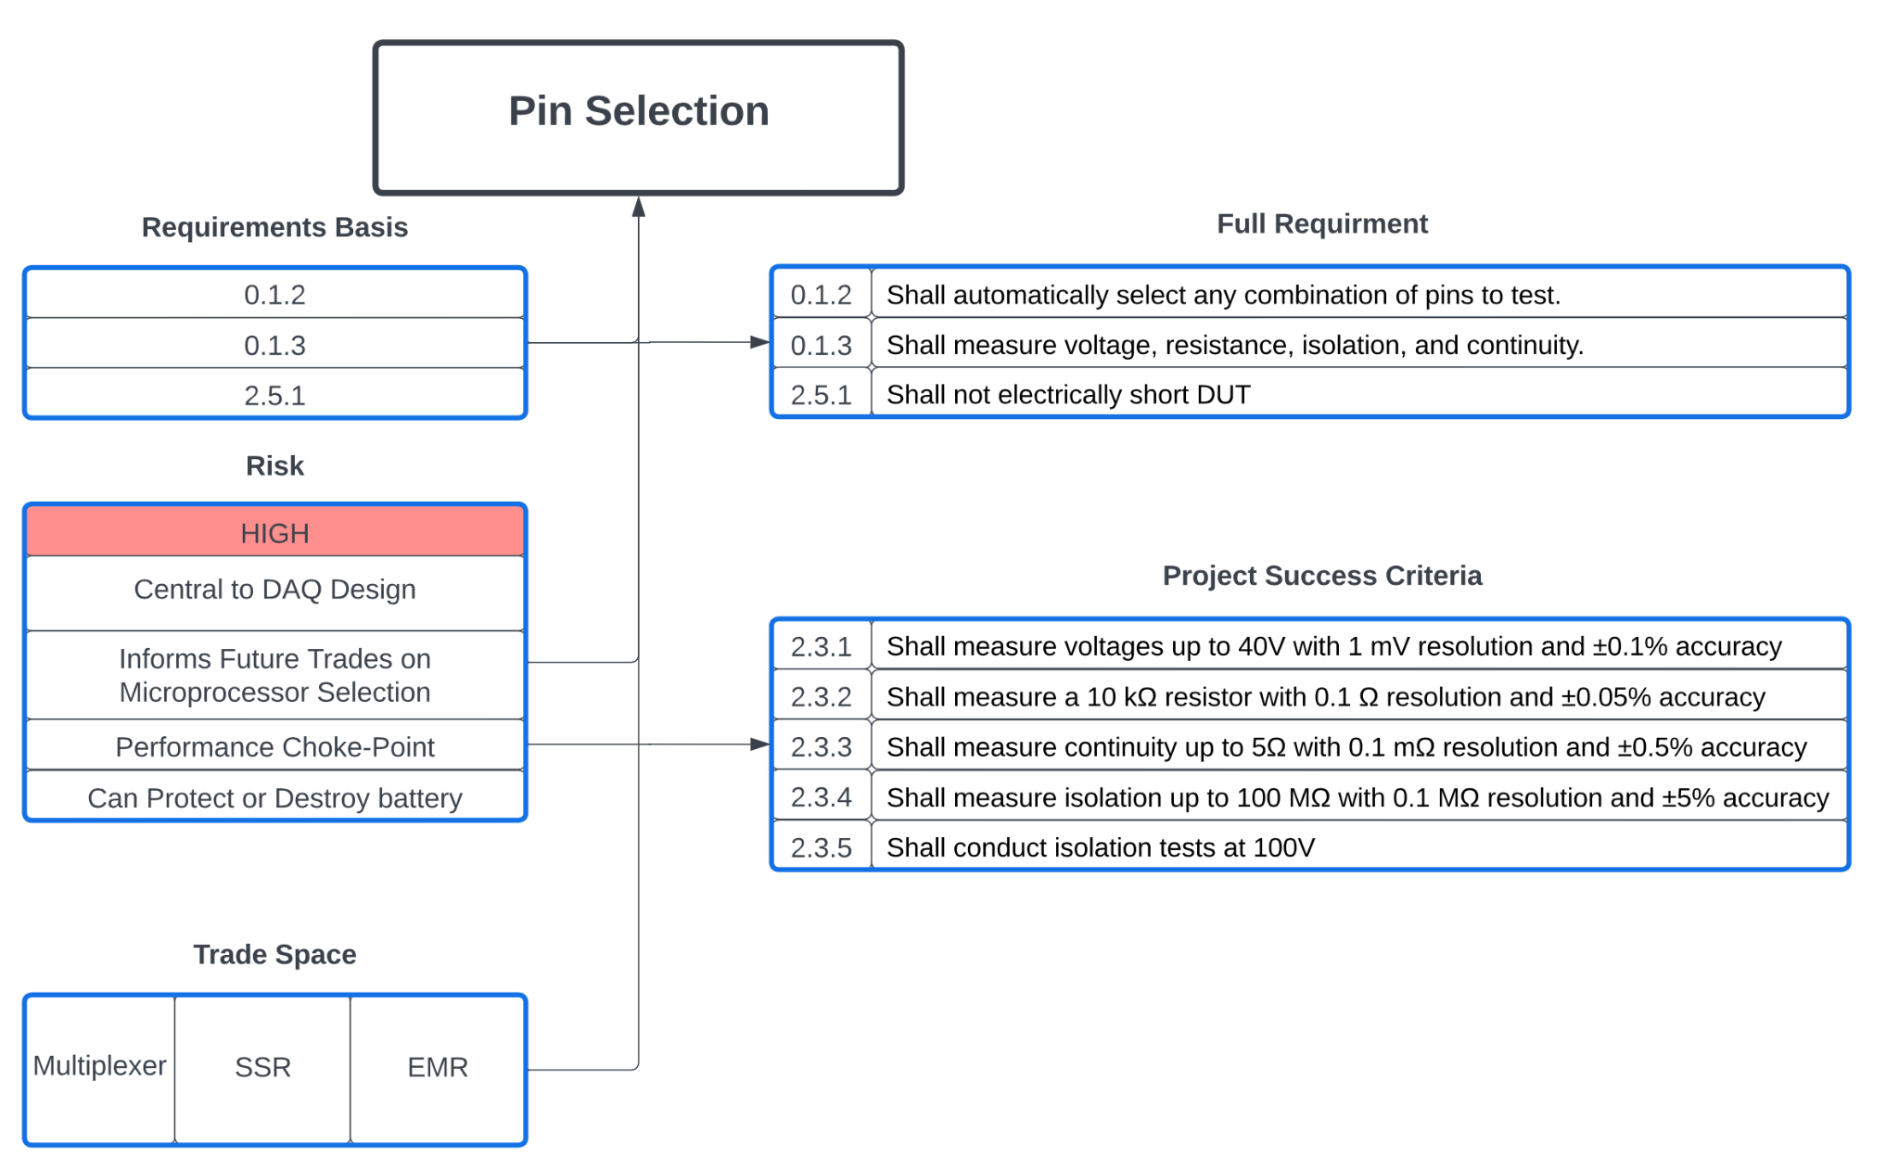
Critical Project Element 2
Notes:
Andruss

Slide 9
Critical Project Elements
E - Electrical P - Physical S - Software
 | CPE |  | Description
CPE1 | Digital Multimeter Design | E | ProBE must be capable of performing all tests to the customer’s requirements – central design point.
CPE2 | Pin Selector Design | E | ProBE must run tests on all pin permutations while providing protection against damage to the battery.
CPE3 | Microprocessor Selection | E | ProBE must provide bespoke control of the entire test process to fulfill the customer’s specific needs.
CPE4 | ESD Protection | P | The system must be robust – resisting interference from external sources while protecting external devices from discharge.
CPE5 | Data Capture | S | Signal information must be stored and exported to a csv file accessible by external systems.
CPE6 | User Interface | S | The user must be able to interact with the system to manage tests and configurations, as well as export data.

Slide 10
Systems Level FBD
Notes:
Based on FBD
Just give a simple explanation of what has been done so far and how our project is taking shape
I am going to show the simplified FBD and talk about the basic steps we have to solve the problem currently. Also ask about the FBD and any changes Matt would make and if it is even necessary.
Walker

Slide 11
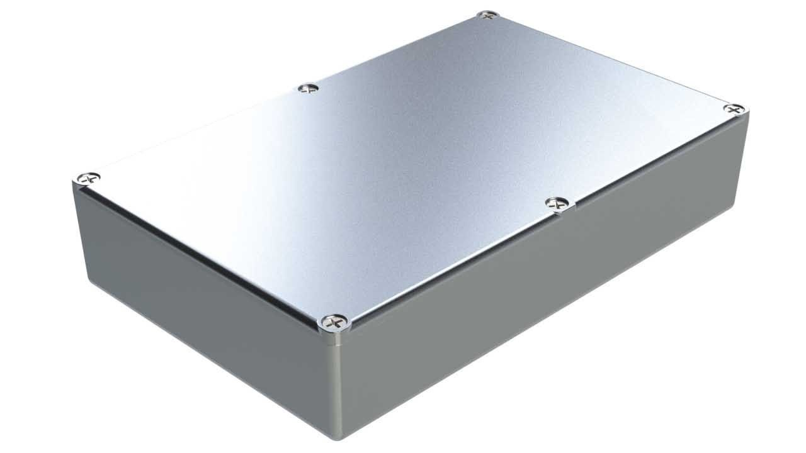
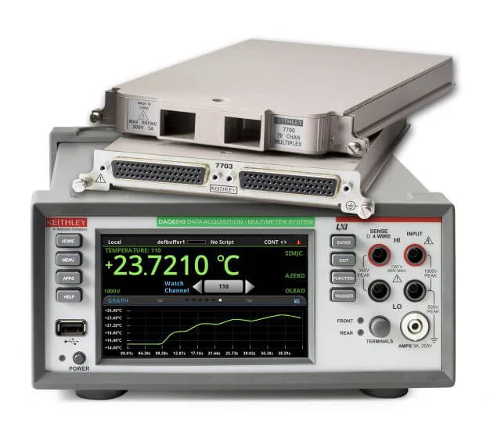
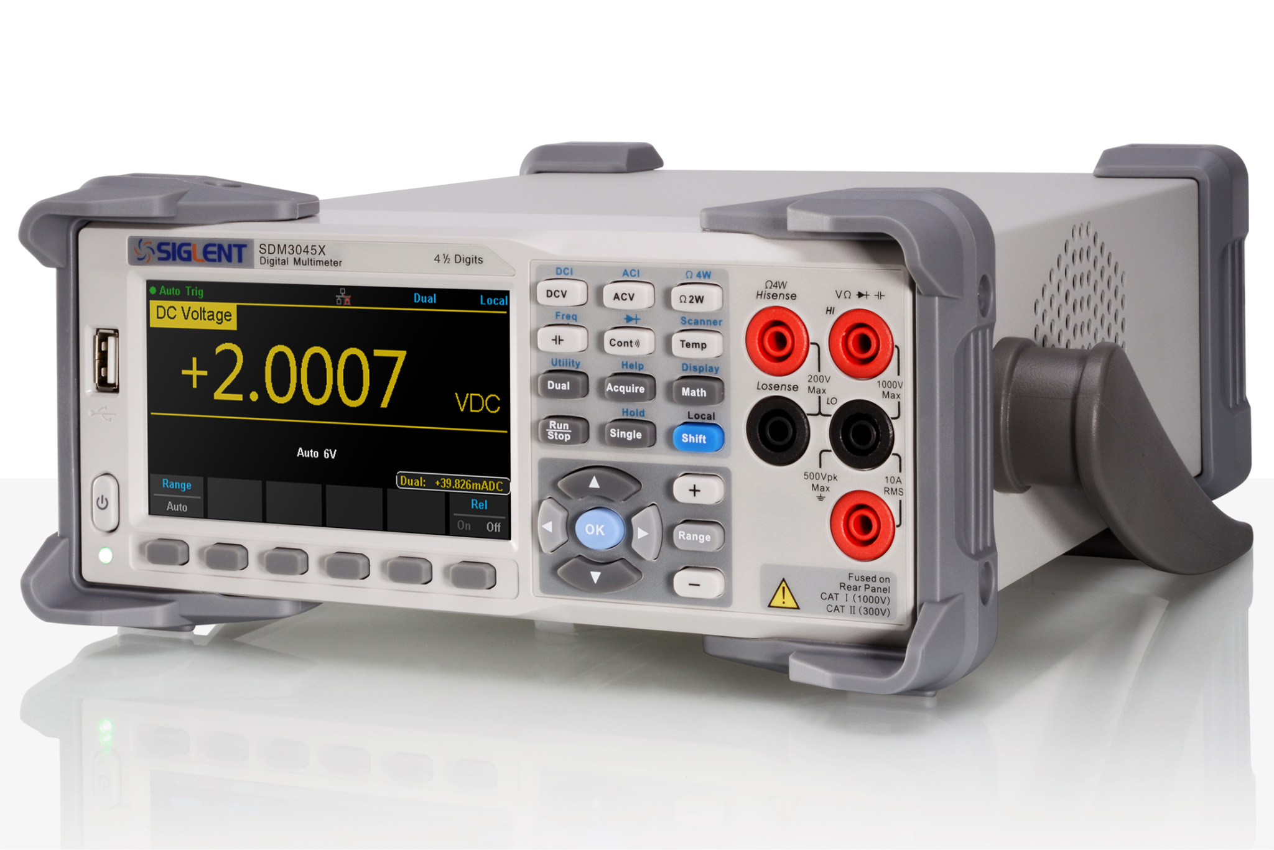
DAQ Architecture
Off the Shelf DMM with Input Selection Module
Off the shelf DMM and Custom Input Selection Module
Custom DMM and Input Selection Module
Custom Input Selection Module
Custom DMM and Input Selection Module
Design Complexity
Cost

Slide 12
DAQ Architecture Trade Results

Slide 13
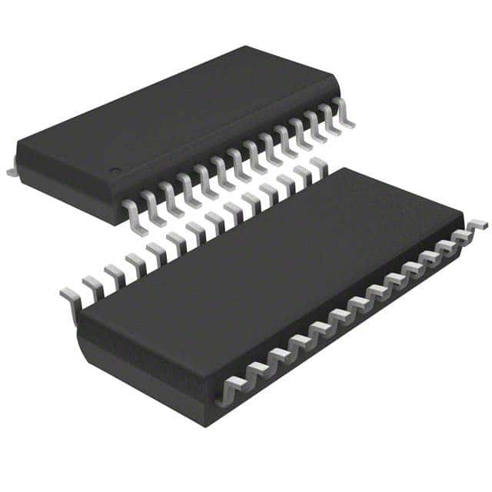
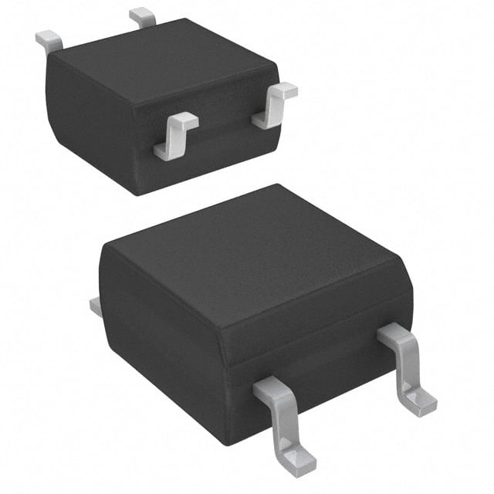
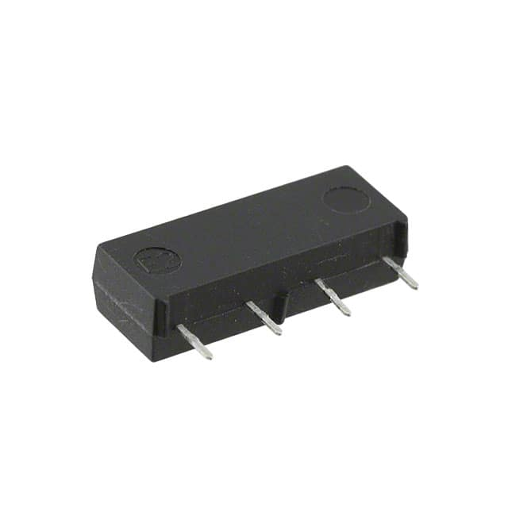
Input Selection Trade
Requirements:
0.1.2 - Shall automatically select any combination of pins to test
1.1.4 - Shall not short battery power pins
C.3 - Shall have a footprint no larger than that of a laptop
16:1 Analog Multiplexer (MUX)
Solid State Relay (SSR)
Electromechanical Relay (EMR)

Slide 14
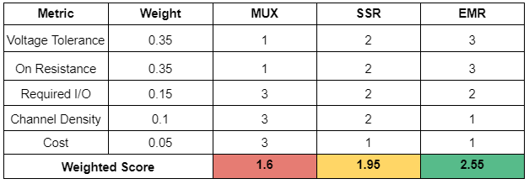
Input Selection Architecture Final Matrix

Slide 15
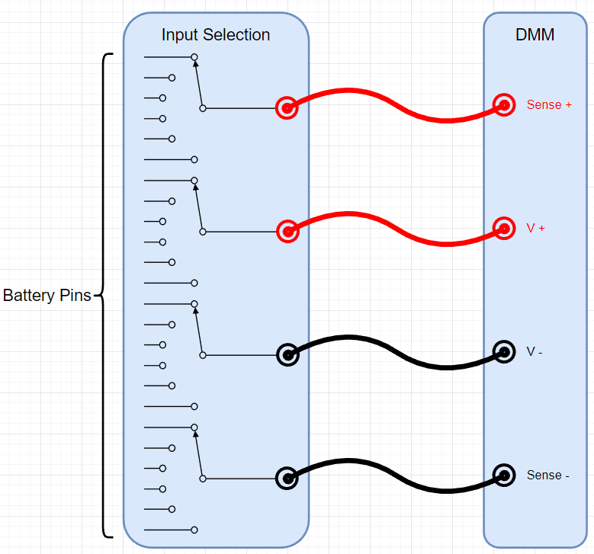
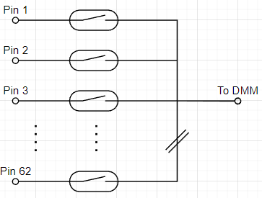
Selected Design
Electromechanical Relay
High voltage tolerance
Low on resistance
No leakage current
Risk of battery short

Slide 16
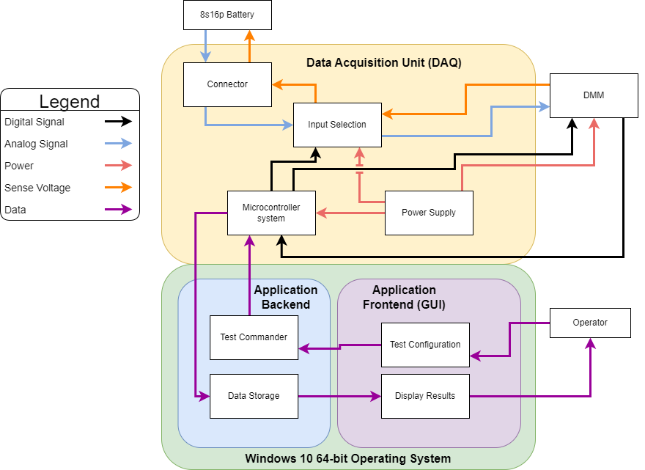
Initial Configuration and Design Space
Key components:
Data Acquisition Unit
Connect to battery
Select test pins
Measure Results
Report to Application
Software Package
User interface
Configure/ Command tests
Store/ Display results
Notes:
Waker

Slide 17
Future Trades:
Near Future Trades:
Select the specific model of DMM to be purchased
Select the a microcontroller with enough pins to instruct the multiplexer and compatibility with the DMM
Connection to DMM
Distant Future Trades:
Material used for DAQ Box
Notes:
Walker

Slide 18
Modelling and Prototyping Plans

Slide 19
Where does risk still exist?

Slide 20
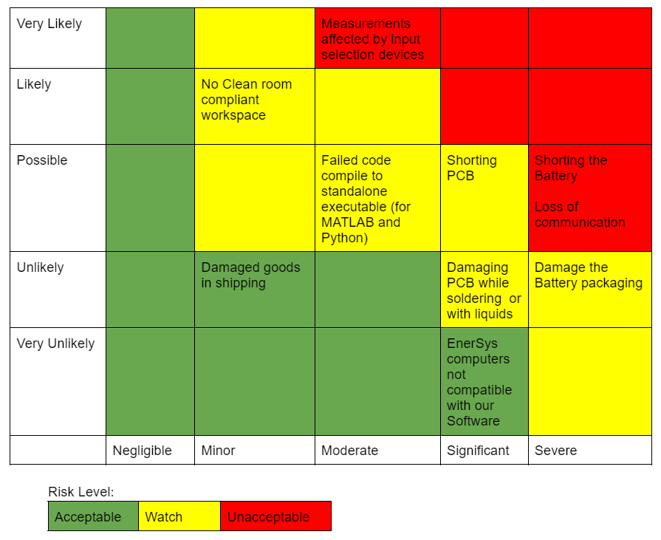
Risk Matrix

Slide 21
Switching System Model
GOAL: Accurately model the switching system to understand signal conditioning required before sending signal to DMM (CPE 2)
ENGINEERING PRINCIPLES:
Complex Impedance
Measurement Techniques
Voltage Dividers
4-wire resistance measurements
Thevenin Equivalent Circuits
Op-Amp Signal conditioning

Slide 22
Switching System Model
MODEL: Characterize all voltage drops and impedances associated with the switching system
METHODS:
Modelling switching systems in electrical softwares (MultiSim, LTSpice, Etc.)
Real-life tests with DC power supplies and multimeters through prototype switching system
RESULTS:
Accurate model of the switching system
Characterization of all electrical complexities with the EMR setup
Proper signal conditioning for the DMM

Slide 23
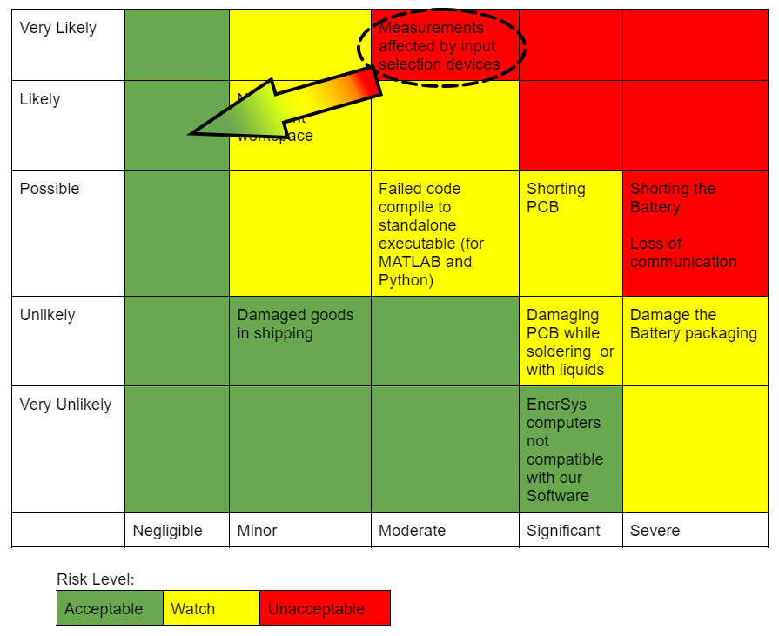
Switching System Model
Reduces the uncertainty in our switching system.
Accurate model ensures the impact of the switching system is properly accounted for.
Reduces the impact of the switching system on our measurements

Slide 24
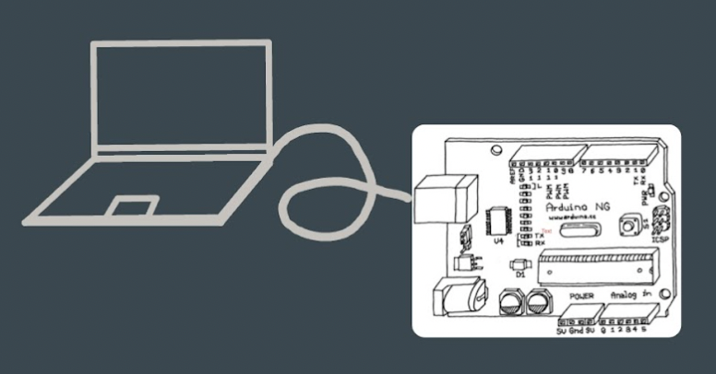
Software USB Communications Prototype
Prototype:
USB communication between microcontroller embedded software and desktop application.
Test:
Test bidirectional dummy string data send and receive.
Feasibility of start/pause/stop features via USB.
Results:
A successful prototype would demonstrate all capabilities in FR 2.6.1, 2.6.5-6, 2.7.1-3.
Functional Requirements: FR 2.6.1, 2.6.5-6, 2.7.1-3

Slide 25
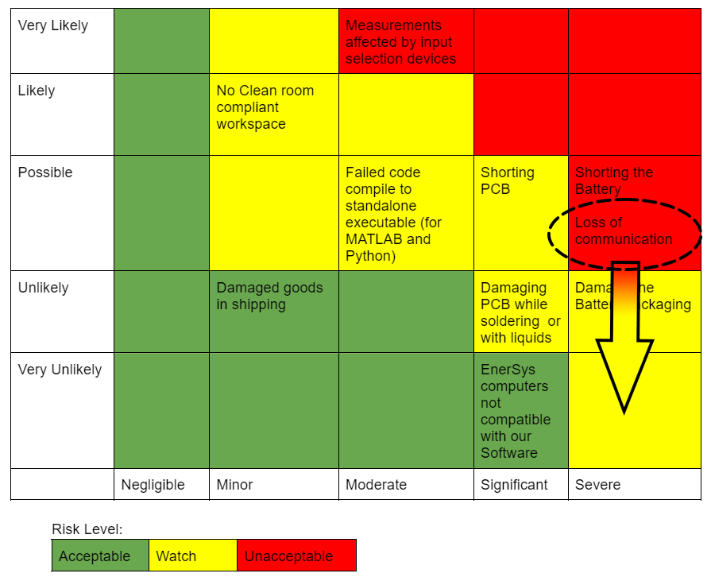
USB Comm. Prototype
Validating USB communication protocols helps inform our software development and puts CPE 5-6 in robust foundation
Reduces/eliminates the risk of loss of signal between the microcontroller and the software

Slide 26
Additional Future Modelling and Prototyping
Prototyping
GUI interface
SCPI (Standard Commands for Programmable Instruments) commands between microcontroller and DMM validation
Software procedure prototype with dummy data
Modeling
USB transaction speed based on simulation of USB protocol

Slide 27
Thank you to the PAB, EnerSys, and our advisor Matt Rhode

Slide 28
Backup Slides

Slide 29
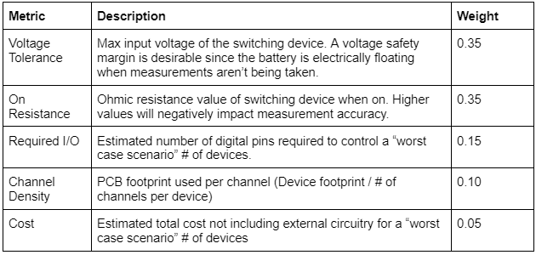
Input Selection Trade Tables

Slide 30
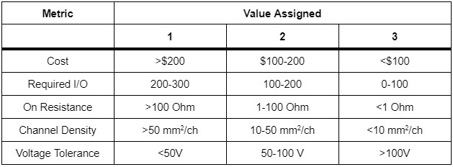
Input Selection Trade Tables Cont.

Slide 31
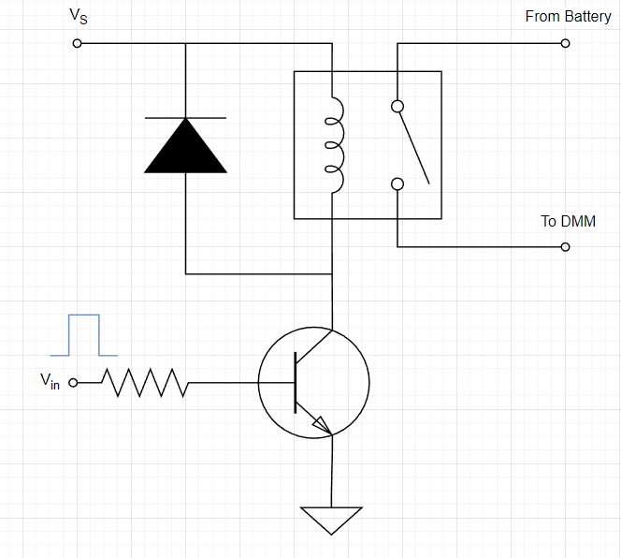
EMR Control Circuit

Slide 32
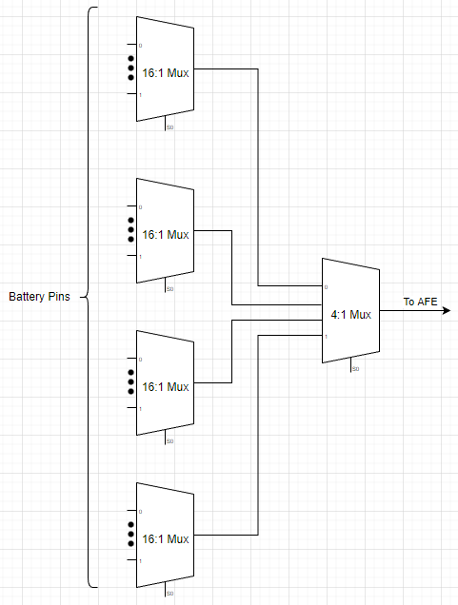
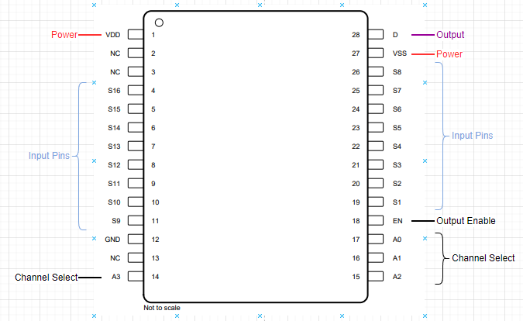
Alternative Design - MUX
Specifications
16:1 Analog Multiplexer
36V Supply Voltage
0-36V Input Voltage
250 Ω On-Resistance
Break before make switching
2000V HBM ESD Protection
500V CDM ESD Protection
Benefits
Only one channel can be selected at a time (short protection)
Simple Control Interface (Parallel lines)
Internal ESD Protection

Slide 33
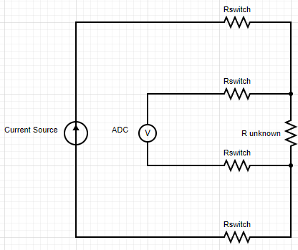
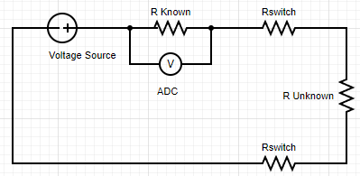
The Problem with Two-Wire Resistance Measurement
Two-Wire Measurement
Voltage divider method
In line switch resistance is included in resistance measurement
Analog Multiplexer resistance is too high for continuity (low resistance) measurements
Can be used for isolation (high resistance) measurements
Four-Wire Measurement
Current source provides known current through unknown resistor
ADC has high input resistance (no current draw)
ADC measures actual voltage drop across resistor
Requires 4 sets of switches to operate

Slide 34
Software Design Requirements
Able to robustly communicate with USB devices on computer
Able to decode and encode signal from DAQ
Able to generate GUI and control the test
Able to output data in .csv file
Able to graph live data retrieved from DAQ
Able to generate executable file for target operating system from the code file

Slide 35
Python 3
Advantages:
Free software and mostly free third-party libraries.
Similar to MATLAB as a scripting language; easy to learn and read.
Comes with popular PyQt, Tkinter, wxPython for GUI and NumPy, Matplotlib for scientific calculation and plotting.
Disadvantages:
Hard to set up a consistent third-party package environment for development across multiple ends.

Slide 36
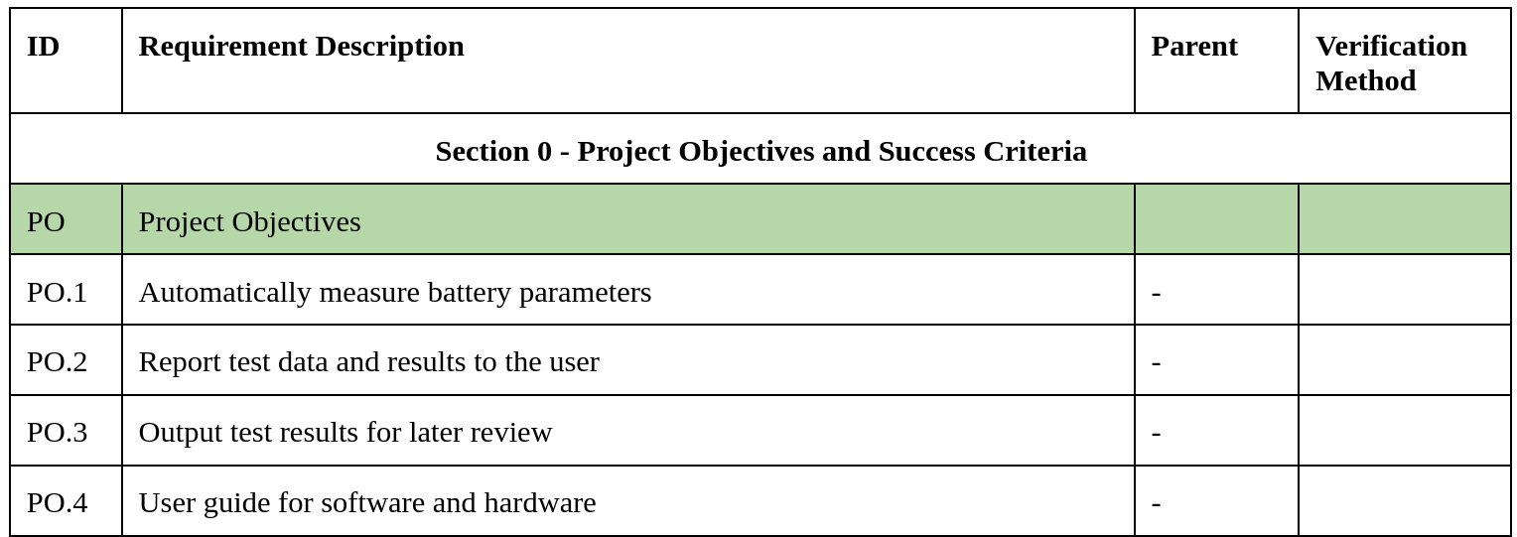
Requirements Flowdown

Slide 37
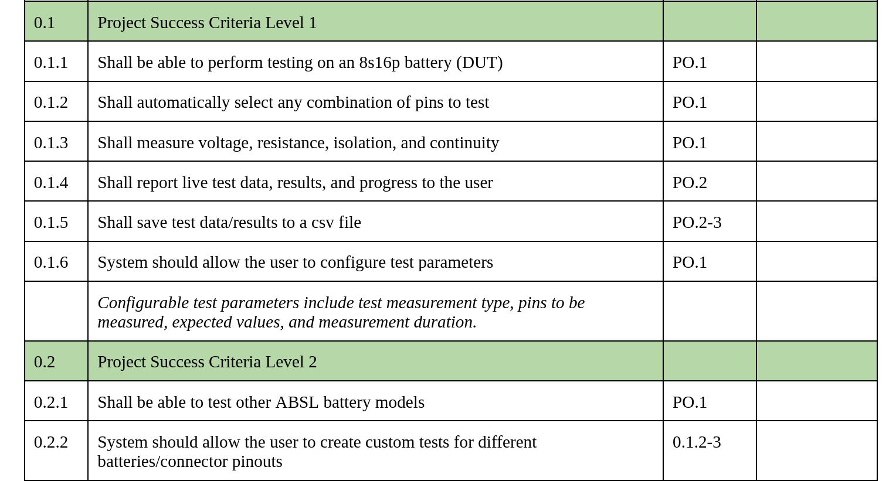

Slide 39
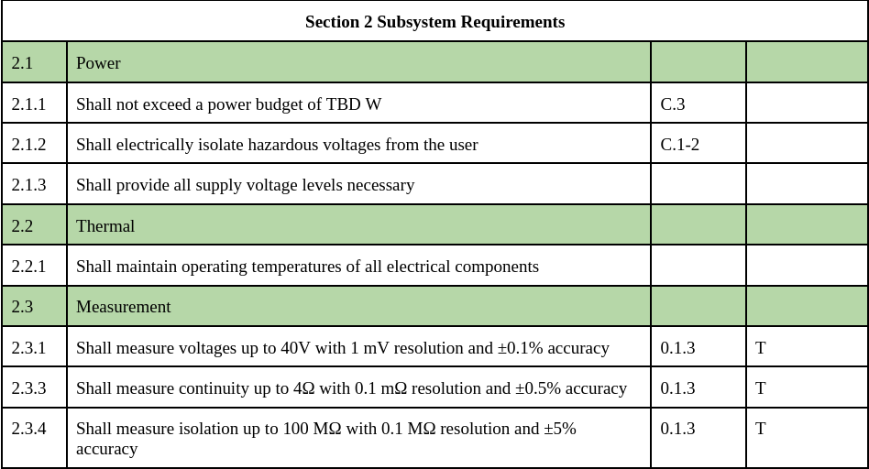

Slide 40
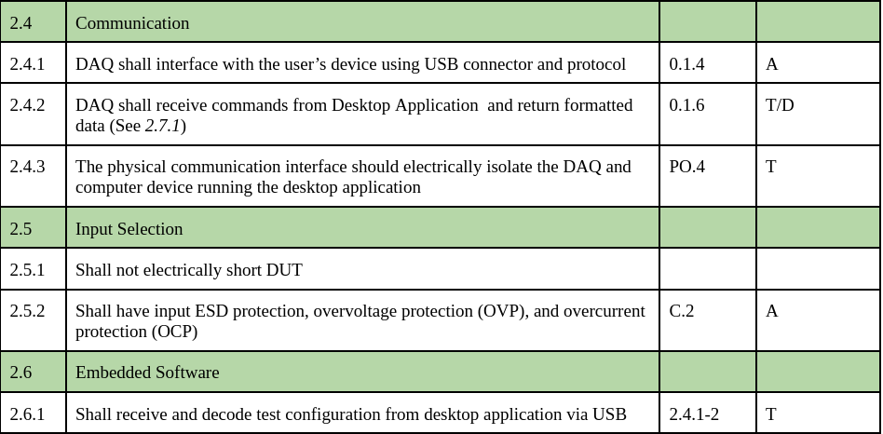

Slide 41
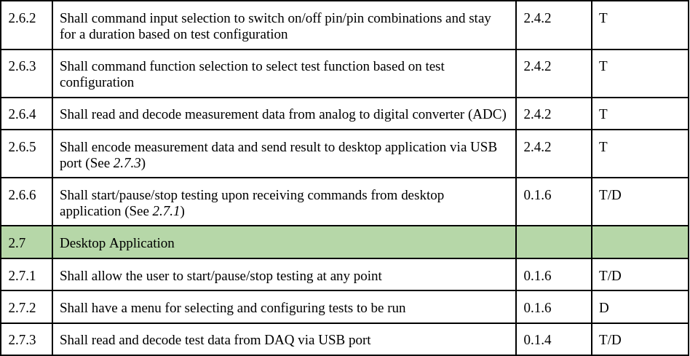

Slide 42
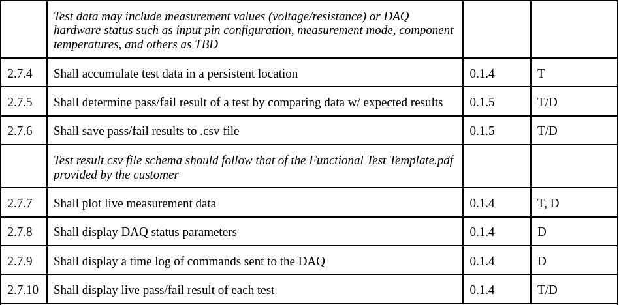

Slide 44
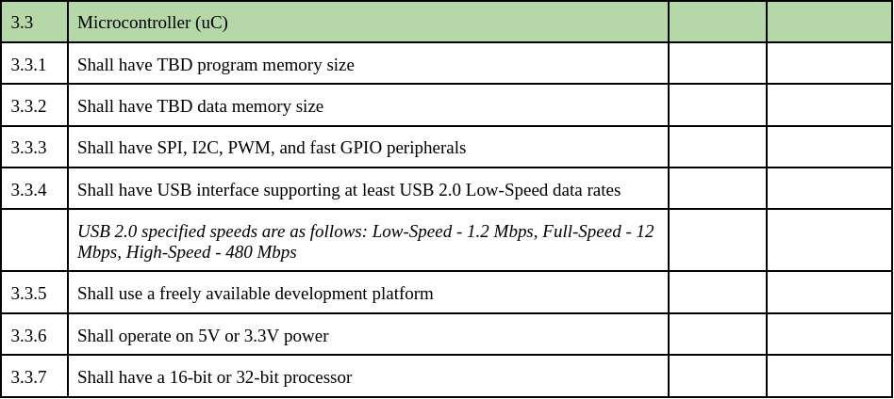

Slide 45
Bibliography:
[1] EnerSys.com Available: https://www.enersys.com/en/.

