Slide 1



Preliminary Design Review
NanoSAM-IV
Nano-Stratospheric Aerosol Measurement
10/5/2022
12:40 PM-1:30 PM
Industry Sponsor: Ball Aerospace
Industry Advisors: Jaykob Velasquez, Jim Baer, Patrick Wessels
Faculty Advisor: Matt Rhode
Team CU-LATR
Presenting: Not Presenting:
Gerald Yoho Lucca Trapani CJ Kennedy
Lucio Murillo Abdoulaye Diallo David Hightower
Garrett Bell Jade Babcock-Chi Benji Brandenburger
Notes:
Introduce team and people who are presenting before diving in!!!!

Slide 2
Preliminary Design Review Outline
Project Description
Objectives, CONOPS, Functional Block Diagram/Requirements
Critical Project Elements Feasibility
Risk analysis & trades introduction
Trade Studies
Key requirements, constraints, & interfaces
Design Metrics, engineering analysis, and risk metrics/weightings
Design options considered
Final Selection & Uncertainty
Current Design Space
Possible Configurations
Trades still to be explored
Modeling and Prototyping Plans
Project Description
Trades
Current Design
Modeling and Prototyping Plan
Notes:
Gerald: Intro & slides 1-8
Lucio: slides 8- 16
Lucca: slides 17- 22
Abdoulaye: slides 23- 27
Jade: slides 28 - 31
Garrett: slides 32-37

Slide 3
Project Description
Project Description
Trades
Current Design
Modeling and Prototyping Plan

Slide 4
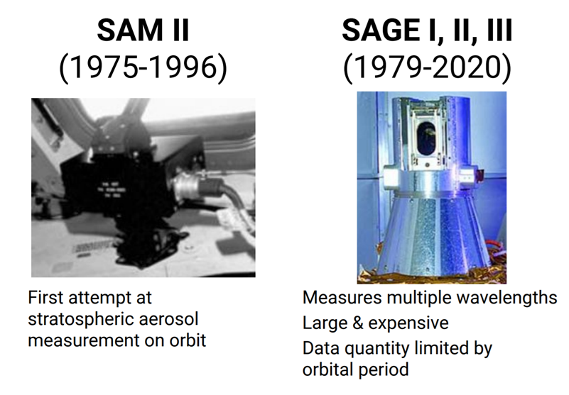
Ball’s Legacy
Project Motivation
Create high resolution profiles of aerosols in the atmosphere
Project Description
Trades
Current Design
Modeling and Prototyping Plan

Slide 5
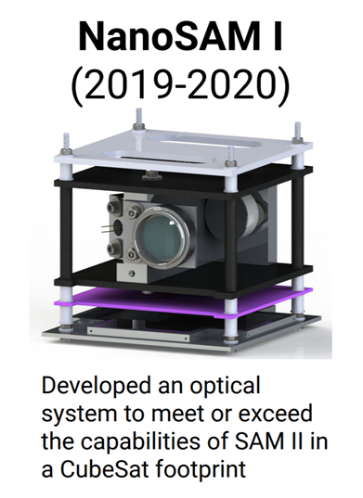
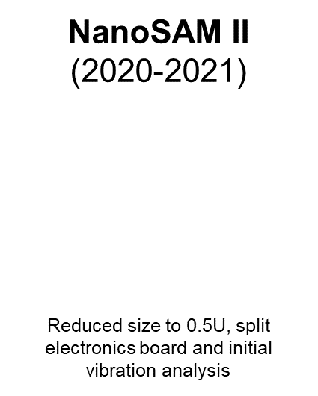
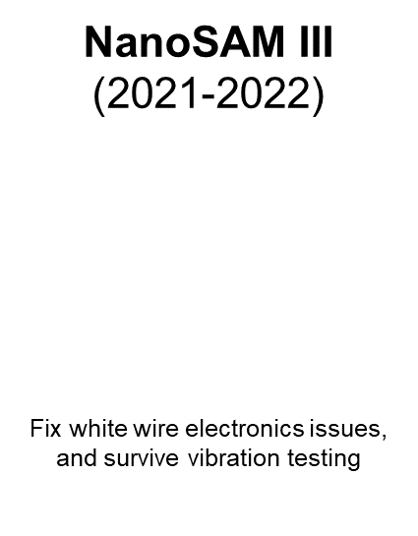
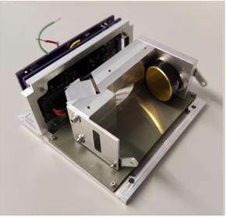
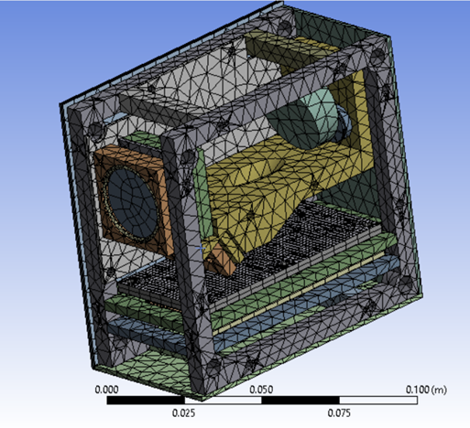
NanoSAM Legacy
Project Description
Trades
Current Design
Modeling and Prototyping Plan

Slide 6
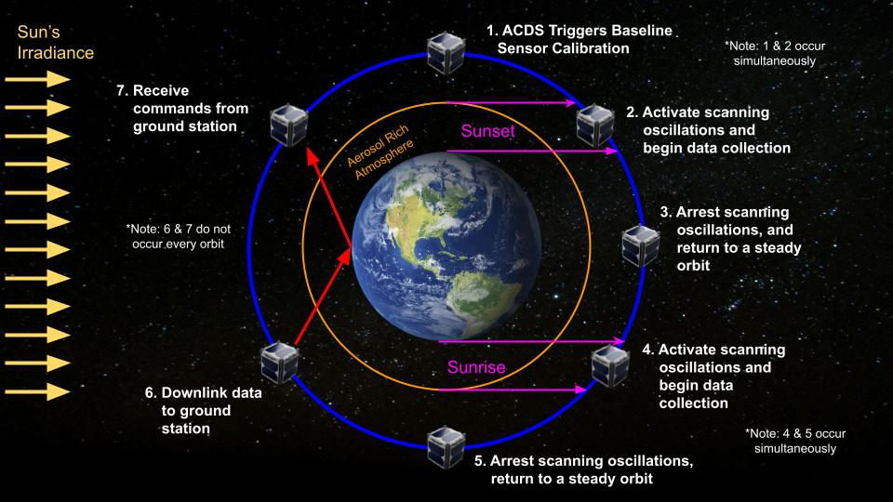
CONOPS I - Greater NanoSAM Mission
Project Description
Trades
Current Design
Modeling and Prototyping Plan
Notes:
Baseline calibration at 5- get more details to verbally explain this quickly

Slide 7
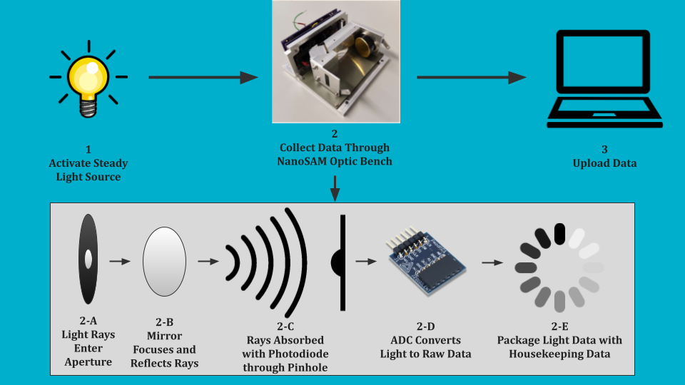
NanoSAM IV
Core Functional Requirements:
Procure and use a physically and radiometrically stable light source.
Take in radiometric data through an optics test bench via a photodiode.
Convert radiometric data from the optics test bench into electrical signals, then to digital data.
Collect and save this digital data (via a controller interface).
Must be able to withstand rigorous testing without failure or degradation and protect circuitry from overvoltage/current.
Project Description
Trades
Current Design
Modeling and Prototyping Plan

Slide 8
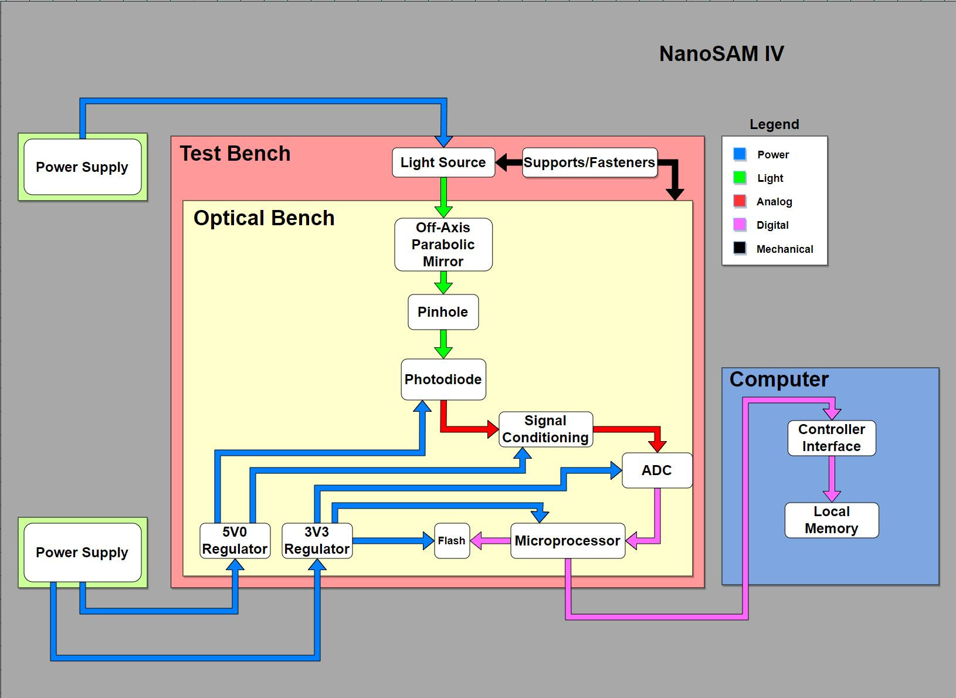
Functional Block Diagram
Project Description
Trades
Current Design
Modeling and Prototyping Plan
Notes:
Starting with Power, we will have separate variable power supplies for the sensor and the light source
The Power for sensors will be at 12 V (common cubesat bus voltage) and converted into 3.3 and 5 V lines to power the internal components of the sensor, specifically the…
The light source will be powered at TBD amps, and emit at constant spectral intensity (radiant intensity per unit wavelength)
The signal from the light source will be focused off an OAP mirror through a pinhole and hit a photodiode on the other side of the pinhole
The photodiode will convert this light signal into an analog electrical signal, which will have some gain and noise reduction applied to it to improve SNR
The ADC will then convert this analog signal into a digital signal which will then be transmitted to microprocessor over a serial line
The microprocessor will package this digital signal with housekeeping data (that includes timestamps, as well as voltage and temps. for critical components)
Packets will be stored in a flash internal memory drive and sent to a computer where it will be stored locally via controller interface
Lastly, it is important to have the optics and light source precisely aligned, so some supports and fasteners will be used to align and fix the position of both.

Slide 9
Critical Project Elements
ID | Description
E.1 | The light source shall be mechanically stable and capable of producing continuous wave radiometric light.
E.2 | A power source shall provide a constant and stable power to the optics/electronics assembly. Not to exceed 8 Watts.
E.5 | A path shall be demonstrated towards the entire optics/electronics assembly fitting within a 0.5U CubeSat.
E.7 | A measurement representing the solar irradiance must be taken using the light source.
ID | Description
E.1 | The light source shall be mechanically stable and capable of producing continuous wave radiometric light.
E.2 | A power source shall provide a constant and stable power to the optics/electronics assembly. Not to exceed 8 Watts.
E.3 | The optics bench shall take in visible light and output an analog signal with a photodiode.
E.4 | The electronics board shall condition the analog signal.
E.5 | A path shall be demonstrated towards the entire optics/electronics assembly fitting within a 0.5U CubeSat.
E.6 | The optics system must be adequately aligned such that light directly hits the photodiode.
E.7 | A measurement representing the solar irradiance must be taken using the light source.
E.8 | The analog measurement signal must be digitized and collected.
E.9 | The controller interface must be able to package, store and present data, and must also control start/stop of data collection.
E.10 | The total cost of the project shall not exceed $4000.
Project Description
Trades
Current Design
Modeling and Prototyping Plan

Slide 10
Most Critical Project Elements
ID | Description | Subsystem Interdependencies
E.1 | The light source shall be mechanically stable and capable of producing continuous wave radiometric light. | Mechanics and Optics must work to produce light that the optics bench can use for data collection.
E.2 | A power source shall provide constant and stable power to the optics/electronics assembly. Not to exceed to 8 Watts. | Electrical and Optics require power to operate.
E.5 | A path shall be demonstrated towards the entire optics/electronics assembly fitting within a 0.5U CubeSat. | Mechanics, Optics, and Electronics must work to produce parts small enough to fit within the size constraints.
E.7 | A measurement representing the solar irradiance must be taken using the light source. | Electronics and Software must use photodiode measurements to produce data representing solar irradiance.
E1, 4,6,7,8
Project Description
Trades
Current Design
Modeling and Prototyping Plan

Slide 11
Risk, Uncertainties, & Trades
ID | Risk | Uncertainties | Trades
E.1 | High: all subsystems rely on light source functionality | - Light source mechanical stability and light wave | Type of light source Features & characteristics of light source
E.2 | High: Electrical and Optics rely on power source to operate | - Provide correct power to individual components - Ability to provide steady, continuous power | Type of power supply Power distribution hardware (board)
E.5 | Low: functionality of CubeSat is dependent on the parts within CubeSat, but not the size limits | - Size of new parts - Previous NanoSAM designs integration with new parts | NanoSAM optics bench to use (or redesign) Electronic components/power supply
E.7 | High: need to get light data into a digital format to represent irradiance, core requirement | -Analog to digital converter capabilities (bits, sampling rate, baud rate, etc) -Data storage and visualization | Microprocessor/ADC choice Software functionality/implementation of previous software
Project Description
Trades
Current Design
Modeling and Prototyping Plan

Slide 12
Trades
Trades | Independent or Dependent | Past Trade Studies
Microprocessor | Dependent | Yes
Light Source | Independent | No
Power Management | Dependent | Yes
Optics Bench | Independent | Yes
Photodiode | Independent | Yes
Board Design | Dependent | Yes
0.5U CubeSat Design | Dependent | Yes
Project Description
Trades
Current Design
Modeling and Prototyping Plan

Slide 13
Trades
Project Description
Trades
Current Design
Modeling and Prototyping Plan
Notes:
For the two to three most important trades provide:
2.1 Key requirements, constraints, and interfaces that determined design metrics, risks, and weightings
2.2 Design metrics, risks, engineering analyses, and weightings that feed into trade matrix
2.3 Design options considered and final trade matrix
2.4 Final selection and uncertainty around it

Slide 14

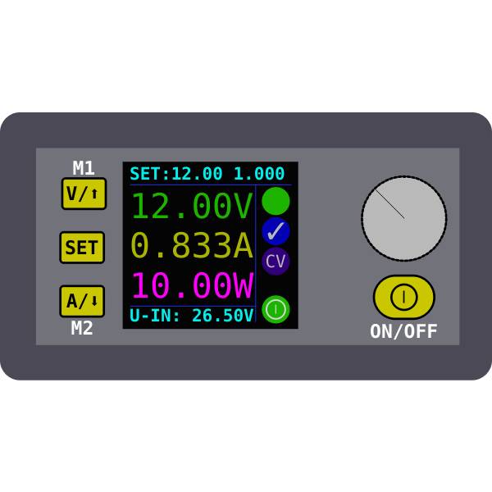
Key Trades for PDR
Light Source
Power Management
Project Description
Trades
Current Design
Modeling and Prototyping Plan

Slide 15
Dependency of Trades
Trade | Project Element | Dependent On | Affects
T.1 Light Source - trading variance in intensity over time, wavelength, life-span, cost | E.1, E.10 | Photodiode - note: photodiode trade study not being conducted in this iteration | Mechanical: support/mounting design and hardware
T.2 Power Management - trading reliability, cost | E.2, E.3, E.4, E.5, E.7, E.8, E.10 | Microcontroller/ADC, photodiode, signal conditioning, light source | Microcontroller/ADC, Photodiode, signal conditioning, light source
Project Description
Trades
Current Design
Modeling and Prototyping Plan

Slide 16
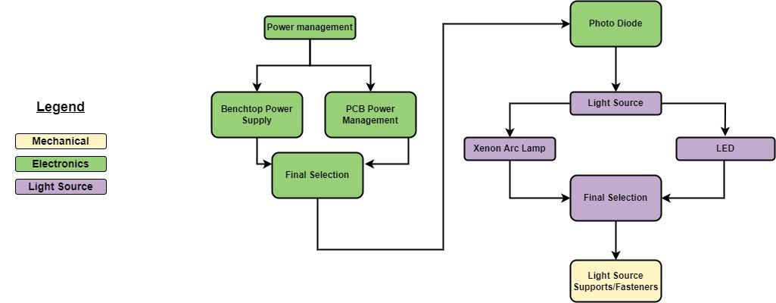
Trade Tree
Project Description
Trades
Current Design
Modeling and Prototyping Plan

Slide 17

Key Trades
Light Source
Power Management
Project Description
Trades
Current Design
Modeling and Prototyping Plan

Slide 18
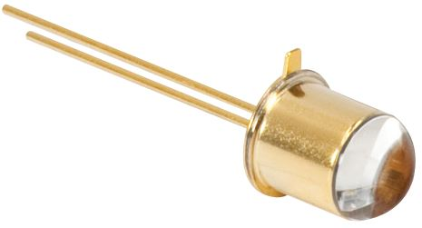
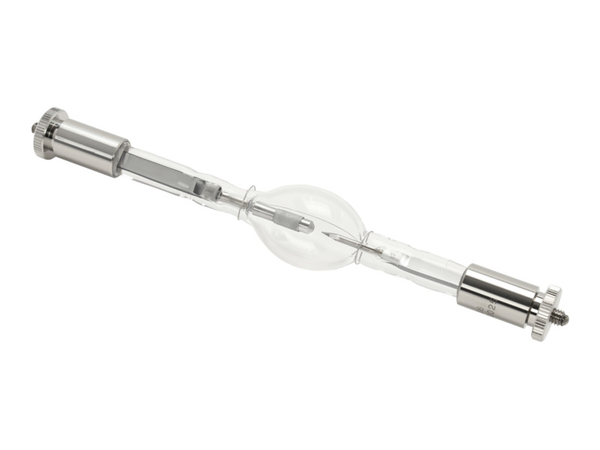
Key Requirements & Constraints
Requirements | Constraints | Interfaces
Secure light source, radiometrically stable continuous wave light | Must be sun-like with some form of scattered light (no lasers) | Photodiode of choice will influence the wavelength range that the light source can operate in
Emulate the sunrise and sunset light conditions related to a typical orbit | Light must be focused with the optics bench into a photodiode | Photodiode influences what wavelength(s) chosen and how electronics operates
The two choices identified:
LED
Xenon Arc Lamp
Project Description
Trades
Current Design
Modeling and Prototyping Plan
Notes:
make sure we can verbally explain why "no lasers" while presenting (don't have to put it into text)

Slide 19
Metrics, Weights & Rationale
Metrics | Weights | Rationale
Intensity Variance | 0.45 | The light must be stable, intensity variance is a very important factor in choosing an adequate light source (E.1)
Cost | 0.3 | Want a quality light but an expensive one is not necessary, not one that will eat into the PCB (electronics) budget (E.10)
Longevity | 0.15 | Light must be able to withstand multiple rounds of testing over the course of many months (turning on and off multiple times) (E.2)
Wavelength | 0.1 | Wavelength must fit inside the photodiode regime (E.1)
Project Description
Trades
Current Design
Modeling and Prototyping Plan

Slide 20
Metrics, Weights & Rationale
Value | Intensity Variance | Cost | Wavelength | Longevity
1 | Light intensity fluctuates greatly (not CW) | > $100/part | Does not emit in photodiode range (320-1100 nm) | Light can only pulse or burst light
2 | Intensity cannot be controlled but fluctuates within some known range | < $100/part | Spectrum emission is unreliable/ unpredictable | Light heats to critical level and is in risk of burnout
3 | Intensity control can be performed with proper design of power source | < $50/part | ~ | Light intensity or stability deteriorates over time when powered
4 | Light is inherently quasi-CW | < $25/part | ~ | Powered indefinitely with minimal deterioration
5 | Light is inherently fully CW | < $10/part | Spectrum emission is within range of photodiode | No deterioration over time
Project Description
Trades
Current Design
Modeling and Prototyping Plan

Slide 21
Light Source Trade Matrix
Possible Options | Metrics | Score
LED | Cost | 4
 | Intensity Variance | 3
 | Wavelength | 5
 | Longevity | 4
Xenon Arc Lamp | Cost | 1
 | Intensity Variance | 3
 | Wavelength | 5
 | Longevity | 3
Project Description
Trades
Current Design
Modeling and Prototyping Plan
Notes:
Requirements: stable, radiometric source, repeatability, “solar simulator”
Constraints: size, intensity, variability, spectrum, temperature dependency

Slide 22
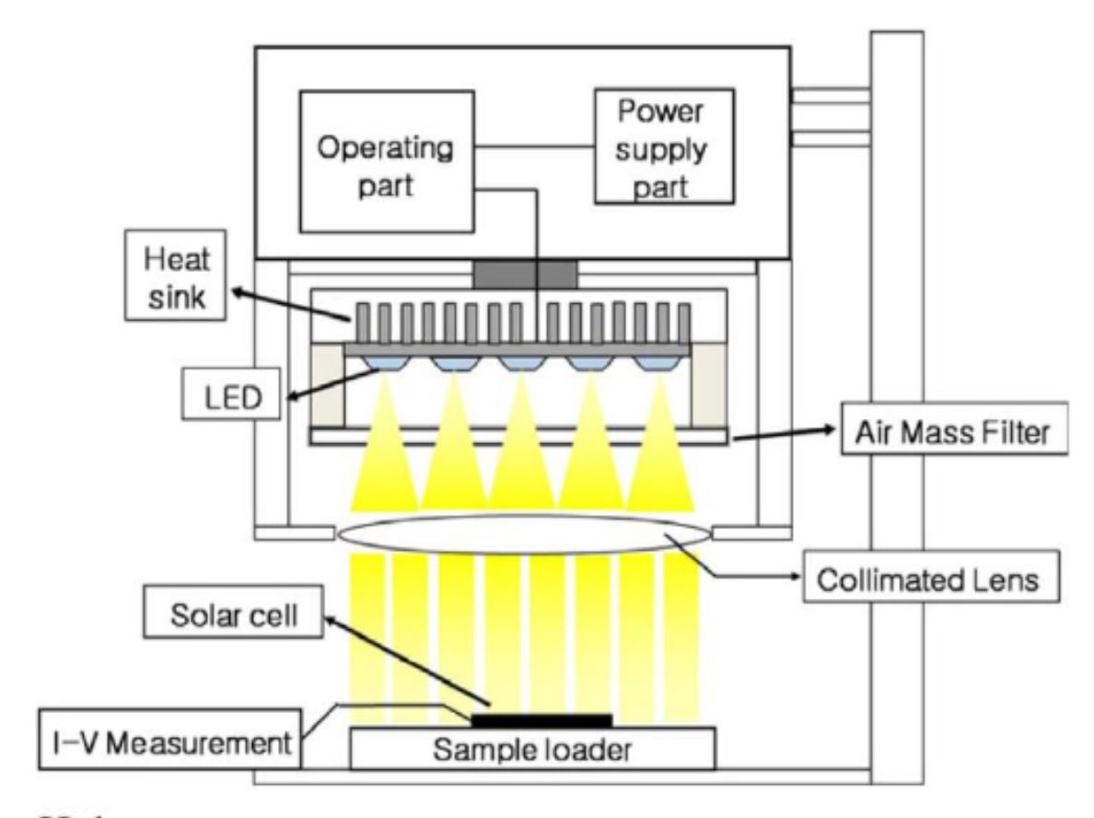

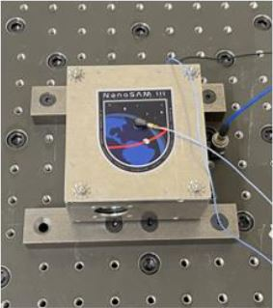
Final Selection
Possible Options | Final Score
Xenon Arc Lamp | 2.9
LED | 3.65
Optics
Provides best stability for cost
Provides wavelength range that matches photodiode
Lasts longer than the others
This decision will dictate trades for the test bench
Project Description
Trades
Current Design
Modeling and Prototyping Plan

Slide 23
Key Trades
Light Source
Power Management
Project Description
Trades
Current Design
Modeling and Prototyping Plan

Slide 24
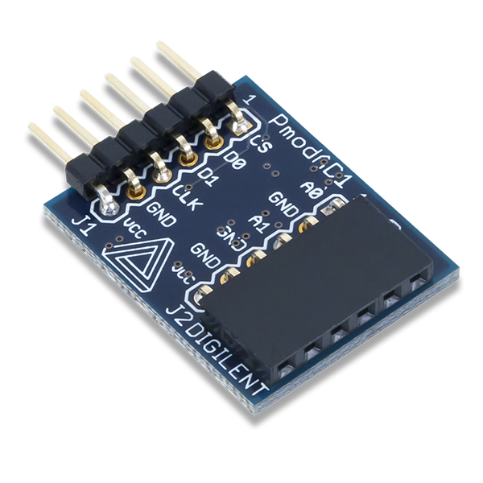
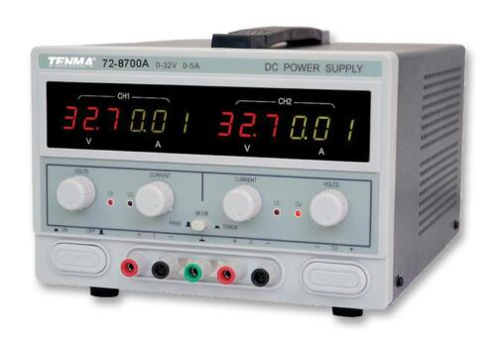
Key Requirements & Constraints
Requirements | Constraints | Interfaces
Must use 8 Watts power to mimic a 0.5U CubeSat | No batteries | Electronics and software must ensure that microprocessor does not alter power consumption drastically
Provide sufficient stable power to all components so that the ADC and signal processing board can do their job | 8 watt maximum power consumption, unlimited for the light source | Mechanics and electronics must figure out ways to reduce overheating in CubeSat
Two choices identified:
Design and manufacture a new PCB board for power
Utilize multiple power bench supplies
Project Description
Trades
Current Design
Modeling and Prototyping Plan
Notes:
No batteries: usage could bring data errors over time that may be associated with power fluctuations. Also, customer suggested that it is not necessary for the scope of this project.

Slide 25
Proposed Weights for Power Management
Metrics | Weights | Rationale
Complexity | 0.15 - 0.25 | Reduce the chance of unforeseen failures and the need of many additional parts. (E.2)
Cost | 0.15 - 0.25 | PCBs design could be expensive, don’t want them to take away from budget too much. (E.10)
Reliability | 0.5 - 0.6 | Must be able to withstand lots of testing without failure or degradation and protect circuitry from overvoltage/current (E.2)
Project Description
Trades
Current Design
Modeling and Prototyping Plan

Slide 26
Proposed Metrics for Power Management
Value | Cost | Complexity | Reliability
1 | expensive | complex | unreliable
2
3
4
5 | inexpensive | Not complex | reliable
TBD
TBD
TBD
Project Description
Trades
Current Design
Modeling and Prototyping Plan

Slide 27
Overall Final Selection
Trade Space | Choice
Light Source | LED
Power Management | TBD
Following the light source trade, the LED has been picked for optimizing performance, physical constraints, and fiscal cost
The power management trade needs to be more deeply investigated due to a lack of understanding in past projects’ decisions
Project Description
Trades
Current Design
Modeling and Prototyping Plan

Slide 28
Current Design Space
Project Description
Trades
Current Design
Modeling and Prototyping Plan

Slide 29
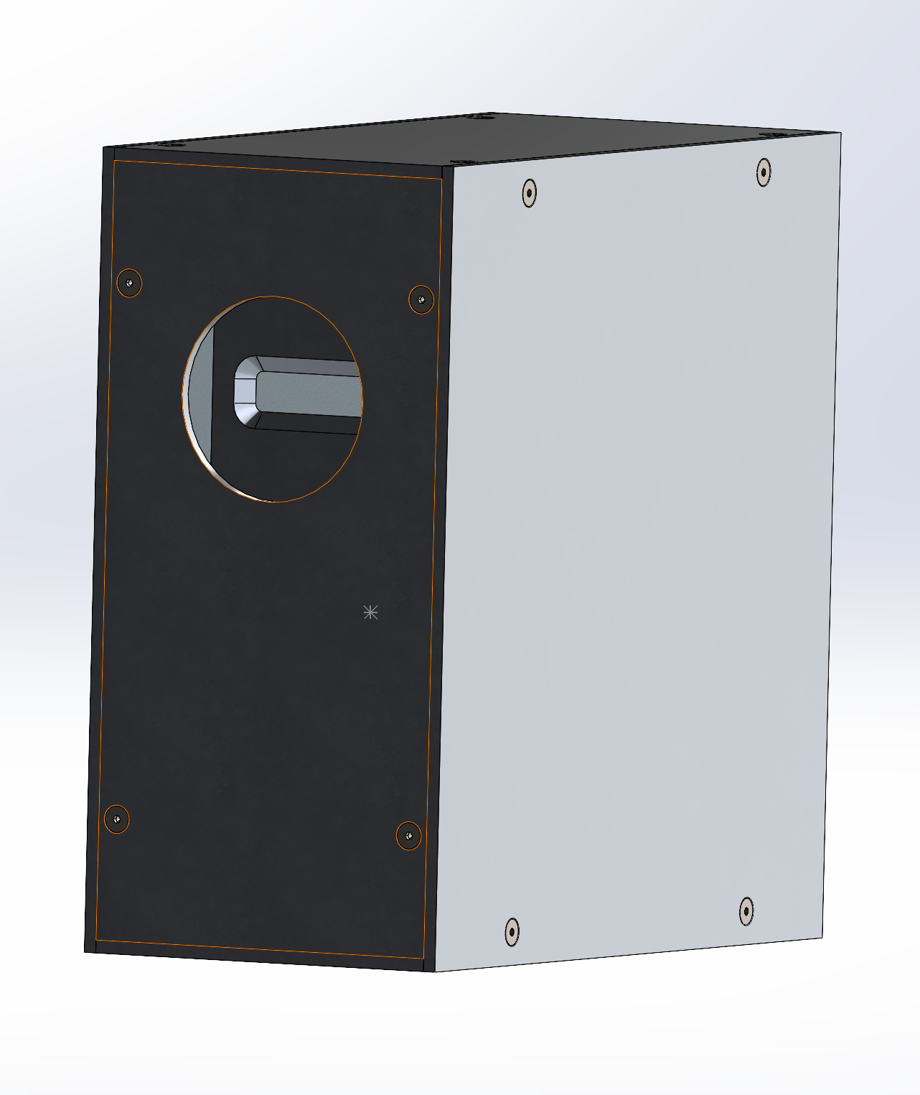
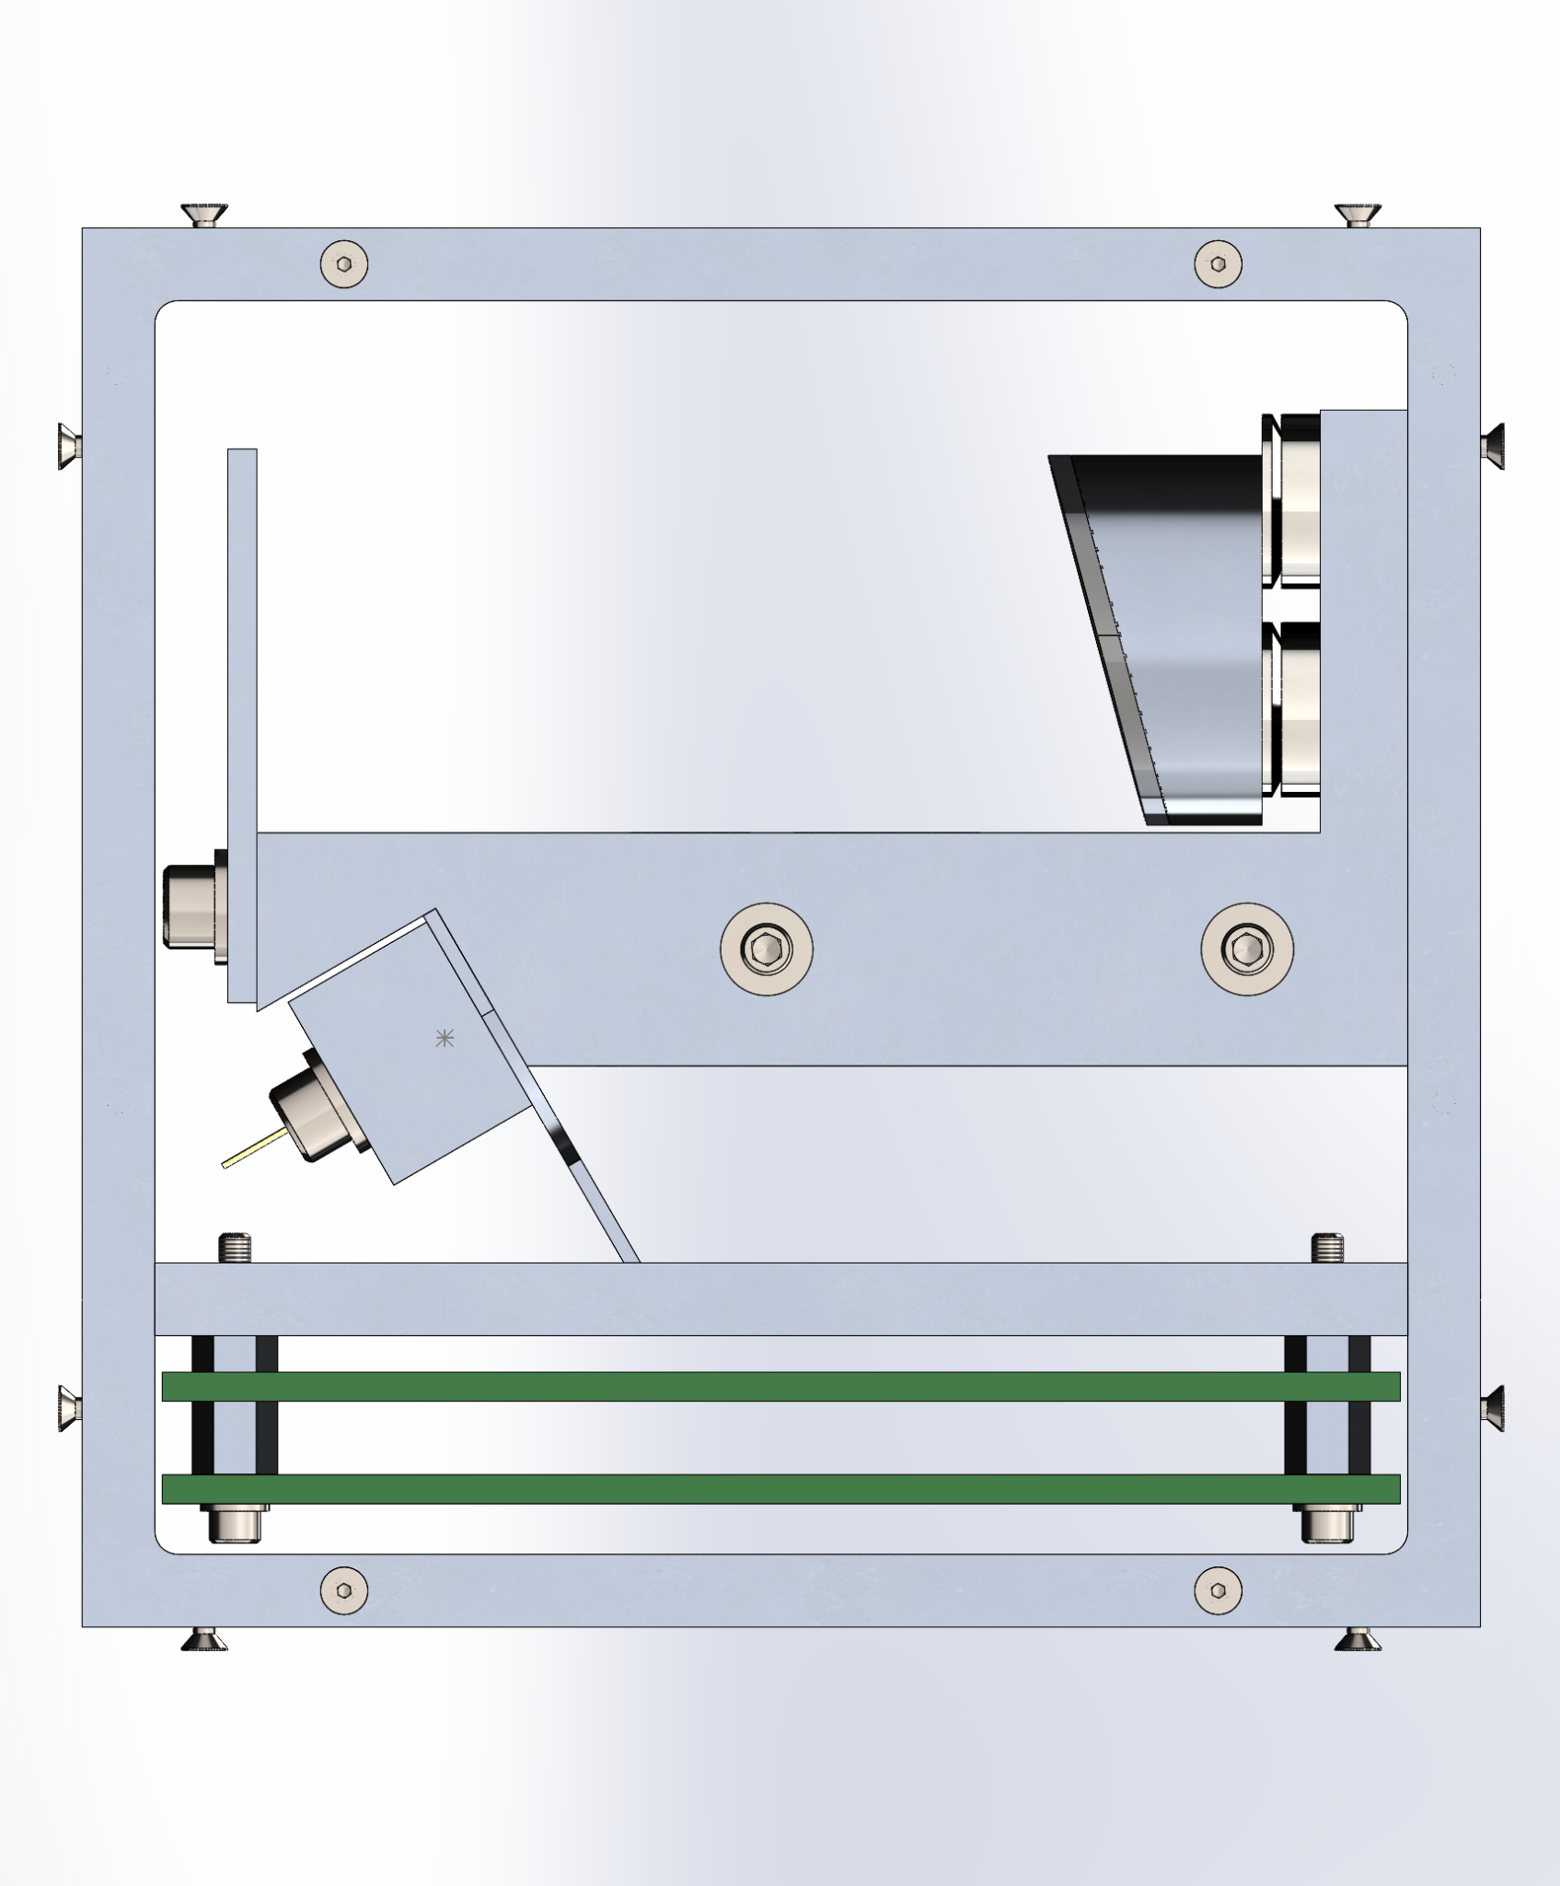
Current Design Space
Light Source | Microcontroller | ADC | Power Supply/Distribution
LED (no ballast) | Teensy | Built In | Benchtop Power Supply
LED (no ballast) | Teensy | Built In | PCB Power Distribution
LED has been chosen for light source, now the specific bulb must be chosen
Power Supply must be further investigated
Until further trades are completed the past projects optics bench will be utilized for modeling and prototyping
Peg board provided by past projects will act as the test bench floor
Project Description
Trades
Current Design
Modeling and Prototyping Plan

Slide 30
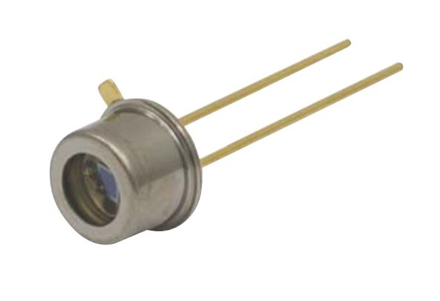
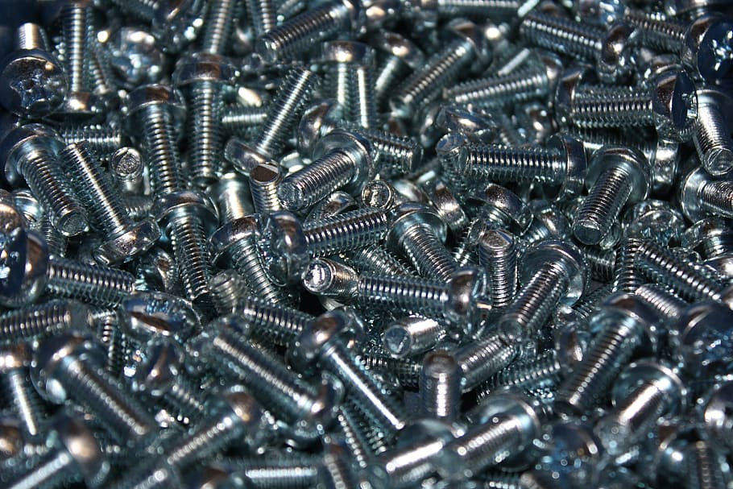
Constraints
The design space is heavily constrained by the work from previous years
The photodiode selection from NanoSAMII plays a huge role in NanoSAM IV’s light source selection
The trades discussed in this presentation narrow the design space further
The light source selection determines components of the test bench
The power management system determines the next steps in manufacturing and prototyping
Photodiode
LED
Light Fixture
Project Description
Trades
Current Design
Modeling and Prototyping Plan
Notes:
specifically NanoSAM II and III

Slide 31
Trade Studies To Still Be
Performed
Trade | Optics Bench | Shape of Test Bench
Potential Design Options | NanoSAM-II, NanoSAM-III, New Design | Square, Concave, Single in-line bar
Important Design Facets | Aligned ≤ 0.5U Removes excess light | Must hold light source in place Hold Optics Bench Stable
Project Description
Trades
Current Design
Modeling and Prototyping Plan

Slide 32
Modeling and Prototyping Plan
Project Description
Trades
Current Design
Modeling and Prototyping Plan

Slide 33
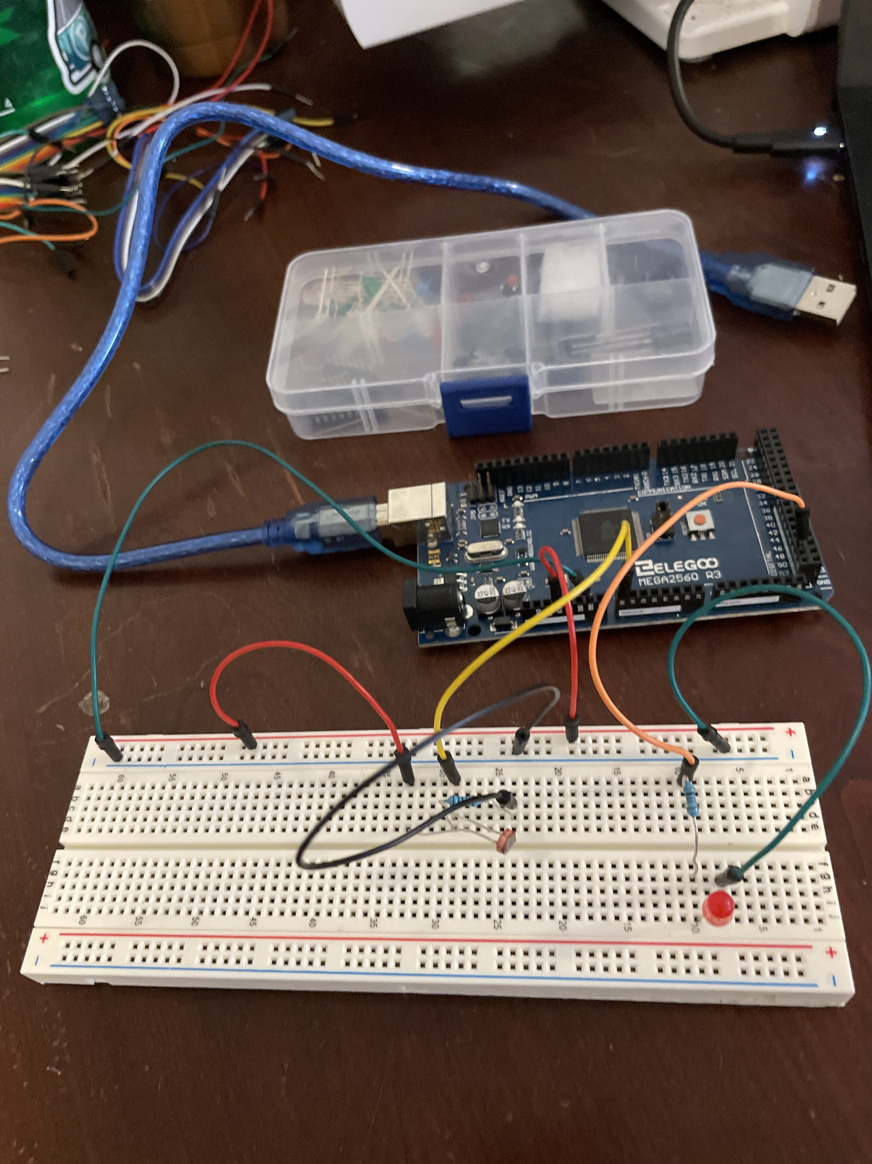
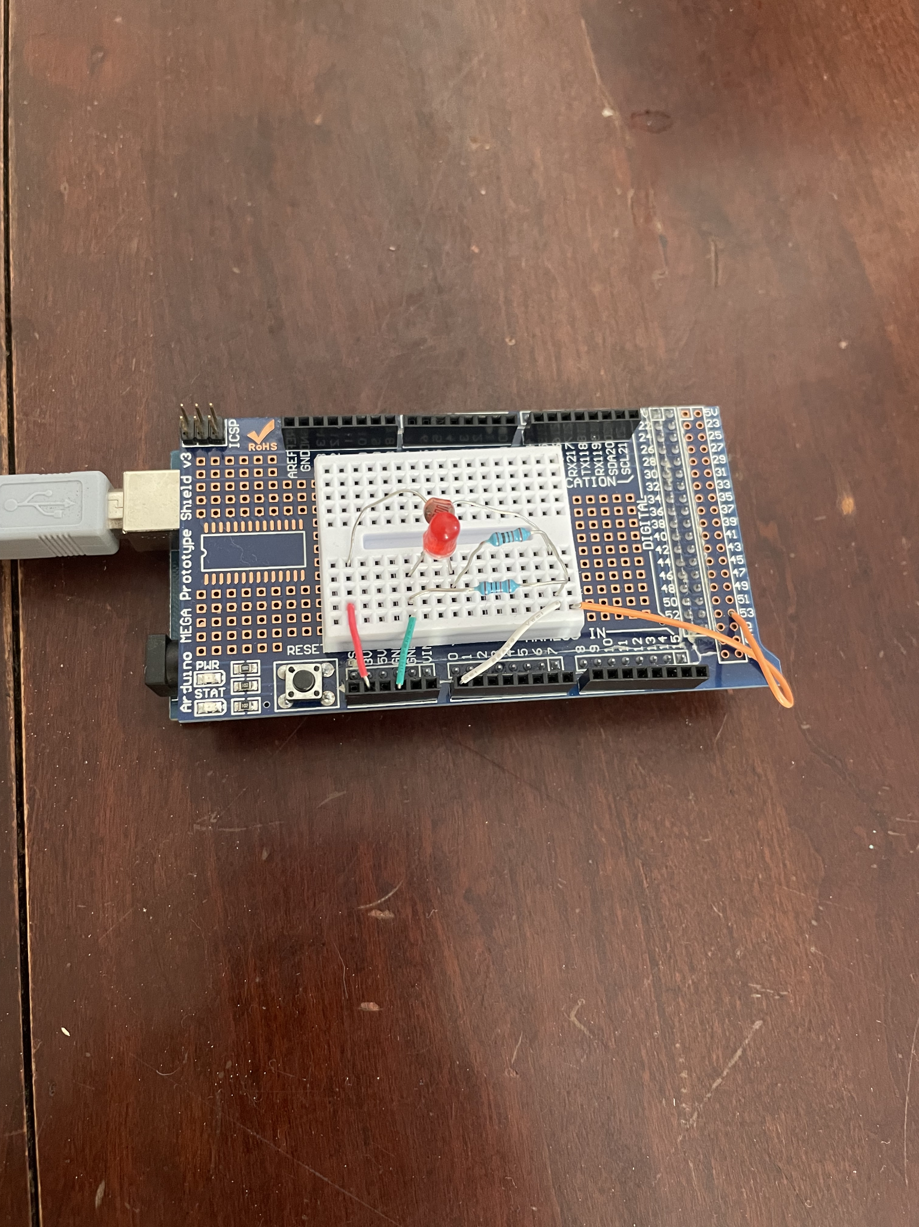
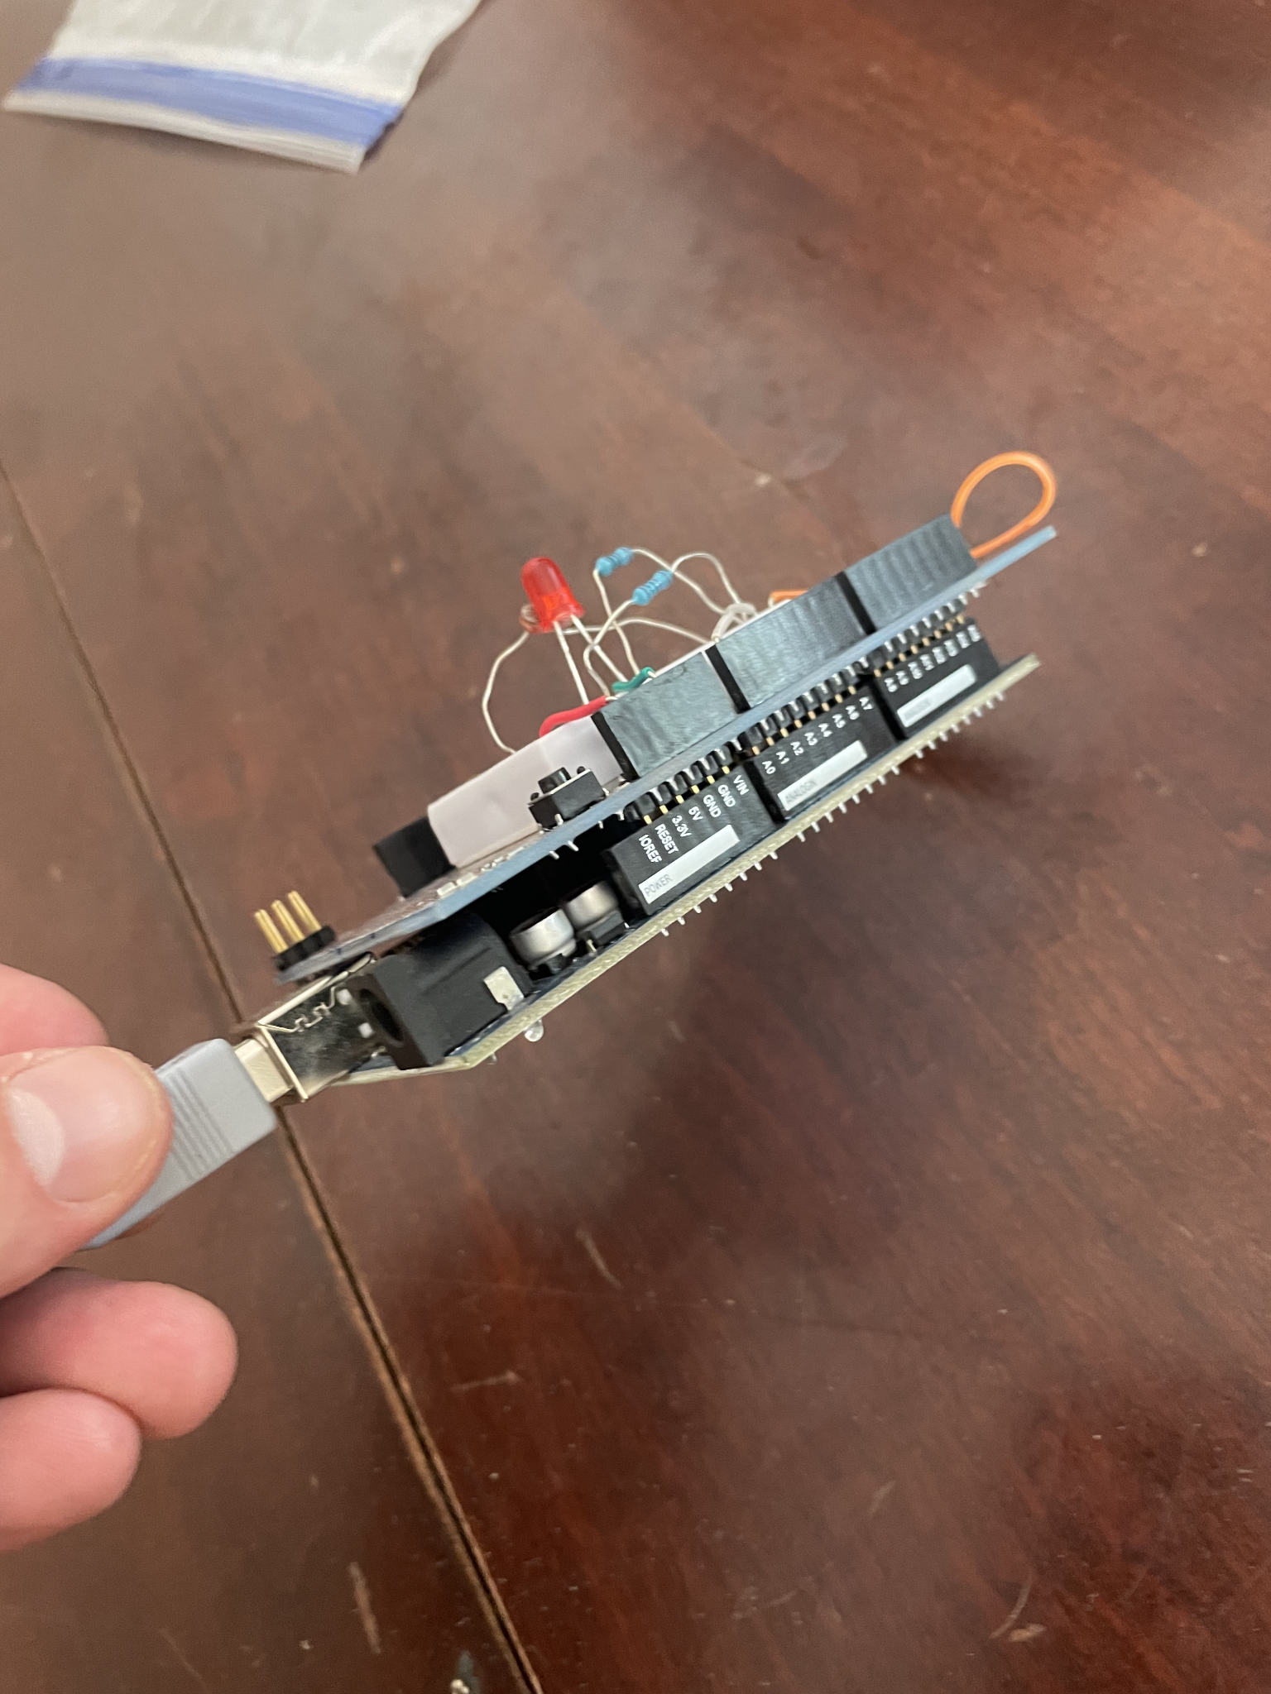
Prototyping Completed
Project Description
Trades
Current Design
Modeling and Prototyping Plan

Slide 34
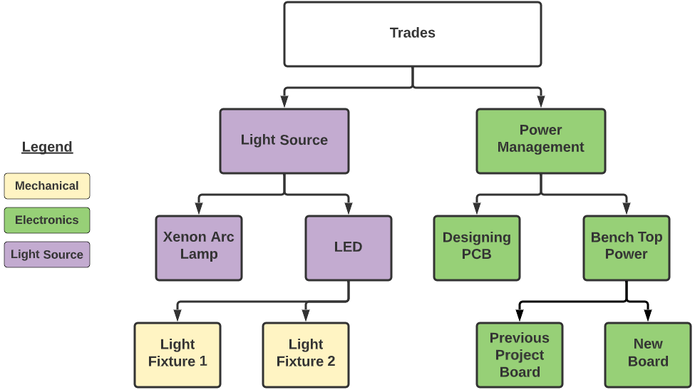
Proposed Future Prototyping
Project Description
Trades
Current Design
Modeling and Prototyping Plan

Slide 35
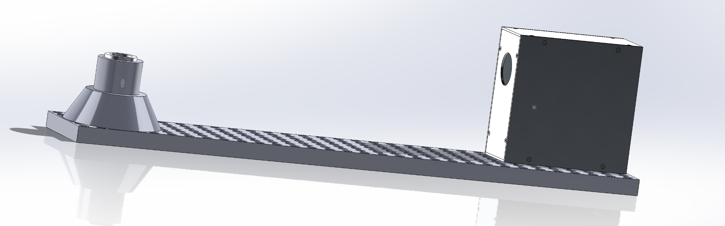
Potential Test Bench Set-Up
1
2
3
Fixed LED light source
NanoSAM Apparatus
Test Bench
Project Description
Trades
Current Design
Modeling and Prototyping Plan

Slide 36
Modeling Moving Forward
Take the low fidelity electronic prototype created and further model it towards a high fidelity prototype
Set up a prototype using past projects boards to test if they still work
If they are verified as working then move forward with past projects electronics models
Past projects software unable to compile
If they are not operational then create a new electronics model using parts that may not have been accessible to past teams
A mathematical model to compare power received at the photodiode by the sun versus light source
May inform gains necessary for signal conditioning
Project Description
Trades
Current Design
Modeling and Prototyping Plan

Slide 37
Questions?

Slide 38
Backup Slides

Slide 39
Project Description Backup
Project Description
Trades
Current Design
Modeling and Prototyping Plan

Slide 40
Level 1 Functional Requirements
Physical:
Demonstrate a path for the data collection hardware to fit into a 0.5U CubeSat
A testing bench shall be manufactured to secure the light source and optical bench
The light source shall be spatially and radiometrically stable
Electrical:
Shall convert a microwatt optical signal into an digital signal
Shall be able to monitor the temperature of the detector
Data Collection hardware shall not exceed a power usage of 8 Watts
Software:
Start and stop radiometric data acquisition on command and include timestamps for critical data
Keep the controller apprised of whether or not the solar signal is above a ‘low threshold‘ of irradiance
Deliver data either continuously to the controller or as a data file after the occultation event
Project Description
Trades
Current Design
Modeling and Prototyping Plan

Slide 41
Level 2 Functional Requirements
Physical:
Implement the data collection hardware into a 0.5U CubeSat
Design and implement a shutter system that will reduce the irradiance to below the threshold set by software
Electrical:
Shall reduce power consumption
Shall achieve an SNR better than or the same as SAM II
Software:
Include housekeeping data in the time stamped data stream
Incorporate error handling
Implement orbit propagation model to start data acquisition
Project Description
Trades
Current Design
Modeling and Prototyping Plan
Notes:
Don’t say emulate the orbit, talk about filtering, it is not connected to the orbit

Slide 42
CONOPS II - NanoSAM-IV Scope
Project Description
Trades
Current Design
Modeling and Prototyping Plan
Notes:
verbally explain that the light source must be both radiometrically stable as well as to have a physically stable/secured base

Slide 43
CPE: Light Source
Project Element | CPE Relation | Description | Subsystem Interdependencies | Risk & Uncertainty
Radiometric, continuous wave light | E.1 | The light source must be chosen with these parameters in mind. Trade studies are being undertaken and described more later to determine best light source. | Mechanics & Optics | High Risk High Uncert.
Mechanically stable | E.1 | The light source must be fixed in place and remain aligned with the optics housing. This flows naturally from the creation of a stable test bench capable of repeated experiments. | Mechanics & Optics | Low Risk High Uncert.
Photodiode | E.3 | Light source must emit light in wavelength that the photodiode can capture. No constraints on what wavelength/power it must test with | Mechanics & Optics | High Risk Low Uncert.
Project Description
Trades
Current Design
Modeling and Prototyping Plan

Slide 44
CPE: Optics Bench
Project Element | CPE Relation | Description | Subsystem Interdependencies | Risk & Uncertainty
Optics Bench | E.3 | There are multiple NanoSAM optics benches available, all in different states of optical alignment. Determine which lights source with trade study. | N/A | Medium Risk High Uncert.
Photodiode | E.1, E.3 | The photodiode must be selected so that it can receive the type of light being created by the light source. | Mechanics & Optics | High Risk Low Uncert.
Alignment | E.3 | Optics must be aligned well enough simply so that light can directly strike the photodiode. No explicit requirements on alignment beyond this. | N/A | Medium Risk Low Uncert.
Project Description
Trades
Current Design
Modeling and Prototyping Plan

Slide 45
CPE: Electronics
Project Element | CPE Relation | Description/Requirements | Subsystem Interdependencies | Risk & Uncertainty
Board | E.4, E.5, E.8 | The electronics board must house most critical electronics. Major requirement is to demonstrate path to fit current 0.5U CubeSat footprint. | Mechanical & Electronics | High Risk High Uncert.
ADC | E.3, E.4, E.8 | The ADC must be matched with the range of the photodiode and must sample at TBD rate. | Optics & Electronics | High Risk Low Uncert.
Signal Conditioning Circuit | E.4 | The signal produced from photodiode needs to be amplified and have a reduction in noise by TBD and TBD dB. | Optics & Electronics | Medium Risk Medium Uncert.
Project Description
Trades
Current Design
Modeling and Prototyping Plan

Slide 46
CPE: Software
Project Element | CPE Relation | Description | Subsystem Interdependencies | Risk & Uncertainty
Microprocessor | E.8 | A microprocessor must be used to package and send digital data to the controller interface. This processor needs to be programmable, and be able to store a TBD amount of data and later dump to the controller interface or continuously send data. Must make sure all other electronics are functioning properly. Requires a trade study. | Electronics & Software | High Risk Medium Uncert.
Controller interface | E.7, E.9 | The controller interface needs to be capable of organizing and displaying data however the team sees fit. Additionally, it must be able to seamlessly start and stop data collection. | Electronics & Software | Low Risk Low Uncert.
Project Description
Trades
Current Design
Modeling and Prototyping Plan

Slide 47
Trades Backup
Project Description
Trades
Current Design
Modeling and Prototyping Plan
Notes:
For the two to three most important trades provide:
2.1 Key requirements, constraints, and interfaces that determined design metrics, risks, and weightings
2.2 Design metrics, risks, engineering analyses, and weightings that feed into trade matrix
2.3 Design options considered and final trade matrix
2.4 Final selection and uncertainty around it

Slide 48
Key Requirements & Constraints
Requirements | Constraints | Interfaces
Start and stop taking radiometric data on command and include timestamps for critical data | Similar data rate to NanoSAM II/III | Must communicate with electronics to ensure no errors or warnings
Deliver data continuously or save as data file for later transfer to controller interface | SNR must be better than NanoSAM II | Data transferred to a computer interface to be processed
Incorporate error handling | Demonstrate a path to fit a 0.5U CubeSat design | Microcontroller chosen influences electronics PCB design
Implement orbit propagation model to start data acquisition | N/A | Mechanics and Software/Electronics must talk about size constraints
Project Description
Trades
Current Design
Modeling and Prototyping Plan

Slide 49
Metrics, Weights & Rationale
Metrics | Weights | Rationale
Cost | 0.2 | Want an effective but relatively inexpensive microprocessor
Size | 0.3 | A path must be demonstrated to fit within a 0.5U CubeSat as well as the PCB boards
Processing Power | 0.5 | Data acquisition is a critical goal of this project, must be able to process light data and convert it to digital data
Project Description
Trades
Current Design
Modeling and Prototyping Plan

Slide 50
Microcontroller/ADC
Possible Options | General Metrics | Value
Teensy 4.0: $23 | Flash Memory and SRAM | 1984 KB, 1024KB
 | Size | (18 x 36 mm)
 | Clock Speed | 600 MHz
Arduino Nano: $20 | Flash Memory and SRAM | 32 KB, 2 KB
 | Size | (18 x 45 mm)
 | Clock Speed | 16 MHz
Raspberry Pi Zero 2 W: $18 | SDRAM | 512MB
 | Size | (65 x 30mm)
 | Clock Speed | 1GHz
Project Description
Trades
Current Design
Modeling and Prototyping Plan
Notes:
https://www.raspberrypi.com/products/raspberry-pi-zero-2-w/
https://store.arduino.cc/products/arduino-nano
https://www.pjrc.com/store/teensy40.html#specs
Risks: low snr, errors in data storage and collection

Slide 51
Microcontroller/ADC Trade Matrix
Possible Options | Metrics | Weight
Teensy 4.0 | Cost | 4
 | Size (18 x 36 mm) | 5
 | Processing Power/Bit Resolution | 3
Arduino Nano | Cost | 4
 | Size (18 x 45 mm) | 4
 | Processing Power/Bit Resolution | 2
Raspberry Pi Zero 2 W | Cost | 4
 | Size (65 x 30mm) | 1
 | Processing Power/Bit Resolution | 5
Project Description
Trades
Current Design
Modeling and Prototyping Plan
Notes:
https://www.raspberrypi.com/products/raspberry-pi-zero-2-w/
https://store.arduino.cc/products/arduino-nano
https://www.pjrc.com/store/teensy40.html#specs
Risks: low snr, errors in data storage and collection

Slide 52
Final Selection
Possible Options | Final Score
Arduino Nano | 3
Raspberry Pi Zero 2 W | 3.6
Teensy 4.0 | 3.8
Provides best processing for size
Close with Rasp. Pi, but Pi was too big
Most convenient due to previous teams’ Teensy boards being available to NanoSAM-IV
Coding language easier for Teensy compared to Rasp. Pi
PCBs’ are designed for the Teensy
Project Description
Trades
Current Design
Modeling and Prototyping Plan

Slide 53
Modeling Moving Forward
Solar Power Received By Photodiode
Solar irradiance or solar constant [W/(m²⸱𝜇m)]
Multiply by wavelength of light source [𝜇m] to get irradiance [W/m²]
Multiply by the area [m²] of the optics aperture to determine power entering the optics bench [W]
Focal length of the mirror [mm] multiplied by angular width of the sun gives image size (diameter) of sun on the pinhole in front of photodiode
Pinhole diameter [mm] divided by Image diameter [mm] gives fraction or ratio of power received by photodiode
Multiply power entering optics bench (from step 3) and ratio of power (step 5) to get Wattage at photodiode
Distance of Light Source to Aperture
*in theory want to find distance light needs to be from bench aperture to achieve the same power (likely not possible, so we need signal conditioning gains to simulate the sun)
Light source optimum power [W] divided by (4𝜋R²), where R is distance from light source to aperture to get light source irradiance [W/m²]
Power density; modeling light source as isotropic radiator
Repeat steps 3 through 8 to determine how much power photodiode sees from light source
Likely a lot less than solar power calculated
Determine signal conditioning gains necessary for photodiode to output analog signals from light source to be similar to conditions where the sun is the source
Project Description
Trades
Current Design
Modeling and Prototyping Plan

Slide 54
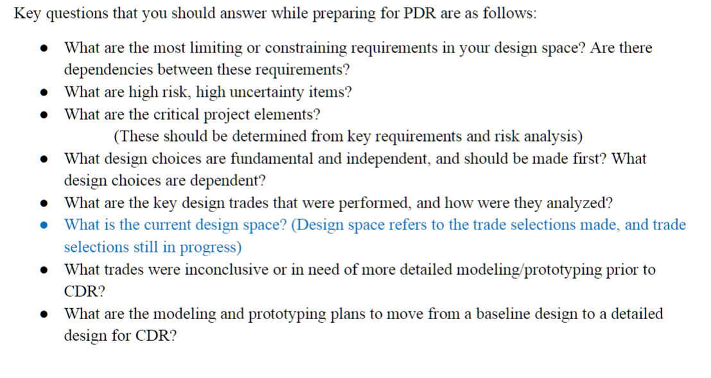

Slide 55
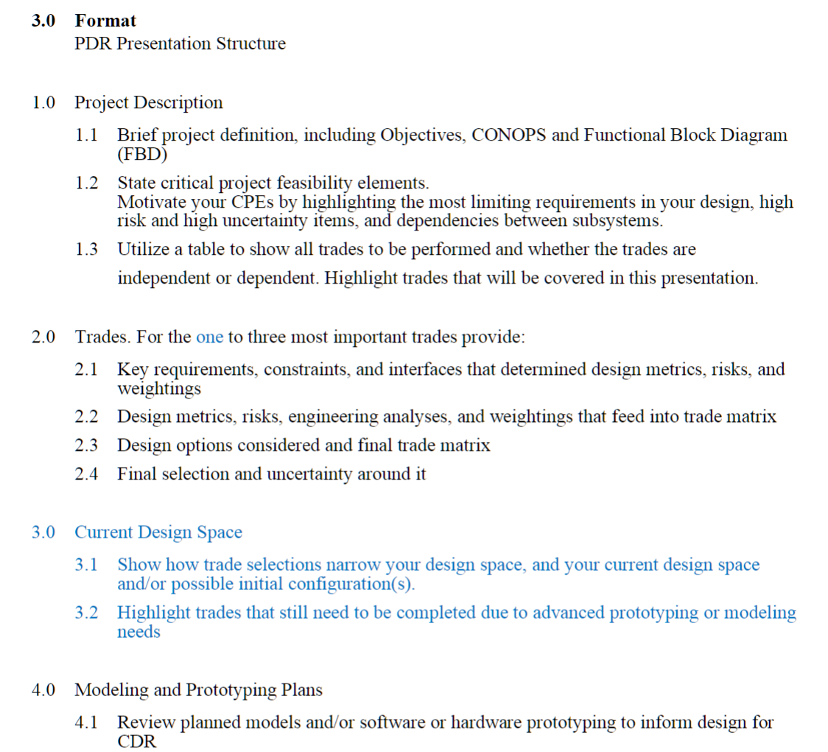
Abdoulaye
Benji
Lucca, Jade
Gerald, Lucio
CJ, Lucca
CJ, Jade
Abdoulaye
Benji
Lucio, Gerald
David, Garrett
David, Garrett

