Slide 1
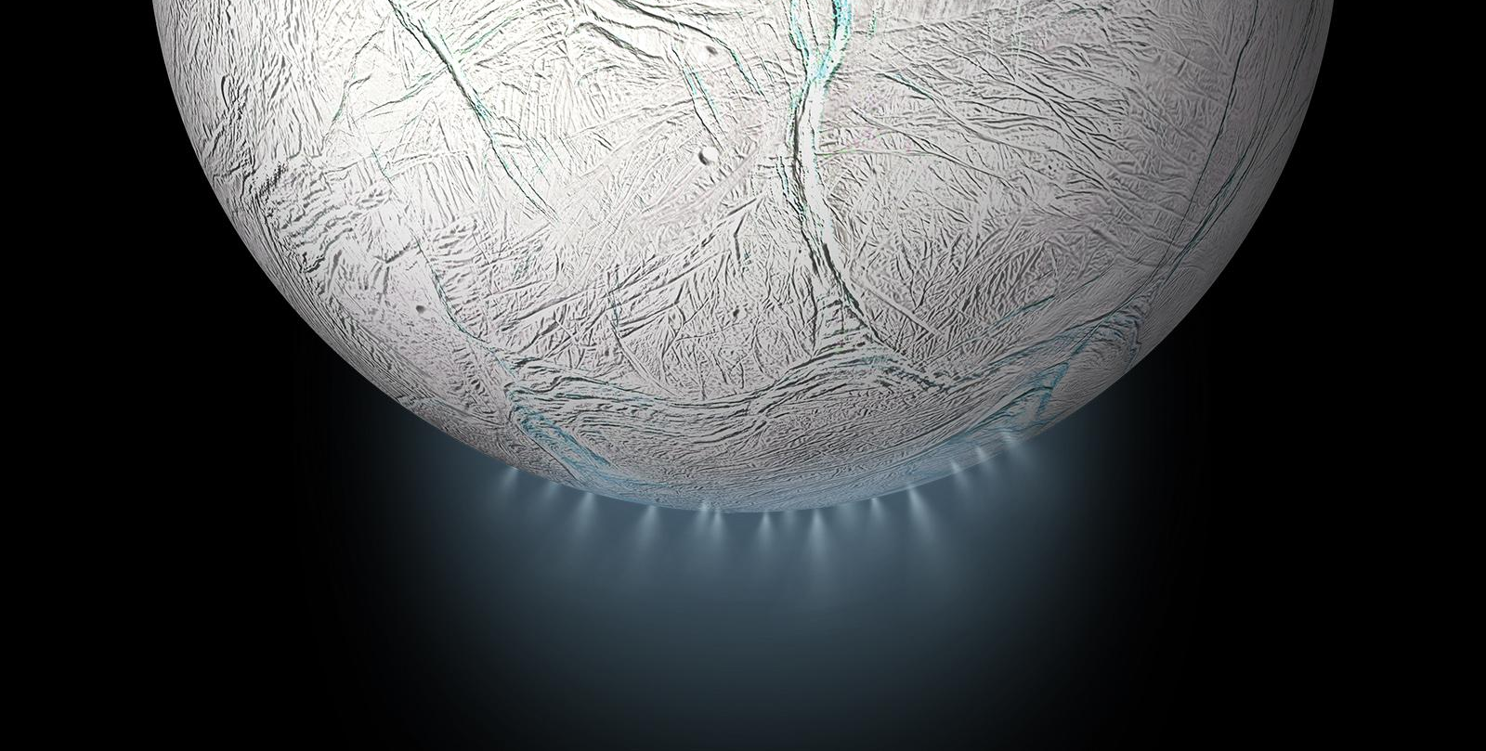
The Ho.M.I.E. Team
October 3rd, 2022
ASEN 4018-012 Team 15
Preliminary Design Review

Slide 2
The Ho.M.I.E.'s

Slide 3
Agenda
01
02
03
04
Project Description
Trade Studies
Design Space
Modeling Plan
Who We Are
Project Overview
CONOPS
Functional Block Diagram
CPE's
Trades Overview
Processor
Pinhole
Collimating Lens
Current Trade Impacts
Available Design Space
Potential Configuration
Mechanical Modeling & Prototyping
Software Modeling

Slide 4
Project Description
Presenters: Brianna Gagliardi & Tess Brodsky

Slide 5
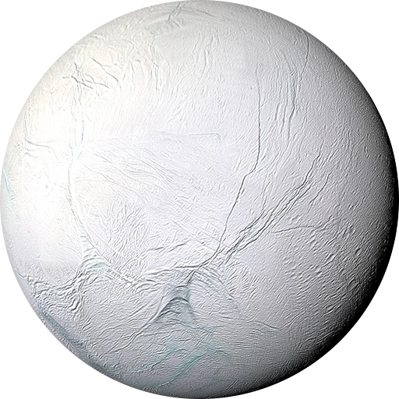
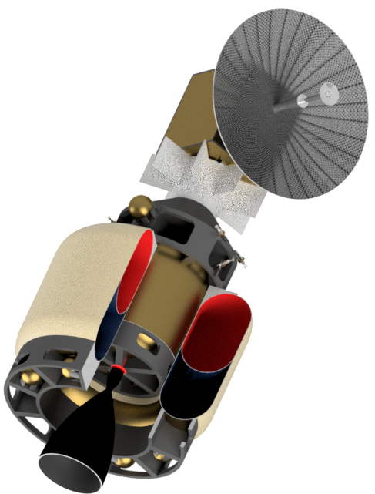
Project Overview
Low-cost astrobiology mission to Enceladus (icy moon of Saturn)
Small satellite to fly through plumes of water
Collect ice grains
Melt ice grains in a closed chamber
Transfer ice grains to a holographic microscope for analysis
Objectives:
Design, build, and test a flight-like Digital Inline Holographic microscope to support the detection and characterization of life from melted ice grain samples collected from the plumes from Enceladus
Design, build, and test an algorithm to reconstruct three-dimensional images from holograms captured by the microscope to analyze Brownian motion
Enceladus
Encelascope + Transfer Stage
*Not to scale

Slide 6
Detailed Objectives
ID | Objective Description | ID | Objective Description | ID | Objective Description
O1 | The microscope shall support the detection and characterization of life in samples of water from Enceladus containing living microorganisms. | O5 | The microscope payload shall fit within a 1U SWAP allocation. | O9 | The microscope shall support meeting the mission requirements under a 1 kbps downlink constraint.
O2 | The microscope shall be flight-like and shall survive launch and operational environmental conditions. | O6 | The microscope shall have a liquid water interface for receiving and expelling samples under expected operating conditions. | O10 | The microscope’s behavior shall be controllable via commands from ground control.
O3 | The microscope implementation shall be a digital inline holographic microscope (DIHM) without a lens between the sample and image sensor (i.e. lens-less DIHM). | O7 | The microscope shall support a 15-year mission life plus 3 years of manufacturing, assembly, testing, and integration. | O11 | The microscope shall output its digital data via the orbiter’s science data downlink.
O4 | The microscope’s processor shall not impact the microscope’s overall thermal operational boundaries to guarantee successful data collection. | O8 | The microscope’s processor and reconstruction algorithm shall be fast enough to keep up with the rate of material collection.
Notes:
Ad specifics to objectives to better define
Combine objectives 2 and 6

Slide 7
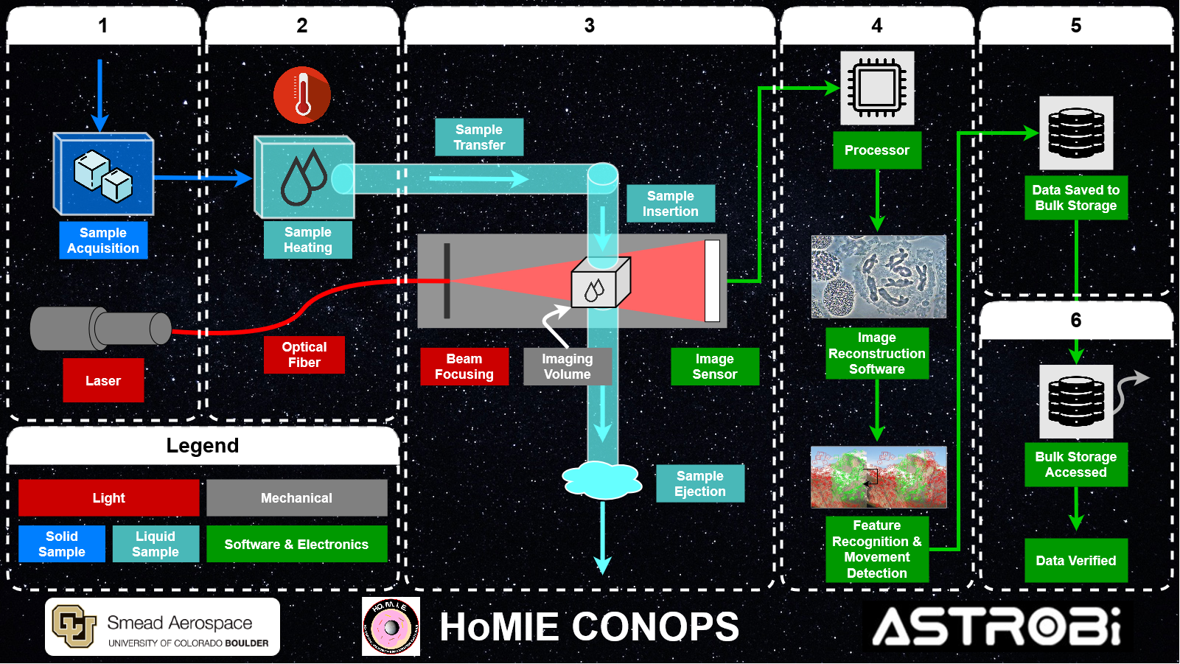
CONOPS

Slide 8
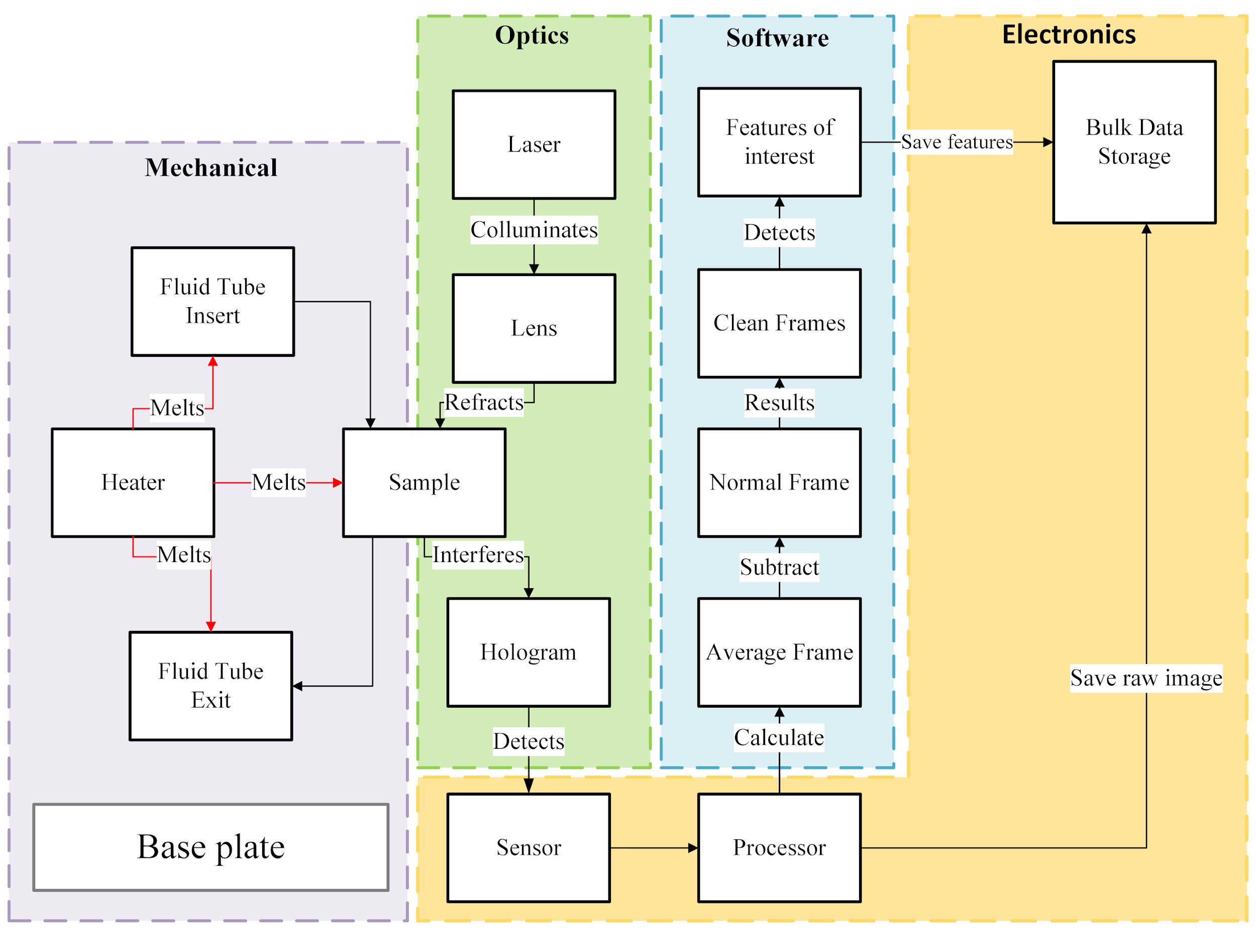
Functional Block Diagram

Slide 9
Critical Project Elements: Limiting Requirements
Critical Project Element |  | Limiting Functional Requirement | Critical Project Element |  | Limiting Functional Requirement
CPE1 | Microscope Functionality | The microscope shall provide a reconstruction resolution of < 0.8μm in the x and y directions, and < 2μm in the z-direction. Note that reconstruction resolution may be a configurable parameter. | CPE4 | Reconstruction Algorithm | Reconstruction of the full 3D imaging volume from one frame or one difference stack shall take less than 12,000 seconds at the required reconstruction resolution.
CPE2 | Microscope Core Interfaces | The microscope’s processor and reconstruction algorithm shall be fast enough to keep up with the rate of material collection. | CPE5 | Detection Algorithm | The software shall provide a method to characterize detected regions and output the characterization as a compact description.
CPE3 | Spacecraft Interfaces | The microscope payload shall fit within a 1U SWAP (size, weight, and power) allocation. | CPE6 | Power | The microscope shall consume less than 10 watts active, and 0.5 watts inactive. The processor shall consume less than 10 watts active, and 0.5 watts inactive.

Slide 10
Critical Project Elements: Risk & Uncertainty
Very Likely |  | Detection algorithm fails to detect motion
Likely | False positive from detection algorithm |  |  | Radiation damage to electronics
Possible
Unlikely |  |  | FOD from spacecraft bus |  | Assembly becomes misaligned during launch, images no longer able to be captured
Very Unlikely |  |  |  | FOD in sample collection | Perforation in microfluidic tubing
 | Negligible | Minor | Moderate | Significant | Severe
Probability
Impact/Consequence
Risk Level:
Acceptable | Watch | Unacceptable

Slide 11
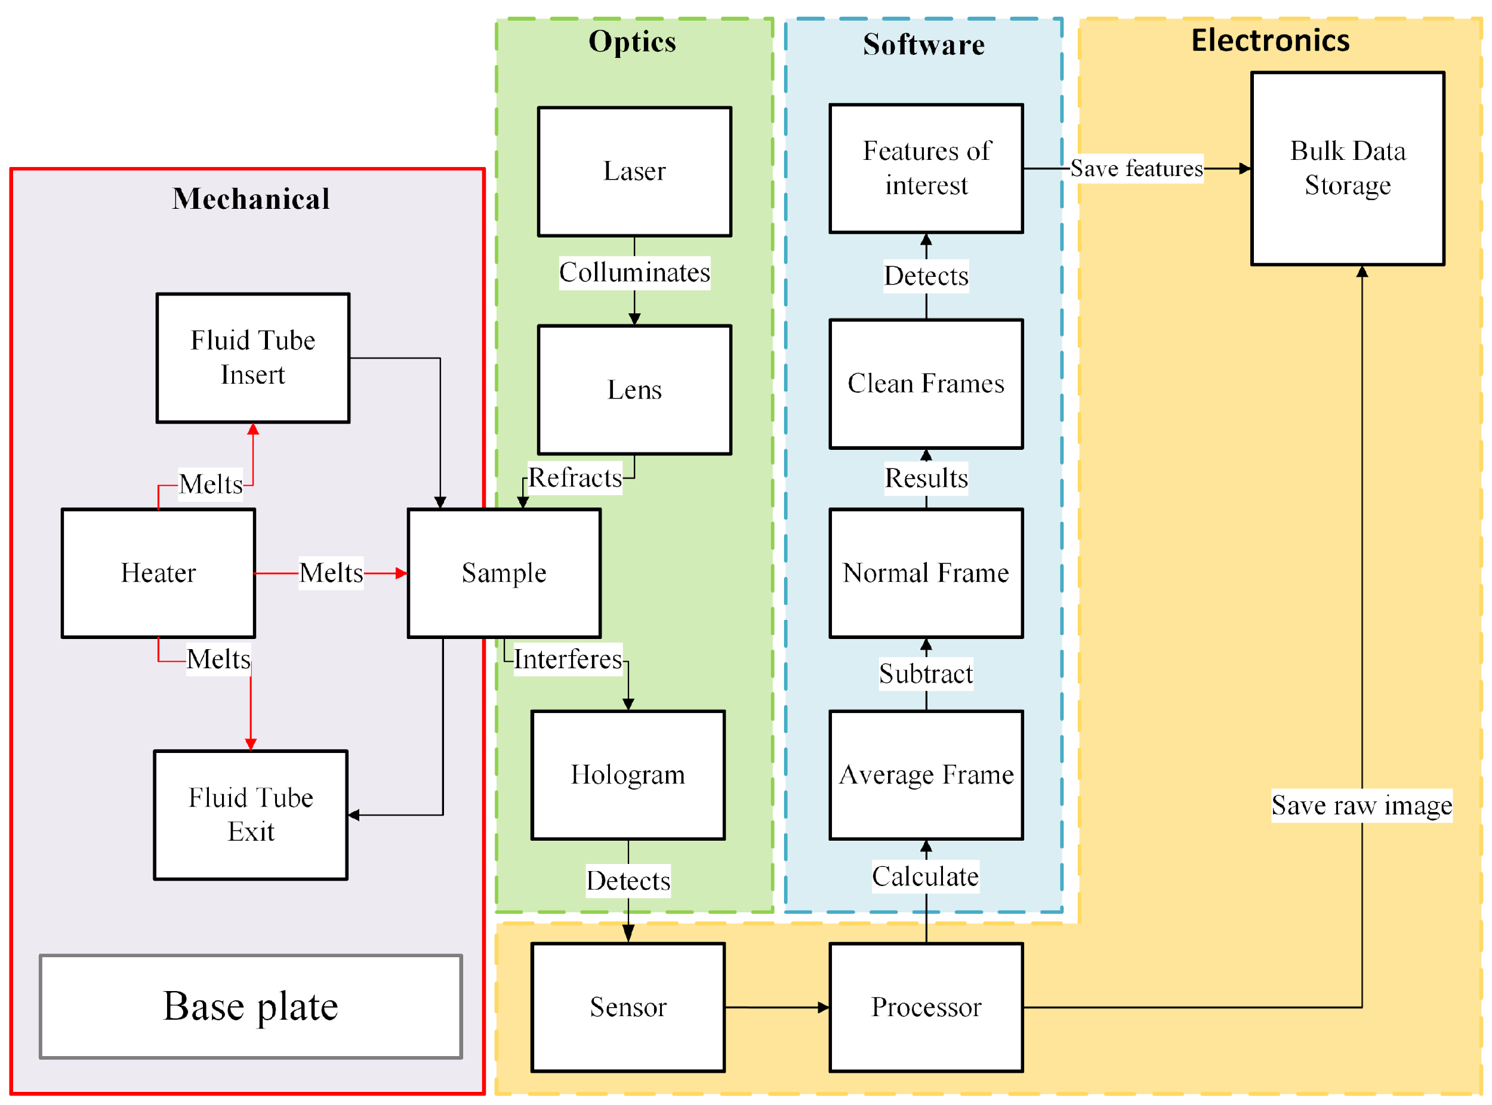
Critical Project Elements: Sub-system Dependencies
Mechanical:
Relies on:
Heat extraction from processor to warm base plate
Power input to heater
Provides:
Heat to ice grains to melt sample to liquid state and maintain liquid state
Structure to hold microscope components

Slide 12
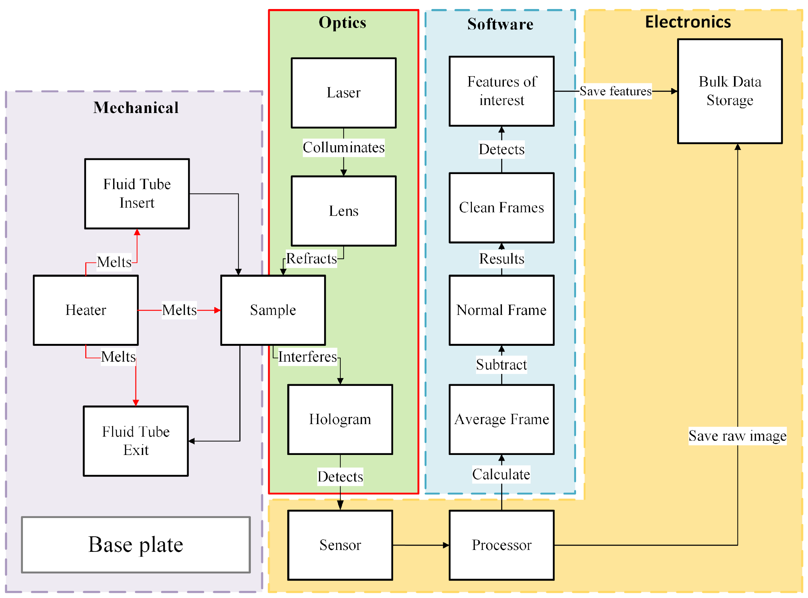
Critical Project Elements: Sub-system Dependencies
Optical:
Relies on:
Sample to be in liquid state
Power for operation of laser
Provides:
Hologram to image sensor
Lens mounting hardware

Slide 13
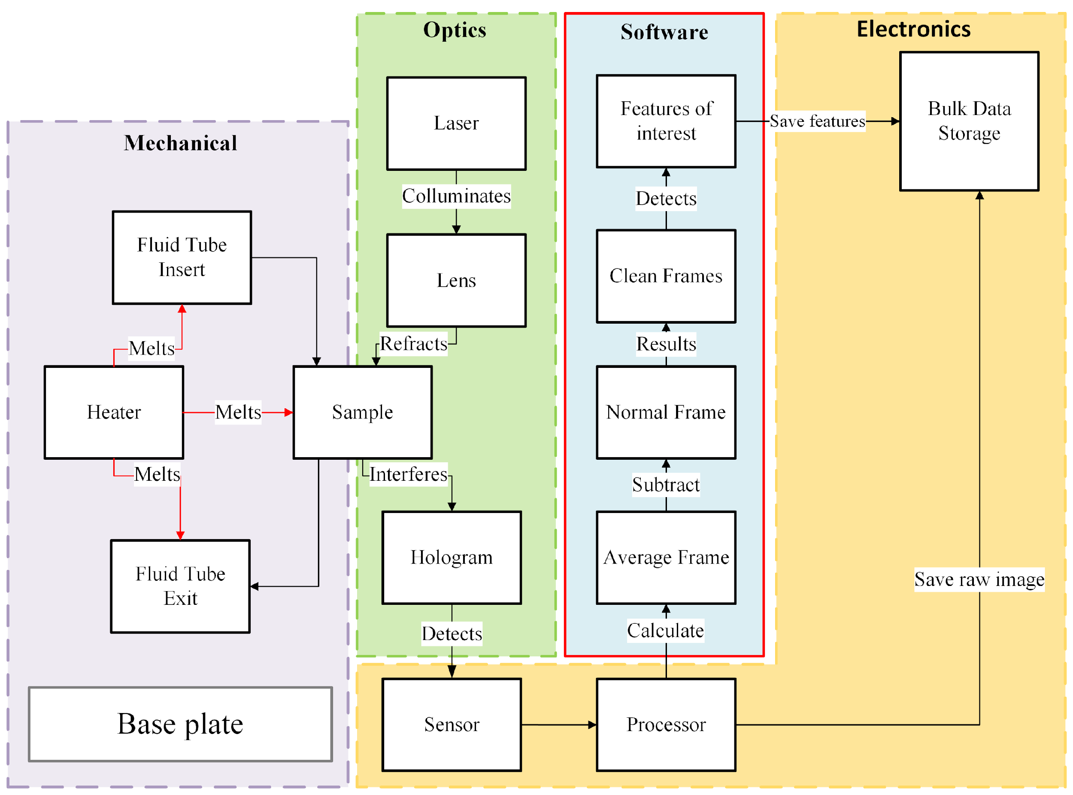
Critical Project Elements: Sub-system Dependencies
Software:
Relies on:
Processor computational power
High resolution image from sensor
Provides:
Clean frame algorithm for removing image noise
Reconstructed image to bulk data storage
Features of interest to bulk data storage

Slide 14
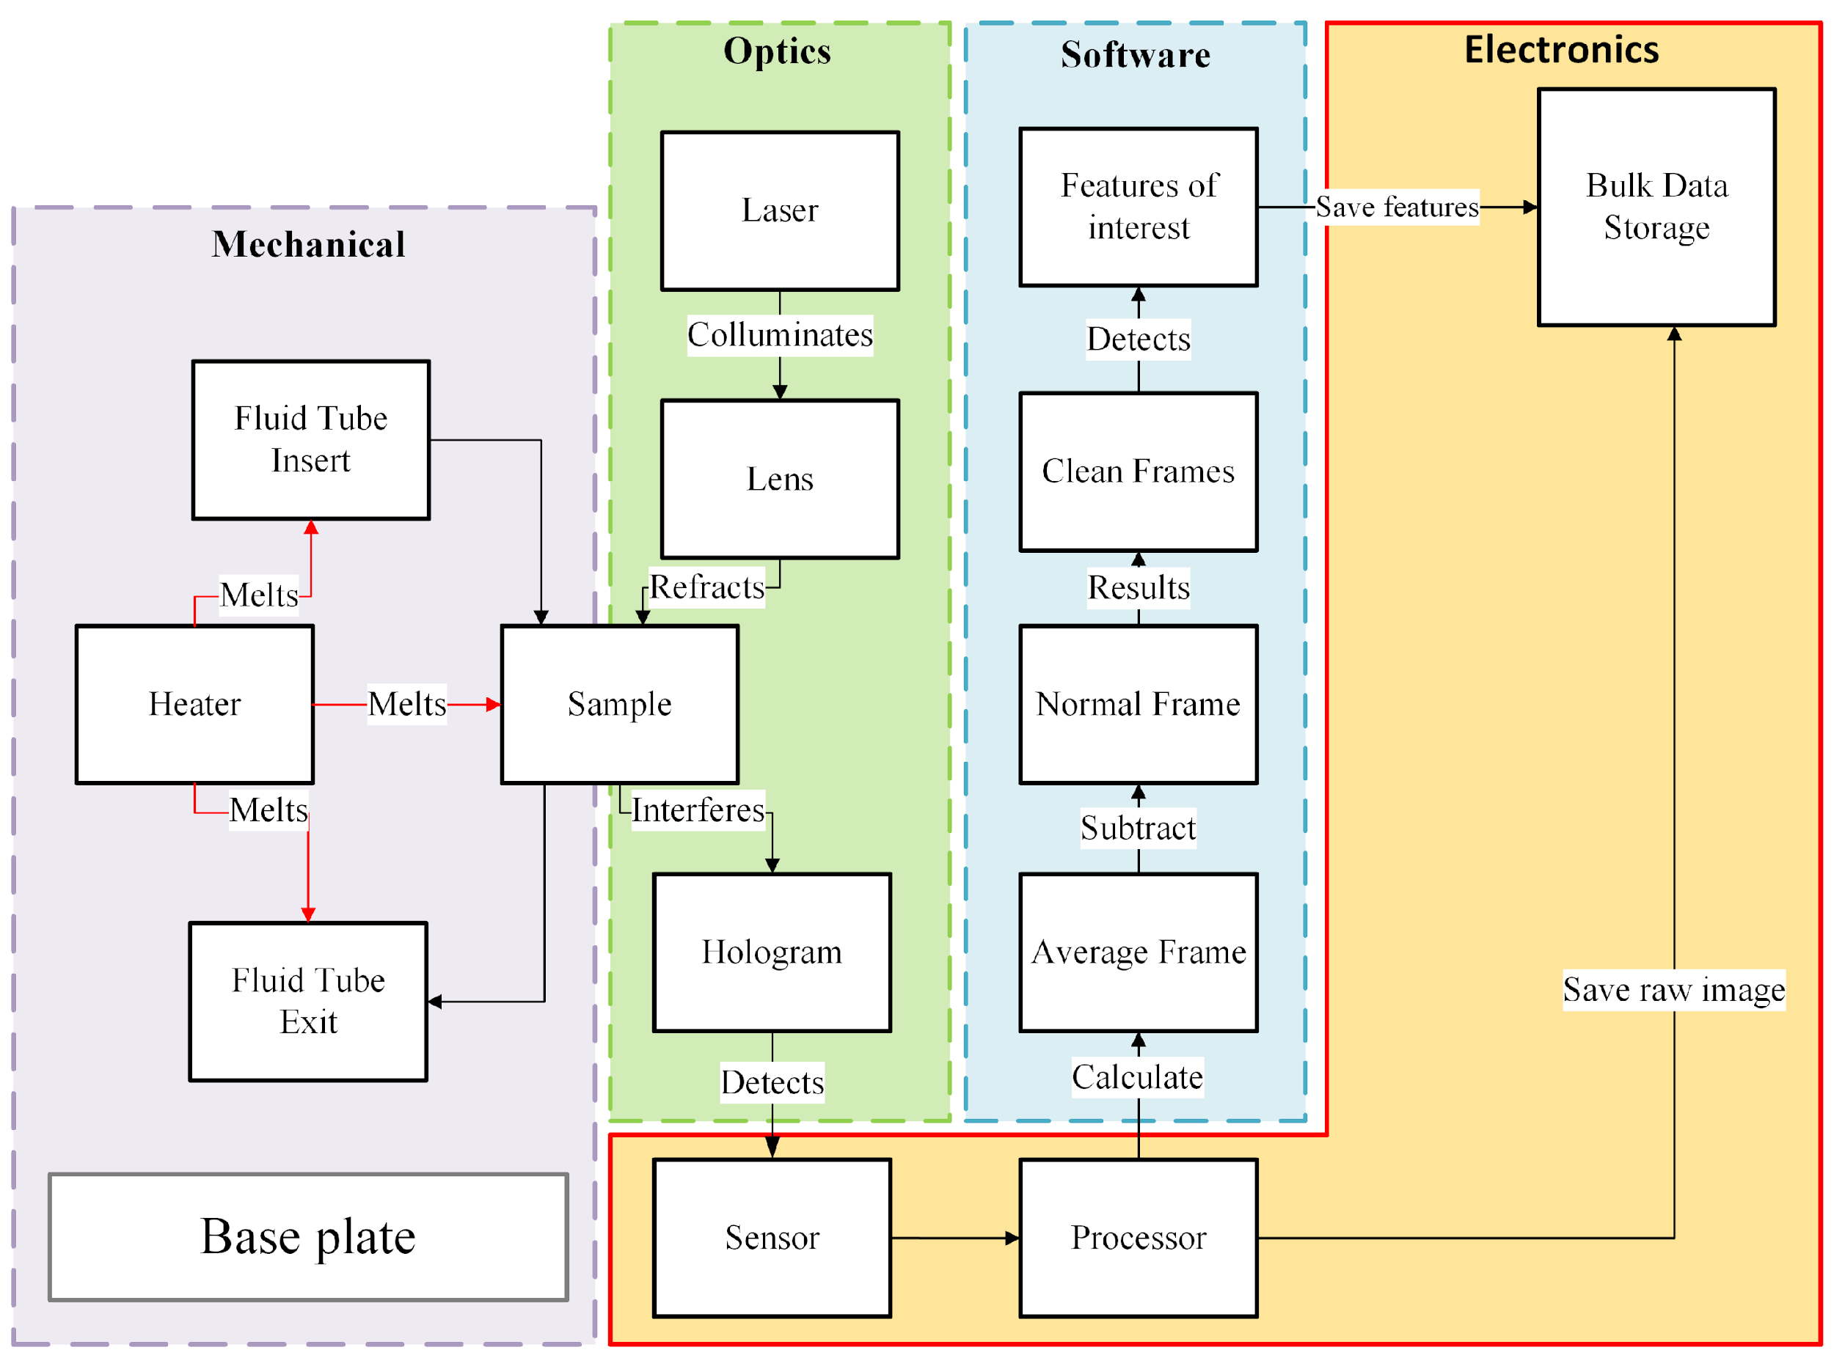
Critical Project Elements: Sub-system Dependencies
Electronics:
Relies on:
Power input
Hologram from optics pipeline
Provides:
Computational power for reconstructing and analyzing data, control via commands from ground station
Power distribution (Not shown)

Slide 15
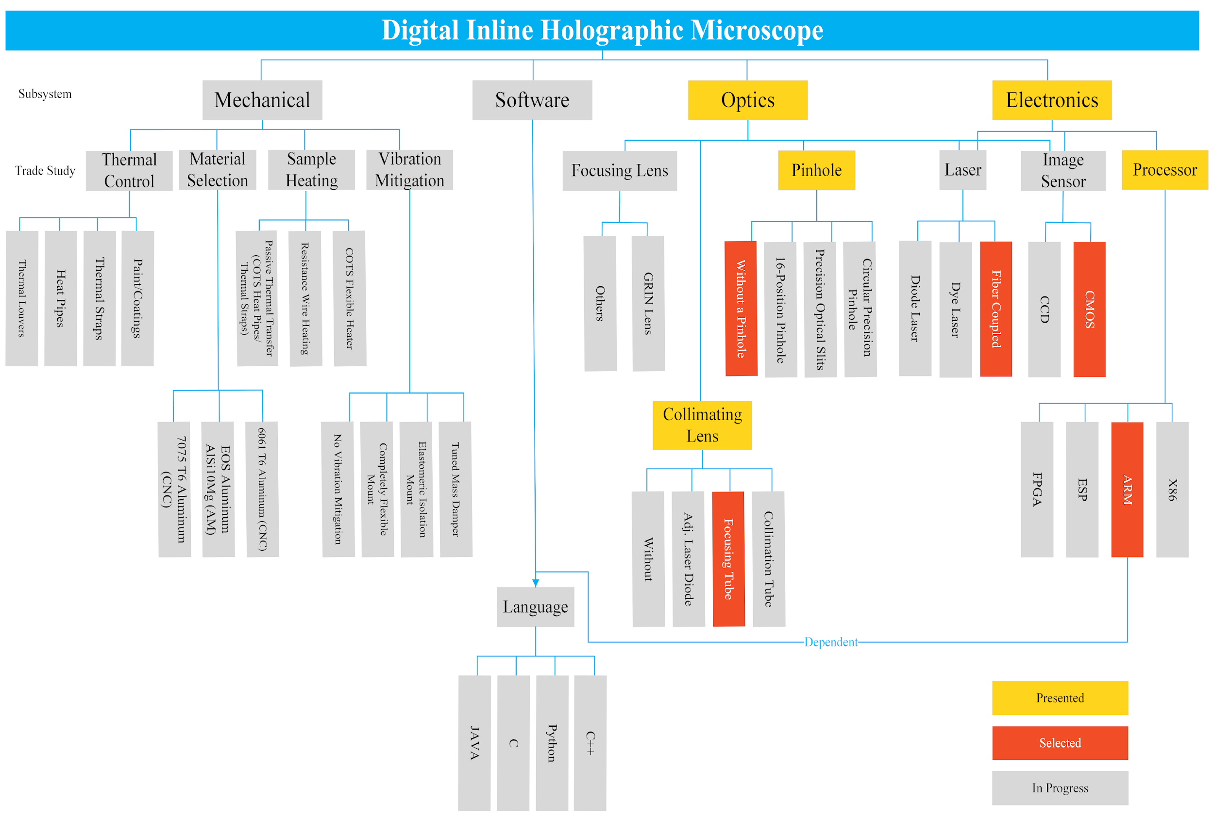
Trade Tree

Slide 16
Trade Tree

Slide 17
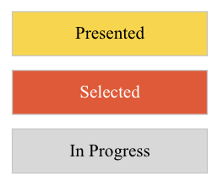
Completed Trades
Electronics
Processor
Image Sensor
Laser
Optics
Collimating Lens
Pinhole
Notes:
Good :)

Slide 18
Trade Studies
Presenters: Nick Iwanicki, Anna Casillas

Slide 19
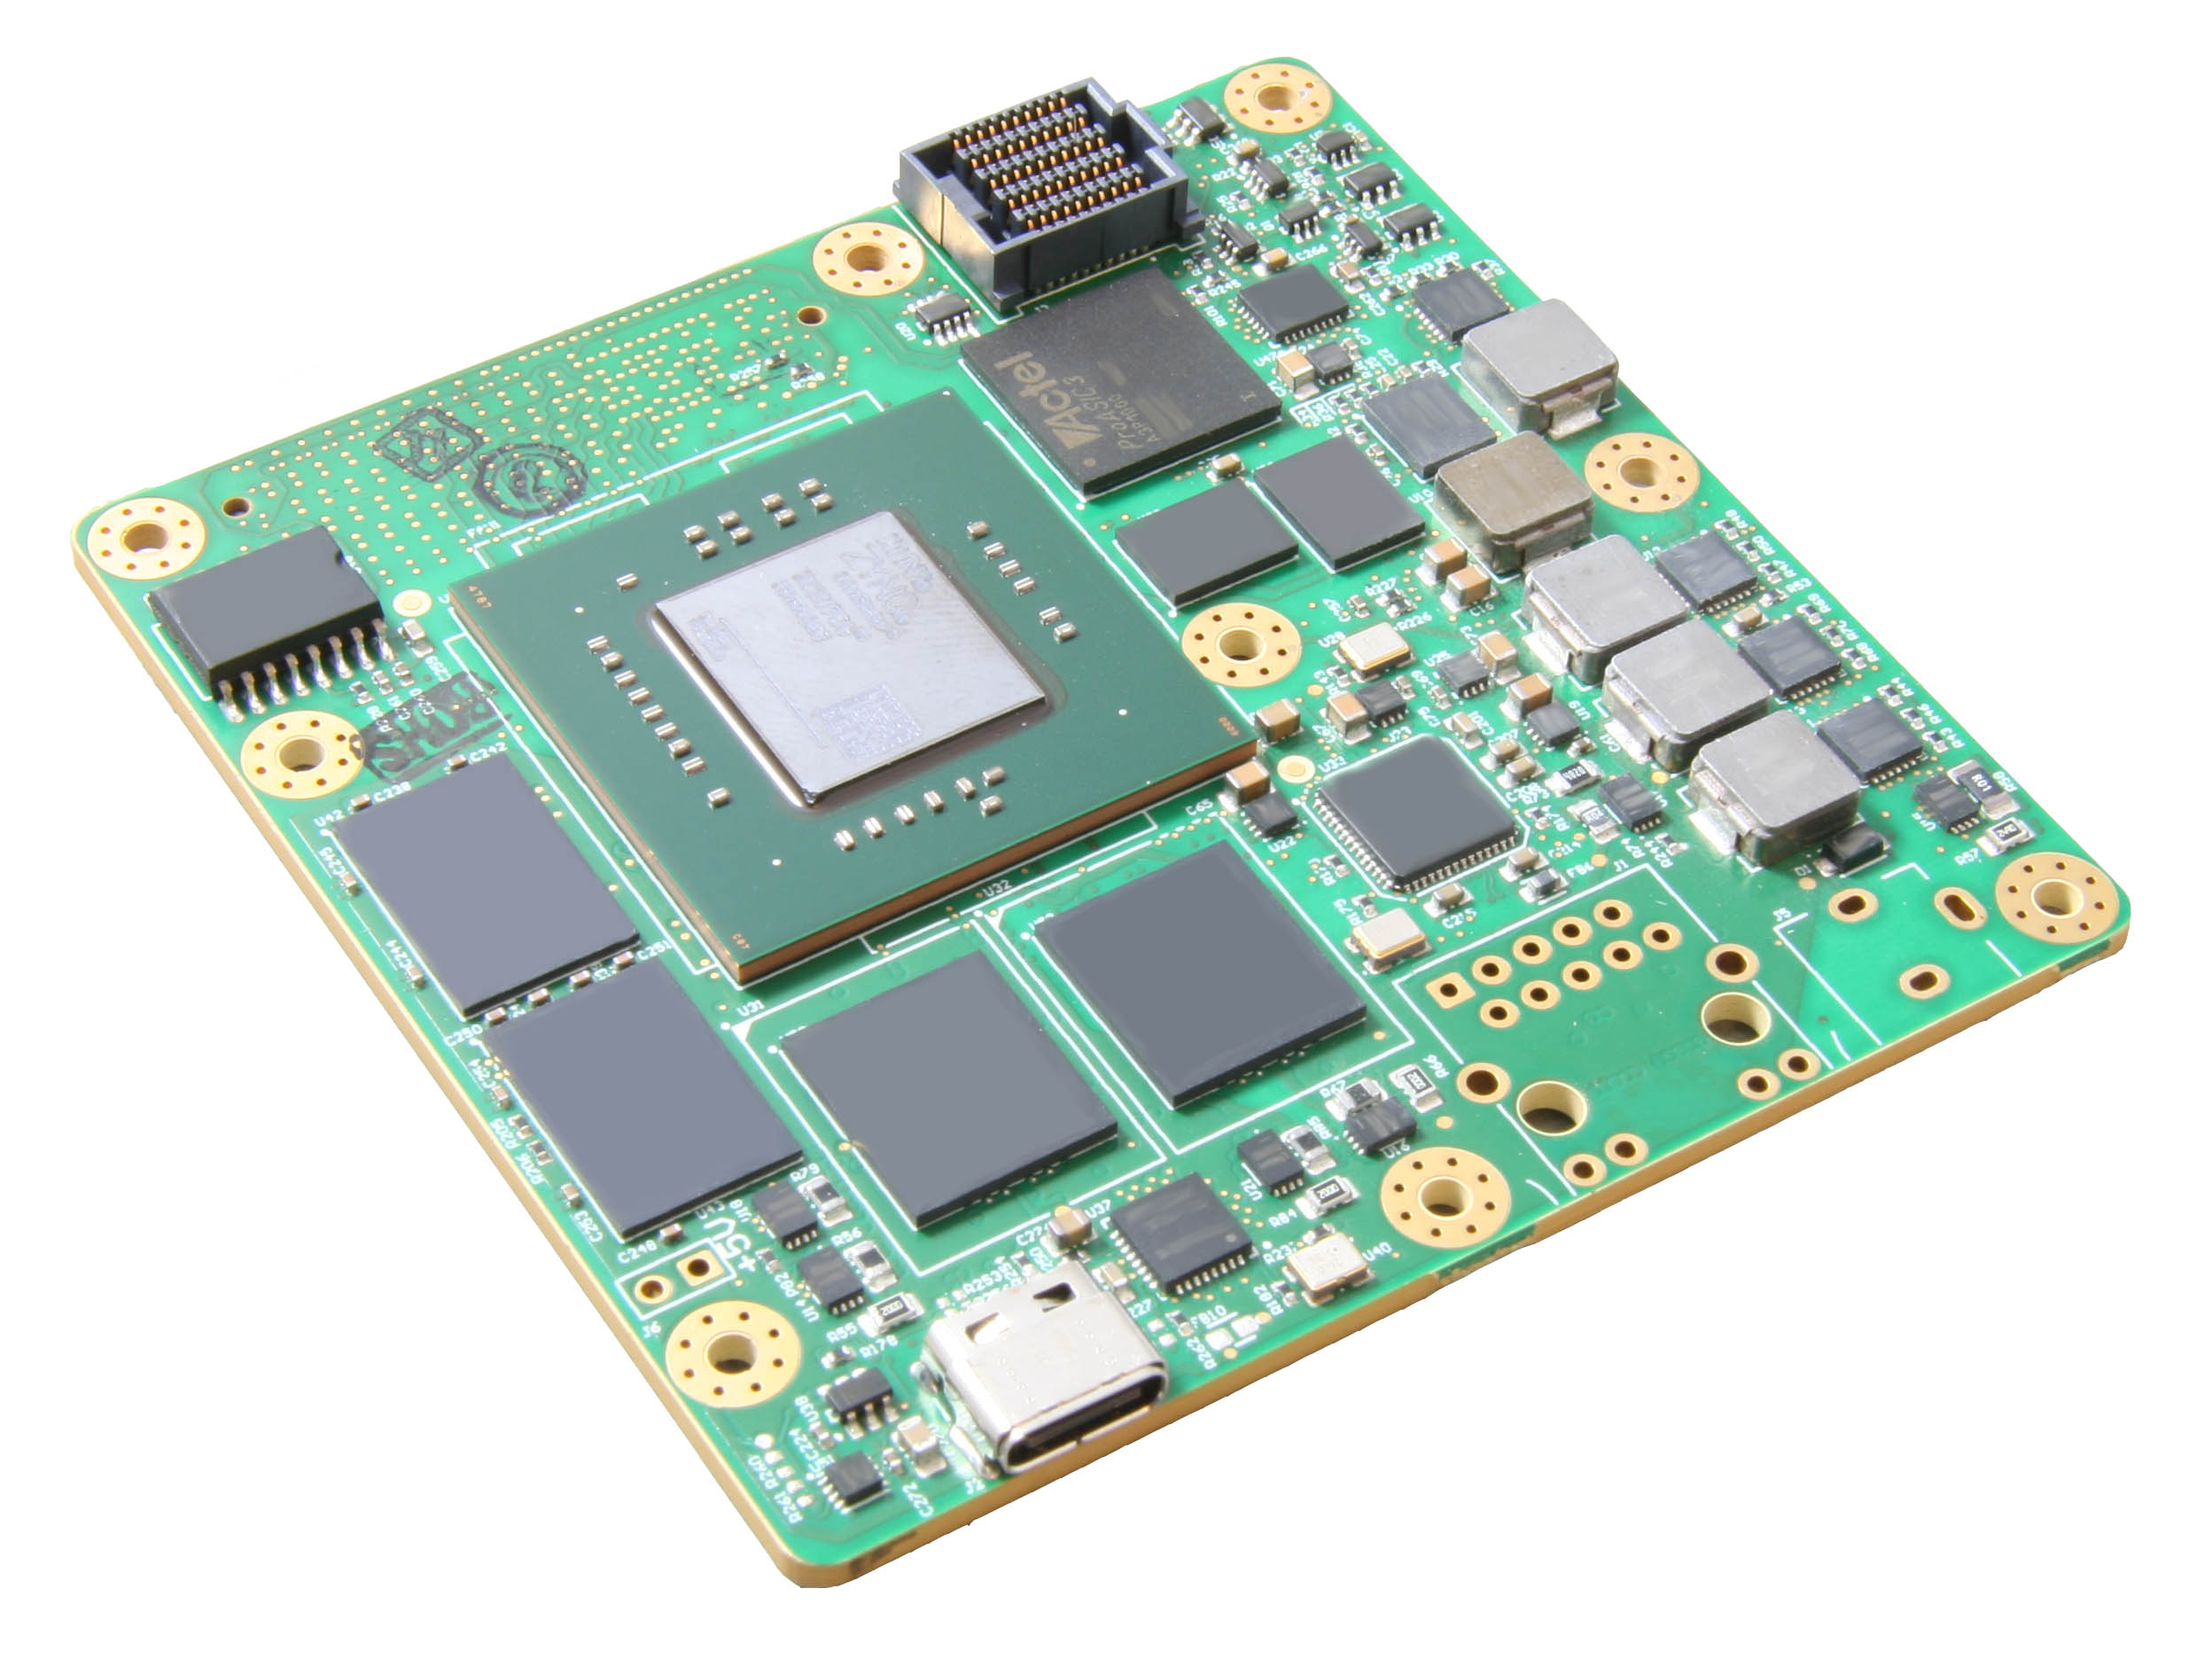
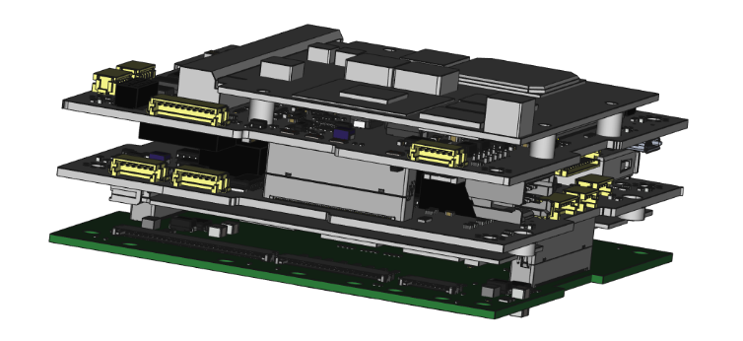
Processor Considerations
Workhorse of the microscope
Reconstructs images and detects movement
Receives and executes commands
Must satisfy objectives 2,4,5,7,8,10
Criteria based off these objectives
Final Criteria:
Power Consumption
Thermal Output
Computational Power
Flexibility
Cost
Durability
Lead Time
Weights decided with software team, based on importance of criterion and objective

Slide 20
Processor Trade Matrix
Processor |  |  |  | X86 | ARM | ESP | FPGA
CRITERIA | Relevant Objective | Weight | SCALE
Power Consumption | O2,O5 | 25% | 3=Most Supportive, 0=Least Supportive | 2 | 3 | 3 | 2
Thermal Output | O2,O4 | 15% | 3=Most Supportive, 0=Least Supportive | 2 | 3 | 3 | 2
Computational Power | O8 | 25% | 3=Most Supportive, 0=Least Supportive | 2 | 2 | 1 | 3
Flexibility | O10,O11 | 5% | 3=Most Supportive, 0=Least Supportive | 3 | 3 | 2 | 1
Cost |  | 5% | 3=Most Supportive, 0=Least Supportive | 2 | 2 | 3 | 1
Durability | O2,O7 | 20% | 3=Most Supportive, 0=Least Supportive | 3 | 2 | 0 | 3
Lead Time/Availability |  | 5% | 3=Most Supportive, 0=Least Supportive | 0 | 2 | 2 | 1
WEIGHTED TOTALS in % |  | 100% |  | 72% | 88% | 67% | 80%

Slide 21
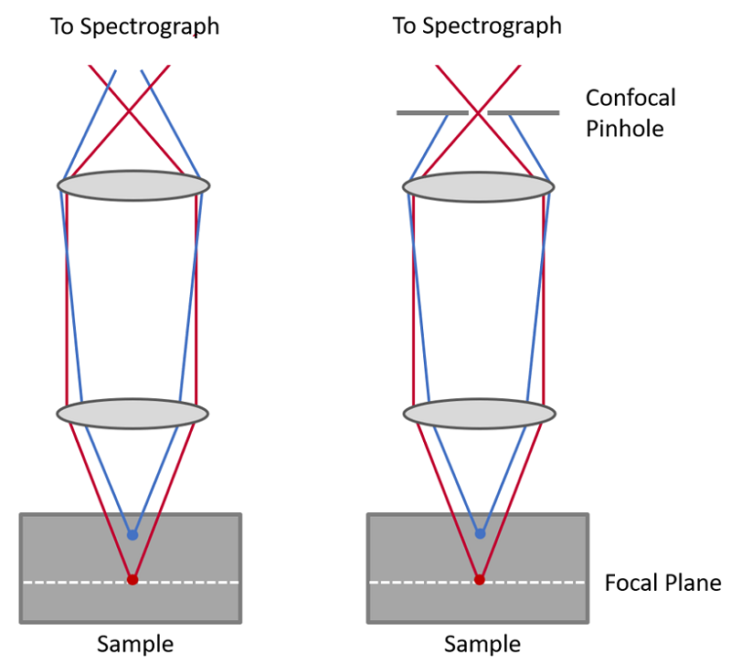
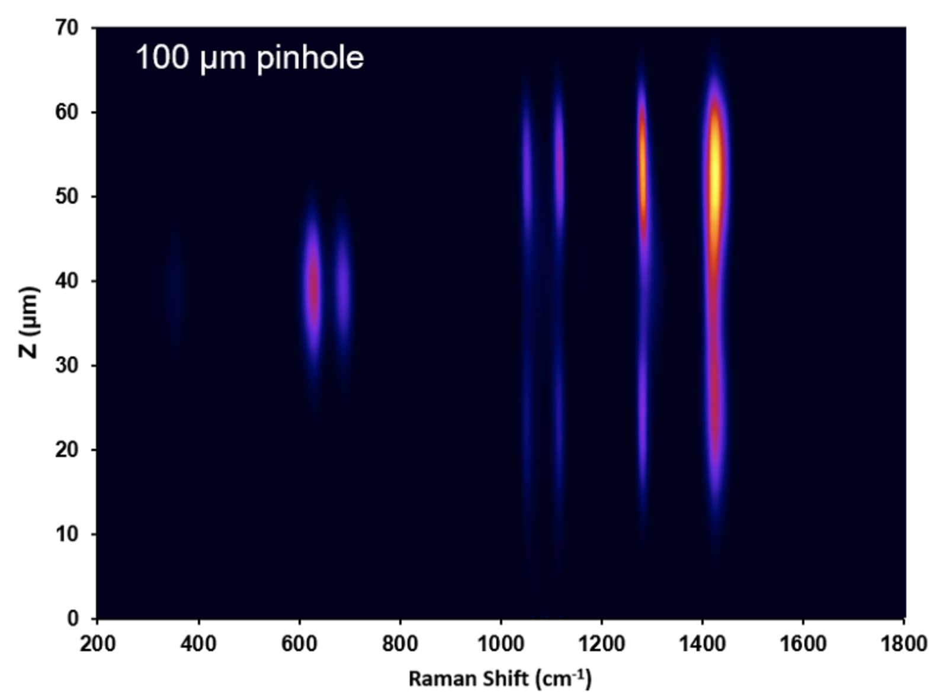
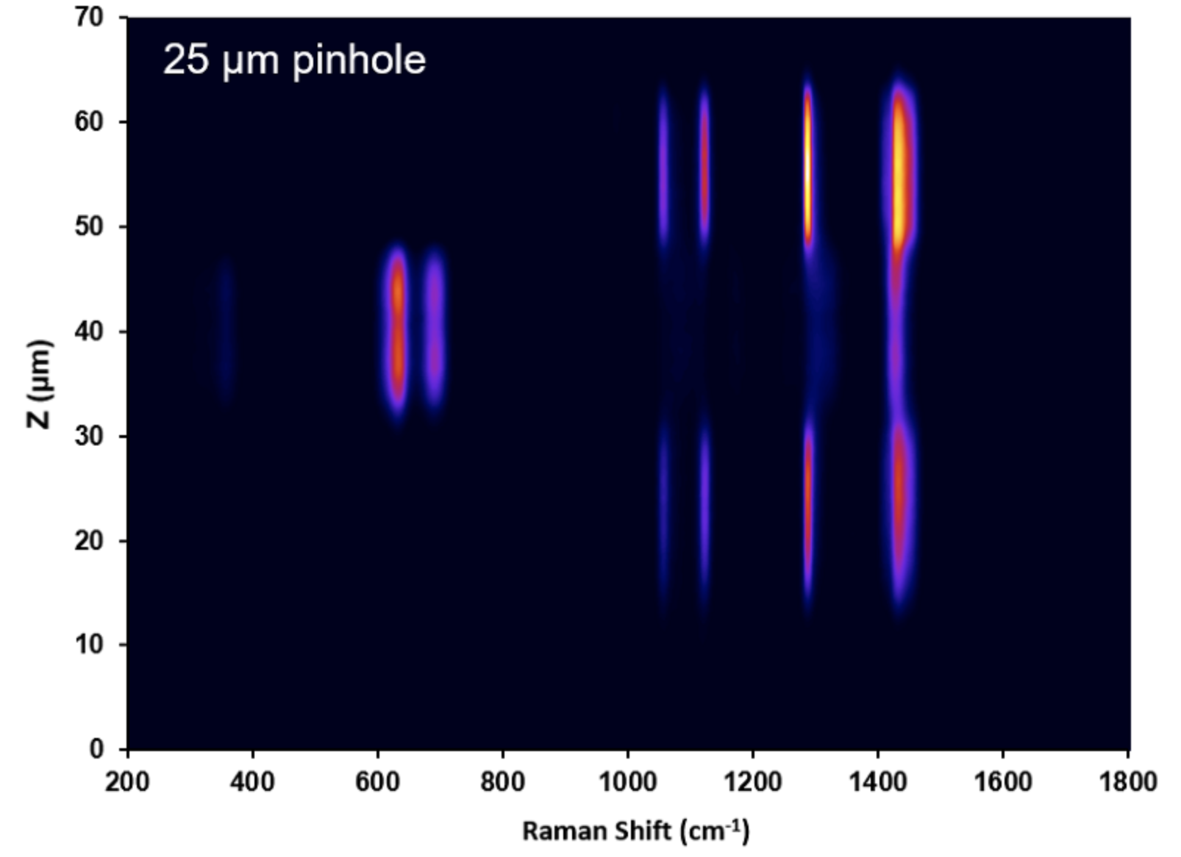
Pinhole Trade Considerations
Optical filter
Risk of misalignment
Thermal effects
Smaller diameters
Increases axial (z) resolution <1µm
Decreases Raman scatter intensity
Increases computational time

Slide 22
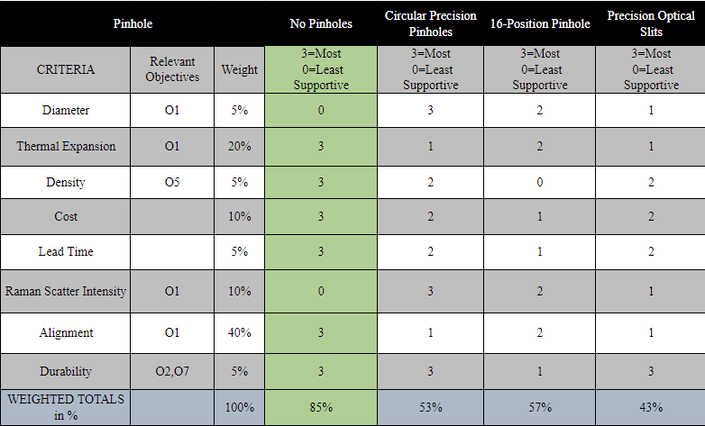
Optical Pinhole Trade Matrix
Notes:
Include "without a pinhole" option

Slide 23
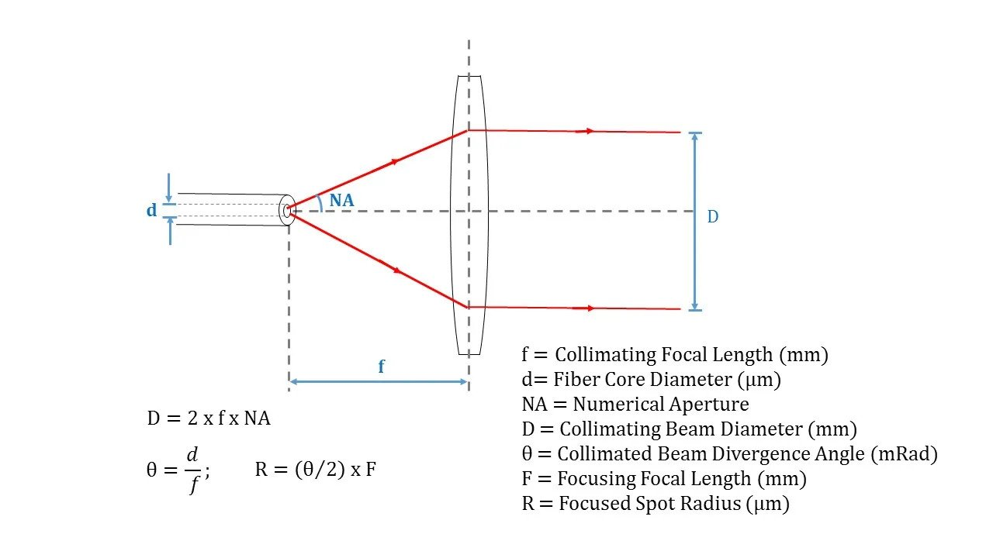
Collimator Lens Trade Considerations
Refracts incoming rays to be parallel
Increases contrast and resolution
Improves collection efficiency
Reduces intensity

Slide 24
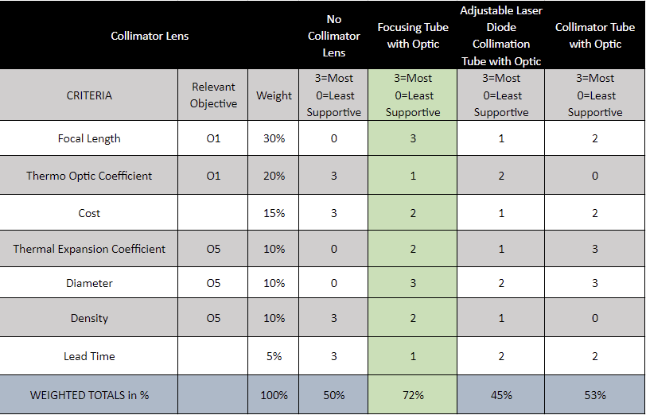
Collimator Lens Trade Matrix

Slide 25
Current Design Space
Presenters: Keith Bliss

Slide 26
Trade Studies Design Impact
Collimating Lens
Lens must be securely mounted in optical assembly
Strong vibrations must be dampened to prevent misalignment
No Pinhole
Misalignment can be avoided using minor vibration mitigation
Thermal impact on the optical assembly is limited to the sample volume
Fiber Coupled Laser
Laser can be placed anywhere in the payload
Thermal isolation is more achievable
CMOS image sensor
Less radiation shielding necessary
Lower power consumption allows for less power budget limitations
ARM processor
Architecture allows for a common programming language
Lower power consumption allows for less power budget limitations

Slide 27
Trades To Be Completed

Slide 28
Trades To Be Completed

Slide 29
Trades To Be Completed
Mechanical
Thermal Control
Sample Heating
Vibration Mitigation
Material Selection
Dependent on all other selections
Software
Coding Language
Dependent on processor selection
Optics
Focusing Lens
Notes:
Good :)

Slide 30
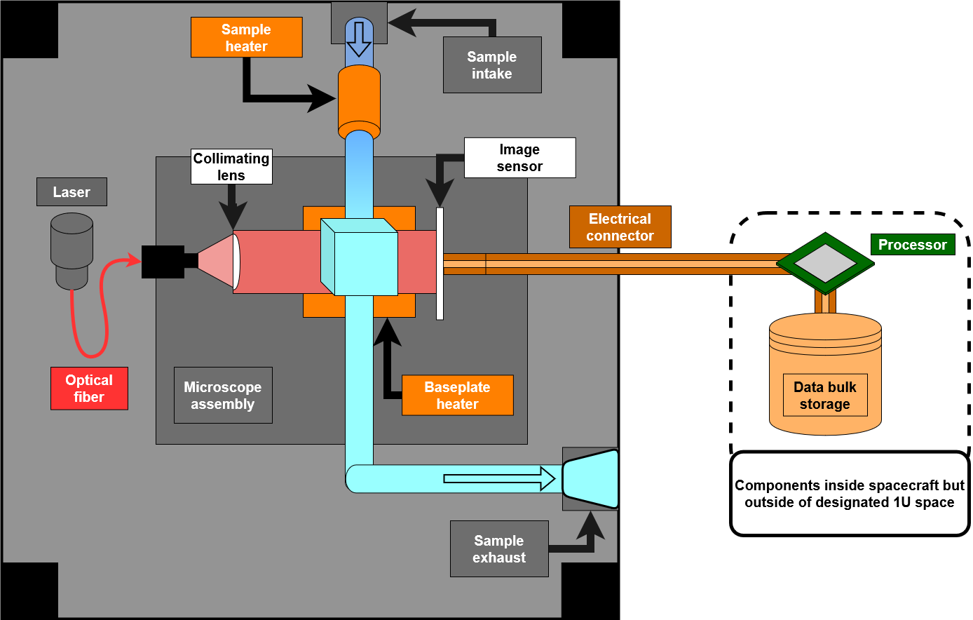
Potential Configuration
Notes:
What is a possible initial configuration?

Slide 31
Modeling & Prototyping
Presenters: Kellen Martin

Slide 32
Modeling & Prototyping: Mechanical
Microscope Assembly | Hydraulic Assembly
Create microscope assembly model with all optics components.
Verify all dimensions are correct according to requirements
Run SOLIDWORKS random vibration and tolerance
Create fluid tubing assembly on SOLIDWORKS.
Test fluid tubing with water
Prove there are no leaks.
Make a plastic 3D print version of the microscope.
Verify all dimensions match
Assess all changes required for deliverable version.
Test fluid tubing with water with electrical heater.
Test for any leaks
Reasess design if needed
Make a final, deliverable version of the microscope.
Use Machining for metal parts
Verify dimentions and tolerances

Slide 33
Modeling & Prototyping: Software
Develop preliminary algorithms in MATLAB
Language Familiarity
Troubleshooting
Modify algorithms to run primarily on GPU
Speed up for debugging and testing
Implement improvements in two phases from Kanka papers ¹ ²
Reduce memory impact
Accelerate processing speed

Slide 34
Questions?

Slide 35
BACKUP SLIDES

Slide 36
Processor Specs
Sample Processors were chosen for each category, and performance metrics were compared when available
Processor | X86(Spacecloud iX5100) | Arm(Xiphos Q8) | ESP(ESP32) | FPGA(Volkh Processing Platform)
CRITERIA
Power Consumption | 10-30W | 4-25W | 1.5W | 0.75-1 W
Thermal Output | 9W TDP | TDP Not Listed | TDP Not Listed | TDP Not Listed
Computational Power | 2-Core 1GHz, 2GB RAM | 4-Core 1.2GHz, 4GB RAM | 2-Core 240 MHz, 8MB RAM | Unknown,128 MB RAM
Flexibility | Capable of multiple tasks on seperate cores | Capable of multiple tasks on seperate cores | Capable of multiple tasks on seperate cores | Singular task, Parallel Processing capable
Cost | Quote Needed | Quote Needed | $3.00 | Quote Needed
Durability | "Radiation Tolerant" | 30krad TID | None Specified | None Specified
Lead Time/Availability | N/A Possibly Discontinued | 5 Months | Available | 3 Months

Slide 37
Optical Pinhole Specs

Slide 38
Collimator Lens Specs

Slide 40
Critical Project Elements
Critical Project Element |  | Risk & Uncertainty | Critical Project Element |  | Risk & Uncertainty
CPE1 | Microscope Functionality | Assembly becomes misaligned during launch and images are no longer able to be sensed Thermal input insufficient in melting ice grain Overheating due to inadequate thermal dissipation | CPE4 | Reconstruction Algorithm | Reconstruction algorithm unable to keep up with the rate at which material is collected and imaged due to poor resolution image Reconstruction algorithm requires above available processing power
CPE2 | Microscope Core Interfaces | Assembly becomes misaligned during launch and images are no longer able to be sensed FOD | CPE5 | Detection Algorithm | Detection algorithm flags images that are not of interest or misses images that are Detection algorithm requires above available processing power
CPE3 | Spacecraft Interfaces | FOD Electrical disconnection and power loss Radiation Damage | CPE6 | Power | Losses in RTG power
Notes:
Replace slide with a risk matrix and details on high risk flight items

Slide 41
Sources
1. Kanka, M., Riesenberg, R., and Kreuzer, H. J., “Reconstruction of high-resolution holographic microscopic images,” Optics Letters, vol. 34, 2009, p. 1162.
2. Kanka, M., Wuttig, A., Graulig, C., and Riesenberg, R., “Fast exact scalar propagation for an in-line holographic microscopy on the diffraction limit,” Optics Letters, vol. 35, 2010, p. 217.

Slide 42
Critical Project Elements
Critical Project Element |  | Sub-system Dependencies | Critical Project Element |  | Sub-system Dependencies
CPE1 | Microscope Functionality | Relies on thermal sub-system to maintain operating temperatures Relies on reconstruction algorithm to produce 3D images of sample Relies on adequate power input to operate Relies on optical sub-system to adequately illuminate and capture image of sample Relies on proper hydraulic tubing for sample transportation and imaging | CPE4 | Reconstruction Algorithm | Relies on holographic image output of image sensor to begin reconstruction Relies on the onboard processor, and in turn, the power subsystem, to produce the holographic image Relies on computing capacity of onboard processor & power supply
CPE2 | Microscope Core Interfaces | Relies on sufficient power input for laser and image sensor operation Relies on sufficient thermal input to ice grain sample for adequate bacterial movement within sample Relies on structural rigidity to keep microscope inline and in place. | CPE5 | Detection Algorithm | Relies on accurate reconstructed image to perform motion detection analysis Relies on computing capacity of onboard processor & power supply Supports transmission of valuable findings via image/data compression
CPE3 | Spacecraft Interfaces | Relies on software to transmit data from processor to satellite bus Relies on thermal management to keep all elements functional Relies on structural integrity to keep everything in rigid and in place. | CPE6 | Power | Power drawn from satellite bus RTG Supports processor, image sensor, laser, and heater
Notes:
Replace slide with highlights on functional block diagram to detail dependencies

