Slide 1
ETNA Preliminary Design Review
Team 14
Presenters: Jake Starkel, Atkin Arnstein, Izaak Beusmans, Devin Davis, Ania Miecznik, Anna Jonsen, Lucas Allen
Additional Members: Srija Boddeda, Hayden Fuller, Bart Kubiak, Max Martinez, Ace Stratton
Company Costumer: ASTROBi
Faculty Advisor: Prof. Lawrence

Slide 2
Presentation Overview
Project Description
Missions
CONOPs
Functional Objectives
CPEs
Critical Trades
Optical Sensor
Laser
Computational Platform
Design Space
Presented Trades
Future Trades
Future Work
Modeling
Prototyping

Slide 3
Project Description

Slide 4
ASTROBi's Mission
The ASTROBi Foundation has dedicated itself to the search for life in space.
ASTROBi's primary interest is Enceladus, one of Saturn's many moons.
It is believed that the water erupting 100km above the surface of Enceladus may contain microbial life
ASTROBi's Encelascope is a 4U privately funded spacecraft currently in feasibility studies. The primary instrument of the Encelascope is a 1U digital inline holographic microscope intended to analyze samples from the erupting plumes.

Slide 5
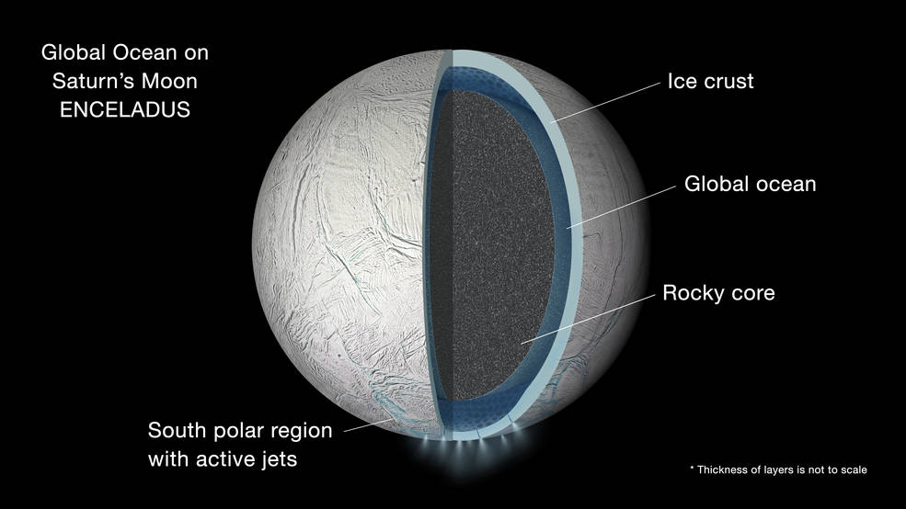
Image Courtesy of NASA: https://www.nasa.gov/press-release/cassini-finds-global-ocean-in-saturns-moon-enceladus

Slide 6
Etna's Mission
Etna will create a flight-like proof-of-concept of a microscope meant to analyze captured water samples from the plumes of Enceladus in the search for life outside of Earth.
Etna's mission is to build a Digital Inline Holographic Microscope (DIHM) that meets the size and resolution requirements set by the ASTROBi Foundation.
In Greek mythology Athena buried Enceladus underneath Mount Etna. The eruptions of Etna are said to be the breath of Enceladus.

Slide 7
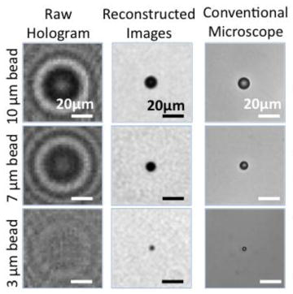
Digital Inline Holographic Microscopy (DIHM)
Beam Conditioning
Sample Volume
Image via: Research Gate

Slide 8
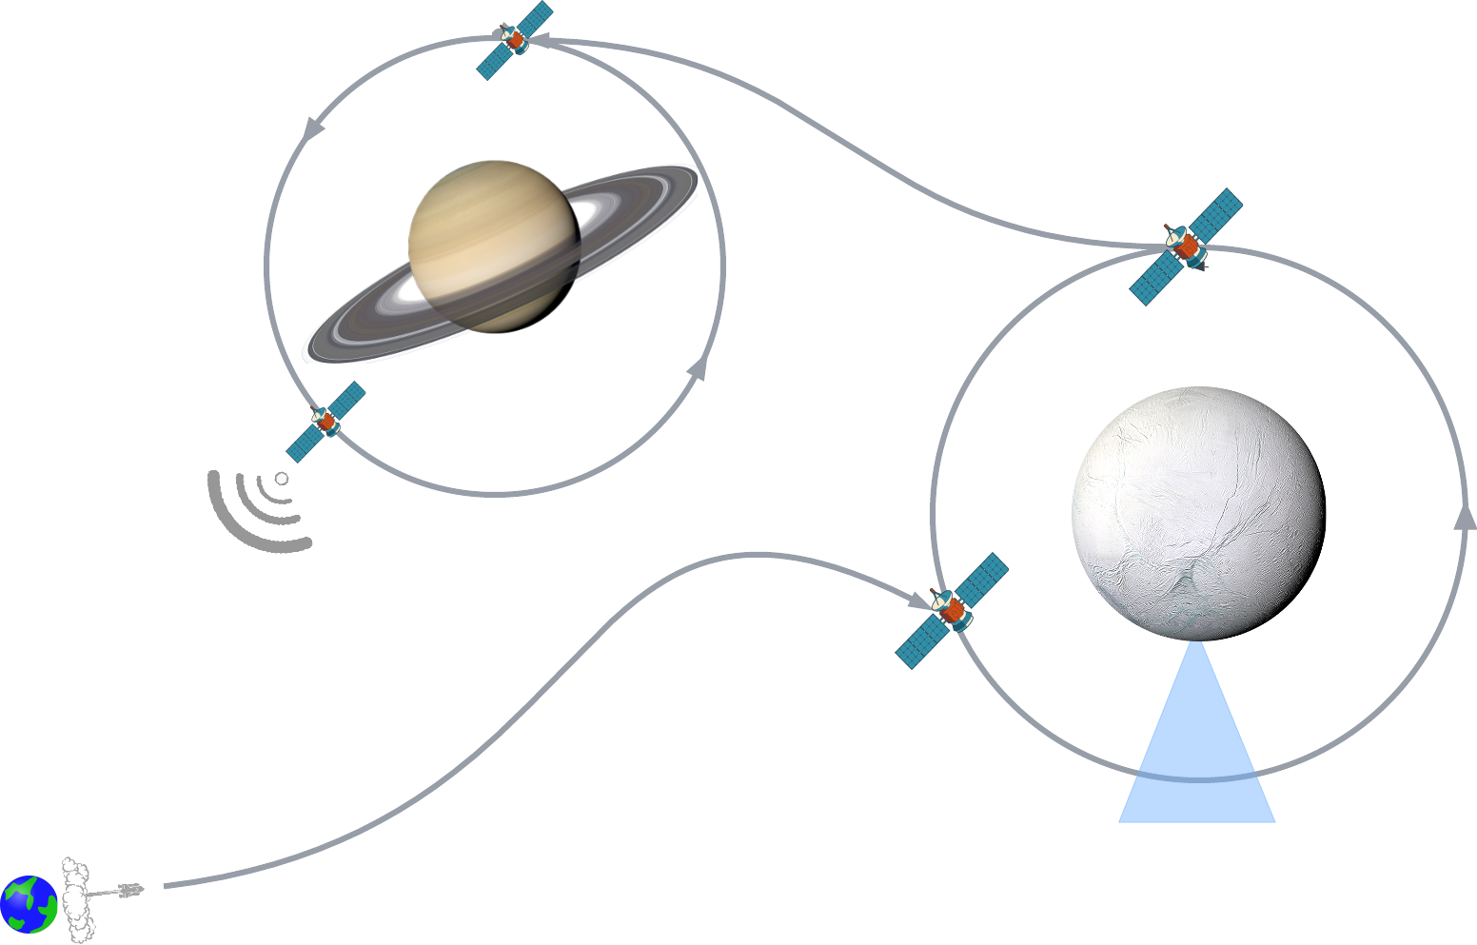
CONOPS: ASTROBi
Transfer to orbit Saturn
Transmit processed data to Earth
Analyze samples while orbiting Enceladus
Navigate to orbit around Enceladus
Pass through plumes to collect liquid saltwater samples

Slide 9
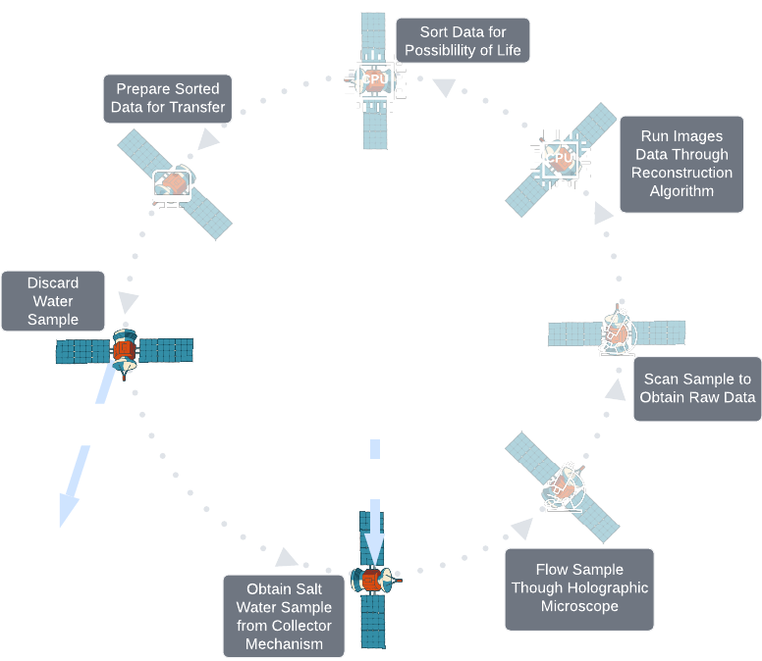
CONOPS: Etna

Slide 10
Functional Objectives
Mission Objectives
Etna shall be flight like
Etna shall be able to satisfy requests for data
Etna shall support the detection of microorganisms
Etna shall process an infinite number of samples
Etnas components and materials shall support a 15 year mission life

Slide 11
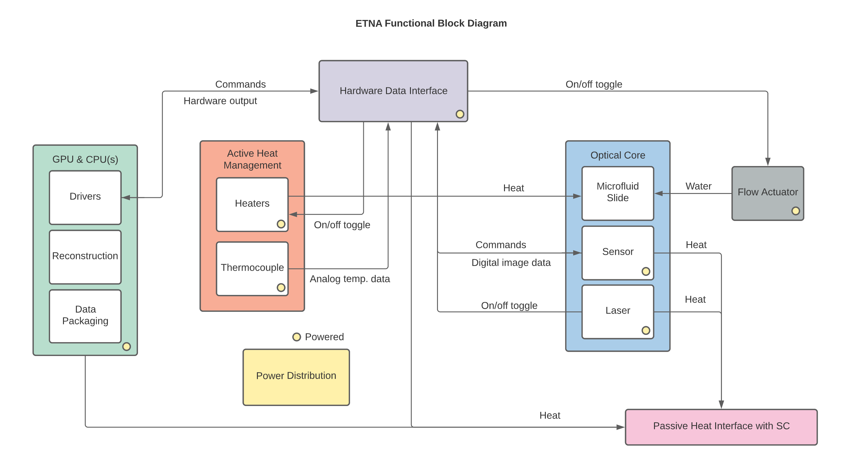
ETNA FUNCTIONAL BLOCK DIAGRAM

Slide 12
Critical Project Elements
CPE​ | Description
E1: Structural Survival​ | Survive simulated launch and operational environment. Support a 15 year mission and 18 year life
E2: Thermal Survival | Survive temperature flux of launch to space Maintain samples and components to specified range
E3: Sample Handling | Accept fluid samples from collector Clear sample volume after imaging Infinite loop ability
E4: Optical Design​ | Capture images with required resolution and framerate
E5: Data Handling and Reconstruction​ | Process captured images within one orbit about Enceladus Provide both raw and processed data as outputs
E6: Data Collection | Reliably capture adequate sample images
E7: Power Consumption​ | Etna and components between active and inactive power constraints

Slide 13
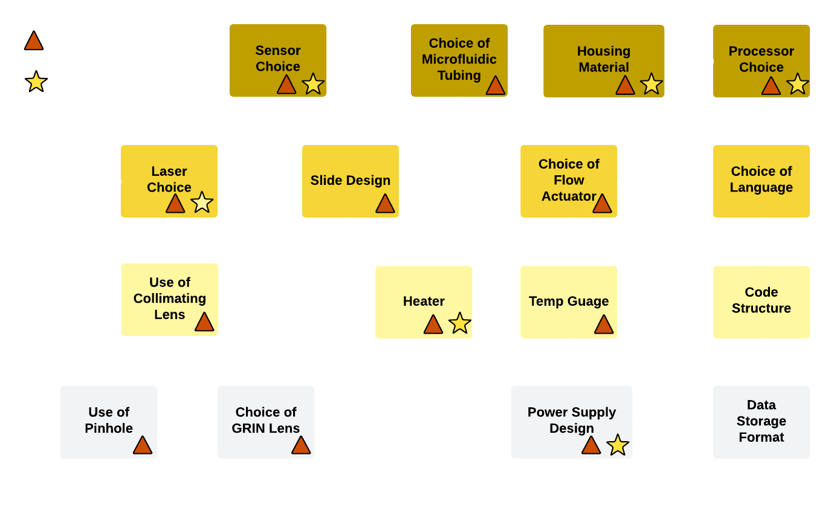
Trade Dependency Flow

Slide 14
Trade Dependency
Type | # | Trade | Parents | Systems
Independent | 1.1 | Choice of optical sensor |  | O, E
 | 1.2 | Choice of processor board |  | S, E
 | 1.3 | Choice of microfluidic tubing |  | M
 | 1.4 | Choice of housing material |  | M
 | 1.5 | Choice of laser |  | O, E
Secondary | 2.1 | Slide design | 1.3, 1.5 | O
 | 2.2 | Programming language | 1.2 | S
 | 2.3 | Choice of flow actuator | 1.3 | M
Tertiary | 3.1 | Use of collimating lens | 1.5 | O
 | 3.2 | Sample heater design | 1.3, 1.2 | M
 | 3.3 | Sample temp. gauge design | 1.3, 1.2 | M
 | 3.4 | Code structure | 2.2 | S
Quaternary | 4.1 | Choice of GRIN lens | 1.1, 1.5, 2.1, 3.1 | O
 | 4.2 | Use of pinhole | 1.5, 3.1 | O
 | 4.3 | Power distribution board design | 1.1, 1.2, 2.3, 3.2, 3.3 | E
 | 4.4 | Data storage format | 1.2, 3.4 | S
 | 4.5 | Use of oversampling | 1.2, 3.4 | S
Component | 5.1 | Mounting configurations | 1.1, 1.2, 1.5, 2.1, 2.3, 3.1, 3.2, 3.3, 4.1, 4.2, 4.3 | O, M
 | 5.2 | Passive thermal pathways | 1.1, 1.2, 1.5, 2.3, 4.3 | M

Slide 15
Key Risks
ROC Matrix
Likelihood | High 5 | Non-optimal optical spacing | Non-optimal optical alignment | Non flight like components |  | Component sourcing
 | 4 | Inaccurate detection algorithm | RAM capacity limitations | Software development learning curve | Damage or Loss of Optics Components | Interface failure
 | 3 |  |  | Debris in optical path | Incorrect temperature detection
 | 2 |  |  |  | Detection algorithm failure | Improper mounting of hardware
 | Low 1 |  | Seals leak or corrode | Non-expected light intensity | Thermal regulation failure
 |  | Low 1 | 2 | 3 | 4 | High 5
 |  | Consequence
Element | Mitigation Strategy
Component Sourcing | Complete trades to select components early Consider cost and lead time in trade
Interface Failure | All interfaces require positive attachment(no fit connections)
Not Flight-Like | Negotiate w/ customer for reasonable substitute if flight like component is not feasible
Improper Mounting of Hardware | Mounting procedures will be drafted and followed rigorously, Procedures will reflect modeled connections.
Damage or Loss of Optical Components | Trades will consider “pre-coupled” components Not retrofitting/modifying small components

Slide 16
Trade 1: Optical Sensor

Slide 17
Trade Considerations
Power draw
Heat from the sensor must not interfere with the experiment
Limited active and inactive loads
Framerate and Resolution
Picture quality depends on resolution
Rapid imaging depends on framerate
As resolution increases framerate decreases
Availability and Cost
Supply chain issues makes supply low
Rarity of parts increases cost
Size
Payload is a 1U Cube-sat
Total sensor size should be minimized
Computer board interface
Compatibility of the sensor with the board
Power regulation required from the board
Physical Interface
Mounting within the system
Survival of testing

Slide 18
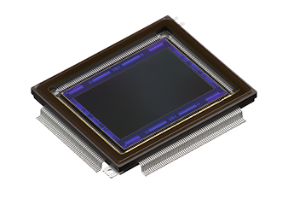
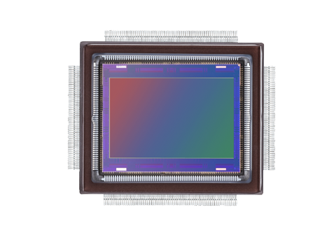
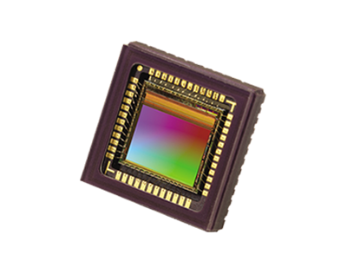
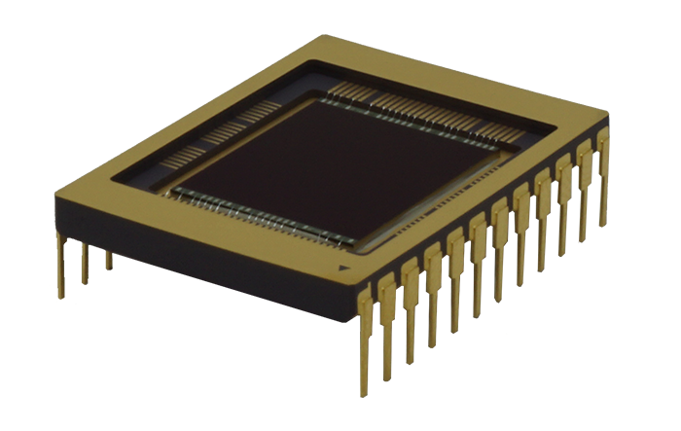
Design Options
CMOS | CCD
Lower Power Consumption | Higher Power Consumption
Lower Resolution | Higher Resolution
Higher Frame Rate | Lower Frame Rate
Less Expensive | More Expensive
Most Digital Inline Holographic Microscopes use CMOS Sensors

Slide 19
Trade Matrix
Metric | Weight 0-1 | Basler Dart da3840 | Alvium 1800 C-291 | Basler Dart daA1920
Framerate | 0.3 | 45 fps | 116 fps | 30 fps
Resolution | 0.3 | 8.3 MP (3840x2160 px) | 2.9 MP (1944x1472 px) | 2 MP (1920x1080 px)
Power Draw | 0.2 | 2 W | 3.8 W | 1.2 W
Cost and Availability | 0.1 | $199 | $440 | $179
Size(w/o mount) | 0.1 | 7.7x4.3 mm | 3.9x2.9 mm | 4.2x2.4 mm
Weighted Total |  | 2.4 | 1.9 | 1.3
1 - Worst | 2 - Mid | 3 - Best
Notes:
The numbers for the Basler Dart da3840 don’t match with what's listed on the product page, did it get swapped with the last column?

Slide 20
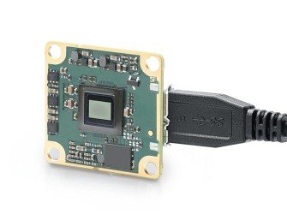
Current Path:
Basler Dart daA3840-45um w/ no mount
Order Number: 108270
CMOS
Rolling Shutter
8.3 MP
45 fps
Monochromatic
7.7 mm x 4.3 mm Sensor
List Price: $199

Slide 21
Trade 2: Laser

Slide 22
Trade Considerations
Temperature Range
Must be operable from -15 – +40 °C
Small temperature range vs expensive temperature controller
Temperature Control
Built in temperature control for laser
Providing more stable laser with a high price tag vs spending time building our own controller
Possibly out of scope of project
Wavelength
Sample chamber needs to be optically transparent
Right balance of intensity and stable
Recommended to us: 405 nm (violet)
Cost
Optical component are expensive
Project budget can’t go to just to optics
Many of the lasers are $3000+

Slide 23
Trade Matrix
Metric | Weight 0-1 | S1FC405 - Fabry-Perot Benchtop Laser Source | S3FC405 - Fabry-Perot Benchtop w/ TEC | Newport w/ Temperature Control
Temperature Range | .4 | 0 – 50 °C | 0 – 50 °C | Can control to: -5 – 80 °C
Cost | .4 | $1941 | $2,394 | $1,797
Wavelength | .1 | 405 ± 10 nm | 405 ± 10 nm | 405 –7/+5 nm
Temperature Control? | .1 | No | Yes | Yes
Weighted Total |  | 1.8 | 1.8 | 2.6
1 - Worst | 2 - Mid | 3 - Best

Slide 24
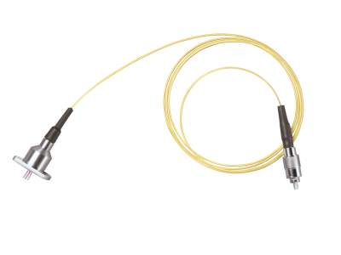
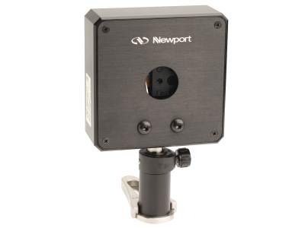
Current Path
Continue to research cost effective options
Define budget for laser
Look at schedule for ordering
(some are 4 – 10 weeks out)

Slide 25
Trade 3: Computational Platform

Slide 26
Trade Considerations
Processor Speed
Programming languages available
Processor clock speed
CPU vs GPU vs FPGA
100 FPS
12,000 seconds for stack processing
Power Limitation
10 Watts active
0.5 Watts inactive
Usability
Is it realistically difficult to work with / learn?
How does the architecture affect development time?

Slide 27
Design Options
CPU vs GPU vs FPGA
Number of cores vs speed of cores vs flexibility
Parallel processing
Power
System On Module (SOM)
Specialized I/O, processors, microcontrollers
Efficient build
Single Board Computer (SBC)
Complete with processor, memory, and I/O
External memory requirements
Relatively inefficient build

Slide 28
Trade Matrix
Metric | Weight 0-1 | Portenta X8 (SOM) | Libre Computer AML-S905X-CC | Radxa Rock 4B Plus RK3399(OP1)
Processor(s) | 0.2 | 4x Arm® Cortex-A53: 1.8 GHz 1x Arm® Cortex-M4: 400 MHz 1x 3D GPU (1x shader, OpenGL®) 1x 2D GPU 1x Arm® Cortex-M7 (MC): 480 MHz 1x Arm® Cortex-M4 (MC): 240 MHz | 1x Arm® Cortex M-53 1x Arm® Mali-450 GPU (OpenGL) | 2x ARM® Cortex-A72: 2 GHz 4x ARM® Cortex-A53: 1.6 GHz Mali T860MP4 GPU
Typical Power Draw | 0.3 | 4 W | 3.3 W | <5 W
Onboard Memory | 0.3 | 2 GB Low Power DDR4 DRAM 16 GB eMMC Flash Module | 2 GB DDR3 SDRAM | 4 GB LPDDR4 16/32/48/128 GB eMMC Flash
Cost | 0.05 | $239 | $45 | $110
Programming Language | 0.15 | Linux host, C/C++, Python | Linux host, C/C++, Python | Linux/Android Host, C/C++, Python
Weighted Total |  | 2.6 | 2.2 | 2.65
1 - Worst | 2 - Mid | 3 - Best

Slide 29
Current Path
Research embedded system design
Research programming techniques regarding GPU utilization, parallel computing, memory optimization, etc.
Develop algorithm in low-level code on a desktop
Continuing research of processor types and configurations
Research into code execution time and optimization
Defining how space ready (thermal, rad hard) the board needs to be
Defining a reasonable budget

Slide 30
Current Design
Notes:
Questions about dependent and independent trades-reference slides 13 and 14 with the trade dependency table and flow chart

Slide 31
Trades Narrowing Design
Optical sensor will inform:
Spacing of optical components
Data transfer and processing
Laser will inform:
Lens choices
Slide material
Computational platform will inform:
Programming techniques
Algorithm development
Power allocation
Notes:
Maybe add a little design tree to each of these by PDR wouldn't be possible to get it done for practice one(like slide 12's tree)-Maybe put the slide 12 tree in this section-ask TA's about it Are these the three that we want to stick with for PDR on Monday?

Slide 32
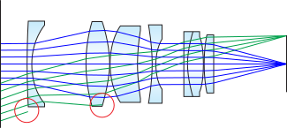
Dependent Trades: Optical Options
This includes items such as a collimating lens, pin hole, etc.
Issues of intensity: trying to prevent vignetting with collimation
Issues of noise: trying to lower SNR using pinhole
Preventing aberration of the image
Laser trade must be completed before this is done
Image via: Edmund Optics

Slide 33
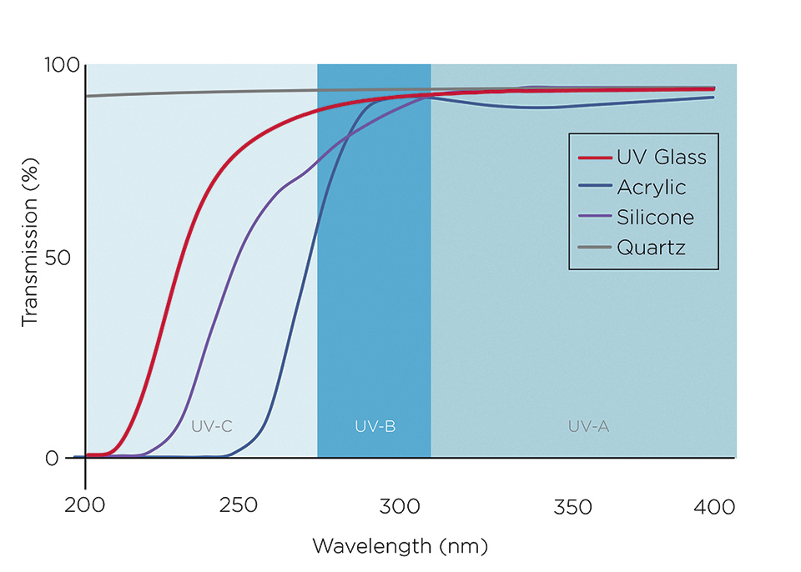
Dependent Trades: Slide Design
The sample holder will need to be optically transparent to the laser
The sample holder will need to be able to withstand vibe
(I.e., some glass is fragile etc.)
The sample holder should not contaminate or ruin the sample
Microfluidics need to be completed first
Image via: LED Professional

Slide 34
Modeling and Prototyping

Slide 35
Future Models
Model the sample temperature regulator
Use a basic analytic heat transfer model to help size the heating elements
Ensure chosen tubing materials will be adequate
Create a thermal model for entire system
Use thermal desktop or other thermal modeling software
Create a preliminary thermal model for the entire microscope system and perform analysis at both hot and cold cases

Slide 36
Future Models
Model how the enclosure will respond to testing
Using a software such as Ansys to model how the enclosure, hardware, and optics will respond to and withstand vibration testing and G-loading
Model the power distribution circuit
Use MultiSim Circuit to model the power distribution circuit
For a better understand how everything will be wired and powered
Model GPU parallelization in MATLAB

Slide 37
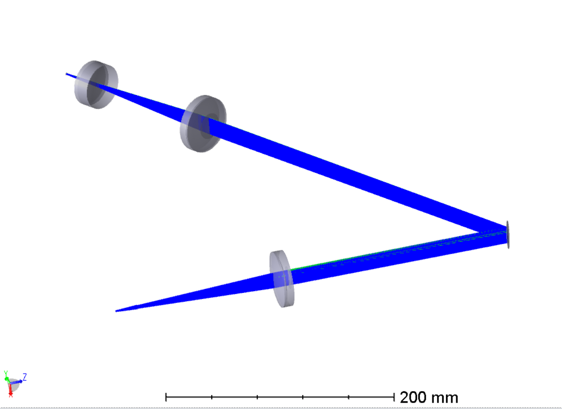
Future Models
Modeling laser-lens-sample system
Complete using ray tracing software: Zemax
Will be able to test properties of chosen laser and lenses
Will solve best optical layout for focus given our constraints

Slide 38
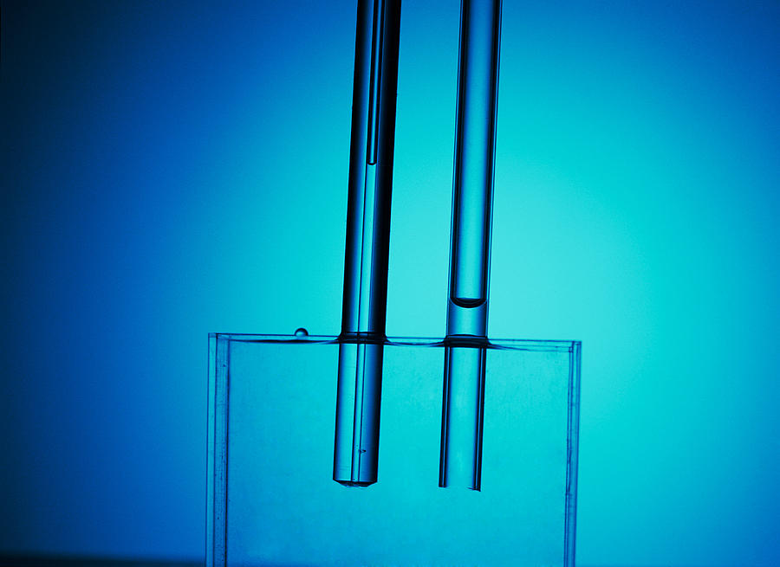
Future Prototyping
Prototype the capillary tubes and valves
Get a better understanding of how the fluid flows through the system by looking at different sized tubing and styles of valves
Will use the data from the prototyping to help with the design of the microscope slide
Prototype the microscope housing
Testing different wall thicknesses and support designs on the shaker table to determine which works best for this application
Image via: Andrew Lambert

Slide 39
Future Software
Determine programming language
Determined with considerations from the likely computational platform
Could use both C++ and Python in parallel to run different tasks on different cores
Further algorithm development at lower level
Use suggested algorithm provided by ASTROBi and rewrite in selected programming language
Research memory optimization techniques and GPU acceleration
Optimize implementation of algorithm to run more efficiently on lower power in the future

Slide 40
Questions?

Slide 41
Back up slides

Slide 42
Sample Temperature Regulator
The current design for the sample temperature regulator is a pipe filled with a temperature-controlled fluid medium that the capillary sample tube runs through.
The fluid will be temperature controlled using thermostatically controlled heaters on the outside of the pipe
The current choice for fluid medium is 1-Butanol which remains liquid at the worst case hot and cold temperatures (-50 and 100°C)

Slide 43
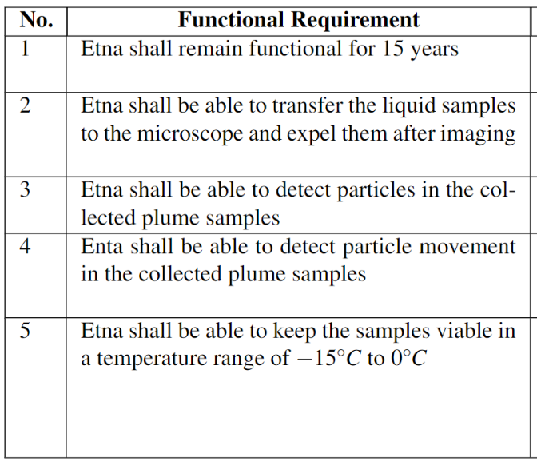
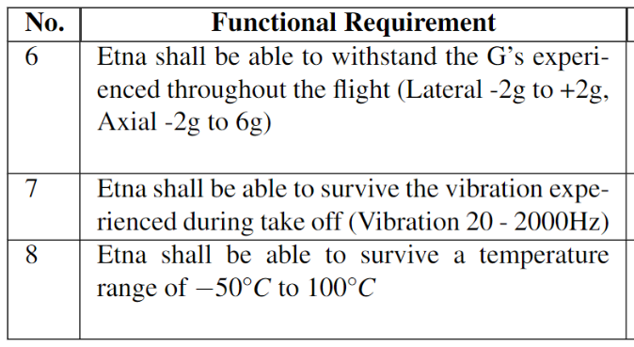
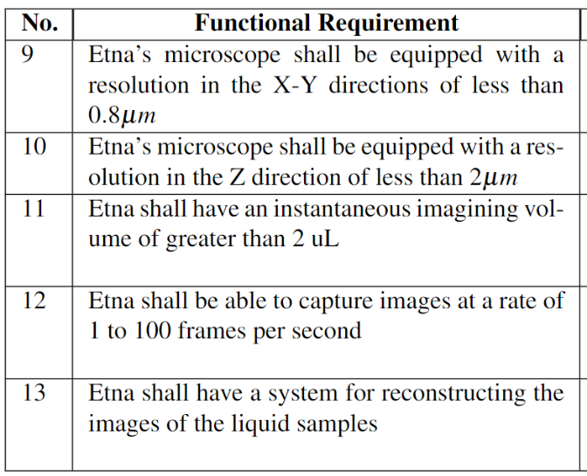
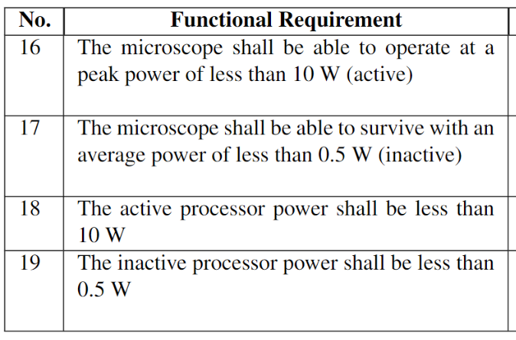
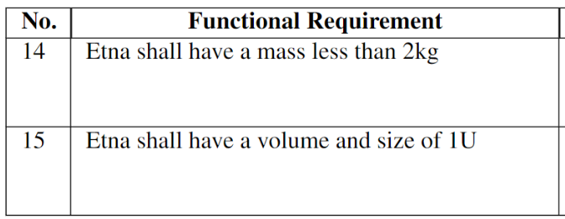
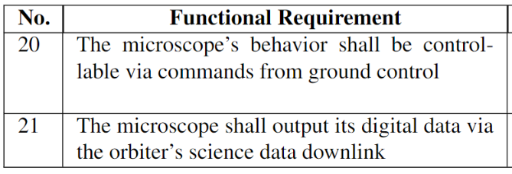
Functional Requirements
Flight Like Requirements
Imaging Requirements
Mission Requirements
Communication
Size, Weight Requirements
Power Requirements

Slide 44
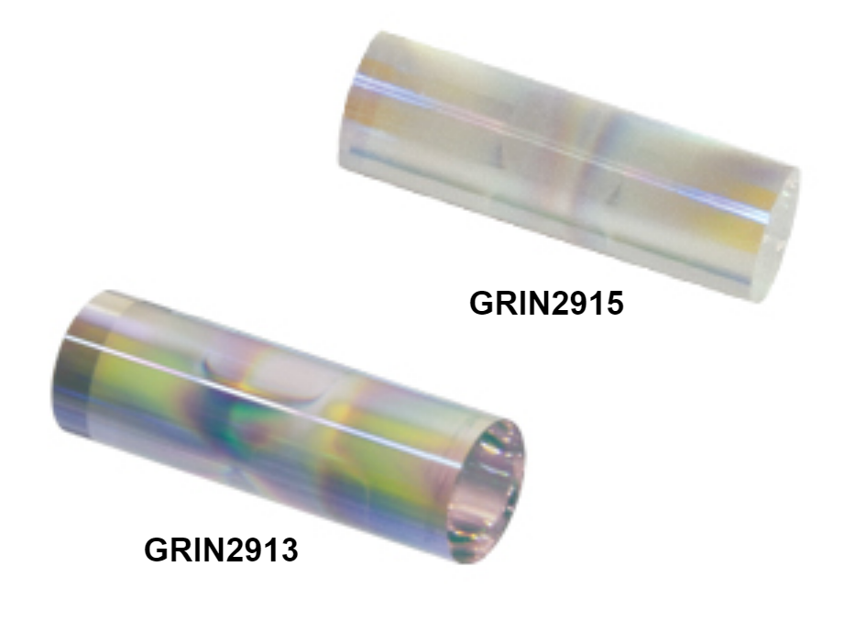
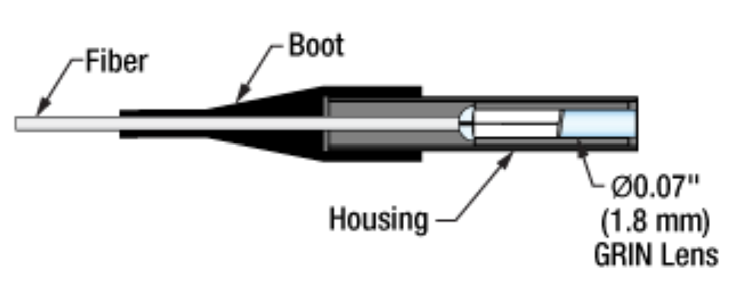
GRIN Lens
Free Lens
Fiber Coupled

Slide 45
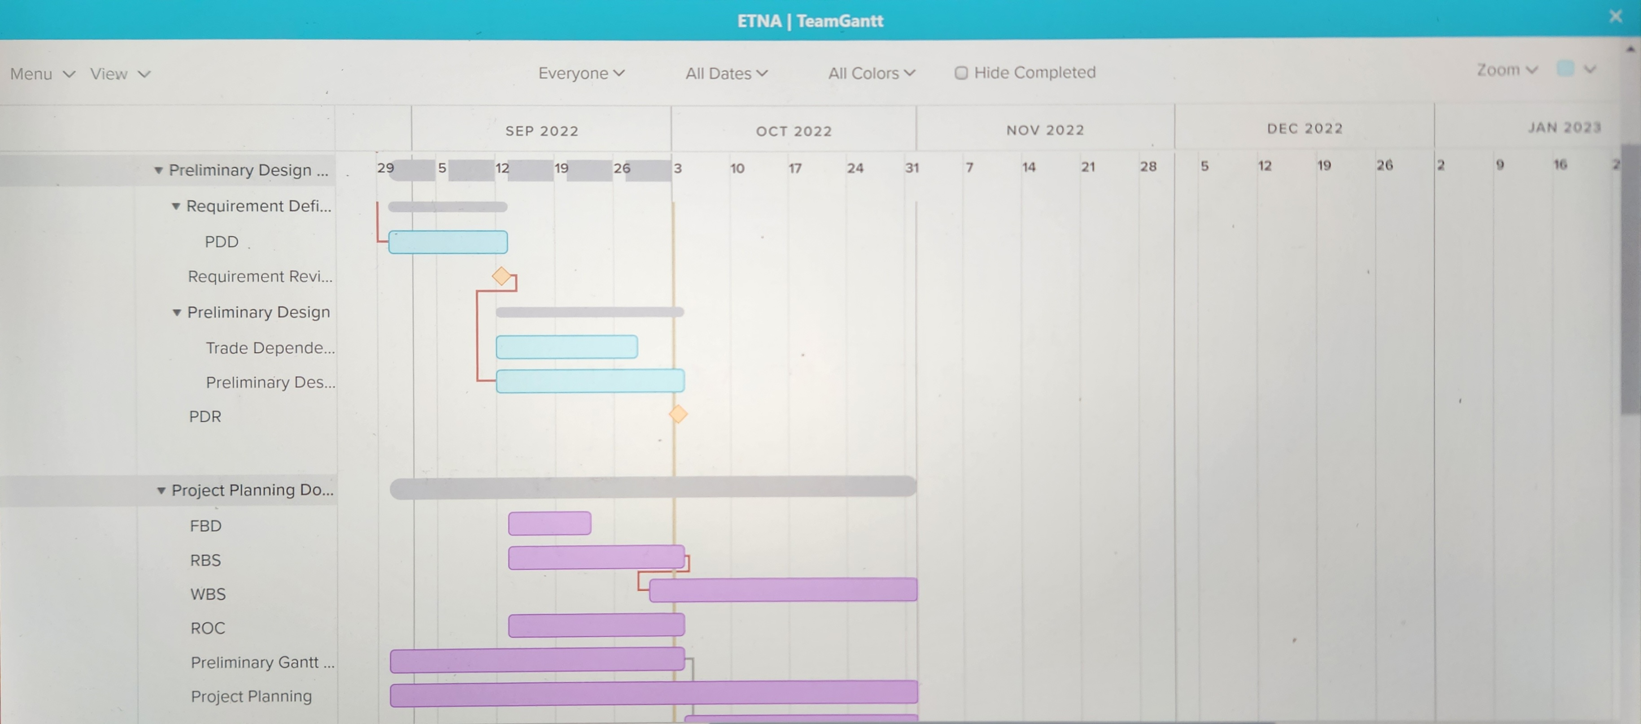
Project Scheduling
Trello – Task Management
Transitioning to SmartSheet for project management

Slide 46
Requirement Flow Down
An Interpretation of Astrobi's Design Requirements

Slide 47
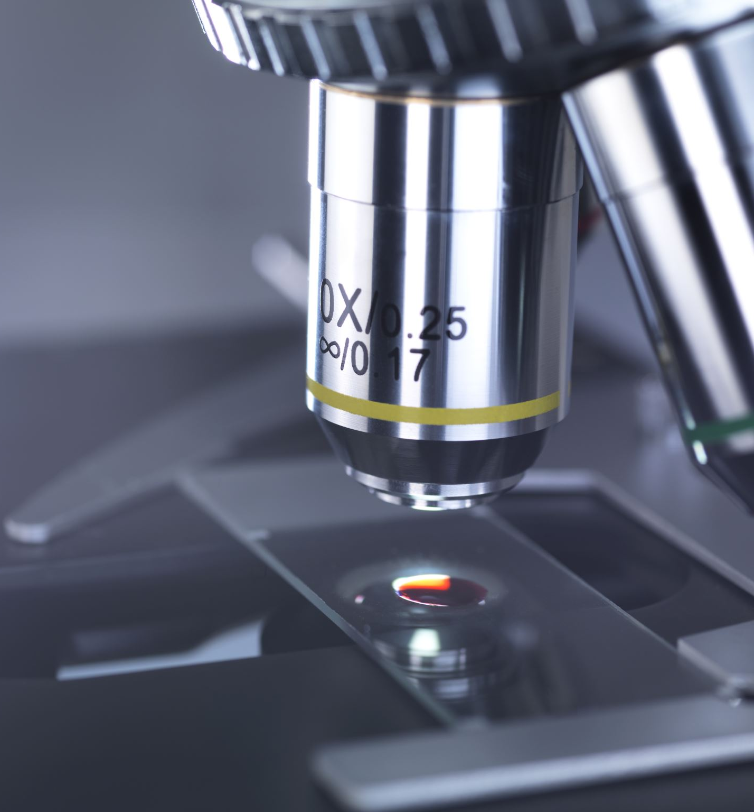
Objective
The high-level objective of the microscope is to support the detection of life, if present, in the plumes of Enceladus
ASTROBi’s vision is that the microscope will provide data that can be analyzed by scientists, who would ultimately “detect” any life that may be present in the plume material
The goal of this project is to prototype a flight-like microscope suitable for this mission, meaning that it is able to satisfy the previously described high-level objective

Slide 48
Trade Study Results
ASTROBi has performed a trade study, which determined that a digital in-line holographic microscope is the most suitable type of microscope for our Encelascope mission, given our cost, mass, power, and volume constraints
This type of instrument has many advantages, but it does also present some challenges
The high data volume output is at odds with our mission’s low-data-rate downlink , and requires the implementation of data management features to mitigate the impact

Slide 49
Requirements
Requirements, noted R-, are mandatory, shall be verified with an acceptable verification method and shall be complied with
Requirements , noted G-, are desirable requirements with the objective to increase the scientific return or performance of the mission
Some of these TBDs will be resolved as part of the requirements flow-down process performed by the students

Slide 50
Top-Level Requirement
R-DIHM-TOP-0 Purpose: The microscope shall support the detection and characterization of life in samples of water from Enceladus containing living microorganisms
This requirement may be verified in a laboratory setting by demonstrating that the behavior of living bacteria under realistic conditions can be observed in a time series of reconstructed images

Slide 51
Physical 1
Flight-like, in this case, means that the components should be substantially similar to their flight equivalents, but are not required to be produced using flight-qualified materials and processes
R-DIHM-PHYS-2 Microscope Type: The microscope implementation shall be a lensless digital inline holographic microscope
R-DIHM-PHYS-2.1 Microscope Design: The lensless digital in-line holographic microscope shall consist of a laser source, an optional collimating lens, a beam-spreading lens, an optional pinhole, a sample chamber, and an image sensor
G-DIHM-PHYS-1 Flight-Like: The microscope should be flight-like.

Slide 52
Physical 2
R-DIHM-PHYS-3.2 Weight: The microscope shall weigh less than 2 kg.
The optical design must be considered in conjunction with the laser to ensure enough light intensity is available at the sensor for useful exposure lengths and frame rates
R-DIHM-PHYS-2.3 Processor: The microscope’s processor shall not impact the microscope’s overall thermal performance
R-DIHM-PHYS-3 SWAP: The microscope payload shall fit within a 1U SWAP allocation
R-DIHM-PHYS-3.1 Size: The microscope shall fit within a 1U payload volume
R-DIHM-PHYS-2.2 Laser: The microscope shall use a laser as a coherent light source, with a wavelength, spatial and temporal coherence sufficient to support the resolution requirements.

Slide 53
Physical 3
R-DIHM-PHYS-4 Environment: The microscope shall survive launch and operational environmental conditions.
G-DIHM-PHYS-3.4 Microscope Power: The microscope should consume less than 5 watts active, and 0.1 watts inactive.
R-DIHM-PHYS-3.5 Processor Power: The processor shall consume less than 10 watts active, and .5 watts inactive.
G-DIHM-PHYS-3.6 Processor Power: The processor should consume less than 5 watts active, and 0.1 watts inactive.
R-DIHM-PHYS-3.3 Microscope Power: The microscope shall consume less than 10 watts active, and 0.5 watts inactive.

Slide 54
Physical 4
R-DIHM-PHYS-4.1 Launch Vibration: The microscope shall survive random vibration up to the values in the left table. Log-linear interpolation is to be used to interpolate between values.
R-DIHM-PHYS-4.2 Operational Vibration: The microscope shall operate and meet all performance requirements in the presence of vibrations from the orbiter’s reaction wheels.
R-DIHM-PHYS-4.3 Acoustic: The microscope shall survive an Overall Sound Pressure Level (OASPL) up to 135dB.
R-DIHM-PHYS-4.4 Shock: The microscope shall survive shock loads up to 1000g.
R-DIHM-PHYS-4.5 G-force: The microscope shall survive continuous g-forces of up to 8g on any axis.
R-DIHM-PHYS-4.6 Thermal Survival: The microscope shall survive temperatures from -50C to +100C. An oven and a freezer may be used to verify this requirement, rather than a TVAC chamber.
Frequency (Hz) | PSD (g²/Hz)
20 | 0.013
50 | 0.030
800 | 0.030
2000 | 0.013

Slide 55
Physical 5
R-DIHM-PHYS-4.7 Thermal Operation: The microscope shall operate over temperatures ranging from -15C to +40C in a vacuum. This requirement shall be verified by analysis and should be verified by TVAC testing if a facility can be identified.
R-DIHM-PHYS-4.8 Depressurization: The microscope shall survive depressurization at a rate of 0.5 psi/s.
G-DIHM-PHYS-4.9 Outgassing: The microscope should not employ any materials with outgassing properties that could contaminate any optics or instruments onboard the orbiter, including optics within the microscope. Note that the orbiter will also host a Raman Spectrometer, which is very sensitive to organic materials.
R-DIHM-PHYS-5 Electrical interface: TBD (contractor specified)
R-DIHM-PHYS-6 Mechanical interface: The microscope shall mate with a flat, temperature-controlled, aluminum baseplate, sized to accommodate 1U payloads.
R-DIHM-PHYS-7 Packaging: The microscope shall be fully enclosed in a 1U housing that provides all interfaces with the spacecraft.

Slide 56
Physical 6
R-DIHM-PHYS-8 Sample Handling: The microscope shall have a liquid water interface for receiving and expelling samples under expected operating conditions.
R-DIHM-PHYS-8.1 Sample input: The microscope shall accept the sample input via microfluidic tubing, which flows into the sample imaging chamber.
R-DIHM-PHYS-8.2 Sample output: The microscope shall expel the sample from the sample chamber via microfluidic tubing.
R-DIHM-PHYS-8.3 Bubble mitigation: The microscope shall prevent bubbles from entering the sample chamber.
R-DIHM-PHYS-8.4 Bubble flushing: The microscope shall provide a method for flushing bubbles from the imaging chamber.
R-DIHM-PHYS-8.5 Passive sample heating: The microscope shall not heat the sample by more than +5 degrees C relative to the baseplate temperature, except when the sample heater is activated.

Slide 57
Physical 7
R-DIHM-PHYS-8.6 Active sample heating: The microscope shall provide a method to actively heat the sample by a configurable amount relative to the baseplate temperature, with 1 degree C resolution and 1 degree C accuracy. Note that this feature must apply over the entire extent of the sample transfer mechanism, as it is the method that will be used to mitigate freezing, in the case of unknown freezing point depression due to unknown salinity.
R-DIHM-PHYS-8.7 Sample volume: The sample volume shall be large enough to accommodate the required instantaneous imaging volume (greater than 2μL), while satisfying the resolution requirements.
R-DIHM-PHYS-8.8 Flow control: The sample flow shall be controllable so images can be captured while the flow is stopped.
R-DIHM-PHYS-9 Mission Life: The microscope shall support a 15 year mission life.
R-DIHM-PHYS-9.1 Design life: The components and materials in the microscope shall support a design life of 18 years.
R-DIHM-PHYS-10 Cleanliness: The optical assembly shall be free of debris and contamination that could affect the light path. Note that this implies careful lens and optical fiber handling procedures, and a design that keeps out dust. The design should make cleaning easy if necessary.

Slide 58
Performance 1
R-DIHM-PERF-1 Framerate: The microscope shall support a configurable framerate from 1 to 100 FPS, in 1 FPS increments.
R-DIHM-PERF-3 Resolution: The microscope shall provide a reconstruction resolution of < 0.8μm in the x and y directions, and < 2μm in the z-direction. Note that reconstruction resolution may be a configurable parameter.
R-DIHM-PERF-1.1 Frame jitter: The frame-to-frame time difference shall vary by less than 0.1ms, 2-sigma.
R-DIHM-PERF-2 Exposure: The microscope shall support configurable exposure times from 0.1ms to 1 second, with an accuracy of 0.01ms, 2-sigma.
R-DIHM-PERF-2.1 Gain: The microscope shall support configurable sensor gain over the range supported by the image sensor.

Slide 59
Performance 2
R-DIHM-PERF-4 Throughput: The microscope’s processor and reconstruction algorithm shall be fast enough to keep up with the rate of material collection.
R-DIHM-PERF-4.2 Reconstruction Speed: Reconstruction of the full 3D imaging volume from one frame or one difference stack shall take less than 12,000 seconds at the required reconstruction resolution. See the “Processing Speed Analysis” section in the Appendix.
R-DIHM-PERF-4.1 Imaging volume: The microscope shall provide an instantaneous imaging volume > 2μL.
Note that this requirement implies that the reconstruction algorithm needs to be re-implemented efficiently, and targeted to the selected processor hardware. The use of a compiled language, efficient FFT libraries, multiple CPU cores, and SIMD or GPGPU instructions are likely needed to satisfy this requirement.

Slide 60
Functional 1
R-DIHM-FUNC-1.2 Single frame reconstruction: The software shall provide a method to reconstruct specified z-slices for a single frame, and provide the option to subtract out an average frame prior to reconstruction.
R-DIHM-FUNC-1.3 Difference frame reconstruction: The software shall provide a method to reconstruct specified z-slices for the difference between two frames.
R-DIHM-FUNC-1 Downlink Constraint: The microscope shall support meeting the mission requirements under a 1 kbps downlink constraint. R-DIHM-FUNC-1.1 Average frame computation: The software shall provide a method to compute an average frame.
R-DIHM-FUNC-1.4 Difference stack reconstruction: The software shall provide a method to reconstruct specified z-slices for a difference stack.

Slide 61
Functional 2
R-DIHM-FUNC-1.6 Difference frame detection: The software shall provide a method to detect features-of-interest in a difference frame reconstruction.
R-DIHM-FUNC-1.7 Difference stack detection: The software shall provide a method to detect features-of-interest in a difference stack reconstruction.
R-DIHM-FUNC-1.5 Single frame detection: The software shall provide a method to detect features-of-interest in a single frame reconstruction.
R-DIHM-FUNC-1.9 Reachback: The software shall provide a method to retrieve and optionally process requested data from the bulk storage device.
R-DIHM-FUNC-1.8 Buffering: The software shall support saving processed data to a non-volatile bulk storage device, operating as a FIFO.
R-DIHM-FUNC-1.8b Raw Storage: The software shall support saving all raw hologram data to the bulk storage device.

Slide 62
Commanding
R-DIHM-COMD-1 Commanding: The microscope’s behavior shall be controllable via commands from ground control
R-DIHM-COMD-1.1 Supported commands: TBD
R-DIHM-COMD-1.2 Command interface: TBD
R-DIHM-COMD-1.3 Command response: The software shall acknowledge the receipt of commands and provide informative responses when relevant

Slide 63
Output 1
R-DIHM-OUTP-1 The microscope shall output its digital data via the orbiter’s science data downlink.
R-DIHM-OUTP-1.1 Raw frame: The software shall provide a method to output raw image frames from the image sensor.
R-DIHM-OUTP-1.2 Average frame: The software shall provide a method to output average frames, averaged over a configurable subset of stored frames.
R-DIHM-OUTP-1.3 Clean frame: The software shall provide a method to output cleaned frames, which are computed as follows: clean_frame = raw_frame - avg_frame
R-DIHM-OUTP-1.4 Difference frame: The software shall provide a method to output the difference between two frames.

Slide 64
Output 2
R-DIHM-OUTP-1.5 Difference stack: The software shall provide a method to output a difference stack, which is the sum over multiple frame differences.
R-DIHM-OUTP-1.6 Detected frame regions: The software shall provide a method to output detected regions from a reconstructed frame.
R-DIHM-OUTP-1.7 Detected difference frame regions: The software shall provide a method to output detected regions from a reconstructed difference frame.
R-DIHM-OUTP-1.8 Detected difference stack regions: The software shall provide a method to output detected regions from a reconstructed difference stack.

Slide 65
Output 3
R-DIHM-OUTP-1.9 Detection descriptors: The software shall provide a method to characterize detected regions, and output the characterization as a compact description.
R-DIHM-OUTP-1.10 Summary statistics: The software shall provide a method to compute and output statistics over a subset of detection descriptors.
R-DIHM-OUTP-1.11 Compression: The software shall provide a method to compress data prior to output.
R-DIHM-OUTP-1.12 Compression estimation: The software shall provide a method to estimate the amount of compression achievable for a specified item of output data.

Slide 66
Processing Speed Analysis
This analysis determines how quickly an imaging volume must be reconstructed in order to keep up with the rate that sample material is being collected
Note that in the typical CONOPs, 100 frames would be captured per imaging volume, but not all of these frames would be reconstructed
Instead, a difference stack would be created for all 100 frames, and the difference stack would be reconstructed
Orbital Period p = 9972 seconds, Sample collected per orbit c =1.6 microliters, Sample transfer efficiency e = 50%
Processor activity duty cycle d 50% , Processing time limit for one imaging volume L = 12,465 seconds = t*d
Imaging volume v = 2 microliters, Time to accumulate one imaging volume t = 24,930 seconds = p*v/c/e

Slide 67
Trades Narrowing Design
Optical Sensor
Will inform the holographic lens choices as well as distances between lenses
Will inform the electrical board layout and analog processing
Will affect software's filtering and usage of data
Laser
The decision on pinhole and collimating lenses will need to be made due to intensity
Effect mechanical design regarding mounting
Processor
Has significant implications for power distribution
Will inform choice of programming techniques
Notes:
Maybe add a little design tree to each of these by PDR wouldn't be possible to get it done for practice one(like slide 12's tree)-Maybe put the slide 12 tree in this section-ask TA's about it Are these the three that we want to stick with for PDR on Monday?

