Slide 1
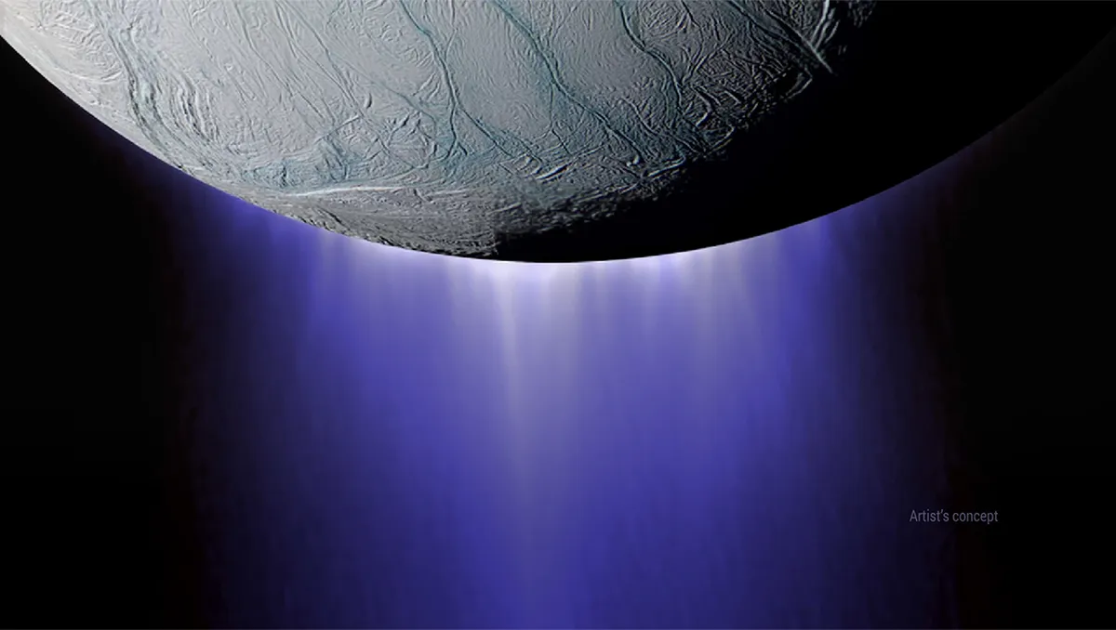
Micro-resolution Unidirectional Sensor for Ice Collisions - M.U.S.I.C.
Preliminary Design Review
Notes:
Key questions that
you should answer while preparing for
PDR are as follows:
●
What are the
most limiting
or
constraining
requirements in your design space? Are there
dependencies between these requirements?
●
What are high ris
k, high uncertainty items?
●
What are the critical project elements?
(These should be determined from key requirements and risk analysis)
●
What design choices are fundamental and independent, and should be made first? What
design choices are dependent?
●
Wha
t are the key design trades that were performed, and how were they analyzed?
●
What is the baseline design selection?
●
What design choices were inconclusive or in need of more detailed modeling/prototyping
prior to CDR?
●
What are the modeling and prototyping plans to move from a baseline design to a detailed
design for CDR?

Slide 2
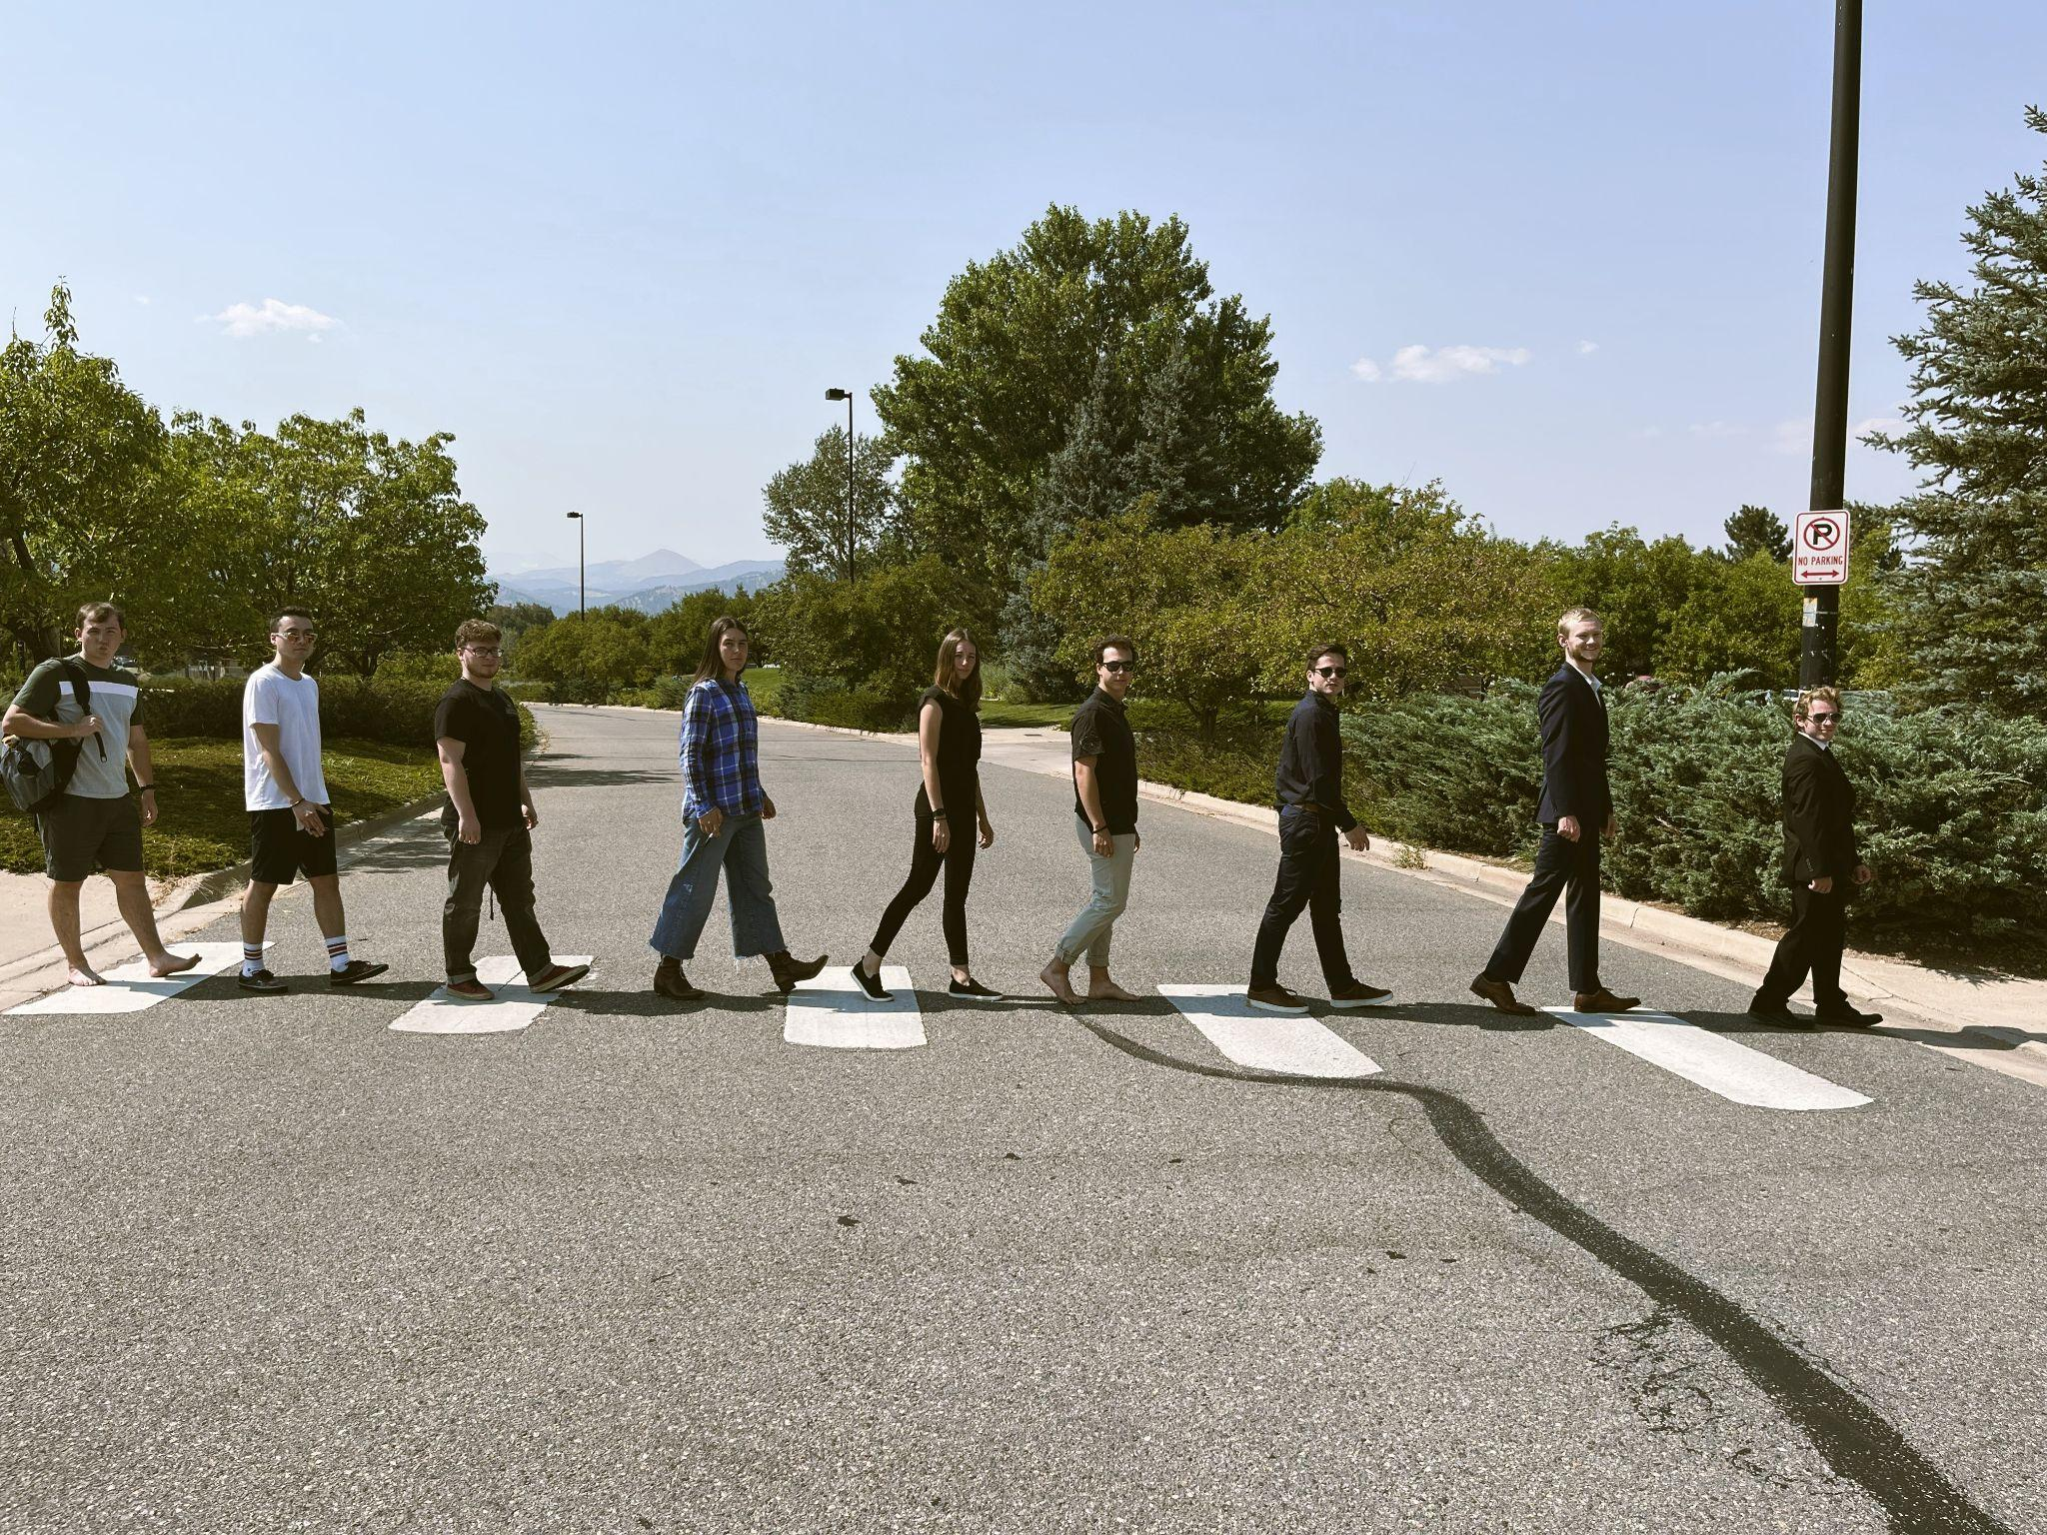
Team Members
Tim Shaw
Alec Macchia
Cyrus Nichols
Sophia Trissell
Riley Gordon
Bradley Bishop
Tyler Schwinck
Garrett Lycett
Jarrett Bartson
Notes:
Listed Left to Right

Slide 3
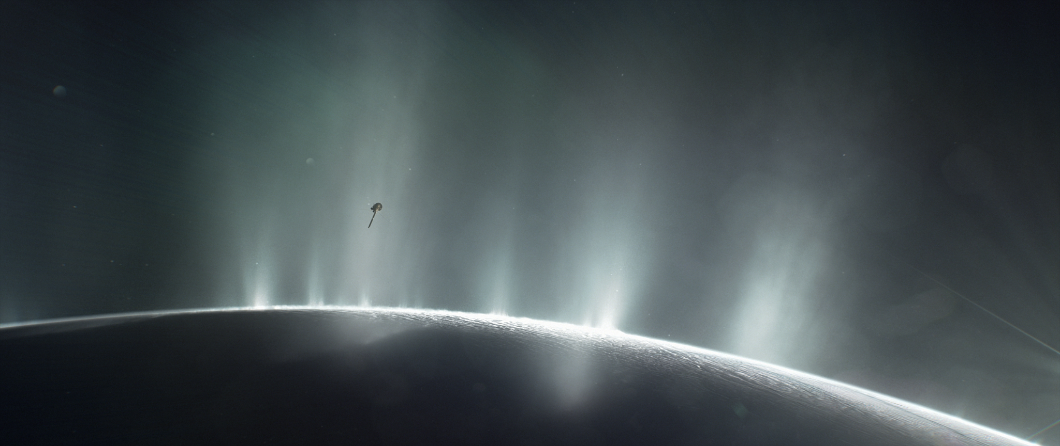
Project Overview
Image courtesy of NASA https://solarsystem.nasa.gov/resources/17737/enceladus-plume/
Notes:
1.1
Brief project definition, including Objectives, CONOPS and Functional Block Diagram
(FBD)
1.2
State critical project feasibility elements.
Motivate your CPEs by highlighting the most limiting requirements in your design, high
risk and high uncertainty items, and dependencies between subsystems.
1.3
Utilize a table to show all trades performed and whet
her the trades were independent or
dependent. Highlight trades that will be covered in this presentation.

Slide 4
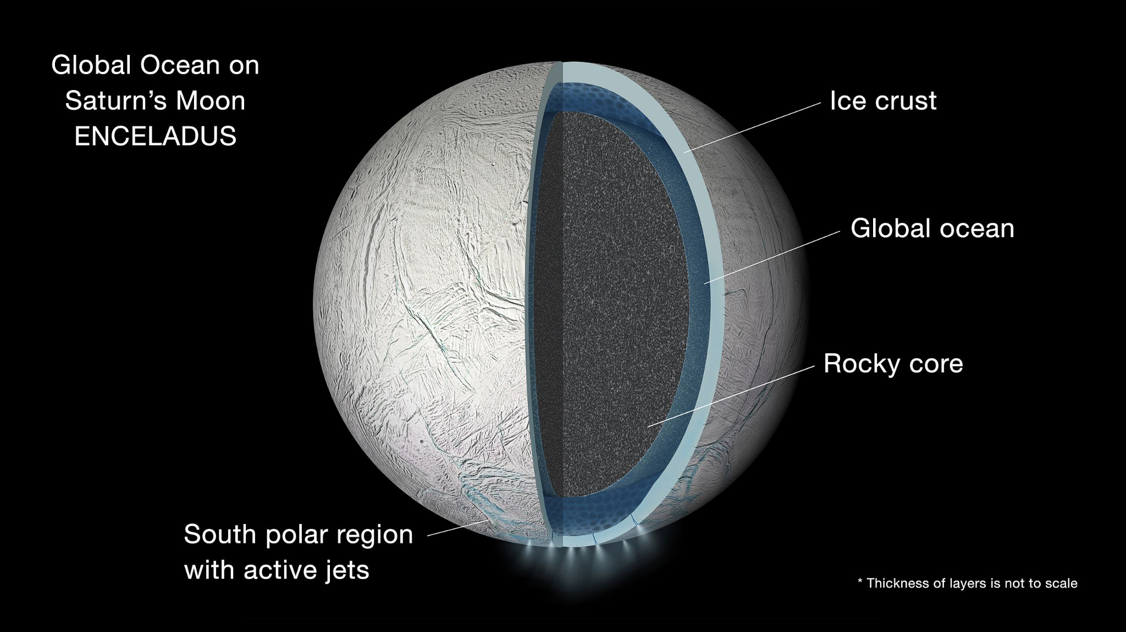
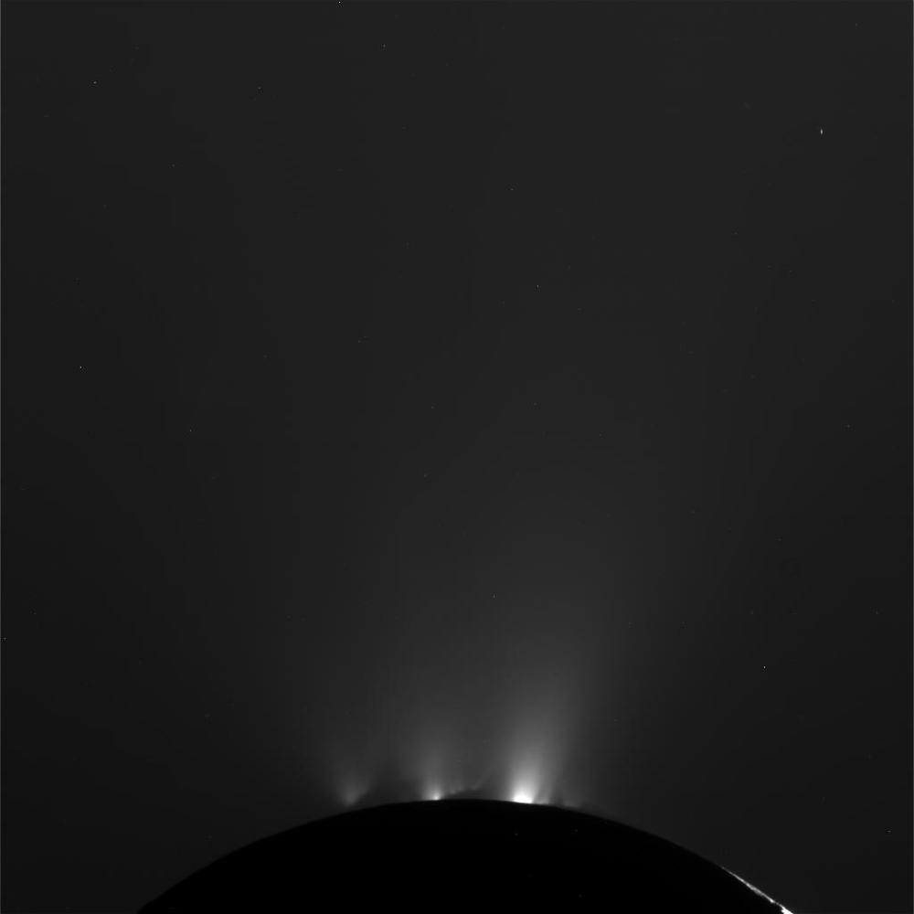
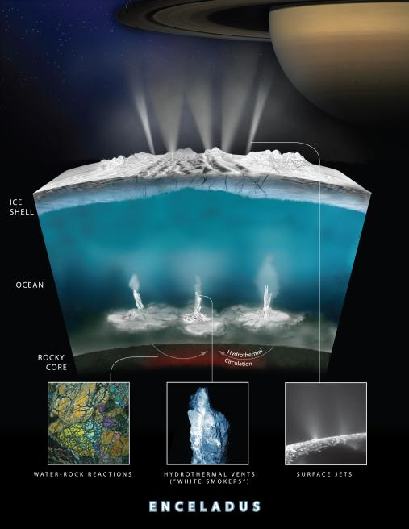
Enceladus and Water
Moon of Saturn with water under a surface of ice
Tidal heating causes water to escape in the form of geysers
Geyser particles may contain organics
Enceladus Images and Diagrams courtesy of NASA JPL Photojournal: https://photojournal.jpl.nasa.gov/figures/PIA19656_fig1.jpg https://photojournal.jpl.nasa.gov/jpegMod/PIA21442_modest.jpg https://photojournal.jpl.nasa.gov/jpegMod/PIA14858_modest.jpg
Notes:
Discuss the components of Enceladus that are important to us
Notes from practice PDR Run
Largest composition of water relative to….?

Slide 5
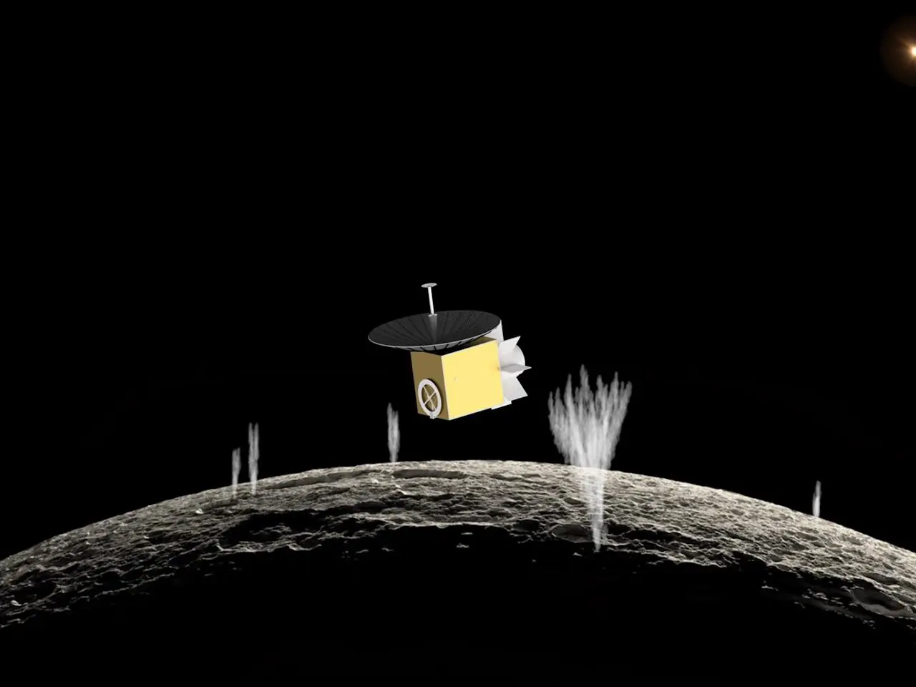
ASTROBi Mission Profile
ASTROBi wants to take samples of the plumes of Enceladus to be viewed with a microscope
Proper positioning within the plume is critical to obtain the correct sample
Notes:
Discuss why we are tasked with our project

Slide 6
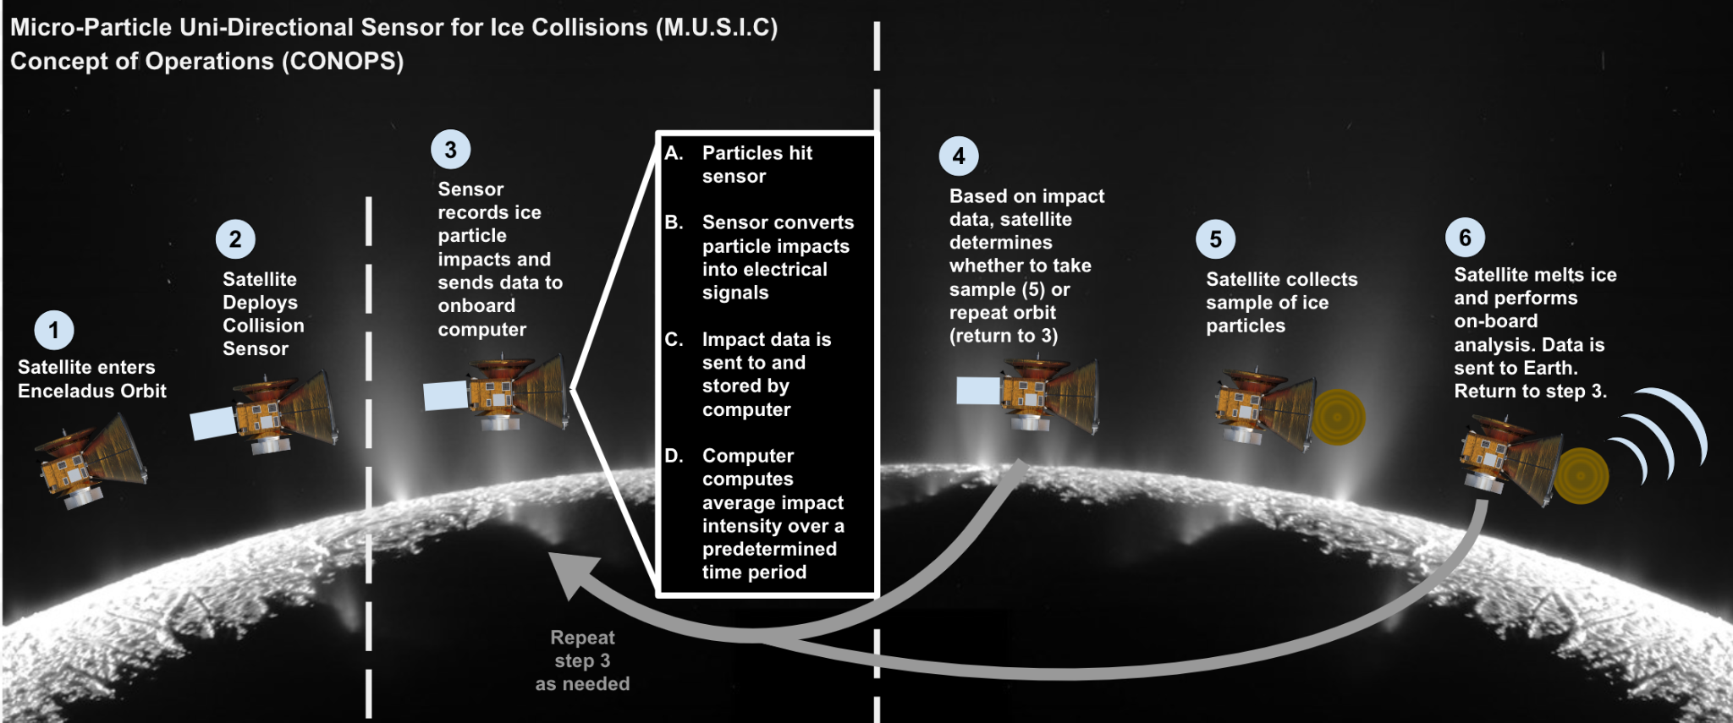
M.U.S.I.C. CONOPS

Slide 7
Objectives
Simulate the detection process
Detect the presence of small particles
Process the data from the impacts for:
Plume density
Particle sizes
Particle velocities

Slide 8
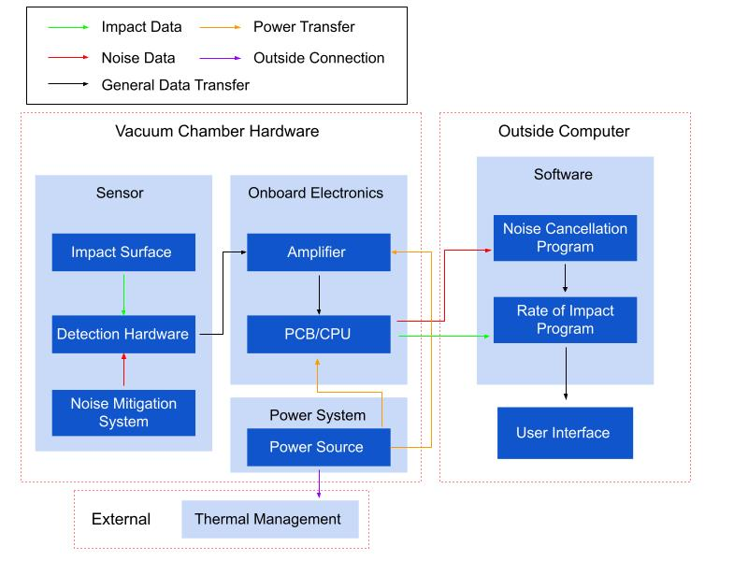
Functional Block Diagram

Slide 9
CPEs
Critical Project Element | Reasoning
Sensor | Necessary for data collection
Data Analysis | Noise reduction, impact data processing
Testing/Simulation Software | Assisting/predicting testing results
Notes:
Delete chamber, create in slide table
Sensor
Develop means to detect acoustic signals
Includes acquisition of parts and assembly

Slide 10
Level 1 Requirements
Operational in bench conditions
Survive repeated impacts from small particles
Provide impact data over given window of time
Notes:
Can still speak on vacuum and its complexity. Can speak on noise under impact data

Slide 11
Limiting Requirements | Trade Impact
1 Watt power consumption | Complexity
Size of the particles to be detected | Sensitivity Cost
Rate of particle impact | Sensitivity Testability
Notes:
Is this related to the requirement flow down?

Slide 12
Trade Study
Notes:
Impact of
Easy of construction - square vs circular

Slide 13
Particle Sensor
Key Requirements:
Sufficient sensitivity
Testability
Survivability
Key Constraints:
Size - 10x10x10cm volume
1W power consumption
Predictability
Cost
Notes:
Make a table with the requirements and numbers
For the two to three most important trades provide:
2.1
Key requirements, constraints, and interfaces that determined design metrics, risks, and
w
eightings
2.2
Design metrics, risks, engineering analyses, and weightings that feed into trade matrix
2.3
Design options considered and final trade matrix
2.4
Final selection and uncertainty around it

Slide 14
Trade Considerations
Design Choices
Mission environment
Magnitude of plate deflection
Feasibility of testing
Complexity of components
Plate deflection
Laser diffraction
Capacitor voltage
Piezoelectric
Notes:
This slide is supposed to capture this: Design metrics, risks, engineering analyses, and weightings that feed into trade matrix

Slide 15
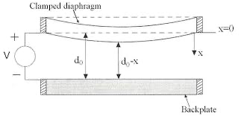
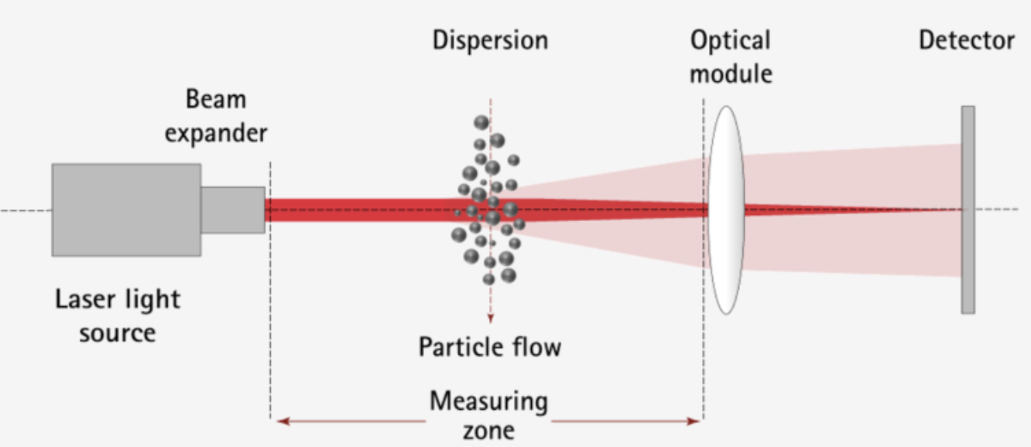
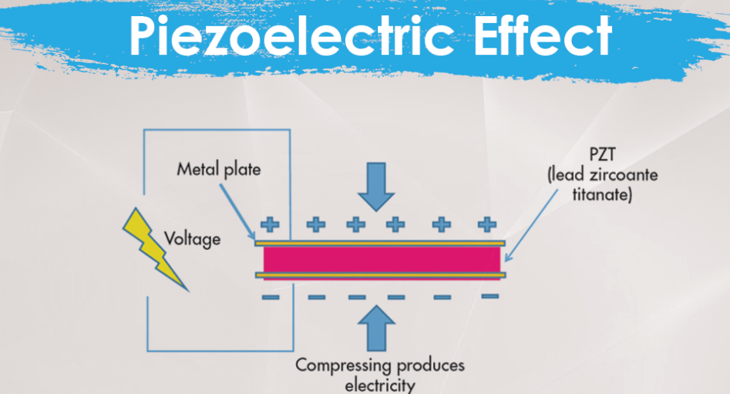
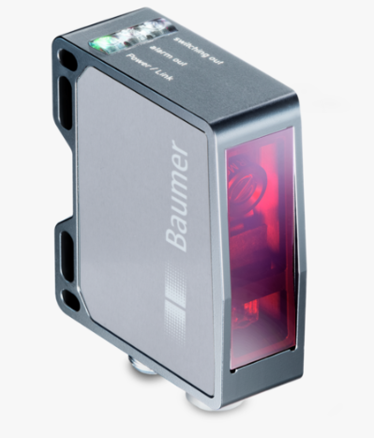
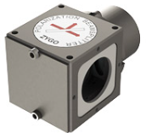
Capacitance Measure change in voltage across a variable capacitor | Laser Diffraction Measure angular variation of scattered light as a laser beam hits particle to determine size
Piezoelectric Use a material that creates a voltage when it deforms | Plate Deflection Measure the deflection of the plate with respect to time
Notes:
More Information on Laser Diffraction:
https://gordon-riley.atlassian.net/wiki/spaces/MUSIC/pages/24379393/Laser+Diffraction+for+Small+Particles
Mention risks for each one (write on notecards)

Slide 16
Trade Metrics
Metric | Weight | 1 | 2 | 3
Sensitivity | 0.4 | > 10μm | > 1μm | < 1 μm
Complexity | 0.15 | Built from scratch | Some COTS part | All COTS parts
Testability | 0.2 | Extensive Testing (Laboratory) | Complex Bench-top | Bench-top
Cost/Market Availability | 0.15 | >$2000 | $500-$2000 | <$500
Resilience | 0.1 | Could break during use | Could break if mishandled | Difficult to break
Notes:
Sensitivity - particle size

Slide 17
Trade Results
Metric | Weight | Piezoelectric | Capacitance | Laser Diffraction | Photoelectric
Sensitivity | 0.4 | 1 | 2 | 3 | 2
Complexity | 0.15 | 2 | 1 | 1 | 2
Testability | 0.2 | 3 | 3 | 2 | 3
Cost/Market Availability | 0.15 | 3 | 3 | 2 | 2
Resiliency | 0.1 | 1 | 2 | 1 | 3
Score |  | 1.85 | 2.2 | 2.15 | 2.3

Slide 18
Results and Current Design Space
Means of Detection: Plate deformation
Power: Currently Low Concern
Sensitivity: Plausible
Size: No Concern

Slide 19
Further Trade Exploration
Capacitor noise levels
Vacuum environment
Laser interferometer
Material thickness/Machinability
Noise mitigation
Notes:
This is to help with questions about how we’ll eliminate a tie. Mention Eriks interferometer idea, get more detail on laser distance measurements?

Slide 20
Preliminary Risk Assessment
Risk Matrix
Very Likely
Likely |  |  | 5 |  | 1
Possible |  |  | 3
Unlikely |  |  |  |  | 2, 4
Very Unlikely
 | Insign. | Minor | Mod. | Major | Severe
Sensitivity of sensor (20)
Data processor failure (10)
Power over 1W (9)
Cost over budget (10)
Can’t survive vacuum (12)
L
i
k
e
l
i
h
o
o
d
Consequence
Notes:
Possible points of error/margin for chosen sensor
Risk!! - stop light chart from lecture
TALK TO HOW TO MITIGATE THESE RISKS

Slide 21
Modeling & Prototyping Plan
Notes:
4.1
Review planned models and prototyping to inform detailed design for CDR

Slide 22
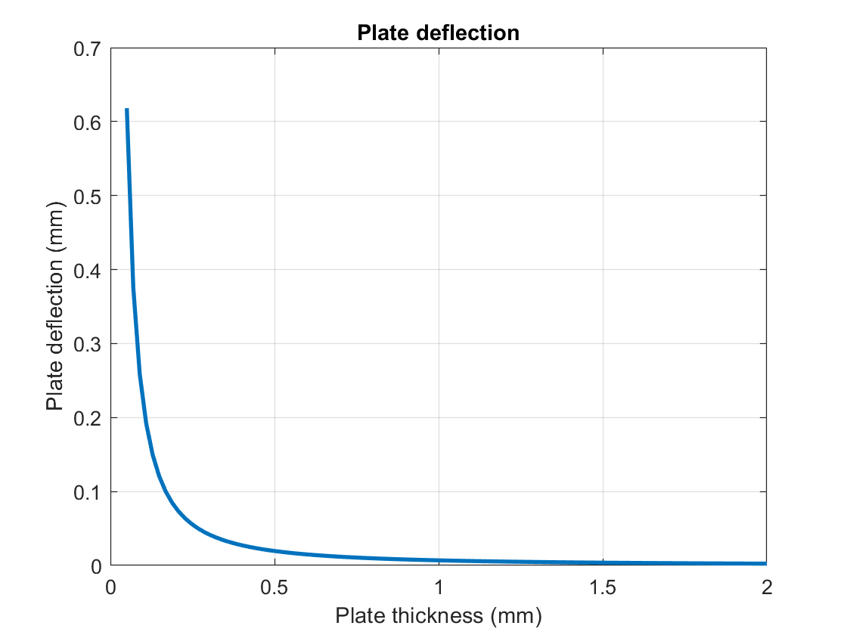
Modeling
Models will assist prototyping
ANSYS plate deflection
Spring-mass analysis
Notes:
At a high level we just want to mention that no matter what the trade results are, we’ll have mathematical models to help us prototypes. WE’ll be computing deflections, voltages, particle velocities, etc. Our future plan is to investigate ANSYS simulations of loads on a plate, which we’ll use as another source of data to inform our prototyping and material choices. We also plan to look into the spring mass analysis as yet another source of data for informing our design.

Slide 23
Tabletop Testing: Level 1
Objectives:
Verify baseline functionality outside of vacuum environment
Characterization of noise and interference
Test detection using available particles (salt, sand, etc)
Notes:
Salt grain of 0.05 mg dropped from 4.6 mm

Slide 24
Vacuum Chamber Testing: Level 2
In-State Testing
CU Autonomous Vehicle Systems (AVS) Lab
Contact: Dr. Hanspeter Schaub
Objectives:
Survivability and functionality in vacuum environment
Further characterization of setup noise
Notes:
https://hanspeterschaub.info/AVSlab.html
https://drive.google.com/file/d/1iW7apHNcxmsBezpzPFKQHHzVJxkaCbDf/view
9-Pin feedthrough available
Slowly lower pressure to test survivability
Noise floor and interference

Slide 25
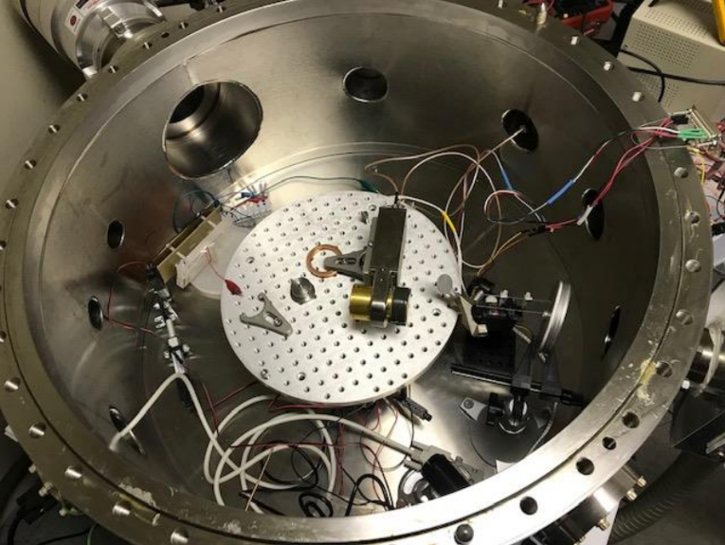
Vacuum Chamber Testing: Out-of-state
RadNet Medical Imaging
Particle Accelerator
Objectives:
Test mission functionality
Development of procedure
Notes:
San Francisco, CA
1-1k pps, 10-100 ideal
25-pin and 15-pin feedthroughs available

Slide 26
Advanced Studies
Cost function - price and construction
Analysis of construction parameters
Data processing
Further risk
Notes:
Consistent capitalization
From PDR slides - Trades that are not completed due to advanced modeling/prototyping needs
FAQ - https://docs.google.com/document/d/1mWQEt4e3HHxQaco_CUfCPlgVvULdl65fGFoZyJxIwNk/edit
As requested by customer
Momentum-based Method
1D vs 2D
MATLAB or ANSYS
Cost function incorporating component pricing and manufacturing feasibility
Construction - Plate Thickness, Capacitor Spacing, Number of Lasers and Mounting Mechanisms

Slide 27
Thank you for watching!

Slide 28
Backup Slides

Slide 29
Level 1 Requirements
The sensor shall fit inside the vacuum chamber testing apparatus.
The detection hardware shall be capable of operating at laboratory bench conditions.
The sensor shall be able to survive repeated impacts from small ice particles.
The vacuum portion of the sensor shall not use more than 1W of power.
The sensor shall mitigate vibrations inside the vacuum chamber.
The sensor shall be able to detect impacts with similar momentum to ice particles prior to vacuum chamber testing.
The system shall be able to provide data over a given window of time to the user.
The system shall be able to measure the noise floor and be able to take this into account when measuring impacts.
The system shall be able to determine the rate of impacts.

Slide 30
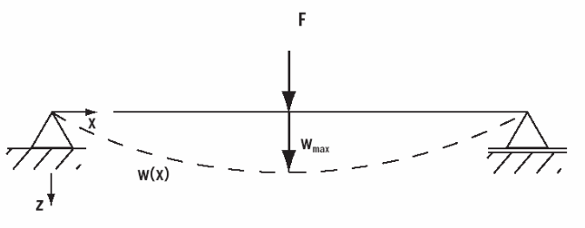
Plate Deflection
Pros:
Commercial sensors available
Simple to model
Data is directly related to the applied force
Cons:
Need very high resolution (nm)
Expensive
Risks:
Mechanical Stability
Interfacing with COTS components
Measure the deflection of the plate with respect to time
Notes:
Ultrasonics & physical push displacement sensors up to mm sensitivity, no more.
Photoelectric:
Benefits: Easily testable, simple setup
Cons: Expensive (ranging from $600-$10,000)
Risk: Will it be sensitive enough?
Interferometer:
Benefits: Highly sensitive, testable, simple setup
Cons: Very expensive, might be out of budget
Risk: Little to no risk

Slide 31
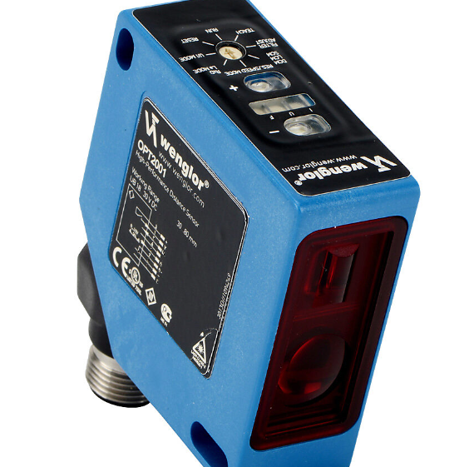
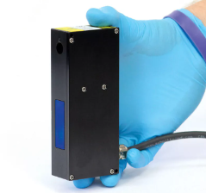
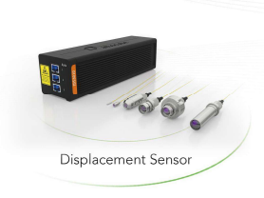
Plate Deflection Measurement
From simulations, we expect between 100s of nm to 10s of µm displacements
Sensors on market:
Photoelectric: Resolution as high as 0.2µm
Interferometer: Resolution in nm range
No other sensor types on market sensitive enough to detect displacements
Resolution: 8um 0.2um 1um
Notes:
Ultrasonics & physical push displacement sensors up to mm sensitivity, no more.
Photoelectric:
Benefits: Easily testable, simple setup
Cons: Expensive (ranging from $600-$10,000)
Risk: Will it be sensitive enough?
Interferometer:
Benefits: Highly sensitive, testable, simple setup
Cons: Very expensive, might be out of budget
Risk: Little to no risk

Slide 32
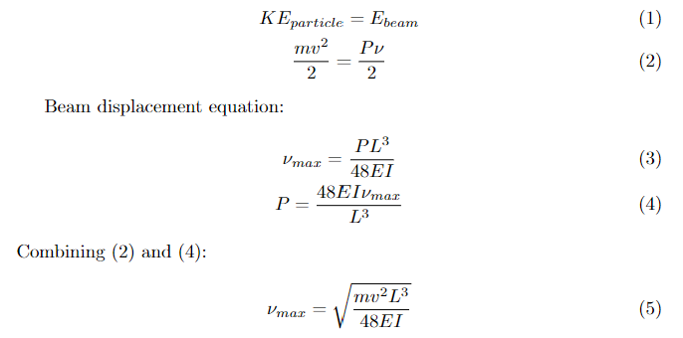
Beam deflection

Slide 33
Capacitor Voltage Measurement
Pros:
High sensitivity (down to 100s of nm) at low cost
Cons:
Difficult to model
Cannot differentiate between single and multiple impacts
Risks:
Complex
Mechanical stability
Measure change in voltage across a variable capacitor

Slide 34
Laser Particle Diffraction
Laser hits particle and light propagates from the edges
Size of particle affects the angle and intensity of the scattered light
Benefits: Wide dynamic size range, Flexible sample types, Fast measurements, Easy to interpret, Sensitivity (~30 nm)
Cons: Assumes hard spherical model, Optical concentration range, Expensive (Self-build?)
Risk: Possible error due to different particle shapes and accuracy of self-built sensor
Notes:
Size affects angle
Smaller particles scatter light through larger angles

Slide 35
Laser Particle Diffraction
Pros:
Wide dynamic size range
Fast measurements
Sensitivity ~10 nm
Cons:
Assumes hard spherical particles
Expensive, unless self-built
Power
Complex
Risks:
High possibility of error in data
Measure concentration of particles via scattering of a laser
Notes:
Size affects angle
Smaller particles scatter light through larger angles

Slide 36
Piezoelectric
Pros:
Commercially available
Fast response time
Data is directly related to the applied force
Cons:
Limited sensitivity
Low design flexibility
Cannot differentiate between single and multiple impacts
Risks:
Required sensitivity may not be achievable
Use a material that creates a voltage when it deforms

Slide 37
Sensitivity Analysis
Sensor Type | Piezoelectric | Capacitor | Laser Diffraction | Plate Deflection
Sensitivity | uv/um | mv/um | Min particle size: 10nm diameter | Photoelectric: 0.2μm Interferometer: 0.5nm
Notes:
Talk about why sensitivity is the most important parameter, also mention that we computed sensitivity for the capacitor and laser diffraction as a function of applied force and plate thickness. Mention that we found 10^3 more sensitivity for cap then direct deflection. SLIDES WITH PLOTS ARE IN BACKUP

Slide 38
Requirements - Mission

Slide 39
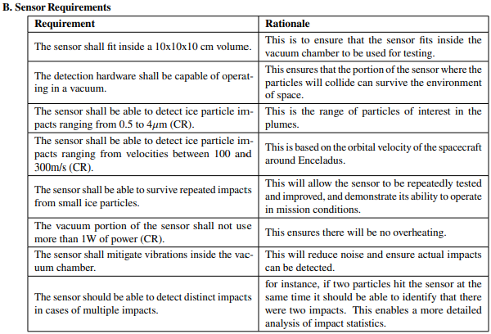
Requirements - Sensor

Slide 40
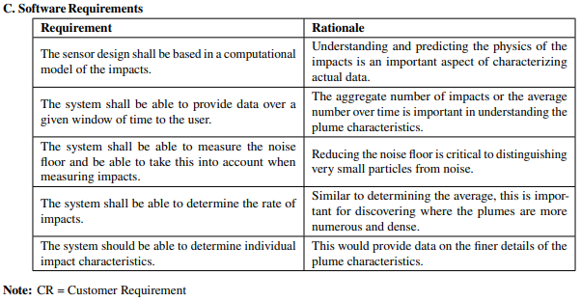
Requirements - Software

Slide 41
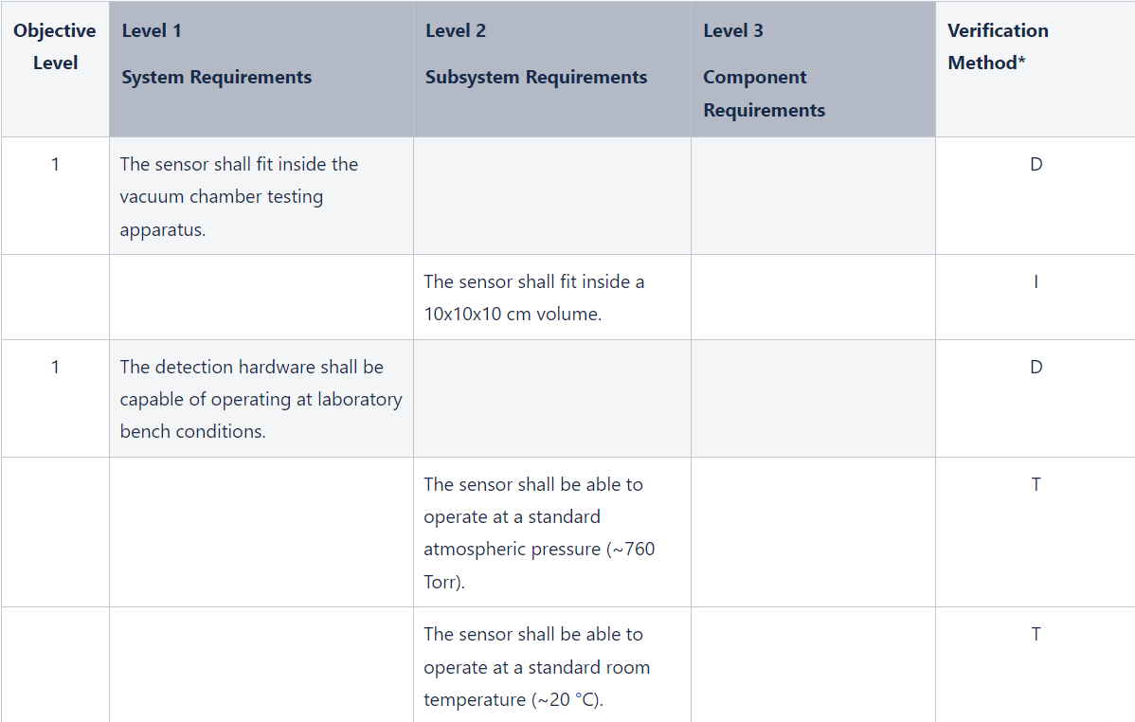
Requirement Breakdown

Slide 42
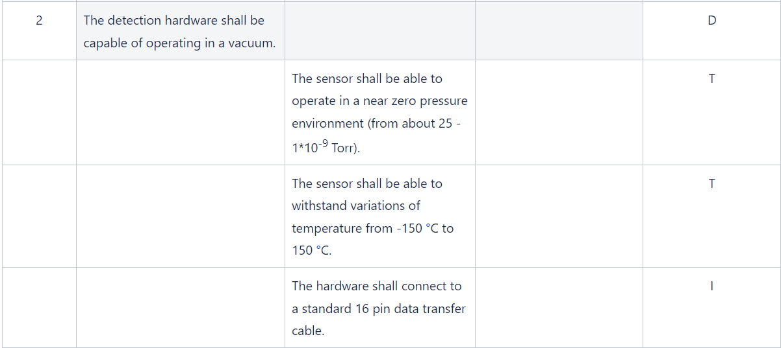
Requirement Breakdown (cont’d)

Slide 43
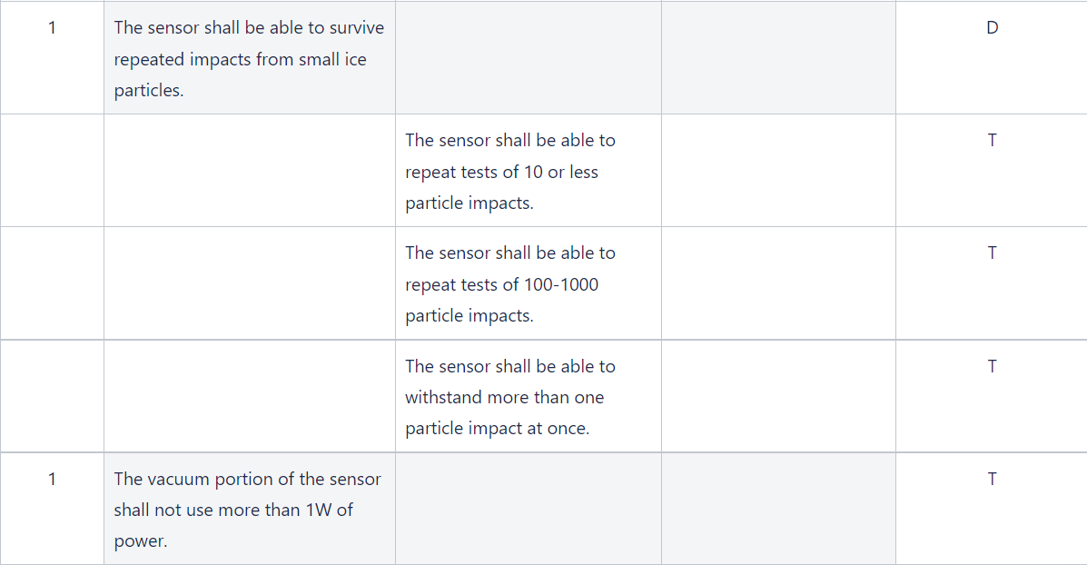
Requirement Breakdown (cont’d)

Slide 44
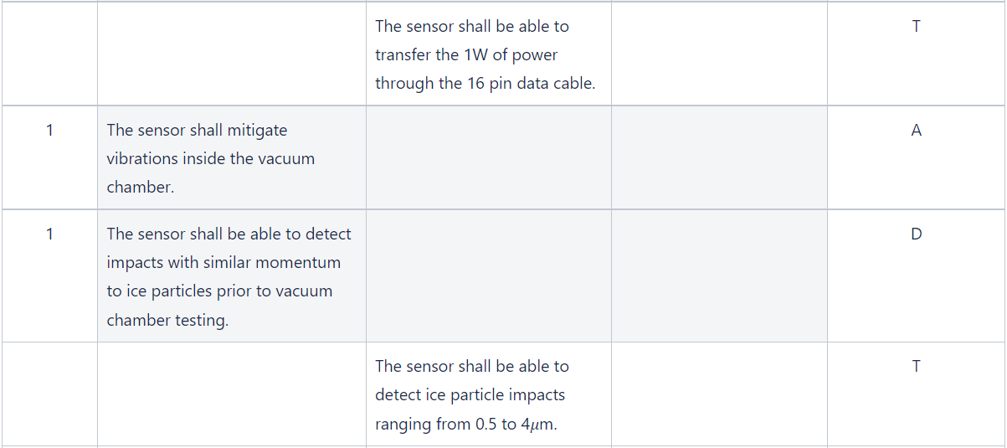
Requirement Breakdown (cont’d)

Slide 45
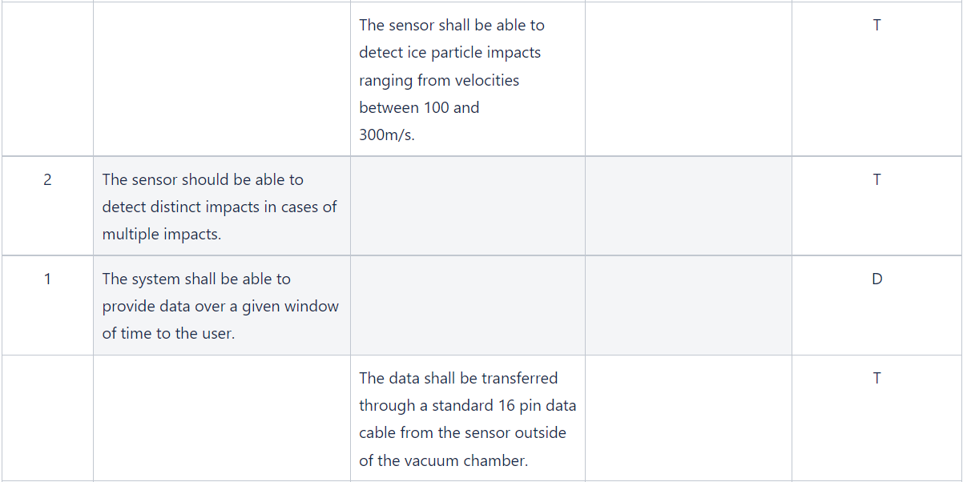
Requirement Breakdown (cont’d)

Slide 46
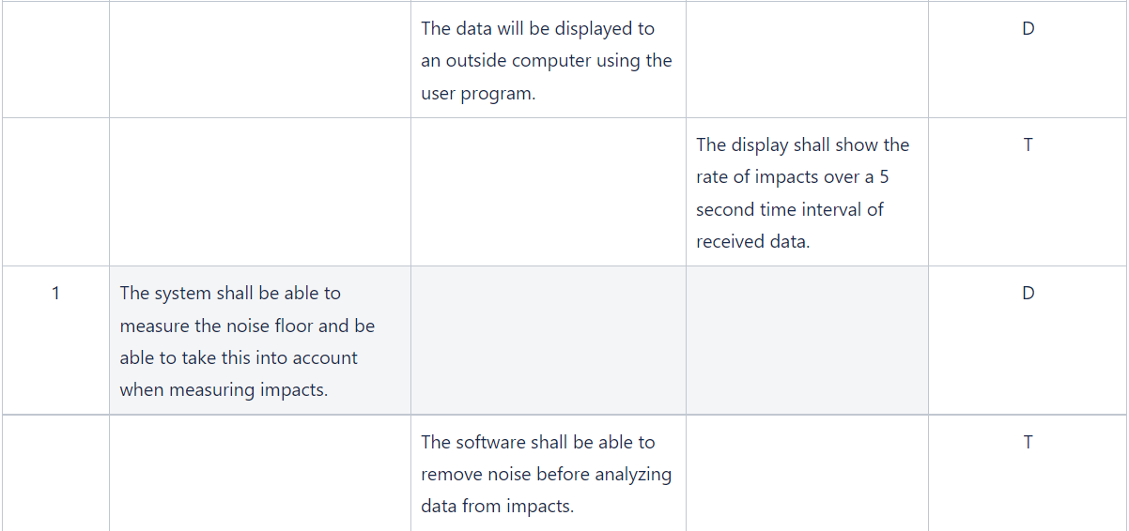
Requirement Breakdown (cont’d)

Slide 47
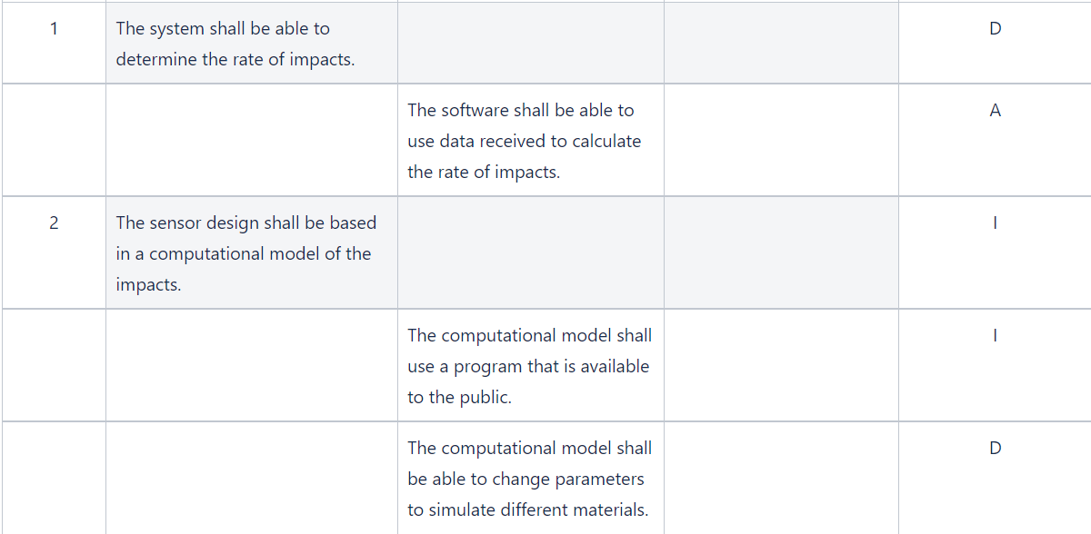
Requirement Breakdown (cont’d)

Slide 48
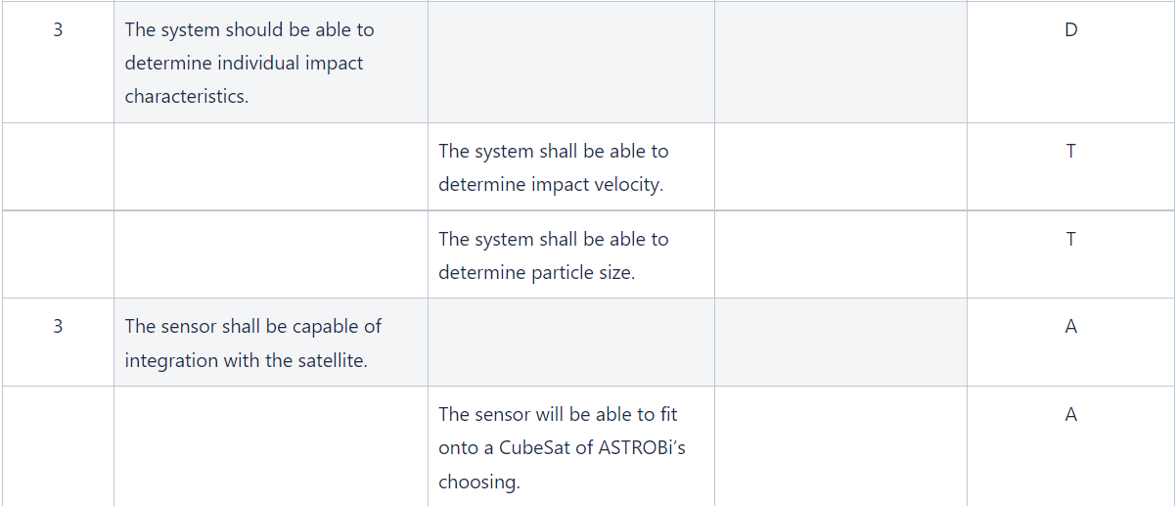
Requirement Breakdown (cont’d)

Slide 49
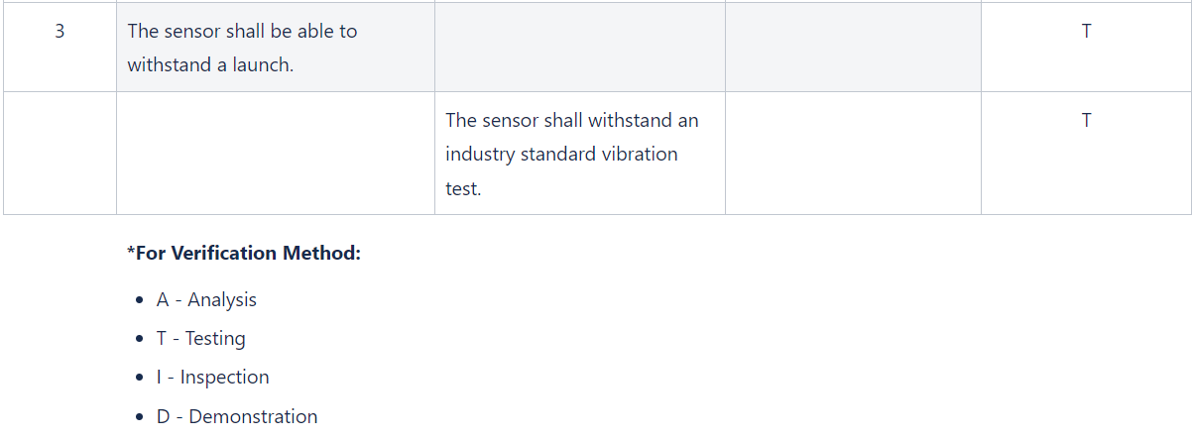
Requirement Breakdown (cont’d)

Slide 50
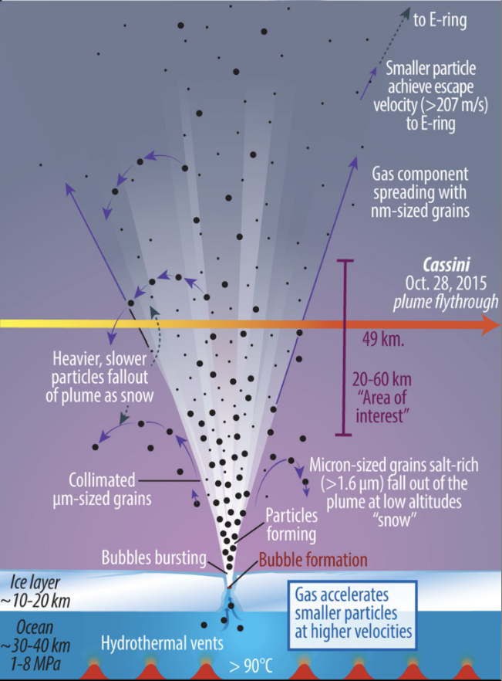
Impact rates

Slide 51
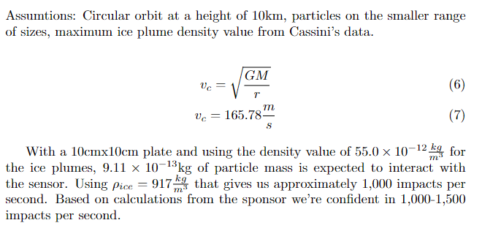
Impact rates

Slide 52
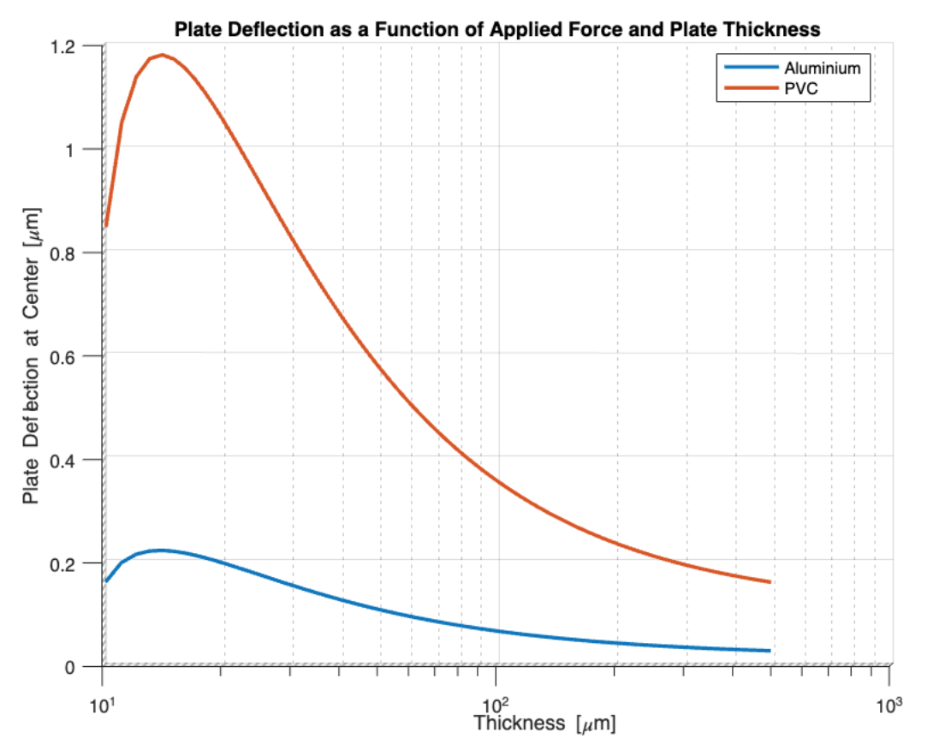
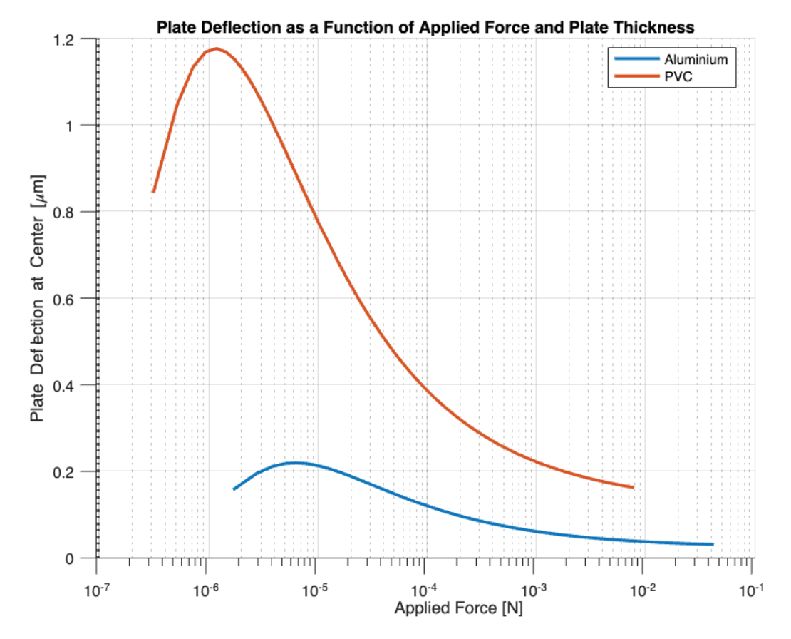
Preliminary Models: Model 1
Square plate with a point load applied at its center
Notes:
Asumptions:
Force exerted by an ice particle on the plate is equal to the force it would exert on a 2D beam as calculated using energy methods
Plate is not punctured
Material is uniform
Geometric symmetry
Area of impact << thickness of plate

Slide 53
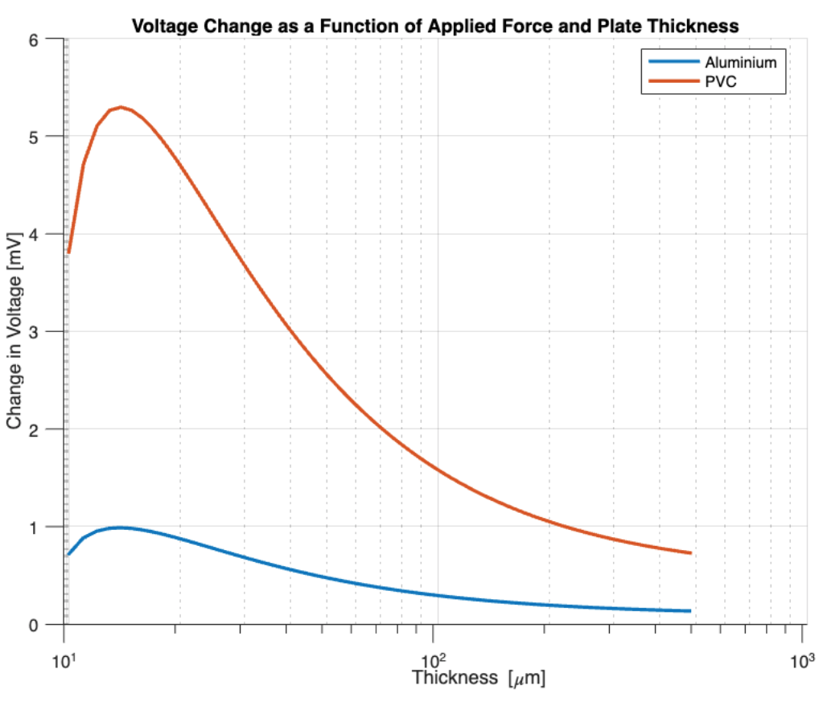
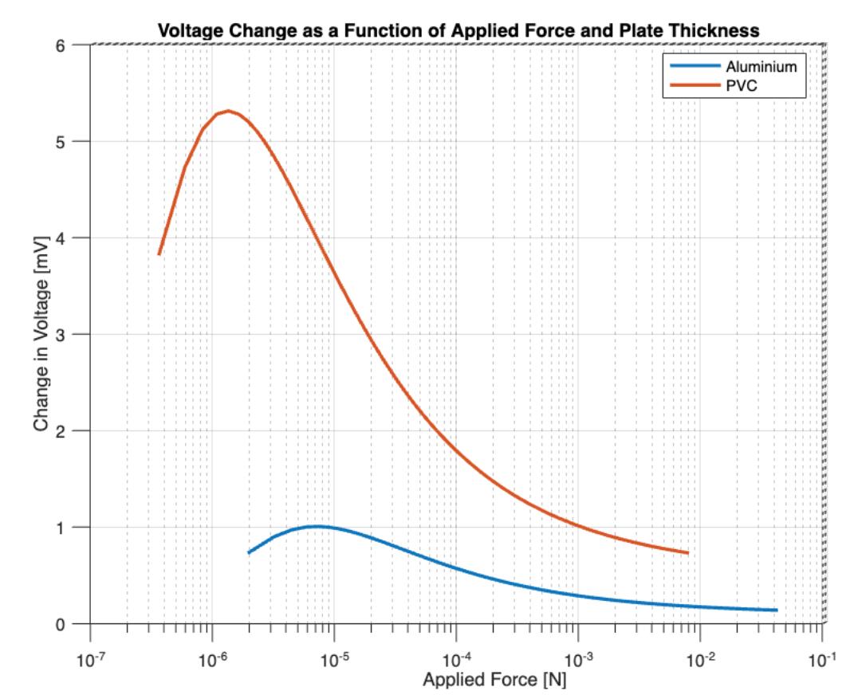
Preliminary Models: Model 2
Capacitor with variable plate spacing
Notes:
A parallel plate capacitor whose top plate is the plate experiencing the applied point load in the previous model
Assumptions:
Infinite plates
Top plate deflects uniformly
Charge is constant

Slide 54
Impact Research and Limitations
Material Limits of Water Ice
Yield strength of 0.7-3.5 MPa
Maximum force to 440 nN
Energy Dissipation
Impact vaporization
Frictional losses in sensor material
Impact Physics
Impact momentum losses
Material momentum losses

Slide 55
Similar particle testing
Mass of grain of salt ≅ 0.05 mg
Dropped from height of 0.0046m = 4.6mm
Momentum same as ice particle = 2.641x10⁻⁹ kg m²/s²
Can purchase smaller particles down to the several microns range

Slide 56
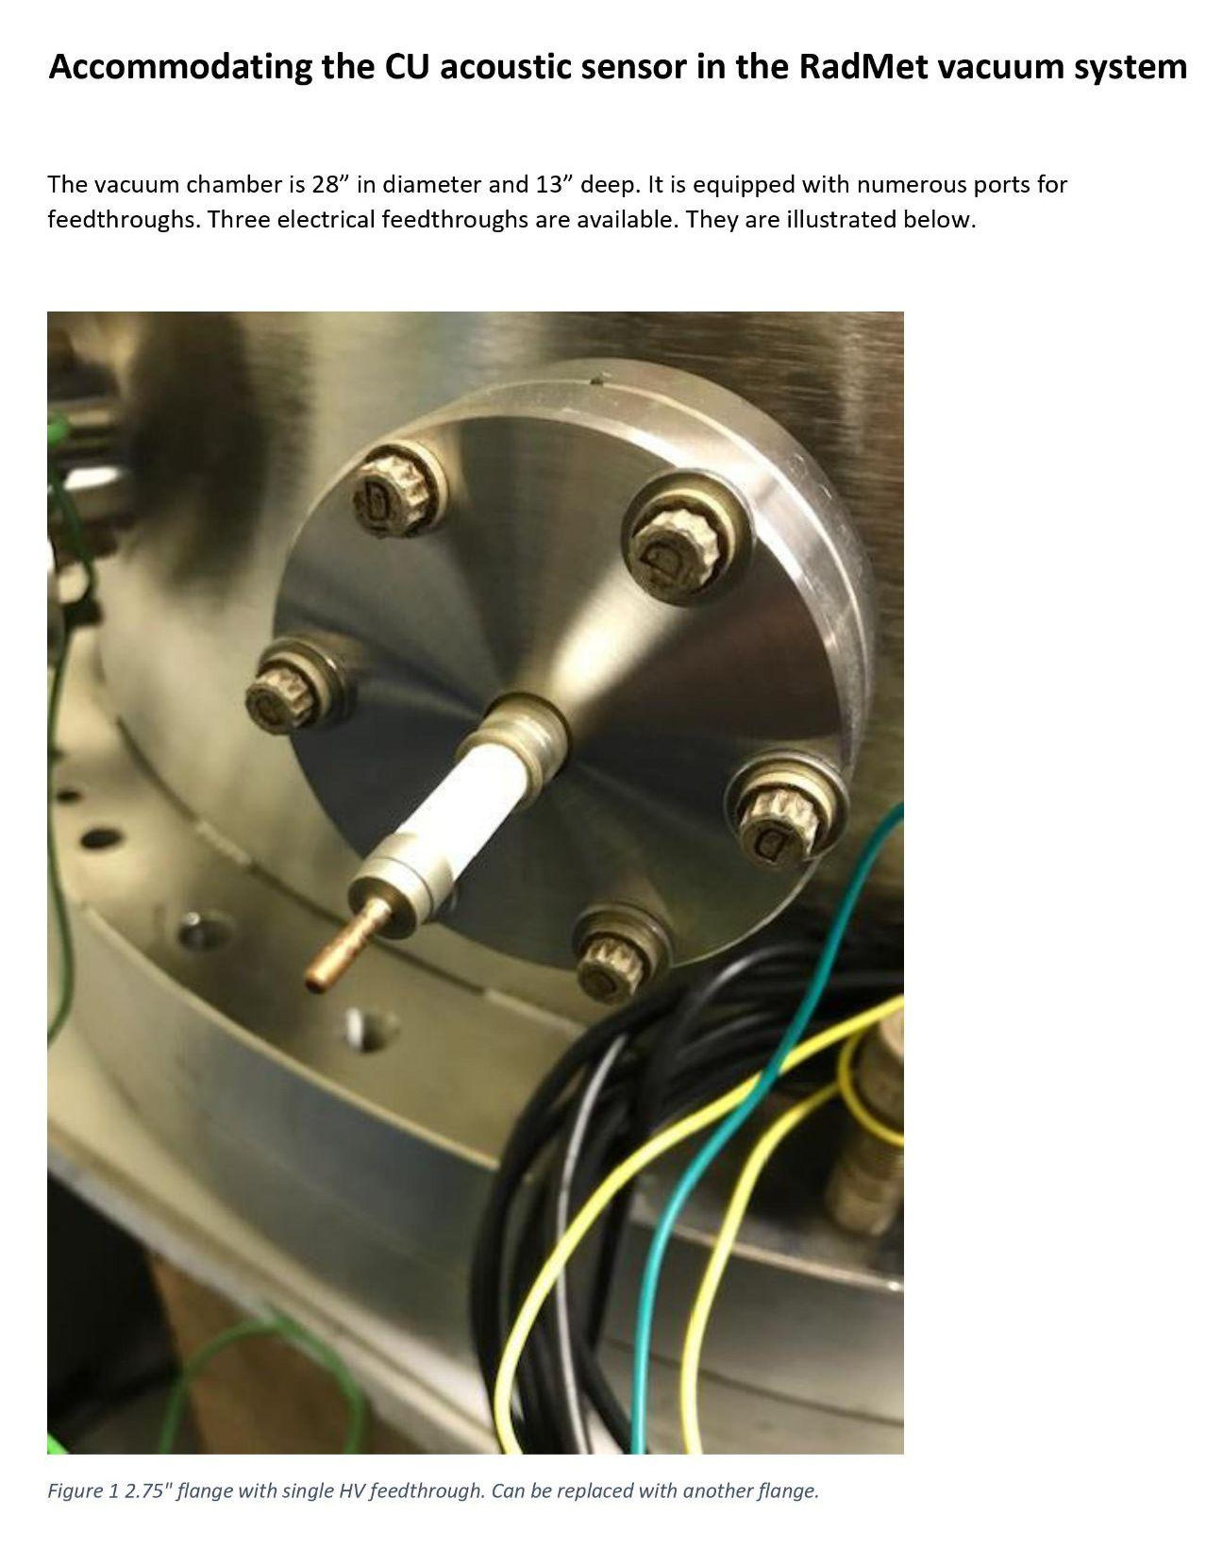
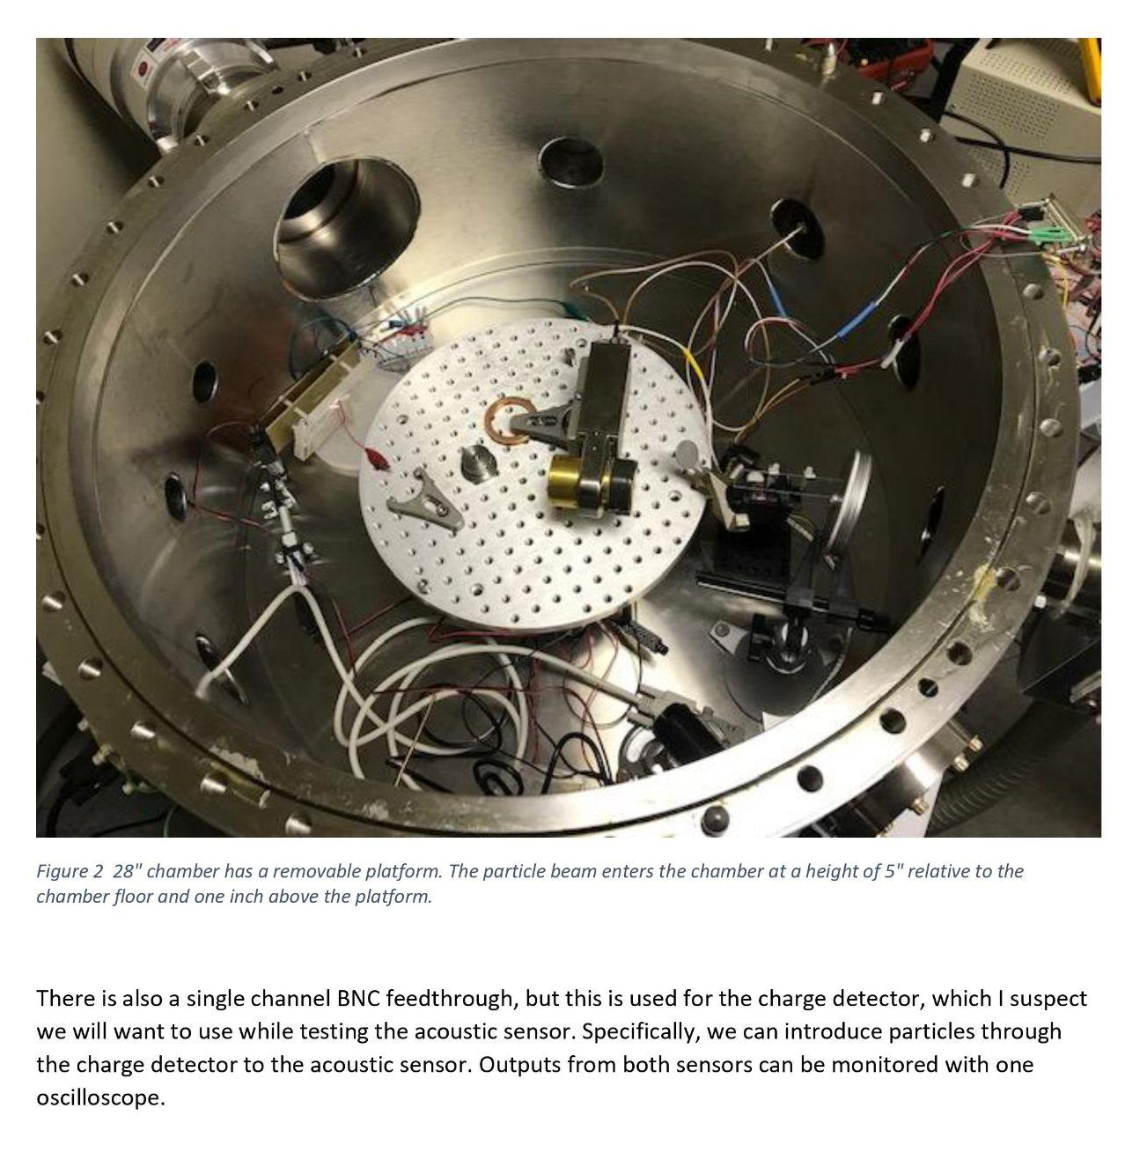
Customer Supplied Vacuum Chamber Testing Information

Slide 57
RadNet Vacuum Chamber Testing Information (cont.)

