Slide 1
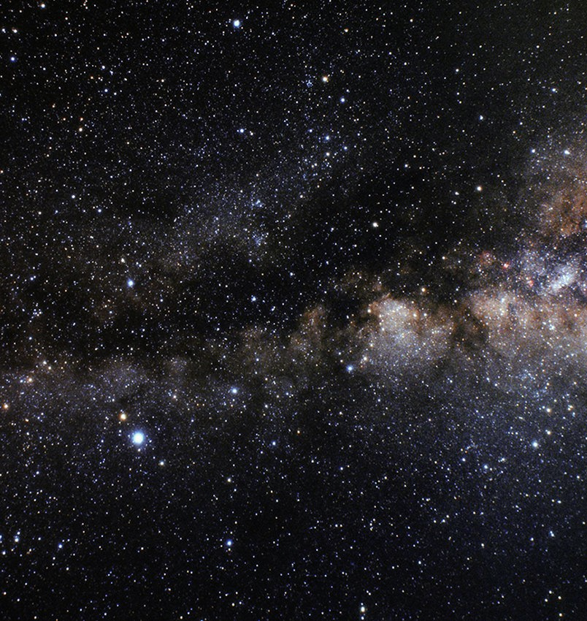
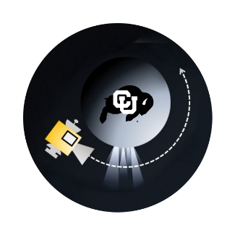
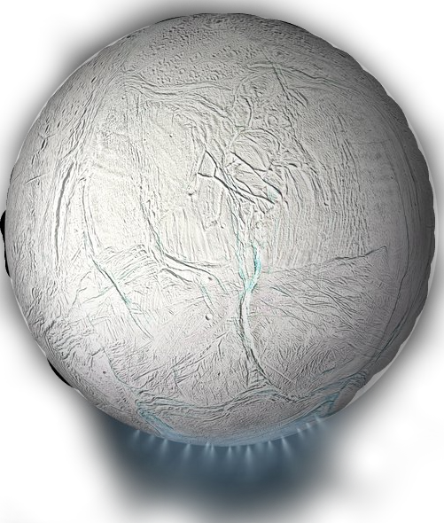
I²CE PDR
Group 12
Sponsored by: ASTROBi
Notes:
Brady Kopec, Kate Boykin, Lila Monprode, Reid Schneckenburger, Joe Miserlian, Jack Huston, Skylar Clark, Ben Esser, Ryan Bennett

Slide 2
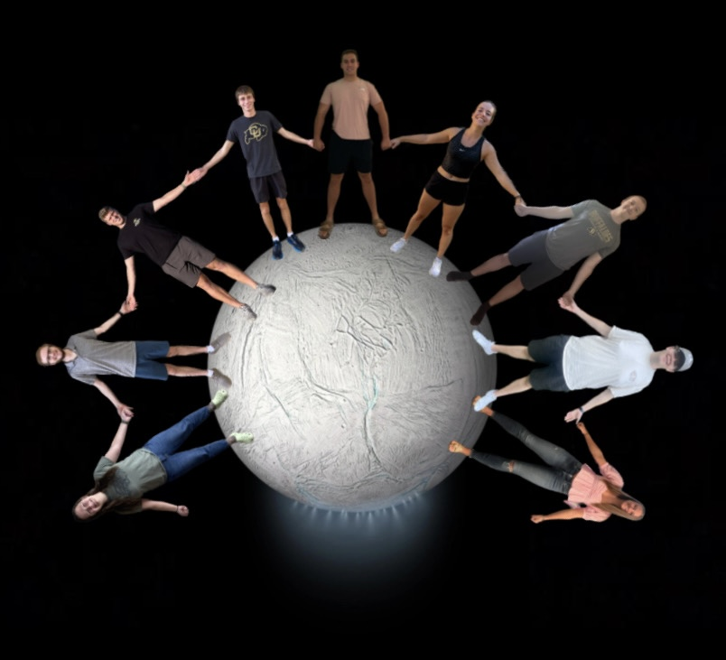
Skylar Jack Reid Joe Brady Kate Ben Ryan Lila

Slide 3
Project Description

Slide 4
Project Definition
This project is to design and fabricate a proof-of-concept sensor capable of measuring the plume density of ice particles around Enceladus

Slide 5
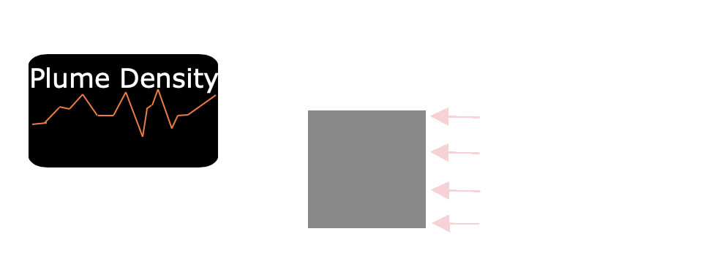
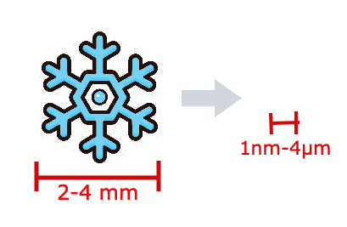
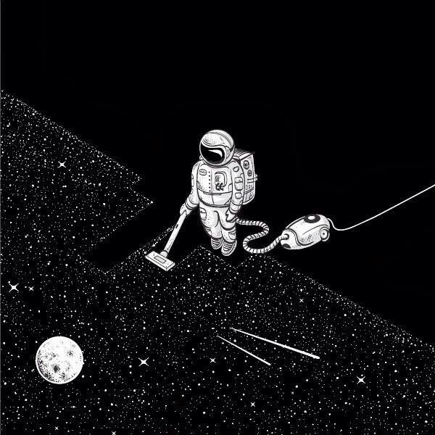
Primary Objectives
Measure incident particle flux over time
2) Detect particles from 0.5 μm to 4 μm in radius​
~1,000 – 1,000,000 times smaller
3) Operate in vacuum conditions

Slide 6
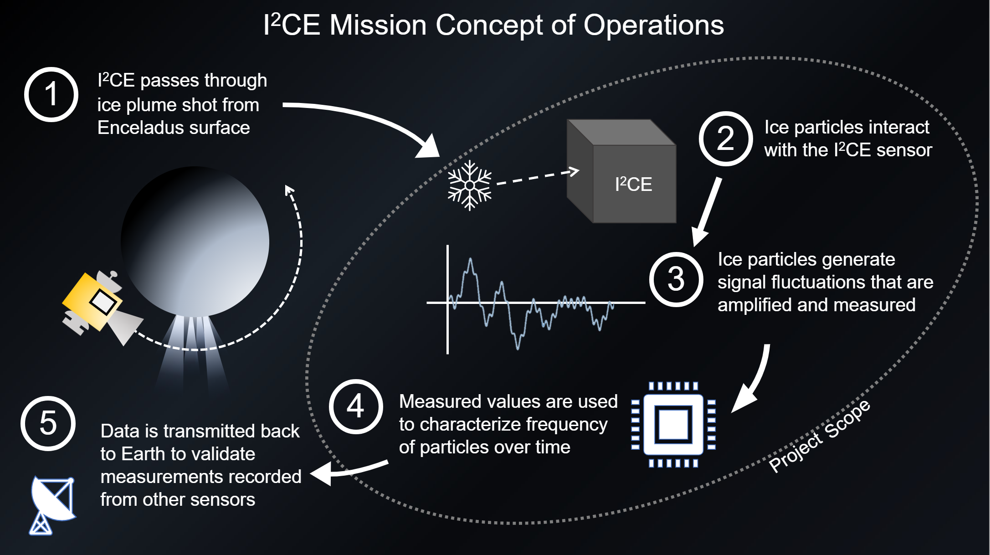
Notes:
We need to update this conops – maybe no more vibration detection

Slide 7
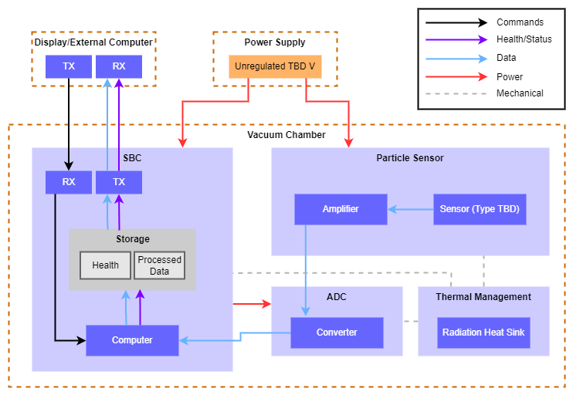
General Functional Block Diagram
Key:
SBC: Single Board Computer
ADC: Analog to Digital Converter
TX: Transmit Line
RX: Receive Line

Slide 8
Critical Project Elements
Geyser Density Detection
  Measure particles per second incident to the spacecraft
  Used to prove that the spacecraft is flying through ice plume
Noise Mitigation:
  Must reduce external noise
  Maximizes usable data
Simulation:
  Must quantitatively model the sensor response to incident ice particles

Slide 9
Trades

Slide 10
Trades
Trade | Possible Options | Dependent on | Priority
Detection Method | Acoustic (vibrations), Electrostatic charge, Light scattering | N/A | HIGH
Data collection unit | Vibration sensor (Acoustic), Current sensor (electrostatics), Light sensor (Optics) | Detection Method | Medium
ADC | Balancing sampling rate with power consumption | Detection Method | Medium
Computing device | Arduino, Rasberry Pi, Data transmission straight to external computer | ADC | Low
Heat Dissipation Method | Finned heat sink, Passive radiation heat rejection | N/A | Low

Slide 11
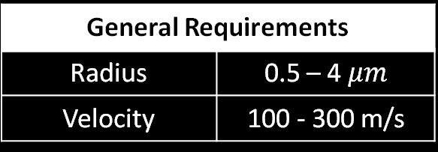
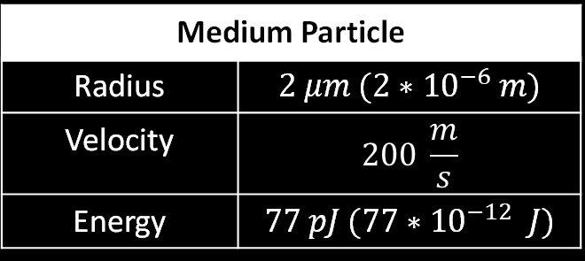

Key Requirement: Detect Particles
General Requirements
Radius | 0.5 – 4 $μm$
Velocity | 100 - 300 m/s
Medium Particle
Radius | $$2 μm (2∗{10}^{−6} m)$$
Velocity | $$200 \frac{m}{s}$$
Energy | $$77 pJ (77{∗10}^{−12} J)$$
Measure particles with a radius between $0.5$ and $4 μm$
  ~90% of all mass encountered is $<1 μm$, with the majority at $2 nm$
  Particles are charged, with maximum charge limited by their radius
  Incident particles between 0.5 and 4$μm: 8.95$ $\frac{particles}{cm^{2}s}$
10/3/2022
IICE – ASTROBi – Smead Department of Aerospace Engineering
11

Slide 12
Key Constraints: Size & Heat Dissipation
5cm x 10cm maximum incident surface
  Sensor surface must be smaller to account for frame/wiring
Larger area = more particles
More particles = more data
Maximum of 1 Watt heat dissipation inside vacuum chamber
≤1W
Sensor surface/opening
5 cm
10 cm
10 cm
10/3/2022
IICE – ASTROBi – Smead Department of Aerospace Engineering
12

Slide 13
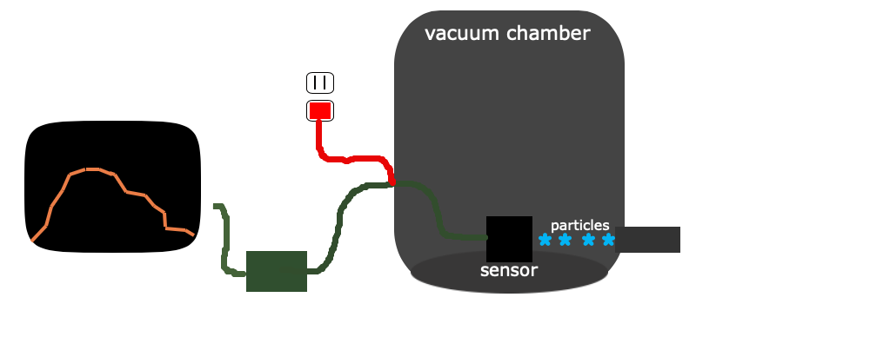
Key Interface: Vacuum Chamber
Device must be able to attach to vacuum chamber floor with sensor in line with ice particle beam
Device must be able to make all electrical connections through a 25-pin feedthrough

Slide 14
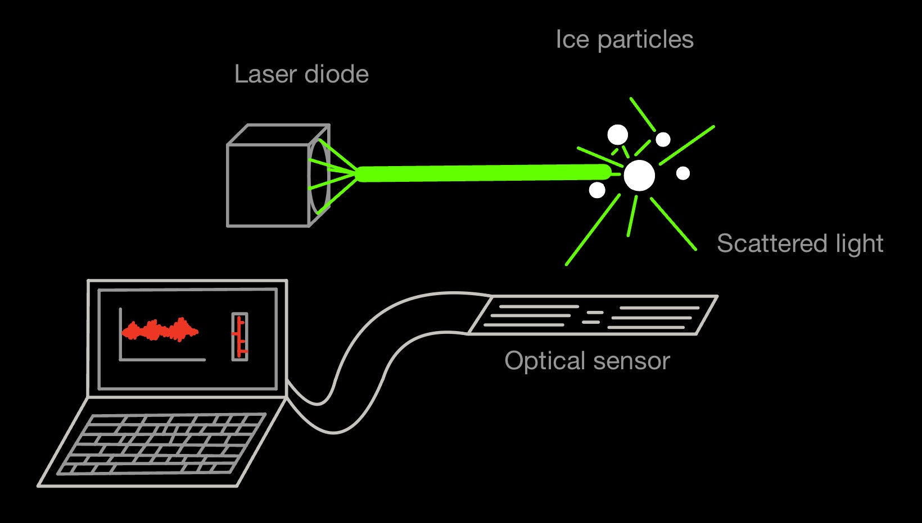
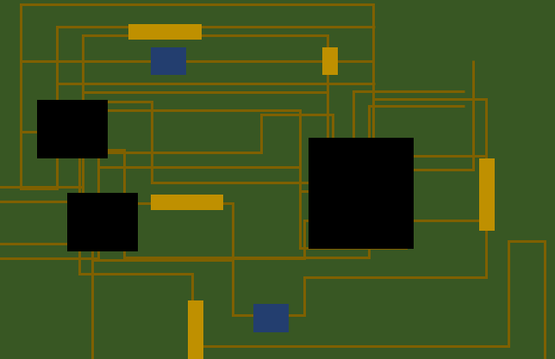

Trade: Detection Method
Acoustic Detection
Vibration sensing
Optical Detection
Light scattering
Charge Based Detection
Electrostatic induction and conduction

Slide 15
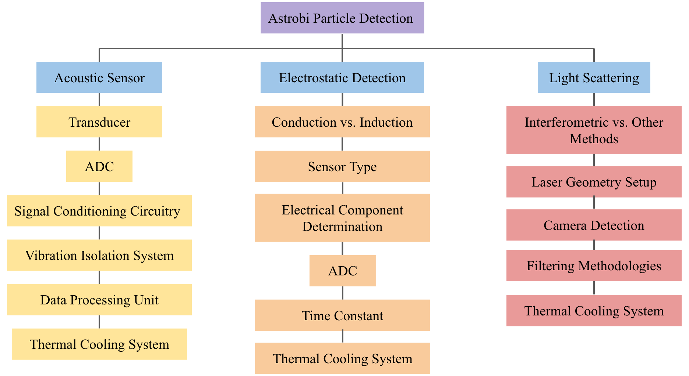
Trade Tree
10/3/2022
IICE – ASTROBi – Smead Department of Aerospace Engineering
15

Slide 16
Sensor Selection Criteria
Criteria | Weight
Sensitivity | 0.3
Versatility | 0.2
Power Consumption | 0.2
Cost | 0.15
Heritage/Available Resources | 0.15
Notes:
Sensity – How big of a response does a certain sensor type
Versatility – Range of particle sizes

Slide 17
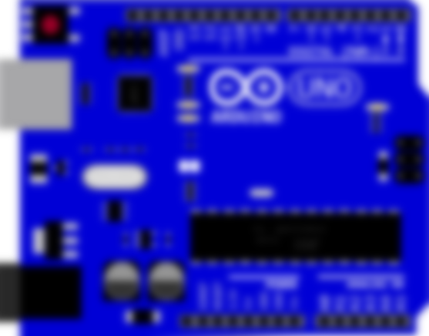
Design Option: Acoustic Sensor
Original design plan for the project (ASTROBi Acoustic Sensor)
Ice collision generates measured vibrations
Charge Sensitive Amplifier (CSA)
Analog to Digital Converter (ADC)
Vibration Transducer
(Proximity, Fiber optic Displacement, Piezoelectric , Accelerometer)

Slide 18

Acoustic Sensor: Engineering Analysis
Momentum Methods:
  Used change in momentum along with beam deflection equations
Energy Methods:
  Conservation of energy with kinetic energy of particle and strain energy of beam
Spring-Mass Model:
  Currently in development
$$v_{max}$$

Slide 19
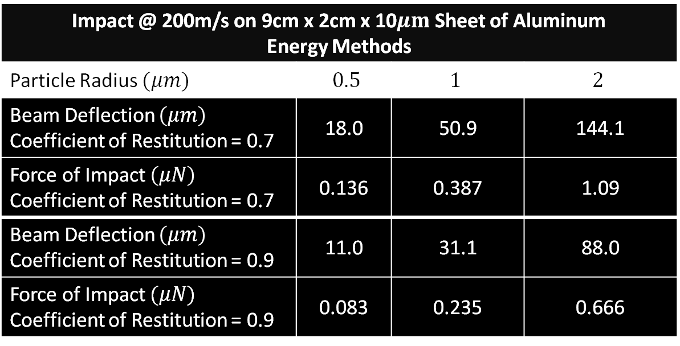
Acoustic Sensor: Deflection Results
Impact @ 200m/s on 9cm x 2cm x 10$μm$ Sheet of Aluminum Energy Methods
Particle Radius $(μm)$ | $0.5$ | $$1$$ | $$2$$
Beam Deflection $\left(μm\right)$ Coefficient of Restitution = 0.7 | 18.0 | 50.9 | 144.1
Force of Impact $\left(μN\right)$ Coefficient of Restitution = 0.7 | 0.136 | 0.387 | 1.09
Beam Deflection $\left(μm\right)$ Coefficient of Restitution = 0.9 | 11.0 | 31.1 | 88.0
Force of Impact $(μN)$ Coefficient of Restitution = 0.9 | 0.083 | 0.235 | 0.666
Notes:
Assumptions:
Perfect energy conversion, no losses

Slide 20
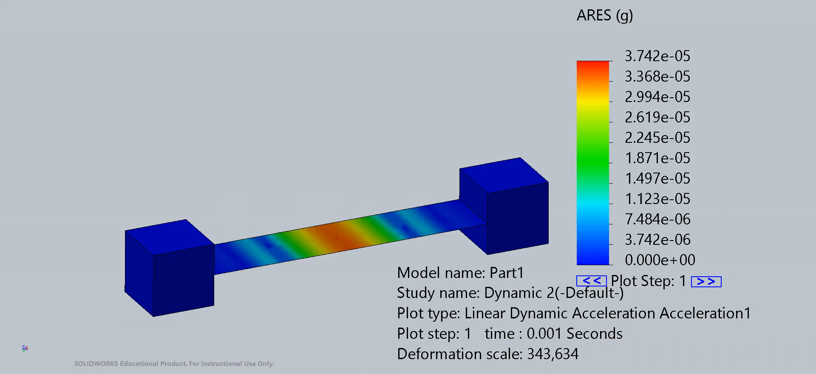

Acceleration Based Methods
Measures acceleration of foil surface
Best case yields $3.74⋅{10}^{−5}$ g
  Assumes infinitely light accelerometer placed on the surface of the foil
  Far below commercial grade accelerometer chips

Slide 21
Acoustic Sensor: Trade Performance
Sensitivity: TBD
  Working on finishing simulation to determine sensitivity
Versatility: 3
Power Consumption: 4
Cost: 4
Heritage: 1.5
Notes:
Sensitivity: TBD
Would need transducer sensitive enough to measure these small displacements over
Will impact vibrations stand out enough over noise from external vibrations?
We will create spring-mass simulation to analyze the vibrational response
Versatility: 3
Could detect individual impacts for larger, less frequent particles
Output depends only on size and velocity of particle

Slide 22
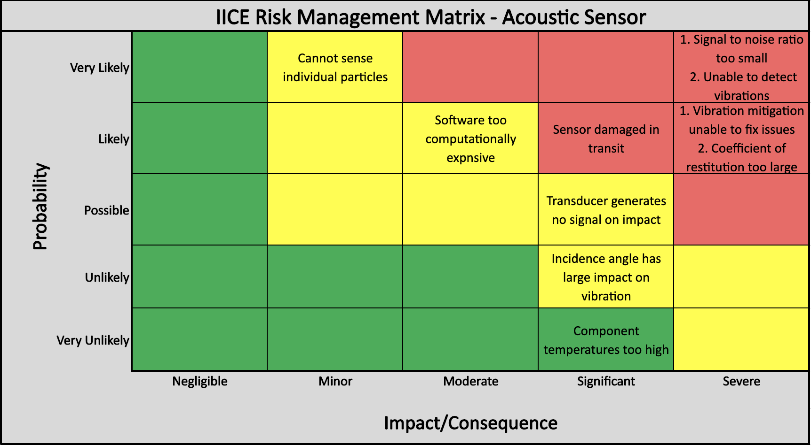
Acoustic Sensor: Risk Management

Slide 23
Design Option: Optical Sensor
Utilization of Light scattering to detect particles

Slide 24
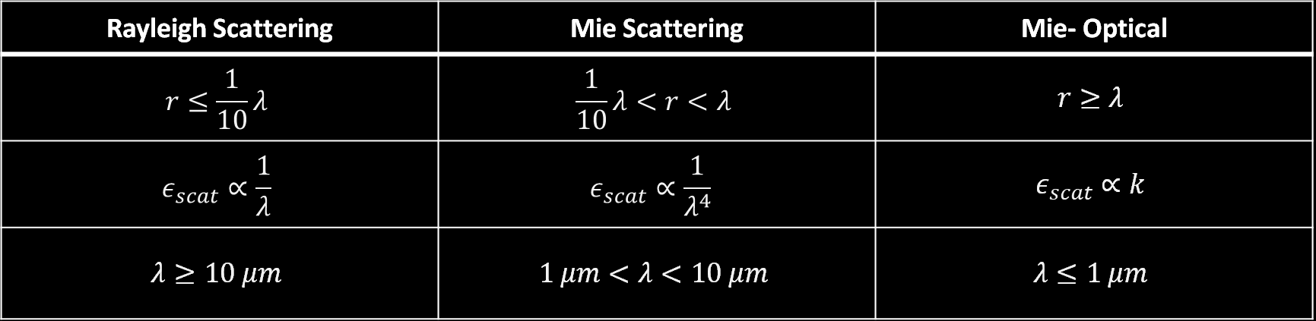

Optical Sensor
Rayleigh Scattering | Mie Scattering | Mie- Optical
$$r≤\frac{1}{10}λ$$ | $$\frac{1}{10}λ<r<λ$$ | $$r≥λ$$
$$ε_{scat}∝\frac{1}{λ}$$ | $$ε_{scat}∝\frac{1}{λ^{4}}$$ | $$ε_{scat}∝k$$
$$λ≥10 μm$$ | $$1 μm<λ<10 μm$$ | $$λ≤1 μm$$
Where $λ$ is wavelength
$ε_{scat}$ is scattering efficiency
$r$ is radius of particle

Slide 25
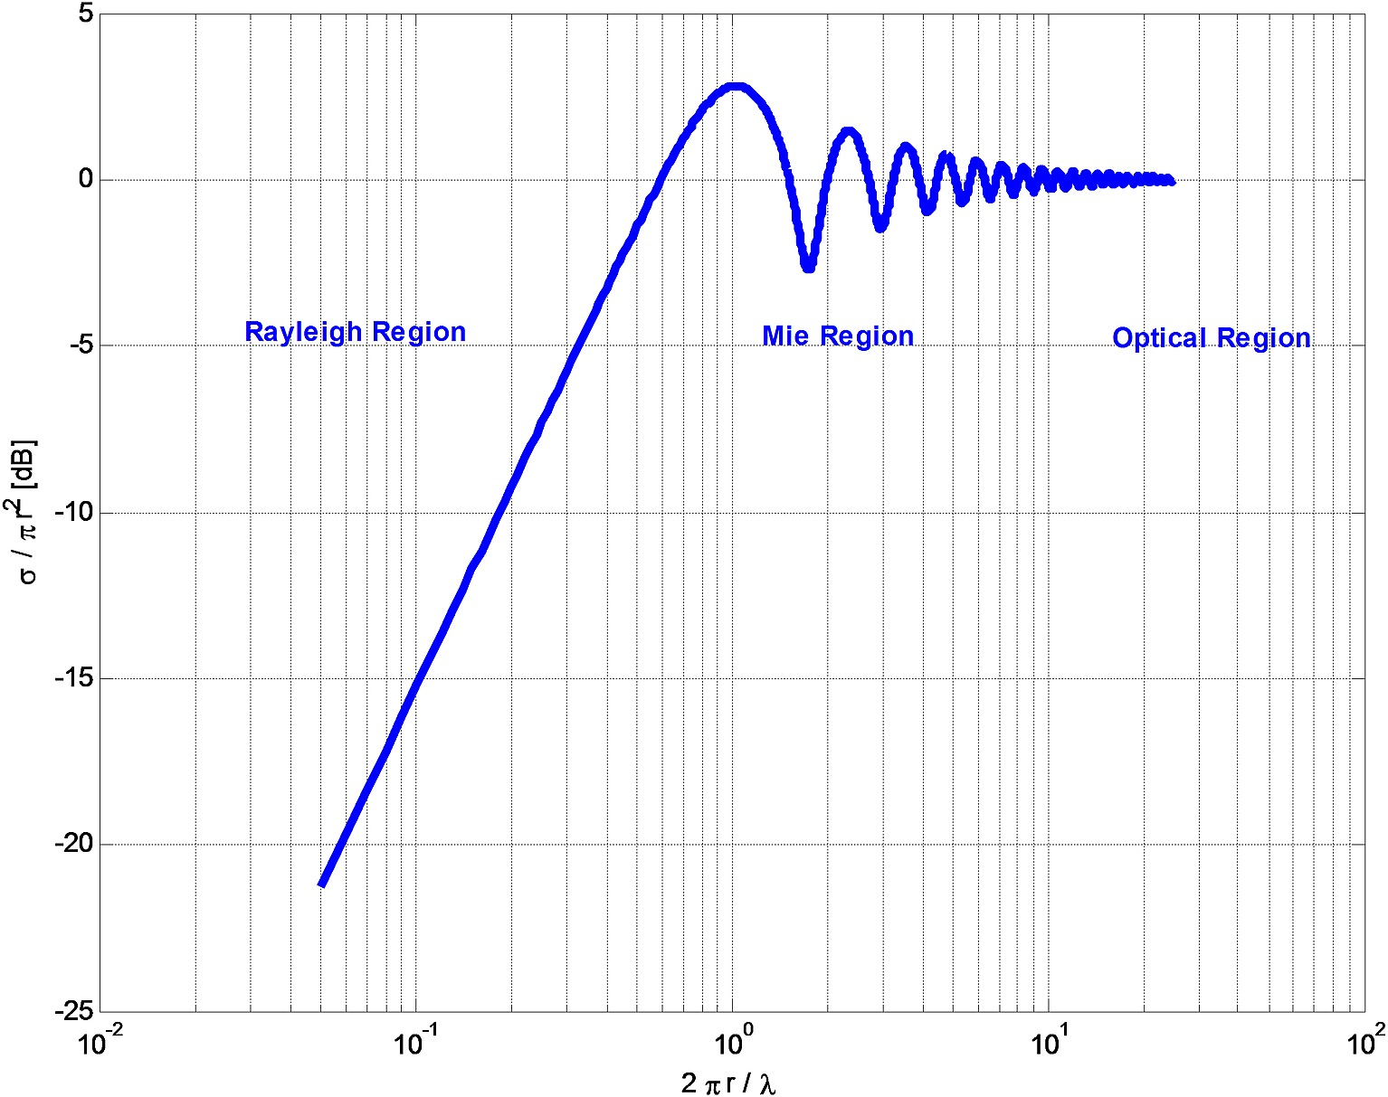
Optical Sensor
Optic Cross Section as a Function of wavelength
Highest receivable signal in start of Mie scattering Region

Slide 26
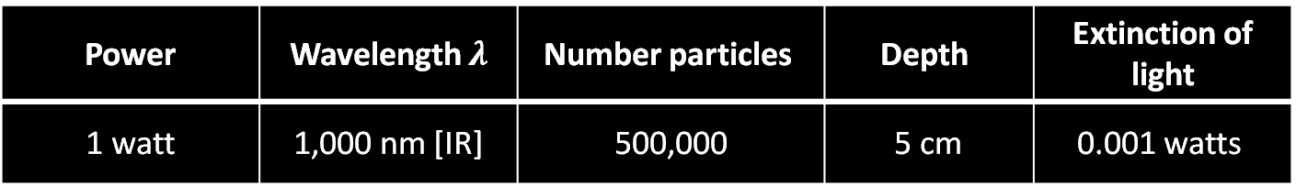
Optical Sensor
Power | Wavelength $λ$ | Number particles | Depth | Extinction of light
1 watt | 1,000 nm [IR] | 500,000 | 5 cm | 0.001 watts
500,000-micron sized particles is not an accurate reflection of the orbit parameters
Depth of sampling environment limits scattering effects
Permittivity of ice used in the calculation was an estimate and would significantly change scattering and absorption

Slide 27
Optical Sensor: Trade Performance
Sensitivity: 3
  Easily detects single sized particle
Versatility: 1
Power Consumption: 1
Cost: 1
Heritage: 3
  No current examples of high velocity detection

Slide 28
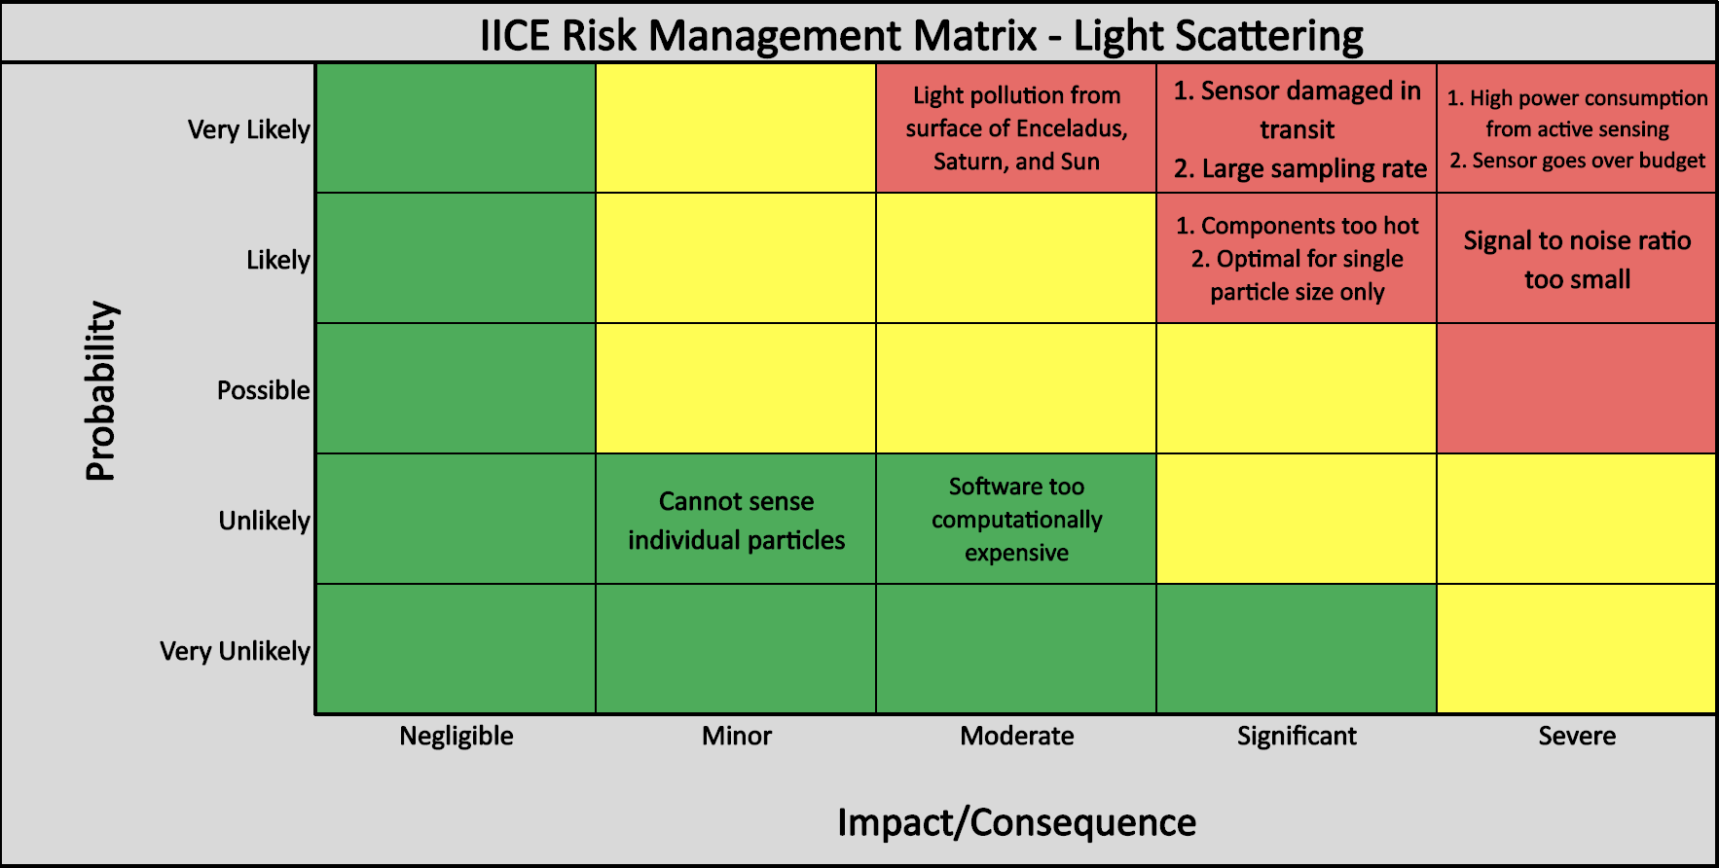
Optical Sensor: Risk Management

Slide 29
Design Option: Electrostatic Sensor
Utilization of charge carrying particles to induce or conduct charge into the sensor device.
Induction
Conduction
Charge Sensitive Amplifier (CSA)
Analog to Digital Converter (ADC)
Ice Particles

Slide 30


Electrostatic Sensor
Requires particles to be charged
Cassini’s E5 (25 km) fly-by suggests these particles carry charge
$q_{d}=0.31 to 0.57 \left(−e\right)⋅\left(\frac{r}{1 nm}\right)$
$q_{total}=7.75 \frac{pC}{cm^{2}s}$
$q −$Charge
$e −$ Elementary Charge (charge of one electron)
$C−$Coulombs
$r−$Radius of Particle

Slide 31
Electrostatic Sensor
Induction Based
  Negatively charged particles fly through a conductive wire grid
  Particles induce a current in the wire
  Measurements of the amperage show particle charge
  Additional grids can be added
    Velocity and trajectory

Slide 32
Electrostatic Sensor
Conduction Based – Faraday’s Cup
  Measure total charge density
  Incident particles impact sensor face, causing some charge to be transferred
  Sensor face is discharged periodically, measuring amperage
    Cannot measure individual particles
Conduction
Ice Particles

Slide 33
Electrostatic Sensor: Trade Performance
Sensitivity: 4
  May be capable of detecting individual particles (Induction)
  Can easily detect groups of particles over short time span (Conduction)
Versatility: 4
Power Consumption: 3
Cost: 5
  Common components
Heritage: 4
  Previously used by Cassini in transits of Enceladus’ ice plumes

Slide 34
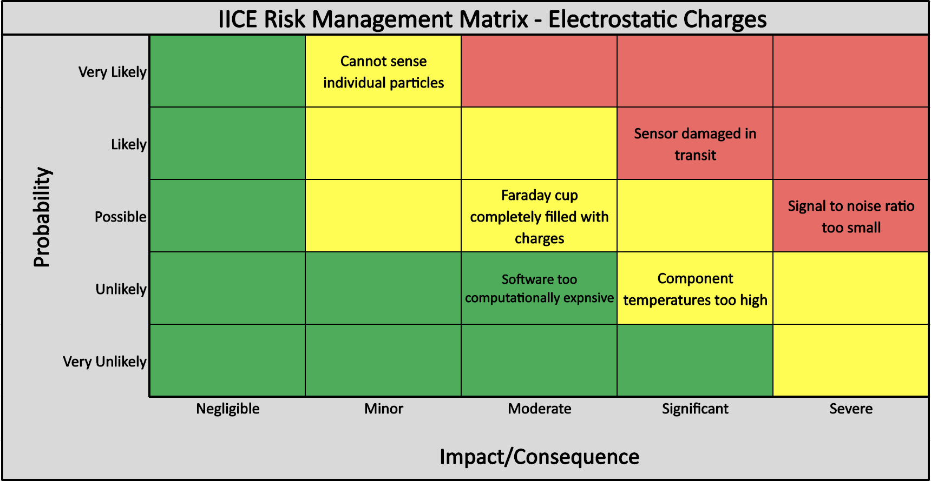
Electrostatic Sensor: Risk Management

Slide 35
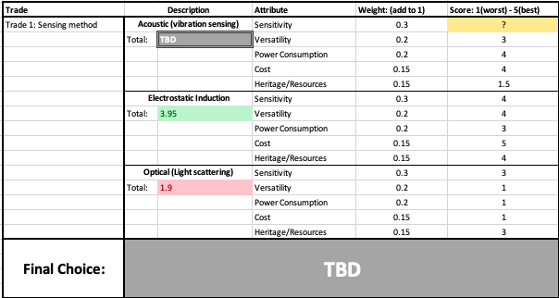
Trade Matrix with Weightings

Slide 36
Current Design Space

Slide 37
Current Design Configuration
SBC (Single Board Computer) :
Raspberry Pi
Heat rejection method:
Cooling through conduction/radiation​
Particle Sensor:
EITHER
Acoustic sensor:
-Aluminum sheet as impact surface
-Transducer converting vibration to analog signal​​
Electrostatic sensor:
Use induction and/or conduction of excess charge in ice particles
10/3/2022
IICE – ASTROBi – Smead Department of Aerospace Engineering
37

Slide 38
Current Unknowns & Plans for Solving
Acoustic Sensor
  Feasibility of measuring ripple vibrations
  Method for vibration mitigation within vacuum chamber
Electrostatic Sensor
Solve ANSYS model and MATLAB representation of spring mass system
Investigate suspension techniques
Induction vs. conduction-based sensing strategy
Quantitative feasibility analysis

Slide 39

Future Trade Studies
Acoustic Sensor | Electrostatic Sensor
Determine optimal impact membrane size Transducer type: decide between proximity, piezoelectric, fiber optic displacement, and accelerometer ADC requirements | Investigate charge sensitive amplifiers in comparison to alternative sensors ADC requirements Radiative coating

Slide 40
Modeling and Prototyping Plans

Slide 41
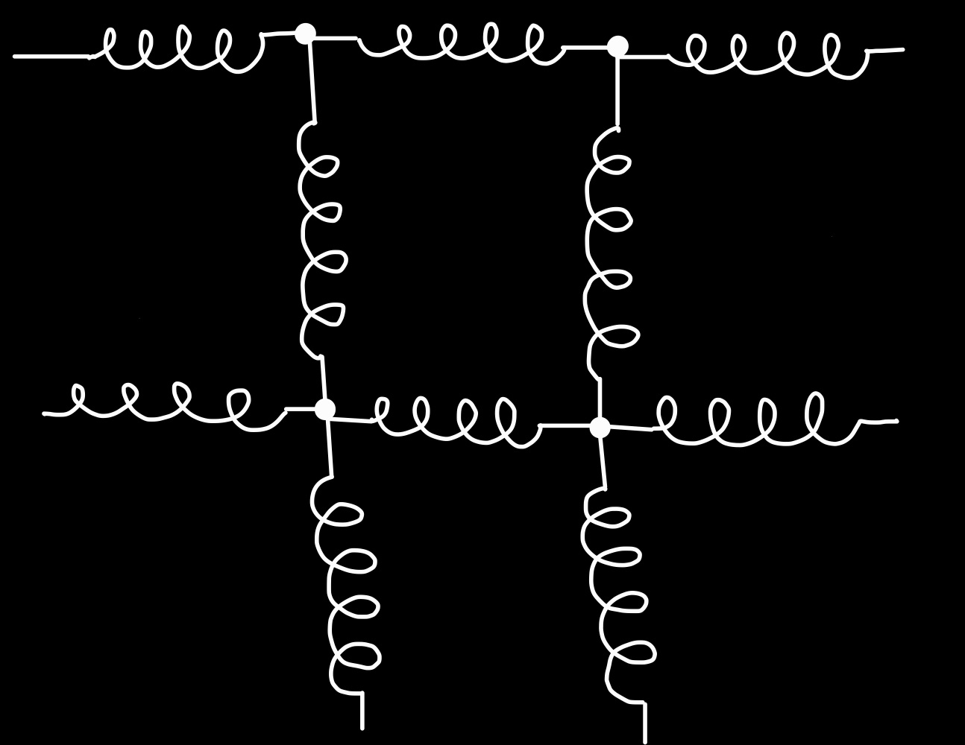
Vibration Detection Sensor Modeling
Move away from maximum deflection models and pivot to pure vibrational analysis
  ANSYS FEM: mass – spring – hinge model
  Impact surface modeled as mass – spring system
    Individual elements act independently, allowing concentric ‘wave-like’ movement patterns
Momentum transfer to point mass
10/3/2022
IICE – ASTROBi – Smead Department of Aerospace Engineering
41

Slide 42

Electrostatic Charge Sensor Modeling
Simulate electrical circuit / prototype PCB
  Test charge detection ability
Model sensor output for simulated charges
  Cylindrical, panel, or wire induction sensor type (Trade Study)
Model ice sublimation
  Determine if heat input is required to clear sensor
Model effects of space environment on sensor
10/3/2022
IICE – ASTROBi – Smead Department of Aerospace Engineering
42

Slide 43
Thank you for listening!
Special thanks to:
Advisor: Dr. Erik Knudsen
Sponsor: Erik Buehler & ASTROBi Foundation
Course Coordinators: Dr. Kathryn Wingate & Chris Muldrow
The Senior Project Advisory Board

Slide 44
Backup Slides and Slide Links
Summary of Papers
Backup Slides
  Electrostatic Detection Slides
    Parallel Plates Induction
    Cylinder Induction
    Conduction Calculation
    Mass Build Up
    Charge Sensitive Amplifier
    CSA Sensitivity
    CSA Results
    0.5 micron to 5-micron plot
    Methods of Adding Charge to Particles
    Current 3D Designs
  Vibration Detection Slides
    Beam Deflection Calculations
  Optical Detection Slides
  Completed Trades Slides
    Heat Rejection Trade
    SBC (Single-Board Computer) Trade

Slide 45
Summary of Papers Used

Slide 46
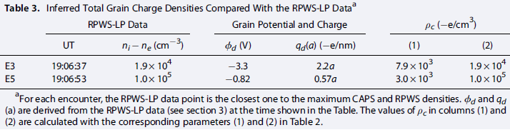
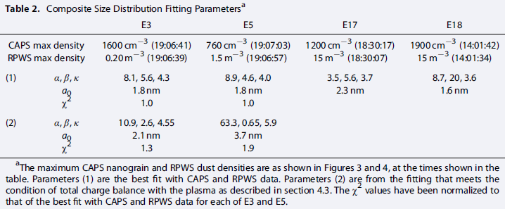



Characteristics of ice grains in the Enceladus plume from Cassini observations [2015]
$n_{d}$ - Particle Density $\left(\frac{particles}{m^{3}}\right)$
$r$ - Particle Radius
$α, β, C,κ,a_{0}$ - Curve Fitting Parameters
Most particles in ice plume are < 1 $μm$ radius
Particles are negatively charged and differ by size
Cassini’s E5 transit occurred at same altitude as our mission
  Charge parameters were calculated from this transit
Specific Particle Size Densities:
$n_{d}=\int_{r_{min}}^{r_{max}}{\frac{dn}{da}da}$ $\frac{dn}{da}=Cr^{α}{\left[1+\frac{α}{κ}{\left(\frac{r}{a_{0}}\right)}^{β}\right]}^{−\frac{α+κ}{β}}$
Dong, Y., T. W. Hill, and S.-Y. Ye (2015), Characteristics of ice grains in the Enceladus plume from Cassini observations, J. Geophys. Res. Space Physics, 120, 915–937, doi:10.1002/ 2014JA020288.

Slide 47
Electrostatic Sensing Method Backup Slides

Slide 48





Electrostatic Induction Calculation
Parallel Plates (Green’s Reciprocity Theorem)
Charge on Plate 1
  $q_{1}=−q⋅\frac{a}{d}$
Charge on Plate 2
  $q_{2}=−q⋅\frac{b}{d}=−q⋅\frac{d−a}{d}$
Plate 1
$$a$$
$$q$$
$$d$$
$$b=d−a$$
Plate 2
American Journal of Physics, Volume 44, No. 11, November 1976

Slide 49




Electrostatic Induction Calculation
Cylinder (Imianitov and Mikhailovskaia)
Charge on Cylinder Wall
$$\frac{q_{cyl}}{q}=\frac{\left|z_{0}\right|+c}{2{\left[{\left(\left|z_{0}\right|+c\right)}^{2}+a^{2}\right]}^{\frac{1}{2}}}−\frac{\left|z_{0}\right|−c}{2{\left[{\left(\left|z_{0}\right|−c\right)}^{2}+a^{2}\right]}^{\frac{1}{2}} }$$
$$c$$
$$a$$
$$z_{0}$$

Slide 50

Electrostatic Conduction Calculation
Total charge flux is built up overtime as charge is transferred and stored in the Faraday Cup
Charge sensitive amplifier proven sensitive down to $≈2 fC$
Estimated charge flux based on Cassini’s E5 (25km) pass
  ${\dot{q}}_{in}=7.75\frac{pC}{s}/cm^{2}$
For a $1cm^{2}$ faraday cup entrance
  0.25 ms to reach minimum charge level $→$Theoretical sample frequency of $\sim 3500 Hz$

Slide 51

Faraday Cup Mass Build Up
For 1cm by 1cm Faraday Cup cross sectional area
  Expected mass flux of $4.64\frac{femtograms}{second}$
  Total transit time of 216 seconds
Total mass per orbit = $\sim 1000 fg$
Will consider thermal calculation to see if ice particles will sublimate at a rate high enough to self clear
  Possibility of adding a heating element to ensure self clearing of particles

Slide 52







Charge Sensitive Amplifier
$$C_{1}$$
Commonly used circuit
  Commonly found designs can sense charges across sensor of around 2 femtocoulombs
Integrates current through Op-Amp
Value of $C_{1}$ determines the gain of the sensor
Value of $R_{1}$ determines time constant of sensing
$$R_{1}$$
$$q_{in}→$$
$$V_{out}=\frac{q_{in}}{C_{1}}$$
$$sensor$$

Slide 53

Charge Sensitive Amplifier Sensitivity
Assume $C_{1}=2pF$, $R_{1}=50 MΩ$
Second stage voltage amplifier (Gain of 20)
16-bit Analog to Digital Shield on 0-5V Range (0.076 mV resolution)
Theoretical resolution of $0.0076 fC$
Maximum input charge of $0.5 pC$ before maximum ADC value

Slide 54
Charge Sensitive Amplifier Results
Charge Sensitive Amplifier
  Multiple proven designs used previously for this purpose
    One circuit shows noise floor of 0.2fC [1]
      Scale required for induction-based method
    Simpler design shows noise floor of 200fC [2]
      Satisfactory for conduction-based method
  Utilize op-amp current integrator with voltage amplifier into ADC
  Care must be taken to lower noise floor as much as possible
[1] Robert Nerem and David Jones, “Charged Particle Pickup Tube Detector Used in Experimental Applications and Classroom Demonstrations”, Phys. Teach. 58, 200 (Feb. 2020)​
[2] Ralf Srama and Siegfried Auer, “Low-charge detector for the monitoring of hyper-velocity micron-sized dust particles”, 2008 Meas. Sci. Technol. 19 055203

Slide 55

0.5$μm$ to 5$μm$ Particle Charges

Slide 56

Method of Adding Charge to Particles
Particles require $≥2fC$ of charge to be detected
Currently have $0.02 −0.25 fC$ of charge
Requires addition of $\sim 12358−3000$electrons per particle
Could be accomplished with electron gun / electron beam
  Further research is required

Slide 57
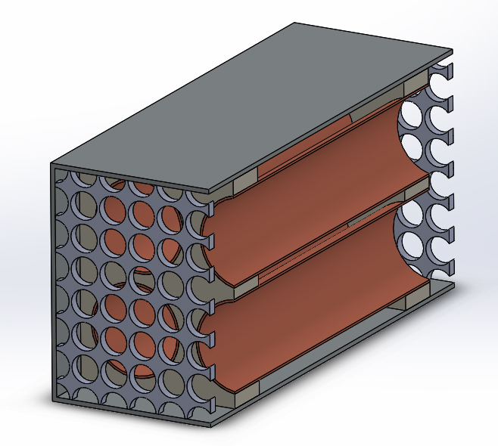
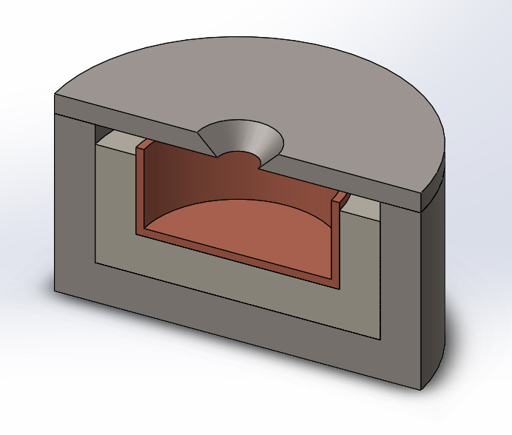
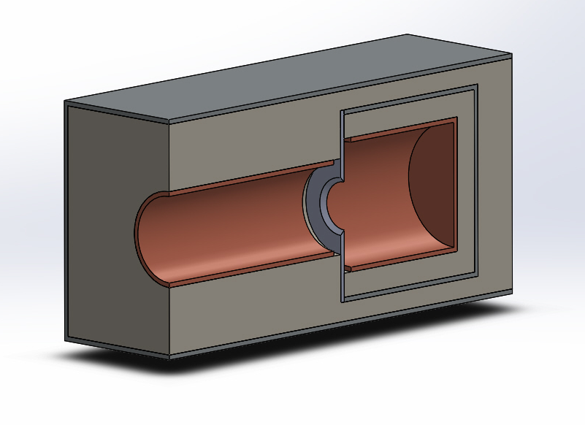
Possible Electrostatic Design Space
Trade selection has narrowed down the possible sensing method
Potential sensing types are electrostatic induction, conduction, or a hybrid type (inductor tube prior to conduction collector)
Induction Method
Conduction Method
Hybrid Method

Slide 58
Vibration Sensing Method Backup Slides

Slide 59




Acoustic Sensor: Engineering Analysis
Momentum Methods:
  Calculated force from change in momentum of particles
  Used appropriate beam deflection equation
    Did both point load and distributed load
Energy Methods:
  Conservation of energy with kinetic energy of particle and strain energy of beam
$$F=RmΔV$$
$$v_{max}=\frac{FL^{3}}{48EI}$$
$$v_{max}$$
$R=$ impact rate (particles/sec)
$m=$ mass of particle
$ΔV=$ velocity change of Particle
$e=$ modulus of elasticity
F = force of impact
$$\frac{1}{2}mV^{2}=\frac{1}{2}Fv_{max}+\frac{1}{2}m{(eV)}^{2}$$

Slide 60
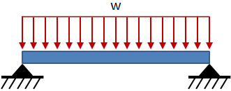
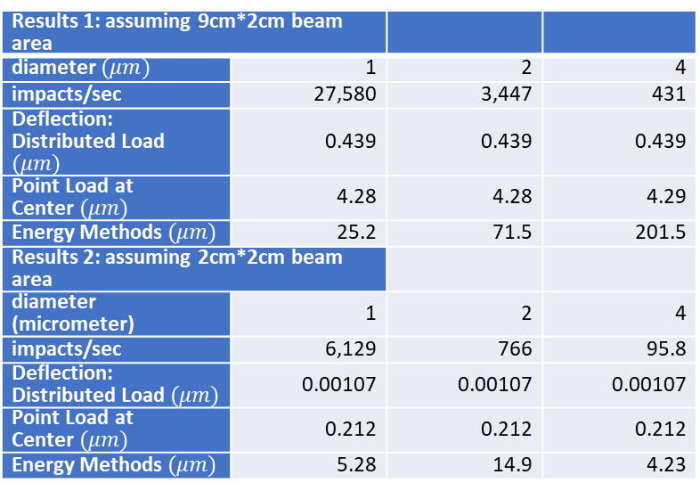
Beam Deflection Calculations
Results 1: assuming 9cm*2cm beam area
diameter $(μm)$ | 1 | 2 | 4
impacts/sec | 27,580 | 3,447 | 431
Deflection: Distributed Load $(μm)$ | 0.439 | 0.439 | 0.439
Point Load at Center$(μm)$ | 4.28 | 4.28 | 4.29
Energy Methods$(μm)$ | 25.2 | 71.5 | 201.5
Results 2: assuming 2cm*2cm beam area
diameter (micrometer) | 1 | 2 | 4
impacts/sec | 6,129 | 766 | 95.8
Deflection: Distributed Load$(μm)$ | 0.00107 | 0.00107 | 0.00107
Point Load at Center$(μm)$ | 0.212 | 0.212 | 0.212
Energy Methods$(μm)$ | 5.28 | 14.9 | 4.23
$$v_{max}$$

Slide 61
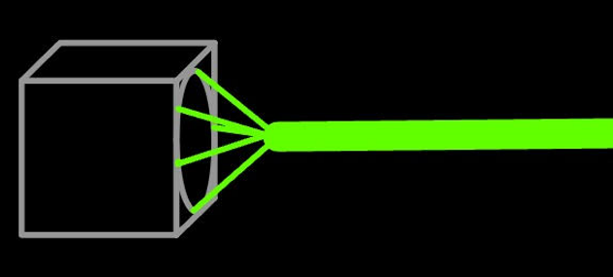

Light Reflection Method
Magnifies small changes in foil surface over a distance using laser light reflected off mirrored surface
Confident model of foil behavior needed to fully quantify results
Limited by size constraint
Sensor
$$v_{max}$$

Slide 62
Optical Sensing Method Backup Slides

Slide 63

Optical Sensor
Mie Scattering Approximation
$\frac{I}{I_{0}}=e^{−ε_{ext}z}$
$$ε_{ext}=N(\frac{πD^{2}}{4})(Q_{scat}+Q_{abs})$$
$$Q_{scat}=\frac{8}{3}x^{4}{\left|\frac{ε_{ice}−ε_{0}}{ε_{ice}+2ε_{0}}\right|}^{2}$$
$$Q_{abs}=4x Im\left[\frac{ε_{ice}−ε_{0}}{ε_{ice}+2ε_{0}}\right]$$
Where $x=\frac{2πr}{λ}$ & $D=2r$
$\frac{I}{I_{0}}$ is the ratio of non scattered light to light
$ε$ is the electromagnetic permittivity of a medium
$N$ is the number of particles & $z$ is the depth of the volume

Slide 64
Resources and References- optics
Oziel, Moshe; Korenstein, Rafi; Rubinsky, Boris (2017): The radar cross section (RCS), σ, as a function of the wavelength, λ.. PLOS ONE. Figure. https://doi.org/10.1371/journal.pone.0186381.g003
https://www.gfdl.noaa.gov/wp-content/uploads/files/user_files/pag/lecture2008/lecture3.pdf
https://eprints.lib.hokudai.ac.jp/dspace/bitstream/2115/32469/1/P185-212.pdf

Slide 65
Completed Trades Slides

Slide 66
Heat Rejection Method Trade

Slide 67
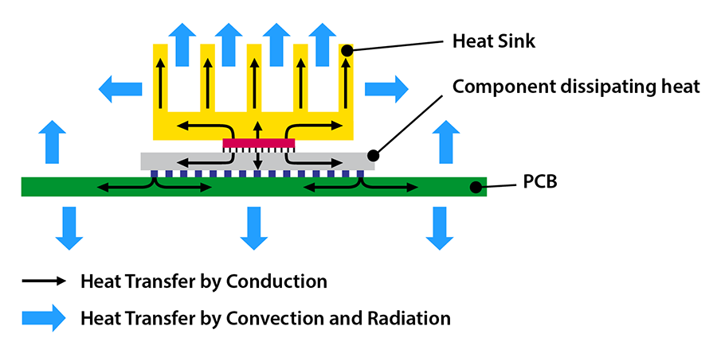
Thermal Analysis Trade
Finned Heat Sink
Radiative Cooling
Inefficient for vacuum applications (no fluid medium)
Larger volume usage
High emissivity and high thermal conductivity coating/cover
Conduction Radiation

Slide 68
Selection Criteria
Weight
0.25
0.25
0.3
0.2
Vacuum Compatible: How well will this method work in a vacuum?
Volume: How large is the thermal system?
Cost: How much of the budget will the system take up?
Ease of integration: Is this heat sink easy to integrate and use?

Slide 69
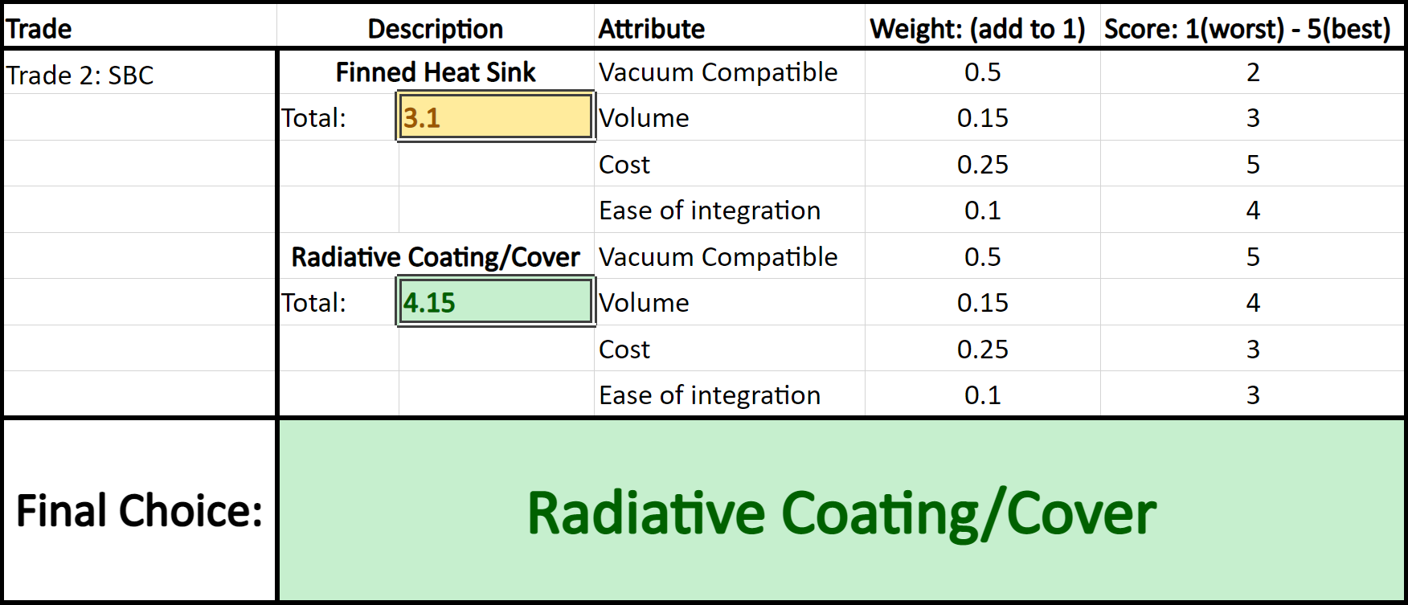
Thermal Trade Matrix

Slide 70
Computing Device (SBC) Trade

Slide 71
Arduino vs. Raspberry Pi
Arduino
Pros:
Low cost
Low power consumption (~200 mW)*
Open source
Cons:
Lower clock speeds
Less ram
Raspberry Pi
Pros:
Higher clock speeds
More RAM
Cons:
Closed source firmware
More expensive
Higher power consumption (~700 mW)*
* SBC will NOT be in vacuum chamber, so power consumption is ~negligible

Slide 72
Selection Criteria
Weight
0.25
0.25
0.3
0.2
Clock Speed: How well will the computer perform?
RAM: How large is the RAM on the computer?
Cost: How much of the budget will the computer take up?
Ease of use: Is this computer easy to program and use?

Slide 73
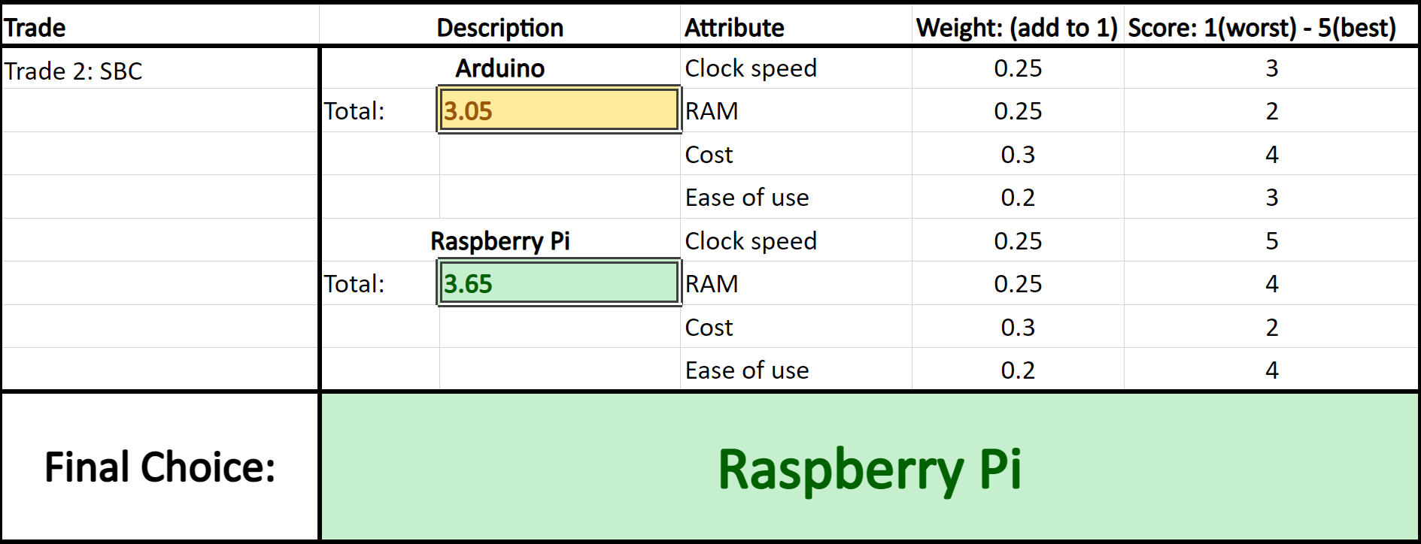
SBC Trade Matrix

