Slide 1
MARCo PoLo
Mobile Astronautic Ranging and Control for Positioning and Location
Preliminary Design Review
Presenters:
Kintan Surghani, Brian Byrne,
Justin Pedersen, Austin Coleman,
Matt Davis, Ray Stine, Kevin Cook
Company Sponsor:
Lockheed Martin -
Taylor Maurer and
Josh Nelson
Full Group:
Jackson DePenning,
Nadia Abuharus, Ben Arnold,
Tyler Sterrett, Tyler Candler
Faculty Advisor:
Alexandra Le Moine
Notes:
Good, but individual intros are not necessary (can do if we have time)

Slide 2
Presentation Agenda
1.0 Project Description
2.0 Trades
3.0 Current Design Space
4.0 Modeling / Prototyping
5.0 Questions
Notes:
KIN

Slide 3
Acronyms/Terminology
Term | Definition
MARCo PoLo | Mobile Astronautic Ranging and Control for Positioning and Location
SOSC | Space Operation Simulation Center
Sensor Suite | Small housing that contains the sensor(s) and any other electrical components
Marco | The “mock cube satellite” that will house the sensor suite, processor, and mount to the larger robot at the SOSC. This will be moving at a rate of ~1 cm/s.
Polo | A “mock satellite” that houses nothing and will be mounted to the smaller robot at the SOSC. This object is what will be “sensed” by our sensor suite. This will not be mobile.
Notes:
KIN
Good

Slide 4
Project Description
Project Description

Slide 5
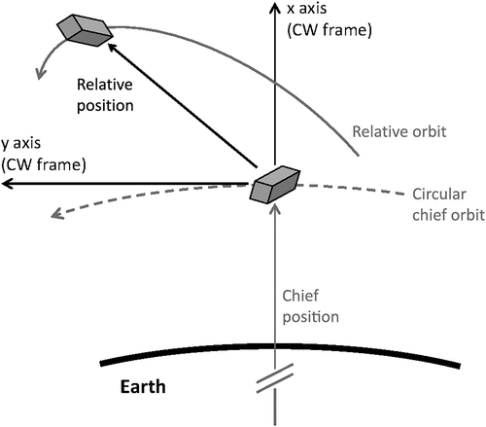
Motivation: CubeSats are the Future!
Primary Goal:
Efficiently extend the design life of on-orbit spacecraft as well as enable additional capabilities via on-orbit upgrades
Solution:
Low-cost CubeSats equipped to perform satellite servicing
Will dock with the malfunctioning satellite and perform the needed maintenance or upgrades
Requires sensor suite capable of measuring relative position
1.0 Project Description
2.0 Trades
3.0 Current Design Space
4.0 Modeling / Prototyping
5.0 Questions
Notes:
KEVIN
Good graphic
Why are we here, what are we doing

Slide 6
Mission Objectives
O | Mission Objectives
O.1 | Prototype sensor suite to gather data of surrounding objects to determine relative position/orientation
O.2 | Develop algorithm to refine sensor data into relative position measurements (6 DOF)
O.3 | Develop processor to run algorithm
O.4 | Maximize in-situ performance
1.0 Project Description
2.0 Trades
3.0 Current Design Space
4.0 Modeling / Prototyping
5.0 Questions
Notes:
KIN
Order change: MO, CONOPs, FBD, CPEs

Slide 7
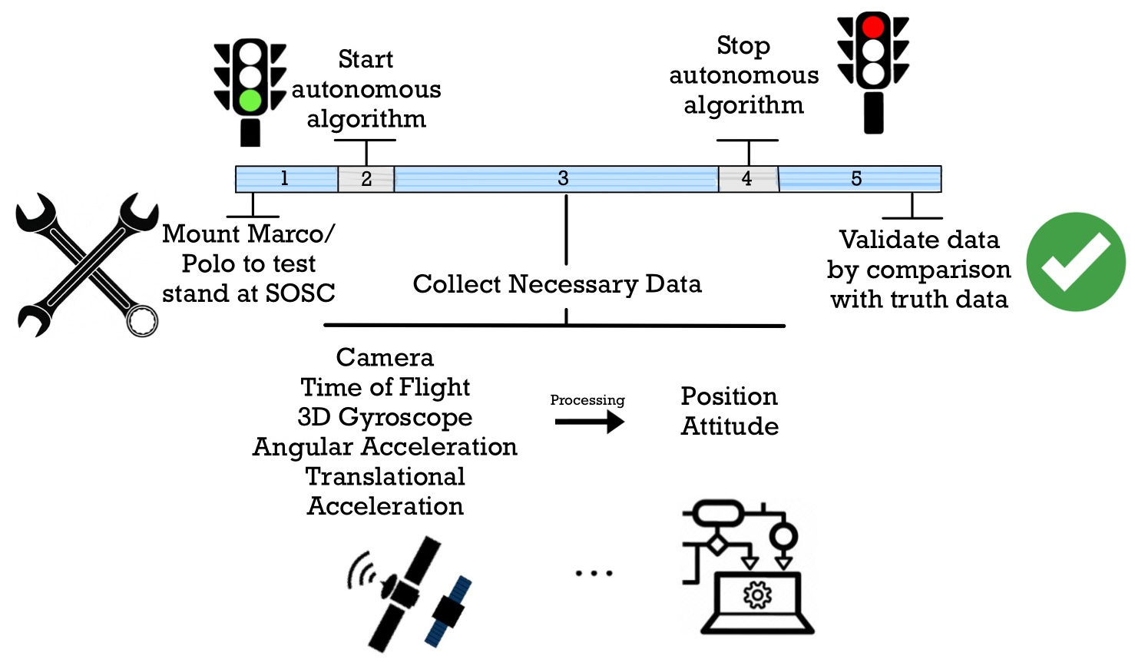
Concept of Operations (CONOPs)
1.0 Project Description
2.0 Trades
3.0 Current Design Space
4.0 Modeling / Prototyping
5.0 Questions
Notes:
KIN
Bigger text needed

Slide 8
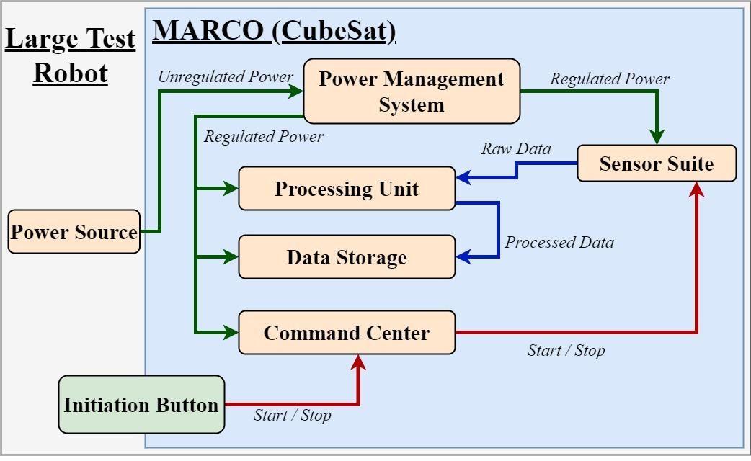
Functional Block Diagram (FBD)
1.0 Project Description
2.0 Trades
3.0 Current Design Space
4.0 Modeling / Prototyping
5.0 Questions
Notes:
BRIAN

Slide 9
CPEs
SC | Mission Success Criteria
SC.1 | Shall be capable of measuring objects up to 30 meters away
SC.2 | Shall be capable of measuring arbitrary and unknown objects
SC.3 | Shall transform raw translational data to target relative measurements
SC.4 | Shall transform raw rotational data to target relative measurements
SC.5 | Shall be capable of sampling/storing at least 3 hours worth of data
SC.6 | Shall record relative position measurements at a minimum rate of 1 Hz
SC.7 | Shall be autonomous with the exception of start and stop
SC.8 | Shall be compatible with SOSC testing facilities
SC.9 | Shall be functionally validated prior to SOSC test day
CPE | Critical Project Element
CPE.1 | Sensors
CPE.2 | Algorithm
CPE.3 | Processor
CPE.4 | SOSC Testing / Prototype
1.0 Project Description
2.0 Trades
3.0 Current Design Space
4.0 Modeling / Prototyping
5.0 Questions
Notes:
KIN
CPEs come after FBD and Conops
Highlight most limiting reqs in design, explain how those feed into SCs

Slide 10
Key Risk Analysis
R | Risk Description | Mitigation Plan | CPE
R.1 | Unable to capture target object within desired range | Preliminary tests | CPE.1 (Sensors)
R.2 | Algorithm crashes or data corruption occurs | Test using sample data for complete SOSC test duration | Backup Algorithm | CPE.2 (Algorithm)
R.3 | Central processing system is overloaded | Preliminary test to check proper processing power and data storage | CPE.3 (Processor)
R.4 | Mounting system malfunctions (does not mount properly to test stand or demounts during testing) | Confirm system is to exact LM specs and test system before SOSC full system test day | CPE.4 (SOSC Testing)
R.5 | Parts delayed | Order parts before spring semester
CPE.1
CPE.3
1.0 Project Description
2.0 Trades
3.0 Current Design Space
4.0 Modeling / Prototyping
5.0 Questions
Notes:
JUSTIN
Good, check font on CPE.1

Slide 11
Key Risk Matrix
R | Risk Description
R.1 | Unable to capture target object within desired range
R.2 | Algorithm crashes or data corruption occurs
R.3 | Central processing system is overloaded
R.4 | Mounting system malfunctions (does not mount properly to test stand or demounts during testing)
R.5 | Parts delayed
 | 5
 | 4 |  |  |  | R.3
 | 3 |  | R.5 | R.1
 | 2 |  |  |  |  | R.2, R.4
 | 1
 |  | 1 | 2 | 3 | 4 | 5
 | CONSEQUENCES
LIKELIHOOD
R.5
R.1
R.3
R.2, R.4
1.0 Project Description
2.0 Trades
3.0 Current Design Space
4.0 Modeling / Prototyping
5.0 Questions
Notes:
JUSTIN
Explain why R.4 moves from 5–>2?
Likely bringing down likelihood, not consequence with our mitigation

Slide 12
Trades Table
T | Trades | Independent | Dependency
T.1 | Sensor | Yes
T.2 | Processor | No | T.1/T.3
T.3 | Algorithm | No | T.1/T.2
T.4 | Material | Yes
T.5 | Circuit Manufacturing | No | T.1/T.2
T.6 | Power Regulation | No | T.1/T.2
T.7 | Accessibility | Yes
T.8 | Design Software* | Yes
T.9 | Analysis Software* | Yes
1.0 Project Description
2.0 Trades
3.0 Current Design Space
4.0 Modeling / Prototyping
5.0 Questions
Notes:
RAY
Make table bigger and make sure to discuss dependencies
* Refers to trades that are smaller and more of a conversation

Slide 13
Project Description
Trade Studies

Slide 14
#1 Trade Study: Sensor(s)
Metric | Description | Weight | Scores
 |  |  | 3 | 2 | 1
Computational Expense | Computational expense of associated algorithms: Goal: Minimize load on CPU with raw data | 0.3 | Real time processing (≥1 Hz) | Slow real time processing (<1 Hz) | Post processing only
Cost | Cost of sensor(s): Goal: Minimize cost in a way that still maximizes all other metrics | 0.15 | Less than $1000 | $1000-$2000 | More than $2000
Range | Sensor measurement range - Goal: Maximize usable range of measurements at a minimum of 30m | 0.2 | More than 50 m | 30-50 m | Less than 30 m
Accuracy | Sensor measurement accuracy (resolution): Goal: Ensure accuracy of ± 1m and ±15 degrees | 0.25 | Meets accuracy requirement over 30 m | Meets accuracy requirement in range 20-30 m | Meets accuracy requirement under 20 m
Risk | Risk level of sensor: Goal: Minimize risk by prioritizing sensors with easy integration and history of reliability | 0.1 | Low risk: Simple system with a heritage of performance/reliability | Medium: More complex, harder to integrate and less heritage of reliability | High: Highly complex, very difficult to integrate and little to no heritage of reliability
1.0 Project Description
2.0 Trades
3.0 Current Design Space
4.0 Modeling / Prototyping
5.0 Questions
Notes:
AUSTIN
I made a copy and tidied it up/matched the formatting of the processor trade slide.
Thoughts?
I think this looks really nice - thanks to whoever did this (Kintan?)

Slide 15
#1 Trade Study: Sensor(s)
Metric | Weight | LiDAR | Radar | Camera
Computational Expense | 0.3 | 2 | 3 | 2
Cost | 0.15 | 2 | 2 | 2
Range | 0.2 | 2 | 2 | 1
Accuracy | 0.25 | 3 | 1 | 2
Risk | 0.1 | 2 | 3 | 2
Score | 1 | 2.25 | 2.15 | 1.8
1.0 Project Description
2.0 Trades
3.0 Current Design Space
4.0 Modeling / Prototyping
5.0 Questions
Notes:
AUSTIN
Good job Austin!

Slide 16
#2 Trade Study: Processor
Metric | Description | Weight | Scores
 |  |  | 3 | 2 | 1
Processing Speed | CPU computational speed Goal: To run algorithm fast enough to meet the 1Hz output requirement | 0.45 | >4 GHz | 2.5-4 GHz | <2.5 GHz
Internal Storage | Type of storage associated with board Goal: Compatibility with a custom M.2 SSD that we'd have to buy seperately | 0.35 | M.2/SATA compatible | fixed >500 Gb/SD card or USB | fixed and <500Gb
Size | Physical area of the board Goal: Minimize this within options that meet the first first two requirements | 0.1 | <50 cm^2 | 50-100 cm^2 | 100-150 cm^2
Cost | Cost in US dollars Goal: Minimize within options that meet the first two metrics | 0.1 | <$300 | $300-$750 | >$750
1.0 Project Description
2.0 Trades
3.0 Current Design Space
4.0 Modeling / Prototyping
5.0 Questions
Notes:
MATT
Verbalize requirements, constraints and interfaces! On all trades
Dependent on algorithm. Size and cost are less significant because everything we looked at in the trade space of single board computers is within an acceptable range of both size and cost for our budgets. While a device with very high processing and storage scores will be valued the highest by this weighting system, we aim to determine a minimum value for both of those metrics such that we can minimize both size and cost within the options that will satisfy our needs.
Size: hopefully this allows us to meet size requirements but not as important as we've gotten permission to expand processor size.
M.2 is SSD small high performance flash storage useful for smaller applications (Backup slides?)
SATA is common protocol

Slide 17
#2 Trade Study: Processor
Metric | Weight | Intel NUC 11 Pro Board* (4-core) | Latte Panda 3 Delta | Raspberry Pi 4 | Odyssey Blue J4125 | Intel NUC 11 Pro Board** (2-core) | UDOO Bolt Gear | UDOO Board *** | Odroid M1
Processing Speed | 0.45 | 3 | 2 | 1 | 2 | 3 | 2 | 1 | 1
Internal Storage | 0.35 | 3 | 3 | 2 | 3 | 3 | 3 | 3 | 3
Size | 0.1 | 1 | 2 | 3 | 1 | 1 | 1 | 1 | 1
Cost | 0.1 | 1 | 3 | 3 | 3 | 2 | 2 | 3 | 3
Score | 1 | 2.6 | 2.45 | 1.75 | 2.35 | 2.7 | 2.25 | 1.9 | 1.9
*Model NUC11TNBv7
** Model NUC11TNBi3
*** Model SB02-3740-0000-C1-V
1.0 Project Description
2.0 Trades
3.0 Current Design Space
4.0 Modeling / Prototyping
5.0 Questions
Notes:
MATT
Explain how Pro Board ** does have a higher score, but the trade off is that it only has two cores. The Pro Board * has a similar, but smaller score, but the benefit is that it has 4 cores
Will algorithm work on processor? This is the essential question to answer before finalizing our decision
Top scored processor here should be good for our needs especially if our selected algorithm runs in series rather than parallel, unless we decide we need to parallelize our algorithm to optimize its runtime.

Slide 18
Project Description
Current Baseline Design

Slide 19
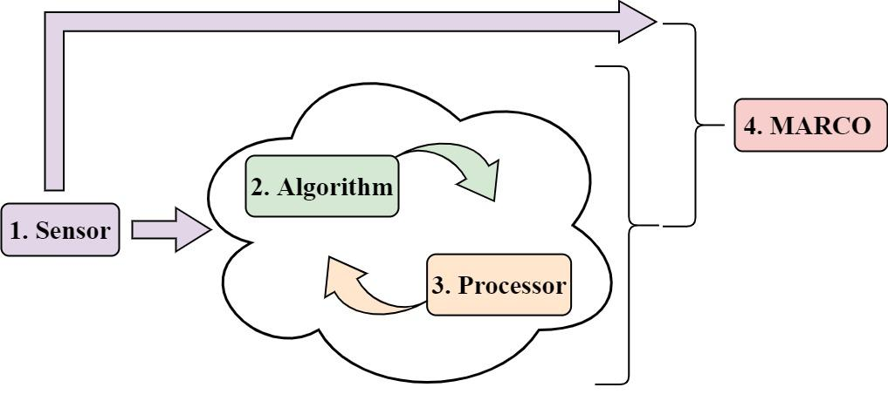
Design Space
1.0 Project Description
2.0 Trades
3.0 Current Design Space
4.0 Modeling / Prototyping
5.0 Questions
Notes:
BRAIN

Slide 20
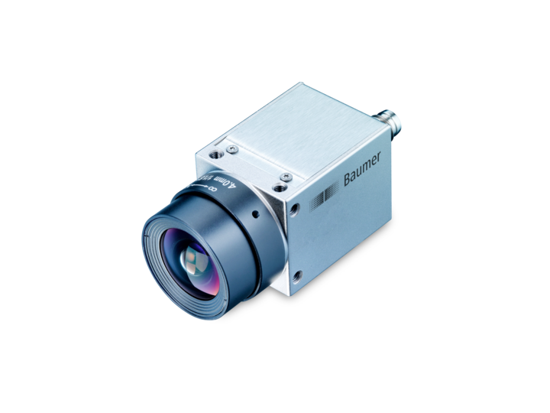
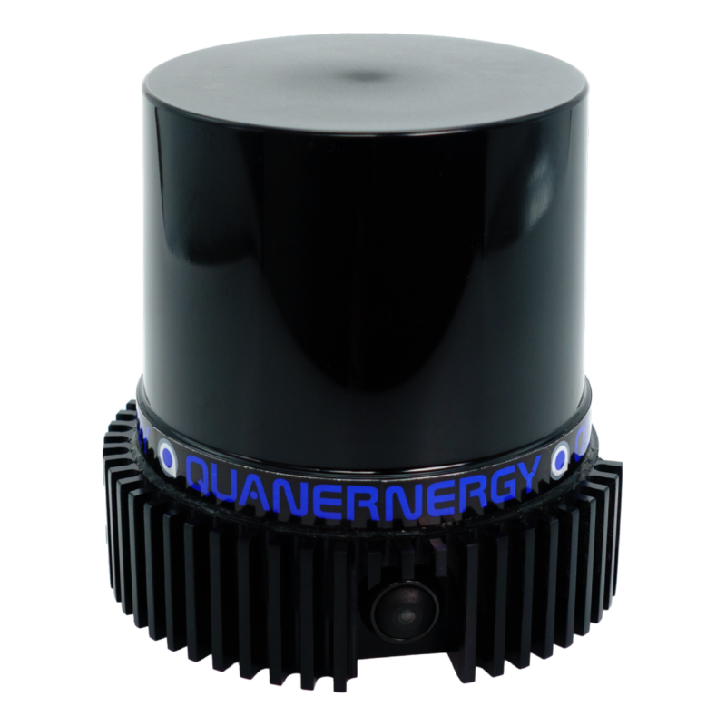
Future Trades
Sensor Suite:
Is LiDAR our best option?
How can we quantitatively determine the accuracy of a camera system?
How many sensors will we need?
vs
LiDAR
Camera System
1.0 Project Description
2.0 Trades
3.0 Current Design Space
4.0 Modeling / Prototyping
5.0 Questions
Notes:
BRIAN
Text too small, may not need FBD here. Talk to Le Moine
Add in figures to illustrate - reduce text and add photos
Don’t be repetitive

Slide 21
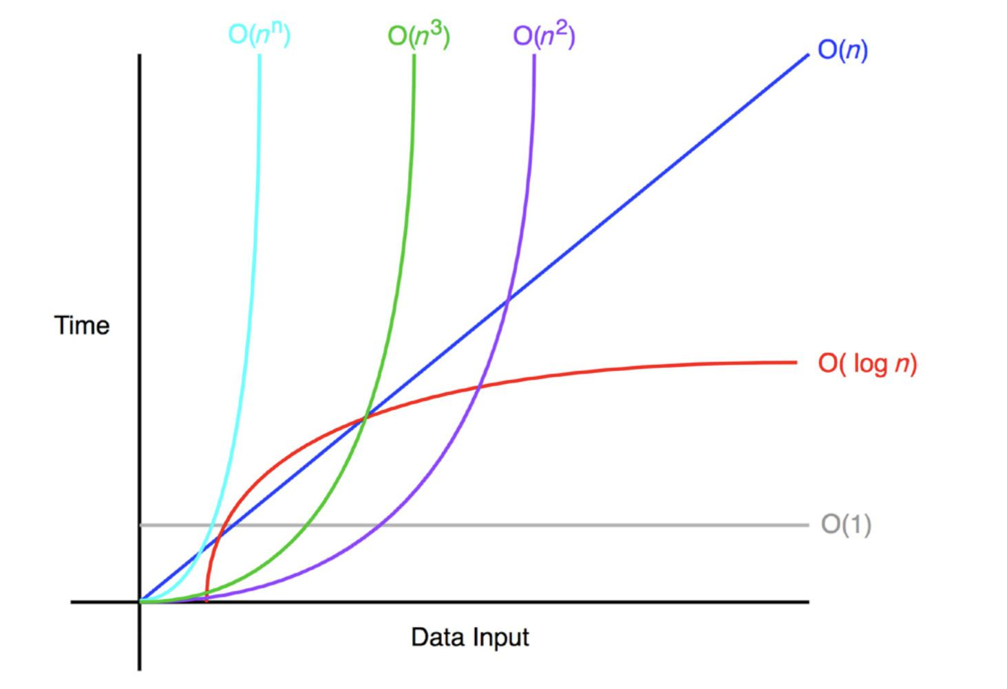
Future Trades
Algorithm:
What is the Big(O) notation?
How realistic is it to implement?
How to develop a semi-autonomous software system?
Processor:
What is the minimum required processing power needed?
Can it act as our command center?
How much storage do we need?
1.0 Project Description
2.0 Trades
3.0 Current Design Space
4.0 Modeling / Prototyping
5.0 Questions
Notes:
BRIAN
Text too small, may not need FBD here. Talk to Le Moine
Add in figures to illustrate - reduce text and add photos
Don’t be repetitive

Slide 22
Project Description
Modeling and Prototyping

Slide 23
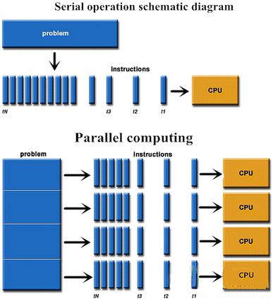
Moving Forward: Software
Pick sensor type
Hardware Trade -> Exact Model
Start Software Trades
Determine Raw Data type sensor outputs
Find Compatible Algorithms
Determine Accessibility
Parallel vs Series
Determine Optimal Amount of Cores
1.0 Project Description
2.0 Trades
3.0 Current Design Space
4.0 Modeling / Prototyping
5.0 Questions
Notes:
RAY
Good text to figure balance
Should we transition this into more of a graphic?
ASSUME SENSOR HAS BEEN SELECTED

Slide 24
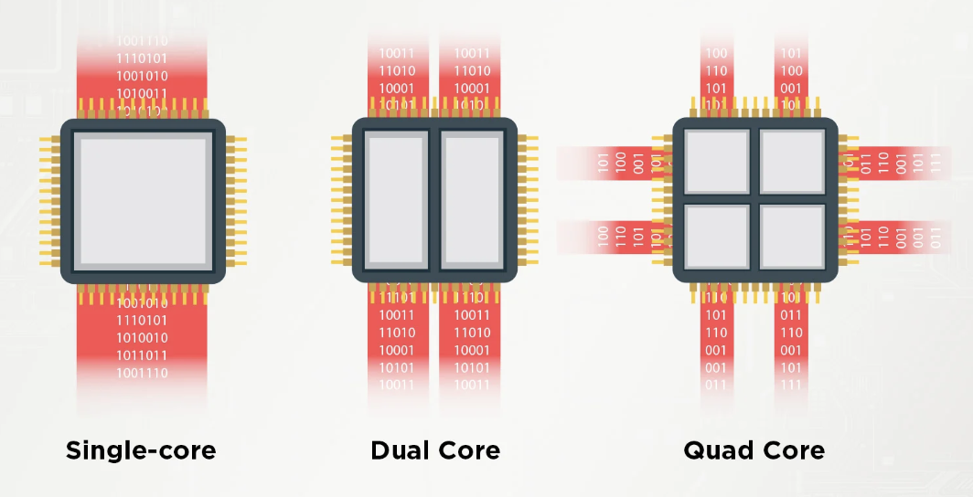
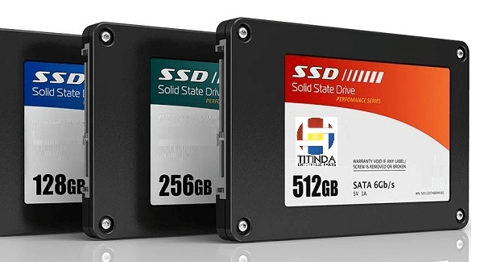
Moving Forward: Electrical
Pick processor
Hardware Trade -> Exact Model
Algorithm complexity
Storage Requirements
Design circuit
Hardware trade for power regulation
Hardware trade for circuit manufacturing
Custom circuit design?
Determine test initiation method
1.0 Project Description
2.0 Trades
3.0 Current Design Space
4.0 Modeling / Prototyping
5.0 Questions
Notes:
JUSTIN
Too much text, make similar to slide 22 (moving forward sw)
Include pictures of intel nuc, rPi, etc.
Should we transition this into more of a graphic?
ASSUME SENSOR + ALGORITHM HAS BEEN SELECTED

Slide 25
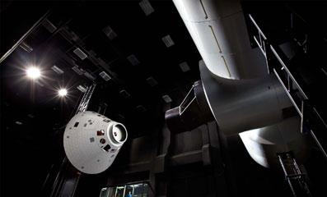
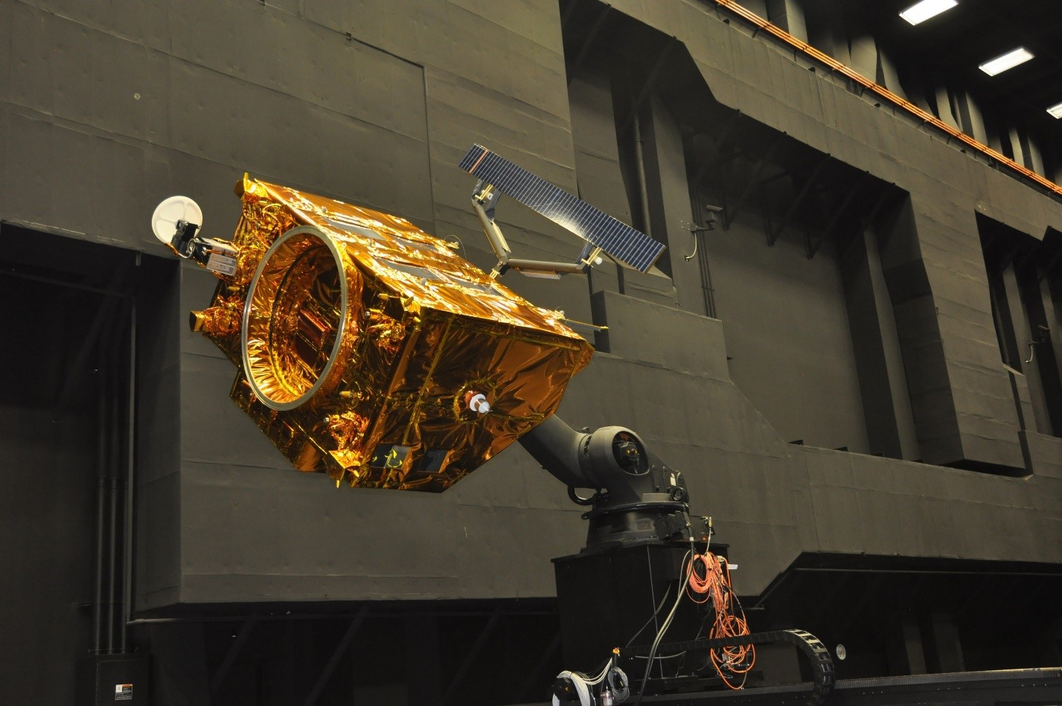
Moving Forward: Mechanical
Determine enclosure material
Hardware Trade -> Exact Model
Determine component layout in enclosure
Accessibility Trade
Hinged lid vs. bolt-on lid
Determine mounting pattern for SOSC
Bolt-on vs flanged base
Develop test subject that accurately represents possible targets
1.0 Project Description
2.0 Trades
3.0 Current Design Space
4.0 Modeling / Prototyping
5.0 Questions
Notes:
KEVIN
Again, too much text, make similar to sw moving forward
Should we transition this into more of a graphic?
ASSUME SENSOR + ALGORITHM + PROCESSOR HAS BEEN SELECTED
#4 We know it has to fit onto an optical breadboard with ¼” holes and a 1”x1” grid
Determine enclosure material
Hardware Trade -> Exact Model
Using mass, strength, cost, and manufacturability metrics to determine best course of action
Continue trades on accessibility
Hinged lid vs. bolt-on lid
Stress-testing prototypes
Ergonomic positioning
Determine component layout in enclosure
Most efficient vs volume constraints
Determine mounting pattern for SOSC
Bolt-on vs flanged base
Develop a comprehensive test subject that accurately represents possible targets
Size, shape, material, and coating
Checkerboard pattern vs. no pattern

Slide 26
Project Description
Questions

Slide 27
Backup Slides
Notes:
HYPERLINKED TABLE OF CONTENTS

Slide 28
Table of Contents
Acknowledgements/References
Administrative
Software
Electrical
Mechanical

Slide 29
Acknowledgements/
References

Slide 30
Acknowledgements
Taylor Mauer (LM)
Josh Nelson (LM)
Jeffrey Thayer
Alexandra Le Moine
Bobby Hodgkinson
Trudy Schwartz
Kathryn Wingate
Scott Palo
Jasmin Chadha
Andreas Brecl
Chris Muldrow
Matt Rhodes
Samia Juras

Slide 31
References
Jung, S., Park, S.-Y., Park, H.-E., Park, C.-D., Kim, S.-W., and Jang, Y.-S., “Real-time determination of relative position between satellites using Laser Ranging,” Journal of Astronomy and Space Sciences, vol. 29, 2012, pp. 351–362.
Langer, D., “An Integrated MMW Radar System for Outdoor Navigation,” Proceedings of IEEE International Conference on Robotics and Automation, Jan. 1997.
Opromolla, R., and Nocerino, A., “Uncooperative spacecraft relative navigation with lidar-based unscented Kalman filter,” IEEE Access, vol. 7, 2019, pp. 180012–180026.
Roos, F., Kellner, D., Klappstein, J., Dickmann, J., Dietmayer, K., Muller-Glaser, K. D., and Waldschmidt, C., “Estimation of the orientation of vehicles in high-resolution radar images,” 2015 IEEE MTT-S International Conference on Microwaves for Intelligent Mobility (ICMIM), 2015.
Sherer, T. P., Martin, S. M., and Bevly, D. M., “Keynote: Radar Probabilistic Data Association filter with GPS aiding for target selection and relative position determination,” ION Pacific PNT, 2017.
Zhang, Y., Han, Y., Yu, R., Yang, Z., Wang, Z., and Zhang, J., “Pose measurement and motion estimation of space on-orbit CubeSats based on micro-doppler effect using laser coherent radar,” Applied Sciences, vol. 12, 2022, p. 4021.

Slide 32
References
Wa̧sik Alicja, Ventura, R., Pereira, J. N., Lima, P. U., and Martinoli, A., “Lidar-based relative position estimation and tracking for Multi-robot systems,” Advances in Intelligent Systems and Computing, 2015, pp. 3–16.
Lotti, A., Modenini, D., Tortora, P., Saponara, M., and Perino, M. A., “Deep Learning for Real Time Satellite Pose Estimation on Low Power Edge TPU,” arXiv.
Kisantal, M., Sharma, S., Park, T. H., Izzo, D., Martens, M., and D'Amico, S., “Satellite Pose Estimation Challenge: Dataset, Competition Design, and results,” IEEE Transactions on Aerospace and Electronic Systems, vol. 56, 2020, pp. 4083–4098.
Montella, C., “The Kalman filter and related algorithms: A literature review” Available: https://www.researchgate.net/publication/236897001_The_Kalman_Filter_and_Related_Algorithms_A_Literature_Review.
“Satellite Solutions,” Lockheed Martin Available: https://www.lockheedmartin.com/en-us/products/satellite.html.

Slide 33
References
Zhao, G., 2018. LiDAR-Based Non-Cooperative Tumbling Spacecraft Pose Tracking by Fusing Depth Maps and Point Clouds. MDPI, [online] Available: https://o365coloradoedu.sharepoint.com/:b:/r/sites/AEROENGR-MARCoPoLo/Shared%20Documents/Software/LiDAR%20Research%20Papers%20%26%20Resources/Zhao%20et%20al.%20Pose%20using%20LiDAR%20Point%20Clouds.pdf?csf=1&web=1&e=vvaAPG
Galante, J. et. al, n. d. Pose Measurement Performance of the Argon Relative Navigation Sensor Suite in Simulated Flight Conditions. [online] Available at: https://scholar.google.com/scholar_url?url=https://ntrs.nasa.gov/api/citations/20120013578/downloads/20120013578.pdf&hl=en&sa=X&ei=RU0vY-ODGe2KywTYs7iICQ&scisig=AAGBfm01u0YB6vqBNuYvUHORj9_wGF5TiA&oi=scholarr.
Petrick, D. et. al, n.d. Adapting the Reconfigurable SpaceCube Processing System for Multiple Mission Applications. [online] Zenodo.org. Available at: https://zenodo.org/record/1263941/files/article.pdf

Slide 34
Administrative

Slide 35
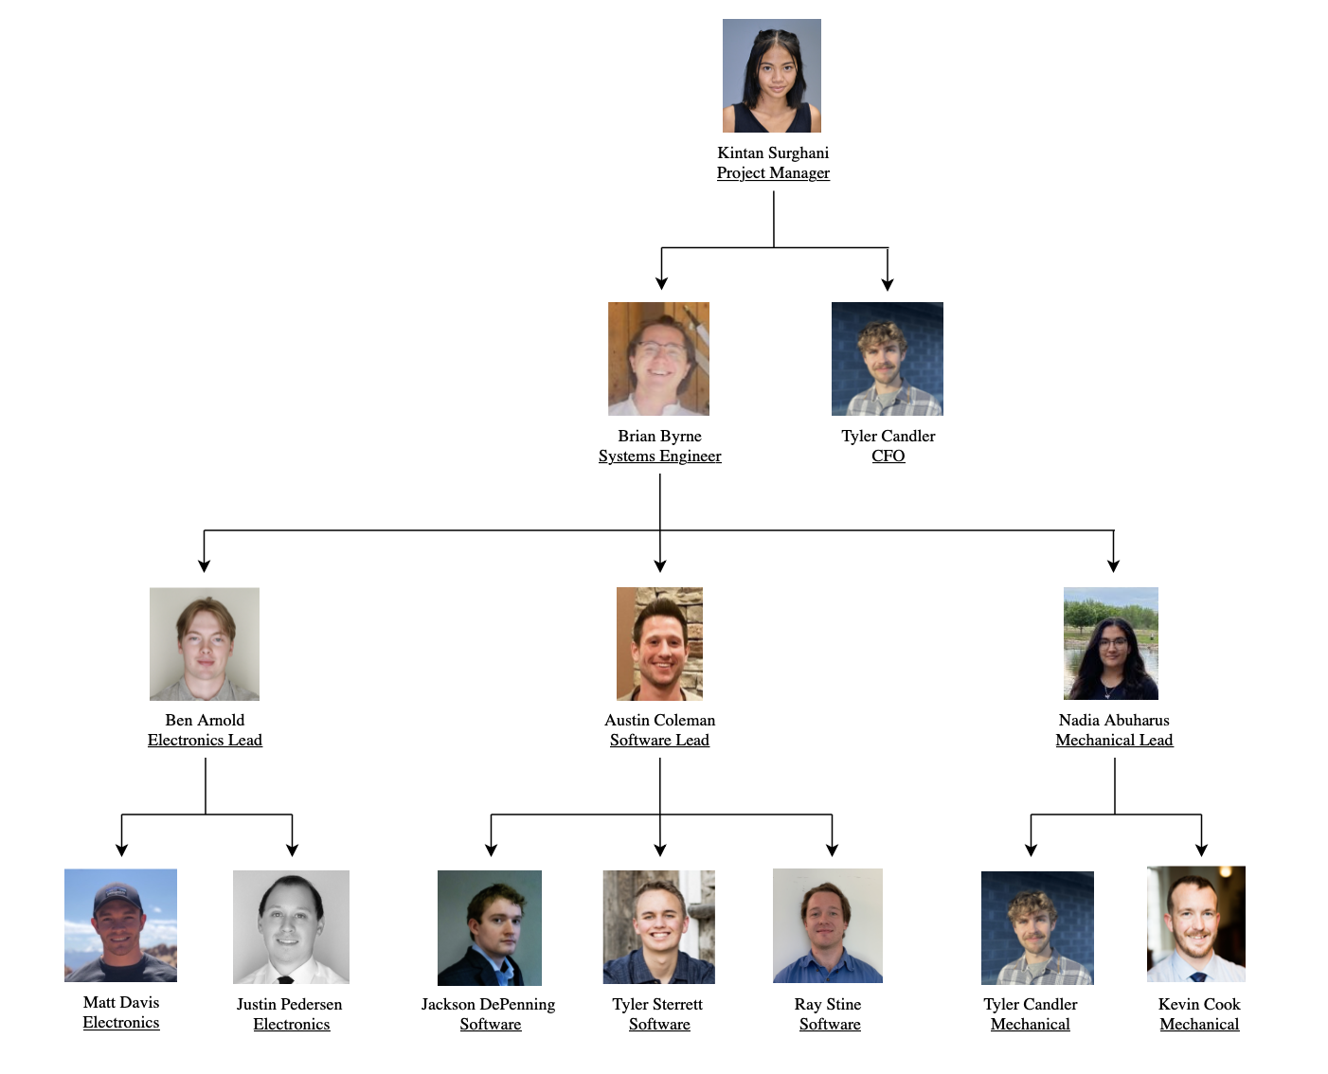
Organization Chart

Slide 36
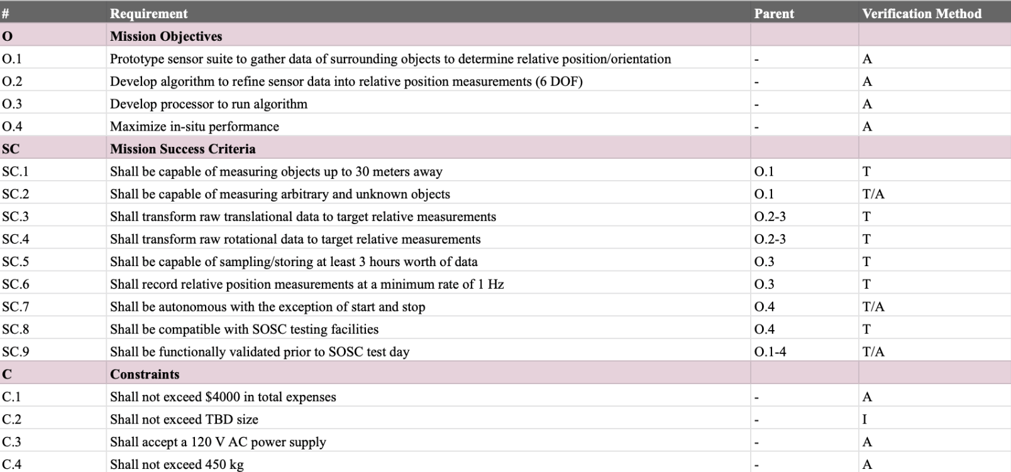
Requirements (LVL 0)

Slide 37
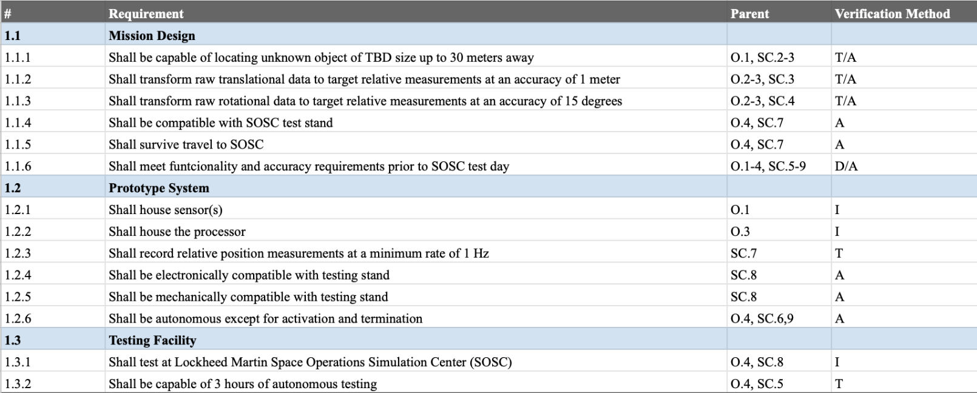
Requirements (LVL 1)

Slide 38
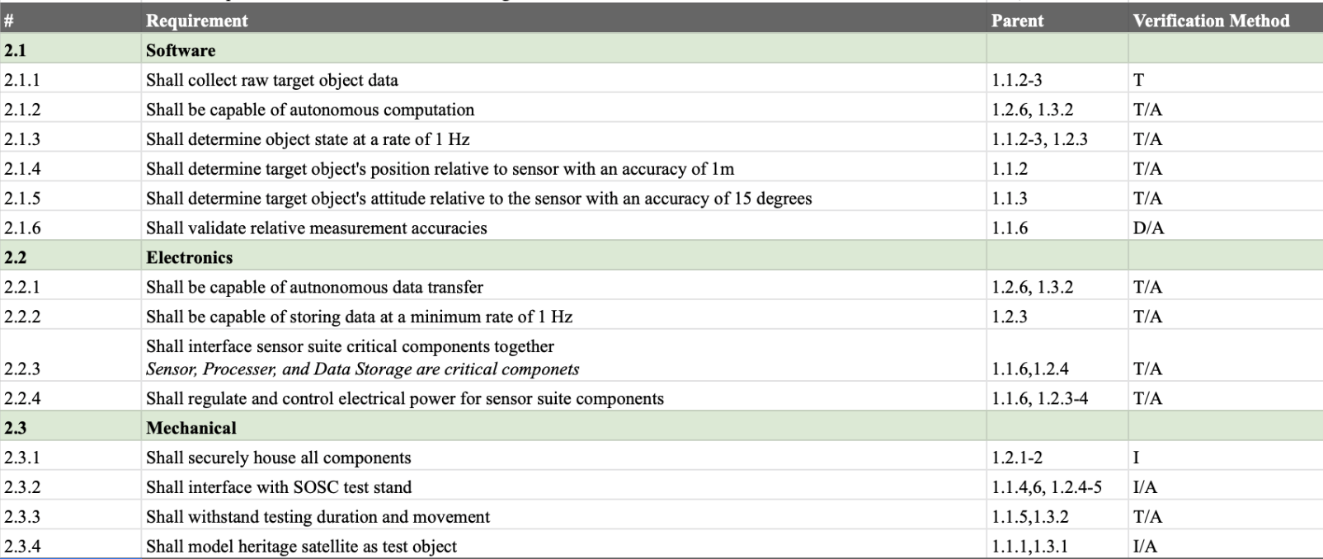
Requirements (LVL 2)

Slide 39
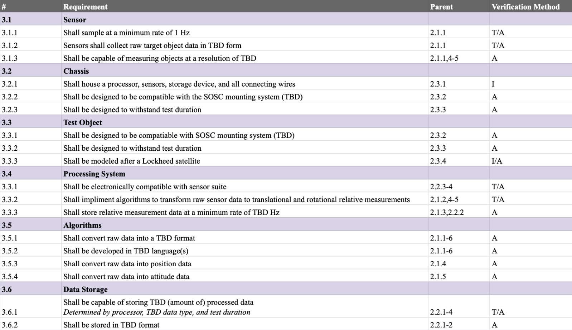
Requirements (LVL 3)

Slide 40
Software

Slide 41
#1 Trade Study: Sensor(s)
Metric | Description | Weight | Scores
 |  |  | 3 | 2 | 1
Computational Expense | Computational expense of associated algorithms - In order to meet SC.6, raw sensor data must be converted into meaningful relative position and attitude (pose) measurements at a minimum rate of 1 Hz | 0.3 | Real time processing (>=1 Hz) | Slow real time processing (<1 Hz) | Post processing only
Cost | Cost of sensor(s) - The project has a maximum budget of $4000. While the sensor suite is an important component of the system design, its cost is a key consideration in selecting a sensor type. | 0.15 | Less than $1000 | $1000-$2000 | More than $2000
Range | Sensor measurement range - In order to meet SC.1, the sensor suite must be capable of providing sufficiently accurate data up to 30 m away. | 0.2 | More than 50 m | 30-50 m | Less than 30 m
Accuracy | Sensor measurement accuracy (resolution) - In order to meet 1.1.2 and 1.1.3, sufficient sensor resolution data is required to ensure position measurements will be accurate to within 1 m, and attitude measurements will be accurate to within 15 degrees. | 0.25 | Meets accuracy requirement over 30 m | Meets accuracy requirement in range 20-30 m | Meets accuracy requirement under 20 m
Risk | Risk level of sensor - The sensor suite will be required to obtain relative location information of the test object in the SOSC testing facility. This information is vital to the project objectives, so any risks associated with specific sensor types must be accounted for. | 0.1 | Low risk - a relatively simple system overall that has heritage demonstrating reliability of performance in similar applications. | Medium - a system either more complex and difficult to integrate into overall system, or a system that has limited heritage that proves performance in similar applications. | High - a system of high complexity that is unrealistic to successfully implement into overall system, or has no heritage proving it can be utilized in applications comparable to the mission.
1.0 Project Description
2.0 Trades
3.0 Current Design Space
4.0 Modeling / Prototyping
5.0 Questions
Notes:
AUSTIN
Less text, too much info and hard to read
Could think about splitting this table up
Are these too lengthy and detailed? Should we split it up? I can make the risk one shorter. Is that mainly what you were thinking?
Yeah I can make it shorter. Do you want me to leave the others as is?
IDK I just thought that maybe its just text heavy and doesn’t look presentable…but thats something we can ask Jasmin
Yeah I can make it shorter. Do you want me to leave the others as is?
Just leave them where they are at for now. We’ll ask Jasmin tmrw morning. Actually, yes maybe condense risks and leave the others

Slide 42
#3 Trade Study: Algorithm
Metric | Description | Weight | Scores
 |  |  | 3 | 2 | 1
Computational Expense | Computational expense of algorithm -In order to meet SC.7, raw sensor data must be converted into meaningful relative position and attitude (pose) measurements at a minimum rate of 1 Hz. | 0.3 | Algorithm is able to output pose measurements at a rate greater than 2 Hz, giving 2x margin on FR.2 and FR.3 time rates | Algorithm is able to output pose measurements at a rate greater than 1 Hz, giving 1x margin on FR.2 and FR.3 time rates | Algorithm is unable to output pose measurements at a rate equal to 1 Hz, fails FR.2 and FR.3
Complexity/Time Consumption | Estimated workload of implementing algorithms within project timeline, including verification and validation | 0.3 | Algorithm of moderate complexity structurally and mathematically that it can be implemented within the given timeframe with little instruction | Algorithm of high enough complexity that moderate amount of instruction from technical experts/faculty advisor likely to be able to implement within the given timeframe. | Algorithm either too complex in general to implement or would require unsatisfactory level of guidance and instruction.
Data Dependence | Dependence on quality, cadence and throughput of input sensor data, increase in required data input drives higher algorithm complexity and computational expense | 0.1 | Algorithm that is capable of producing results to the level of accuracy desired by the mission with low quality data. | Algorithm that can realistically achieve results outlined by mission requirements but imposes some constraints on sensor quality. | Algorithm that will require data to level of fidelity that the mission won't be able to provide due to financial constraints on sensor choice.
Pose Resolvability | Demonstrated ability of algorithms to resolve pose of objects in prior use cases | 0.3 | Algorithm is able to resolve objects to less than 0.5 m of accuracy and 8 degrees of rotational accuracy, 2x pose margin on FR.2 and FR.3 | Algorithm is able to resolve objects to less than 1 m of accuracy and 15 degrees of rotational accuracy, 1x pose margin on FR.2 and FR.3 | Algorithm is able to resolve objects to greater than 1 m of accuracy and 15 degrees of rotational accuracy, fails FR.2 and FR.3
1.0 Project Description
2.0 Trades
3.0 Current Design Space
4.0 Modeling / Prototyping
5.0 Summary
Notes:
DON’T PRESENT
availability metric answered by complexity/ time consumption (clarification needed?)
OPEN SOURCE ?
Stick with serial code ! (metric for processor?)
Stray away from any parallelization

Slide 43
#3 Trade Study: Algorithm
Metric | Weight | Kalman Filter | Iterative Closest Point | Pose Estimation | VSLAM
Computational Expense | 0.3 | 1 | 1 | 2 | 2
Complexity/Time Consumption | 0.3 | 2 | 2 | 3 | 2
Data Dependence | 0.1 | 2 | 3 | 2 | 3
Pose Resolvability | 0.3 | 3 | 3 | 3 | 3
Score | 1 | 2 | 2.1 | 2.6 | 2.4
1.0 Project Description
2.0 Trades
3.0 Current Design Space
4.0 Modeling / Prototyping
5.0 Summary
Notes:
DON’T PRESENT
availability metric

Slide 44
#3 Trade Study: Validation System
Metric | Description | Weight | Scores
 |  |  | 3 | 2 | 1
Translational Movement Measurement Accuracy | Ability to determine movement of target object in the X Y Z positional axis within acceptable accuracy parameters. | 0.35 | Reliably provides measurements at an accuracy less than 1 meter | Reliably provides measurements at an accuracy approximately 1 meter | Reliably provides measurements at an accuracy greater than 1 meter
Rotational Movement Measurement Accuracy | Ability to determine movement of target object in the Φ θ Ψ rotational axis within acceptable accuracy parameters | 0.35 | Reliably provides measurements at accuracy of less than 15 degrees | Reliably provides measurements at accuracy of approximately 15 degrees | Reliably provides measurements at accuracy of greater than 15 degrees
Cost | The monetary cost of validation systems. The project has a maximum budget of $4000 dollars and validation is not as high priority as other components from a cost perspective. | 0.1 | Less than $75 | $75 - $125 | More than $125
Power Consumption/Implementation | Amount of power necessary for validation system measured in volts. Accounts for both consumption while in use and for implementation of power system. | 0.1 | Less than 6 V | 6 V - 10 V | More than 10 V
Computational Complexity | The complexity of the validation computing system, measured by difficulty to implement and ability to operate in real time. | 0.1 | Real-time processing with little implementation complexity | Real-time processing with appreciable complexity to implement | Either post-processing only or complex enough that it becomes unreliable as a validation system
Notes:
DON’T PRESENT
availability metric answered by complexity/ time consumption (clarification needed?)
OPEN SOURCE ?
Stick with serial code ! (metric for processor?)
Stray away from any parallelization

Slide 45
#3 Trade Study: Validation System
Metric | Weight | IMU | Gyro + Accelerometer | Range Finder + Rotating Jig
Translational Movement Measurement Accuracy | 0.35 | 3 | 3 | 3
Rotational Movement Measurement Accuracy | 0.35 | 3 | 3 | 3
Cost | 0.1 | 3 | 2 | 1
Power Consumption/Implementation | 0.1 | 3 | 2 | 3
Computational Complexity | 0.1 | 3 | 3 | 1
Score | 1 | 2.7 | 2.6 | 2.3
Notes:
DON’T PRESENT
availability metric

Slide 46
Electrical

Slide 47
Trade Study: Circuit Building
Build PCB
Building a PCB would be the most size efficient option and once built makes electronics integration much easier
This would increase manufacturing complexity and cost, and presents risk of having to do multiple revisions on a project without ample time
Splice Wires Point-to-Point
This is a less elegant solution but is probably sufficient for the complexity of our circuit design
More risk of shorting or making wiring mistakes
Cheaper and allows for making changes in design much more easily especially far along in the process
Notes:
Ask Jasmin if we need to format this better
Can say we might not have to do this at all, it might literally just be a converter to take the data in whatever form the sensor outputs it and give it to the processor
Are these dependent each other?
Can this be transformed into a tree to better visualize? Refer to Lecture 8 slide 12

Slide 48
Trade Study: Power Regulation
Use regulator that comes with hardware
This is the preferred option as it simplifies our manufacturing process and guarantees hardware compliance
This plan relies on receiving a power chord with linear regulation with each piece of electrical hardware (interdependent on sensor and processor decisions)
The reason that we would choose not to use the default regulator is if a custom built one would be preferable for meeting the size requirements (this is an interdependency with mechanical design)
Build linear regulator
Non-switching
Reliable and low ripple
Switching
Smaller, but with higher complexity and higher ripple
Notes:
Can this be transformed into a tree to better visualize? Refer to Lecture 8 slide 12

Slide 49
Trade Study: Initiation Sequence
Initiate on receiving power
Simpler hardware
Possibly easier to integrate into full CubeSat
Initiate with start button/switch
Could make startup errors less likely?
Possibly more elegant for the scope of our project even if it would work differently when fully integrated

Slide 50
Mechanical

Slide 51
Trade Study: Chassis Material
Metric | Description | Weight | Scores
 |  |  | 3 | 2 | 1
Mass | While C.4 gives the team an upper limit of 450kg, mass should be minimized for ease of transportation, as well as mounting | 0.15 | Material Density below 2 g/cc. | Material density between 2 and 3 g/cc. | Material density greater than 3 g/cc.
Strength | In order to fulfill 1.1.5, 1.1.6, 1.2.1, and 1.2.2 the enclosure needs to be sufficiently strong to avoid mounted components from coming loose during testing as well as during transportation | 0.2 | Tensile strength greater than 150 MPa. | Tensile strength between 50-150 MPa. | Tensile strength less than 50 MPa.
Cost | The Team has a budget of $4000 dollars. It is anticipated that a good portion of the team's budget will be taken up by sensor selection, so minimizing the cost of materials for manufacturing is key to fulfilling C.1 | 0.2 | Less than $250. | $250-$500 | Greater than $500.
Manufacturability | The team has a strict timeline to fulfill 1.3.1, with a testing date on April 6th at the SOSC. If assembly components need to be remanufactured close to the testing date, slow manufacturing time | 0.45 | Less than a week to manufacture. Materials available off the shelf | Between 1 - 4 weeks to manufacture. Materials readily available to purchase | Longer than 1 month to manufacture. Materials not readily available/require special order.

Slide 52
Trade Study: Chassis Material
Metric | Weight | Aluminum | Acrylic | PLA
Mass Density [g/cc] | 0.15 | 2 | 3 | 3
Strength [MPa] | 0.2 | 3 | 2 | 1
Cost [$] | 0.2 | 2 | 3 | 3
Manufacturability | 0.45 | 2 | 2 | 3
Score | 1 | 2.2 | 2.35 | 2.6

Slide 53
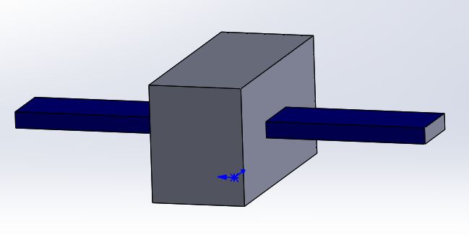
Current Test Subject
Preliminary CAD block design
This specific design shape and size is inspired by the LM 2100 series
The test subject will be made as simple as possible, seeing as it is just acting as the object that the sensor suite will identify
Dimensions: 4.75ft x 6ft x 12 ft
Given its larger size, this will likely be made using a blend of sheet metal (for the bus) and 3D printed PLA (for the mock solar panels)
Checkerboard pattern may be included on the exterior of the bus

Slide 54
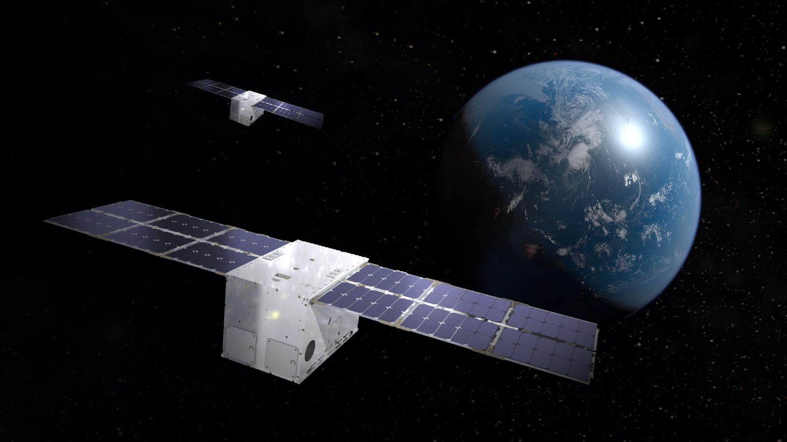
Chassis References
MARCo PoLo is being developed for use on the LINUSS (Lockheed Martin In-space Upgrade Satellite System) CubeSat
2 LM 50TM 12U vehicles in geosynchronous orbit
“LINUSS’ mission is to validate essential maneuvering capabilities for Lockheed Martin’s future space upgrade and servicing missions, as well as to showcase miniaturized Space Domain Awareness capabilities.”
Notes:
https://news.lockheedmartin.com/linuss-small-sats-mission

Slide 55
Test Subject References
Weight: ~2-330 lbs / 1-150 kg
Power: 2-250 W
Size: 1U to half ESPA
Mission life: Three months to five years
Weight: 400-800 kg
Power: 1.3-16.0 kW
Size: ~1.1 x 1.7 m footprint / 1.5-3.0 m tall
Weight: 606-4,850 lbs / 275-2,200 kg
Power: 1.5-10 kW
Size: ~6 ft / ~1.8 m tall hexagon
Weight: 5,070-14,330 lbs / 2,300-6,500 kg
Power: 20 kW
Size: ~12x6 ft / ~3.7x1.8 m rectangle
Notes:
https://www.lockheedmartin.com/en-us/products/satellite.html

Slide 56
Mounting Specifications
Large Robot Mounting:
Can accommodate any hardware or equipment that would mount on a horizontal optical breadboard (1/4-20 fasteners on a 1” x 1” pattern).
Small Robot Mounting:
Mounting to the robot’s flange is a possibility but awkward for visitors due to the large hardware and tight tolerances. There are interface plates that can be adapted to 80/20 framework, etc. LM can provide some custom fabrication to adapt to the SOSC. Any object that can allow fastening to an 11”x 11” plate can be accommodated.
Notes:
KEVIN
I want to add this in, but IDK which section it should go in

